Slide 1
Requirements for a Vacuum Chamber to Replicate the Space Environment
Natalie Nicole Perez, Gabriella Silva Araujo, Dr. Alicia Petersen
University of Florida
Region II Student Conference, April 3-4th, 2025
Copyright © by University of Florida
Published by the American Institute of Aeronautics and Astronautics, Inc., with permission.
Notes:
Both

Slide 2
What is Space Weather?
Sun is a massive ball of dynamic plasma
  Super high in energy!
Space weather is driven by the Sun’s activity which explosively releases Solar Energetic Particles (SEPs), Coronal Mass Ejections (CMEs), and solar flares
  SEPs travel using the solar magnetic field
  CMEs interact with Earth’s magnetic field, causing geomagnetic storms
Notes:
Natalie

Slide 3
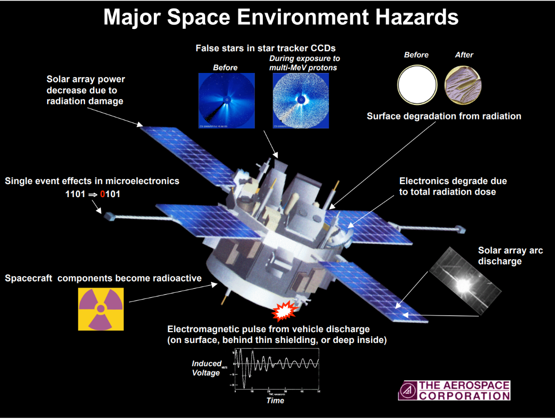
How Does Space Weather Effect Spacecraft?
Earth’s magnetosphere acts as a shield from energetic particles in space
During a geomagnetic storm, high energy particles and radiation from the Sun penetrate this shielding, potentially damaging the spacecraft
[1] Mazur, J. E., O’Brien, P., and Fennell, J. F., “Space Environment Effects on Space Systems,” Presentation at the Workshop on Science Associated With the Lunar Exploration Architecture, Feb.–Mar. 2007.
Notes:
Gabi

Slide 4
The Problem
Designing, building, launching, and maintaining spacecraft is extremely expensive
We depend on satellites for navigation, communications, defense, weather monitoring
Space weather can lead to premature mission failure → Huge financial and utility loss!
Notes:
Gabi

Slide 5
Our Solution
We need an easy and effective way to see how space weather will affect spacecraft without having to launch it into space
  This would allow for the easier development of new aerospace technologies
    i.e. Increasing Technology Readiness Level
How can we do this on Earth?
  The Space Environment Vacuum Chamber (SEVC)!
How is this different than pre existing chambers?
  We add plasma!!!
Notes:
Gabi

Slide 6
How Can We Model the Space Environment on Earth?
What base criteria does the SEVC need to run?
What do we need to add specifically to model the space environment?
How do we make sure that each add-on is working properly?
Notes:
Natalie

Slide 7
General Criteria
General criteria encompasses everything that any vacuum chamber needs to function
  Size of chamber
  Vacuum capabilities and pump
  Chamber stand
Notes:
Gabi

Slide 8
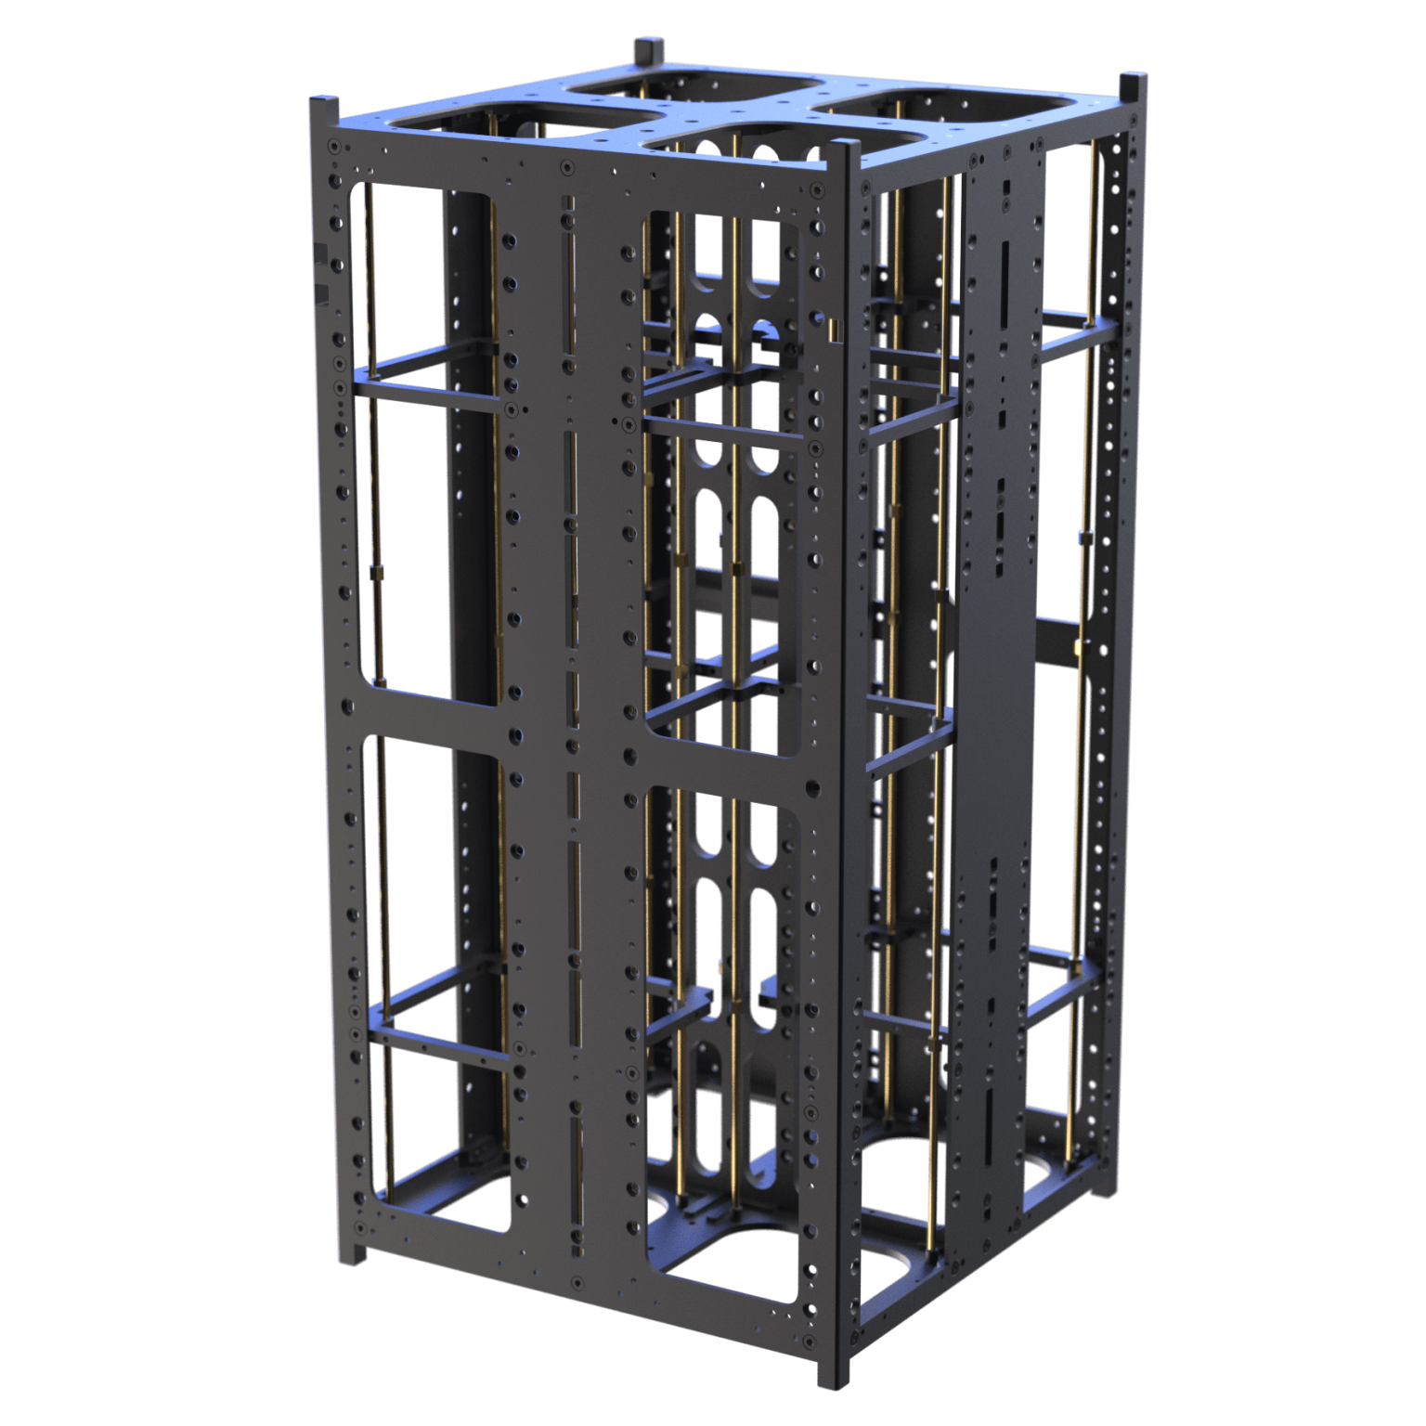
General Criteria
Size of Chamber
  Large chambers require constant exhaustive maintenance
  Small chambers limit variety of experiments
  The SEVC will have the internal dimensions of 20” X 20” X 28”
    Large enough to house a 16-Unit CubeSat
[2] EnduroSat, “16U CubeSat Structure,” retrieved 1 April 2025, https://www.endurosat.com/products/16u-structure/
Notes:
Natalie

Slide 9
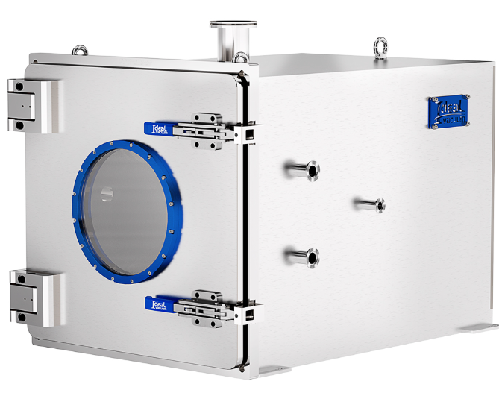
General Criteria
Vacuum Capabilities
  Limited by both the pump used and chamber itself
    Stainless steel chambers seal better and will be used
  The ambient pressure at Low Earth Orbit (LEO) ranges from 1×10⁻¹⁰ Torr to 5×10⁻⁸ Torr
    A vacuum pump that can reach at minimum 1×10⁻⁸ Torr is used
[3] IdealVacuum Products, “Custom Vacuum Chambers Welded Stainless Steel 20x20x28 inch, Preconfigured with ISO and KF Flanges, User Selectable Latching Door and Options,” retrieved 1 April 2025, https://www.idealvac.com/en-us/Custom-Vacuum-Chambers-Welded-Stainless-Steel-20x20x28-inch-Preconfigured-with-ISO-and-KF-Flanges-User-Selectable-Latching-Door-and-Options/pp/P1012246AllOps=155-161-169OptQtys=1-1-1
Notes:
Natalie

Slide 10
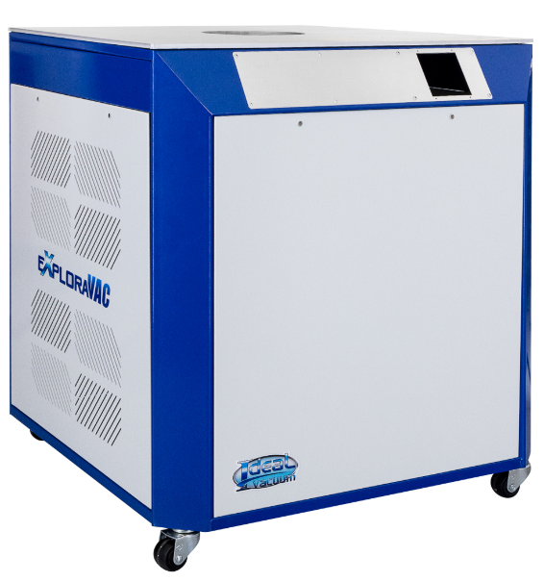
General Criteria
Chamber Stand
  Creates a stable foundation for the chamber
    Fitted specifically for the SEVC’s dimensions
  Customizable for electronic components,specific vacuum chamber criteria, and experimental setup
[4] IdealVacuum Products, “Ideal Vacuum ExploraVAC Environmental Chamber Series System Stand, for up to 28 in. Chambers
,” retrieved 1 April 2025, https://www.idealvac.com/en-us/Ideal-Vacuum-ExploraVAC-Environmental-Chamber-Series-System-Stand-for-up-to-28-in-Chambers/pp/P1012142
Notes:
Gabi

Slide 11
Specific Criteria
Specific criteria encompasses everything that a vacuum chamber needs to transform into an SEVC
  Temperature Control
  Energetic Particle Sources
    Electron Source
    Proton Source
  Magnetic Field Generator
Notes:
Gabi

Slide 12
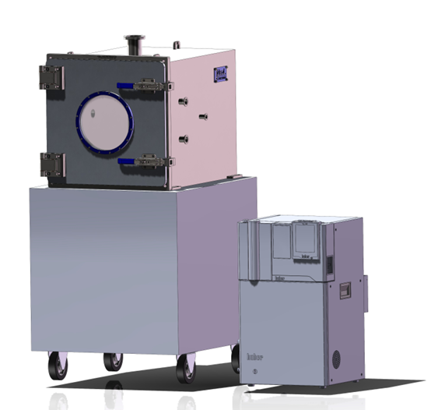
Specific Criteria
Temperature Control
  Temperatures in LEO range from –65°C to +125°C
  The SEVC’s temperature control unit can maintain a tight range of temperatures from –75°C to +250°C
Vacuum Chamber
Stand
Temp Control Unit
Notes:
Natalie

Slide 13
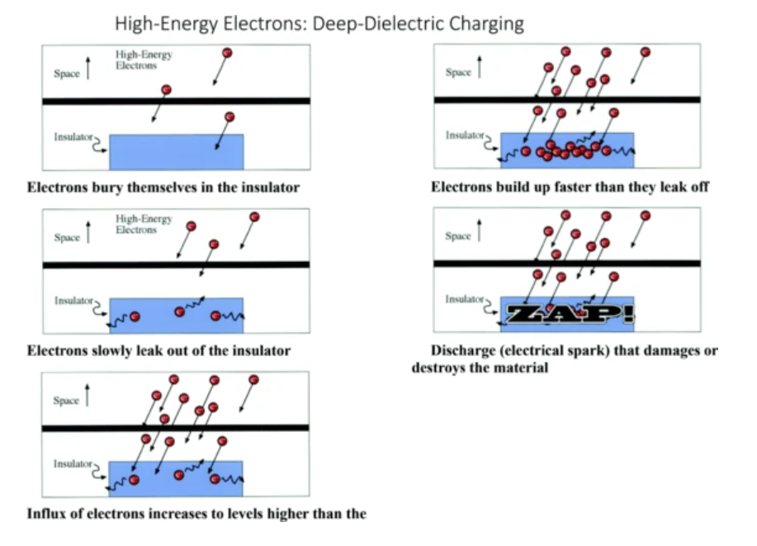
Specific Criteria
Energetic Particle Sources
  Energetic electrons and protons are types of SEPs that contribute to solar ionizing radiation
  They can breach through radiation shielding of a spacecraft and create permanent damage
  Important to model them!
[5] Baker, D. N., Erickson, P. J., Fennell, J. F., Foster, J. C., Jaynes, A. N., and Verronen, P. T., ”Space Weather Effects in the Earth’s Radiation Belts,” Space Science Reviews, Vol. 214, No. 1, 2018, pp. 1-60. https://doi.org/10.1007/s11214-017-0452-7
Notes:
Natalie

Slide 14
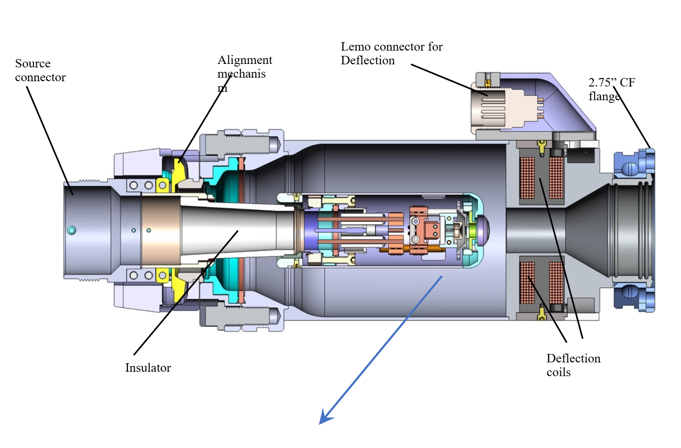
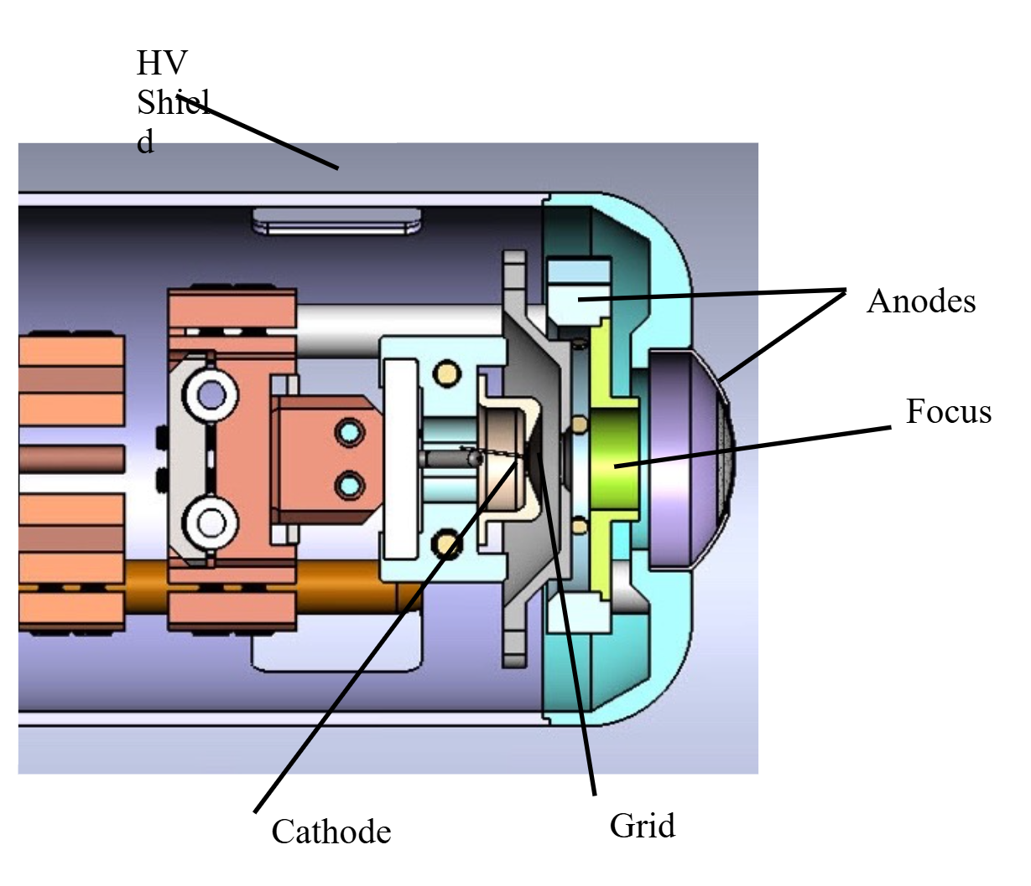
Specific Criteria
Electron Source
  Energetic electrons range from a few keV to a few MeV
  The SEVC introduces these electrons through the use of an electron beam gun
    Tungsten feed
    Energy range: 200 eV to 30 keV
    Uniform flood spot size: 15mm to 500mm
[6] Kimball Physics, “EGF-4104/EGPS-4104,” retrieved 1 April 2025, https://www.kimballphysics.com/product/egf-4104-egps-4104/
Notes:
Natalie

Slide 15
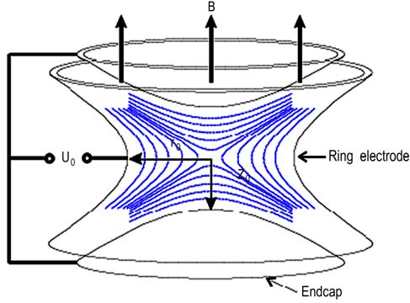
Specific Criteria
Proton Source
  Energy range for moderate SEP events can be from 20-80 MeV
    Extreme events exceed this range
  Solar Wind Plasma
    Bulk proton source can be employed using a penning trap
      Precise control over particle motion and confinement.
    Solar wind proton energy range order of 0.5-10 keV
[7] Kt, S., Gupta, A., Joshi, G., Mohan, S., Pushpa, R., and Ananthamurthy, S., “Loading Detection and Number Estimation of an Electron Plasma in a Penning Trap,” Plasma Science and Technology, Vol 11. No. 521, 2009 https://doi.org/10.1088/1009-0630/11/5/02
Notes:
Gabi

Slide 16
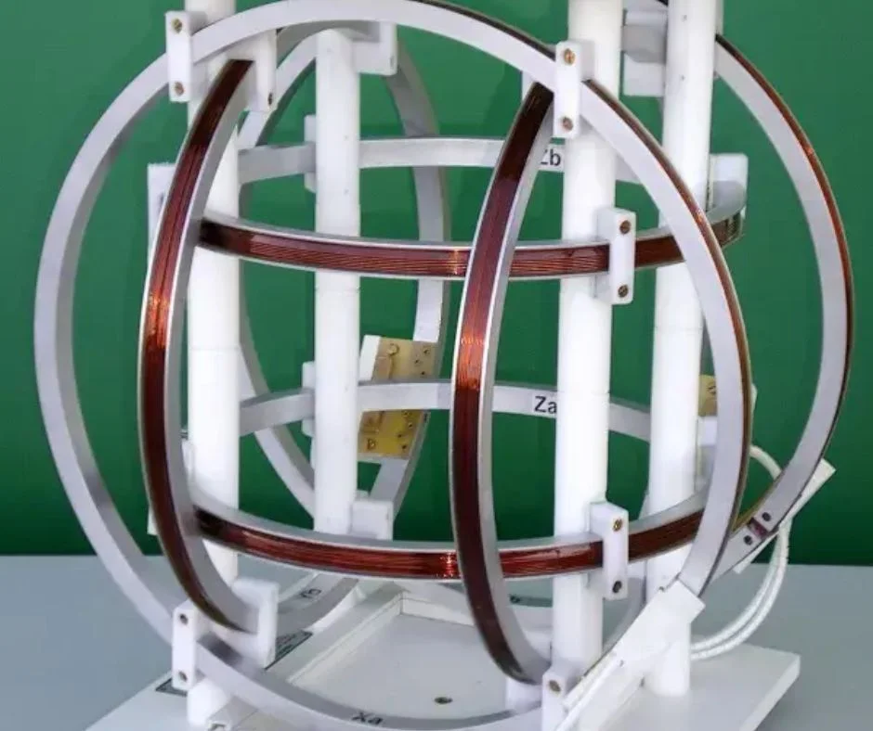
Specific Criteria
Magnetic Field Generator
  The dynamics of SEPs are governed by the magnetic field
  Helmholtz cage control a volume of uniform magnetic field in their centers
    These coils can be used to “cancel” the Earth’s magnetic field
[8] Positioning Navigation Intelligence, “Helmholtz Coil: Design, Applications, and Impact,” retrieved 1 April 2025, https://www.pnisensor.com/helmholtz-coil-design-applications-and-impact/
Notes:
Gabi

Slide 17
Sensors
Sensors are needed in the SEVC to measure how well every addition is working
  Particle sensor
  Temperature sensor
  Vacuum sensor
  Magnetic field sensor
Notes:
Natalie

Slide 18
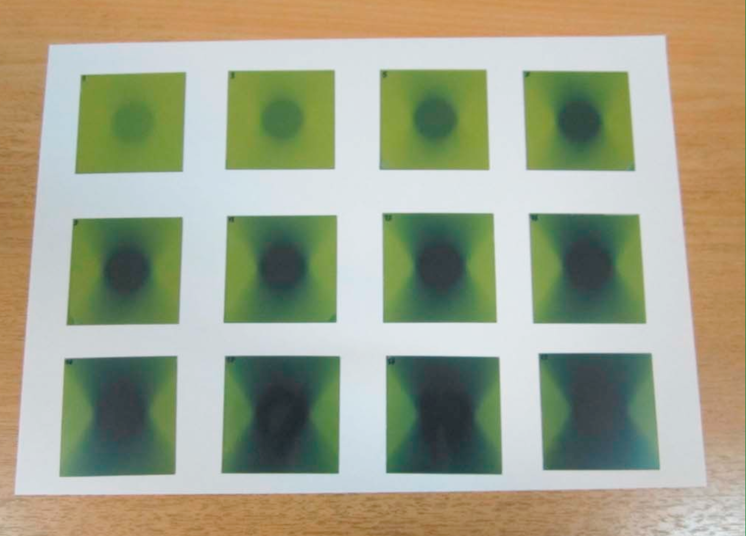
Sensors
Particle Sensor
  Radiochromic sheets!
    Changes color when exposed to ionizing radiation
    Radiochromic analysis software gives quantitative values of dosage
https://www.sciencedirect.com/science/article/pii/S0958394717300134
[9] Najafi, M., Geraily, G., Shirazi, A., Esfahani, M., and Teimouri, Javad., “Analysis of Gafchromic EBT3 film calibration irradiated with gamma rays from different systems: Gamma Knife and Cobalt-60 unit,” Medical Dosimetry, Vol 42. No. 3, 2017, pp. 159-168. https://doi.org/10.1016/j.meddos.2017.01.003
Notes:
Natalie

Slide 19
Sensors
Temperature Sensor
  Thermometer!
    Temperature control unit has one built in
Vacuum Sensor
  Chamber and stand comes with a built in digital readout for the current vacuum
Magnetic Field Sensor
  A microelectromechanical systems (MEM) magnetometer
  Fluxgate magnetometer placed inside Helmholtz cage
Notes:
Gabi

Slide 20
Planned Projects
A view into what the SEVC is able to do!
  Materials Testing
    Additive Manufacturing
    Composites
    Coverglasses
  Instrument Testing
  Cubesat Testing
Notes:
Gabi

Slide 21
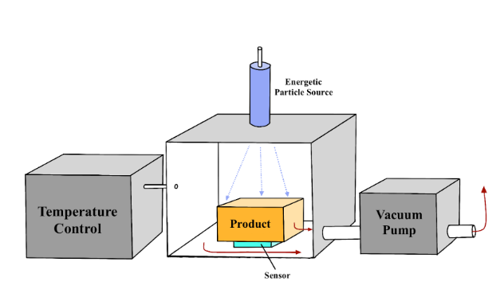
Planned Projects
Materials Testing
  Additive Manufacturing in Aerospace
    Easier to make unique and hard to manufacture parts
      Lower manufacturing costs for spacecraft!
    Use the SEVC to quantitatively test
    their ionizing radiation shielding
    capabilities!
      Measure how much radiation
      breaches the material
      Determine which material is most suitable for space!
Notes:
Natalie

Slide 22
Planned Projects
  Composites
    Complex geometry and great strength to weight ratio
    Customize matrices and fibers
      Change properties based off of needed specifications
      Experiment to determine best combinations
    Test their ionizing radiation shielding
    capabilities!
      Measure how much radiation
      breaches the material
    Test their structural integrity and how that changes when exposed to high energy particles over different period of time
Notes:
Gabriella

Slide 23
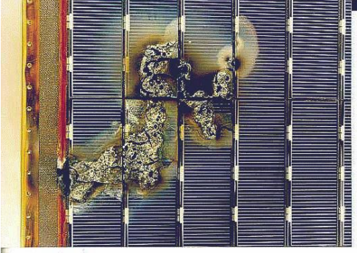
Planned Projects
Coverglass
  Radiation and SEPs cause damage to spacecraft solar cells
  Coverglasses prevent this!
  Testing in the SEVC of which coverglasses protect solar cells the best!
    Measure the energy output of the solar cell after exposure
[10] NASA, “Low Earth Orbit Spacecraft Charging Design Handbook,” NASA-NDBK-4006, 2007.
Notes:
Natalie

Slide 24
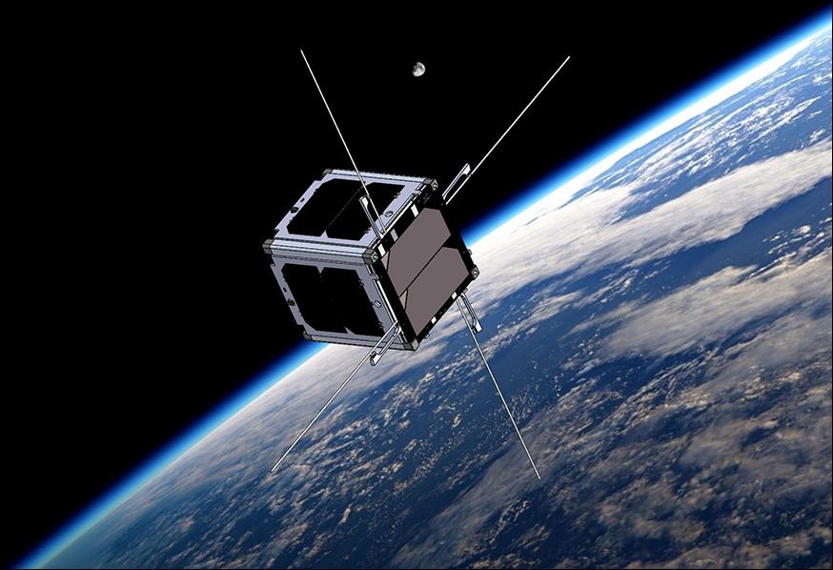
Planned Projects
Instrument Development and Testing
  Space weather instruments
    Onboard monitoring
    Forecasting
Cubesat Resiliency Testing
  Space Environment Simulations
    Plasma, vacuum and
temperature
[11] Virginia Space Grant Consortium, “Virginia CubeSat Constellation,” retrieved 1 April 2025, https://vsgc.odu.edu/virginiacubesatconstellation/
Notes:
Gabriella

Slide 25
What Does This Mean?
In order to model the space environment in our lab we are using:
  Vacuum Chamber size : 20” X 20” X 28”
  Vacuum pump: Reaching 1×10⁻⁸ Torr
  Temperature Control Unit: –75°C to +250°C
  Energetic particle Sources : Electron source & Proton Source
  Magnetic Field Generation
  Sensors
The possibility of experiments are endless!
Notes:
Natalie

Slide 26
Conclusion
Space weather replication is critical for ensuring successful space missions
  The SEVC is an effective and replicable model that other labs can easily use, making space environment testing more widespread!
By modeling the space environment to a higher degree by including plasma, we can make findings on aerospace materials and test newly developed aerospace technology, All risk free without ever having to spend money on a launch!
Notes:
Both

