Slide 1
Design and Fabrication of a Mars Rover Four-Wheel Rocker Suspension System
Isabelle Pinto, Zachary Gan
Georgia Tech RoboJackets
AIAA Region II Student Conference, April 3rd-4th
Copyright © by Isabelle Pinto and Zachary Gan
Published by the American Institute of Aeronautics and Astronautics, Inc., with permission.

Slide 2
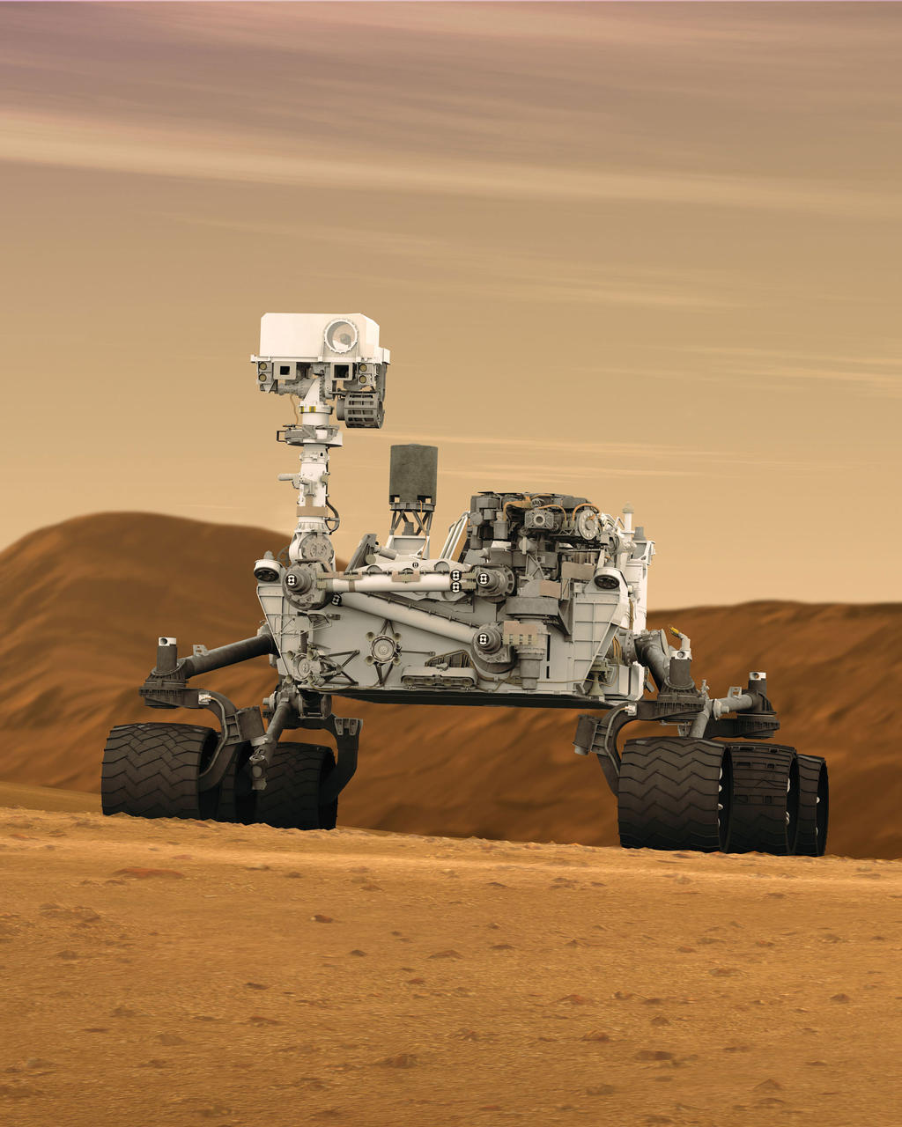
Background and Introduction
Constraint | Requirement
Size | Fit completely within 1.2 x 1.2 x 1.2 m box
Weight | 50 kg when deployed, 70 kg total
Power | No tethered power or power source inapplicable to Mars
Environment | Withstand temperatures over 37 F as well as dust, wind, rain, and uneven or sandy terrain
Capability | Lift objects of up to 5 kg and perform detail work such as keyboard typing
source: NASA
Notes:
Motivation
What is URC
Discuss requirements
“This leads into the design drivers”

Slide 3
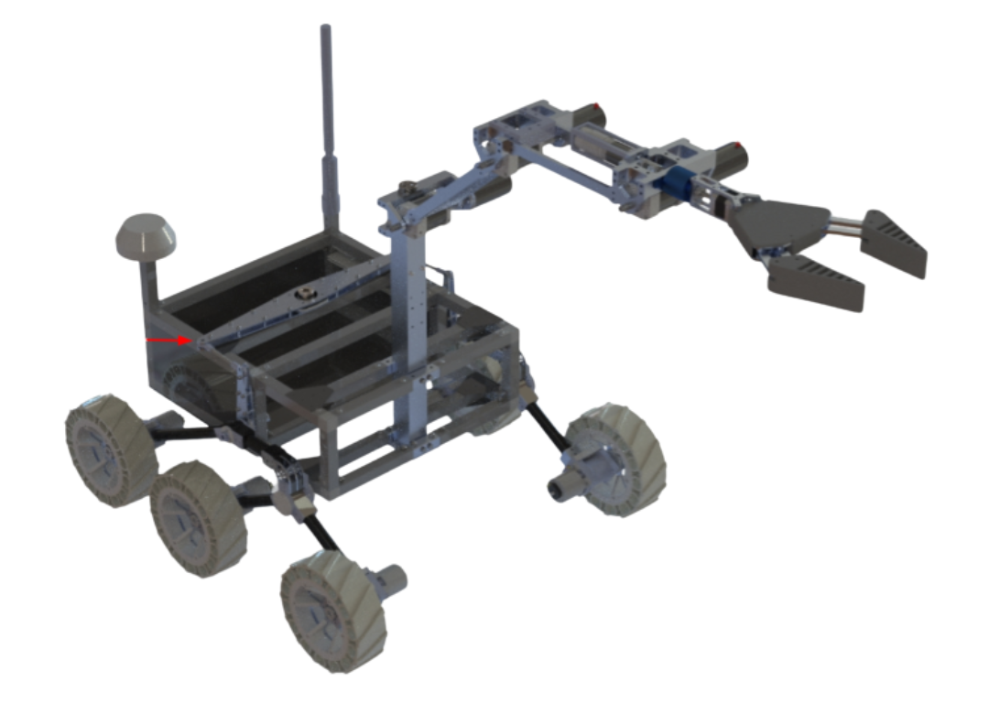
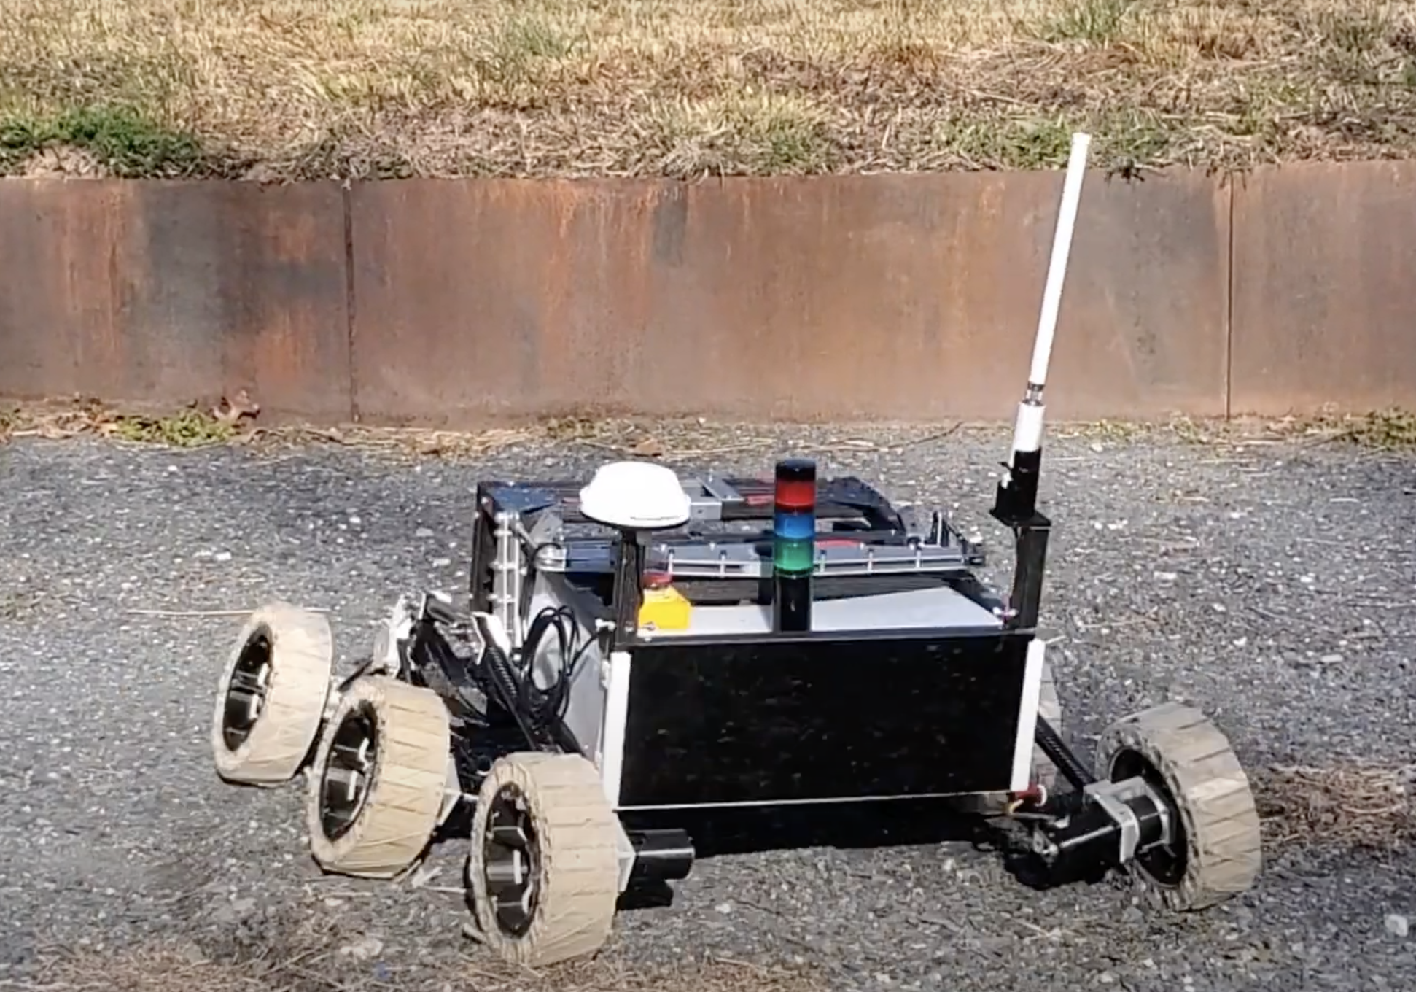
Motivation
Design drivers: simplicity, weight, durability, repairability, cost, and modularity
Differential bar location increases stability but decreases electronics accessibility
Six wheels provide redundancy but add weight
Total drivetrain mass of 11 kg
Rocker-bogey system maintains surface contact in uneven or sandy terrain
Wheels bowing outwards steals traction, stresses shafts
Images source: RoboJackets
Notes:
Design drivers
discuss six wheels > rocker bogey > differential bar
Discuss high mass
Discuss bowing

Slide 4
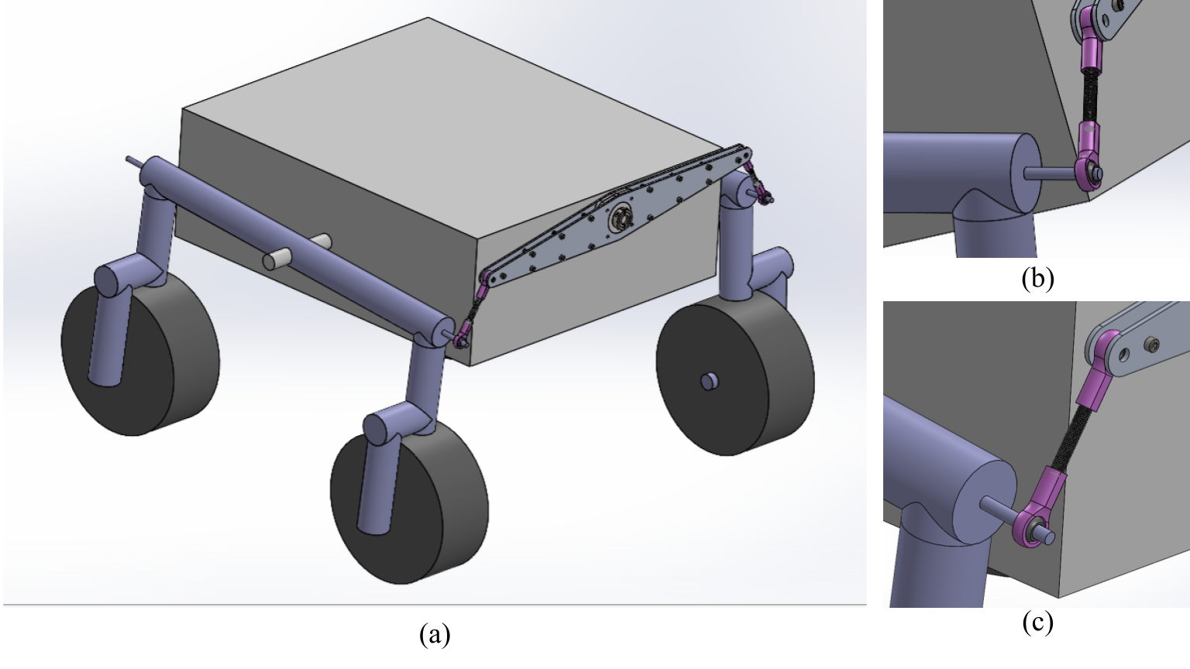
Initial Design
Changes
  Implementation of back differential bar
    Greater torque on legs
    More accessibility to electronics
  Longer horizontal leg bar
  Transition to orthogonal, rather than diagonal shaft connections
    Greater clearance for obstacles
    Simpler to design and manufacture
Image source: RoboJackets
Observations
  Greater freedom in leg articulation
  Greater clearance
  Complications due to change in axis about which differential bar rotates

Slide 5
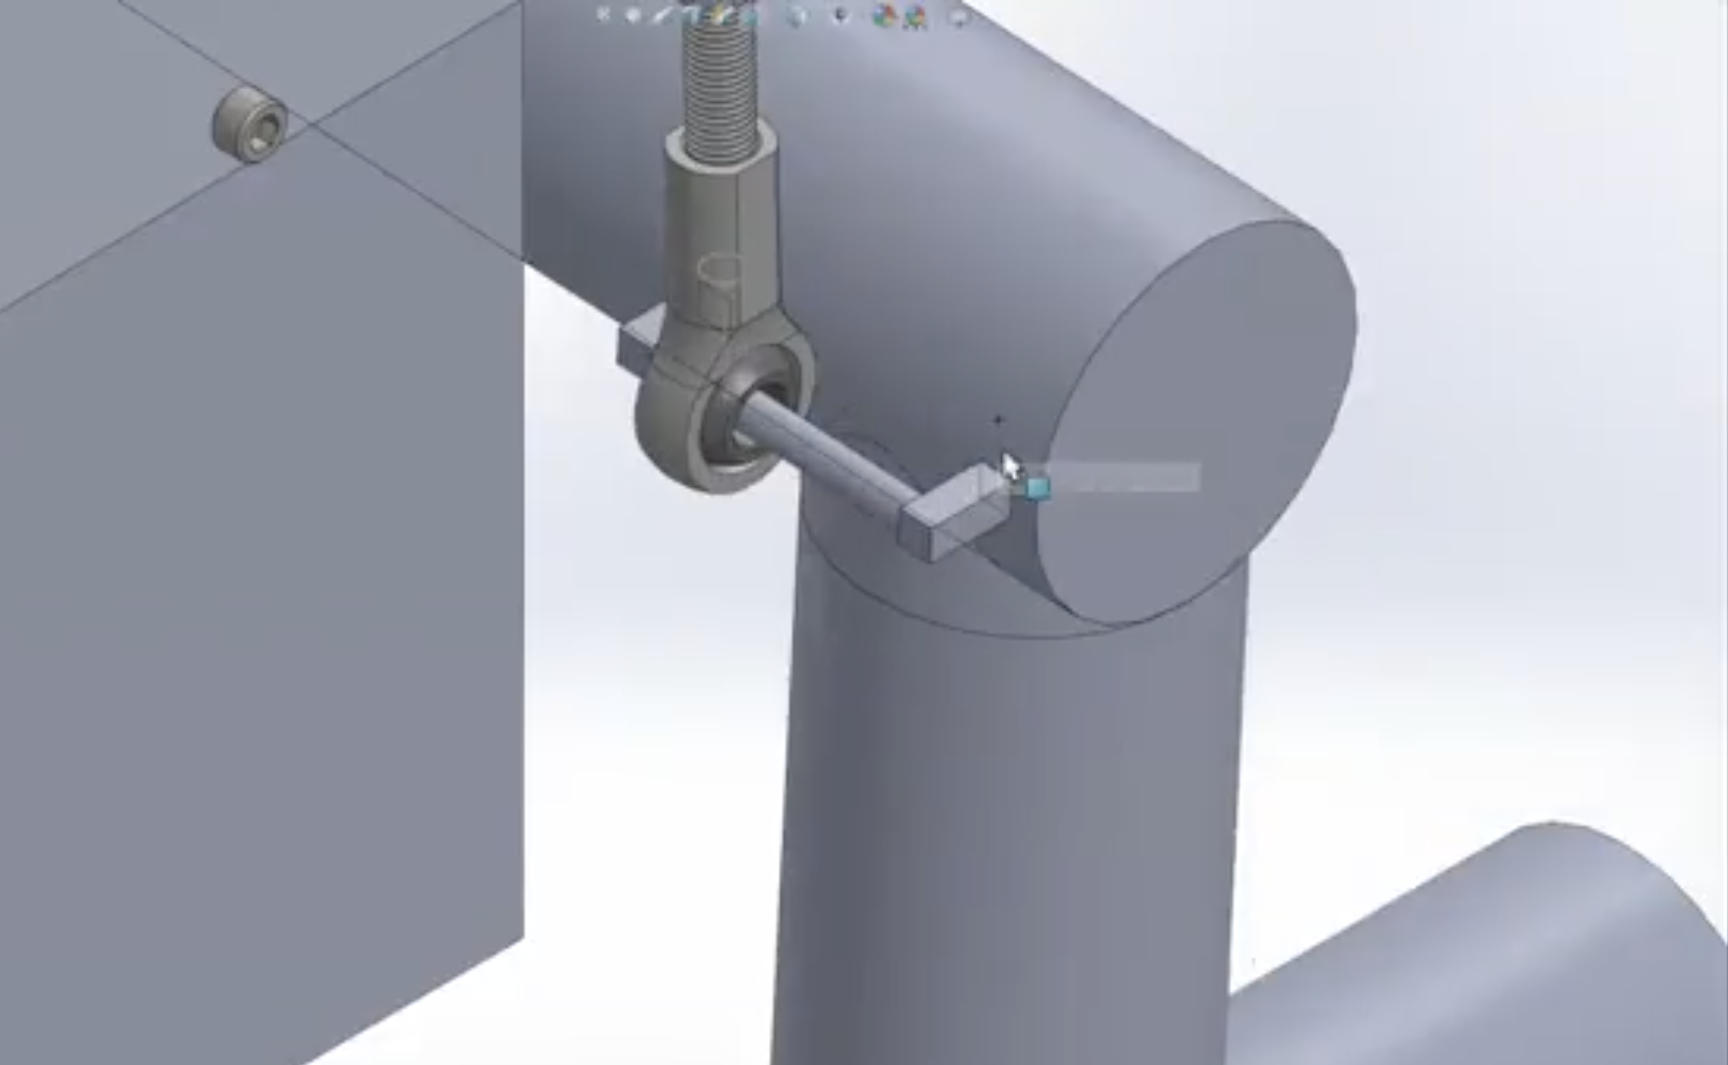
Design Evolution
Challenge | Proposed Solution
Differential bar-leg connection | Rotate linkage connections Allow linkage limited freedom to translate along horizontal bar Place linkage outside differential bar, allowing it to rotate out of plane with differential bar
Horizontal shaft-vertical shaft connection | Drill through carbon fiber (CF) horizontal shaft Clamp CF shaft Use aluminum gussets to support leg-linkage connection and drill largest hole outside of CF shaft
Images source: RoboJackets

Slide 6
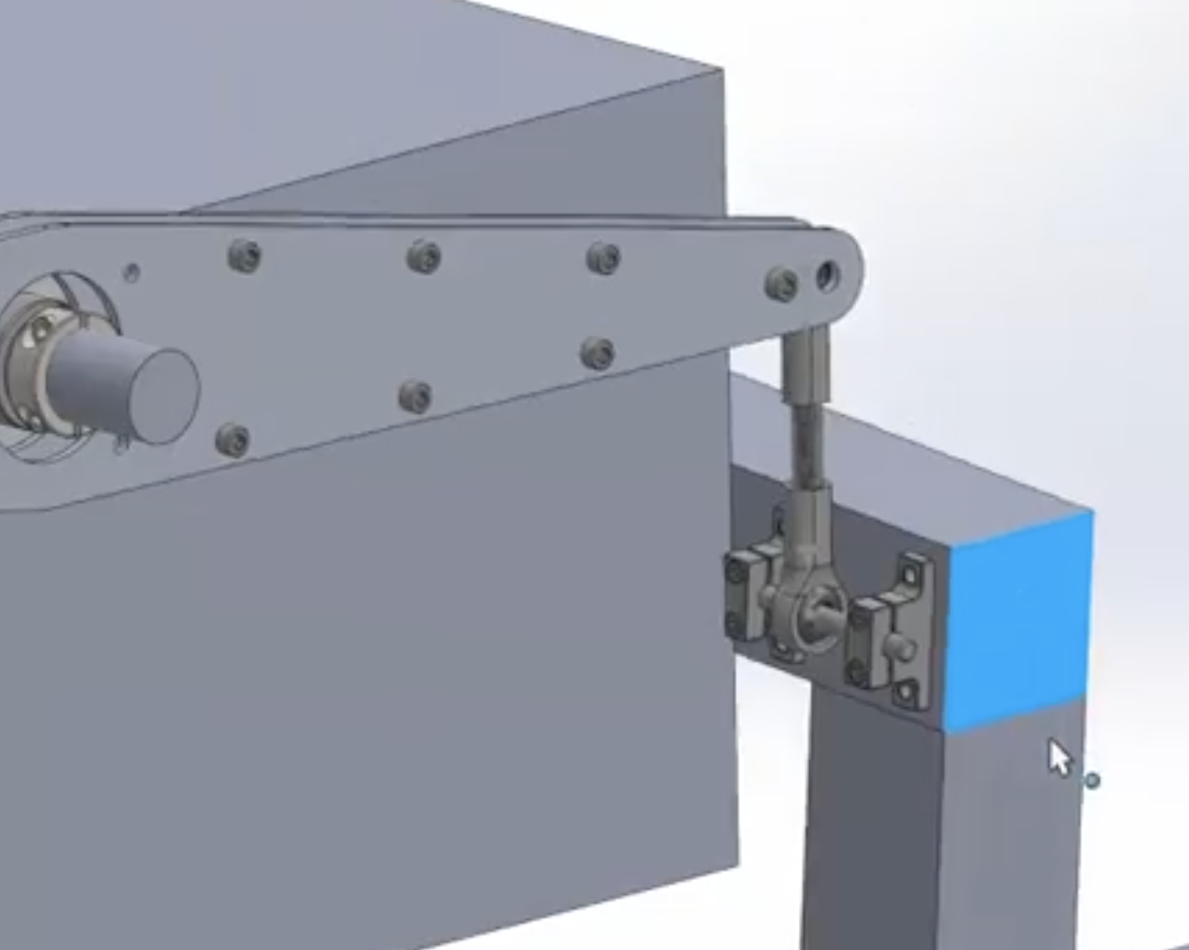
Design Evolution
Challenge | Proposed Solution
Differential bar-leg connection | Rotate linkage connections Allow linkage limited freedom to translate along horizontal bar Place linkage outside differential bar, allowing it to rotate out of plane with differential bar
Horizontal shaft-vertical shaft connection | Drill through carbon fiber (CF) horizontal shaft Clamp CF shaft Use aluminum gussets to support leg-linkage connection and drill largest hole outside of CF shaft
Images source: RoboJackets

Slide 7
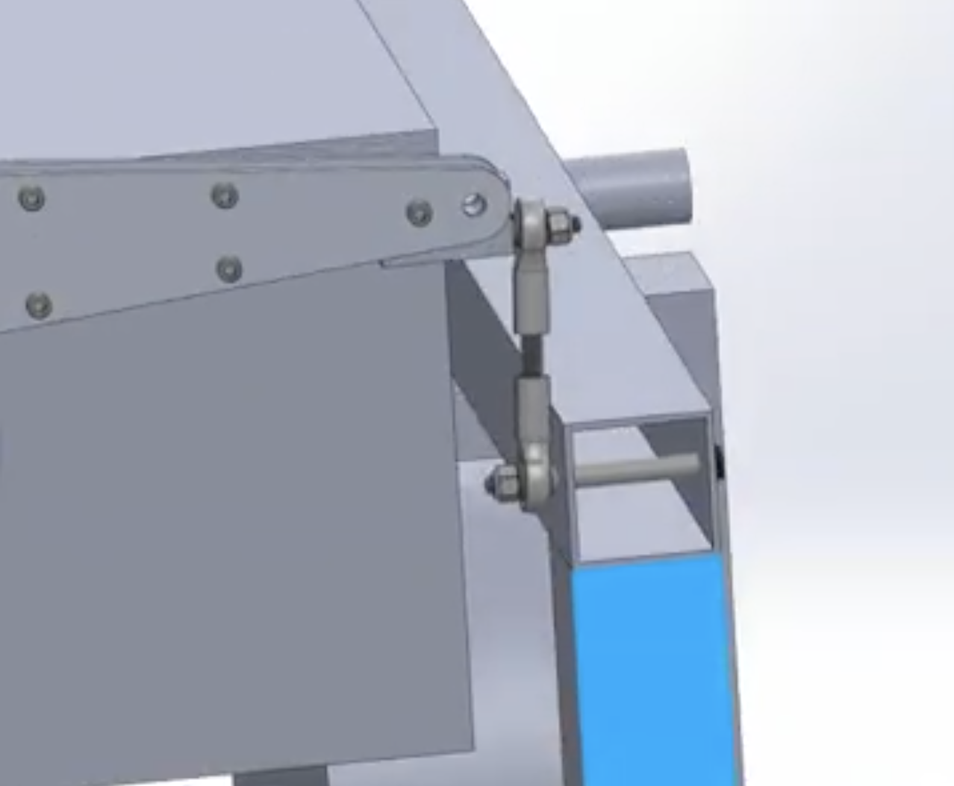
Design Evolution
Challenge | Proposed Solution
Differential bar-leg connection | Rotate linkage connections Allow linkage limited freedom to translate along horizontal bar Place linkage outside differential bar, allowing it to rotate out of plane with differential bar
Horizontal shaft-vertical shaft connection | Drill through carbon fiber (CF) horizontal shaft Clamp CF shaft Use aluminum gussets to support leg-linkage connection and drill largest hole outside of CF shaft
Images source: RoboJackets

Slide 8
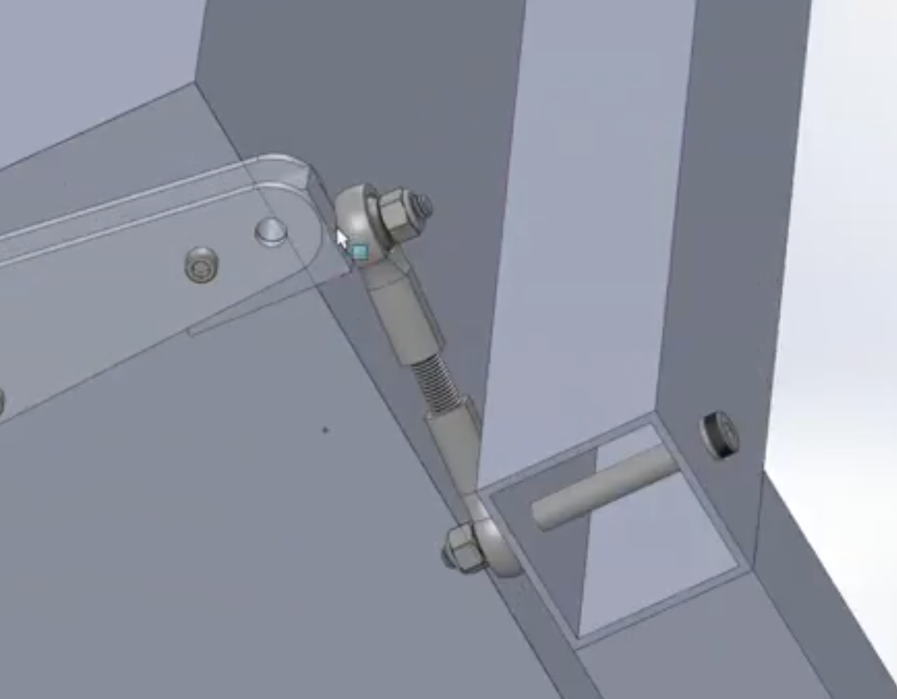
Design Evolution
Challenge | Proposed Solution
Differential bar-leg connection | Rotate linkage connections Allow linkage limited freedom to translate along horizontal bar Place linkage outside differential bar, allowing it to rotate out of plane with differential bar
Horizontal shaft-vertical shaft connection | Drill through carbon fiber (CF) horizontal shaft Clamp CF shaft Use aluminum gussets to support leg-linkage connection and drill largest hole outside of CF shaft
Images source: RoboJackets

Slide 9
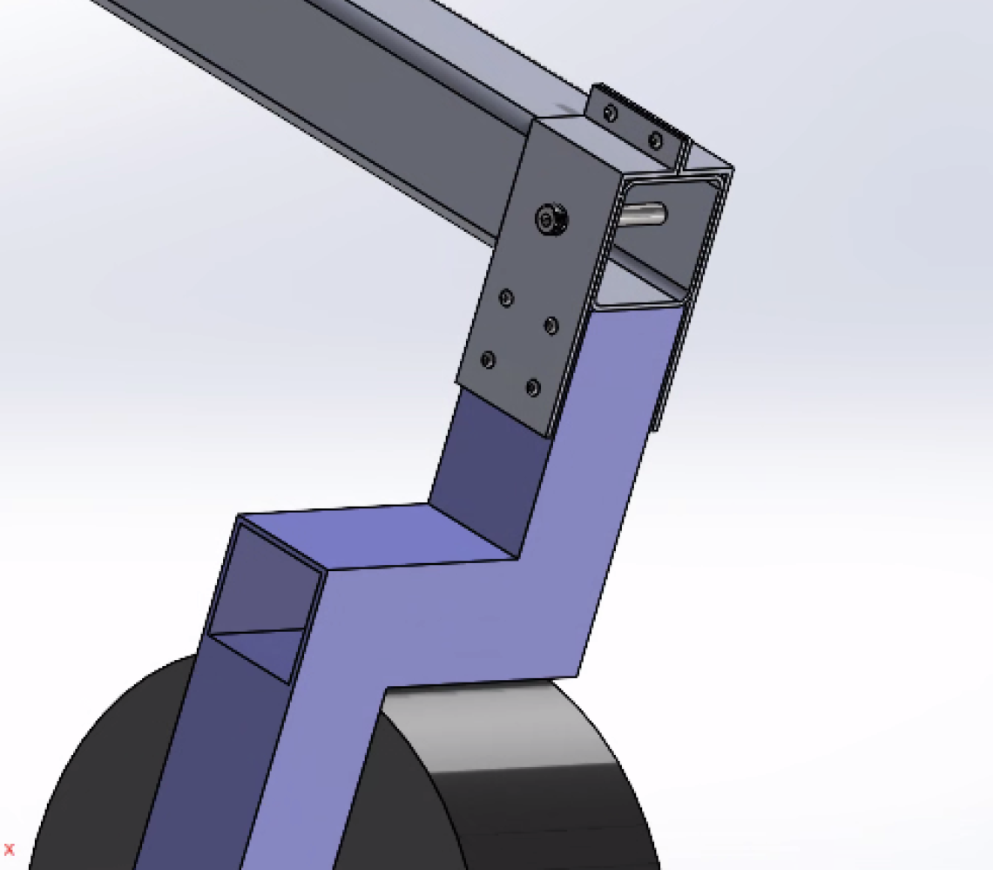
Design Evolution
Challenge | Proposed Solution
Differential bar-leg connection | Rotate linkage connections Allow linkage limited freedom to translate along horizontal bar Place linkage outside differential bar, allowing it to rotate out of plane with differential bar
Horizontal shaft-vertical shaft connection | Drill through carbon fiber (CF) horizontal shaft Clamp CF shaft Use aluminum gussets to support leg-linkage connection and drill largest hole outside of CF shaft
Images source: RoboJackets

Slide 10
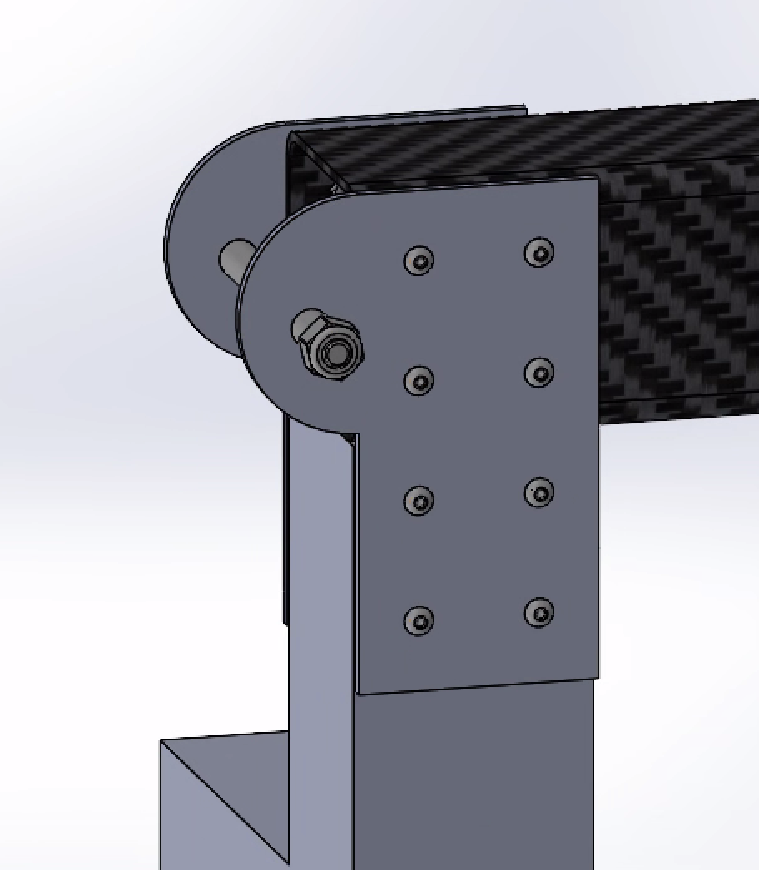
Design Evolution
Challenge | Proposed Solution
Differential bar-leg connection | Rotate linkage connections Allow linkage limited freedom to translate along horizontal bar Place linkage outside differential bar, allowing it to rotate out of plane with differential bar
Horizontal shaft-vertical shaft connection | Drill through carbon fiber (CF) horizontal shaft Clamp CF shaft Use aluminum gussets to support leg-linkage connection and drill largest hole outside of CF shaft
Images source: RoboJackets

Slide 11
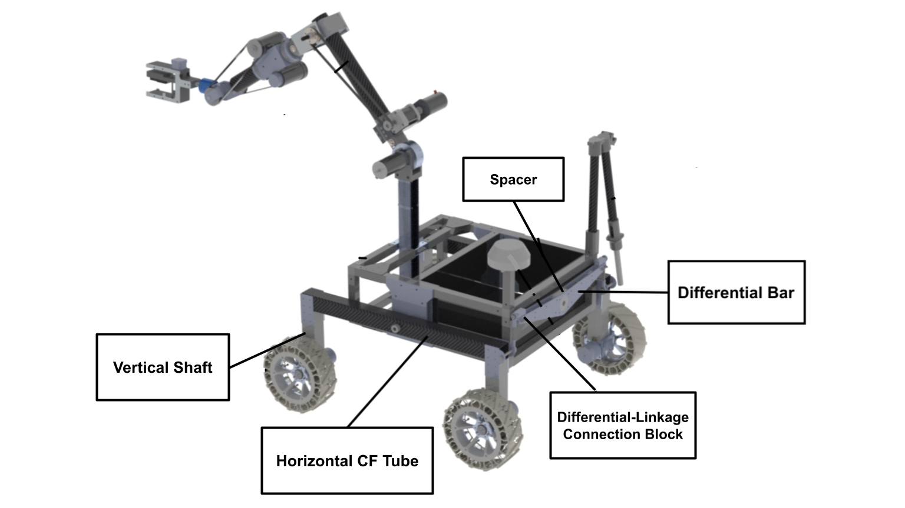
Final Design
Images source: RoboJackets

Slide 12
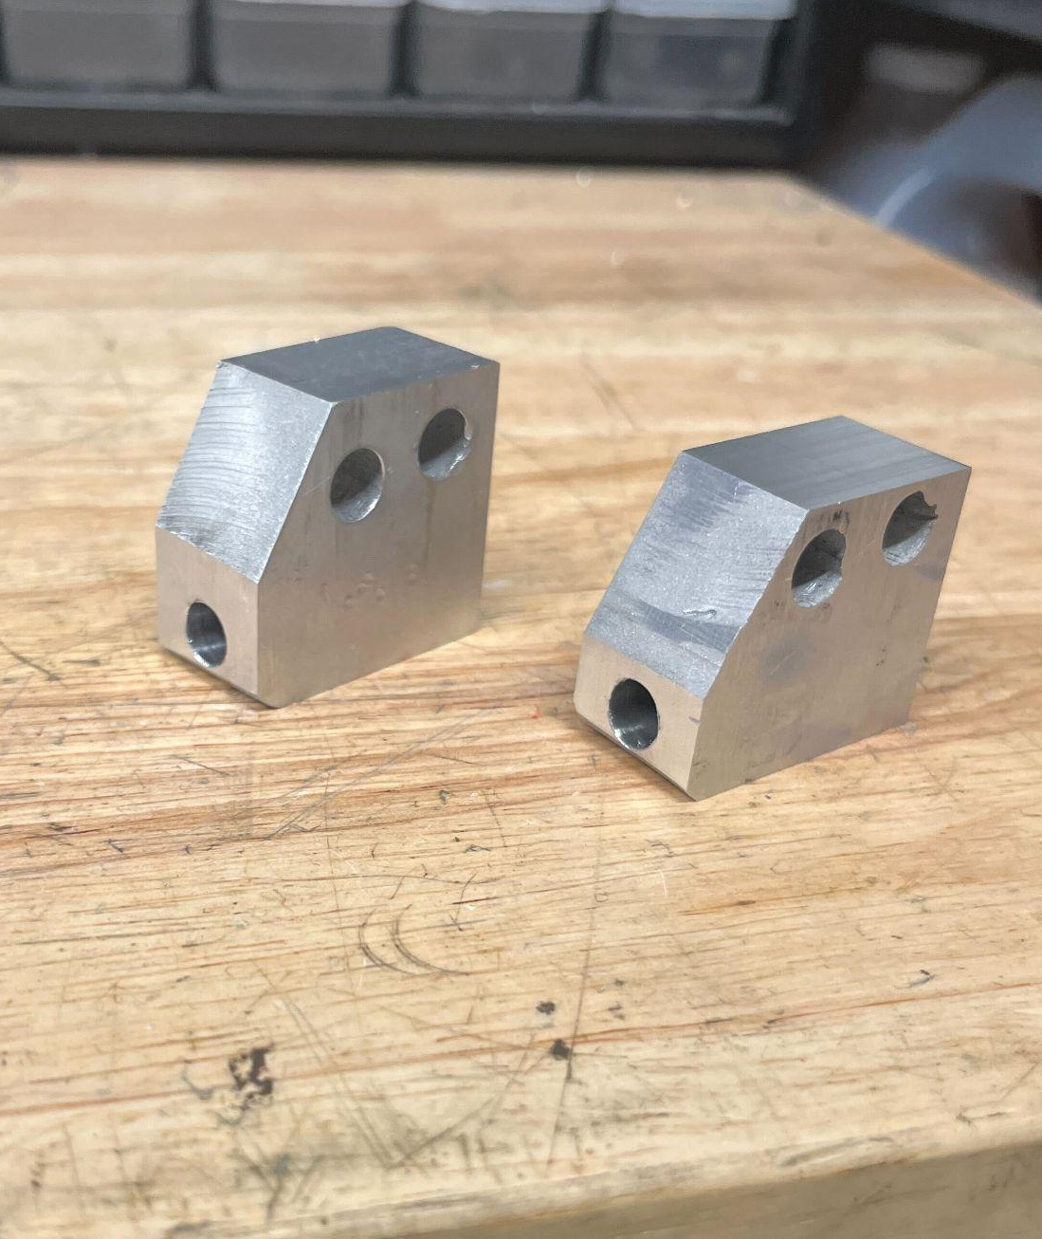
Fabrication
Component | Manufacturing Method
Vertical Shaft | Waterjet, then welded together
Horizontal CF Tube | Purchased and drilled
Differential-Linkage Connection Block | Cut out on waterjet, then third hole was drilled with vertical mill
Spacer | 3D Printed
Differential Bar | Waterjet
Images source: RoboJackets

Slide 13
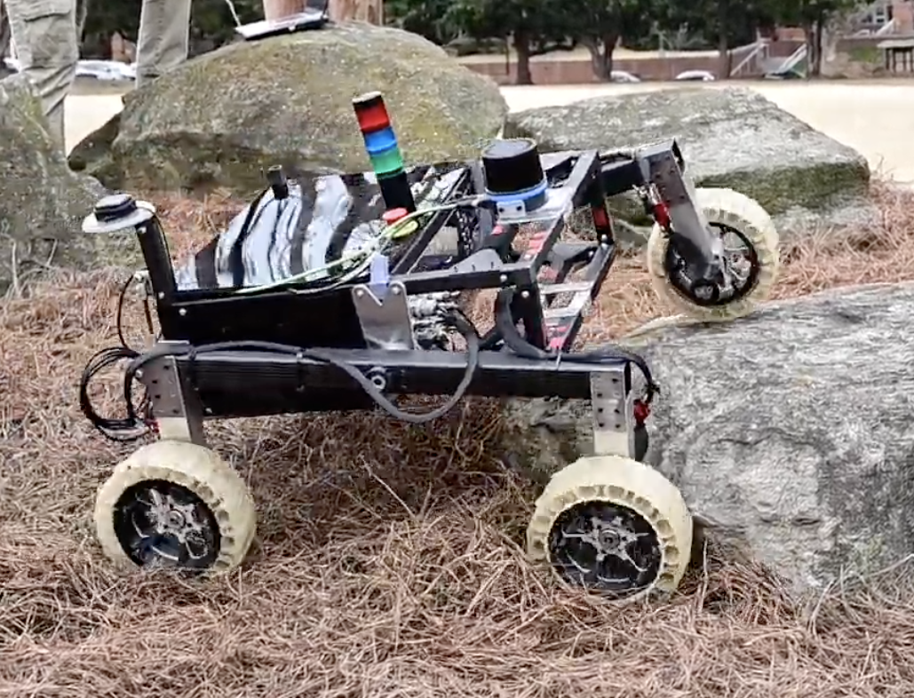
Results
Testing conducted on Georgia Tech campus
  Environmental changes would not affect geometric performance metrics (eg: maximum obstacle height)
Significant increase in structural stability due to vertical aluminum shafts
  No bowing observed
16 in maximum obstacle height
30 degree longitudinal and latitudinal angle of climb
Image source: RoboJackets

Slide 14
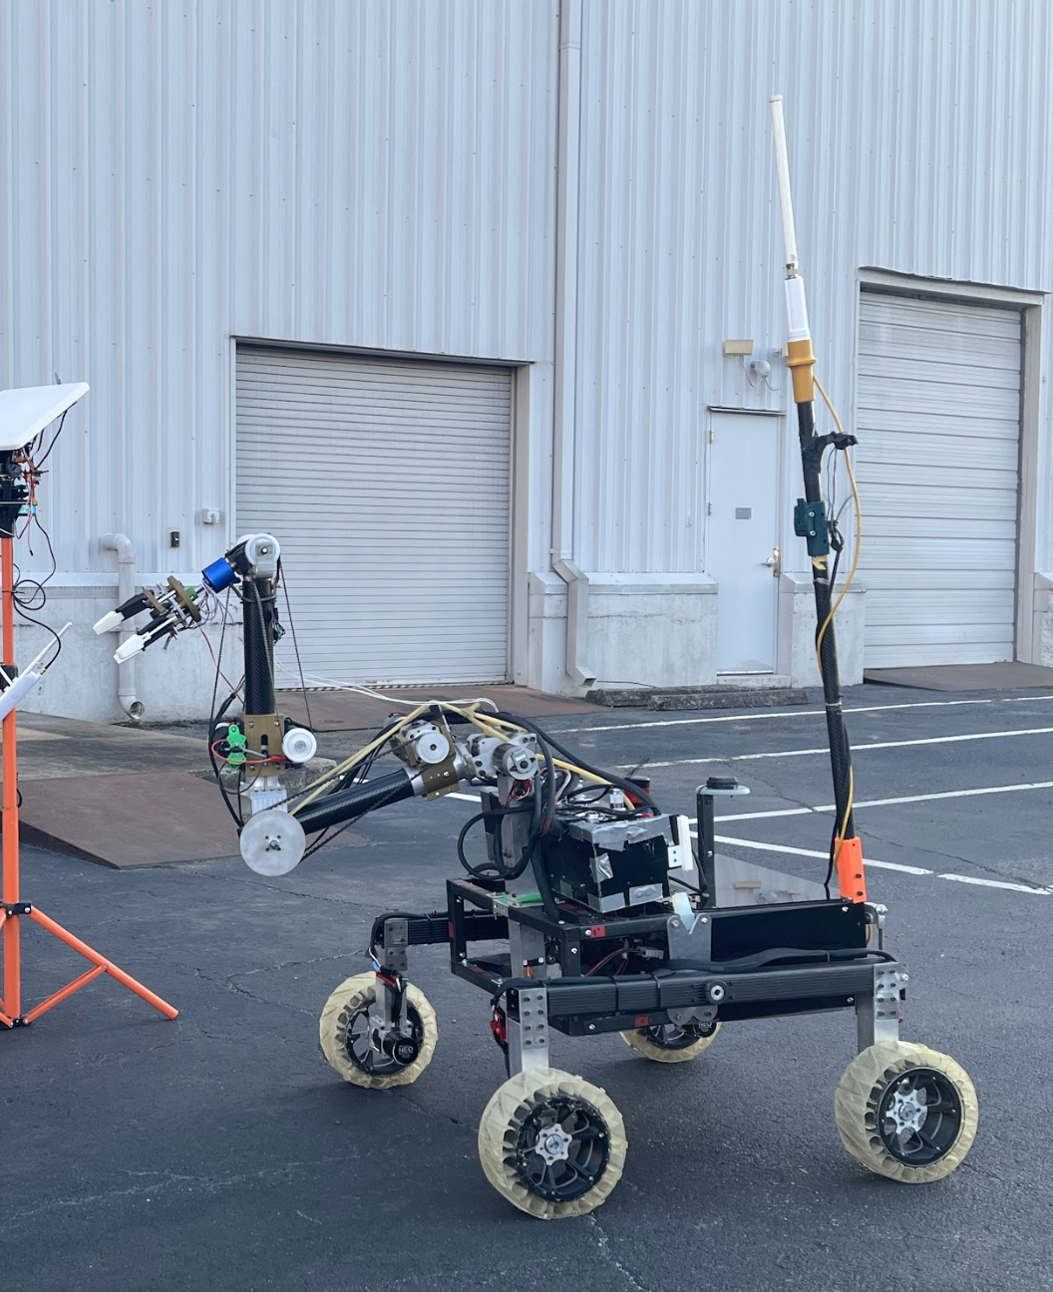
Evaluation and Conclusions
Design Metric Evaluation
  Structural stability and durability significantly improved with aluminum reinforcements
  Repairability improved with simpler and fewer joints
  Cost decreased marginally
  Weight decreased with removal of 2 wheels and bogey system
  Increased risk of failure due to lower redundancy
Conclusions
  Four wheel systems are viable in even highly uneven terrain
  Shorter duration or manned Mars missions could benefit from a lighter, more mobile four-wheel design
Future Work
  Reinforce connection of differential bar to chassis
  Redesign gussets to optimize weight and shape
Image source: RoboJackets
  Compete in Mars Desert Research Station for further information

