Slide 1


DESIGN AND ANALYSIS OF HIGH-BYPASS TURBOFAN ENGINE NACELLE TO ENHANCE PERFORMANCE
A RESEARCH BY MOUHAMADOU DIOP
Supervised by Dr. Adeel Khalid

Slide 2

AGENDA
BACKGROUND AND SCOPE
METHODOLOGY
ANALYSIS AND RESULTS
NEW DESIGN
WIND TUNNEL TEST
CONCLUSIONS

Slide 3

Background
High-bypass turbofan engine produced a joint venture between GE Aerospace (USA) and Safran Aircraft Engines (France)
It was selected by Boeing as the sole-source powerplant for its Next-Generation 737 planes
NASA has conducted studies on propulsion technologies to reduce thrust specific energy consumption

Slide 4
Scope
Optimize CFM56-7B engine
How?:
Geometrical changes on the engine to create an optimized model.
Create a 3D model of the engine using available documents.
Perform dimension changes and implement the desired design iterations to create an optimized model using CFD.
3D Print both models and measure the drag force that they are subjected to at various speeds and conclude.

Slide 5
Methodology
Create a 3D model of the engine by tracing around airfoil with respect to dimension ratios.
Integrate dimension changes and analyze the speed and pressure inside the inlet.
Create an optimized model by combining the dimensions that results in higher pressure and lower velocity inside the inlet.
3D print the baseline and optimized model.
Run an experiment using a wind tunnel to measure the drag force created by each model at various air speeds.

Slide 6
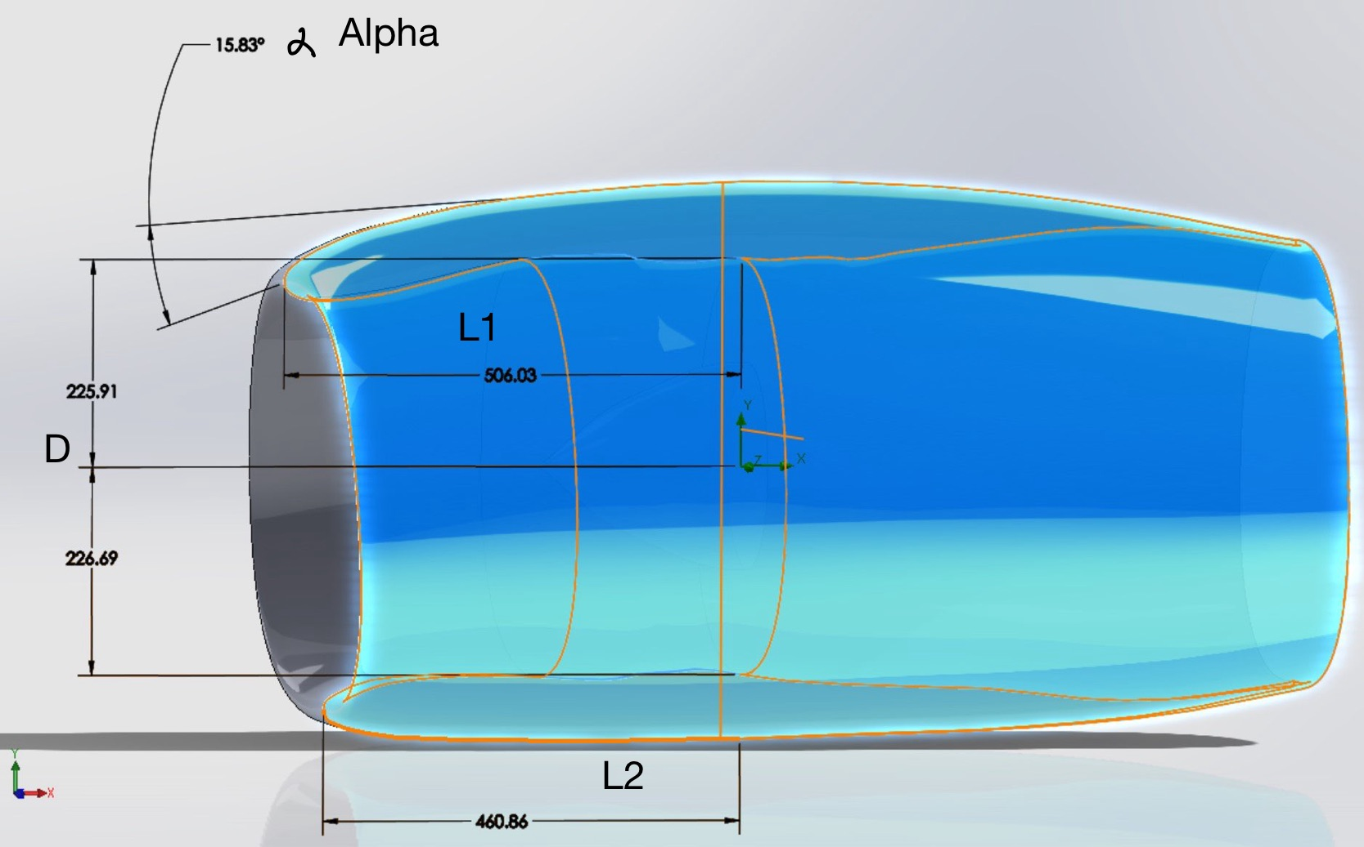
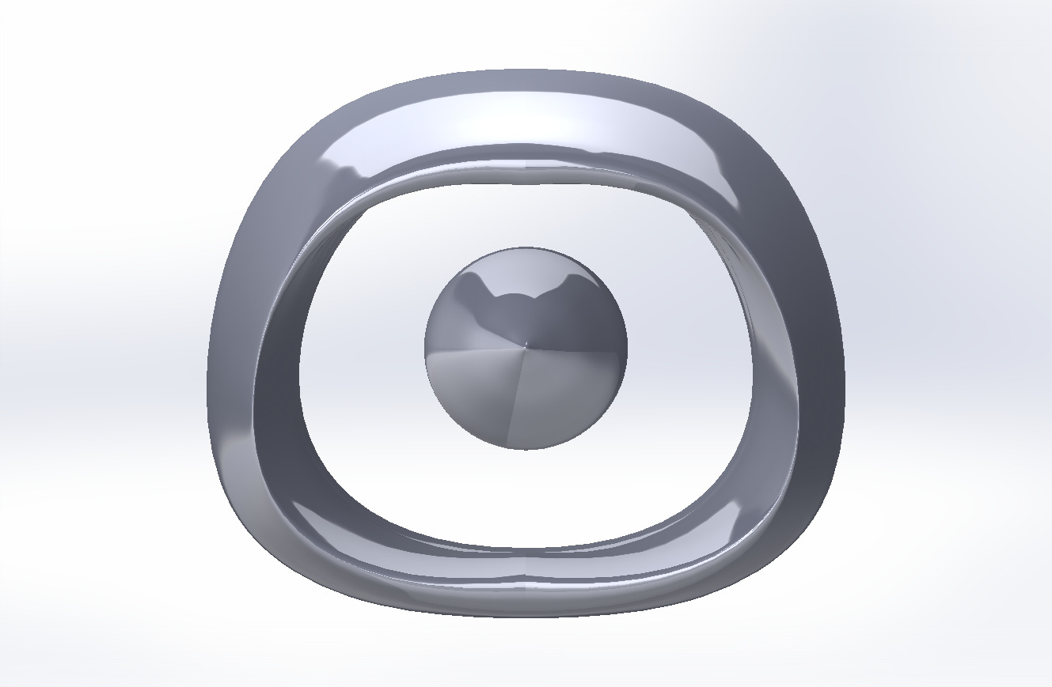
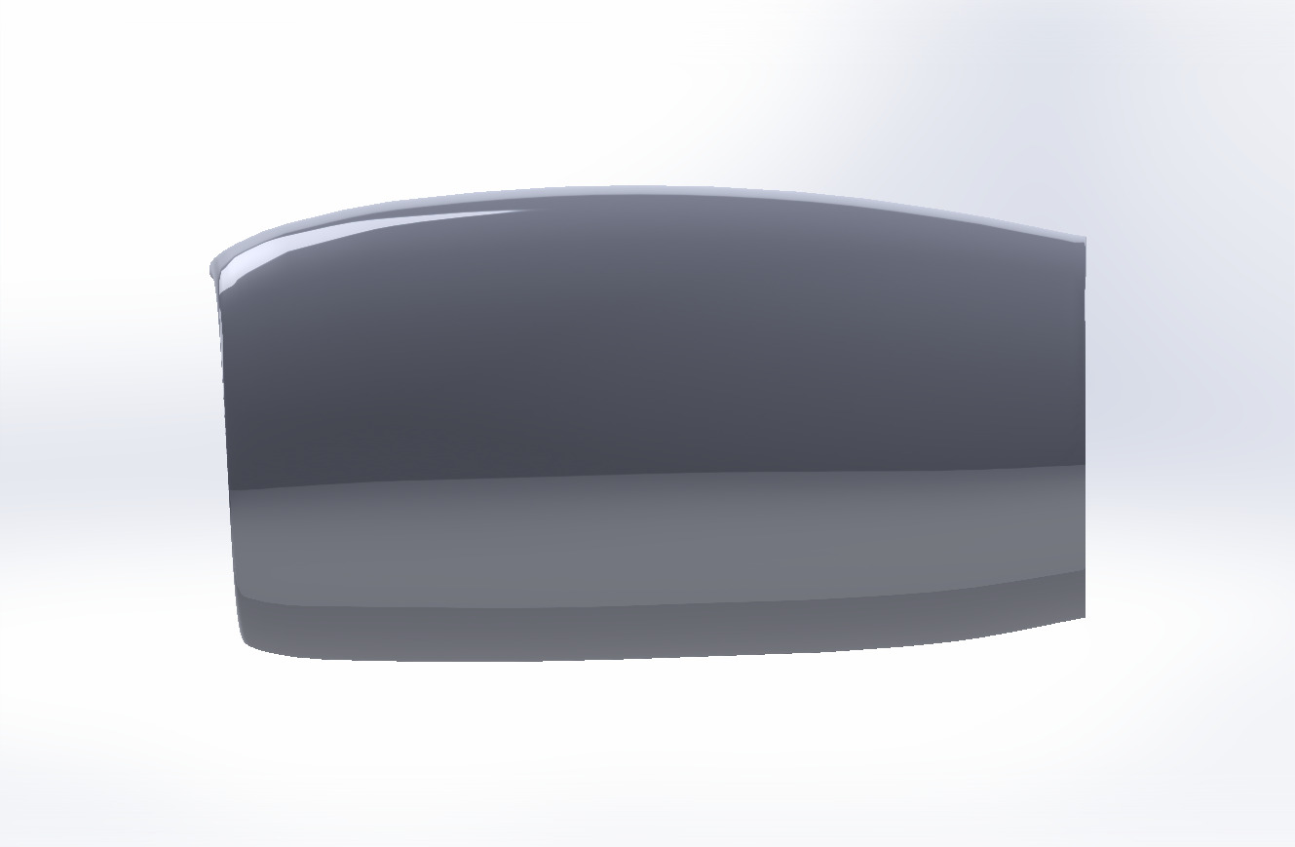
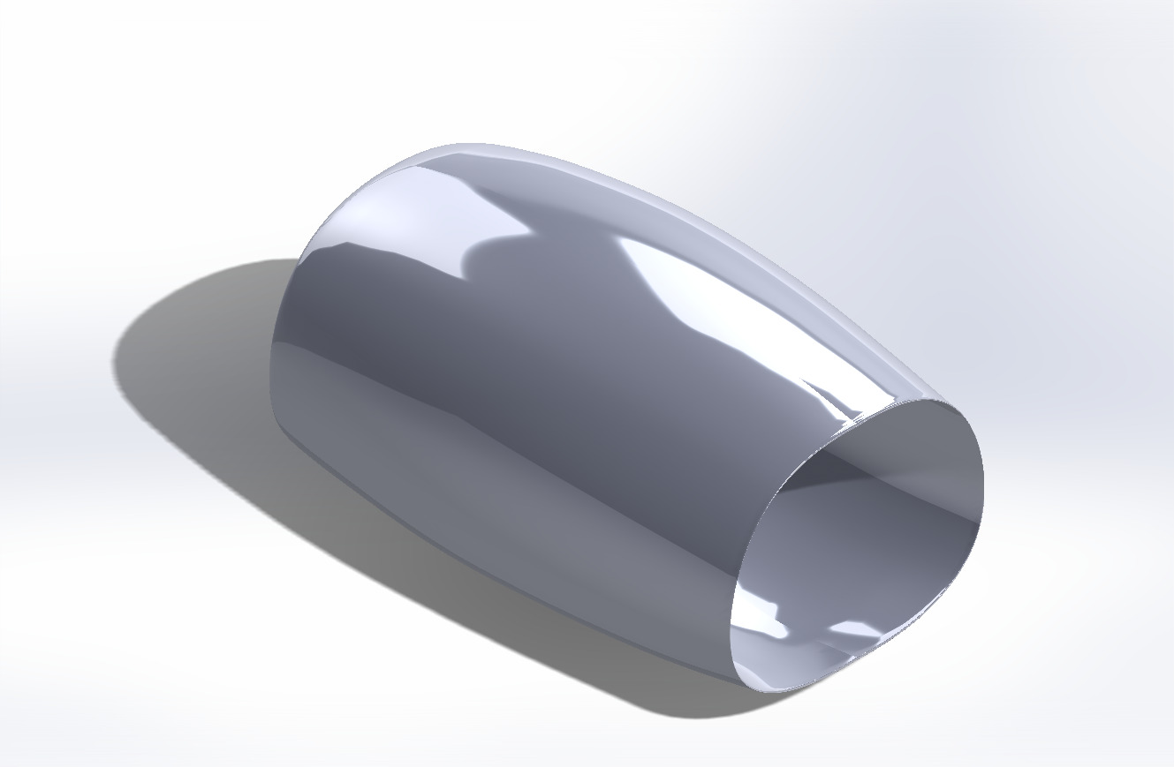
Methodology
CFM56-7B engine baseline

Slide 7
Methodology
VARIABLE | BASELINE (mm) | -1% | -2.5% | -5% | 1% | 2.5% | 5%
Inlet upper length (L1) | 506.03 | 500.97 | 493.38 | 480.73 | 511.09 | 518.68 | 531.33
Inlet lower length (L2) | 460.86 | 456.25 | 449.34 | 437.82 | 465.47 | 472.38 | 483.90
Inlet Diameter (D) | 464.15 | 459.51 | 452.55 | 440.94 | 468.79 | 475.75 | 487.36
VARIABLE | BASELINE (Degrees) | -2.5% | -5.0% | -10% | 2.5% | 5.0% | 10%
Angle of Attack Upper (alpha) | 15.83 | 15.44 | 15.04 | 14.25 | 16.23 | 16.63 | 17.42
These values will be scaled to a factor of 4.01x to get the model of the engine at real-life dimension and then complete CFD analysis.

Slide 8
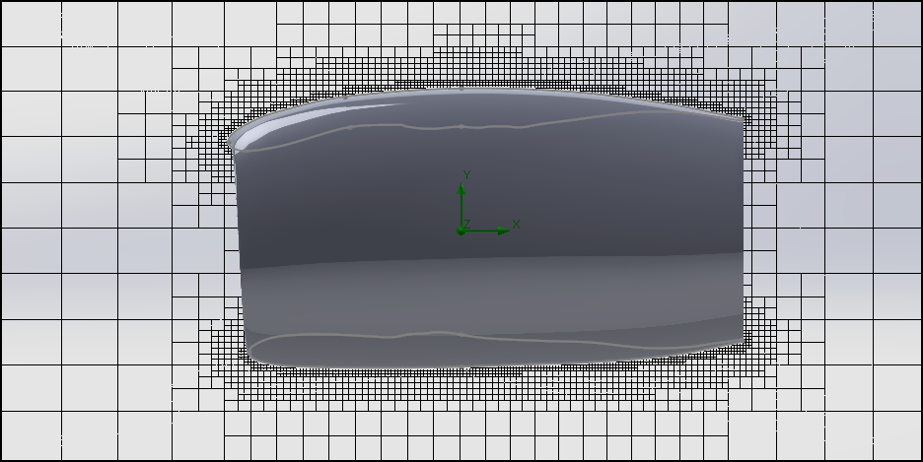
Analysis and Results
Boundary Conditions
Fluid: Air
Altitude: 10668 meters
Speed: 835 Km/h
Mesh Refinement:
- Optimal for aerospace analysis (Equidistant).
Computational Fluid Dynamics

Slide 9
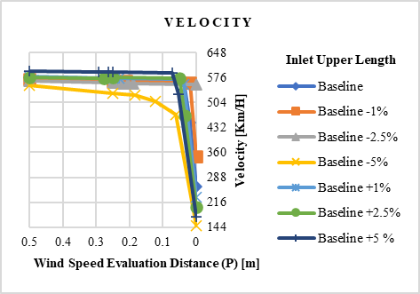
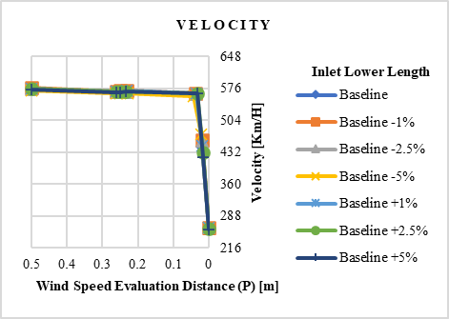
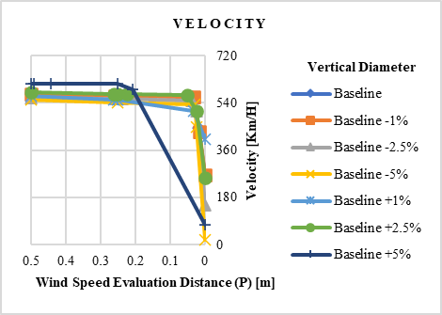
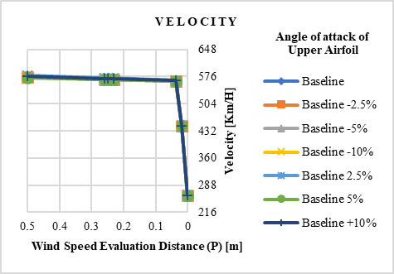
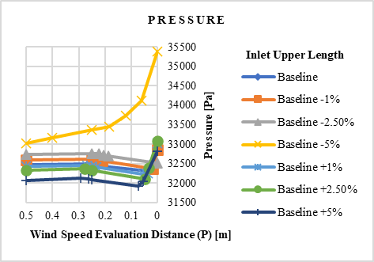
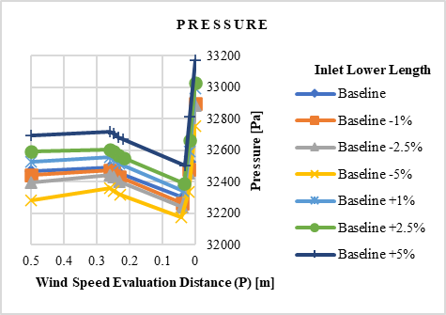
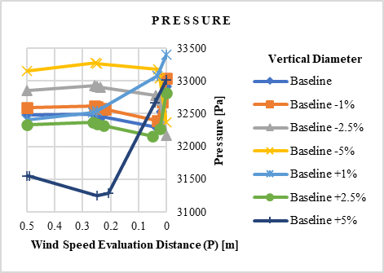
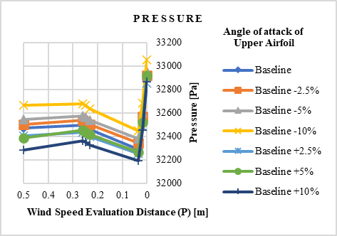
Analysis and Results
Geometrical Changes
Velocity and Pressure of each design change for the Inlet Upper Length parameter (U).
Velocity and Pressure of each design change for the Inlet Lower Length parameter (L).
Velocity and Pressure of each design change for the Diameter parameter (D).
Velocity and Pressure of each design change for the Angle of Attack parameter (α).

Slide 10
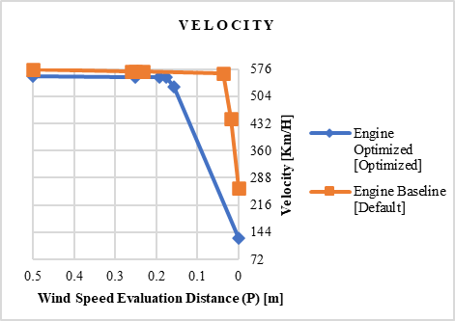
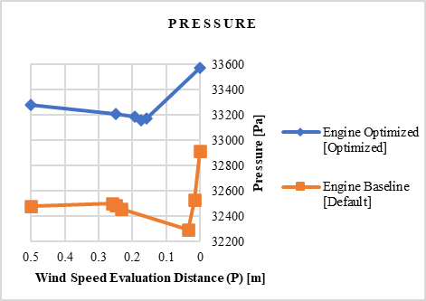
Analysis and Results
- Optimized model is created by changing the baseline model by:
-5% on the upper inlet length
+5% on the lower inlet length
-5% on the diameter
-10% on the angle α
Velocity and Pressure of the Baseline and Optimized model.

Slide 11
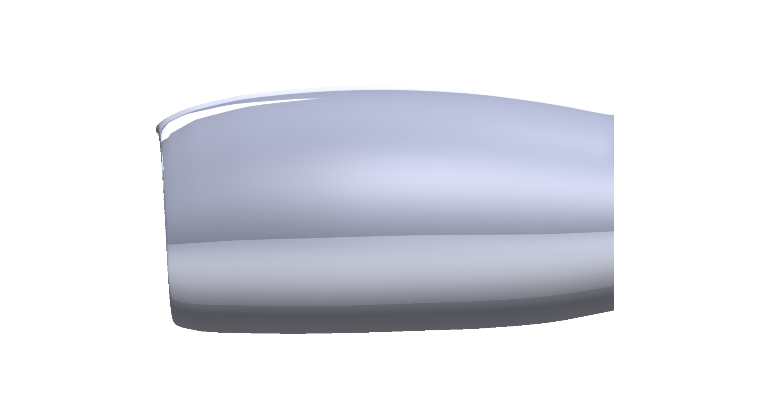
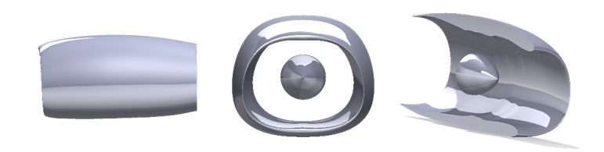
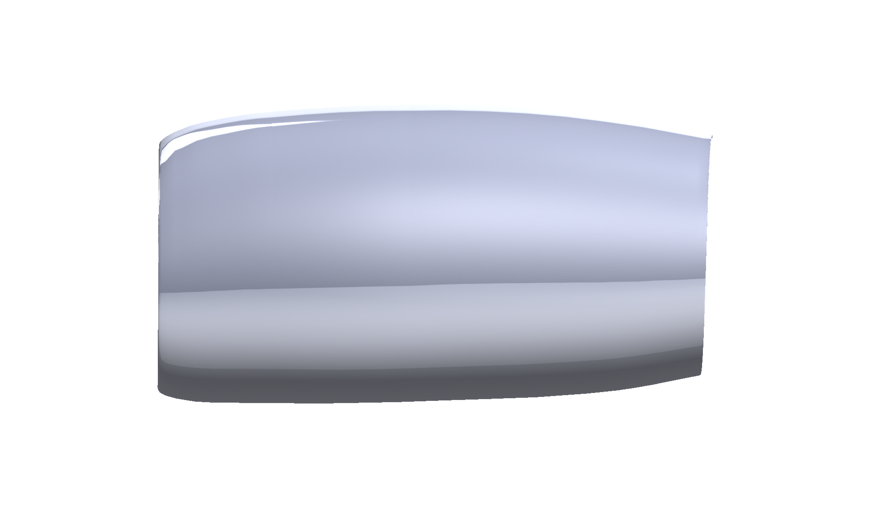
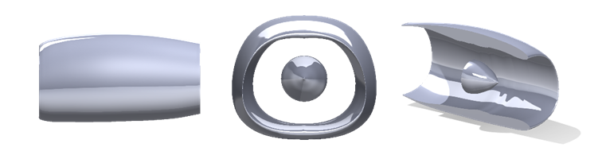
New Design
CFM56-7B optimized model
Baseline CMF56-7B model
Optimized CMF56-7B model

Slide 12
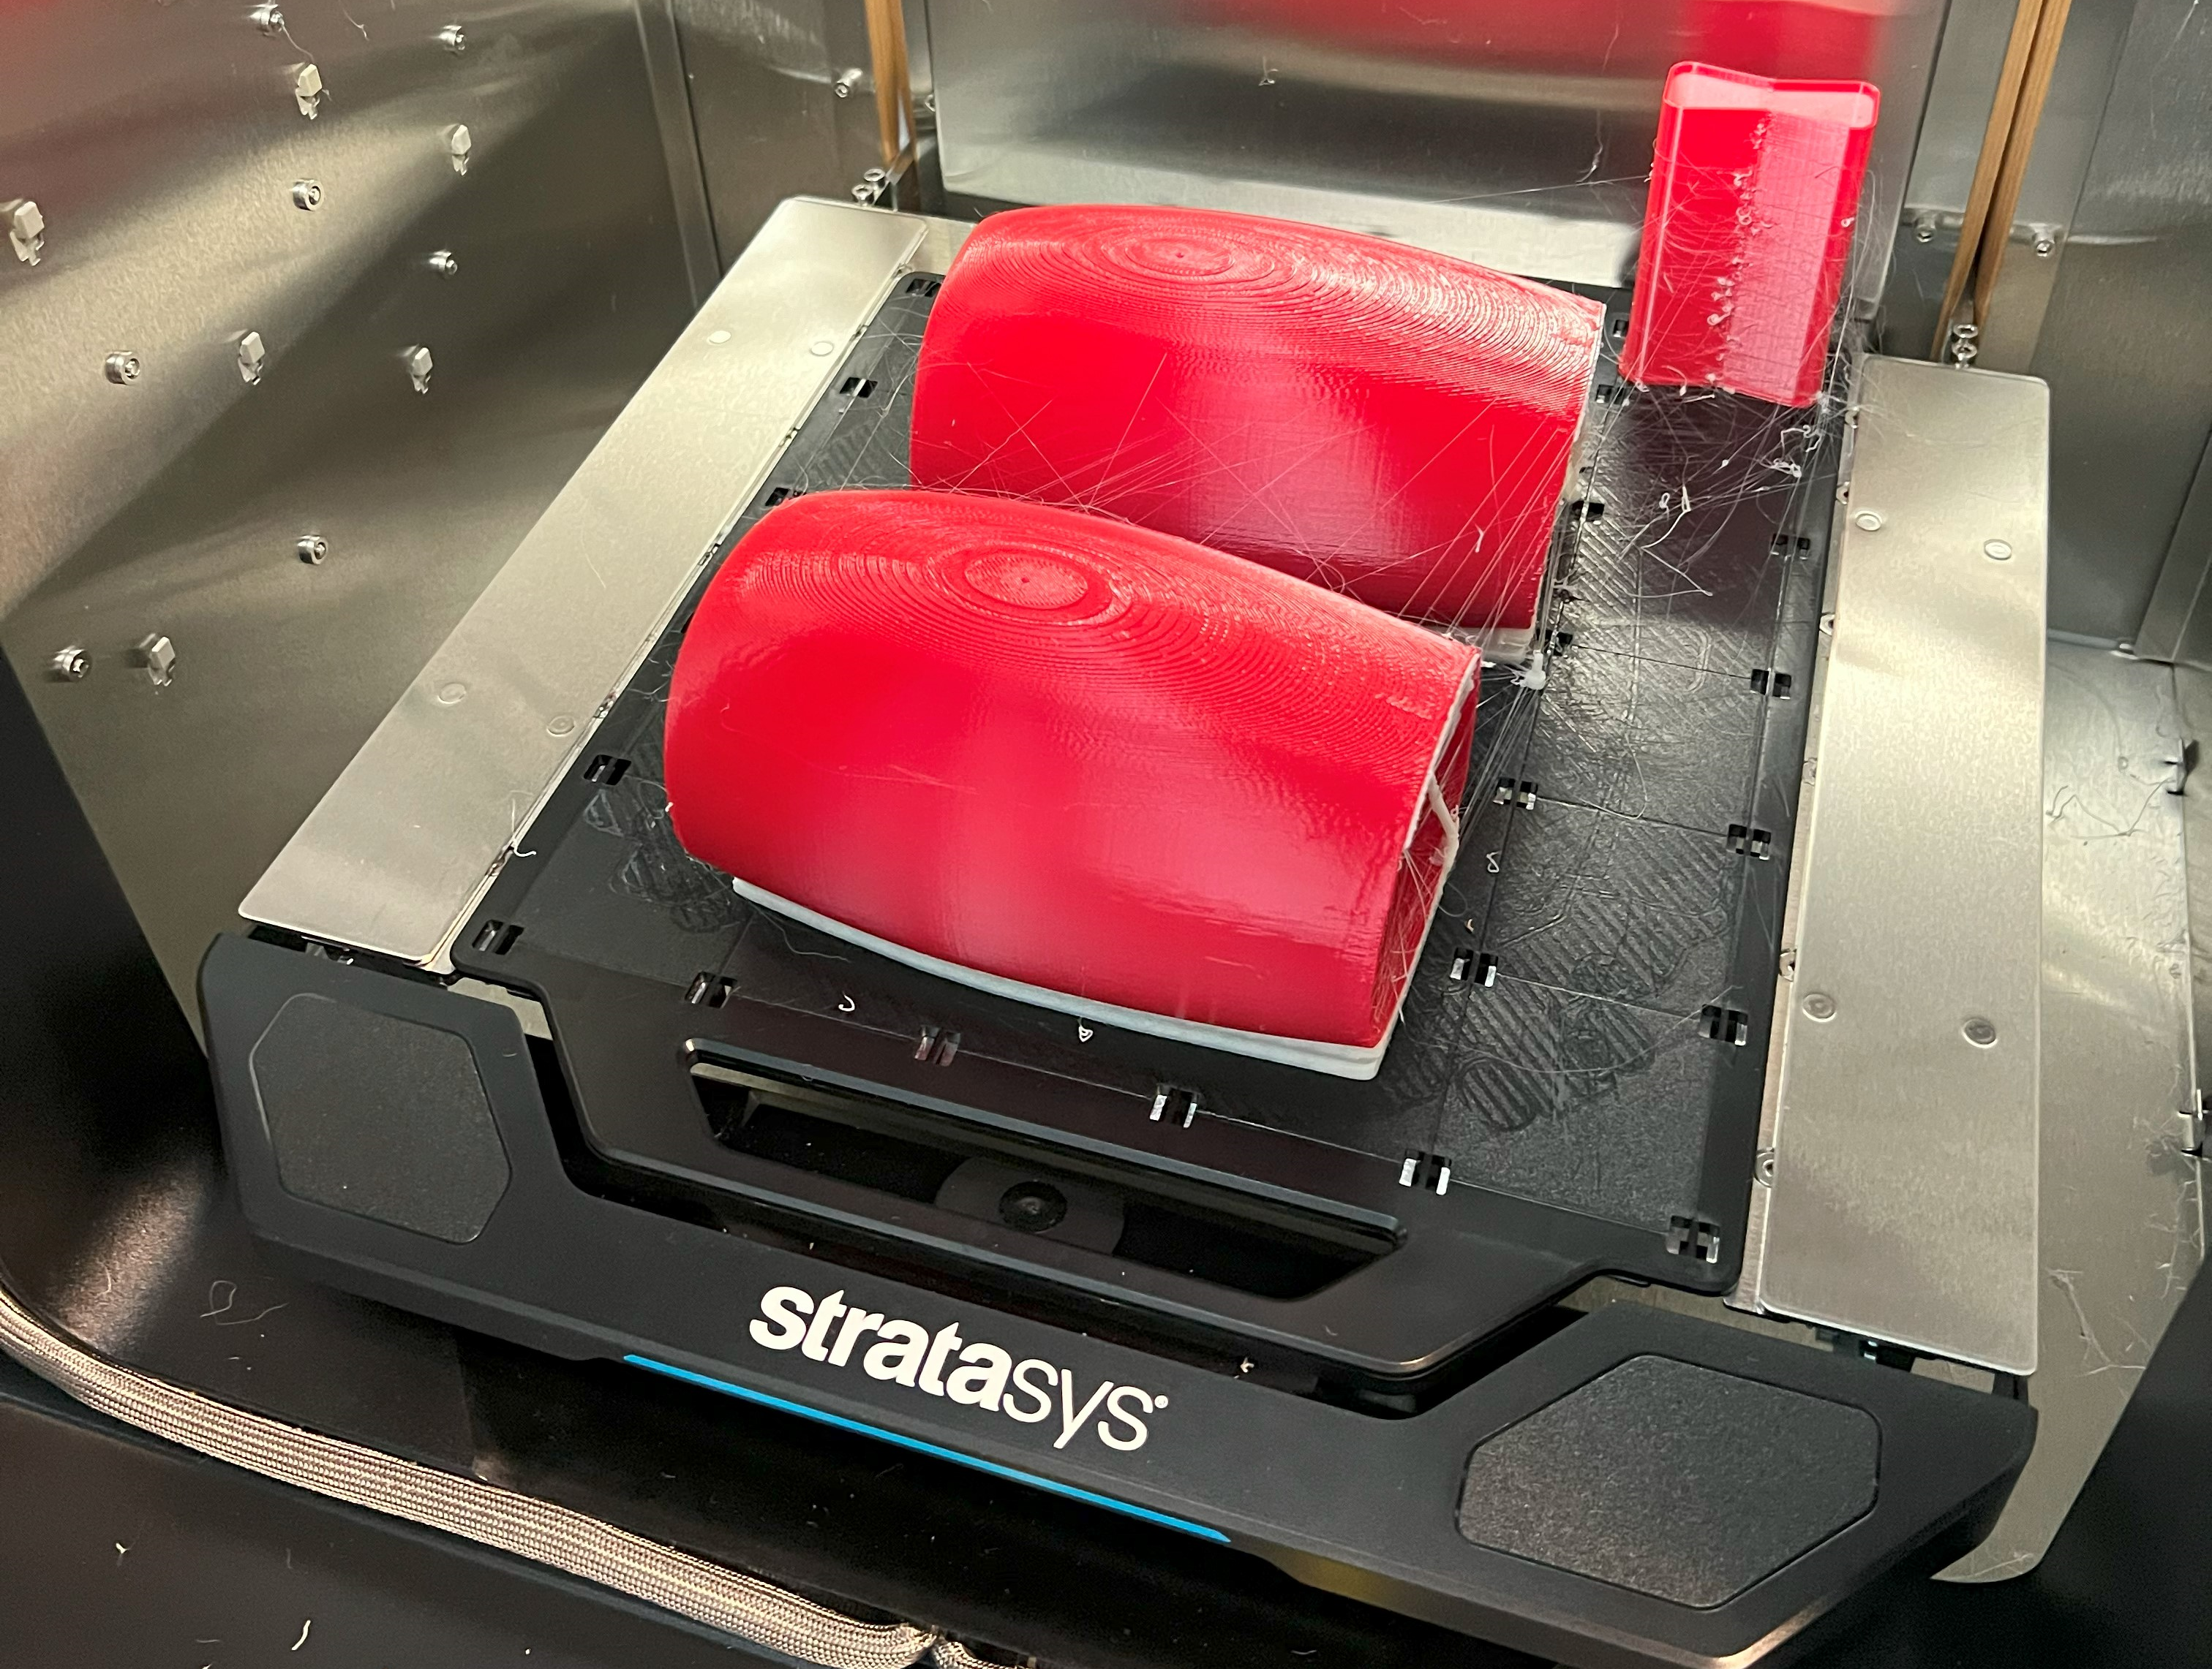
Wind Tunnel Test
Printing Phase
Models are loaded to a slicer software (GrabCAD)
Printing is done with a Stratasys F170 printer.

Slide 13
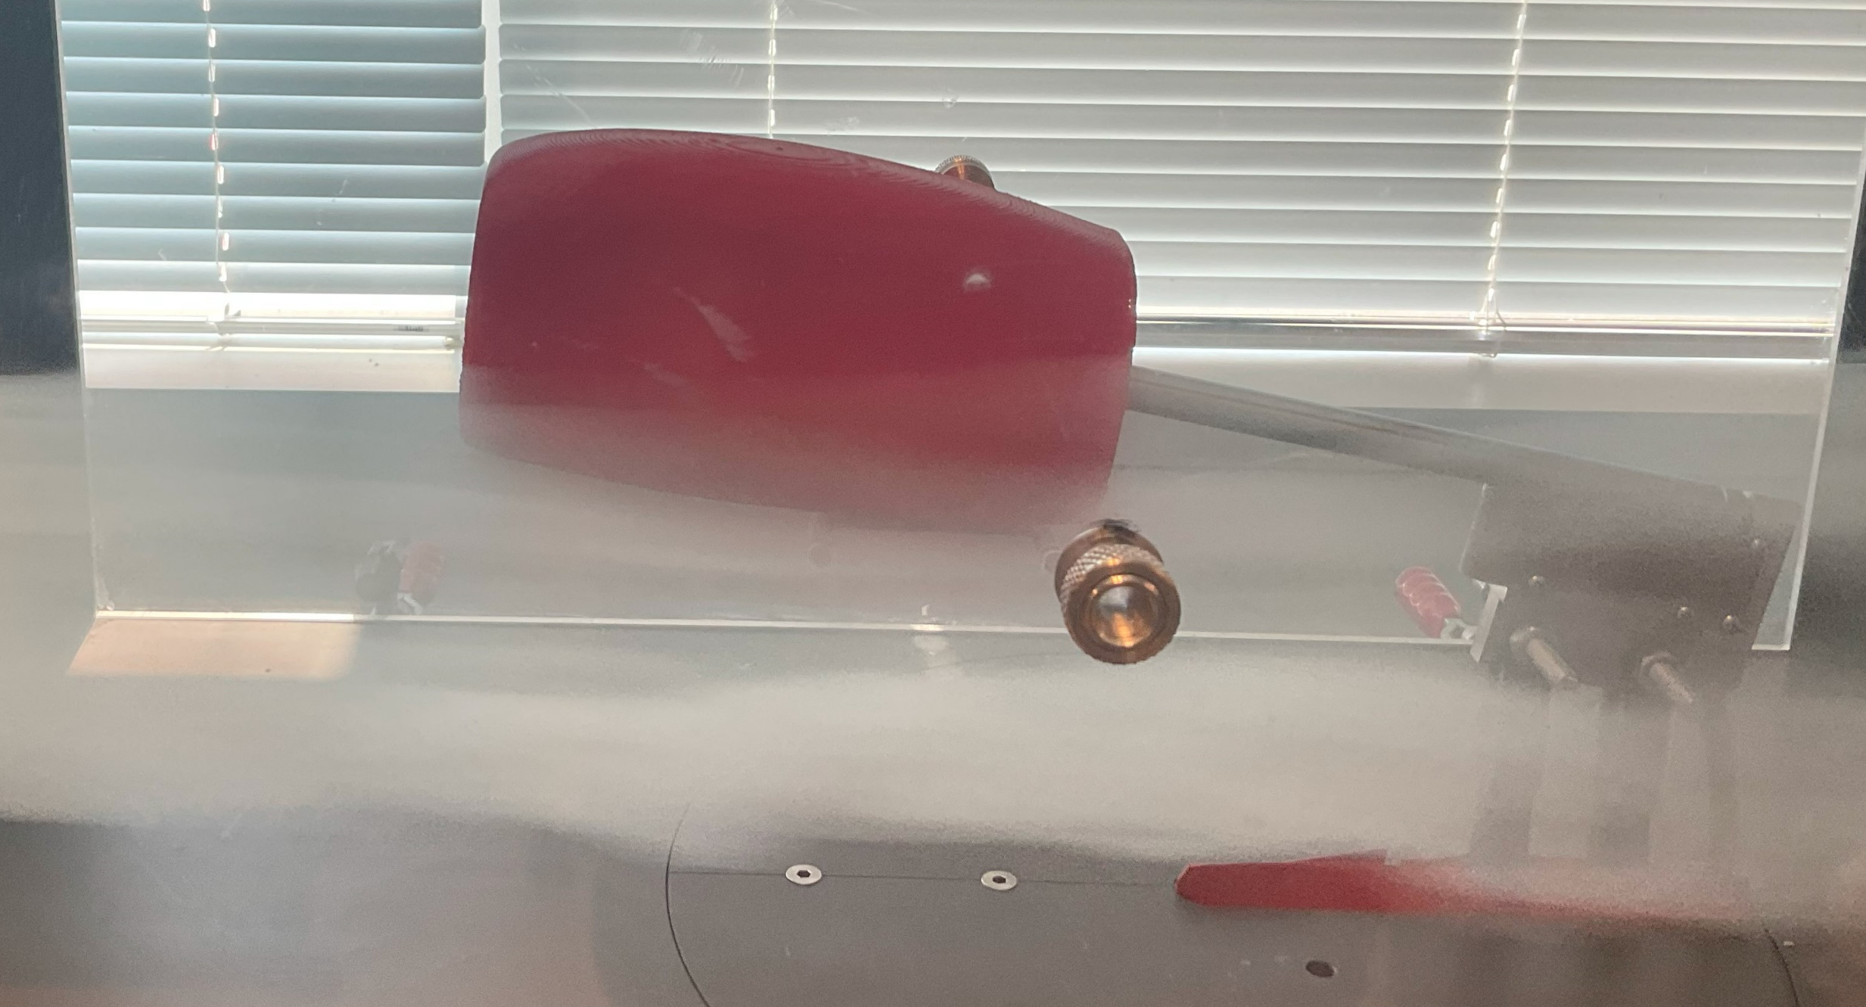
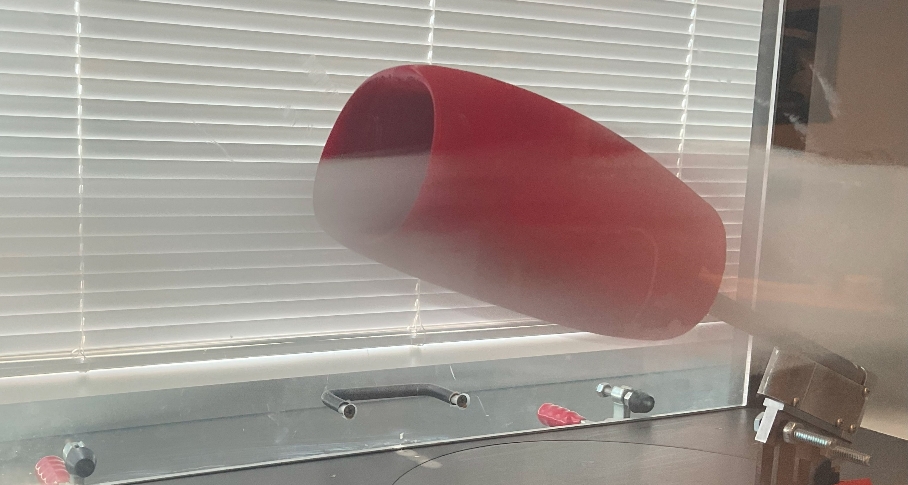
Wind Tunnel Test
Testing Phase
Models are mounted to a balancing sting in the EWT (Educational Wind Tunnel).
Axial Force is measured and Drag is calculated.
Drag is measured at different speeds of the surrounding air and at different angles.

Slide 14
Wind Tunnel Test
Experiment Results
The optimized model experiences less average drag than the baseline.
The behavior of the engine at various angles of attack is reasonably similar with slight value differences for drag experienced.

Slide 15
Wind Tunnel Test
Configuration | Percentage Drag Reduction δ (%)
-15° Angle of Attack | -18.37
-10° Angle of Attack | -1.94
-5° Angle of Attack | 21.14
+5° Angle of Attack | -7.69
+10° Angle of Attack | -16.67
+15° Angle of Attack | -2.20
Percentage Drag Reduction
Percent difference between the average drag experienced by the baseline model and the average drag experience by the optimized model.
Average drag reduction is experienced
At 5° Angle of attack, average drag increase is observed.

Slide 16
Conclusions
Conclusion
The experiment conducted in the wind tunnel has shown that there is a lower average drag experienced by the optimized model.
The optimized model provides higher pressure and lower velocity inside the inlet without any change is the drag force experienced.
The optimized model can be considered as successful in completing the purpose of the study.

Slide 17
Next Steps
What to do next ?
Create a better 3d model of the CMF56-7B for better accuracy in CFD results.
Include engine elements such as blades/shaft to analyze their impact on the pressure and velocity of air inside the inlet.
Complete an additional wind tunnel test with more accurate sensor.

Slide 18
References
“OWNER’S & OPERATOR’S GUIDE: CFM56-7B,” Aircraft Commerce, 2023.
“Propulsion Technologies to Reduce Thrust Specific Energy Consumption,” NASA, 2023.
“Technical Manual Index,” CFM International, 2023.

Slide 19

Acknowledgments
This research is supervised by Dr. Adeel Khalid.
Professor of Industrial & Systems Engineering
Interim Assistant Dean of Research
Coordinator of the Aerospace Engineering minor
akhalid2@kennesaw.edu

