Slide 1

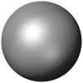
Numerical Study of Transonic Flow Characteristics Around a Compound Delta Wing
Andrew Marion
Undergraduate Research Assistant
Department of Mechanical Engineering
Southern Polytechnic College of Engineering and Engineering Technology
Advisor: Dr. Gaurav Sharma
Kennesaw State University
2025 AIAA Region II Student Conference
April 3-4, 2025
Copyright© by A. T. Marion and G. Sharma. Published by the American Institute of Aeronautics, Inc., with permission
Notes:
Hi, I am Andrew Marion I am a sophomore at Kennesaw state university and an Undergraduate research assistant at KSU’s advance aerodynamics and propulsion lab.

Slide 2
OUTLINE
COMPUTATIONAL APPROACH
RESULTS
CONCLUSIONS
MOTIVATION & BACKGROUND
OBJECTIVES
FUTURE WORK
Notes:
This is the outline of my presentation. I am going to go over the introduction, then cover the objectives. After that I will go through the computational methodology, discuss some of the results, talk about the parametric studies and finish with conclusions and future work. Let’s start with the introduction.

Slide 3
OUTLINE
COMPUTATIONAL APPROACH
RESULTS
CONCLUSIONS
MOTIVATION & BACKGROUND
OBJECTIVES
FUTURE WORK
Notes:
First lets discus the motivation and background for this study.

Slide 4
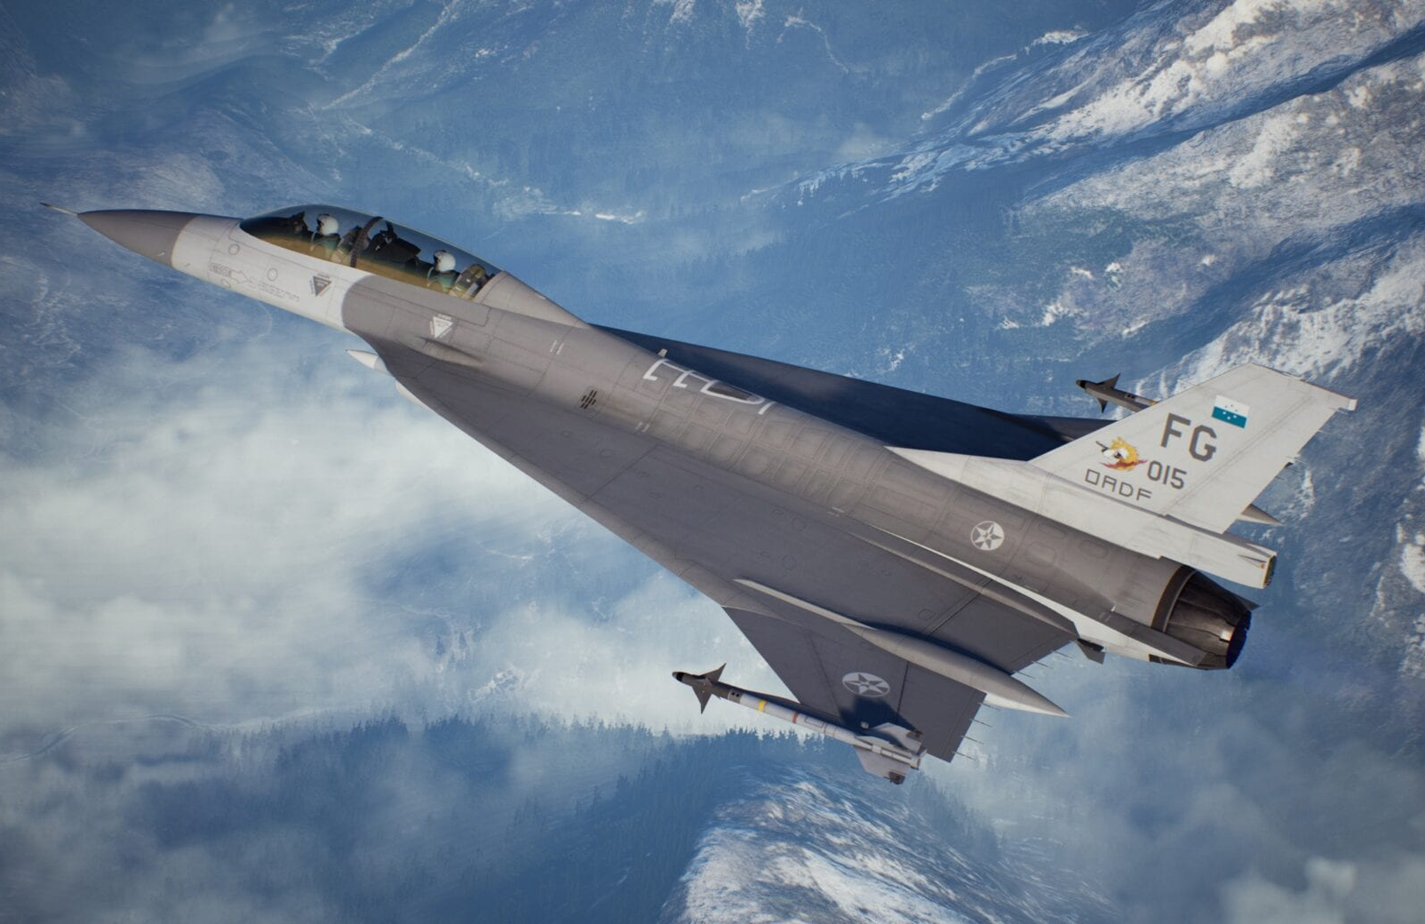
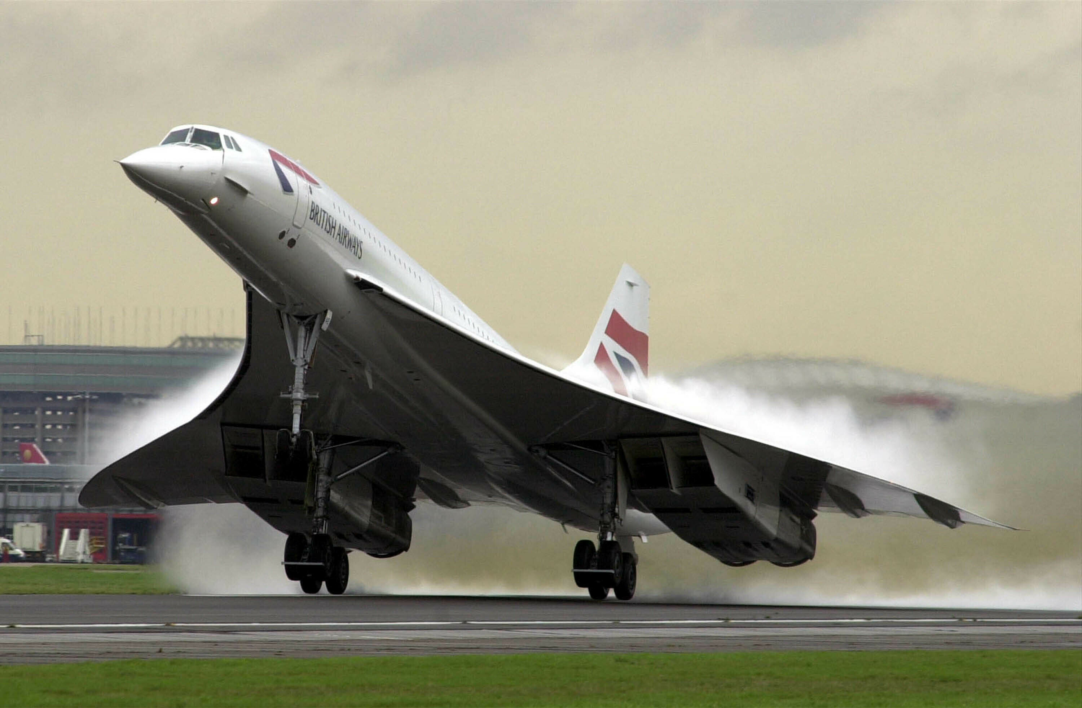
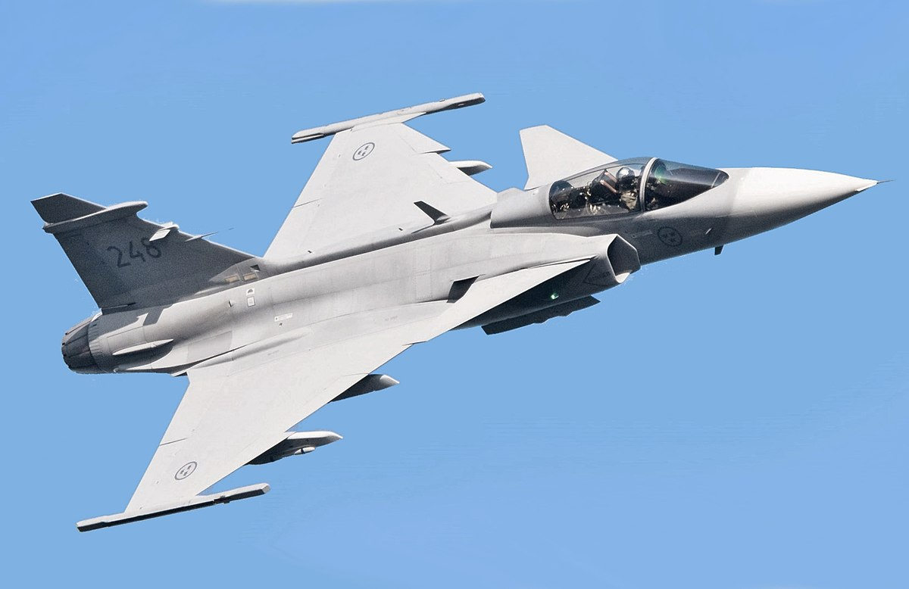
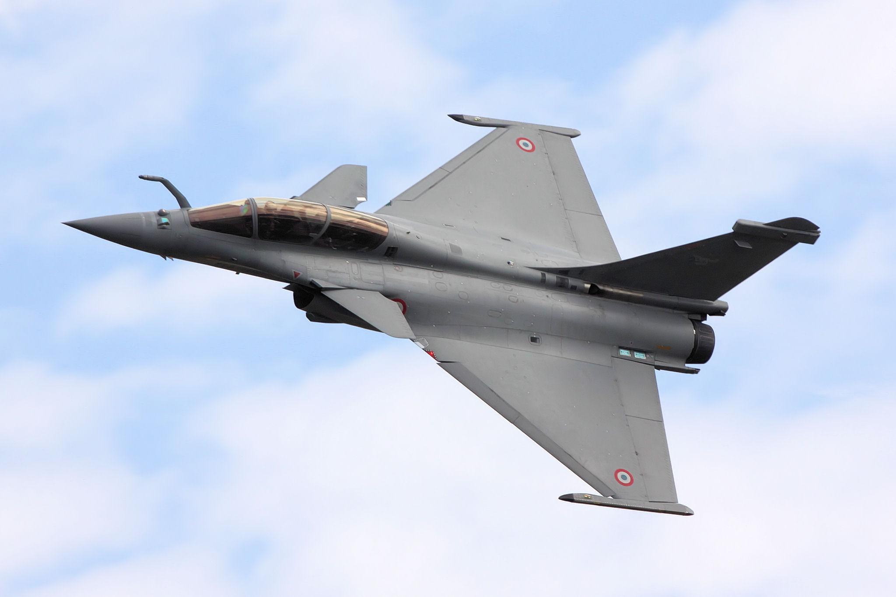
Delta Wing
F-16XL
Source: Acepedia
Concorde
Source: NPR
SAAB JAS 39 Gripen
Source: Wikipedia
Dassault Rafale
Source: Wikipedia
Notes:
Delta wings are a specialized class of highly swept wings, widely used in supersonic aircraft design due to their unique aerodynamic advantages. They have been used for civilian applications such as the concord shown here and military aircraft like the f-16xl. One of their key benefits is the ability to minimize wave drag at high speeds due to there low thickness to chord ratio—a critical factor for supersonic flight. But perhaps their most remarkable feature is their ability to generate lift through vortex formation at high angles of attack, far beyond what conventional wings can achieve. This phenomenon, known as vortex lift, significantly expands the flight envelope, enabling aircraft to perform aggressive maneuvers while maintaining stability.

Slide 5
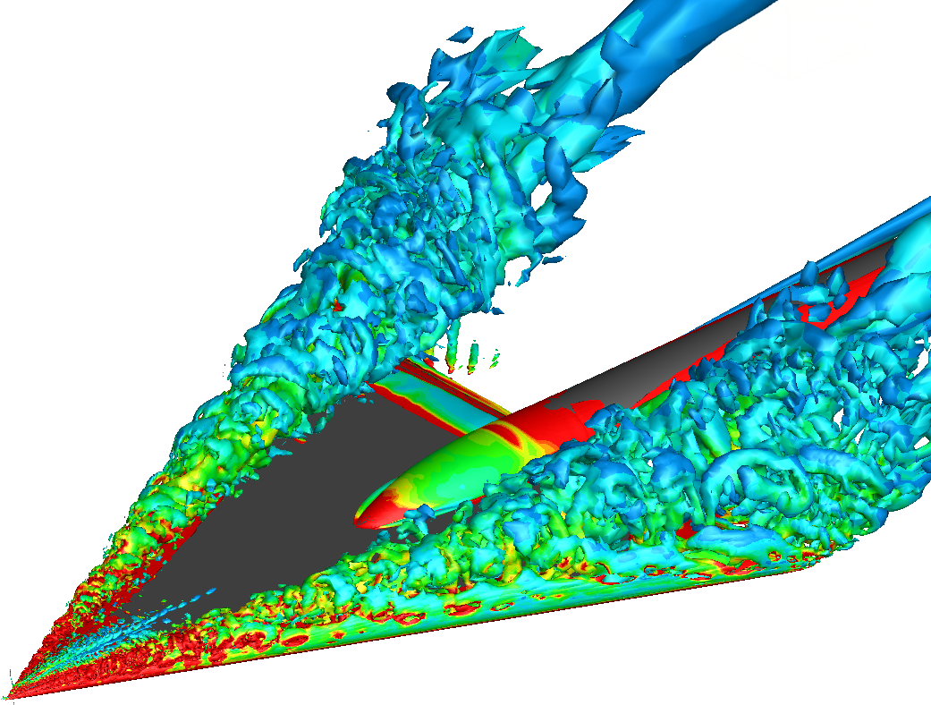
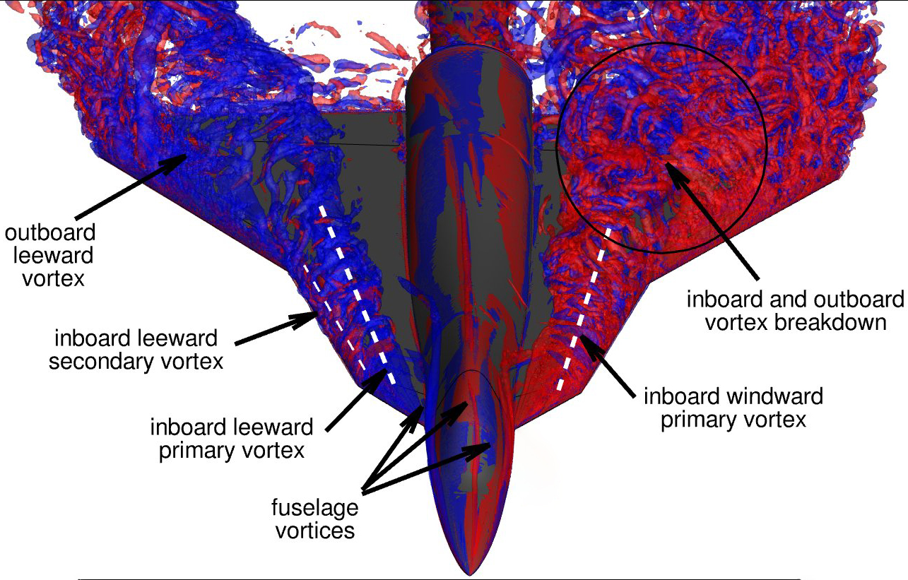
Delta Wing – Vortex Dynamics
Vortex formation over delta wing
Source: Scientific Computing
Source: CFD Lab UniBw
Notes:
The aerodynamics of delta wings are dominated by the formation of two counter-rotating vortices that originate at the sharp leading edges and propagate downstream along the wing surface as shown on the left. These Leading-Edge Vortices—or LEVs for short—play a crucial role in enhancing lift. As air flows over the wing, these vortices accelerate the airflow downward, creating a strong low-pressure region on the upper surface. This suction effect substantially increases lift, particularly at high angles of attack where traditional airflow separation would otherwise cause a stall.
However, this vortex-dominated flow has its limits. As the angle of attack continues to increase, a critical phenomenon known as vortex breakdown occurs shown on the right. The vortices suddenly destabilize, burst and collapse, which leads to an abrupt loss of lift and introduces severe aerodynamic instabilities. This becomes even more complex in the transonic regime, where shock waves begin to form and interact with the vortices. These shock waves not only disrupt the vortex structure but also induce additional wave drag, further degrading performance. For fighter aircraft—which primarily operate and maneuver in the transonic range—this poses a major challenge, as it directly impacts agility, aerodynamic efficiency, and controllability.

Slide 6
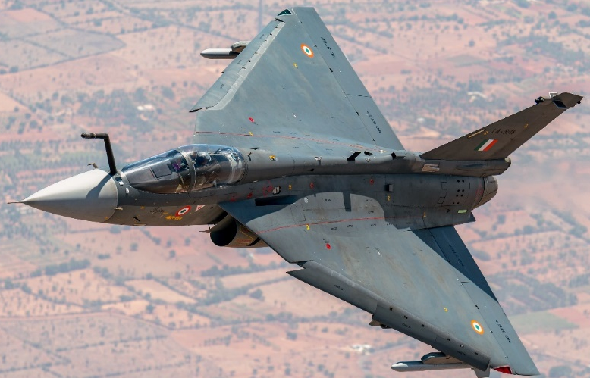
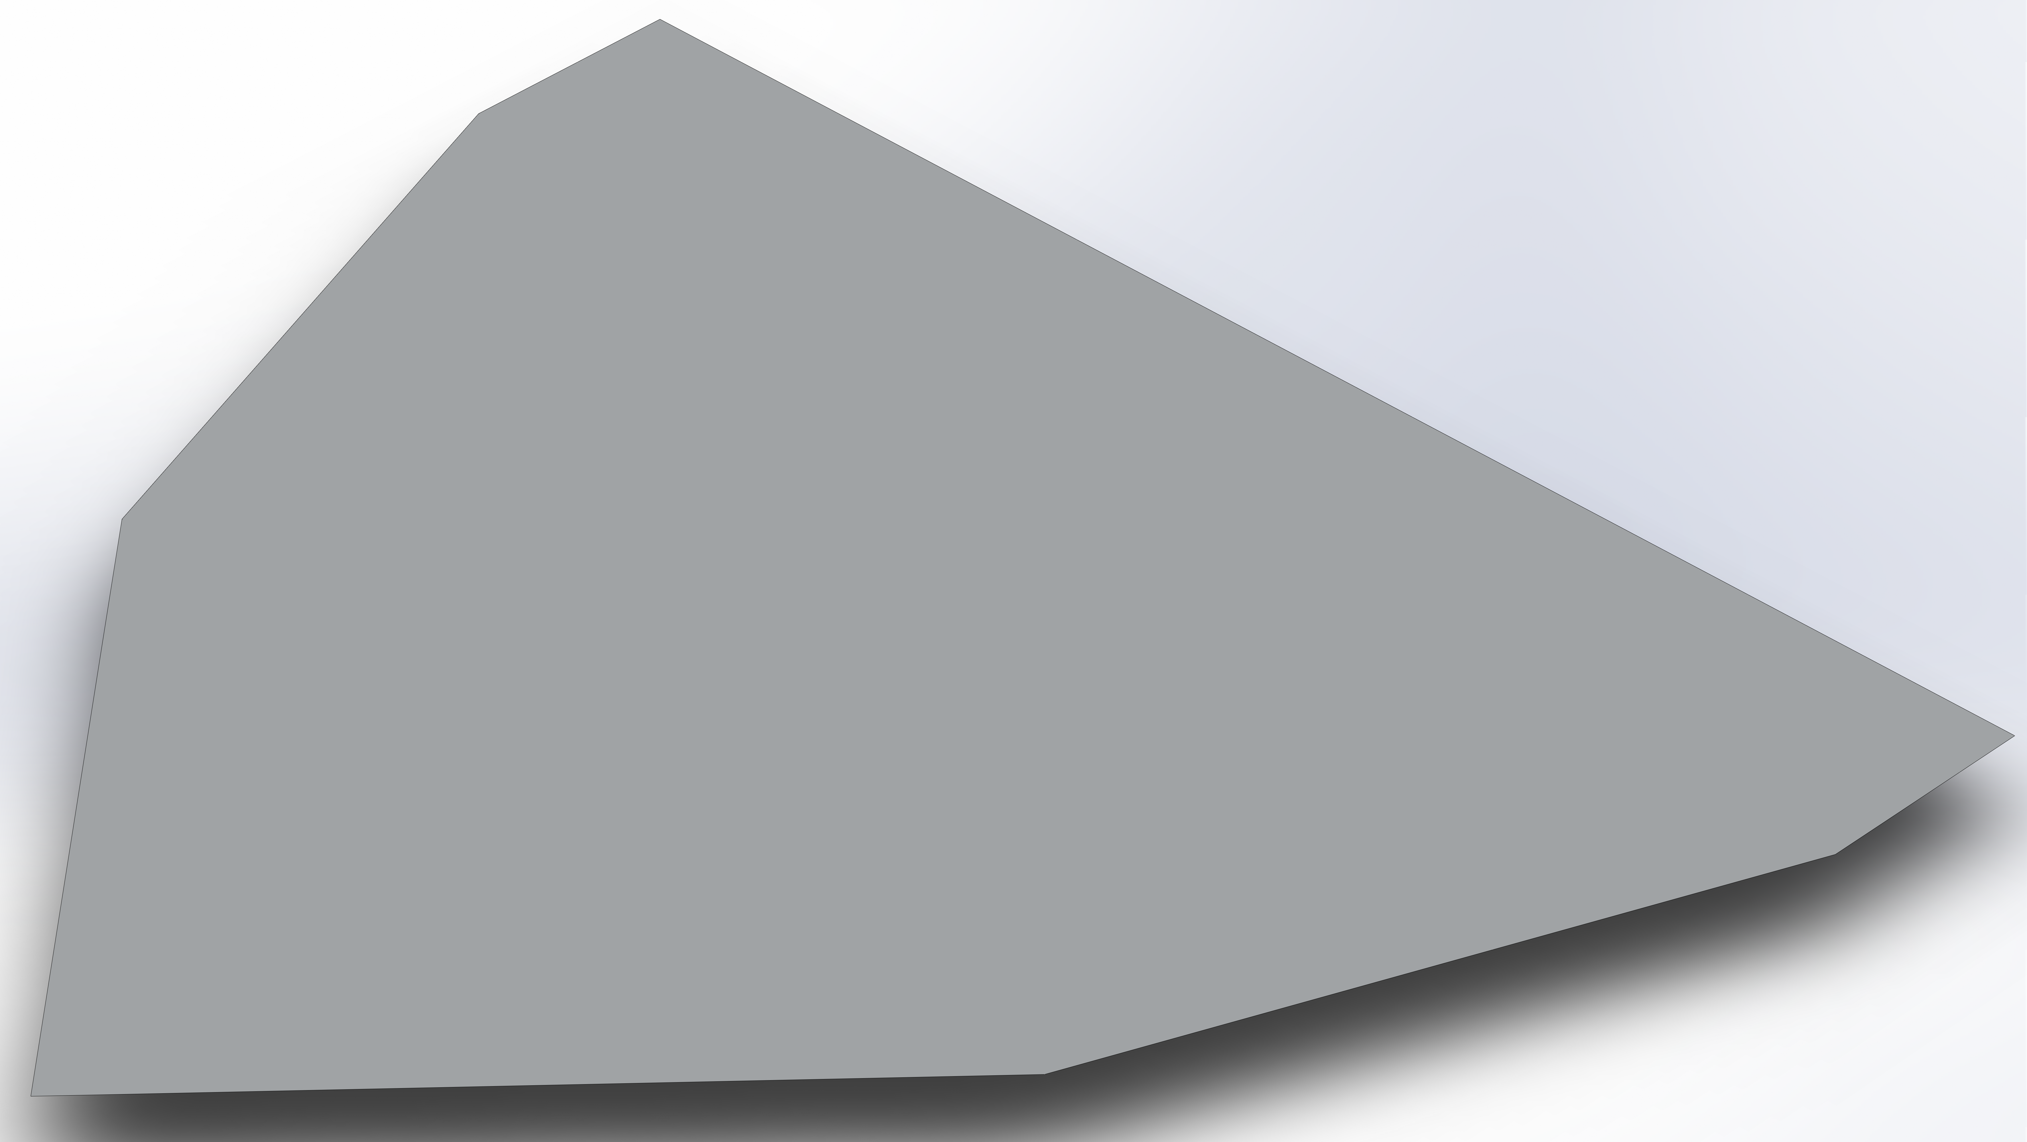
Compound Delta Wing
HAL Tejas
Source: Wikipedia
Compound Delta Wing Geometry
Notes:
One of the key contributors to strong shock formation is a sudden geometric change, such as the cropped tips often found on delta wings. To address these issues, compound delta wings have been proposed—a refined design featuring multiple leading-edge sweep angles. By gradually transitioning between different sweep angles, rather than using a single sharp break, these wings can better control vortex formation and potentially weaken shock waves. The smoother geometric transition helps in maintaining more stable vortices and reduces the intensity of shock-induced drag.
In this study, we focus on a specific compound delta wing inspired by the design of the HAL Tejas fighter jet. Our wing features two distinct sweep angles: a shallower inboard section for enhanced vortex stability and a steeper outboard section to optimize transonic performance. Additionally, the wing incorporates a cropped tip, a common feature in modern combat aircraft to balance aerodynamic efficiency and structural weight. Through this research, we aim to uncover how these design choices influence vortex dynamics, shock interactions, and overall aerodynamic performance—providing valuable insights for next-generation aircraft design.

Slide 7
OUTLINE
COMPUTATIONAL APPROACH
RESULTS
CONCLUSIONS
MOTIVATION & BACKGROUND
OBJECTIVES
FUTURE WORK
Notes:
This is the outline of my presentation. I am going to go over the introduction, then cover the objectives. After that I will go through the computational methodology, discuss some of the results, talk about the parametric studies and finish with conclusions and future work. Let’s start with the introduction.

Slide 8
Objectives
Conduct detailed aerodynamic analysis of a compound delta wing in the transonic regime
  Angle of attack range: 0° to 55°
  Mach numbers: M = 0.75, 0.85, 0.95, 1.0, 1.05, 1.1; Corresponding Reynolds numbers: 𝑅𝑒 = 3.17 x 10⁶, 3.59 x 10⁶, 4.02 x 10⁶, 4.23 x 10⁶, 4.44 x 10⁶, and 4.65 x 10⁶
Evaluate improvements in aerodynamic efficiency compared to a baseline wing configuration
Characterize vortex dynamics and flow structures associated with the compound delta wing under transonic conditions
Notes:
The primary goal of this research is to thoroughly investigate and characterize the complex transonic flow behavior over a compound delta wing configuration, with a particular emphasis on the formation, development, and breakdown of leading-edge vortices, as well as their dynamic interaction with shock structures in the flow field.
To achieve this, we conducted a comprehensive analysis across a carefully selected range of flight conditions—specifically, Mach numbers spanning from 0.75, representing the lower transonic regime, up to 1.1, which places us in the upper transonic range. This range is critical because it captures the key aerodynamic phenomena that occur as the flow transitions from subsonic to supersonic speeds, including the formation of shock waves, local flow accelerations, and the resulting pressure distributions.
Additionally, we explored a wide range of angles of attack—from 0 degrees, representing level flight conditions, all the way up to 55 degrees, where highly separated and vortical flows dominate. This broad range allows us to assess not only the linear aerodynamic characteristics but also the highly nonlinear behaviors that emerge at extreme flight conditions, such as vortex bursting, shock-induced separations, and their combined effects on lift and drag.
To ensure our findings are meaningful, we benchmarked the aerodynamic performance of the compound delta wing against a baseline wing configuration. This comparative analysis provides critical insights into the efficiency and potential advantages—or limitations—of the compound delta design in the transonic regime.

Slide 9
OUTLINE
COMPUTATIONAL APPROACH
RESULTS
CONCLUSIONS
MOTIVATION & BACKGROUND
OBJECTIVES
FUTURE WORK
Notes:
This is the outline of my presentation. I am going to go over the introduction, then cover the objectives. After that I will go through the computational methodology, discuss some of the results, talk about the parametric studies and finish with conclusions and future work. Let’s start with the introduction.

Slide 10
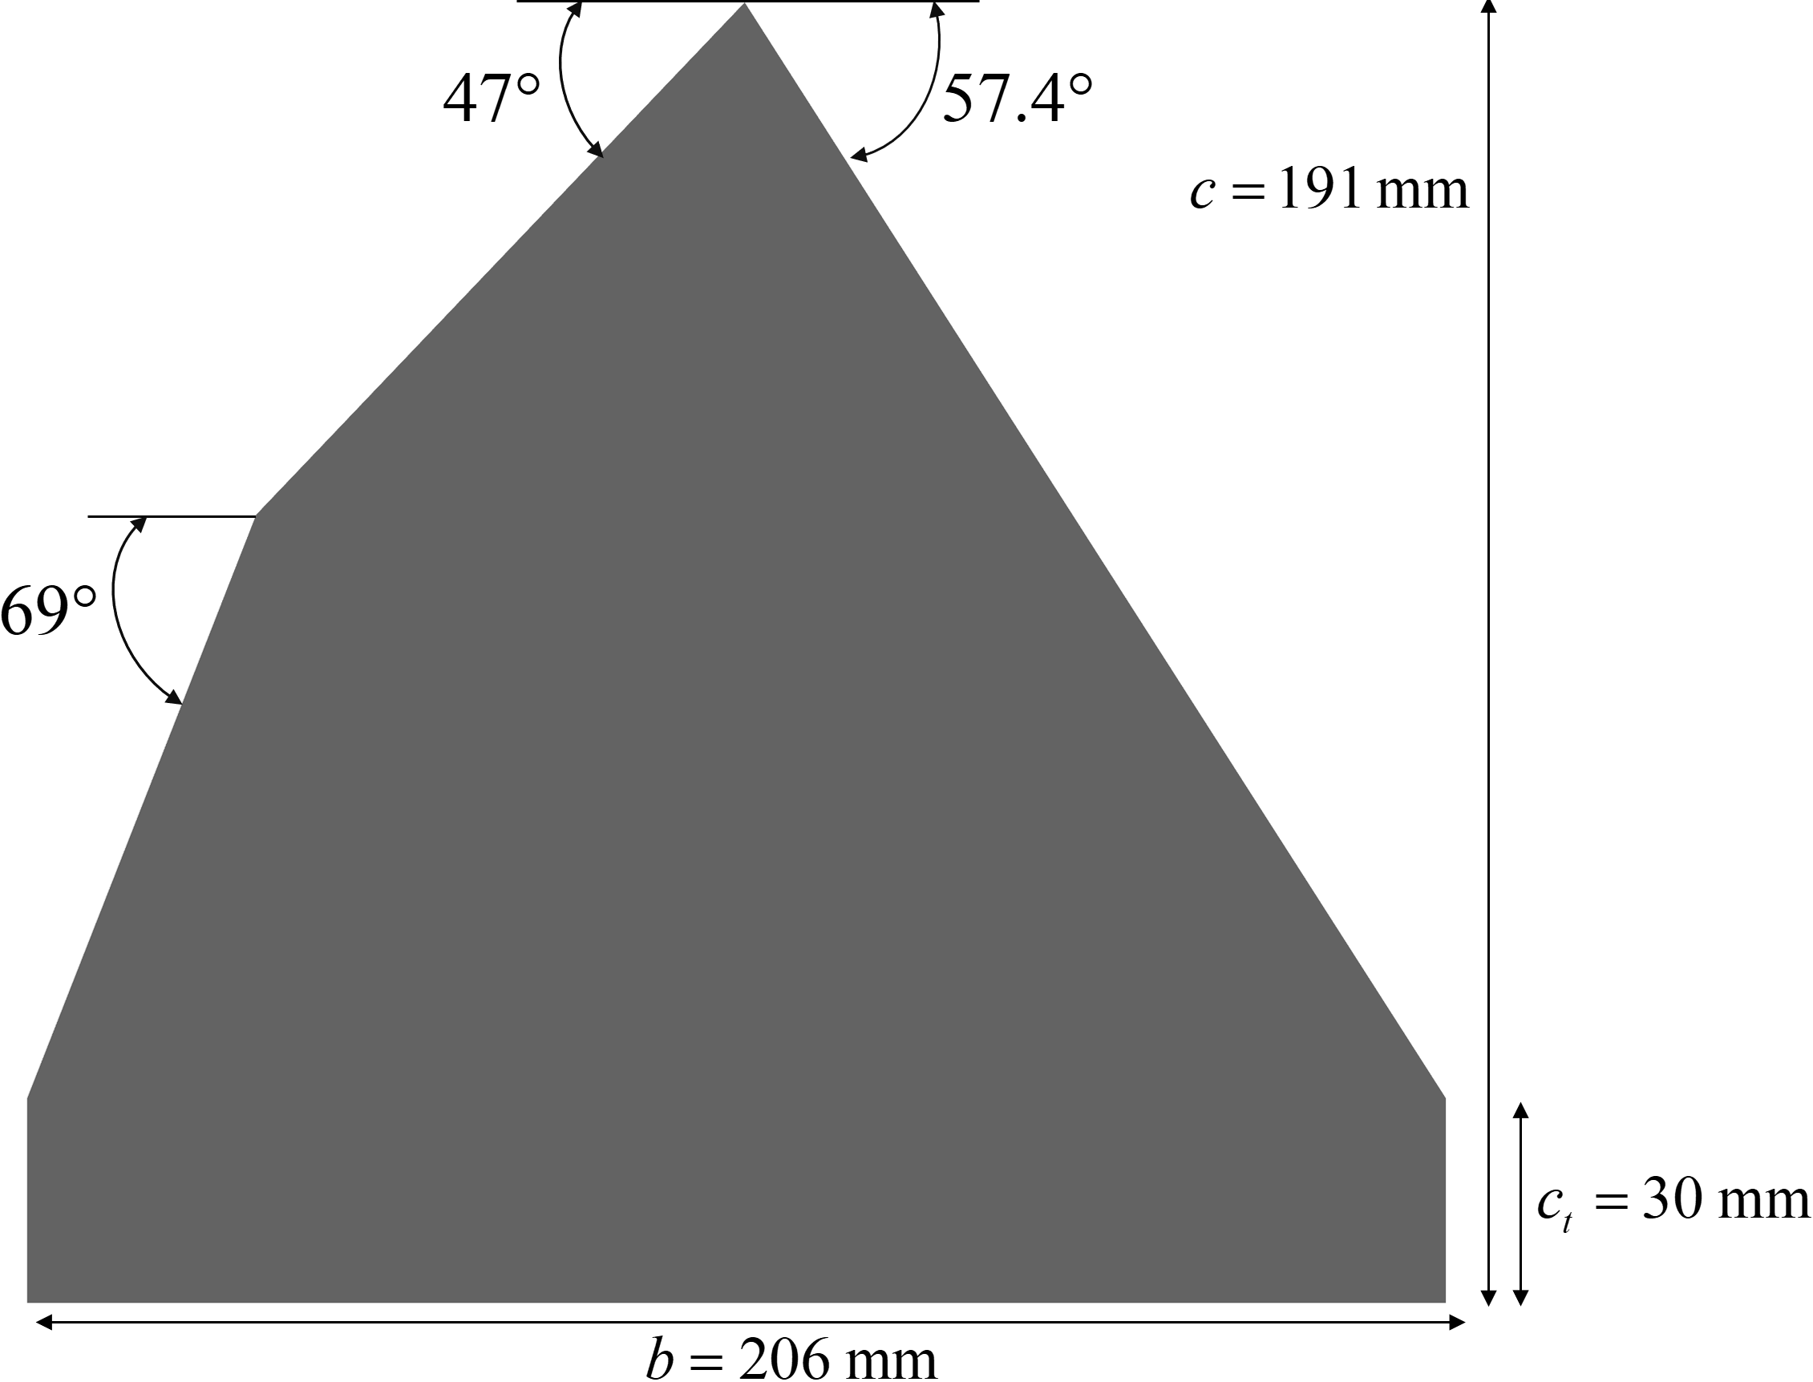
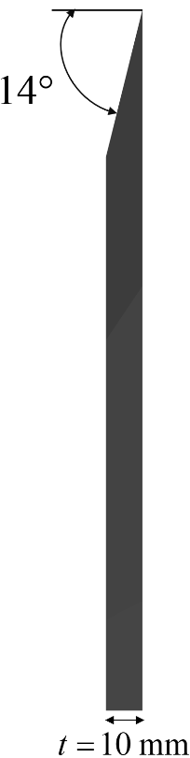
Geometry
Dual leading-edge sweep angles
Sharp leading-edge profile
30 mm tip chord
Notes:
Here, we see the two wing geometries used in this study. On the left, we have the compound delta wing, and on the right, the baseline delta wing for comparison. To ensure a fair and meaningful evaluation, both wings were designed with identical key dimensions—including the same wing span, root chord, tip chord, and thickness as well as featuring the same 30 mm crop were the wing is truncated to prevent wingtip stall. —so that any differences in aerodynamic performance can be directly attributed to their planform shape and sweep variation rather than size or scale effects.
The primary distinction between the two lies in their leading-edge sweep angles. The compound delta wing features a double-swept design, starting with an initial sweep of 47 degrees before transitioning sharply to a steeper 69-degree sweep further outboard. This configuration is intended to enhance vortex formation and stability at high angles of attack while managing shock interactions in transonic flight.
In contrast, the baseline wing follows a traditional single-sweep design with a constant leading-edge angle of 57.4 degrees, providing a conventional reference for aerodynamic efficiency. By comparing these two configurations, we can isolate the effects of the compound sweep and determine whether the more complex geometry offers advantages in terms of aerodynamic performance in the transonic flight regime."

Slide 11
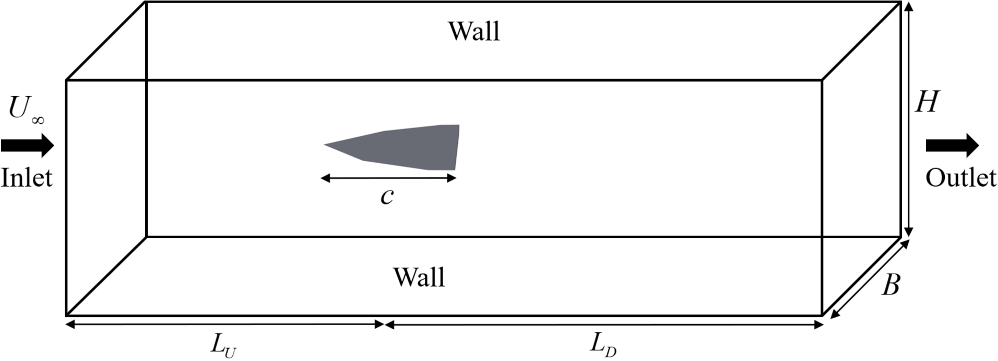
Domain & Boundary Conditions
L_{U} = 7c; L_{D} = 15c; B = 5c; H = 5c
Notes:
Next, we constructed a carefully designed fluid domain around the wing to accurately capture all aerodynamic phenomena. The size of this computational domain was determined based on the wing's root chord length shown by c—a critical reference dimension that ensures proper scaling. Careful consideration was made of the domain's height, width, and length to ensure that the wing's wake and vortex structures could fully develop without being constrained by numerical boundaries.
For boundary conditions, we applied a pressure far-field at the inlet and side walls to simulate free-stream conditions, while the outlet was defined as a pressure outlet to allow for flow to smoothly exit.

Slide 12
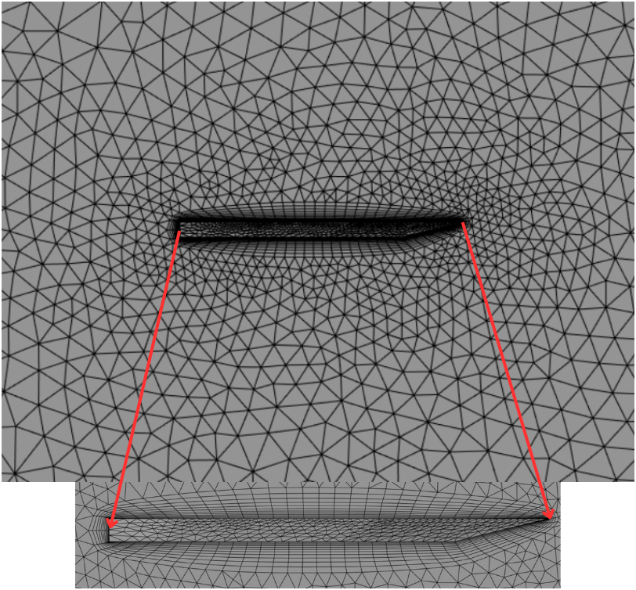

Mesh – Generation & Convergence
No. of Elements | $$C_{L}$$ | % Error
300,000 | 0.03435 | 4.10%
1,500,000 | 0.03430 | 3.94%
3,000,000 | 0.03411 | 3.36%
4,400,000 | 0.03414 | 3.47%
7,400,000 | 0.03424 | 3.76%
13,200,000 | 0.03416 | 3.53%
Notes:
For our computations, we adopted a patch independent unstructured meshing approach, which provides flexibility in handling the geometry of our compound delta wing—particularly in areas with sharp edges and changes in sweep.
To achieve optimal resolution, we employed several refinement techniques. Face sizing was applied to maintain high element density across the entire wing surface, while targeted edge sizing further enhanced resolution along the leading and trailing edges—key regions where vortices initiate and flow separation occurs. Most importantly, we implemented a carefully constructed inflation layer around the wing to properly resolve the boundary layer, which is absolutely critical for accurate prediction of viscous effects and flow separation behavior.
However, mesh quality alone isn't enough—we also needed to ensure our results were numerically reliable. To achieve this, we conducted a comprehensive mesh independence study, testing six different mesh resolutions ranging from very coarse to extremely fine. This systematic approach allowed us to identify the point where further mesh refinement no longer significantly impacted our results—indicating we had reached an acceptable level of numerical convergence. After careful evaluation, we selected a mesh with 3 million elements, as it provided an ideal balance between computational efficiency and solution accuracy.

Slide 13
Computational Model
Unsteady Reynolds-averaged Navier–Stokes (URANS) equations
Density-based solver
Compressible flow
Spalart–Allmaras (SA) turbulence model
Gradient evaluation: Least-squares cell-based scheme
Roe-FDS (Flux Difference Splitting)
Notes:
With our mesh finalized, we proceeded to set up the numerical simulation in ANSYS Fluent, a finite volume-based solver well-suited for complex aerodynamic problems. Given the inherently time-dependent nature of vortex flow over delta wings—especially at high angles of attack—we opted to solve the Unsteady Reynolds-Averaged Navier-Stokes (URANS) equations. This approach provides a balance between resolving large-scale unsteady vortex dynamics and maintaining reasonable computational demand.
Since our study focuses on the transonic regime, where compressibility effects are significant, we selected a density-based solver with the compressible flow formulation. To accurately model the air's thermodynamic properties, we defined density using the ideal gas law and viscosity via Sutherland’s law.
For turbulence modeling, we chose the Spalart-Allmaras or for short S-A model, is a single-equation approach known for its robustness and computational efficiency in high-angle-of-attack flows. While more advanced models like k-omega or the Reynolds Stress Model (RSM) offer higher fidelity, they require solving additional transport equations—two for k-omega and seven for RSM—making them significantly more expensive for our set-up. The S-A model provided a reliable compromise, delivering accurate results without excessive computational cost.
To ensure numerical accuracy, we employed a least-squares cell-based scheme for gradient computations, which improves the resolution of secondary flow effects like vortex diffusion. For flux evaluation—critical in capturing shocks and pressure discontinuities—we adopted the Roe-FDS (Flux Difference Splitting) method, a proven approach for transonic and supersonic flows due to its ability to handle sharp gradients while maintaining stability.
This carefully selected combination of solver settings allowed us to efficiently simulate the complex, unsteady flow physics while ensuring reliable results across our studies range of Mach numbers and angles of attack.

Slide 14
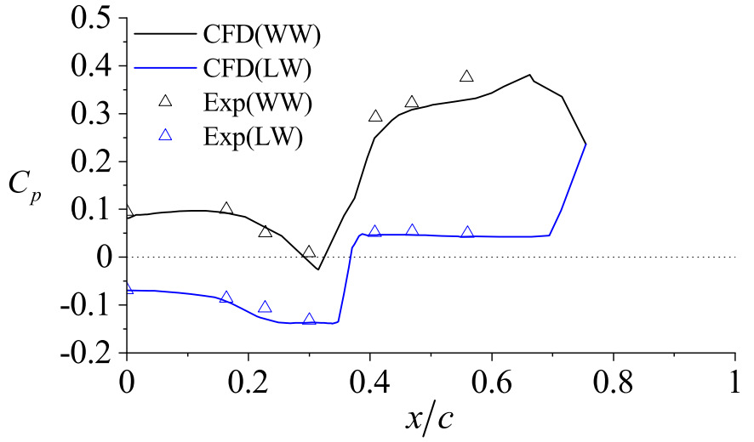
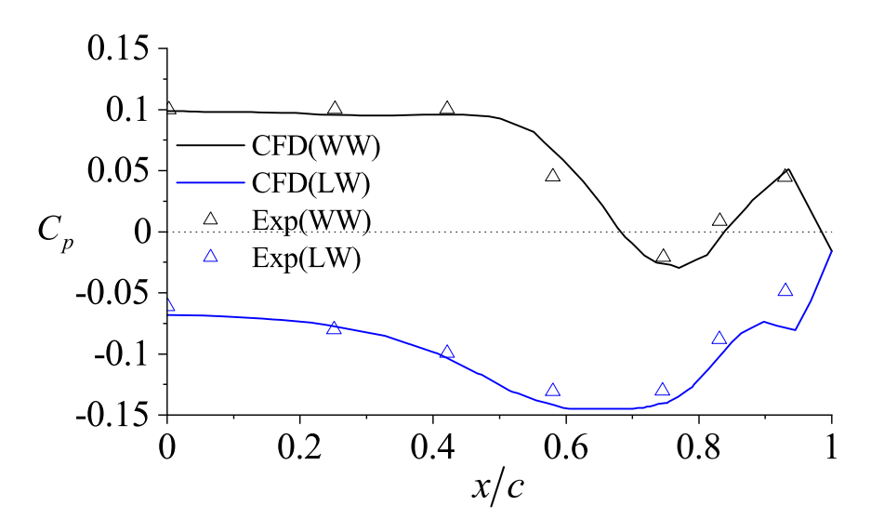
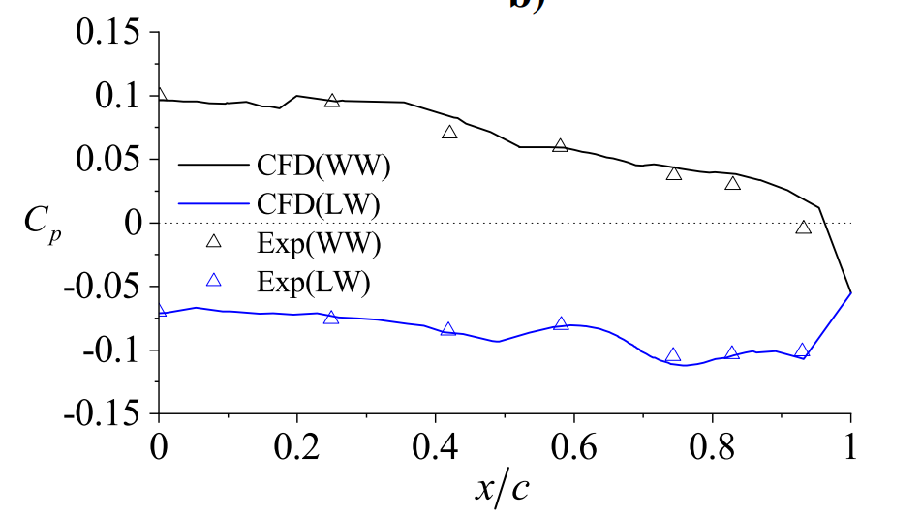

Validation Study
$$α$$ | $C_{L}$ CFD | $C_{L}$Experiments | % Error
1.3° | 0.03411 | 0.033 | 3.36%
6.3° | 0.16462 | 0.164 | 0.38%
Stallings Jr., R. L. and Lamb, M., “Wing-Alone Aerodynamic Characteristics for High Angles of Attack at Supersonic Speeds,” Technical Report NASA-TP-1889, NASA, 1981[12]
Notes:
Before applying our numerical model to the compound delta wing, it was critical to validate its accuracy against established experimental data. For this validation, we selected a study by Stallings Jr. and Lamb, which provides comprehensive wind tunnel measurements for various delta wing configurations at supersonic speeds. Specifically, we focused on their Model 5 due to its comparable aspect ratio to our test geometry - this close similarity in fundamental parameters made it an ideal benchmark for our validation process.
We replicated the experimental conditions in our simulation, matching the test parameters of Mach 2.16 and 6.3 degrees angle of attack. Our validation process proceeded in two key stages: First, we examined the coefficient of pressure distribution at three strategic chordwise locations. As these plots clearly demonstrate, our computational results show strong agreement with the experimental data across both the windward and leeward surfaces, particularly in capturing the pressure peaks and gradients that characterize the flow physics.
The second validation step involved comparing lift characteristics. We evaluated the coefficient of lift at two distinct angles of attack - 1.3 and 6.3 degrees. The results were promising, with an average deviation of 1.87% from the experimental values. This close correlation gives us high confidence in our numerical approach's ability to accurately predict both surface pressures and aerodynamic forces. With this foundation established, we can proceed to analyze our compound delta wing configuration with confidence in our results.

Slide 15
OUTLINE
COMPUTATIONAL APPROACH
RESULTS
CONCLUSIONS
MOTIVATION & BACKGROUND
OBJECTIVES
FUTURE WORK
Notes:
Know with our model complete we move on the ] results found in this study.

Slide 16
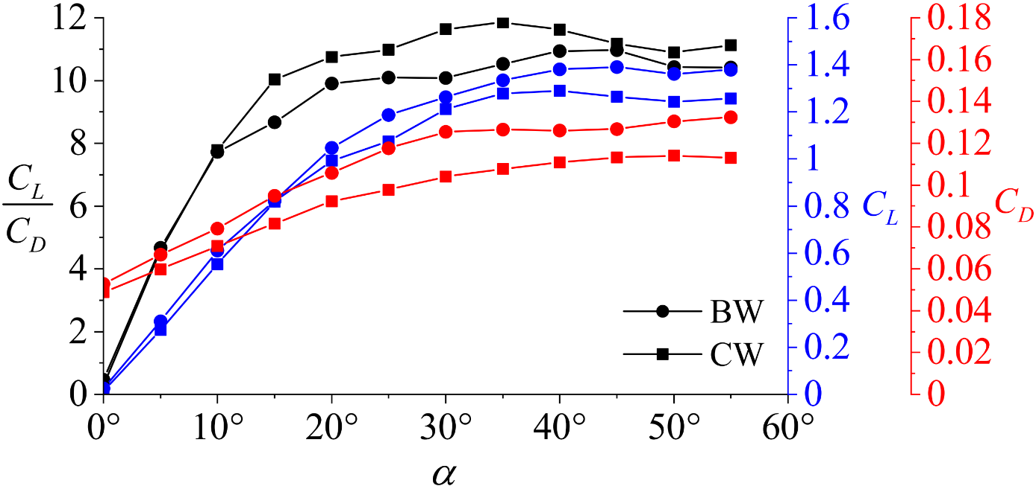
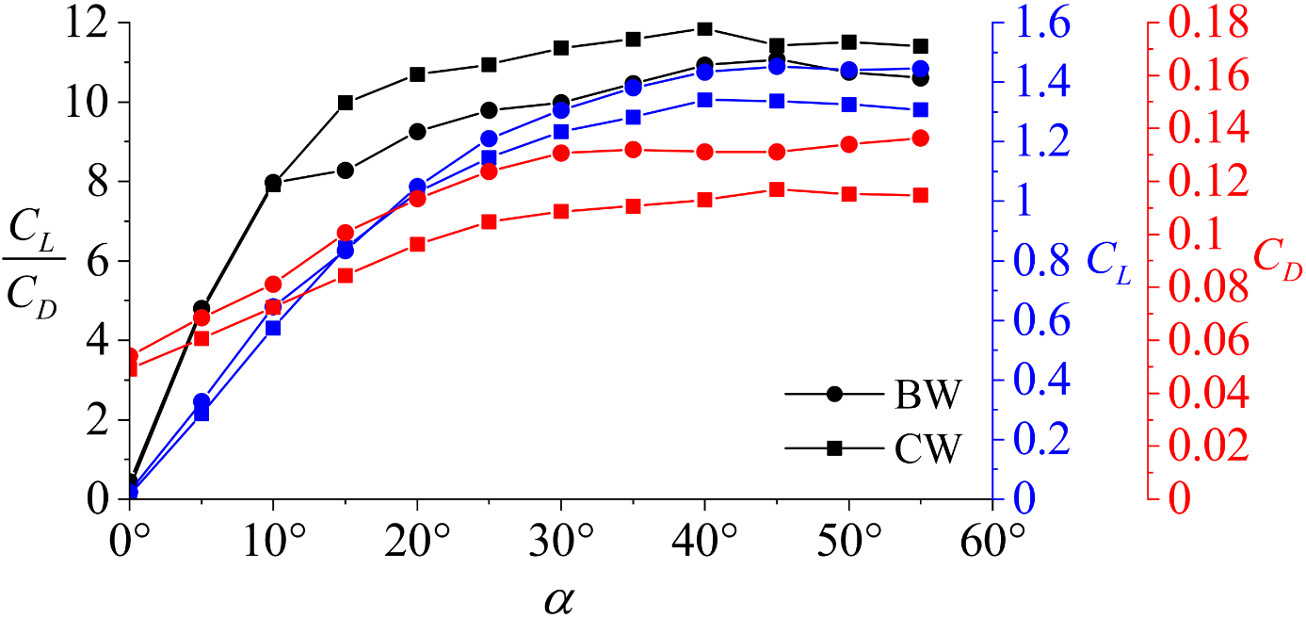

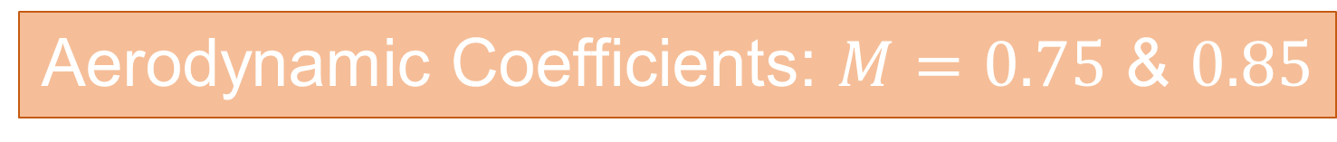
Aerodynamic Coefficients: $M=0.75$ & $0.85$
Mach Number$(M)$ | $C_{L}$ Change | $C_{D}$Change | $C_{L}$/$C_{D}$
0.75 | – 7.14% | – 13.31% | 7.24%
0.85 | – 6.79% | – 14.21% | 8.77%
Notes:
Our first comparison of the compound and base wing consisted of the Aerodynamic Coefficients. This first slide shows Mach numbers 0.75 and 0.85. The graphs show a consentient reduction of drag at all angles of attack. This reduction in drag is an average of 13.31% and 14.21% for Mach 0.75 and 0.85 respectively.
Regarding lift characteristics we see slight reductions at both speeds that become larger as angle of attack is increased. The baseline configuration achieves its peak lift coefficient at 45 degrees angle of attack, while the compound wing attains a maximum lift coefficient of at 40 degrees before dropping of at both Mach numbers. This indicates that the compound geometry experiences earlier vortex breakdown and weaker vortex induced suction than the baseline design.
Most significantly, the lift-to-drag ratio - our primary metric for aerodynamic efficiency - shows consistent improvements of 7.22% at Mach 0.75 and 8.77% at Mach 0.85. These results conclusively demonstrate that while the compound wing exhibits some compromise in maximum lift capability, it delivers superior overall aerodynamic efficiency in the low transonic regime.

Slide 17
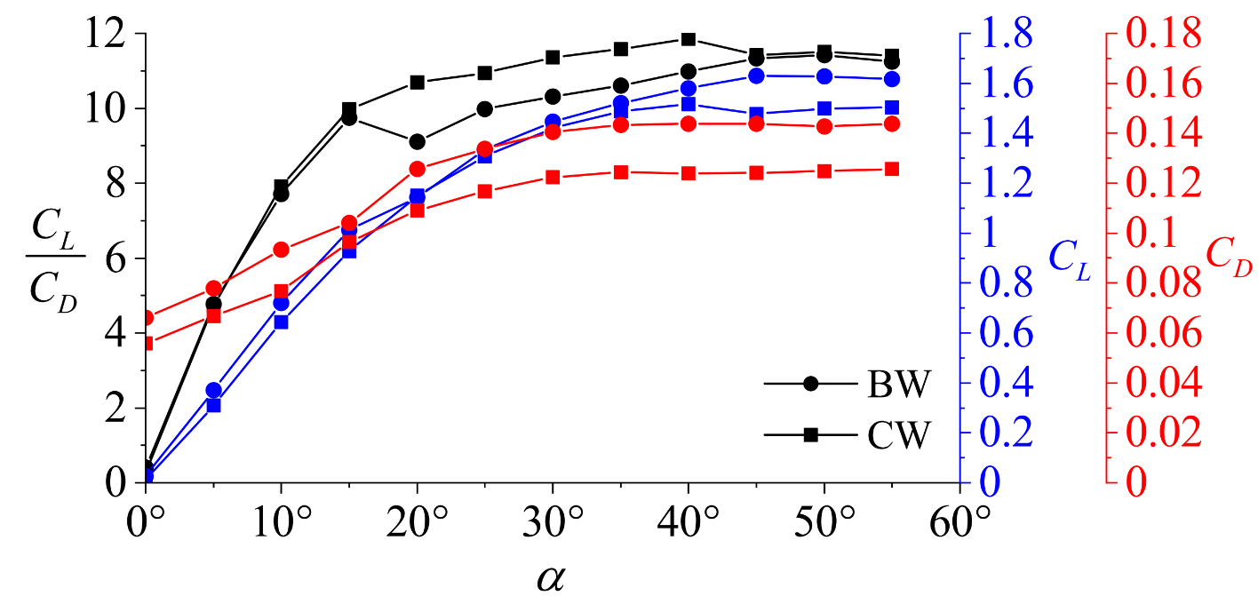
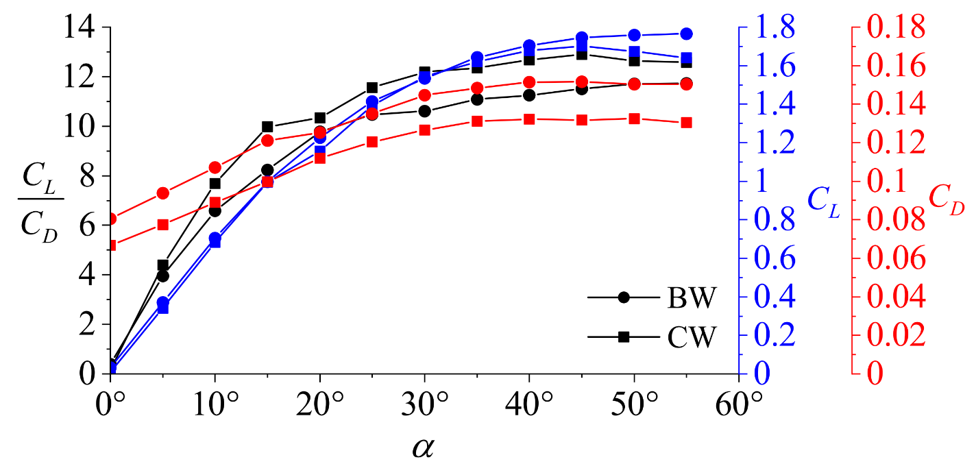

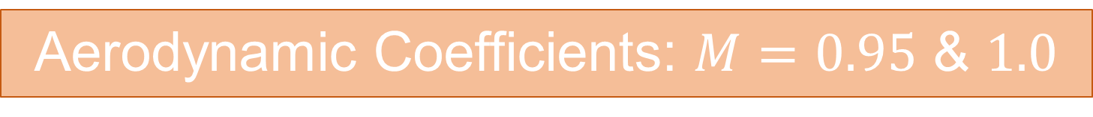
Aerodynamic Coefficients: $M=0.95$ & $1.0$
Mach Number$(M)$ | $C_{L}$ Change | $C_{D}$Change | $C_{L}$/$C_{D}$
0.95 | – 6.36% | – 13.07% | 7.76%
1.0 | – 3.23% | – 13.51% | 11.97%
Notes:
Proceeding to higher Mach numbers of 0.95 and 1.0, our analysis reveals several critical trends. The compound wing continues to exhibit reduced lift coefficients compared to the baseline, though the magnitude of this reduction decreases significantly as the flow approaches sonic conditions - from 6.36% at Mach 0.95 to just 3.23% at Mach 1.0. Notably, at Mach 1.0 and 45 degrees angle of attack, we observe a clear divergence in performance, indicating earlier vortex breakdown over the compound wing configuration.
The drag characteristics maintain their favorable trend, with the compound wing demonstrating consistent reductions across all angles of attack. This improvement is likely attributed to reduced wave drag resulting from weaker shock structures. Most significantly, the lift-to-drag ratio enhancement becomes particularly pronounced at sonic conditions, escalating to an 11.97% improvement at Mach 1.0. This substantial increase shows the compound wing’s enhancements in efficiency over the base wing as the flow transitions to sonic velocities.

Slide 18
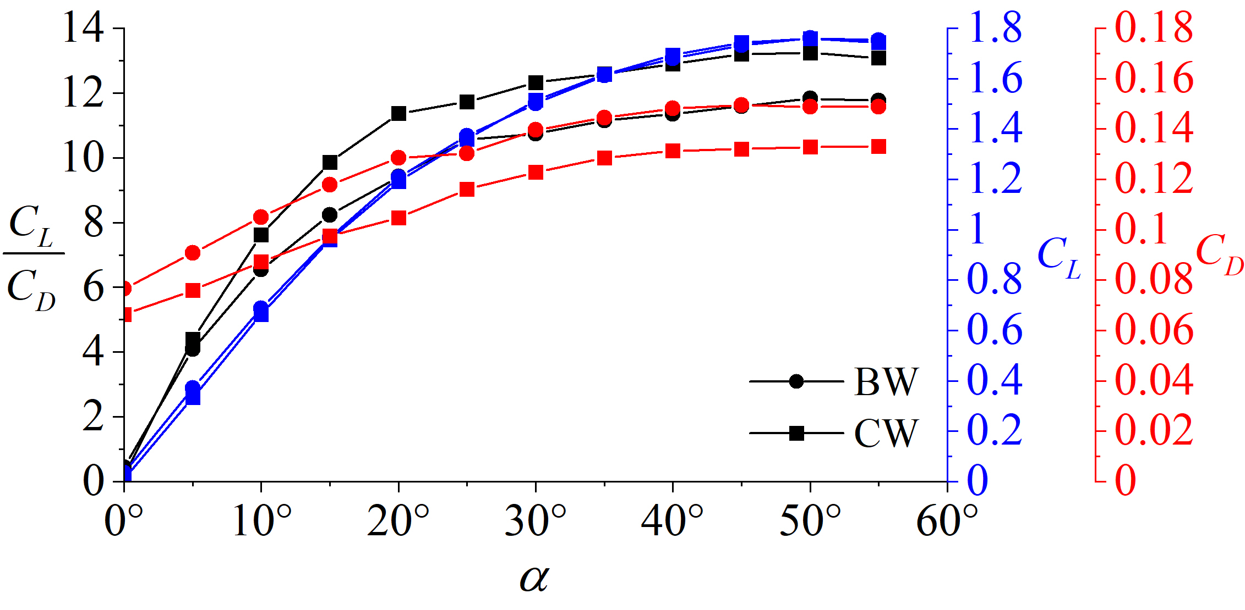
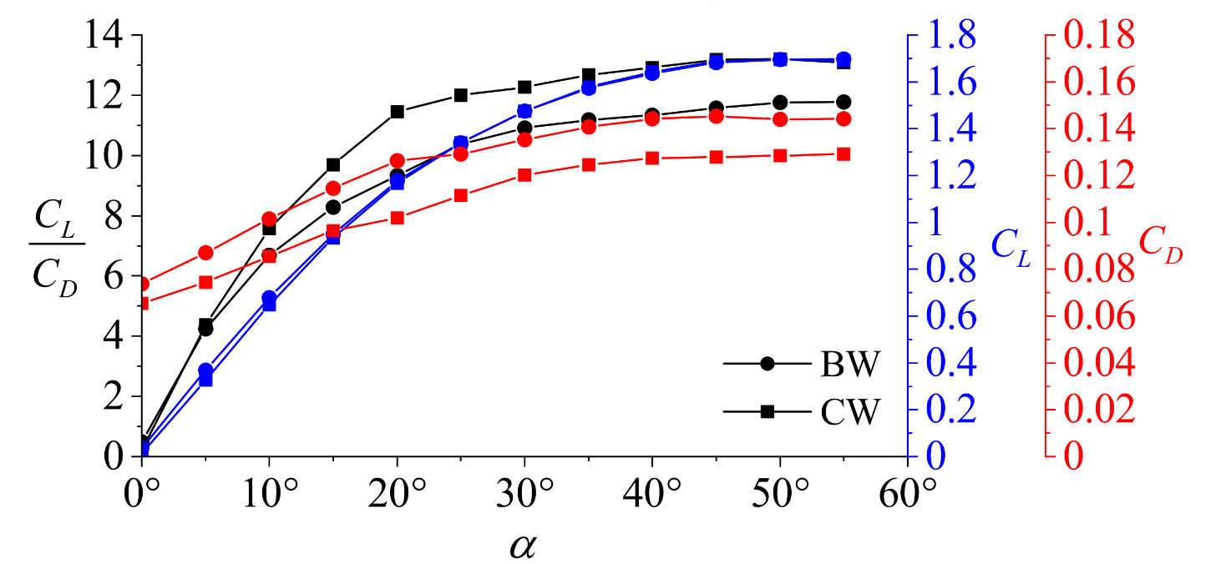

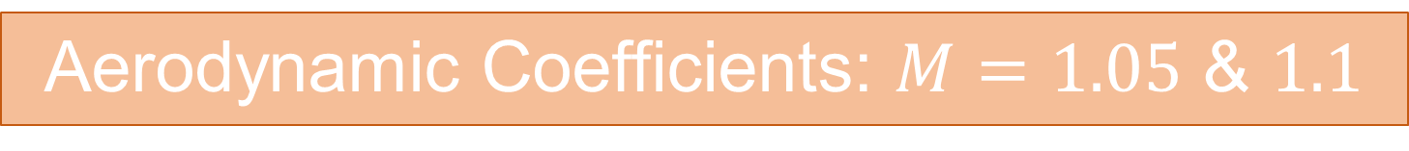
Aerodynamic Coefficients: $M=1.05$ & $1.1$
Mach Number$(M)$ | $C_{L}$ Change | $C_{D}$Change | $C_{L}$/$C_{D}$
1.05 | – 1.37% | – 13.39% | 13.95%
1.1 | – 1.61% | – 13.31% | 13.57%
Notes:
Proceeding to the upper transonic regime at Mach 1.05 and 1.1, several critical observations emerge from our analysis. The compound wing demonstrates a reduced lift coefficient variance compared to lower Mach numbers. Notably, the absence of performance divergence at elevated angles of attack suggests the vortex system maintains strength, avoiding complete breakdown phenomena observed in the lower mach numbers.
The drag reduction trends remain consistent with our previous findings, showing comparable improvements to those measured at lower Mach numbers. Most significantly, the lift-to-drag ratio enhancement reaches its maximum values in this regime - achieving 13.95% improvement at Mach 1.05 and 13.57% at Mach 1.1. These results conclusively demonstrate that the compound delta wing's aerodynamic efficiency benefits are most pronounced in the upper transonic speed range.

Slide 19
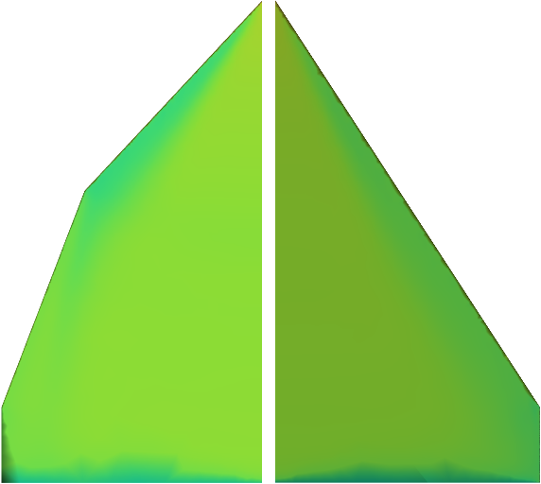
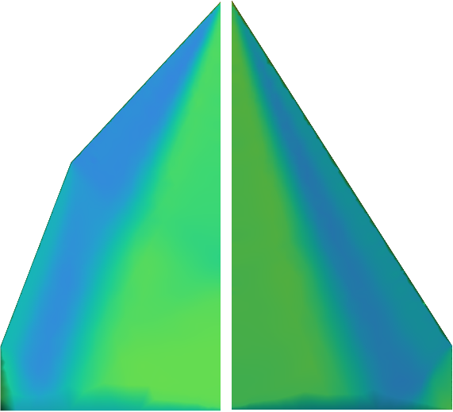
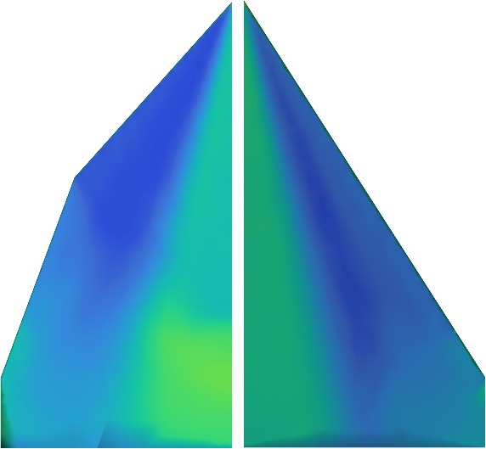
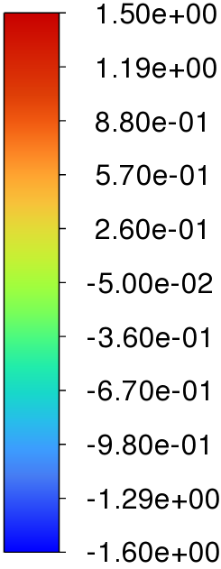
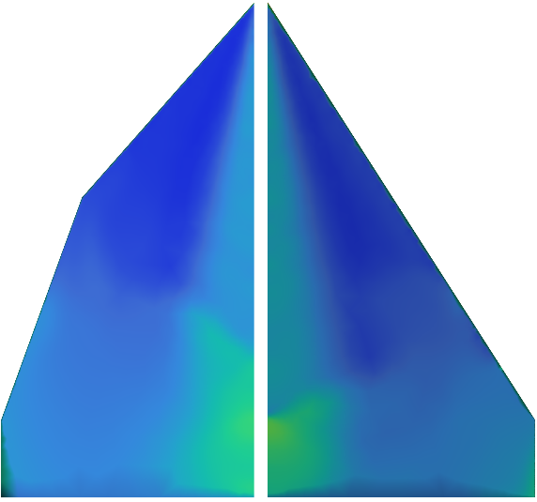
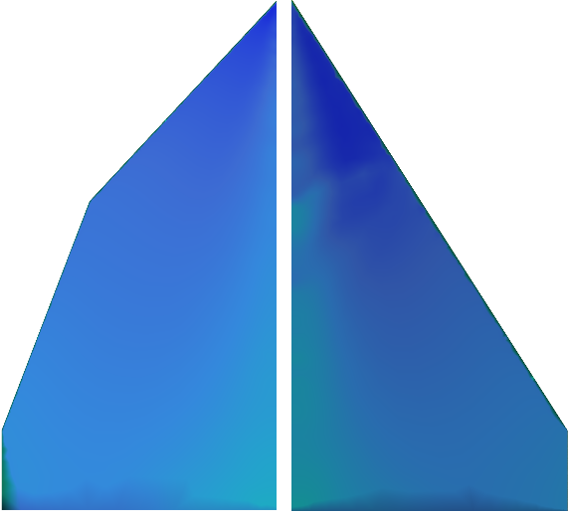
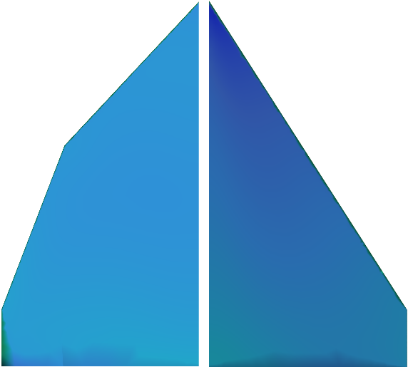
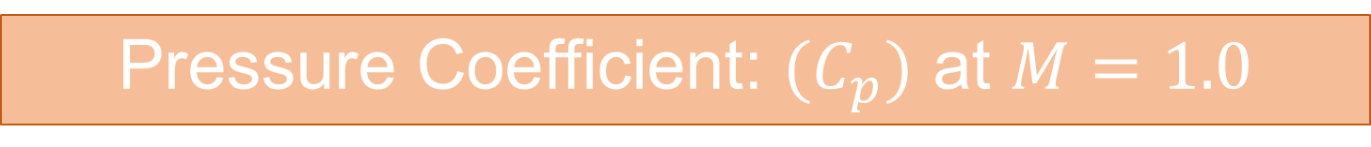
Pressure Coefficient: $(C_{p})$ at $M=1.0$
Notes:
We then compared the pressure coefficient over the surface of the wings at Mach 1.0. At 0 degrees both wings exhibit minimal vortex formation, with largely uniform pressure distribution. However, the compound wing produces a smaller low-pressure region near the initial leading-edge sweep, whereas the base wing generates a larger region across the entire leading edge. At 10 degrees a large low-pressure region forms of the initial leading edge of the compound wing indicating vortex formation. Crossflow shock waves begin to emerge over the compound wing starting at the leading-edge kink, propagating downstream.
At 20 degrees the leading-edge vortices continue to increase in intensity, but incipient flow separation is observed on the compound wing at approximately 70% chord, whereas the base wing maintains attached flow. This premature separation is likely responsible for the compound wing’s lower maximum coefficient of lift. At 30 degrees we see breakdown occurring over both wings at around 50% and 70% of the chord for the compound and base wing respectively. Then at 40 and 50 degrees complete flow separation is observed at higher angles.

Slide 20
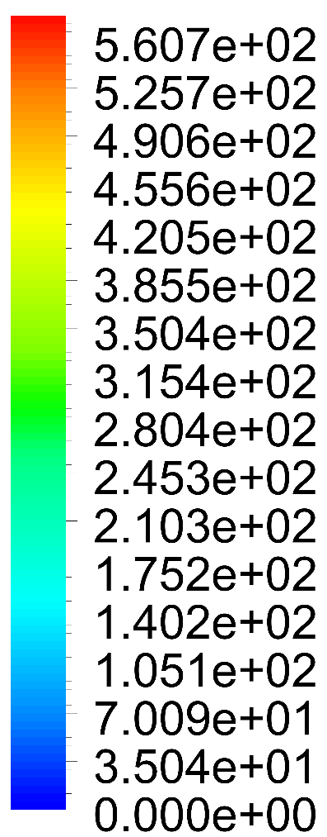
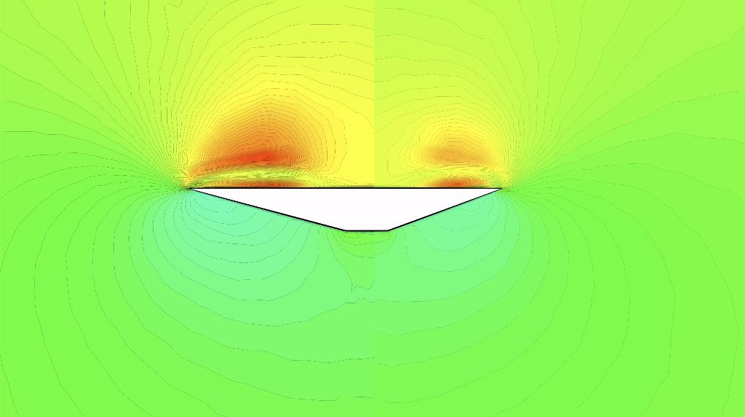
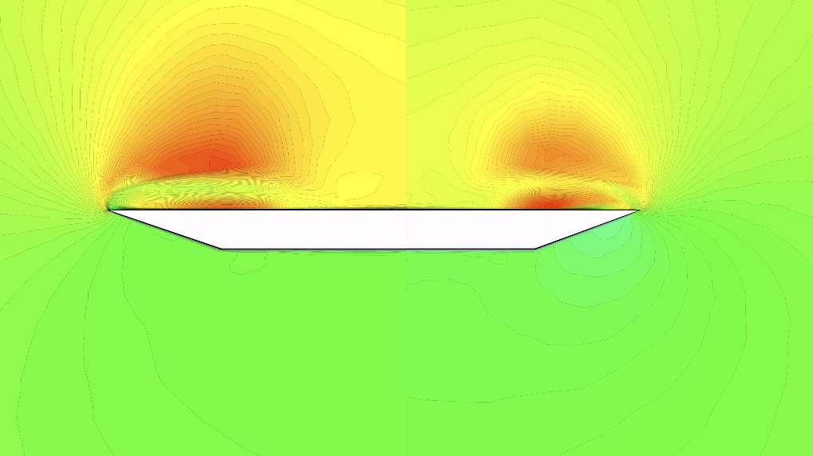
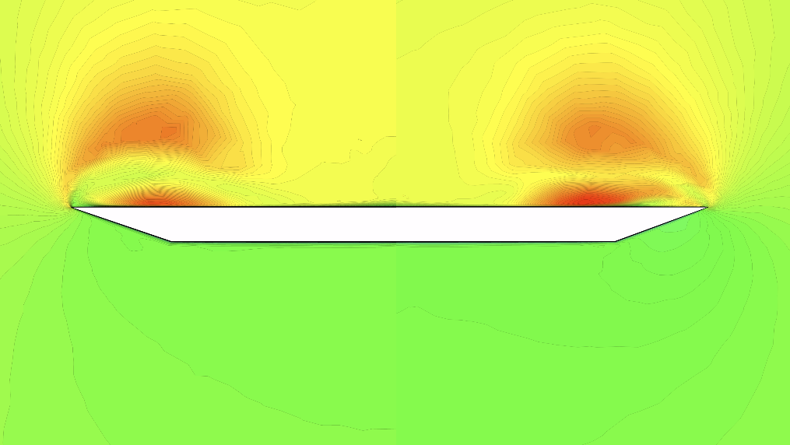
Velocity Contours on Crossflow Planes
At M = 1.0 and α = 15°
[m/s]
Notes:
We then compared Velocity contours on Crossflow planes in order to better understand vortex development over the two wings. At 25 percent of the chord The compound wing shown on the left exhibits a more intense vortex compared to the base wing, resulting in a more forward-shifted low-pressure region as was shown in the Pressure Coefficient contours.
At 50% of the chord, the compound wing continues to exhibit a stronger primary vortex, while the base wing develops a more distinct secondary vortex beneath the primary vortex. This difference highlights a key deviation from conventional delta wing flow behavior, where the compound wing largely suppresses the secondary vortex formation.
At 75% of the chord, the vortex structure over the compound wing begins to weaken, indicating premature vortex breakdown. This breakdown is observed as a loss of vortex coherence and a reduction in velocity magnitude within the vortex core. In contrast, the base wing retains a well-defined vortex system, with both primary and secondary vortices strengthening downstream.

Slide 21
OUTLINE
COMPUTATIONAL APPROACH
RESULTS
CONCLUSIONS
MOTIVATION & BACKGROUND
OBJECTIVES
FUTURE WORK
Notes:
This is the outline of my presentation. I am going to go over the introduction, then cover the objectives. After that I will go through the computational methodology, discuss some of the results, talk about the parametric studies and finish with conclusions and future work. Let’s start with the introduction.

Slide 22
Conclusions
The compound delta wing shows a 10.54% improvement in aerodynamic efficiency in the transonic regime, driven by reduced drag and a moderate decrease in lift compared to the baseline wing
Efficiency gains are more pronounced at higher angles of attack (α >15°)
Results indicate a forward-shifted primary vortex and weakened secondary vortex, contributing to earlier vortex breakdown
Shock waves from the leading-edge kink interact with the primary vortex, significantly influencing vortex behavior
Notes:
Based on the study we concluded, The compound delta wing demonstrates an increase in aerodynamic efficiency over the base wing. Most notably, a 10.54% increase in lift to drag ratio across all Mach number in the study highlighting the potential of a multiple sweep configuration on transonic aircraft. This study also further characterized the flow in the transonic regime over the compound delta wing indicating a forward shift of the primary vortex as well as a reduced secondary vortex. Shock-vortex interactions were also observed over the compound delta wing influencing vortex formation. All this data on the compound delta wing will be helpful In future studies on how to improve its aerodynamic characteristics.

Slide 23
OUTLINE
COMPUTATIONAL APPROACH
RESULTS
CONCLUSIONS
MOTIVATION & BACKGROUND
OBJECTIVES
FUTURE WORK
Notes:
This is the outline of my presentation. I am going to go over the introduction, then cover the objectives. After that I will go through the computational methodology, discuss some of the results, talk about the parametric studies and finish with conclusions and future work. Let’s start with the introduction.

Slide 24
Future Work
Implement Detached Eddy Simulation (DES) and Large Eddy Simulation (LES) to study the post-stall flow behavior of the compound delta wing
Further analyze the impact of additional leading-edge sweep on shock formation over the wing
Extend the investigation to a broader range of flow regimes, including subsonic and supersonic conditions
Analyze the effects of varying leading-edge sweep angles on aerodynamic performance and vortex behavior
Explore active and passive flow control strategies—such as periodic blowing—to delay vortex breakdown and enhance flow stability
Notes:
Some future work planed for this topic is to employ large eddy simulations in order to study the post stall regime in more depth something RANS models are incapable of. Additionally further investigate the impacts of the multi swept configuration on shock formations. Also to expand the current study into the subsonic and supersonic regime to characterize the delta wing through more flow regimes.

Slide 25
References
[1] Lee, S., “A Cross Flow Vortex Model of Delta Wings,” AIAA AVIATION 2023 Forum, AIAA Paper 2023-3751, June 2023. doi:10.2514/6.2023-3751.
[2] Ericsson, L., “Delta Wing Vortex Breakdown Dynamics,” 33rd Aerospace Sciences Meeting and Exhibit, AIAA Paper 1995-367, January 1995. doi:10.2514/6.1995-367.
[3] Bannink, W., Houtman, E., and Ottochian, S., “Investigation of the Vortex Flow Over a Sharp-edged Delta Wing in the Transonic Speed Regime,” Technical Report, Delft University of Technology, 1989.
[4] Stanbrook, A. and Squire, L. C., “Possible Types of Flow at Swept Leading Edges,” Aeronautical Quarterly, Vol. 15, No. 1, February 1964, pp. 72–82. doi:10.1017/s0001925900003024.
[5] Verhaagen, N., Jenkins, L., Kern, S., and Washburn, A., “A Study of the Vortex Flow Over a 76/40-deg Double-Delta Wing,” 33rd Aerospace Sciences Meeting and Exhibit, AIAA Paper 1995-650, January 1995. doi:10.2514/6.1995-650.
[6] Ruetten, M. and Zastrow, J., “Vortex Interaction, Vorticity Flux and Torsion Over a Generic Double-Delta Wing Configuration,” AIAA AVIATION 2022 Forum, AIAA Paper 2022-3994, June 2022. doi:10.2514/6.2022-3994.
[7] Werner, M., Schütte, A., and Weiss, S., “Turbulence Model Effects on Vortex Interaction Prediction on a Multiswept Delta Wing,” Journal of Aircraft, Vol. 61, No. 1, January 2024, pp. 211–221. doi:10.2514/1.c037421.
[8] Naimuddin, M., Chopra, G., and Sharma, G., “Experimental & Computational Study on Compound Delta Wing,” Journal of Basic and Applied Engineering Research, Vol. 1, No. 3, October 2014, pp. 47–52.
[9] Sharma, G., Naimuddin, M., Chopra, G., Sinha, J., and Sharma, G., “Numerical Analysis of Flow Field Over Compound Delta Wing at Subsonic and Supersonic Speeds,” 2016 IEEE Aerospace Conference, Vol. 1, Big Sky, Montana, March 2016, pp. 1–20. doi:10.1109/aero.2016.7500662.
[10] Spalart, P. and Allmaras, S., “A One-Equation Turbulence Model for Aerodynamic Flows,” 30th Aerospace Sciences Meeting and Exhibit, AIAA Paper 1992-439, January 1992. doi:10.2514/6.1992-439.
[11] Sutherland, W., “LII. The Viscosity of Gases and Molecular Force,” The London, Edinburgh, and Dublin Philosophical Magazine and Journal of Science, Vol. 36, No. 223, December 1893, pp. 507–531. doi:10.1080/14786449308620508.
[12] Stallings Jr., R. L. and Lamb, M., “Wing-Alone Aerodynamic Characteristics for High Angles of Attack at Supersonic Speeds,” Technical Report NASA-TP-1889, NASA, 1981.

Slide 26
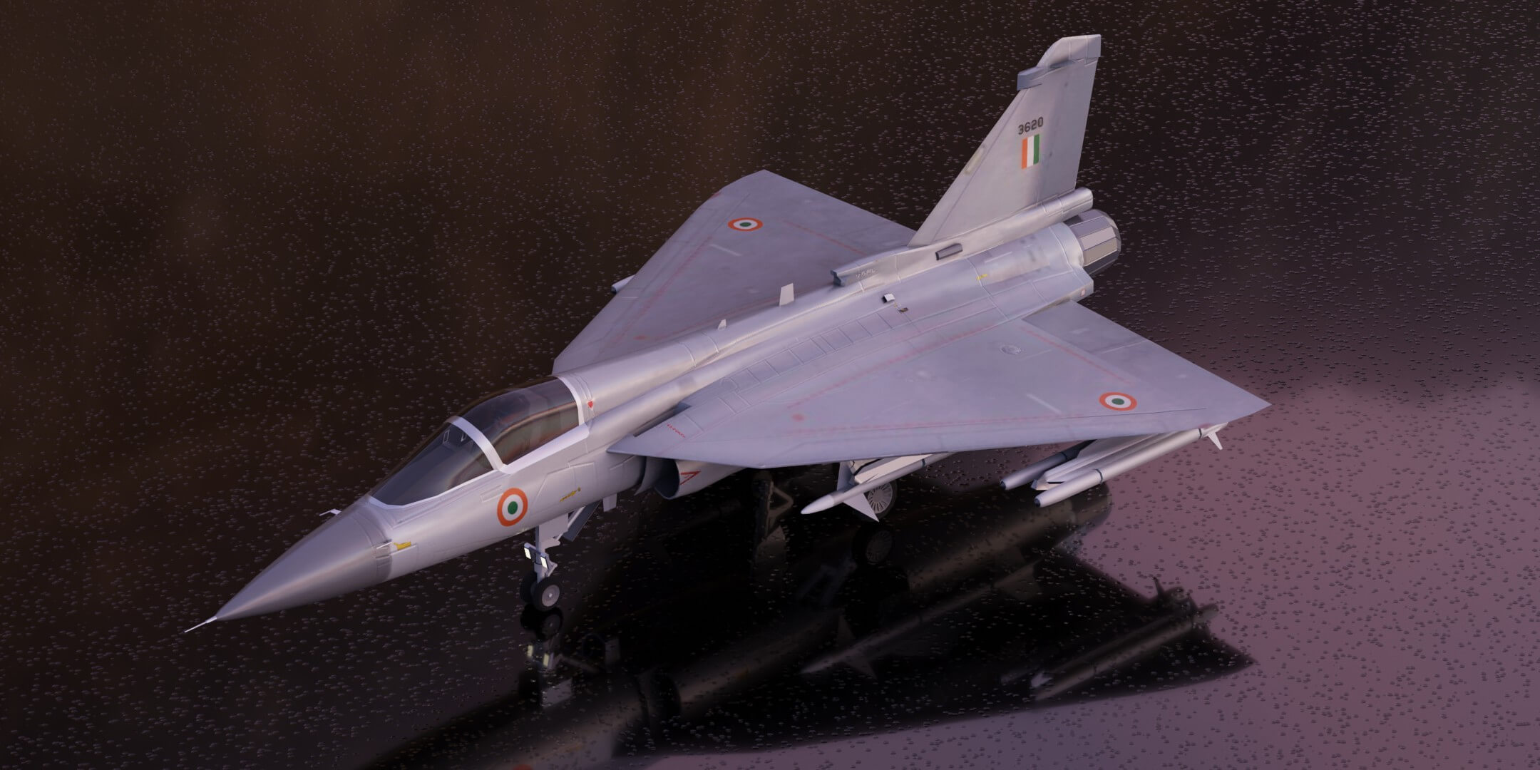
Being able to understand the language of the universe is a vital tool in decrypting the world of Physics!
Email: amarion8@students.kennesaw.edu
Questions?

