Slide 1




Planetary Locomotion Systems for Enhanced Mobility:
Through Hybrid and Adaptive Methods
Haitish Gandhi & Dr. Cagri Kilic
Embry-Riddle Aeronautical University, Daytona Beach, FL
2025 Student Conference Region II, April 2 – April 4
Date: 3/19/2025
Copyright © by Haitish Gandhi
Published by the American Institute of Aeronautics and Astronautics, Inc., with permission.

Slide 2

Gandhi - Research Paper

Slide 3

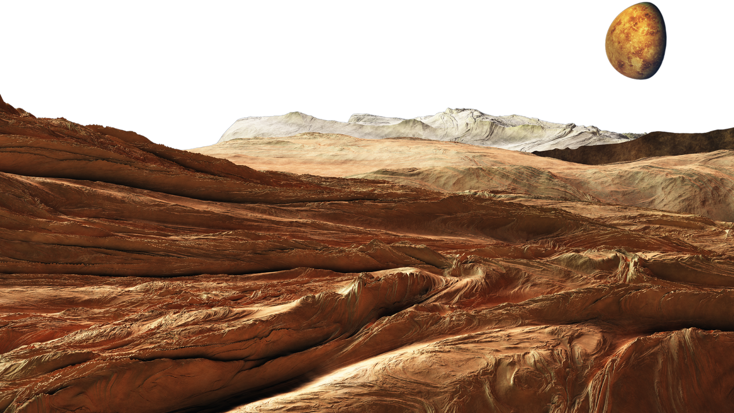
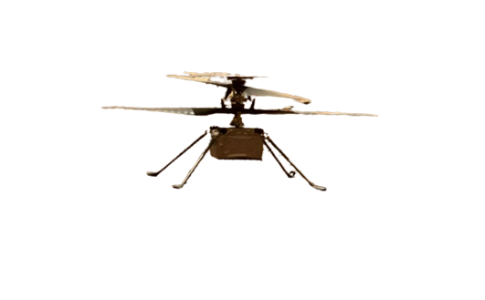
Problem Statement
Challenges in Planetary Exploration:
  Planetary surfaces like Mars are unpredictable, featuring steep cliffs, loose soil, and uneven terrain that impede traditional space robotic systems.
Limitations of Existing Systems:
  Rovers: Effective on smooth terrains but struggle with rough, unstable environments.
  Legged Robots: Offer adaptability and stability but are slow and consume high amounts of energy.
  Aerial Drones: Provide rapid movement but have limited battery life and struggle in thin atmospheres like Mars.
***Need for a Hybrid Approach: No single system can navigate all terrain types efficiently, limiting the potential of scientific exploration.

Slide 4

Research Focus
Categorizing Existing Locomotion Methods
  Classifying wheeled, legged, undulating, and tethered systems.
  Analyzing their advantages, drawbacks, and applications.
Current Limitations of Single-Mode Locomotion
  Wheeled rovers – Struggle with sand, soft soil, and rocky terrain.
  Legged robots – Mechanically complex, high power requirements.
  Tethered & undulating systems – Limited deployment flexibility.
  Aerial Helicopters – Limited flight time, atmospheres.
Identifying Promising Hybrid Systems
  Combining multiple locomotion strategies for improved adaptability.
  Exploring wheel-leg hybrids, shape-changing designs, and novel mechanisms.

Slide 5
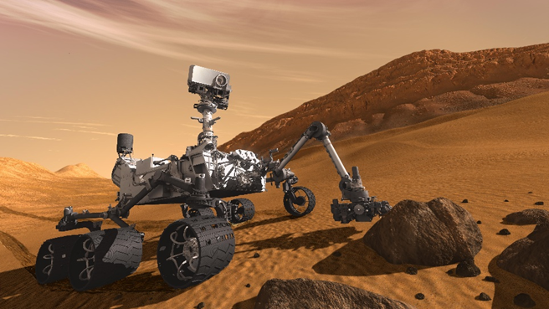
Wheeled Locomotion
Why Wheels?
  Simple mechanics with minimal energy consumption.
  Reliable on smooth and semi-rough terrains.
Challenges
  Poor traction in loose soil and on steep inclines.
  Regolith issues: Electrostatic dust on the Moon sticks to moving parts, causing damage.
Example: NASA’s Perseverance Rover
  Equipped with rocker-bogie suspension for rough terrain.
  Visual based thinking through machine learning, making driving through uncharted terrains easier.
Perseverance Rover [15]

Slide 6
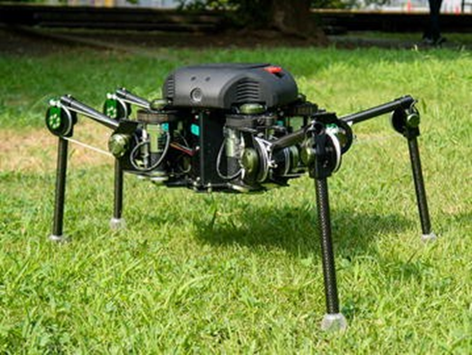
Legged Locomotion
Why Legs?
  Inspired by animals, allowing traversal over rocky or unstable terrain.
  Adaptable movement strategies for diverse surfaces.
Challenges
  High power consumption compared to wheels.
  Complex joint coordination, balancing requirements, and onboard computing module.
Example: TITAN Quadruped Robot
  Under development for planetary exploration prototypes.
  Can dynamically adjust its legs for different surfaces.
TITAN-XIII: sprawling-type quadruped robot [2]

Slide 7
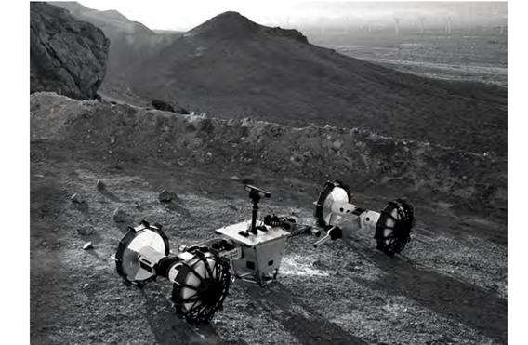
Tethered Locomotion
Why Use Tethers?
  Essential for steep slopes and crater descents.
  Provides continuous power and data transfer.
Challenges
  Limited by tether length, and strength.
  Risk of entanglement in rugged environments.
Example: Axel Rover
  Designed for lunar and Martian crater exploration.
  Uses a retractable tether system to descend into hard-to-reach areas.
Axel Rover [5]

Slide 8
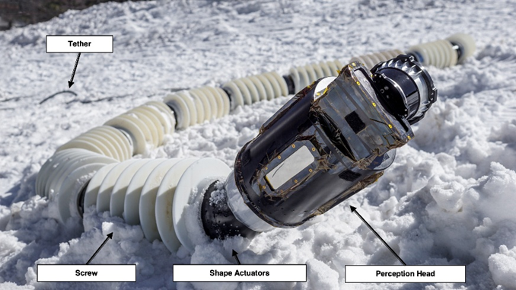
Undulating Locomotion
Why Snake-like Movement?
  Can maneuver through tight spaces and tunnels.
  Flexible body structure adapts to various obstacles.
Challenges
  Limited payload capacity.
  Independent battery source.
  Requires high-precision control for movement.
Example: EELS Robot
  Under development for planetary surfaces in Europa.
  Can swim under ice or crawl through narrow tunnels, equipped with screw like movement.
Early Prototype of EELS Robot [16]

Slide 9
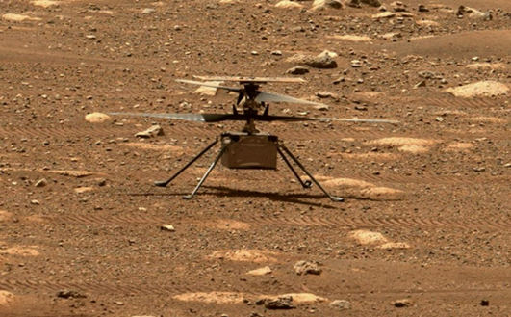
Airborne Locomotion
Why Fly?
  Overcomes terrain obstacles effortlessly.
  Can scout areas inaccessible to ground robots.
  Surface mapping.
Challenges
  Requires significant energy for lift-off, maneuvering.
  Limited by atmospheric planets and atmosphere density.
Example: Ingenuity Helicopter
  First aerial vehicle deployed on Mars (90 seconds/flight).
  Uses lightweight materials and advanced rotor systems.
  Higher RPM (2400-2700) x10 faster than needed on Earth.
Ingenuity Helicopter [11]

Slide 10
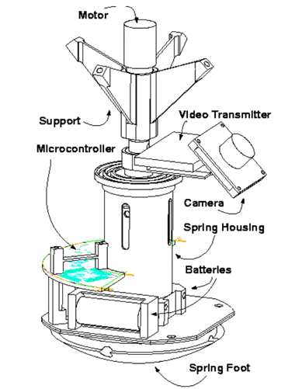
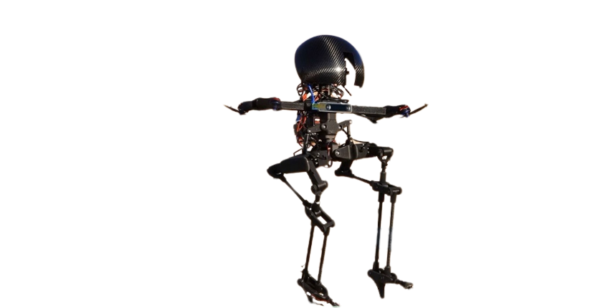
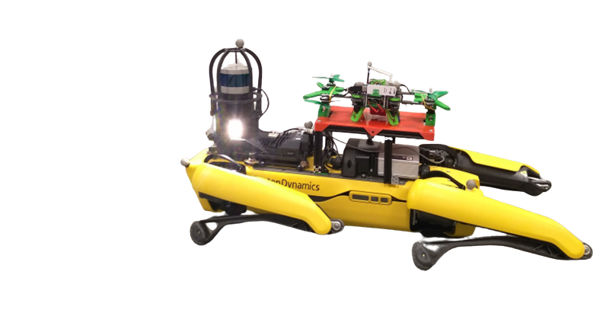
Hybrid Locomotion
Combining Strengths
  Multi-modal systems improve adaptability.
  Transitions between locomotion modes reduce energy consumption based on what is needed.
Examples
  LEONARDO (Caltech): Walking + flying.
  Spot + Drone Synergy: Drones accompanying quadrupeds for a dual mission.
  Hopping mechanism - integration of hopping and rolling models.
Implications for Space Exploration
  Greater mission flexibility.
  Improved reach and exploration efficiency.
Hopping Mechanism [20]
LEONARDO [21]
Boston Dynamics Spot + Drone [4]

Slide 11
Overview of Locomotion Methods
Locomotion Type | Example Applications | Best Environments
Wheeled | Mars Rovers (Curiosity, Perseverance) | Flat, stable terrain
Legged | Quadrupeds (Titan, Spot) | Rocky, uneven surfaces
Tethered | Axel Rover | Steep slopes, deep craters
Undulating | EELS Robot | Lava tubes, tight spaces
Airborne | Ingenuity Helicopter | Rugged terrain, aerial recon
Hybrid | LEONARDO (walking & flying) | Mixed terrain

Slide 12
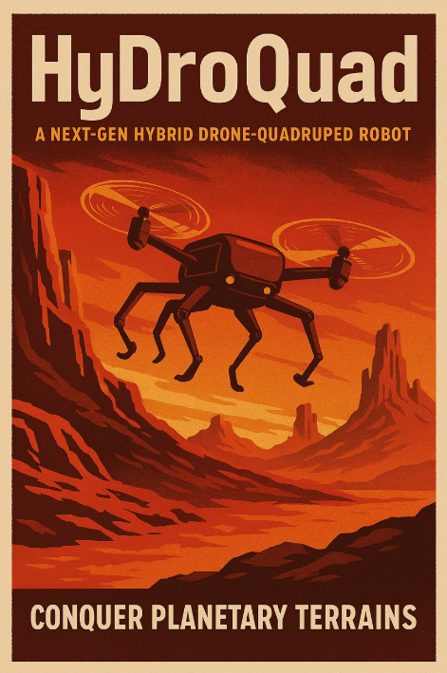
Case Study - HyDroQuad
Research at Embry-Riddle
  Investigating quadrupedal + aerial mobility.
  Enhancing control systems for smooth transitions between walking and flying.
  Systems integration and control.
Key Features
  Lightweight carbon fiber frame.
  Teleoperated switch control (initially) >> AI integration.
Potential Applications
  Future Mars and atmospheric planet missions.
  Earth related disaster response robotics.

Slide 13


What the Future Holds
Advancements in Hybrid Locomotion
  Improved multi-modal transitions.
  AI-driven adaptive mobility strategies.
Integration of Bio-Inspired Gaits
  Mimicking four legged animals, spiders, birds, and many other types of movement for better efficiency.
Machine Learning and Reinforcement Learning
  Enhancing real-time decision-making in planetary robots.
Expanding Beyond Mars
  Adapting these technologies for Europa, Enceladus, Titan, and asteroid missions.

Slide 14


Questions?
Email: Haitish.Astro@gmail.com

