Slide 1
Schlieren Imaging of a Hypersonic Wave Rider Model in a Hypersonic Arcjet Tunnel
Carson Waddell and Damiano Baccarella
AIAA Student Conference Region II - April 3rd, 2025 - Greensboro (NC)

Slide 2
Introduction
Hypersonic airbreathing propulsion systems are costly and time intensive to design and manufacture to scale.
High speed wind tunnels are vital to ramjet and scramjet development due to their accuracy in simulating high speed and high temperature environments.
To gain a better understanding of supersonic phenomenon that occur on these engines and their vehicles, flow visualization techniques such as schlieren imaging must be implemented.
Properly recording and analyzing images from high speed testing is difficult due to the dynamic environment produced in these wind tunnels.
Objectives:
  Identify shock formations on the vehicle.
  Calculate Upstream Mach number from oblique shocks formed.

Slide 3
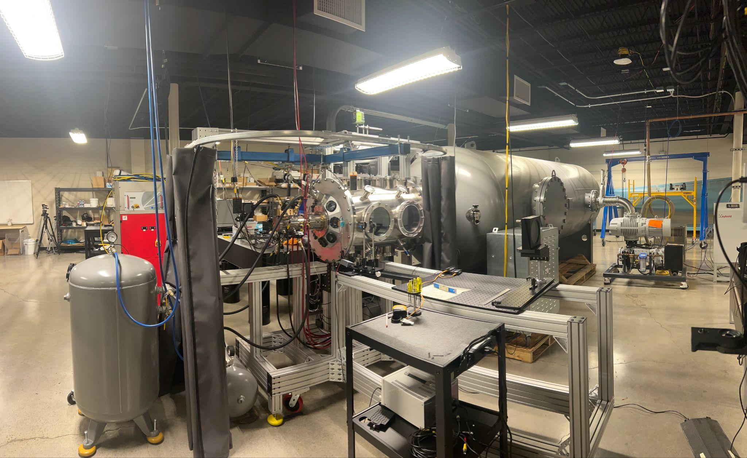
Facility Overview
Testing Conditions:
  Conical nozzle design
    85 mm exit diameter
  Mach 6 flow
  Nitrogen (N₂) working gas
    21.9 g/s flow rate
  Arc-off configuration

Slide 4
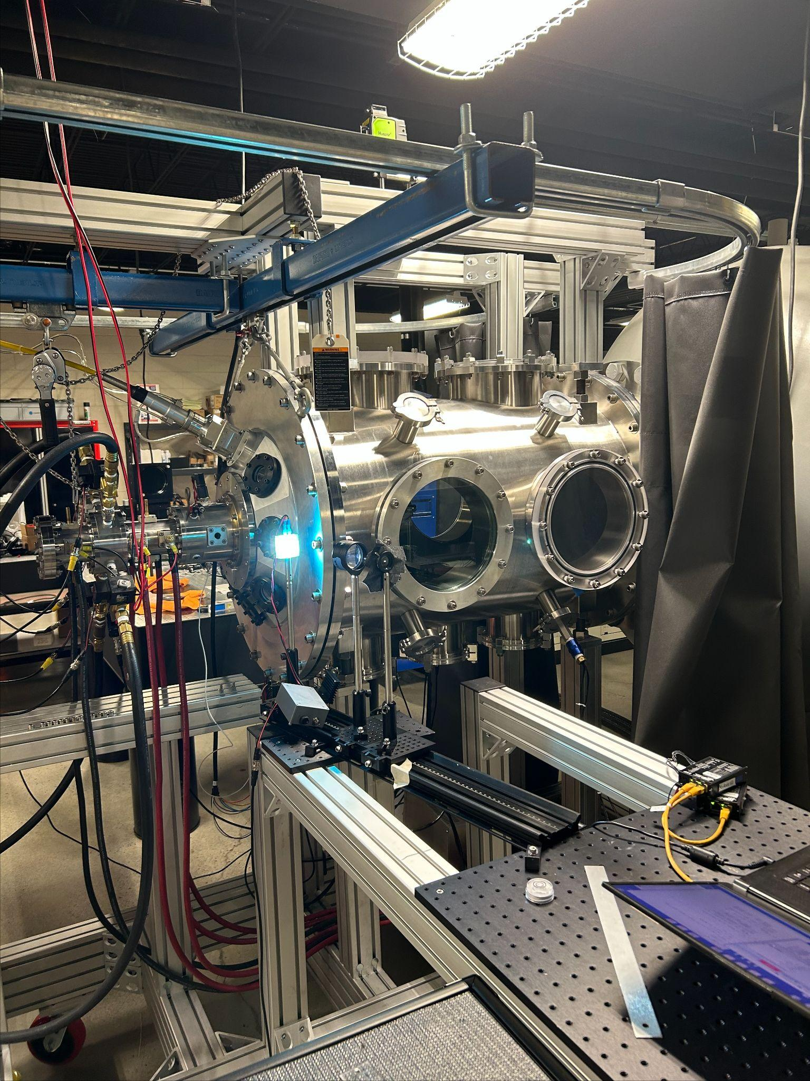
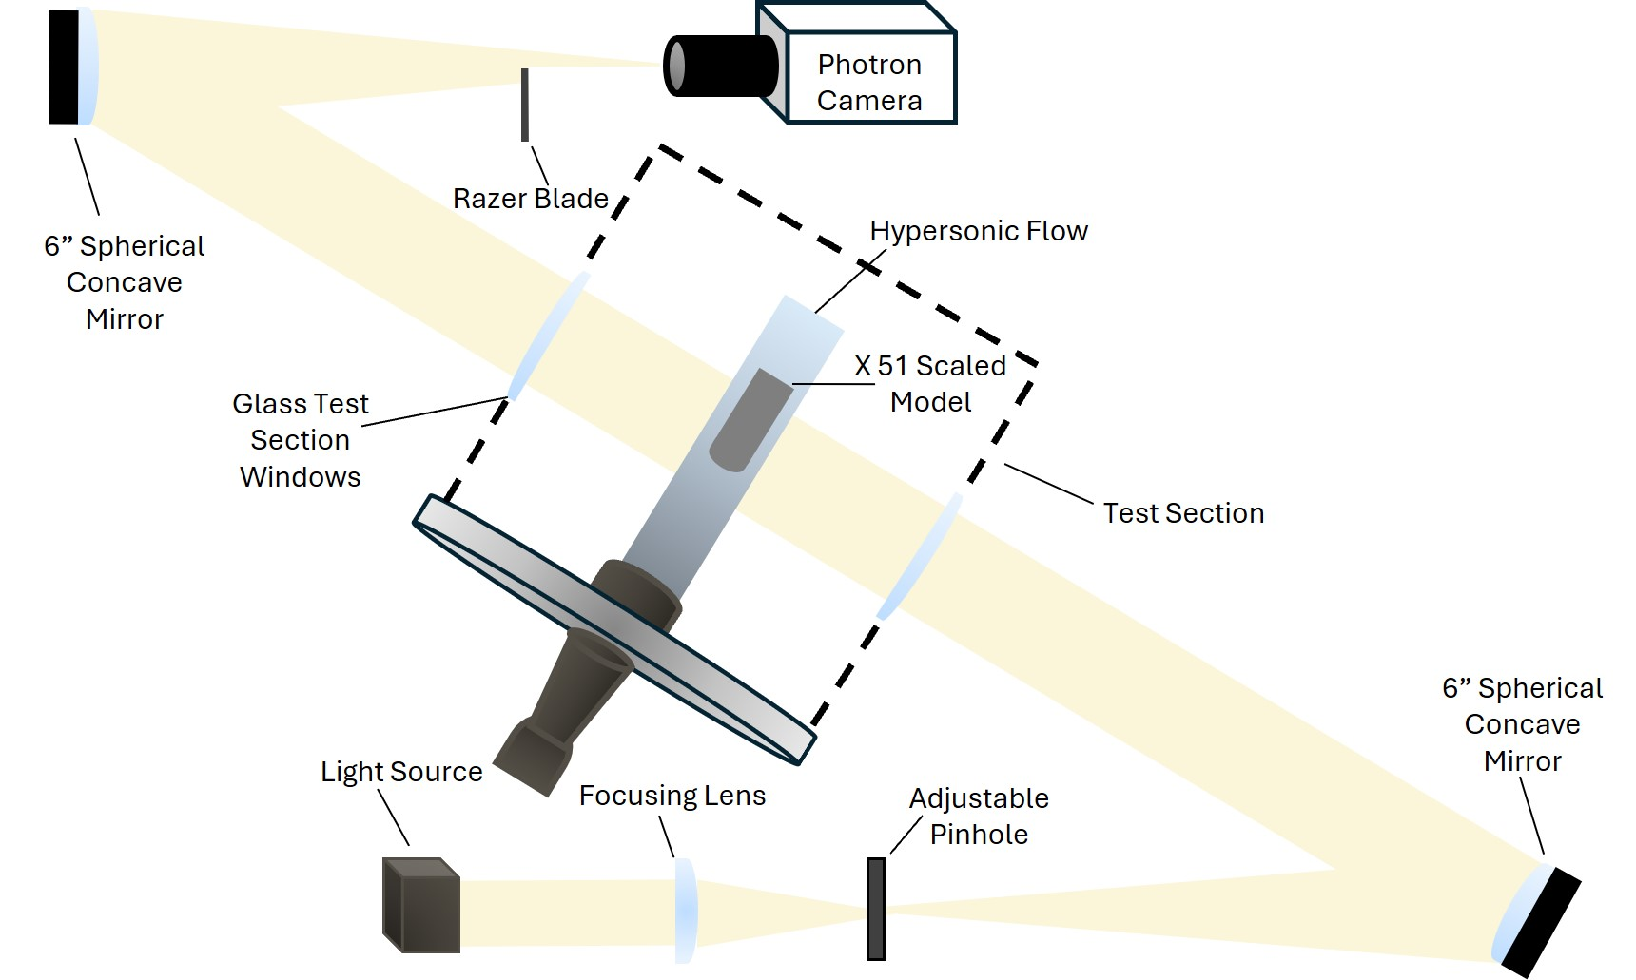
Experimental Setup
Z-Type Schlieren:
  White light source
  75 mm plano convex focusing lens
  6 inch diameter viewing frame
Imaging:
  Photron Nova X16 camera
  100 mm Macro 2x lens
  44,000 Hz capture rate
  25 mm spatial resolution
2 tests at two different angles of attack

Slide 5
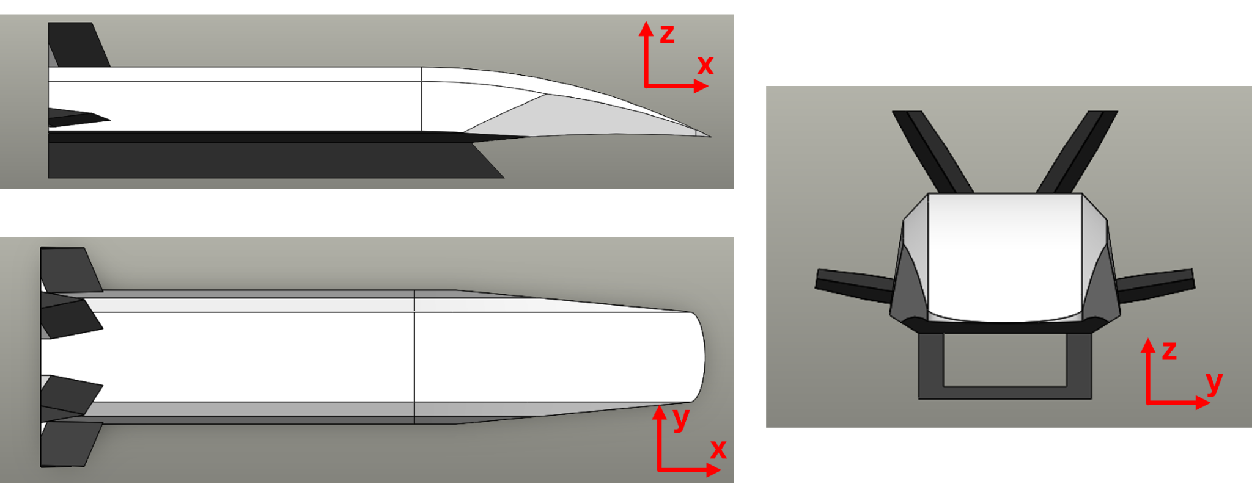
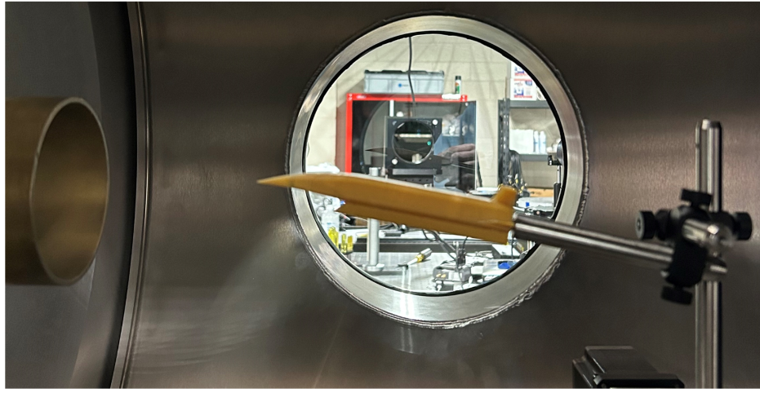
Vehicle Design
Hypersonic Waverider Modeling:
  123 x 23 x 19 mm
  87.0 mm² inlet cross section
Hypersonic Waverider Construction:
  3D printed to 0.4 mm tolerances
  76.2 mm from the nozzle exit

Slide 6
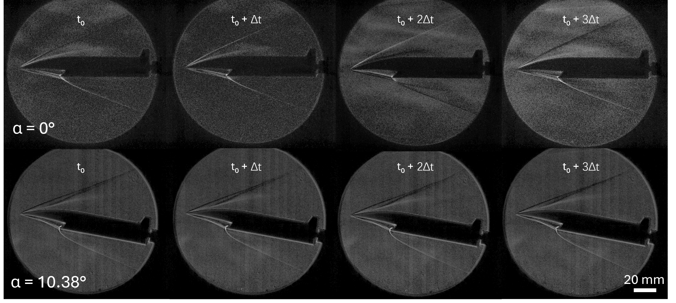
Schlieren Imaging
The values of t₀ and Δt are 113.6 ms and 22.7 ms respectively.

Slide 7
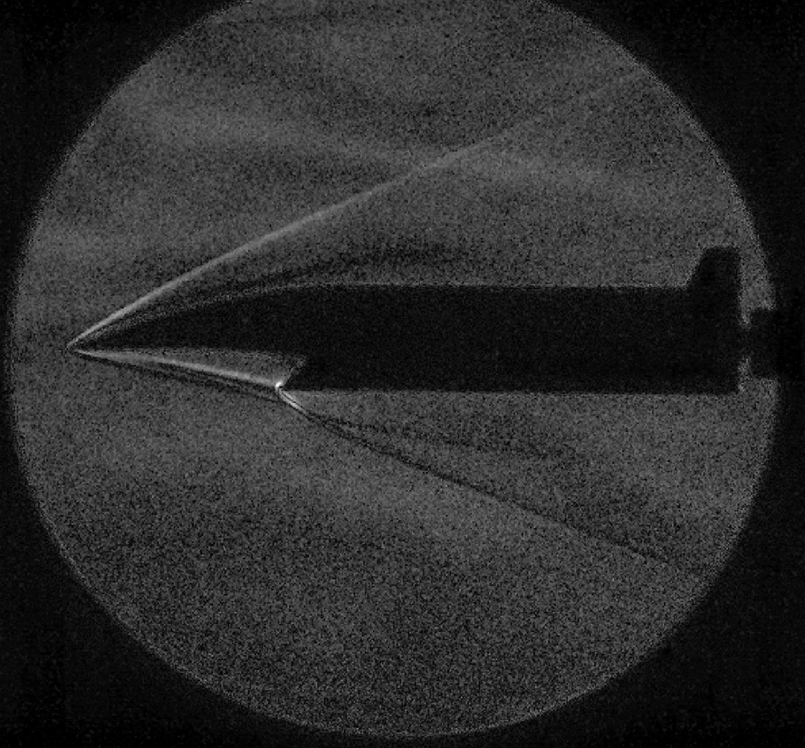

Schlieren Imaging (𝛼 = 0°)
Flow Boundary
Oblique Shock
Bow Shock
Shock Propagates Past Inlet
Flow Boundary

Slide 8
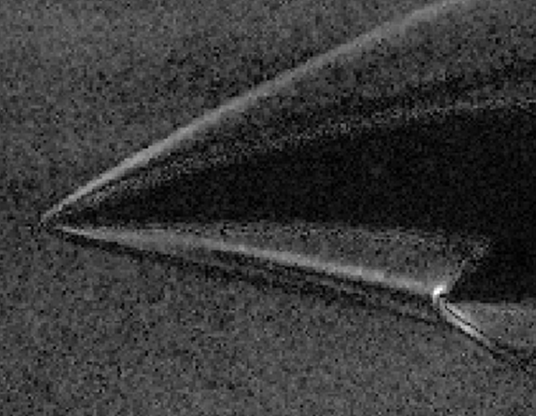
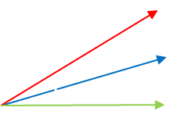

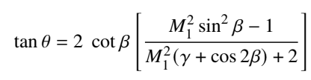
Schlieren Imaging (𝛼 = 0°)
Measurement Data:
𝜃 = 21.80°
𝛽 = 32.35°
Mach Number = 4.78 ± 0.5
Oblique Shock Attachment
Curved Lower Shock

Slide 9
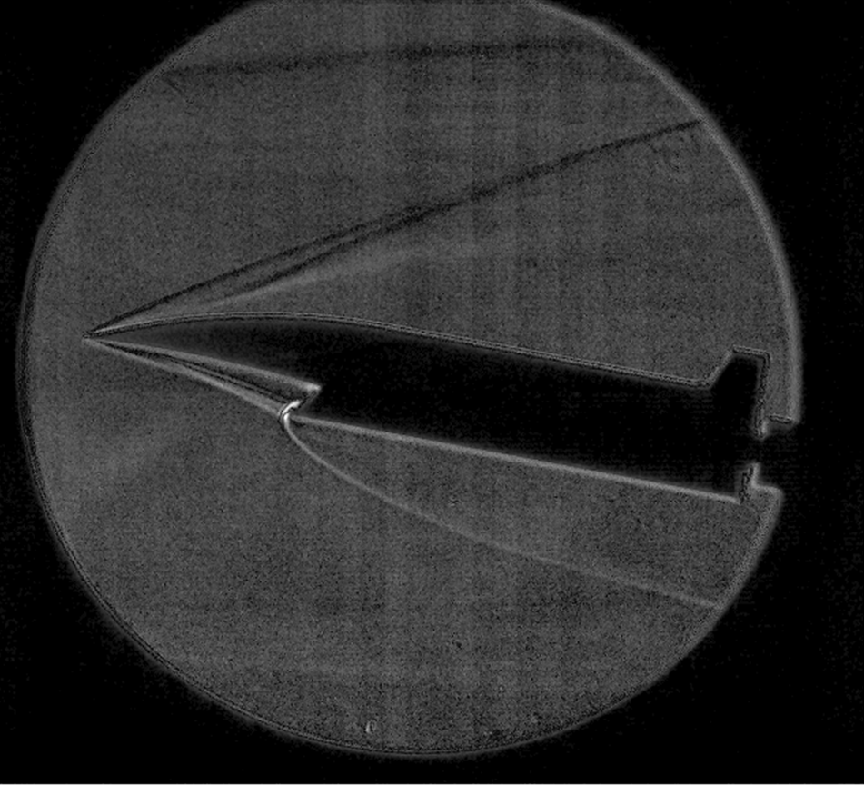
Schlieren Imaging (𝛼 = 10.38°)
Flow Boundary
Shock Interaction
Secondary Shock
Bow Shock
Flow Boundary

Slide 10
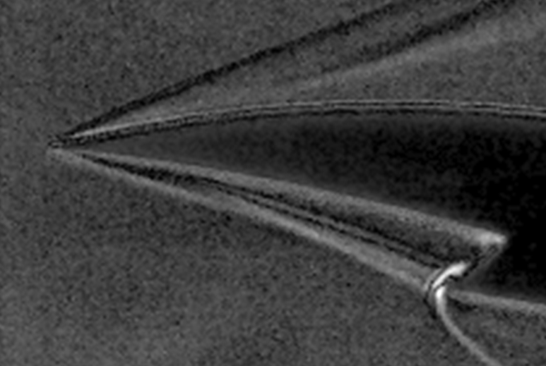
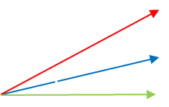
Schlieren Imaging (𝛼 = 10.38°)
Measurement Data:
𝜃 = 15.95°
𝛽 = 26.57°
Mach Number = 4.47 ± 0.5
Oblique Shock Attachment
Curved Lower Shock

Slide 11
Schlieren Imaging

Slide 12
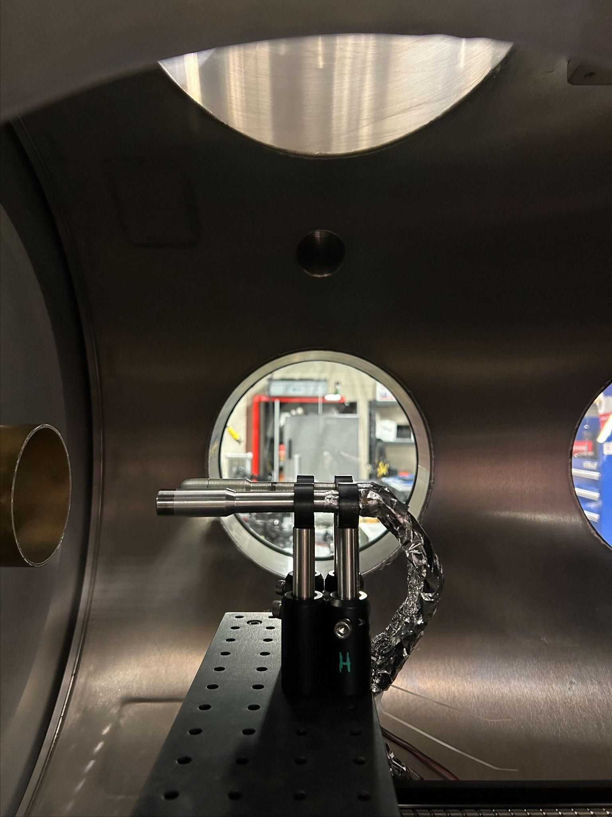
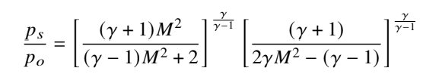
Pitot Probe Analysis
Pitot Probe Data:
  𝑝s /𝑝ₒ = 0.0145
  Upstream mach number of 7.09.
Experimental Error
  𝛼 = 0° resulted in a 32.58 % error
  𝛼 = 10.38° resulted in a 36.95 % error
Pitot Probe Setup:
  76.2 mm from nozzle
  Kulite sensor in plenum

Slide 13
Conclusion
Schlieren imaging had strong contrast and distinct features throughout entire testing duration.
Upstream mach numbers could be calculated for 𝛼 = 10.38° and 𝛼 = 0°.
Petot probe data allowed for calculation of the true upstream mach number of 7.09.
Lower oblique shock was observed intersecting with the engine inlet.

Slide 14
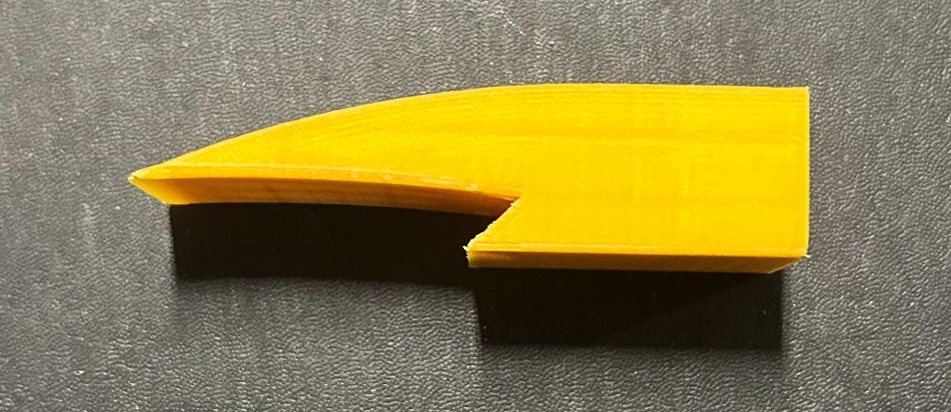
Future Work
Future work:
  Different Schlieren imaging setup to improve spatial resolution and reduce error.
  Planar shaped vehicle model along the y-axis.
  Vehicle manufactured out of anodized aluminum to allow testing in high enthalpy flow.

Slide 15

Acknowledgments
This work is based upon research supported by the US Air Force Office of Scientific Research (AFOSR) Young Investigator Award
number FA9550-21-1-0183 monitored by Dr. Amanda Chou.
The authors gratefully acknowledge this source of support.

Slide 16
Thank You for Your Attention
Questions?

