Slide 1


Increasing the Range & Effectiveness of Air-to-Air Missiles using Directed Energy Weapons
Allen Pradhan, B.S. Aerospace Engineering
Embry-Riddle Aeronautical university, Daytona Beach

Slide 2
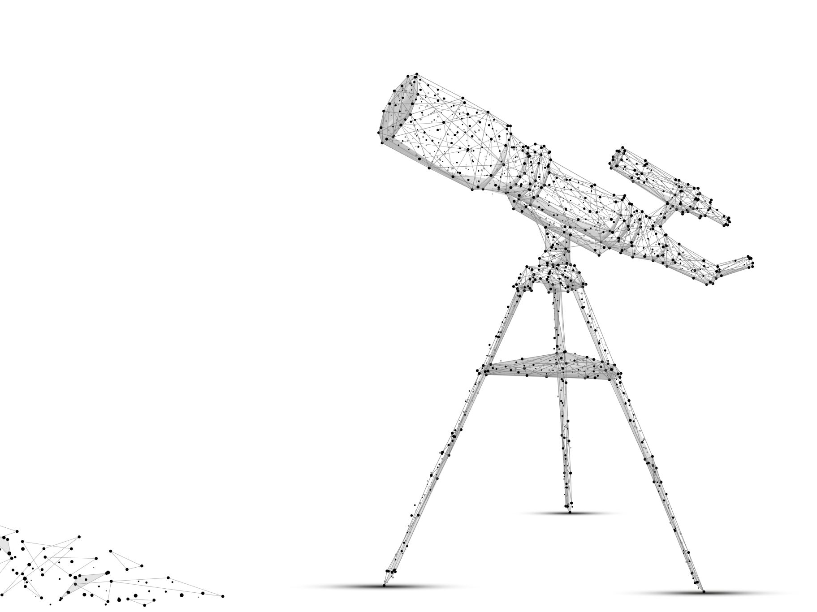
Introduction
Overview of Air-to-Air Missiles
Current limitations in range and effectiveness
The role of High Energy Laser(HEL) in modern warfare
Purpose of integrating Directed Energy Weapons with missiles

Slide 3
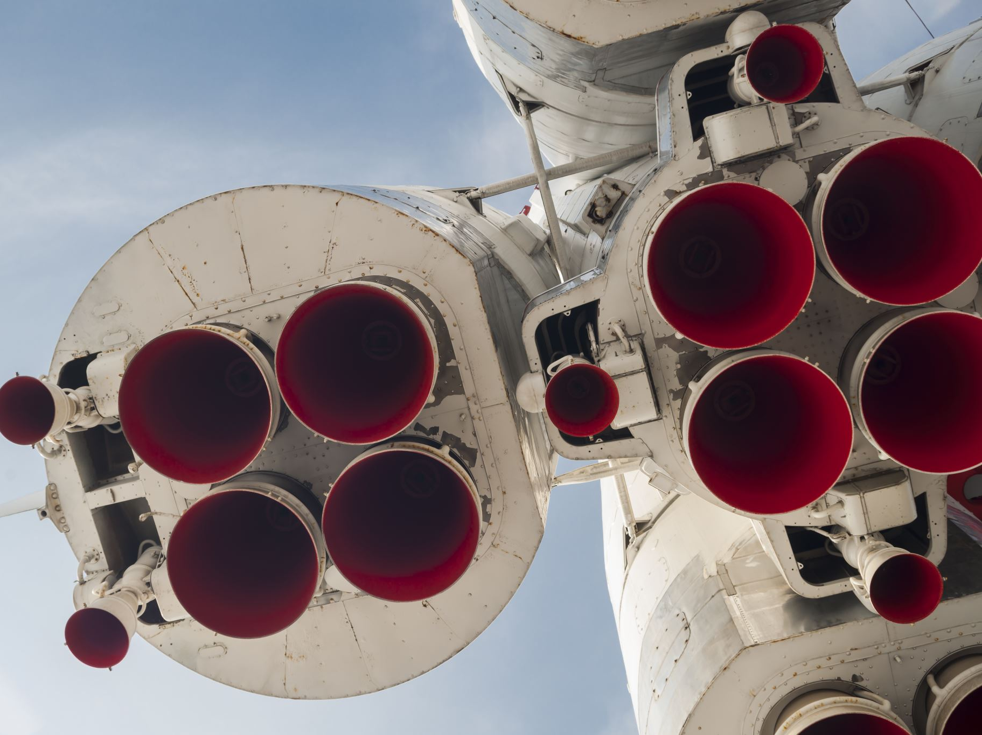
What are Air-to-Air Missiles?
The purpose of Air-to-air missiles is to be fired from aircraft to disable other aircraft or airborne objects.
First introduced in 1956, AIM-9 Falcon was the first Air-to-Air missile with a range of 6 miles.
Currently, the one of the most advanced Air-to-Air missile is the MBDA Meteor with a range of over 100 miles.

Slide 4
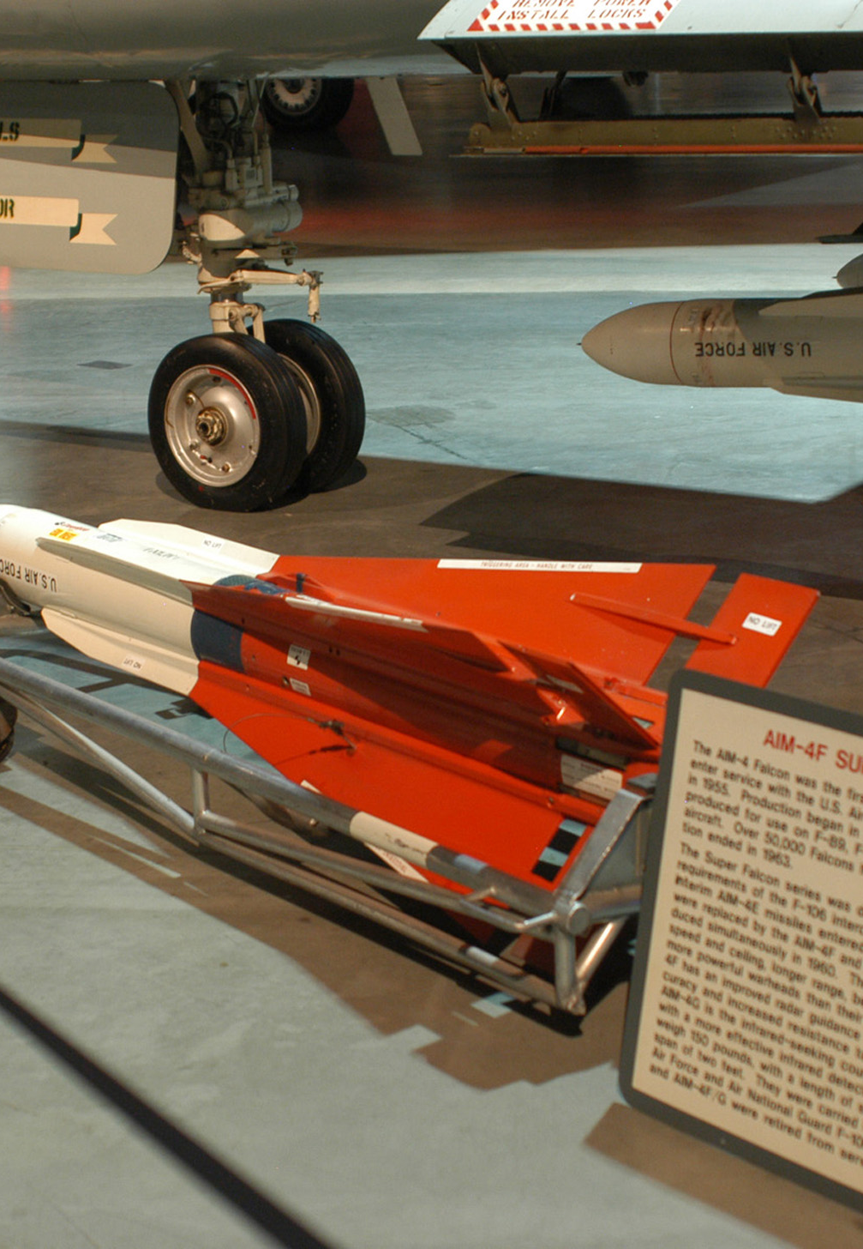
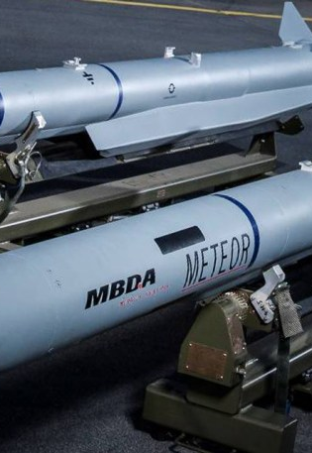

Slide 5
Limitations of traditional missile technology
Shorter range
Countermeasures like flares and chaffs reduce effectiveness
Single use Limitation

Slide 6
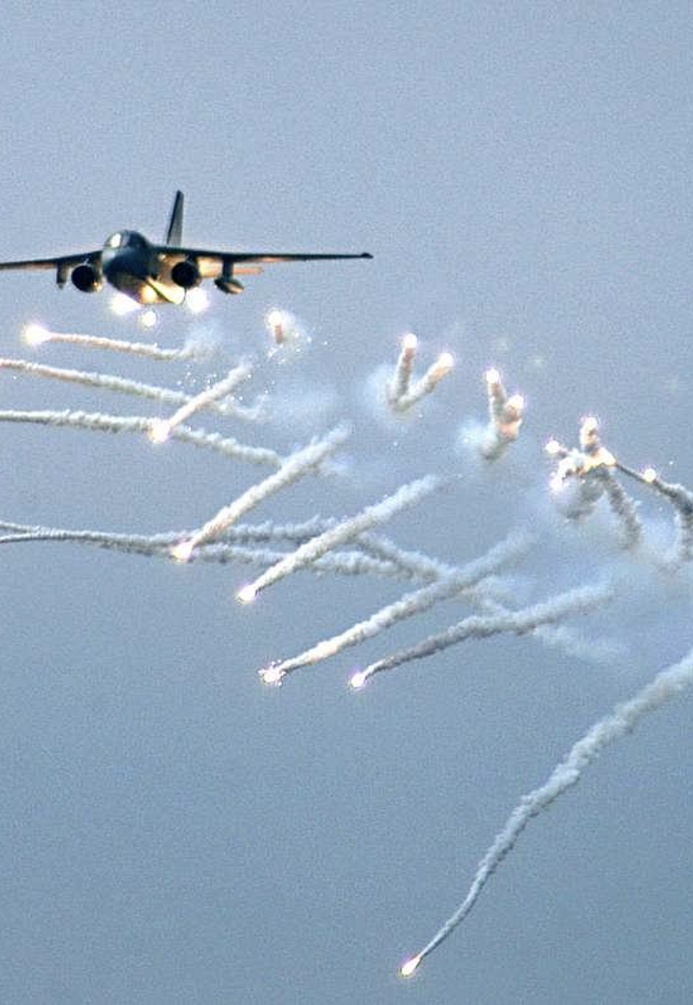
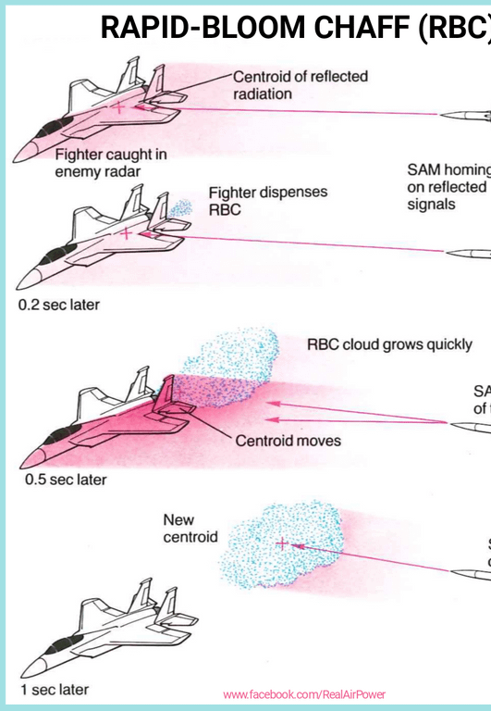

Slide 7
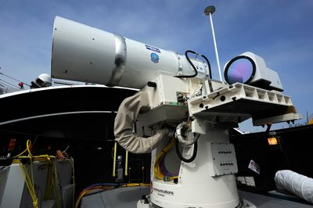
High Energy laser(HEL)
A device that produces a focused ray of optical radiation, delivering a large amount of energy in a short duration
Lockheed Martin and BAE Systems currently have HELs underdevelopment.
HELIOs system

Slide 8
Advantages of High-Energy Lasers (HEL)
Speed-of-Light Engagement
Precision
Cost Efficiency
Multi-Target Capability

Slide 9
Laser-Integrated Air-to-Air Missile System (L.I.A.M.S)
Hybrid Architecture:
Traditional missile body (propulsion & guidance)
Integrated High-Energy Laser in the nose
Key Concept:
Missile closes distance using rocket propulsion
HEL engages the target at standoff distances, damaging or destroying key components
Advantages Over Conventional Missiles:
Extended lethal range
Superior countermeasure resistance
Speed-of-light strike capability

Slide 10
Operational modes of L.i.A.m.s
Long-Range:
  Missile uses its propulsion system to travel toward the target, laser system is then activated at a an optimal distance, allowing the missile to neutralize threats without direct impact.
Short-Range:
  In close combat scenarios, the laser module functions independently, allowing L.I.A.M.S to engage multiple targets without using its propulsion.

Slide 11
Key Challenges to Development of L.I.A.M.S
Energy Storage & Delivery
Challenge: Sustained, high-power laser output in compact form
Solution: Hybrid power systems (capacitor & battery), AI-based power management
Atmospheric Distortions
Challenge: Thermal blooming and beam scattering
Solution: Adaptive optics, beam focusing, frequency modulation
Thermal Control
Challenge: Laser operation produces extreme heat
Solution: Advanced cooling systems, heat exchangers, thermal coatings

Slide 12
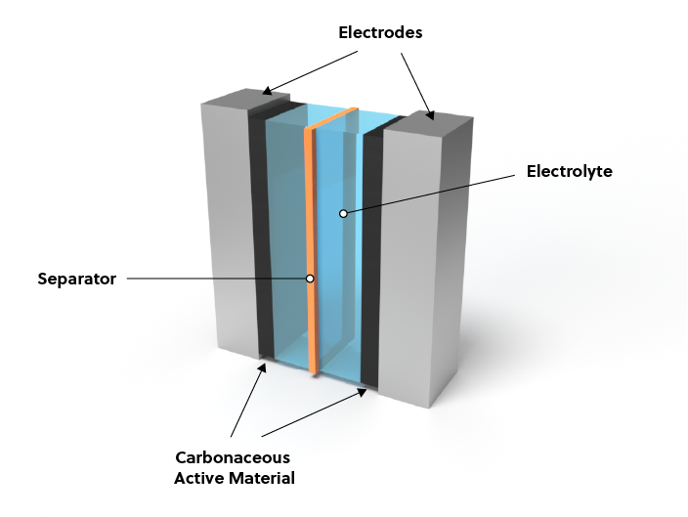
Graphene Supercapacitor

Slide 13
Future Outlook
Ongoing Research:
Advanced materials (graphene, next-gen composites)
Higher-power lasers with improved efficiency
Operational Impact:
Reduces cost-per-engagement dramatically
Increases survivability of host aircraft through rapid, reusable engagements

Slide 14
Conclusion
L.I.A.M.S. offers:
Extended range via laser-driven engagements
Better countermeasure resistance
Lower operational costs thanks to reusable laser shots
Engage multiple targets
Significance:
Redefines the speed, accuracy, and cost-effectiveness of air-to-air warfare
Overcomes the intrinsic limitations of traditional explosive-based missile designs

Slide 15

Questions?
allenpadhan99@gmail.com

