Slide 1
Utilization of a Portable Ground Station to
Conduct Site Surveys in the S-Band
Frequency for CubeSat at MSU’s Mission
Madelyn Sloan Berry, Daniel Hurley, Elijah Frazure, & Mims Hillis
Mississippi State University
AIAA Region II Student Conference, April 2nd-5th 2025
Copyright © by Madelyn Sloan Berry, Daniel Hurley, Elijah Frazure, Mims Hillis
Published by the American Institute of Aeronautics and Astronautics, Inc., with permission.

Slide 2

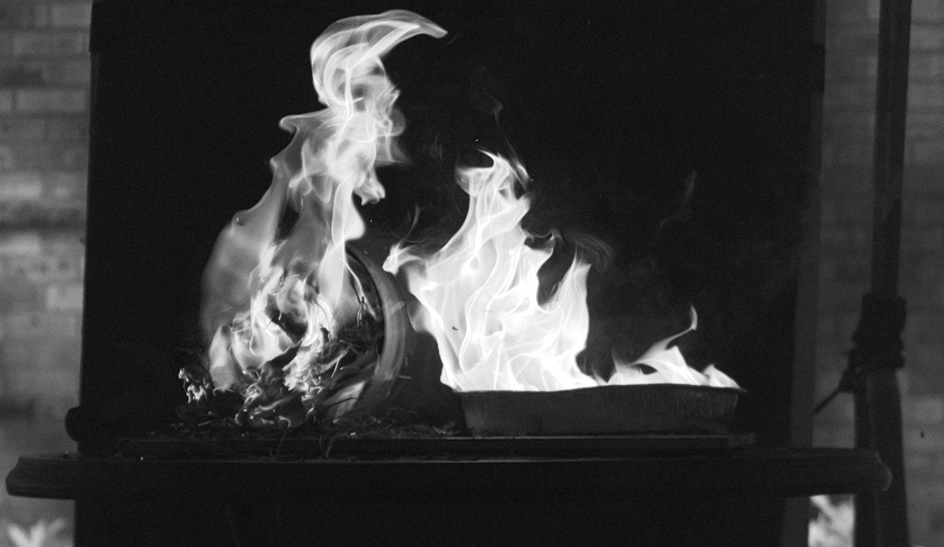
Mission and Purpose for Conducting Site Surveys
CubeSat at MSU
  Undergraduate team working to design, launch, and operate Mississippi’s first satellite: 1-Mississippi
Hyperspectral Imaging Payload
  S-Band Frequency (2.4 GHz)
Ground Station Communication System Development

Slide 3
Experiment and Project Outline
Where are we going to put our ground station?
  Conducting Site Surveys with a portable test ground station
Test Ground Station Development
Conducting Site Surveys
Results
Analysis and Conclusion

Slide 4




Establishing Driving Engineering Factors
System Requirements
Design Constraints
Radio Frequency Capabilities
Azimuth & Elevation Control
Portable
Low Cost

Slide 5
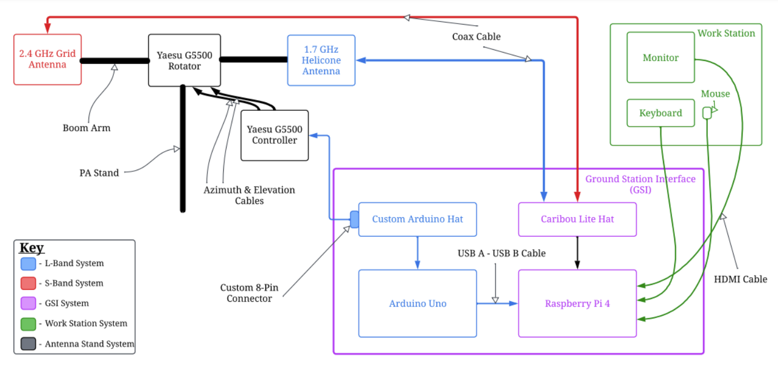
Overview of Portable Ground Station Design

Slide 6
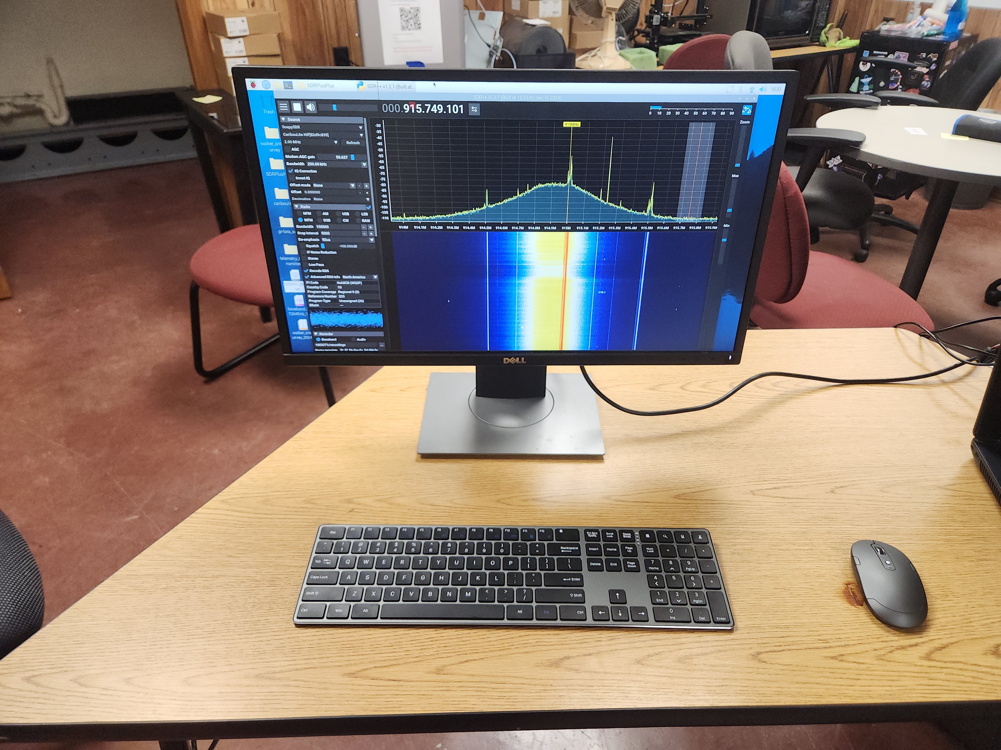
User Interface Workstation System Components
Monitor
(SDR++)
Mouse
Keyboard

Slide 7
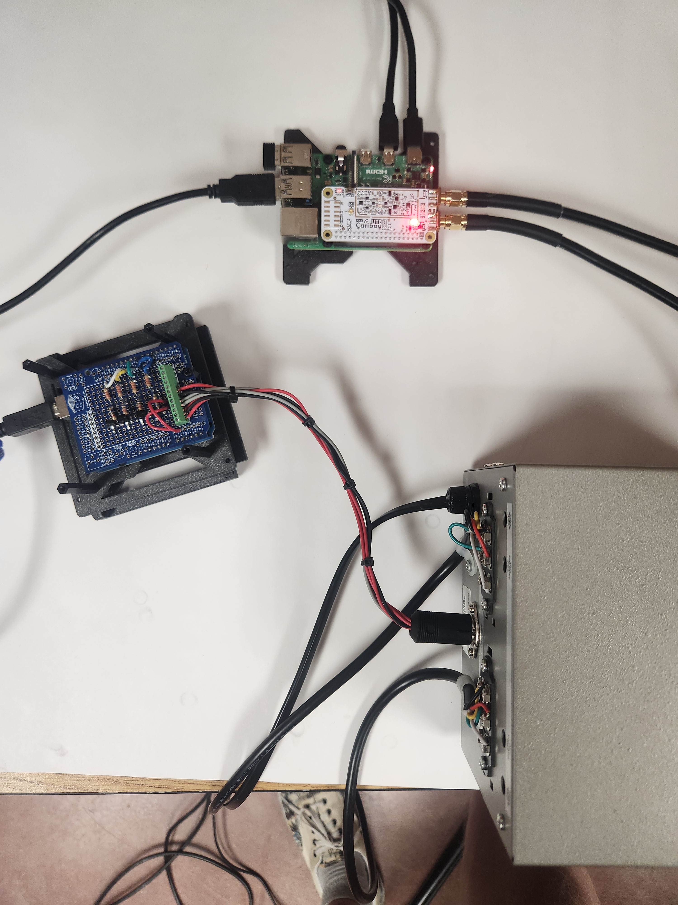
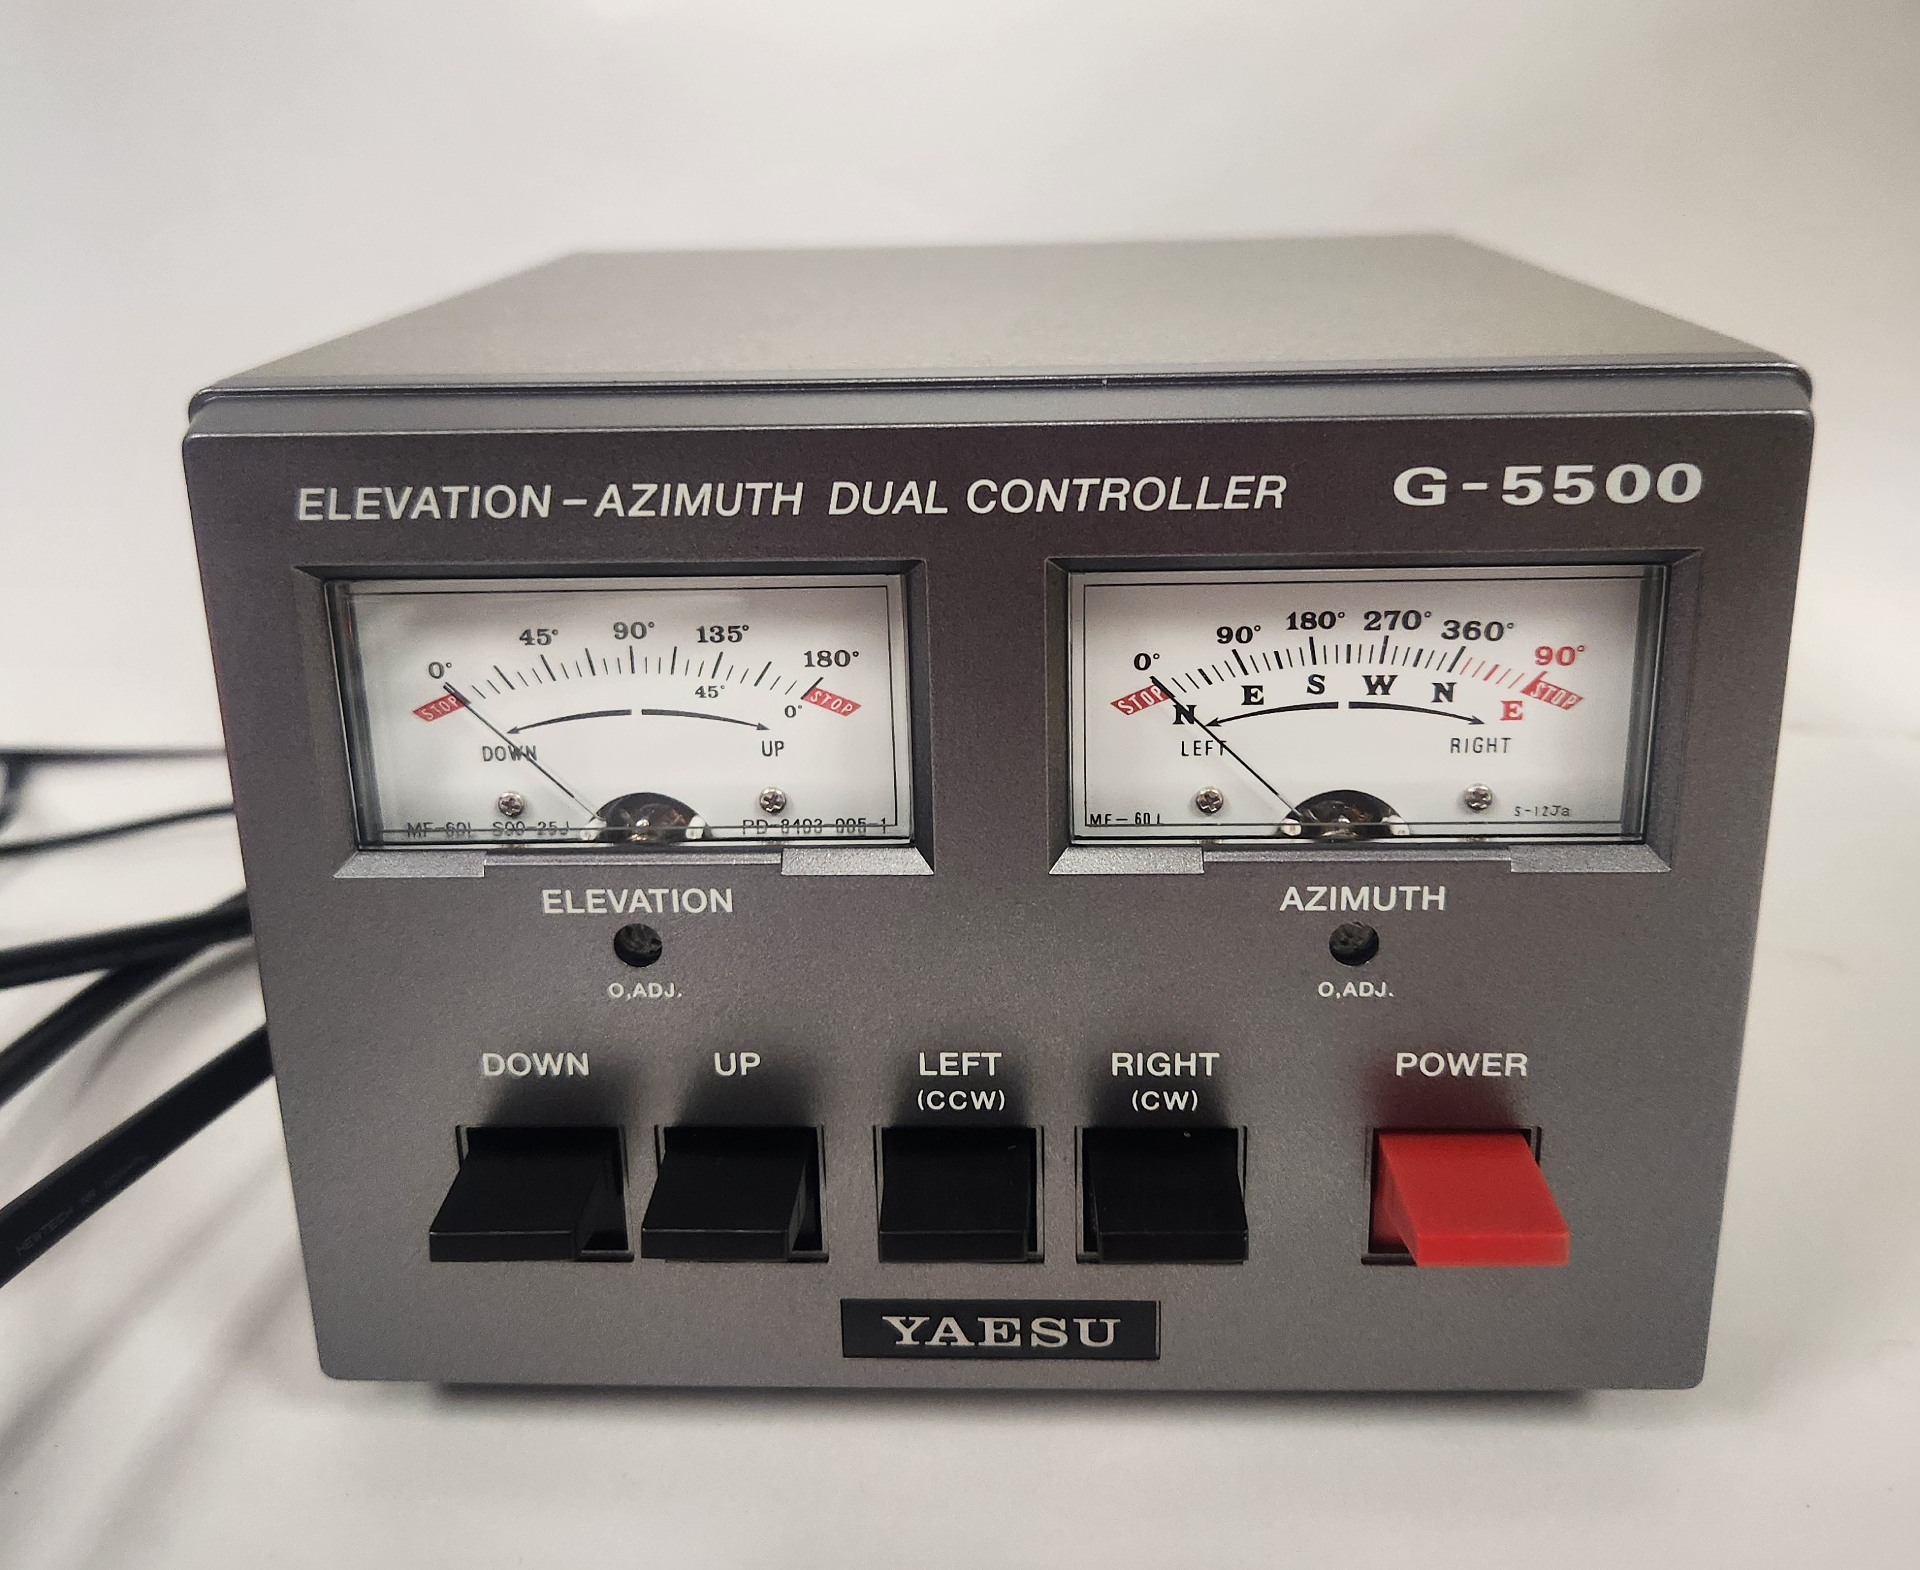
Ground Station Interface (GSI) Components
Arduino Uno
Raspberry Pi 4
Custom 8 Pin Connector
Yaesu G-5500 Controller
Caribou Lite

Slide 8
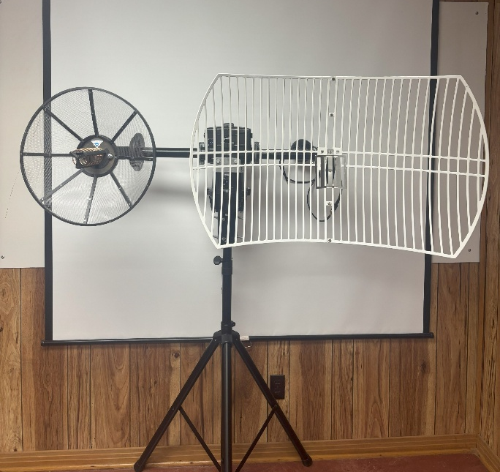
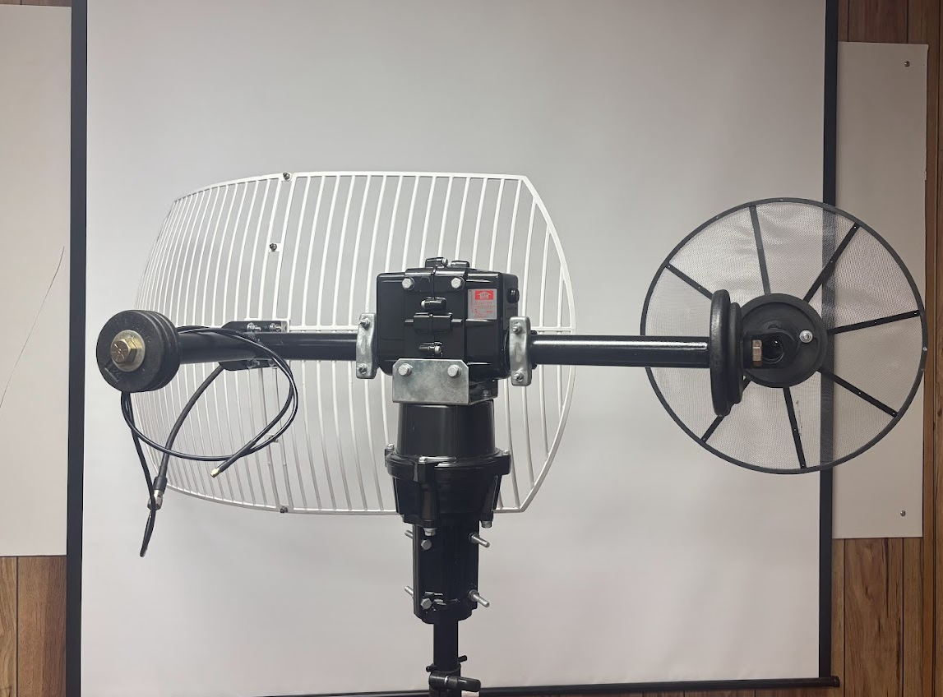
Antenna Stand System Components
S-Band Antenna
L-Band Antenna
Counter Weights
PA Stand
Boom Arm
Rotator

Slide 9
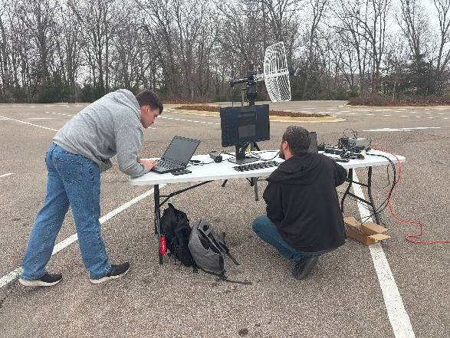
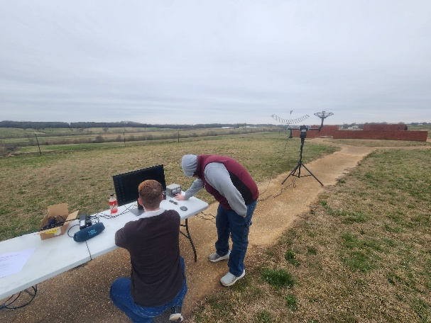
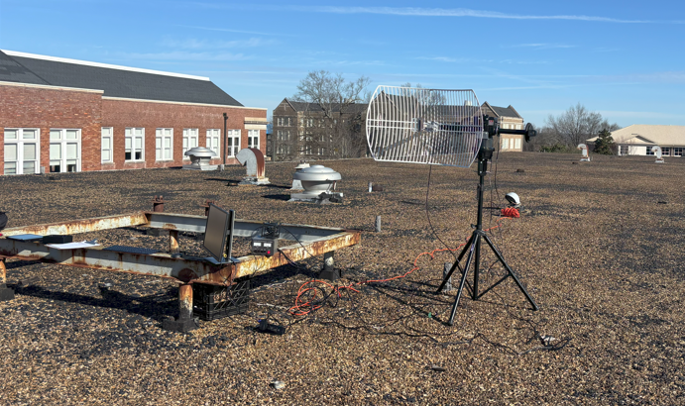
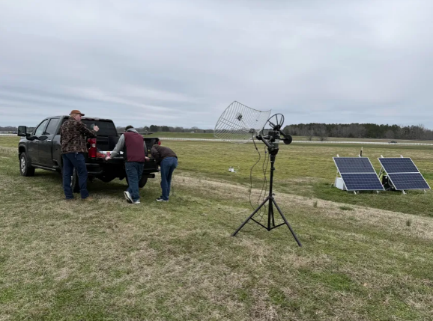
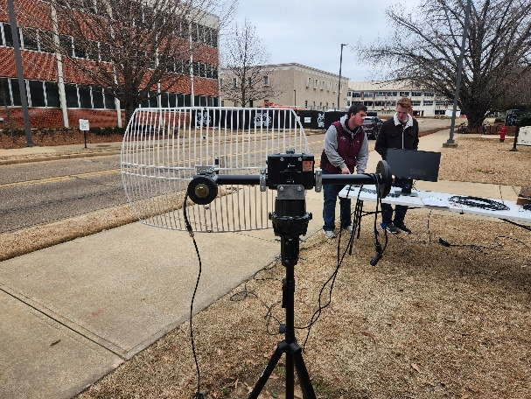
Determined Locations to Conduct Site Surveys
Location criteria
Pump House
South Farm
  Accessibility
  Infrastructure
  Regulations
  Safety
  Space
Walker Roof
North Farm
Patterson Lawn

Slide 10
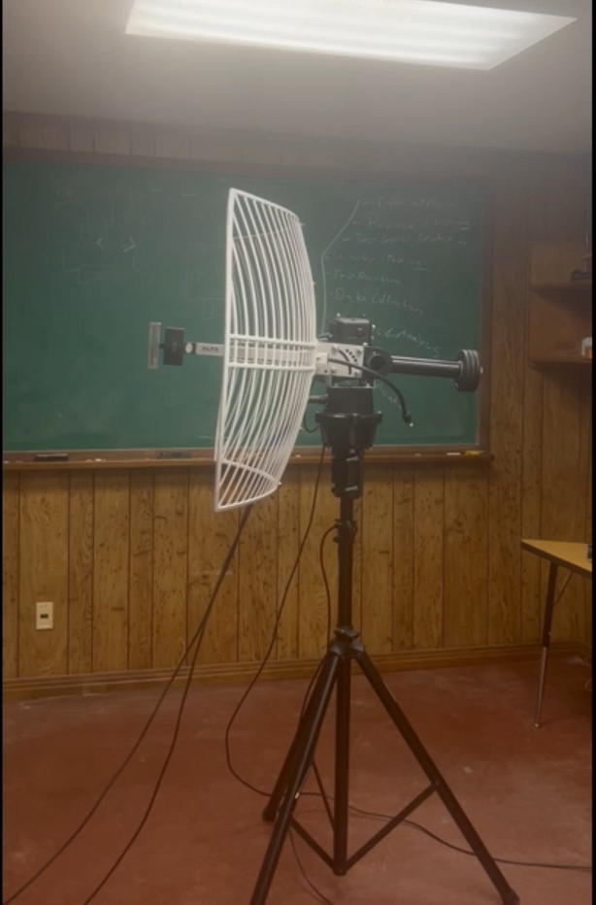
Establishing Testing Criteria and Scope
Qualitative Data
  Line of Sight (LOS)
  Terrain Description
  Power/Internet Accessibility
Quantitative Data
  Elevation
  Radio Frequency (RF) Analysis
    Noise Level measurements

Slide 11
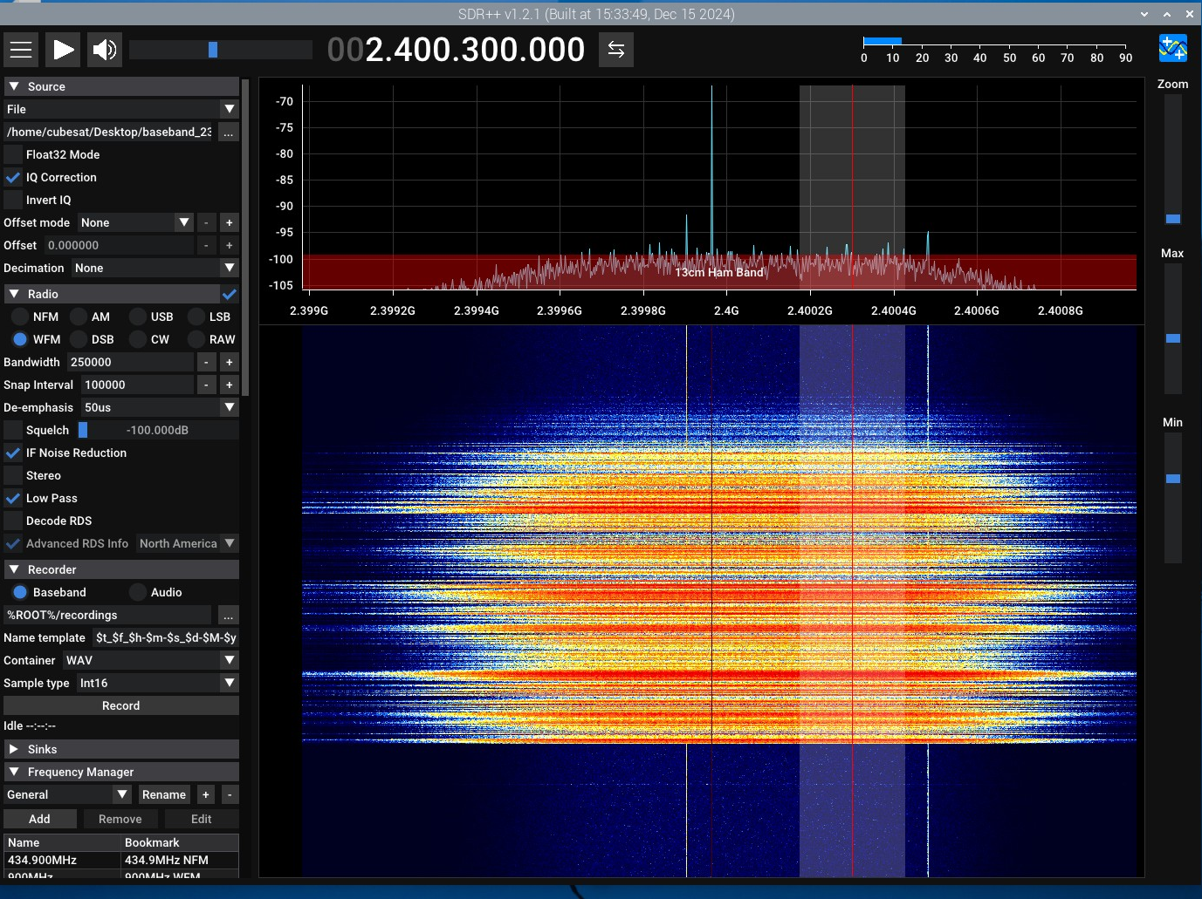
Radio Frequency Testing Procedure and Sample Results
Walker Roof (North to South Data)
Elevation (degrees) | Ground Station (dBW) | Spectrum Analyzer (dBW)
0 | -100 | -120.0
22.5 | -100 | -120.9
45 | -99 | -121.0
67.5 | -98 | -119.9
90 | -98 | -120.4
112.5 | -98 | -120.1
135 | -98 | -120.5
157.5 | -98 | -119.5
180 | -98 | -121.0
Average | -98.56 | -120.37
Frequency Level
Measured
Noise Level
Noise/Background Signals

Slide 12
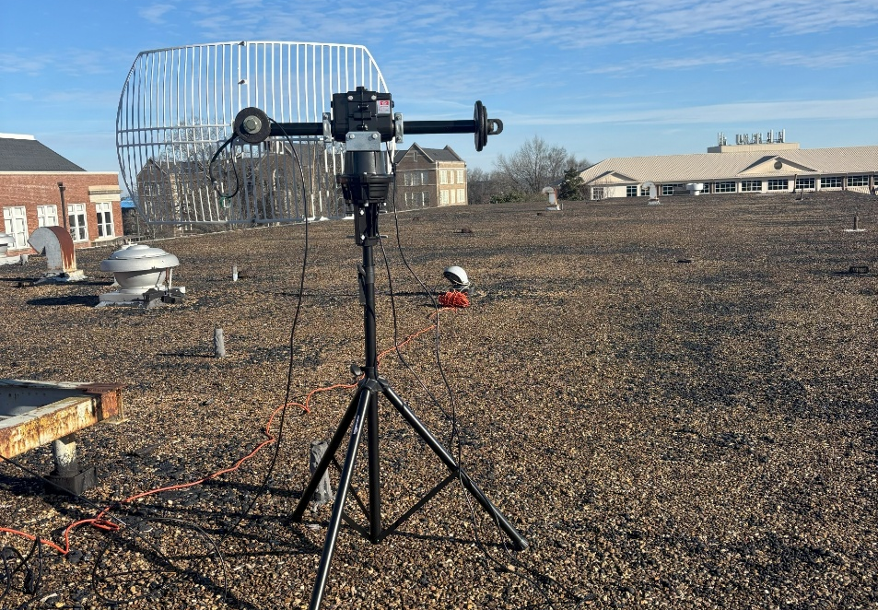
Observations From Walker Roof Testing
Walker Roof
Hilbun Hall
Excellent Infrastructure
  Aerospace Building
  Power and Internet
  Indoor Storage
RF Environment (Hilbun Hall)
  Noise Floor Increase
  Negligible Impact
    10 degrees Elevation
    5 degrees Azimuth

Slide 13
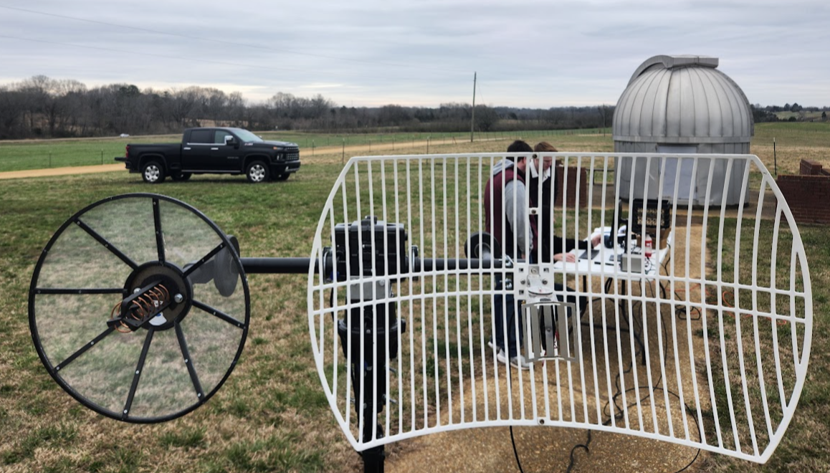
Observations From South Farm Testing
South Farm
Observatory
Limited Infrastructure
  Limited Gate Access
  Available Power
  No Indoor Storage
RF Environment
  Expected to be quiet

Slide 14
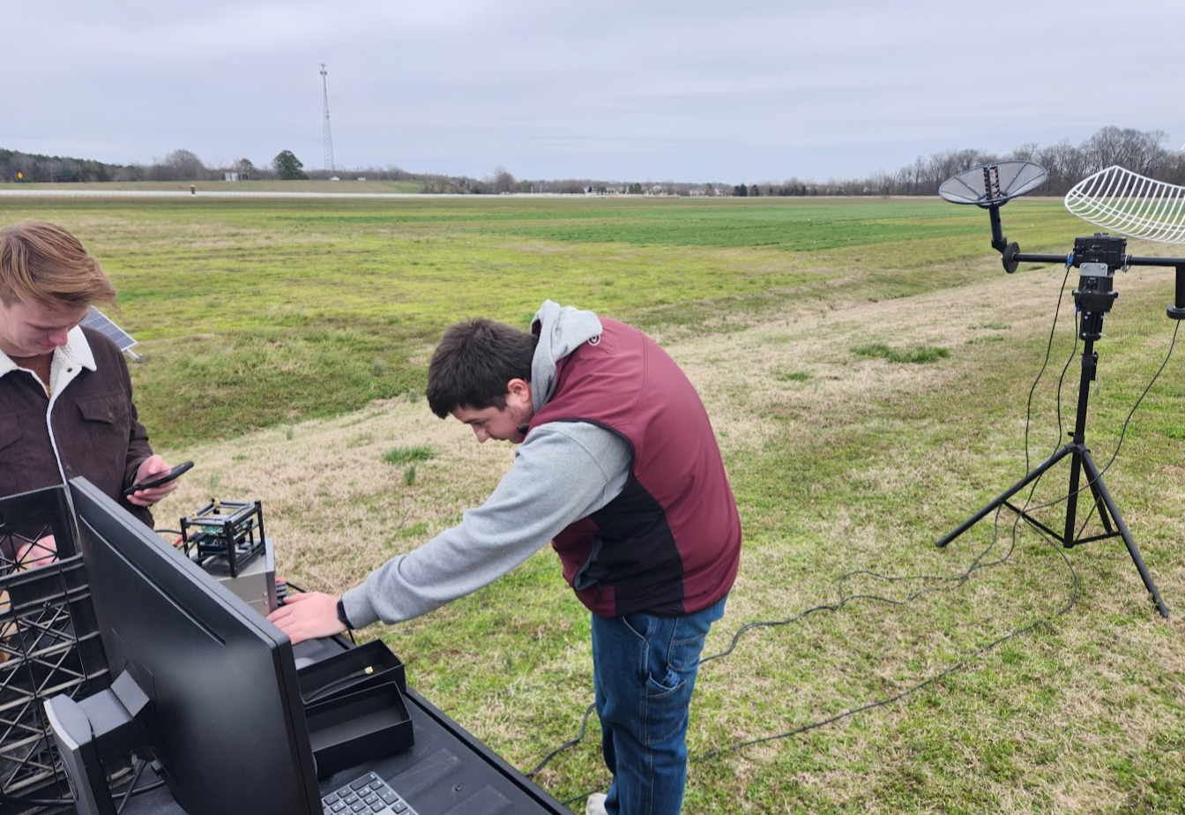
Observations From North Farm Testing
North Farm
No Infrastructure
  Limited Gate Access
  No available power
  No Indoor Storage
RF Environment
  Expected to be quiet

Slide 15
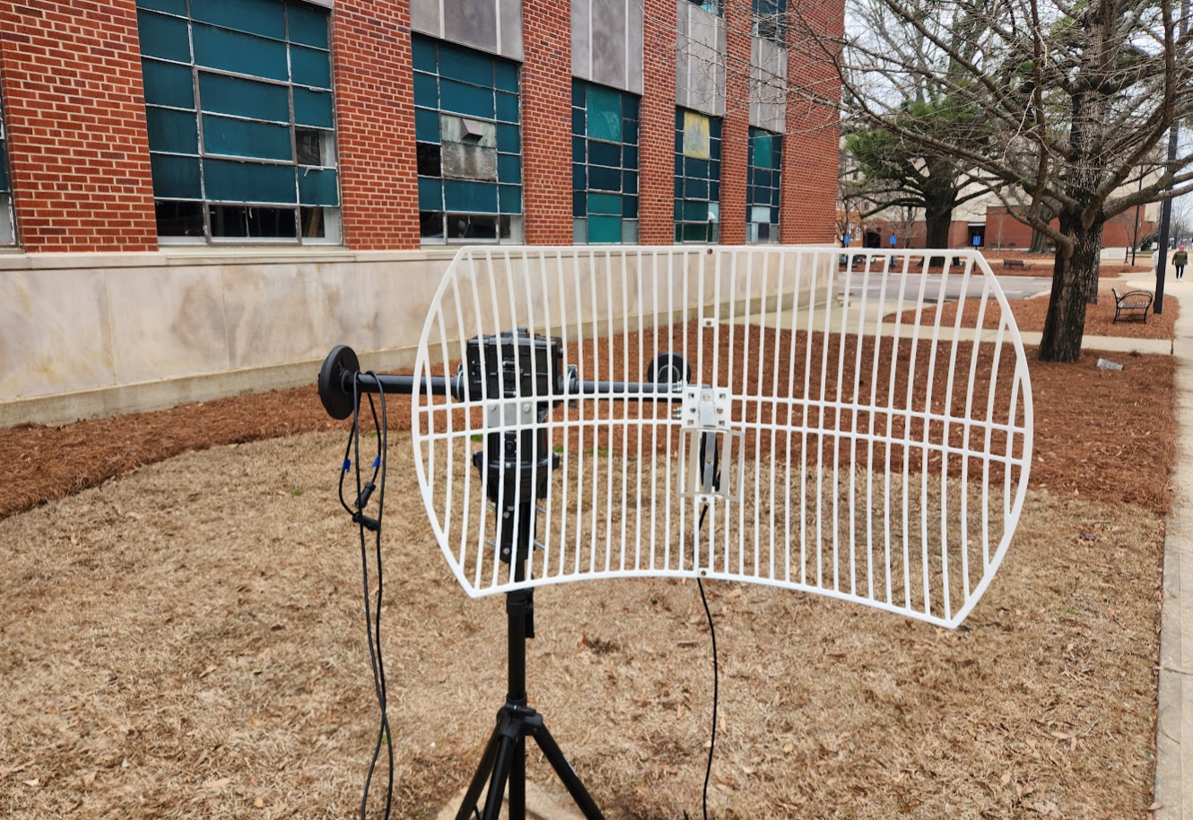
Observations From Patterson Lab Testing
Patterson Lab
Limited Infrastructure
  Tall Buildings
  Available Power and Storage
  Limited Space
RF Environment
  Hilbun Interference
  Passing Cars

Slide 16
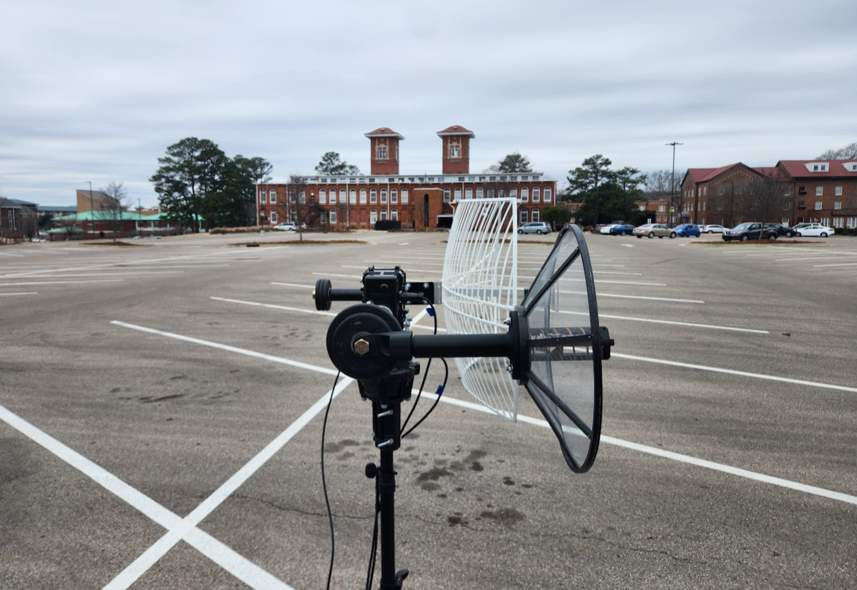
Observations From Pump House Testing
Pump House
Limited Infrastructure
  Limited Space
  Available power
  No Indoor Storage
RF Environment
  Passing Cars

Slide 17
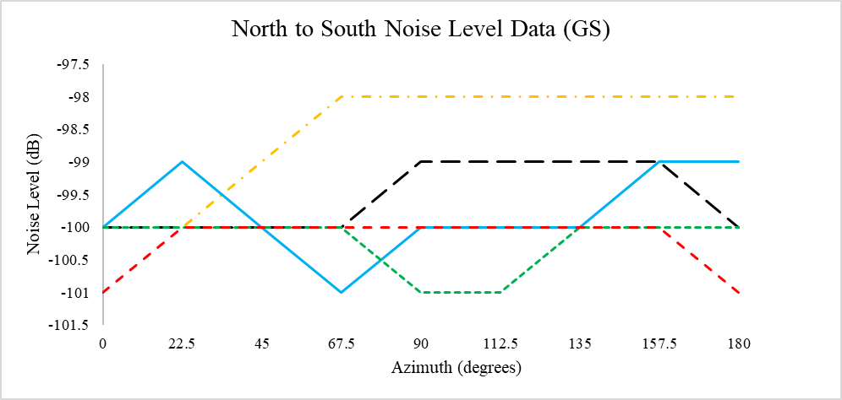
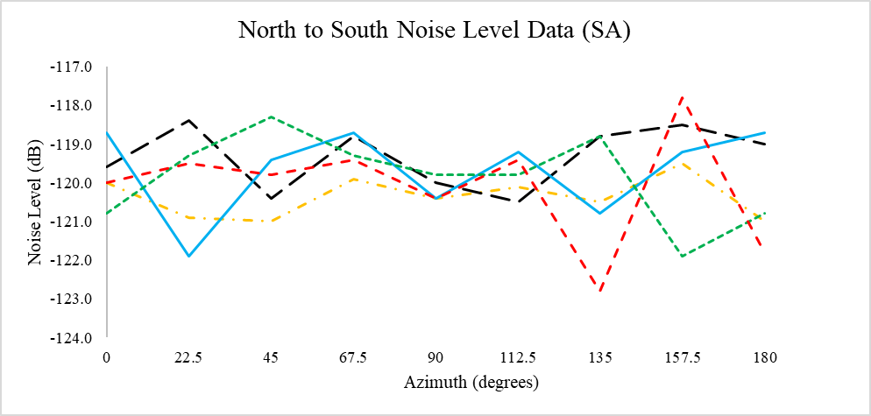
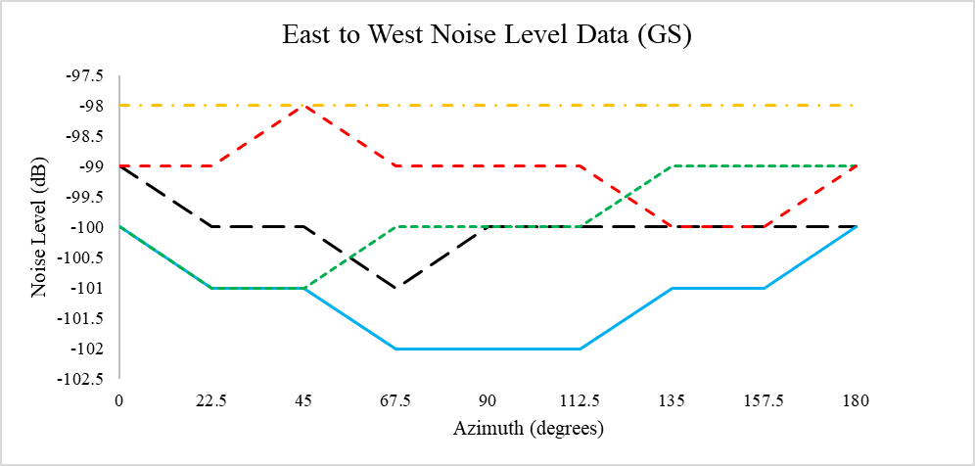
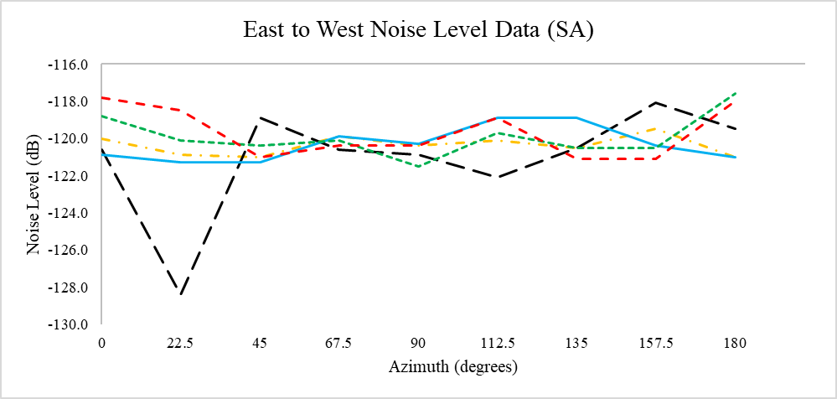
Plotting of Collected Noise Data Points

Slide 18
Comparing Maximum and Minimum Average Noise
Site | Portable Ground Station (dB) | TinySA Spectrum Analyzer (dB)
Walker Roof | -98.28 | -120.37
Patterson Lawn | -99.67 | -119.89
Pump House | -99.78 | -120.20
North Farm | -100.06 | -119.89
South Farm | -100.44 | -119.99
Ground Station Range: 2.17 dB
TinySA Range: 0.48 dB

Slide 19
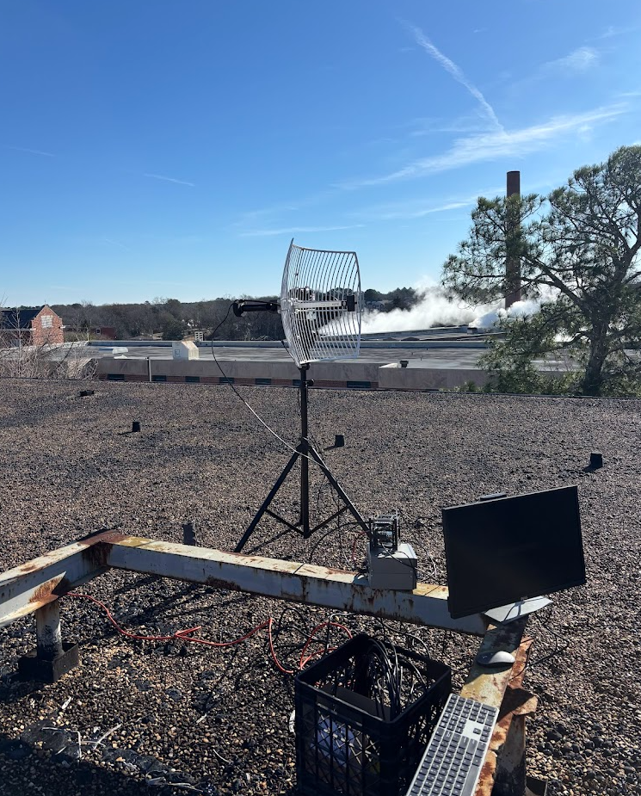
Predicted Results vs Experimental Results
  Predicted Results
    South Farm & North Farm would be significantly quieter than Walker Roof
  Experimental Results
    The difference between South Farm and Walker Roof is negligible.
  Explanation
    Buildings block a large portion of anticipated RF interference

Slide 20
Comparing and Ranking Test Sites
Category | Weight | Walker Roof | Pump House | South Farm | Patterson Lab | North Farm
Noise Floor | 3 | 1 | 3 | 5 | 2 | 4
Accessibility | 3 | 5 | 3 | 2 | 4 | 1
Internet | 2 | 5 | 3 | 2 | 4 | 1
Power | 2 | 5 | 3 | 4 | 2 | 1
Line of Sight | 2 | 4 | 2 | 5 | 1 | 3
Space | 1 | 5 | 1 | 4 | 2 | 3
Obstructions | 1 | 4 | 2 | 5 | 1 | 3
Terrian | 1 | 2 | 4 | 1 | 5 | 3
Elevation | 1 | 5 | 2 | 4 | 1 | 3
Weighted Totals |  | 62 | 49 | 54 | 40 | 35

Slide 21
Conclusions and Next Steps
Permanent Ground Station on Walker Rooftop
  South Farm back-up location
Present findings to Mississippi State University and the MSU Aerospace Department
Repeatable Experiment Procedure
  University Student Groups
  Radio Enthusiasts

Slide 22

Acknowledgements
CubeSat at MSU Student Team
Faculty Advisor, Mr. Wolz
MSU Aerospace Engineering Department
Bagley College of Engineering
American Institute of Aeronautics and Astronautics

Slide 23
Questions?

