Slide 1
Review of Mishaps in Rendezvous and Proximity Operations
Isabella Dalisay Fernandez
University of Florida
Region II 2025 Student Conference, April 3-4th
Copyright © by Isabella Dalisay Fernandez
Published by the American Institute of Aeronautics and Astronautics, Inc., with permission.

Slide 2
Introduction
Rendezvous and Proximity Operations (RPO)
  Approach and interaction between spacecraft
Applications
  In-space Servicing, Assembly, and Manufacturing (ISAM)
    Refuel old satellites
  Orbital debris removal

Slide 3
Why?
Why is this important?
  RPO missions are becoming more complicated and uncertain
  Can help avoid unnecessary costly mistakes
Why did I choose this project?

Slide 4
Introduction
1990 STS-32
1997 Progress-Mir
2007 Orbital Express
1992 STS-49
2005 DART

Slide 5
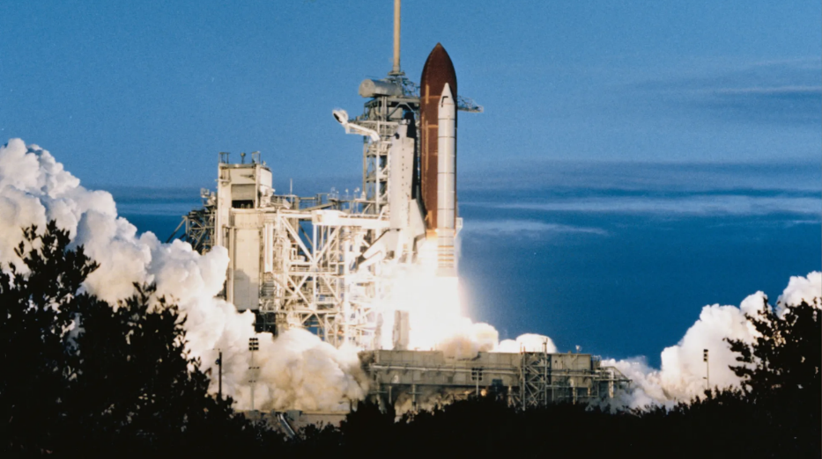
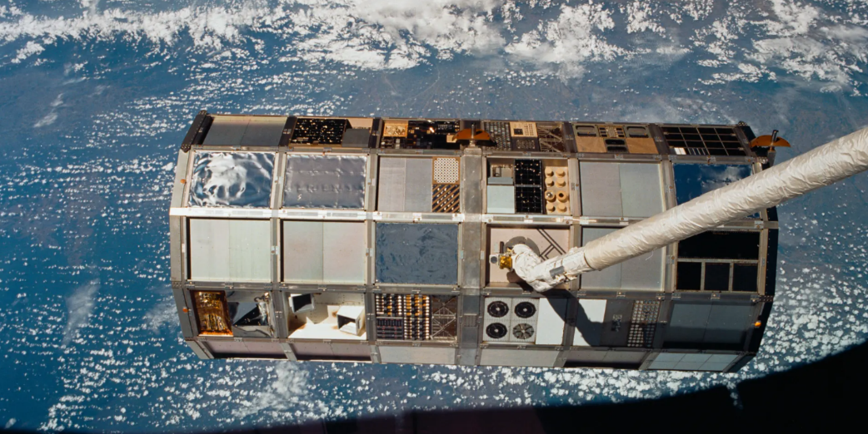
STS-32
[1]

Slide 6

STS-32
Project Background
  Long Duration Exposure Facility (LDEF)
    Deployed 1984
  Columbia launched 1990
[2]

Slide 7
STS-32
Project Execution
  Radar lock initiated before 2nd star tracker pass
  Radar acquisition occurred after Corrective Combination Maneuver (NCC) burn
  Radar data incorporated into navigation

Slide 8
STS-32
Project Execution
  Radar range and radar range rate data began to degrade
  Navigation filter rejected the two measurements
  Mission control inhibited the data
  Star tracker pass was completed

Slide 9
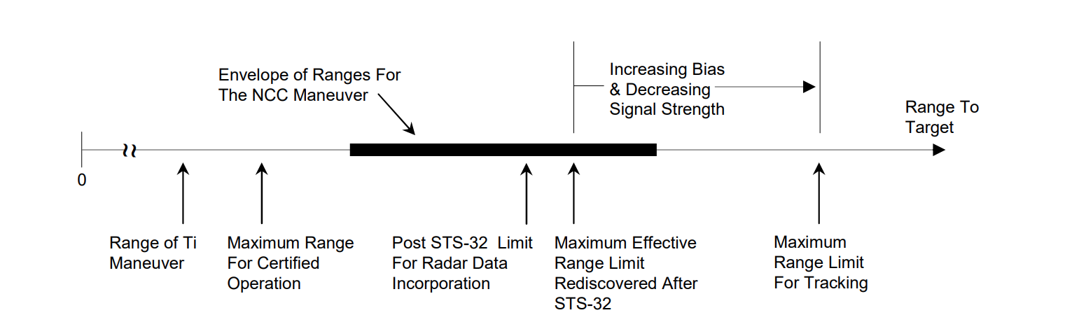
STS-32
Radar hardware introduced range measurement bias at extreme ranges
[2]

Slide 10
STS-32
Lessons Learned
  Characteristics of sensors must be thoroughly documented

Slide 11
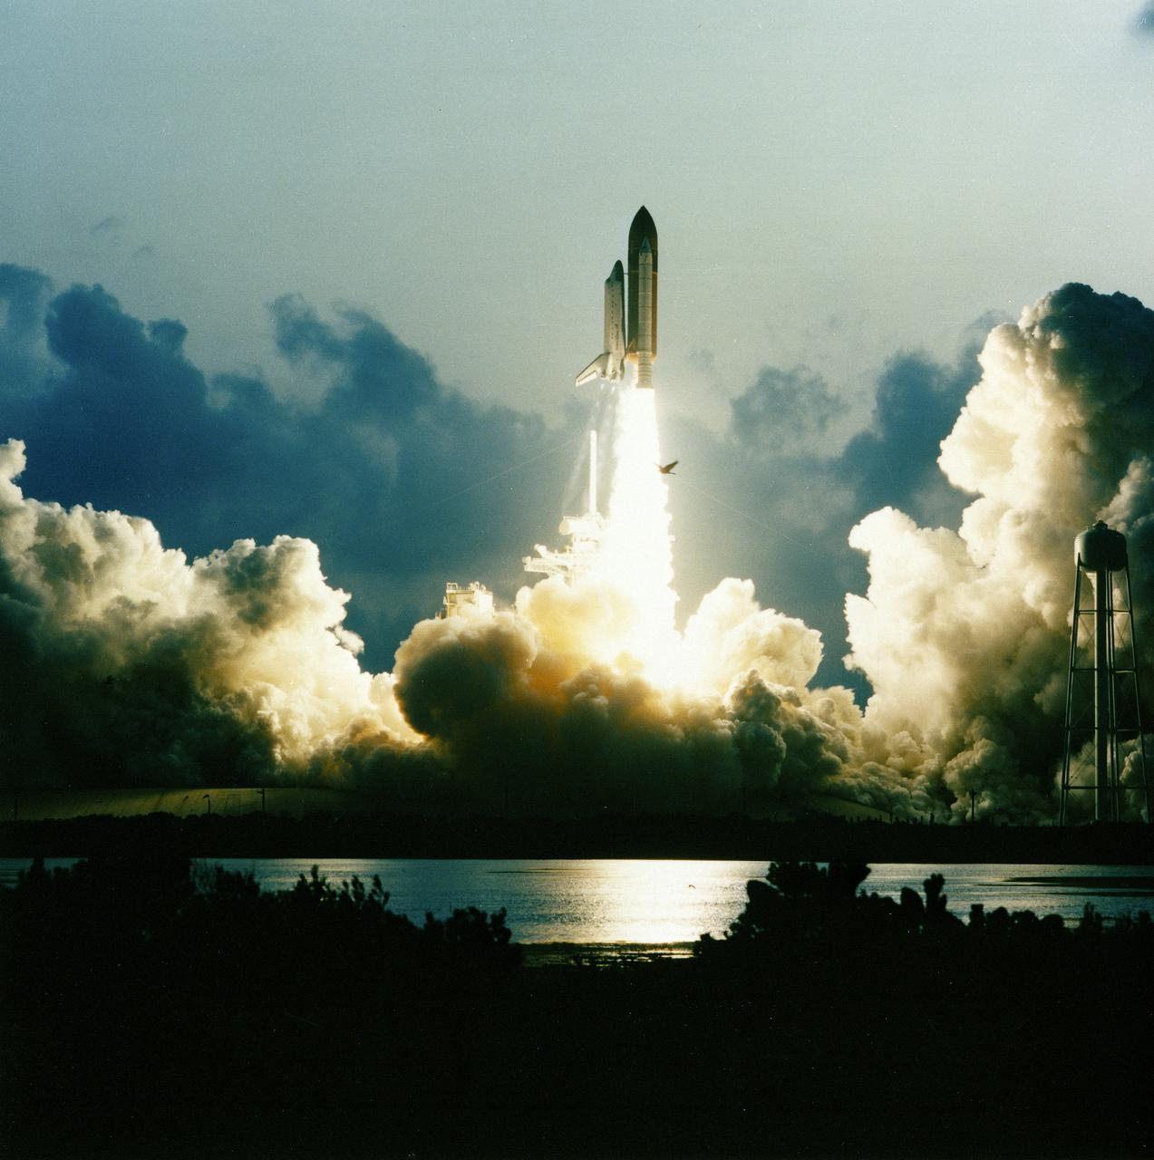
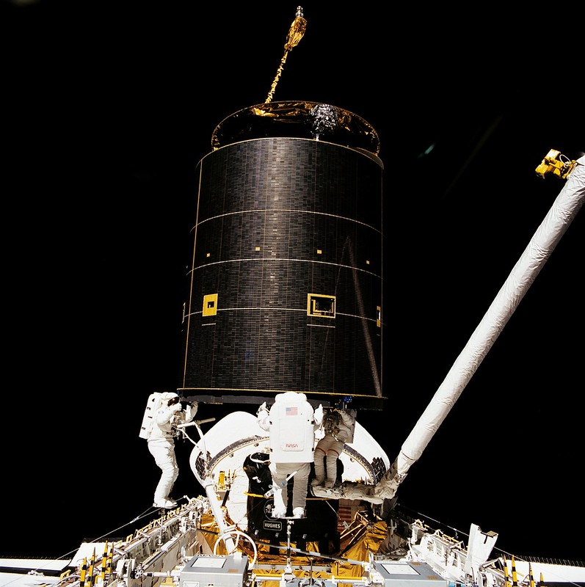
STS-49
[3]

Slide 12
STS-49
Project Background
  Attach Perigee Kick Motor (PKM) to INTELSAT VI (F-3)

Slide 13
STS-49
Project Execution
  Capture bar unable to stay connected
  New capture technique using hands
  Targeting attempt could not converge
    Lambert targeting code was the source of targeting failure

Slide 14
STS-49
Project Execution
  New GNC software reloading did not work
  Ti-Delay Maneuver
  Mission Control manually computed Ti
  Ti targeting attempts were successful
  PKM functioned successfully, INTELSAT continued its operations

Slide 15
STS-49
Lambert Targeting Anomaly
  Anomaly did not occur in the first 35 times it was used throughout STS-49
  Assigning of single-precision values to double-precision variables
  Comparison of single-precision variables with double-precision variables

Slide 16
STS-49
Lessons Learned
  Experienced and interdisciplinary flight control team
  Proper documentation and testing of changes made to code within iteration loops
  Proper review of analysis and technical reports
  Creation of documents describing software requirements for nonspecialists

Slide 17
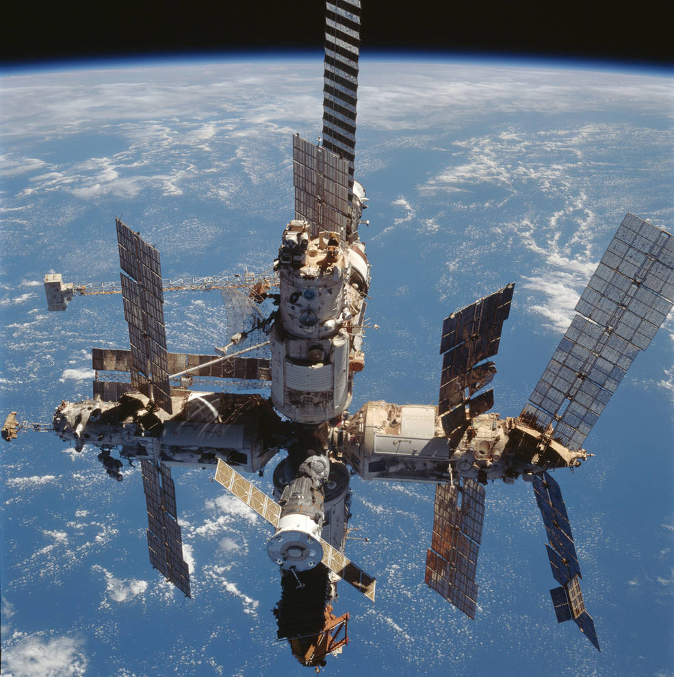
Progress-Mir
[4]

Slide 18
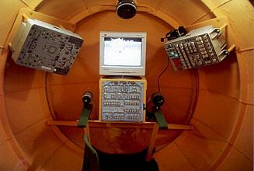
Progress-Mir
Project Background
  Teleoperated Rendezvous Control System (TORU)
  Russian Control Center to position Progress above Mir
  TORU Operator Vasiliy Tsibliyev control Progress to dock with Mir
[5]

Slide 19
Progress-Mir
Project Execution
  Tsibliyev’s screen was blank
  Screen worked after turning off emitter, ground control members manually calculated data
  Progress not visible in windows when it should have been in visual range

Slide 20
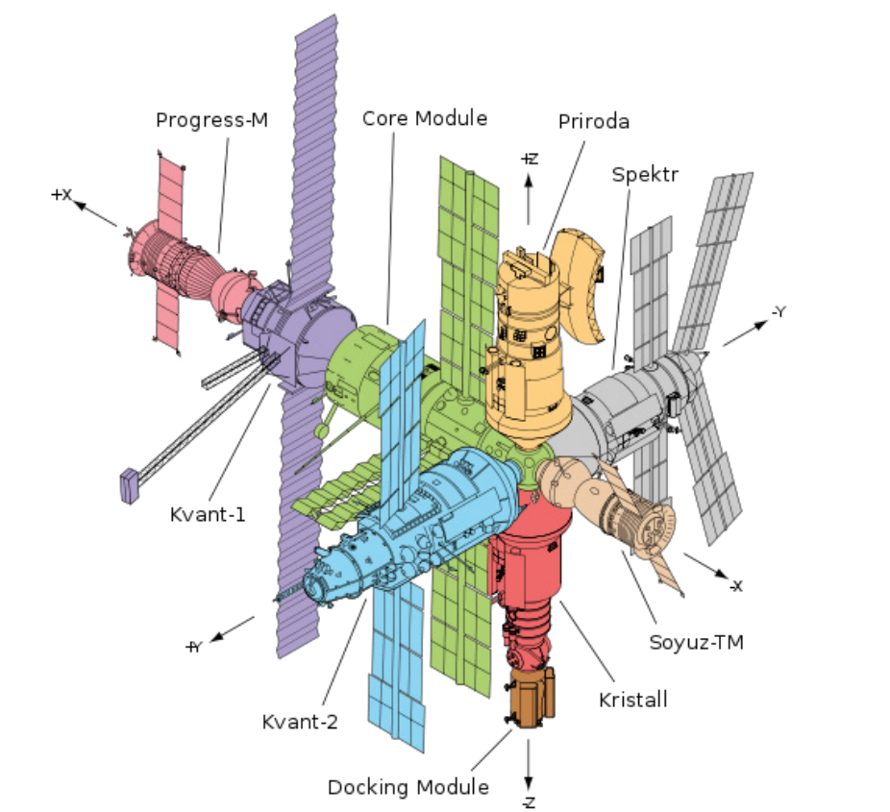
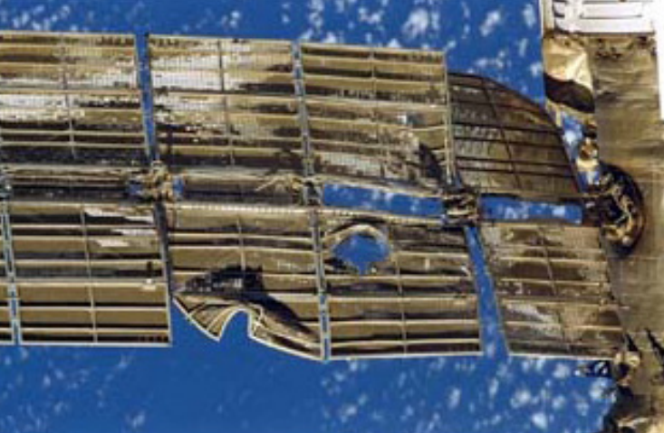
Progress-Mir
[5]

Slide 21
Progress-Mir
Project Execution
  A hole was punctured into Spektr, depressurizing the module
  Crew members sealed off the leak
  Reoriented Mir with help from ground control for solar panels to use sun

Slide 22
Progress-Mir
Lessons Learned
  Sharing of information essential to mission success and safety
  The negative effects of economic and social pressure an organization is facing
  Safer redesigning of docking system > forced docking on faulty system
  Radio contact with ground control

Slide 23
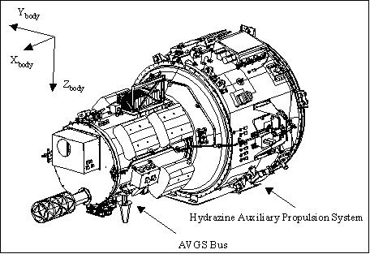
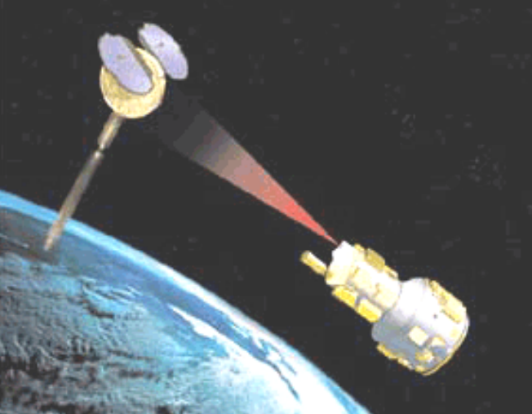
DART
[7]
[6]

Slide 24
DART
Project Background
  Demonstration of Autonomous Rendezvous Technology (DART) spacecraft
    Not designed to receive commands from ground control
  Multiple Paths, Beyond-Line-of-Sight Communications (MUBLCOM) satellite

Slide 25
DART
Project Execution
  Launch, early orbit, and rendezvous were completely successful
  DART started using more propellant than expected during proximity operations phrase
  DART detected it was out of propellant and initiated its department sequence
  Collided with MUBLCOM

Slide 26
DART
Detail into mishaps
Differences between estimated and measured position
DART restarted estimated speed and position using GPS; but GPS was inaccurate
Computational resets
DART premature departure and retirement
More differences between estimated and measured positions
Extra thruster firings, excessive fuel usage
Cyclic software resets

Slide 27
DART
Lessons Learned
  Quality of training and experience
  Rigorous GNC software development
  Management checks to prevent improper vehicle configurations from schedule pressure
  Risk assessments for high-priority flights

Slide 28
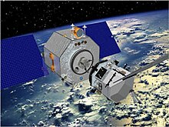
Orbital Express
[8]

Slide 29
Orbital Express
Project Background
  Demonstrate on-orbit satellite servicing autonomously
Autonomous Space Transfer and Robotic Orbiter (ASTRO)
Next generation Satellite/Commodity Spacecraft (NextSat/CSC)

Slide 30
Orbital Express
Project Execution
  ASTRO’s sensor computer had major failure, making it miscalculate its position and orientation
  ASTRO drifted unexpectedly, approached NextSat at wrong angle
  Unplanned configuration, triggering an automatic safety abort
  Manual intervention from ground operators to stabilize system
  ASTRO was able to successfully dock with NextSat

Slide 31
Orbital Express
Mishap details
  ASTRO’s sensor computer’s major failure causes ASTRO to execute abort procedure and the loss of autonomous rendezvous and capture sensor system (ARCSS) data
Errors compound and further deteriorate the navigation fix
Navigation filter rejected data from IR sensor
Accumulation of errors in previous navigation data

Slide 32
Orbital Express
Lessons Learned
  Assumptions made regarding navigation
  Relevance of IR sensors
  Problems from interdependence between sensor and navigation software
  Interference from ground control

Slide 33
Most Prominent Lessons Learned
Changes across systems must be thoroughly tested and properly documented.
  STS-32
  STS-49
  DART

Slide 34
Most Prominent Lessons Learned
Be cognizant of the pressure a company may face and the effects of this pressure on projects.
  Progress-Mir
  DART

Slide 35
Most Prominent Lessons Learned
Personnel and crew members should be interdisciplinary and well-experienced.
  STS-49
  DART

Slide 36
Most Prominent Lessons Learned
Avoid designs that preclude intervention from ground control.
  STS-49
  Orbital Express
  DART

Slide 37
Most Prominent Lessons Learned
Changes across systems must be thoroughly tested and properly documented.
Be cognizant of the pressure a company may face and the effects of this pressure on projects.
Personnel and crew members should be interdisciplinary and well-experienced.
Avoid designs that preclude intervention from ground control.

Slide 38
References
[1] Uri, John. “35 Years Ago: STS-32 Returns the Long Duration Exposure Facility,” NASA, Jan. 2025,
https://www.nasa.gov/centers-and-facilities/johnson/35-years-ago-sts-32-returns-the-long-duration-exposure-facility/
[2] Goodman, J. “Lessons Learned From Seven Space Shuttle Missions,” NASA CR–2007–213697, Jan. 2007.
[3] Lethbridge, C. “STS-49 Fact Sheet,” Spaceline,
https://www.spaceline.org/united-states-manned-space-flight/space-shuttle-mission-program-fact-sheets/sts-49/
[4] Uri, John. “20 Years Ago: Space Station Mir Reenters Earth’s Atmosphere,” NASA, Mar. 2021,
https://www.nasa.gov/history/20-years-ago-space-station-mir-reenters-earths-atmosphere/
[5] Lilley, S., “Spektr of Failure,” NASA, Vol. 4, Nov. 2010.
[6] Kramer, H., “DART: Rendezvous,” eoPortal, May 2012.
[7] Wander, S. “Fender Bender,” NASA, Vol. 2, No. 7, Sept. 2008,
https://sma.nasa.gov/docs/default-source/safety-messages/safetymessage-2008-09-01dartsautomatedcollision.pdf?sfvrsn=f3a91ef8_4
[8] “Orbital Express Space Operations Architecture,” Tactical Technology Office, Feb. 2007, https://web.archive.org/web/20070313165744/http://www.darpa.mil/tto/programs/oe.htm

