Slide 1

AERODYNAMIC MODELING FOR THRUST VECTOR CONTROL ROCKETRY
Rushil Negandhi, Jackson Meyers, Sameer Sheth, Hector Sanchez
GUIDANCE, NAVIGATION AND CONTROL
RAMBLIN’ ROCKET CLUB
GEORGIA INSTITUTE OF TECHNOLOGY
2025 AIAA Region II Student Conference, 3 April - 4 April 2025​
Copyright © by GNC Project of Ramblin' Rocket Club ​
Published by the American Institute of Aeronautics and Astronautics, Inc., with permission.
Notes:
Rushil: Hello everyone. My name is Rushil Negandhi and this is, Jackson Meyers, Sameer Sheth, and Hector Sanchez. Today, we represent the CFD simulations team within the Guidance, Navigation, and Control (GNC) team under the Ramblin’ Rocket Club at Georgia Tech. We will be talking about the development of an aerodynamic model for our vehicle.

Slide 2

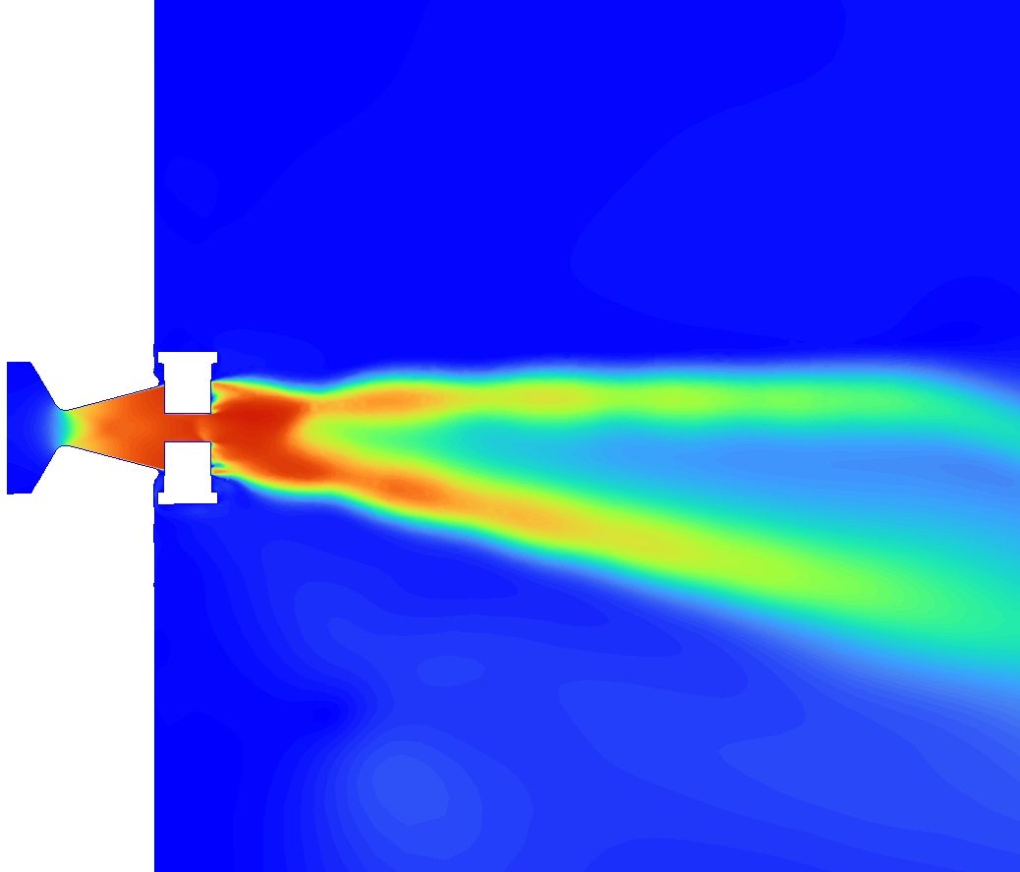

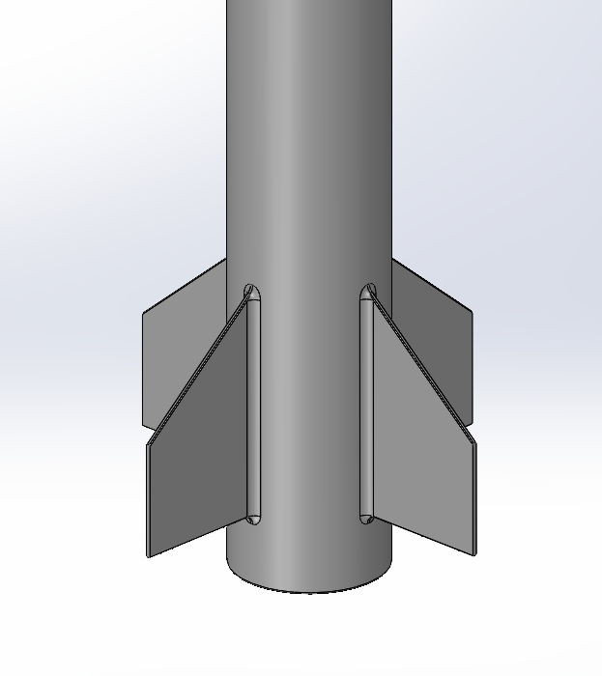
“Active Stability”
MOTIVATION
Goal: Build an actively stabilized rocket using jet vane thrust vector control
“Passive Stability”
Requires aerodynamic modeling of forces and moments at any flight condition
Notes:
Hector:
At GNC, our goal is to design, build, and launch an actively-stabilized rocket using jet vane thrust vector control.
Thrust vector control provides “active” stability to a rocket
When paired with a control system, deviations from a desired trajectory are calculated and the system will adjust the thrust accordingly to bring the vehicle back to its desired state.
However, even without controls, rockets can possess a “passive” stability system.
Specifically, the rocket body and fins experience aerodynamic forces that restore the rocket to its original position.
In order to properly account for the interaction between the passive and active stability systems, and to accurately simulate the trajectory of the rocket, an aerodynamic model of the rocket is required.
Flip the order, this model should output the aerodynamic forces and moments acting on the rocket at any flight condition – including Mach number, angle of attack, altitude, and even the rotation rates of the vehicle.
We can then pass this model off to our controls team, so they can tune their controls system.
While existing rocket trajectory software such as OpenRocket or RASAero do model aerodynamics, they often use extensive theoretical methods and neglect or greatly simplify dynamic stability.

Slide 3
AERODYNAMIC MODEL ROADMAP
Background
Static Stability: Approach
Static Stability: Results
Dynamic Stability Characterization
Georgia Institute of Technology | Guidance, Navigation, and Control
3

Slide 4
BACKGROUND
Static Stability
Dynamic Stability
Instantaneous disturbance (angle of attack) causes vehicle to experience restoring moment​
Forces/moments caused by motion of vehicle over time​
Focus on pitch rate, yaw rate, and roll rate restoring moments
Characterized using CFD and regression models
Estimated using theoretical methods
Notes:
Rushil: To approach the aerodynamic model, we must consider two types of stability – static and dynamic.
If we consider a rocket flying at a nonzero angle of attack, the fins produce a force that induces a restoring moment on the vehicle. This is known as “static” stability because it does not involve any transient effects. This is easily and accurately characterized using Computational Fluid Dynamics (CFD) simulations run at a series of flight conditions and nonlinear regression modeling performed to interpolate this data.
Dynamic stability is more complex. It involves the time-based oscillations caused by the rotation rates of the vehicle and the rate of change of angle of attack for example. The contribution from the latter was assumed to be small due to controlled, small perturbations and computational complexity. Because modeling transient effects in CFD exceeded our computational resource capabilities, these forces and moments were calculated using theoretical methods.

Slide 5
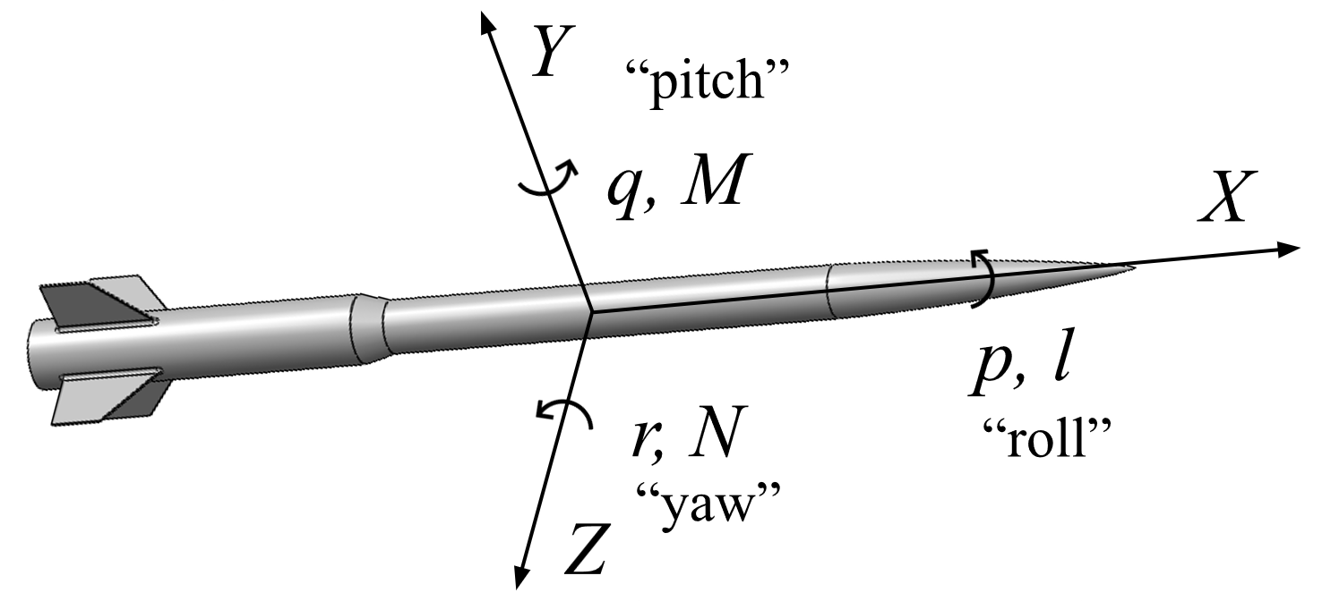




BACKGROUND
$$C_{L,total} =C_{L}+{\left(C_{L}\right)}_{q}$$
Lift Force →
$$C_{D,total}=C_{D}+{\left(C_{D}\right)}_{q}$$
Drag Force →
$$C_{M,total}=C_{M}+{\left(C_{M}\right)}_{q}$$
Pitch Moment →
$$C_{l,total} ={\left(C_{l}\right)}_{p}$$
Roll Moment →
“Static Stability” Contributions + “Dynamic Stability” Contributions
Notes:
Sameer: [make sure to mention pitch vs yaw]
These are how each aerodynamic force and moment is broken down into their static and dynamic contributions
The static stability terms are primarily functions of angle of attack and the dynamic terms are functions of rotations rates
We assumed a negligible drag force due to the pitch rate due to its significantly smaller values.
The rocket has two planes of symmetry meaning moments and forces acting in the pitch direction will similarly apply in the yaw direction
Finally, we also assumed that the fins have a negligible cant, or nonzero incidence angle with respect to the longitiudinal axis, meaning there is no static contribution to roll moment
As mentioned, the aerodynamic forces and moments acting on a rocket at any time comprise of contributions from both static and dynamic stability. Here, we establish how each force/moment is broken down. The orange terms represent force and moment coefficients as a function of angle of attack, while the blue terms describe contributions from rotation rates. [Describe variables and convention using picture]. Note that the lift force is actually a “side” force that acts in the lateral direction, caused by the fins. Drag force due to pitch rate was assumed to be small, and was neglected. Since the rocket has two planes of symmetry, moments and forces acting in the pitch direction can be applied to the yaw axes exactly. In this presentation, we will refer to longitudinal forces and moments in the sense of “pitch.” Finally, we note that there is no static contribution to roll moment because the fins do not feature in cant. In other words, since the fins do not have a natural nonzero incidence angle in reference to the longitudinal axis, roll moment is only a function of the roll motion of the rocket.
Emphasize colors and how they are used in the future

Slide 6
AERODYNAMIC MODEL ROADMAP
Background
Static Stability: Approach
Static Stability: Results
Dynamic Stability Characterization
Georgia Institute of Technology | Guidance, Navigation, and Control
6

Slide 7
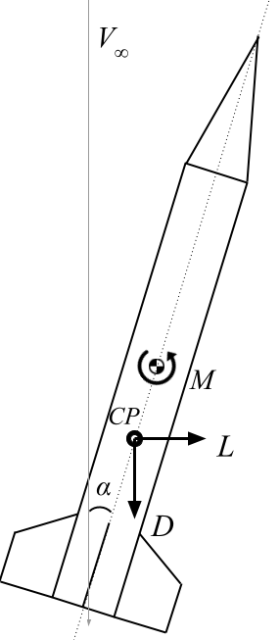
STATIC STABILITY: APPROACH
Aerodynamic coefficients are primarily a function of angle of attack (AOA) and Mach number
AOA – fins produce lift force → restoring moment
Mach number – compressibility effects
Altitude/density effects incorporated into non-dimensionalization
Notes:
Rushil: In the sense of static stability, the lift, drag, and moment aerodynamic coefficients are primarily a function of angle of attack and Mach number.
The image shows the mechanism of passive stability. When the fins – which can be thought of as small wings - are placed at an angle of attack, they produce a lift force in the direction normal to the freestream velocity. In addition, the rocket’s drag force is shown. The sum of these forces produce a moment around the center of gravity of the rocket. The moment arm is the distance between the center of gravity and the center of pressure, which is the average location of all pressure acting on the vehicle. This moment pushes the rocket back into the direction of the freestream velocity.
Mach number is also an independent variable here because compressibility affects aerodynamic forces. We choose not to depend on compressibility “corrections” because they are largely theoretical and may not capture low-aspect ratio 3D effects well. Note that density (affected by altitude) is not a variable because of non-dimensionalization that incorporates density effects.
To achieve expressions for lift, drag, and pitching moment that are functions of these two variables, we begin by simulating the rocket using CFD under aoa of 0,2.5, 5 and Mach of 0.2 to 0.7 with increments of 0.1, for a total of 18 simulations. Only three angles of attack are necessary to model the aerodynamics at small angles, which was observed to be highly linear. Simulations show our rocket goes up to Mach 0.6, so we want to make sure we are covering this entire range. After extracting lift, drag, and pitching moment, we use regression models to curve-fit the data to achieve analytical expressions rather than a table of values.

Slide 8
STATIC STABILITY: APPROACH
1. Simulate vehicle at AOA 0, 2.5, and 5 degrees, and Mach numbers 0.2 – 0.7
2. Extract lift, drag, pitching moment
3. Use regression models to curve-fit CFD data, achieving analytical expressions
Notes:
Rushil: In the sense of static stability, the lift, drag, and moment aerodynamic coefficients are primarily a function of angle of attack and Mach number.
The image shows the mechanism of passive stability. When the fins – which can be thought of as small wings - are placed at an angle of attack, they produce a lift force in the direction normal to the freestream velocity. In addition, the rocket’s drag force is shown. The sum of these forces produce a moment around the center of gravity of the rocket. The moment arm is the distance between the center of gravity and the center of pressure, which is the average location of all pressure acting on the vehicle. This moment pushes the rocket back into the direction of the freestream velocity.
Mach number is also an independent variable here because compressibility affects aerodynamic forces. We choose not to depend on compressibility “corrections” because they are largely theoretical and may not capture low-aspect ratio 3D effects well. Note that density (affected by altitude) is not a variable because of non-dimensionalization that incorporates density effects.
To achieve expressions for lift, drag, and pitching moment that are functions of these two variables, we begin by simulating the rocket using CFD under aoa of 0,2.5, 5 and Mach of 0.2 to 0.7 with increments of 0.1, for a total of 18 simulations. Only three angles of attack are necessary to model the aerodynamics at small angles, which was observed to be highly linear. Simulations show our rocket goes up to Mach 0.6, so we want to make sure we are covering this entire range. After extracting lift, drag, and pitching moment, we use regression models to curve-fit the data to achieve analytical expressions rather than a table of values.

Slide 9
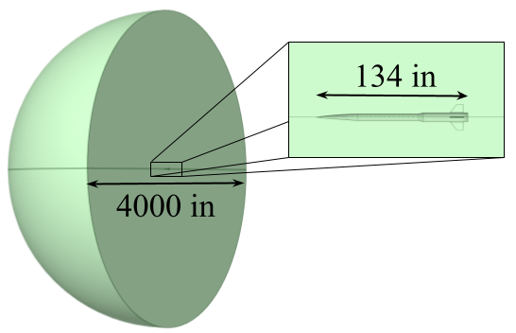
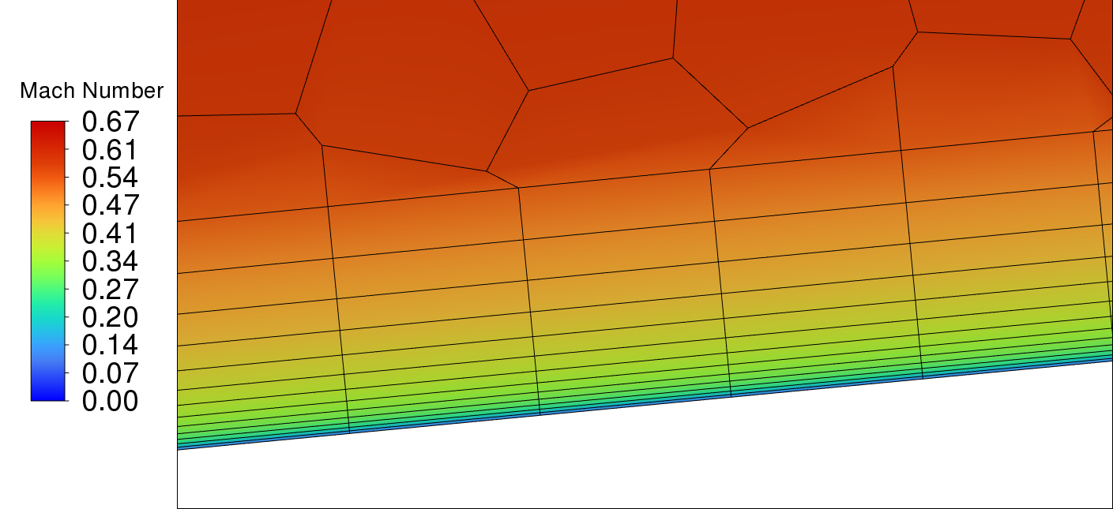
STATIC STABILITY: CFD SETUP
Geometry
  Defeaturing
  Fluid domain
Meshing
  Refined near body
  Inflation layers
Setup
  Farfield, symmetry, wall boundary conditions
Solve
  Pressure-based solver [1]
  Turbulence model: k-ω SST [2]
  Steady-state
Notes:
Jackson: CFD and meshing was performed using Ansys Fluent. First, the rocket model was defeatured, simplifying fasteners, launch lugs, and holes that would excessively complicate meshing and simulation. The fluid domain was built such that the farfield is about 15 rocket lengths far, ensuring that this boundary condition properly represents the freestream conditions. When meshing, measures were taken to ensure a sufficiently fine mesh near the body itself, especially at the wall. Shown here, inflation layer meshing contains the entire boundary layer, and a small first layer height is ensured to accurate modeling of the viscous sublayer by the turbulence model. Apart from the farfield, the boundary conditions used are a wall for the rocket itself, and a symmetry plane to reduce computational expense. A pressure-based solver was used for faster converge, and the k-omega SST model for accurate turbulence modeling.

Slide 10
AERODYNAMIC MODEL ROADMAP
Background
Static Stability: Approach
Static Stability: Results
Dynamic Stability Characterization
Georgia Institute of Technology | Guidance, Navigation, and Control
10

Slide 11
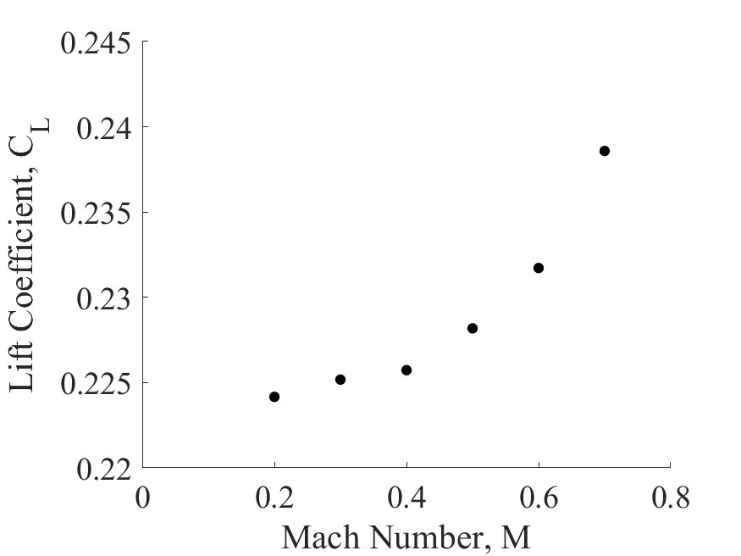
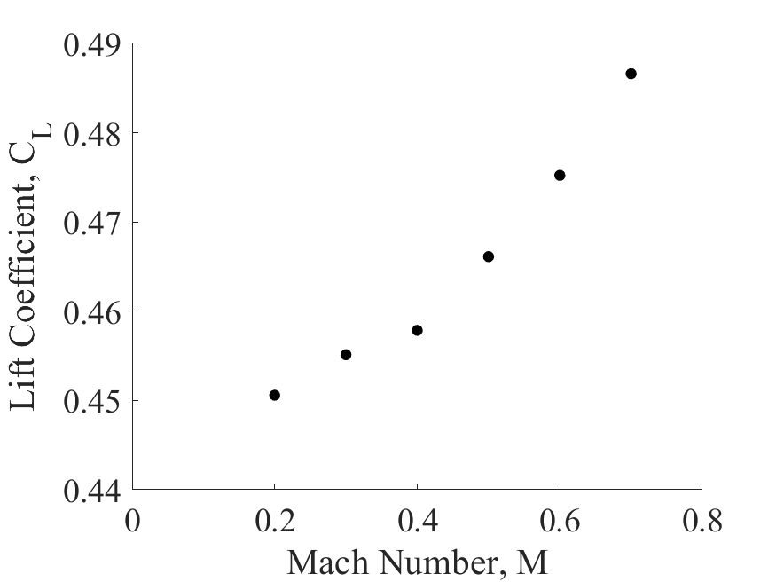


STATIC STABILITY: RESULTS, LIFT
$$α={2.5}^{∘}$$
$$α=5^{∘}$$
Notes:
Sameer:
Raw cfd results for the simultions
Linear trend with angle of attack
Mach number trend follows Prandtl glauert (explain what this is and be sure to mention that this is an altered version, you can even point out the sqrt(M^2-1), people might recognize that.
Led to a low MRE of about 0.8 %
Perfromed nonlinear least squares fit
Mention that 0 AOA gives 0 lift so its not shown.

Slide 12
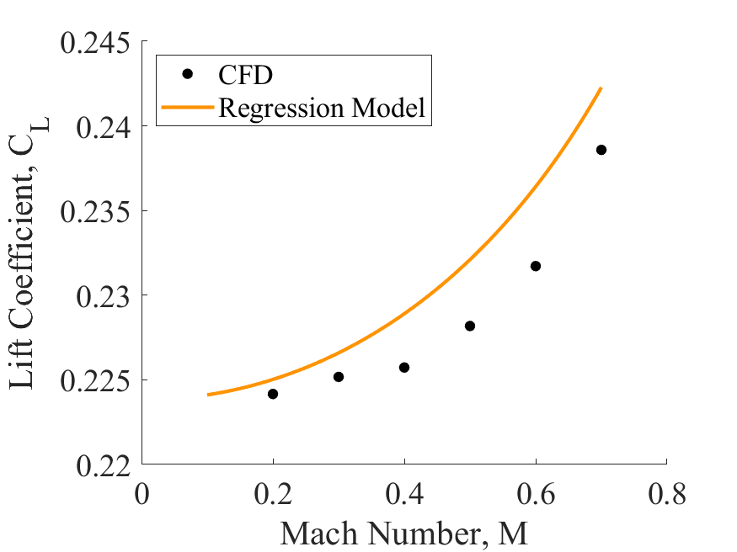
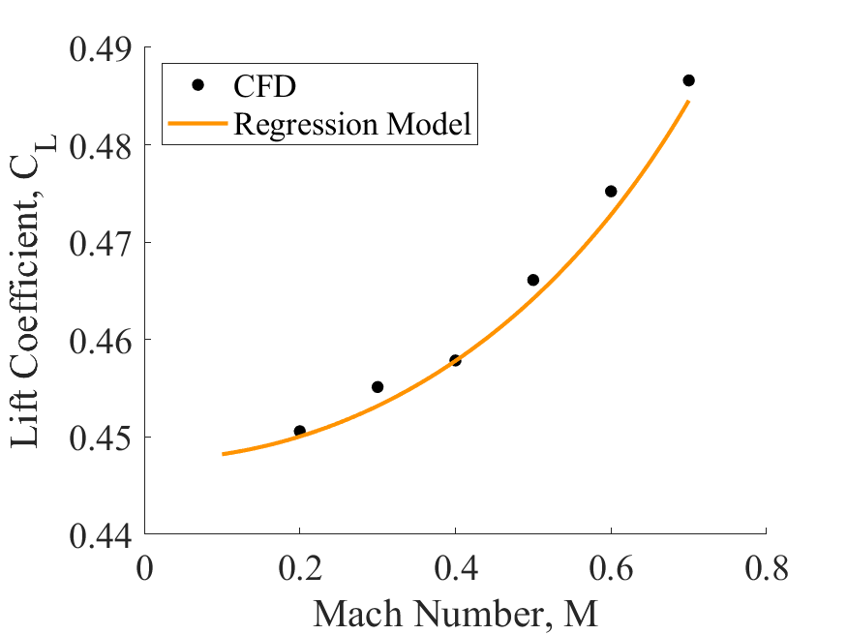



STATIC STABILITY: RESULTS, LIFT
$$α={2.5}^{∘}$$
$$α=5^{∘}$$
$$C_{L}\left(α, M_{∞}\right)=α\left(\frac{A}{B+\sqrt{1−M_{∞}^{2}}}\right)$$
Mean Relative Error: 0.801%
[3]
Notes:
Sameer:
Raw cfd results for the simultions
Linear trend with angle of attack
Mach number trend follows Prandtl glauert
Led to a low MRE of about 0.8 %

Slide 13
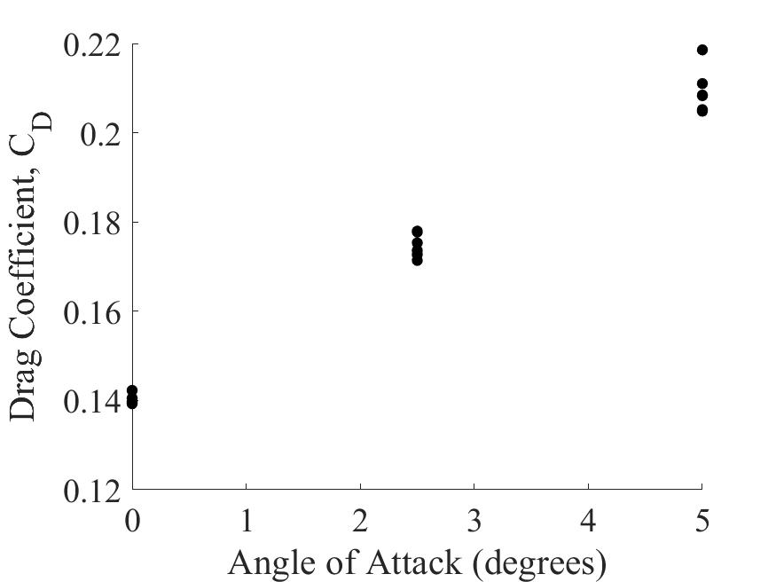
STATIC STABILITY: RESULTS, DRAG
Notes:
Sameer: yap a little
The drag was seemingly constant with Mach number so only considered the angle of attack
Raw cfd results for the simultions
linear trend with angle of attack – explain why not quadratic could be attributed to the low AR fins and high parasitic drag of the rocket
Nonzero y-intercept
Constnat with mach number
Led to a low MRE of about 1.5 %

Slide 14
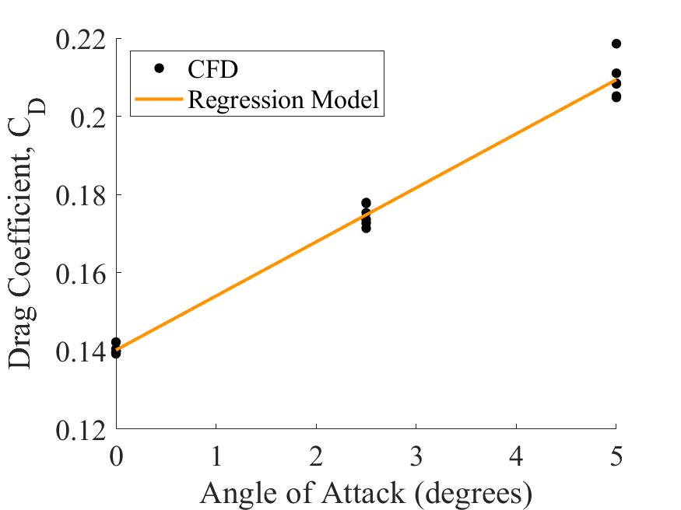

STATIC STABILITY: RESULTS, DRAG
Mean Relative Error: 1.384%
$$C_{D}\left(α\right)=Aα+B$$
Notes:
Sameer: yap a little
Raw cfd results for the simultions
linear trend with angle of attack
Y-intercept
Constnat with mach number
Led to a low MRE of about 0.75 %

Slide 15
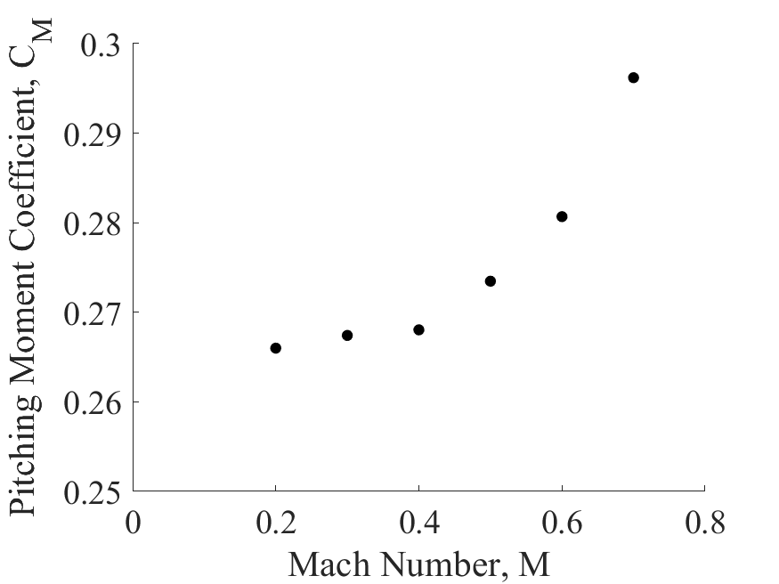
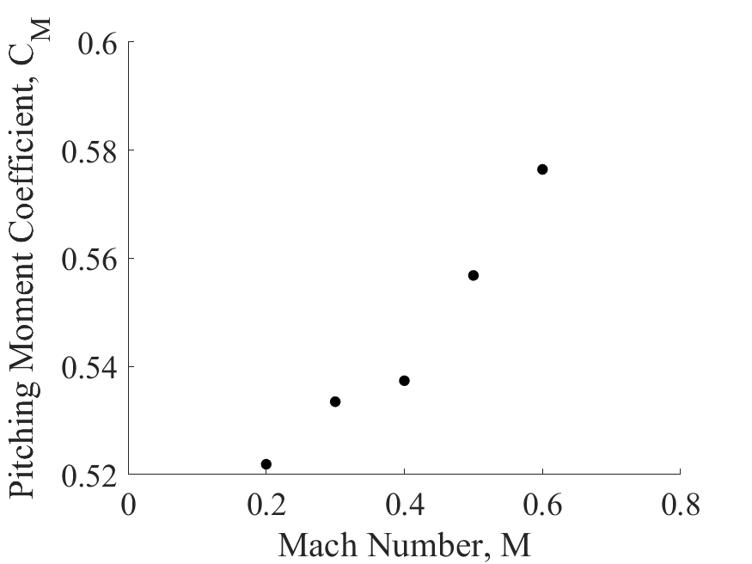
STATIC STABILITY: RESULTS, MOMENT
$$α=5^{∘}$$
$$α={2.5}^{∘}$$
$$α=5^{∘}$$
$$α={2.5}^{∘}$$
Notes:
Sameer:
Raw cfd results for the simultions
Mach number trend follows Prandtl glauert
Combination of both lift and drag
Led to a low MRE of about 0.8 %

Slide 16
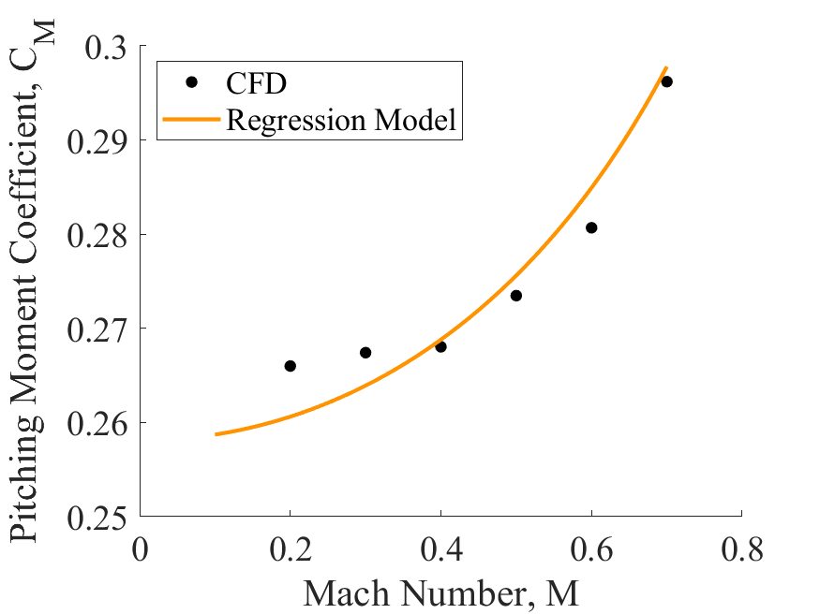
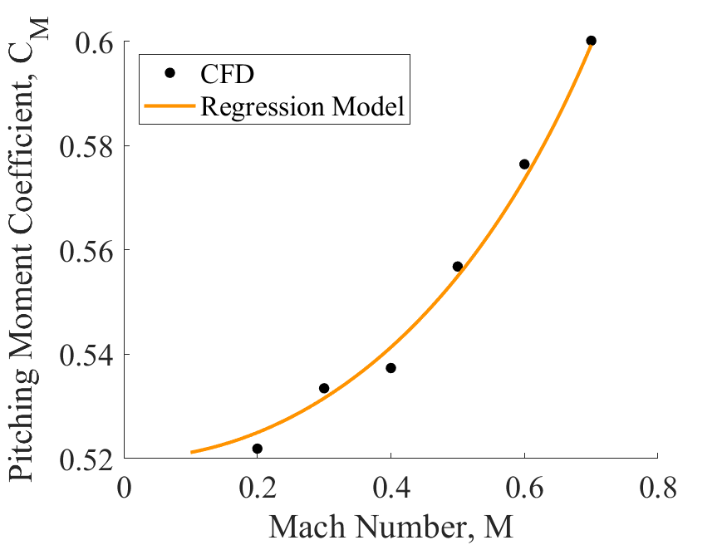

STATIC STABILITY: RESULTS, MOMENT
$$α=5^{∘}$$
$$α={2.5}^{∘}$$
$$α=5^{∘}$$
$$α={2.5}^{∘}$$
$$C_{M}\left(α, M_{∞}\right)=α\left(\frac{A}{B+\sqrt{1−M_{∞}^{2}}}+Cα+D\right)$$
Mean Relative Error: 0.758%
Notes:
Sameer:
Raw cfd results for the simultions
Mach number trend follows Prandtl glauert
Combination of both lift and drag
Led to a low MRE of about 0.8 %

Slide 17
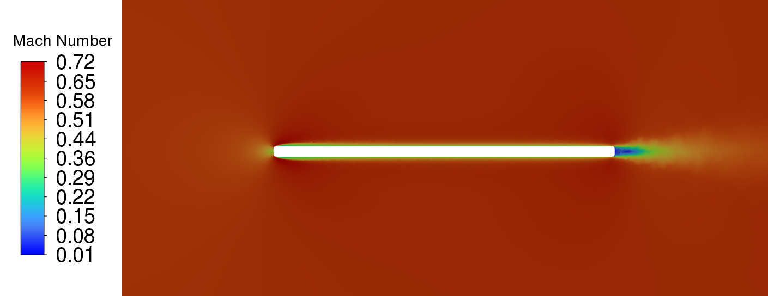
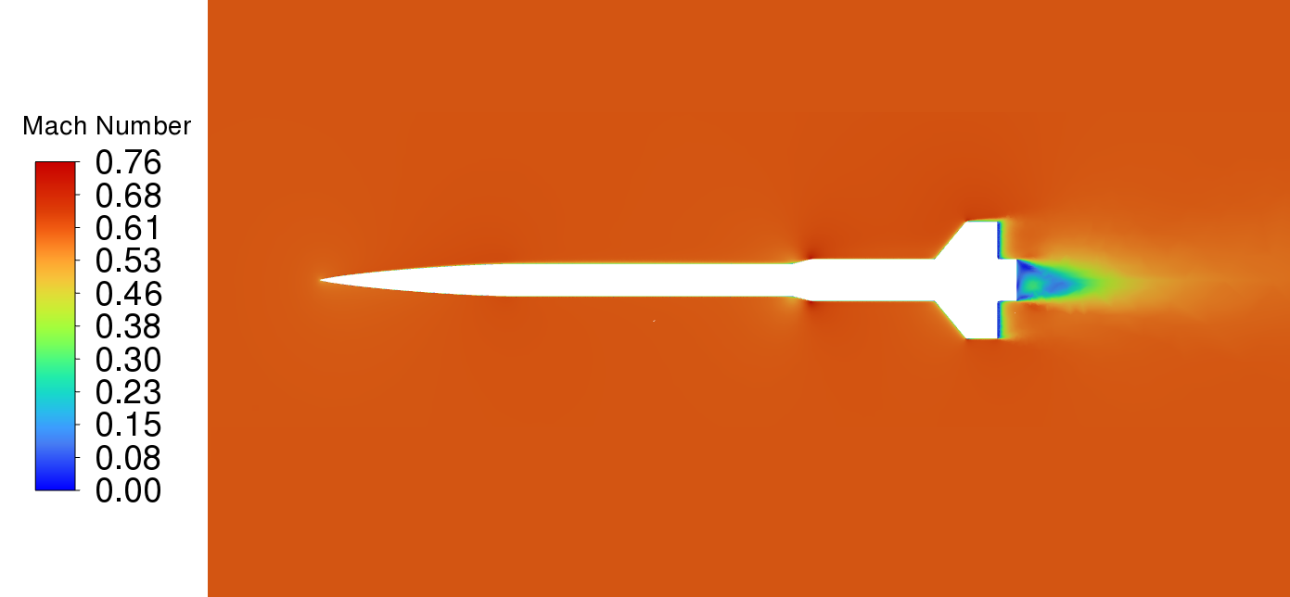
STATIC STABILITY: RESULTS
Minimal error from nonlinear regression
  Compressibility corrections
  Low aspect ratio
Error between CFD and flight
  Defeaturing – low drag contribution
  Performance under uncertainties
Notes:
Jackson: As shown, there is minimal error between the regression model and the data. Much of this error can be attributed to theoretical compressibility corrections, which do not capture all the complex flow attributes such as low-aspect ratio. What is more of concern is the error between these CFD results and actual flight. These could be attributed to defeaturing of the rocket, which could result in inaccurate prediction of drag. Fortunately, drag has little impact on the actual restoring moments and stability system. Additionally, the controls and simulations team has shown that the vehicle performs well even under high uncertainties.
We should also note some of the nonlinear effects that were neglected. Aeroelastic oscillations were assumed to be small due to the high-stiffness carbon fiber fins that will prevent excessive elastic deflection. Magnus effect – which results in lift due to roll rate, was ignored because we do not expect excessive roll rates with our control system. Additionall, induced pitch and roll were ignored due to small angles of attack.

Slide 18
AERODYNAMIC MODEL ROADMAP
Background
Static Stability: Approach
Static Stability: Results
Dynamic Stability Characterization
Georgia Institute of Technology | Guidance, Navigation, and Control
15

Slide 19
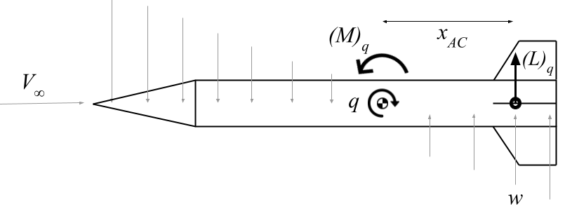



DYNAMIC STABILITY: LONGITUDINAL
Lift force due to pitch rate, q:
$${\left(C_{L}\right)}_{q}=\frac{{∂C}_{L}}{∂α_{q}}α_{q}$$
Pitching moment due to pitch rate, q:
$$\tan^{−1}\left(\frac{qx_{AC}}{V_{∞}}\right)$$
Semi-empirical estimate for low-aspect ratio fins [4]
$${\left(C_{M}\right)}_{q}=\frac{x_{AC}}{d}{\left(C_{L}\right)}_{q}$$
Non-dimensional moment arm
Notes:
Rushil: We have now established the static stability contributions to the aerodynamic model. To this, we will add the forces and moment caused by dynamic stability contributions. We use some theoretical methods to predict the forces and moments caused by pitch rate. We assume 0 angle of attack. As the rocket pitches, the fins are plunged into the flow, causing the relative velocity to have an upward component. This induces an angle of attack, causing a lift force. This also induced a stabilizing moment as shown. The 3D lift curve slope for low-aspect ratio wings is estimated using a sem-empirical formulation. The induced angle of attack is the inverse tangent of the ratio of the normal velocity component to the freestream velocity. The pitching moment is found by multiplying by the moment arm, although this is non-dimensionalized by the rocket diameter. Note, again, that the same formulation can be applied to the yaw axis.

Slide 20
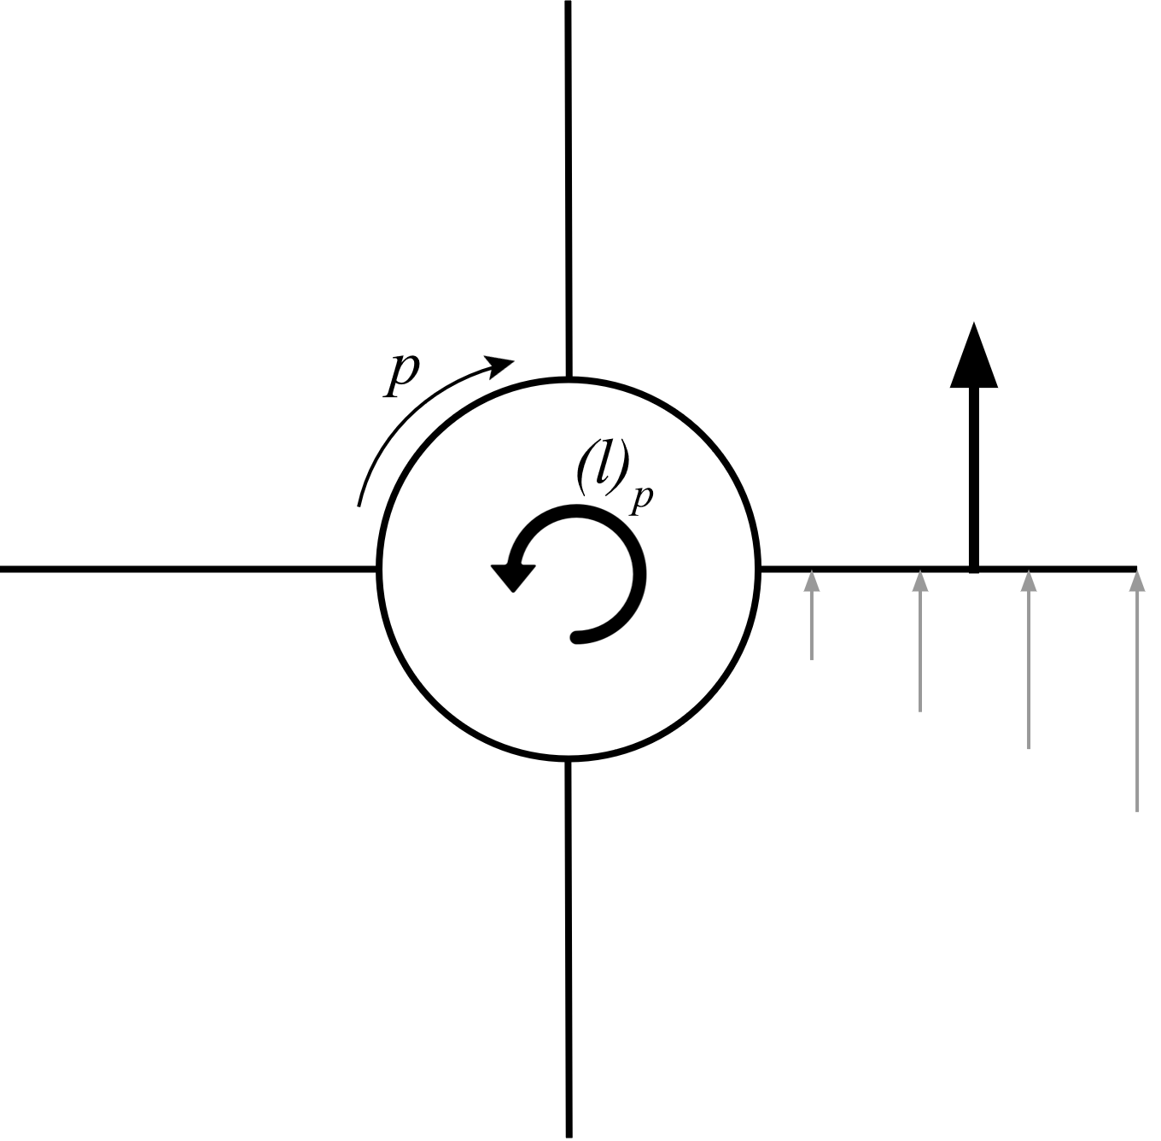


DYNAMIC STABILITY: ROLL
Rolling moment due to roll rate, p [5]:
Spanwise strip position
$${\left(C_{l}\right)}_{p}=N\sum_{i}{\frac{F_{i}ξ_{i}}{\frac{1}{2}ρV_{∞}^{2}S_{fin}d}}$$
Number of fins
$$F_{i}=\frac{1}{2}ρV_{∞}^{2}\frac{2π}{\sqrt{1−M^{2}}}c_{i}ξ_{i}\frac{pξ_{i}}{V_{∞}}$$
Force on each strip
Notes:
Hector:
In a similar fashion as the longitudinal stability, when a roll rate is introduced, stabilizing roll moments are created by the fins in the direction opposite of the roll rate
The formulation for this coefficient of moment was taken from the documentation of the rocket simulation software "OpenRocket"
This formulation splits a fin into a series of strips that produce some Force F at a location xi away from the center of the body, which would produce the restoring moment
Now the force of each strip is found by assuming a prandtl-glauert corrected lift curve slope of 2pi, dynamic pressure, area of each strip, and local angle of attack
Note that no net forces are produced here as each is canceled out by the symmetrical fin geometry, assuming zero angle of attack.

Slide 21
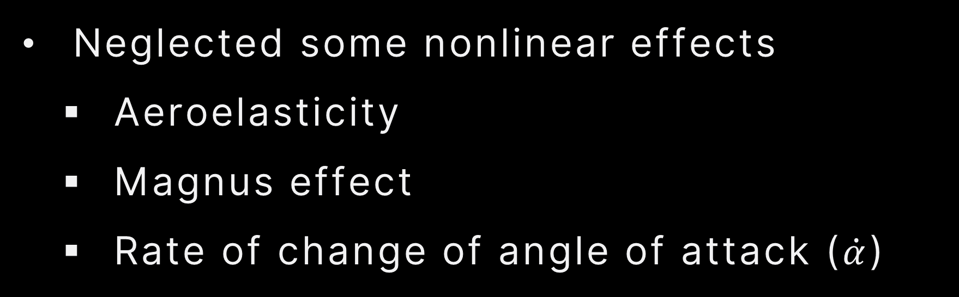
DYNAMIC STABILITY: SUMMARY
Accuracy
  Aerodynamic center approximation
  No method of strips
  Body effects
Neglected some nonlinear effects
  Aeroelasticity
  Magnus effect
  Rate of change of angle of attack ($\dot{α}$)
Notes:
Rushil:

Slide 22
CONCLUDING REMARKS
An aerodynamic model to predict forces and moments at any flight was developed
Used by controls team to simulate trajectory and account for aerodynamics
Future work:
  Use moving fluid domains and transient simulations
  Incorporate nonlinear effects previously neglected
  Automate simulations, more flight conditions
Notes:
Sameer: yap some
Mention that the aerodynamic model considers both static and dynamic stability
Moving fluid domains and transient simulations allow for a cfd-based calculation of dynamic stability contributions

Slide 23
REFERENCES
[1] ANSYS, “ANSYS FLUENT 12.0 Theory Guide,” ANSYS FLUENT 12.0/12.1 Documentation, 2024.
[2] Menter, F. R., “Two-Equation Eddy-Viscosity Turbulence Models for Engineering Applications,” AIAA Journal, Vol. 32, No. 8,1994, pp. 1598–1605. https://doi.org/10.2514/3.12149.
[3] Karman, T. V., “Compressibility Effects in Aerodynamics,” Journal of the Aeronautical Sciences, Vol. 8, No. 9, 1941.https://doi.org/10.2514/8.10737.
[4] Diederich, F. W., “A plan-form parameter for correlating certain aerodynamic characteristics of swept wings,” Tech. Rep.NACA-TN-2335, National Advisory Committee for Aeronautics, 1951.
[5] Niskanen, S., “OpenRocket Technical Documentation,” 2011.

Slide 24


Notes:
Hector: we would like to thank our sponsors for the help they have provided in completing this study.

Slide 25

THANK YOU

