Slide 1
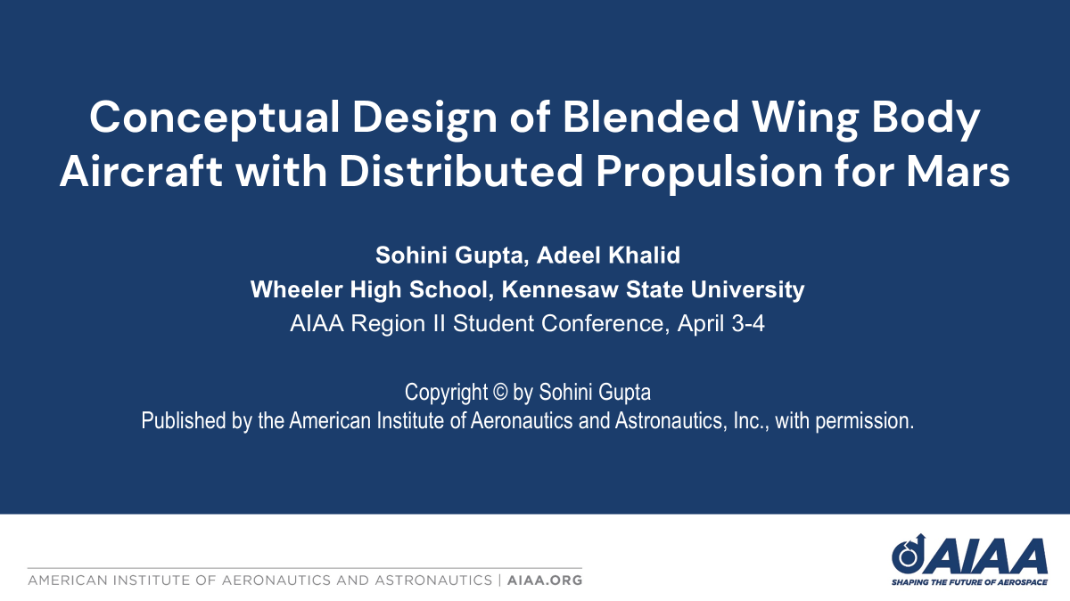

Slide 2
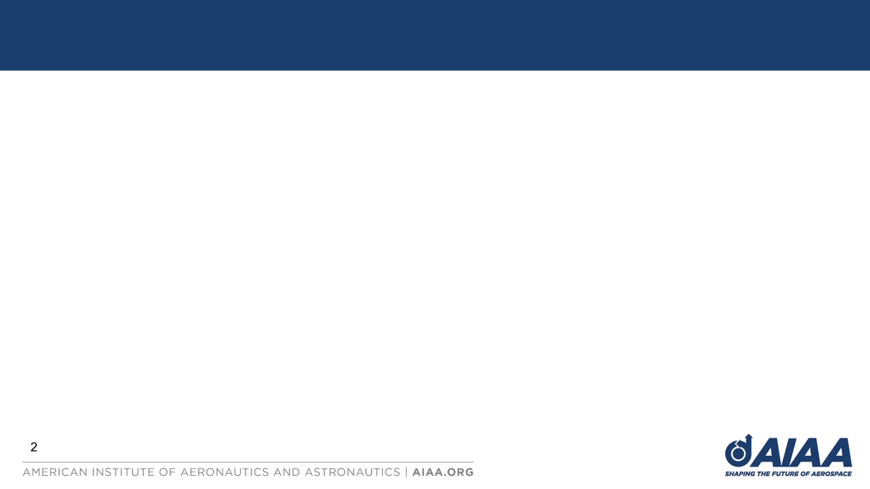
Design Sub-Problems
DSP 1 - Airfoil Selection
DSP 2 - 3D CAD Model
Sub Problem: selecting airfoil based on their data, Reynolds number, and conceptual sketches
Measure of Success: Lift-to-Drag is the highest compared to other airfoils
Sub Problem: creating CAD models of BWB
Measure of Success: CFD analysis shows Lift is greater than upper limit of weight range at cruise conditions
2

Slide 3
Methodology Flow Chart
1) Conceptual Sketches
2) Cruise Speed Estimation
3) Chord Length Estimation
4) Reynolds Number Estimation
Sub Problem: selecting airfoil based on their data, Reynolds number, and conceptual sketches
Measure of Success: Lift-to-Drag is the highest compared to other airfoils and is above 60
6) CAD Modeling
7) CFD Simulation
8) Determine Lift & Drag
5) Airfoil Selection
3
Notes:
Mention iterative weight estimation

Slide 4
Methodology Flow Chart - Airfoil Selection
1) Conceptual Sketches
2) Determine Kinematic Viscosity of Martian Atmosphere
3) Reynolds Number Estimation
4) Find Airfoil Models
5) Interpolate Data
6) Compare Data
7) Select Airfoil
8) Integrate Into CAD Model
4
Notes:
Viscosity and atmospheric density of mars

Slide 5
Mission Profile: MARVIN500
General survey & mapping
Survey land using various instruments
General survey & mapping
Survey land using various instruments
|—100 km—|
|—100 km—|
3
4
5
6
7
|———2 km———|
descent
climb
2
8
takeoff
landing
1
9
Range: 250 km
Loiter time: 30 mins each block
Cruise segment
Loiter segment
5

Slide 6
Mission Profile: MARVIN5K
Imaging & Mapping
Land & Environmental survey
Imaging & Mapping
Land & Environmental survey
Imaging & Mapping
Land & Environmental survey
Test imaging & mapping
100 km
100 km
100 km
5
6
7
8
9
10
11
Sub Problem: selecting airfoil based on their data, Reynolds number, and conceptual sketches
Measure of Success: Lift-to-Drag is the highest compared to other airfoils and is above 60
20 km
|—————2 km—————|
3
4
descent
|——1 km——|
climb
2
12
takeoff
landing
1
13
Range: 500 km
Loiter time: 30 mins each block
Cruise segment
Loiter segment
6

Slide 7
Mission Profile: MARVIN50K
Imaging & Mapping
Land & Environmental survey
Imaging & Mapping
Land & Environmental survey
|—100 km—|
|—100 km—|
|—100 km—|
3
4
5
6
7
8
9
|———2 km———|
13
12
11
10
|———120 km———|
climb
|—100 km—|
descent
2
Land & Environmental survey
Imaging & Mapping
Land & Environmental survey
Imaging & Mapping
takeoff
1
landing
14
15
Cruise segment
Range: 600 km
Loiter time: 30 mins each block
Loiter segment
7
Notes:
This one uses net capture mechanism to retrieve aircraft

Slide 8
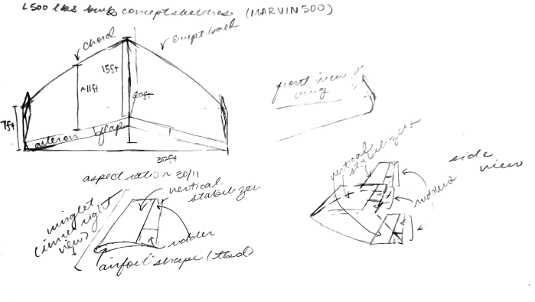
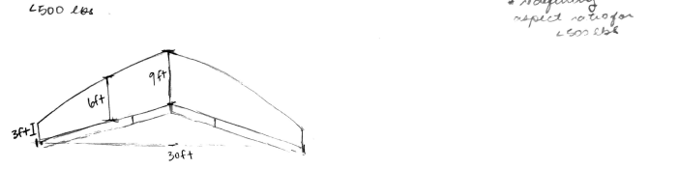
Final Conceptual Sketches - MARVIN500
Top: defines shape and views
Bottom: modifies dimensions
8

Slide 9
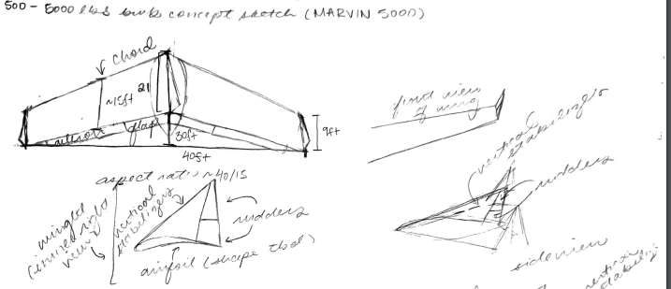
Final Conceptual Sketches - MARVIN5K
9

Slide 10
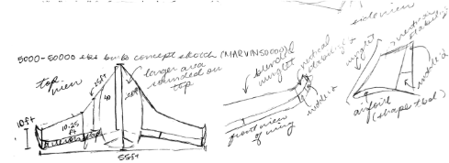
Final Conceptual Sketches - MARVIN50K
10

Slide 11

DSP1: Airfoil Selection
MOS: Maximized L/D

Slide 12
Cruise Speed Estimation
Model | Cruise Speed (m/s)
MARVIN500 | 62.23
MARVIN5K | 78.68
MARVIN50K | 197.37
Averaged cruise speed from past models
Not enough BWB models → general fixed-wing UAVs used
12

Slide 13
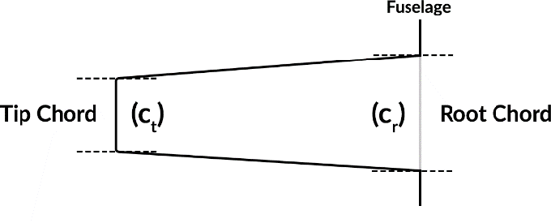
Airfoil Chord Estimation
Model | Chord Length ft (m)
MARVIN500 | 6 (1.83)
MARVIN5K | 15 (4.57)
MARVIN50K | 25 (7.62)
Averaged wing width
Found from Conceptual Sketches
Avg. Chord
Source
13

Slide 14
Reynolds Number Estimation
Model | Reynolds Number
MARVIN500 | 118,052.39
MARVIN5K | 373,154.12
MARVIN50K | 1,560,109.32
Re = vl/μ
  v → cruise speed
  l → characteristic length (chord length)
  μ → kinematic viscosity (0.000964 m²/s)
Source
14

Slide 15
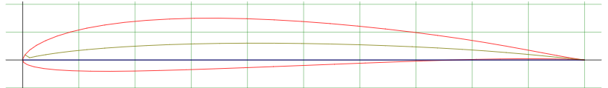
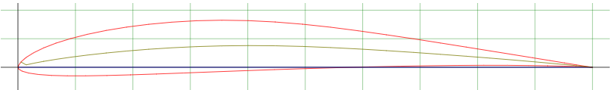
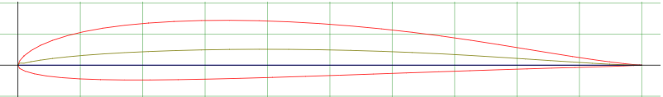
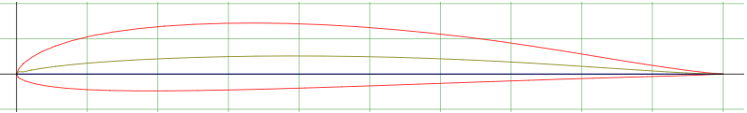
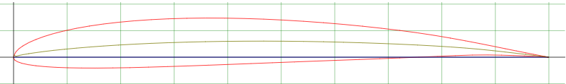
Airfoil Models
Airfoil Model
Sd7037
E387
E174
NACA6409
S7075
Source
14
Notes:
Add a chart before this showing all five airfoils

Slide 16
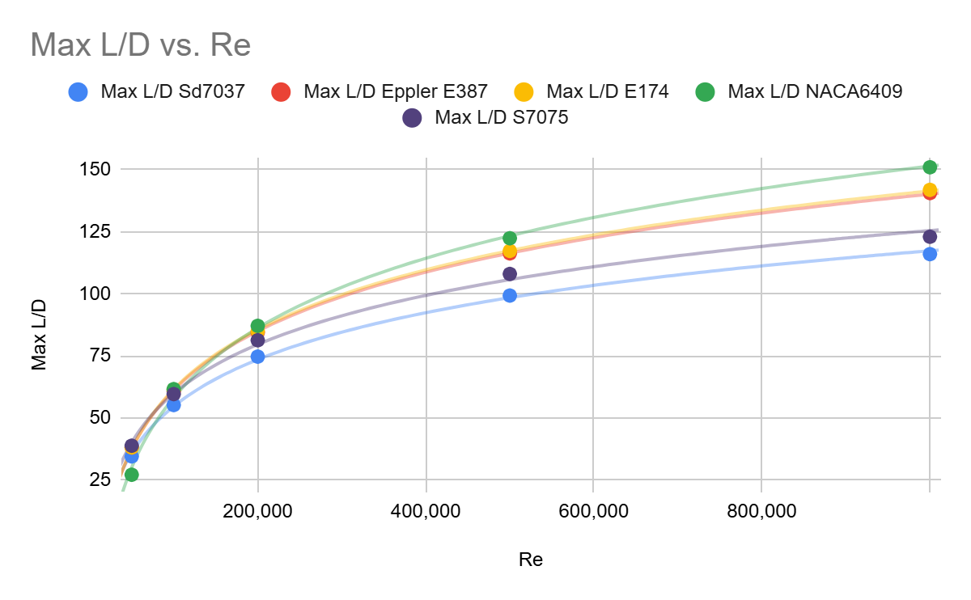
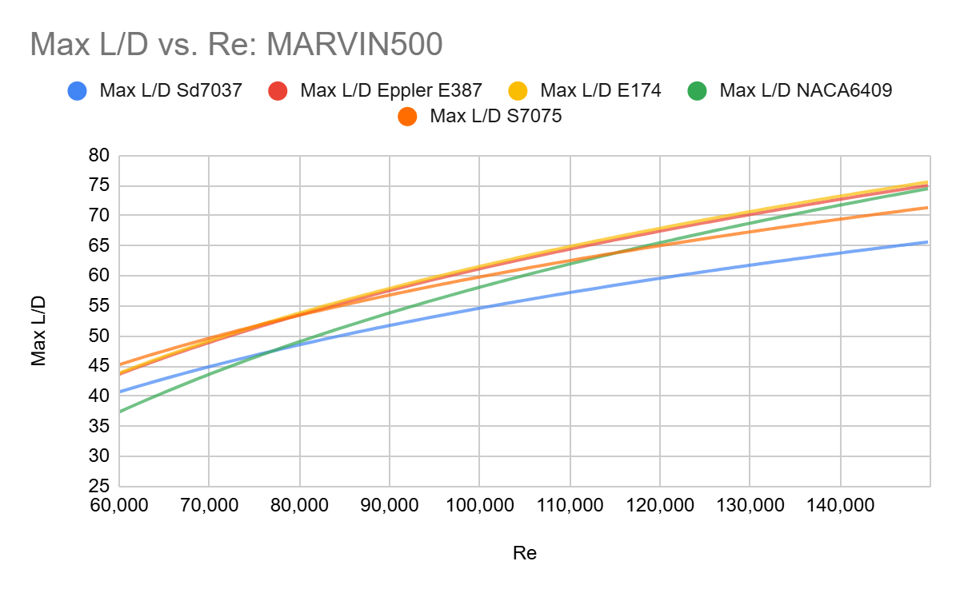
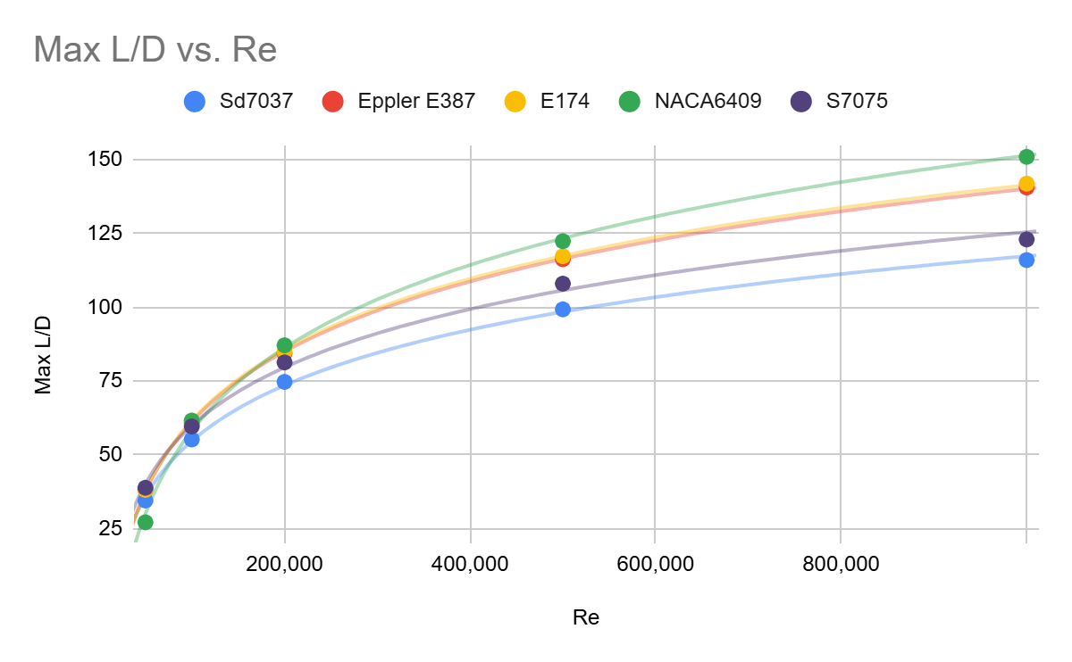
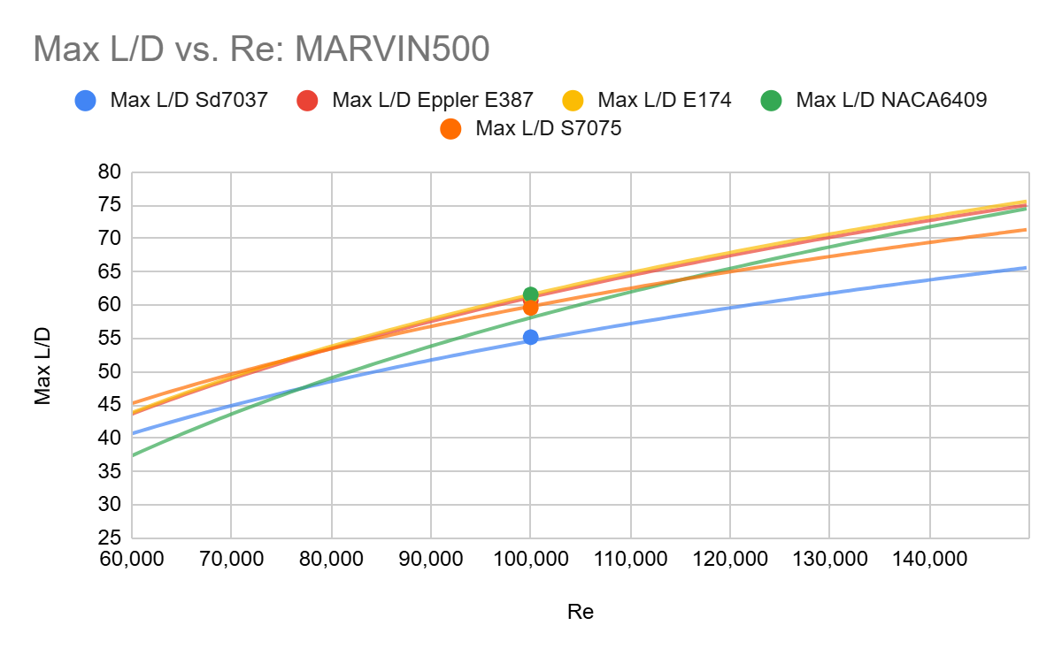
Airfoil Data Interpolation
Source
14
Notes:
Add a chart before this showing all five airfoils

Slide 17
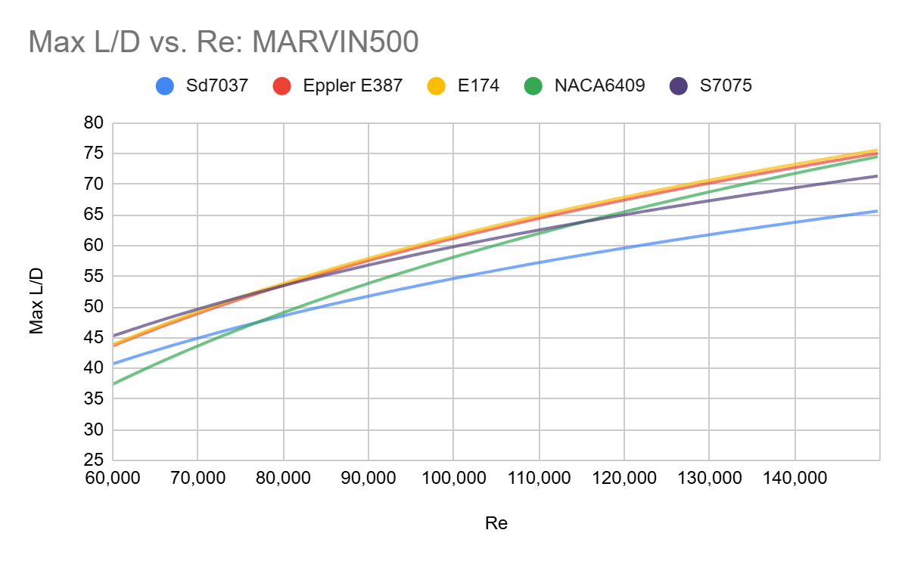
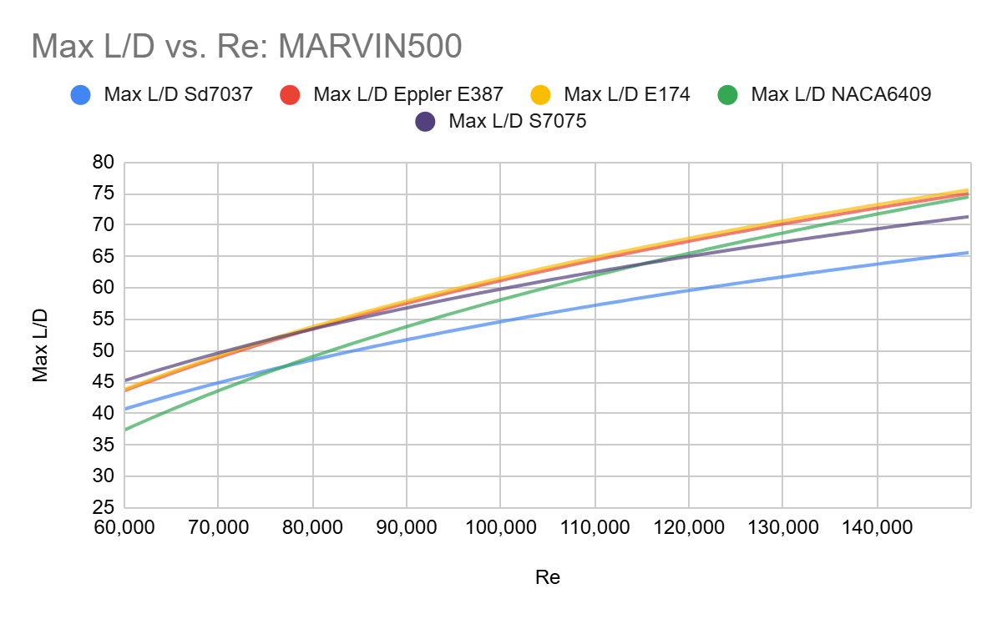
Airfoil Data Interpolation: MARVIN500
Source
14

Slide 18
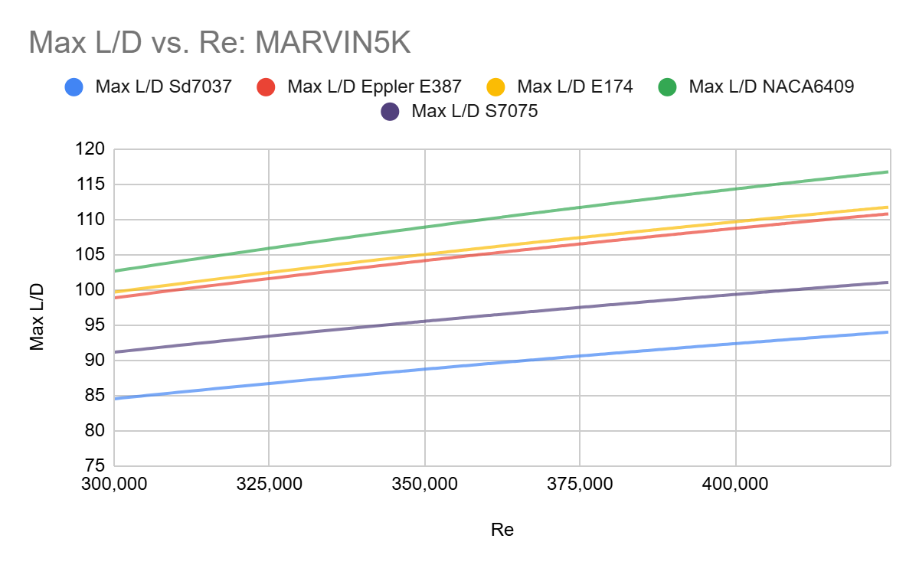
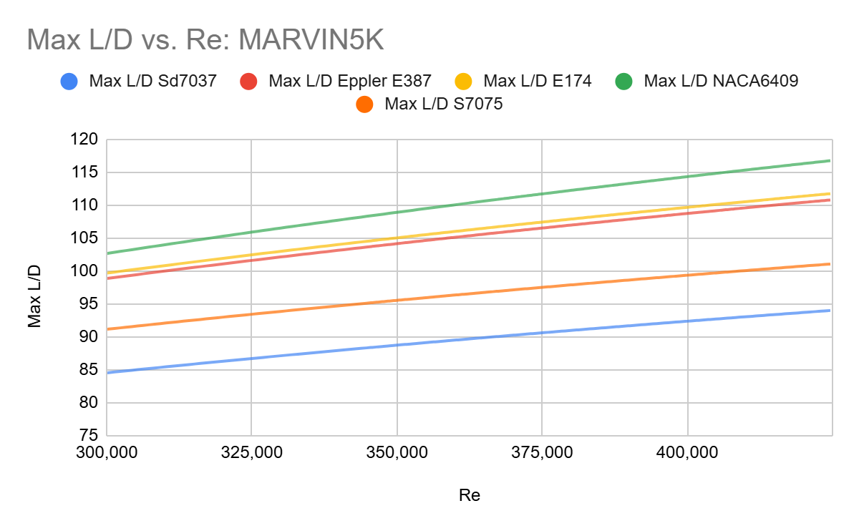
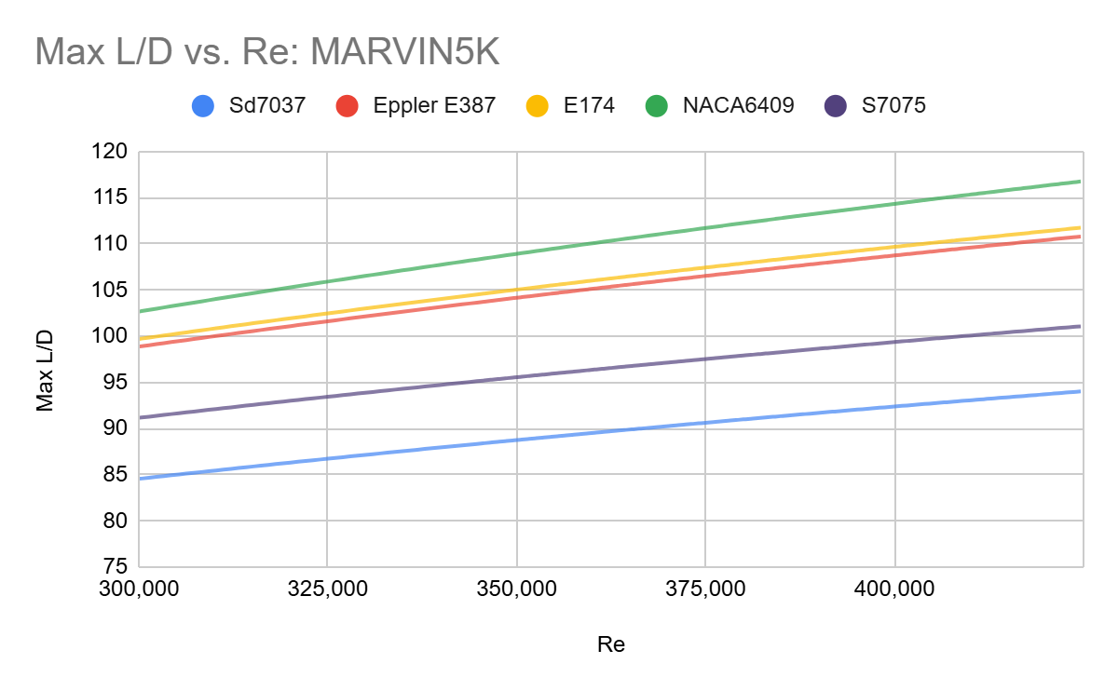
Airfoil Data Interpolation: MARVIN5K
Source
14

Slide 19
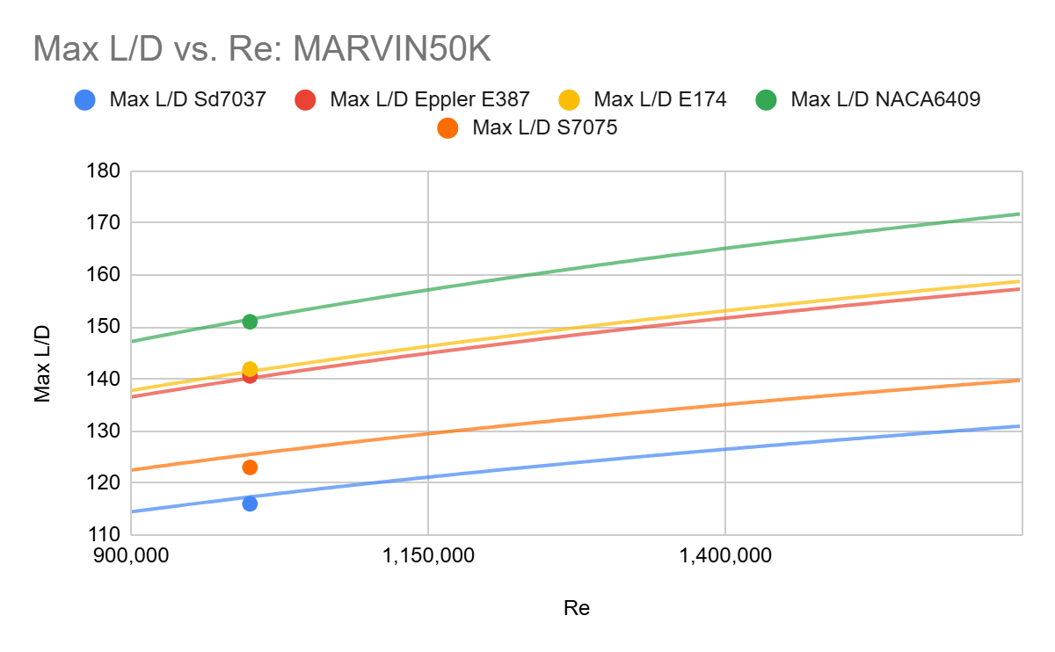
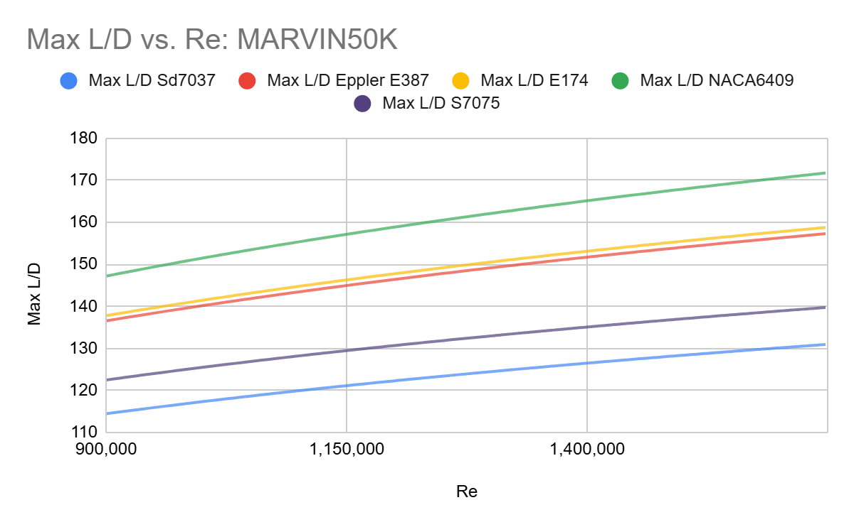
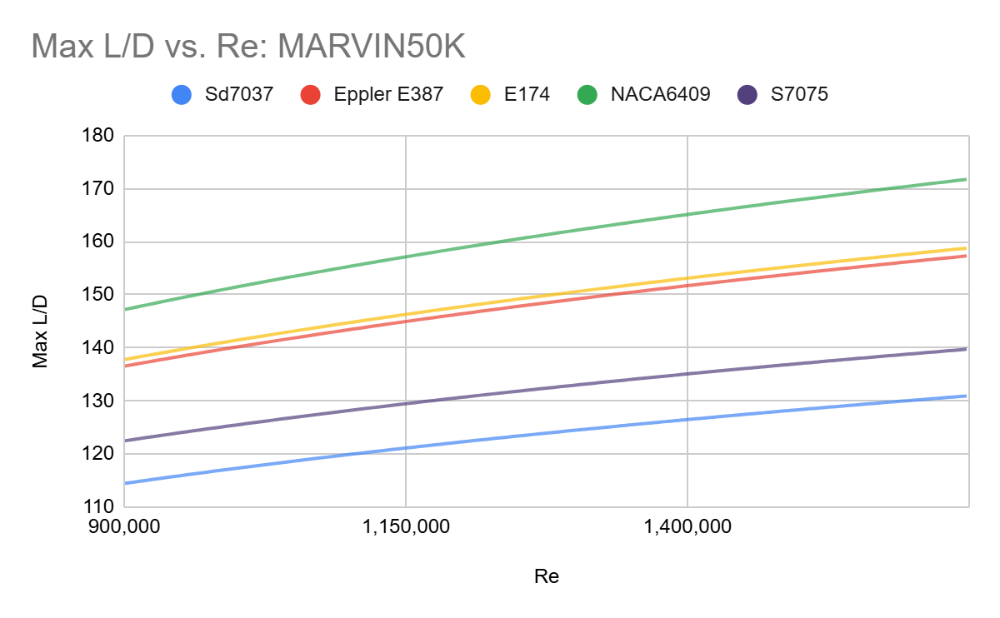
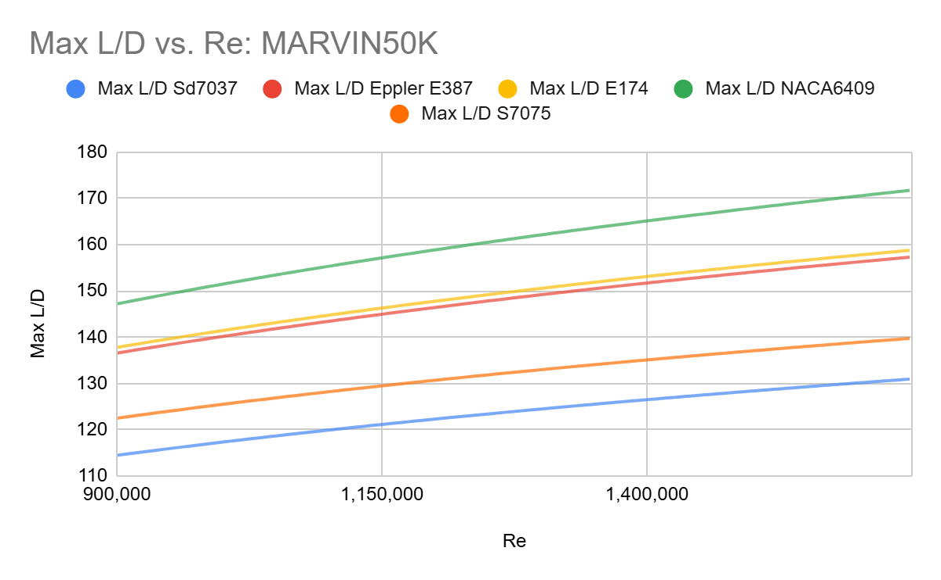
Airfoil Data Interpolation: MARVIN50K
Source
14

Slide 20
Airfoil Selection
MARVIN500: E174; L/D = 67.26
MARVIN5K: NACA6409; L/D = 110.60
MARVIN50K: NACA6409; L/D = 168.54
Data from airfoil database interpolated to find the L/D for aircraft based on its calculated Re
Data is tested and accurate; based on wind tunnel tests
Source
15

Slide 21
DSP2: CAD Modeling
MOS: Lift is greater than upper weight limit

Slide 22
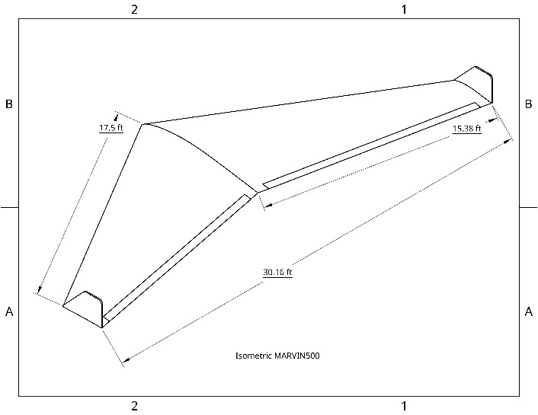
CAD Models - MARVIN500
17
Notes:
Show just isometric

Slide 23
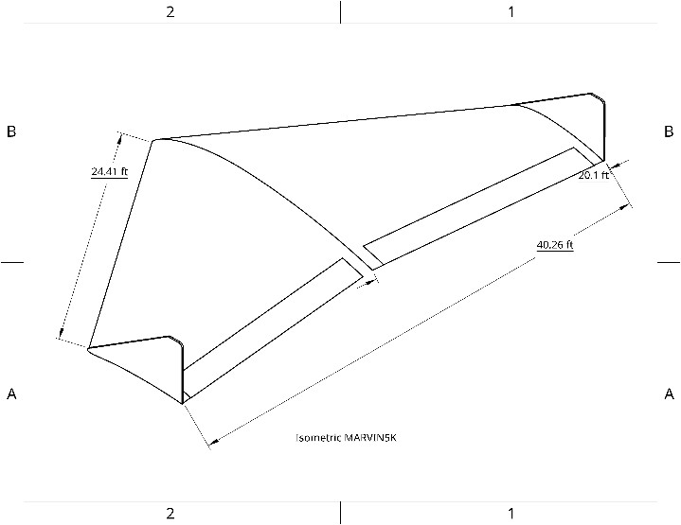
CAD Models - MARVIN5K
18

Slide 24
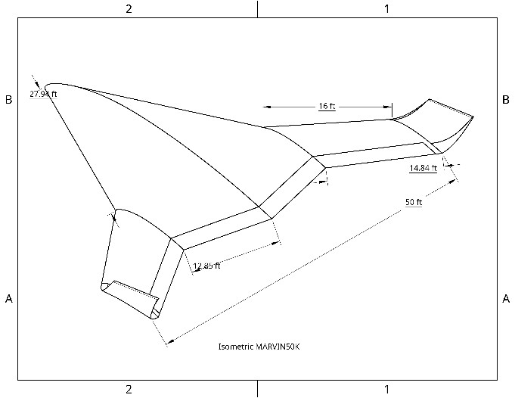
CAD Models - MARVIN50K
19

Slide 25
CFD Simulation Results
Parameters:
  Mars Environment, Gravity: 3.73 m/s², Altitude: 2km, Initial velocity = cruise speed in x-direction
Average Lift and Average Drag values taken into consideration
Up to 300 iterations of CFD calculations per aircraft
Model | Average Lift (N) | L/D | Weight (N) | Payload Capacity (N)
MARVIN500 | 4,994.24 | 12.49 | 764.30 | 4,229.94
MARVIN5K | 28,907.7 | 7.38 | 7,643.03 | 21,263.97
MARVIN50K | 500,712 | 10.37 | 76,430.31 | 424,281.69
20

Slide 26
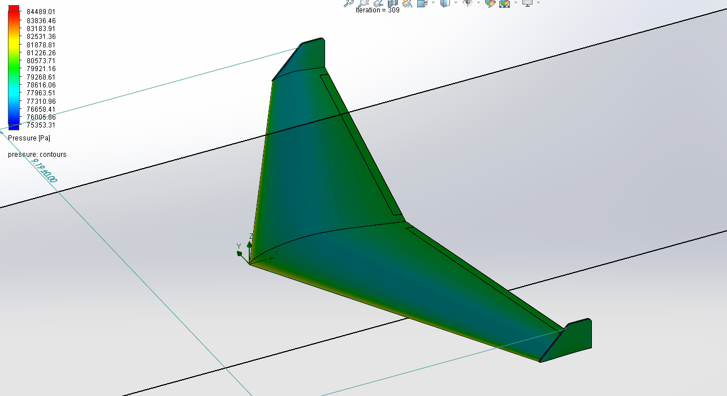
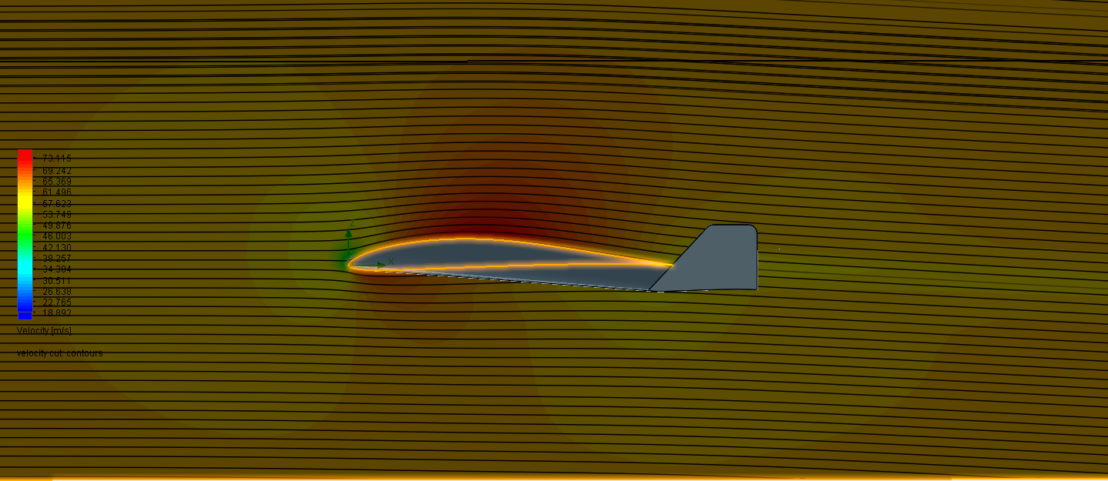
Conclusions and Implications
Future Work
Conclusions & Implications
Velocity & pressure plots
Comparison to traditional aircraft
Dimensional Analysis
Configuration layout
Prototyping & wind tunnel testing
Lift greater than upper limit of aircraft’s weight on Mars for all models
MARVIN models have the potential to fly on Mars
High-level MARVIN models can be integrated into future missions
Pressure Plot for MARVIN500
Velocity Plot for MARVIN500
21

Slide 27
Questions?
Thank you!

Slide 28


Slide 29
References
Airfoil tools. (2019). Airfoiltools.com. Retrieved August 27, 2024 from https://airfoiltools.com
Airfoil tools: CLARK Y. (2019). Airfoiltools.com. Retrieved November 5, 2024 from http://airfoiltools.com/airfoil/details?airfoil=clarky-il
Airfoil tools: E174. (2019). Airfoiltools.com. Retrieved November 5, 2024 from http://airfoiltools.com/airfoil/details?airfoil=e174-il
Airfoil tools: E387. (2019). Airfoiltools.com. Retrieved November 5, 2024 from http://airfoiltools.com/airfoil/details?airfoil=e387-il
Airfoil tools: NACA 0012-34. (2019). Airfoiltools.com. Retrieved November 5, 2024 from http://airfoiltools.com/airfoil/details?airfoil=naca001234-il
Airfoil tools: NACA6409. (2019). Airfoiltools.com. Retrieved November 5, 2024 from http://airfoiltools.com/airfoil/details?airfoil=n6409-il

Slide 30
References
Airfoil tools: NASA SC(2)-0518. (2019). Airfoiltools.com. Retrieved November 5, 2024 from http://airfoiltools.com/airfoil/details?airfoil=sc20518-il
Airfoil tools: S3014-095-85. (2019). Airfoiltools.com. Retrieved November 5, 2024 from http://airfoiltools.com/airfoil/details?airfoil=s3014-il
Airfoil tools: S7075. (2019). Airfoiltools.com. Retrieved November 5, 2024 from http://airfoiltools.com/airfoil/details?airfoil=s7075-il
Airfoil tools: SA7035. (2019). Airfoiltools.com. Retrieved November 5, 2024 from http://airfoiltools.com/airfoil/details?airfoil=sa7035-il
Airfoil tools: Sd7037. (2019). Airfoiltools.com. Retrieved November 5, 2024 from http://airfoiltools.com/airfoil/details?airfoil=sd7037-il

Slide 31
References
Airforce Technology. (2003, May 13). X-45 J-UCAV (Joint Unmanned Combat Air System). Airforce Technology. https://www.airforce-technology.com/projects/x-45-ucav/
Ansys. (n.d.). Quality assurance. Retrieved October 29, 2024 from https://www.ansys.com/company-information/quality-assurance
Bridgeman, L. (1947). Jane’s all the world’s aircraft 1974. Sampson Low, Marston, & Co.
Brown, D. (1970). Miles aircraft since 1925. Putnam.
Creech, G. (2013, April 17). X-48 research: All good things must come to an end. Nasa.gov. https://www.nasa.gov/centers-and-facilities/armstrong/x-48-research-all-good-things-must-come-to-an-end/

Slide 32
References
Estes, A. (2013, February 6). The future of drone warfare is scary. The Atlantic Wire. https://web.archive.org/web/20131111073443/http://www.theatlanticwire.com/technology/2013/02/future-drone-warfare-is-frightening/61884/
First flight of the Elbit Systems Hermes 900 UAV - Defense update. (2009, December 9). Defense Update: - Military Technology & Defense News. https://defense-update.com/20091209_first-flight-hermes-900-uav.html
Fujita, K., Luong, R., Nagai, H., & Asai, K. (2012). Conceptual design of Mars airplane. Transactions of the Japan Society for Aeronautical and Space Sciences, Aerospace Technology Japan, 10(28), 5–10. https://doi.org/10.2322/tastj.10.te_5
Gelzer, C. (2010, February 11). X-48B blended wing body - NASA. Nasa.gov. https://www.nasa.gov/aeronautics/x-48b/

Slide 33
References
Hidaka, H., & Okamoto, M. (2014). An experimental study of triangular airfoils for mars airplane. Transactions of the Japan Society for Aeronautical and Space Sciences, 12(ists29), p. 21-27. https://doi.org/10.2322/tastj.12.pk_21
Jackson, P. (2000). Jane’s all the world’s aircraft, 2000-2001. Jane’s Information Group.
Kim, H. D. (2010, September 19). Distributed propulsion vehicles. International Congress of the Aeronautical Sciences. 27th International Congress of the Aeronautical Sciences, Nice, France. https://ntrs.nasa.gov/citations/20100036222
Leifsson, L. T., Ko, A., Mason, W. H., Schetz, J. A., Haftka, R. T., & Grossman, B. (2005). Multidisciplinary design optimization for a blended wing body transport aircraft with distributed propulsion. Aerospace Science and Technology, 25(1). https://doi.org/10.1016/j.ast.2011.12.004

Slide 34
References
Lyu, Z., & Martins, J. R. R. A. (2014). Aerodynamic design optimization studies of a blended-wing-body aircraft. Journal of Aircraft, 51(5), 1604–1617. https://doi.org/10.2514/1.c032491
McDonnell XP-67. (1999). Www.joebaugher.com. https://www.joebaugher.com/usaf_fighters/p67.html
NASA Glenn Research Center. (2023). N3-X. Grc.nasa.gov. https://www1.grc.nasa.gov/aeronautics/eap/airplane-concepts/n3x/
Navy unmanned combat air system advanced development program office Navy UCAS ADPO. (2012, August 17). Archive.org. https://web.archive.org/web/20170420235706/https://www.slideserve.com/conroy/navy-unmanned-combat-air-system-advanced-development-program-office-navy-ucas-adpo

Slide 35
References
Northrop Grumman. (2020). Bat UAS: family of multi-mission, persistent and affordable tactical unmanned aircraft systems. https://cdn.northropgrumman.com/-/media/wp-content/uploads/BAT_Datasheet.pdf?v=1.0.0
Onshape. (n.d.). Why Onshape?. Retrieved October 29, 2024 from https://www.onshape.com/en/why-onshape
Rajarajan, S., Surya, P., Karthikeyan, M., Manikandan, P., & Lokeshkumar, K. (2021). Numerical study of unconventional airfoils at low Reynolds number for the application of Mars flight. International Journal of Applied Engineering Research, 16(5), 362-371. https://doi.org/10.13140/RG.2.2.33666.20163
Raymer, D. P. (1992). Aircraft design: A conceptual approach. American Institute of Aeronautics and Astronautics.
RUSI. (2024). Hermes 900 UAV. RUSI | Armed Drones in the Middle East. https://drones.rusi.org/drone-inventory/

Slide 36
References
Simscale. (2023, March 16). What is CFD | Computational fluid dynamics? Simscale. Retrieved October 29, 2024 from https://www.simscale.com/docs/simwiki/cfd-computational-fluid-dynamics/what-is-cfd-computational-fluid-dynamics/
SOLIDWORKS. (2017, November 28). SOLIDWORKS Flow Simulation. Retrieved October 29, 2024 from https://www.solidworks.com/product/solidworks-flow-simulation
Şugar-Gabor, O., & Koreanschi, A. (2020). Design of supercritical low-Reynolds-number airfoils for fixed-wing flight on Mars. Journal of Aerospace Engineering, 33(5). https://doi.org/10.1061/(asce)as.1943-5525.0001166
The National Academies of Science Engineering Medicine. (2020). Leveraging unmanned systems for Coast Guard missions. https://doi.org/10.17226/25987

Slide 37
References
U.S. Air Force. (2015a, September 23). MQ-1B Predator. U.S. Air Force. https://www.af.mil/About-Us/Fact-Sheets/Display/Article/104469/mq-1b-predator/
U.S. Air Force. (2015b, September 23). MQ-9 Reaper. U.S. Air Force. https://www.af.mil/About-Us/Fact-Sheets/Display/Article/104470/mq-9-reaper/
Walker, D. D. (2008). Preliminary design, flight simulation, and task evaluation of a Mars airplane. TRACE: Tennessee Research and Creative Exchange. https://trace.tennessee.edu/utk_gradthes/496/

