Slide 1
Proposal for a CubeSat probe constellation to map Titan's atmosphere
Giol Vinyals-i-Roca
Embry-Riddle Aeronautical University
2025 Region II Student Conference, 3-4 April 2025
Copyright © by Giol Vinyals-i-roca
Published by the American Institute of Aeronautics and Astronautics, Inc., with permission.

Slide 2
Introduction: Scope
Scientific
  Design a mission to create a 3D profile of Titan’s atmosphere
Technical
  Design and build a CubeSat prototype

Slide 3
Mission Design

Slide 4
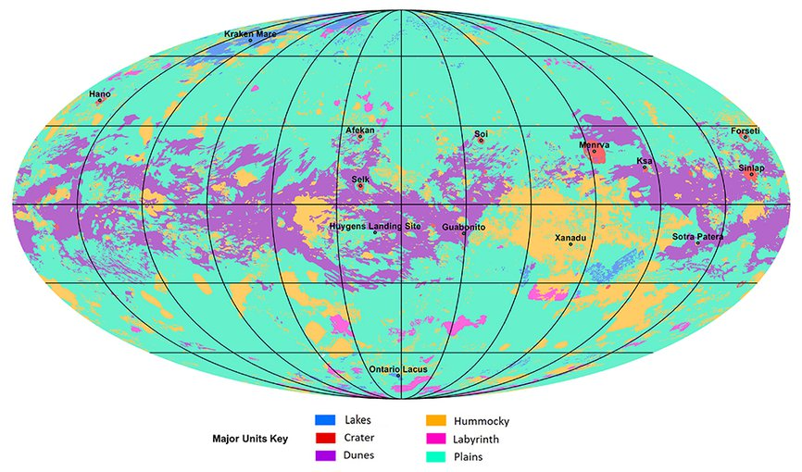
Introduction: Scientific Relevance
Only celestial body with liquid in the surface
Atmosphere
Organic compounds
Data from Cassini-Huygens mission
Global map of Titan's major geomorphological units

Slide 5
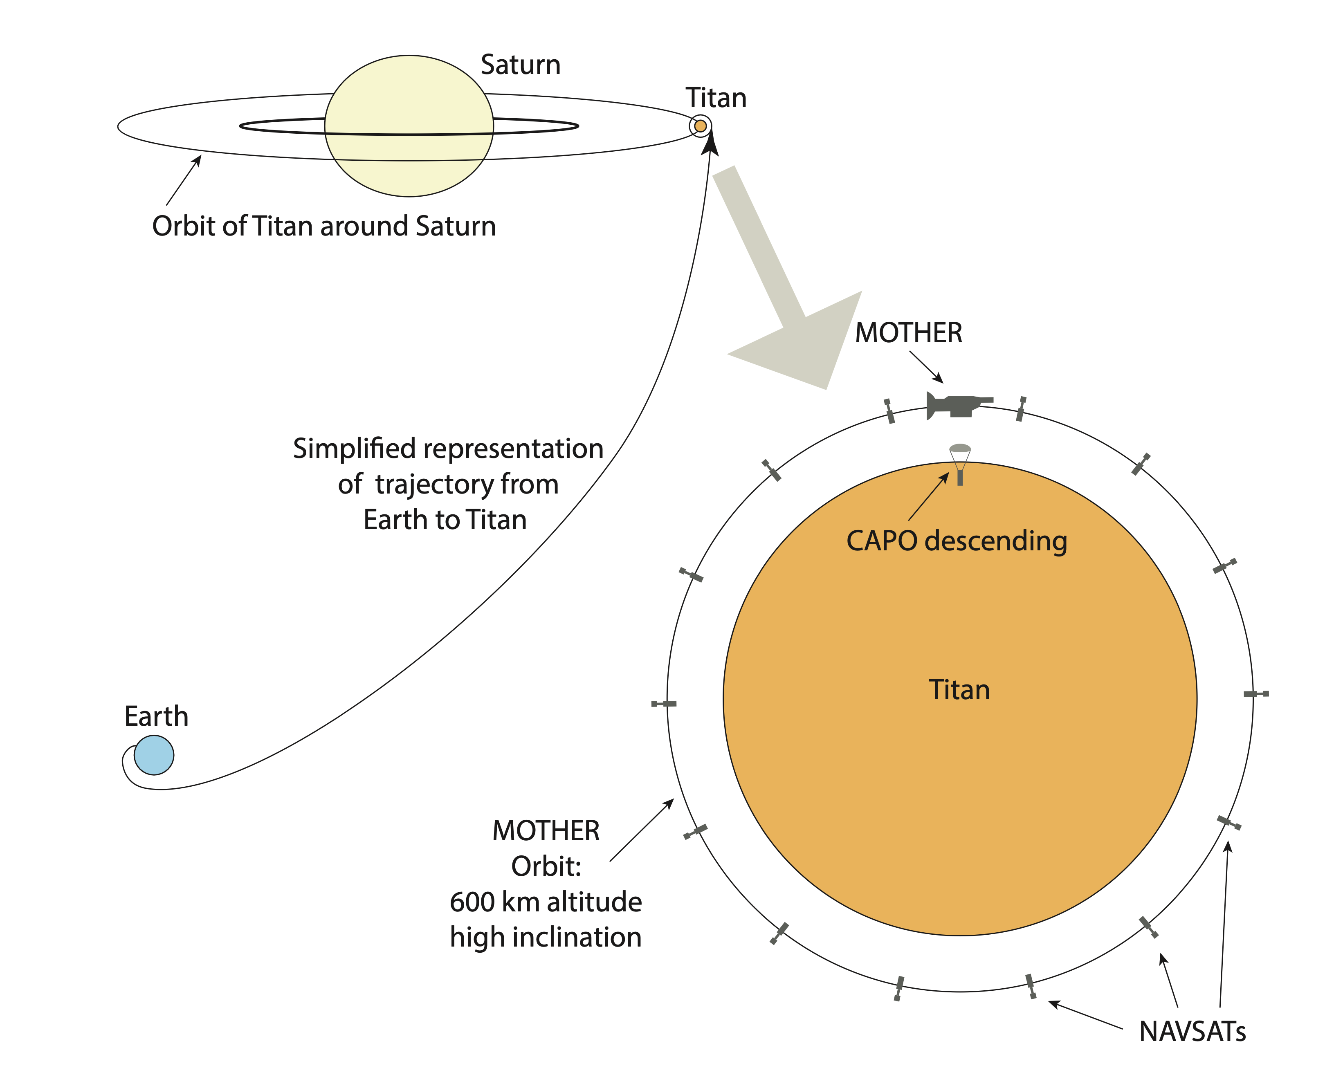
System Design
CAPO: Cubesat Atmospheric PrObe
MOTHER: Master Orbiter for Titan atmospHEric Research
NAVSAT: NAVigation SATellite
System diagram

Slide 6
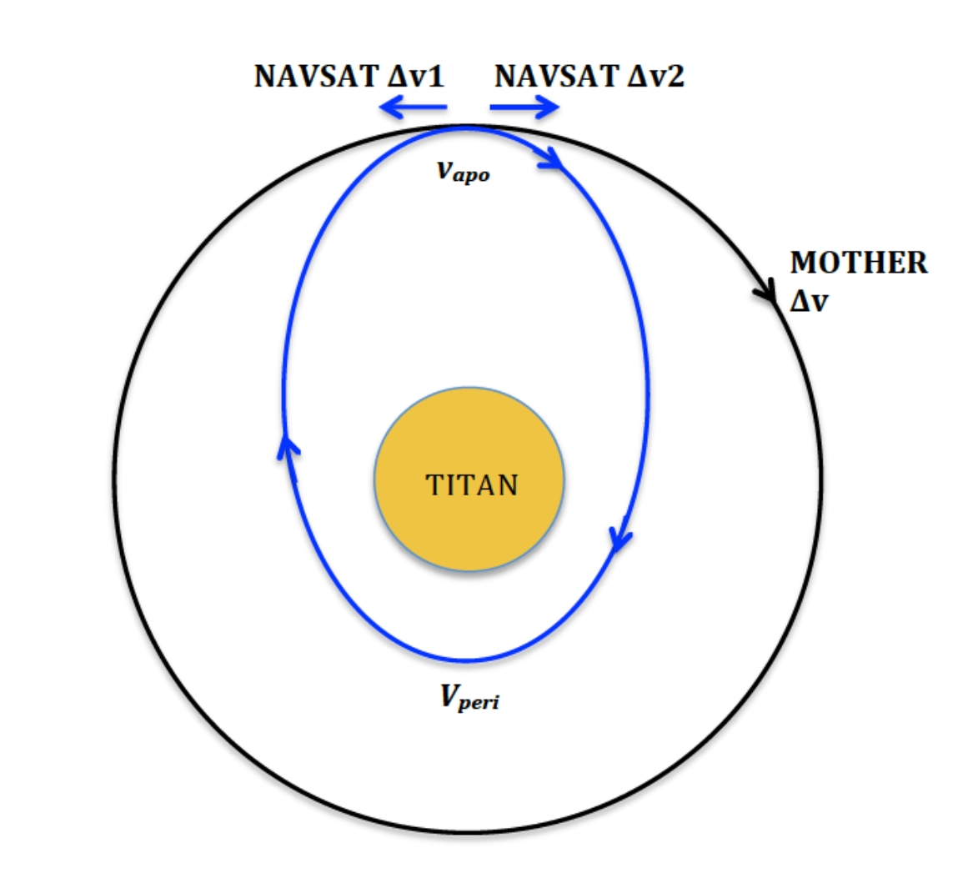
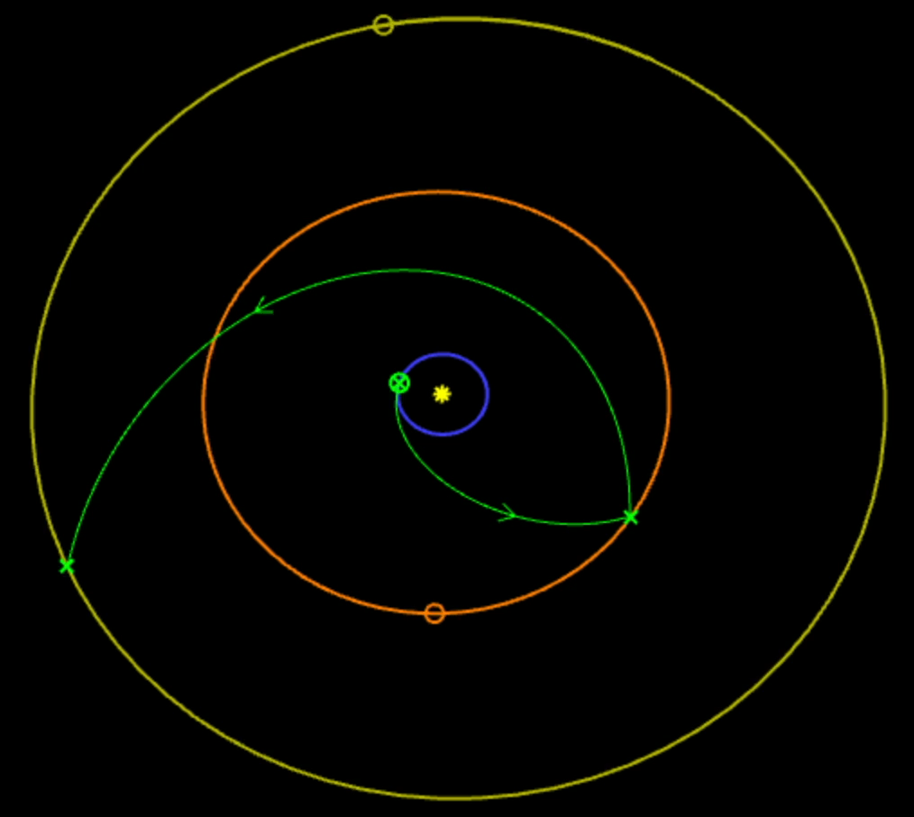
Trajectory
Hohmann transfer orbits diagram
Image extracted from JPL, NASA, Trajectory browser

Slide 7
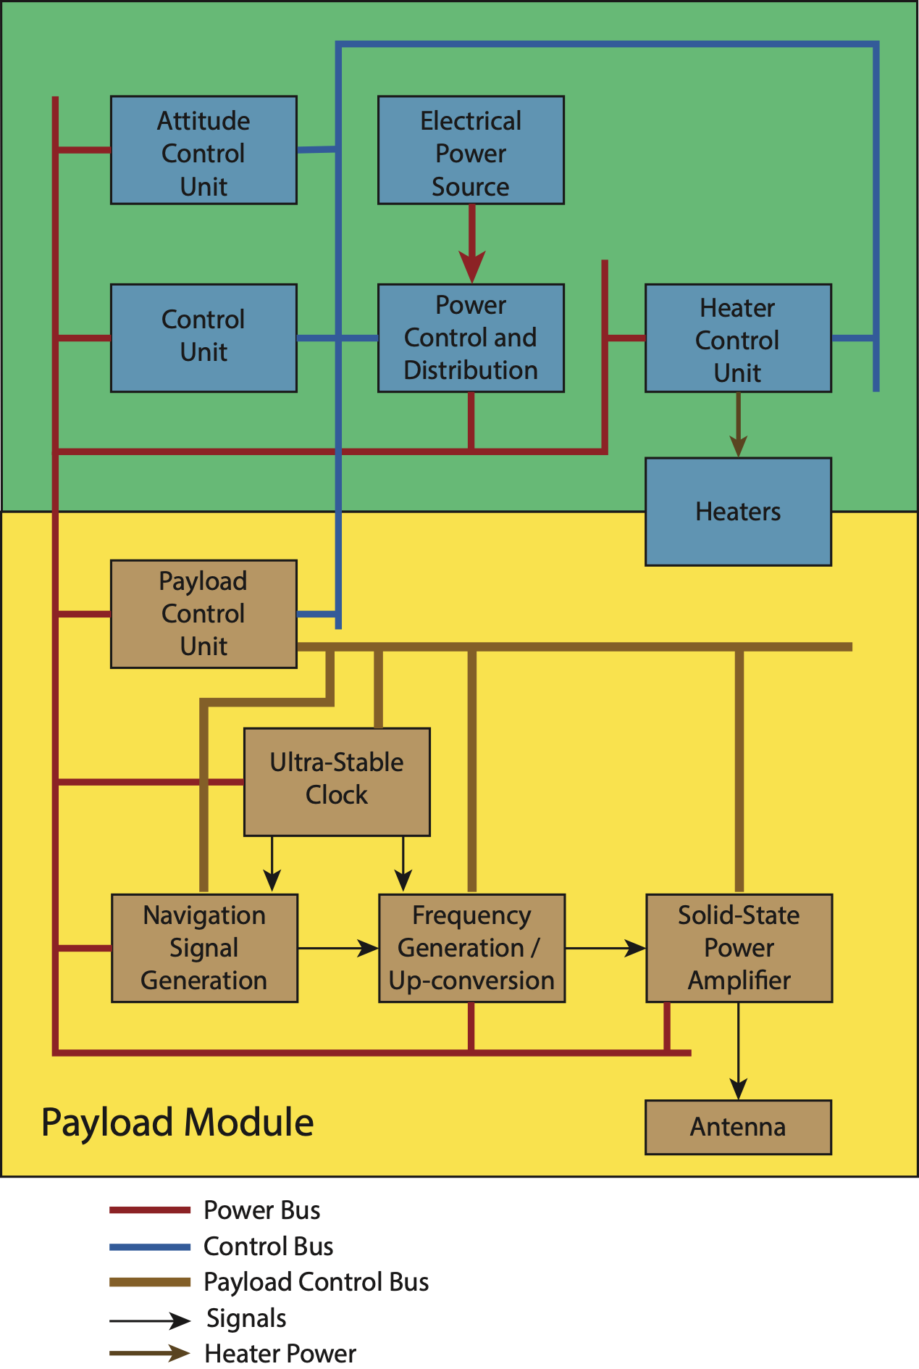
NAVSAT’s Design
Main requirements
  Propulsion system
  Localization system

Slide 8
CAPO Prototype

Slide 9
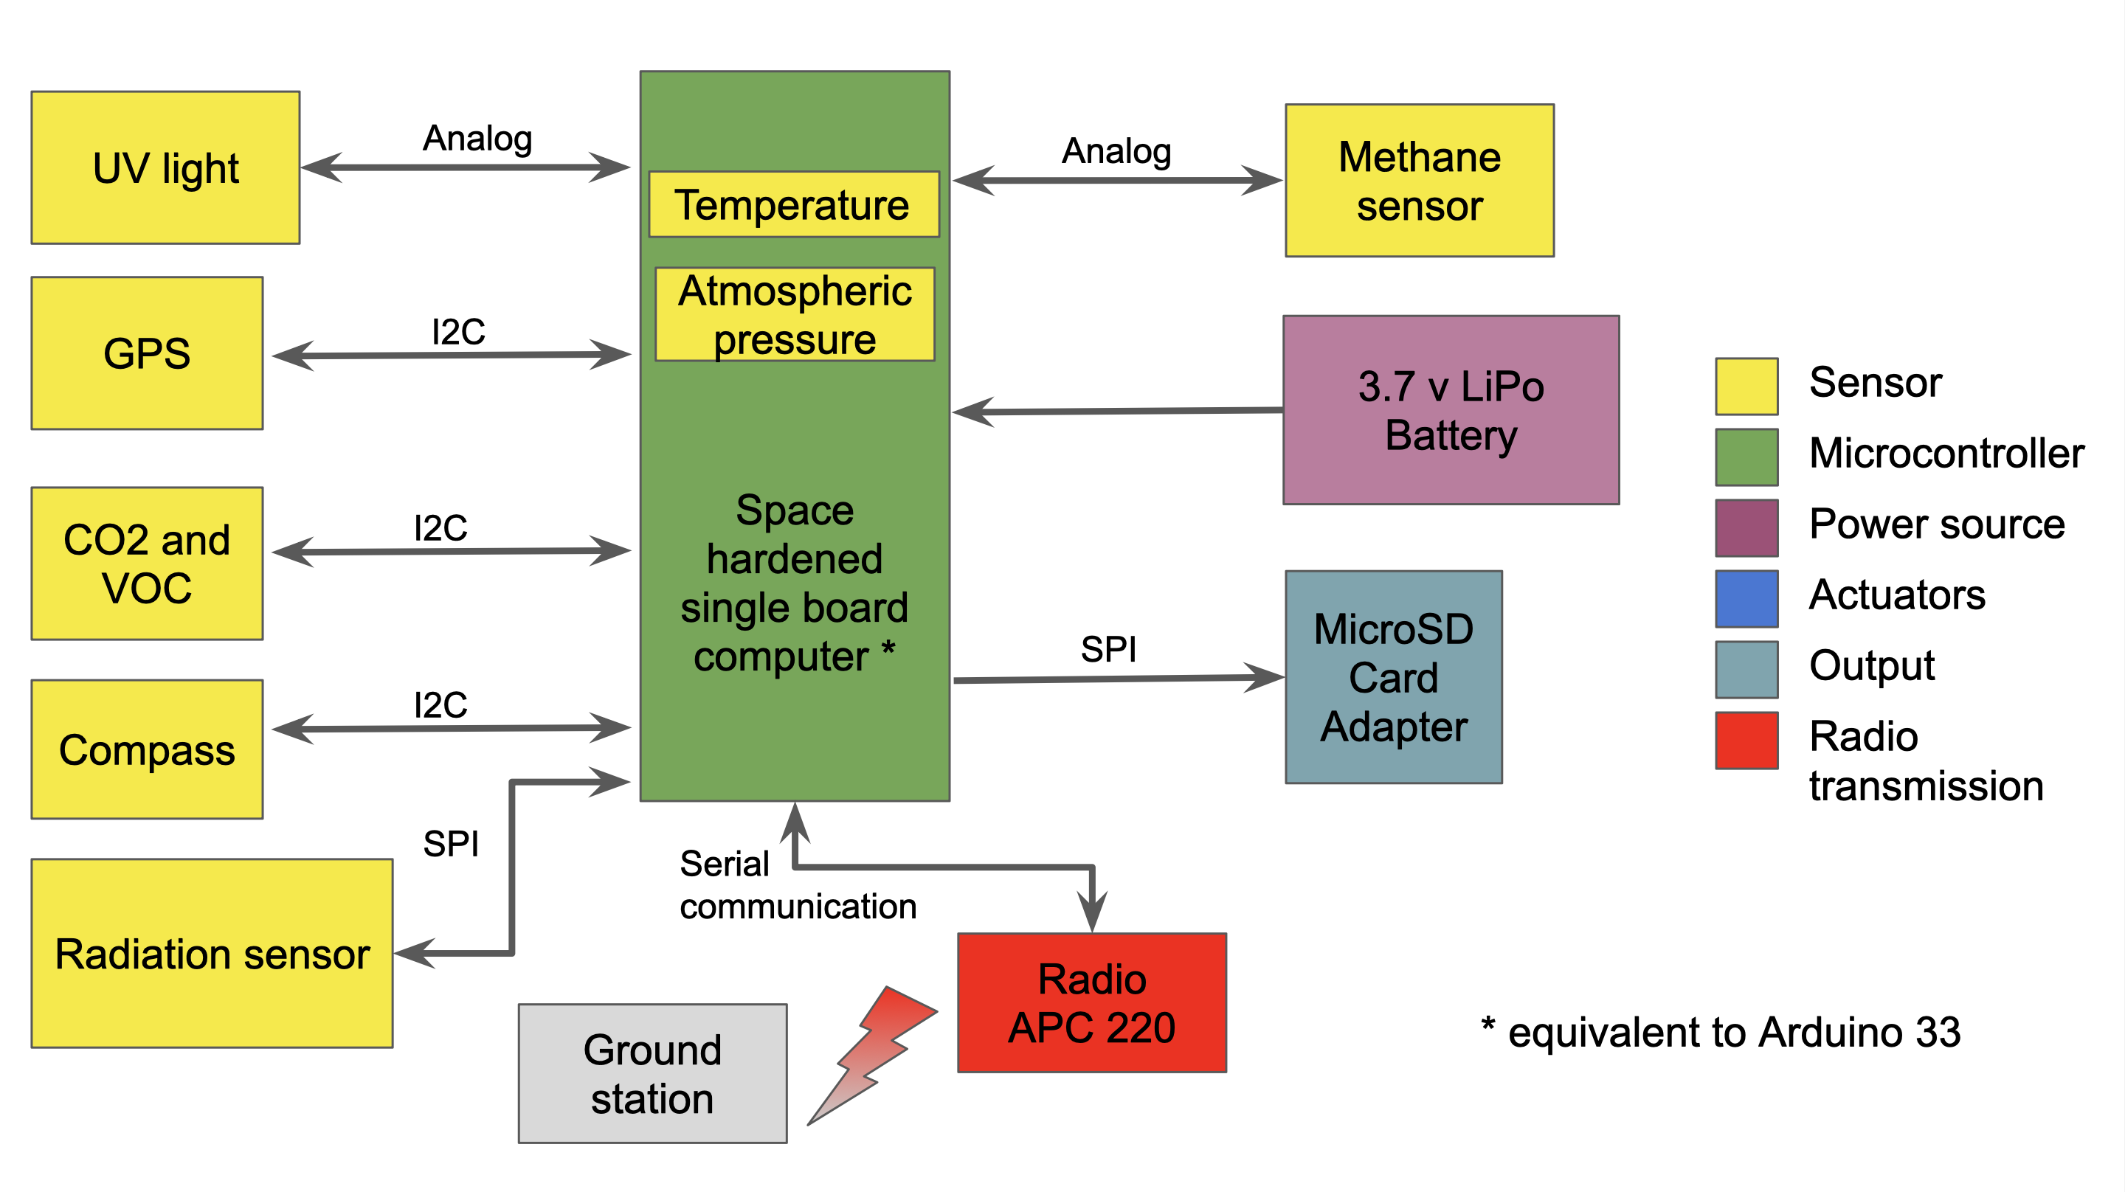
Electronics Design
Block diagram of the CAPO’s prototype components

Slide 10
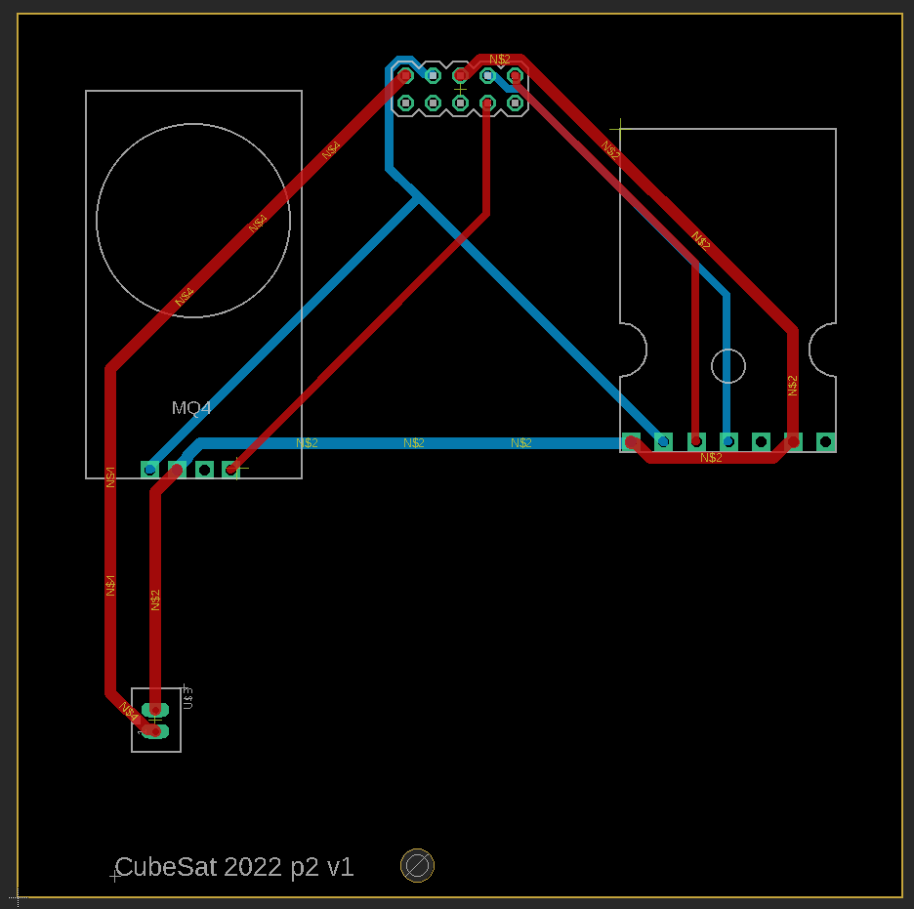
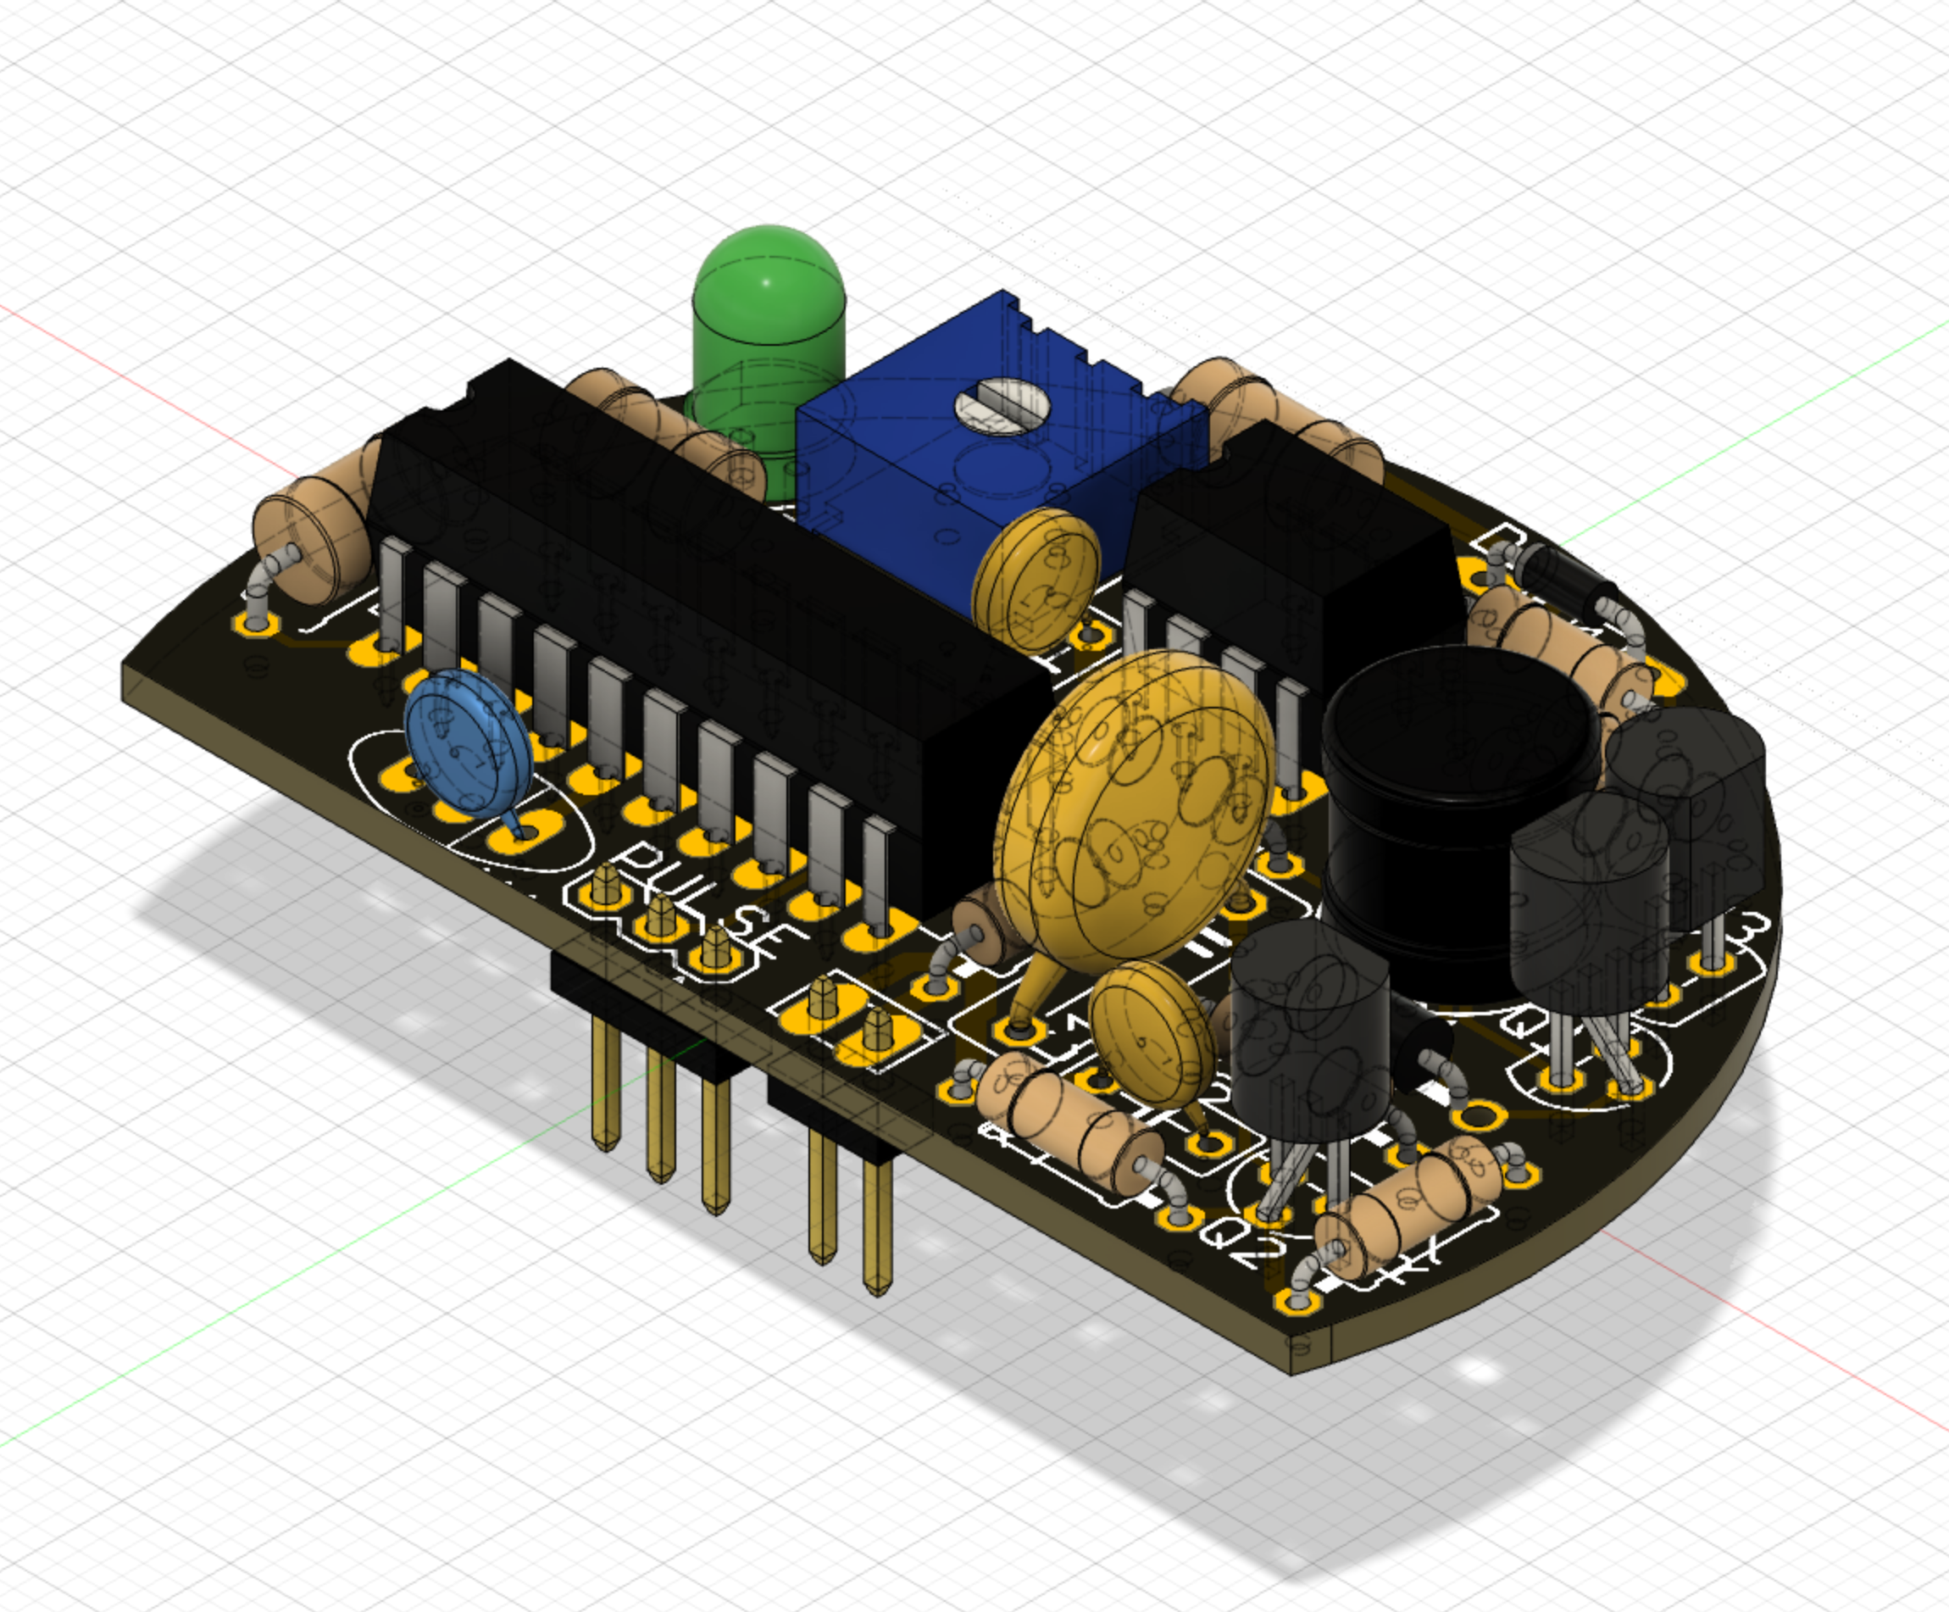
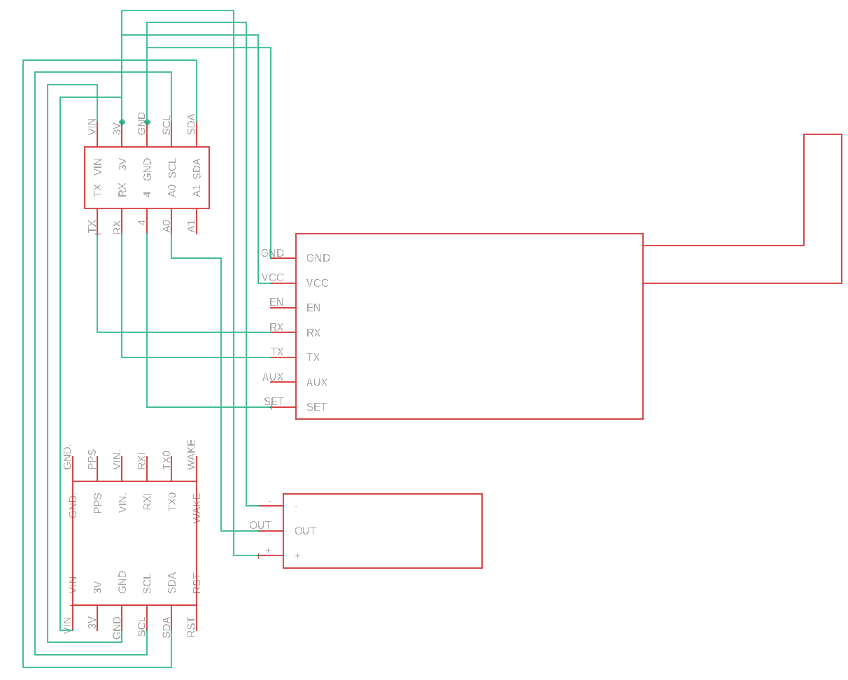
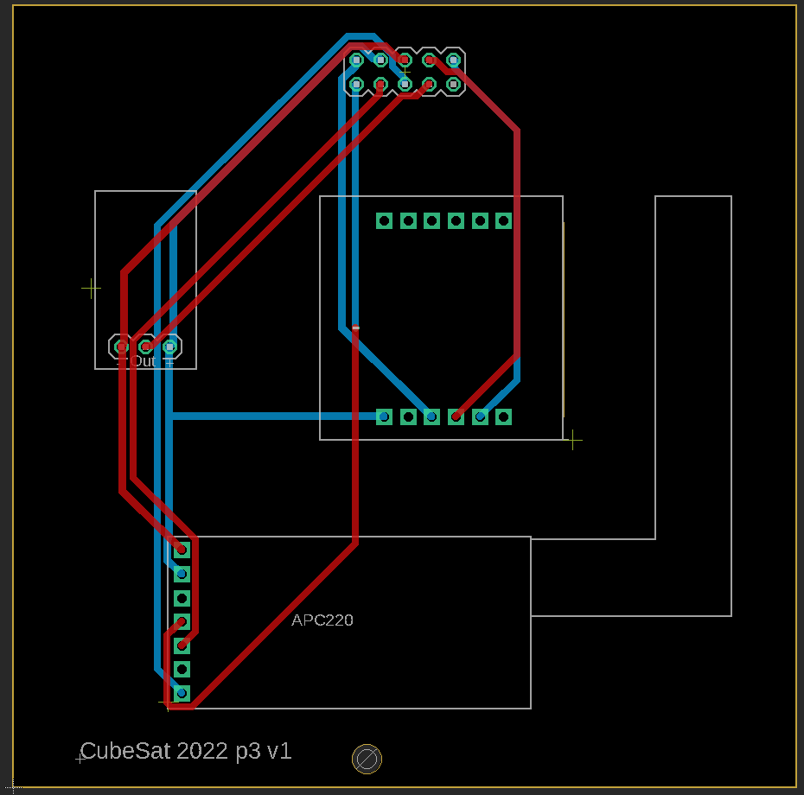
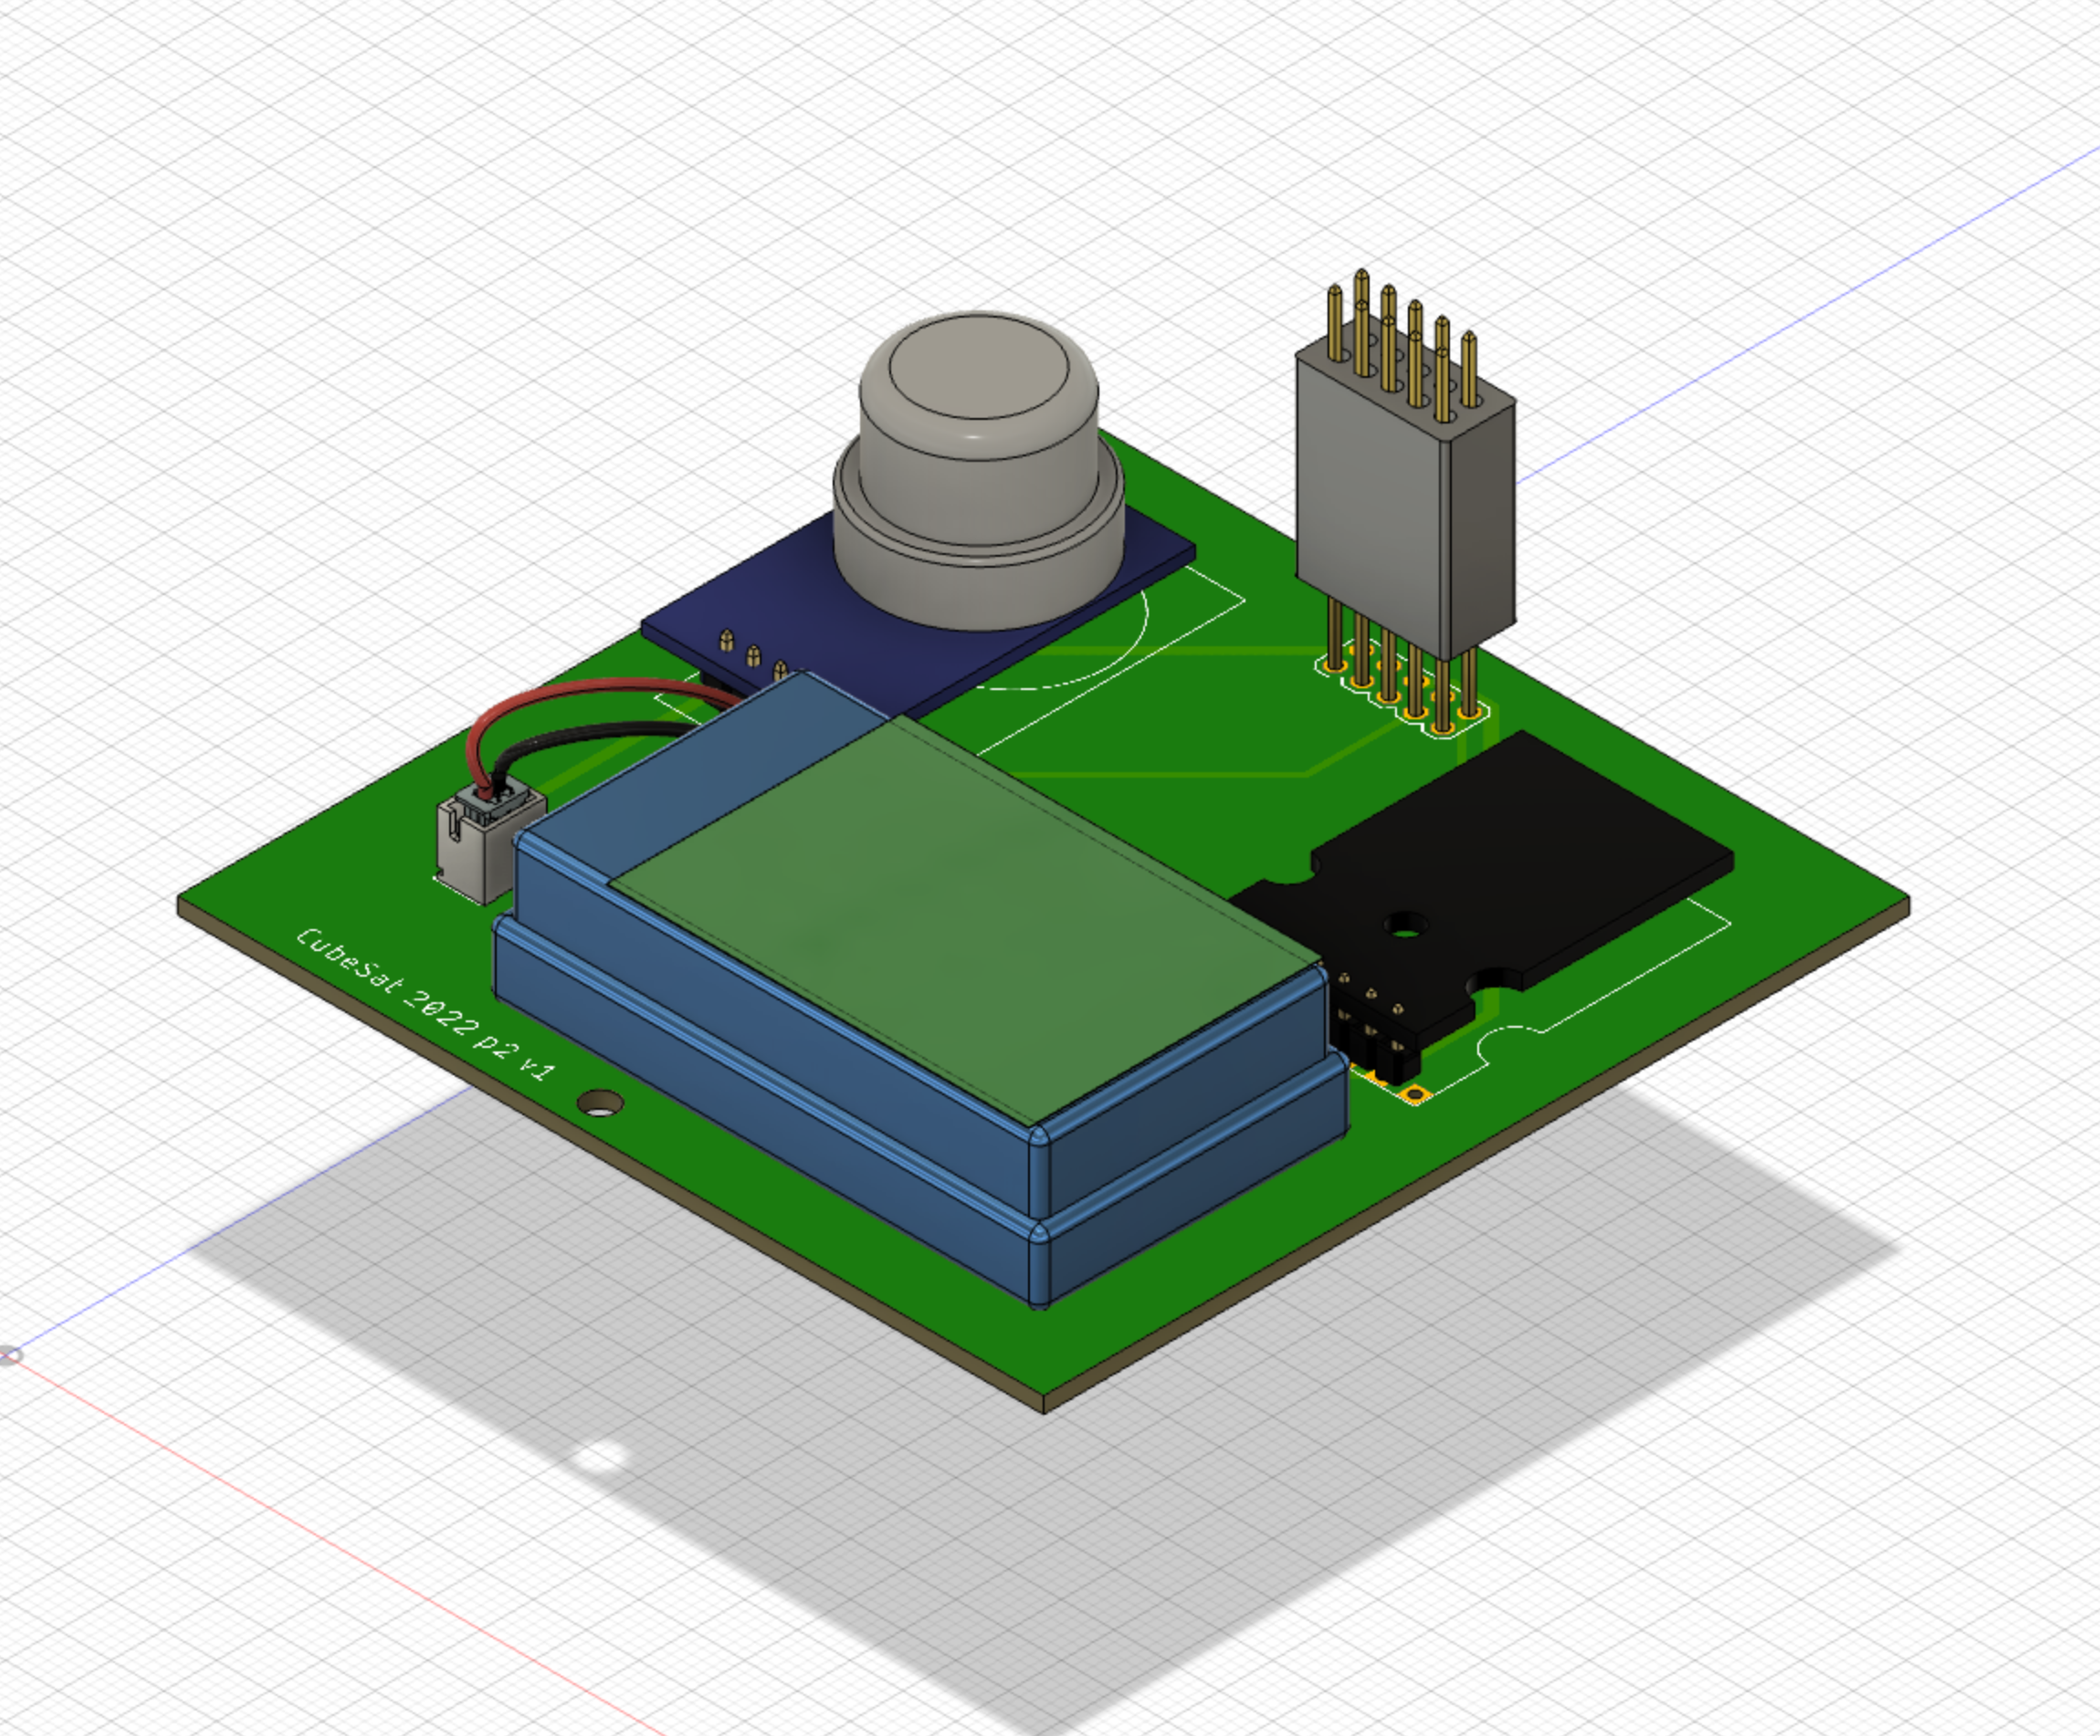
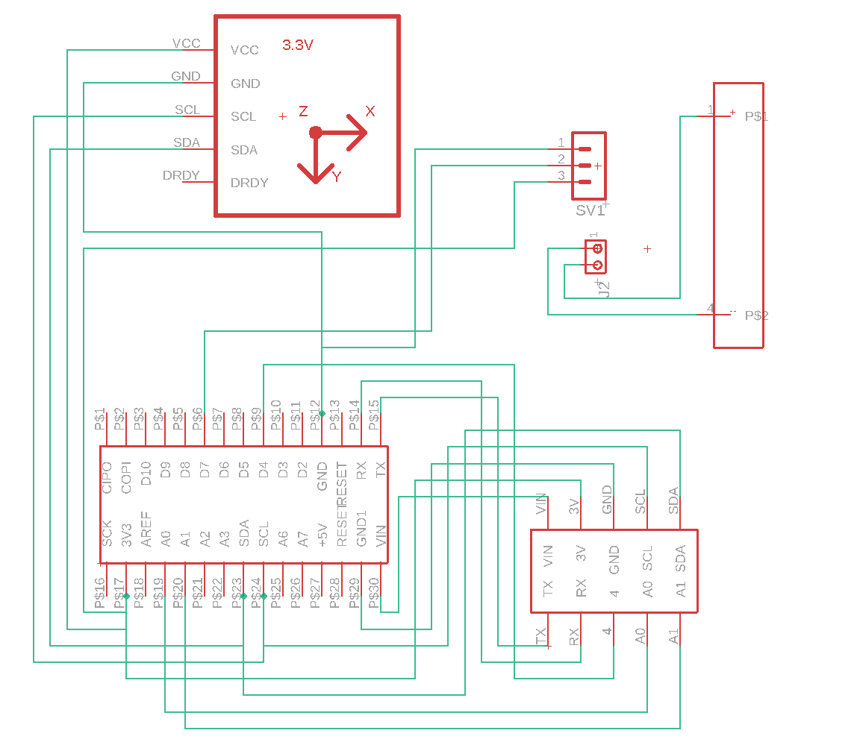
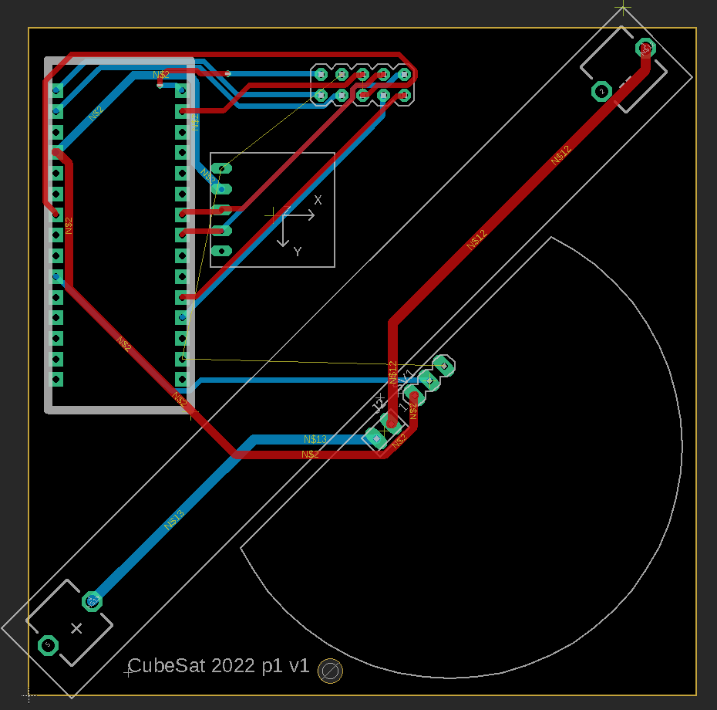
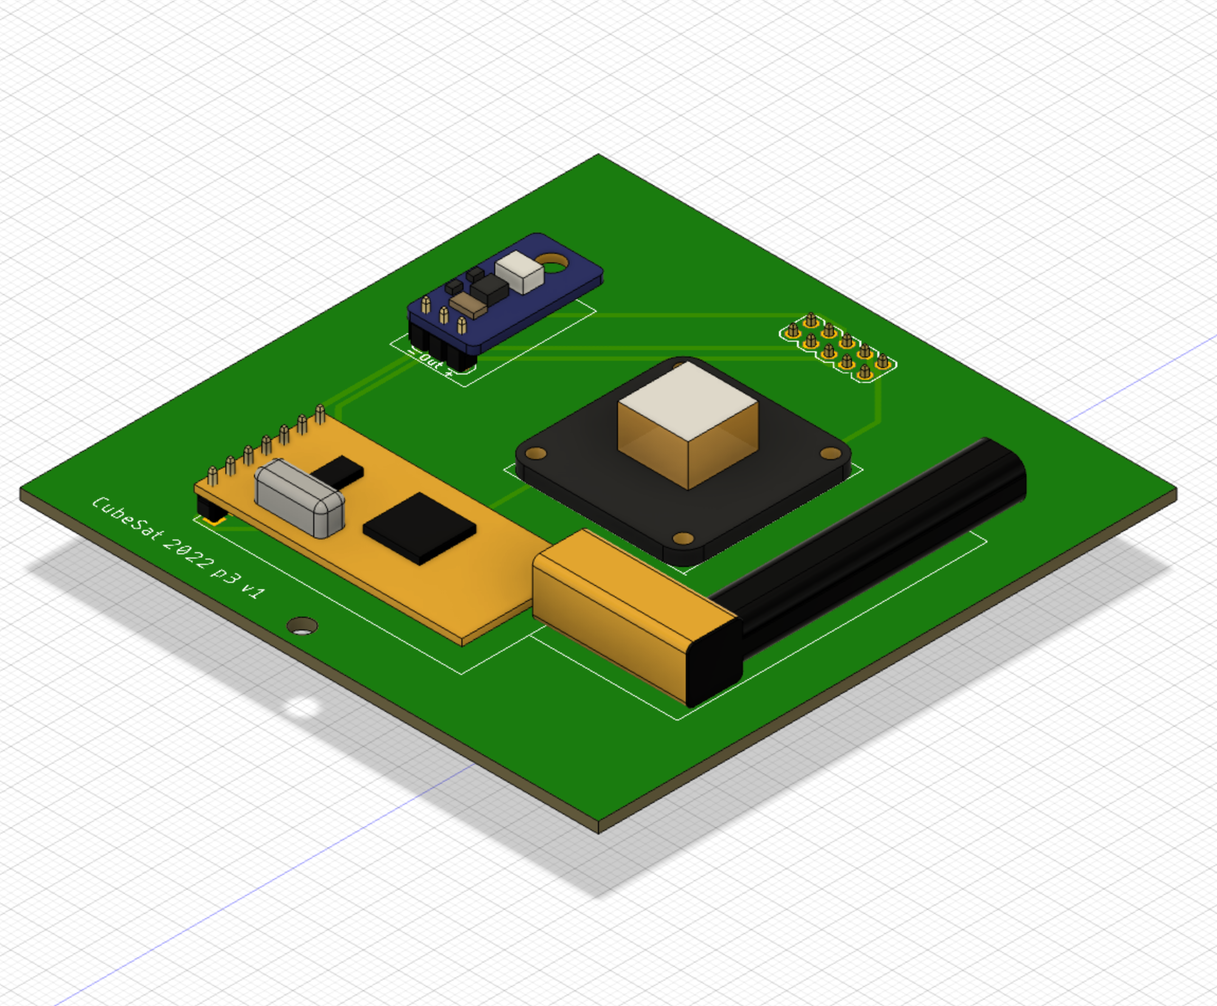
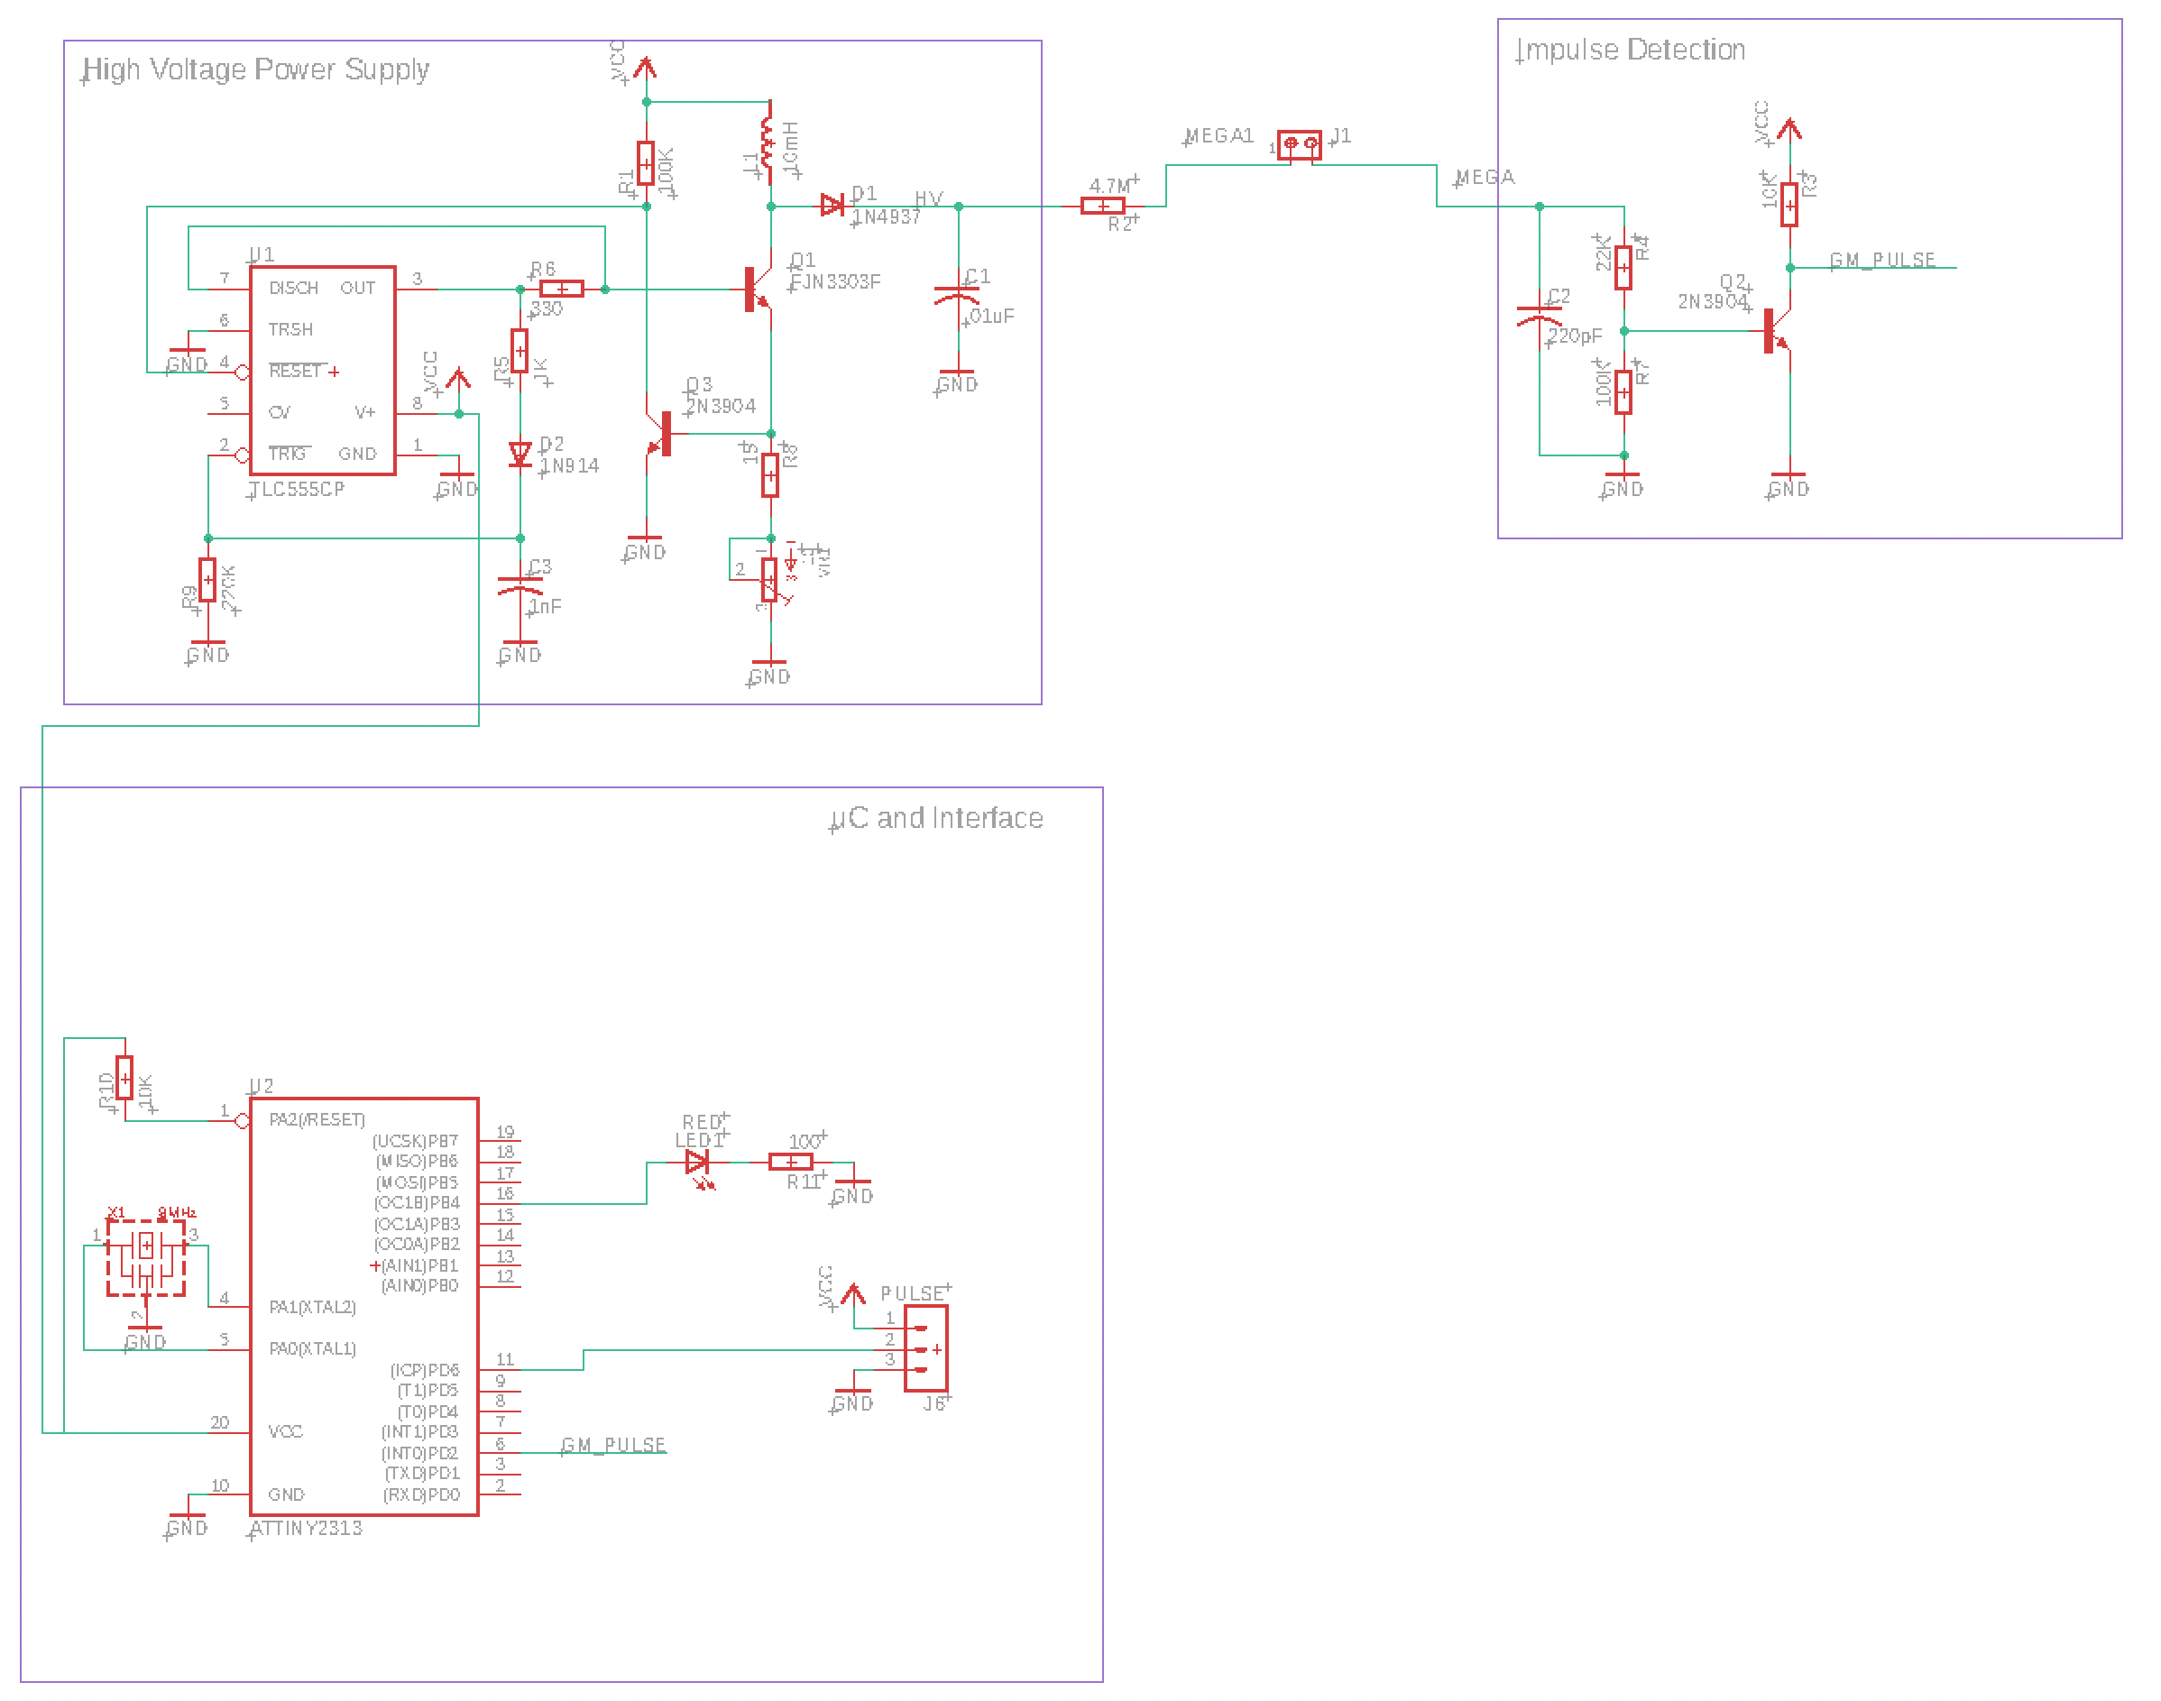
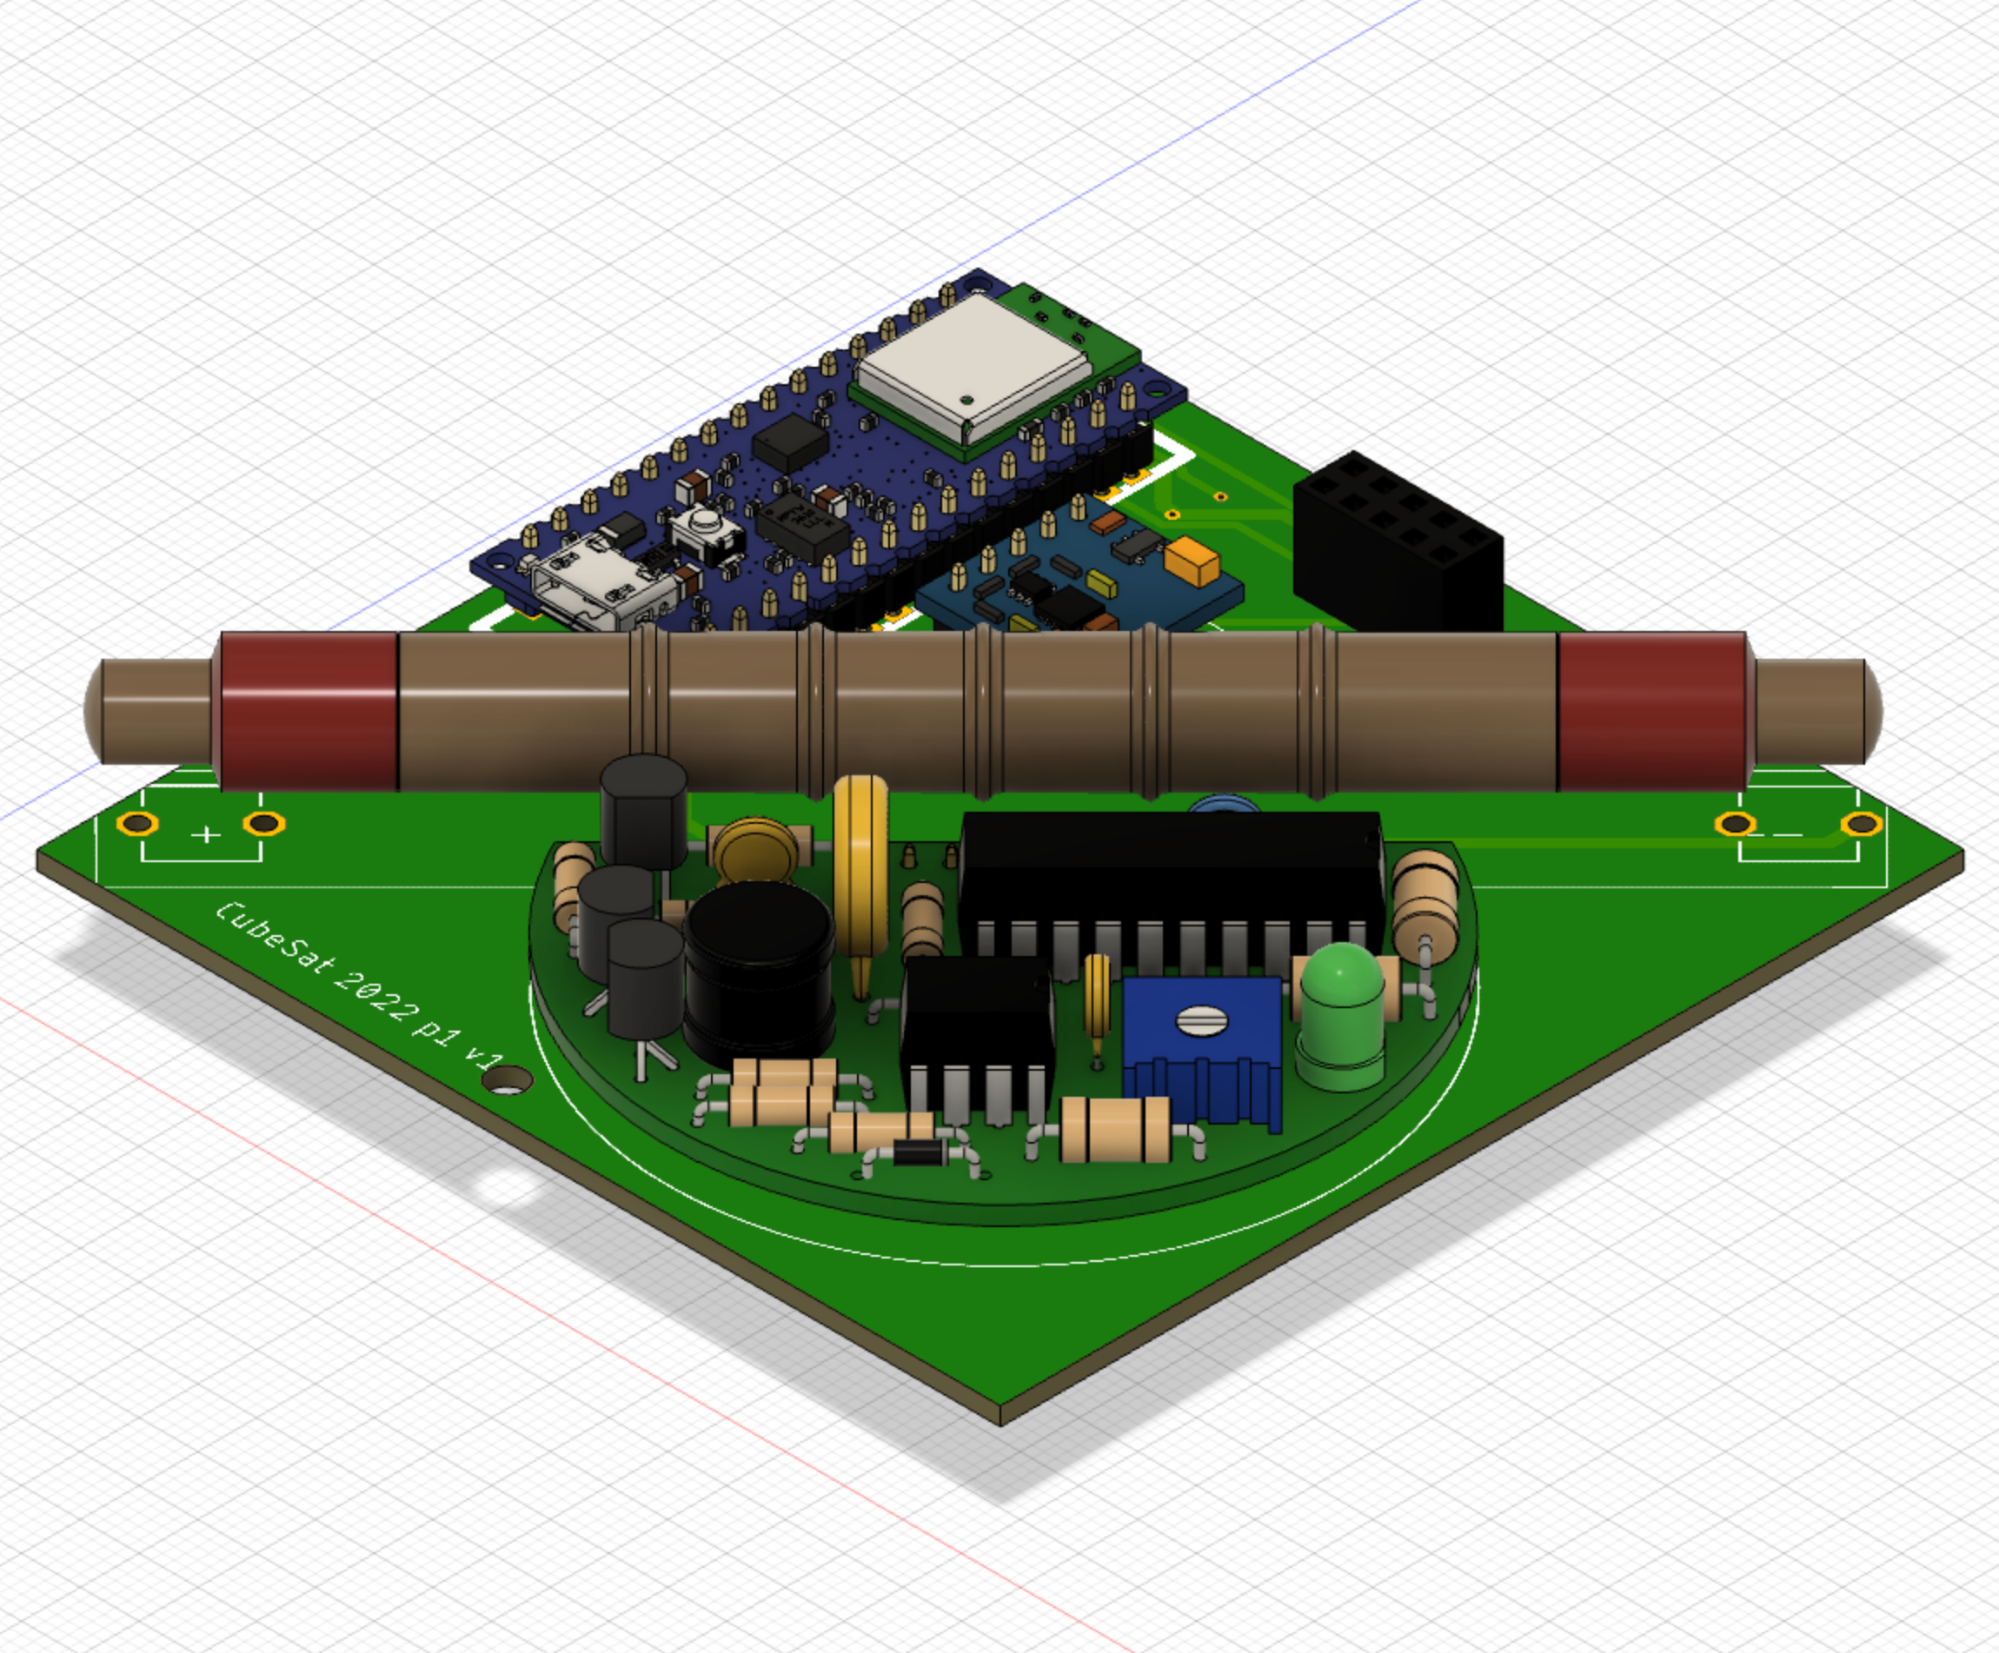
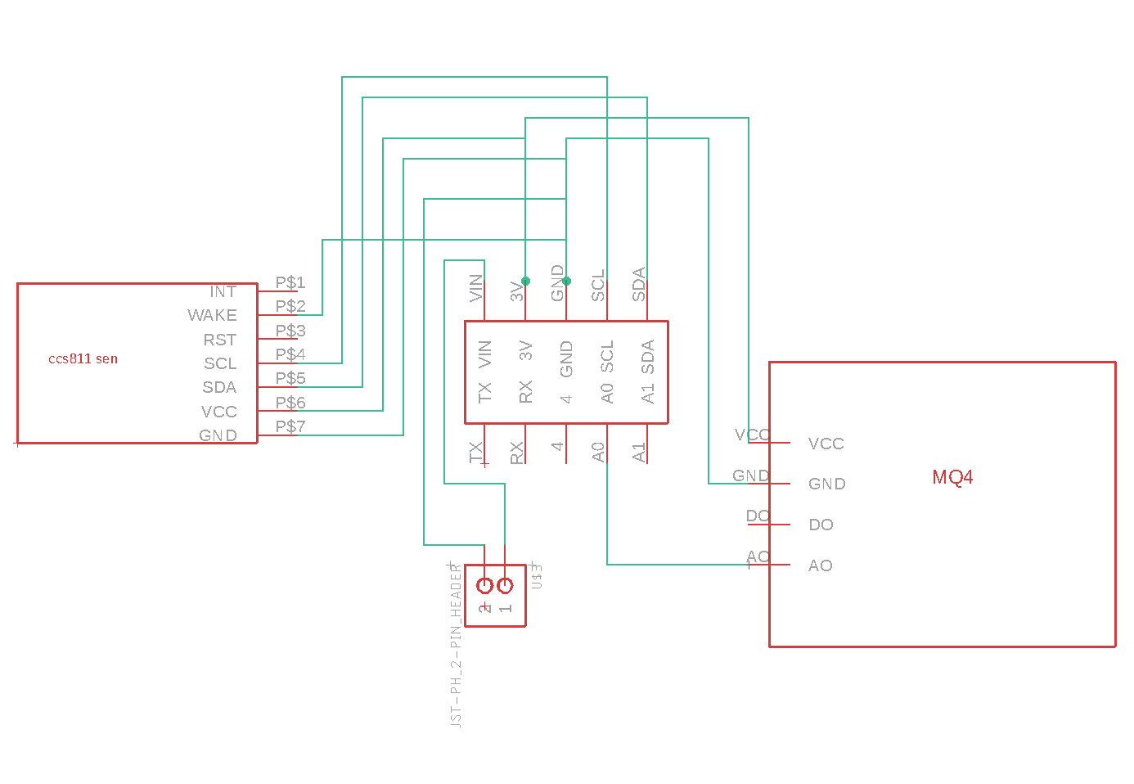
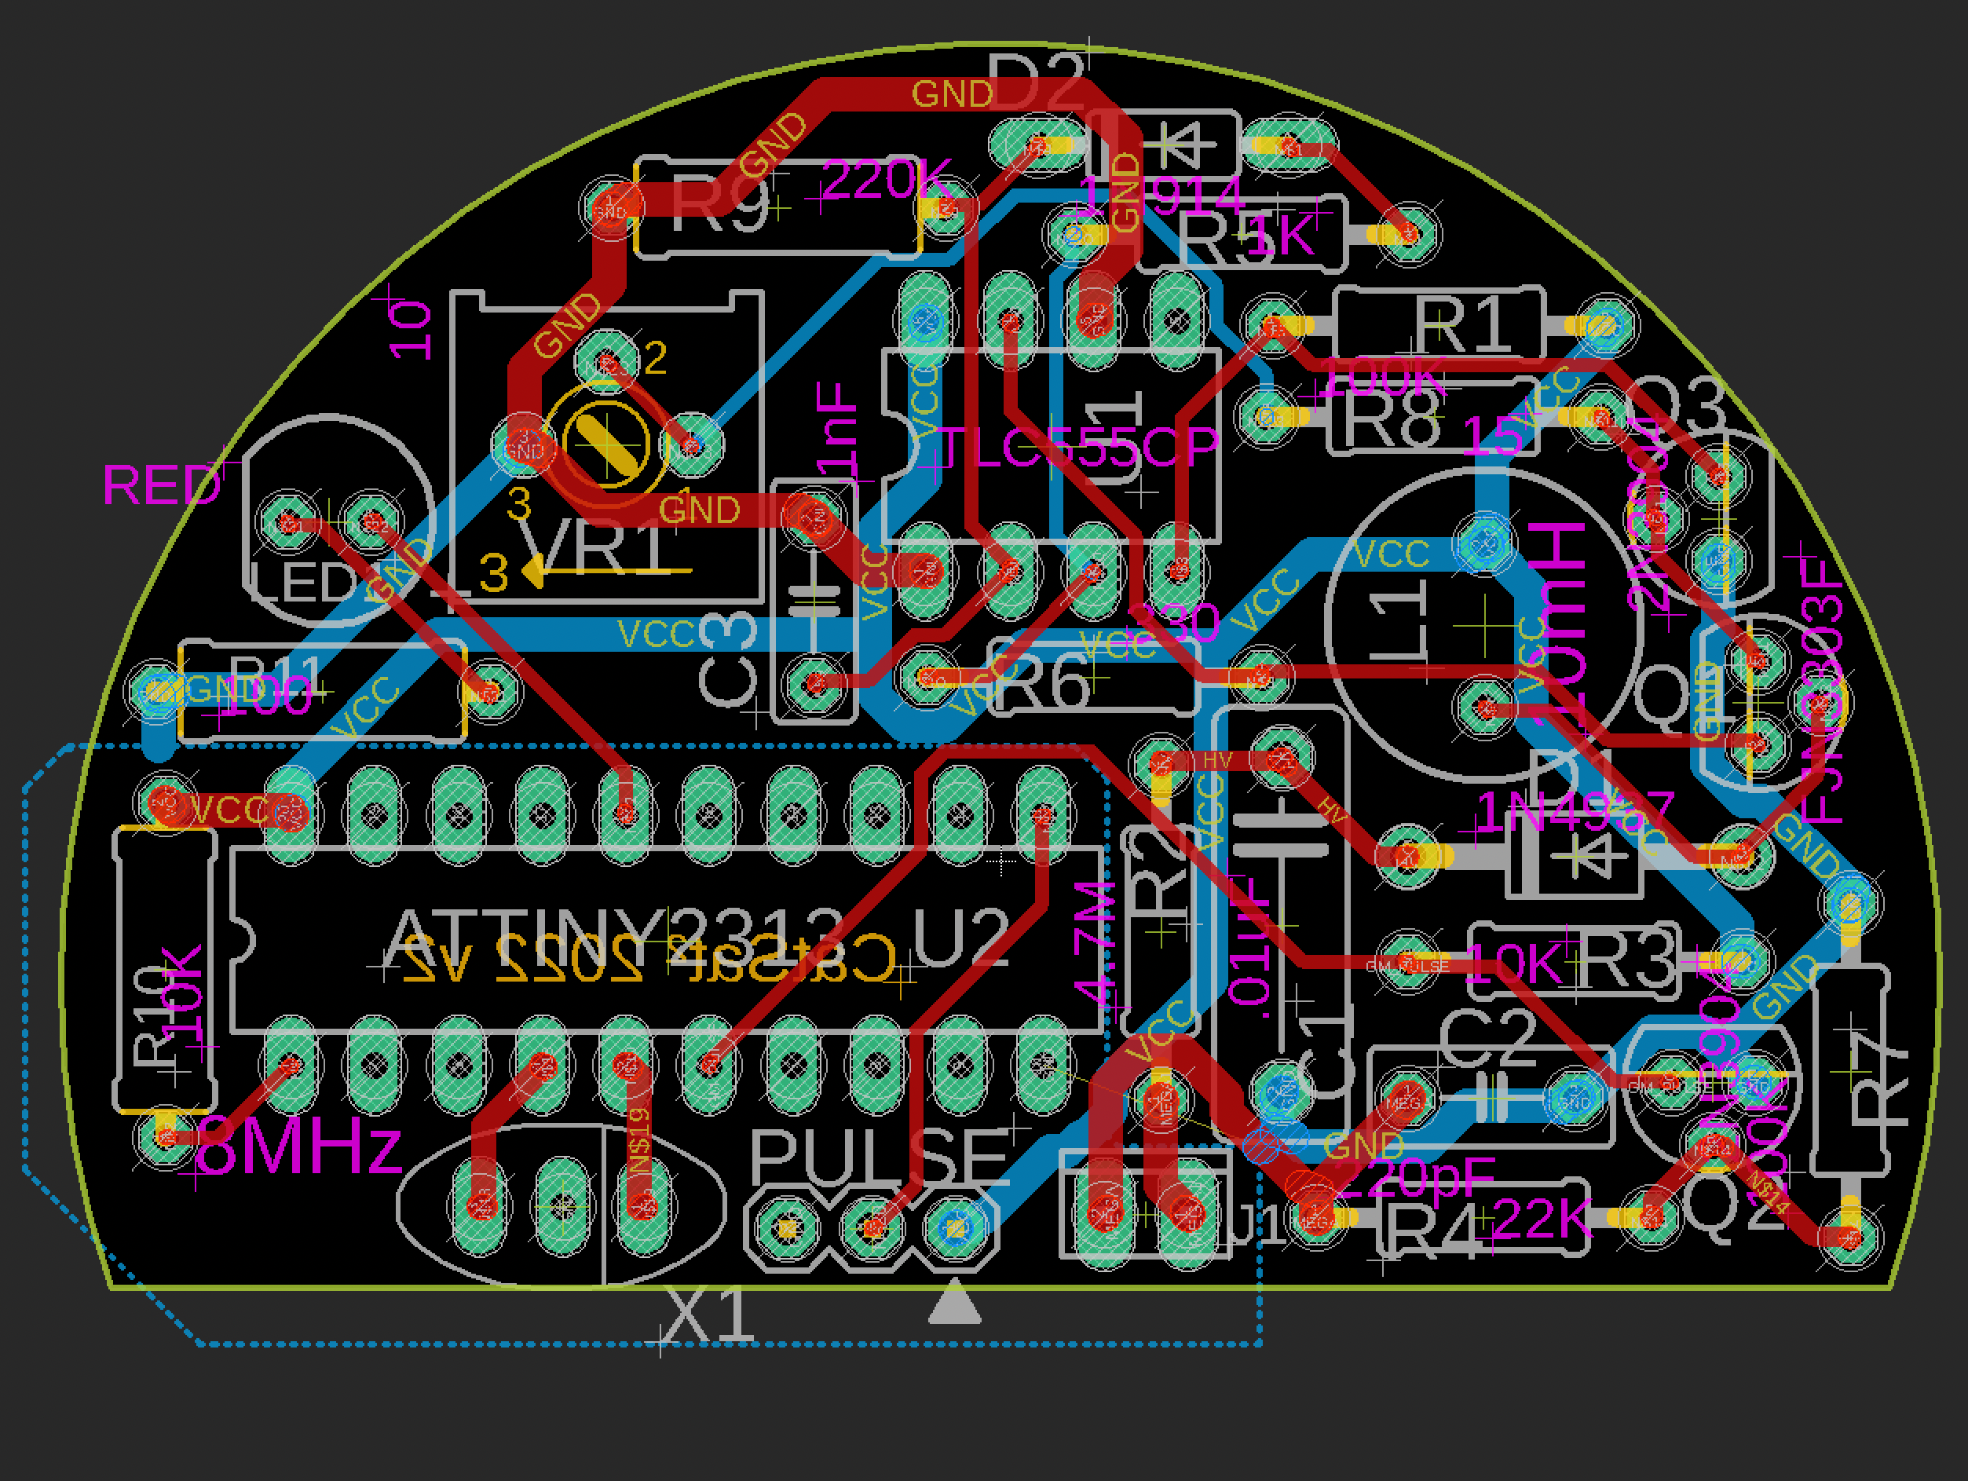
Electronics design: PCBs
 | Board 1 | Board 2 | Board 3 | Geiger Counter
Schematic
Board
3D model

Slide 11
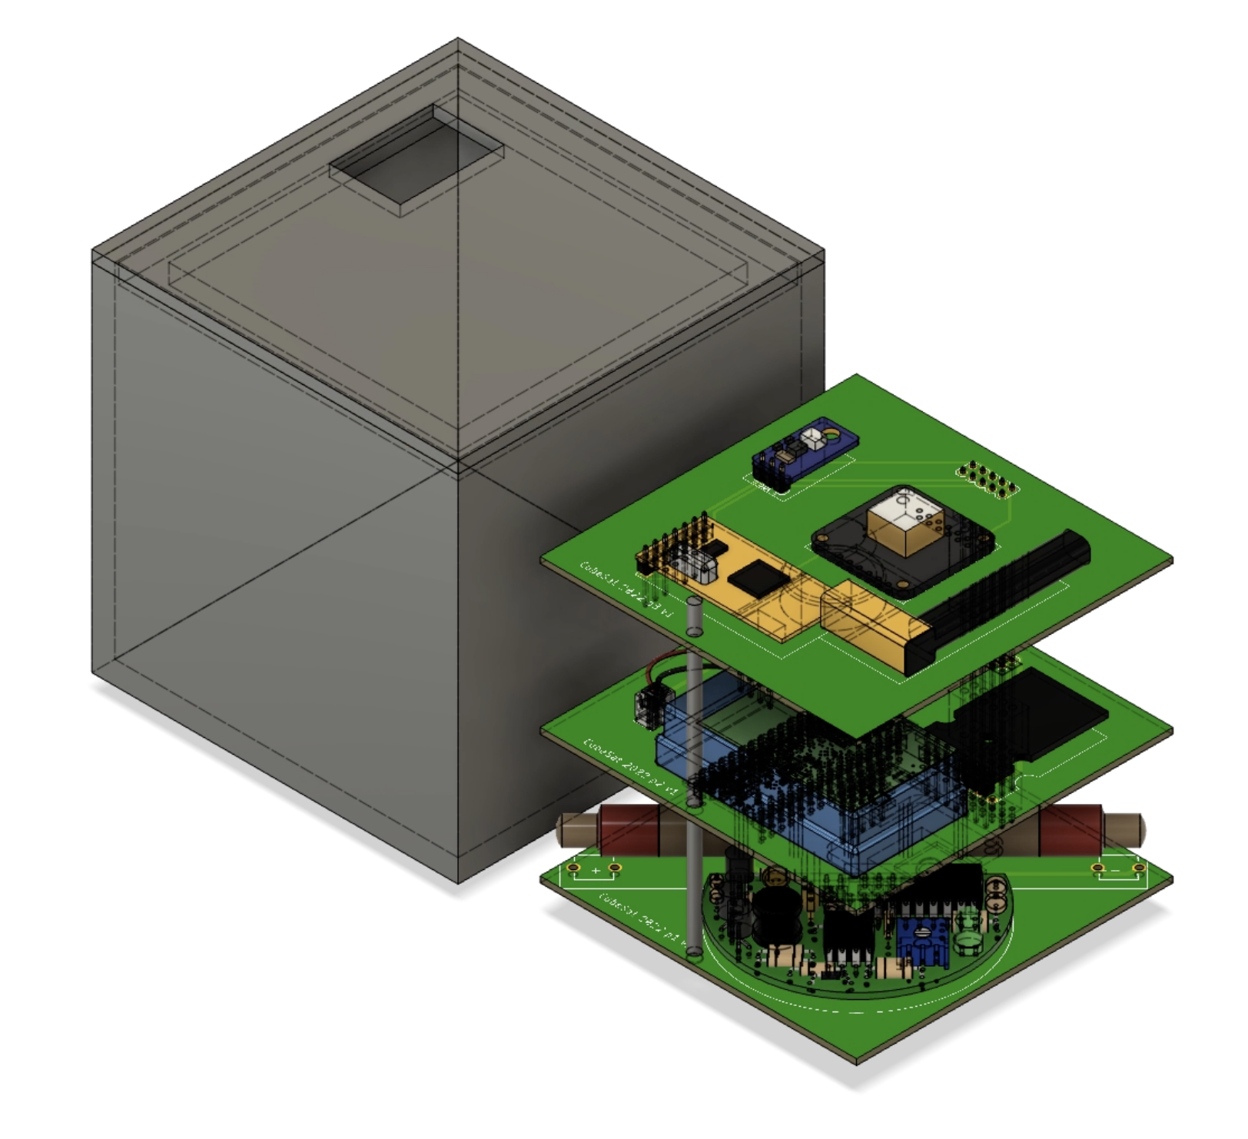
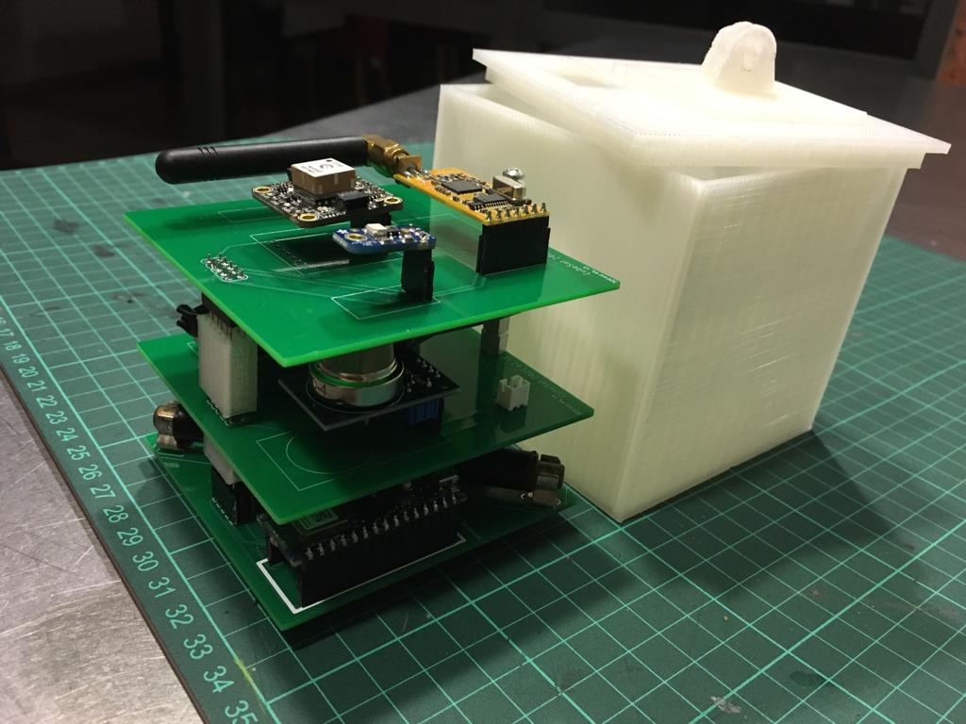
3D model and prototype
3D model, designed with Fusion 360
CAPO prototype

Slide 12
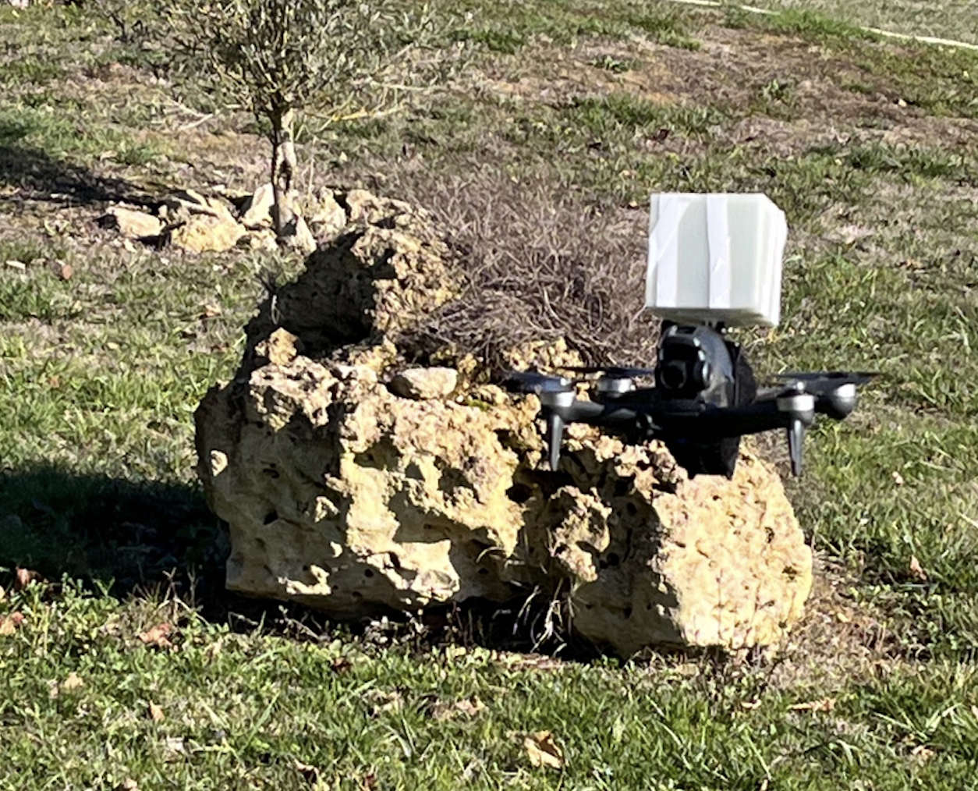
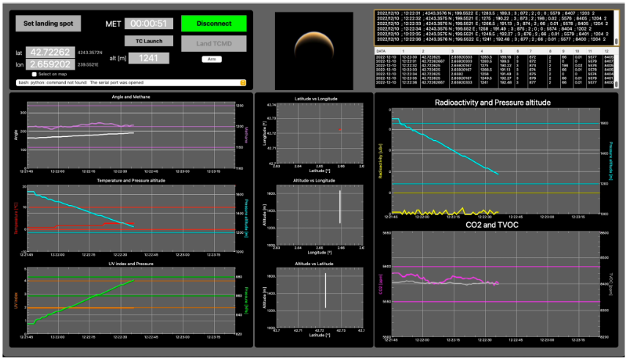
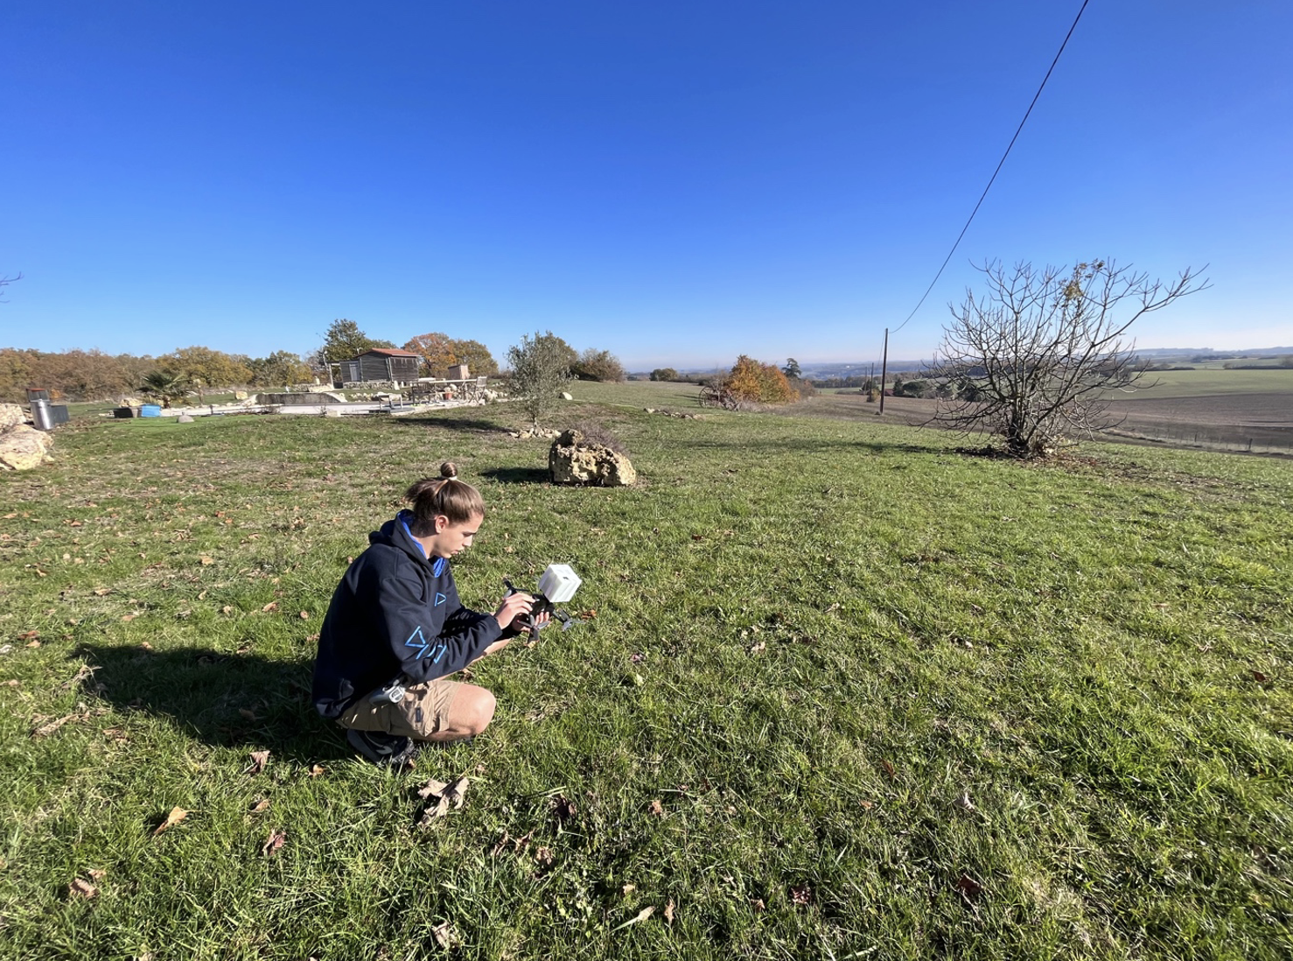
Test and validation
Ground station
Validation test

Slide 13
Conclusions and Future Research

Slide 14
Results
Scientific
  Proposal to create a 3D profile of Titan’s atmosphere
Technical
  Design and functional CAPO prototype
  NAVSAT’s design
Established requirements:
  CAPOs
  NAVSATs
  MOTHER
  Launch Vehicle

Slide 15
Future work
Ethical considerations:
  RTGs, waste and contamination
Combine with existing missions: Dragonfly
Extend concept to other planets

Slide 16
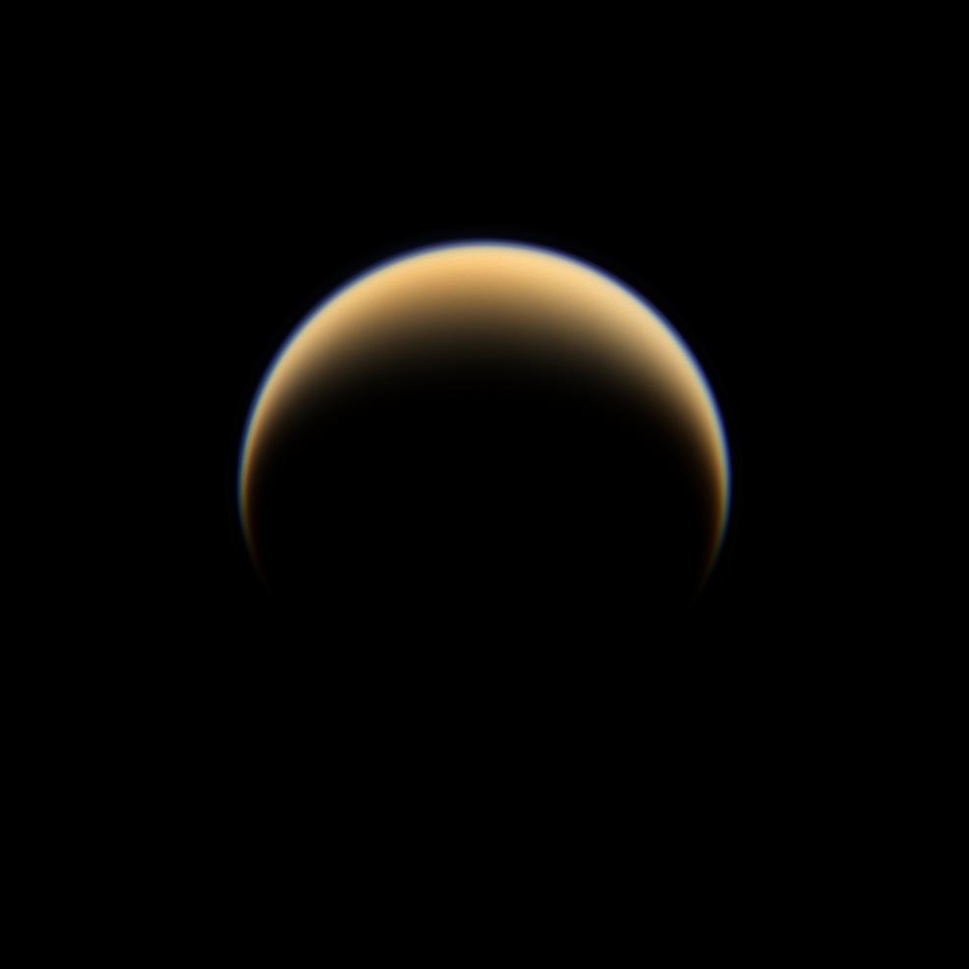
Thank you for your attention

Slide 18
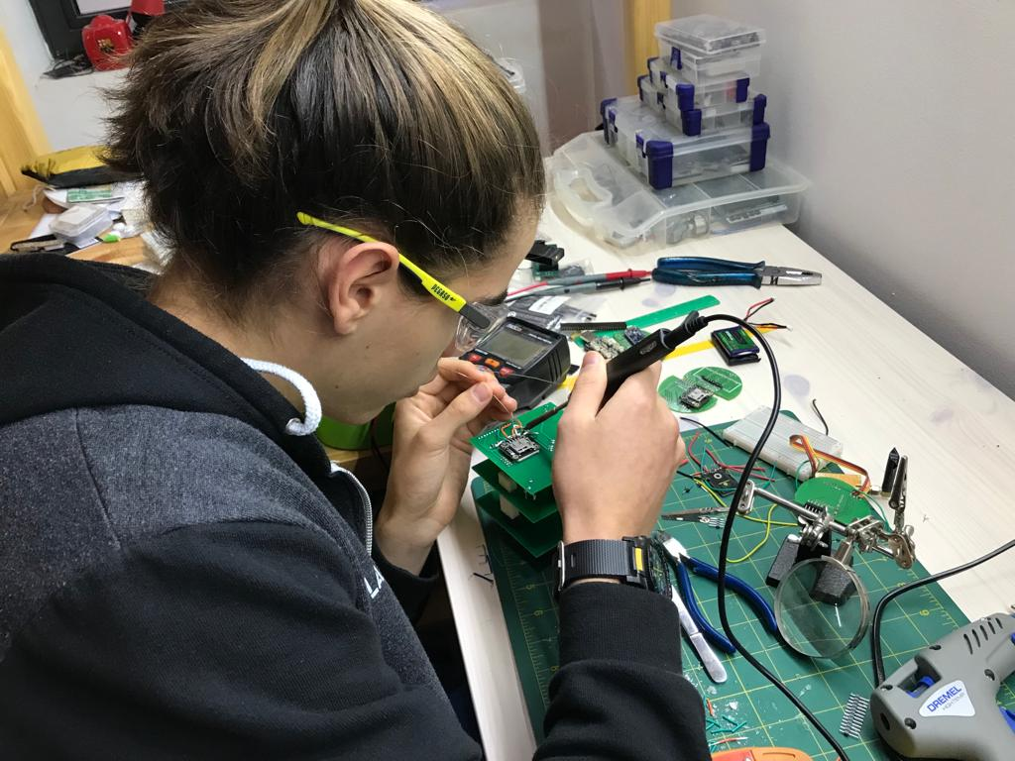
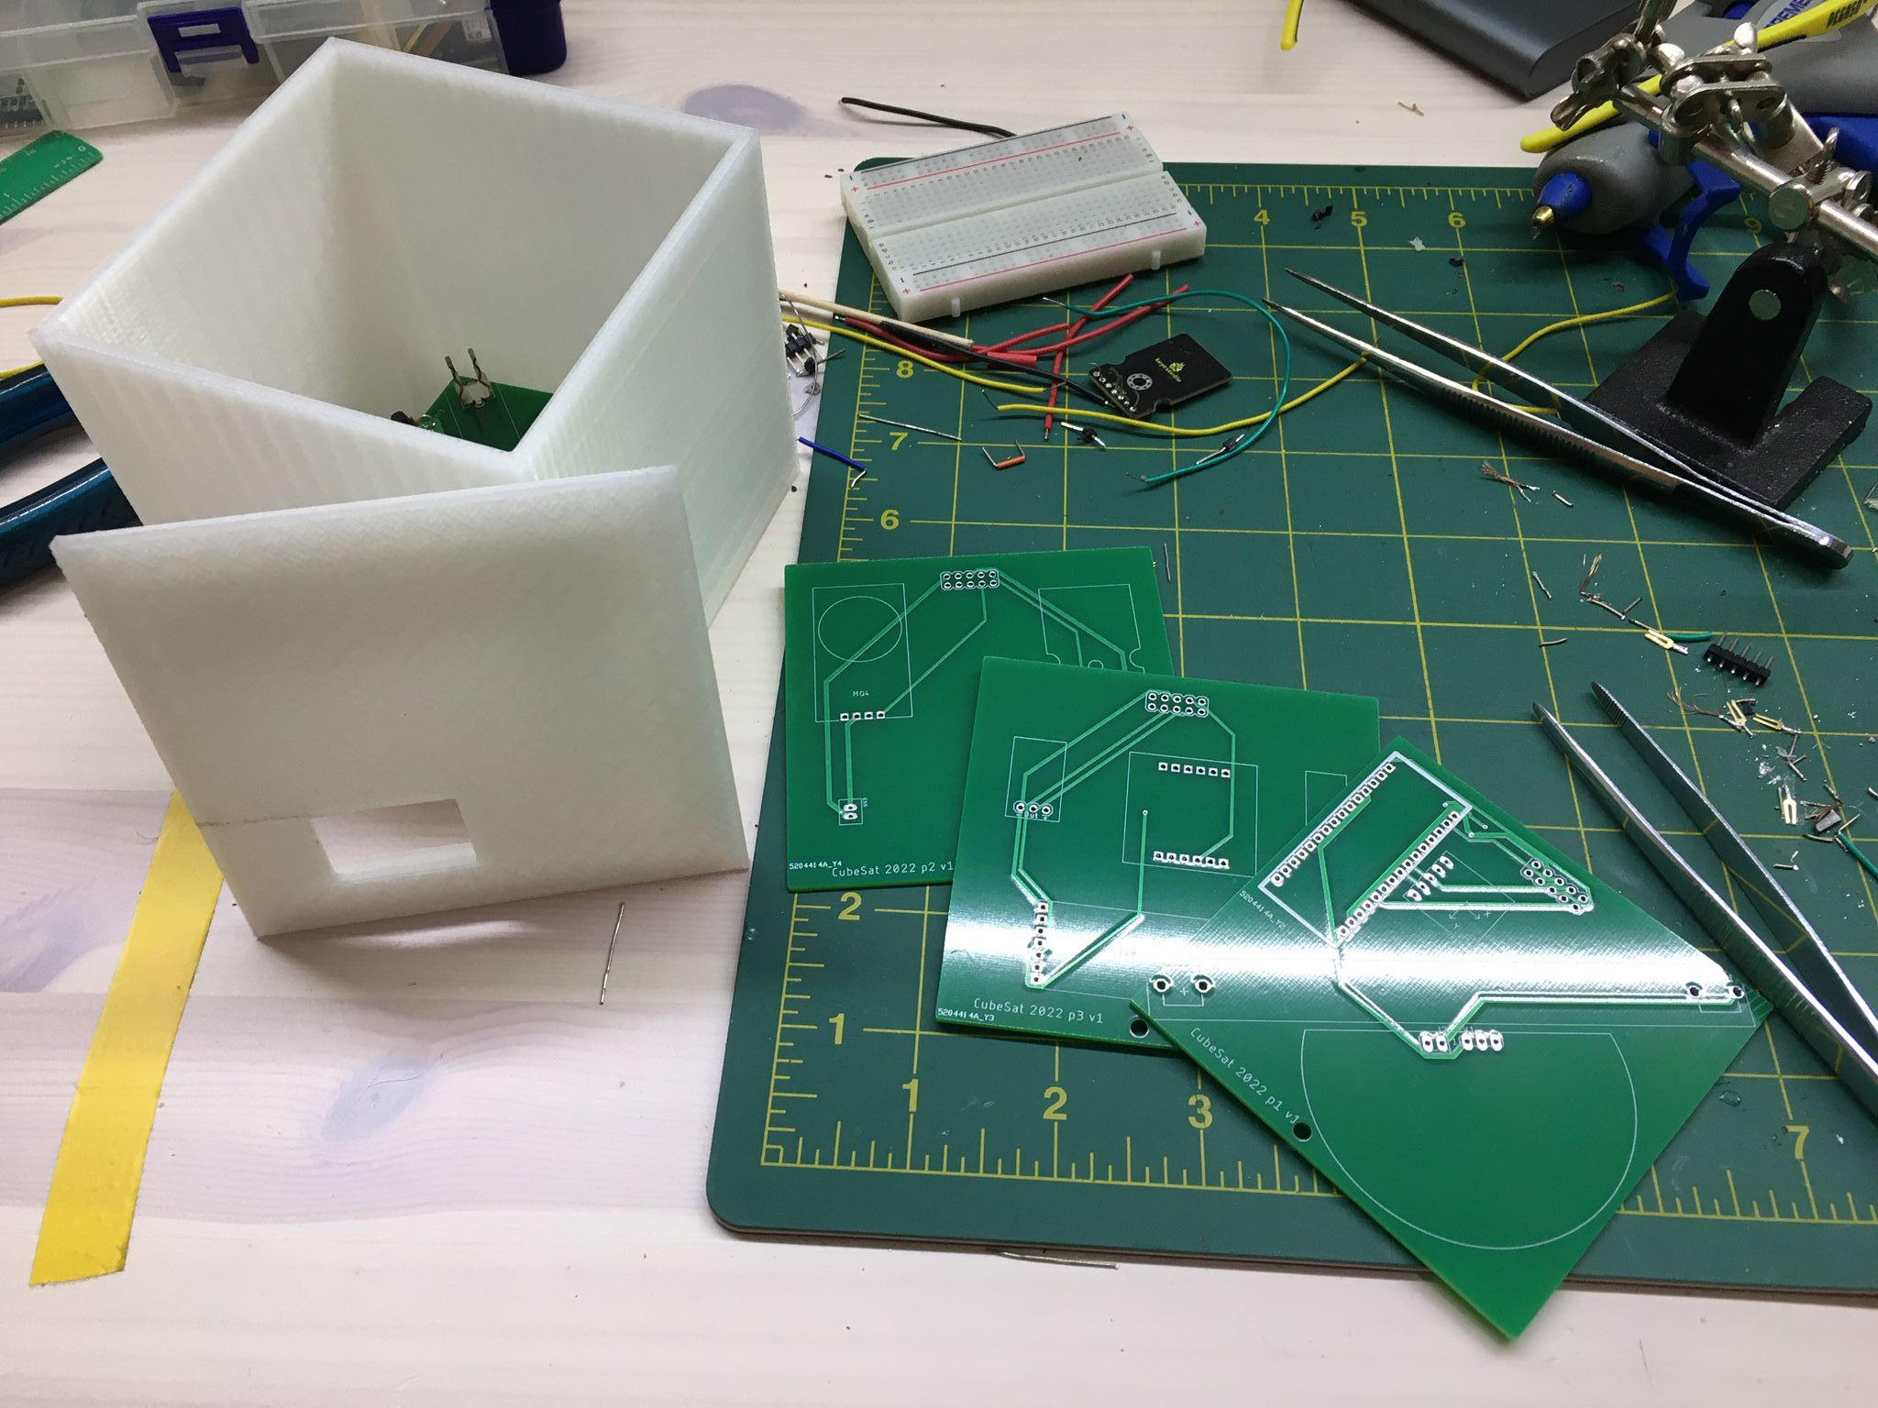
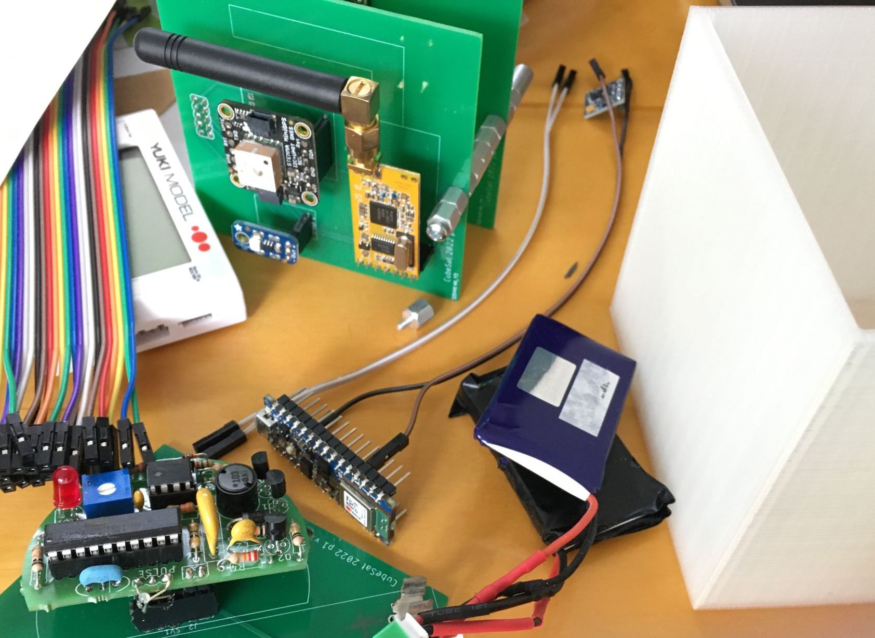

Slide 19
MOTHER requirements
It shall be able to communicate with the Earth control station.
It shall be able to control its attitude during all parts of the mission, including the cruse from the Earth.
It shall bring a protective environment to all the passengers (CAPOs plus NAVSATs), from radiation, micro meteorites, extreme temperatures from launch until deployment.
It shall be able to manage the health of the batteries in all of the passengers and ensure that they are all fully charged before deployment.
It shall be able to communicate (send and receive) with the visible NAVSATs using a radio link.
It shall be able to communicate (send and receive) with the CAPOs using a radio link.
It shall spin the CAPOs around their long axis, by powering a reaction wheel inside the CAPO, before deployment.
It shall be able to deploy the NAVSATs.
It shall include the means for the mission control centre to calculate its orbit.
It shall have ∆v capacity to be able to maintain its orbit, considering the atmospheric drag at 600 km.
It shall have a lifetime covering all the duration of the mission, hence include a powerful power supply system
It shall transmit navigation signals which can be received by the CAPOs

Slide 20
NAVSATs requirements
It shall have a propulsion system with enough ∆v to perform the Hohmann transfer orbit.
It shall have additional ∆v capacity to be able to maintain its orbit, considering the atmospheric drag at 600 km.
It shall be capable of sending and receiving data from other visible NAVSATs and MOTHER, if visible.
It shall include the means to allow the calculation of its orbit.
It shall include the means to know and control its attitude
It shall have a lifetime covering all the duration of the mission, hence include a powerful power supply system
It shall transmit navigation signals which can be received by the CAPOs

Slide 21
CAPOs requirements
It shall have a propulsion system of maximum 1U, capable of providing a ∆v of more than 1.7 km/s.
It shall have a system to remove the spin (de-spin) after the propulsion system has been fired.
It shall have a means to limit its descent speed.
It shall have a power source capable of operations for X minutes (descent time plus surface time).
The power source shall be capable of charging from the MOTHER and receiving charge from the de-spin mechanism.
It shall be able to endure Titan’s harsh atmospheric conditions, such as very low temperatures (down to 70 K), CH4 rain, etc.
It shall be able to transmit and receive data via a radio link with the MOTHER. It shall be able to receive data from the NAVSATs.
It shall be able to measure the following parameters: Temperature; CH4; Ultraviolet light; Atmospheric pressure; Magnetic field; CO2; Other VOC; Energetic particles.
It shall be able to store all the measurements’ data while it is not linked with the MOTHER.
It shall be able to retrieve an approximate location using the NAVSATs’ signals.

Slide 22
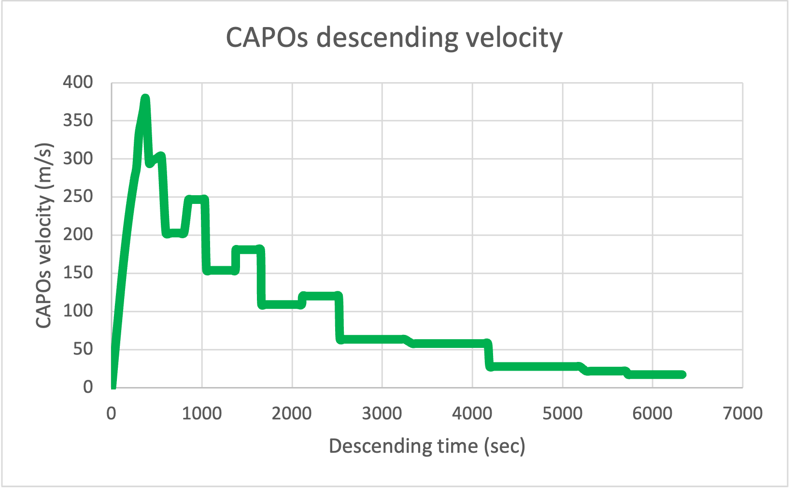
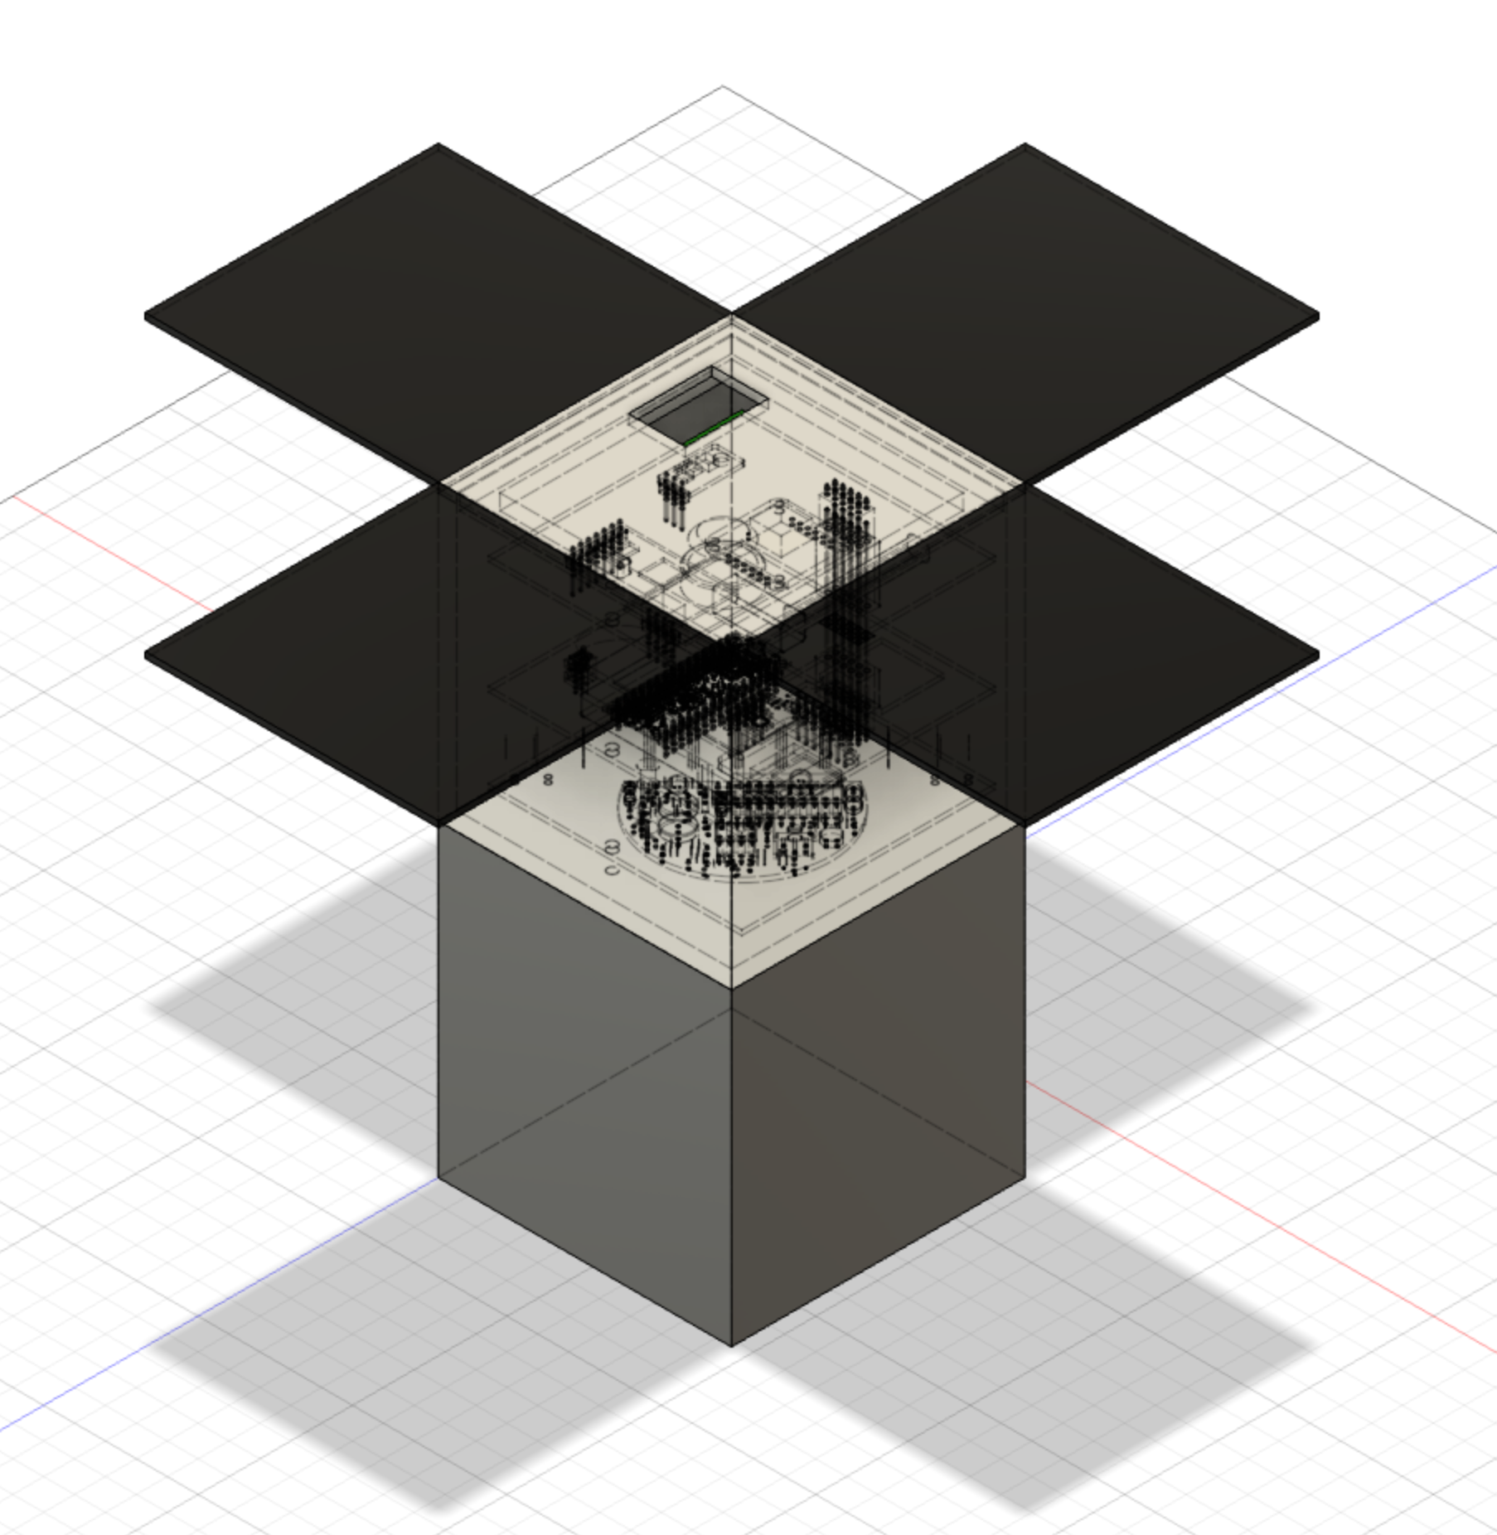
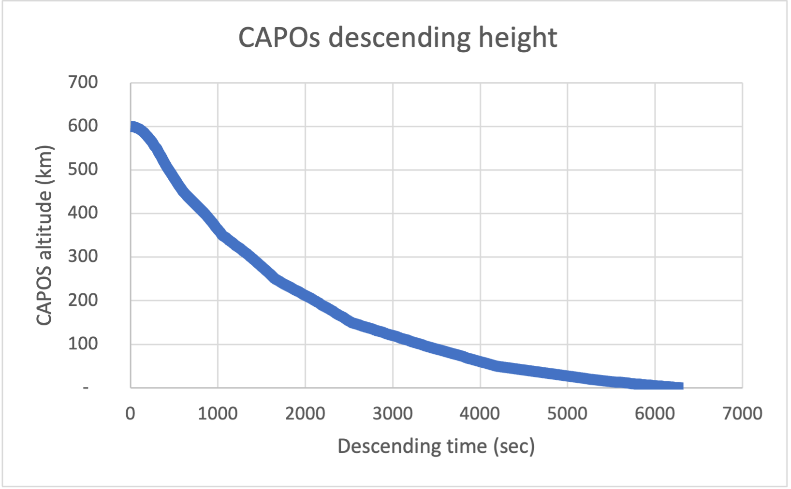
CAPOs descent

Slide 23
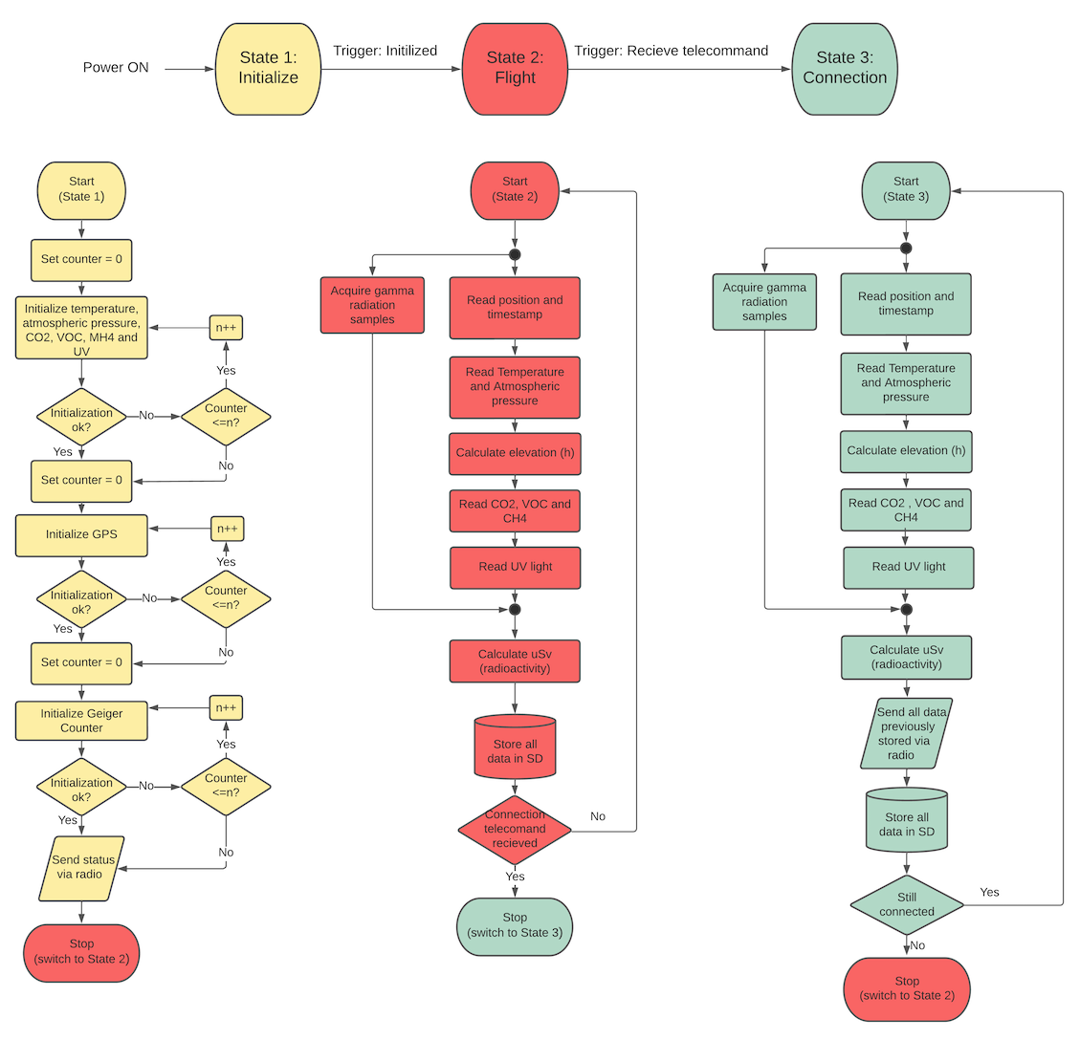
CAPOs SW flowchart

Slide 24
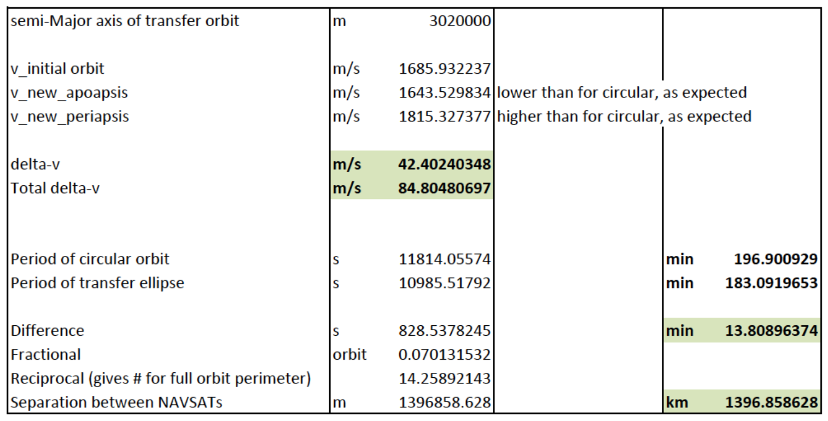
Hohmann transfer orbit details

