Slide 1
Computationally Generated Charts for Critical Local Buckling Stress of L-, T-, and Cruciform-Section Columns
Joshua Griffin
Mississippi State University
AIAA Region II Student Conference, Apirl 3rd 2025

Slide 2

Hello, I’m…
Joshua Griffin
Undergraduate Senior, Aerospace Engineering, Mississippi State University.

Slide 3
BUCKLING
01
What is buckling and what is being considered?

Slide 4



What is buckling?
A loss of stability in a structural element subjected to compressive stress.
Deformation mode of element transitions from axial to lateral at a critical load.
unloaded loaded
loaded, axial deformation
loaded, lateral deflection

Slide 5
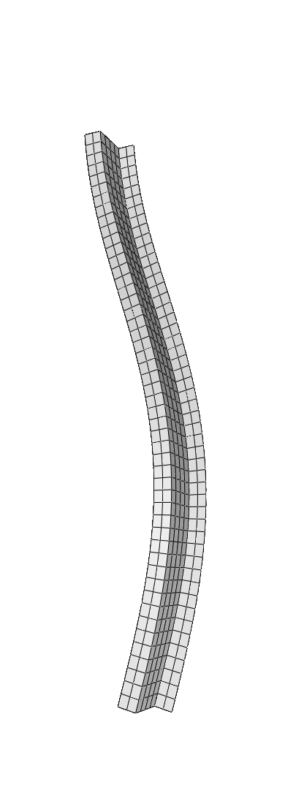
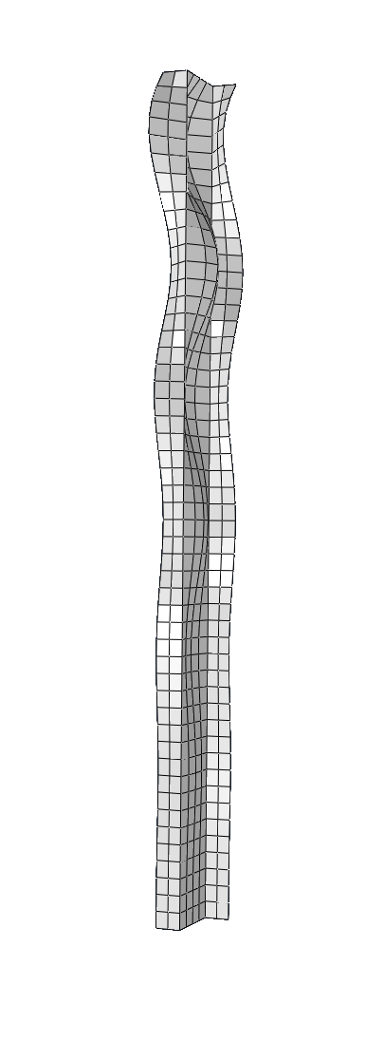
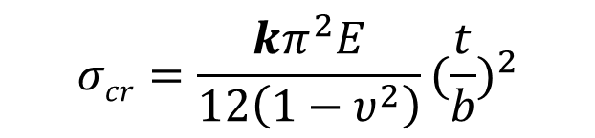
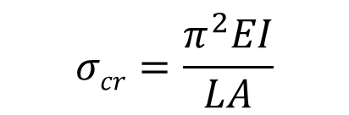
Global vs. Local buckling
Global - Affects the
entire structure or
component.
Local – Occurs in
localized regions of
a structural element.
$$σcr=\frac{π^{2}EI}{LA}$$
$$σcr=\frac{kπ^{2}E}{12\left(1−υ^{2}\right)}{(\frac{t}{b})}^{2}$$
Charts historically used to determine k.

Slide 6
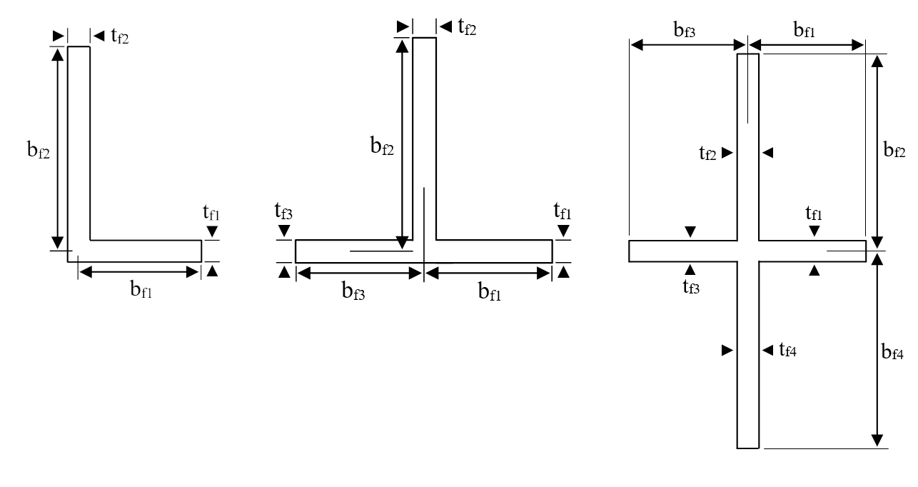
Geometries for Study
L- , T- , & Cruciform Section Stringers
Dimensional defines
Ratios for Charts
t_{f1} = t_{f3} b_{f1} = b_{f3}
t_{f2} = t_{f4} b_{f2} = b_{f4}
t_{f2} b_{f1}
t_{f1} b_{f2}

Slide 7
NUMERICAL METHODS
02
Finding unknowns with moment distribution

Slide 8
Moment Distribution in Beams
A technique to analyze statically indeterminate beams by iteratively distributing internal moments until equilibrium is achieved.
“locked”
“unlocked”
distributed to equilibrium
Moments distributed according to stiffness.
[1] Cross, H., “Analysis of Continuous Frames by Distributing Fixed-End Moments,” Proceedings of the American Society of Civil Engineers, Part 1, May 1930, pp. 919-928

Slide 9
Moment Distribution in Plate Structures
Half-wavelength,
λ
Strain experienced rather than moment applied
Stiffness afforded by flange dependent on:
    Length of flange, b
Poisson’s ratio, υ
Half-wavelength experience, λ
Local buckling coefficient, k
[2] Lundquist, E. E., Stowell, Z. E., and Schuette, E. H., “Principles of Moment Distribution Applied to Stability of Structures Composed of Bars or Plates,” NACA-WR-L-326, Jan. 1943.

Slide 10
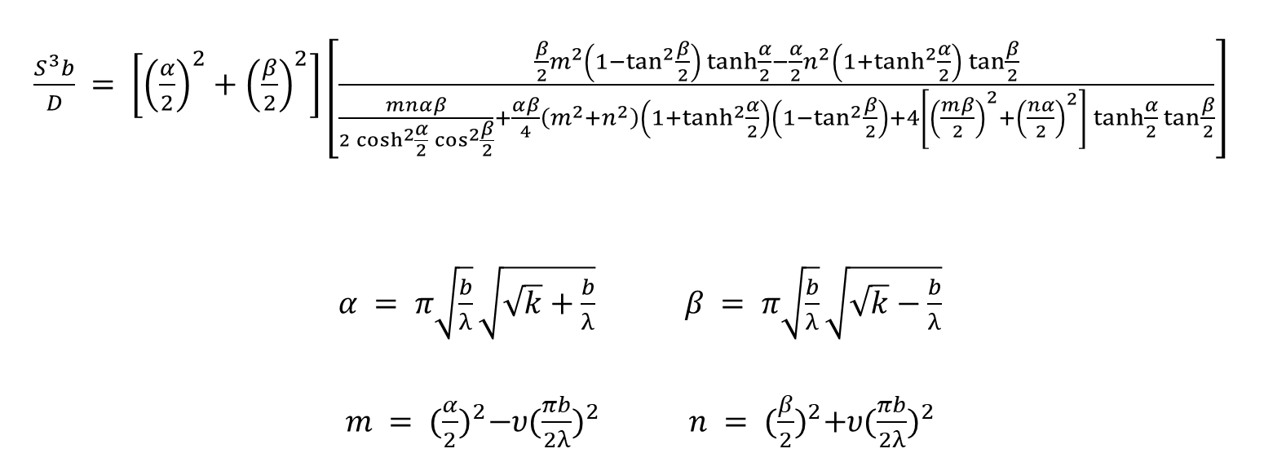
Flange Stiffness Equation
$\frac{S^{3}b}{D} = \left[{\left(\frac{α}{2}\right)}^{2}+{\left(\frac{β}{2}\right)}^{2}\right]\left[\frac{\frac{β}{2}m^{2}\left(1−\tan^{2}{\frac{β}{2}}\right)\tanh{\frac{α}{2}}−\frac{α}{2}n^{2}\left(1+\tanh^{2}{\frac{α}{2}}\right)\tan{\frac{β}{2}}}{\frac{mnαβ}{2\cosh^{2}{\frac{α}{2}}\cos^{2}{\frac{β}{2}}}+\frac{αβ}{4}\left(m^{2}+n^{2}\right)\left(1+\tanh^{2}{\frac{α}{2}}\right)\left(1−\tan^{2}{\frac{β}{2}}\right)+4\left[{\left(\frac{mβ}{2}\right)}^{2}+{\left(\frac{nα}{2}\right)}^{2}\right]\tanh{\frac{α}{2}}\tan{\frac{β}{2}}}\right]$
$α = π\sqrt{\frac{b}{λ}}\sqrt{\sqrt{k}+\frac{b}{λ}}$ $β = π\sqrt{\frac{b}{λ}}\sqrt{\sqrt{k}−\frac{b}{λ}}$
$m = {(\frac{α}{2})}^{2}−υ{(\frac{πb}{2λ})}^{2}$ $n = {(\frac{β}{2})}^{2}+υ{(\frac{πb}{2λ})}^{2}$
υ , Poisson's ratio, taken as 0.3

Slide 11
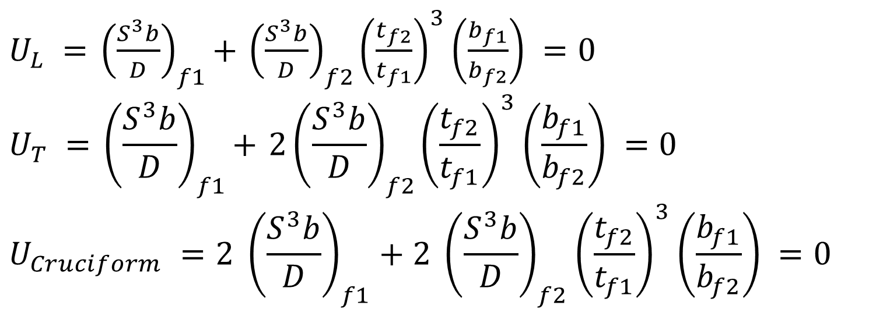
Moment Distribution Equilibriums
$U_{L} ={ \left(\frac{S^{3}b}{D}\right)}_{f1}+{ \left(\frac{S^{3}b}{D}\right)}_{f2}{\left(\frac{t_{f2}}{t_{f1}}\right)}^{3}\left(\frac{b_{f1}}{b_{f2}}\right) =0$
$$U_{T} ={ \left(\frac{S^{3}b}{D}\right)}_{f1}+{ 2\left(\frac{S^{3}b}{D}\right)}_{f2}{\left(\frac{t_{f2}}{t_{f1}}\right)}^{3}\left(\frac{b_{f1}}{b_{f2}}\right) =0$$
$$U_{Cruciform} ={2 \left(\frac{S^{3}b}{D}\right)}_{f1}+{2 \left(\frac{S^{3}b}{D}\right)}_{f2}{\left(\frac{t_{f2}}{t_{f1}}\right)}^{3}\left(\frac{b_{f1}}{b_{f2}}\right) =0$$

Slide 12
IMPLEMENTATION
03
Process and considerations

Slide 13
Programmed Moment Distribution Method
01 >
02 >
03 >
Assume a value of λ / b.
Find first value of k satisfiying U = 0 for the value of λ / b.
Iterate 1 & 2 with a search pattern to find λ / b with lowest correlating k
04 >
1-3 repeated for a range of dimensions of the column cross-section
This process was programmed in C.
~ 36 hours on 1 thread for each chart.

Slide 14
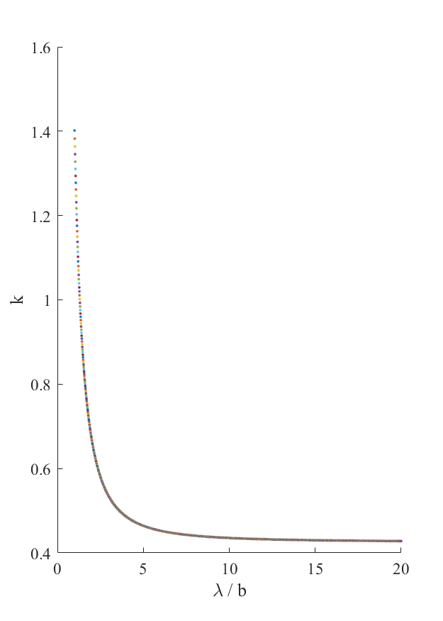
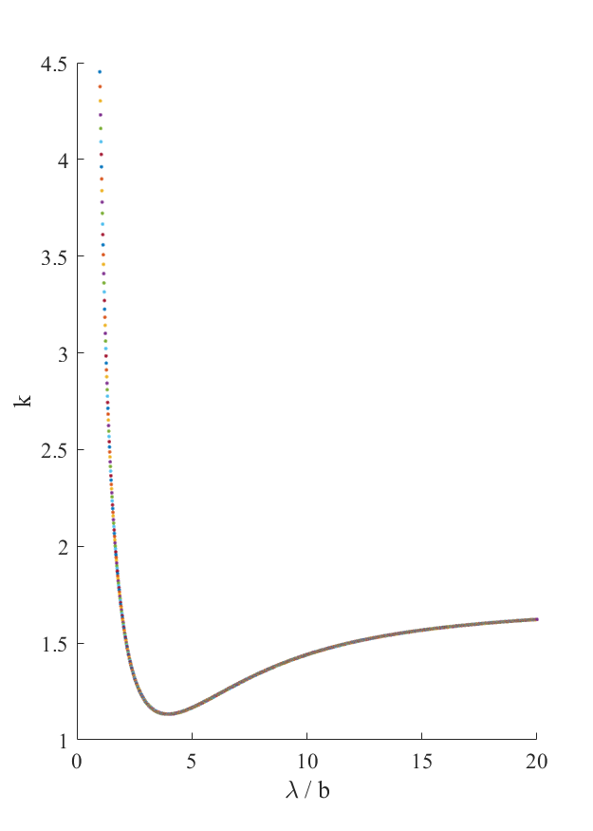
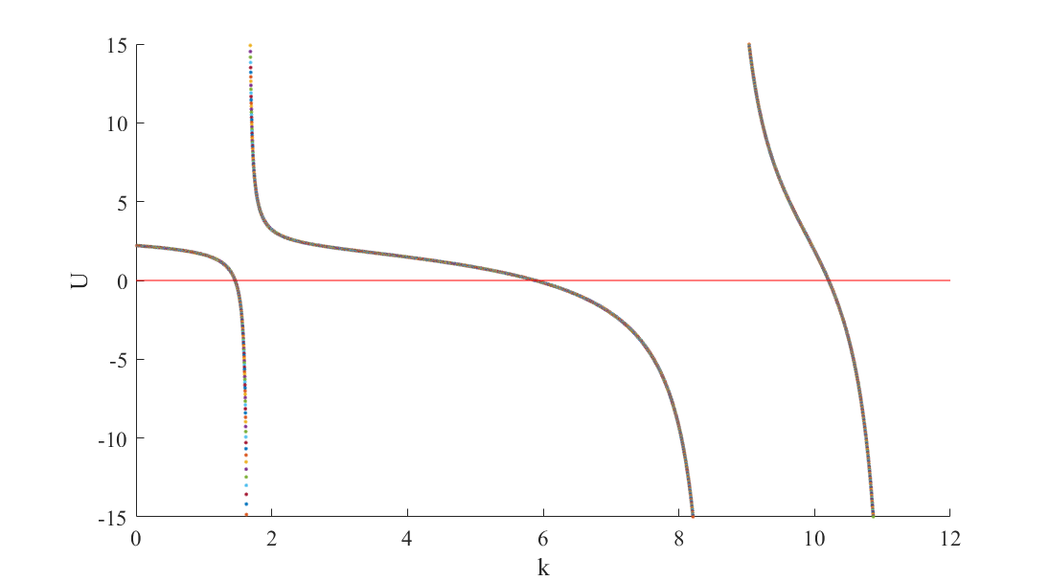
Undocumented Behaviors Accounted For
Discontinuous behavior of U with respect to k
Multiple modes of k with respect to λ / b
t_{f2}/t_{f1} = 1.0 , b_{f1}/b_{f2} = 1.0
t_{f2}/t_{f1} = 0.5 , b_{f1}/b_{f2} = 0.5
Chart of Equilibrium Equation, U
When finding first k to satisfy U = 0
Charts of k vs. λ / b
When finding lowest k

Slide 15
VALIDATION
04
Finite element analysis in Abaqus

Slide 16
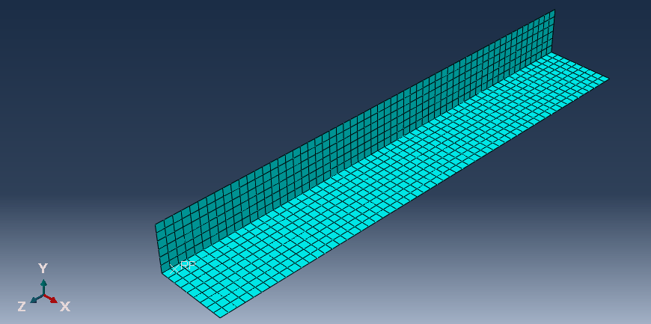
Material Properties & Geometry for FEA
E = 10.6 x 10⁶ psi
υ = 0.3
Column 10” in length
Flanges f2 & f4, 1” wide & 1/10” thick.
Flanges f1 & f3 varied to achieve desired values of b_{f1}/b_{f2} & t_{f2}/t_{f1} .

Slide 17
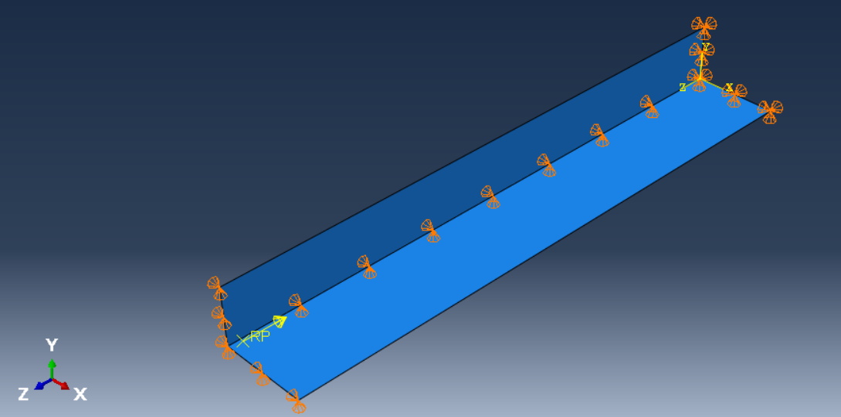
Boundary Conditions & Applied Load for FEA
Unit load applied & constrained to one end.
Simply supported BC given to unloaded end.
Loaded end and joint given partial simple support.

Slide 18
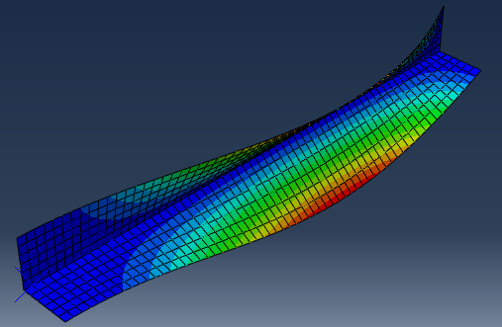
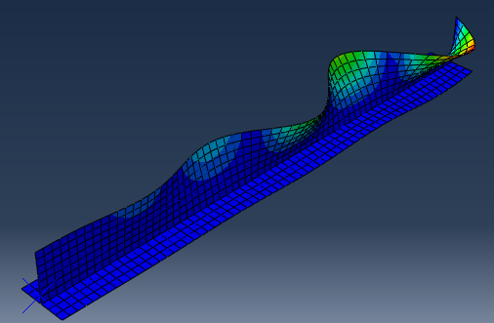
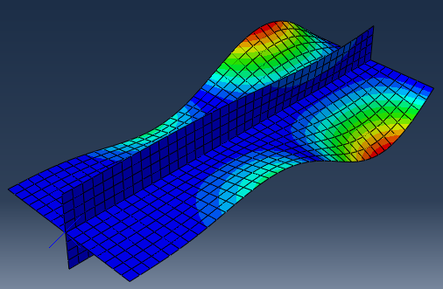
FEA Results from Abaqus
Models run with a linear perturbation buckling step
k obtained from critical load

Slide 19
RESULTS
05
Comparison and final product

Slide 20
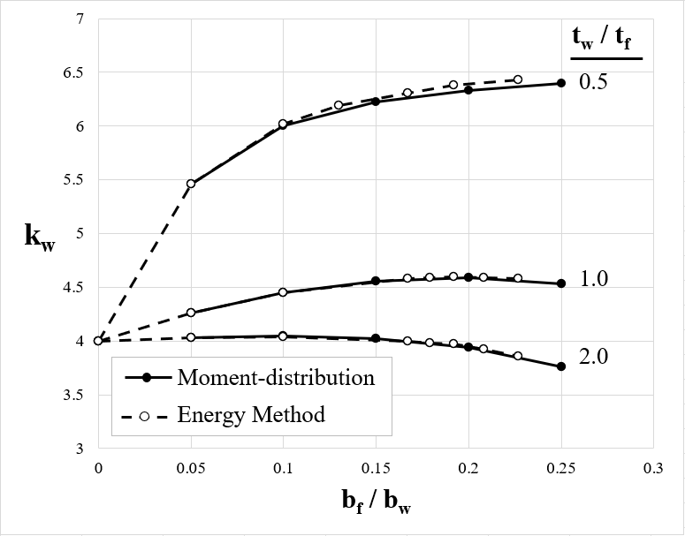
Moment Distribution vs. Energy Methods
Process for Z & C columns reproduced where energy methods were previously used.

Slide 21
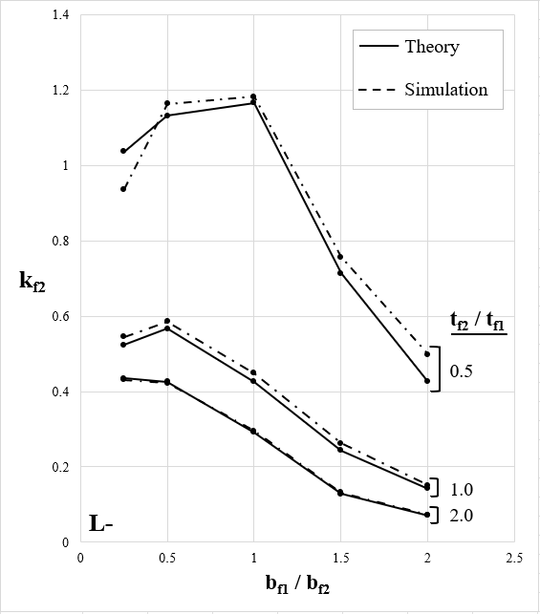
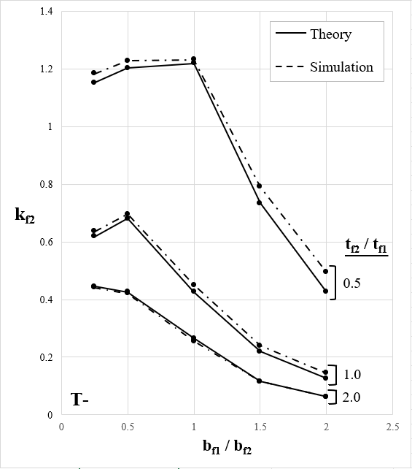
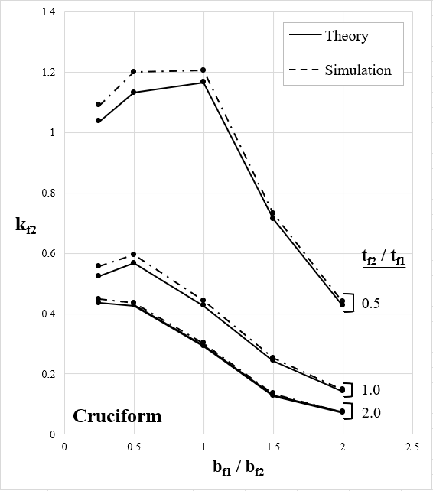

Moment Distribution vs. FEA
$$2.73\frac{I_{f1}}{b_{f2}t_{f2}^{3}}−\frac{A_{f1}}{b_{f2}t_{f2}} ≥5$$
Magnitude of Error
0.1231% to 17.04%
Mean Magnitude of Error
4.586%
Mean Magnitude of Error
3.606%
with outliners removed
[3]
[3] Bruhn, E. F., Analysis and Design of Flight Vehicle Structures, Jacobs Publishing, Carmel, IN, 1973, p. C7.6

Slide 22
