Slide 1




Design Analysis of Medium Form Factor Stealth UAVs with Variable Sweep Wings for ISR Missions Using Advanced Composite RAM
by Dheer Chhabria
AIAA REGION II
Copyright © by Dheer Chhabria
Published by the American Institute of Aeronautics and Astronautics, Inc., with permission

Slide 2
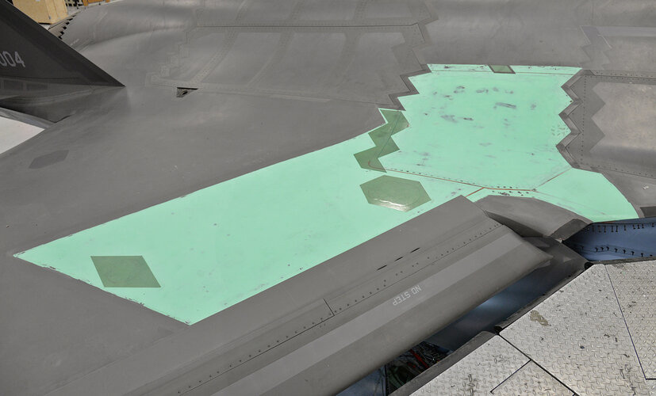
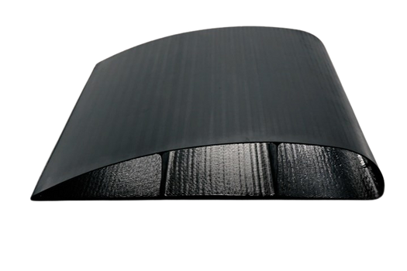
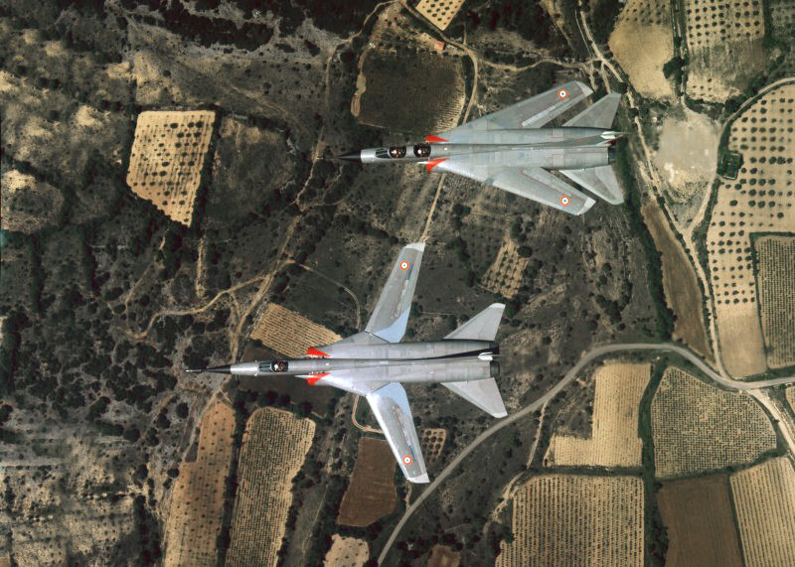
Abstract
  Hybrid titanium-CFRP structure
  Variable sweep wings
  RAM coatings and shaping
  Validated through CFD
This UAV design combines structural strength and stealth. It uses a titanium core for mechanical loads and a CFRP outer shell integrated with radar-absorbing materials. Variable-sweep wings allow it to adapt aerodynamically mid-flight. The design was validated using simulations like CFD.
Notes:
"This UAV design combines structural strength and stealth. It uses a titanium core for mechanical loads and a CFRP outer shell integrated with radar-absorbing materials. Variable-sweep wings allow it to adapt aerodynamically mid-flight. The design was validated using simulations like CFD and finite element analysis."

Slide 3
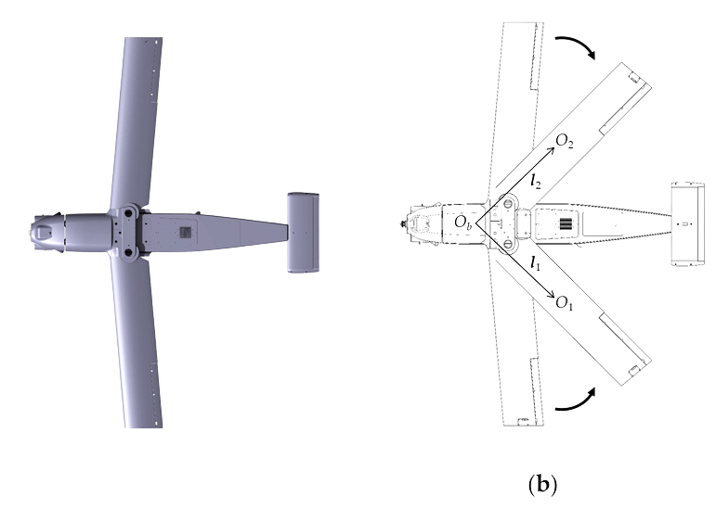
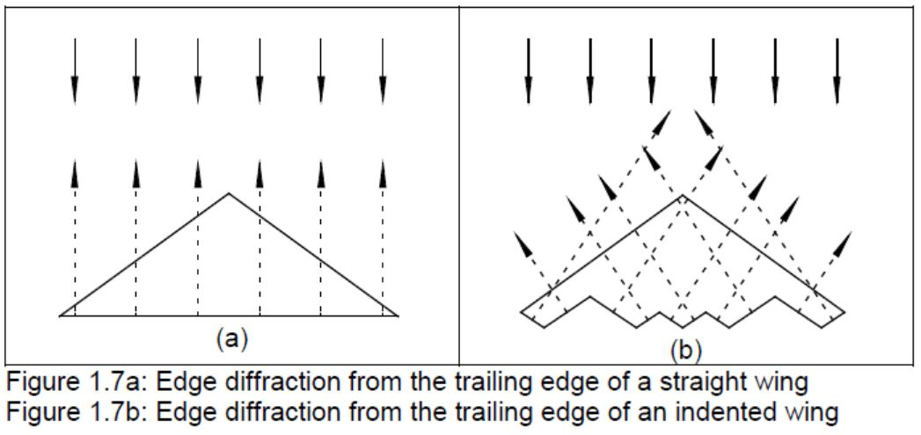
Literature Review
  Morphing wings and aeroelastic tailoring
  CNT and polymer-based RAMs
  CFRP: lightweight and EM absorbing
  Advances in stealth shaping
Past studies show that variable geometry wings significantly improve UAV performance. Carbon nanotubes (CNTs) and conductive polymers are major RAM innovations. CFRPs remain the dominant structural and stealth materials. This research builds on those principles.

Slide 4
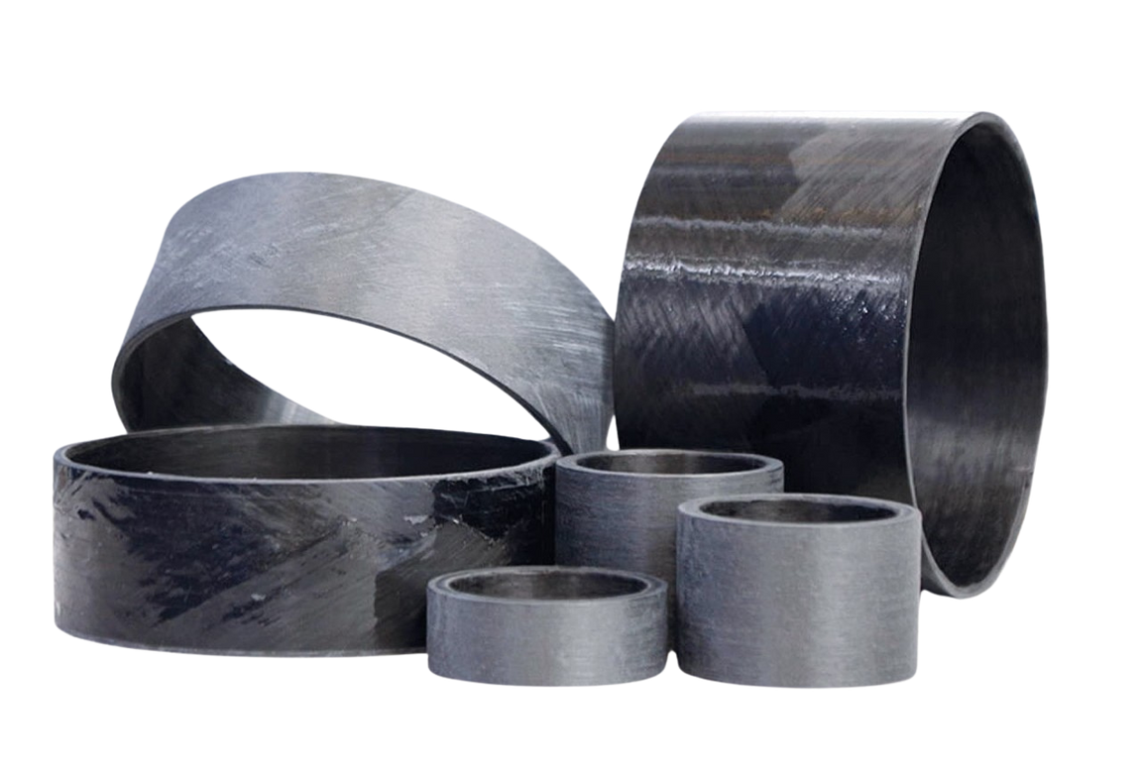
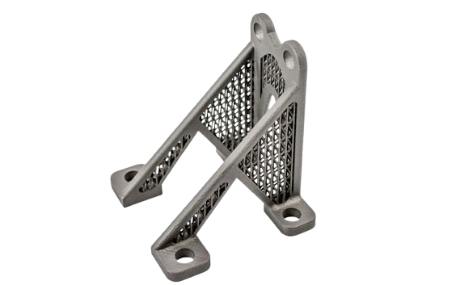
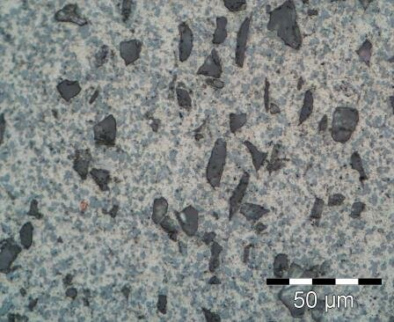
Airframe Design: Materials
  Titanium inner tube (⌀93.5 mm)
  CFRP shell (⌀100 mm, 4 mm thick)
  RAM-enhanced CFRP
The airframe uses a titanium tube to bear structural loads, with a CFRP shell that offers lightness and stealth. CFRP is infused with RAM coatings. This hybrid approach ensures durability, weight savings, and low radar cross section.
Notes:
"The airframe uses a titanium tube to bear structural loads, with a CFRP shell that offers lightness and stealth. CFRP is infused with RAM coatings. This hybrid approach ensures durability, weight savings, and low radar cross-section."

Slide 5
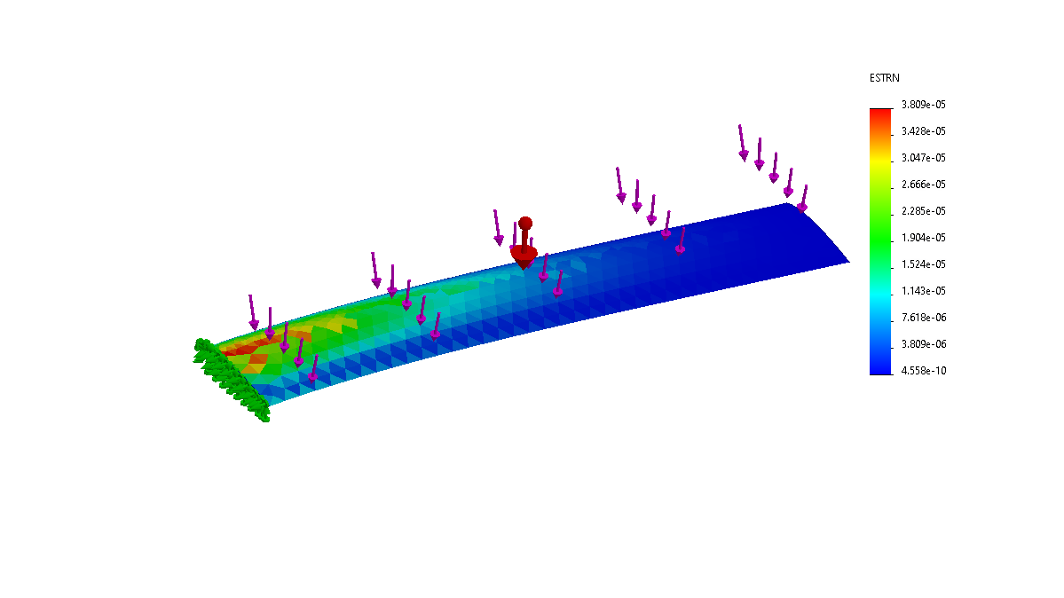
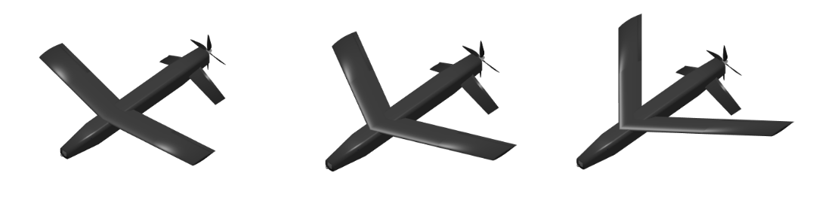
Load and Stress Considerations
  FEA validates strength
  CFRP dampens vibration
  Sweep angles: 10°, 28°, 45°
  Peak structural stress tolerance: ~6Gs
FEA confirms the CFRP covered titanium wing withstands up to 6Gs. Titanium handles internal loads, while CFRP dampens vibrations and reduces deformation. Variable sweep angles enhance performance mid flight.

Slide 6
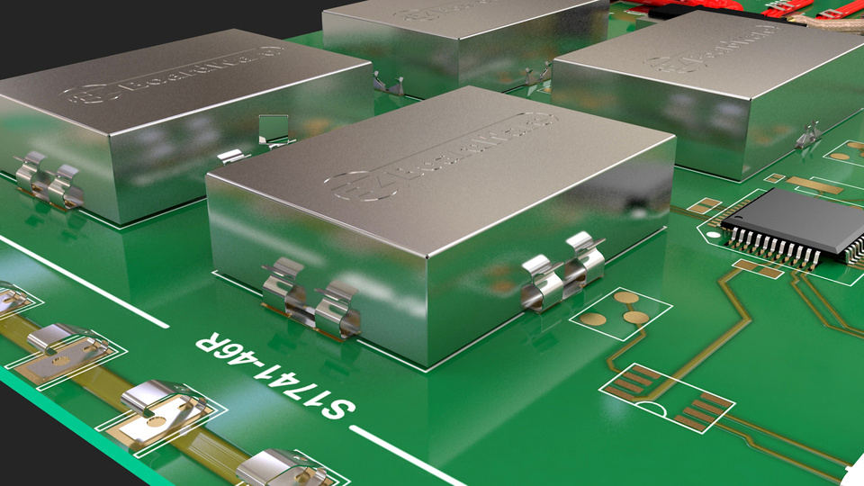
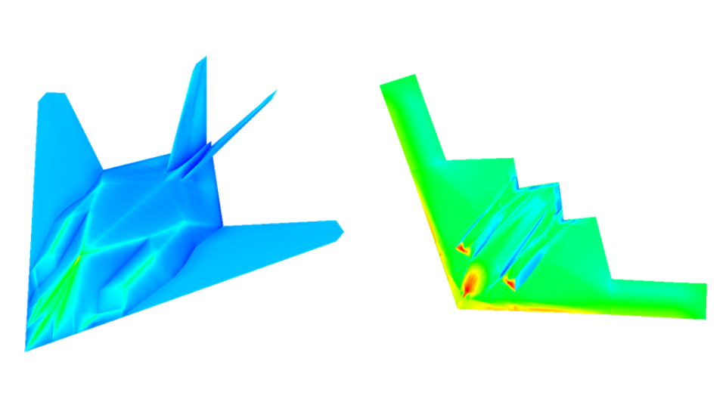
Internal Payload & Stealth
  EMI shielded titanium core
  RAM coated CFRP
  Smooth surface, stealth shape
  RCS ↓ ~35%
Stealth comes from multiple factors. The internal electronics are shielded by titanium. RAM is applied to the CFRP shell, and the design eliminates sharp protrusions that bounce radar. These combine to reduce radar cross section by up to 42%
Notes:
"The airframe uses a titanium tube to bear structural loads, with a CFRP shell that offers lightness and stealth. CFRP is infused with RAM coatings. This hybrid approach ensures durability, weight savings, and low radar cross-section."

Slide 7
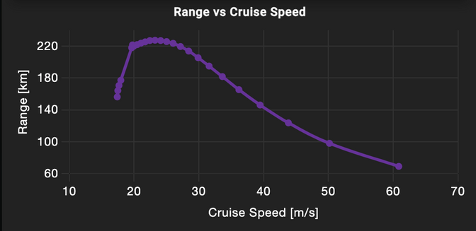
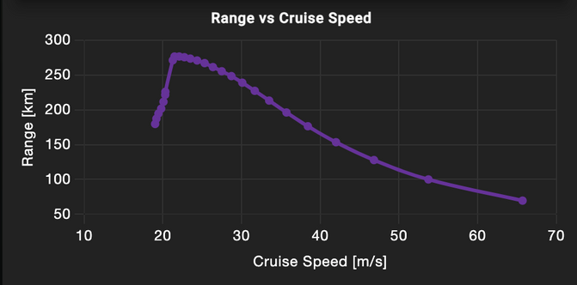
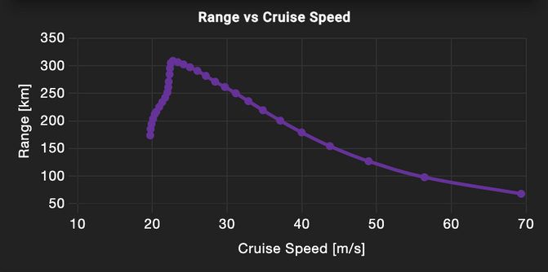
Variable Sweep Wing Benefits
  45 deg
  37 % increase in range when wings are swept from 45 deg to 10 deg
  Range: 20m/s → 70 m/s
  Sweep angles optimize drag & lift
  Real time morphing
  28 deg
  10 deg
The morphing wings adapt during flight. At low sweep angles, the UAV loiters with less drag. At high sweep angles, it gains maneuverability. This design expanded its speed envelope from 22 m/s to over 70 m/s

Slide 8
L/D , Lift and Drag Curves

Slide 9
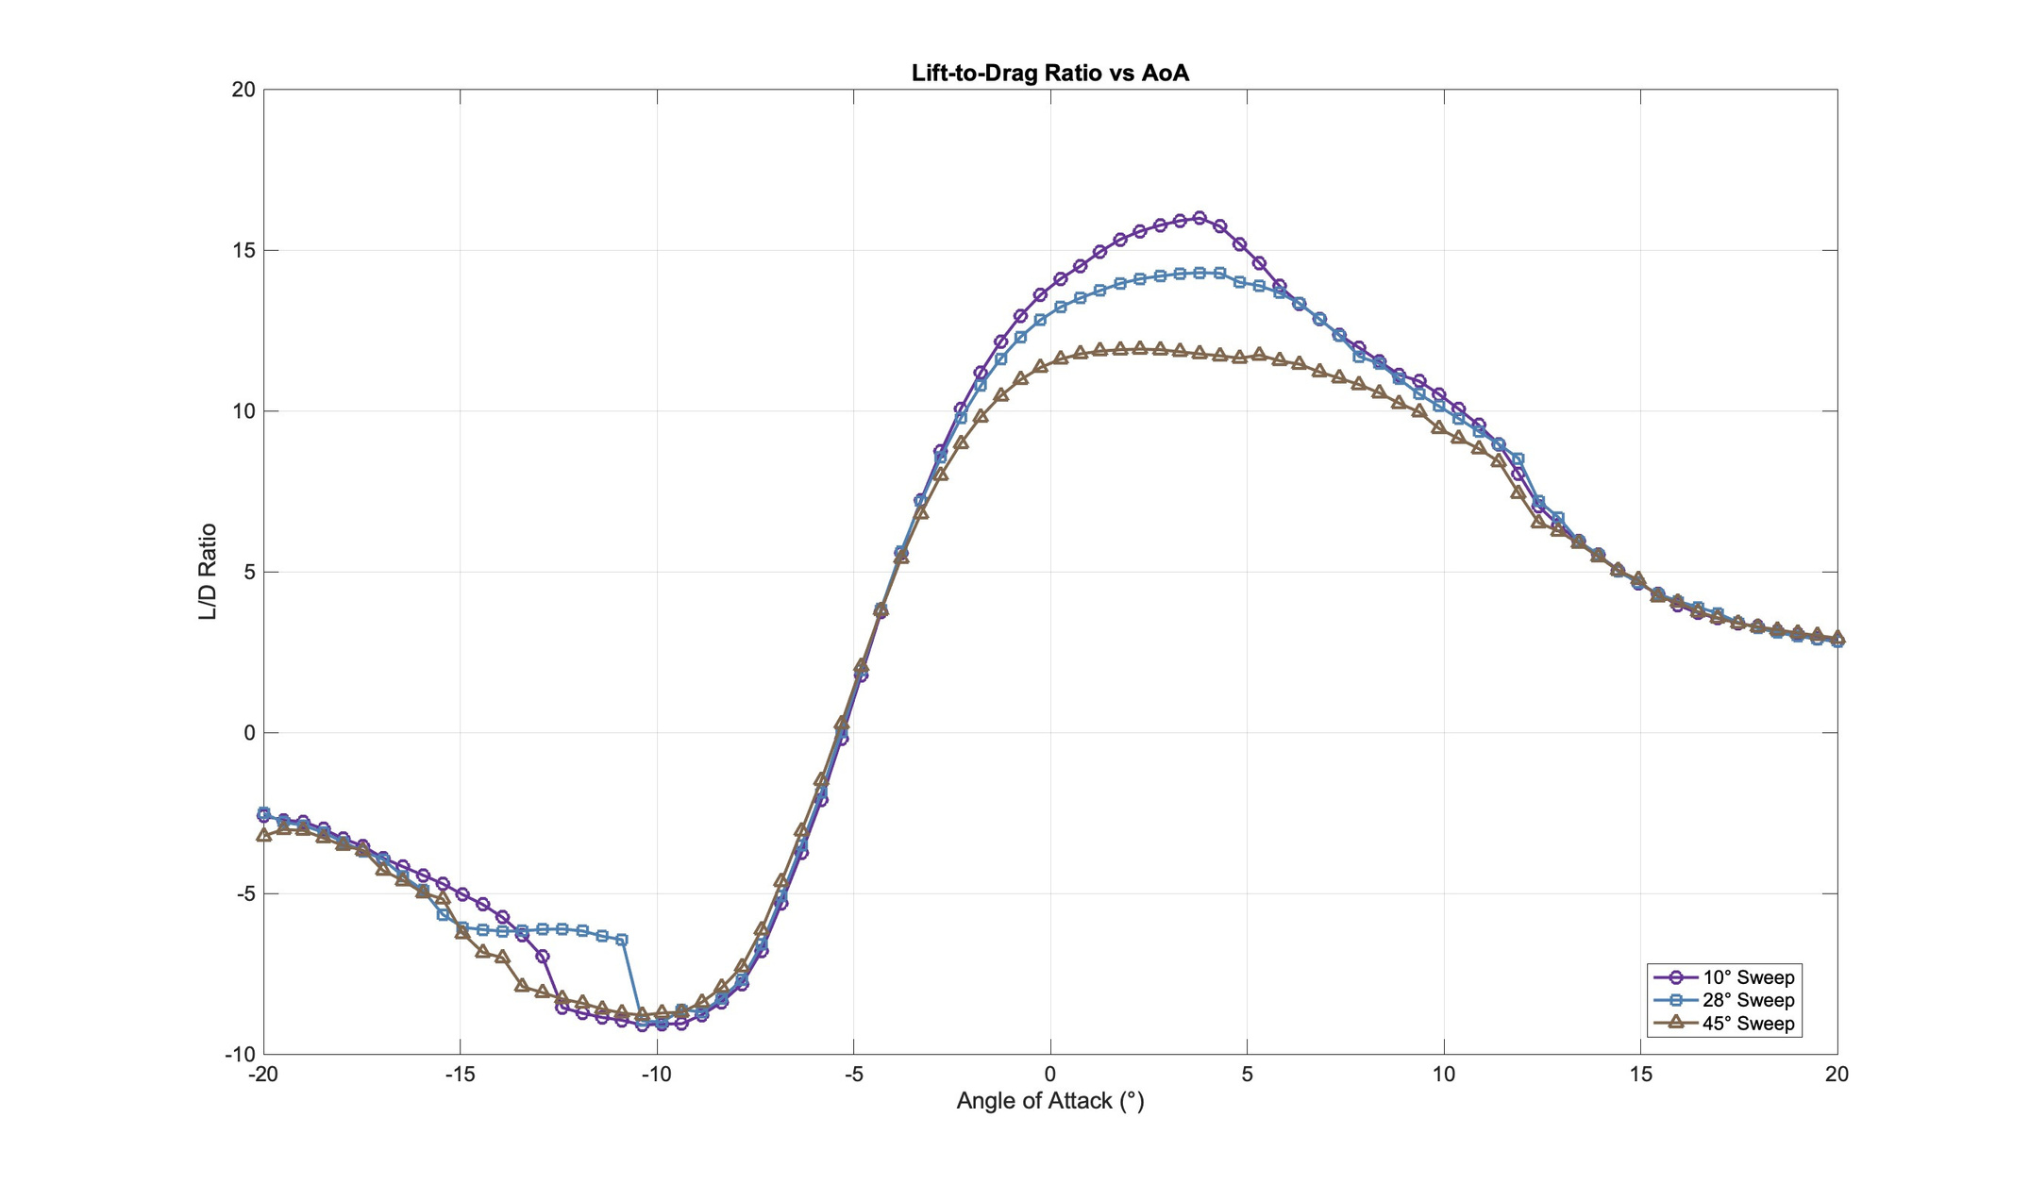

Slide 10
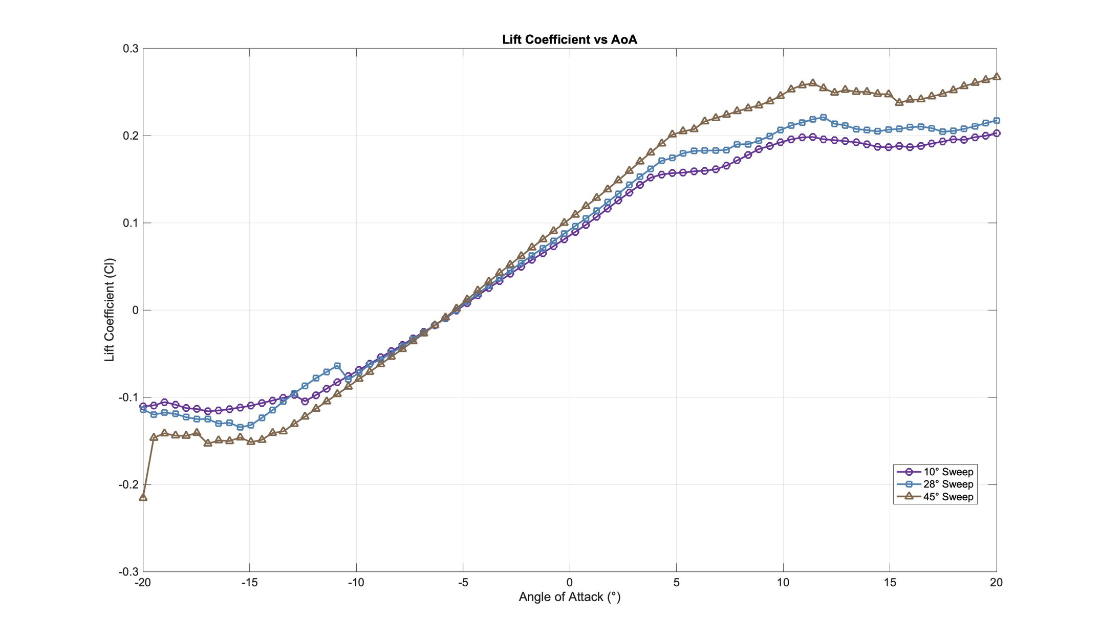

Slide 11
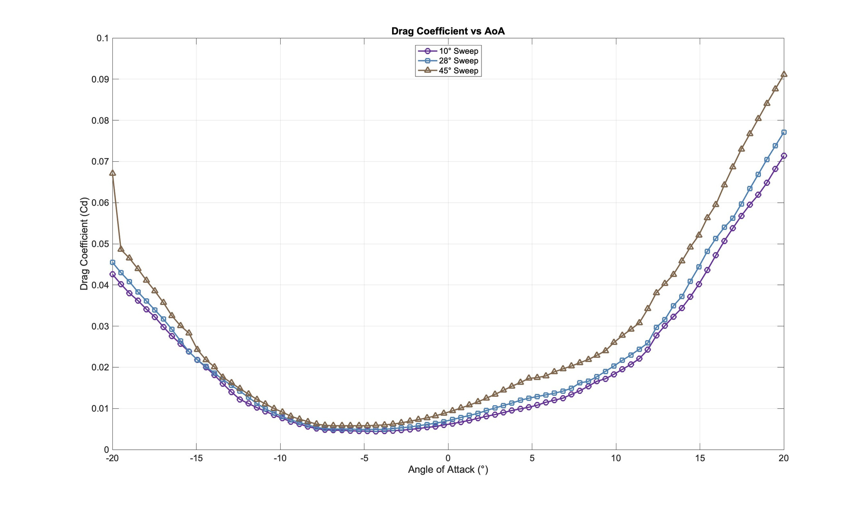

Slide 12
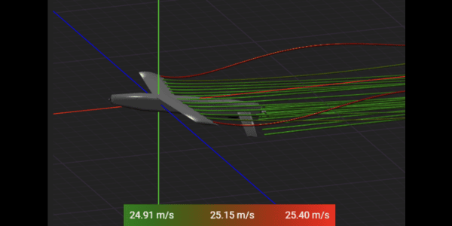
Aerodynamic Performance & Flight Simulation
  Optimal lift-to-drag at 4° AoA
  Max endurance and range between 20–25 m/s
  Drag increases rapidly beyond 10° AoA
  Stall and vortex formation occur after 20° AoA
  Flow visualizations confirm aerodynamic behavior
Flight simulations and CAD models show that the UAV performs best at 4° AoA and around 20–25 m/s. Beyond this, drag rises quickly, and stall begins after 20°. The sweep angle CAD models and flow visuals validate these aerodynamic trends.

Slide 13
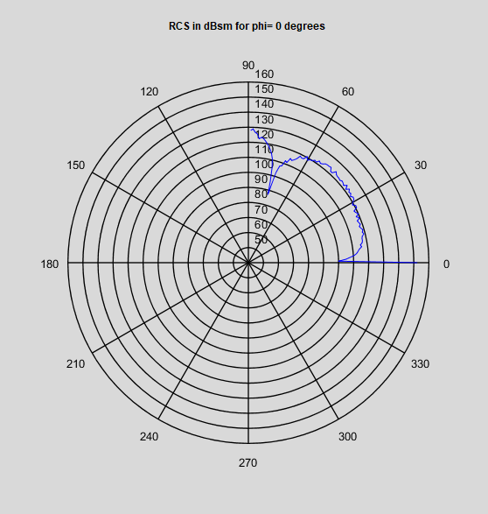
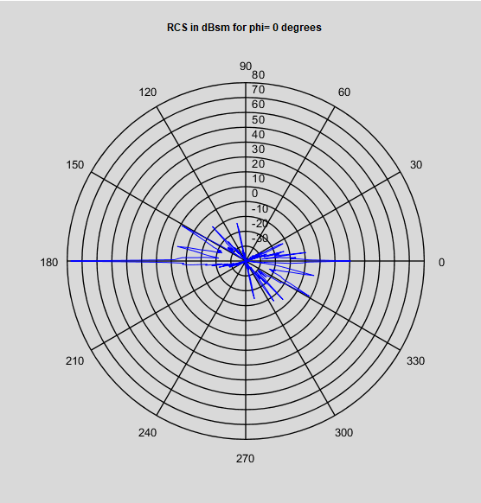
Stealth Techniques
  RAM: carbonyl iron, MnZn ferrites
  Covers X-, C-, S-band radar
  RCS reduced from 120 → 70 dBsm which is 42% radar signature reduction
Carbonyl iron, with relative permeability around 500–1000 and very low resistivity (~10⁻⁴ ohm·cm), is effective for X-, C-, and S-band absorption but prone to eddy currents. Mixing it with polymers increases resistivity, reducing reflections. MnZn ferrites have much higher relative permeability 1000–15,000 and resistivity (~10³ ohm·cm), making them ideal for low frequency stealth. Both are crucial for broad spectrum RCS reduction.
Notes:
"The airframe uses a titanium tube to bear structural loads, with a CFRP shell that offers lightness and stealth. CFRP is infused with RAM coatings. This hybrid approach ensures durability, weight savings, and low radar cross-section."

Slide 14

Thank you
Email: dheerchhabria@gmail.com
LinkedIn: linkedin.com/in/dheerchhabria

