Slide 1


Studying the Effects of a Backward Facing Step in Enhancing Fuel Mixing in Scramjets
Grayson Hayes and Surabhi Singh
Embry-Riddle Aeronautical University, Daytona Beach, FL
AIAA Region II Student Conference 2025
Copyright © by Grayson Hayes
Published by the American Institute of Aeronautics and Astronautics, Inc., with permission.

Slide 2
Motivation
As flight speeds increase, it is necessary to take several influences into account when selecting a propulsion method
The solid-fuel scramjet (SFSJ) has proven to be a promising candidate for delivering high specific impulse with relatively low complexity and cost
Little work has been performed to evaluate the flow structures which induce mixing in an SFSJ by implementing a backward facing step (BFS)
As such, computational fluid dynamics (CFD) analysis has been performed to evaluate the flow structures immediately following a BFS and identify the causes of mixing in the region.

Slide 3
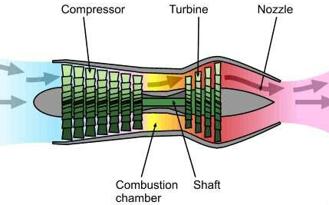
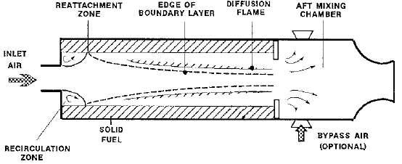
Background
Different regimes of flight speed necessitate different methods of propulsion to adapt to the environment of operation
For Mach numbers less than three, the turbojet (Fig. 1) is often the most efficient choice.
Beyond this range, the Solid Fuel Ramjet (SFRJ)(Fig.2) becomes the best choice
  However, as the incoming flow reaches the hypersonic regime, the total pressure loss within an SFRJ rises
For the hypersonic regime, the SFSJ has been considered a promising candidate to efficiently produce thrust with a relatively low cost and complexity
Fig. 1 : Diagram of a turbojet (Brown 2009)
Fig. 2 : Diagram of a SFRJ (Ben-Yakar 1998)

Slide 4
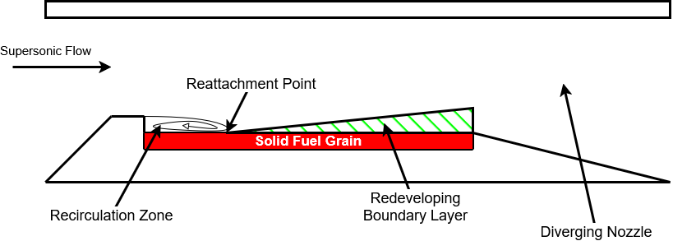
Background - SFSJ
As the supersonic flow travels through the engine (Fig. 3), multiple distinct flow features appear.
The recirculation zone immediately following the BFS is known to be a significant contributor to fuel-air mixing
The reattachment point has been shown to induce a higher regression rate of the fuel grain
The redeveloping boundary layer is where most combustion takes place
Fig. 3 : Diagram of the flow within an SFSJ

Slide 5


Background - SFSJ
One of the key advantages of the SFSJ over the SFRJ is that the mass flow rate through the SFSJ is not limited
  Thus, very large mass flow rates can be achieved (Cohen-Zur 1998)
The recirculation zone (Fig. 4) is the main point of focus for this study
  This zone, with its lower velocities and higher temperatures is of great importance to self-sustained combustion within the SFSJ
The recirculation zone leads to the presence of the flameholding region, a region of near-constant combustion within the SFSJ
  This region is vital due to the short time-spans which reactants spend inside of the SFSJ
Flow, $M_{∞}>1$
Recirculation Zone, $M_{local}<1$
Step-height, h
Fig. 4 : Diagram of the flow within the recirculation zone

Slide 6
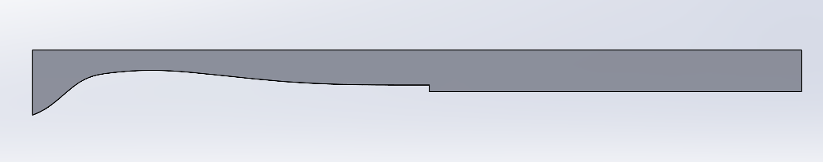
Simulations
This study used Computational Fluid Dynamics to characterize the flow following a BFS and identify flow structures within the recirculation zone
An asymmetric nozzle (Fig. 2) which produces a Mach 2 cold flow was simulated without any combustive processes
Two different step-heights for the BFS were simulated, eighth-inch and quarter-inch
  These heights were chosen to represent an eighth-inch fuel grain at the beginning and end of its life
BFS
Fig. 2 : Image of the simulated geometry
In addition to the internal geometry, a 45-degree external cone extending five inches was simulated to represent the atmospheric exit
  This has been applied for previous simulations when the exit condition is unknown (Singh, Et. Al 2025)

Slide 7

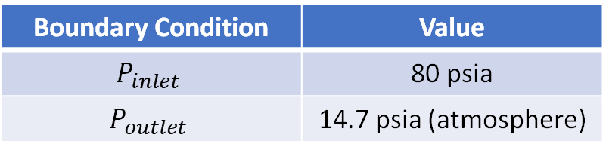

Simulations
Simulations were performed in ANSYS Fluent using the density-based solver and the $k−ω$ SST turbulence model
Meshing for each step-height was performed in Fidelity Pointwise using a hybrid structured and unstructured grid (Fig. 3)
A $y^{+}$ of $∼$0.01 was found for most of the grid, with a spike to 60 at the corner of the BFS
The boundary conditions for the simulations can be found in Table 1
Fig. 3 : Image of the mesh at the BFS
Boundary Condition | Value
$$P_{inlet}$$ | 80 psia
$$P_{outlet}$$ | 14.7 psia (atmosphere)
Table 1 : Boundary conditions for CFD

Slide 8
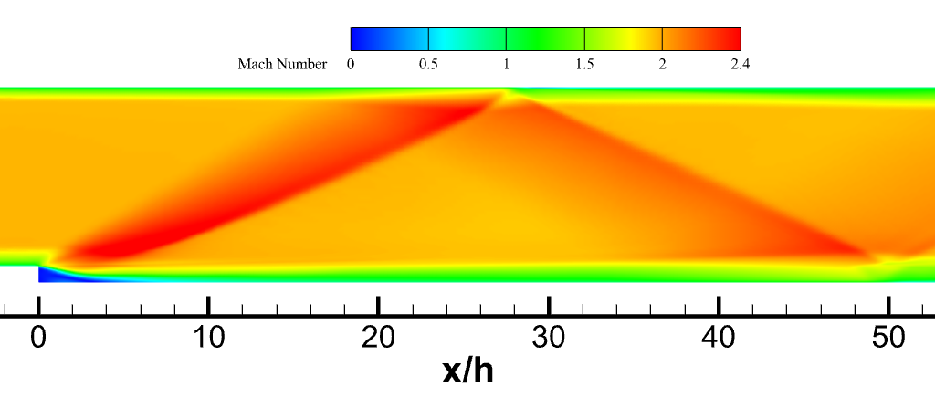
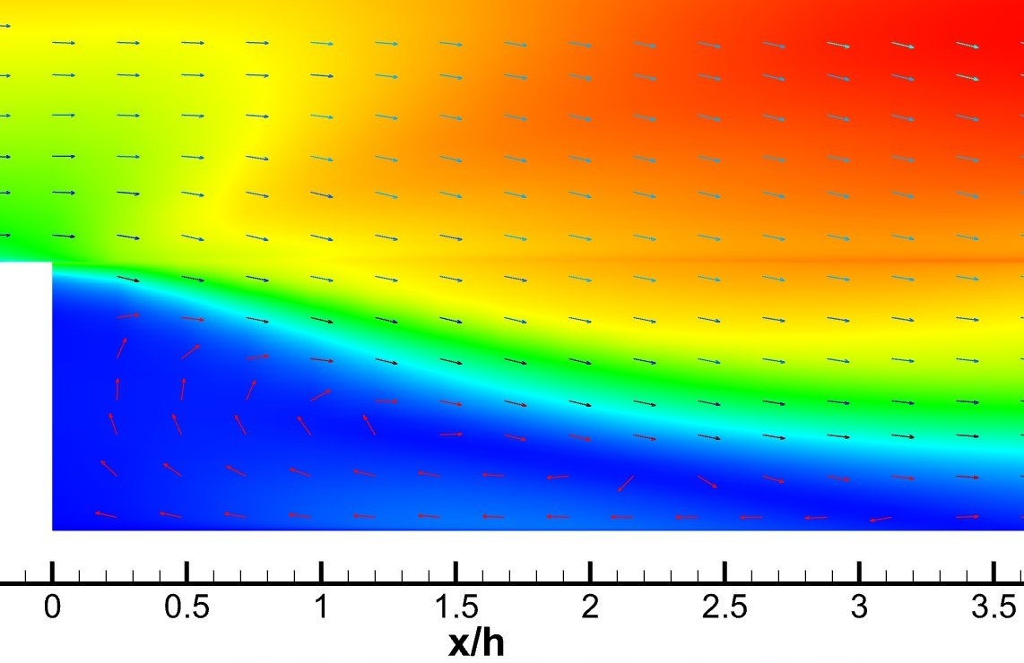
Approx. Extent of
Recirculation Region
Results – Eighth-inch
The Mach field (Fig. 4) shows the expansion expected following the step and the subsequent oblique shock
The growing boundary layer before the step lessens the severity of separation
Oblique Shock
Fig. 4 : Mach field following the eighth-inch BFS
Zooming in to the recirculation region shows a main large vortex structure, which is likely a main contributor to fuel-air mixing within the recirculation zone
Fig. 5 : Zoomed Mach field for the eighth-inch BFS
Notes:
Mention non-dimensionalization and growing boundary lessening severity of separation

Slide 9
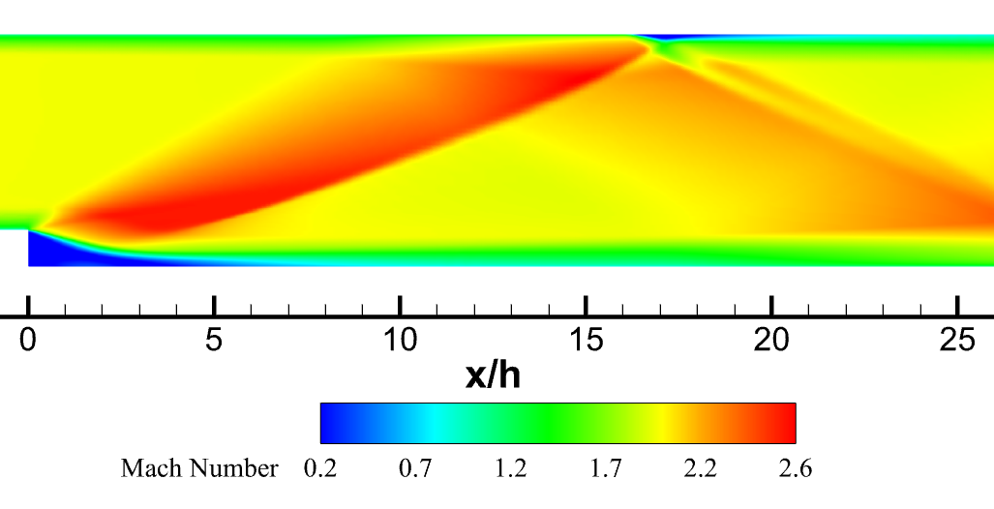
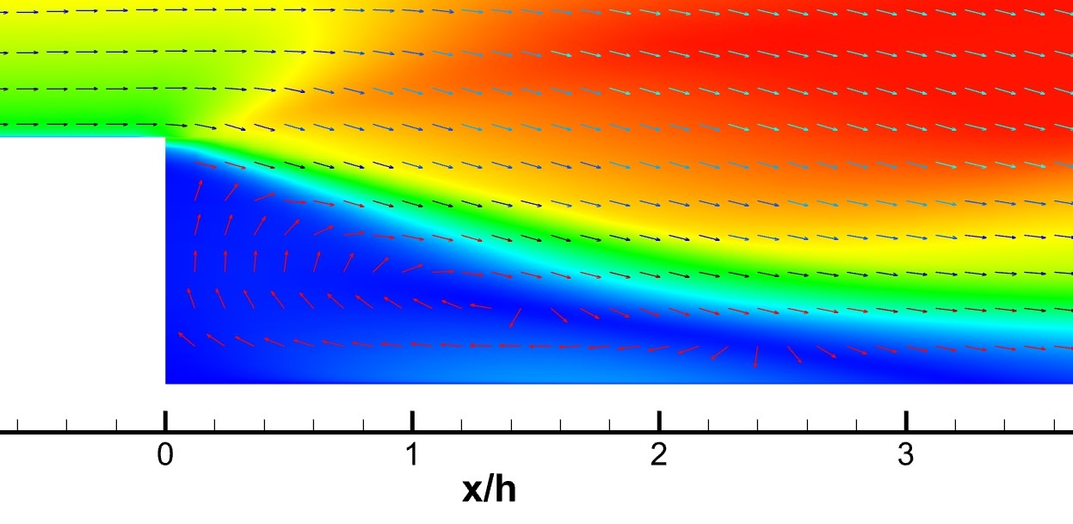
Results – Quarter-Inch
Approx. Extent of
Recirculation Region
The Mach field shown for the quarter-inch step is very similar to the eighth-inch step
The separation region is noticeably larger for this step, which is a known relationship (Ben-Yakar 1998)
Oblique Shock
Fig. 6 : Mach field following the quarter-inch BFS
The same vortex structure appears in the quarter-inch step recirculation region as in the eighth-inch
Fig. 7 : Zoomed Mach field for the quarter-inch BFS
Notes:
Mention non-dimensionalization

Slide 10
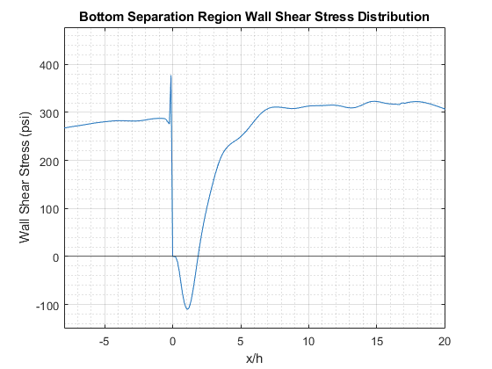
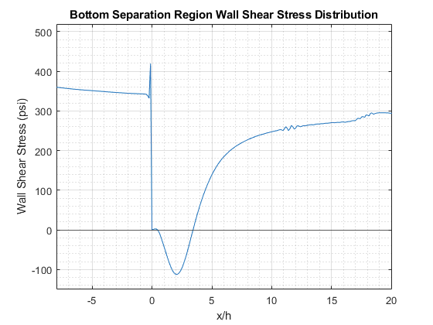
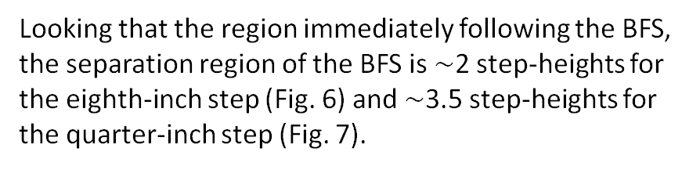
Results – Separation Region
By extracting the wall data from Fluent, the extent of the separation region can be examined
Regions in which the wall shear stress is negative represent the separated regions of the flow (Kim 1996)
Looking that the region immediately following the BFS, the separation region of the BFS is $∼$2 step-heights for the eighth-inch step (Fig. 6) and $∼$3.5 step-heights for the quarter-inch step (Fig. 7).
Fig. 6 : Wall shear stress distribution for the eighth-inch step
Fig. 7 : Wall shear stress distribution for the quarter-inch step
Notes:
mention non-dimensionalization

Slide 11
Conclusion
Simulations have been performed for a backward facing step to replicate the fuel-air mixing conditions of a solid-fuel scramjet
The results of these simulations showed a region immediately following the step which has relatively low velocities and a large vortical structure
  It is likely that these factors are the main contributors for the creation of the flameholding region within the scramjet
An increase in the size of the recirculation zone with an increase in step-height has been shown across two different step-heights

Slide 12
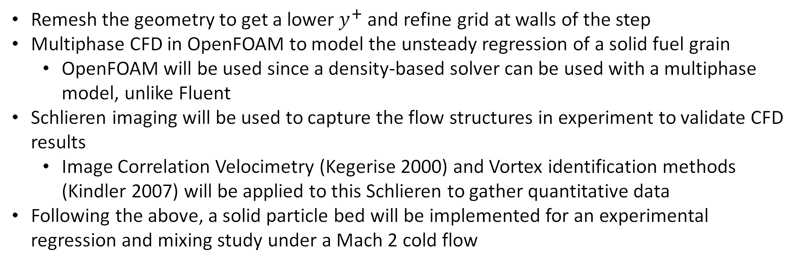
Future Work
Remesh the geometry to get a lower $y^{+}$ and refine grid at walls of the step
Multiphase CFD in OpenFOAM to model the unsteady regression of a solid fuel grain
  OpenFOAM will be used since a density-based solver can be used with a multiphase model, unlike Fluent
Schlieren imaging will be used to capture the flow structures in experiment to validate CFD results
  Image Correlation Velocimetry (Kegerise 2000) and Vortex identification methods (Kindler 2007) will be applied to this Schlieren to gather quantitative data
Following the above, a solid particle bed will be implemented for an experimental regression and mixing study under a Mach 2 cold flow
Notes:
explain things multiple times

Slide 13
Thank You!
Any Questions?
Notes:
Add supplementary slides with extra sims pics

