Slide 1
April 4th, 2025
Design and Testing of an Airbrake System for a Sounding Rocket
UGA Rocketry Team
2025 AIAA Region 2 Conference

Slide 2
Competition Requirements
Mechanical Design
Control Systems Design
Manufacturing
Assembly
Testing

Slide 3
Competition Requirements

Slide 4
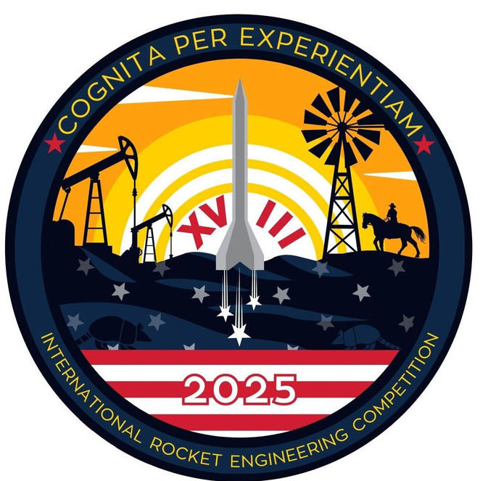

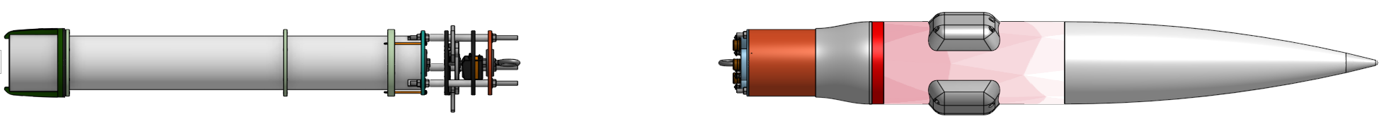
IREC Rocket
International Rocketry Engineering Competition (IREC)
10,000 ft COTS Category
2nd year competing
30% of points go towards apogee goal
Bonus SRAD Points

Slide 5
Requirements
# | Requirement (The airbrake system...) | Importance | Verification
I | Shall be able to deploy and retract during flight | Medium | Embedded testing
II | Shall not impact fins by causing unstable airflow | High | CFD simulations
III | Shall increase total rocket drag when deployed | High | CFD simulations
IV | Slots shall not cause significant structural changes to the airframe | High | FEA simulations
V | Shall not weigh more than 3 lbs in total weight | Medium | Assembly testing
VI | Deployment shall be modeled and controlled from live flight data | Medium | Software testing

Slide 6
Mechanical Design

Slide 7
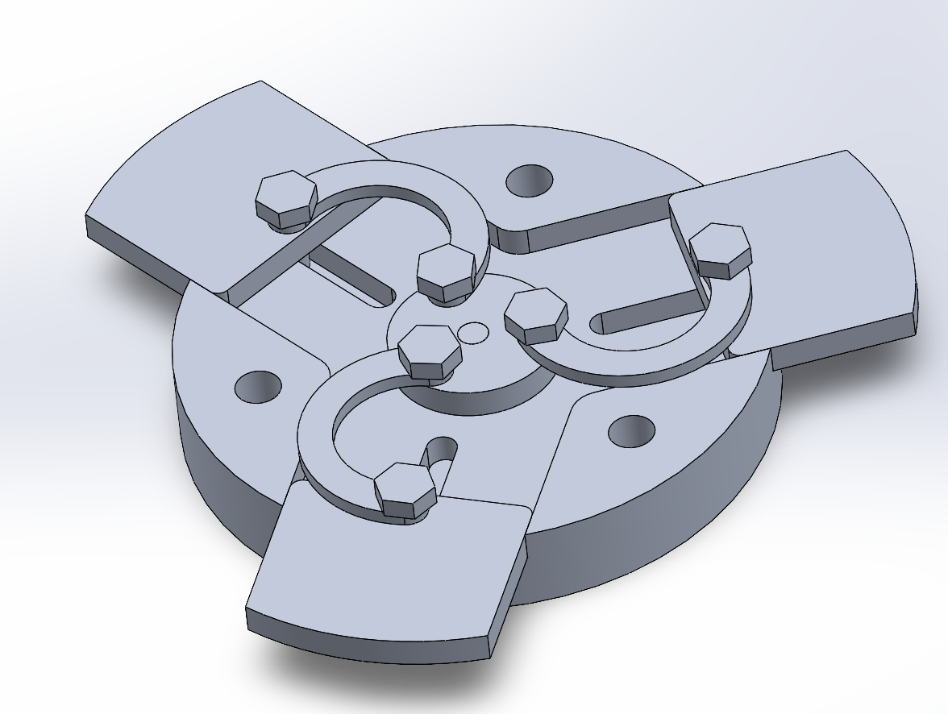
Design 1
Extension is reliant on rotation of center disk and 3 curved linkages
Plates held in place by a bolt and guide walls
All 6061 - Aluminum
Deployment is Exponential

Slide 8
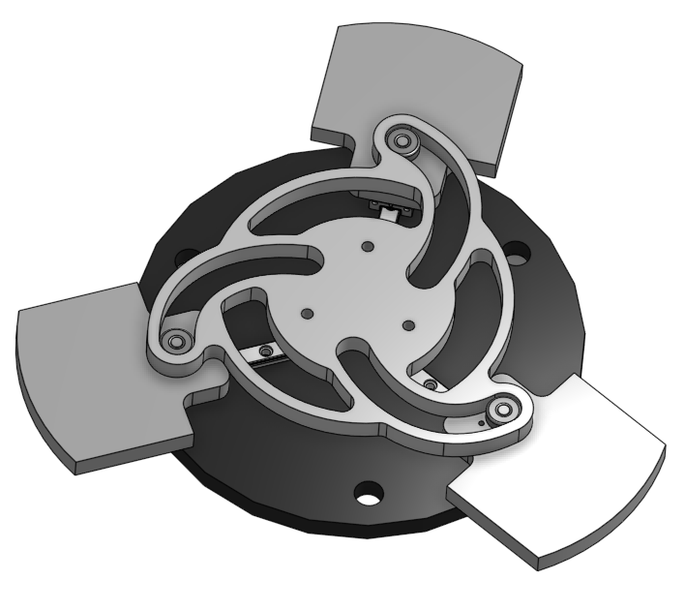
Design 2
Three aluminum petals on rail guides
An aluminum actuating plate
G10 Fiberglass top and bottom plates
When the actuator plate is rotated by the servomotor, the plates radially extend.

Slide 9
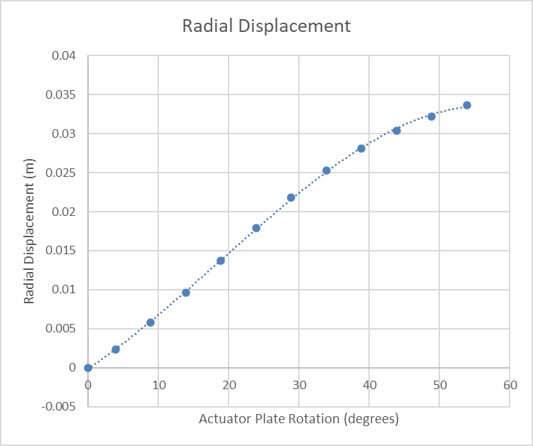
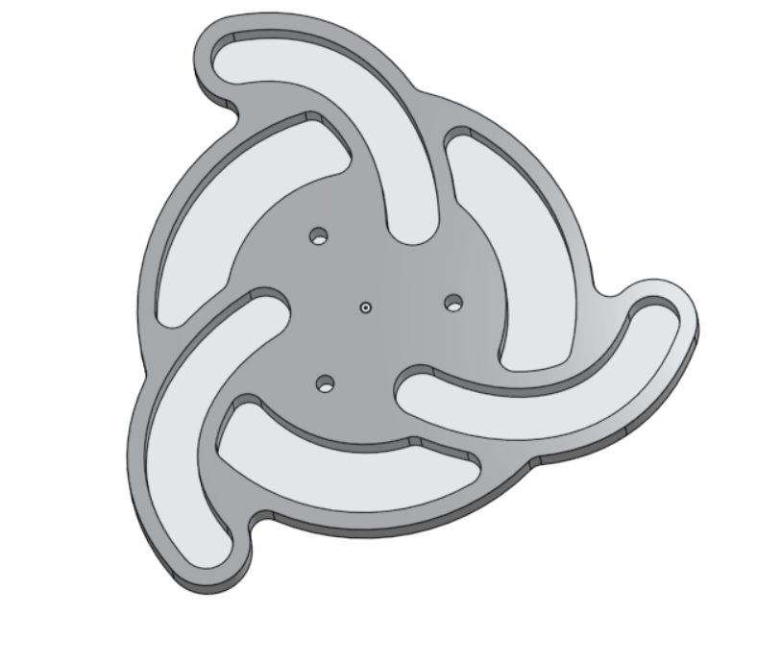
Mechanical Design
The actuating path has been optimized to follow a relatively linear displacement to rotation.
Plates are prevented from from being pushed back when fully extended because the last portion of the actuator path is perpendicular to the radius, constraining its movement
  Only rotation will be able to move them

Slide 10
Control System Design

Slide 11
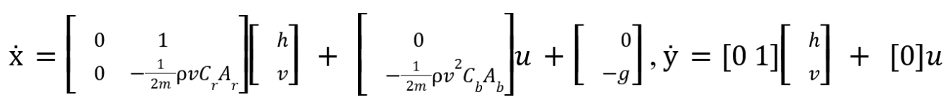
Algorithms and Equations
A Model Predictive Control (MPC) system is implemented using a quadratic cost function to minimize deviations between the predicted model and the observed state
The plant for our model is a state-space representation of the fewest possible variables to accurately represent the flight dynamics
Notes:
PARSA ANDREW KYLE UR DEAD :(
Both Matlab and Simulink are used to process this data into a percentage that can be used to determine the deployment percentage of the airbrakes.
Below is the state space equation we have

Slide 12
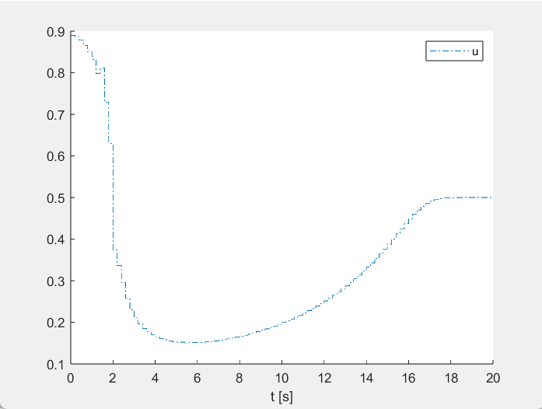
Control System Design
The graph shown illustrates the deployment percentage of the airbrakes as a number 0-1 in a simulated parameterized flight path trajectory.
The MPC calculates the optimal deployment starting at burnout and stops at apogee
Notes:
PARSA ANDREW KYLE UR DEAD :(

Slide 13
Manufacturing and Assembly

Slide 14
Manufacturing
Materials : G10 Fiberglass Bulk Plates, ¼” Aluminum, Fasteners, Stainless Steel Linear Rail Guide, ⅛” Shaft Diameter Ball Bearings
Waterjet Actuator Plate, Petals, and Bulk Plates
Drill for holes meant for 5/16” rods in bulk plates
Tapped Petals using #5 Tap to fasten ball bearings, drilled two 0.08” holes to fasten petal to rail carriage using M2 Screws
Cut down 5/16” 304 Stainless Steel Tube to make spacers to provide structure between plates
Notes:
Mention fea results led to using different materials

Slide 15
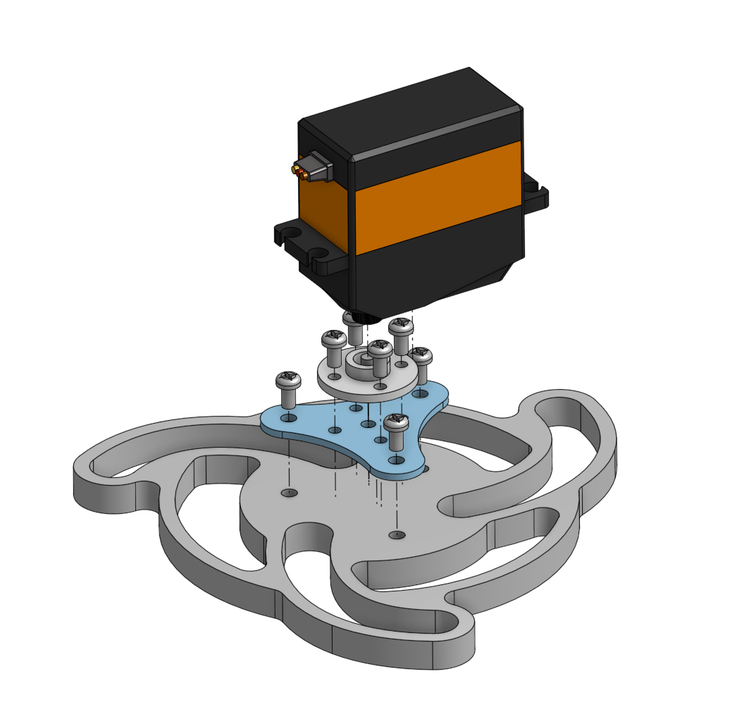
Attaching HPS-3518SG Servo to Actuator Plate
Used servo disk to allow for torque to be transferred from servo to actuator plate
Implemented a 3D printed servo hub to prevent the need for counterboring
Fastened using steel M_ screws to prevent shearing
HPS-3518SG Servo
Servo Disk
Servo Hub
Actuator Plate

Slide 16
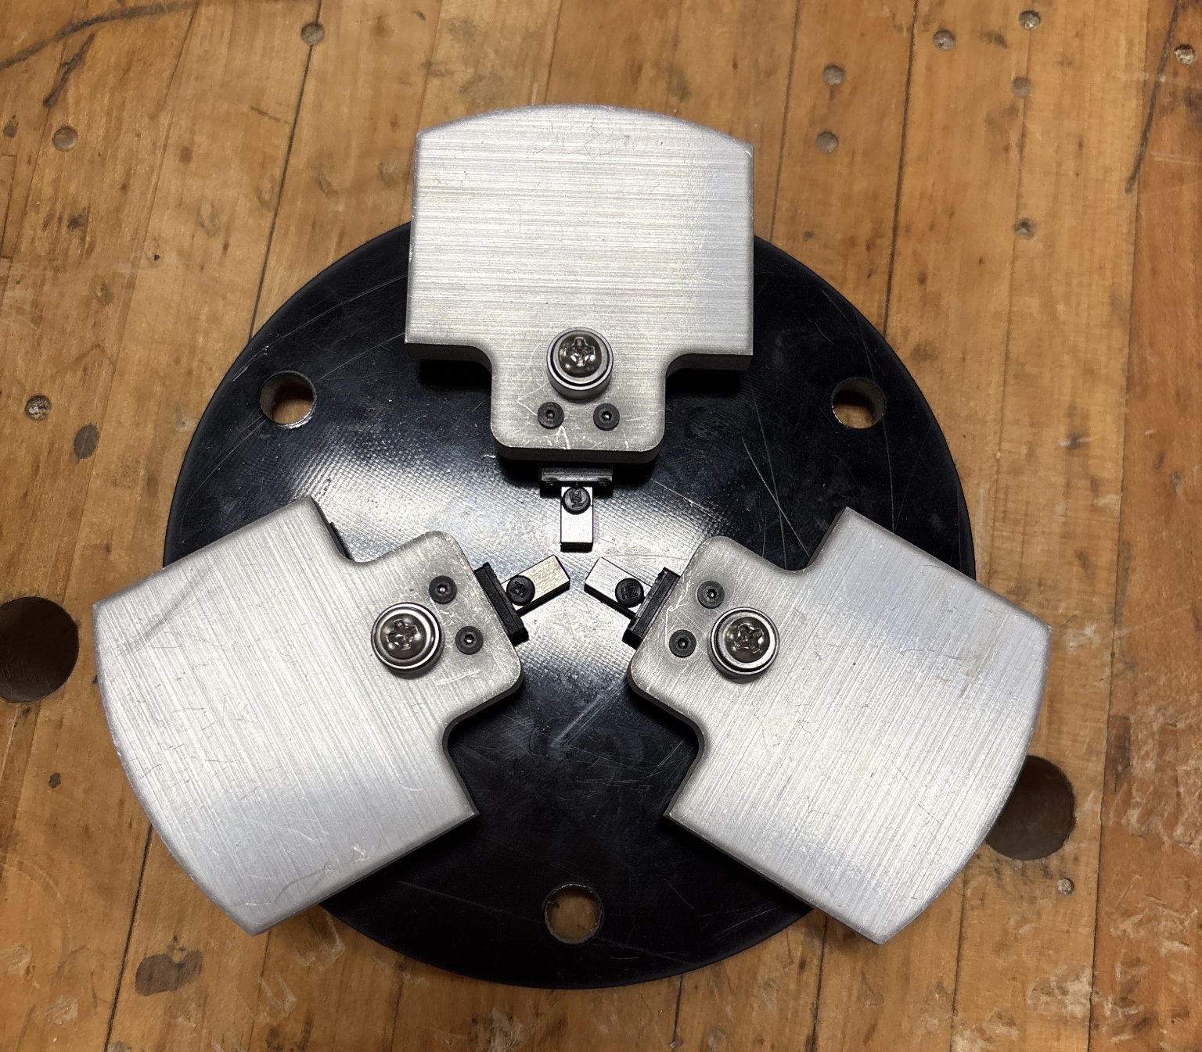
Assembling Bottom Airbrake Plate
Fastened Rail Carriages to the bottom plate using M2 Screws
Used M2 Screws to fasten petals to rail carriage
Used Number 5 Screws to fix ⅛” Shaft diameter ball bearing to Petal

Slide 17
Full Assembly
Placed 5/16” Stainless Steel Spacers on threaded rods between plates to provide structure
Attached Servo Assembly to top plate using the supports on the servo and holes drilled into Top Plate
Fastened 2 Battery Holders to be used with the electronics in the mechanism
Bottom and Top Bulk Plate serve as intermediary between motor tube and rest of aft section respectively

Slide 18
Testing
Test launch scheduled 4/12
Set altitude deployment and apogee retraction
Live telemetry results
In-lab system and structure testing complete
FEA results verified

