Slide 1
GT-AIAA: Fostering Critical Thinking and Real-World Connections
Ethan Traub and Rishita Mhatre
Georgia Tech AIAA Chapter
AIAA Region II Student Conference, April 3rd-April 4th 2025
Copyright © by Ethan Traub and Rishita Mhatre
Published by the American Institute of Aeronautics and Astronautics, Inc., with permission.

Slide 2
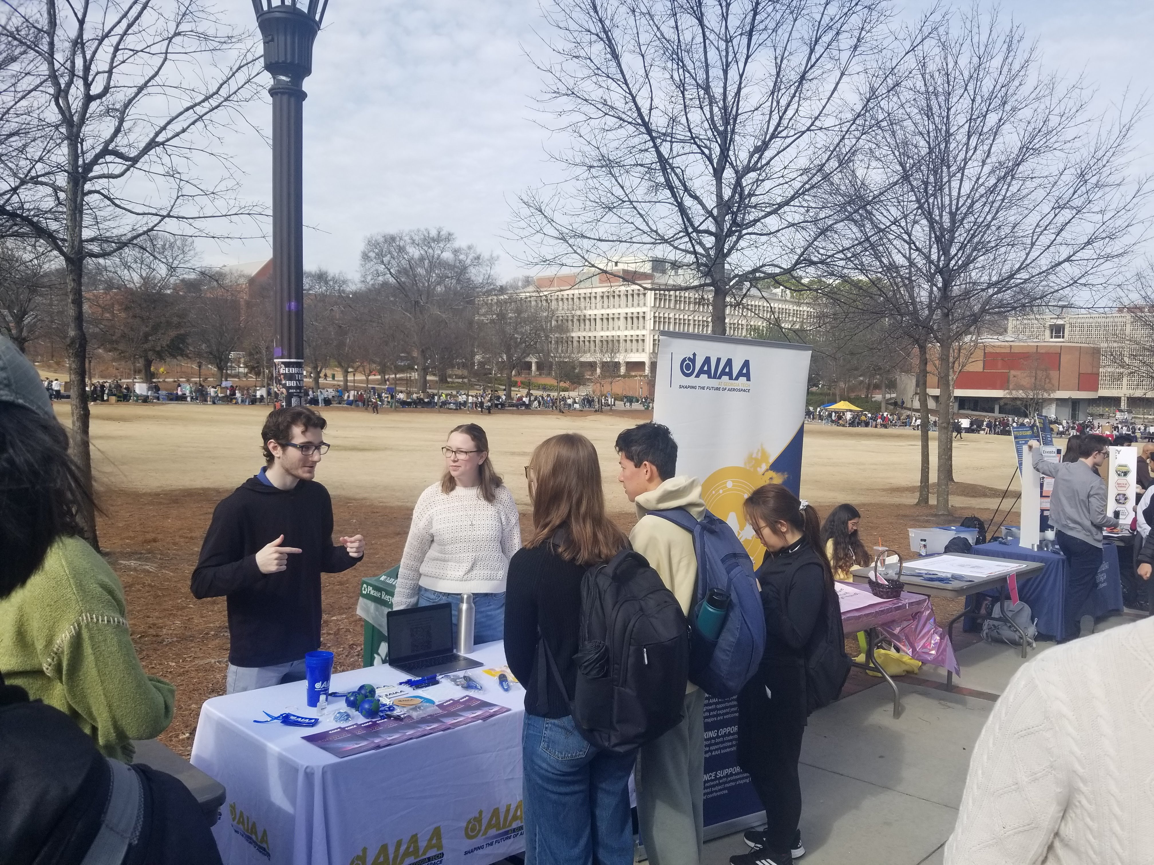
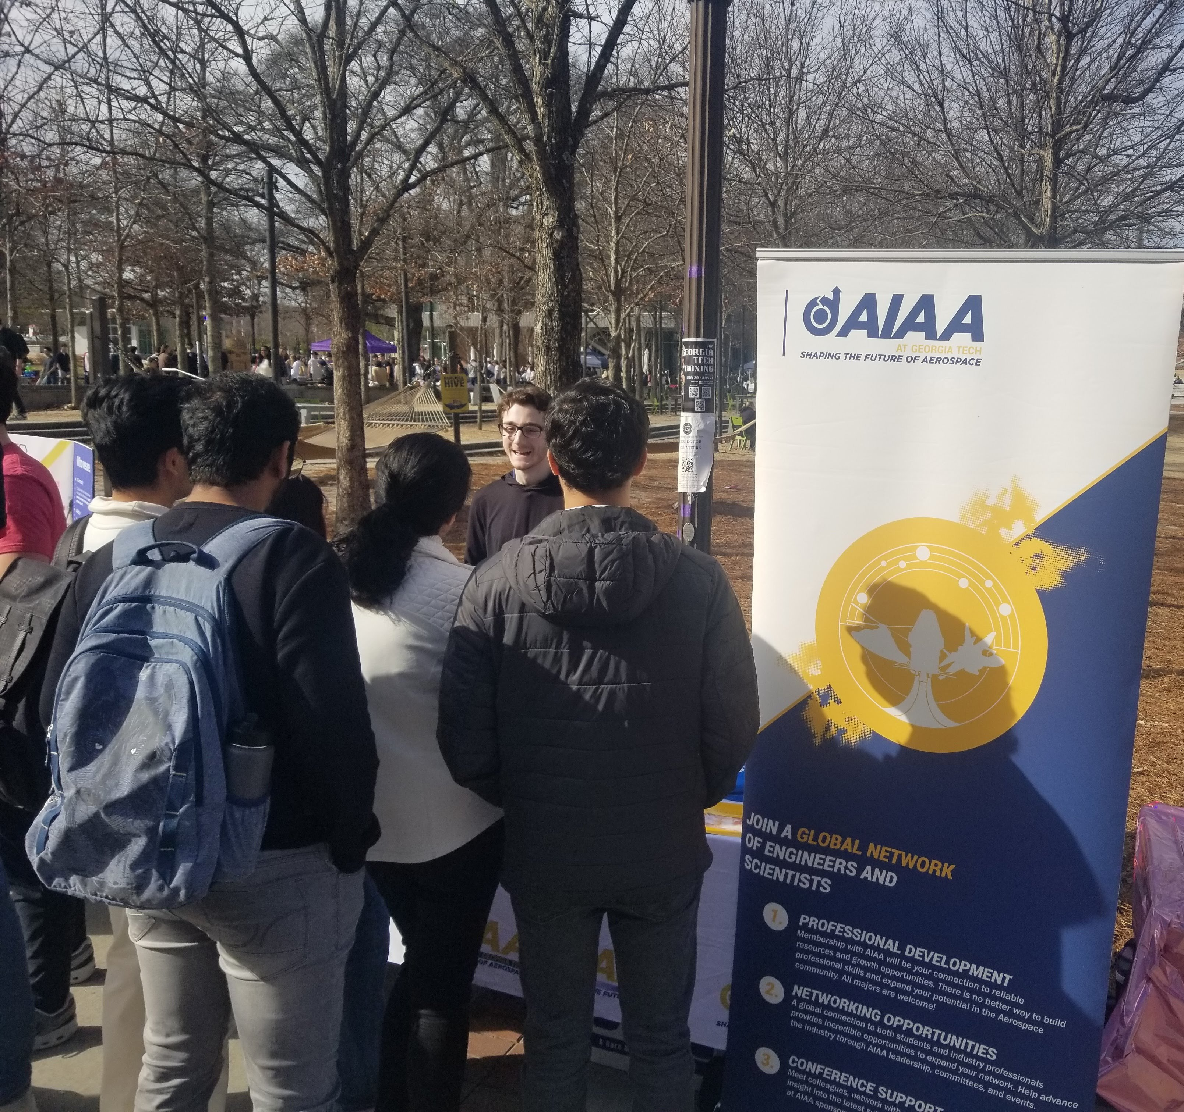
Motivation
Accelerating student growth has led to more students seeking small group settings, problem solving opportunities, and connections with peers and industry.

Slide 3
Introduction
GT-AIAA has recognized students' desire for becoming better problem solvers and collaborators.
To tackle the changing academic landscape, GT-AIAA has worked to expand the previously successful Lockheed Martin Case study to a multi-company case-study series alongside our other offerings.

Slide 4
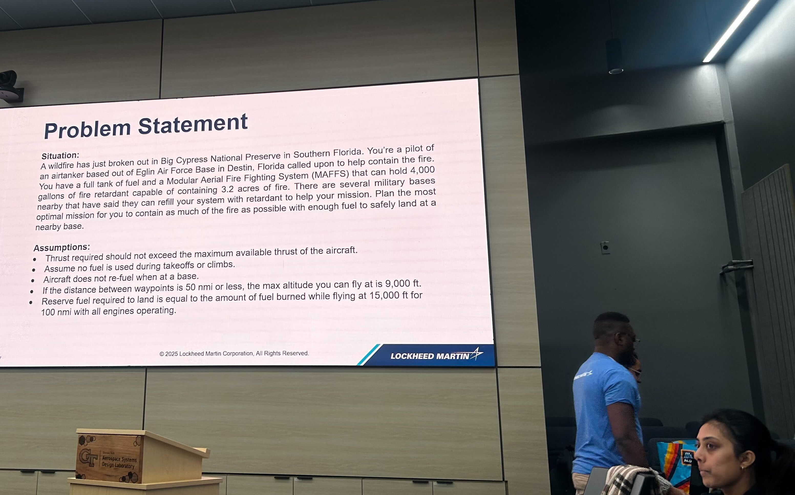
Lockheed Martin Case Study
The first case study event was led by a group of Lockheed Martin engineers in recognition of Engineers Week.
Teams were tasked with developing the optimal flight profile to fight a fire in a hypothetical emergency.

Slide 5
Lockheed Martin Case Study
The event was made accessible to all students, regardless of academic year, by providing them with the necessary background knowledge, equations, etc.
Once students formulated their plan, they had the opportunity to defend their process in front of the Lockheed Martin team.

Slide 6
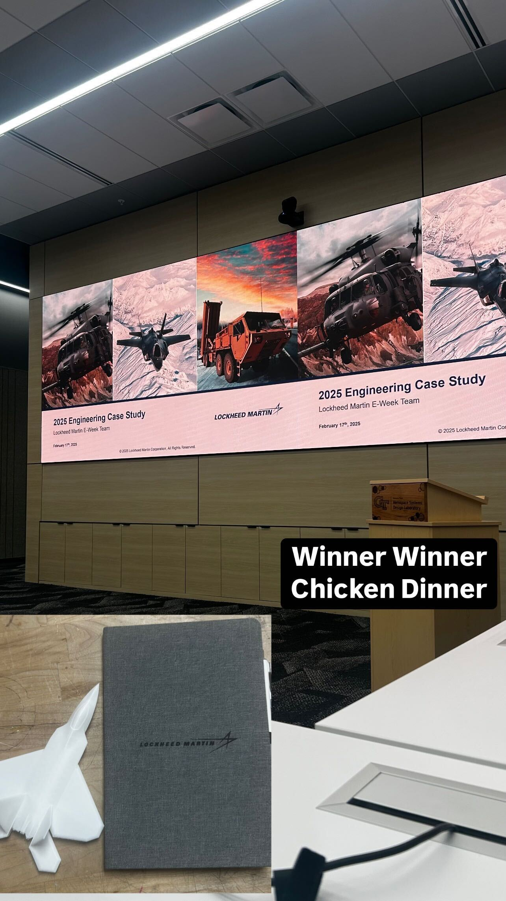
Results
Many of the participants left the event feeling more confident in their problem-solving capabilities.
Attendees credited the event with teaching them about the importance of critical thinking over plain textbook knowledge.

Slide 7
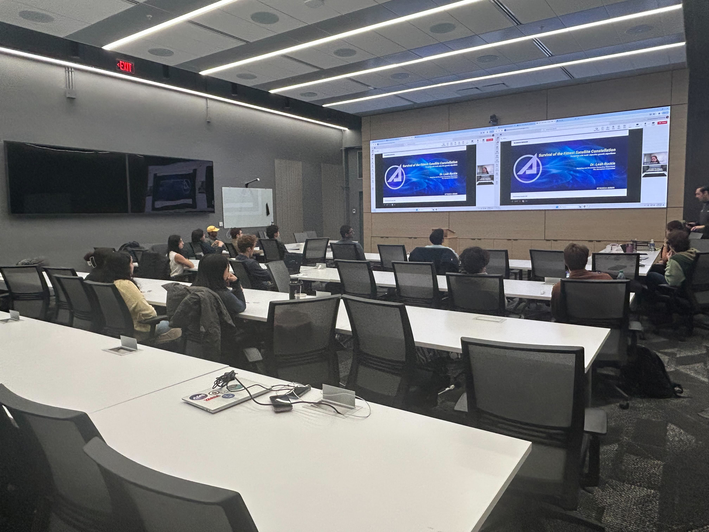
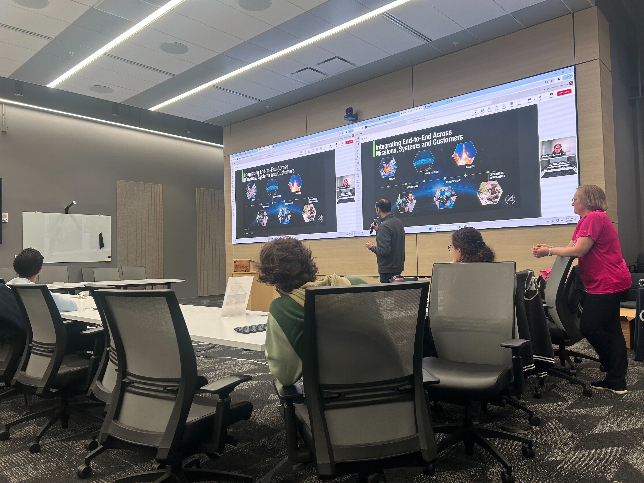
Further Action
Due to the success of the Lockheed Martin Case Study event, GT-AIAA has expanded the case study series to include companies like The Aerospace Corporation and Joby Aviation.

Slide 8
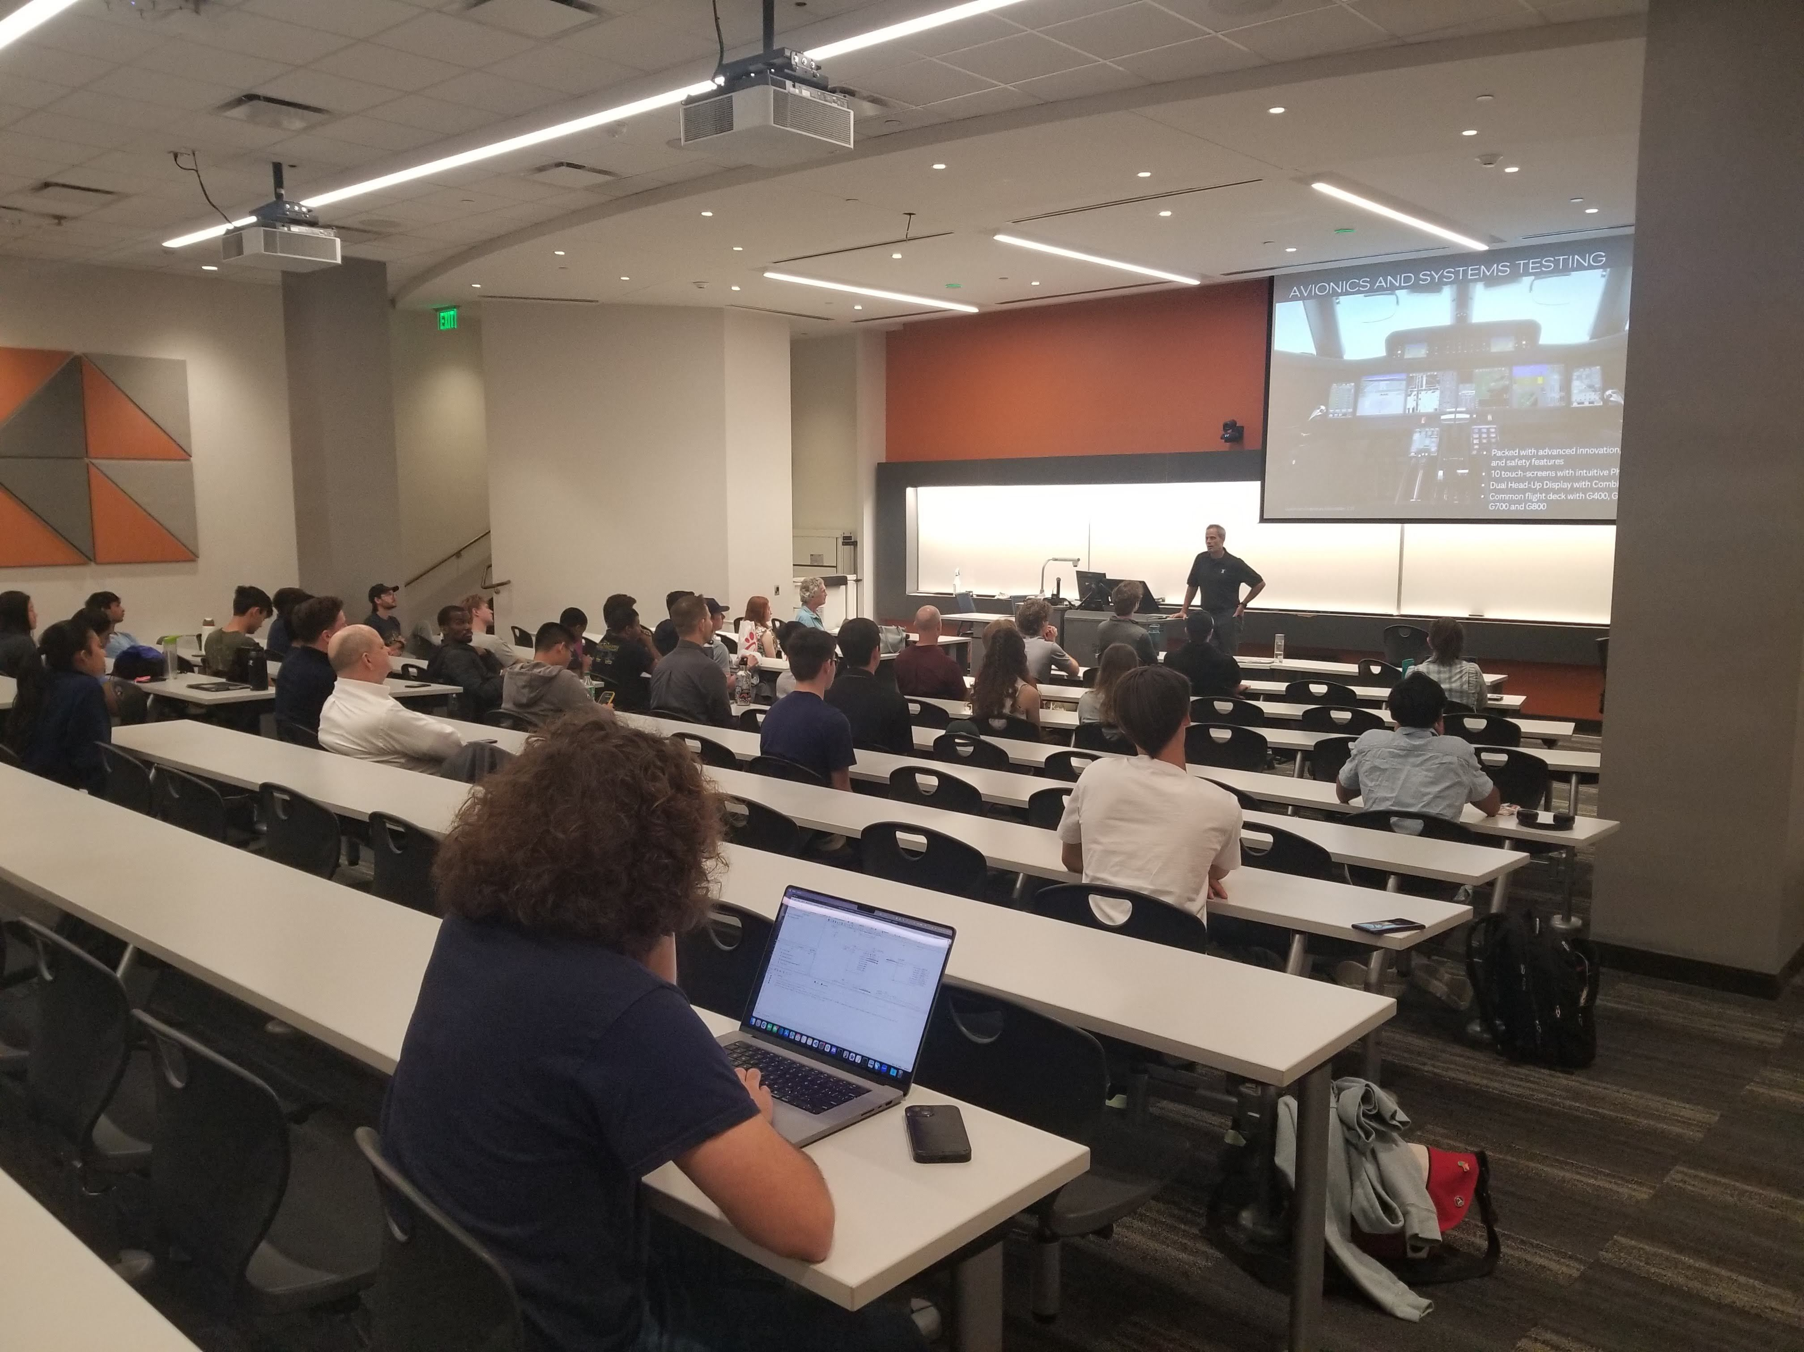
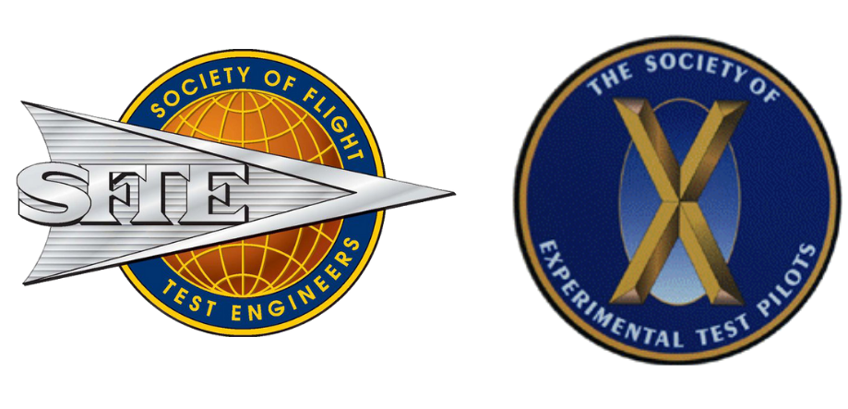
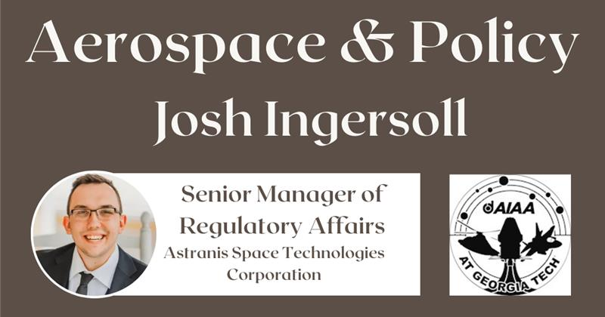
Further Offerings
The case study events mark only a few of the many initiatives undertaken by GT-AIAA.
Resume review with GE Aerospace
Flight tester event with Flight Tester societies SFTE and SETP
Aerospace Policy event with Josh Ingersoll

Slide 9
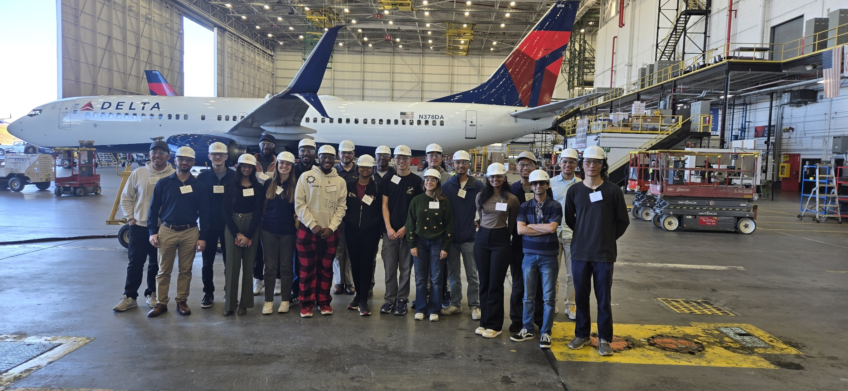
Further Offerings
Another flagship event was the Delta Tech-Ops tour where attendees had the opportunity to gain a more real-world and hands-on perspective.

Slide 10
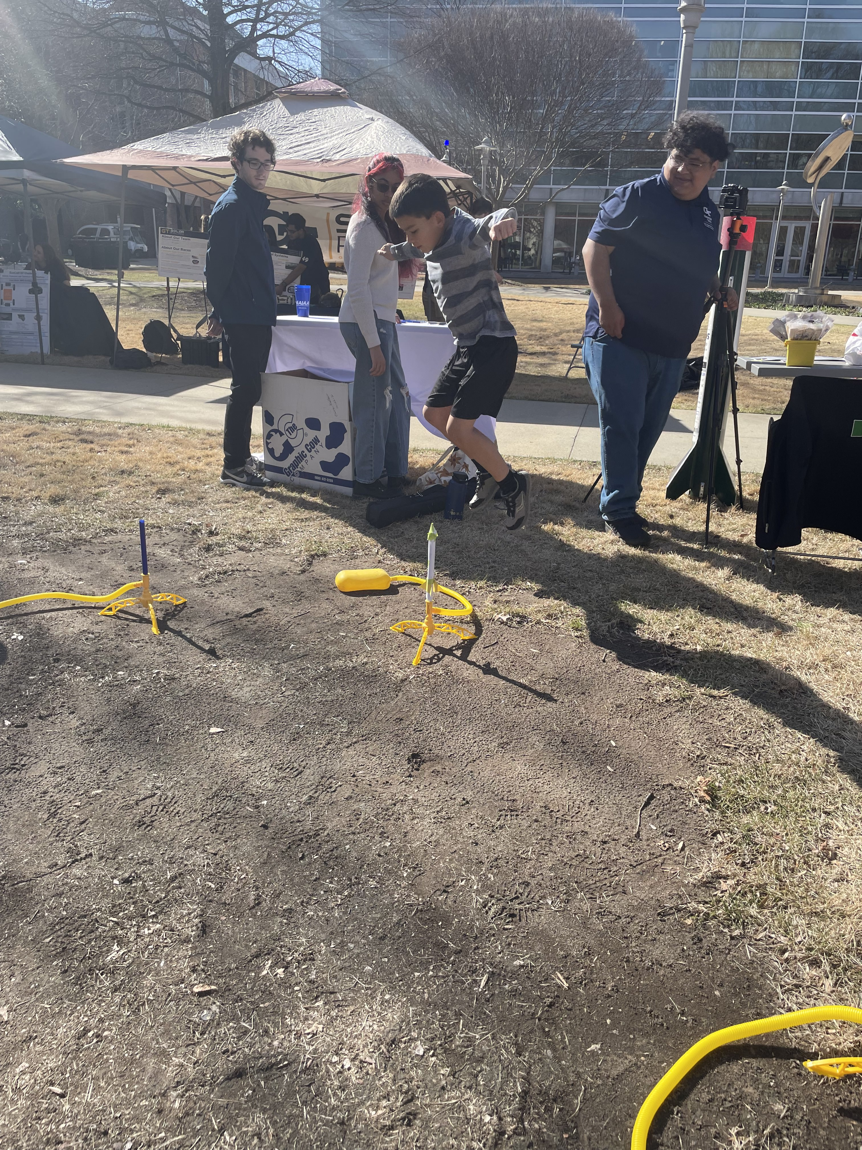
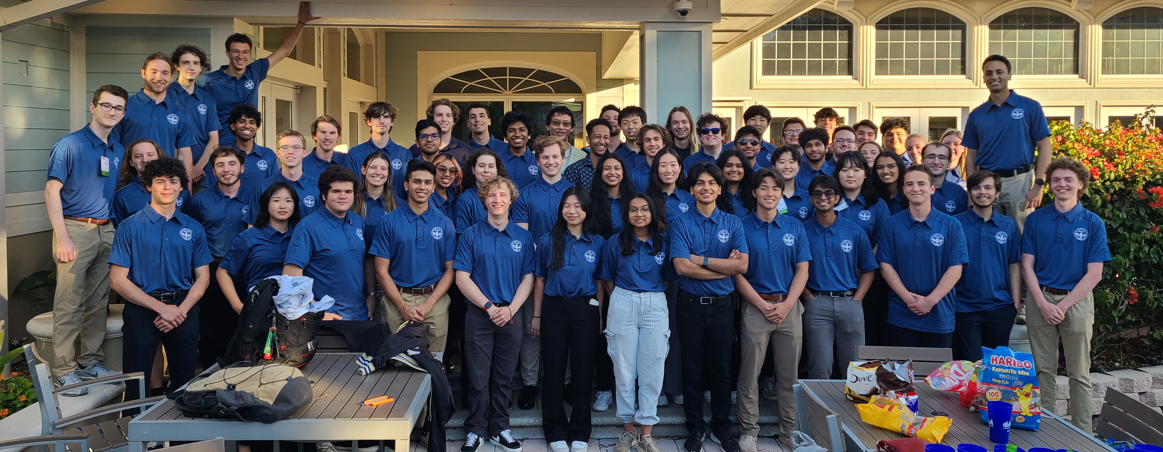
Offering more opportunities to get involved
Adding committees to our executive board has allowed us to involve more members at large, start outreach initiatives, and maintain high conference attendance!

Slide 11
Conclusion
GT-AIAA has maintained its mission to strengthen our connection with the aerospace industry.
We have further helped prepare members both technically and professionally.
GT-AIAA seeks to continue to evolve and give back to our community building upon past successes and introducing new initiatives.

