Slide 1
Development of an Outdoor Multi Agent Robot Toolkit at the UF Autonomy Park
James W. Cross and Warren E. Dixon¹
University of Florida
AIAA Region II Student Conference, April 3-4, 2025
Copyright © by James W. Cross
Published by the American Institute of Aeronautics and Astronautics, Inc., with permission.
¹Faculty Advisor, Mechanical and Aerospace Engineering Department

Slide 2
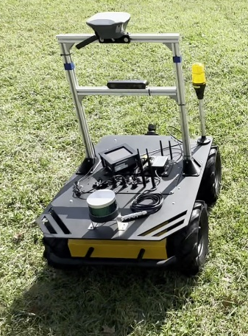
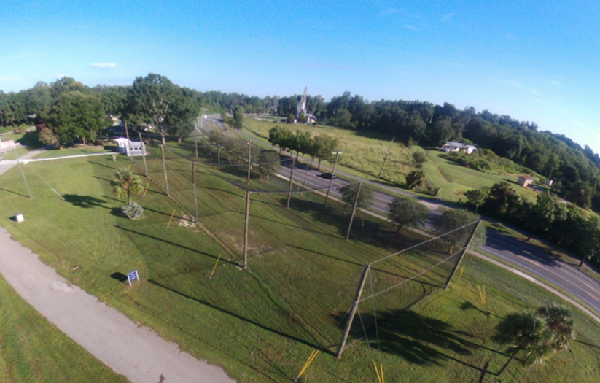
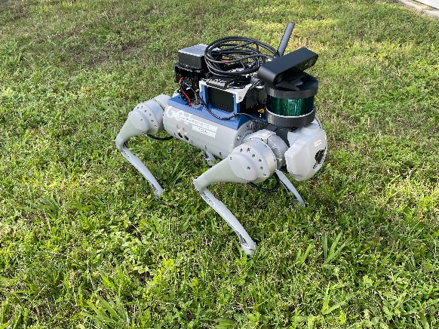
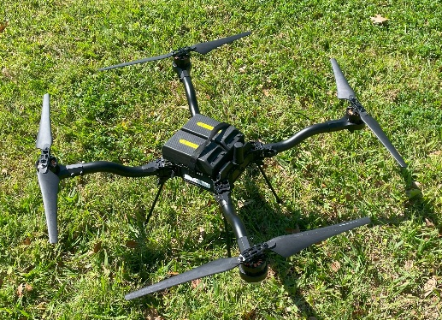
University of Florida Autonomy Park
Support multi-agent outdoor robotics development
75x27x18 meter netted enclosure
Ground Robots |  | Aerial Robots
Quadruped | Wheeled
(3) Unitree Go1 | (2) Clearpath Jackal | (1) Freefly Alta-X
(1) Unitree B1 | (2) Clearpath Husky | (3) Freefly Astro
 |  | (20) Custom¹ Multirotor
^{[1]} “Custom” refers to lab-built quadcopters assembled using a variety of off-the-shelf parts.

Slide 3
Research Objectives
Research group standardization for working with 30+ robots
Develop a toolkit for common functions
Prove out the toolkit with a representative experiment
Notes:
What do we want to do at the apark

Slide 4
Project Goals
Build confidence in state feedback information
  Justify RTK-GPS
  Multirotor aircraft altitude challenges
Toolkit development
  Automatic frame conversion in ROS2
  Nonholonomic to holonomic command conversion
  Visualization and data logging
  Prove out a workflow to run herding experiments
Notes:
WHAT PROBLEM(S) ARE YOU TRYING TO ADDRESS!
Python simulation and ROS2 in the loop simulation using Euler integration to simulate robot feedback. (not rigorous sims, enough to verify function)

Slide 5
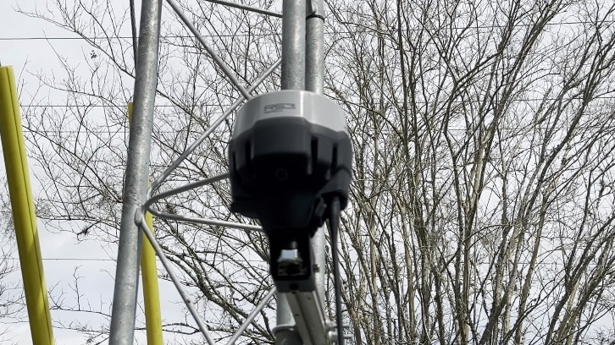
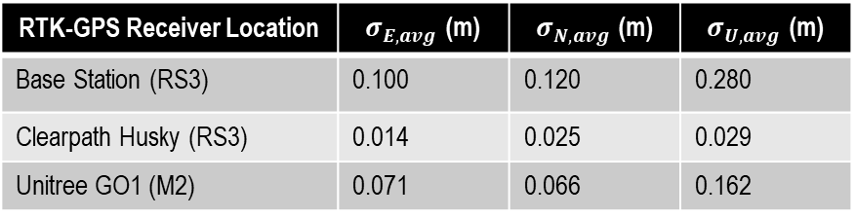
Outdoor Localization
Motion capture systems are unsuitable
RTK-GPS (Real-Time Kinematic Global Positioning System)
  A base station at a surveyed point broadcasts GPS corrections
  CSRS-PPP used to survey
  Emlid Reach RS3 (950g) & M2 (35g)
RTK-GPS Receiver Location | $σ_{E,avg}$ (m) | $σ_{N,avg}$ (m) | $σ_{U,avg}$ (m)
Base Station (RS3) | 0.100 | 0.120 | 0.280
Clearpath Husky (RS3) | 0.014 | 0.025 | 0.029
Unitree GO1 (M2) | 0.071 | 0.066 | 0.162
Notes:
Sigma is the value at one standard deviation from the average. Represents positional uncertainty

Slide 6
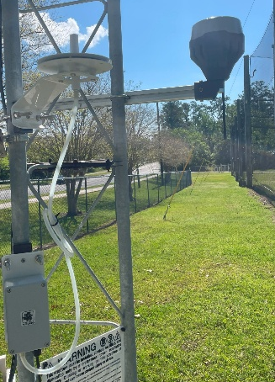
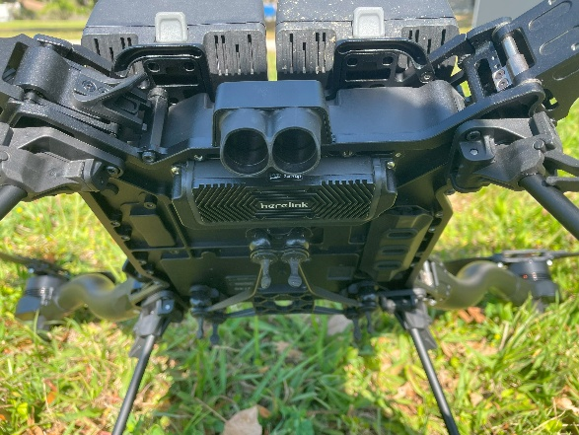
Localization Challenges
UAV Altitude Control
  RTK-GPS unsuitable for direct altitude measurement (even fused with IMU data)
  Inconsistent behavior as weather changes
  AMSL pressure and local barometric pressure discrepancy
  Downwards facing single-beam LIDAR
  Barometer corrections (planned)

Slide 7
Herding
Interaction dynamic
Target Agent
Goal Location
Herding Agent
Notes:
Herding is a type of autonomous behavior that is analogous to a dog herding a flock of sheep between paddocks. The problem contains herding agents and target agents that use an interaction dynamic to guide the target agents towards a goal location.

Slide 8
Who can Benefit
Aerospace – UAV control
Defense – Missile Intercept Problems
Agriculture – UAV teaming for herding livestock
Many problems benefit from Heterogenous Robotic Systems
  Offer sensing and coordination advantages
  Aerial and ground robots are well suited to help one another

Slide 9
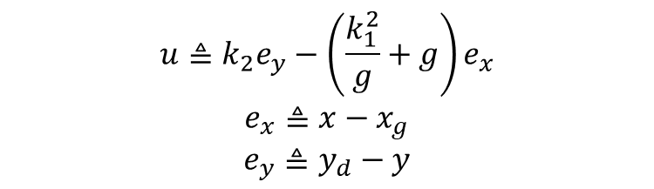
Herding Controller
$$u≜k_{2}e_{y}−\left(\frac{k_{1}^{2}}{g}+g\right)e_{x}$$
$$e_{x}≜{x−x}_{g}$$
$$e_{y}≜y_{d}−y$$
(1)
(2)
(3)
[2]
Notes:
We consider everything as a point mass. Just give it velocity commands and receive position updates. This allows controllers to be widely applicable but require additional implementation work to transform sensor inputs and control outputs.

Slide 10
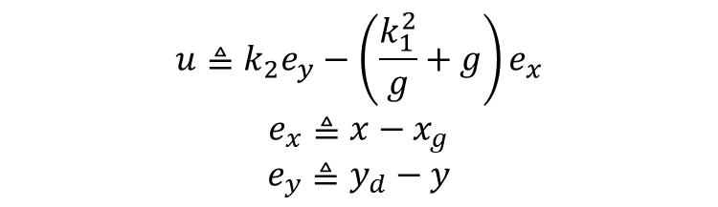
Herding Controller
Interaction Dynamic
Herding Agent Control Output
Gains
$$u≜k_{2}e_{y}−\left(\frac{k_{1}^{2}}{g}+g\right)e_{x}$$
$$e_{x}≜{x−x}_{g}$$
$$e_{y}≜y_{d}−y$$
(1)
(2)
(3)
[2]
Target Agent Error
Goal Location
Herding Agent Error
Herding Agent Desired Trajectory

Slide 11
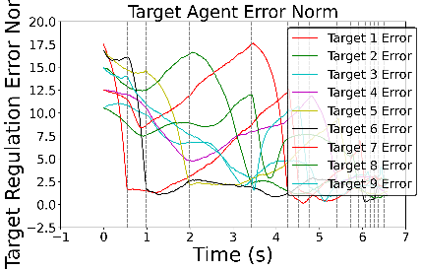


Toolkit Development
Automatic Frame Conversion | Command Conversion | Common Experiment Functions
Robot Operating System 2 (ROS2) TF library Convert GPS data in world frame {G} to Autonomy Park frame {L} Attach frame information to ROS2 pose messages | Nonholonomic to holonomic command conversion Allows ground and air robots to receive one type of command message (ROS2 cmd_vel) | Simple integration function for coarse robot simulation Real time visualization Data logging to .csv files Distance between every agent (Euclidian norm) Interaction dynamics (fear-based) Levy Walk (pareto distribution)
$$\left[v_{xG},v_{yG}\right]⟹\left[v_{xL},v_{yL}\right]$$
$$\left[v_{x},v_{y}\right]⟹\left[v,ω\right]$$

Slide 12
Herding Toolkit Benefits
Separates development and test hardware
Standardizes the group’s convention when implementing experiments
Included visualization tools help monitor controller performance

Slide 13
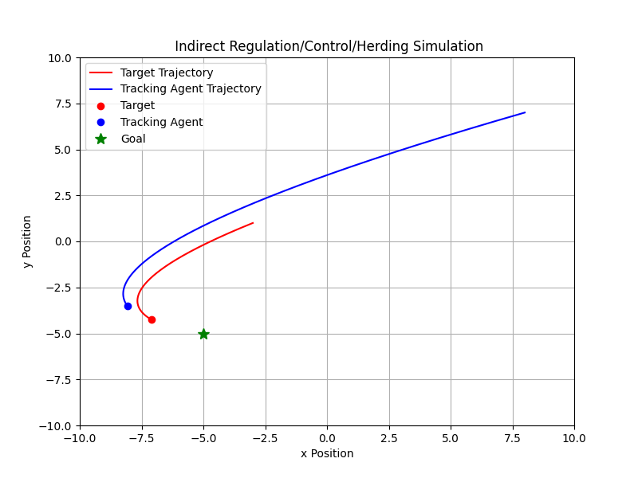
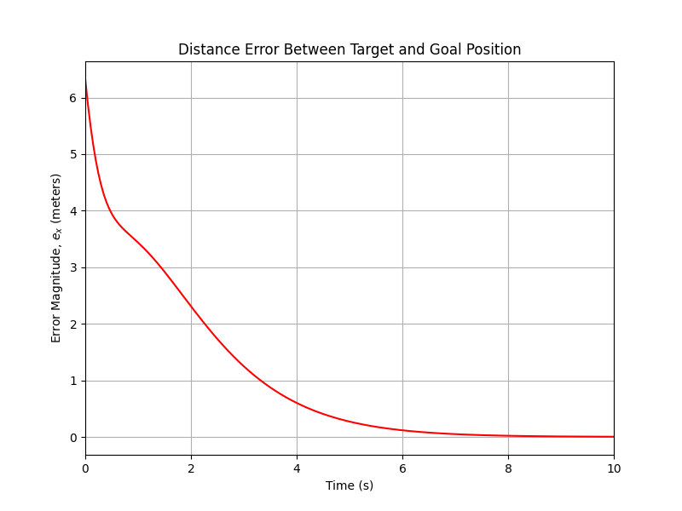
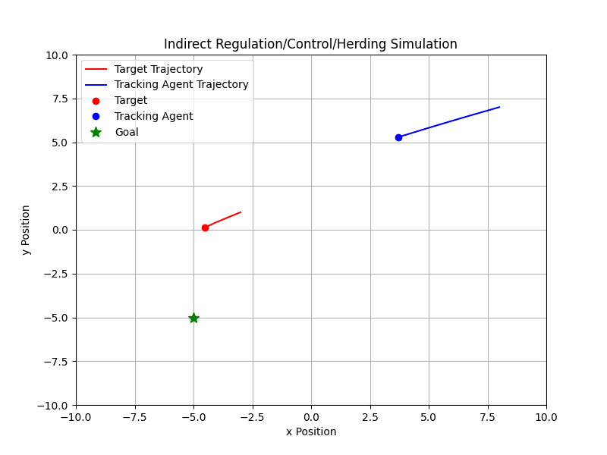
Simulated Results

Slide 14
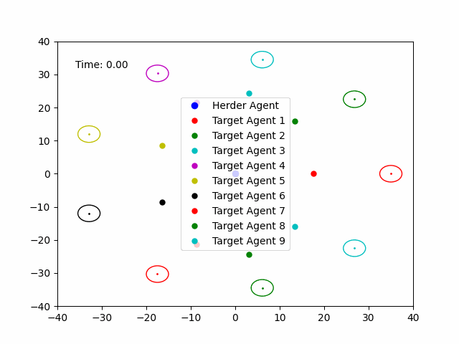
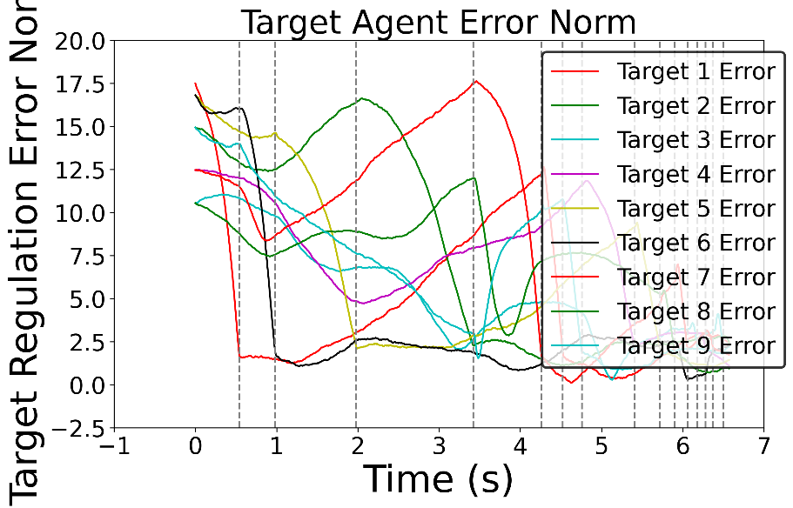
N-agent compatible
Implementation based on Adaptive Control work by C. Nino¹
¹Nino, C. F., Patil, O. S., Philor, J. N., Bell, Z. I., and Dixon, W. E. Deep Adaptive Indirect Herding of Multiple Target Agents with Unknown Interaction Dynamics.

Slide 15
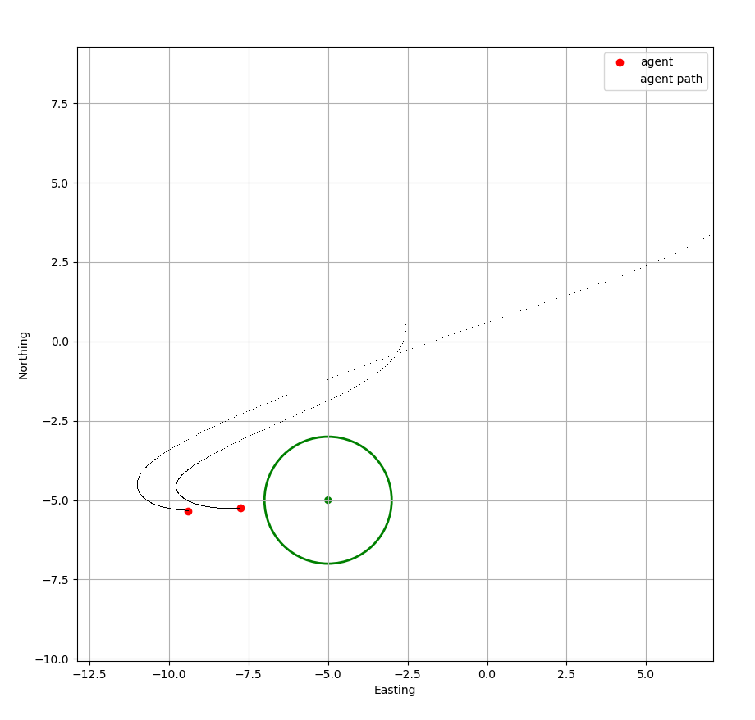
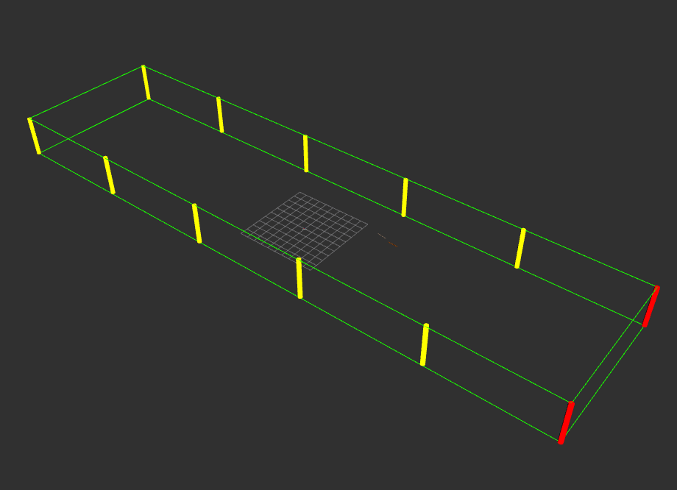
ROS2-in-the-loop Simulation
Euler integration for position updates
RVIZ environment to verify trajectories

Slide 16
Limitations and Next Steps
Only compatible with 2D problems, projected cylinders
Limited to first-order velocity-level control
Run an experiment
Incorporate additional robots
Notes:
Drones cant fly over rovers and lose altitude hold when pitching to translate

Slide 17
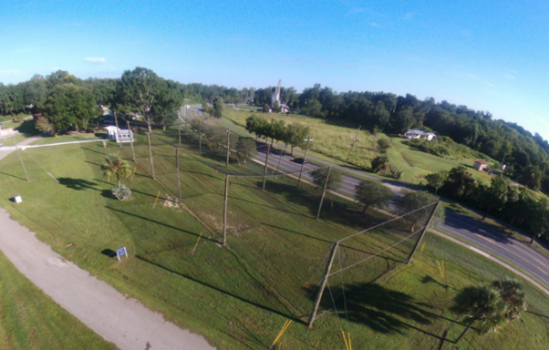
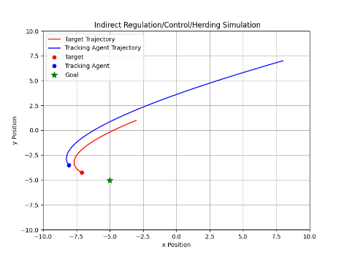
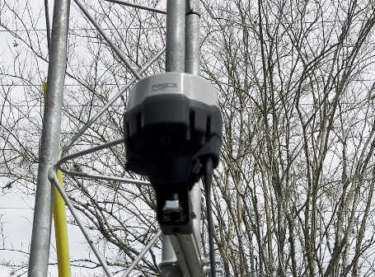
Conclusions
Validated localization approach
Provided a set of functions that are widely applicable
Successfully implemented a herding controller
Future work will explore advanced control methods and experiments

