Slide 1
CFD Investigation of Dragonfly Wing
Gracye Lamb, Amirdhini Pechiammal, Ananya Mahavratayajula, Devanshi Bhargava, and Aadhavan Magesh
Exascale Computational Fluid Dynamics VIP, Georgia Tech
2025 Region II Student Conference, 3 April 2025 – 4 April 2025
Copyright © by Gracye Lamb, Amirdhini Pechiammal, Ananya Mahavratayajula, Devanshi Bhargava, and Aadhavaan Magesh, Exascale Computational Fluid Dynamics VIP
Published by the American Institute of Aeronautics and Astronautics, Inc., with permission.

Slide 2
Introduction and Background
  Dragonfly Flight Mechanics
  Independent forewing & hindwing motion – Enhances agility and stability
  Leading-edge vortices (LEVs) – Improves lift and prevents flow separation
  Corrugated wing structure – Reduces drag and increases lift efficiency
  Structural benefits – Lightweight, rigid, and aerodynamically efficient

Slide 3
Introduction and Background
  Structure of Investigation
  Static Wing Gliding – Sustains lift at high angles of attack without flow separation
  Dynamic Flapping Flight – How lift and drag behave as motion is introduced
  CFD-based analysis in OpenFOAM – Investigates unsteady flow effects and lift generation

Slide 4
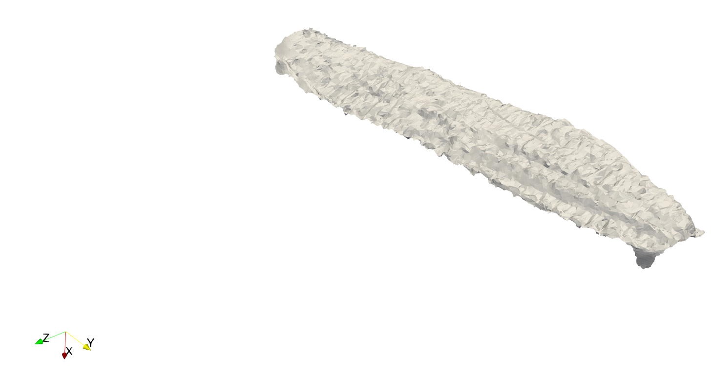
Orthetrum caledonicum Forewing

Slide 5
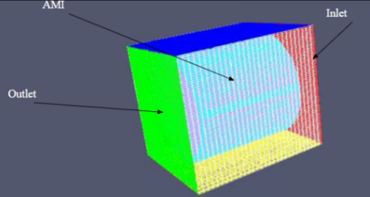
Initial and Boundary Condition Files
Purpose
  Define airflow and turbulence
Turbulence
  KOmegaSST
  CyclicAMI
Airflow
  Wall functions
  Inlet/outlet
Newtonian Fluid = Kinematic Viscosity of 1e-05

Slide 6
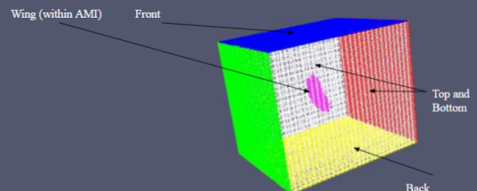
Initial and Boundary Condition Files (cont.)
Solver & System Files:
  pimpleFoam Solver
  Small time step (0.0002 seconds)
  Scotch Decomposition (8 processors)
Stability / Precision
  Euler time-stepping
  Gauss linear gradient
  GAMG solver
    Tolerance = 1e-7

Slide 7
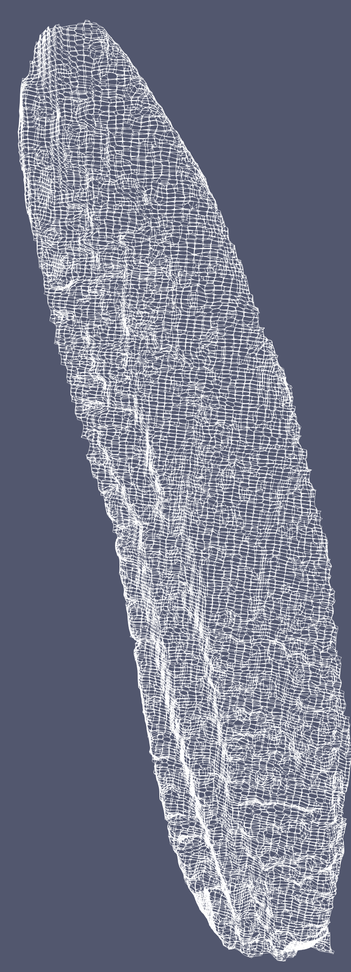

Static Case Meshing
blockMesh -> surfaceFeatureExtract -> snappyHexMesh
snappyHexMesh refinement level: 2 -> 3
Domain Size: 1400 x 1000 x 1600 mm
250000 cells

Slide 8
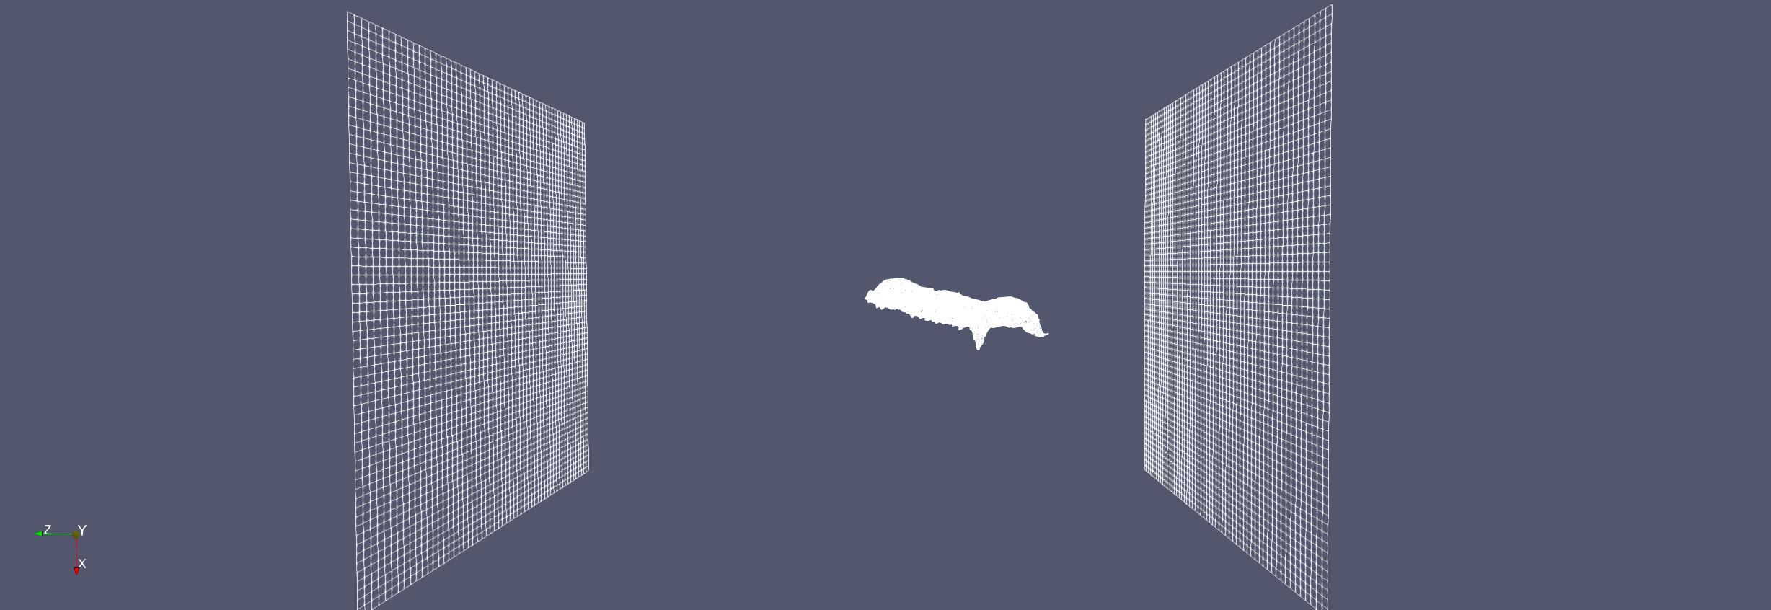
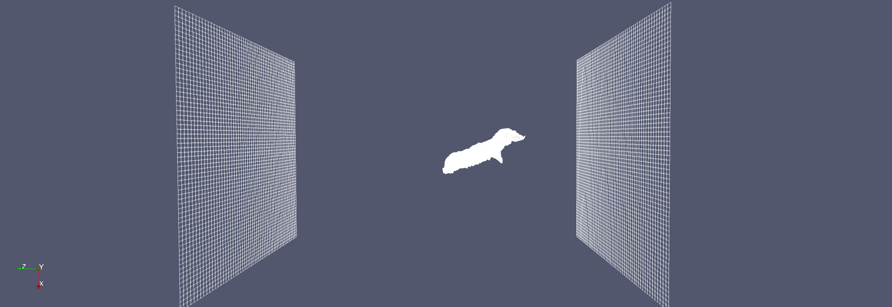
Static Case Setup
Changing AoA variation:
  Ambient Flow Conditions
    Change the flow velocity vector
  Geometry Rotation
    surfaceTransformPoints rotates the geometry before meshing

Slide 9
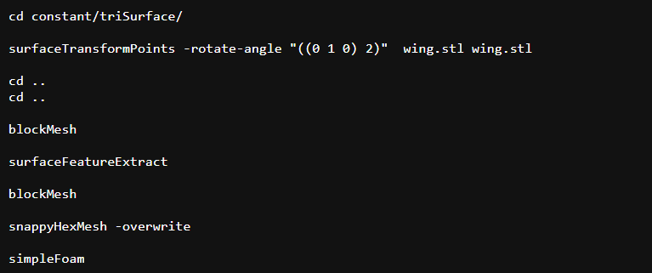
Static Case Process
Process
ForceCoeffs
  dragonFlyX -> forceCoeffs1 -> 0 -> coefficient_0.dat
    Find Cl v Cd
Script repeated from 0 to 60 degrees

Slide 10
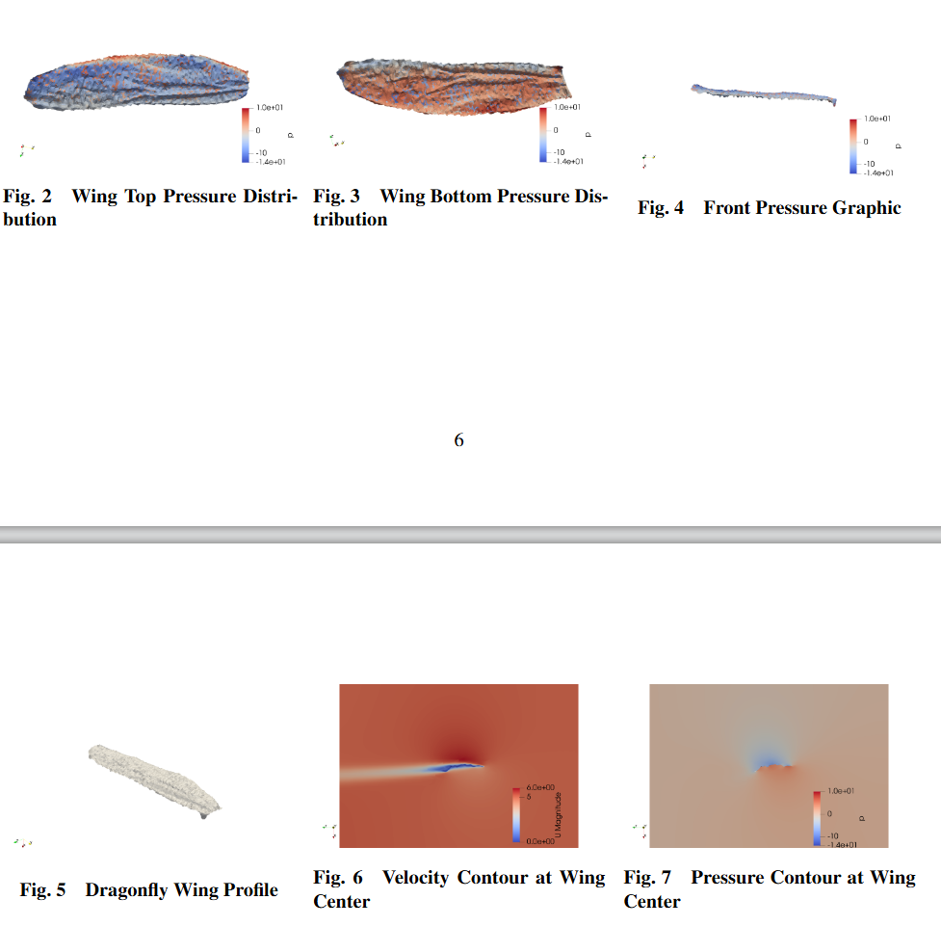
Static Case Results
Pressure distributions and velocities in Fig. 2,3,4.
Fig. 2 & 3 show pressure difference of 2.4 Pa -> constant Pa values on top of wing except for trailing edges

Slide 11
Static Case Results
Figures 4 and 7 support the fact that the wing must produce lift as there is a pressure gradient along the wing
top of the wing ->1 Pa greater than the equilibrium value
bottom of the wing ->1.4 Pa lower than the equilibrium

Slide 12
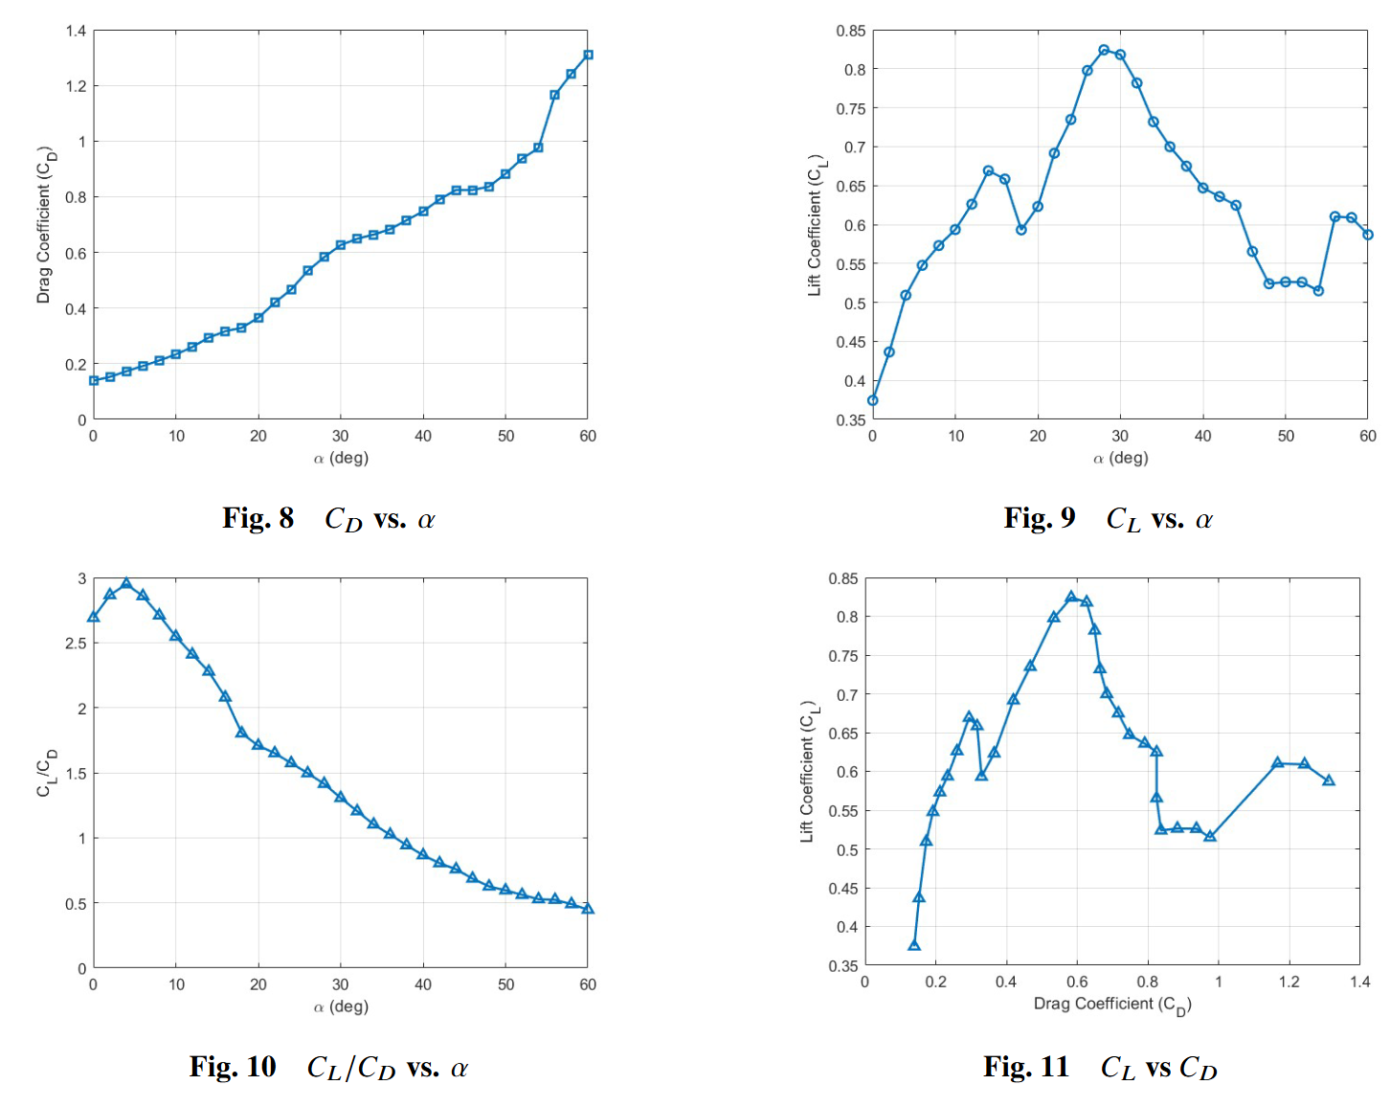
Static Case Results
Fig. 8: 0 < 𝛼 < 50, 0.144 < Cd < 0.883; max Cd = 1.3
@ 𝛼 = 60
Fig. 9: peak #1 @ 𝛼 = 14, Cl = 0.669, Cl increase until Cl = 0.824 at 𝛼 = 28 and declines past the stall point

Slide 13
Static Case Results
Fig. 10: most efficient lift produced at 𝛼 = 6 w/ ratio of 3, higher induced drag past 𝛼 = 4
Fig. 11: similar to Fig. 9 because of linear increase with 𝛼

Slide 14
Dynamic Case Meshing
Similar procedure to static meshing
  Requires AMI, a cylinder stl around rotating region
  900 mm in length, 450 mm radius
Using blockMesh and snappyHexMesh
  Approximately 500,000 cells
createPatch command
  This created a patch for the inside and outside of the cylinder
  In addition to inlet, outlet, topAndBottom, front, back, and wing

Slide 15
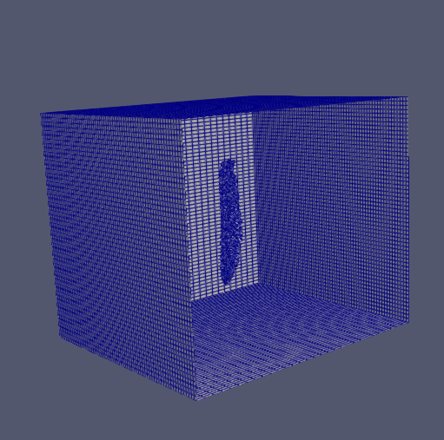
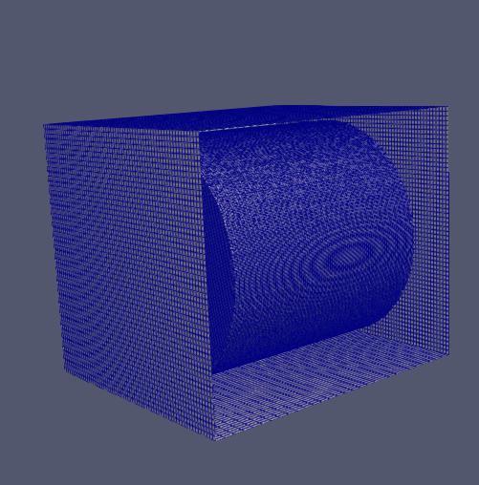
Dynamic Case Meshing

Slide 16
Dynamic Case Setup
Changing dihedral angle variation:
  Angle between the span of wing and x-axis
  Plus or minus 15 degrees, with a 30 Hz frequency
Run the case and collect data
  Write interval = 0.0032s for a total of 0.192 seconds
  About 5 complete flap cycles
Calculations within Paraview
  To find lift/drag coefficient at each time step

Slide 17
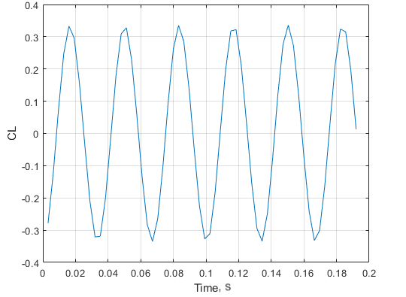
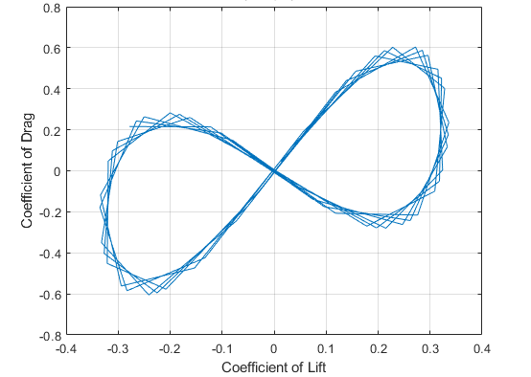
Dynamic Case Results
Upstroke
Downstroke

Slide 18
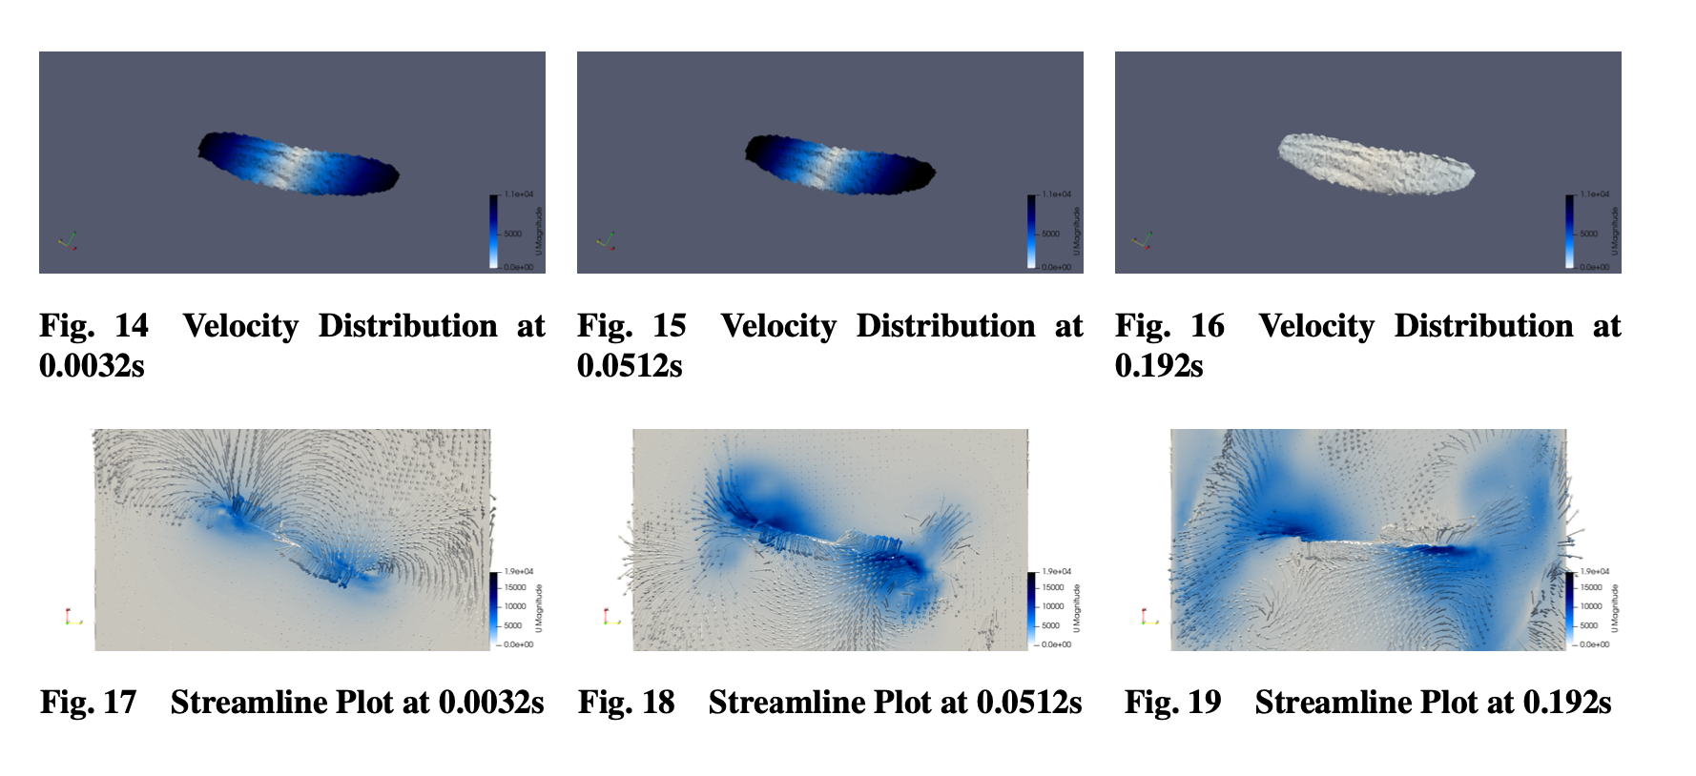
Dynamic Case Results
0.0032 sec – high velocity at wing tips
0.0512 sec – more intense velocities and vortices
0.192 sec – flow stability

Slide 19
Dynamic Case Results
Vortex structures near wing tip during early time steps
Mid-flap – attached vortices, maximize lift efficiency

Slide 20
Conclusion
Creates complex flow patterns
  Enhancing lift, decreasing drag, controlling flow patterns
Future Directions
  In the future we can simulate the entire flapping cycle
  This features the rotation of the wing on the upstroke to decrease drag
Implications
  Bioinspired designs for MAVs
  Fluid structure interaction
Notes:
Conclusion & Implications:
"In summary, our study demonstrates that dragonfly wings leverage unsteady aerodynamics, with periodic lift and drag variations contributing to their exceptional flight efficiency. These findings have strong implications for micro-air vehicle (MAV) development, suggesting that incorporating corrugated wing structures and controlled flapping motions could enhance lift generation while reducing energy expenditure."
"Future research could explore multi-wing interactions and flexible wing dynamics to better replicate the full complexity of dragonfly flight

Slide 21
References
[1] Zhu, S. B. X. D. Y. W. L. X. Y. X., Z., “Three-dimensional sweeping motion effects on hovering dragonflies,” Aerospace Science and Technology, Vol. 127, 2022. https://doi.org/https://doi.org/10.1016/j.ast.2022.107701.
[2] Alexander, D., “Unusual Phase Relationships Between The Forewings And Hindwings In Flying Dragonflies,” J Exp Biol, Vol. 109, No. 1, 1984, p. 379–383. https://doi.org/https://doi.org/10.1242/jeb.109.1.379.
[3] Bode-Oke, Z. S. D. H., A. T., “Flying in reverse: kinematics and aerodynamics of a dragonfly in backward free flight,” Journal of the Royal Society Interface, Vol. 15, No. 143, 2018. https://doi.org/https://doi.org/10.1098/rsif.2018.0102.
[4] Büsse, G. C. H. T., S., “Homologization of the Flight Musculature of Zygoptera (Insecta: Odonata) and Neoptera (Insecta),” PLOS ONE, Vol. 8, 2013, pp. 1–16. https://doi.org/https://doi.org/10.1371/journal.pone.0055787.
[5] Pan, G. S. W. J. H. X., Y., “Aerodynamic performance of a flyable flapping wing rotor with dragonfly-like flexible wings,” Aerospace Science and Technology, Vol. 148, 2024, p. 109090. https://doi.org/https://doi.org/10.1016/j.ast.2024.109090.
[6] Wakeling, E. C. P., J. M., “Dragonfly Flight: III. Lift and Power Requirements,” J Exp Biol, Vol. 200, No. 3, 1997, p. 583–600. https://doi.org/https://doi.org/10.1242/jeb.200.3.583.
[7] Salami E., M. E. G. N. N. N., Ward T.A., “A review of aerodynamic studies on dragonfly flight,” Proceedings of the Institution of Mechanical Engineers, Part C: Journal of Mechanical Engineering Science, Vol. 233, No. 18, 2019, pp. 6519–6537. https://doi.org/https://doi.org/10.1177/0954406219861133.
[8] Sun, L. S. L., M., “A computational study of the aerodynamic forces and power requirements of dragonfly (Aeschna juncea) hovering,” J Exp Biol, Vol. 207, No. 11, 2004, pp. 1887–1901. https://doi.org/https://doi.org/10.1242/jeb.00969.
[9] Yu, Z. H. X. R. S. Y. . W. K., W., “Characterization of Wingbeat Frequency of Different Taxa of Migratory Insects in Northeast Asia,” Insects, Vol. 13, No. 6, 2022. https://doi.org/https://doi.org/10.3390/insects13060520.

Slide 22
References
[10] Sivasankaran, W. T. S. E. V. R. F. C. J. M., P.N., “An experimental study of elastic properties of dragonfly-like flapping wings for use in biomimetic micro air vehicles (BMAVs),” Chinese Journal of Aeronautics, Vol. 30, No. 6, 2017, pp. 726–737. https://doi.org/https://doi.org/10.1016/j.cja.2017.02.011.
[11] Aracheloff, C., Garrouste, R., Nel, A., Godoy-Diana, R., and Thiria, B., “Subtle frequency matching reveals resonant phenomenon in the flight of Odonata,” Journal of the Royal Society Interface, Vol. 21, No. 219, 2024, p. 20240401. https://doi.org/https://doi:10.1098/rsif.2024.0401.
[12] Sun, B. B., J., “The structure and mechanical properties of dragonfly wings and their role on flyability,” Comptes Rendus Mécanique, Vol. 340, No. 1-2, 2012, pp. 3–17. https://doi.org/https://doi.org/10.1016/j.crme.2011.11.003.
[13] Jongerius, L. D., S.R., “Structural Analysis of a Dragonfly Wing,” Exp Mech, Vol. 50, 2010, p. 1323–1334. https://doi.org/https: //doi.org/10.1007/s11340-010-9411-x.
[14] Kesel, A., “Aerodynamic Characteristics of Dragonfly Wing Sections Compared with Technical Aerofoils,” J Exp Biol, Vol. 203, No. 20, 2000, p. 3125–3135. https://doi.org/https://doi.org/10.1242/jeb.203.20.3125.
[15] Levy, S. A., D., “Parameter study of simplified dragonfly airfoil geometry at Reynolds number of 6000,” Journal of Theoretical Biology, Vol. 266, No. 4, 2010, pp. 691–702. https://doi.org/https://doi.org/10.1016/j.jtbi.2010.07.016.
[16] May, M., “Thermoregulation and Adaptation to Temperature in Dragonflies (Odonata: Anisoptera),” Journal of Bionic Engineering, Vol. 46, 1976, pp. 1–32. https://doi.org/https://doi.org/10.2307/1942392.
[17] Wakeling, E. C. P., J. M., “Dragonfly Flight: I. Gliding Flight and Steady-State Aerodynamic Forces,” J Exp Biol, Vol. 200, No. 3, 1997, p. 543–556. https://doi.org/https://doi.org/10.1242/jeb.200.3.543.

Slide 23
References
[18] Benedetti, B. G. C. S. B. M., L., “A numerical study about the flight of the dragonfly: 2D gliding and 3D hovering regimes,” International Journal of Engineering Research and Technology, Vol. 13, No. 11, 2020, pp. 3310–3320. https://doi.org/https://doi.org/10.37624/IJERT/13.11.2020.3310-3320.
[19] Usherwood J.R., L. F., “Phasing of dragonfly wings can improve aerodynamic efficiency by removing swirl.” J R Soc Interface, Vol. 5, No. 28, 2008, pp. 1303–1307–1307. https://doi.org/https://doi.org/10.1098/rsif.2008.0124.
[20] Shilong, M. S., L., “Aerodynamic force and flow structures of two airfoils in flapping motions,” Acta Mech Sinica, Vol. 17, 2001, pp. 310–331. https://doi.org/https://doi.org/10.1007/BF02487459.
[21] Chitsaz, Nasim; Marian, Romeo; Chahl, Javaan (2020). Experimental method for 3D reconstruction of Odonata wings (methodology and dataset) [Dataset]. Dryad. https://doi.org/10.5061/dryad.6t1g1jwtt

