Slide 1
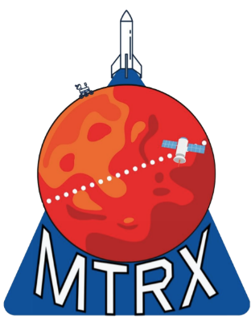

Innovative Lander-Deployed Penetrator for Mars Subsurface Exploration Using Cold Gas Propulsion
Essence Howard, Rithika Nagarajan, Colin Brown
Embry-Riddle Aeronautical University
AIAA Region II Student Conference, April 3-4 2025
Published by the American Institute of Aeronautics and Astronautics, Inc., with permission.
Notes:
Mention the roles of the three of us

Slide 2
Background
Mars' subsurface exploration is crucial for understanding geological history and identifying resources for future missions.
Challenges include regolith composition, extreme environmental conditions, and achieving sufficient depth while maintaining instrument integrity.
Previous attempts to deploy penetrators on Mars have faced failures, including NASA's Deep Space 2 mission in 1999.
Notes:
The proposed lander-deployed penetrator system uses cold gas thrusters for controlled subsurface insertion, reducing mechanical stresses and ensuring precise depth control.
The system is designed to function in Mars' harsh conditions, with high-strength materials, active thermal regulation, and a redundant communication system.
The onboard scientific payload facilitates real-time data collection and transmission, enabling high-resolution analysis of the Martian subsurface.

Slide 3
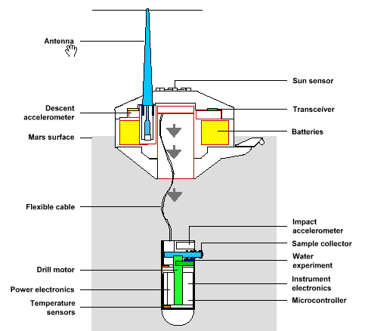
Previous Attempts
Previous attempts to deploy penetrators on Mars have faced failures, including NASA's Deep Space 2 mission in 1999 and Russia’s Mars 96 mission in 1996.
This is an image of NASA’s penetrator from the Deep Space 2 mission.
Notes:
Go into detail on why they failed

Slide 4
Objectives
Addresses limited surface exploration data due to cosmic radiation, oxidation, and weathering.
Deep Subsurface Probes enhances the likelihood of detecting preserved biosignatures or signs of past life.
Develops controlled penetrator system using cold gas thrusters for enhanced structural integrity.
Enables autonomous operation and long-duration data collection.
Notes:
As stated before, exploring Mars' subsurface is critical for understanding its past geologic activity, potential life habitats, and locating resources for future human missions.
Subsurface investigations provide insights into planetary formation, climate evolution, and volatiles like water ice.
Subsurface exploration enables the detection of buried water ice deposits, critical for understanding Mars' hydrological history and future crewed missions.
This research lays the foundation for future planetary exploration missions on Mars and other celestial bodies where subsurface analysis is critical.

Slide 5
Constraints
Endure temperature variations from -125°C to 20°C and operate under low atmospheric pressure (~6 mbar) with resistance to extreme dust conditions.
Utilize a stable lander platform for penetrator deployment with cold gas thrusters providing controlled penetration to a depth of 1.75 meters.
Incorporate rugged, miniaturized scientific instruments including seismometers, spectrometers, temperature and pressure sensors, microscopic imagers, and moisture detection sensors.
Notes:
Topics that are on slide: environmental, lander and deployment, scientific instrumentation
environmental constraints…. 1
lander and deployment constraints…. 2
penetration depth and sampling constraints…. 3
power and communication constraints…. 4
scientific instrumentation constraints…. 5
longevity and reliability constraints…. 6

Slide 6
Design Innovations
Cold gas thrusters provide precise depth modulation, adapting to various terrain types.
Tungsten-tipped nose cone ensures efficient penetration through dense layers.
Aluminum foam-filled (AFFT) shock absorbers protect onboard systems, preventing excessive force transmission.
Hybrid power system combines high-energy-density lithium-ion batteries with radioisotope thermoelectric generators for a robust energy supply.
Notes:
Controlled Penetration with Cold Gas Thrusters…. 1
Structural Enhancements for Impact Survival…. 2
Talk more about the afft abreviation
Advanced Power and Communication Systems…. 3
Reliable communication system, a redundant UHF/X-band system, maintains stable data flow.

Slide 7
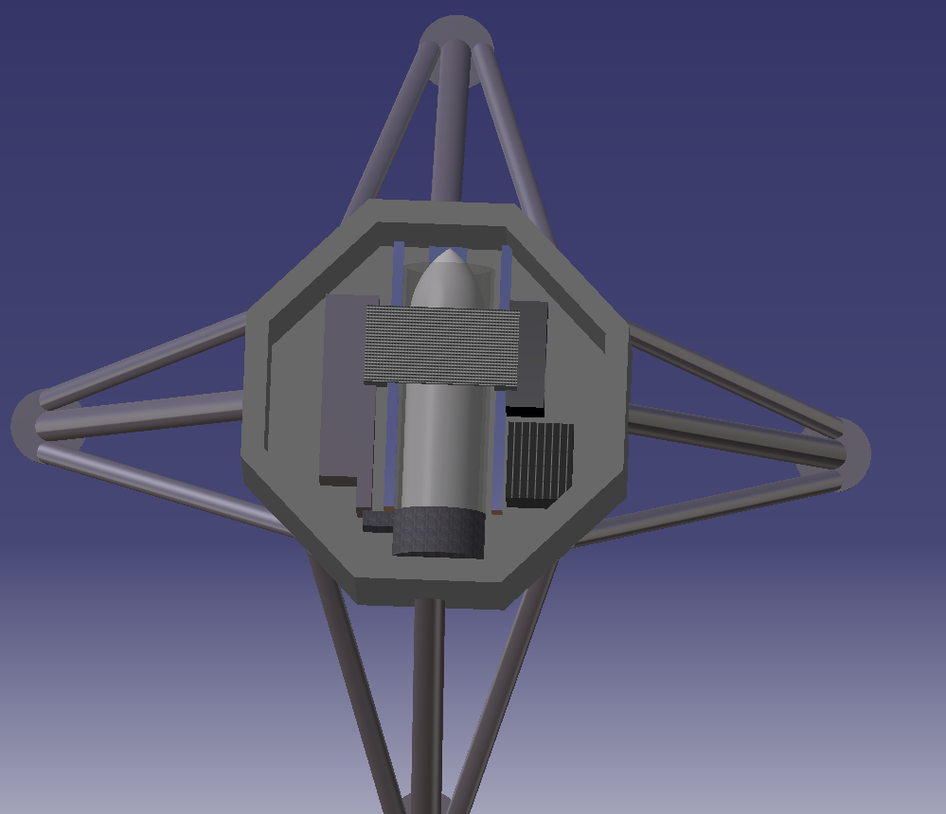
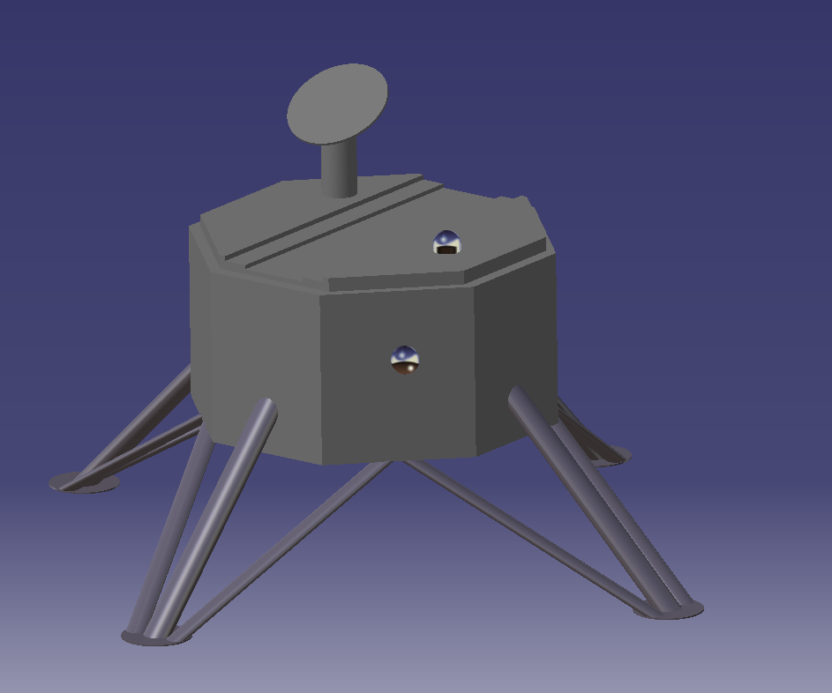
CAD Design
Notes:
Mention how colin did the cad on CATIA v5

Slide 8
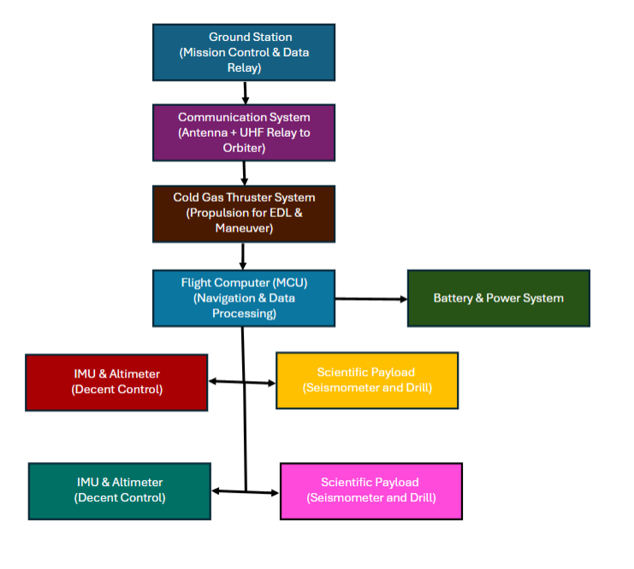
System Design
This figure depicts the interconnected parts of the Mars lander mission, tracing the path from mission control to scientific payload operations.
Notes:
System Block Diagram for the lander and penetrator system.

Slide 9
Power and Communication Systems
Store data locally in non-volatile memory in case of transmission delays.
Utilize waste heat from electronics or RTG to prevent freezing of critical components.
Use MEMS-based (Micro-Electro-Mechanical Systems) sensors for compact, low-power instrumentation.
Notes:
Briefly mention last points from slide 6 regarding the design innovations for advanced power and communication
Store data locally in non-volatile memory in case of transmission delays.
Utilize waste heat from electronics or RTG to prevent freezing of critical components
Use MEMS-based (Micro-Electro-Mechanical Systems) sensors for compact, low-power instrumentation.
Equip the penetrator with a hardened seismometer to detect underground vibrations.
Use Raman and laser-induced breakdown spectroscopy (LIBS) instruments for mineralogical analysis. Design flexible PCB connections to withstand impact forces.

Slide 10
Subsystem Designs
Utilizes radiation-hardened electronics covered with depleted boron for protection against high-energy particle destruction.
Utilizes UltraFlex Solar Arrays for efficient power management during planetary exploration.
Equipped with a VibraTech seismometer for seismic activity detection and environmental monitoring sensors like BME280 for temperature, humidity, barometric pressure, and volatile organic compounds.
Notes:
Environmental Durability enhancements… 1
Aerospace Fabrications’ Cryogenic Multilayer Superinsulator4 provides enhanced thermal protection for cryogenic applications.
Labyrinth seals in the design reduce dust entry, protecting component integrity in dusty Martian conditions.
Lander… 2
Talk more about the ultraflex solar arrays and possibly electrostatics to help with dust
Ground-penetrating radar system, RIMFAX, for subsurface analysis.
These integrated systems support the lander's mission by ensuring reliable power generation, precise environmental monitoring, and advanced scientific exploration.

Slide 11
Testing and Simulations
Temperature cycling ensures functionality of materials, electronics, and power systems.
Penetrator tested in low-pressure environment for thruster efficiency.
Cold gas thruster stability test to assess propulsion system's control over trajectory and penetration depth.
Field tests in Martian analog environments to validate penetration ability, sensor performance, and communication systems.
Notes:
Explain why each are important in the testing process of penny and lander
Thermal and Vacuum Testing... 1
Since PENNY will operate in low atmospheric pressure (~6 mbar) and extreme temperatures (-125°C to 20°C), thermal and vacuum testing is essential.
Multi-layer insulation and aerogel coatings assessed for heat retention.
RTG system tested for internal temperature maintenance and freezing prevention.
Vibration and Impact Testing… 2
Mechanical stress testing to simulate launch and entry forces.
Shock and drop tests to evaluate impact resilience.
Field Deployment Simulations… 3
Simulation of Martian regolith conditions in desert, permafrost, and volcanic regions.
• Real-world testing of scientific instruments like seismometers, spectrometers, and temperature sensors.
• Assessment of UHF and X-band transmission systems in remote locations.
• Evaluation of PENNY's resilience, efficiency, and reliability through thermal, mechanical, and field tests.
• Confirmation of system's capability for long-term scientific exploration and subsurface data collection.
Theses test and simulations will help with validating what PENNY and the lander are capable of as well as any possible adjustments.

Slide 12
Conclusion
Employs a thruster-assisted deployment to mitigate risks of communication loss, structural failure, and inadequate penetration depth.
Features a high-strength, structurally reinforced penetrator casing to withstand extreme environmental conditions.
The system's modular design allows for future modifications based on mission-specific requirements.
Notes:
• Utilizes a cold gas propulsion system for precise and controlled subsurface insertion.
• Integrates a tethered data transmission architecture for continuous communication with the lander.
• Incorporates advanced onboard instrumentation for real-time analysis of the Martian subsurface.
• Features a robust thermal management system for long-term operational stability in Mars' harsh environment.
• The PENNY system's adaptability makes it a versatile tool for planetary exploration beyond Mars.
• The PENNY mission sets a new standard for subsurface planetary exploration, enhancing current exploration efforts and laying the groundwork for future advancements in autonomous planetary science.

Slide 13
Thank you!

