Slide 1
Aerodynamic Analysis of Generative AI Supersonic Aircraft Design
Jacob Pence and Parker Blenk
Faculty Advisor - Dr. Ramana Pidaparti

Slide 2
Agenda
Background
Objectives
Methodologies
Designs
Simulation Details
Results
Limitations
Conclusions

Slide 3
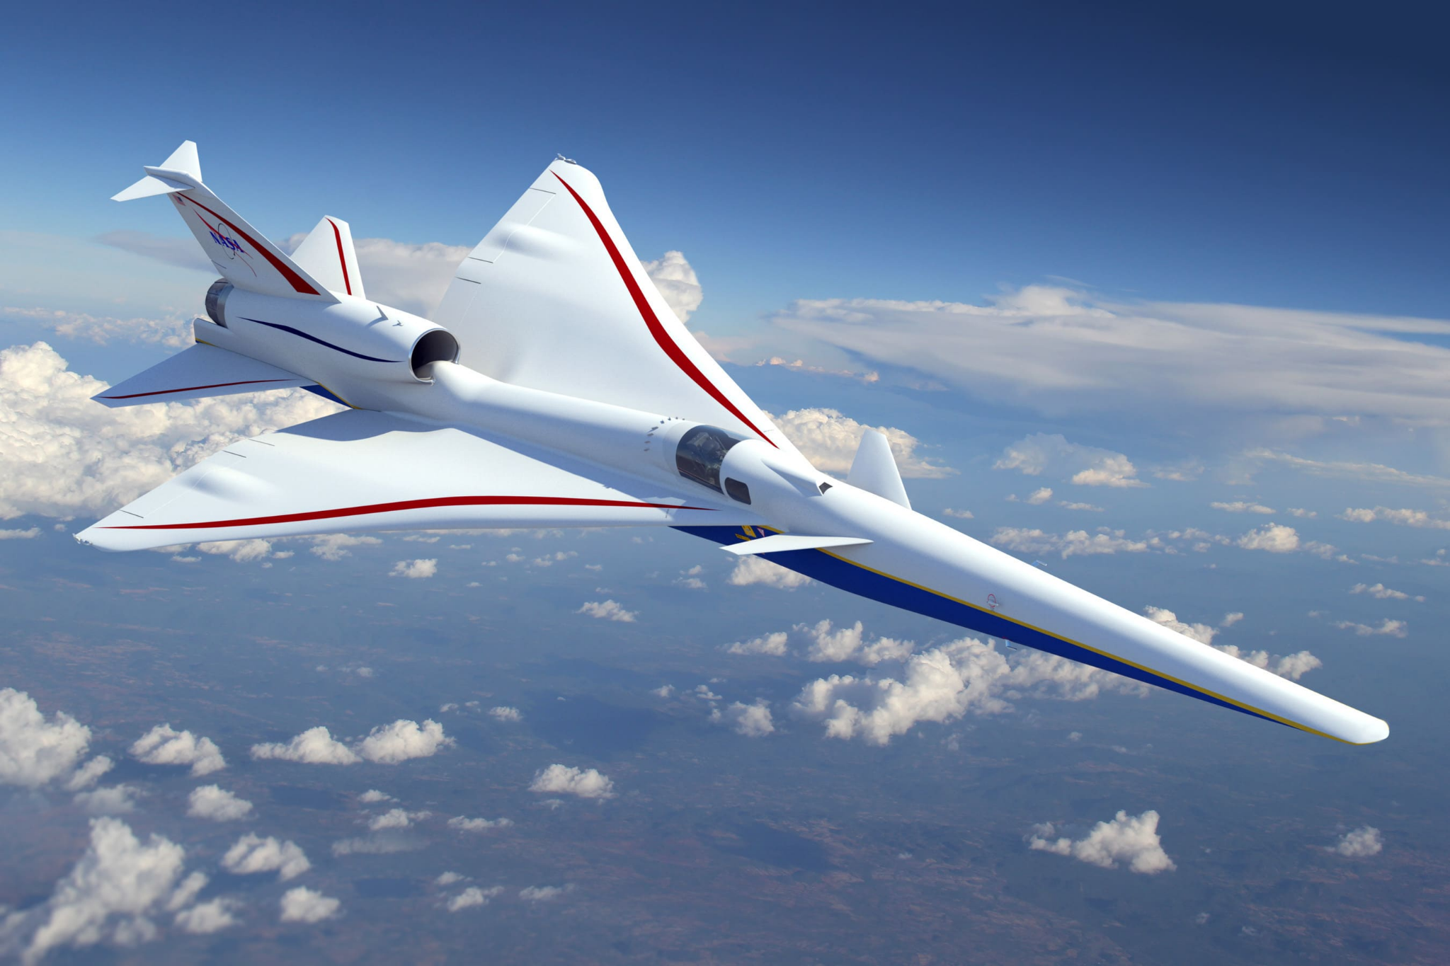
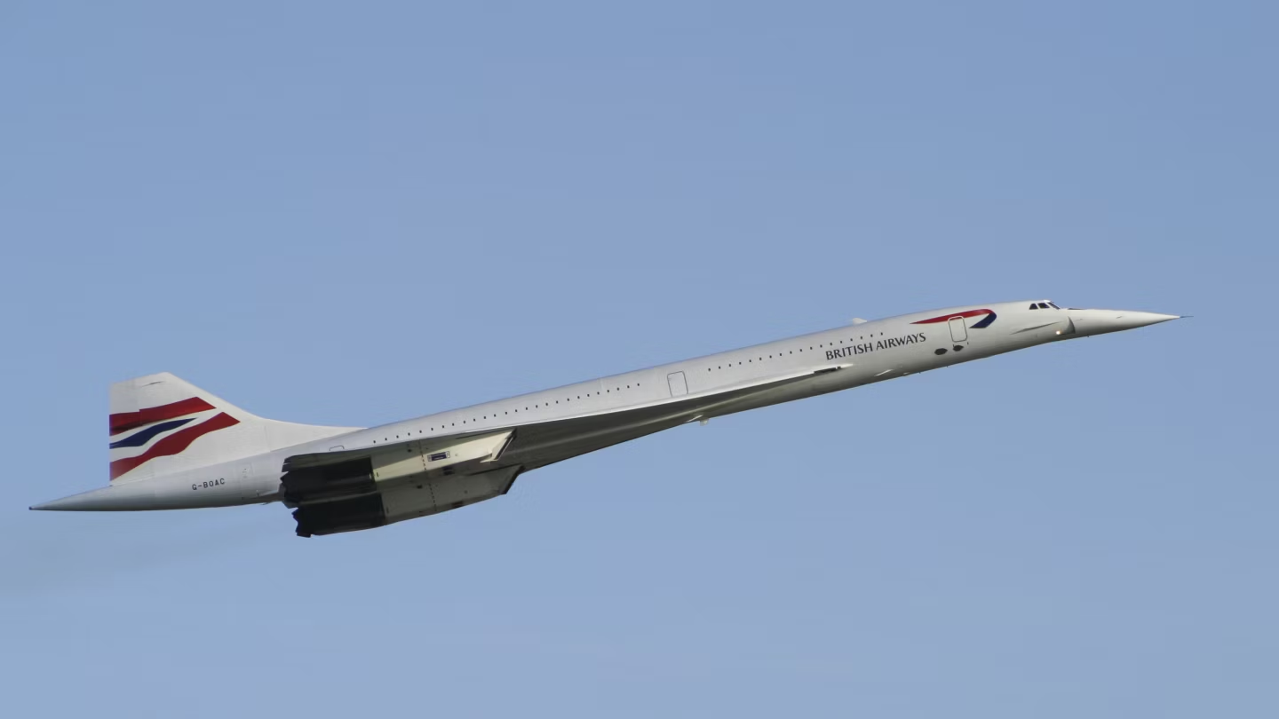
Background
Supersonic aircraft design is stagnant.
  Supersonic fighter jets live in same design tree.
Non-fighter jet designs are limited due to FAA.
  NASA and Lockheed created Boom.
  Concorde flew in 1969.

Slide 4
Objective
The main objective of this study is to investigate AI-driven design.
  Determine if the use of LLM’s can produce aerodynamically viable supersonic aircraft using prompt-based strategies.
Offer insight into integrating AI into industry.
  Potentially speeding up the design process and increasing innovation in supersonic aircraft.
Leverage CFD to compare the aerodynamic capabilities to traditionally-made supersonic aircraft.
  Analyze lift-to-drag (L/D) ratios, pressure distributions, Mach contours

Slide 5
Approach
Used ChatGPT o1
  Most advanced model openly accessible by the public.
Used OpenVSP and Fusion360 for creating 3D models.
  Allowed for easiest creation of blended body design.
  Fusion360 merged the bodies for simulation.
ANSYS Fluent and Fluent Aero used for performance simulations.
  Fluent Aero allowed for easy mach sweep simulations.

Slide 6
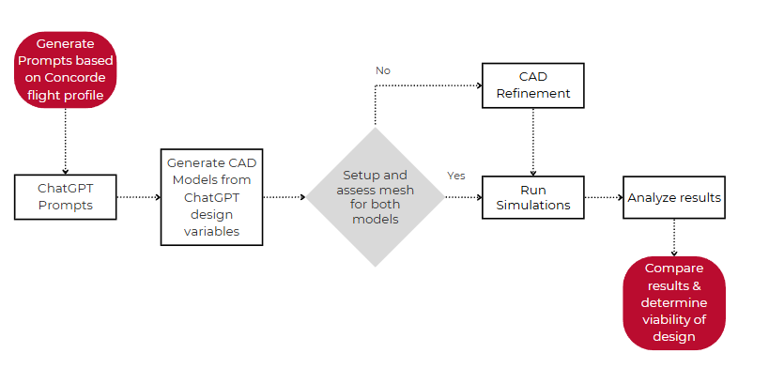
Methodologies
WorkFlow

Slide 7
AI Prompts
Generic Prompt: “Please design a supersonic jet, and give design characteristics”
Detailed Prompt: “Design a supersonic jet that meets the takeoff, flight, and mission criteria listed. For takeoff conditions, the takeoff speed is Mach 0.3, and the maximum takeoff weight (MTOW) is between 69,000 and 75,000 pounds. For the cruise conditions, the maximum speed of this aircraft is Mach 2.0 with a cruising speed between Mach 0.8-0.85, the cruising altitude is roughly 55,000 feet, and the cruise weight is between 54,000 and 60,000 pounds. There are no radar considerations for this aircraft, and the length of the aircraft should be between the range of 50-65 feet. One focus of the aircraft is the high-performance level at a large range of angles of attack, not just level flight. Lastly, provide an airfoil for this aircraft. Please take all of these flight and mission criteria and give exact aircraft design characteristics that will perform best for these criteria.”

Slide 8
Design Variable | Design Value
Length | 105 ft
Fuselage Diameter (max) | 7.55 ft
Wingspan, Area | 50 ft, 753.5 ft²
Wing Leading Edge Sweep | 60º
Chord Length (root, tip) | 39.4, 4 ft
t/c (root, tip) | 3.5 %, 2.5%
Airfoil | NACA 0004
Vertical Stabilizer Height, Area | 13.3 ft, 118.4 ft²
Vertical Stabilizer Airfoil | Double Wedge (4% t/c)
Horizontal Stabilizer Span, Area | 16.5 ft, 129 ft²
Horizontal Stabilizer Airfoil | Double Wedge (4% t/c)
Generic Model

Slide 9
Design Variable | Design Value
Length | 60 ft
Fuselage Diameter (max) | 6 ft
Wingspan, Area | 32 ft, 600 ft²
Wing Leading Edge Sweep | 58º outboard, 55º near root
Chord Length (root, tip) | 30, 7.5 ft
t/c (root, tip) | 4%, 4%
Airfoil | NACA 65A004
Vertical Stabilizer Height, Area | 10 ft, 120 ft²
Vertical Stabilizer Airfoil | NACA 65A004
Horizontal Stabilizer Span, Area | 13 ft, 120 ft²
Horizontal Stabilizer Airfoil | NACA 64A004
Detailed Model

Slide 10
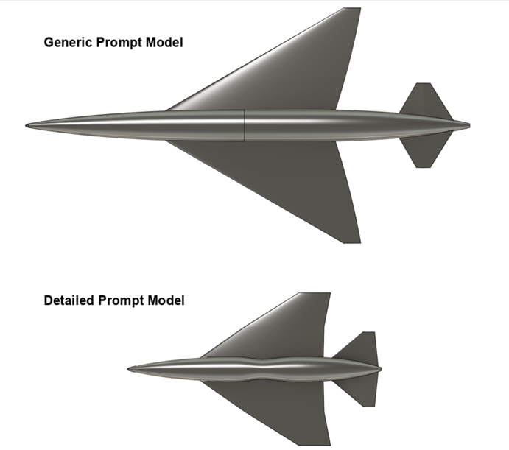
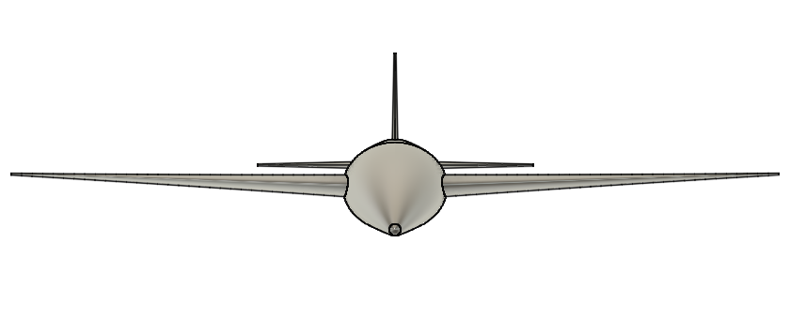
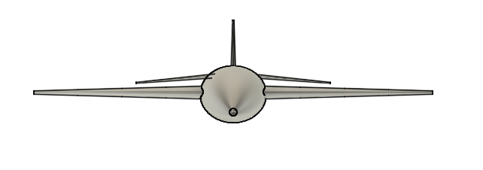
Design Images
Generic Model
Detailed Model

Slide 11
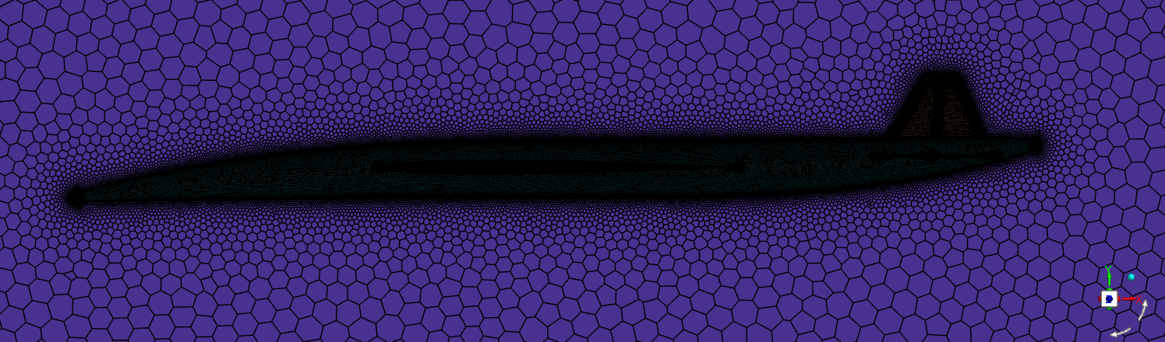
Design Analysis - CFD Simulations
Meshing
To accurately solve the flow characteristics, the complex geometry must be broken into smaller cells or elements.
Symmetric plane used to reduce total cell count .
Local sizings around the edges of the aircraft (i.e. wings, stabilizers, etc.).
Accurate boundary layer representation.
Both volume meshes incorporated polyhedral cells and in total featured over 6 million cells.

Slide 12
Design Analysis - CFD Simulations
Simulation
All simulations performed in ANSYS used k-𝛚 SST turbulence model with the density based solver.
ANSYS Fluent
  Used to run the standard cruise conditions of each model.
    Altitude: 55,000 ft
    AoA: 3.5 degrees
    Speed: Mach 2.0
ANSYS Fluent Aero
  Performed the Mach sweep to simulate climbing at a constant rate.
    Altitude: 27,000-55,000 ft
    Mach range: 0.95-1.7 (Mach 0.15 intervals)
    AoA: 7.0 degrees

Slide 13
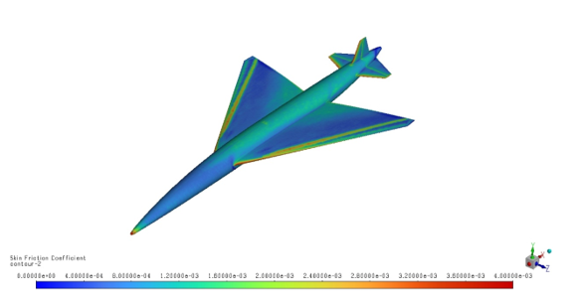
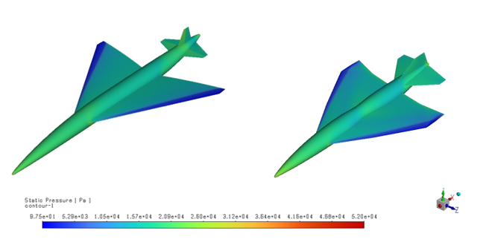
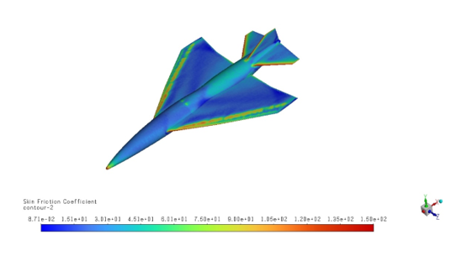
Interpreting CFD Results
Red and yellow regions demonstrate areas of high skin friction
Oblique shock wave formation at the leading edge of the wing

Slide 14
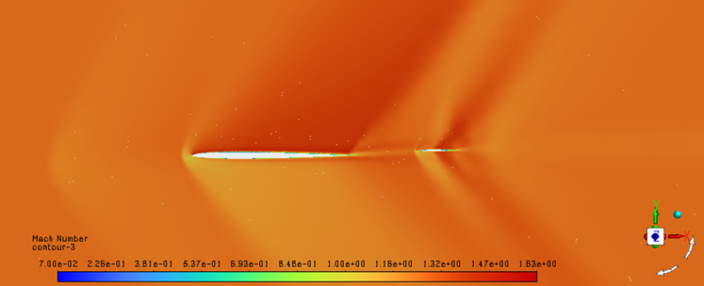
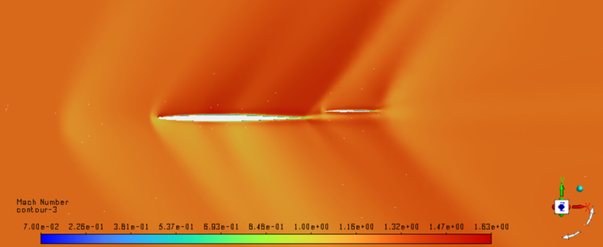
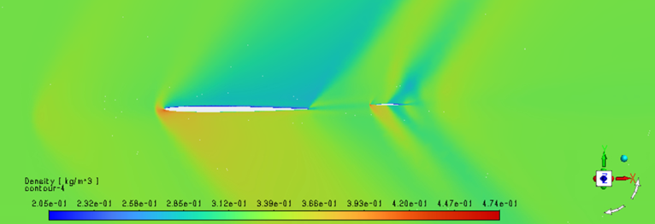
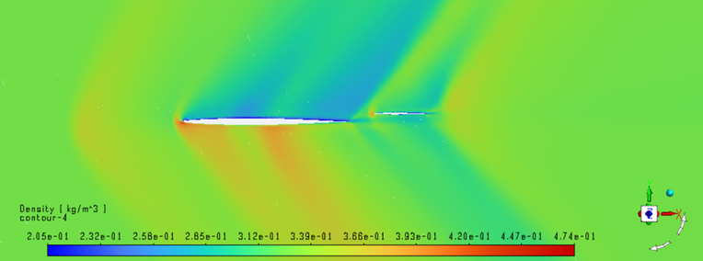
Interpreting CFD Results
Mach number decreases, while density increases at this point.
Double wedge airfoil creates oblique shock waves with an expansion fan.

Slide 15
CFD Results
Climb Conditions
Cruise Conditions
M∞ | GM |  | DM
 | C_{L} | C_{D} | C_{L} | C_{D}
0.95 | 0.3455 | 0.0405 | 0.3012 | 0.0354
1.1 | 0.3252 | 0.0417 | 0.3058 | 0.0430
1.25 | 0.3069 | 0.0399 | 0.2961 | 0.0418
1.4 | 0.2827 | 0.0376 | 0.2754 | 0.0398
1.55 | 0.2592 | 0.0355 | 0.2515 | 0.0375
1.7 | 0.2371 | 0.0333 | 0.2293 | 0.0353
Variable | GM | DM
C_{L} (Wing) | 0.0453 | 0.0427
C_{L} (Aircraft) | 0.0505 | 0.0446
C_{D} (Wing) | 0.0049 | 0.0057
C_{D} (Aircraft) | 0.0078 | 0.0115
L/D (wing) | 9.2449 | 7.4912
L/D (Aircraft) | 6.4744 | 3.8783

Slide 16
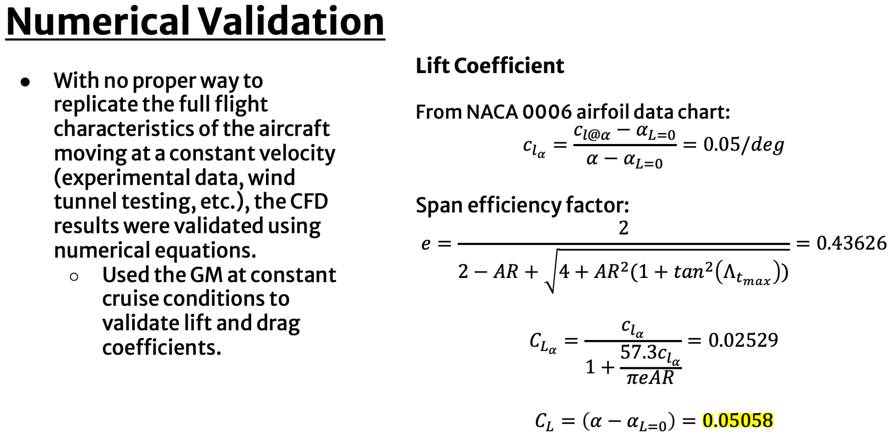
Numerical Validation
With no proper way to replicate the full flight characteristics of the aircraft moving at a constant velocity (experimental data, wind tunnel testing, etc.), the CFD results were validated using numerical equations.
  Used the GM at constant cruise conditions to validate lift and drag coefficients.
Lift Coefficient

Slide 17
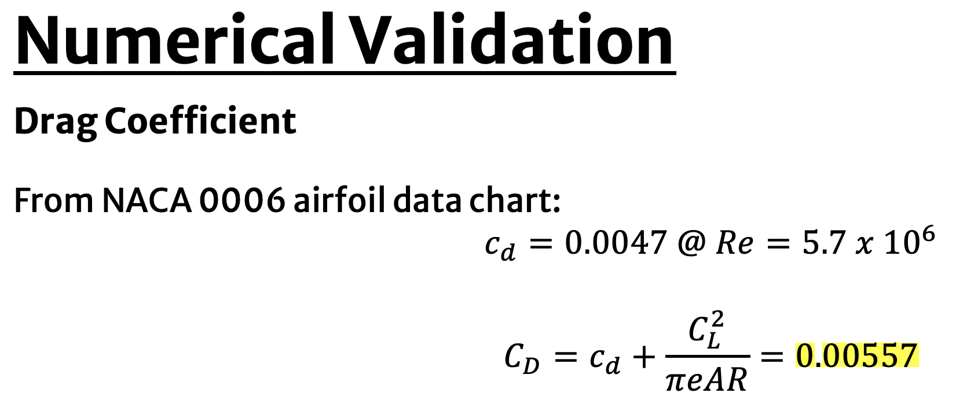
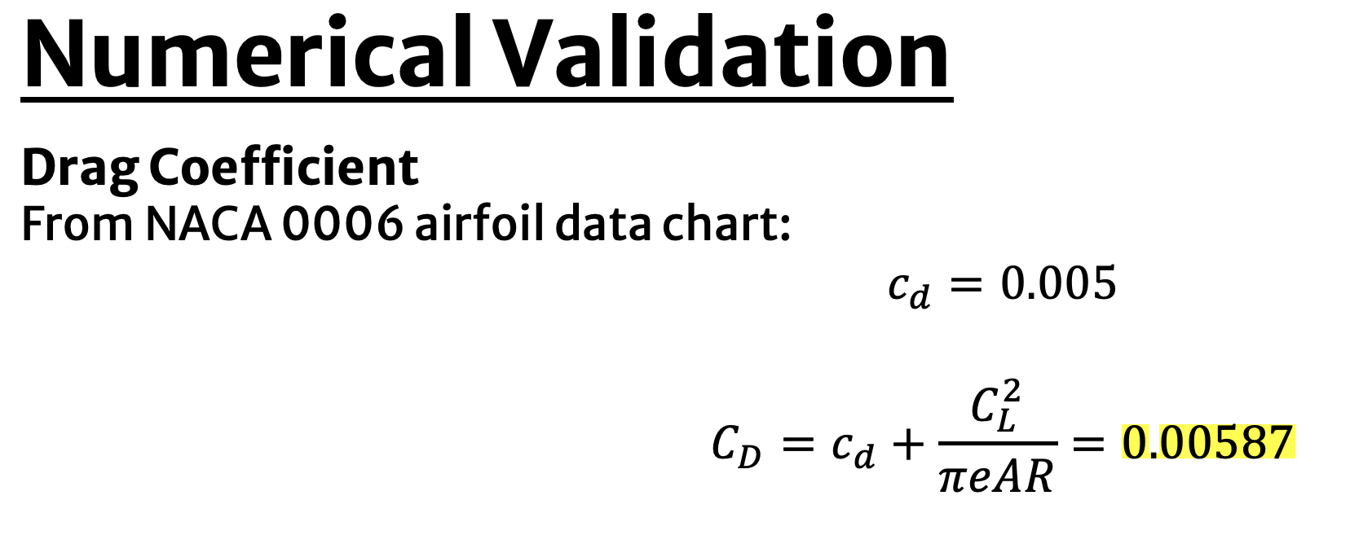
Comparing numerical validation results to CFD results, both C_{L} and C_{D} values fall within ~12% error.
Errors in numerical and simulated values are likely attributed to several reasons:
  Estimations in airfoil data
  Approximations of values from chart

Slide 18
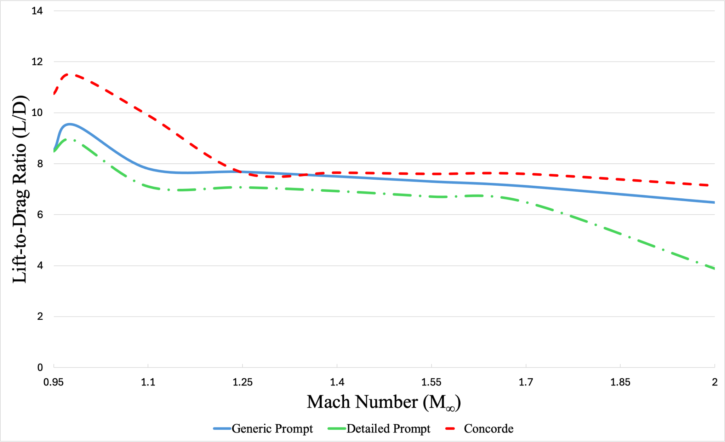
Data Comparison
Simulated L/D for Mach 0.95-2.
Concorde performed better at climbing conditions, with a peak L/D of ~11.5, and marginally better at cruising conditions compared to the GM.
DM performed significantly worse at all Mach numbers, with significant drop off at cruising conditions.

Slide 19
Discussion
L/D main performance characteristic considered.
  Could be calculated by hand relatively easily for validation of sims.
Performance compared to Concorde numbers to determine viability.
GM performed better in each sim than the DM.
Likely reasons for better performance by GM:
  GM is closer in design to Concorde than DM.
  GM has better airfoil shapes for supersonic flight, such as double wedge horizontal and vertical stabilizers.
  Longer fuselage allows for better spacing between wing and stabilizers.

Slide 20
Limitations
One aspect of this study was the exclusion of structural and propulsion details, as well as intricate details between each geometry. All of which would affect the design process and overall the aerodynamic viability.
Limited scope
  Only compared data to one supersonic aircraft design.
  Focused on L/D to determine aerodynamic capability
Limited validation studies
  Theoretical aerodynamic potential.

Slide 21
Conclusion
Introduction of industry 4.0 has potential to change aerospace design.
  Changes need to be made to make process more efficient.
  Lack of ability to generate CAD model hurts efficiency.
Using this study, AI has the ability to produce aerodynamically viable supersonic designs.
  Further testing needed for other aspects of aerospace design, such as propulsion and structure.
  Full flight profiles need to be considered for more accurate comparisons.
  Proper validation case studies.

Slide 22
References
[1] Aprovitola A, Di Nuzzo PE, Pezzella G, Viviani A. “Aerodynamic Analysis of a Supersonic Transport Aircraft at Landing Speed Conditions”, Energies, 2021; 14(20):6615. https://doi.org/10.3390/en14206615
[2] Brandt, Steven A., Introduction to Aeronautics: A Design Perspective, American Institute of Aeronautics and Astronautics, March 2015
[3] ChatGPT, OpenAI, Ver. o1, San Francisco, CA, 2015
[4] Chen, S., Qiu, J., Yang, H. et al. Deep learning for inverse design of low-boom supersonic configurations. Adv. Aerodyn. 5, 13 (2023). https://doi.org/10.1186/s42774-023-00145-1
[5] Leishman, J. Gordon, Introduction to Aerospace Flight Vehicles, Embry-Riddle Aeronautical University, Jan 2023, Chap. 13
[6] Mair, W. Austyn, Aircraft Performance, Cambridge University Press, 1992, Chap. 3, 10. https://doi.org/10.1017/CBO9780511607134
[7] Mason, W.H. “Some Supersonic Aerodynamics”, Virginia Tech University Configuration Aerodynamics Class, 2016. https://archive.aoe.vt.edu/mason/Mason_f/SupersonicPres.pdf
[8] Mathew, B. C; Kumar, A., Pal, D., Verma, D.K, and R. K. Saini, Brandt, Review on Generative Design Methods and Performance Analysis of Aircraft, AIP Conf. Proc. 2962, 020001 (2024).
[9] Ordaz, Irian and Rallabhandi, Sriram K. “Boom Minimization Framework for Supersonic Aircraft Using CFD Analysis”, NASA, 2010. https://ntrs.nasa.gov/api/citations/20100002817/downloads/20100002817.pdf
[10] Starr, Fred, “The Supersonic Conundrum: The Faster You Go, The Less Fuel is Used” August 2020. https://fredstarr.com/wp-content/uploads/The-Supersonic-Conundrum-pdf.pdf

Slide 23
Questions?
Thank you!

