Slide 1
Inflatable Structure for Lunar Additive Manufacturing
AIAA Region II Student Conference 2025
Robert Davis, Cooper Grace, Brandon Meadows, Corbin Murphy, and Micah Vranes

Slide 2
Topics
Background
Design Requirements
Design Overview
Structural Considerations
Proposed Designs
Current and Future Work

Slide 3
Background

Slide 4
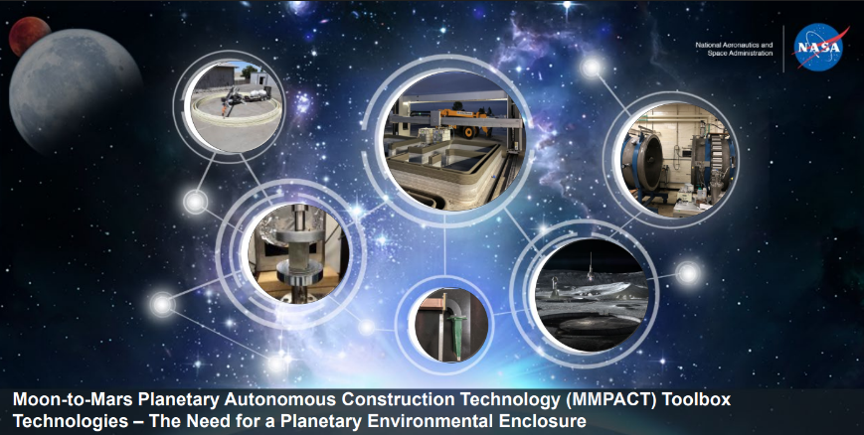
Road to Human Habitation
Amentum Space Exploration Group (ASEG)
Moon-to-Mars Planetary Autonomous Construction Technology (MMPACT) Toolbox
  Includes several industry and educational partners
  Enable development of lunar economy
  Provide customizable infrastructure
  Construction material development and testing
Lunar Regolith-Based Concrete
  Lunar Regolith concrete requires a water-based binder
  All materials can be collected in-situ on the Moon at select landing sites
  Concrete can be 3D printed to form landing pads, habitats, and other mission critical infrastructure
  The Moon’s South Pole is the target for missions due to the presence of water
Figure 1. Amentum MMPACT Toolbox [5]

Slide 5
Design Requirements
Able to withstand an internal pressure of 0.5 - 1.0 atm
Accommodate transportation requirements from Earth
Provide nominal protection against micrometeorite and radiation
Target Size of 80 ft diameter and 20 ft height
Accommodate a full-scale 3D printer
Accommodate a an airlock¹
Accommodate feedthrough for power, pressure control, etc.
Human Habitation is not a requirement
¹ This requirement was later removed due to scope of project

Slide 6
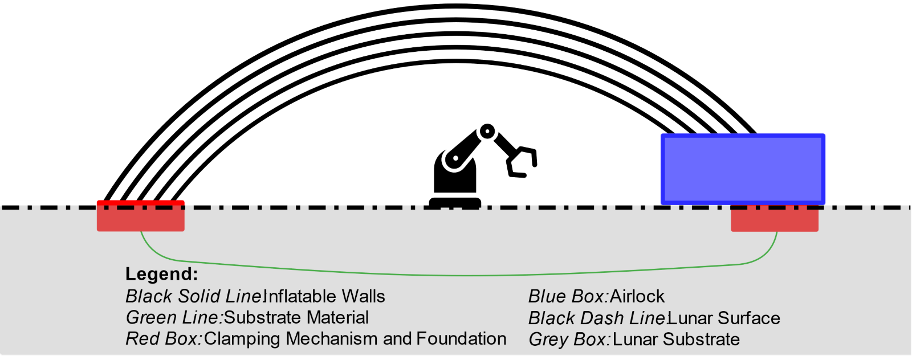
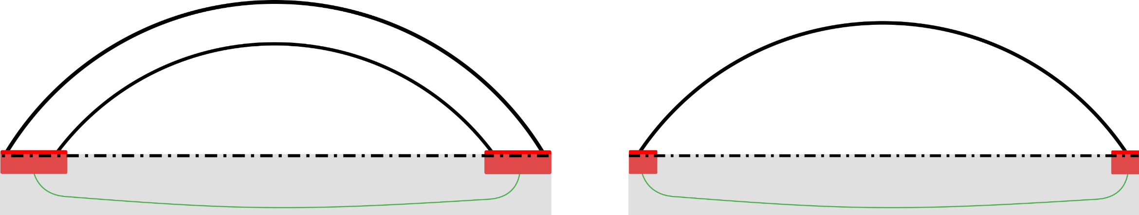



Proposed Design Concept: The Bubble
Multi-shelled, inflatable structure
Two main components: clamp and shell
Utilizes fabric shells to allow for inflation and easy transportation
Pressure differential across each shell to reduce stress on fabrics
Modular and scalable design
Figure 2. Diagram of proposed Bubble concept
0.5 atm $∆P$
0.5 atm $∆P$
1 atm $∆P$
1 atm Pressure
1 atm Pressure
Figure 3. Multiple shells allows for the pressure across each shell to be a partial pressure of the desired total pressure

Slide 7
Design Constraints

Slide 8
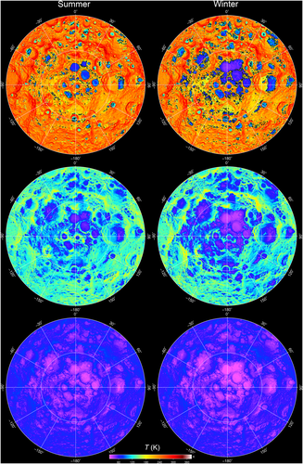
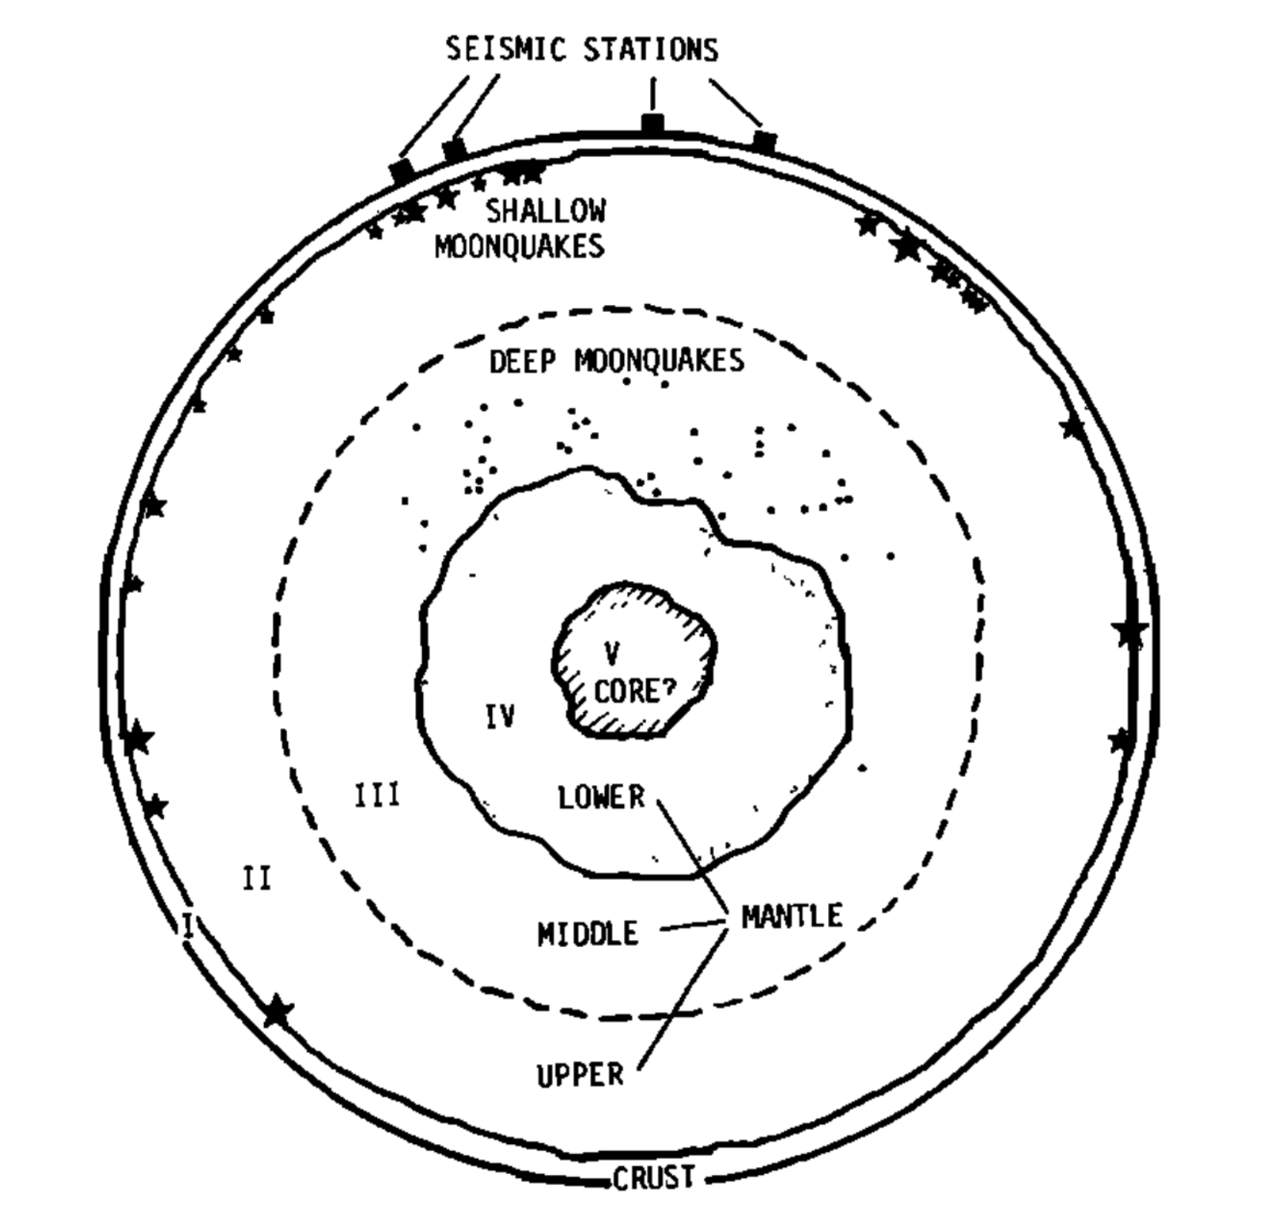
Environmental Hazards²
Lunar Regolith Dust
  Highly abrasive and adherent, sharp as glass
  Rips spacesuits
  Clogs mechanism
Micrometeorite Impacts [1]
  Like microscopic bullets, pose a risk of puncturing shells
  Most have diameters on the order of microns
  Impact velocity excess of 100 km/s
Moonquakes [2]
  Lunar equivalent of earthquakes
  Data collected during Apollo missions
  Prolonged duration
Thermal
  Surface temperature of the lunar surface ranges from -274 F° to 135 F°
  Lunar cycle is about one month
Radiation Material Degradation
  Lack of atmosphere leads to intense heating of exposed surfaces
  Solar radiation degrades structural integrity
Figure 4. Schematic diagram of lunar interior [2]
Figure 5. Maximum, average, and minimum temperature maps of lunar south pole [3]
² List of environmental hazards from ASEG

Slide 9
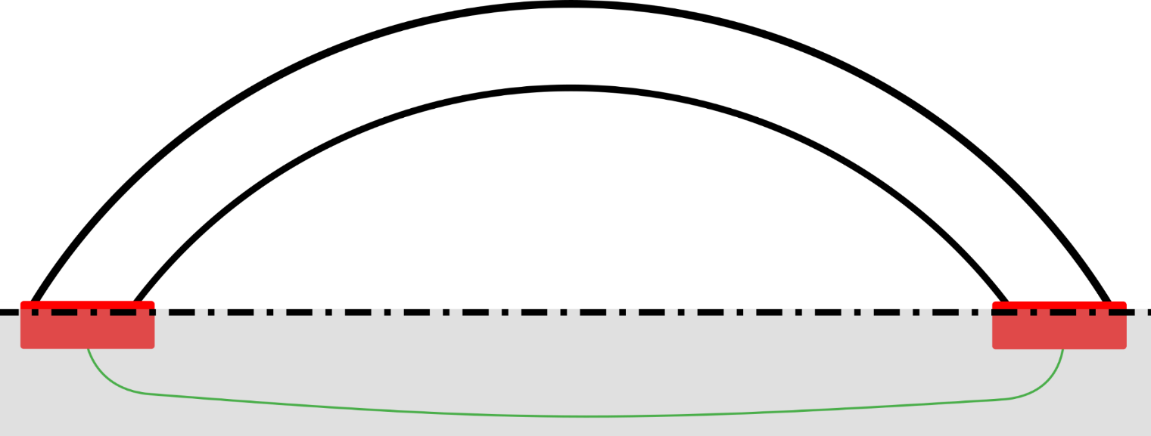
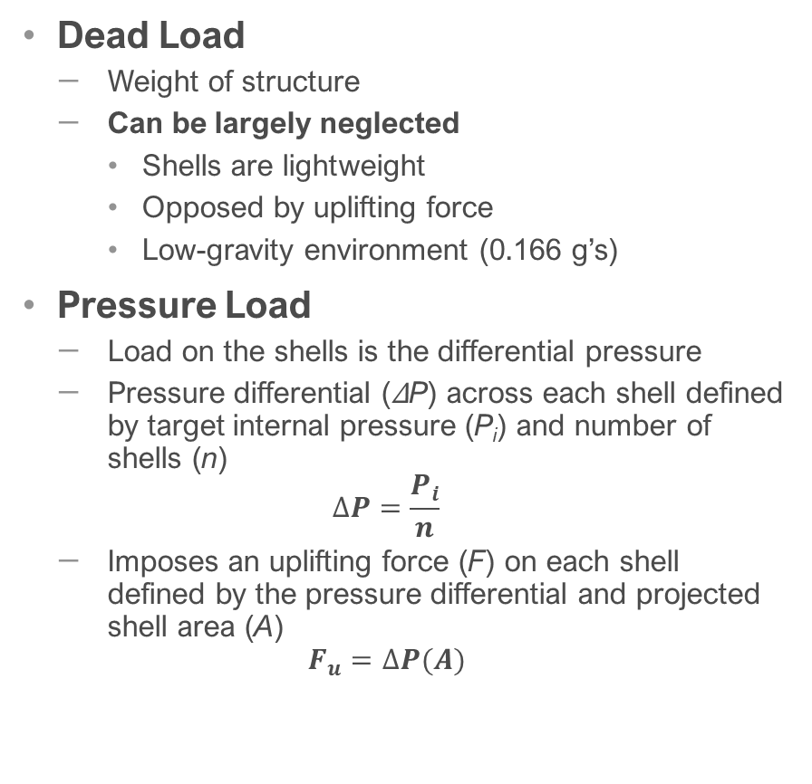



Structural Loads
Dead Load
  Weight of structure
  Can be largely neglected
    Shells are lightweight
    Opposed by uplifting force
    Low-gravity environment (0.166 g’s)
Pressure Load
  Load on the shells is the differential pressure
  Pressure differential (∆P) across each shell defined by target internal pressure (P_{i}) and number of shells (n)
  $$∆P=\frac{P_{i}}{n}$$
  Imposes an uplifting force (F) on each shell defined by the pressure differential and projected shell area (A)
  $$F_{u}=∆P(A)$$
Uplifting Force (F_{u})
$$∆P$$
$$∆P$$
Internal Pressure (P)
$$P_{i}=∆P∗n$$
Reaction Force
Reaction Force
Figure 6. Diagram showing forces acting on the Bubble.
Notes:
Can be largely neglected due to
Lightweight structure comprised of fabric and clamps
Opposed by uplifting force form internal pressure
Low-gravity environment with gravitational acceleration 83.4% lower than Earth’s

Slide 10
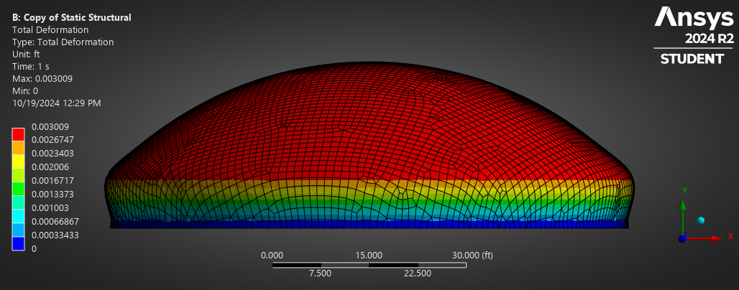
Structural Loads (cont.)
Seismic Load
  Dynamic load, dependent on weight and natural modes of structure
  Lightweight, flexible structure, so seismic load not a big concern
Thermal Cycling
  Extreme temperature range: -274 F° to 135 F°
  Major material fatigue from cyclical shrinking and expansion of materials
  Operational cycle limits on components likely necessary
Complex Stress Distribution
  Due to constraint at the shell base, classical pressure vessel equation are invalid
  Stress state more complex than uniform biaxial tension
  Causes bulging near the shell base
  Finite element analysis necessary to compute stresses
Figure 7. Scaled deformation of single shell Bubble to exhibit bulging from pressure load
Notes:
Can be largely neglected due to
Lightweight structure comprised of fabric and clamps
Opposed by uplifting force form internal pressure
Low-gravity environment with gravitational acceleration 83.4% lower than Earth’s

Slide 11
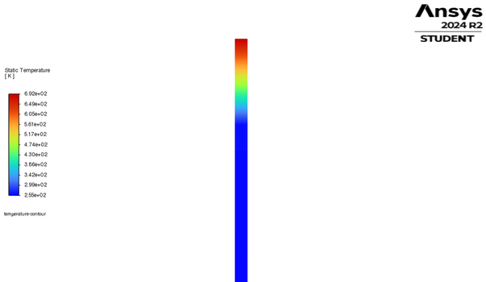
Shell Heating
Thermal Range
  Temperature range of -274 F° to 134.6 F°
  Solar irradiance of 1361 W/m²
Thermal Problems
  Thermal expansion
  Increase in pressure
  May exceed operating conditions of materials
Simulation Conditions
  1D Simulation chosen due to computational limitations
  Time step of 240s over 5000 iterations to simulate a full lunar cycle
  Assume material to be Kevlar
Boundary Conditions
  Constant heat flux applied to outer shell of The Bubble
  Constant surface temperature applied to bottom layers of The Bubble
Results
  Outer layer of shell reaches 785 F°
  Exceeds operation temperatures by 33 F°
  More testing needed
Kevlar Shells
Figure 8. Ansys 1D Heat Transfer Simulation

Slide 12
The Bubbles

Slide 13
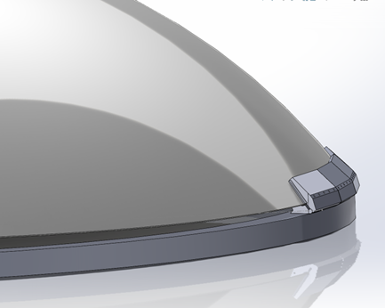
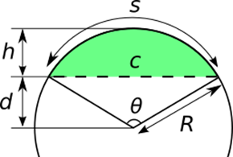
Full Scale Dome Methodology
Concept started using the 80ft diameter and 20ft height. Used partial hemispherical structure for optimal volume.
Reusability is a focus as a production facility.
  Shell (fabric) material is not pierced through each assembly or disassembly.
  No holes in shell reduce stress concentrations.
Modularity of clamp pieces and shell material ensure easy transportation, unloading, and assembly on site.
  Minimal specialized tools required, enhanced serviceability, and long-term maintenance.
Figure 9. Partial Hemisphere geometry [7]
Figure 10. Dome with clamp cutaway
Figure 11. Multi-Shell Design concept

Slide 14
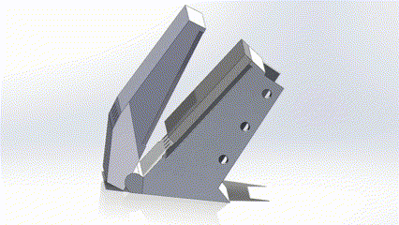
Full Scale Dome Single Shell
Clamp design emphasizes friction and clamping force to hold down shells.
  Simple design to reduce regolith collection issues between assemblies.
  Holds a 32.7 degrees angle to optimize for natural shell shape.
Clamps are bolted together to create the full circular structure, 42 units in total for the 80ft diameter ring.
Current clamping area is ~1,690 square inches per clamp module (~11.7 square ft).
  70,980 sq in or 493 sq ft in total.
Weight of each clamp, assuming Al 6061, in a lunar environment is a combined 600 lbs.
Figure 12. Dome with clamp cutaway
Figure 13. Clamping mechanism

Slide 15
Full Scale Dome Multi-Shell
Between each shell exists an air gap of slightly reduced pressure but increased diameter of the dome by small amounts.
  Gaps between shells are primarily dictated by clamp base footprint.
Using 5 shells with a ΔP of 0.2 atm (2.94 psi) to create 1 atm (14.7 psia) on the interior, 2.58 million lbf of uplifting force per shell is created.
Layering reduces stress significantly and helps manage and disperse stress through clamp systems.
Figure 14. Dome with clamp cutaway
Figure 15. Multi-Shell Design concept

Slide 16
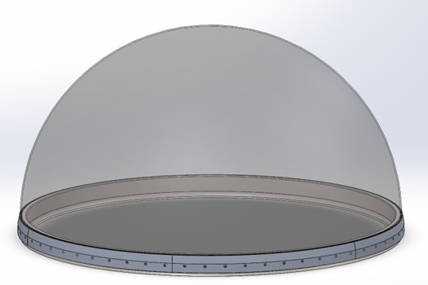
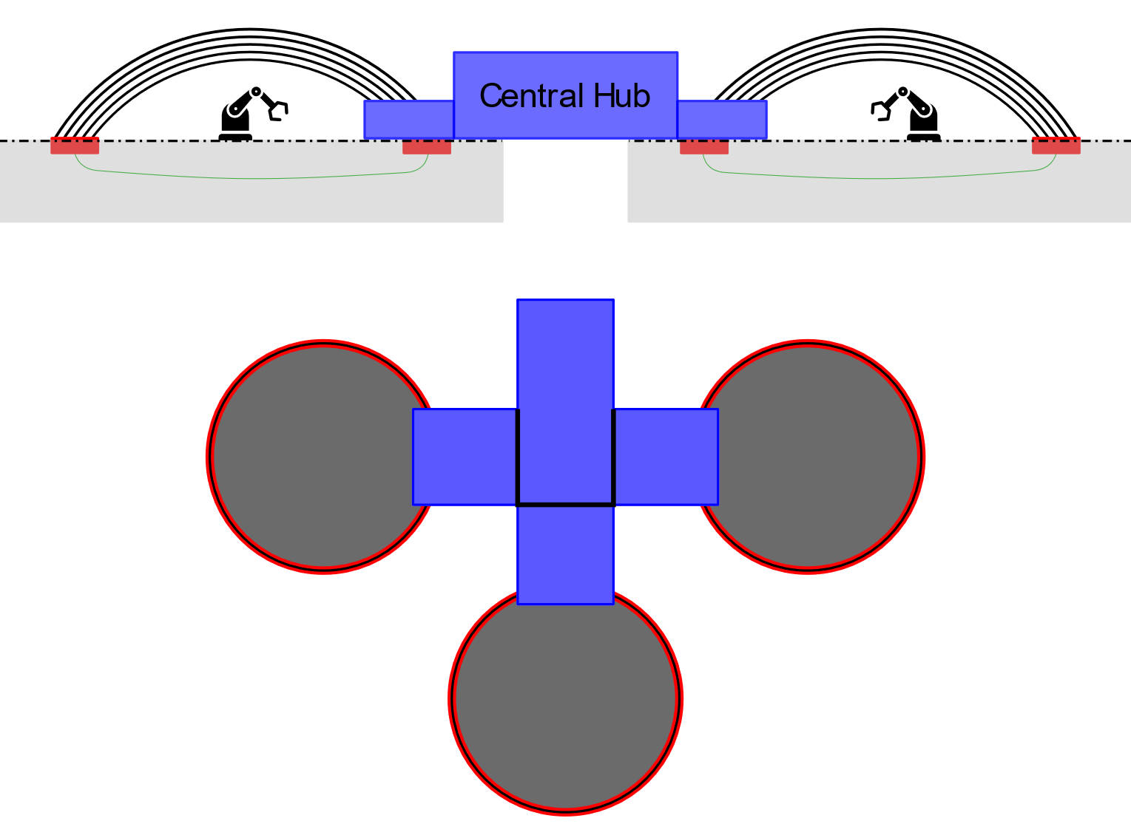
Small-Scale Dome Methodology
Smaller scale pressurized dome of about 26ft diameter.
  Determined from SpaceX Human Landing System (HLS) Starship as selected by NASA for other lunar missions.
  Maximum diameter of Starship cargo bay ~26ft or 9m
Solid ring construction to minimize emergent airgaps due to thermal cycling.
Hemispherical shape to optimize height.
Ideal for subscale printing of infrastructure materials and could be improved by linking with other domes to create a manufacturing facility with different goals to larger dome.
  The same dome concept can take advantage of other MMPACT technologies, such as small-scale concrete printers or molds.
Figure 16. Clamp segments
Figure 17. Small scale dome habitation concept

Slide 17
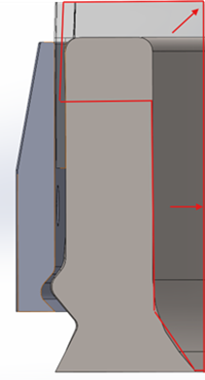
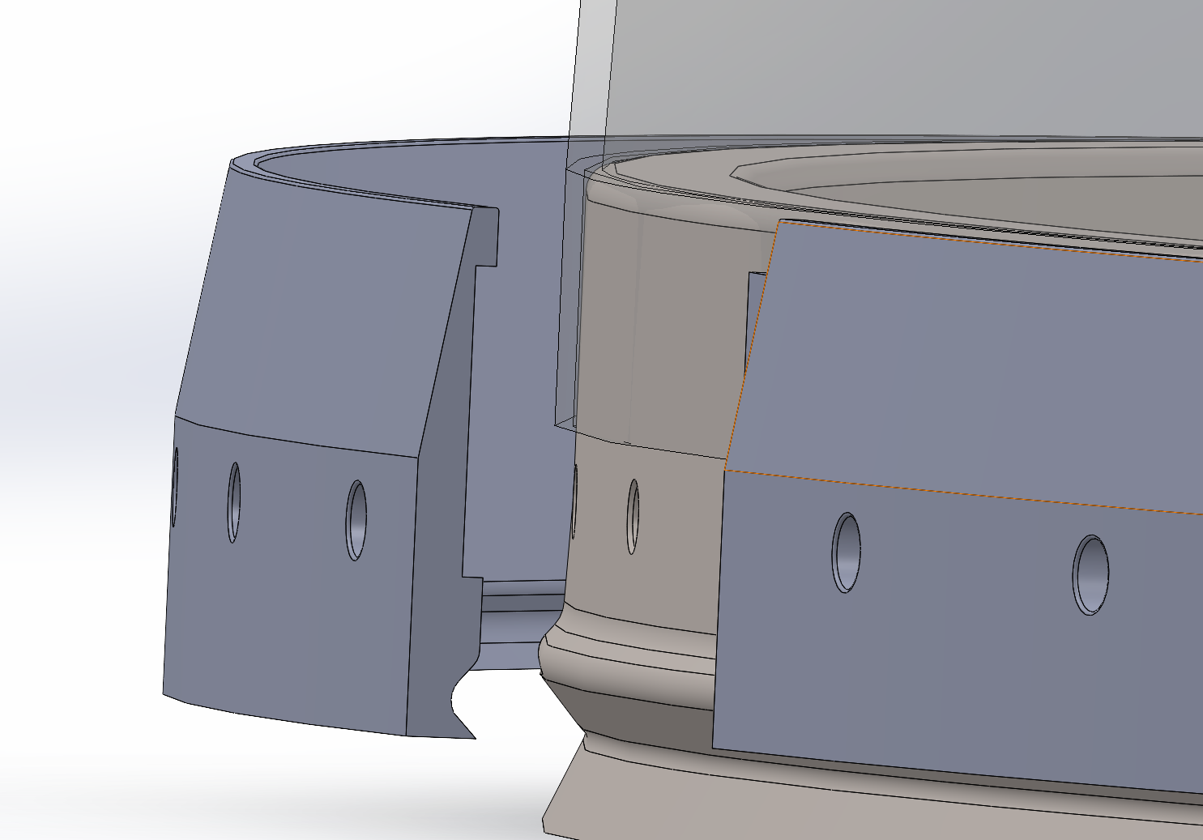
Small-Scale Dome
Reduced scale allows for less shells as the materials can handle more load.
  Greater factor of safety available with likely human proximity.
Using 3 shells of ΔP of about 0.33 atm (4.85 psia) difference and 1 atm (14.7 psia) internally, produces uplifting forces of ~424,200lbs per shell.
Clamp height of 18" with total width of 7.6"
  Total clamping area of 23,160 sq in or 160.9 sq ft.
Lunar weight of the overall ring and included clamps 610lbs per layer, assuming the same Al 6061 alloy.
Figure 18. Small Clamp profile
Figure 19. Clamp segments

Slide 18
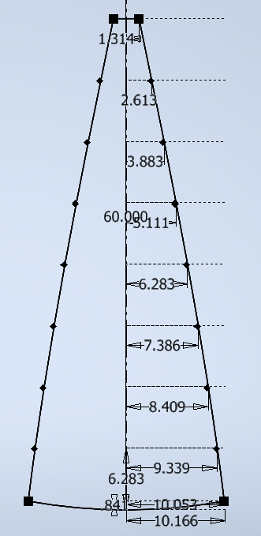
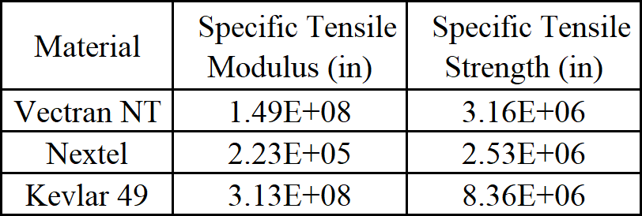
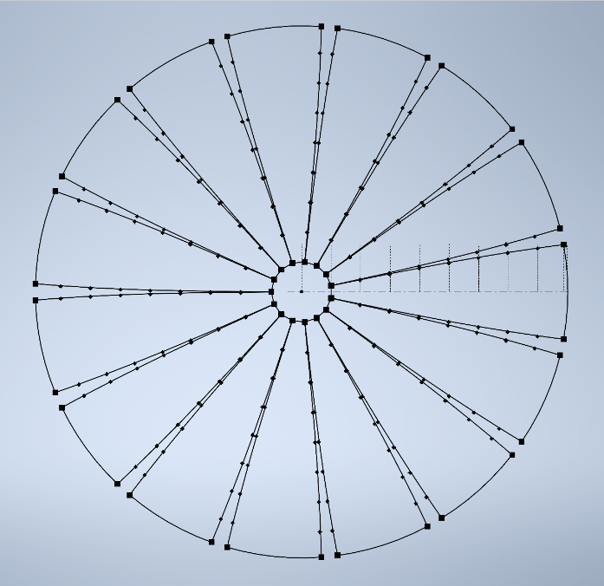
Shell
Table 1. Material Strength Comparison
Material Requirements
  Sufficient strength to withstand pressure load
  Protection from micrometeorites
  Resistance to solar radiation
  Abrasion resistance from lunar regolith dust
Material Candidates
  Vectran NT
  Nextel
  Kevlar 49
Kevlar 49 is leading candidate due to superior specific modulus and specific strength as well as great abrasive protection [4] and ballistic protection
Kevlar has radiation shielding comparable to Polyethelyne [5]
Shell Design
  Multi-leaf dome design with 80 ft inner shell diameter and 20 ft inner shell height
Figure 20. 15 leaf shell design (top down 2D view)
Figure 21. Diagram of a shell leaf
Notes:
Polyethelyne is used on the ISS for Radiation protection

Slide 19
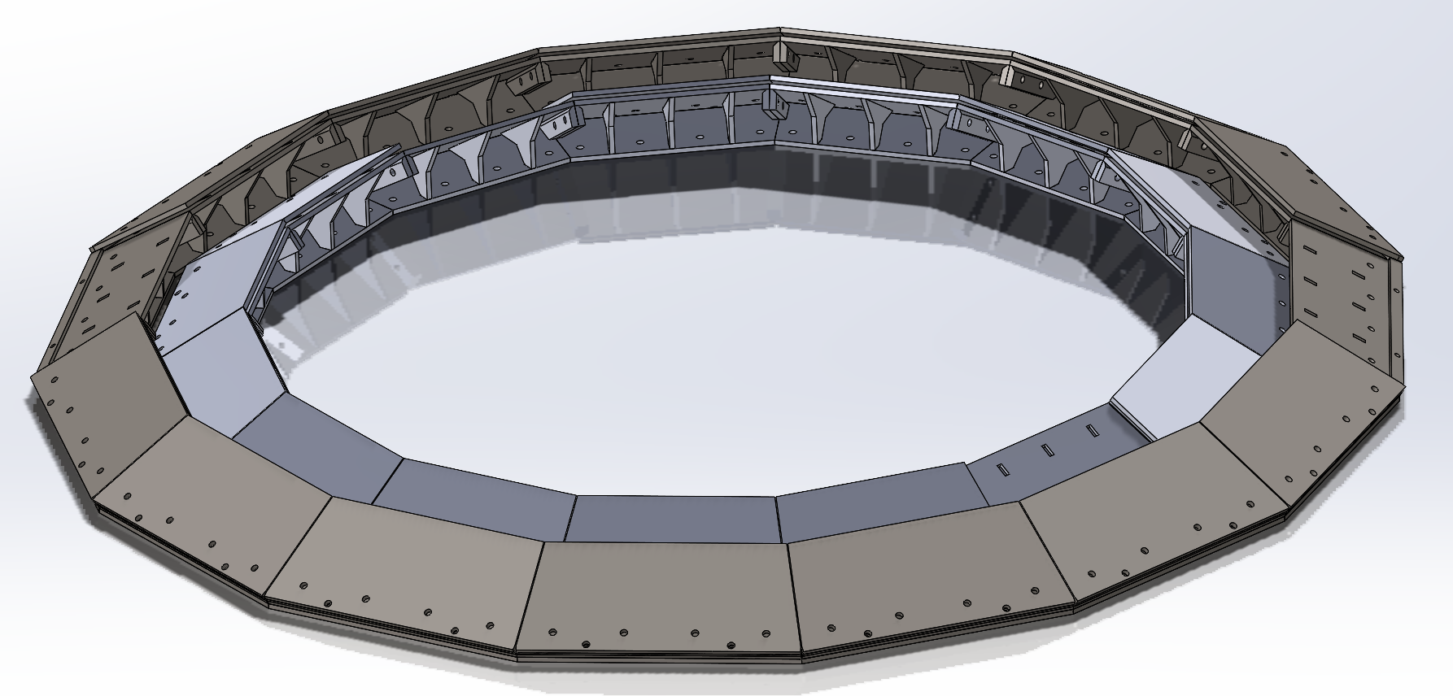
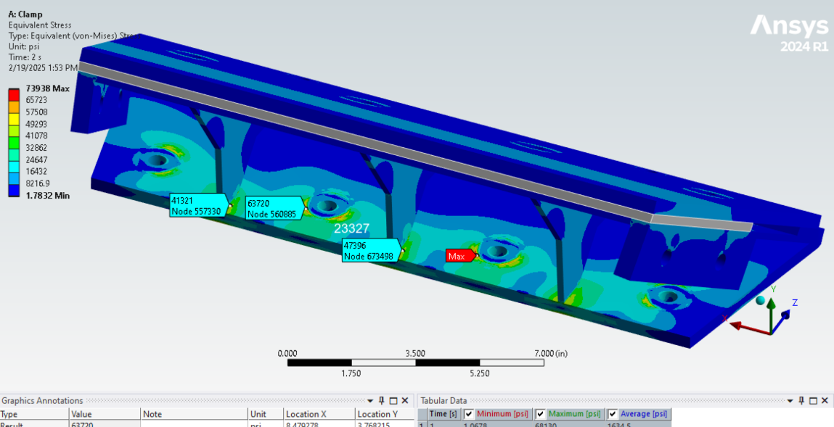
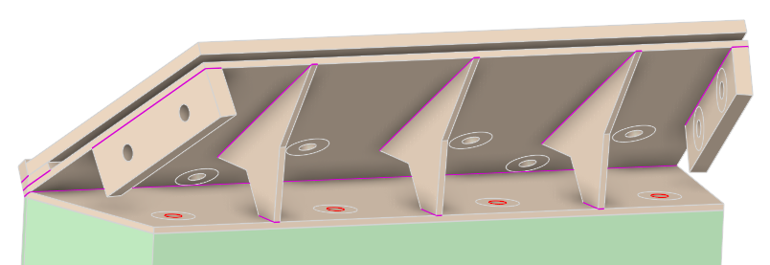
Current Work
8-ft Prototype
  1/10 Scale of 80-ft model
  2 Shells
  Designed for easy manufacturing
    Only uses plate steel
  Unable to continue due to financial issues with manufacturing the structure
Figure 22. 2-Shell Assembled Model
Figure 24. View of a Single Clamp
Figure 23. Stress Analysis on a Single Clamp

Slide 20
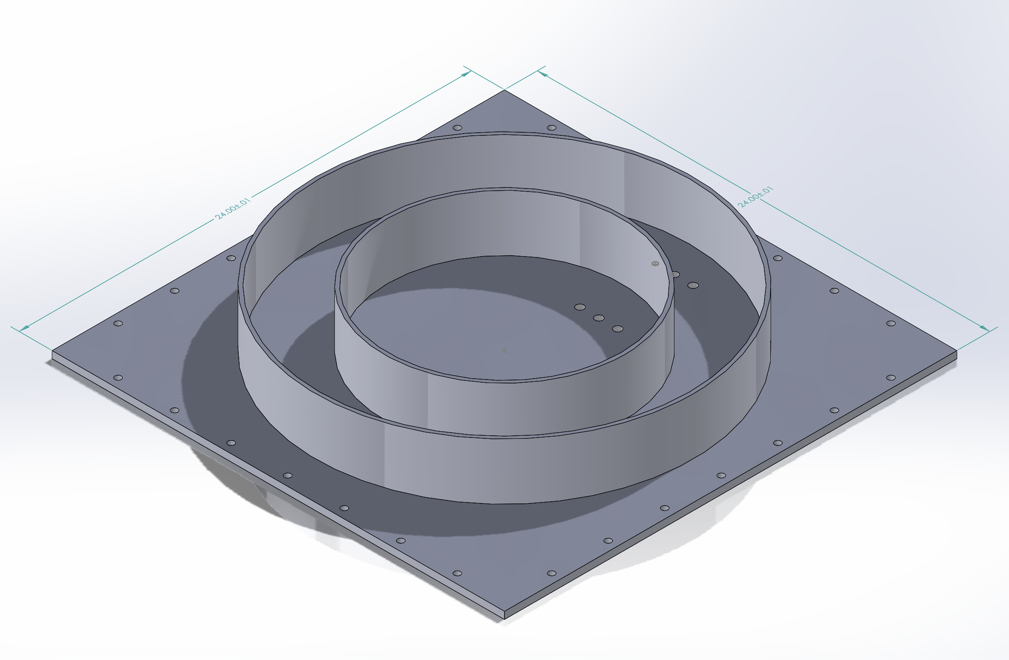
Current Work
2-ft Prototype
  Designed to test the multi-layer design
  Not focused on the clamp design to simplify production
  2-Shell design
  Currently being manufactured
  Easily reproduced
Acquiring shell material samples for 2-ft prototype and individual testing such as
  Abrasion
  Impact testing
  Tensile testing with stitches
Figure 25. 2-ft Test Model Rendering

Slide 21
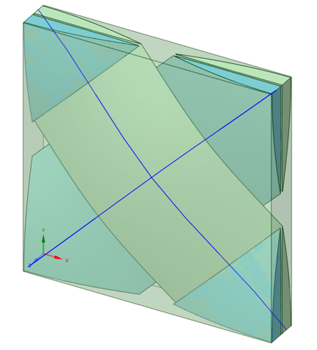
Future Work
Revisit the 8-ft model
Test and document material failure from pressurization and environmental effects
  Test fabrics to develop an effective model for FEA analysis of shell
Develop concepts for the foundation of the structure on the Moon
Figure 27. Representative Volume Element (RVE) of a woven composite created in Ansys Material Designer (MD).
Figure 26. 2-Shell Assembled Model

Slide 22
Acknowledgements
The UTSI Senior Design team would like to thank Dr. Trevor Moeller of the University of Tennessee Space Institute, Michael Fiske of Amentum Space Exploration Group, and Jack Stickley of the University of Tennessee Space Institute for their help and supervision over our capstone project.

Slide 23
References
R. G. Clinton, Jr., PhD, et al. NASA’s Moon-to-Mars Planetary Autonomous Construction Technology Project. NASA 20220013715. Sep 2022.
Pokorný, P., Janches, D., Sarantos, M., Szalay, J. R., Horányi, M., Nesvorný, D., & Kuchner, M. J. (2019). Meteoroids at the Moon: Orbital properties, surface vaporization, and impact ejecta production. Journal of Geophysical Research: Planets, 124, 752–778. https://doi.org/10.1029/2018JE005912
Nakamura, Y., Latham, G. v., & Dorman, H. J. (1982). Apollo lunar seismic experiment - final summary. Journal of Geophysical Research, 87(Supplement). https://doi.org/10.1029/jb087is01p0a117\
Williams, J.-P., Greenhagen, B. T., Paige, D. A., Schorghofer, N., Sefton-Nash, E., Hayne, P. O., et al. (2019). Seasonal polar temperatures on the Moon. Journal of Geophysical Research: Planets, 124, 2505–2521. https://doi.org/10.1029/2019JE006028Andino, A. F., Silva, D., Ortiz, N., Alvarez, O., Colon, J. A., Colon, M., Gonzalez, I. C. (1992). First Lunar Outpost. USRA Advanced Design Program, Proceedings of the 8th Annual Summer Conference: (pp. 237-249). NASA.
G. A. Smithers. A One-Piece Lunar Regolith Bag Garage Prototype. NASA/TM-2007-215073. Sep 2007.
Narici, L., Casolino, M., Di Fino, L. et al. Performances of Kevlar and Polyethylene as radiation shielding on-board the International Space Station in high latitude radiation environment. Sci Rep 7, 1644 (2017). https://doi.org/10.1038/s41598-017-01707-2
“Circular segment,” Wikipedia Available: https://en.wikipedia.org/wiki/Circular_segment#.

Slide 24
Questions?

Slide 25
Back Matter

Slide 26
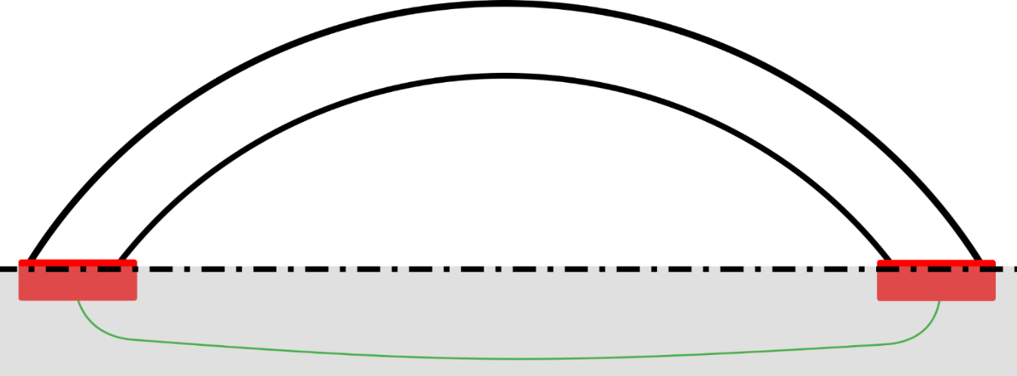
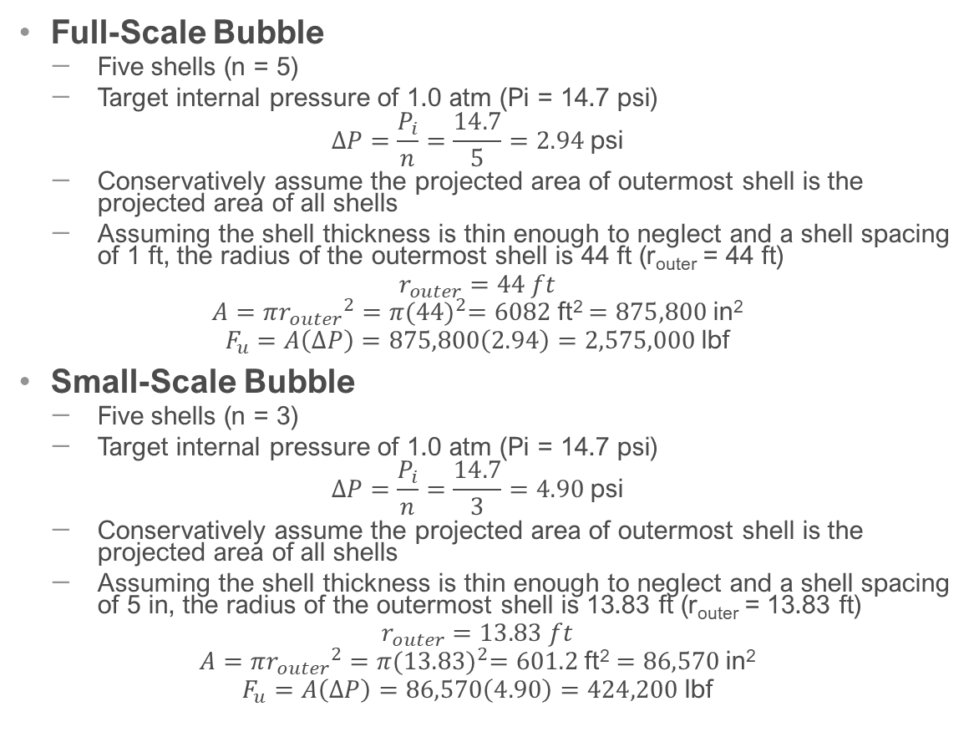

Uplifting Force Calculation
Full-Scale Bubble
  Five shells (n = 5)
  Target internal pressure of 1.0 atm (Pi = 14.7 psi)
  $$∆P=\frac{P_{i}}{n}=\frac{14.7}{5}=2.94 \text{psi}$$
  Conservatively assume the projected area of outermost shell is the projected area of all shells
  Assuming the shell thickness is thin enough to neglect and a shell spacing of 1 ft, the radius of the outermost shell is 44 ft (r_{outer} = 44 ft)
  $$r_{outer}=44 ft$$
  $$A=π{r_{outer}}^{2}=π{(44)}^{2}=6082 \text{ft}\text{2}=875,800 \text{in}\text{2}$$
  $$F_{u}=A\left(∆P\right)=875,800\left(2.94\right)=2,575,000 \text{lbf}$$
Small-Scale Bubble
  Five shells (n = 3)
  Target internal pressure of 1.0 atm (Pi = 14.7 psi)
  $$∆P=\frac{P_{i}}{n}=\frac{14.7}{3}=4.90 \text{psi}$$
  Conservatively assume the projected area of outermost shell is the projected area of all shells
  Assuming the shell thickness is thin enough to neglect and a shell spacing of 5 in, the radius of the outermost shell is 13.83 ft (r_{outer} = 13.83 ft)
  $$r_{outer}=13.83 ft$$
  $$A=π{r_{outer}}^{2}=π{(13.83)}^{2}=601.2 \text{ft}\text{2}=86,570 \text{in}\text{2}$$
  $$F_{u}=A\left(∆P\right)=86,570\left(4.90\right)=424,200 \text{lbf}$$
Uplifting Force (F_{u})
$$∆P$$
$$∆P$$
Internal Pressure (P)
$$P_{i}=∆P∗n$$
Reaction Force
Reaction Force
Figure 6. Diagram showing forces acting on the Bubble.
Notes:
Can be largely neglected due to
Lightweight structure comprised of fabric and clamps
Opposed by uplifting force form internal pressure
Low-gravity environment with gravitational acceleration 83.4% lower than Earth’s

Slide 27
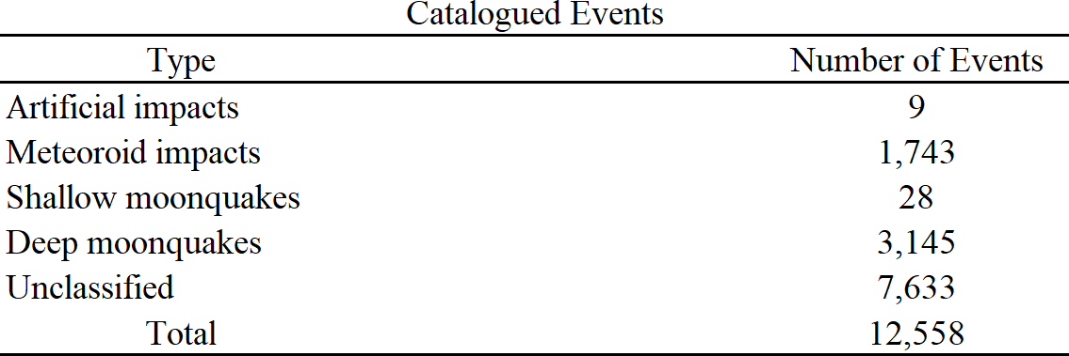
Moonquakes!
Seismics data collected during Apollo missions [1]
Four stations only setup near landing sites
Various Sources
  Deep Moonquakes
  Thermal Moonquakes
  Shallow Moonquakes
Schematic diagram of lunar interior from and table of catalogued seismic events from Nakamura et al. [1]
Notes:
Deep Moonquakes
Most abundant type
Small in magnitude
Occurrence has strong correlation to tides raised by Earth and Sun
Thermal Moonquakes
Small disturbances caused by temperature variations around Moon’s surface
Shallow Moonquakes
Most critical seismic disturbance
Strongest variety
Likely caused by Moon shrinking over time from interior cooling
Can last hours whereas earthquakes dampen out in minutes
Prolonged duration make them a critical consideration for permanent lunar habitats

Slide 28
Notes:
Deep Moonquakes
Most abundant type
Small in magnitude
Occurrence has strong correlation to tides raised by Earth and Sun
Thermal Moonquakes
Small disturbances caused by temperature variations around Moon’s surface
Shallow Moonquakes
Most critical seismic disturbance
Strongest variety
Likely caused by Moon shrinking over time from interior cooling
Can last hours whereas earthquakes dampen out in minutes
Prolonged duration make them a critical consideration for permanent lunar habitats

