Slide 1
Feasibility Study of a Motion Capture Based, Moveable Three-Dimensional Digital Image Correlation System
Andrew Walters, Grant Custer, Elise Roberson, Nathan Snyder

Slide 2
TABLE OF CONTENTS
MEET THE TEAM
INTRODUCTION
EXPERIMENTAL SET-UP
DATA ANALYSIS
DATA COMPARISON
ERROR SOURCES
FUTURE IMPROVEMENT

Slide 3

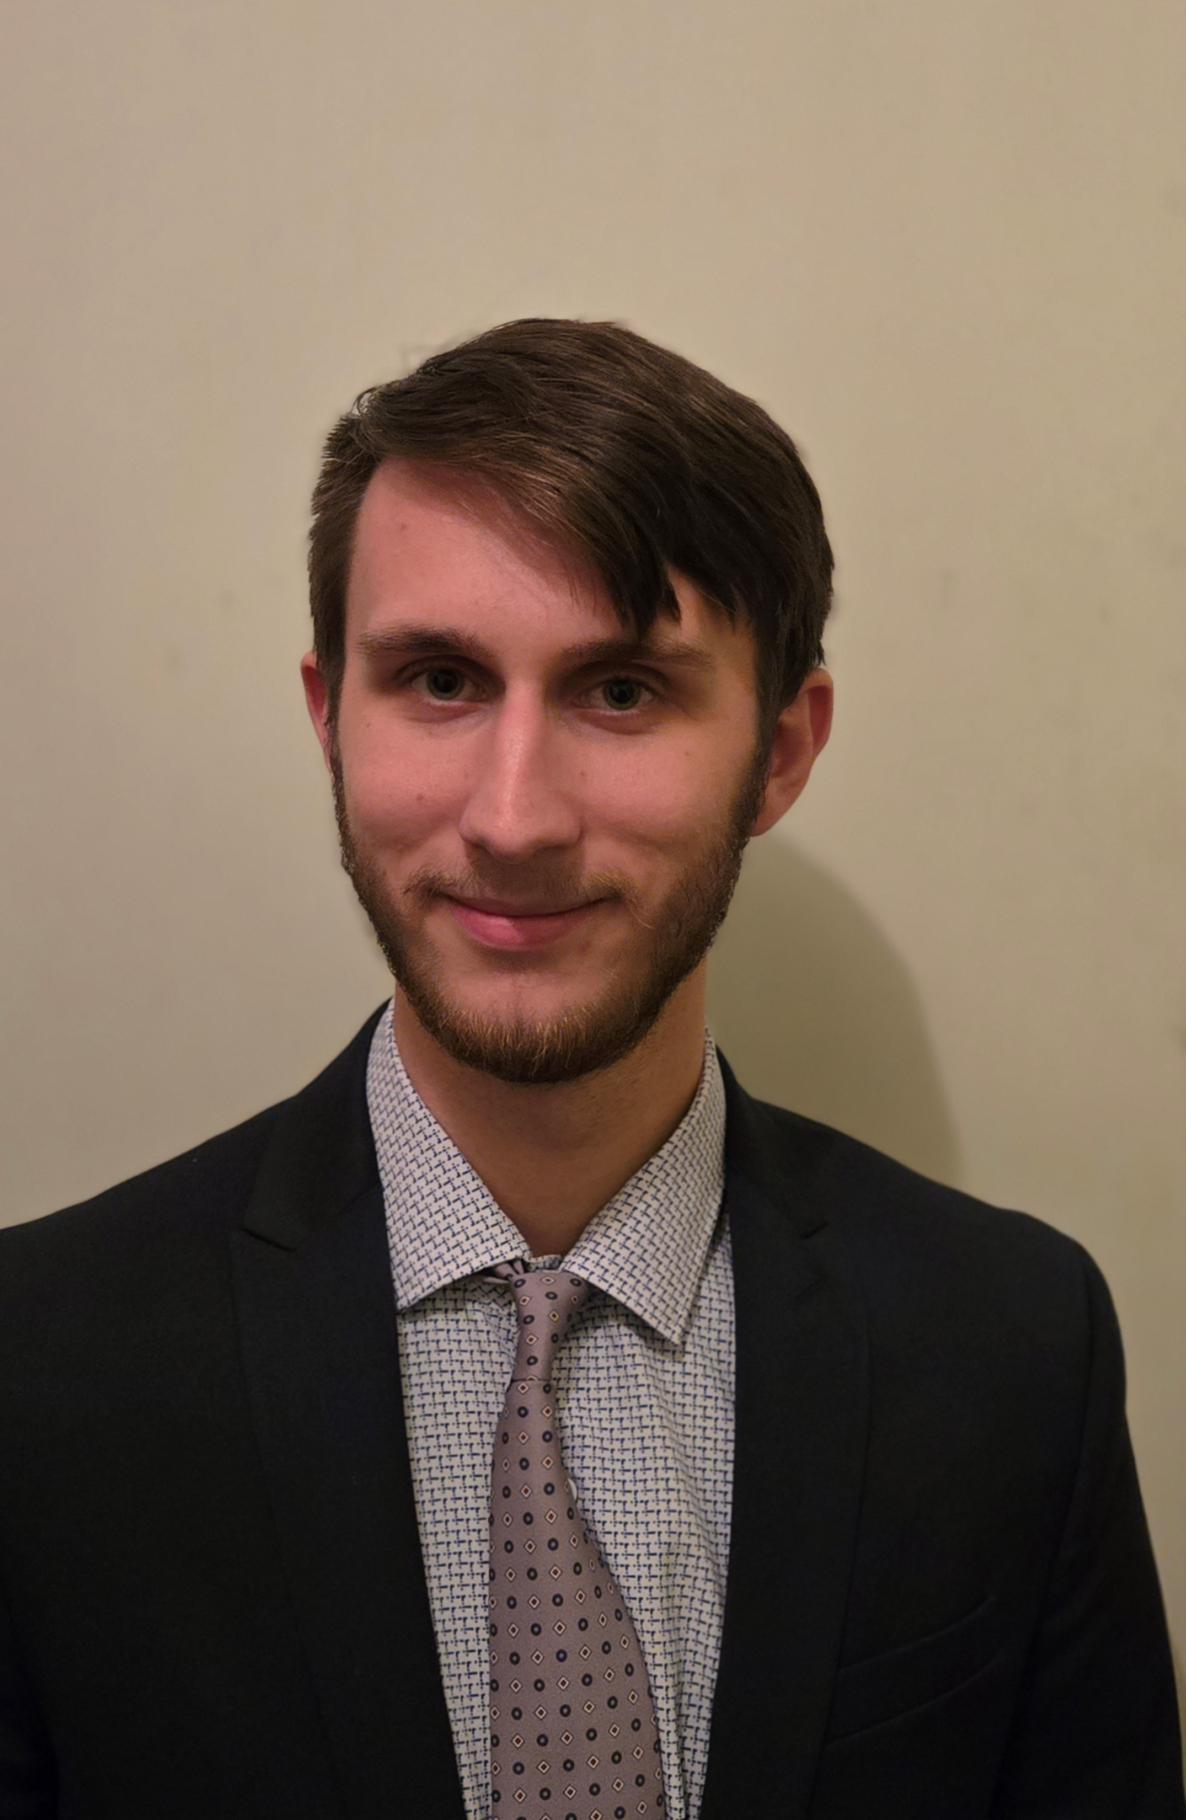
I. MEET THE TEAM
Andrew Walters
Aerospace Engineering Senior at Mississippi State University.
My experience is in composite structures and structural analysis using DIC systems.
Nathan Snyder
Aerospace Engineer Senior at Mississippi State University
My experience is in thermodynamic analytics and research. I previously worked for Lockheed Martin on cryogenic system design.

Slide 4
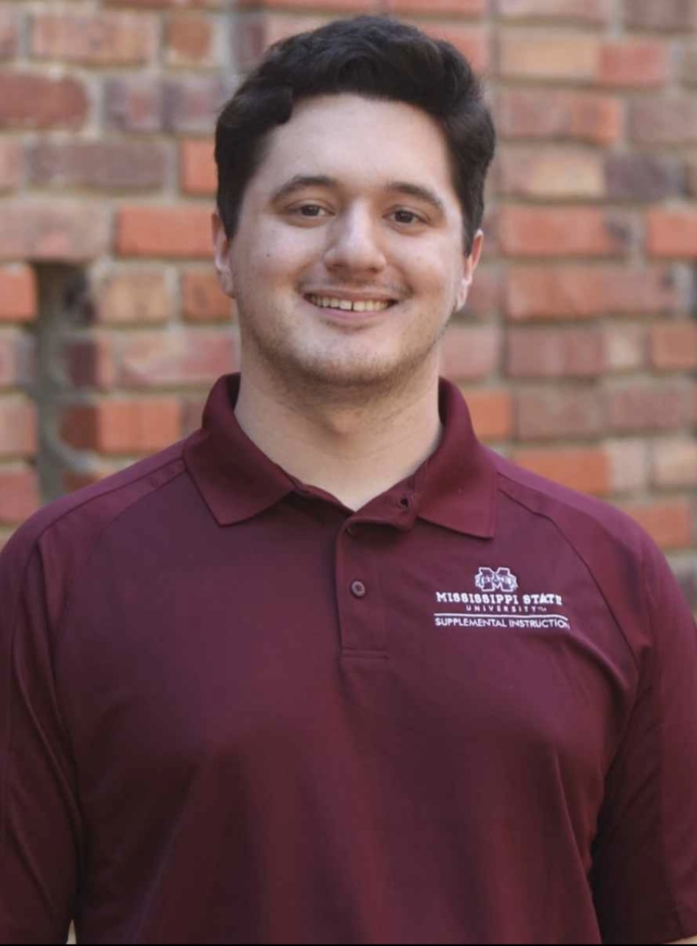
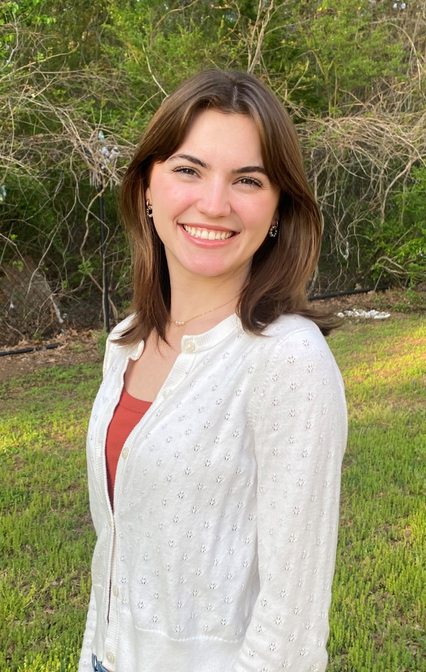
I. MEET THE TEAM
Grant Custer
Aerospace Engineer Senior at Mississippi State University
My experience is in coding
Elise Roberson
Aerospace Engineering senior at Mississippi State University
My experience is in composite structures

Slide 5
II. INTRODUCTION
3-D DIC is limited by needs for regular recalibration and extensive post processing
Proposed dual camera mount (DCM) system reduces calibration errors by forcing cameras to move dependently
Post processing is done through MATLAB to reduce time

Slide 6
EQUIPMENT
III. EXPERIMENTAL SET-UP
Optitrack Motion Capture System (12-camera array from ASRL, Raspet Lab)
Canon EOS M6 Mark II Cameras (2 units)
Carbon Fiber Test Specimens
Test Specimen Deformation Frame
Camera Tripod
Dual Camera Mount (DCM)
Calibration Board for VIC 3-D
Notes:
The experimental setup relies on a suite of specialized equipment. The Optitrack system was used to track camera orientation and position during initial testing. High-resolution Canon cameras captured detailed images, and carbon fiber specimens were selected due to their predictable deformation characteristics. Stability during imaging was provided by a rigid tripod and the Dual Camera Mounting system. Calibration was achieved through a precision calibration board compatible with VIC 3-D software.

Slide 7
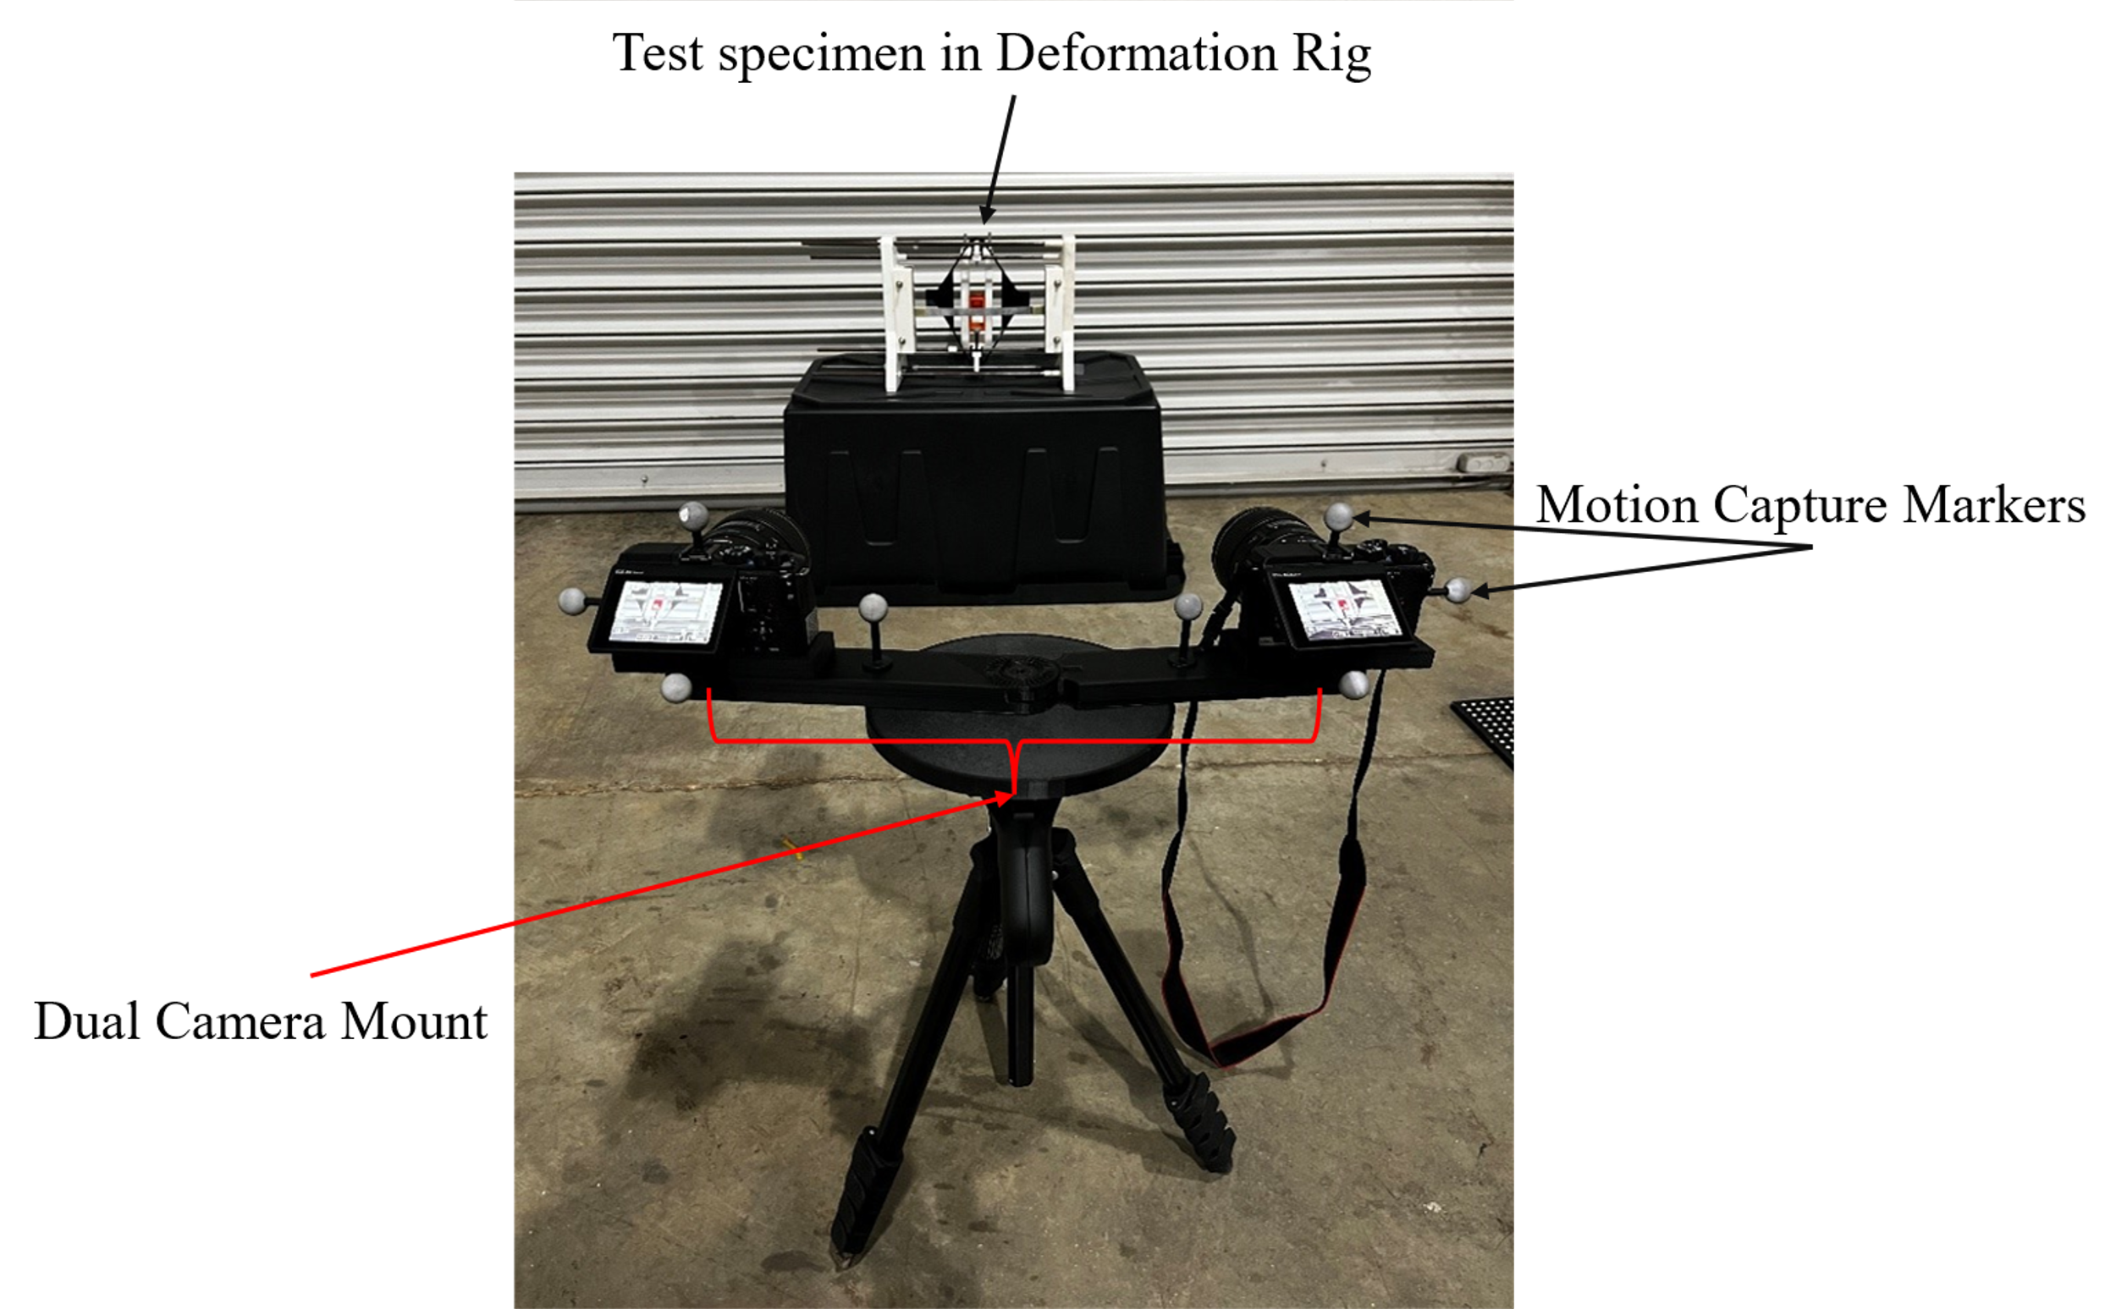
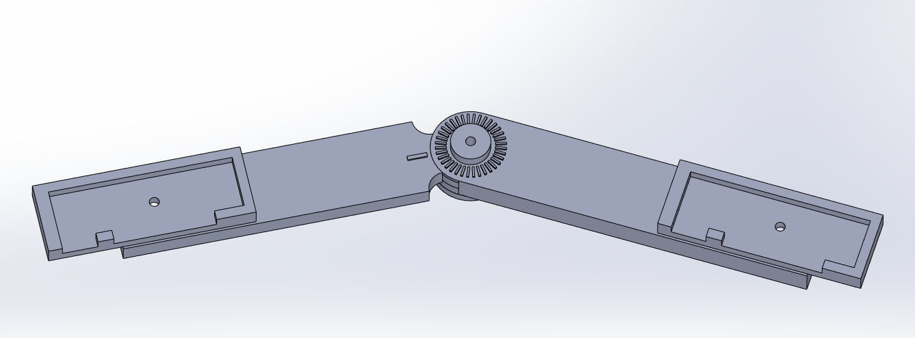
DUAL CAMERA MOUNT
III. EXPERIMENTAL SET-UP
Dual Camera Mount 3D model
Notes:
Even slight vibrations can cause image blur, which leads to major inaccuracies in DIC. We solved this with a sturdy tripod and the DCM system. The DCM ensures both cameras stay aligned and fixed throughout the deformation process, maintaining consistent imaging geometry.

Slide 8
MOTION CAPTURE
III. EXPERIMENTAL SET-UP
Initial calibration with Optitrack system
Reflective markers on cameras tracked in real time
Provided spatial orientation of cameras
Established accurate pointing angles and positions
Notes:
Initially, we relied heavily on the motion capture system. Markers were placed on each camera, and their 3D coordinates were tracked as the cameras were oriented toward the specimen. This helped define camera geometry before the DCM was developed.

Slide 9
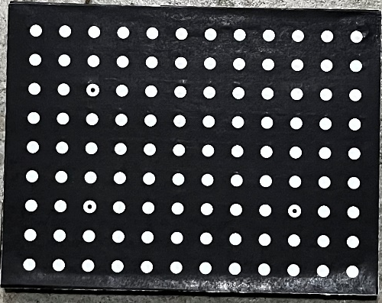
VIC 3-D CALIBRATION
III. EXPERIMENTAL SET-UP
VIC 3-D calculates:
  Baseline distance between cameras
  Convergence angle
  Field of view
  Camera orientation
  Focal length
Notes:
VIC 3-D cannot process images without prior calibration. Using a flat panel with a dot grid, we captured synchronized images from both cameras at multiple angles and positions. These images allow VIC 3-D to understand how the two views relate spatially and geometrically.

Slide 10
SET-UP EVOLUTION
III. EXPERIMENTAL SET-UP
Original setup:
• Two separate tripods
• Required constant recalibration
• Relied heavily on motion capture data
Improved setup:
• Dual Camera Mount (DCM)
• Single tripod system
• Simplified positioning and alignment
Notes:
Initially, using separate tripods made consistent camera geometry difficult. Small changes in angle or distance meant constant recalibration. The DCM evolved from this problem—it holds both cameras on a single adjustable rig, ensuring repeatability and stability.

Slide 11
BENEFITS OF DCM
III. EXPERIMENTAL SET-UP
Maintains fixed angle and distance between cameras
Reduces setup time
No recalibration needed when moved around specimen
Allows fixed focal point to rotate around specimen
Accuracy within acceptable margin of VIC 3-D
Notes:
The DCM allowed us to move the cameras without needing to recalibrate. It maintains a fixed baseline and convergence angle, which is crucial for consistent DIC analysis. The results are comparable to VIC 3-D, meaning our low-cost system achieves industry-grade performance.

Slide 12
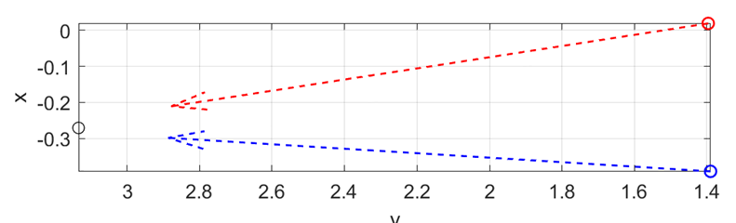
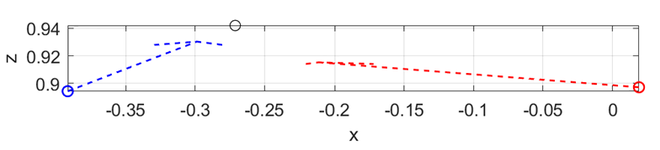
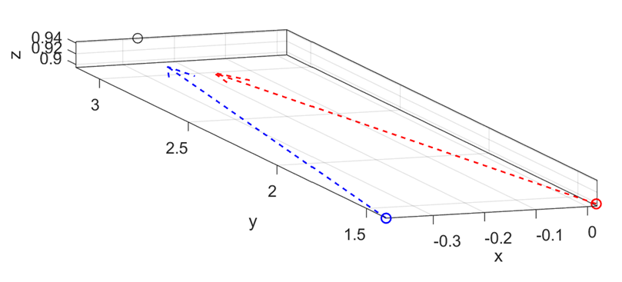
IV. DATA ANALYSIS
Done prior to creating the DCM
Used the motion capture system to generate camera position data
Imported the position data into MATLAB to test camera alignment

Slide 13
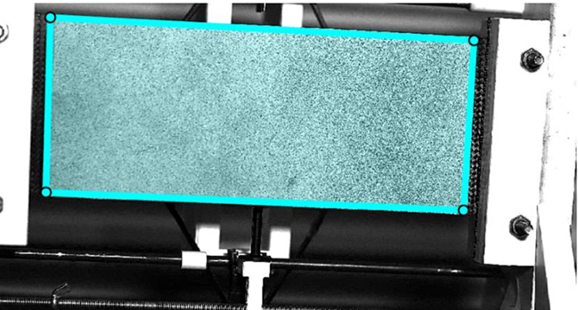
IV. DATA ANALYSIS
Processed the images in MATLAB
ROI selected on the first left image
Data points were overlayed on all the images as the specimen deformed

Slide 14
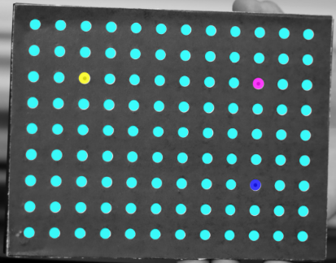
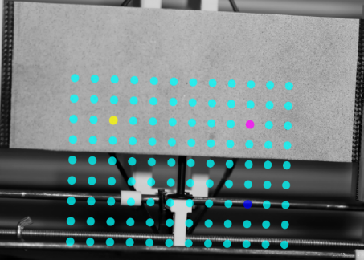
IV. DATA ANALYSIS
Highlighted calibration panel for VIC-3D
Calibration data on specimen

Slide 15
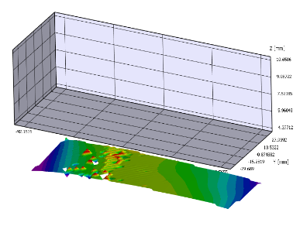
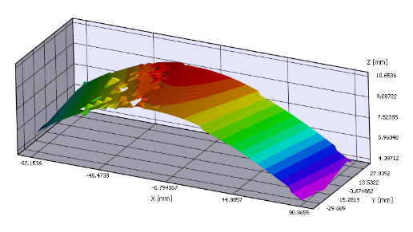
IV. DATA ANALYSIS
Undeformed specimen in VIC 3-D
Fully deformed specimen in VIC 3-D

Slide 16
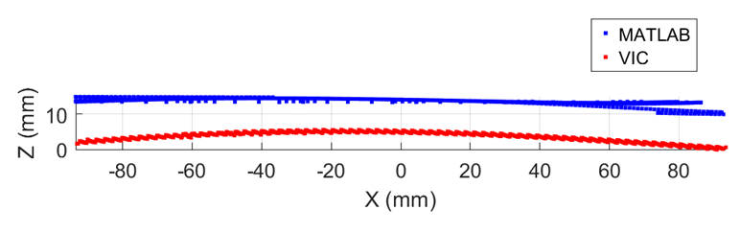
V. DATA COMPARISON
Final deformation compared between MATLAB and VIC
Error: 12.28%

Slide 17
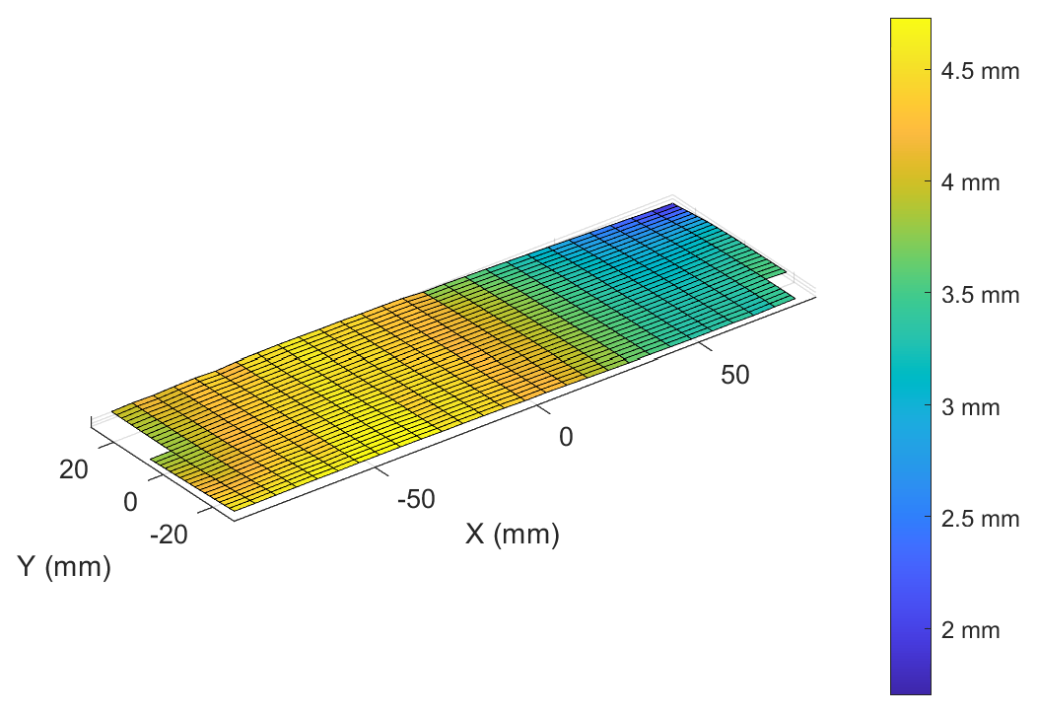
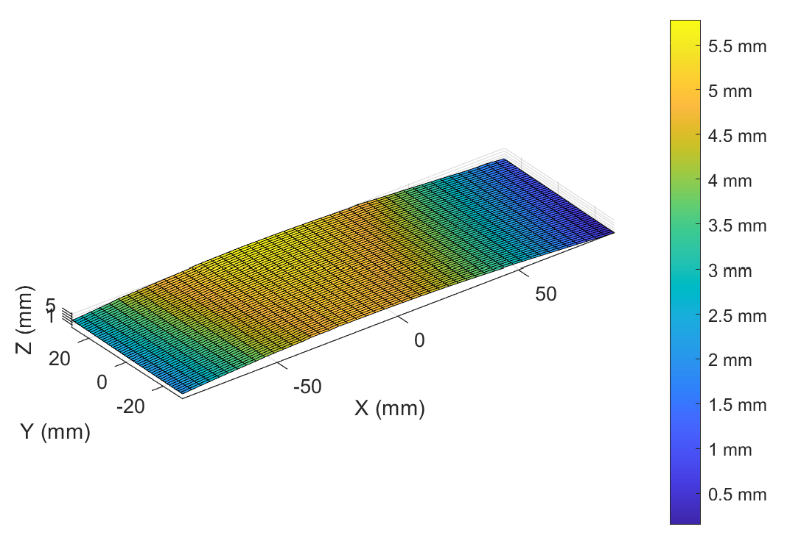
V. DATA COMPARISON
MATLAB:
Max Deformation: 5.0411 mm
VIC:
Max Deformation: 5.747 mm

Slide 18
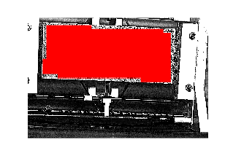
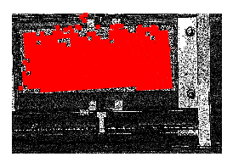
VI. ERROR SOURCES
Generation of points between images
Picture quality

Slide 19
VII. FUTURE IMPROVEMENT
Refining the MATLAB code to better generate points between images
Better pictures
  Quality
  Lighting
  Camera Positioning
Improving the user interface

Slide 20
Questions?

