Slide 1

Additive Manufacturing for the AIAA Design/Build/Fly Competition
Mechanical Engineering Senior Design Team​
University of Memphis​
2025 Region II Student Conference, April 3rd-April 4th, 2025

Slide 2

Motivation
Determine the feasibility of using additive manufactured parts to fabricate a remote-controlled aircraft capable of satisfying the 2025 AIAA Design/Build/Fly competition mission requirements.

Slide 3
Management Summary
Team Structure: 4 Seniors, 2 Faculty Advisors
​
Advisors oversee AIAA club affiliation
Team leader sets and oversees team members' responsibilities and obligations within the project​
Team sets project management style, roles, tasks, and other duties
​
Each member responsible for individual tasks or areas of the project

Slide 4
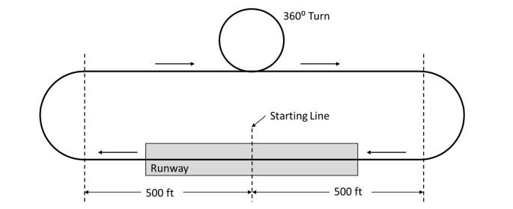
Mission Requirements
3 flight missions, 1 ground mission, and 1 technical inspection
Mothership allowed up to 6’ (72”) wingspan, separate glider with no motor must be able to attach to mothership
Required glider and external weight in the form of "fuel tanks" for some missions
Ground mission: Glider, fuel tanks, electronics must be assembled on mothership in 5 minutes
Mission 1: No payload, 3 laps in 5 minutes (landing not included in time)
Mission 2: Payload and glider attached, 3 laps in 5 minutes (landing not included in time)
Mission 3: Payload attached but empty, glider attached, release glider after first lap, glider must land within 5 minutes of throttling for takeoff at a predetermined location

Slide 5
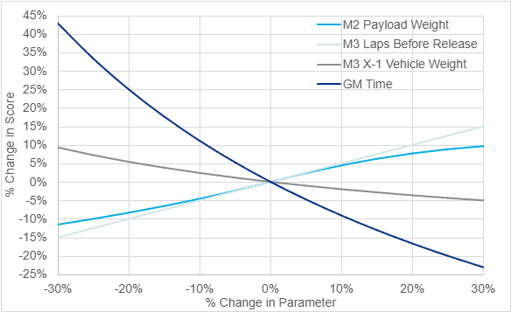
Scoring Sensitivity Analysis
Design Focuses on Payload Weight (M2) , Speed (M3)
Maximizing the amount of 1 lb “fuel tanks” being carried by the aircraft without sacrificing too much speed
Note:
M2 = Mission 2
M3 = Mission 3
GM = Ground Mission

Slide 6
Design and Analysis Methodology
DBF Rulebook requirements and guidelines
Results from Scoring Sensitivity Analysis
Manufacturability
Tool for Analysis: eCalc

Slide 7
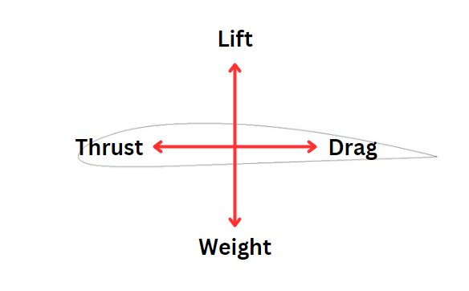
Analysis
Aircraft will primarily be in low angle of attack conditions
Need an airfoil with optimal lift and drag properties at low angles of attack
Need to determine lift, drag, weight, and thrust
Wing area an important consideration, tied to wingspan

Slide 8
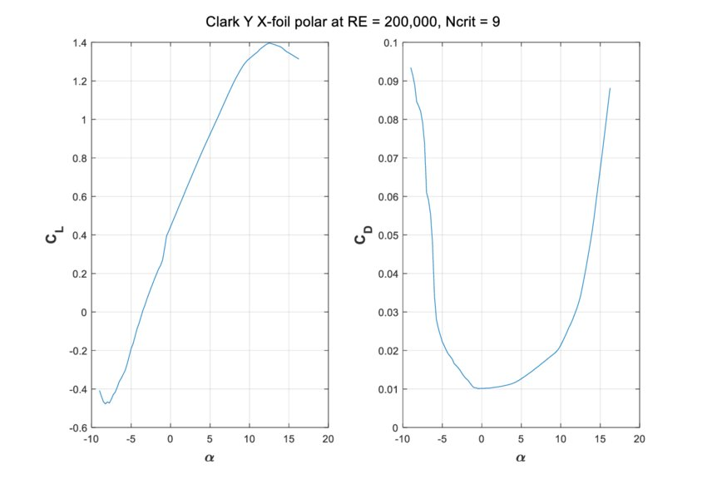
Analysis (Airfoil Selection)
Clark-Y airfoil determined to be the best choice for the application
High coefficient of lift at low angle attack
Low coefficient of drag at low angle of attack

Slide 9
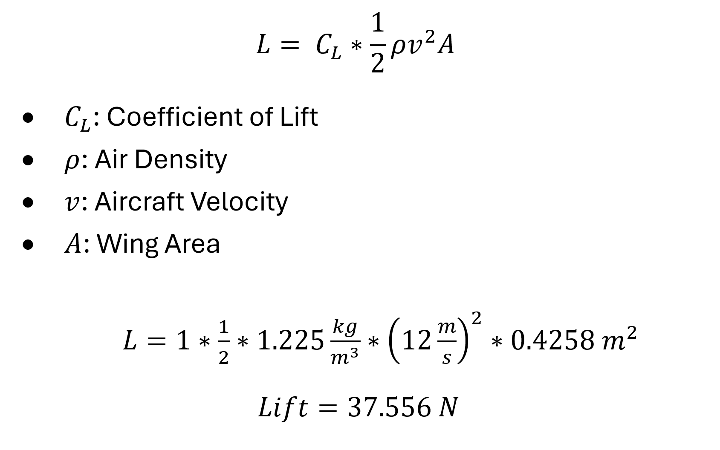
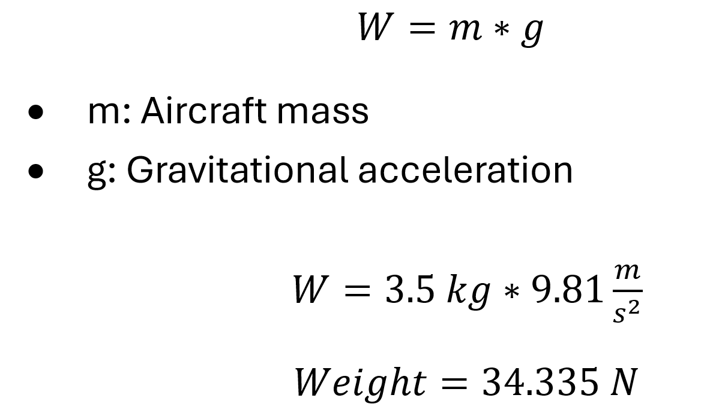
Mothership Analysis (Weight, Lift)
Weight
Lift
Note: Mass of all additional items (glider, tank holders, purchased parts) considered in the weight calculation

Slide 10
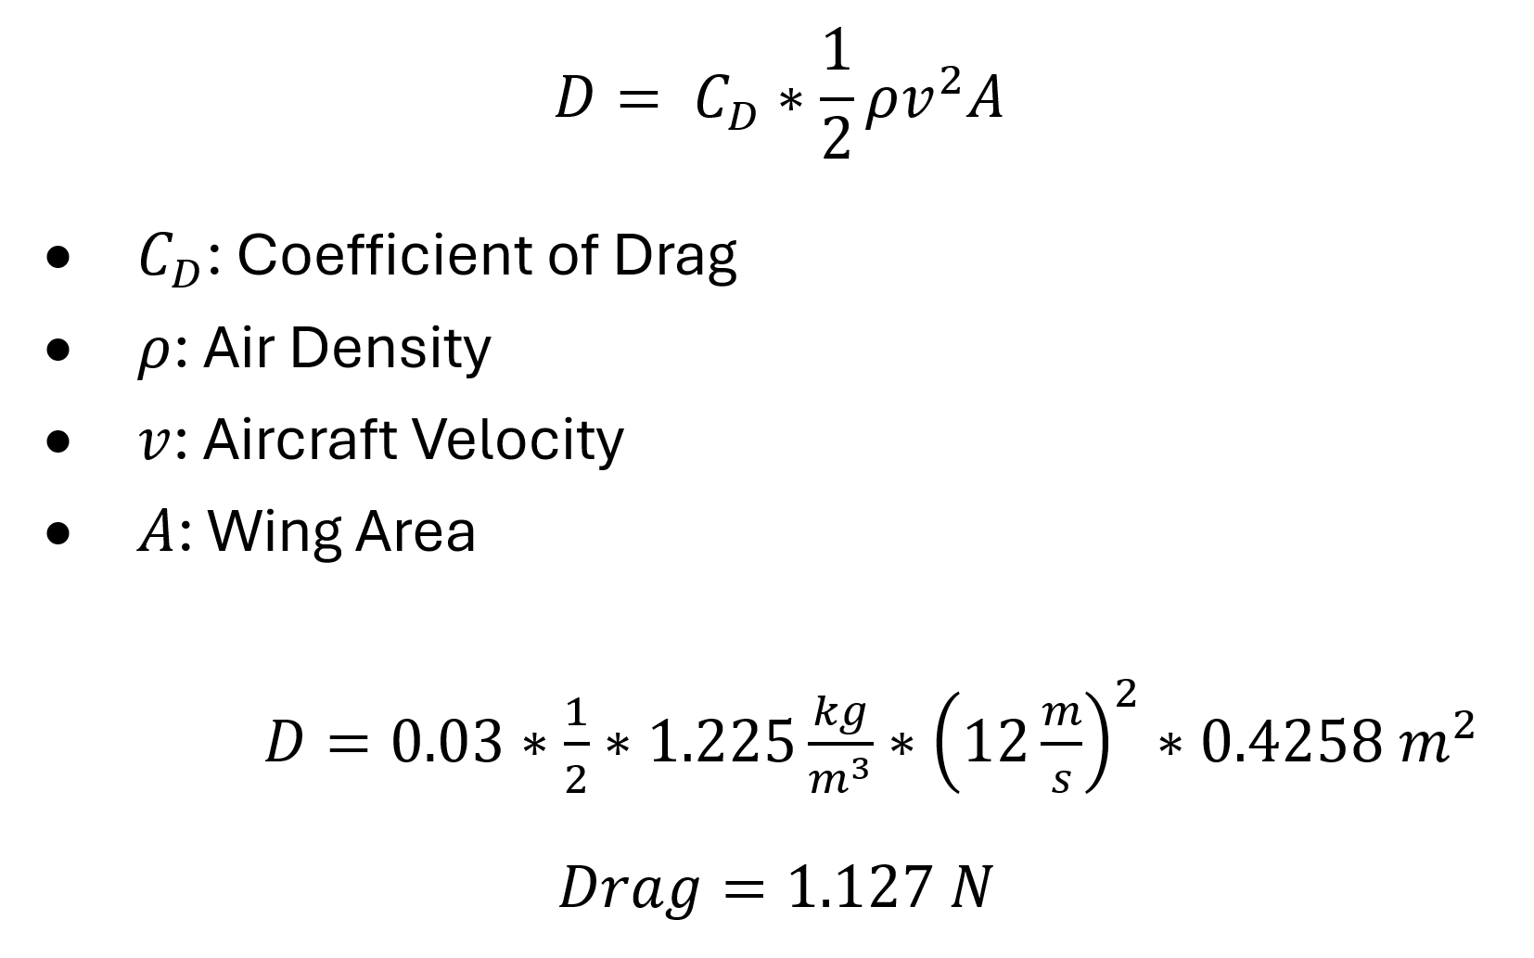
Mothership Analysis (Drag, Thrust)
Drag
Thrust
Thrust Output by motor must exceed Drag value for acceleration and takeoff
Motor consideration involved how much excess thrust it could produce and the extra weight of the motor

Slide 11
Mothership Analysis
eCalc used to determine the stall speed and other important properties of the aircraft (such as flight time, power draw, temp. during operation)
Stall speed determined by the velocity necessary for the lift force to overcome the weight of the plane, this is necessary for takeoff and flight
Simulates flight conditions to give a closer estimation to actual values (lift and drag equations assume ideal conditions)

Slide 12
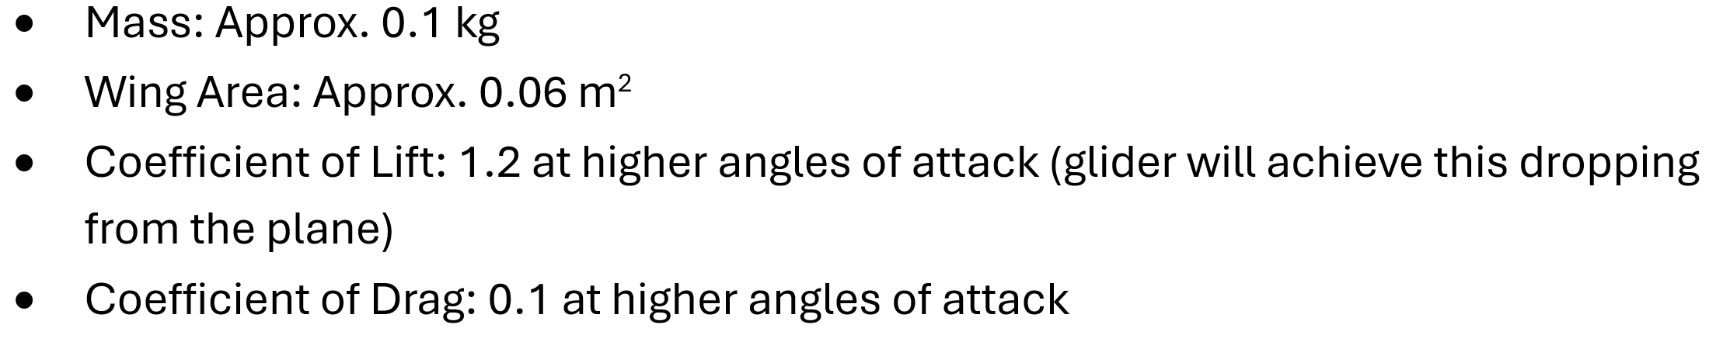
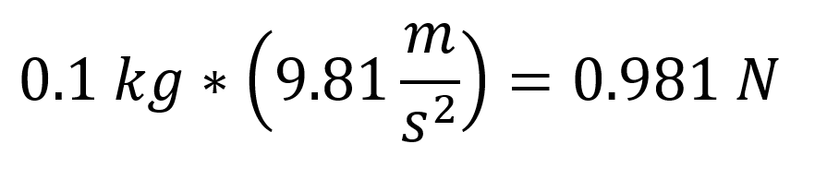
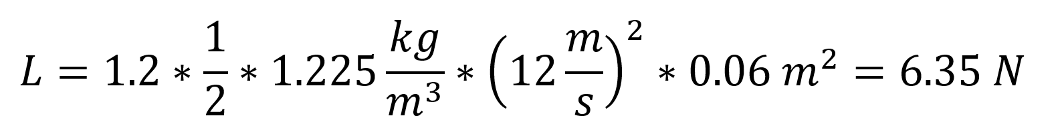
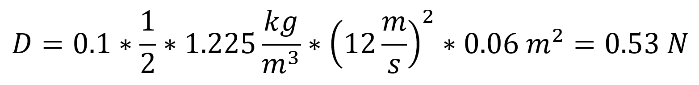
Glider Analysis
Weight
Lift
Drag

Slide 13
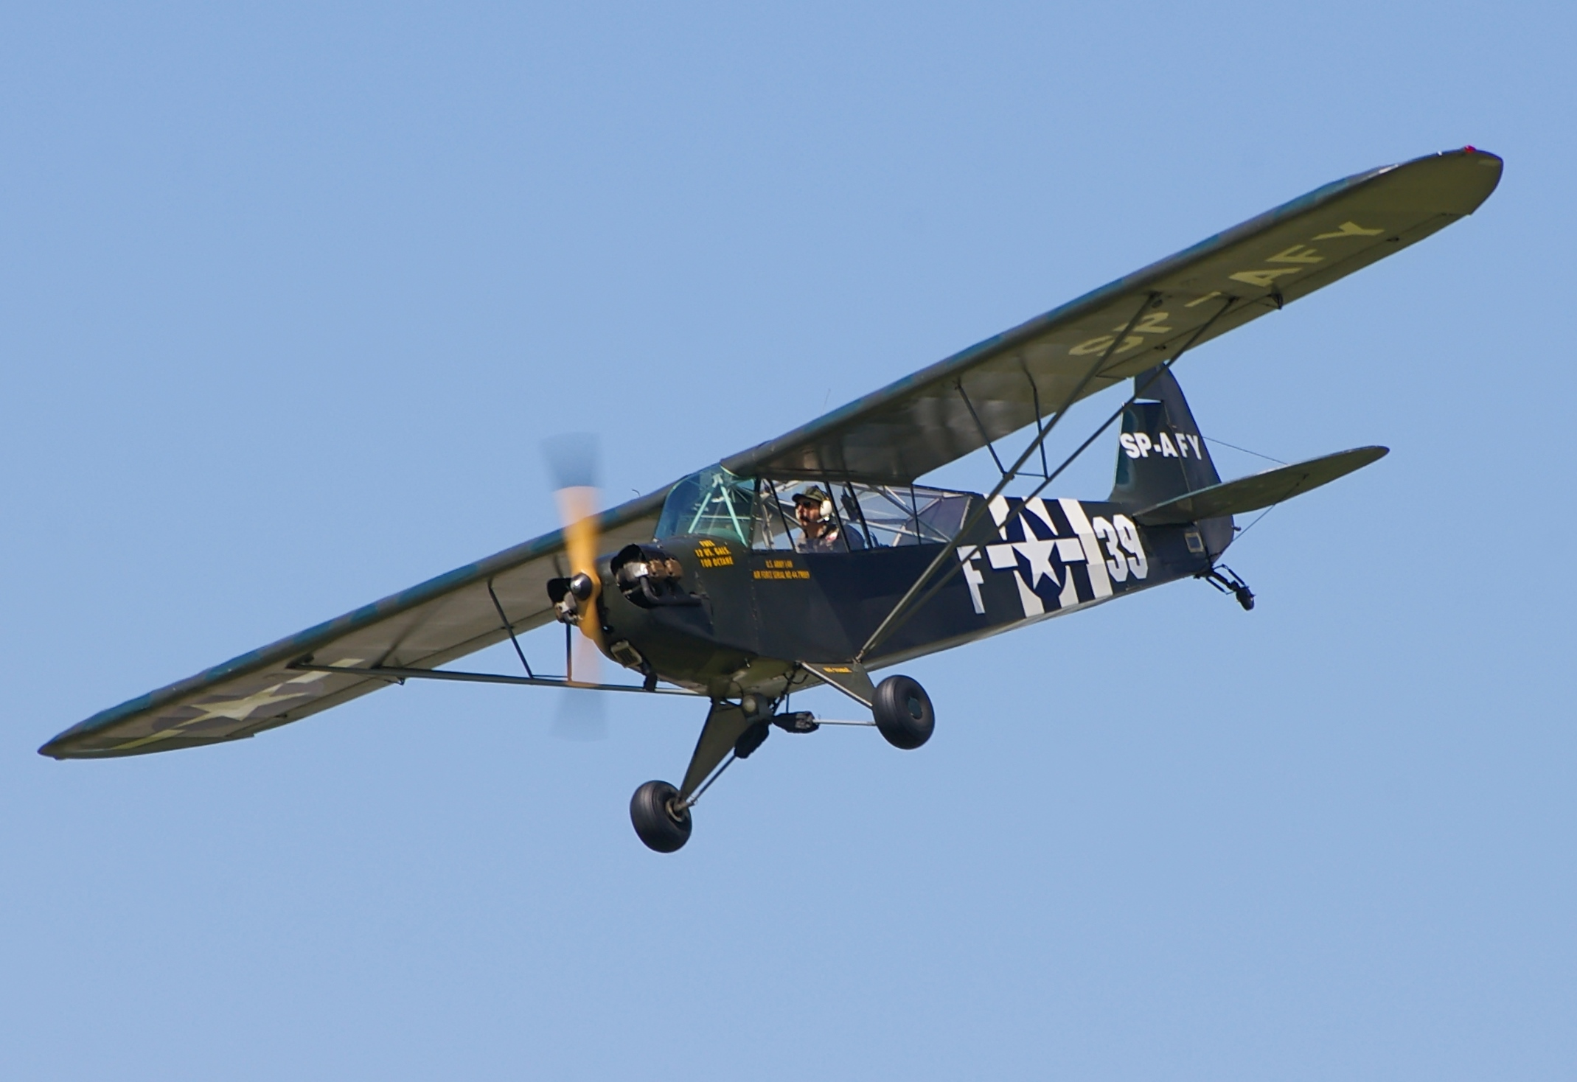
Mothership Concept
Based on the Piper J-3 Cub Aircraft
Prioritizes low weight, agility, and structural integrity

Slide 14
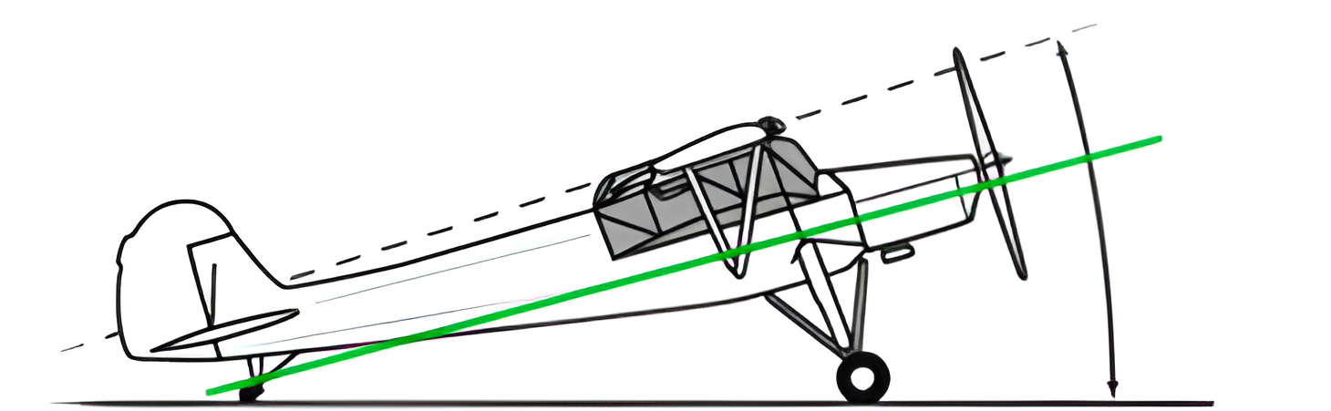
Mothership Concept
Tail-Dragging Configuration
Two larger wheels near the front of the plane with a small wheel close to the tail for stability and structural purposes

Slide 15
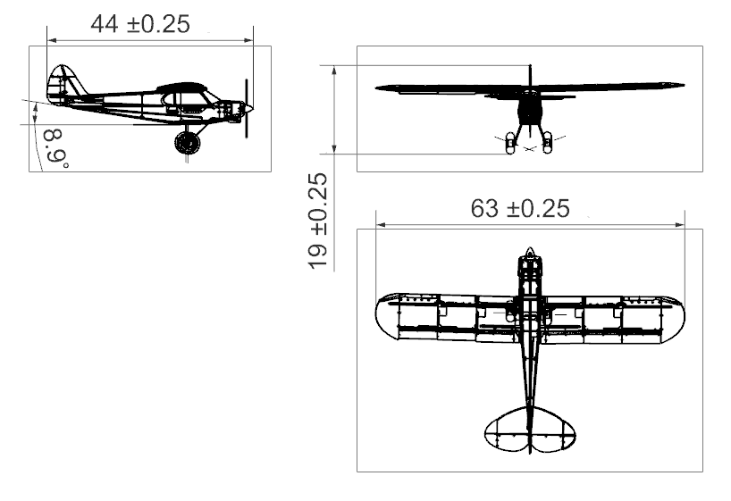
Mothership Design Drawings
Note: All dimensions in Inches unless otherwise specified

Slide 16
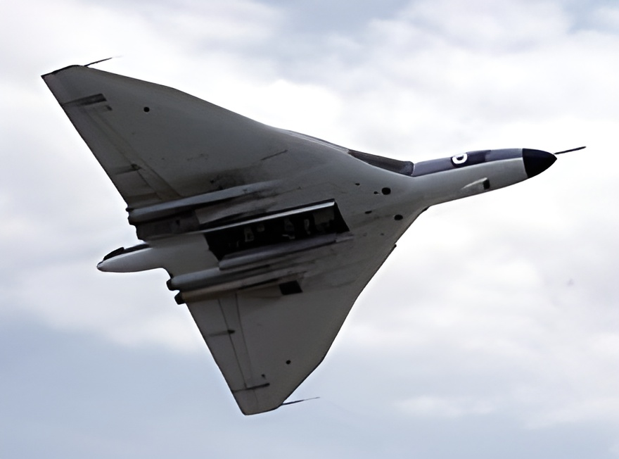
Glider Concept
Based on the Delta Wing
Much smaller than mothership to accommodate landing gear and tank holders
Attaches under fuselage with a payload release mechanism

Slide 17
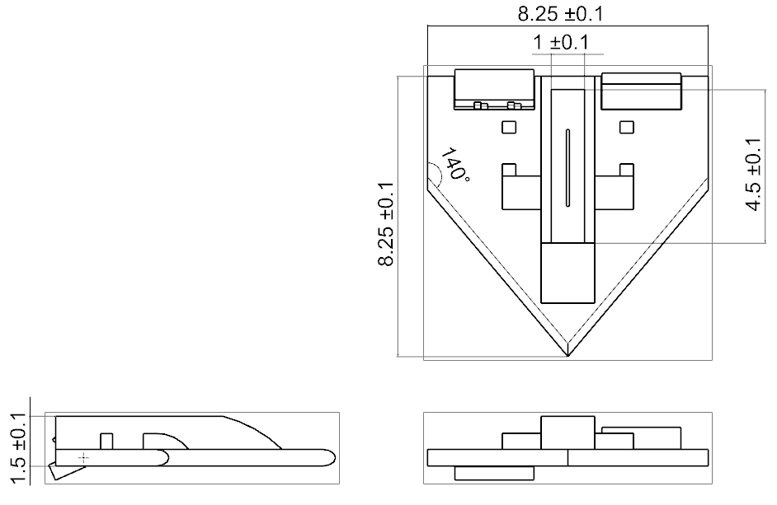
Glider Design Drawings
Note: All dimensions in Inches unless otherwise specified

Slide 18
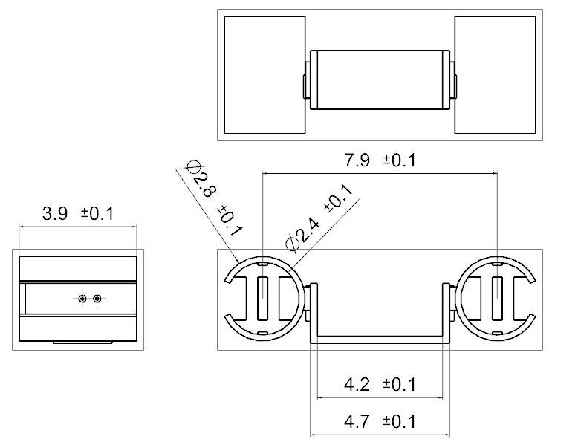
Tank Mounts Design
Simple mounting bracket made to hold two fuel tanks
Attaches to the top of the fuselage with a simple clip
Resembles a cup holder
Note: All dimensions in Inches unless otherwise specified

Slide 19
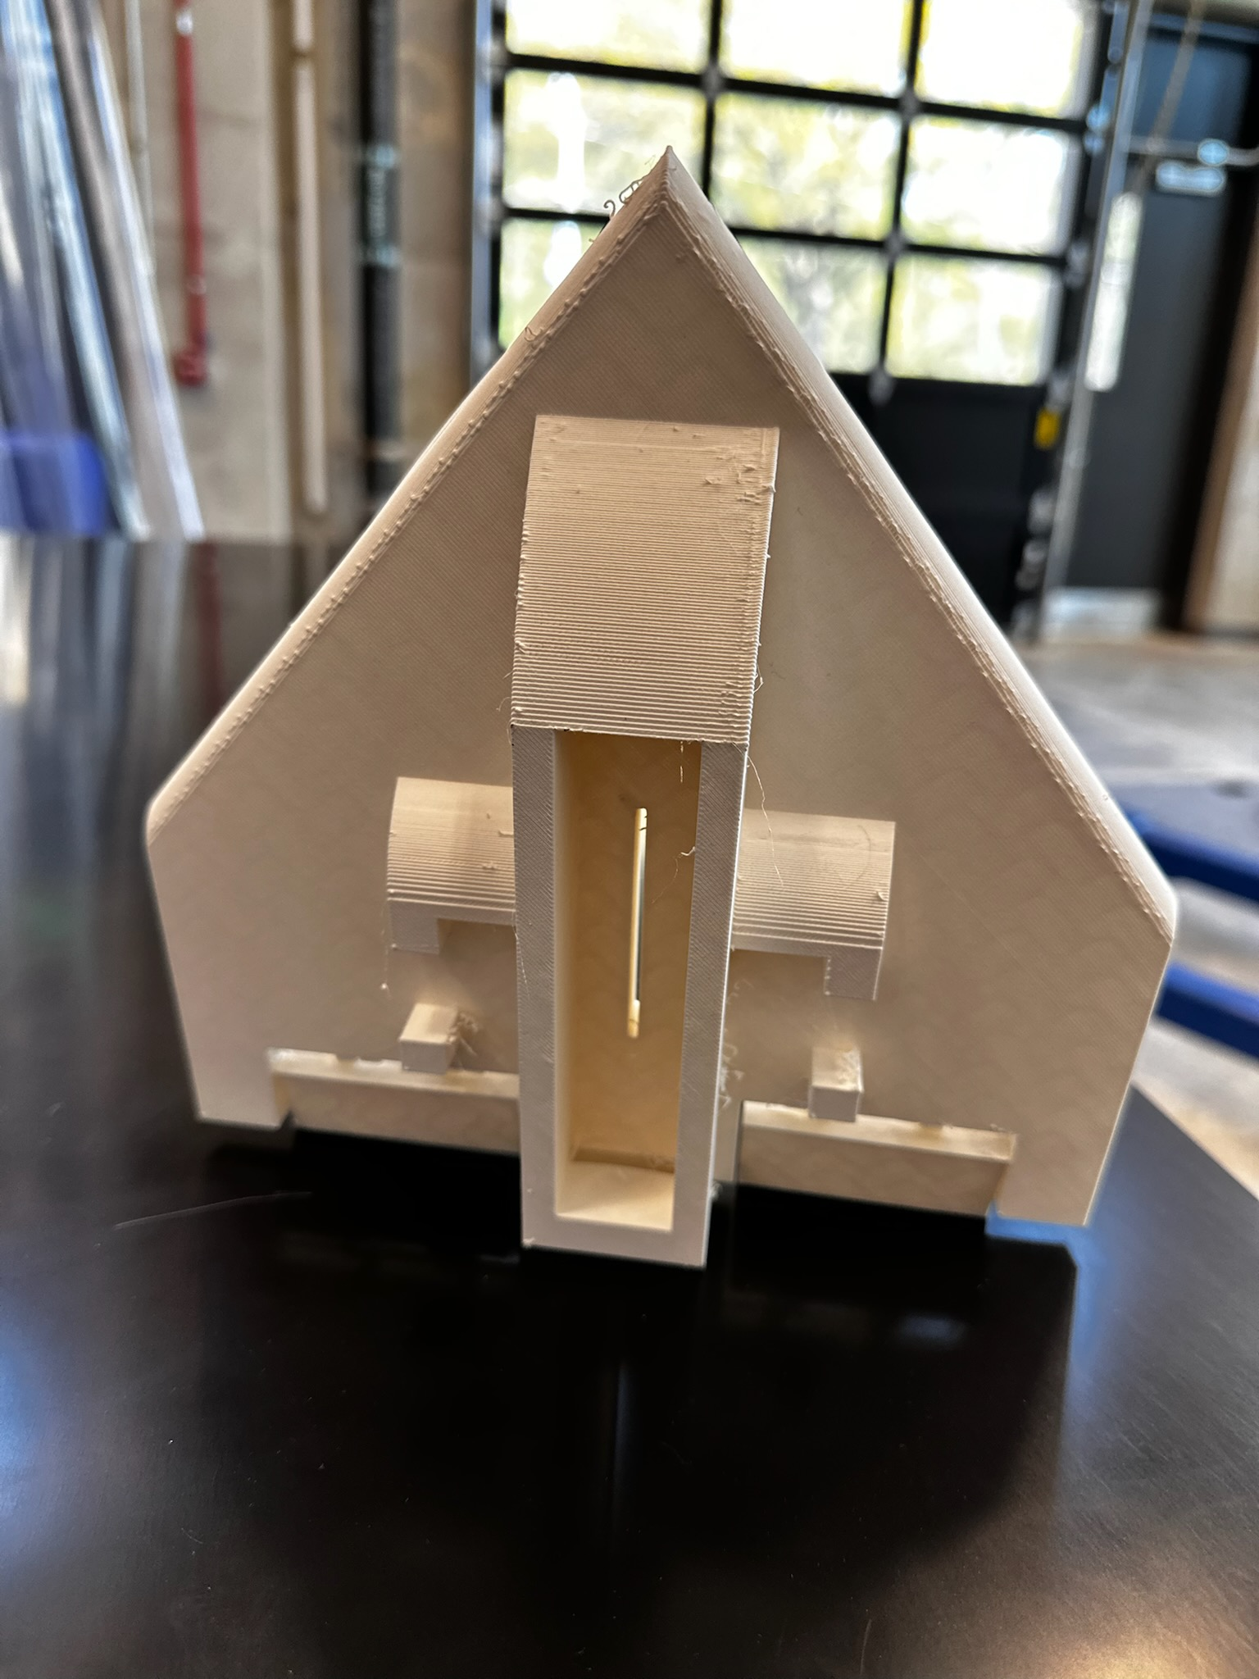
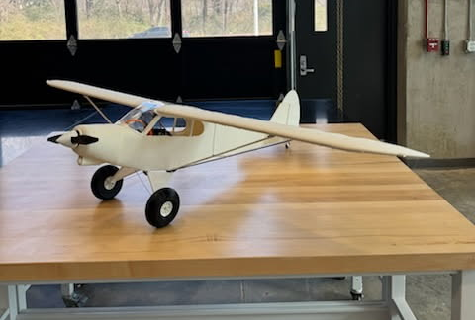
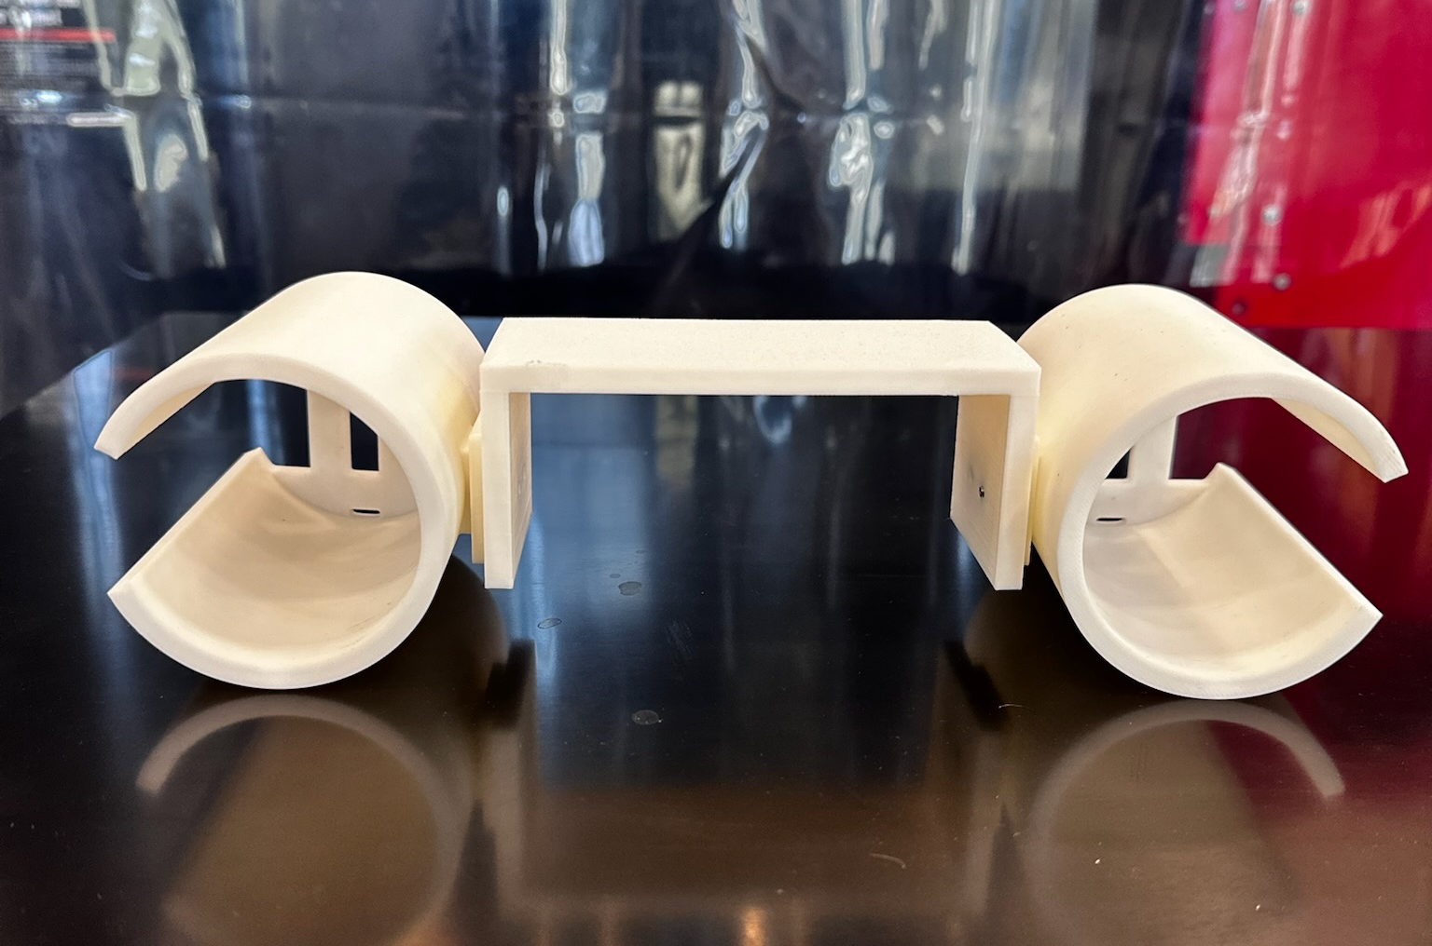
Fabricated Components

Slide 20
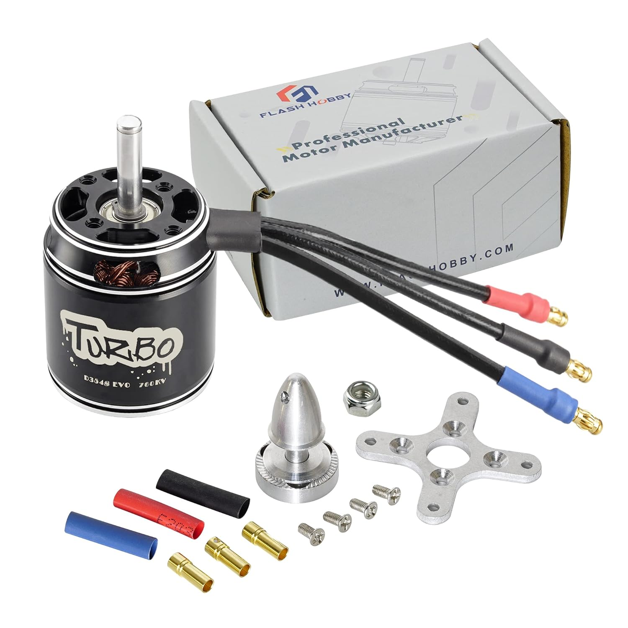
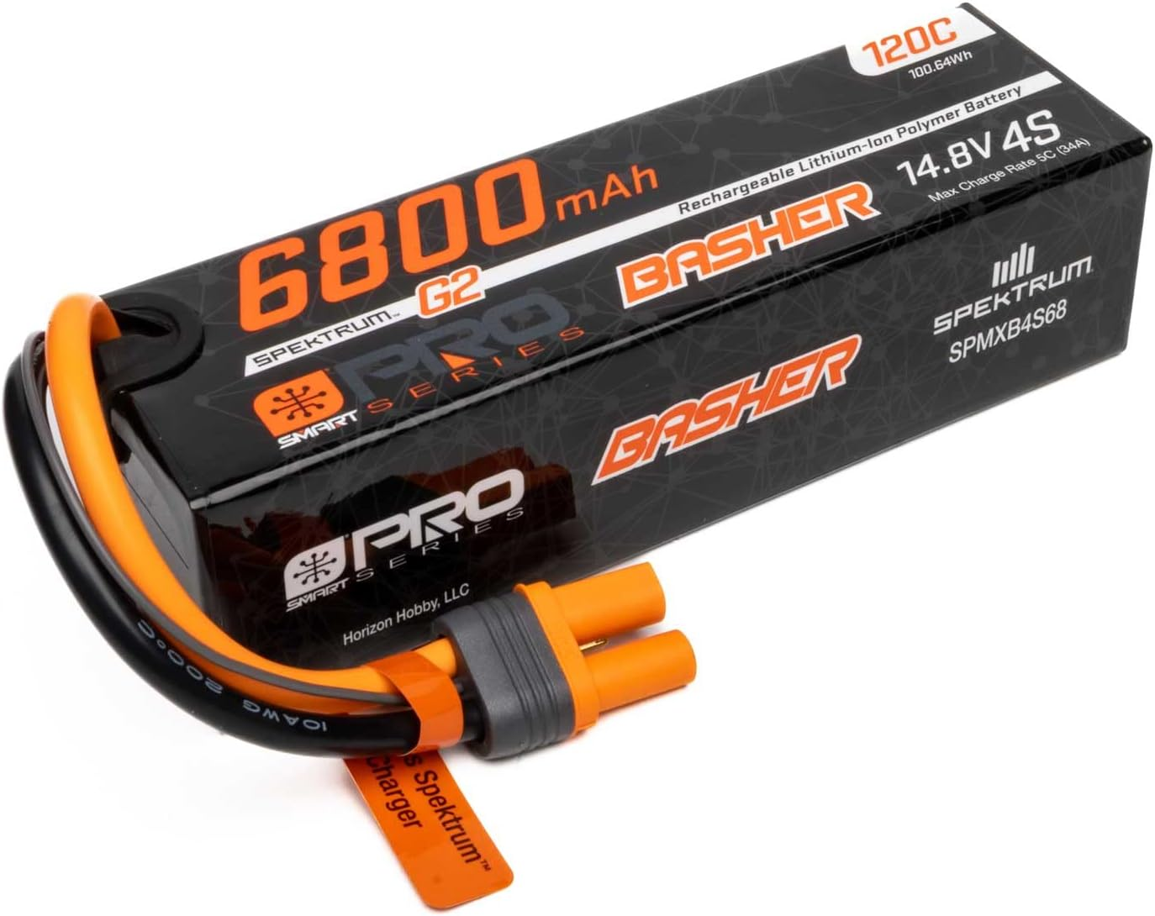
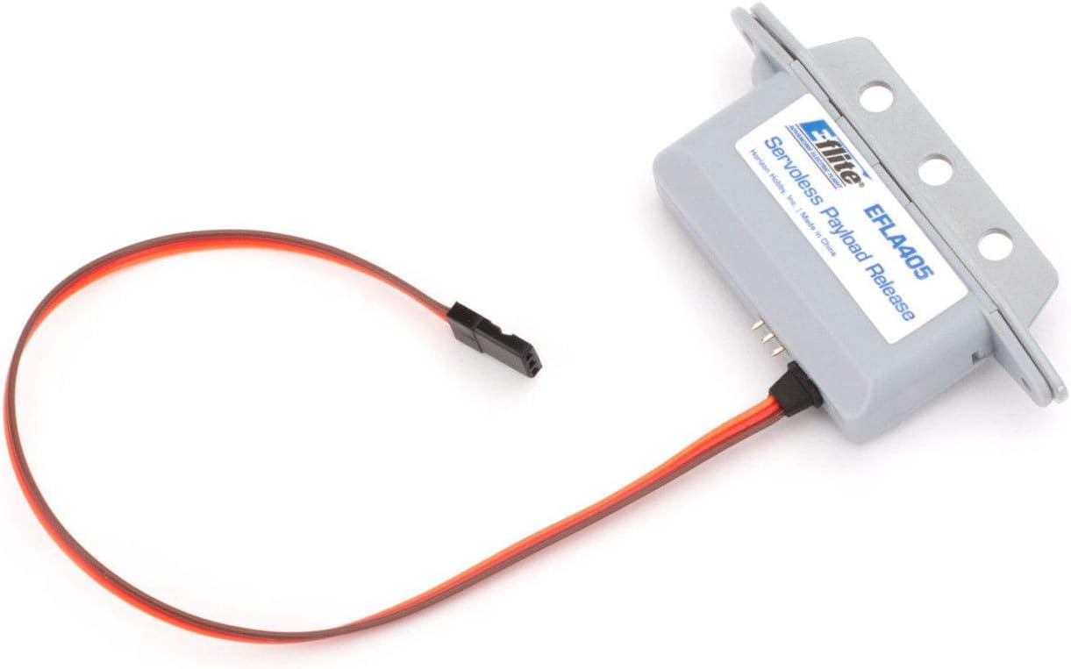
Purchased Components
Motor: FLASH HOBBY D3548EVO 1150KV 760KV 900kv RC
Brushless Motor Battery: Spektrum 14.8V 6800mAh 4S 120C Smart G2 Pro Basher LiPo: IC5, SPMXB4S68
Payload Release: E-flite Servoless Payload Release EFLA405

Slide 21
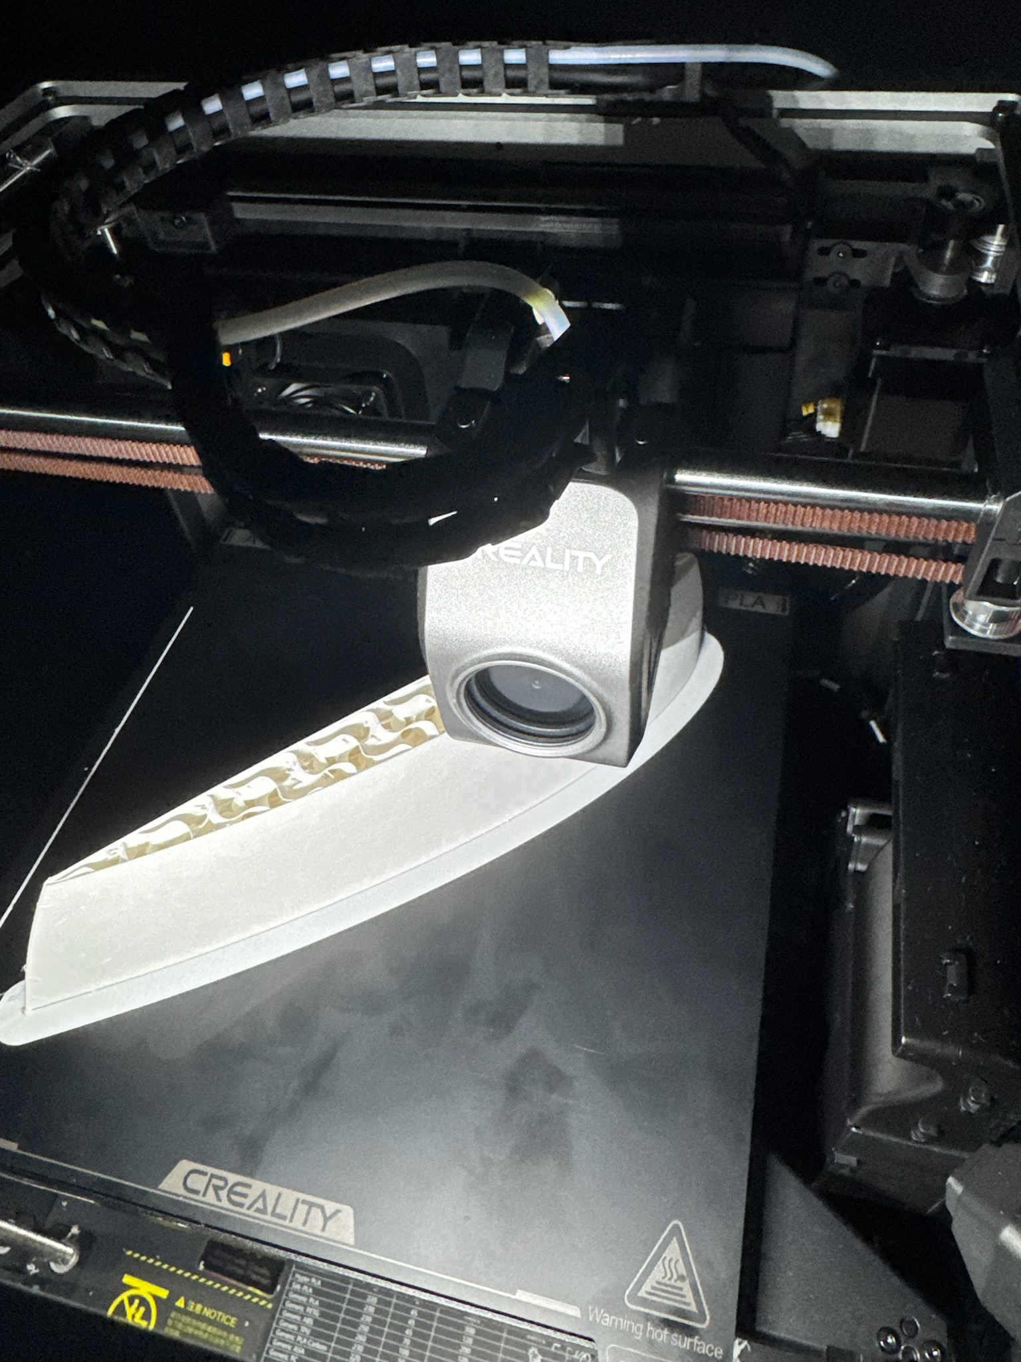
3-D printing Media
Printing saves manufacturing time and weight (all parts printed within a week)
Different types of filament used for different applications
Fuselage, Wing frames, Glider: foaming LW-PLA (lightweight)
Landing Gear Wheels: TPU (absorbs shock and weight well)
Overall plane lighter than Balsa wood (another common plane material), though slightly less durable. This tradeoff was deemed worthwhile for the weight savings (New design weighs 3N less)

Slide 22
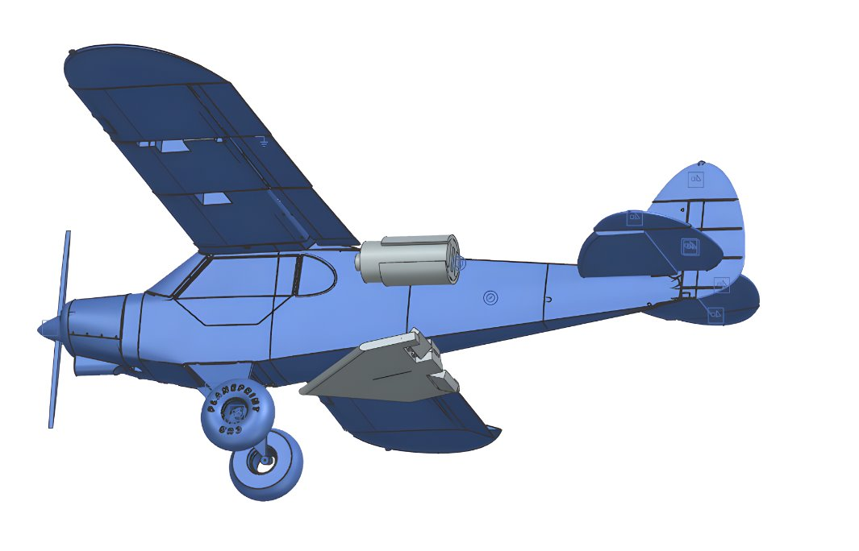
Design Drawings
Full System CAD Model

Slide 23
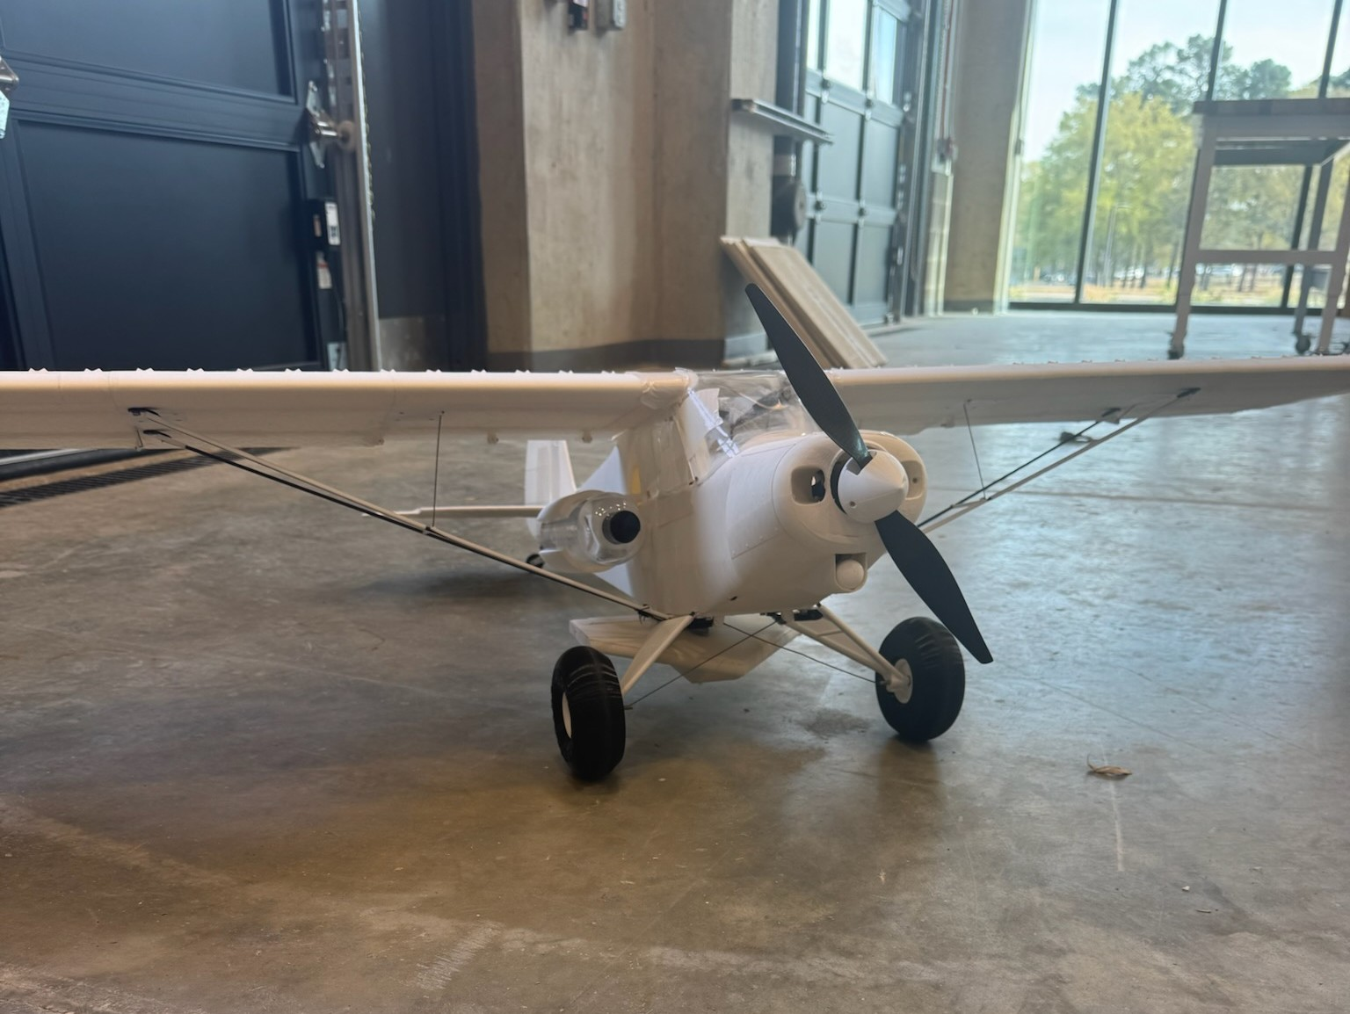
Prototype

Slide 24
Testing
A full test flight of the prototype is planned
Servos for wings, glider fully tested and functional
Motor fully tested and functional
Payload release tested and functional

Slide 25


