Slide 1
Exploring the Safety Concerns of the V-22 Osprey
Isabel Mancini and Emily Marshall
Florida Institute of Technology
Region II Student Conference, April 3-4, 2025

Slide 2
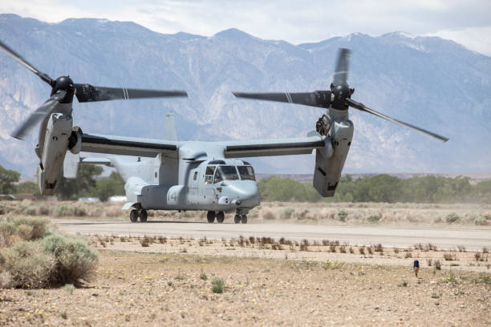
History of the V-22 Osprey
  Developed in 1980s
  Uses tiltrotor technology
  Development completed in 2005
  Entered service in 2007
MV-22 Osprey [1]

Slide 3
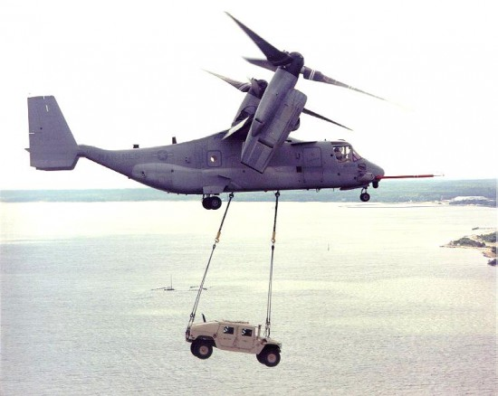
What makes the V22-Osprey Unique
  Twin tilt rotor aircraft
  VTOL
  Aerial refueling
  Approximately 1000 miles range
  Reaches over 300 mph
MV-22 Osprey transporting a vehicle [18]

Slide 4
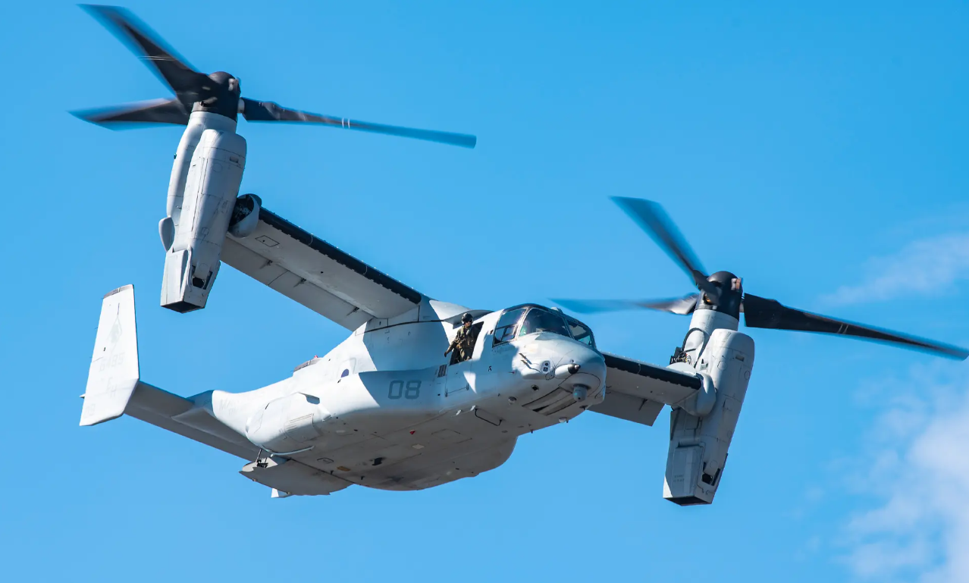
Features of the V-22 Osprey
Bell Boeing V-22 Osprey [21]

Slide 5
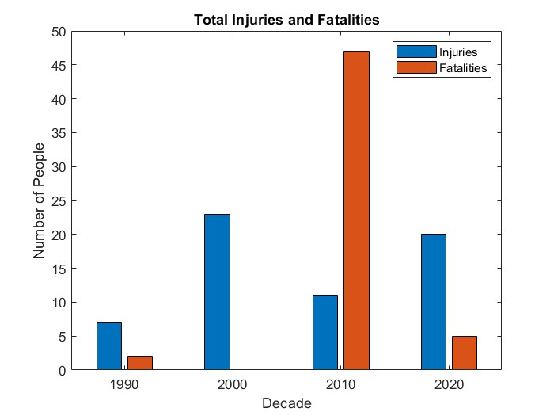
Graph of Casualties

Slide 6
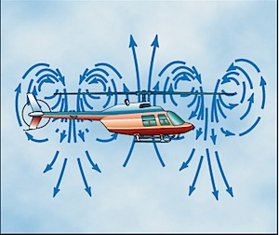
Vortex Ring State
  Occurs during landing
  Pilots approach landing site
  Pilot has no control over lift
  Free fall feeling to crew
Diagram of Vortex Ring State [25]

Slide 7
Process of Vortex Ring State
Approaches landing too quickly

Slide 8
Process of Vortex Ring State
Approaches landing too quickly
Downwash gets pushed up

Slide 9
Process of Vortex Ring State
Approaches landing too quickly
Downwash gets pushed up
Downwash wraps around airfoil

Slide 10
Process of Vortex Ring State
Approaches landing too quickly
Downwash gets pushed up
A ring vortex pocket is produced
Downwash wraps around airfoil

Slide 11
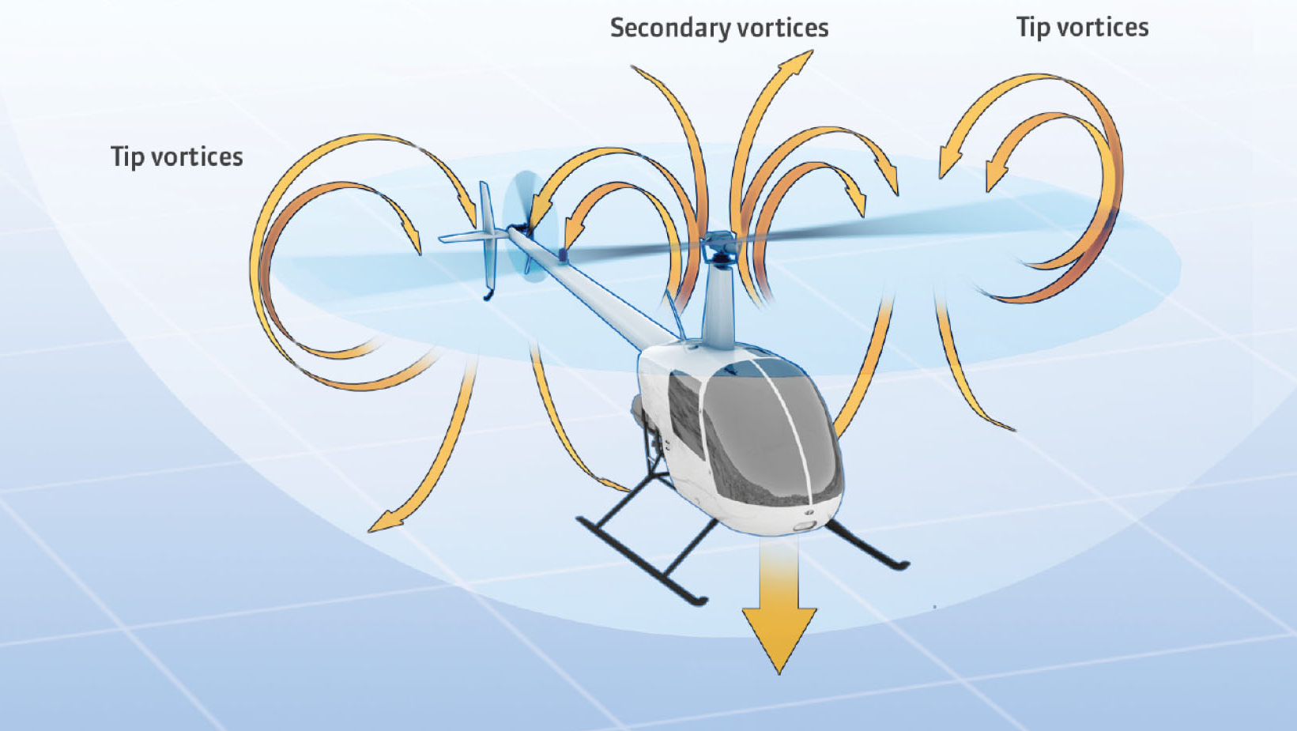
Vortex Ring State
Diagram of Vortex Ring State [17]

Slide 12
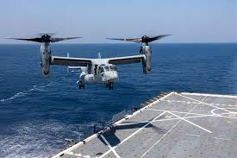
Vortex ring state recovery
Recognize vortex ring state
Accelerate forward and downward
Osprey is already close to the ground
Osprey Landing [26]

Slide 13
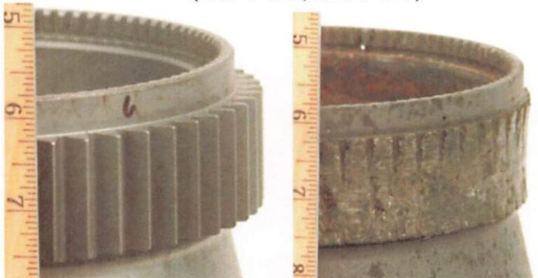
Gearbox Malfunctions
  Proprotor gearboxes allow the nacelles to transition
  Malfunctions often due to a crack, or excessive wear.
Gears Worn Down from CV-22 Osprey [7]​

Slide 14
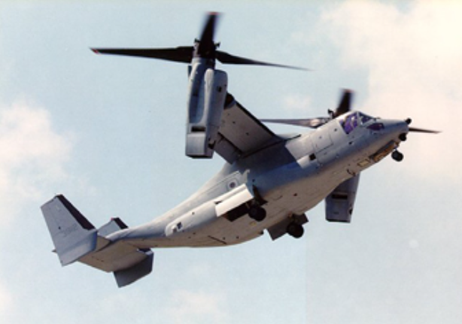
Gearbox Malfunctions
  Most recent crash in 2023
  Produced by Universal Stainless
  Lawsuits due to non-metallic inclusions
  X-53 steel alloy
V-22 Osprey [24]

Slide 15
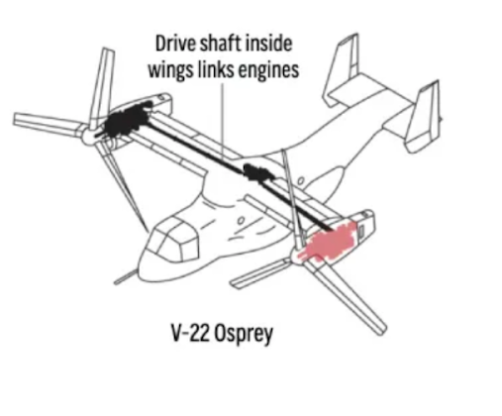
Input Quill Assembly
  Transmits power to nacelles
  Allows for the proprotors to rotate
  Sprag clutches
  Most recent crash June 2022
Diagram of Proprotor Gearbox Location [3]

Slide 16
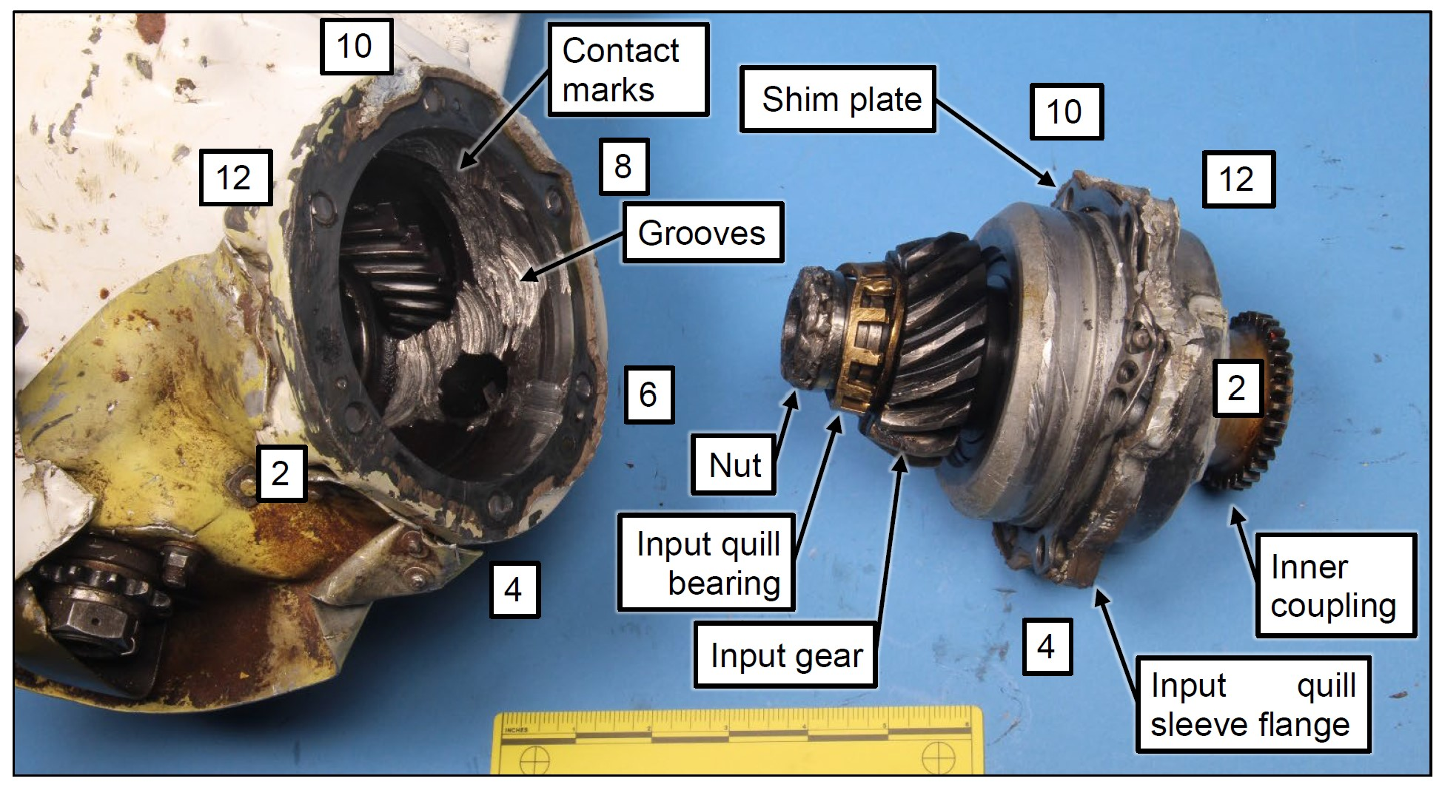
Input Quill Assembly
Input Quill and TGB of Bell UH-1H [20]

Slide 17
How Hard Clutch Engagements Occurs
Sprag gears don’t catch

Slide 18
How Hard Clutch Engagements Occurs
Sprag gears don’t catch
Power cannot be transferred

Slide 19
How Hard Clutch Engagements Occurs
Sprag gears don’t catch
Power cannot be transferred
The proprotor loses power

Slide 20
How Hard Clutch Engagements Occurs
Sprag
gears don’t catch
Power cannot be transferred
Aircraft rolls
The proprotor loses power

Slide 21
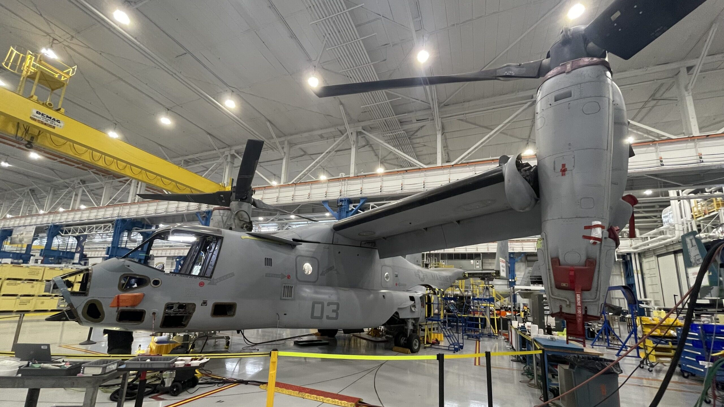
Input Quill Assembly Solution
  Input Quill hours started being logged
  No fatalities since new solution
  Grounded twice after solution implementation
V-22 Osprey undergoing an Upgrade [23]

Slide 22
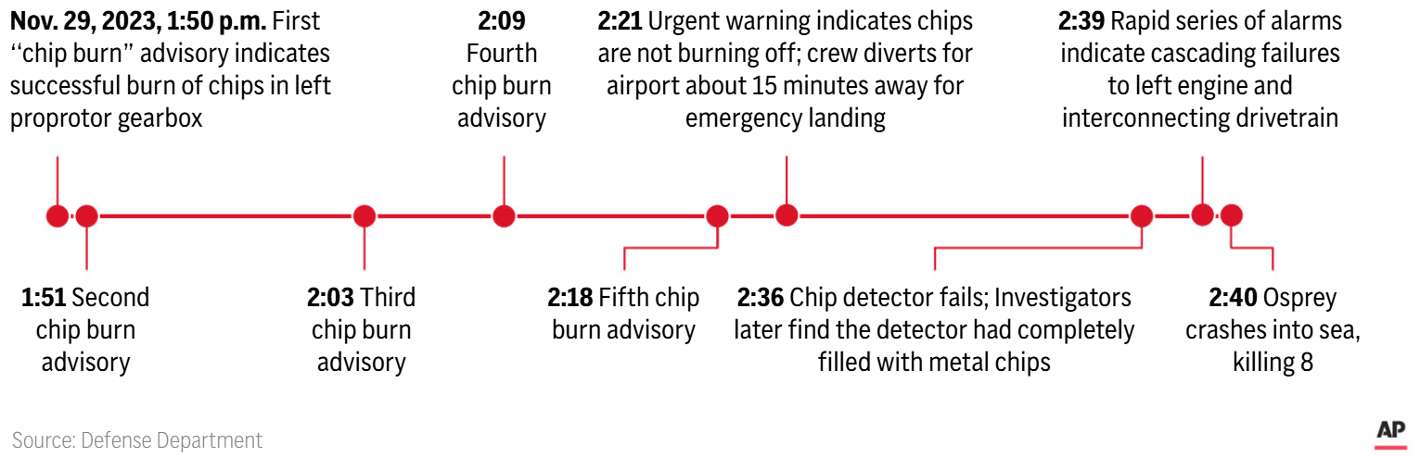
Inadequate Pilot Response
Timeline of the November 2023 Crash [9]

Slide 23
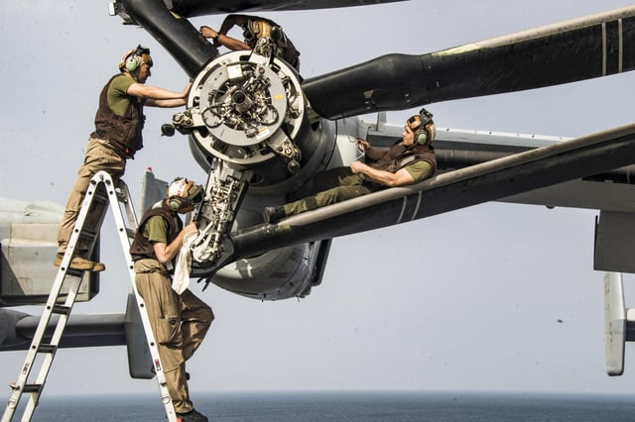
Improper Maintenance
Low operational readiness
Different thresholds of maintenance
Manual gets overlooked
History of falsified maintenance records
Maintenace crew working on a Nacelle [22]

Slide 24
Direct Responses to the Concerns
Flight hour minimum required on gearboxes
Ospreys were grounded, predicted to resume operations this year (2025)
Osprey is not cleared to travel 30 minutes offshore

Slide 25
Direct Responses to the Concerns
Flight hour minimum required on gearboxes
Ospreys were grounded, predicted to resume operations this year (2025)
Osprey is not cleared to travel 30 minutes offshore

Slide 26
Direct Responses to the Concerns
Flight hour minimum required on gearboxes
Ospreys were grounded, predicted to resume operations this year (2025)
Osprey is not cleared to travel 30 minutes offshore

Slide 27
Direct Responses to the Concerns
New Chip Detectors
Refined Triple Melt Steel
New Input Quill Assembly
Flight Data Sensors

Slide 28
Direct Responses to the Concerns
New Chip Detectors
Refined Triple Melt Steel
New Input Quill Assembly
Flight Data Sensors

Slide 29
Direct Responses to the Concerns
New Chip Detectors
Refined Triple Melt Steel
New Input Quill Assembly
Flight Data Sensors

Slide 30
Direct Responses to the Concerns
New Chip Detectors
Refined Triple Melt Steel
New Input Quill Assembly
Flight Data Sensors

Slide 31
Conclusion
Advancement in technology
Reoccurring safety issues
No replacement can be found or made
Vehicle will be safe when mechanics are reworked

Slide 33
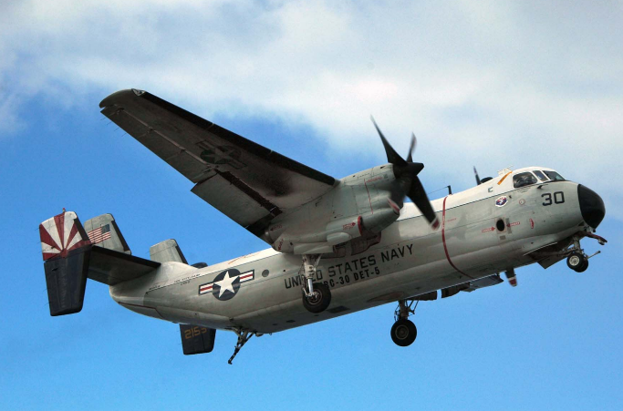
V-22 Osprey vs C-2A Greyhound
Stopped being produced in 1987
Transports cargo and personnel
Osprey was set to replace them
Brought back temporarily
Top speed 395 mph
Navy C-2A Greyhound (G-123) [14]

Slide 34
Resources
[1] Sierrarat, “V 22 Osprey Pictures, images and Stock Photos,” iStock Available:
https://www.istockphoto.com/photos/v-22-osprey.
[2] Katz, J., “Air Force says ‘catastrophic’ mechanical failure, ‘causal’ crew decisions led to deadly V-22 crash,”
Breaking Defense Available: https://breakingdefense.com/2024/08/air-force-says-catastrophic-mechanical-failure-
causal-crew-decisions-led-to-deadly-v-22-crash/.
[3] Copp, T., “Japan osprey crash caused by cracks in a gear and pilot’s decision to keep flying, Air Force says,” AP
News Available: https://apnews.com/article/osprey-crash-japan-3b7b0951074334bec0f6a54da6309c31
[4] Toropin, K., and Novelly, T., “Military daily news,” Military.com Available: https://www.military.com/daily-
news/2 024/08/21/ flaw-osprey-gears-was-known-decade-prior-deadly-japan-crash-internal-report-shows.html
[5] Ahn, J., “Universal Stainless, set to be acquired, behind Fatal Bell Boeing Osprey Crash,” HUNTERBROOK
Available: https://hntrbrk.com/usap/.
[6] Satam, P., “Poor quality control and outdated equipment at steel company behind failed gears on ill-fated CV-22
Osprey,” The Aviationist Available: https://theaviationist.com/2024/10/27/steel-company-made-failed-gear-crashed-
osprey/.
[7] Aerossurance, “Deadly delay: Catastrophic USAF CV-22B Osprey Gear Box Failure,” Aerossurance Available:
https://aerossurance.com/air-accidents-incidents/deadly-delay-catastrophic-usaf-cv-22b-osprey-gear-box-failure/.

Slide 35
Resources
[8] Johnson, K., “Marine Corps: Hard clutch engagement issue cause of fatal MV-22B Crash,” FLYING Magazine
Available: https://www.flyingmag.com/marine-corps-hard-clutch-engagement-issue-cause-of-fatal-mv-22b-crash/.
[9] Yamaguchi, M., “US and Japanese forces to resume osprey flights in Japan following fatal crash | fox40,” AP
U.S. NEWS Available: https://fox40.com/news/national/ap-us-news/ap-us-and-japanese-forces-to-resume-osprey-
flights-in-japan-following-fatal-crash/.
[10] Davis, J., Inside the most controversial U.S. military aircraft, the V-22 Osprey Available:
https://ig.space/commslink/v-22-osprey-does-it-deserve-its-controversial-reputation.
[11] Abott, R., “Marine Corps highlights new Osprey gearbox sensors in aviation plan, Navy limit at 200 miles,”
Avionics International Available: https://www.aviationtoday.com/2025/02/20/marine-corps-highlights-new-osprey-
gearbox-sensors-in-aviation-plan-navy-limit-at-200-miles/.
[12] Hynes, R., “33 things you probably don’t know about the CH-47 Chinook,” Honeywell Available:
https://aerospace.honeywell.com/us/en/about-us/blogs/33-things-you-probably-do-not-know-about-chinook-ch47.
[13] Navy, “C-2A Greyhound Logistics Aircraft,” United States Navy Available:
https://www.navy.mil/Resources/Fact-Files/Display-FactFiles/Article/2160705/c-2a-greyhound-logistics-aircraft/.
[14] Benolkin, M., “Grumman C-2A Greyhound Photo Gallery,” Cybermodeler Online Available:
https://www.cybermodeler.com/aircraft/e-2/c-2a_gallery.shtml.

Slide 36
Resources
[16] Rosenberg, Z., “Bell V-280 Valor cleared to enter engineering and Manufacturing Development Phase,” Janes
Available: https://www.janes.com/osint-insights/defence-news/air/bell-v-280-valor-cleared-to-enter-engineering-
and-manufacturing-development-phase
[17] Twombly, I., “Technique: The vuichard recovery,” AOPA Available: https://www.aopa.org/news-and-media/all-news/2019/july/flight-training-magazine/technique-vuichard-recovery.
[18] “Why was the Bell Boeing V-22 Osprey not worked on more?,” Aviation Stack Exchange Available: https://aviation.stackexchange.com/questions/22567/why-was-the-bell-boeing-v-22-osprey-not-worked-on-more.
[19] Snow, S., “Despite massive shows of air power, nearly 40 percent of Marine Ospreys are not mission capable,” Marine Corps Times Available: https://www.marinecorpstimes.com/news/your-marine-corps/2019/06/24/despite-massive-show-of-air-power-nearly-40-percent-of-marine-corps-mv-22-ospreys-are-not-mission-capable/.
[20] Aerossurance, “Compressive creep and the loss of a UH-1H’s tail rotor,” Aerossurance Available: https://aerossurance.com/helicopters/compressive-creep-huey-tr/.
[21] Szondy, D., "The V-22 Osprey fleet passes 500,000 flight hours," New Atlas Available: https://newatlas.com/military/v-22-osprey-fleet-passes-500-000-flight-hour/
[22] 1PICRYL - Public Domain Media Search Engine, “Marines assigned to the 26th Marine Expeditionary Unit (26th MEU) perform maintenance on an MV-22 osprey on Th,” PICRYL - Public Domain Media Search Engine Public Domain Image Available: https://itoldya420.getarchive.net/amp/media/marines-assigned-to-the-26th-marine-expeditionary-unit-26th-meu-perform-maintenance-9301dd.

Slide 37
Resources
[23] 1Marrow, M., “Cause of V-22 ‘hard clutch’ issue still unknown, even as fleet repairs moving ahead of Schedule,” Breaking Defense Available: https://breakingdefense.com/2023/05/cause-of-v-22-hard-clutch-issue-still-unknown-even-as-fleet-repairs-moving-ahead-of-schedule/.
[24] "V-22 Osprey" Marines Available: https://www.aviation.marines.mil/About/Aircraft/Tilt-Rotor/ref/the-commoner/
[25] Langer, M., "Air Vortexes" An Electric Mind https://aneclecticmind.com/2011/05/06/on-air-vortexes/
[26] “Unitas 2023: Osprey Landing,” DVIDS Available: https://www.dvidshub.net/image/7894927/unitas-2023-osprey-landing.

