Slide 1


Development of an LQR Controller for a Jet Vanes Thrust-Vectored Rocket
Patrick Barry, Karsten Caillet, David Reynolds, Albert Zheng
AIAA 2025 Region II Student Conference
4/3/2025 – 4/4/2025
Copyright © by Guidance, Navigation, and Control Project
Published by the American Institute of Aeronautics and Astronautics, Inc., with permission.

Slide 2
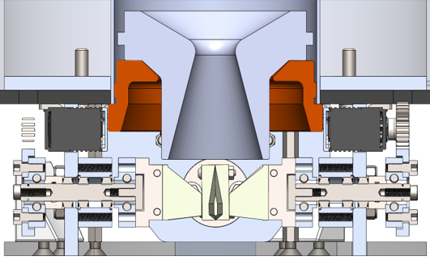
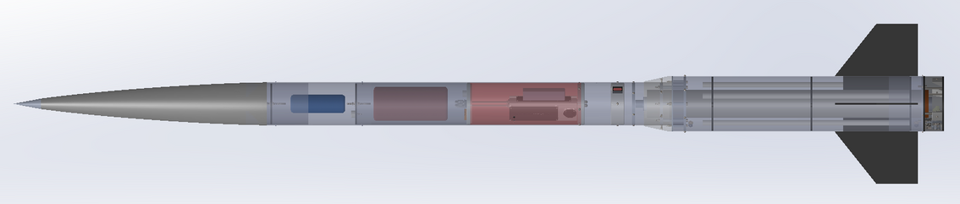
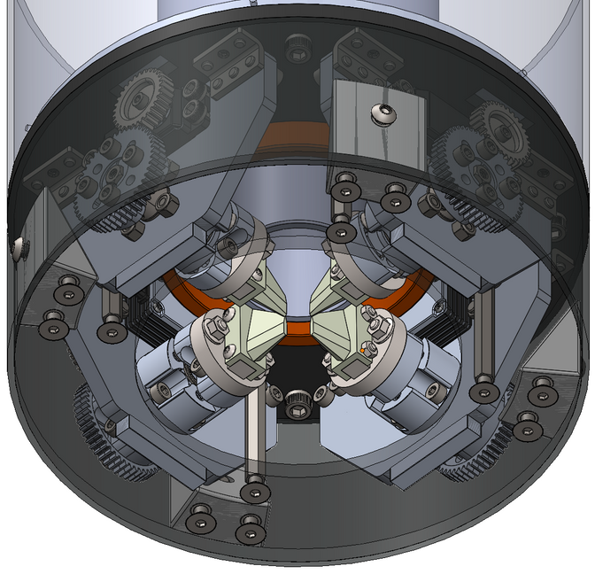
Jet Vanes Rocket
  Current focus of the Guidance, Navigation, and Control (GNC) project within Ramblin’ Rocket Club
  Active rocket control via jet vanes placed at exit of rocket motor nozzle
  Besides motor itself, rocket is 100% designed and built by Georgia Tech undergraduates
    Structure
    Avionics
    Software/Algorithms
    CFD Simulations
Guidance, Navigation, and Control
Georgia Institute of Technology

Slide 3
Controller Validation: Monte Carlo Analysis
Dynamics & Modeling
LQR
Controller Development
Guidance, Navigation, and Control
Georgia Institute of Technology

Slide 4
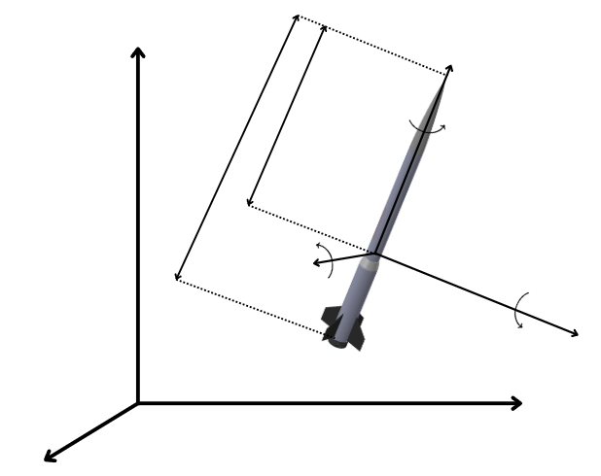









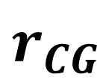

Dynamics and Modeling
Motivation
  Basis for controller linearization
  Validate controller performance
  Open source simulations are open-loop
$$x^{i}$$
$$x^{b}$$
$$p$$
$$r_{CG}$$
$$l$$
$$q$$
$$y^{b}$$
$$r$$
$$z^{b}$$
$$z^{i}$$
$$y^{i}$$
Guidance, Navigation, and Control
Georgia Institute of Technology

Slide 5
Dynamics and Modeling
Motivation
  Basis for controller linearization
  Validate controller performance
  Open source simulations are open-loop
Assumptions
  Flat Earth
$$x^{i}$$
$$x^{b}$$
$$p$$
$$r_{CG}$$
$$l$$
$$q$$
$$y^{b}$$
$$r$$
$$z^{b}$$
$$z^{i}$$
$$y^{i}$$
Guidance, Navigation, and Control
Georgia Institute of Technology

Slide 6

Dynamics and Modeling
Motivation
  Basis for controller linearization
  Validate controller performance
  Open-source simulations are open-loop
Assumptions
  Flat Earth
Frames
  Flat Earth frame $i$
  Body frame $b$
$$x^{i}$$
$$x^{b}$$
$$p$$
$$r_{CG}$$
$$l$$
$$q$$
$$y^{b}$$
$$r$$
$$z^{b}$$
$$z^{i}$$
$$y^{i}$$
Guidance, Navigation, and Control
Georgia Institute of Technology

Slide 7


Dynamics and Modeling
Find 6-DOF Equations of Motion:
$$x^{i}$$
$$x^{b}$$
$${\dot{\vec{ω}}}_{bi}^{b}=I_{b}^{−1}({\vec{M}}^{b}−{\vec{ω}}_{bi}^{b}×I_{b}{\vec{ω}}_{bi}^{b})$$
$$p$$
$$v^{b}$$
$$r_{CG}$$
$$l$$
$$q$$
$$y^{b}$$
$$r$$
$$z^{b}$$
$$z^{i}$$
$$y^{i}$$
Guidance, Navigation, and Control
Georgia Institute of Technology

Slide 8

Dynamics and Modeling
Find 6-DOF Equations of Motion:
$$x^{i}$$
$$x^{b}$$
$${\dot{\vec{ω}}}_{bi}^{b}=I_{b}^{−1}({\vec{M}}^{b}−{\vec{ω}}_{bi}^{b}×I_{b}{\vec{ω}}_{bi}^{b})$$
$$p$$
$$v^{b}$$
$$r_{CG}$$
$$\dot{{\vec{v}}^{b}}=\frac{{\vec{F}}_{b}}{m}−{\vec{ω}}_{bi}^{b}×{\vec{v}}^{b}$$
$$l$$
$$q$$
$$y^{b}$$
$$r$$
$$z^{b}$$
$$z^{i}$$
$$y^{i}$$
Guidance, Navigation, and Control
Georgia Institute of Technology

Slide 9

Dynamics and Modeling
Find 6-DOF Equations of Motion:
$$x^{i}$$
$$x^{b}$$
$${\dot{\vec{ω}}}_{bi}^{b}=I_{b}^{−1}({\vec{M}}^{b}−{\vec{ω}}_{bi}^{b}×I_{b}{\vec{ω}}_{bi}^{b})$$
$$p$$
$$v^{b}$$
$$r_{CG}$$
$$\dot{{\vec{v}}^{b}}=\frac{{\vec{F}}_{b}}{m}−{\vec{ω}}_{bi}^{b}×{\vec{v}}^{b}$$
$$l$$
$$q$$
$${\dot{\vec{q}}}_{bi}=\frac{1}{2}\left[\begin{aligned}−pq_{x}−qq_{y}−rq_{z} \\ pq_{w}+rq_{y}−qq_{z} \\ qq_{w}−rq_{x}+pq_{z} \\ rq_{w}+qq_{x}−pq_{y}\end{aligned}\right]$$
$$y^{b}$$
$$r$$
$$z^{b}$$
$$z^{i}$$
$$y^{i}$$
Guidance, Navigation, and Control
Georgia Institute of Technology

Slide 10

Dynamics and Modeling
Find 6-DOF Equations of Motion:
$$x^{i}$$
$$x^{b}$$
$${\dot{\vec{ω}}}_{bi}^{b}=I_{b}^{−1}({\vec{M}}^{b}−{\vec{ω}}_{bi}^{b}×I_{b}{\vec{ω}}_{bi}^{b})$$
$$p$$
$$v^{b}$$
$$r_{CG}$$
$$\dot{{\vec{v}}^{b}}=\frac{{\vec{F}}_{b}}{m}−{\vec{ω}}_{bi}^{b}×{\vec{v}}^{b}$$
$$l$$
$$q$$
$${\dot{\vec{q}}}_{bi}=\frac{1}{2}\left[\begin{aligned}−pq_{x}−qq_{y}−rq_{z} \\ pq_{w}+rq_{y}−qq_{z} \\ qq_{w}−rq_{x}+pq_{z} \\ rq_{w}+qq_{x}−pq_{y}\end{aligned}\right]$$
$$y^{b}$$
$$r$$
$$z^{b}$$
$$\dot{{\vec{p}}^{i}}={\vec{q}}_{bi}^{∗}⊗{\vec{v}}^{b}⊗{\vec{q}}_{bi}$$
$$z^{i}$$
$$y^{i}$$
Guidance, Navigation, and Control
Georgia Institute of Technology

Slide 11




Dynamics and Modeling
Find ${\vec{F}}^{b}$ and ${\vec{M}}_{cg}^{b}$ :
$$x^{i}$$
$$x^{b}$$
$${\vec{F}}_{G}^{i}=\left[\begin{aligned} −g \\ 0 \\ 0\end{aligned}\right]$$
$$p$$
$$v^{b}$$
$${\vec{F}}_{G}^{b}={\vec{q}}_{bi}⊗{\vec{F}}_{G}^{i}⊗{\vec{q}}_{bi}^{∗}$$
$$r_{CG}$$
$$l$$
$$q$$
$$y^{b}$$
$$r$$
$$z^{b}$$
$$F_{G}$$
$$z^{i}$$
$$y^{i}$$
Guidance, Navigation, and Control
Georgia Institute of Technology

Slide 12






Dynamics and Modeling
Find ${\vec{F}}^{b}$ and ${\vec{M}}_{cg}^{b}$ :
$$x^{i}$$
$$x^{b}$$
$${\vec{F}}_{G}^{i}=\left[\begin{aligned} −g \\ 0 \\ 0\end{aligned}\right]$$
$$p$$
$$v^{b}$$
$${\vec{F}}_{G}^{b}={\vec{q}}_{bi}⊗{\vec{F}}_{G}^{i}⊗{\vec{q}}_{bi}^{∗}$$
$$r_{CG}$$
$$l$$
$${\vec{F}}_{A}^{b}=L\left[\begin{aligned}sin⁡(α) \\ −cos⁡(α) \\ 0\end{aligned}\right]+D\left[\begin{aligned}−cos⁡(α) \\ −sin⁡(α) \\ 0\end{aligned}\right]$$
$$q$$
$$CG$$
$$y^{b}$$
$$CP$$
$$CG0$$
$$r$$
$${\vec{M}}_{A,cg}^{b}={\vec{M}}_{A,cg0}^{b}+{\vec{F}}_{A}^{b}×({\vec{r}}_{cg}^{b}−{\vec{r}}_{cg0}^{b})$$
$$z^{b}$$
$$F_{D}$$
$$F_{G}$$
$$z^{i}$$
$$y^{i}$$
Guidance, Navigation, and Control
Georgia Institute of Technology

Slide 13


Dynamics and Modeling
Find ${\vec{F}}^{b}$ and ${\vec{M}}_{cg}^{b}$ :
$$x^{i}$$
$$x^{b}$$
$${\vec{F}}_{G}^{i}=\left[\begin{aligned} −g \\ 0 \\ 0\end{aligned}\right]$$
$$p$$
$$v^{b}$$
$${\vec{F}}_{G}^{b}={\vec{q}}_{bi}⊗{\vec{F}}_{G}^{i}⊗{\vec{q}}_{bi}^{∗}$$
$$r_{CG}$$
$$l$$
$${\vec{F}}_{A}^{b}=L\left[\begin{aligned}sin⁡(α) \\ −cos⁡(α) \\ 0\end{aligned}\right]+D\left[\begin{aligned}−cos⁡(α) \\ −sin⁡(α) \\ 0\end{aligned}\right]$$
$$q$$
$$CG$$
$$y^{b}$$
$$CP$$
$$CG0$$
$$r$$
$${\vec{M}}_{A,cg}^{b}={\vec{M}}_{A,cg0}^{b}+{\vec{F}}_{A}^{b}×({\vec{r}}_{cg}^{b}−{\vec{r}}_{cg0}^{b})$$
$$z^{b}$$
$$F_{D}$$
$$F_{G}$$
$${\vec{F}}_{T}^{b}=\left[\begin{aligned} T(t) \\ 0 \\ 0\end{aligned}\right]$$
$$F_{T}$$
$$z^{i}$$
$$y^{i}$$
Guidance, Navigation, and Control
Georgia Institute of Technology

Slide 14

Dynamics and Modeling
Find ${\vec{F}}^{b}$ and ${\vec{M}}_{cg}^{b}$ :
$$x^{i}$$
$$x^{b}$$
$${\vec{F}}_{G}^{i}=\left[\begin{aligned} −g \\ 0 \\ 0\end{aligned}\right]$$
$$p$$
$$v^{b}$$
$${\vec{F}}_{G}^{b}={\vec{q}}_{bi}⊗{\vec{F}}_{G}^{i}⊗{\vec{q}}_{bi}^{∗}$$
$$r_{CG}$$
$$l$$
$${\vec{F}}_{A}^{b}=L\left[\begin{aligned}sin⁡(α) \\ −cos⁡(α) \\ 0\end{aligned}\right]+D\left[\begin{aligned}−cos⁡(α) \\ −sin⁡(α) \\ 0\end{aligned}\right]$$
$$q$$
$$CG$$
$$y^{b}$$
$$CP$$
$$CG0$$
$$r$$
$${\vec{M}}_{A,cg}^{b}={\vec{M}}_{A,cg0}^{b}+{\vec{F}}_{A}^{b}×({\vec{r}}_{cg}^{b}−{\vec{r}}_{cg0}^{b})$$
$$z^{b}$$
$$F_{D}$$
$$F_{G}$$
$${\vec{F}}_{T}^{b}=\left[\begin{aligned} T(t) \\ 0 \\ 0\end{aligned}\right]$$
$$CG\left(t_{0}\right)→CG\left(t_{f}\right)$$
$$I^{b}\left(t_{0}\right)→I^{b}\left(t_{f}\right)$$
$$F_{T}$$
$$z^{i}$$
$$y^{i}$$
Guidance, Navigation, and Control
Georgia Institute of Technology

Slide 15
Controller Validation: Monte Carlo Analysis
Dynamics & Modeling
LQR
Controller Development
Guidance, Navigation, and Control
Georgia Institute of Technology

Slide 16







Controller Goals and Architecture
t = 1s
to
t = 5s
t = 5s
to
t = 10s
t = 10s
to
burnout
t < 1s
No control until t = 1s after launch.
Active Stabilization:
0° roll, 0° yaw.
Yaw Maneuver: Hold at 5°.
Maintain 0° roll.
Yaw back to 0°.
Maintain 0° roll.
Rocket
$$r$$
+
-K
$$\overset{⃑}{u}$$
$$\overset{⃑}{x}$$
-
Guidance, Navigation, and Control
Georgia Institute of Technology
Sensors

Slide 17




Linear Quadratic Regulator (LQR) Control
  Goal: establish a feedback control law based on the current state, $\overset{⃑}{x}$.
    $K$ is an “optimal gain matrix.”
    $\overset{⃑}{u}$ is a control input vector.
  Gain matrix $K$ found by minimizing a cost function $J$.
  Quadratic cost function is subject to linear dynamics.
  Note that this requires a linear, time-invariant dynamical system - which a rocket is not.
Guidance, Navigation, and Control
Georgia Institute of Technology

Slide 18
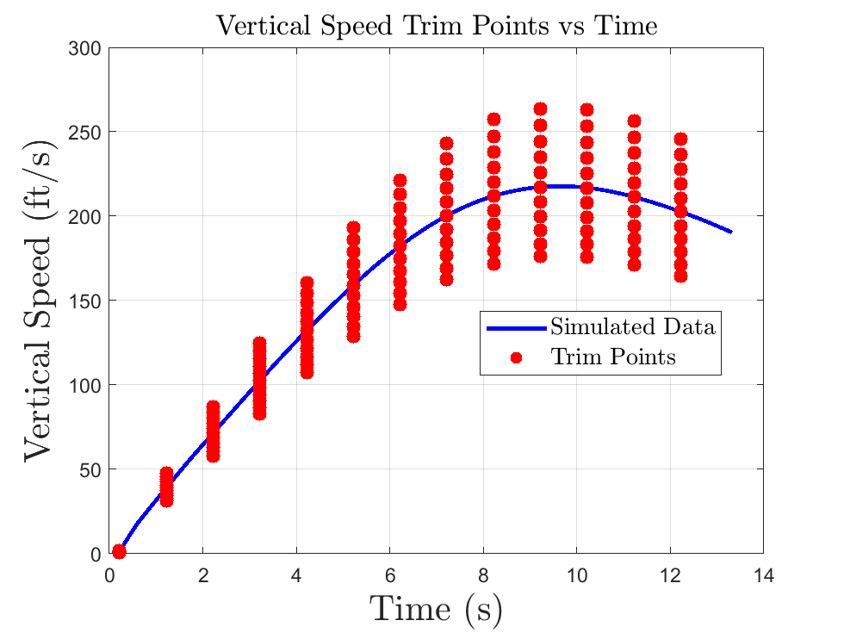
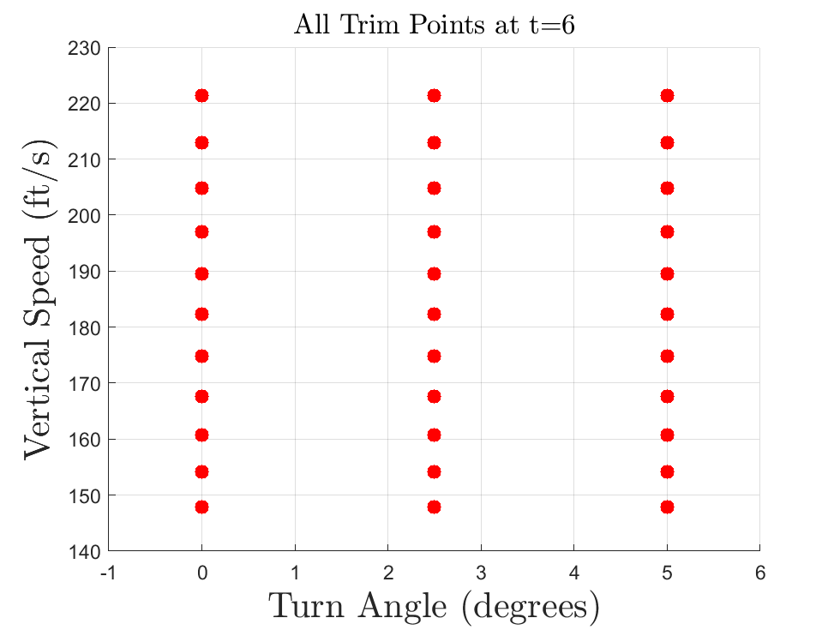

Trim Point Concept
  Trim points are points in state space that satisfy the form $\dot{\overset{⃑}{x}}=f(\overset{⃑}{x},\overset{⃑}{u})$
  Trim points were chosen based on the simulated trajectory with no control
  The current model has 429 trim points
Variable | Number of Variations | Definition
Vertical Speed | 11 | Change in aero force magnitude by 8%
Turn Angle | 3 | 0°, 2.5°, 5°
Time | 13 | 1 every second
Guidance, Navigation, and Control
Georgia Institute of Technology
Notes:
LQR only works with time invariant and linear systems
We need a way to control the rocket. We do that with trim points
What is a trim point?
Points in state space that are dynamically feasible (x_dot = f(x,u))
We can linearize the dynamics around that point and assume it is linear
Use LQR to get a K matrix
TP Generation / Variation
Trim points around simulated trajectory with no control
13 Batches
Each batch as 33 trim points
Example at time 6

Slide 19
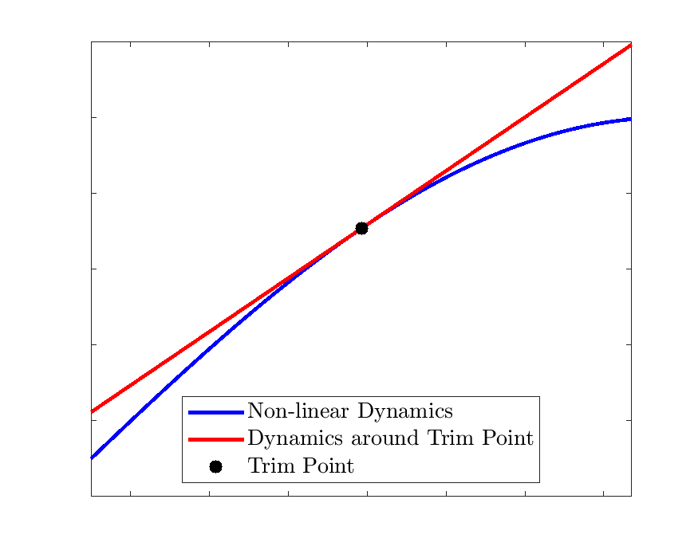






Trim Point Formulation
Dynamics
Trim Point
Given
$$\dot{\overset{⃑}{x}}=f(\overset{⃑}{x}, \overset{⃑}{u})$$
$${\dot{\overset{⃑}{x}}}_{0},{\overset{⃑}{x}}_{0},{\overset{⃑}{u}}_{0}$$
Calculate Jacobian
$$A=\frac{∂f({\overset{⃑}{x}}_{0})}{∂\overset{⃑}{x}}$$
$$B=\frac{∂f({\overset{⃑}{u}}_{0})}{∂\overset{⃑}{u}}$$
Dynamics around Trim Point
$$\dot{\overset{⃑}{x}} −{\dot{\overset{⃑}{x}}}_{0}=A\left(\overset{⃑}{x}−{\overset{⃑}{x}}_{0}\right)+B(\overset{⃑}{u}−{\overset{⃑}{u}}_{0})$$
Simplified equation
$$Δ\dot{\overset{⃑}{x}}=AΔ\overset{⃑}{x}+BΔ\overset{⃑}{u}$$
Gain Matrix
$$K=lqr(A,B,Q,R)$$
Guidance, Navigation, and Control
Georgia Institute of Technology
Notes:
Given
We know dynamics and Trim Points
Calculate Jacobian
This linearizes the dynamics around the trim point
Dynamics
Linear system. This represents the dynamics around the trim point
Simplified equation
Delta is the deviation from the trim points
Controller
To get our K we use the LQR function in MATLAB given our A, B, Q, R
Q and R matrices are the cost associated with the state and control

Slide 20
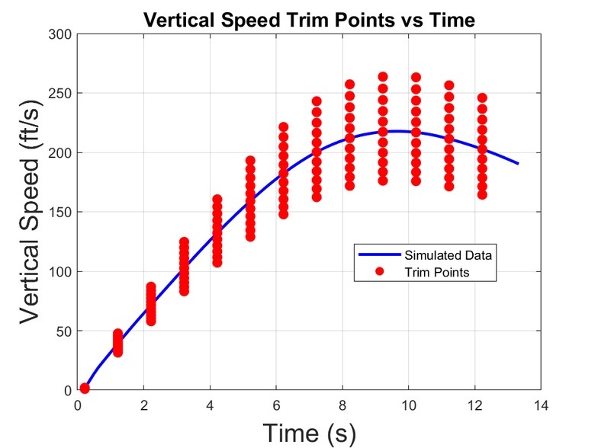

Trim Point Formulation
  Trim points were chosen based on the simulated open loop trajectory with no control
  A set of variations were added based on vertical speed and turn angle
  The current model has 429 trim points (11 vertical speed, 3 turn, 13 time)
Variation | Number of Trim Points | Definition
Vertial Speed | 11 | 8% of moment aero moment change
Turn Angle | 3 | 0°, 2.5°, 5°
Time | 13 | 1 every second

Slide 21

Linearization for A and B Matrices
  To run linear control, linear dynamics are needed
  The system is dynamically feasible if the function F is equal to zero
  The Taylor expansion is taken around the trim point
  The result is the linear equation where the delta is the deviation from the trim point
  This process is done for every trim point

Slide 22



Controllability and Gain Matrix Generation
  Controllability: the ability to bring the system from any initial state to any final state via the control inputs to the system over any given amount of time
    can check the rank of a “controllability matrix;” more intuitive to examine the state and control vectors
    Not every aspect of the nominal rocket state vector is able to be controlled (q₀) - so it is removed to generate gain matrices
  A given gain matrix $K$ can be derived from $A$, $B$, $Q$, $R$.
  Priority given to feasibly controlled states (roll and yaw components of state vector) and truly controlled control inputs (roll and yaw moments)
    Can derive K from Algebraic Riccati Equation, which is abstracted away in MATLAB
  Gain matrix found for every trim point

Slide 23

Controllability and Gain Matrix Generation
  Controllability: a necessary condition for using LQR
    rank of a “controllability matrix;” can also examine the state and control vectors
    Remove $q_{0}$ from state vector for controllability
  A gain matrix $K$ can be derived from $A$, $B$, $Q$, $R$.
  Priority given to feasibly controlled $x_{i}$(roll and yaw components of state vector) and truly controlled $u_{i}$(roll and yaw moments) in $Q$, $R$matrices.
  Gain matrix found for every trim point
Guidance, Navigation, and Control
Georgia Institute of Technology

Slide 24
Gain Scheduling
  Gain matrix is “optimal” only at trim point
  “LQR Gain Selector” algorithm written to ameliorate difference in rocket state from trim point
    Computes Euclidean distance from trim point
    Finds “closest” trim point
    Returns appropriate gain matrix
Rocket State
Guidance, Navigation, and Control
Georgia Institute of Technology
Trim Points

Slide 25
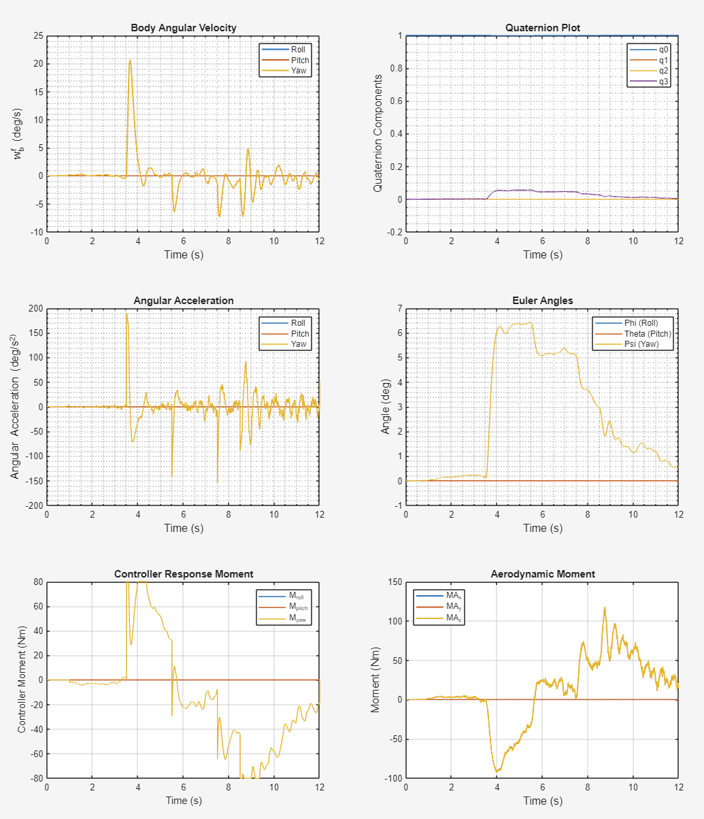
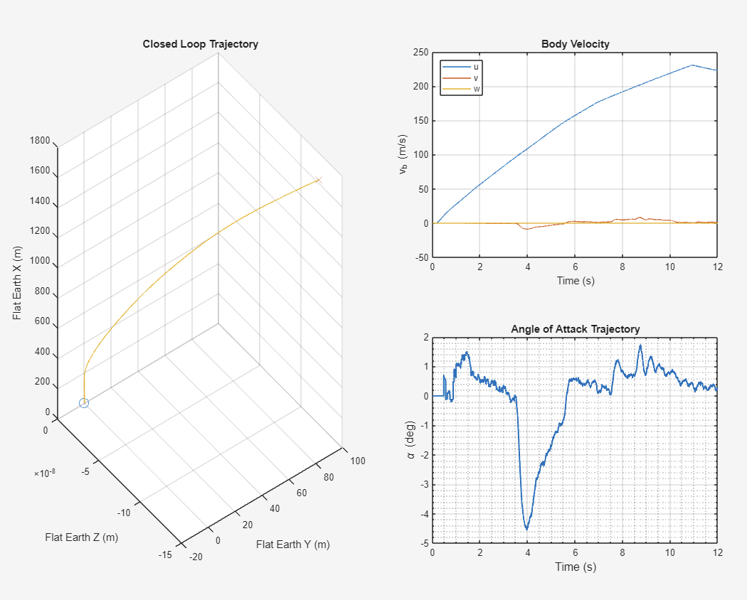
Closed Loop Simulation Dashboard
Guidance, Navigation, and Control
Georgia Institute of Technology

Slide 26
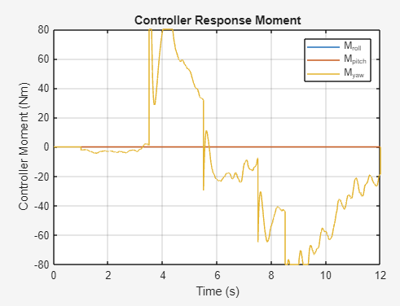
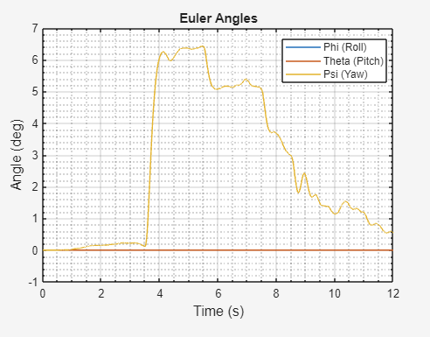
Closed Loop Simulation Dashboard
Guidance, Navigation, and Control
Georgia Institute of Technology

Slide 27
Controller Validation: Monte Carlo Analysis
Dynamics & Modeling
LQR
Controller Development
Guidance, Navigation, and Control
Georgia Institute of Technology

Slide 28
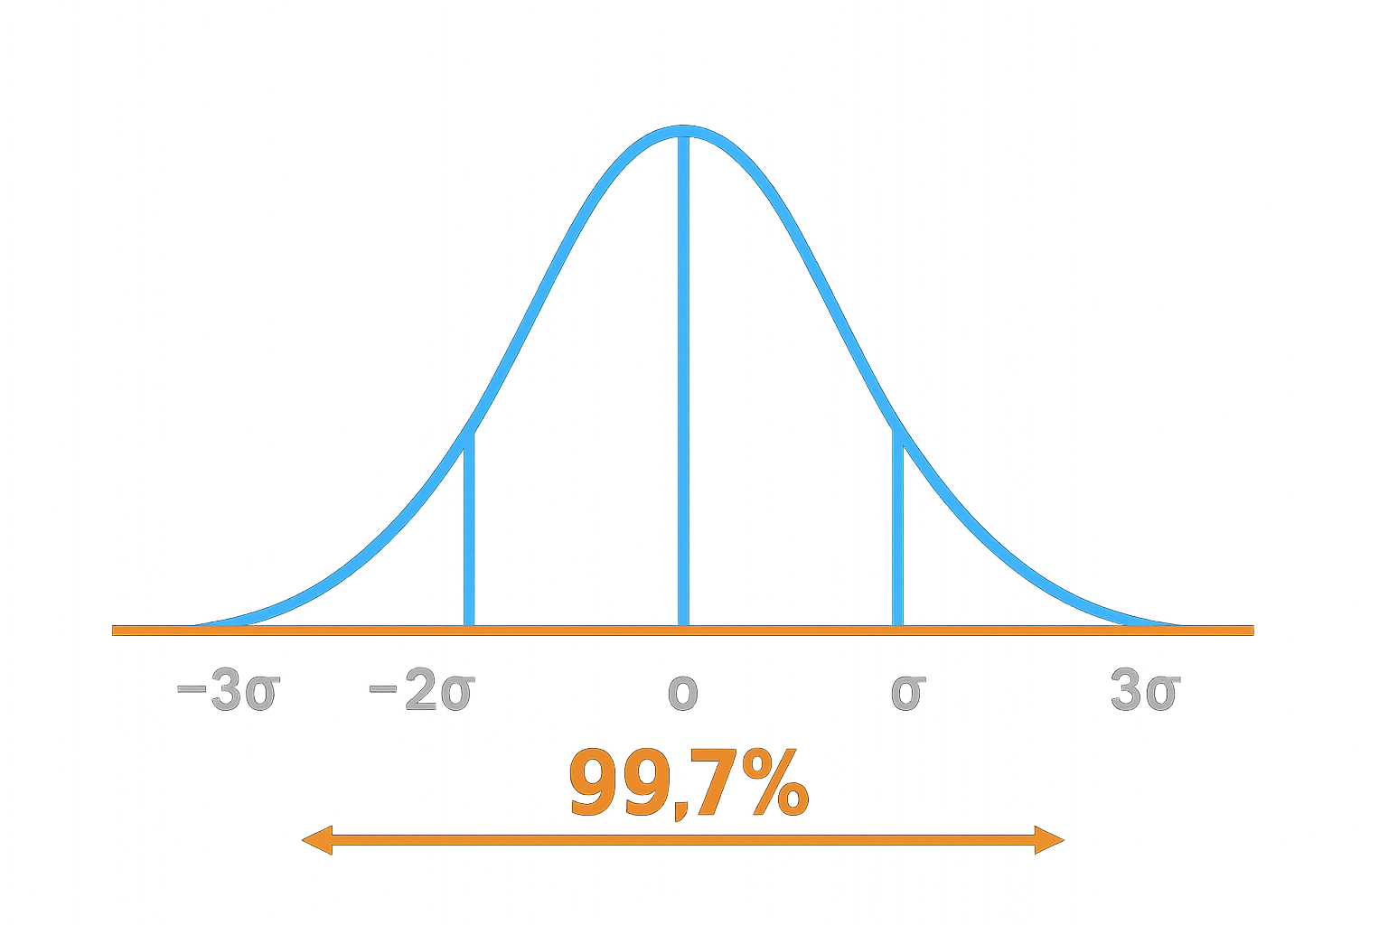
Monte Carlo Analysis
  Evaluate controller stability and performance under a wide range of flight conditions
  The varied parameters include:
    Rocket mass
    Inertia
    CG location
    Thrust curve
    Burn time
    Wind
  3σ (99.7% of all values) of each parameter =±10% of its mean.
Guidance, Navigation, and Control
Georgia Institute of Technology

Slide 29
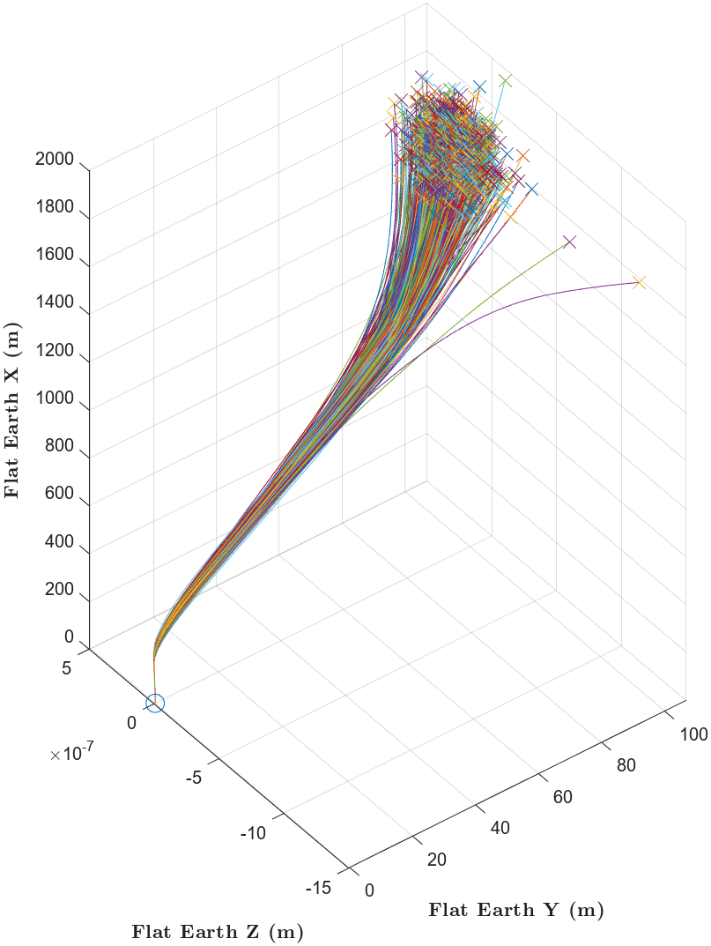
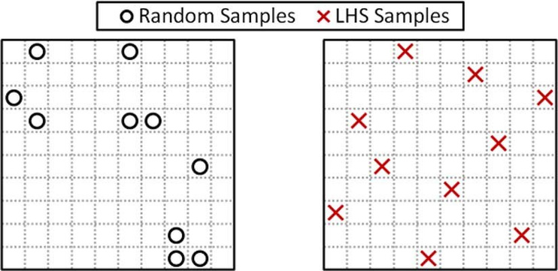
Monte Carlo Analysis
  1000 closed-loop control simulations with random parameters
  Using Latin Hypercube Sampling (LHS) to ensure a good spread of simulated values
Guidance, Navigation, and Control
Georgia Institute of Technology

Slide 30
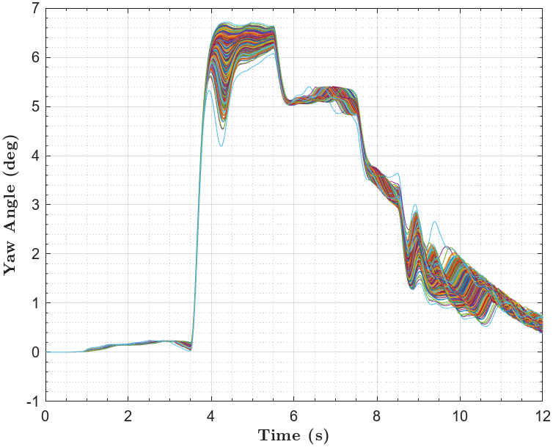
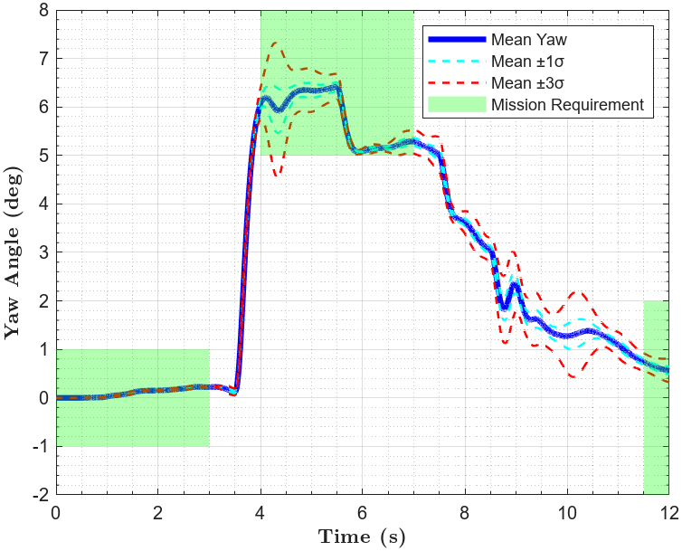
Monte Carlo: Validating the Controller
Guidance, Navigation, and Control
Georgia Institute of Technology

Slide 31


Notes:
Hector: we would like to thank our sponsors for the help they have provided in completing this study.

Slide 32


THANK YOU

