Slide 1



Project OUROBOROS: Material Selection Process for a Low-Power Magnetically Shielded Hall Thruster
Christopher Shiffer, Cameron Rodewald, Isaiah Boyd, Michael Fox

Slide 2
Overview of Presentation
What is a Hall Thruster?
Introduction to ORB-1-D1 Hall Thruster
Discharge Channel Overview and Material Selection
Magnetic Circuit Overview and Material Selection
Glow Discharge Hollow Cathode Overview and Material Selection
Verification and Future Goals

Slide 3
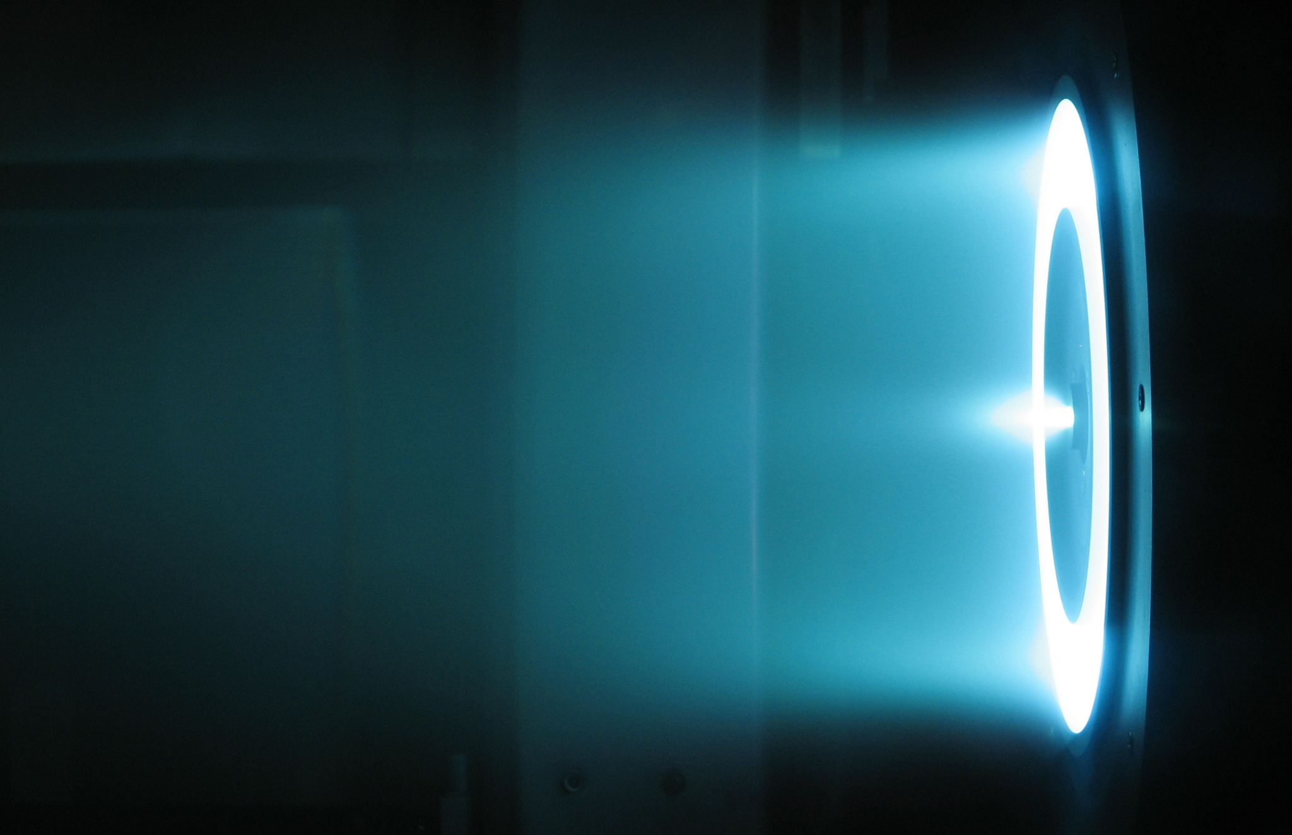
What is a Hall Thruster?

Slide 4
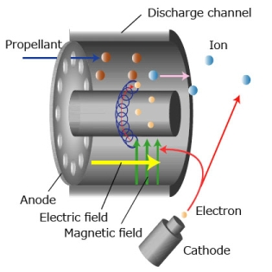
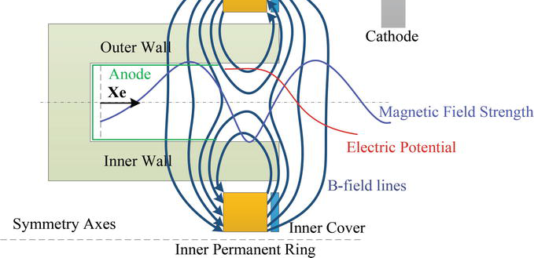
What is A Hall Thruster?
A Hall thruster is an electric propulsion device.
The thruster creates a plasma and accelerates the positive elements out of the annular channel.
The plume exiting the thruster needs to be neutralized, which is accomplished with a hollow cathode neutralizer.
The cathode also provides the initial high energy electrons for ionization.
The positive elements are accelerated by the anode in the base of the thruster (which also acts as the gas diffuser).

Slide 5
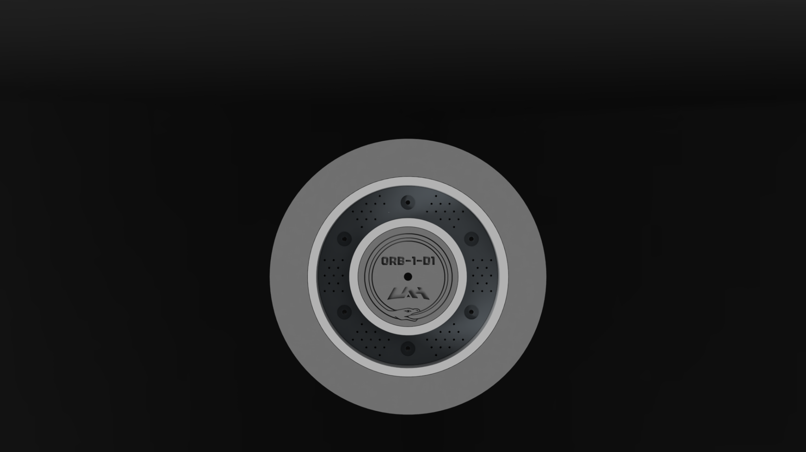
ORB-1-D1

Slide 6
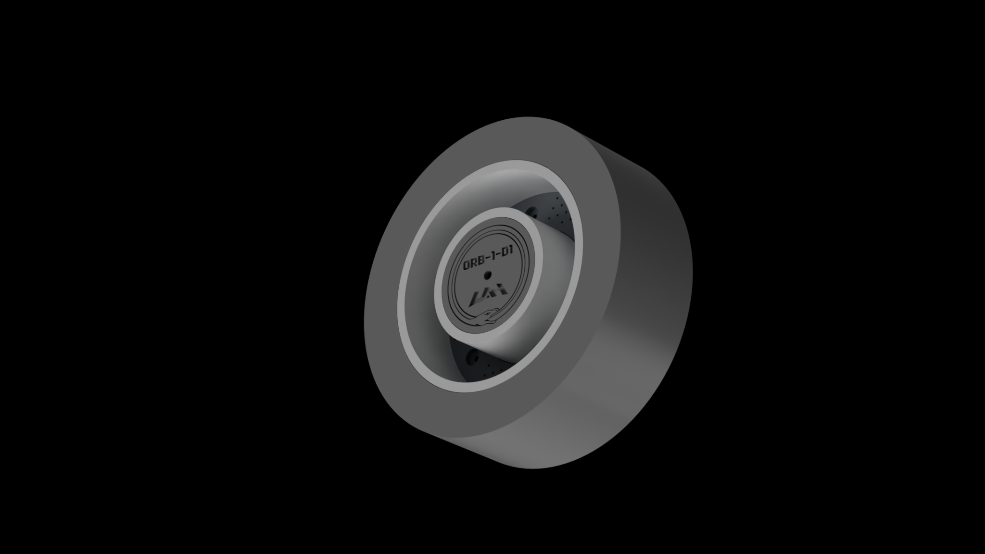
ORB-1-D1 Thruster Characteristics
At the current point in design, several performance characteristics are known.
Our thruster is a low power (1.35 kW at anode), magnetically shielded Hall thruster. Magnetic shielding was introduced to increase thruster operational lifetimes.
Argon was selected as a qualification fuel due to its relative abundance and low cost. Other fuels (krypton, xenon) may be used with some modification.
It is a Stationary Plasma Thruster (SPT), requiring the discharge channel to be a high temperature, high standoff dielectric material.

Slide 7
Discharge Channel Overview and Material Selection

Slide 8
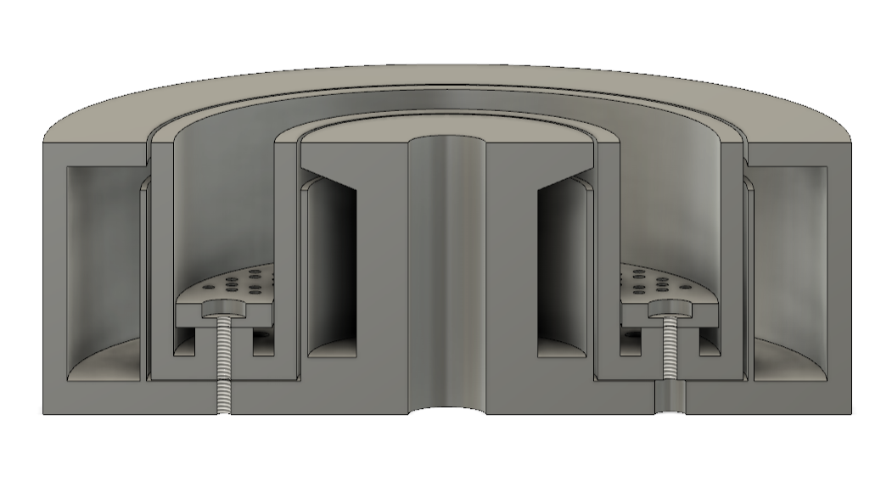
Discharge Channel Design Criteria - Overview
Dielectric Properties
Thermal Properties
Sputtering and Secondary Electron Emission
Manufacturability

Slide 9
Dielectric Properties
The discharge channel will be manufactured from Aluminum Silicate, as it is readily available from industrial suppliers, has low porosity, and has semi-favorable properties comparable to Boron Nitride.
Dielectric Properties:
Dielectric Constant: 5.3 at 1 Mhz
Dielectric Strength: 3.8 DC kV/mm
Less desirable than BN, as it has a lower dielectric strength compared to BN.

Slide 10
Thermal Properties
Various sources have put the temperature of the plasma in the chamber at 600 degrees Celsius, and with the nature of the reaction, the temperature load will be nearly instantaneous. Therefore, it is necessary to utilize a material that has both good thermal stability, and resistance to thermal shock. Aluminum Silicate ceramic is not the ideal choice, however, its material properties do meet these requirements.
Aluminum Silicate Thermal Properties:
Thermal Conductivity: 4 W/mK
Coefficient of Thermal Expansion: 5E-6 / C
Maximum working temperature: 1600 degrees C

Slide 11
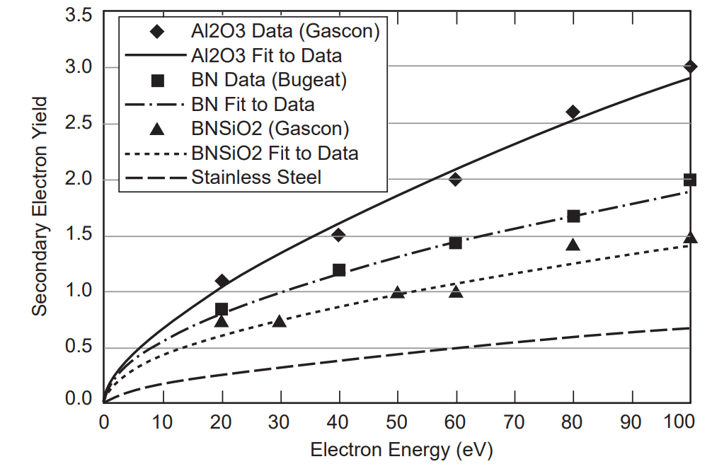
Secondary Electron Emission and Ion Sputtering
The discharge channel’s two most important factors are the secondary electron emission, which influences the efficiency of the thruster via excess electron emissions, and Ion sputtering which is basically erosion of the walls when ions hit them. Boron Nitride is usually the first choice for hall thruster construction due to its more favorable stats in these two categories as seen below.
Aluminum Silicate:
Decent Secondary electron emission
Poor Ion Sputtering performance
Boron Nitride:
Excellent secondary electron emission values.
Excellent ion sputtering performance.
Ref. [1]

Slide 12
Manufacturability and Cost
Aluminum Silicate is not an ideal choice for our thruster, however, it is one of the only machinable ceramics that can be readily bought in the dimensions needed. UAH facilities are available to our team to be able to machine the discharge channel, and there are multiple companies that offer it in the base dimensions.
Boron Nitride is often only available from niche suppliers, and is incredibly expensive in contrast to the rest of the thruster materials. However, it is easier to machine, and it is a better material for this application in every other respect.
Due to our budget however, Aluminum Silicate will meet the base requirements for our first iteration.

Slide 13
Magnetic Circuit Overview and Material Selection

Slide 14
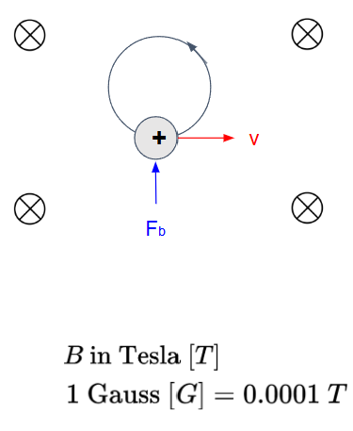
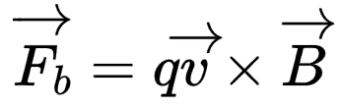
Magnetic Circuit Overview: Theory
Single Particle Motion in a magnetic field:
A charge with velocity v with no E-field will experience no work due to the magnetic field. It will experience a force,
Due to F being orthogonal to v, the magnitude of velocity is not changed, however, the direction is. Therefore the charged particles spin around the magnetic field lines at a certain distance and frequency.
This allows us to “trap” electrons for a period of time at the thruster exit plane and create a plasma.

Slide 15
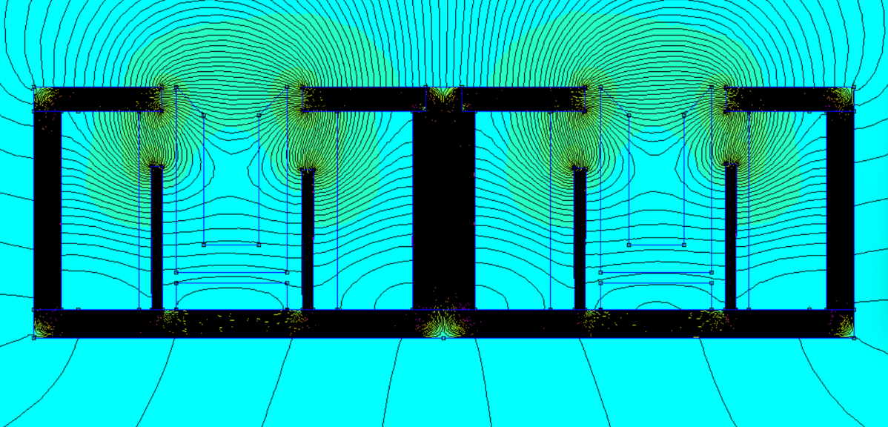
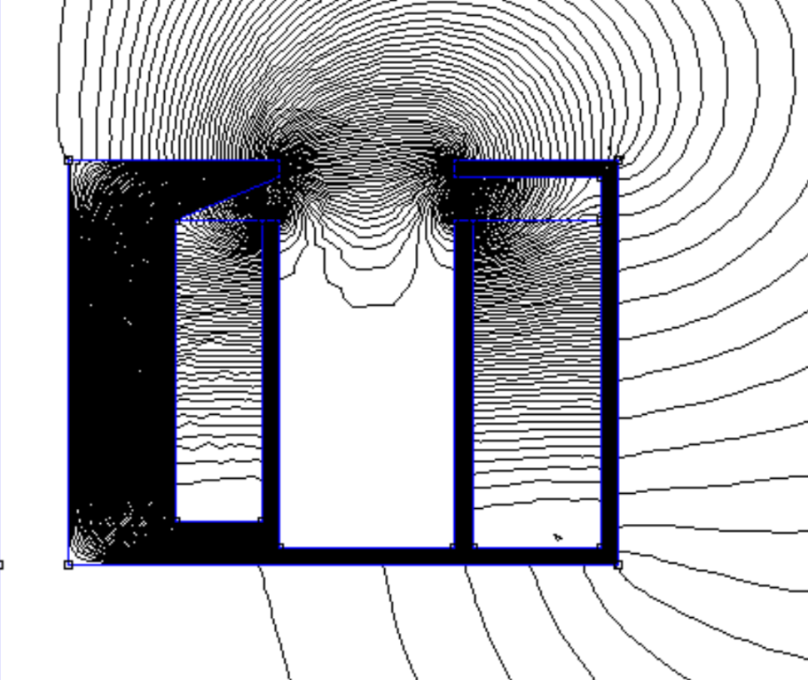
Magnetic Circuit Overview: Hall Thruster Application
The Magnetic circuit is designed in such a way that the majority of the field lines do not terminate on the walls of the discharge chamber. Instead they form a cup which bends around the walls, keeping plasma from forming on the walls. This is achieved through a the use of screens and pole length in order to manipulate the field into the desired shape.

Slide 16
Magnetic Circuit Material Selection
While modeling the magnetic circuit, there were several materials that could be used such as pure iron, however, many of the high permeability materials are incredibly expensive. Low carbon steels offer high enough permeability to be effective, while being much easier to find in the necessary dimensions. 1010 steel was chosen as the material to build the magnetic circuit for a variety of reasons:
Relatively high permeability around 902.6
Low coercivity (near zero)
Easy to machine
Relatively high magnetic saturation point.
Low price and ease of purchase.

Slide 17
Glow Discharge Hollow Cathode Overview & Material Selection

Slide 18
Glow Discharge Hollow Cathode
Relies on secondary electron emission rather than thermionic emission to maintain a DC glow discharge plasma, producing a stream of electrons.
Secondary electron emission occurs when a particle (propellant ion) collides with the cathode surface, knocking an electron off.
This electron is then extracted via electric fields out of the device.
The GDHC supplies the Hall thruster with electrons to maintain plasma, and neutralizes the exiting ion beam.
Electron beam
Extractor electrode
Keeper electrode
Plasma
Ceramic insulators
Cathode cup
Neutral Propellant In

Slide 19
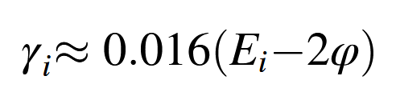



Glow Discharge Design Criteria
V
(To anode)
Good insulators need to separate the electrodes to avoid shorts.
Want a high ion-induced secondary electron emission coefficient.
Thus, our cathode material should have a low work function while being conductive.
Low cost, easily attainable, easily manufacturable, high temperature materials are desired.
Extractor
electrode
Keeper electrode
[1,2]
x
= ion-induced SEE coefficient: higher is better
= neutral’s first ionization energy (propellant property)
Cathode cup
Exit Plane
= cathode work function (material property)
Voltage over the GDHC axial length, scaled (steady-state)
[1] Raizer, Y.P., Gas Discharge Physics, Springer-Verlag Berlin Heidelberg, 1991.
[2] Heri, J., Li, Y.-H., Wang, W.-C., and Huang, P.-H. "Design and Development of Prototype Low Power Glow Discharge Hollow Cathode for Plasma Thruster." Proceedings of the 2023 IEEE International Conference on Aerospace Electronics and Remote Sensing Technology (ICARES), Bali, Indonesia, Oct. 26–27, 2023.

Slide 20
Glow Discharge Material Selection
Material | Work Function (eV) [1] | Price ($/kg) [2]
Beryllium | 3.67 | $1,033.66
Titanium | 3.6-4.3 | $15.81
Chromium | 3.9 | $7.97
Iron | 4.47 | $0.55
Nickel | 4.41 | $15.72
Copper | 4.42 | $9.85
Platinum | 5.6-5.8 | $45,962.02
304 Stainless | 4.3 | $1.42
304 Stainless Steel was chosen for all electrodes (cathode, keeper, and extractor).
  Commonly available, inexpensive, machinable
  Work function of approximately 4.3 eV (Wilson, 1996)
  Iron is another material to consider
Alumina (Al2O3) was chosen for the internal ceramic insulators.
  Commonly available, inexpensive, machinable
  Commonality with other thruster systems
Remaining work on GDHC focuses on:
  Sizing cathode parts for optimal performance
  Characterizing behavior of device via vacuum testing
  Miniaturization to fit within the center mounting area
[1] Wilson, R. G. "Vacuum Thermionic Work Functions of Polycrystalline Be, Ti, Cr, Fe, Ni, Cu, Pt, and Type 304 Stainless Steel." Journal of Applied Physics, Vol. 37, No. 5, 1966.
[2] Shanghai Metals Market, 4/1/2025.

Slide 21
Verification and Future Goals

Slide 22
Verification and Future Goals
Planned hot fire test by Q4 of 2025 of ORB-1-D1.
Verification of material selection from testing data from ORB-1-D1 for next iteration.
Designed and manufactured new iteration (ORB-2-D1) by Q2 2026.
Implementing quality control by using industry standard materials.
Implement additive manufacturing techniques to reduce manufacturing costs.
Design and manufacture flight qualifiable prototype thruster package in ~4 years.

Slide 23
Acknowledgements
Dr. Themistoklis Chronis, University of Alabama in Huntsville, College of Science, Faculty Advisor
University of Alabama in Huntsville, College of Science
University of Alabama in Huntsville, College of Engineering
Blue Origin

Slide 24
References
[1]Jorns, B., Mikellides, I. G., Goebel, D. M., Hofer, R. R., and Wirz, R. E., "Physics of Cross-Field Electron Transport in High-Specific Impulse Hall Thrusters," Proceedings of the 35th International Electric Propulsion Conference, Electric Rocket Propulsion Society, Atlanta, GA, Oct. 2017. [Online]. Available: https://electricrocket.org/IEPC/35_2.pdf
[2] Arrington, L. A., Cuaron, A., and Danczyk, S. A., "Design, Fabrication, and Testing of the UAH-78AM Hall Thruster," Aerospace, Vol. 8, No. 8, 2021, p. 227. DOI: 10.3390/aerospace8080227. [Online]. Available: https://www.mdpi.com/2226-4310/8/8/227
[3] Jorns, B. A., Lappas, V., and Birkan, M., "Magnetic Circuit Optimization for Hall Thrusters Design," Proceedings of the 36th International Electric Propulsion Conference, Electric Rocket Propulsion Society, Vienna, Austria, Sept. 2019. [Online]. Available: https://electricrocket.org/2019/459.pdf
[4]King, D. Q., Polk, J. E., and Huang, W., "Environmental Testing of the HERMeS TDU-2 Hall Thruster," Proceedings of the 2018 AIAA Joint Propulsion Conference, Cincinnati, OH, July 2018. AIAA Paper 2018-4822. [Online]. Available: https://vaguesalutations.github.io/bin/HET_resources/CL_18-3444.pdf
[5]Kamhawi, H. (2019) Performance, Stability, and Thermal Characterization of a Sub-Kilowatt Hall Thruster. Available at: https://electricrocket.org/2019/910.pdf.
[6]Brown, Nathan P., and Mitchell L. R. Walker. “Review of Plasma-Induced Hall Thruster Erosion.” Applied Sciences, vol. 10, no. 11, May 2020, p. 3775. https://doi.org/10.3390/app10113775.
[7]Goebel, Dan M., et al. Fundamentals of Electric Propulsion. John Wiley and Sons, 2023.
[8]Hopping, Ethan P., et al. “Small Hall Effect Thruster With 3D Printed Discharge Channel: Design and Thrust Measurements.” Aerospace, vol. 8, no. 8, Aug. 2021, p. 227. https://doi.org/10.3390/aerospace8080227.
[9] Lieberman, Michael A.; Lichtenberg, Allan J. (2005). Principles of plasma discharges and materials processing (2nd ed.). Hoboken, N.J.: Wiley-Interscience. 546. ISBN 978-0471005773. OCLC 59760348.

Slide 25
References
[10] Applied Ion Systems AIS-TR-027 AIS-GDN1 Glow-Discharge Hollow Cathode Neutralizer Ignition Test 1 - 02/20/2021 Testing Report and Summary
[11] Heri, Juwantono, et al. “Design and Development of Prototype Low Power Glow Discharge Hollow Cathode for Plasma Thruster.” Institute of Electrical and Electronics Engineers, Oct. 2023, pp. 1–5. https://doi.org/10.1109/icares60489.2023.10329910.
[12] Han, Ao, et al. “Effects of Propellant Species on the Discharge Characteristics of Glow Discharge Hollow Cathode.” Vacuum, vol. 221, Dec. 2023, p. 112867. https://doi.org/10.1016/j.vacuum.2023.112867.
[13] Jain, Prachi Lalit. Characterization of a Low Current LaB6 Heaterless Hollow Cathode With Krypton Propellant. 25 June 2020, vtechworks.lib.vt.edu/handle/10919/99141.
[14] Rand, Lauren P., and John D. Williams. “Effect of a Low Work Function Insert on Hollow Cathode Temperature and Operation.” 49th AIAA/ASME/SAE/ASEE Joint Propulsion Conference, July 2013, https://doi.org/10.2514/6.2013-4037.
[15]The Virtual Foundry, "Zirconium Silicate Zircopax Ceramic Filamet™," The Virtual Foundry, accessed Mar. 3, 2025. [Online]. Available: https://shop.thevirtualfoundry.com/collections/ceramic-filaments/products/zirconium-silicate-zircopax-ceramic-filamet
[16]The Virtual Foundry, "Silicon Carbide Filamet™," The Virtual Foundry, accessed Mar. 3, 2025. [Online]. Available: https://shop.thevirtualfoundry.com/products/silicon-carbide-filamet

