Slide 1
Mars Exploration and Surveillance Assets
Liam Gass, Samantha Stein, Tyler Sleva, Tyler Husar, Luke Osland, and Brian O'Connell
Team M.E.S.A. at Embry-Riddle Aeronautical University
AIAA Region II Student Conference, April 3rd-4th, 2025
Copyright © by Liam Gass at Embry-Riddle Aeronautical University, Florida.
Published by the American Institute of Aeronautics and Astronautics, Inc., with permission.

Slide 2

Outline
Background
Objectives and Scope
Mission Phasing
System Architecture
Cost Projections
Summary and Impact

Slide 3
Project Background
The Why of Our Mission

Slide 4
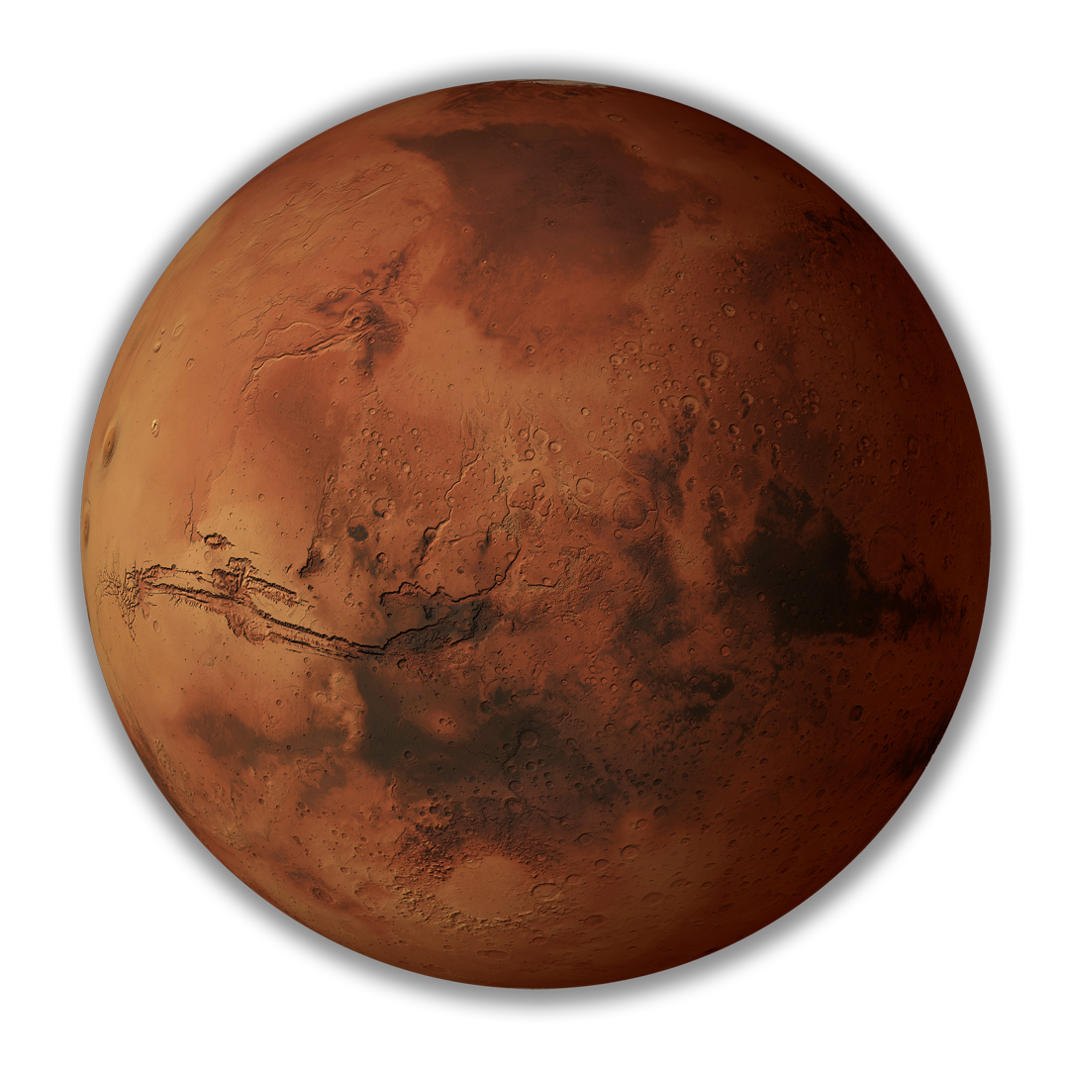
Relevance
Why go to Mars?
  Presence of Ice
  Feasible Human Exploration
  The Search for Life
What can we do?
  Create Mission Standards
  Obtain More Data from Mars
  Advance Technology
Mars: Fertile Ground? | Villanova Magazine | Villanova University https://www1.villanova.edu/university/sites/magazine/summer-2018/mars-fertile-ground.html

Slide 5
Objectives and Scope
Requirements for where we are going

Slide 6
Objectives – NASA
  NASA Policy Directives (NPD):
    NPD 8700.1: NASA Policy for Safety and Mission Success
  NASA Procedural Requirements (NPR):
    NPR 8705.4: Risk Classification for NASA Payloads
    NPR 8715.3: NASA General Safety Program Requirements
    NPR 8715.24: Planetary Protection Provisions for Robotic Extraterrestrial Missions
  NASA Standards:
    NASA-STD-8719.14: Process for Limiting Orbital Debris
    NASA-STD-8719.25: Range Flight Safety Requirements
    NASA-STD-8719.27: Implementing Planetary Protection Requirements for Space Flight
    NASA-STD-8739.8: Software Assurance and Software Safety

Slide 7
Objectives – AIAA
  Design Requirements and Constraints:
    RFP-1: The asset(s) will be launched from Earth to Mars vicinity
    RFP-2: Data objectives include atmospheric composition, geographic surveying, and resource quantification
    RFP-3: The mission concludes at 75% coverage of one or more data objectives
  Mission Timeline Requirements:
    RFP-4: The primary mission will be completed no later than December 31, 2033
    RFP-5: The asset(s) should be capable of operating into the late 2030s
  Total Project Budget:
    RFP-6: The mission, including all development, hardware, launch, and operation, will cost $1 billion USD or less up until the primary mission phase is complete.

Slide 8
Objectives – Team
Primary Goal:
  Create a Terrain and Elevation Profile of the Martian Surface
Secondary Goals:
  Identify and Quantify Resources on Mars via on-site data collection
  Obtain Long-term Data (≥6 months)

Slide 9
Mission Scope
    Stage separation
  Journey to Mars:
    Launch
    Interplanetary travel period
  Primary Mission Phase:
    Probe Launch & Data Collection: Core phase of mission planning and primary mission lifecycle stage.
    Data Collection: Gathers geographic and atmospheric data to meet mission objectives.
    Mission Success: Ensured through extensive testing and redundancy in all subsystems.
    Failure Mitigation: Designed so single-component failures do not cause total mission failure.

Slide 10
Mission Phasing
The Plan of How to Succeed

Slide 11
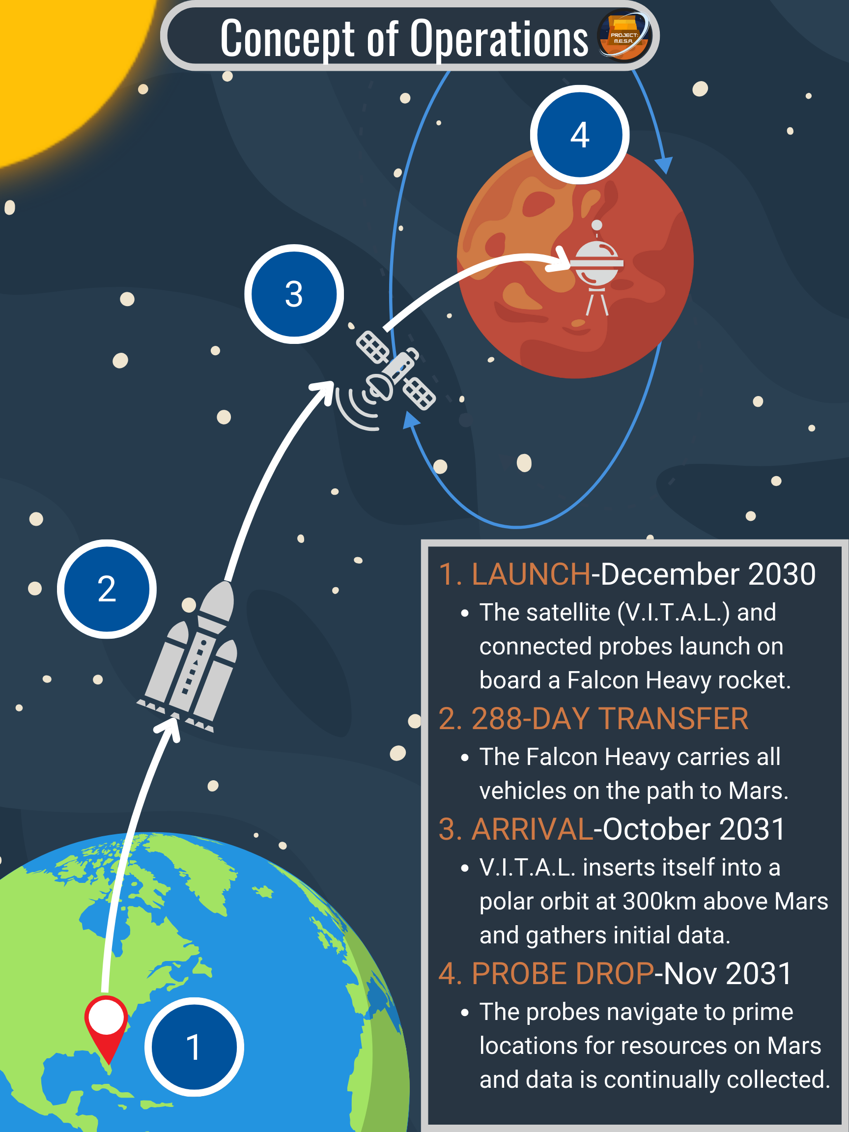
Key Phases & Concept of Ops.
Initial Concept of Operations (image)
Complete Phase System:
  Initial Launch and ΔV Maneuver
  Hohmann Transfer Orbit
  Mars Polar Orbit Insertion
  Initial Operations and Data Collection
  Probe Landing and Primary Data Phase
Continued Operation until E.O.L.

Slide 12
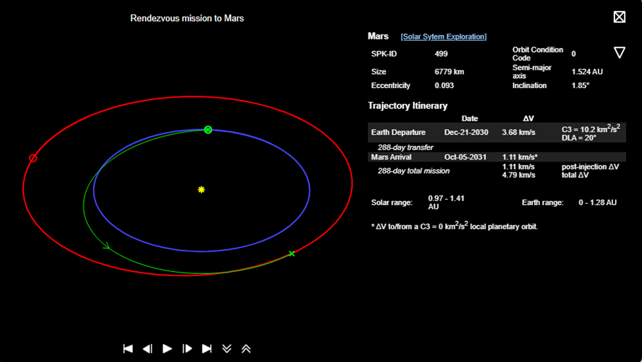
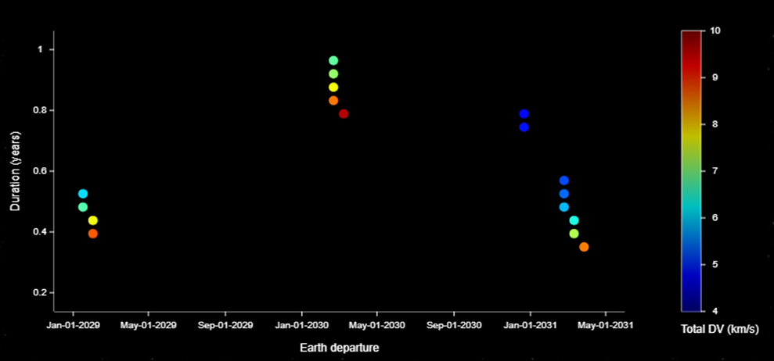
Trajectory
Calculated using NASA's Trajectory browser software.
Departure: Best launch window on December 21st, 2030.
Trajectory: Elliptical orbit around the sun to Mars.
Delta-V: Minimized to 4.79 km/s
  Injection ΔV - 3.68 km/s
  Post-Injection ΔV - 1.11 km/s
Operation: 300 km polar orbit

Slide 13
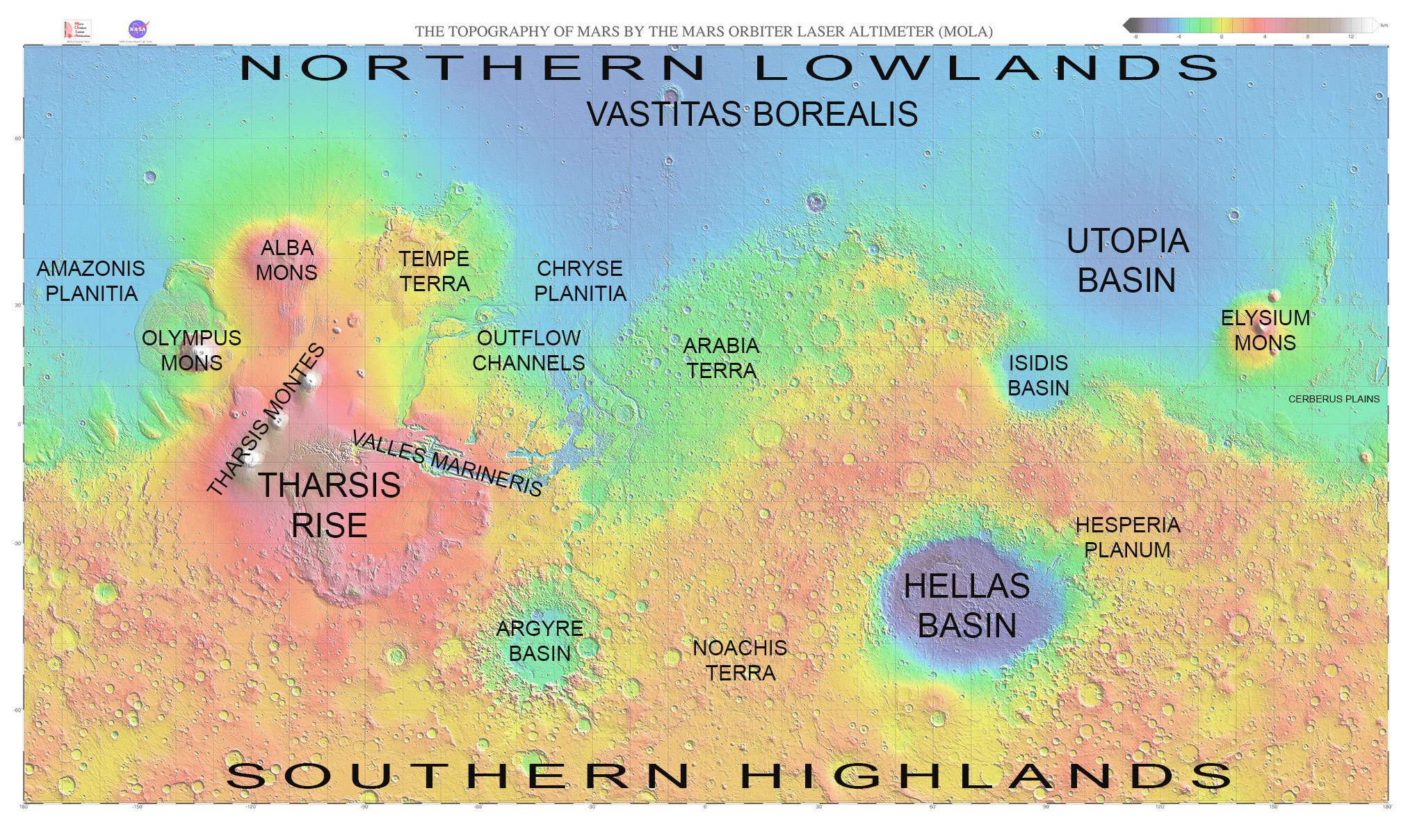
Scientific Goals
Main Goals:
  Geographical Information
  Topological Data Map
Resulting Usage:
  Facilitates further exploration of Mars
  Outcomes of data provide ideal landing spots and resource spots.
  Provides new and updated mapping information
  Shows how Mars has and may continue to change
Map of Mars with major regions labeled | The Planetary Society: https://www.planetary.org/space-images/map-mars-major-features

Slide 14
Engineering Goals
Satellite: Scan for geographical and topographical data.
Probe Release System: Launch probes toward landing and resource sites
Dropship: House probes during atmospheric entry and relays data to the satellite
Probes: Medium-to-long-range mobility with sub-surface and topographical data collection

Slide 15
Sustainability Factors
Renewable Energy: Solar panels will be used for energy, including thrusters, which reduces use of nonrenewable fuel.
Probe Release: Probes will land using on-board thrusters, minimizing impact with the Martian surface.
End of Life: The satellite will deorbit into Mars' atmosphere and burn up to prevent impact and space debris.

Slide 16
M.E.S.A. Architecture
What is used to make the mission happen

Slide 17
Architecture Breakdown
Mars Mission
Mission Operations
Systems Engineering
Payload
Launch Vehicle and Services
Ground Support
Testing and Integration
Safety and Quality Assurance
V.I.T.A.L.
Dropship
Central Comms.
Probes
Manufactured Parts
External Components
Trajectory Analysis
Deploy Ops.
Pre-launch Ops.
Payload Integration
Attachment Fittings
Separation Rings
Data Downlink
Maintenance Ops.

Slide 18
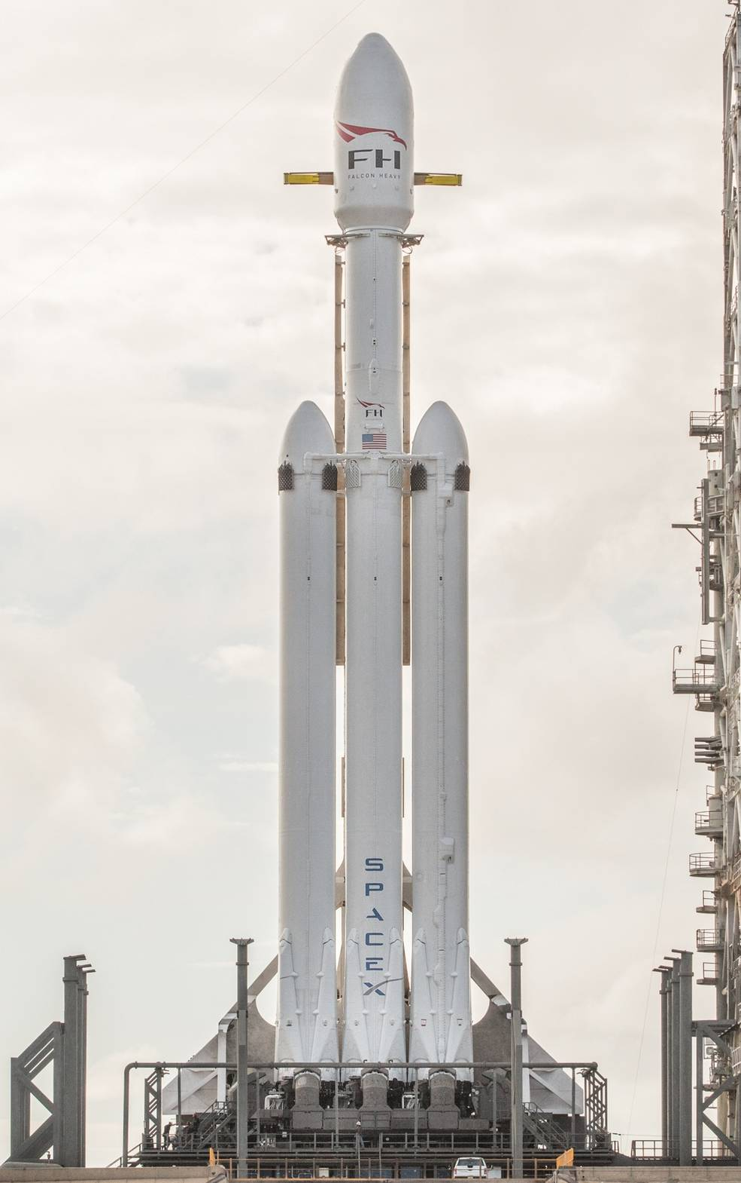
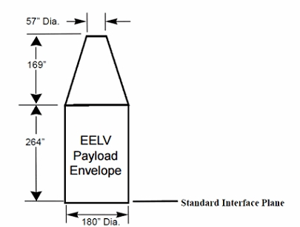
Launch Vehicle – Falcon Heavy
Background/Statistics:
≤16,800 kg Payload Mass (Directly to Mars)
~180 m³ Volume Capacity
Reusable Side Boosters and Center Core
Near-Perfect Success Rate
(HLV EELV Payload Type)
5 Years Ago: First Flight of the Falcon Heavy Rocket - NASA: https://www.nasa.gov/history/5-years-ago-first-flight-of-the-falcon-heavy-rocket/

Slide 19
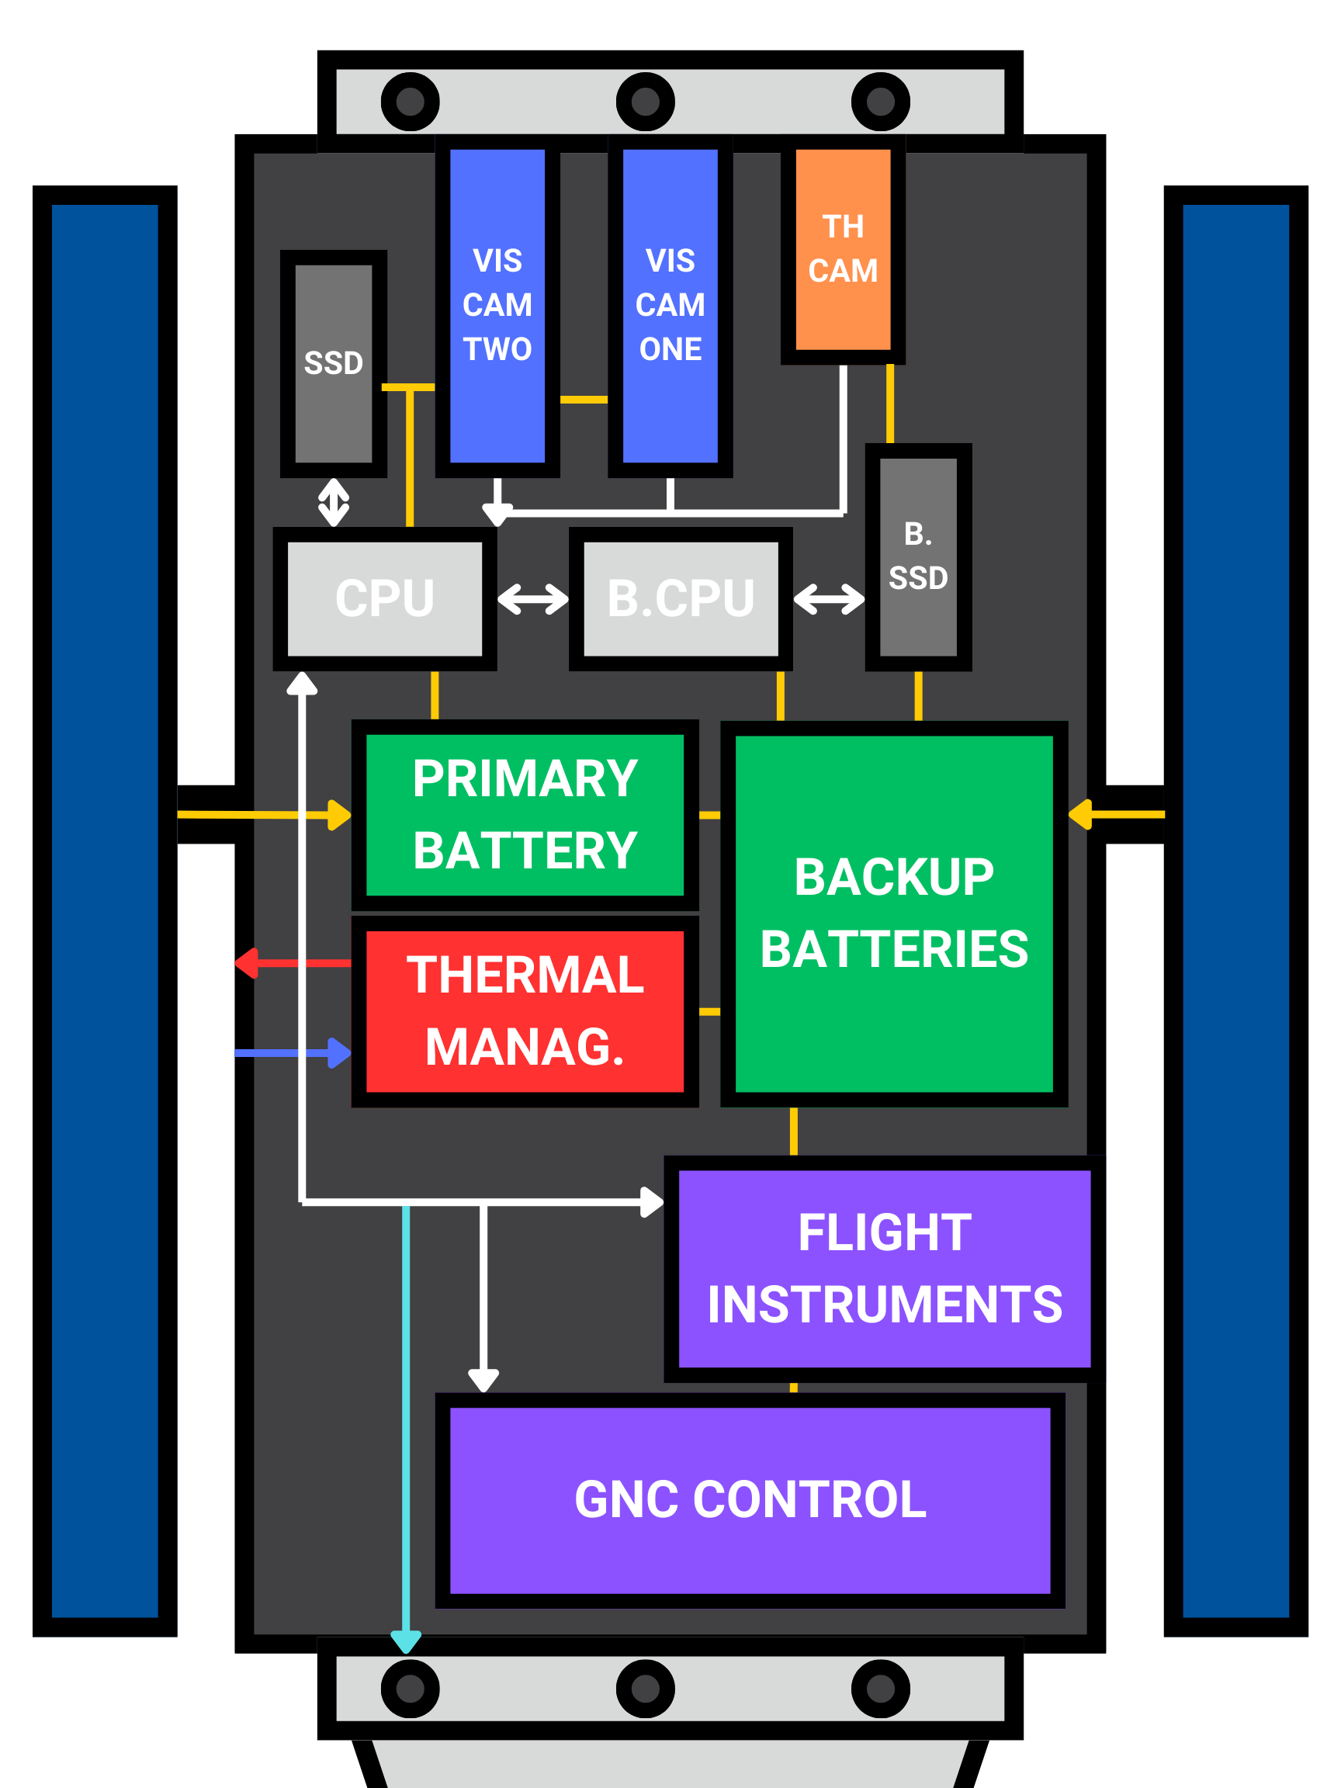
"V.I.T.A.L." Satellite Systems
Versatile Imaging Thermal Analysis (and) Link Satellite
Two Primary "Mapping" Cameras
  L3Harris SpaceView 80 and 50
Secondary Thermal Camera
  Raptor Photonics OWL-640-M
Communications
  X-band (light blue line) and UHF
  Deep Space Network

Slide 20
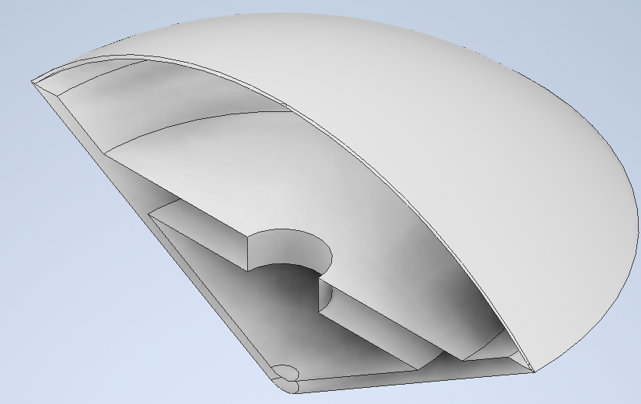
"Mothership" Dropship Layout
Design Considerations
  Thermally isolate probes from heat upon entry into Martian Atmosphere
  Ensure landing of probes onto Martian surface under minimal to zero shock to probes
Anticipated Subsystems
  Communications
  Power
  Dome Release
  Parachute-Airbag
(Side Section View, where components will go)

Slide 21
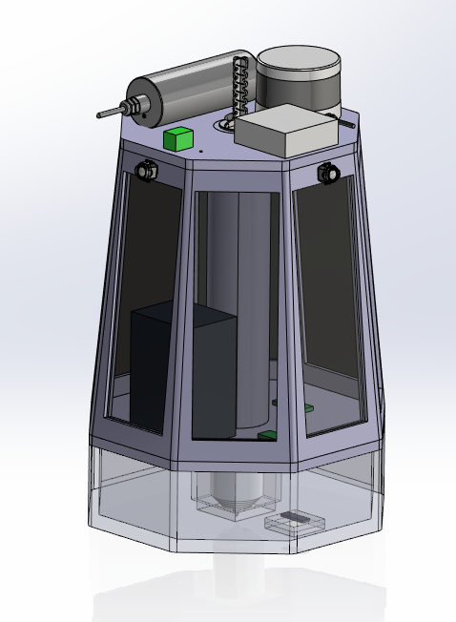
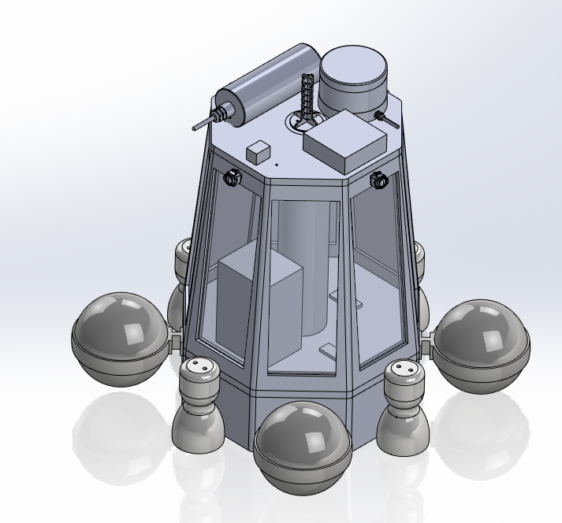
"M.I.N.I." Probe Designs
Mars Interconnected Network Intelligence Probes
CAD Model not including instrument protection mounts
Power, Communications, Instruments, Thrusters

Slide 22
Cost Projections
The costs for when each part of the mission takes place

Slide 23
Cost Estimation Strategy
Utilized NASA's PCEC V2.3 software to perform all cost and WBS analysis
Primarily, the Robotic SC, Planetary calculator
Timeline, heritage ratings, and overall cost were performed throughout the project timeframe and adjusted as needed

Slide 24
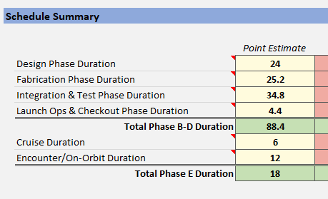
Schedule and Planning
Schedule Summary in Months (image)
Based on previous missions with a similar purpose and estimated spread of time gathered by the platform
Total Duration: ~8.9 years
  Pre-Launch: ~7.4 years
  Primary Mission: 1.5 years

Slide 25
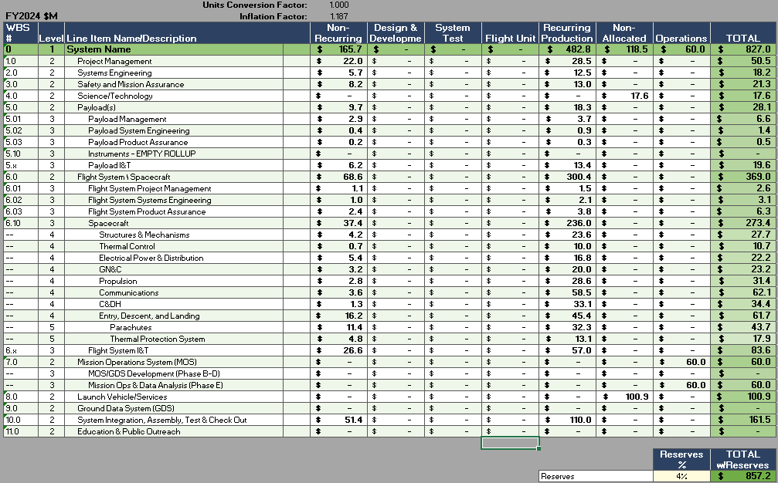
Cost Breakdown
Cost was broken down into systems and subsystems
RFP Standards:
$1 Billion USD in Y2024
Total Mission Estimate (Y2024):
$857.2 Million USD

Slide 26
Cost Breakdown

Slide 27
Summary and Research Impact
The complete mission and who may be affected by the scientific data obtained

Slide 28
Our Mission
Goals: Create a Terrain and Elevation Profile of the Martian Surface
Identify Mars Resources and gather Atmospheric Data
Obtain Long-term Data (≥6 months)
Notes:
(Add the most important factors of the mission to be summarized here)

Slide 29
Potential Impacts from the Mission
Resource Deposit Locations
More Accurate Mars Maps (Surveying)
Mars Atmospheric Composition Data
Notes:
(how this mission and its data collection/complex operations might affect future missions or the industry in general)

