Slide 1


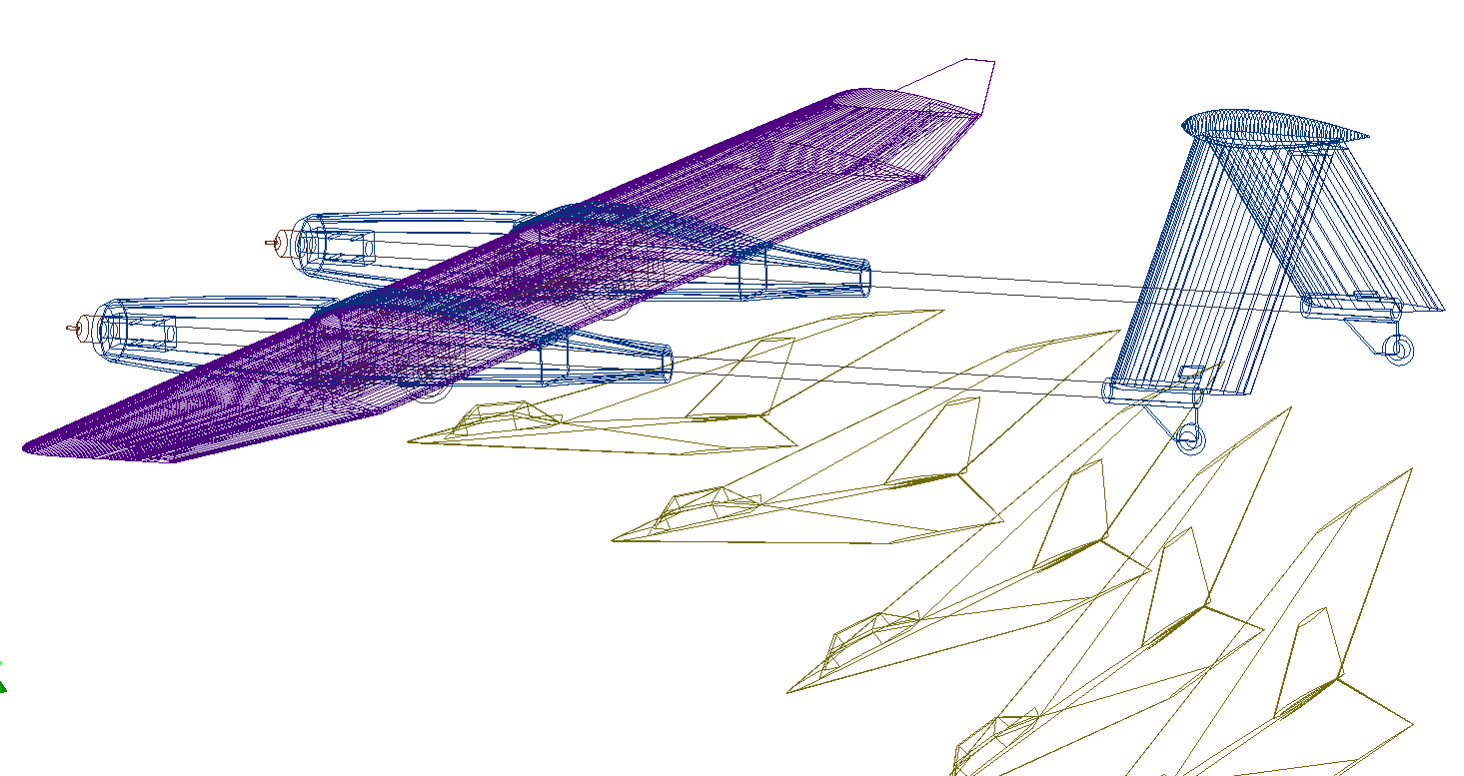
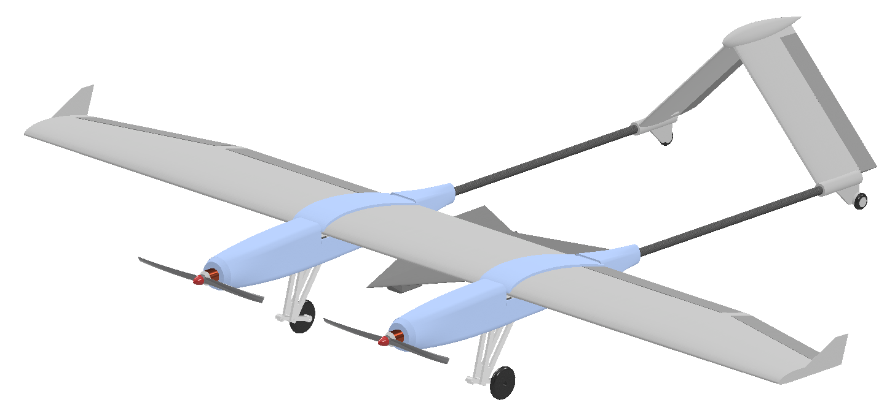


Carrier Plane Design for the AIAA DBF Competition
University of Alabama in Huntsville
Space Hardware Club, SPAROW Program
Kota Mitsumoto, Ryan Maye, Duncan Green

Slide 2
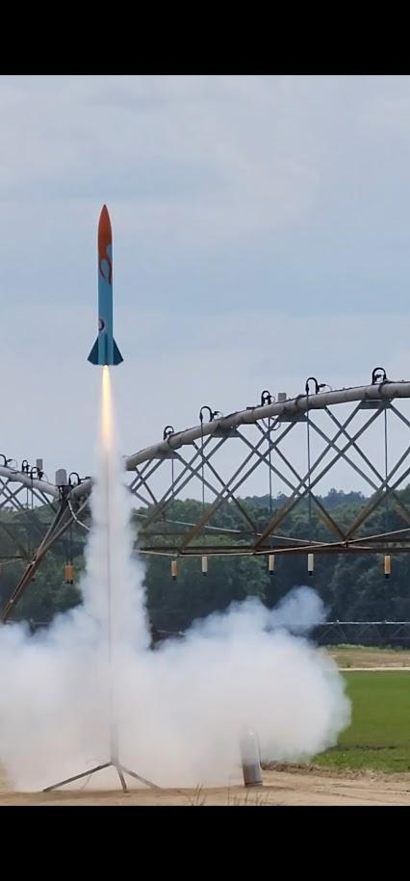
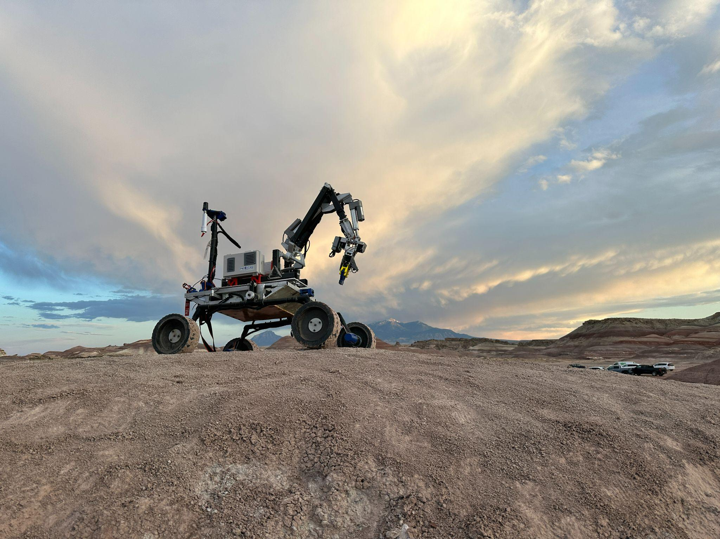

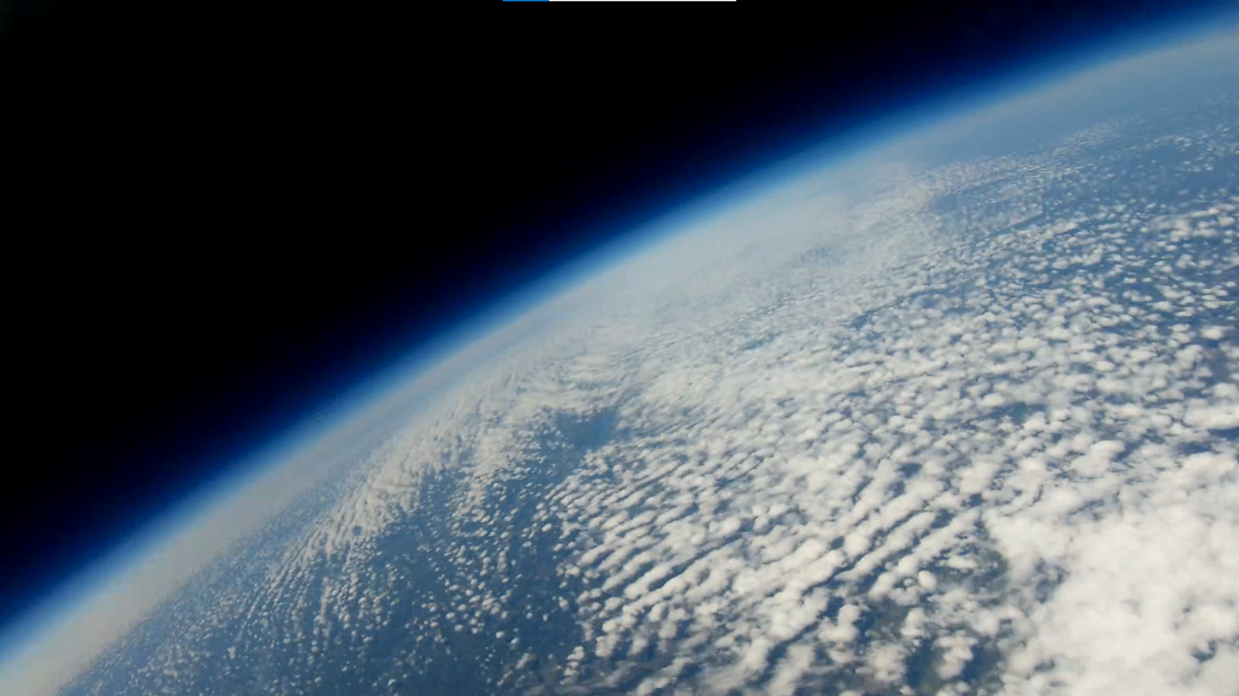
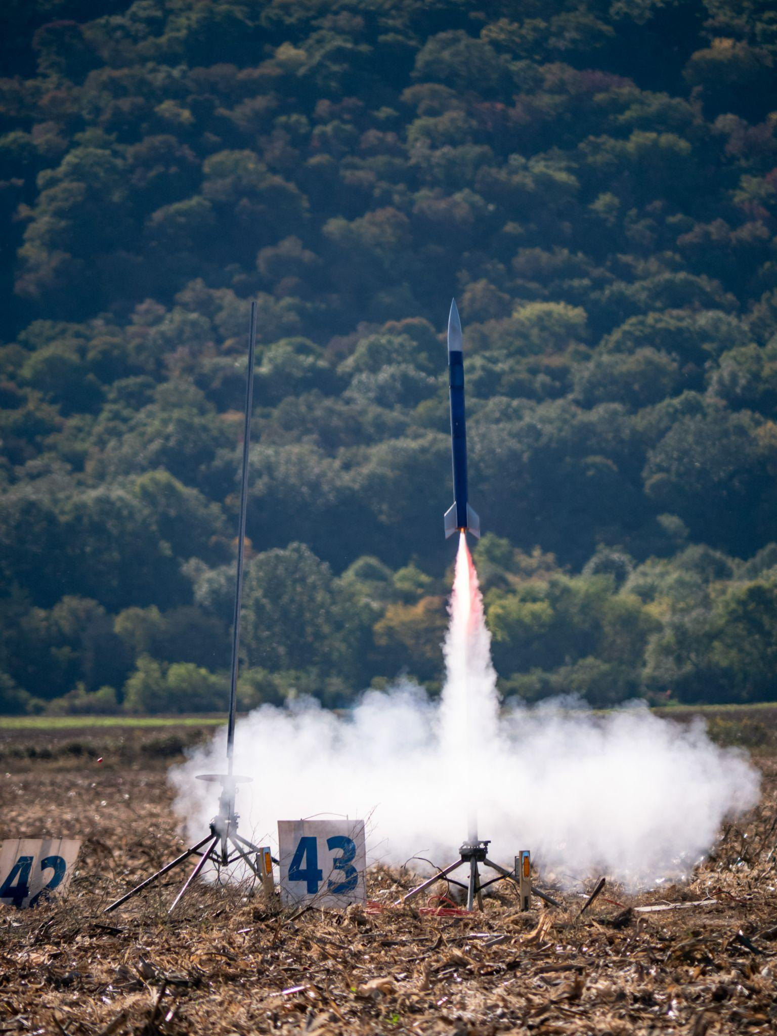
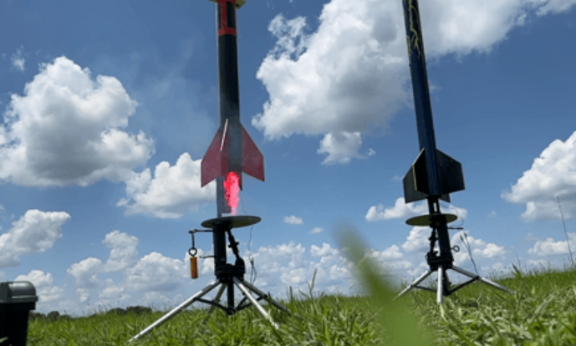
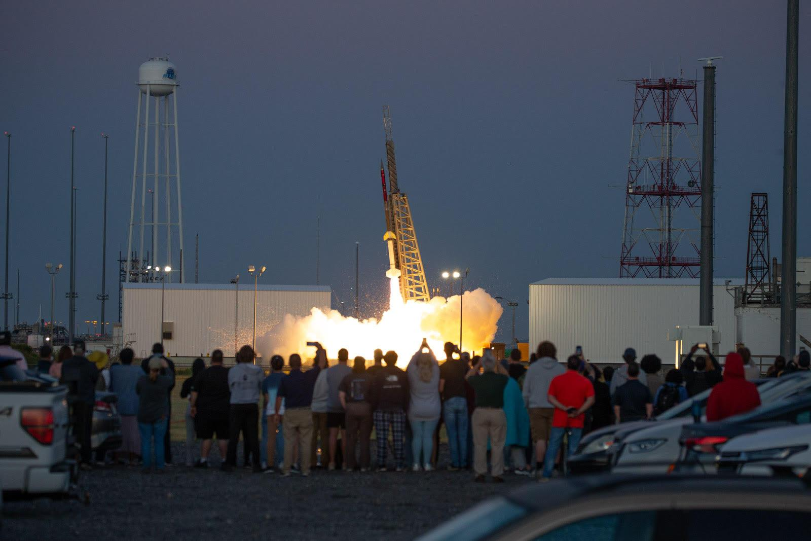
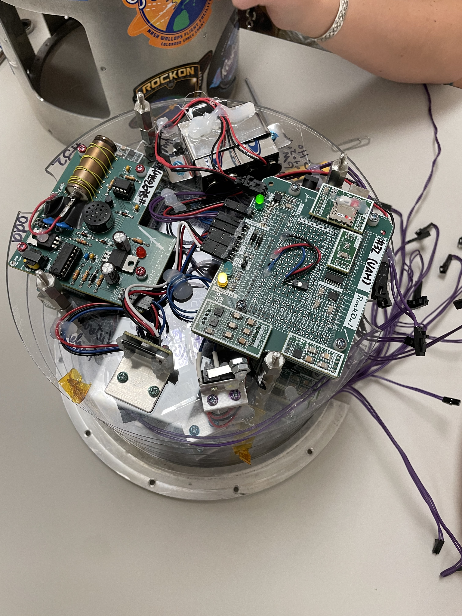
Space Hardware Club
Space Hardware Club provides hands-on hardware and software engineering experience for students through a variety of projects.
There are currently 15 active projects.
SPAROW is a project within the AutoSat program.
AutoSat
BalloonSat
Autonomous Payload Competitions
High-Altitude Ballooning Research
Rocketry
SpaceFlight
High-Powered Rocketry
Student-Run Space Missions
1

Slide 3
Organization Structure
UAH Space Hardware Club
AutoSat
SPAROW
Management
Airframe
Carrier
Works on designing, manufacturing, and testing the airframe of Carrier and Glider.
Glider
Systems
Ground Station
Designs and codes the electrical and software components of the mission.
Glider Navigation
2

Slide 4
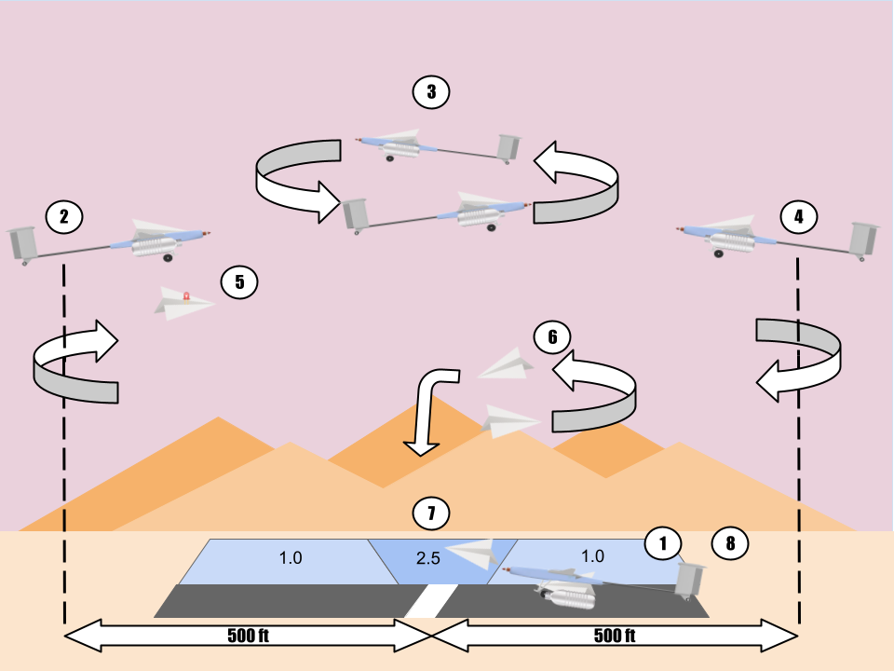
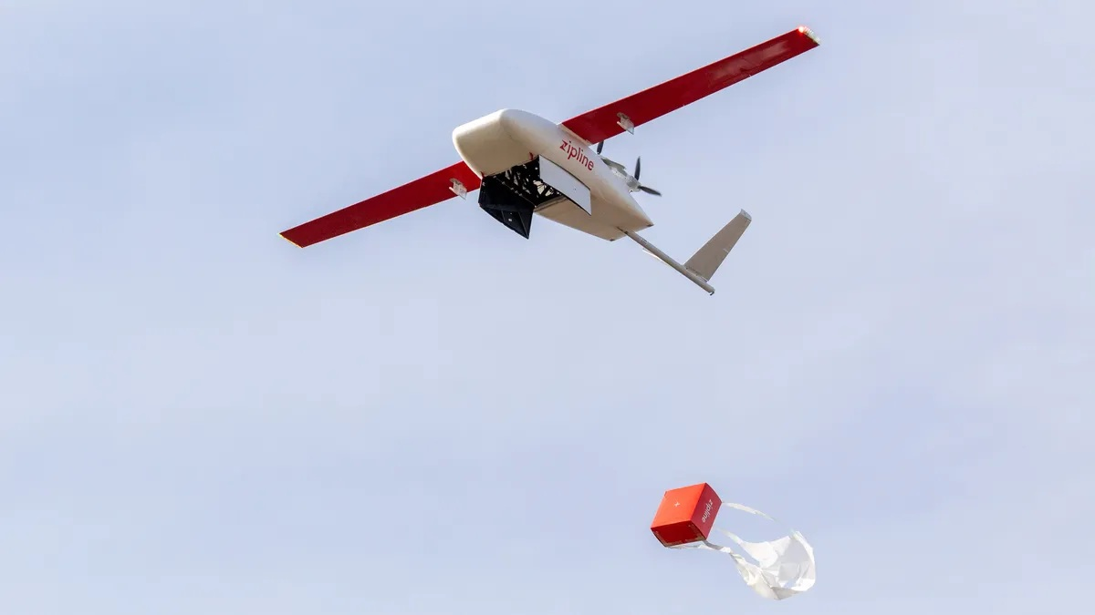
Objectives
Form a team structure capable of producing a UAV each year.
Gain practical engineering experience through designing a UAV.
Understand the design process while learning about the difficulties of developing a project with a large team.
Mission schematic
The 2025 mission set includes runway take-off, flying laps, deploying an autonomous glider mid flight, and performing a runway landing while carrying a payload.
ZIPLINE commercial medical drone
3

Slide 5
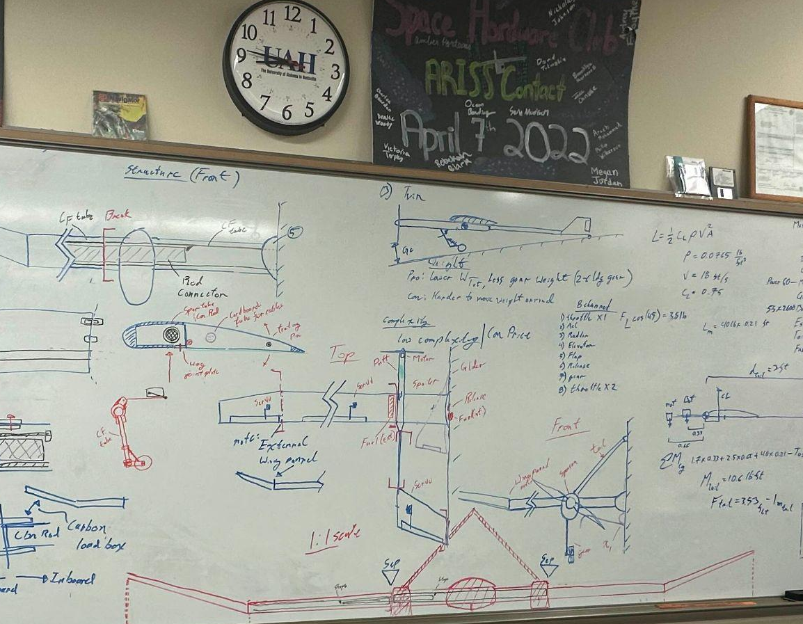
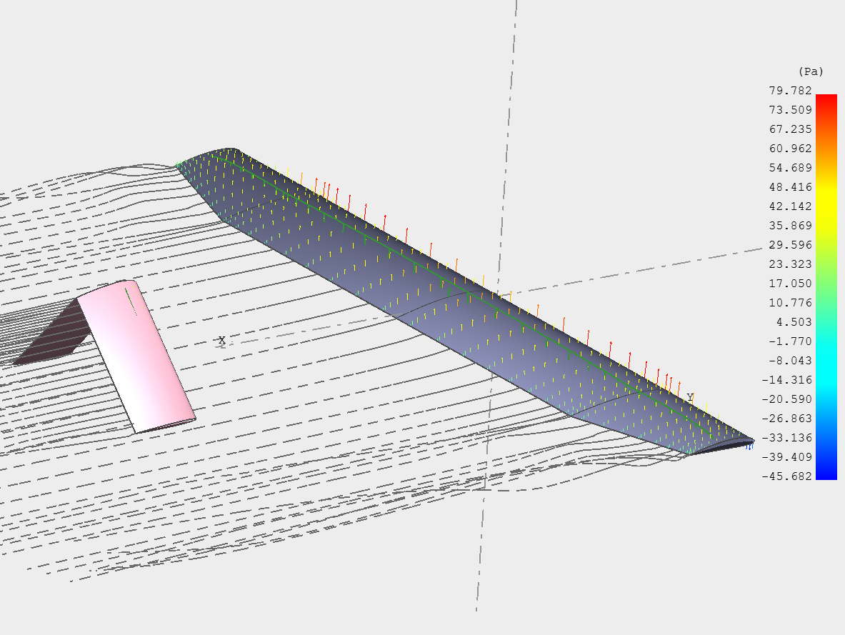
Design Path for Carrier
Research of previous designs
Analysis of the point scoring system
CAD modeling
Design integration with Glider and other systems
Final design
Design requirements
Design brainstorming
Manufacturing
Trade study of airframe base design
Design parameter decision
Test flights
Operational procedures
Preliminary design
XFLR5 Simulation
Numerical analysis of the design (XFLR5)
Competition
Intermediate design
4

Slide 6
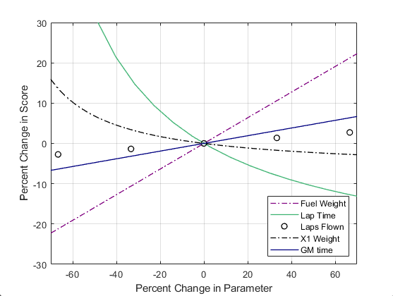
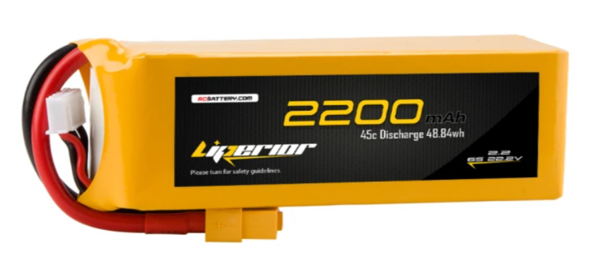
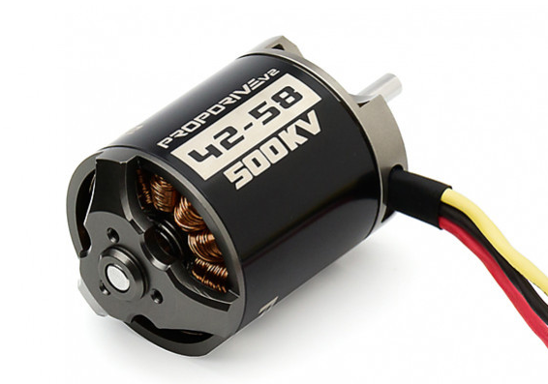
Point Sensitivity Analysis
Lap Time and Payload Weight were found have the largest impact on the total points.
Thus, to maximize the points scored, lightweight low drag designs were prioritized.
Point system sensitivity analysis
6s LiPo batteries (25.2Vmax) and 500kV high torque motors were selected for their high thrust and 9 minutes of flight.
5

Slide 7
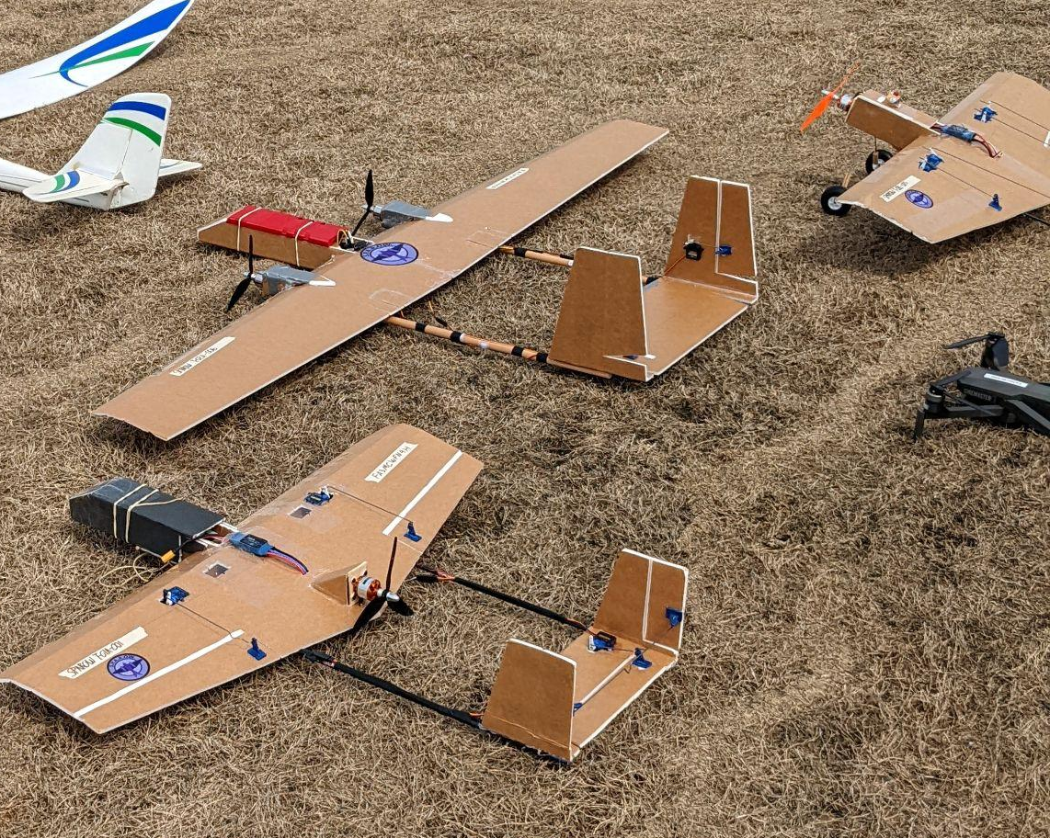
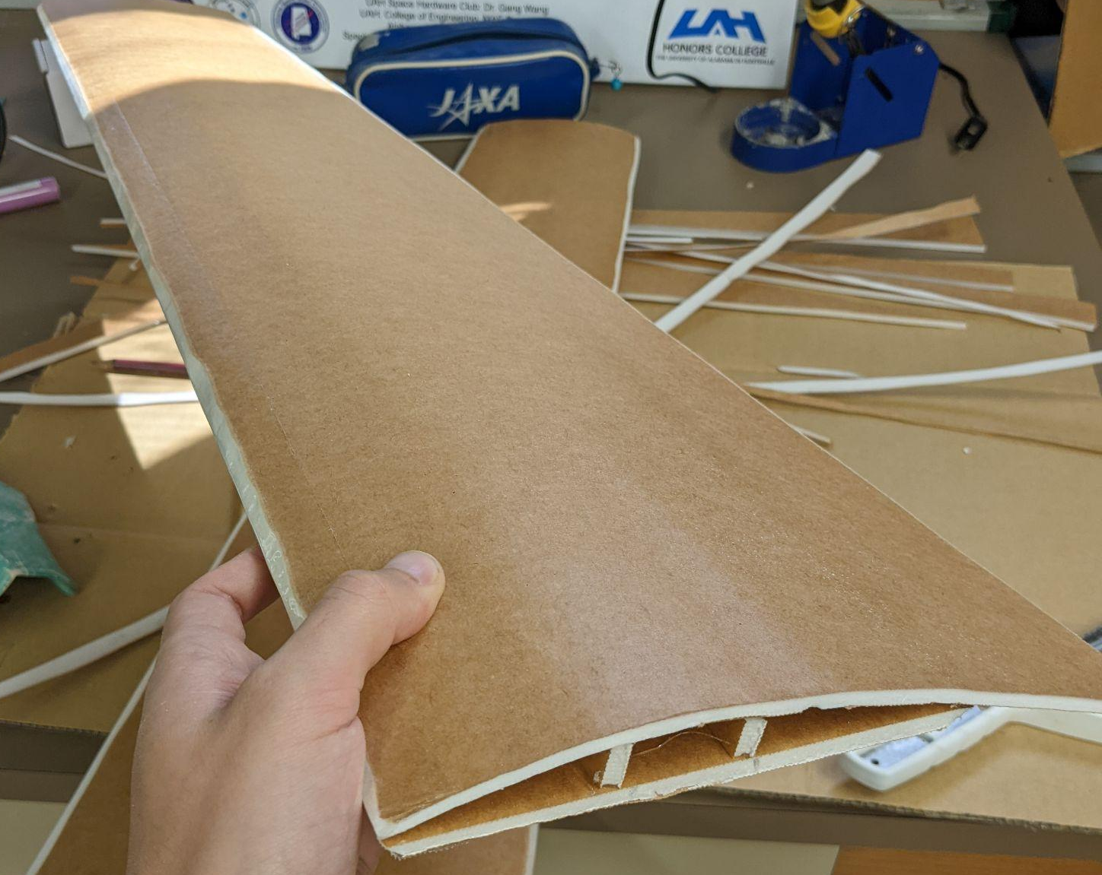
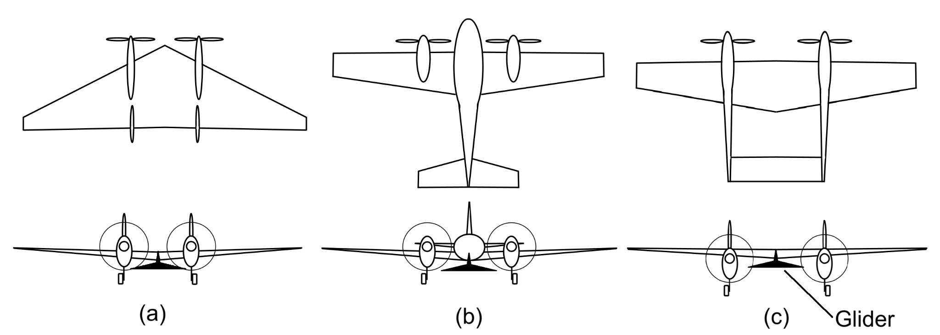
Base Airframe Design Trade Study
Trade studies based on research and prototype test flights indicated that twin prop double fuselage configuration, (c) best suited our requirements.
Foam prototypes
Design (a) lacked the necessary pitch stability while design (b) had limited space under the fuselage for glider housing.
(a) Flying Wing (b) Single Fuselage (c) Double Fuselage
6

Slide 8
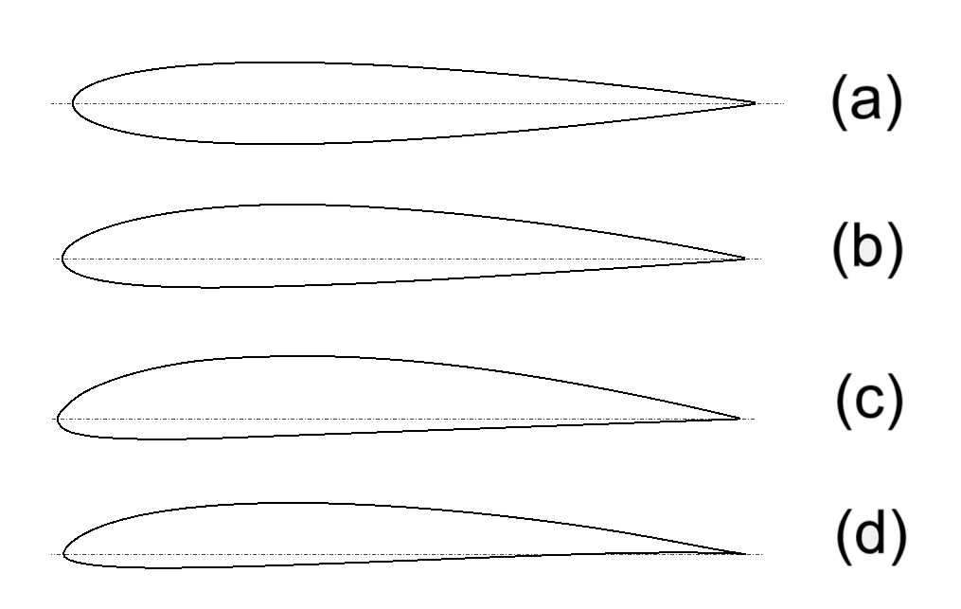
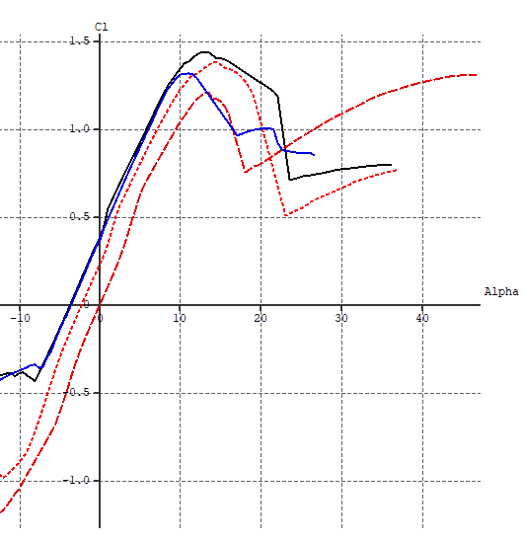
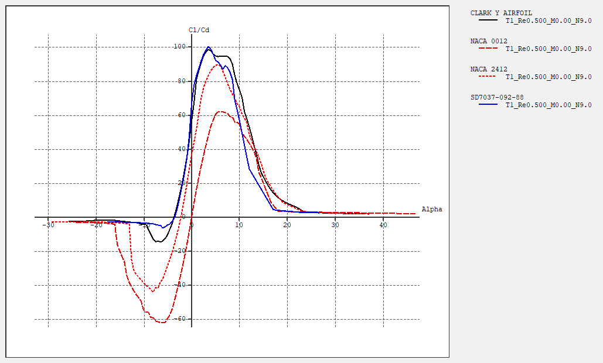
Aerodynamic Analysis (Airfoil)
Using XFLR5 airfoil analysis, the ClarkY profile was selected out of the four airfoils for its good post stall characteristics and high Cl/Cd while having enough thickness to house wirings for electronics.
(a) NACA0012 (b) NACA2412
(c) ClarkY (d) SD7037
(All simulations at Re=5x10^5)
Cl vs Alpha
Cl/Cd vs Alpha
7

Slide 9
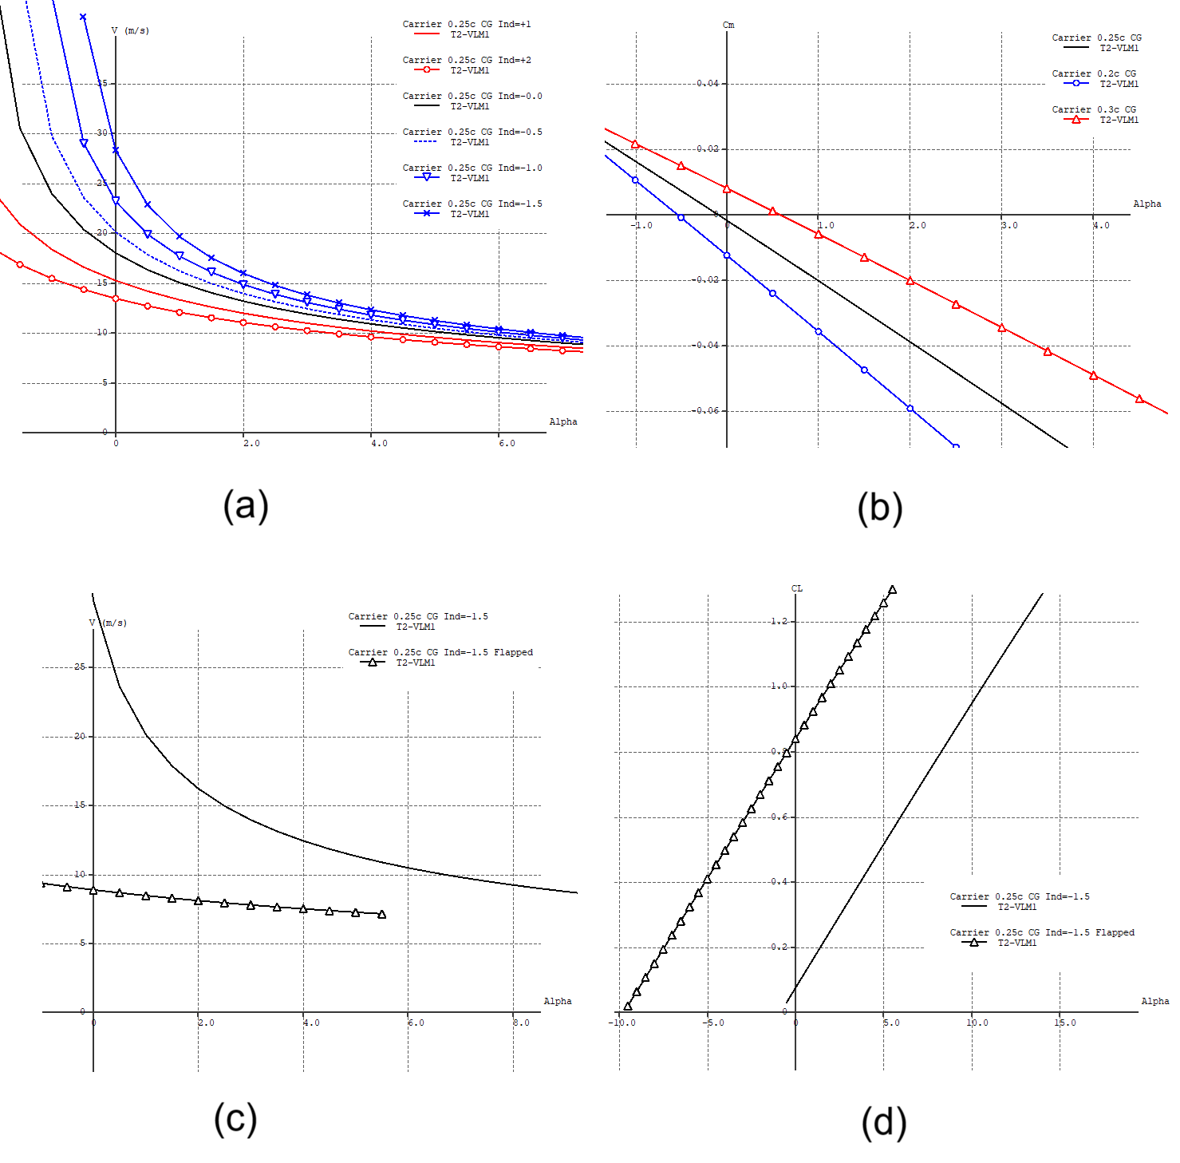
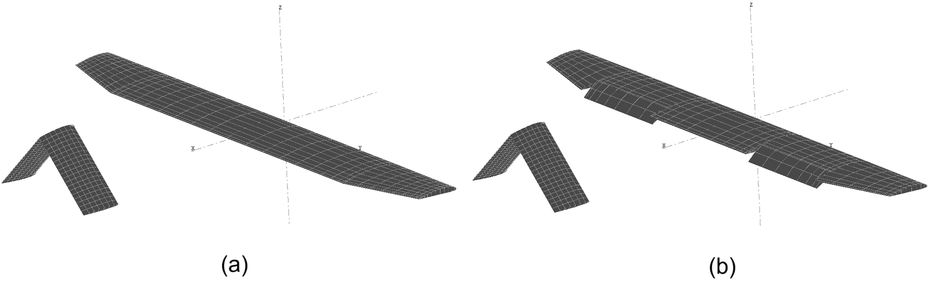
Aerodynamic Analysis (Cm, V)
Pitch stability and cruise velocity were analysed using a wing-only model.
Main wing induced angle was set at -1.5° to achieve a high cruise velocity of 30 m/s.
Cm vs Alpha with various CG shift
Pitch stability was sufficient even with slight shift of CG which may happen at Glider separation.
V cruise vs Alpha with various wing induced angle
XFLR5 Carrier model
8

Slide 10
Aerodynamic Analysis (Flap)
Due to the high cruise speed, flaps are necessary to reduce the stall speed during take-off and landing.
Using 25% chord length flaps reduced the stall speed to 9 m/s while the flaps are deployed.
Carrier model with flaps
V cruise vs Alpha with and without flaps
Cl vs Alpha with and without flaps
9

Slide 11
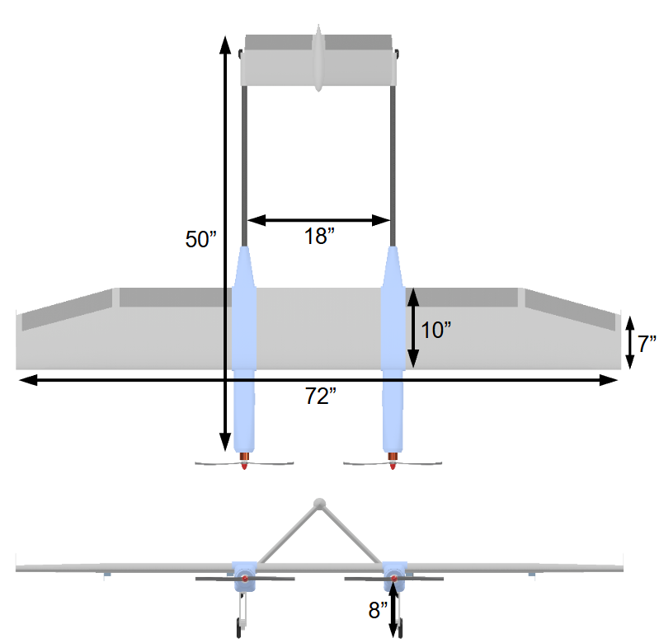
Aerodynamic Analysis
An A-tail design was adopted to minimize the possibility of a mid-air collision during glider separation.
The wing was not designed with dihedral angle due to the added manufacturing complexity and limitations within our current manufacturing abilities.
Weight | 8.51 lb | Max Speed | 60 mph
Wing Area | 687 in² | TWR | 2.2
Wing Span | 72 in | Stored Power | 97.68 Watt Hours
Length | 50 in | Flight Time | 9 minutes
Aspect Ratio | 7.5 | Radio Range | 1.1 km
Intermediate design parameters
Glider separation plan
Basic Carrier dimensions
10

Slide 12
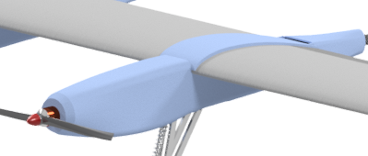
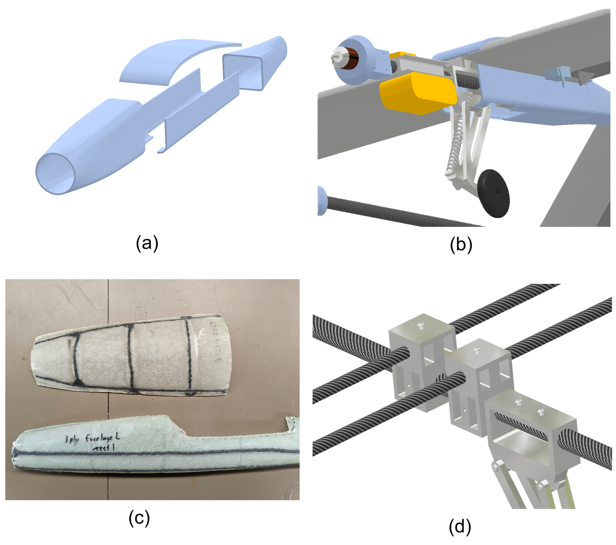
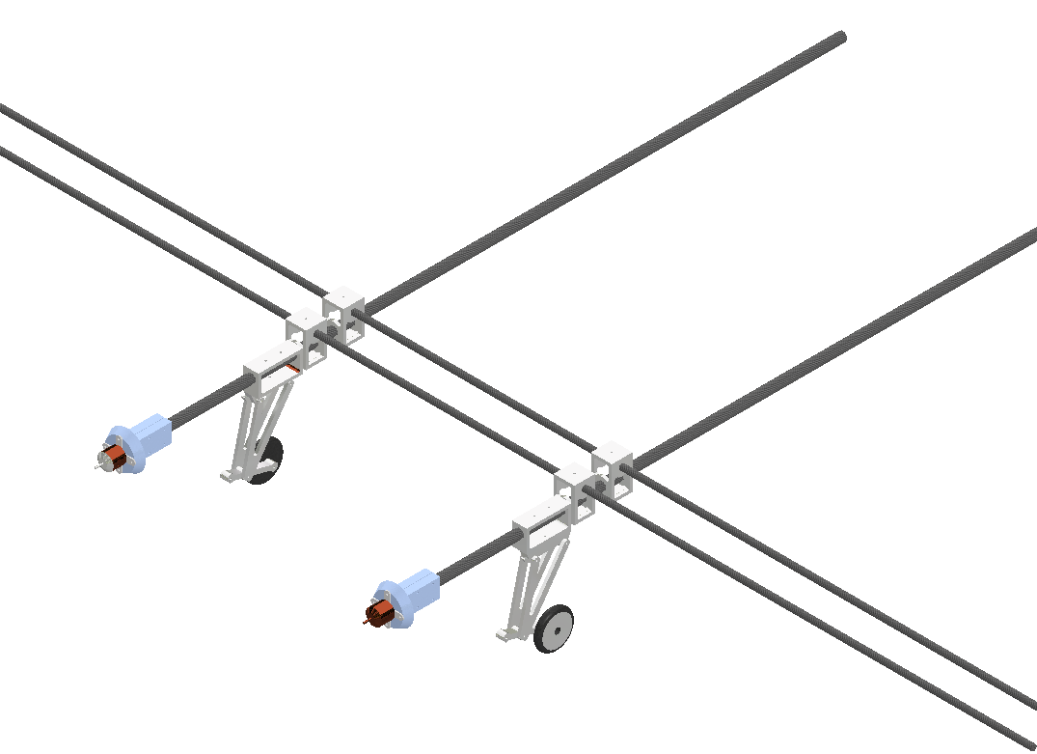
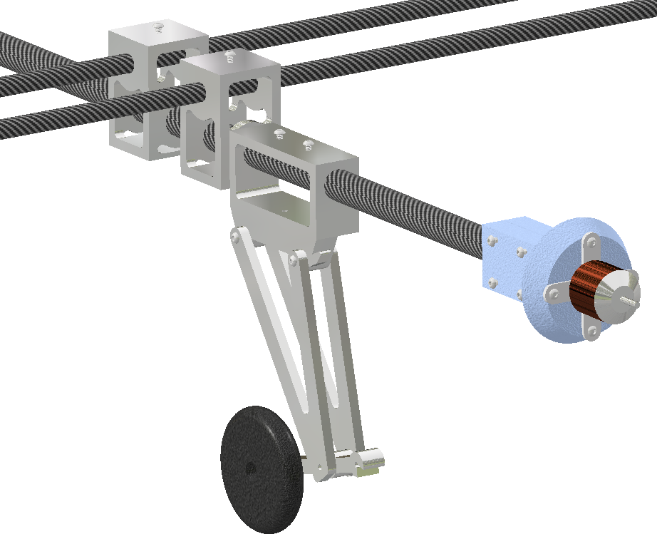
Structural Design
Internal and external structure was designed in CAD (Autodesk Inventor).
The main structure is based on carbon fiber tubes with aluminium connectors for repairability and transportability.
Fuselage fairings
Fiberglass fairings act as aerodynamic covers. This is intended to simultaneously reduce weight and drag
Base carbon fiber bone of Carrier
11

Slide 13
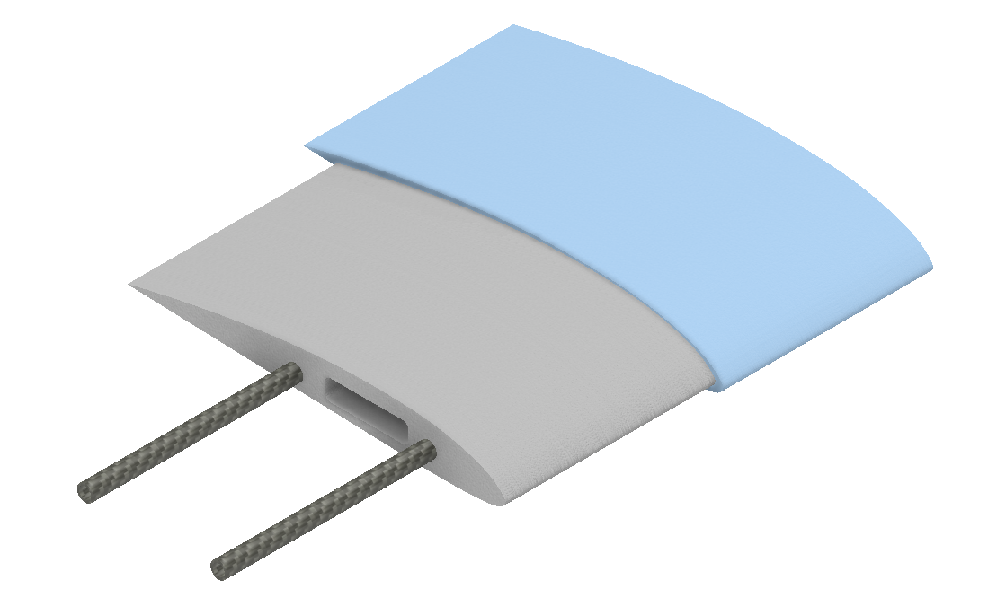
Structural Design
Heavy components such as batteries and motors will be attached directly to the carbon fiber tubes.
Landing gear uses a simple spring suspension. Retractable gear was considered, however, was not adopted due to added complexity and weight.
Wing plan, foam in gray and fiberglass in blue
Wing will be constructed from fiberglass reinforced foam to provide a lightweight yet sturdy wing design. Two offset layers of fiberglass provide structural integrity to the wing skin.
Internal of Carrier
12

Slide 14
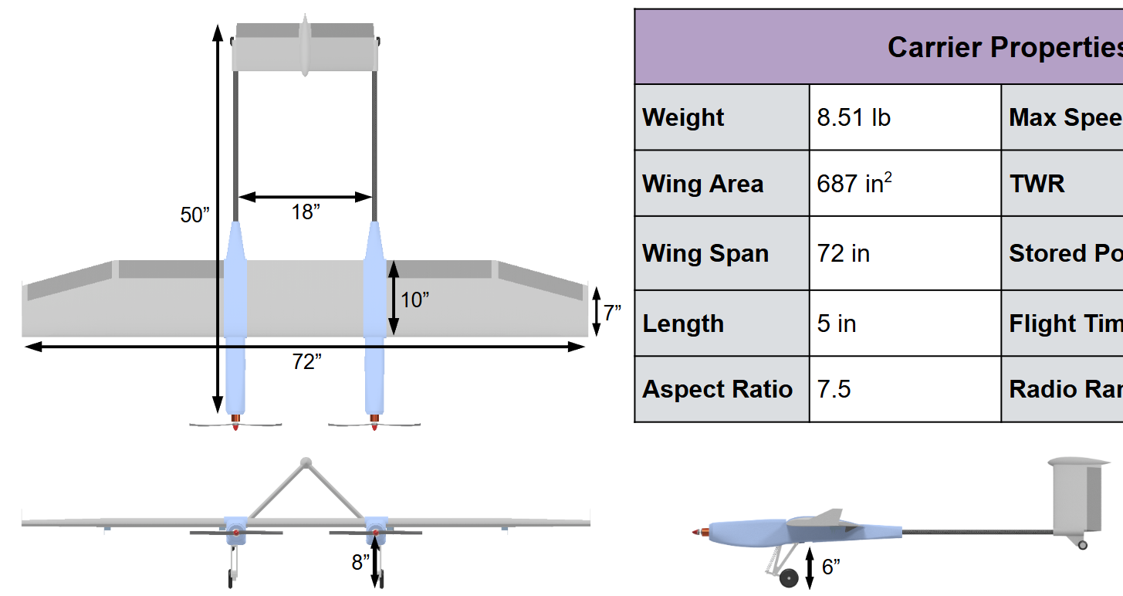
Results
Researched and developed a stable UAV design backed up by computational simulation and reference data.
As a team, gained practical experience working on complex engineering challenges.
Established a team structure which all team members were able to collaboratively identify and create solutions to engineering challenges.
Final design of the Carrier
Final design of the Carrier
13

Slide 15
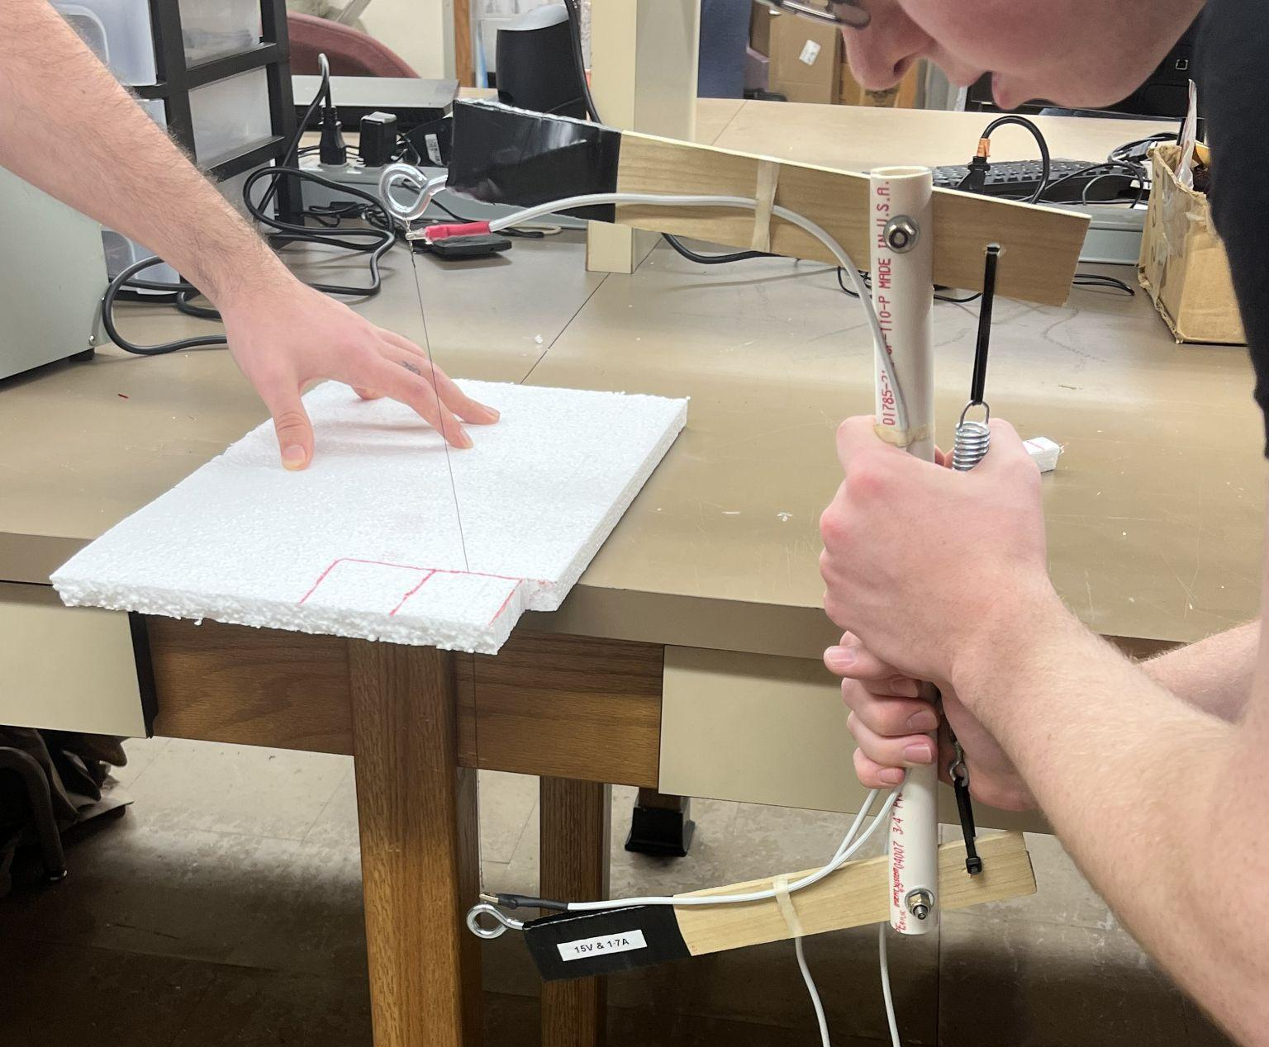
Future Challenges
Team structure and communication chain must be improved since more personnel will be involved in the project for manufacturing phase.
Fiberglass layup and composite vacuuming bagging are both large challenges which must be overcome for future designs.
Foam cutout test
During manufacturing, SPAROW will need to iteratively improve the design step by step to achieve the mission requirements.
Fiberglass layup test
14

Slide 16
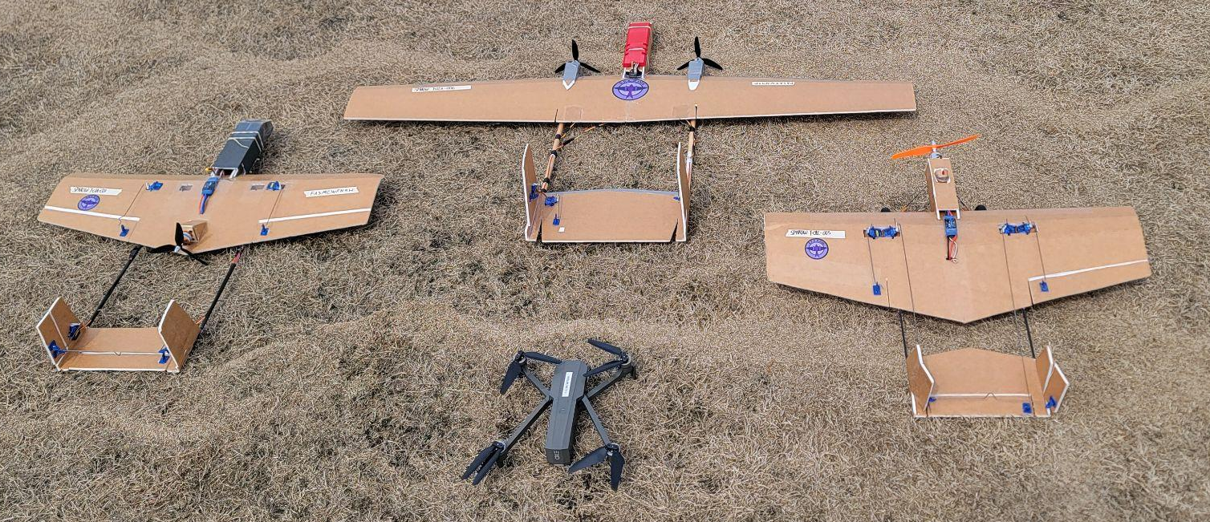
Thank you!
University of Alabama in Huntsville
Space Hardware Club, SPAROW Program
Kota Mitsumoto, Ryan Maye, Duncan Green
15

