Slide 1

3D Terrain Mapping and Optimal Path Planning for Autonomous Ground Vehicles in Off-road Environments
Matt Nguyen

Slide 2

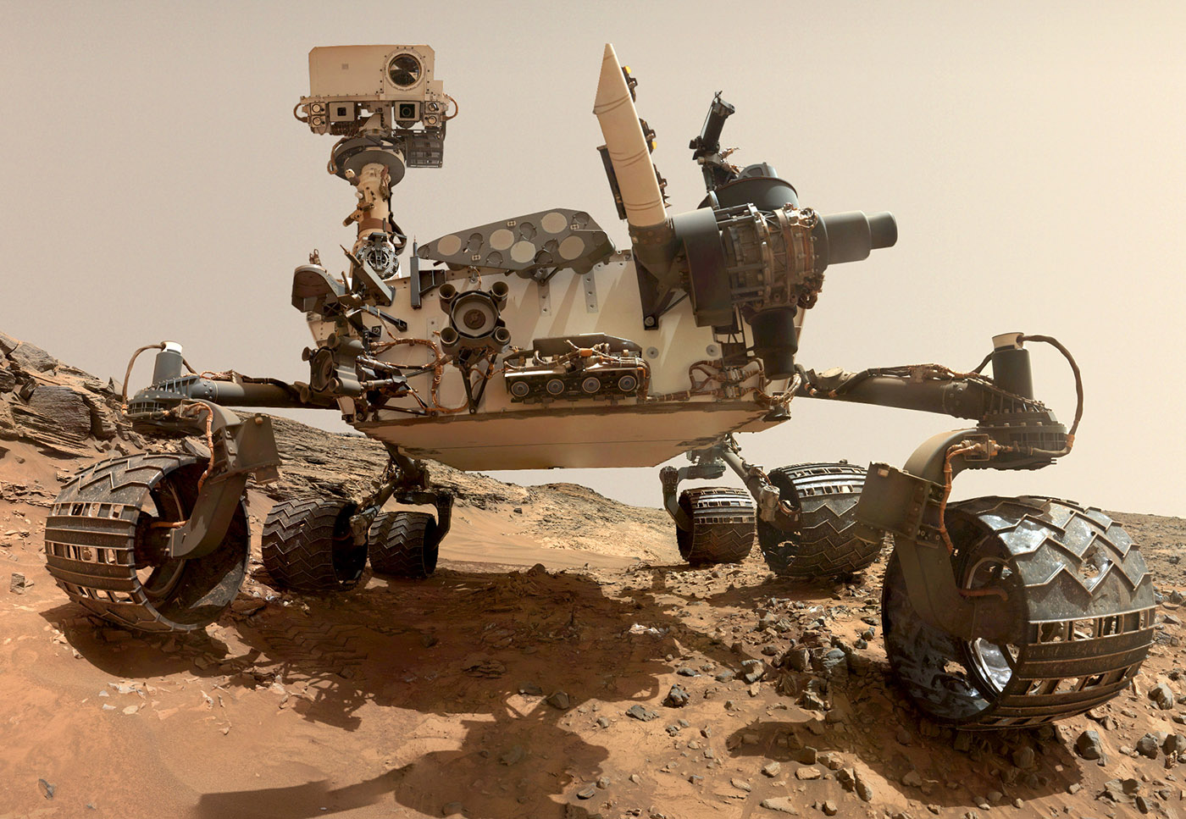
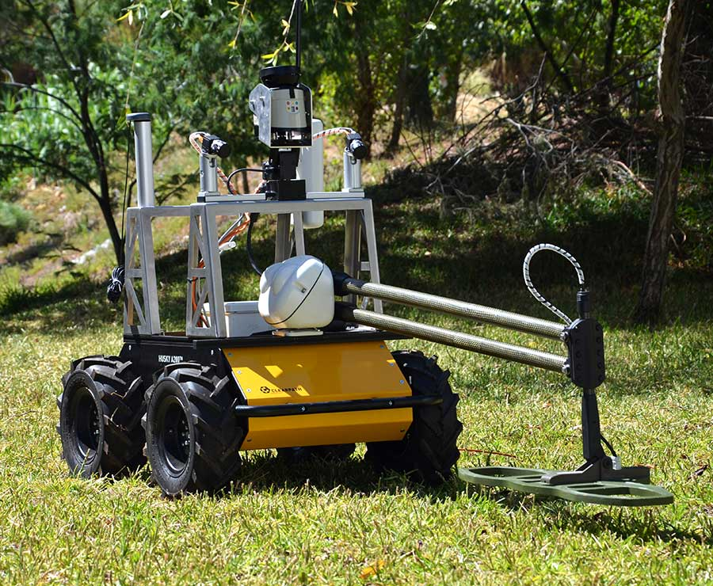
Introduction & Motivation
Autonomous ground vehicles (AGVs) are extensively employed in exploration tasks, such as planetary surface analysis, mine detection, and other remote environments.
This research aims to enhance AGV performance by improving the efficiency of mapping and path planning for optimal navigation.
Photo: issnationallab.org
Photo: clearpathrobotics.com

Slide 3

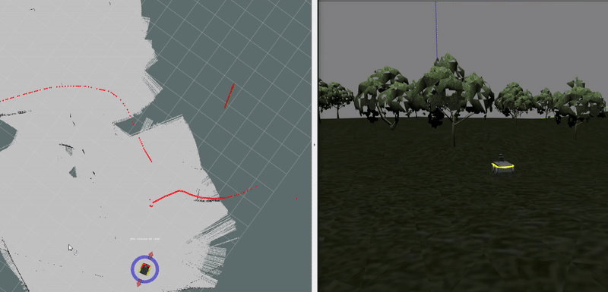
Problem formulation
Currently, the robot generates 2D maps from sensor data. Our goal is to develop 3D mapping and integrate path planning, allowing the robot to dynamically adjust its route based on its past and future predictions.

Slide 4
Approach Overview
The problem of finding the optimal path consists of two main challenges:
          3D Terrain Modeling:
            Convert raw data into a 3D model terrain.
            Minimize deployment time, computational and data storage.
            Ensure interpolation of the original path into an area map while maintaining sufficient detail about terrain characteristics.
          Pathfinding Algorithm Selection:
            Develop an efficient sampling approach to generate nodes along the map.
            Identify a pathfinding algorithm that provides fast and accurate solutions.
            Ensure the algorithm efficiently determines the optimal route from the start to the goal nodes.

Slide 5
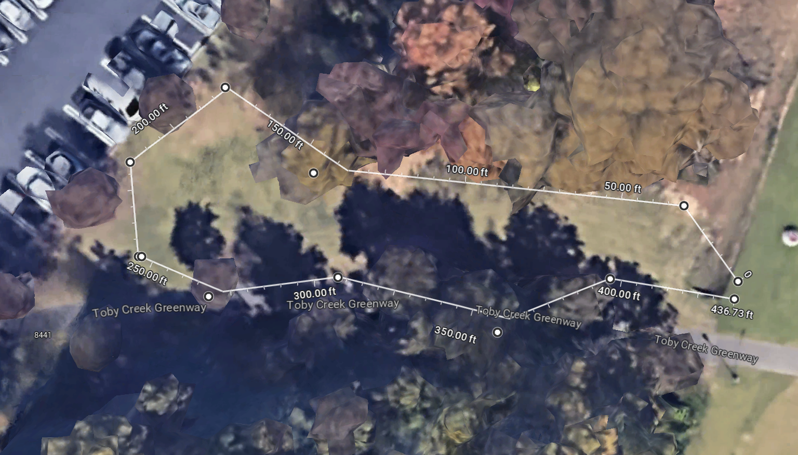
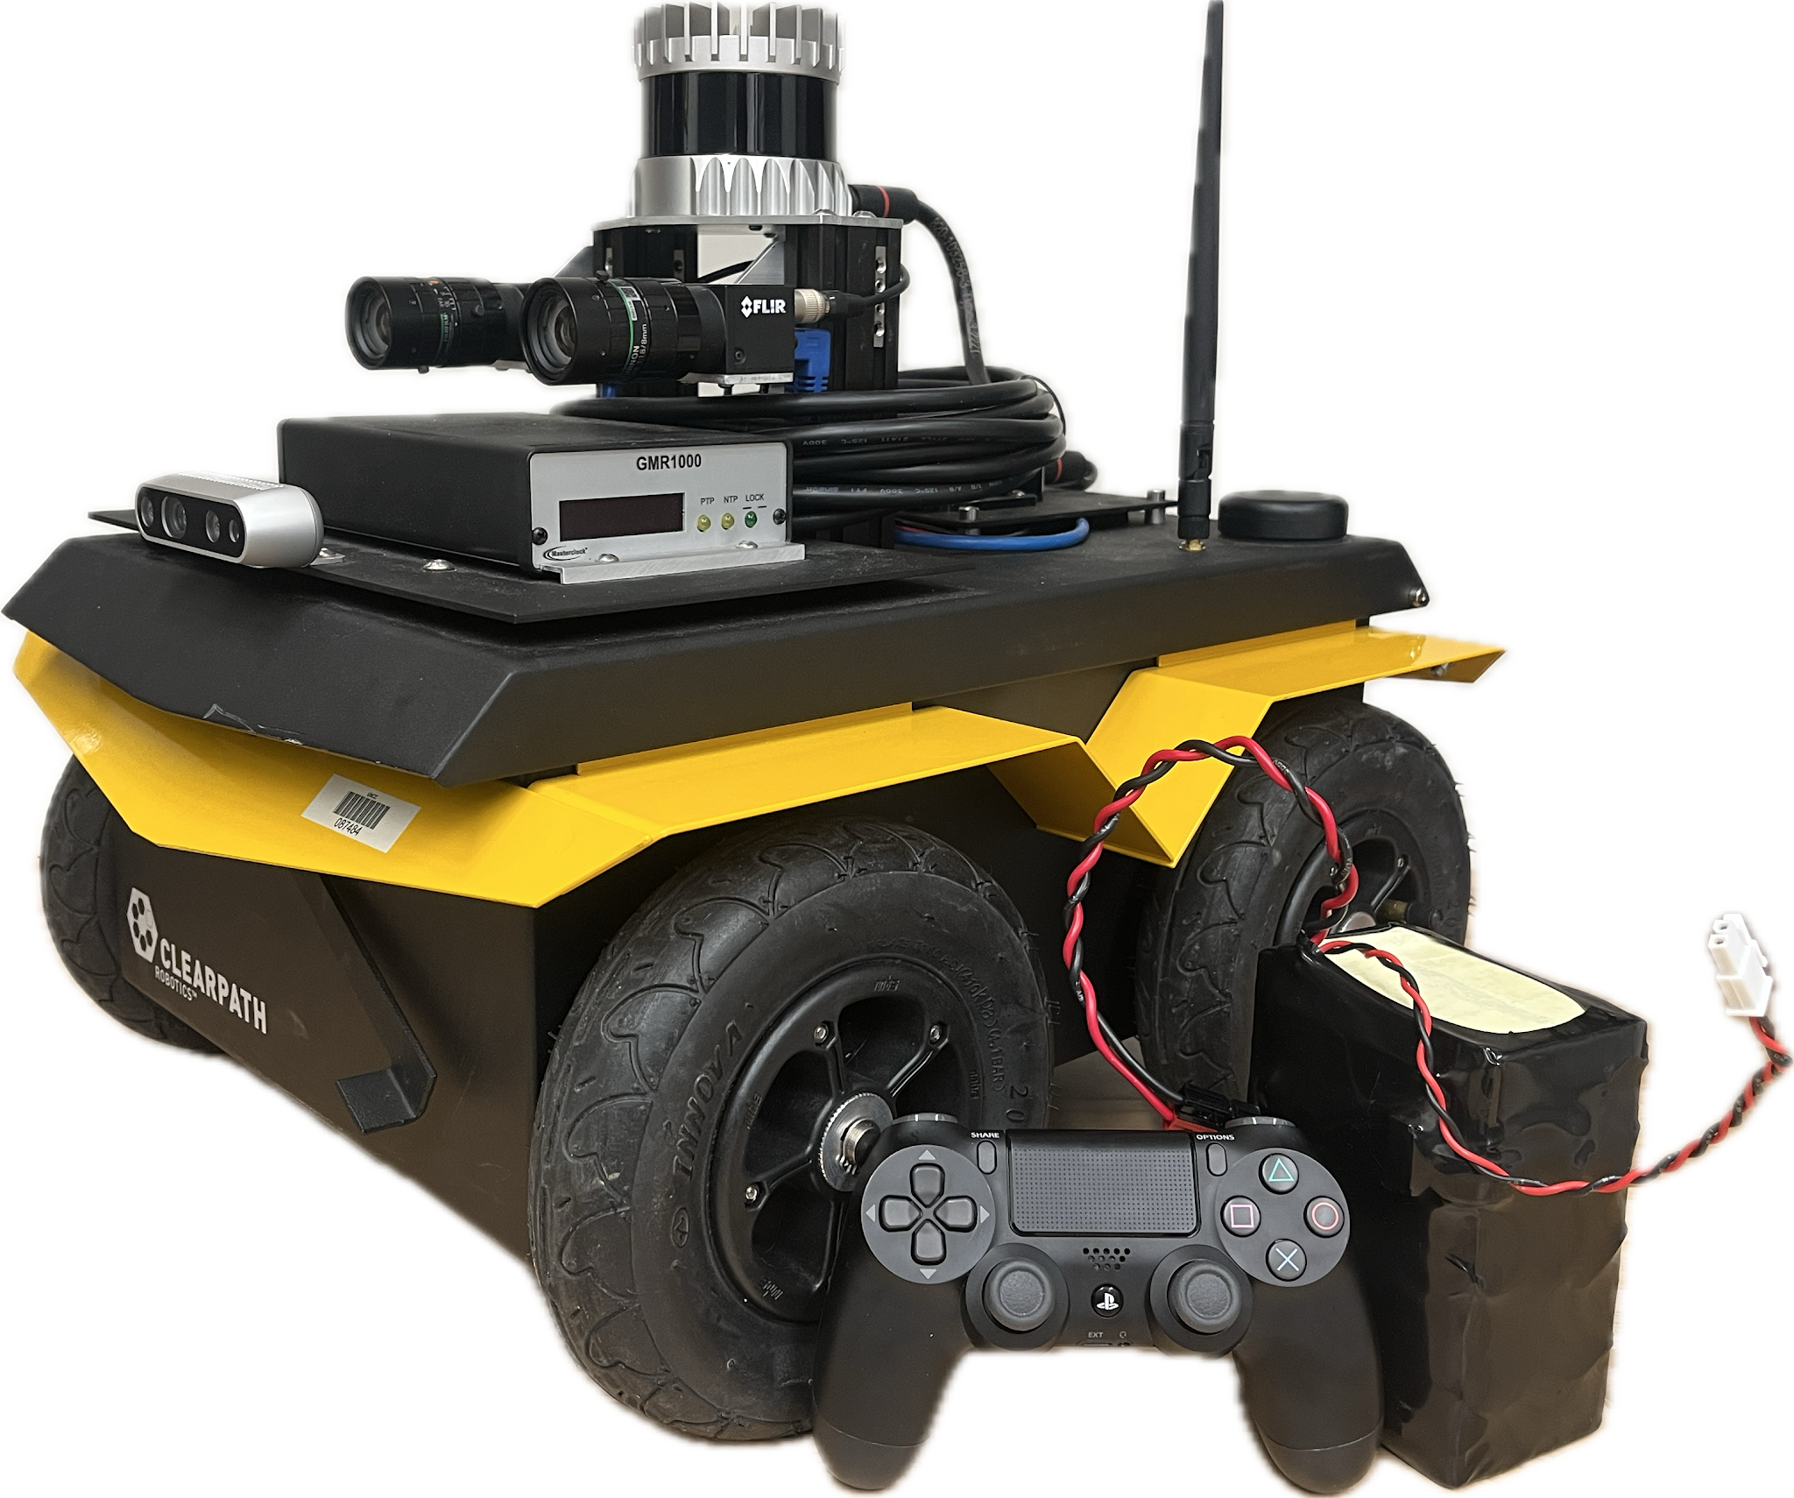
Data collection
High-accuracy clock module for GPS precision timing
Google satellite image of the terrain for which experimental tests were conducted
Clear path Jackal AGV

Slide 6
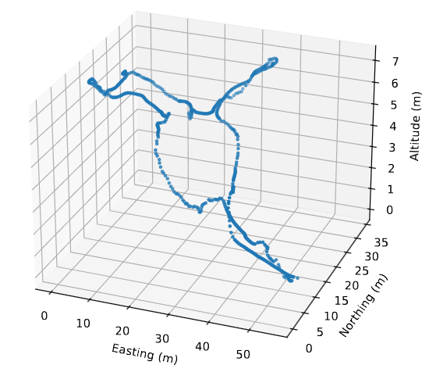
Terrain mapping
The overview steps
Delaunay triangulation
Barycentric Coordinate
Lagrange Interpolation for multidimensions
Original scatter point graph of the GPS coordinate

Slide 7
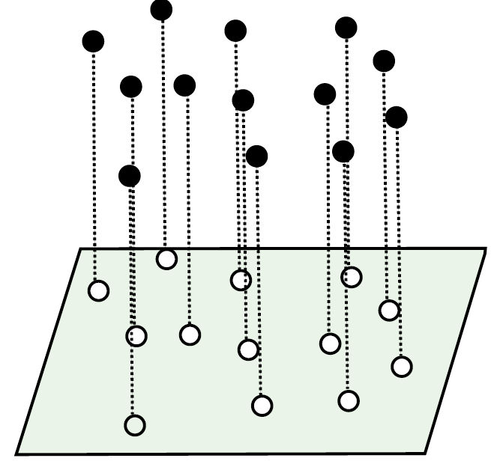
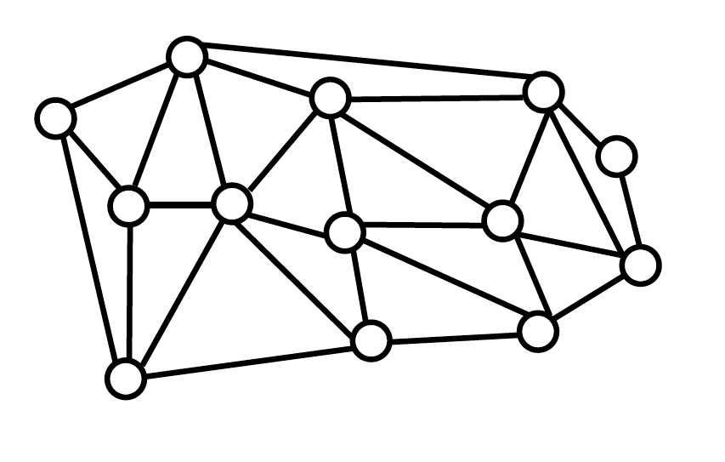
Terrain mapping
Delaunay triangulation
Given $P∈{\text{ℝ}}^{2},$We want to get to a triangulation of vertex set $P$ with no edge can be added without crossing.¹

Slide 8
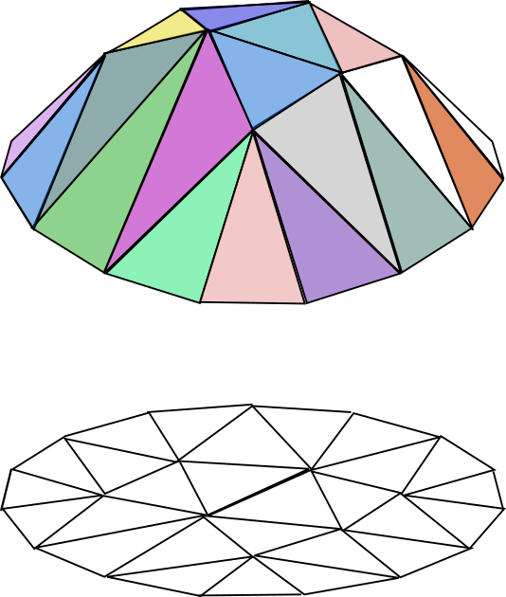
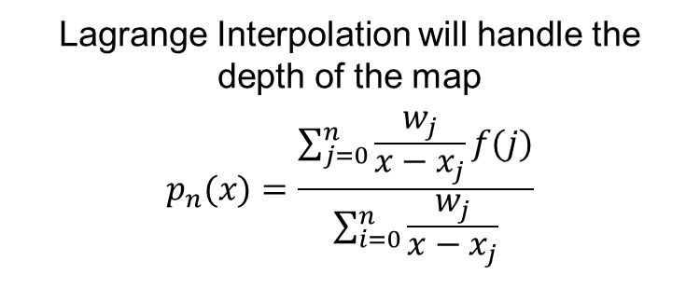
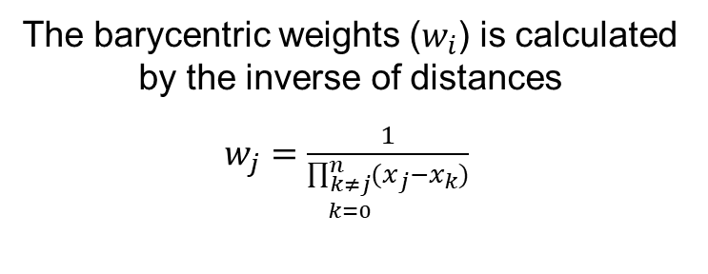
Terrain mapping
The barycentric weights ($w_{i}$) is calculated by the inverse of distances
$w_{j}=\frac{1}{\prod_{\begin{aligned}k≠j \\ k=0\end{aligned}}^{n}{(x_{j}−x_{k})}}$
Lagrange Interpolation will handle the depth of the map
$$p_{n}(x)=\frac{\sum_{j=0}^{n}{\frac{w_{j}}{x−x_{j}}f(j)}}{\sum_{i=0}^{n}{\frac{w_{j}}{x−x_{j}}}}$$

Slide 9
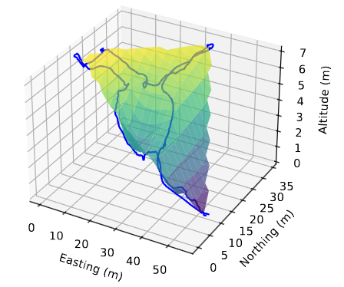
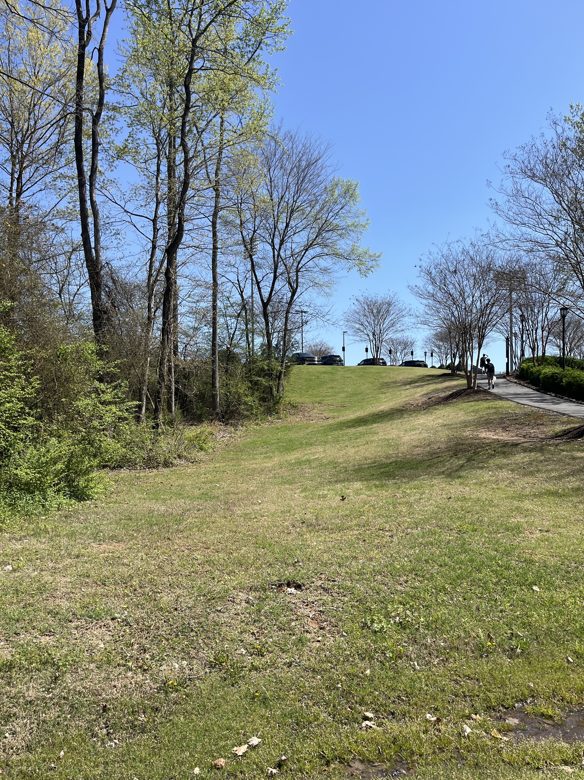
Result map
The terrain the robot was deployed on
Interpolated 3D map from the original path

Slide 10
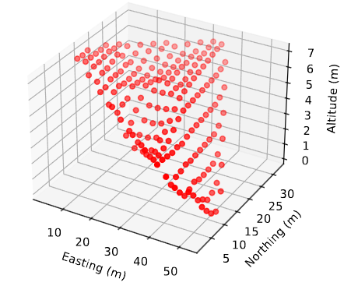
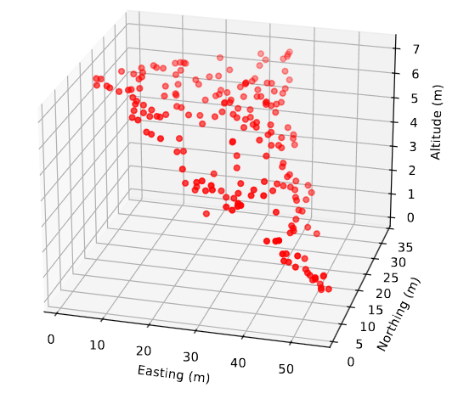
Sampling approaches
Randomly sampling approach
Grided sampling approach

Slide 11
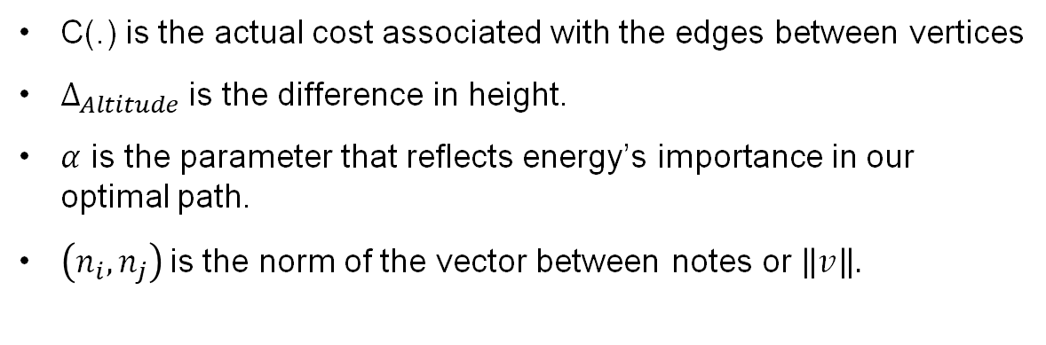
Cost Function
$$C\left(n_{i},n_{j}\right)=(1+exp\left(α∙Δ_{Altitude}\left(n_{i},n_{j}\right)\right))∙D(n_{i},n_{j})$$
C(.) is the actual cost associated with the edges between vertices
$Δ_{Altitude}$ is the difference in height.
$α$ is the parameter that reflects energy’s importance in our optimal path.
$\left(n_{i},n_{j}\right)$is the norm of the vector between notes or $\left\|v\right\|.$

Slide 12
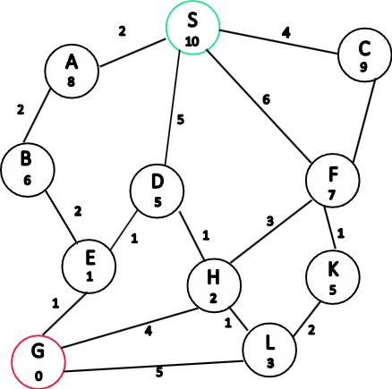
Path planning algorithm
A star algorithm illustration
A star employs Cost and Heuristic variables to find the optimal path:
      Cost is the total cost to get to a specific note.
          Heuristic how far it is in 2D using the distance function to figure out

Slide 13
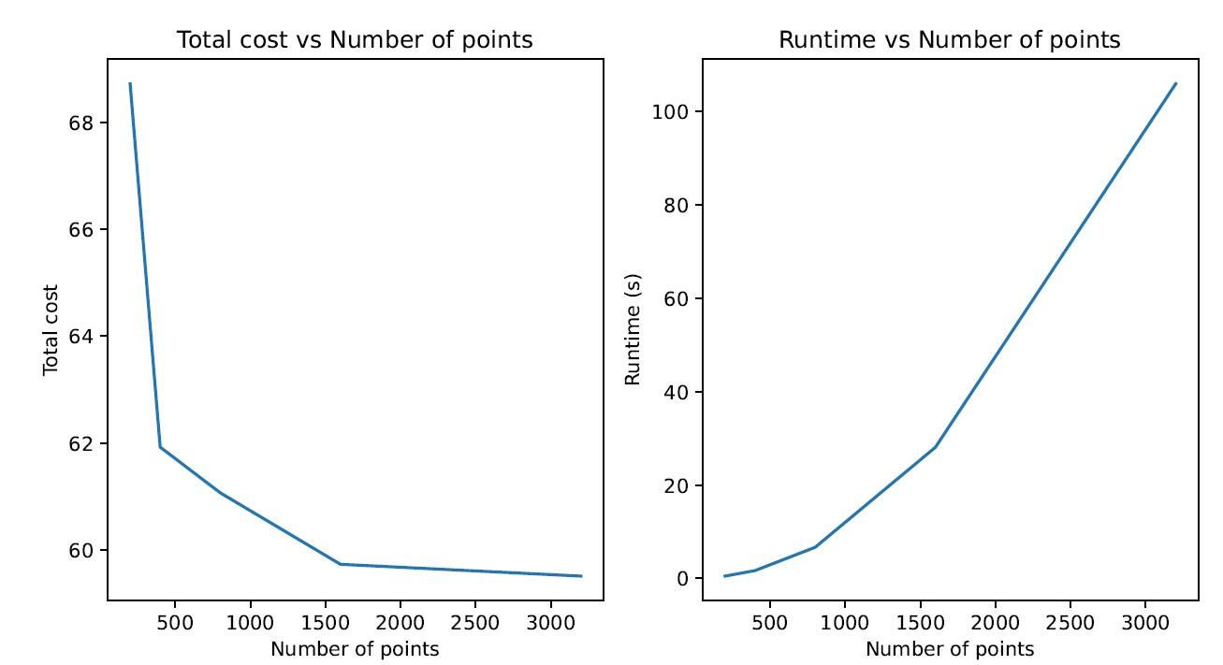
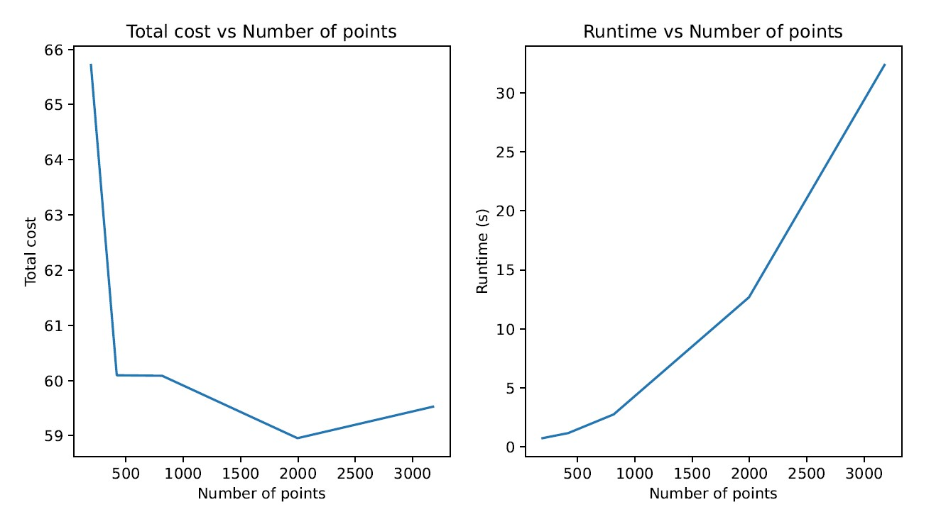
Results
Performance comparison of the two sampling approaches
Random sampling performance results
Gridded sampling performance results

Slide 14
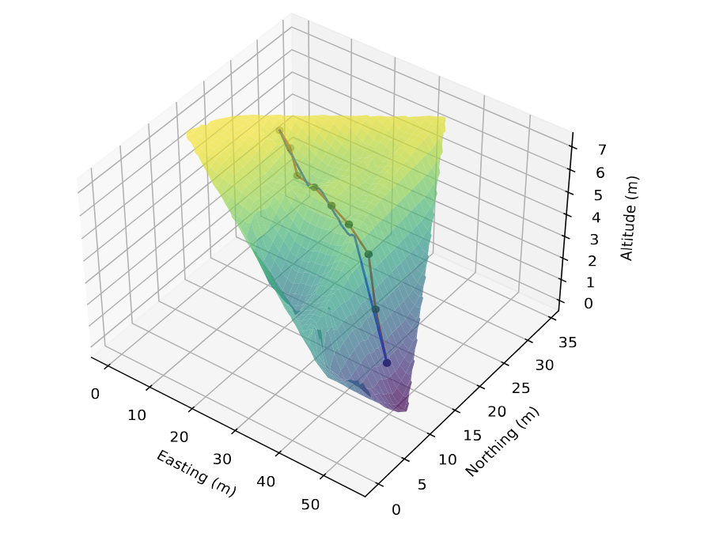
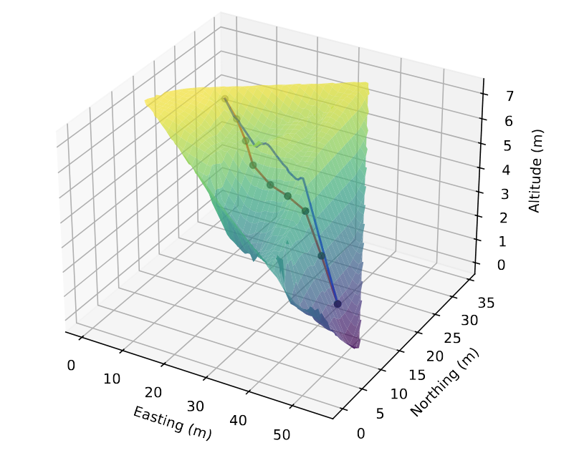
Results
Pathfinding result for 2D distance
Pathfinding results with 3D energy optimal

Slide 15
Conclusion and Future work
  Conclusion: The optimized data reduction enables 3D terrain mapping for the robot, enhancing efficiency and lengthening battery life.
  Future work will involve integrating additional sensors like IMU and LiDAR to improve map accuracy. The goal is for the robot to autonomously perform mapping and path-planning in real-time.

Slide 16

Thank you for listening

Slide 17
References
Kindermann, Philipp. "Lecture 08: Delaunay Triangulation Part I: Height Interpolation." YouTube, uploaded by Philipp Kindermann, 26 June 2020, https://www.youtube.com/watch?v=6UsdvbiJx54.
Berrut, J.-P., and Trefethen, L. N., “Barycentric Lagrange Interpolation,” SIAM Review, Vol. 46, No. 3, 2004, pp. 501–517.https://doi.org/10.1137/S0036144502417715.
Klein, Georges. "Applications of linear barycentric rational interpolation." (2012). https://folia.unifr.ch/documents/302781/files/KleinG.pdf

