Slide 1
LIQUID ROCKETRY LAB ADVANCED PROJECTS
4/4/25

Slide 2







Personnel
Donovan Ngum
Systems Lead
Lucas Nicol
Project Manager
Corey Thunes
Manufacturing Lead
Trevor Larsen
Aerodynamics Lead
Ellie Murray
Safety & Testing Lead
Jose Barbeito
Thermal Analysis Lead
Rodrigo Dacosta
Structures Lead
Notes:
Luke

Slide 3
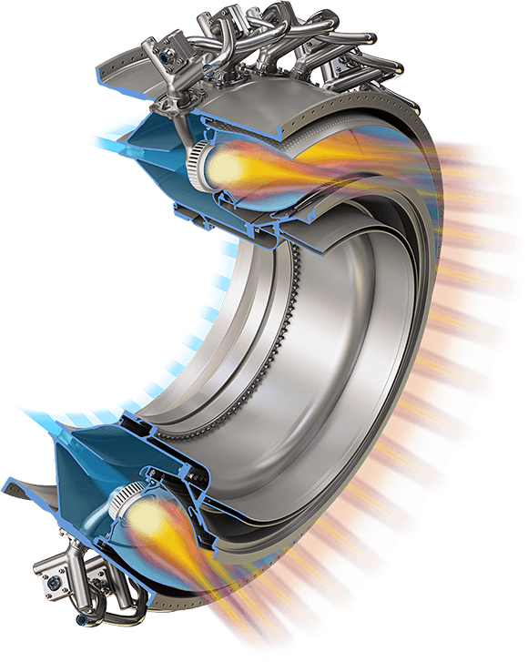
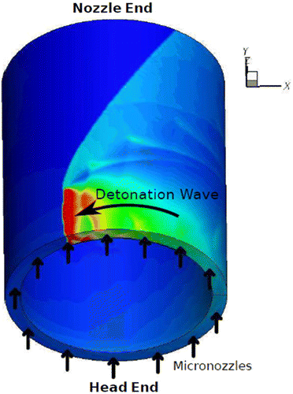
Overview
Turbofans utilize a deflagration process similar to gasoline engines. RDEs use detonation combustion, using shock waves for higher efficiency:
Turbofans:
Subsonic combustion, steady operation, lower peak efficiency.
RDEs:
Supersonic detonation, rapid pressure rise, and higher thermodynamic efficiency.
[1]
[2]

Slide 4
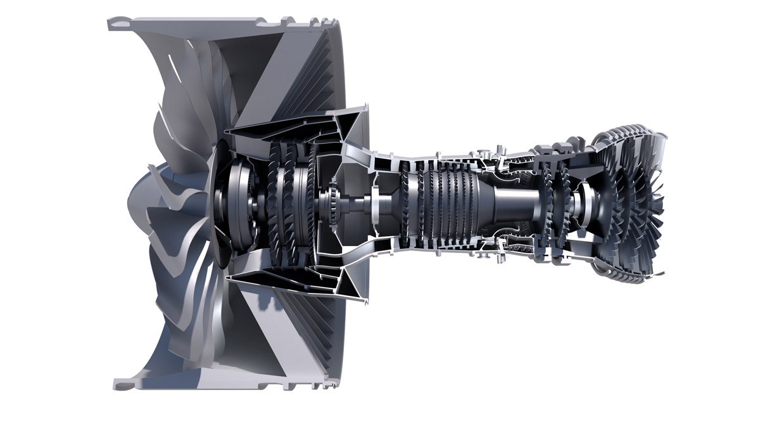
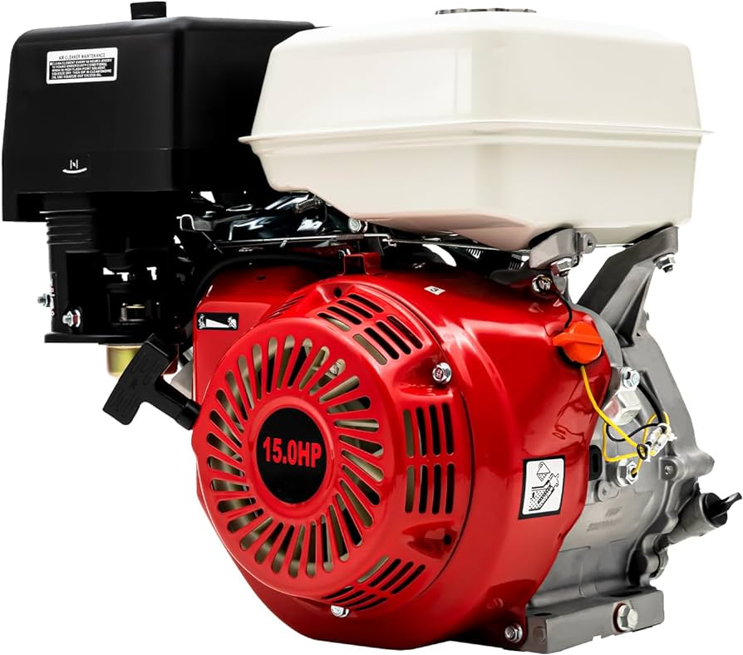
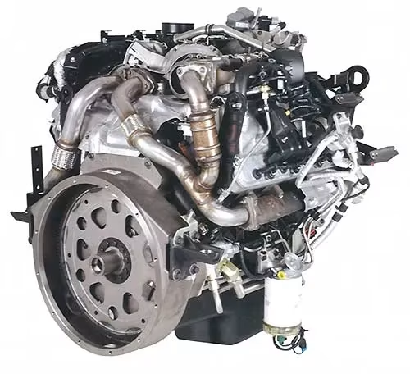
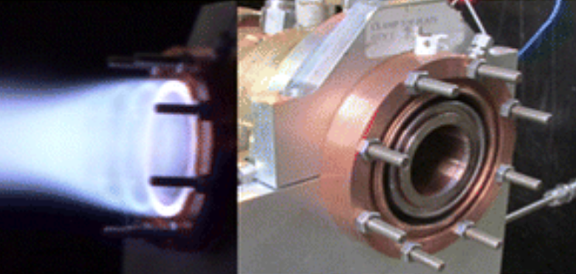
Comparisons - Types of Engines
Gasoline
[4]
[3]
Diesel
[5]
[6]

Slide 5
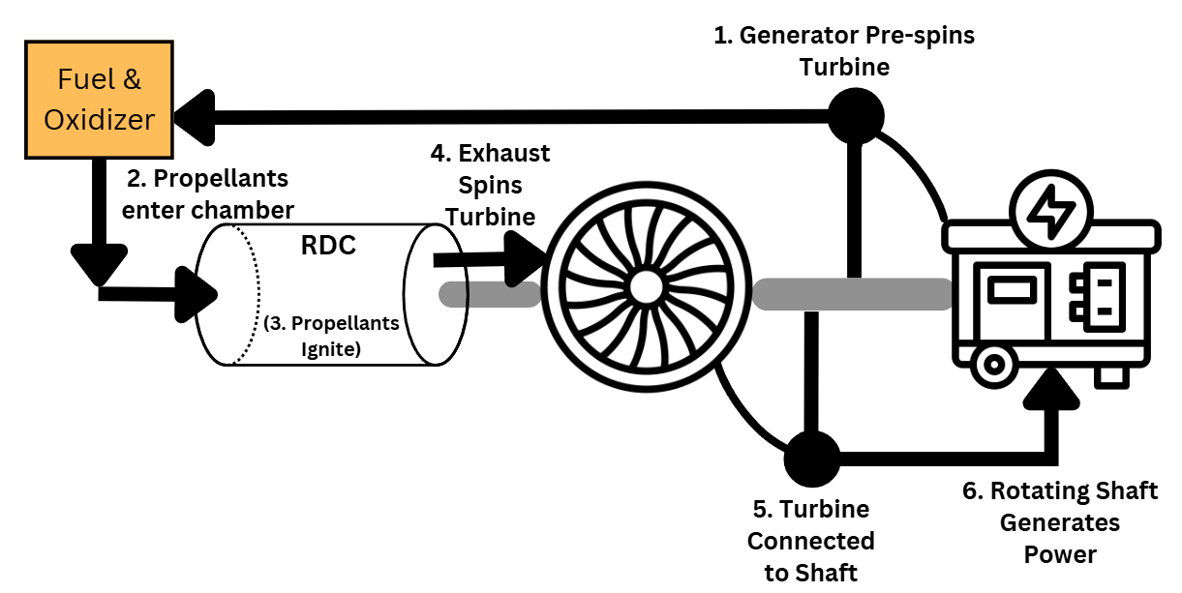

Slide 6
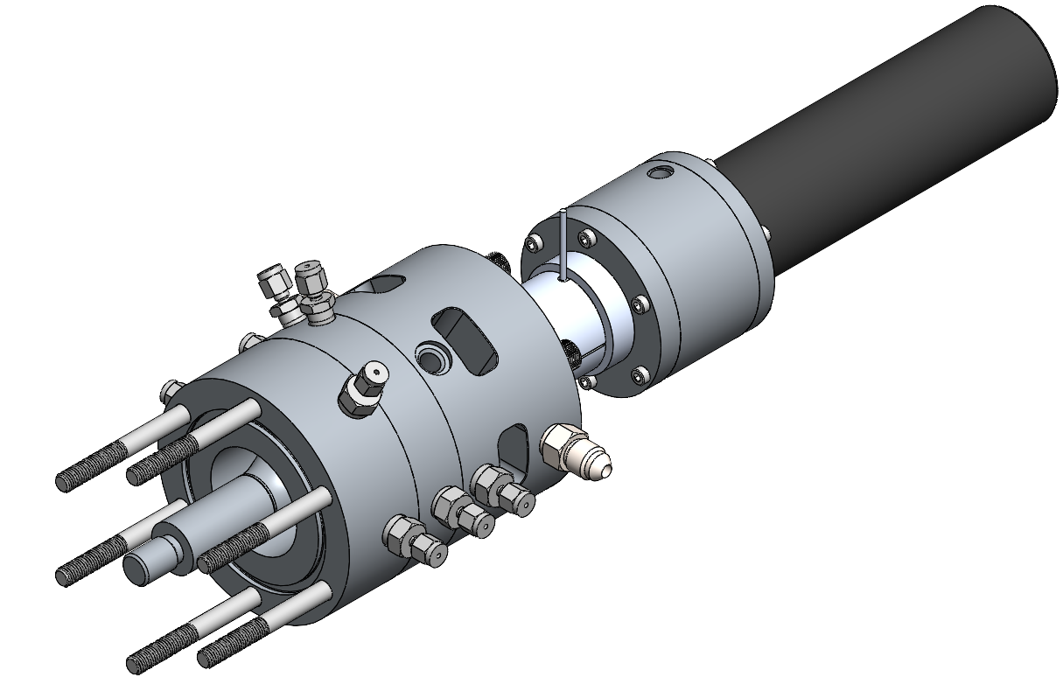

Slide 7
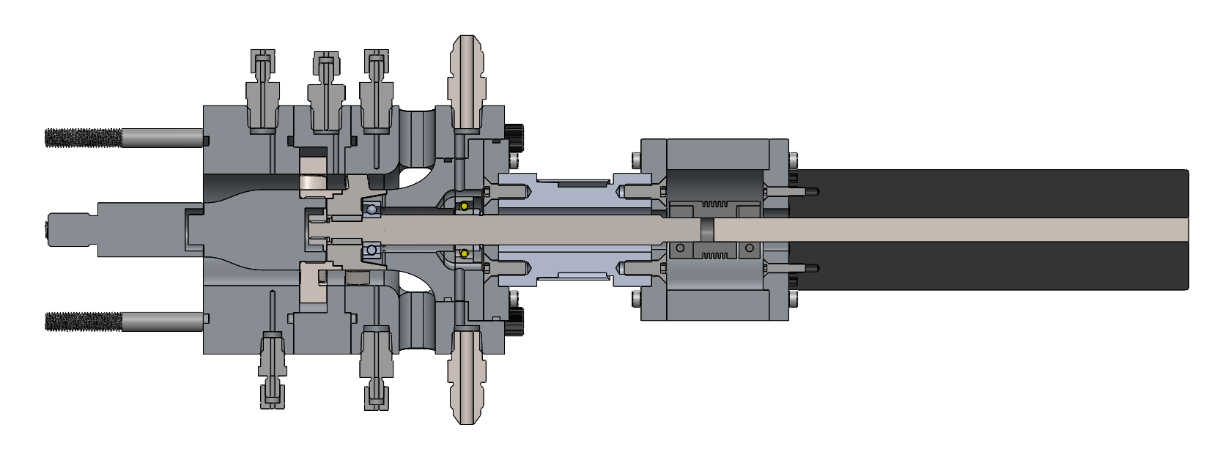
Turbine Shroud
Prestator Sensor Shroud
Stator
Deflector Shroud
Flanges
Exhaust
MK2/15/30/8/8 Coupling
Motor Mount
Deflector
Shaft
Stator Shroud
Rotor
Rear Bearing
Forward Bearing

Slide 8
Thermocouple
Static Pressure
Total Pressure
Static Pressure
Air Sealing Line
Torque Sensor
Exhaust
Air Sealing Line
1539/0.5Y/1692 Motor
Total Pressure
Static Pressure
Thermocouple
2x Thermocouple
Surface Thermocouple

Slide 9
Safety and
Instrumentation
Hierarchy of Controls: Elimination, Substitution, Controls, PPE
FMECA to identify most significant risks
VV&T to ensure system meets requirements
Instrumentation monitors operating conditions
Notes:
Verification, Validation, and Testing

Slide 10
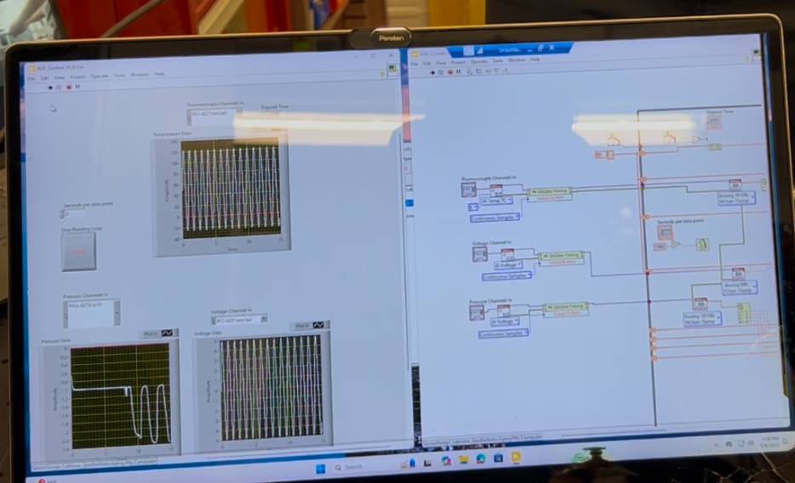
Risk Management Techniques
Engineering Controls
  Safety factors, go/no-go control systems, and safety containment systems
Administrative Controls
  Short test times, warning lights and signage during RDE tests
Extensive modeling during design process to ensure functionality
VV&T to check physical components
No. | System Name | Function | Failure Mode | Cause | Detection | Effect on System | Effect on Function | Severity | Failure Rate | Detection Rate | Mitigation
T.1 | Rotor Section | Converts energy in the fluid to kinetic energy | T.1 slips against the shaft | Loading is too high for the key | RPM sensor | T.1 likely experiences mechanical failure | No conversion of KE to RE | 2 | 2 | 2 | During manufacturing, either by the team or by outsourced manufacturers, care must be taken to size and measure parts precisely. Furthermore, an axial loading test should be employed to ensure nut takes minimal axial loading.
 |  |  | T.1 breaks | Mechanical loading | RPM sensor | T.1 needs replacing | No conversion of KE to RE | 3 | 3 | 2 | Careful design including FEA testing will ensure the turbine has an adequate safety factor. A RPM sensor will track rotational velocities, while short test times reduce the risk.
 |  |  | T.1 melts | Excess heat | RPM sensor | T.1 needs replacing | No conversion of KE to RE | 3 | 3 | 2 | Heat analysis utilizing computer aided simulation will help drive the decision behind selecting materials to survive the temperature conditions at the rotor.

Slide 11
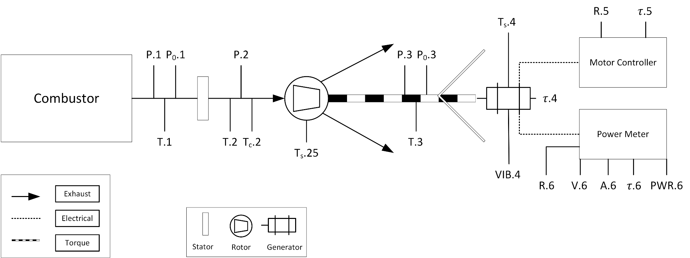
Instrumentation
Location | Parameters
Before Stator | Static and total pressure, temperature
After Stator | Static pressure, temperatures
After Rotor | Static and total pressure, temperature
Generator | Torque, RPM, power

Slide 12
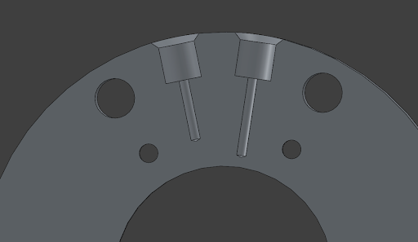
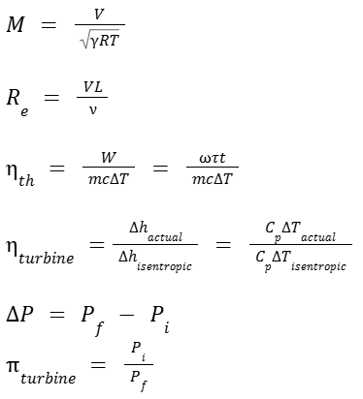
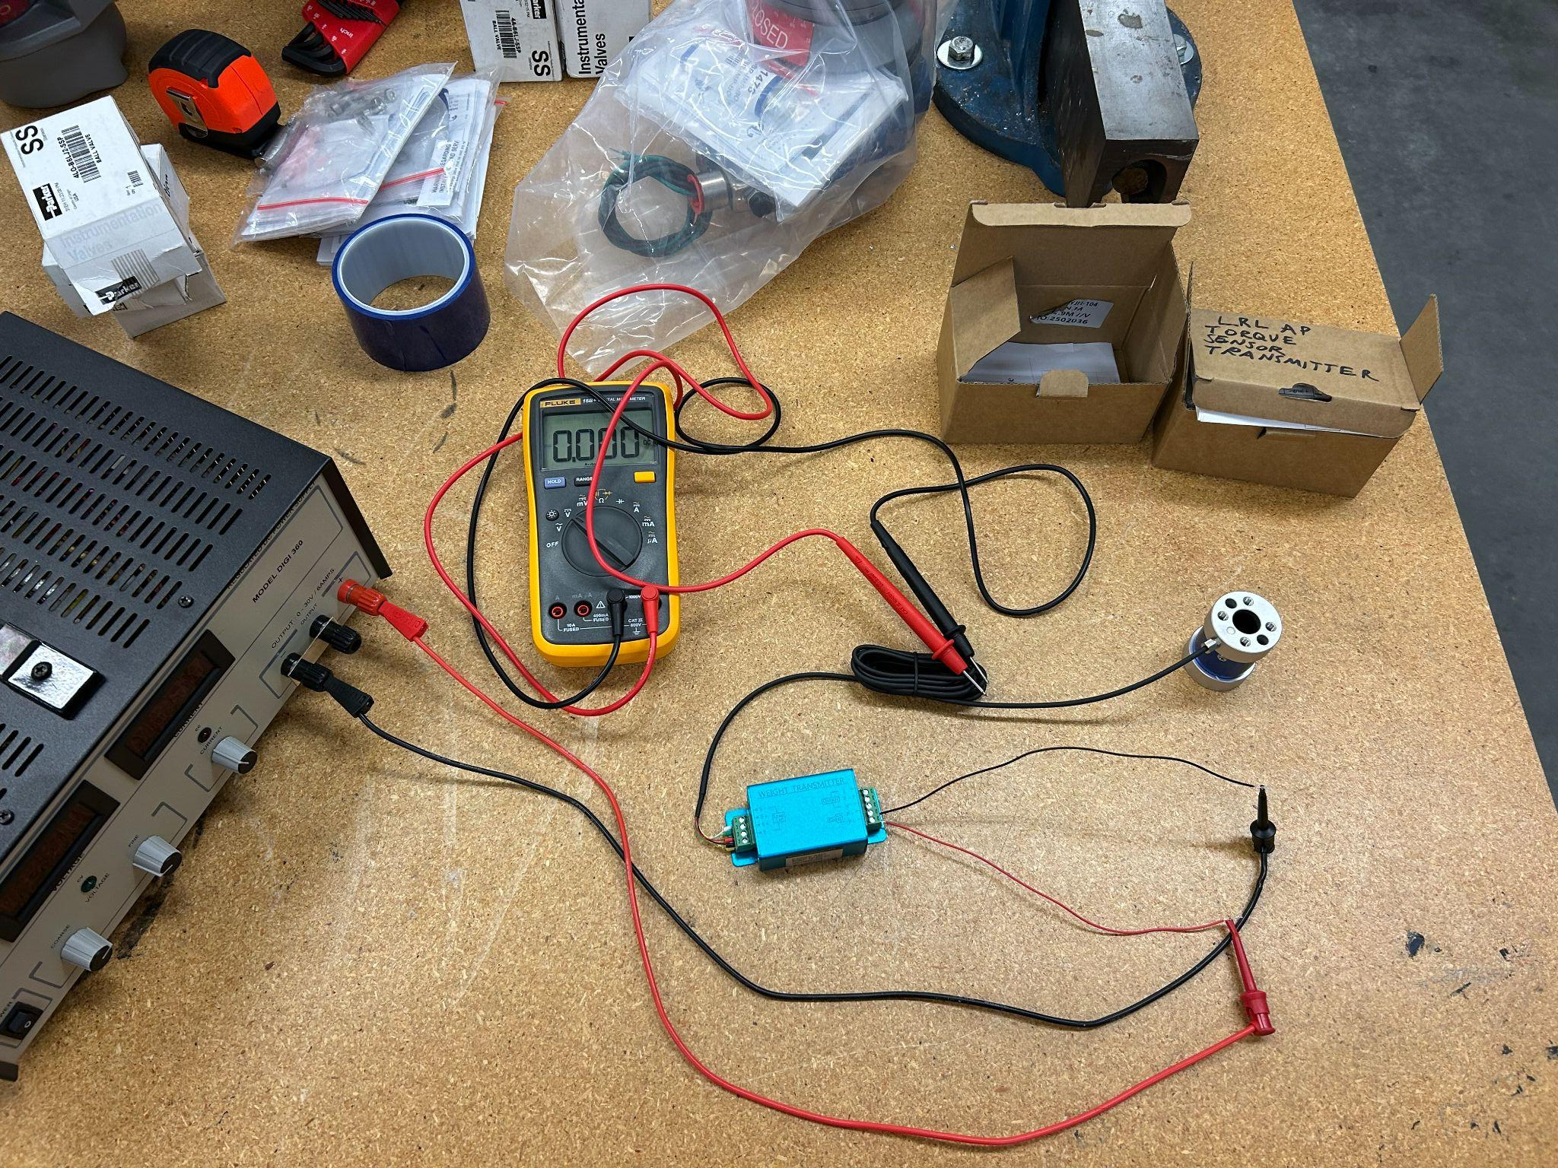
Performance Parameters
Performance Parameter | Theory | Instrumentation
Mach Number |  | Static and Total Pressure Probes, Thermocouples
Reynolds Number |  | Static and Total Pressure Probes
Thermal Efficiency |  | RPM and Torque Sensors, Thermocouples
Adiabatic Turbine Efficiency |  | Thermocouples
Stagnation Pressure Drop and Turbine Expansion Ratio |  | Total Pressure Probes
Heat Transfer Parameters | Surface Temperatures | Surface-mount Thermocouples

Slide 13
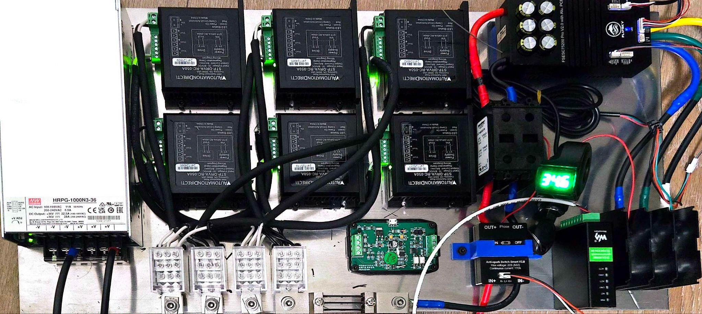
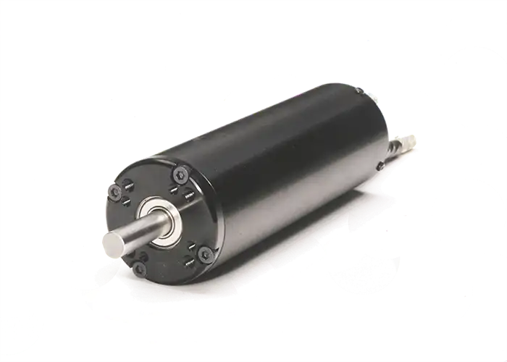
Starter Generator
Starter Generator
Notes:
Dont speak on this one

Slide 14
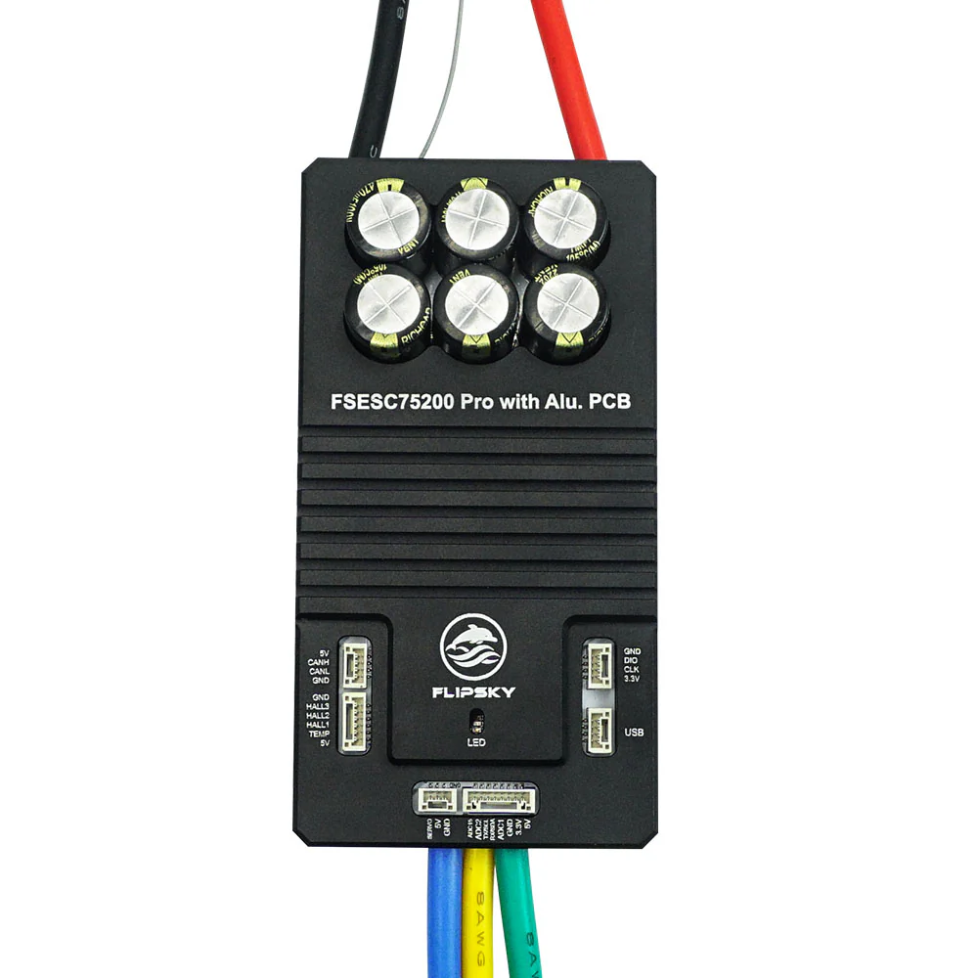
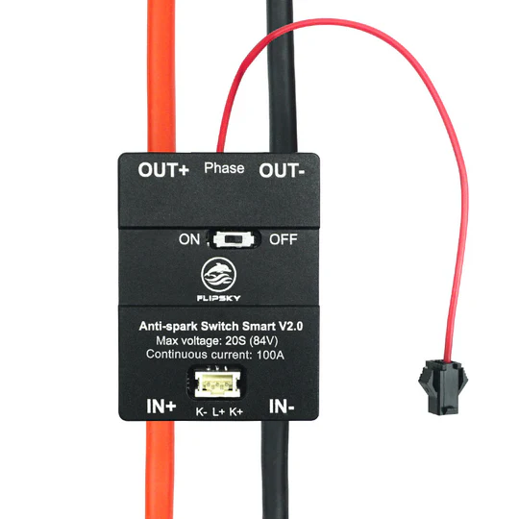

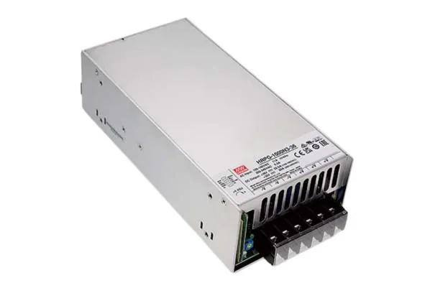
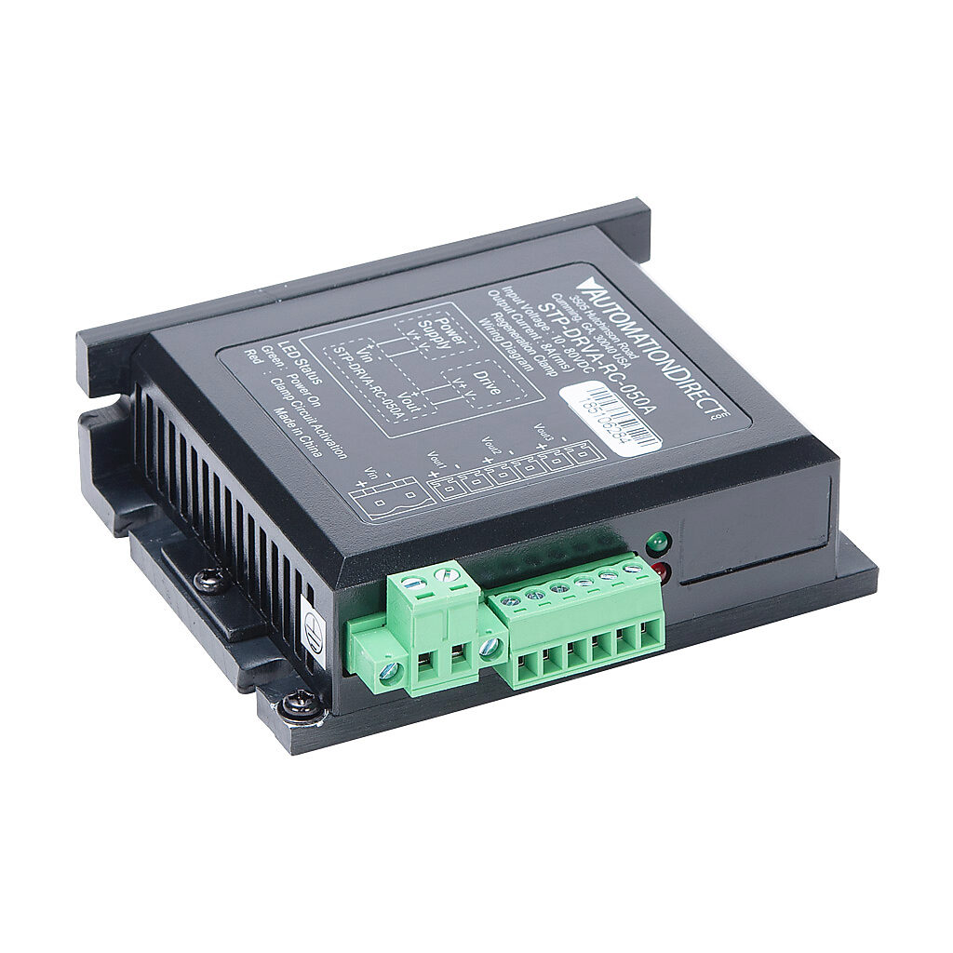
Starter Generator
Prespins shaft and rotor up to operating speed (30k RPM)
Converts mechanical energy of the rotating assembly into electrical energy.
Key Elements
Inrunner BLDC Motor
200A VESC Motor Controller
Anti Spark Switch
Safety Key Switch
DC Power Meter
6x Regen Clamps
1000W 36V Power Supply
Anti Spark Switch
DC Power Meter
Flipsky 75200 Pro VESC
NeuMotors 1539/0.5Y/1692
Regen Clamp
Power Supply
Notes:
Motor:
3500W Continuous
7000W Peak
60000 RPM
35V 197A
40mm OD, 4 poles / 12 slots
Regen Clamps:
50W Continuous (300W)
800W Peak (4800W)

Slide 15
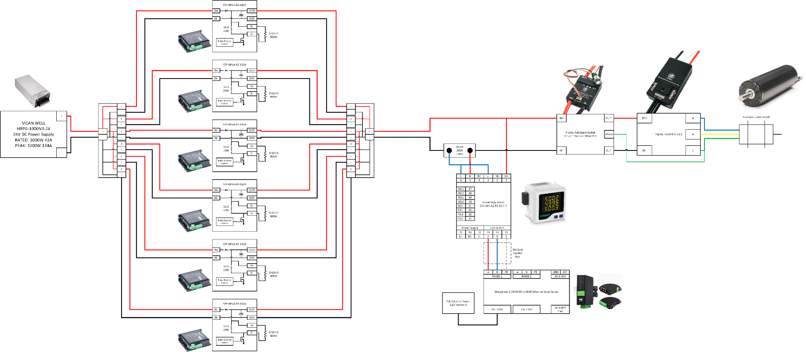
Starter Generator System Diagram

Slide 16
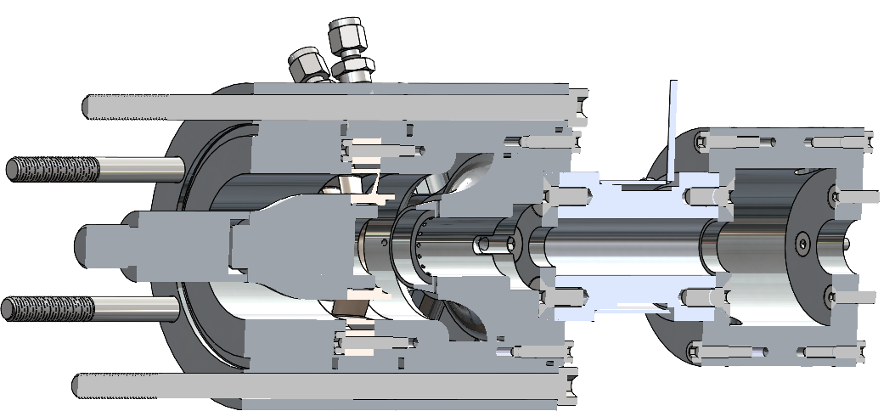
Static Mechanical
Static Mechanical

Slide 17
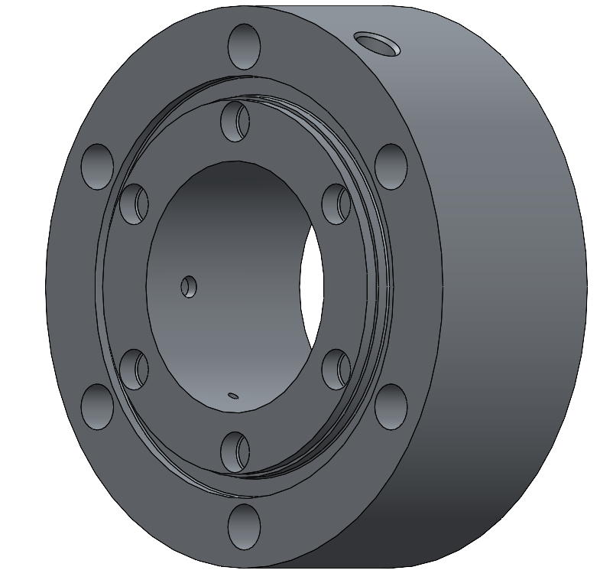
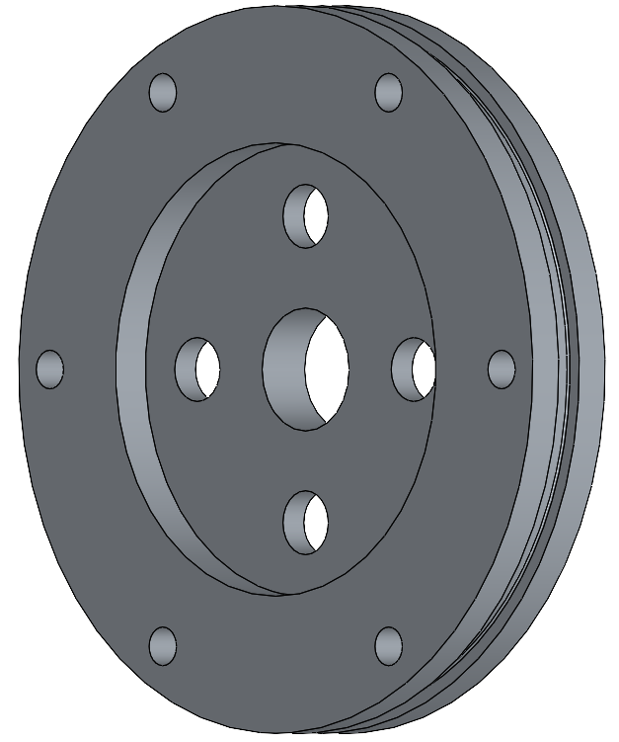
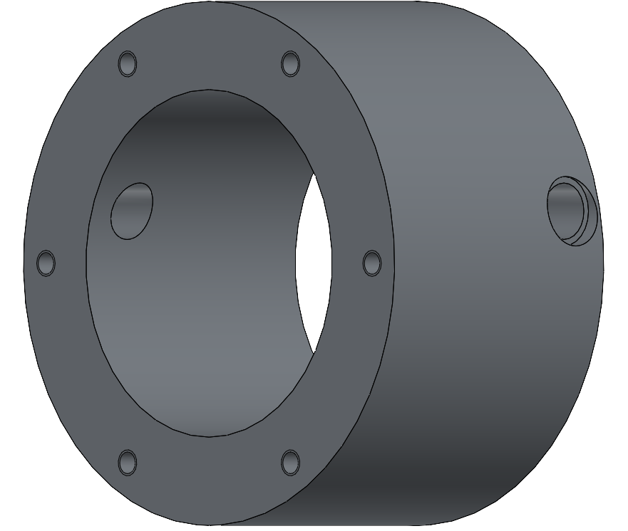
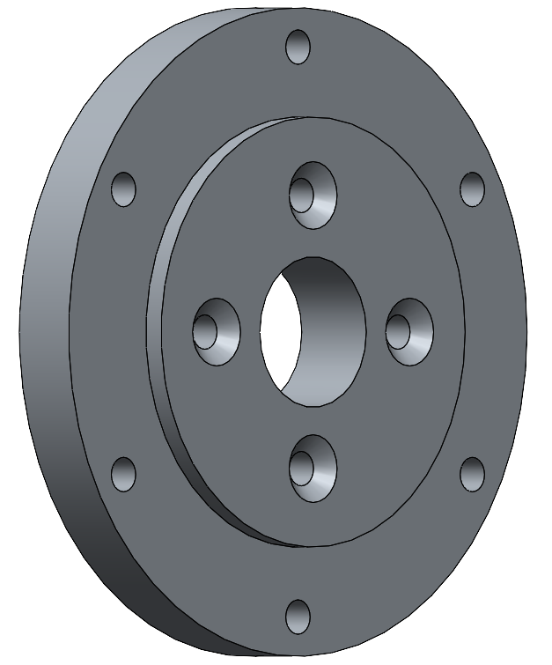
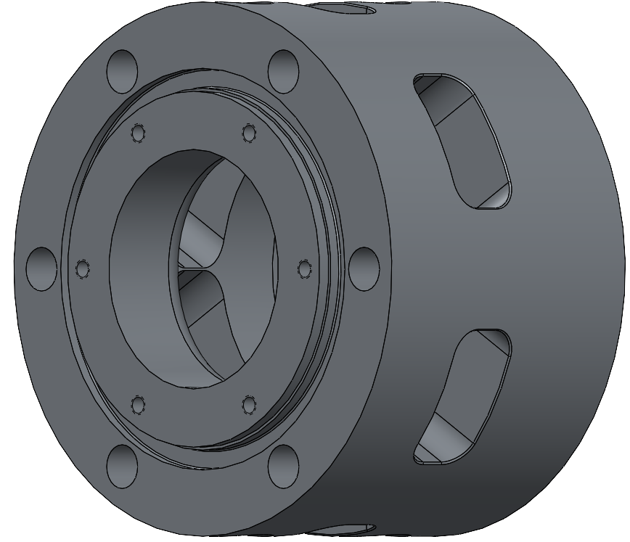
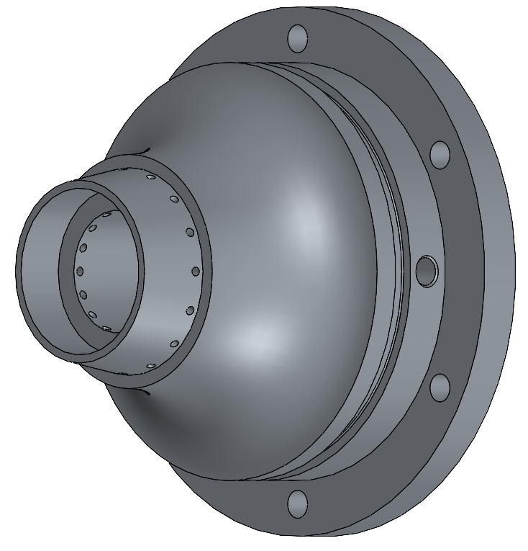
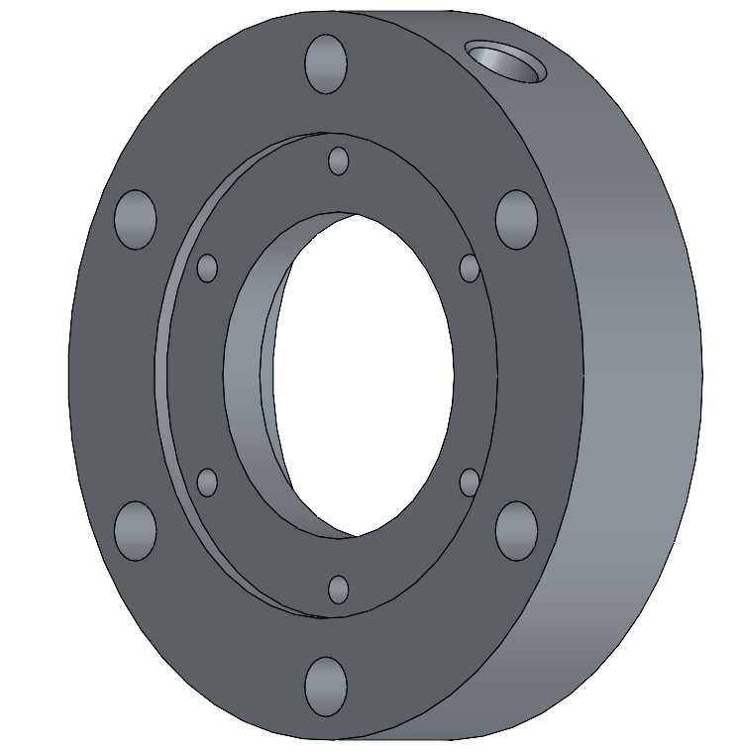
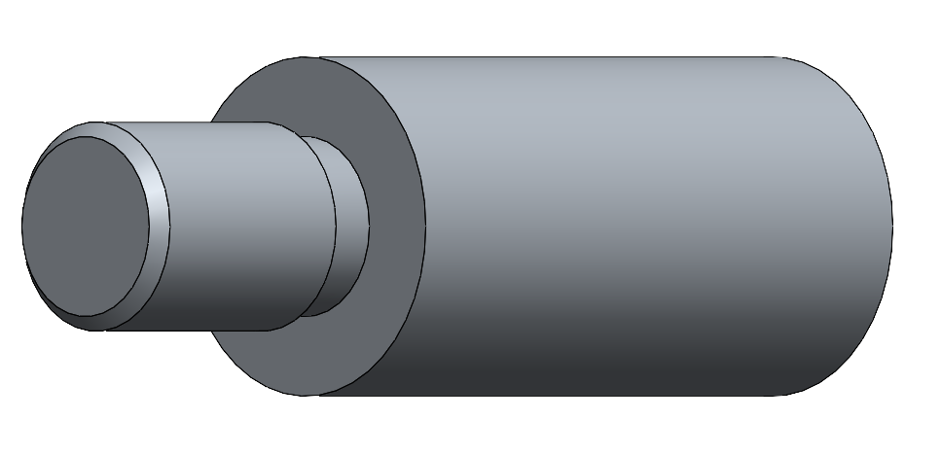
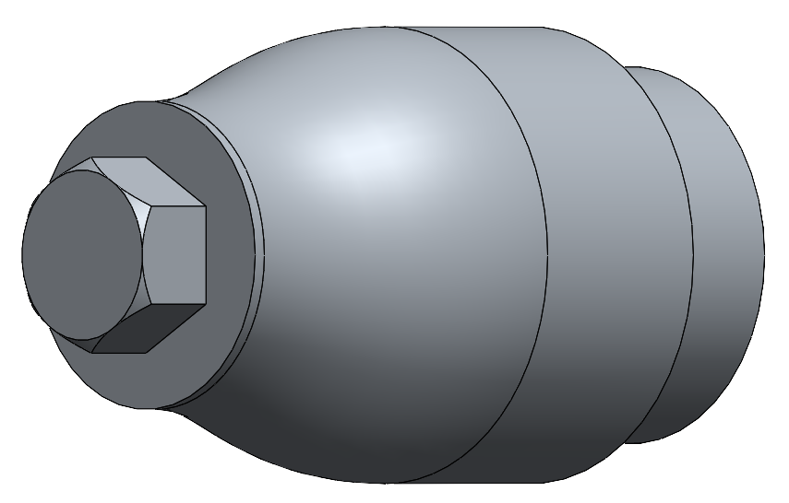
Design Solution - Static Mechanical
Static Mechanical
Rigidly fixes the positions of the stator, turbine, shaft, and motor relative to one another. Protect critical components from exhaust, heat, or shrapnel damage. Guides exhaust.
Key elements
Rigid assembly
Protects components from exhaust and shrapnel
Guides Exhaust
Motor Mount
Motor Mount Flange
Prestator Shroud
Torque Transducer Flange
Deflector
Stator Shroud
Centerbody
Shroud/Outlet
Notes:
Straightness tolerance: 30 micron per 300 mm
Diameter tolerance: +0/-9 micron

Slide 18
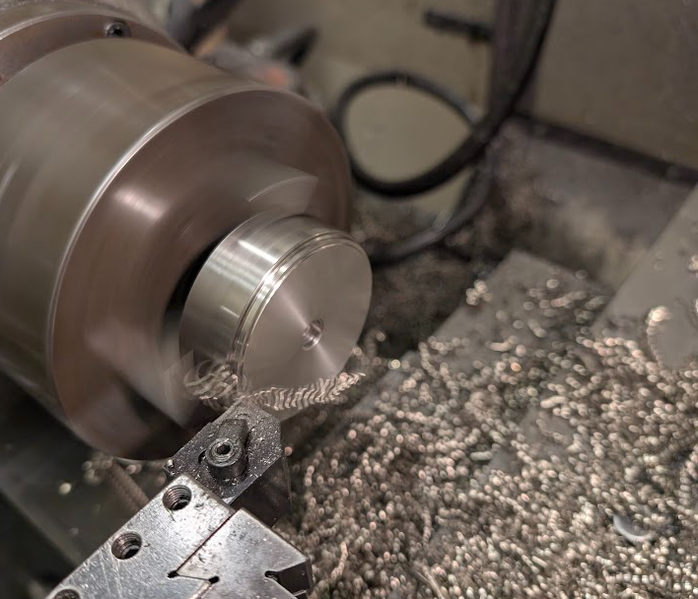
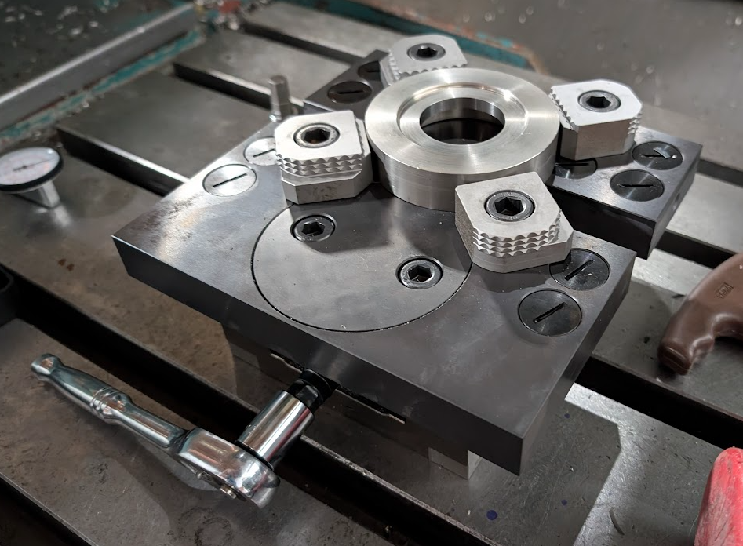
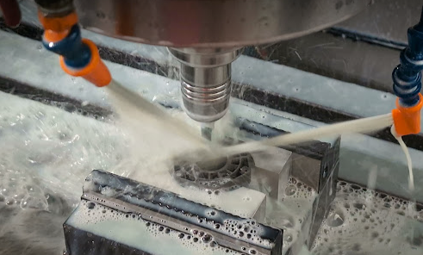
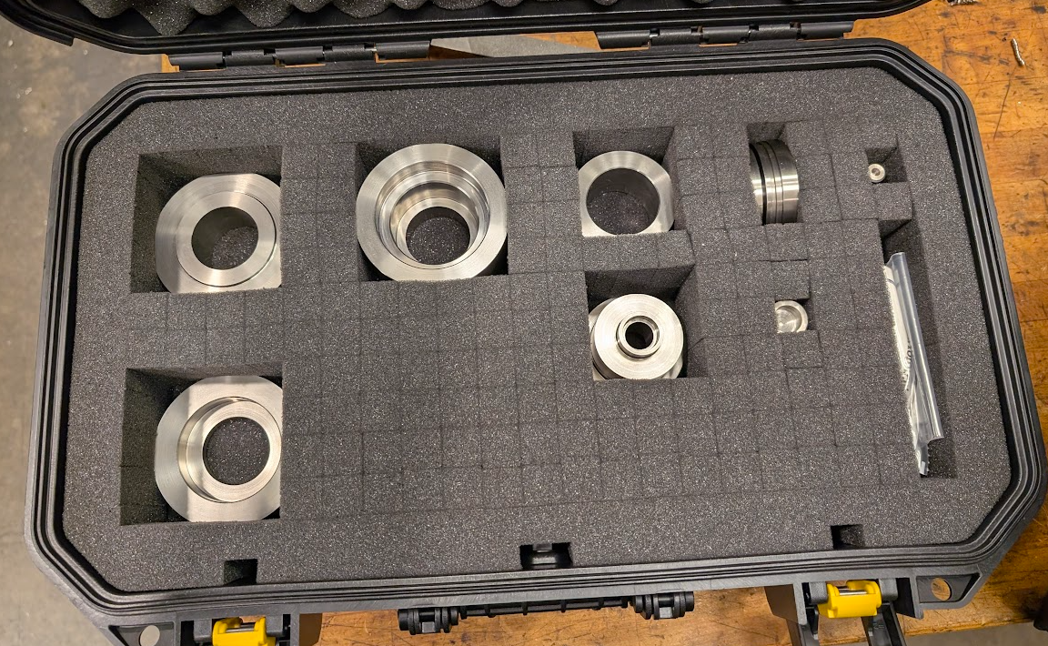
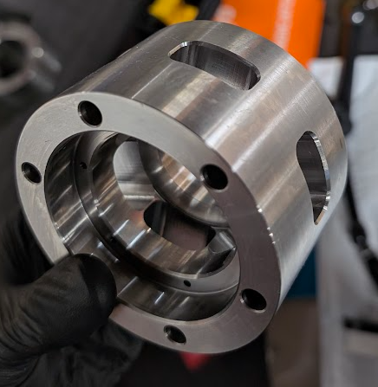
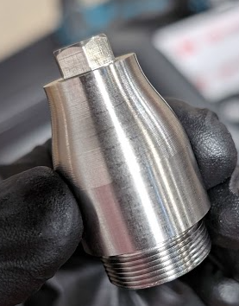
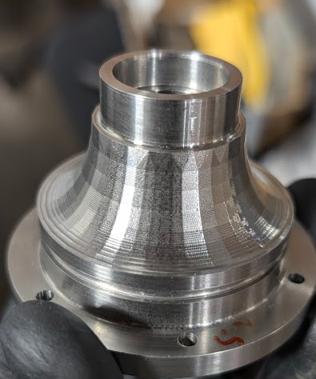
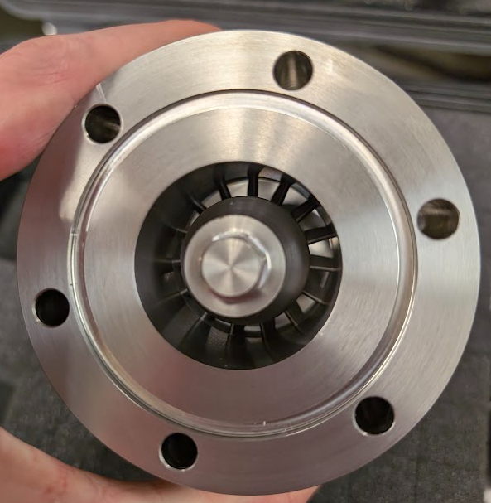
Manufacturing - Static Mechanical
Lathe Operations
303 stainless steel stock
Major diameters turned down from stock
Micrometer, bore gauges, calipers for measurements
Surface plate measurements to check parallelism of opposing faces
Indicator for checking runout
CNC Mill Operations
Bolt tap/clearance drilling
Thread milling
Instrumentation hole milling
3D contour milling
Notes:
Straightness tolerance: 30 micron per 300 mm
Diameter tolerance: +0/-9 micron

Slide 19
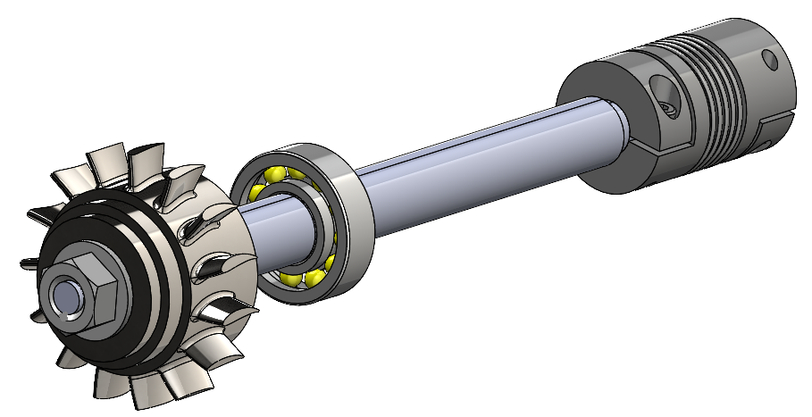
Rotary Mechanical

Slide 20
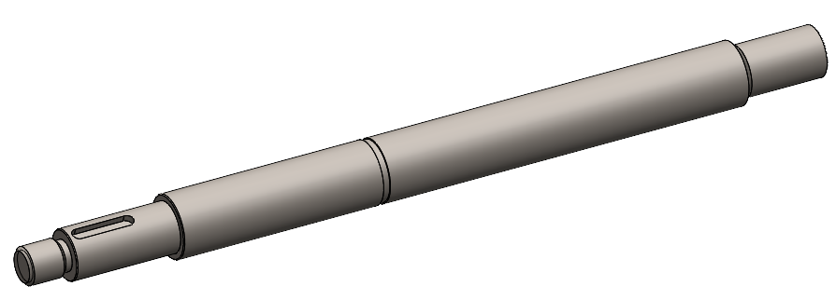
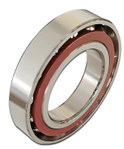
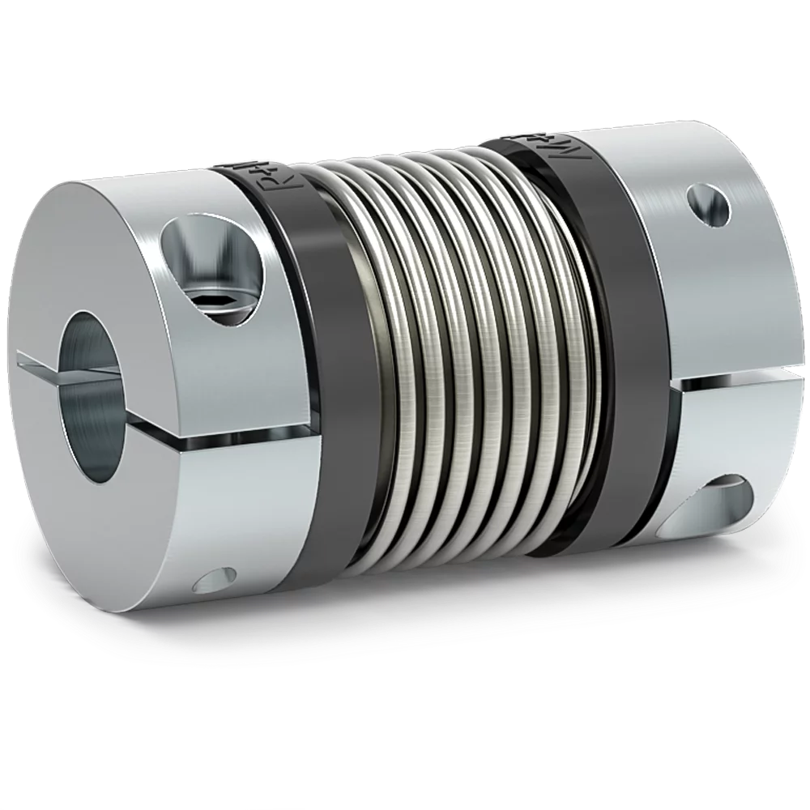
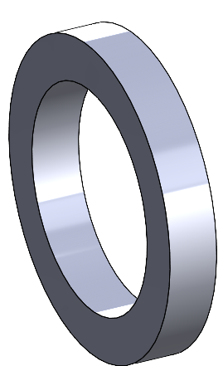
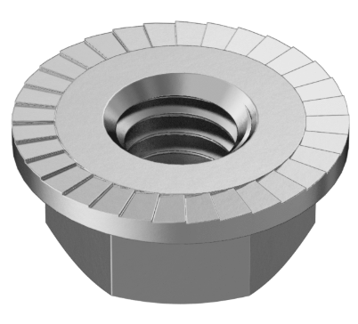
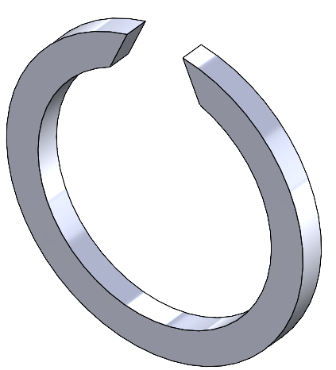
Design Solution - Rotary Mechanical
Shaft
Transfers power from the turbine to the motor and vice versa.
Key elements
420 stainless steel - case hardened, linear motion shaft
Shaft length: 130.25 mm (5.12 in)
2 mm shaft key
Miniature bellows coupling
Angular contact pair
M6 threaded end with serrated flange nut
Spacer ring preloading mechanism
Shaft
Angular Contact Bearing x2
Coupling
Preload Ring
Flange Nut
Rotor Clip
Notes:
Straightness tolerance: 30 micron per 300 mm
Diameter tolerance: +0/-9 micron

Slide 21
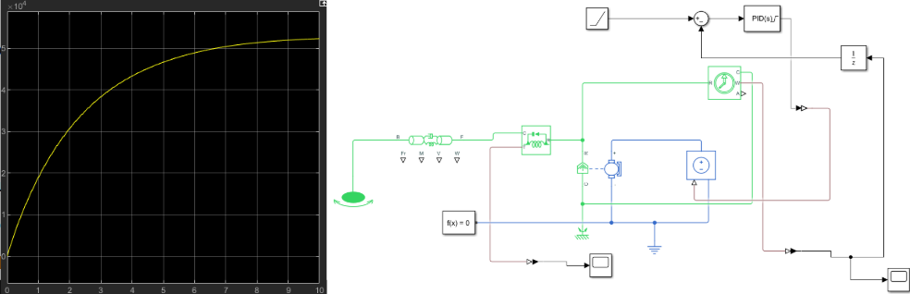
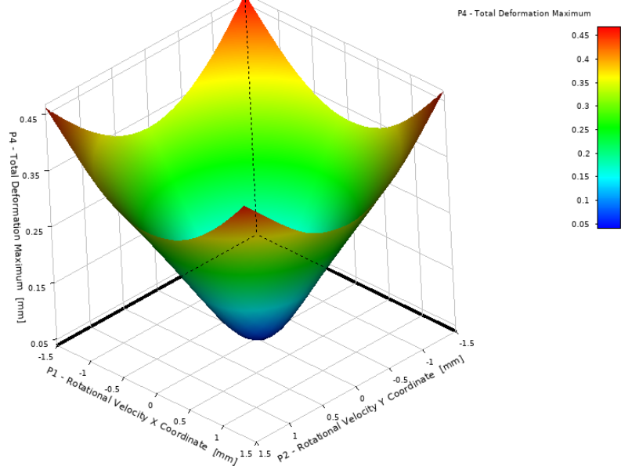
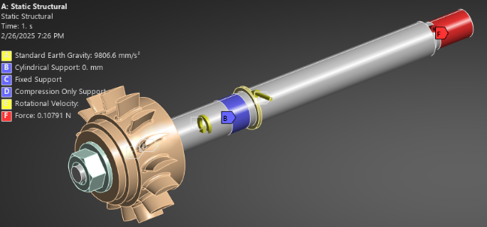
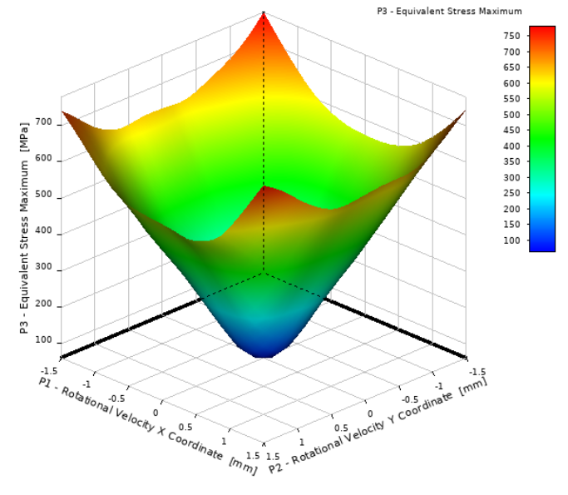
Analysis - Rotary Mechanical
Simple Analysis
Euler-Bernoulli Beam Theory
Rayleigh-Ritz Equation
Critical velocity: 48,000 RPM
Simulink Verification
Simscape driveline tools used
RPM sensor to determine stability
Motor and shaft properly specified.
n
n
i=1
i=1
Finite Element Analysis
Static Structural and Modal Analysis
1st natural frequency: 76,000 RPM
Gravity, rot. velocity
Design of experiment for rot. axis position
  Latin Hypercube Sampling (30 samples)
  Adhere to G2.5 balance per ISO 1940-1
  Max. Imbalance: 1.2 mg per mm of length
Notes:
Equivalent center lumped-weight

Slide 22




Manufacturing - Rotary Mechanical
Lathe Operations
420 stainless steel shaft blank
10 mm 5C collet
Toleranced within a few micron
Finished with high grit sandpaper
Micrometer for verification
Indicator for checking runout
CNC Mill Operations
Thread milling
Milling for keyways
  2 mm shaft key
Notes:
Collet runtout?

Slide 23



Design Process - Rotary Mechanical
Design Validation and Feasibility
Test equations against FEM
Low stress values
Low critical shaft velocity
Stiffer shaft = higher critical velocity
Key Changes
Increased length for torque transducer
Addition of keyways and preload clip
Thicker shaft diameter
1055 Carbon → 420 SS
Spacer ring preloading mechanism added
Notes:
Straightness tolerance: 30 micron per 300 mm
Diameter tolerance: +0/-9 micron

Slide 24

Turbine

Slide 25


Design Solution - Turbine
Turbine Stage
Extracts work from exhaust gas and converts it to mechanical power
Key elements
Stator
  Redirect gas flow at optimal angle into rotor
  Custom camber airfoil with 15 blades
  Inconel 718
Rotor
  Rotating component that extracts work
  NACA 0020 airfoil with 15 blades
  303 Stainless
Designed for high inlet mach number, low pressure ratio, targets 3kW

Slide 26




Analysis - Turbine
0D Analysis
Euler’s Turbomachinery Equation: P = ⍵ṁ(V₃r₃-V₂r₂)
Isentropic, 0D MATLAB model
Analyzed for power target of 3kW
Advanced Design Technology TURBOdesign
Numerical blade generator from set on inlet conditions
Inverse solver uses geometric conditions to generate blade
Manufacturing modifications created from software
Aerodynamics Solutions ADSCFD
Specialized turbomachinery CFD code
Integrated meshing and solver
20% efficiency prediction with current blade design

Slide 27


Manufacturing - Turbine
Mill Turn Operations (rotor)
Completed by NC State’s CAMAL lab
303 stainless steel stock
Major diameters turned down from stock
Full 4 axis milling of blades
Indicator for checking runout
CNC Mill Operations (stator)
Thread milling

Slide 28

Further Work - Turbine
Optimized Blade Design
Thinner blades created to reduce flow separation from previous design
Further Work
Modifying blade shapes for improved efficiency
Changing blade count & RPM to characterize performances changes and off-design operation

Slide 29







A Special Thanks to…
Notes:
Luke

Slide 30
Questions?

Slide 31
Links for Images
[1] https://leehamnews.com/2016/12/02/bjorns-corner-turbofan-engine-challenges-part-5/
[2] https://arc.aiaa.org/doi/10.2514/1.B37959
[3] https://www.amazon.com/15HP-Stroke-Cooled-Gasoline-Splitter/dp/B0CPXP21DH
[4] https://aeroreport.de/en/good-to-know/wie-funktioniert-ein-turbofan-triebwerk-aufbau-eines-triebwerk
[5] https://www.uti.edu/blog/diesel/diesel-engines-explained
[6] https://arc.aiaa.org/doi/10.2514/1.B37959

