Slide 1
Computational Simulations of the King’s Plain Wind Farm
Christopher M Cicalla Jr¹, Bryan Mendoza², Ali M Alabadi,³
Brandon Burnett⁴, and Natania Middleton⁵
Region II Conference, April 3-4, 2025
Published by the American Institute of Aeronautics and Astronautics, Inc., with permission.

Slide 2
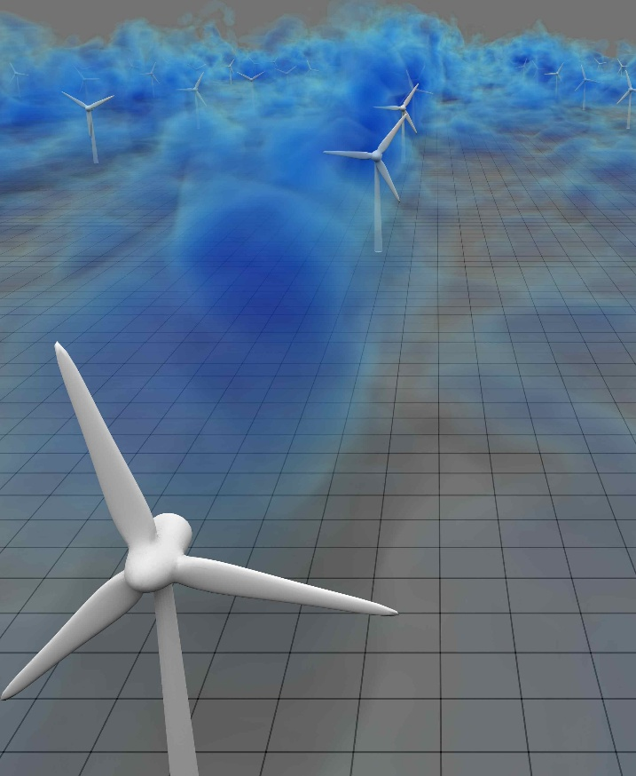
Computational Simulations of the King’s Plain Wind Farm
AWAKEN:
The American WAKE Experiment
​
Simulated wind-farm turbulence: volume rendering of low-velocity wake regions. Visualization courtesy of David Bock (NCSA, XSEDE, Extended Collaborative Support Services)
Leverages the experience, instrumentation, and capabilities of multiple institutions to conduct the most comprehensive wind energy wake experiment to date.
Notes:
The American Wake Experiment is a Department of Energy (D.O.E) sponsored study reaching out to across the US and across the globe.

Slide 3
Computational Simulations of the King’s Plain Wind Farm
AWAKEN:
The American WAKE Experiment
​
Simulated wind-farm turbulence: volume rendering of low-velocity wake regions. Visualization courtesy of David Bock (NCSA, XSEDE, Extended Collaborative Support Services)
Combines resources from multiple institutions to conduct the most comprehensive wind energy wake experiment
Notes:
The American Wake Experiment is a Department of Energy (D.O.E) sponsored study reaching out to across the US and across the globe.

Slide 4
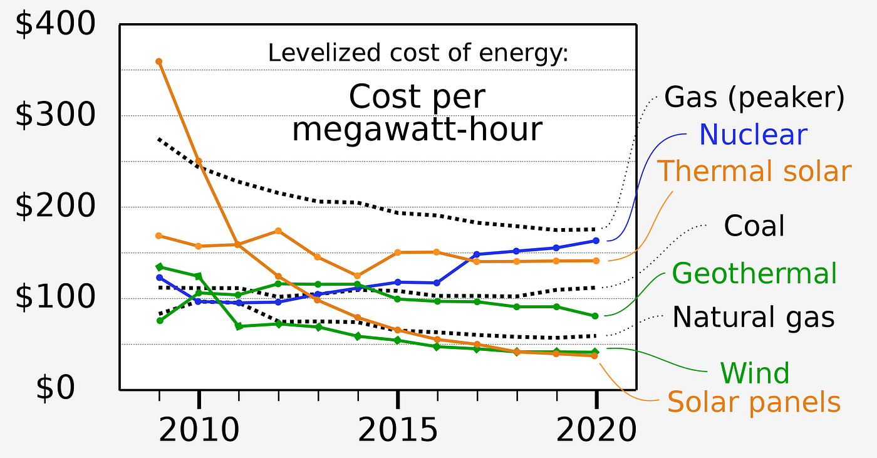
Computational Simulations of the King’s Plain Wind Farm
Motivation for research
Mitigate uncertainty surrounding wind energy​
Levelized cost of electricity​
Help with the global climate crisis
Notes:
Why study turbine wake? Well, we want to develop a better understanding of wakes, to help with the cost of energy, and to lower CO2 emissions for a cleaner future.

Slide 5
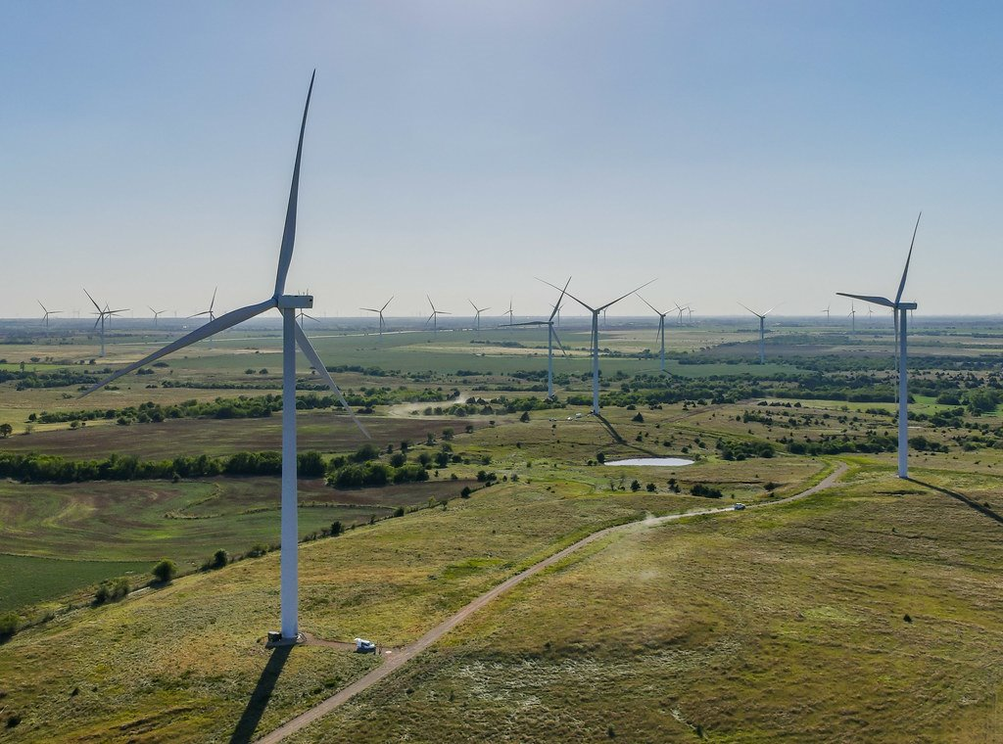
Computational Simulations of the King’s Plain Wind Farm
King's Plain Wind Farm
Located in Garber County, OK
88 2.82 MG GE turbines and a hub height of 89 meters
Approximate area of 60 miles
Image from King’s Plain Wind Farm

Slide 6



Computational Simulations of the King’s Plain Wind Farm
LES solves the scales larger than the grid and models the sub-grid scale
Filtered Conservation of Mass and Momentum in Curvilinear Coordinates
Sub-grid scale modeling: Dynamic Smagorinsky model
Notes:
Large-Eddy simulation and calculations of the wind farm

Slide 7
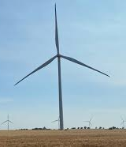

Computational Simulations of the King’s Plain Wind Farm
Actuator Disk Model
Models' rotor as a disk
Prescribes forces uniformly over disk
Thrust calculated by prescribed C_{T}
Notes:
Calculation of the actuator disk

Slide 8
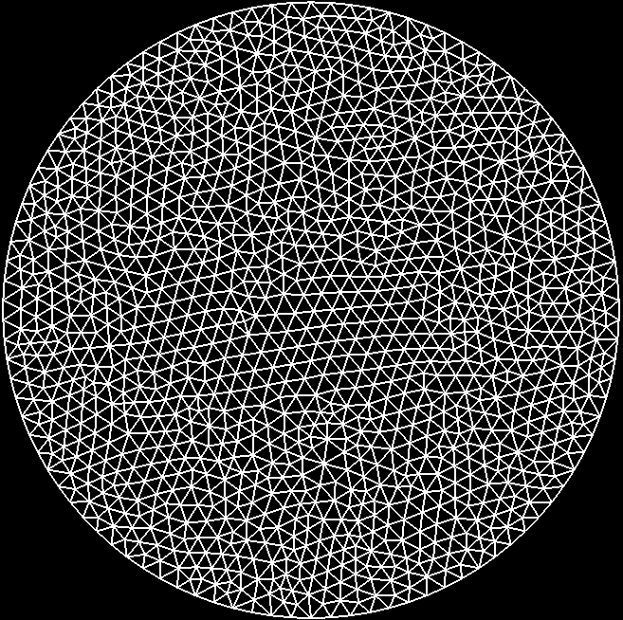
Computational Simulations of the King’s Plain Wind Farm
Actuator Disk Model
Models' rotor as a disk
Prescribes forces uniformly over disk
Thrust calculated by prescribed C_{T}
Notes:
Actuator disk setup for the model to be ran in the HPC

Slide 9
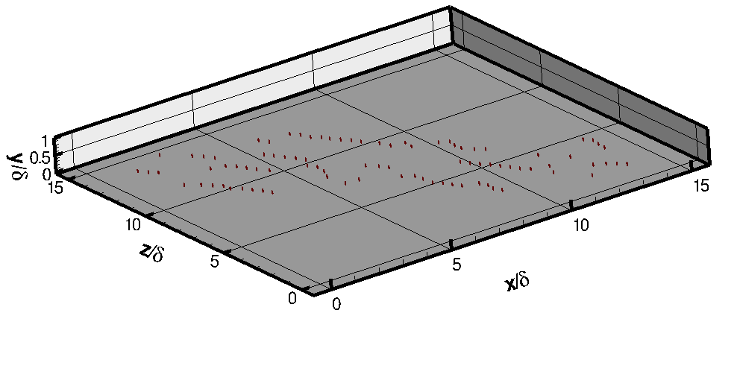
Computational Simulations of the King’s Plain Wind Farm
Domain size:
  L_{x} x L_{y} x L_{z} = 15 km x 1 km x 15 km
88 GE 2.82 MW Turbines
Grid Size:
  N_{x} x N_{y} x N_{z} = 1850 x 50 x 1850
Computational Domain with 88 turbines

Slide 10
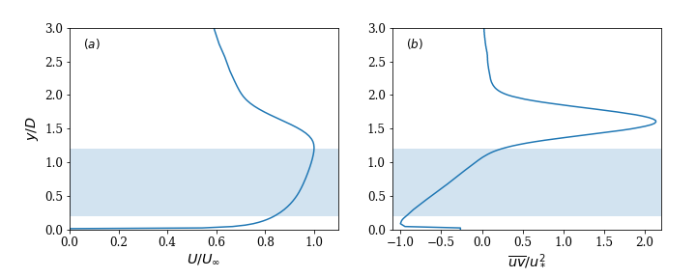
Computational Simulations of the King’s Plain Wind Farm
Fig (a): averaged streamwise velocity
Velocity decreases to around 60% of the max above the turbine
Fig (b) shows how the streamwise-vertical Reynolds stress is affected by friction velocity
Figure 1: (a) Average inflow streamwise velocity U normalized by maximum velocity and (b) streamwise-vertical Reynolds stress normalized by friction velocity.

Slide 11
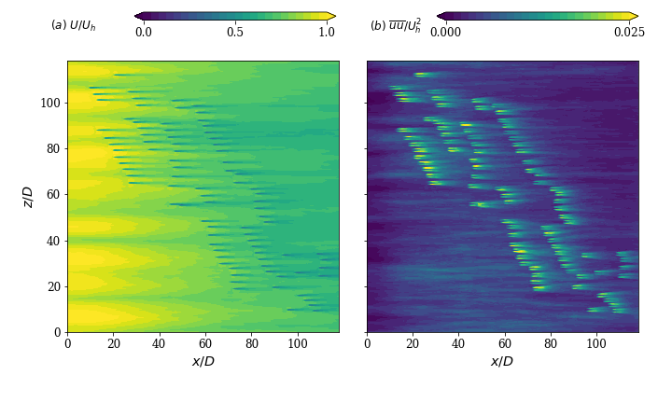
Computational Simulations of the King’s Plain Wind Farm
This figure shows the average incoming stream velocities and the wake downstream
This allows us to see the interactions going on at the hub and downstream hubs

Slide 12
Computational Simulations of the King’s Plain Wind Farm
Here we have the streamwise velocity variance at hub height.
We see how, as the air moves over the hub, velocity gains speed as it enters the wake.

Slide 13
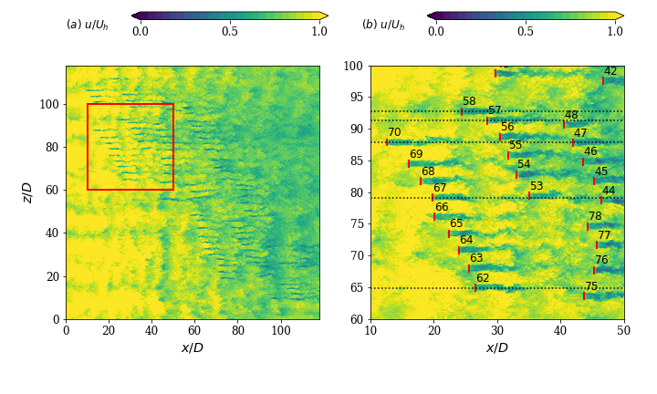
Computational Simulations of the King’s Plain Wind Farm
We are looking at a fraction of time and seeing the incoming flow at the hub.
From there we can see what effect it has downwind.
Figure 3: (a) Instantaneous streamwise velocity at hub height.

Slide 14
Computational Simulations of the King’s Plain Wind Farm
Zoomed in to get a better look
This allows us to make assumptions about the rest of the farms and the velocities

Slide 15
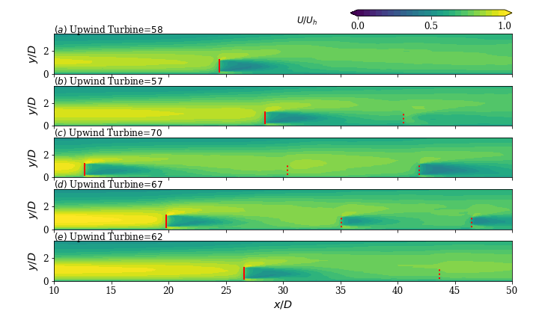
Computational Simulations of the King’s Plain Wind Farm
Figure 4: Instantaneous streamwise velocity on planes centered on upwind turbines 58, 57, 70, 67, and 62. The red lines represent the upwind turbine rotor. Red dashed lines are downwind turbines.

Slide 16
Computational Simulations of the King’s Plain Wind Farm
Here we can see incoming wind when it hits the upwind turbine, as shown by the solid red line. Turbine 58 is by itself in the first figure(a).
In the remaining figures(b-e), we can easily how the wake affects the velocities downwind, represented by the red dashed lines.

Slide 17
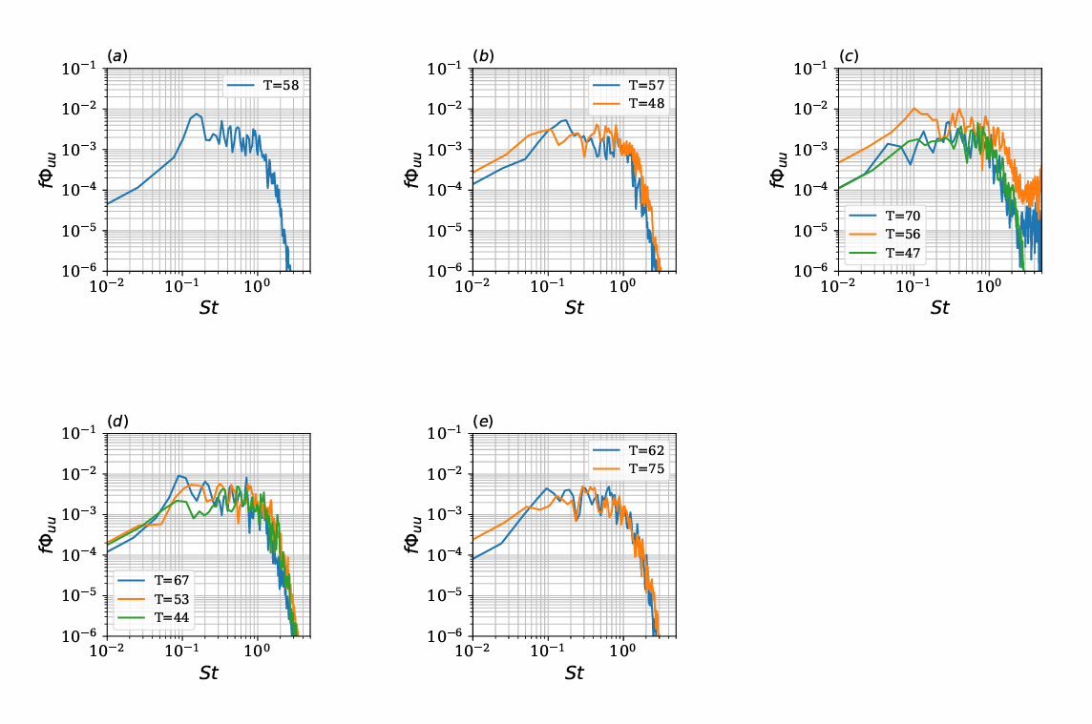
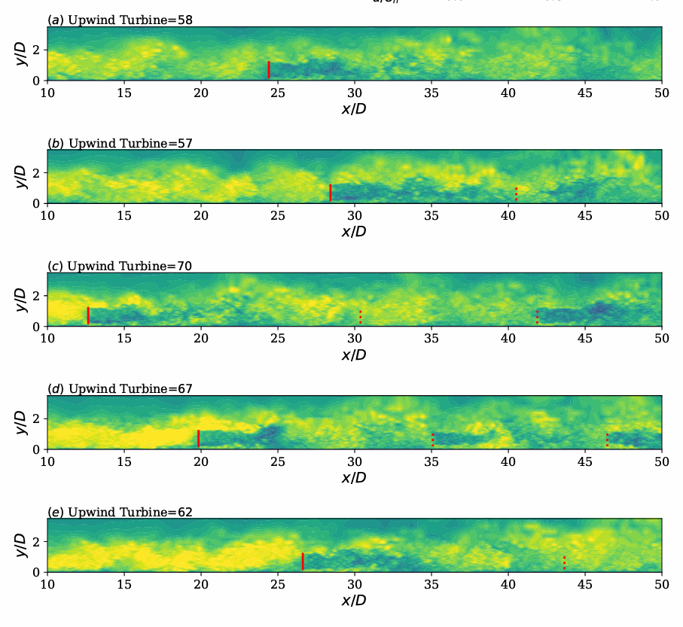
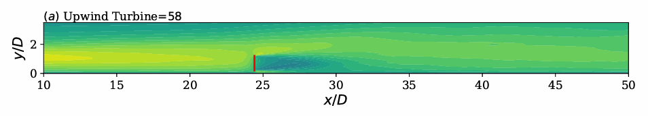

Computational Simulations of the King’s Plain Wind Farm
Turbine 58 shows a lot of wake meandering meaning airflow is not stable, leading to power uncertainty and turbulence

Slide 18
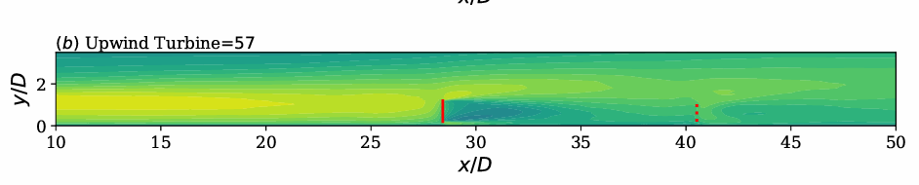
Computational Simulations of the King’s Plain Wind Farm
Here we see turbine 57 with more wake meandering and how it directly affects turbine 48 and the decreased power

Slide 19
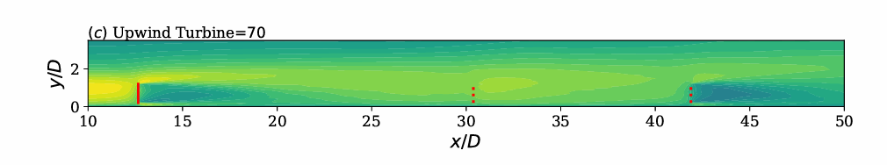
Computational Simulations of the King’s Plain Wind Farm
We can see that 70 does the same but what differs is at 56 the wind almost gather back to full strength but we see the same results from 56 to 47

Slide 20
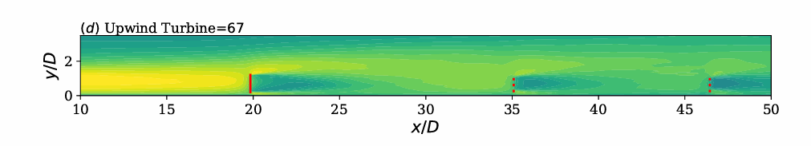
Computational Simulations of the King’s Plain Wind Farm
The turbines here are too close. The wakes behind each upwind turbine directly interfers with the downwind turbine

Slide 21
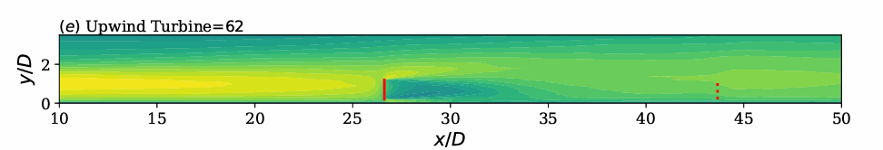
Computational Simulations of the King’s Plain Wind Farm
Notes:
This shows how the up wind turbine takes max power from downwind turbine 75

Slide 22
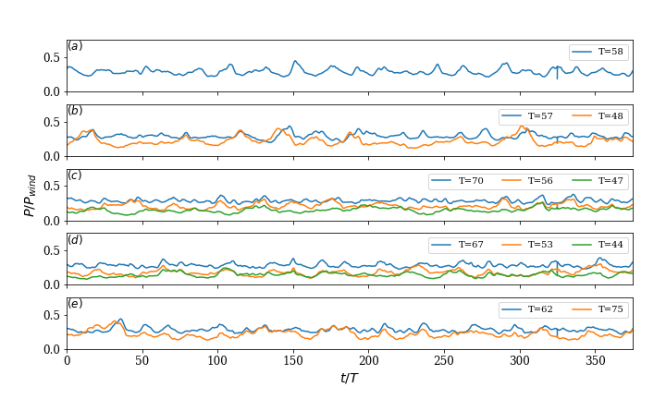
Computational Simulations of the King’s Plain Wind Farm
The blue lines indicate the upwind turbines.
Looking at the graph we can see that upwind turbines affect those down wind
Figure 5: Instantaneous power coefficient for upwind turbines 58, 57, 70, 67, 62.

Slide 23
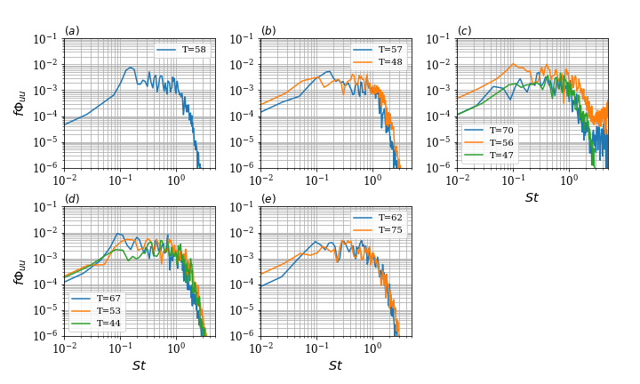
Computational Simulations of the King’s Plain Wind Farm
We look at how turbines affect wakes at specific distances
PSD is used to analyze turbulence and frequency of these waves
Essentially, we look at different turbines, operating in varying conditions change airflow and create turbulence that might affect other turbines downstream

Slide 24
Computational Simulations of the King’s Plain Wind Farm
References
[1] Barthelmie, R. L, et al, Modelling and measurements of wakes in large wind farms. J. Phys. Conf. Ser. 75 (1) 2007, ,012049.
[2] Foti, D., Yang, X., Guala, M., and Sotiropoulos, F., “Wake meandering statistics of a model wind turbine: Insights gained by large eddy simulations,” Physical Review Fluids, Vol. 1, No. 4, 2016, p. 044407.
[2] Foti, D., Yang, X., and Sotiropoulos, F., “Similarity of wake meandering for different wind turbine designs for different scales, Journal of Fluid Mechanics, Vol. 842, 2018, pp. 5–25.
[3] Foti, D., Yang, X., Campagnolo, F., Maniaci, D., and Sotiropoulos, F., “Wake meandering of a model wind turbine operating in two different regimes,” Phys. Rev. Fluids, Vol. 3, No. 5, 2018, p. 054607.
[4] Foti, D., Yang, X., Shen, L., and Sotiropoulos, F., “Effect of wind turbine nacelle on turbine wake dynamics in large wind farms,” Journal of Fluid Mechanics, Vol. 869, 2019, pp. 1–26.
[5] Smagorinsky, J., “General circulation experiments with the primitive equations: I. The basic experiment,” Monthly Weather Review, Vol. 91, No. 3, 1963, pp. 99–164.
[6] Germano, M., Piomelli, U., Moin, P., and Cabot, W. H., “A dynamic sub grid-scale eddy viscosity model,” Physics of Fluids A: Fluid Dynamics, Vol. 3, No. 7, 1991, pp. 1760–1765.

