Slide 1

The Use of Regolith Simulant as a Material for Building Functional Sensors in Extreme Environments
Sofia I. de Hoffmann, Lexi J. Greenwood, and Seetha Raghavan
Notes:
Preface comments:
Emphasize that this is a starting point for discussion on COE needs and appropriate resourcing
Lay aside any assumptions or preconceived notions on faculty workload or other metrics
Let’s look at the data and go where the data takes us
Look at the big picture, try to avoid going into the details because that won’t help us today – I’m happy to follow up later with any relevant or necessary details
Positive, forward-leaning discussion on what we can achieve together

Slide 2
In-Situ Resource Utilization
Growing interest in lunar exploration
Combined with in-space manufacturing to expand lunar operations
Exploring the creation of functional sensors to monitor and measure the environment and to create safety systems
Transportation of materials from Earth is expense
Cutting down on launch weight, improves efficiency
Background & Motivation
Testing Methods & Experiment
Results and Analysis
Summary & Future Work
1
Notes:
Add pictures of people transporting materials to the moon --> economic issues and in-situ processing
EXPLAIN MORE
Artemis - NASA
WHY IS IT IMPORTANT, MAKE A CASE
WHY ARE WE DOING THIS RESEARCH
ADD BULLET POINTS
FOCUS ON SCIENCE

Slide 3
Motivation and Objective
Motivation:
Determine the potential of using lunar regolith simulants for the development of functional sensors to be used in extreme environments
Objective:
The viability of compressive mechanical sensors can be analyzed using Raman spectroscopy. Mechanical stress alters atomic vibrations, leading to measurable spectral changes.
Background & Motivation
Testing Methods & Experiment
Results and Analysis
Summary & Future Work
2

Slide 4
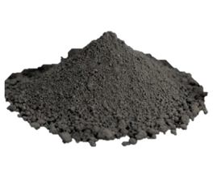
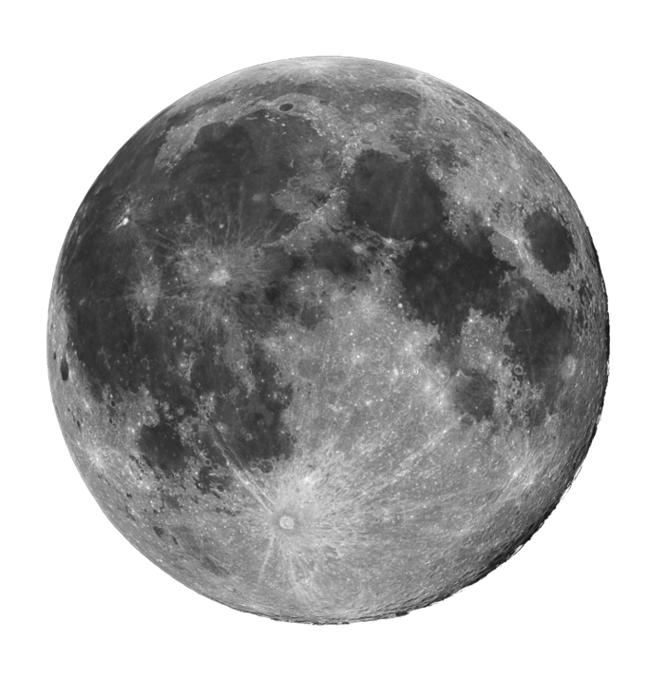
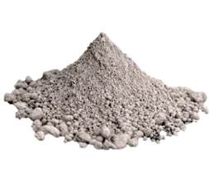
Lunar Regolith
Lunar regolith is angular and jagged in nature
Highland
  Older
  Result of impacts and crust cooling
Mare
  Younger
  Result of volcanic activity
Lunar Mare
Average Particle Size: 7 µm
Particle Size Range: <0.04 - 32 µm
Cohesion: 0.172 kPa
Lunar Highland
Average Particle Size: 7 µm
Particle Size Range: <0.04 - 35 µm
Cohesion: 0.205 kPa
Background & Motivation
Testing Methods & Experiment
Results and Analysis
Summary & Future Work
3
Notes:
Due to micrometeorite impacts and lack of erosion from both water and wind
Add moon picture – box LHS
Fragmented rock material that forms the land surface
Covers almost the entire surface of the moon
Lunar regolith is different from Earth regolith
Forms through meteoroid impacts and exposure to cosmic radiation
It can be classified into two, based on its origin
Lunar Highland (light)
Lunar Mare (dark)
Extra fine dust simulants are used to evaluate and test this material
Simulants were created based on samples from the Apollo mission
On this paper we focused on LHS
LOAD TRANSFER – ADD PARTICLE SIZE AND SHAPE
WHY IS LHS AND LMS DIFERENT --> particle size

Slide 5
Simulant Composition/Mineralogy
LHS 1D
Mineralogy Wt% | LHS-1D
Olivine ((Mg,Fe)₂SiO₄) | 0.3
Pyroxene (CaMgSi₂O₆) | 0.2
Glass-Rich Basalt | 24.7
Anorthosite (CaAl₂Si₂O₈) | 74.4
Ilmenite (FeTiO₃) | 0.4
Anorthosite mainly consists of the mineral group called plagioclase
RRR
485-488,505,557-564,504,483,503
Raman Peaks (cm⁻¹)
Background & Motivation
Testing Methods & Experiment
Results and Analysis
Summary & Future Work
4

Slide 6
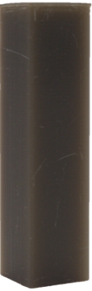
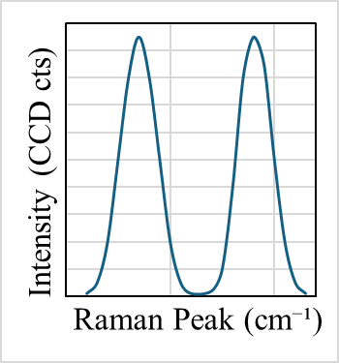
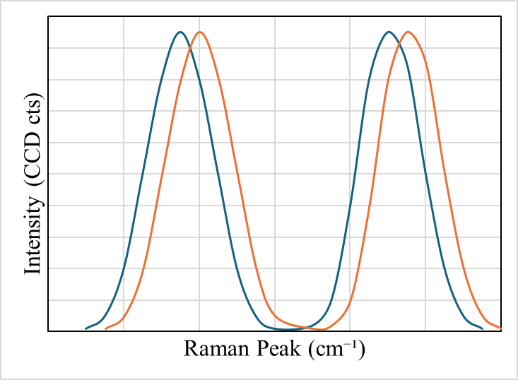
Uniaxial Compression
Raman Spectroscopy
Laser to excite molecules
Each individual resultant peak shows a singular molecular bond
Every material has characteristic peaks
Observing peak shifts due to external stimuli can be used to determine the sensing properties of a material
Background & Motivation
Testing Methods & Experiment
Results and Analysis
Summary & Future Work
5
Notes:
To observe the material’s response to stress, we applied uniaxial compression to the simulants. Using Raman spectroscopy, we measured how external stimuli, such as mechanical stress, shift the peaks in the Raman spectrum. These shifts allow us to assess the material's sensing properties. Each peak corresponds to a specific molecular bond, and these shifts provide valuable data on how the material behaves under stress.
Uses a laser to excite molecules
A small fraction of the laser is inelastically scattered to create a Raman scatter
Each individual resultant peak shows a singular molecular bond
Every material has characteristic peaks, and the composition of samples can be determined using these
Observing peak shifts due to external stimuli can be used to determine the sensing properties of a material

Slide 7
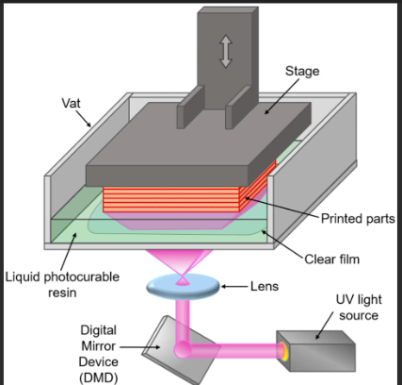
Sample
Digital light processing (DLP), is a type of 3D printing that uses UV light to cure a sample layer by layer
16mm
3.8mm
Zongheng3D. (n.d.). DLP 3D Printing: Comprehensive Guide
Background & Motivation
Testing Methods & Experiment
Results and Analysis
Summary & Future Work
6
Notes:
The samples were fabricated using Digital Light Processing (DLP) 3D printing, a method that uses UV light to cure resin layer by layer. This technique allowed us to precisely control the sample dimensions, which were 16 mm by 3.8 mm by 3.8 mm. DLP 3D printing is advantageous for creating detailed, reproducible samples.
Regolith simulant composites (LHS-1D) were manufactured by 3D printing with DLP. 10 wt% regolith was chosen for manufacturing to ensure sufficient concentration to provide Raman intensity without issues of agglomeration [16]. The epoxy resin and LHS were mixed together for three minutes, using the THINKY mixer AR-100. The mixture was then 3D printed using a DLP printer with a 5 𝜇m layer thickness and cured with 405 nm UV light for 6 seconds per layer. For postprocessing, the samples were washed with isopropyl alcohol and additional UV curing for three minutes. The sample can be observed in Fig 1b. The dimensions of the sample was 16 mm X 3.8 mm X 3.8 mm.

Slide 8
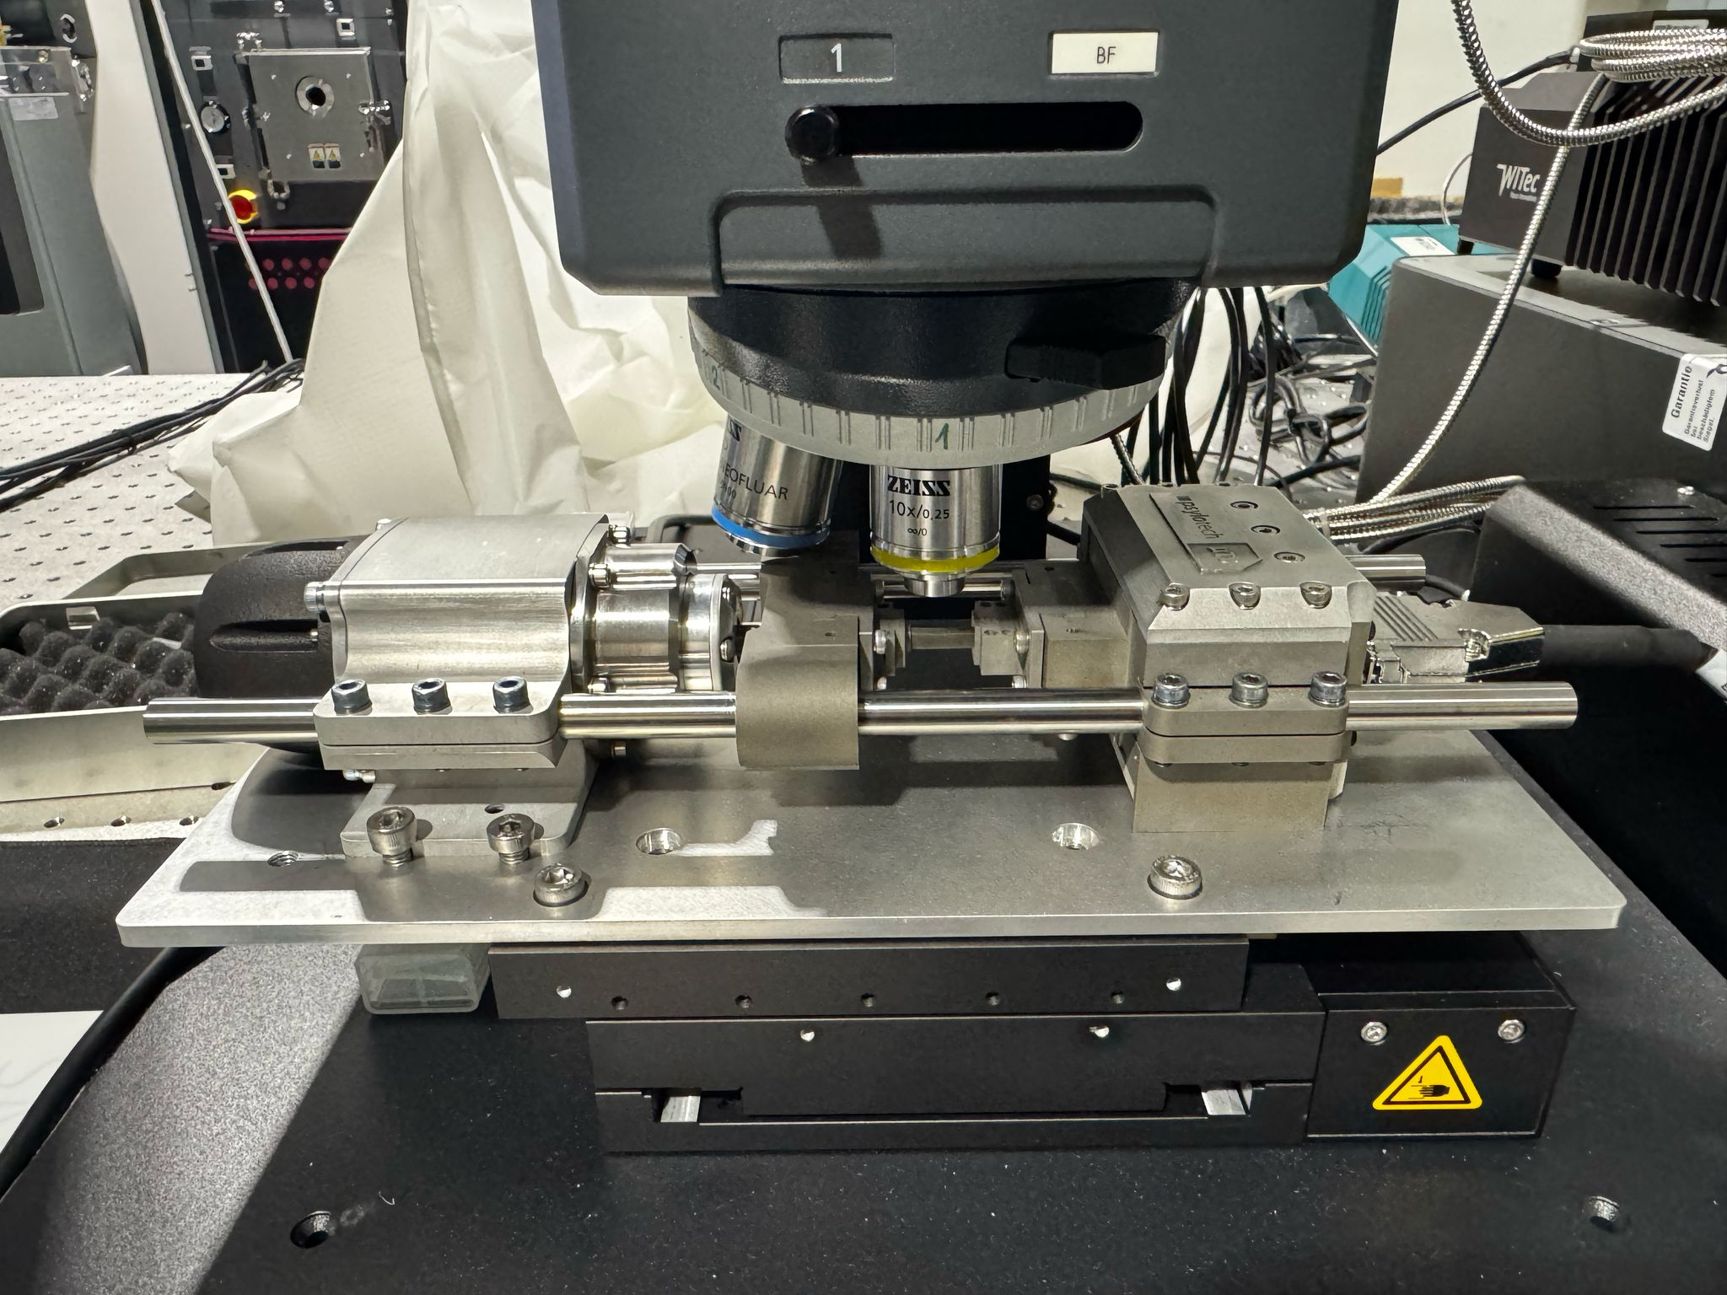
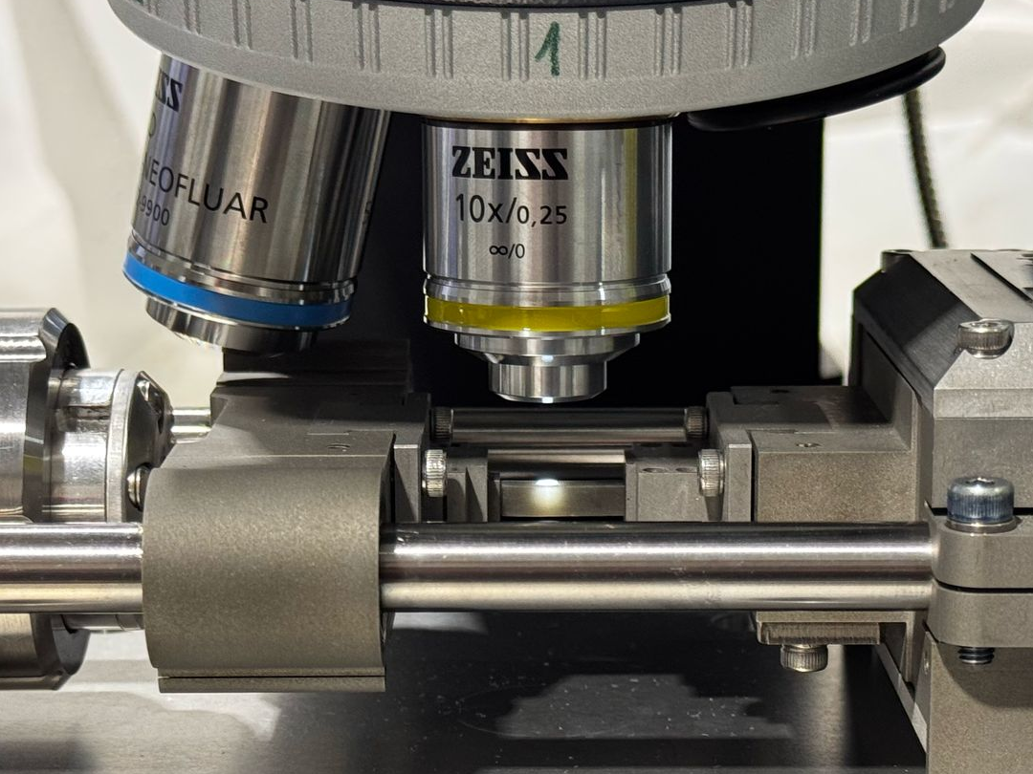
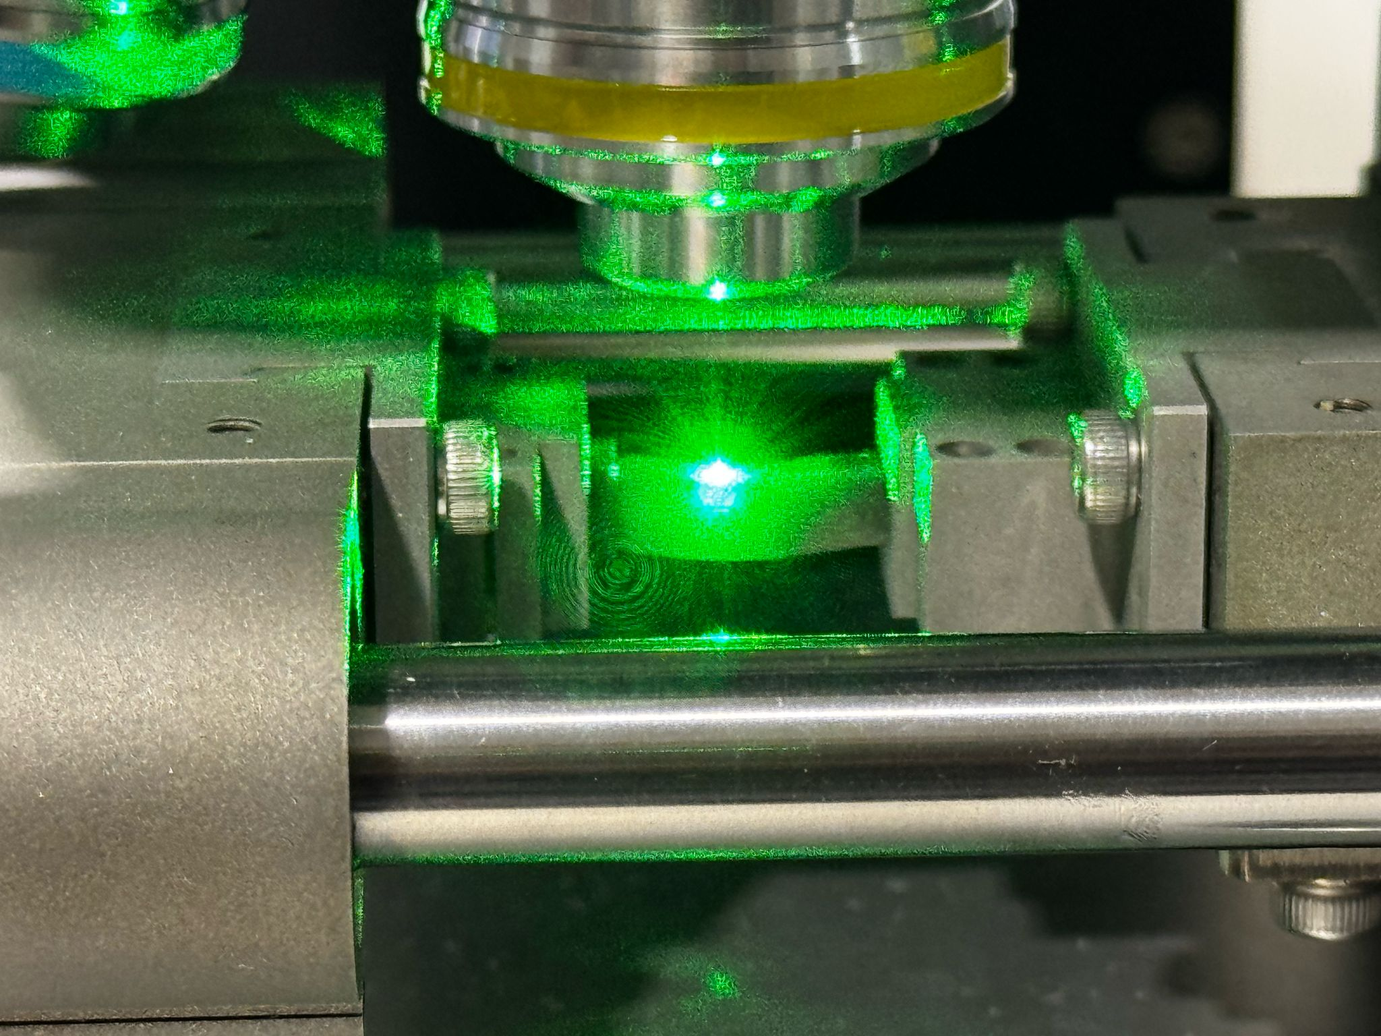
Experimental Setup
a)
Raman
b)
c)
Uniaxial loading cell
Specimen
a) Experimental setup with Raman and light microscope function, equipped with uniaxial loading cell;
b) High magnification of experimental setup with mounted specimen in uniaxial loading cell;
c) Loaded specimen exposed to a 532 nm laser
Background & Motivation
Testing Methods & Experiment
Results and Analysis
Summary & Future Work
7
Notes:
In this experiment, we utilized a detailed experimental setup that combined both Raman spectroscopy with a uniaxial loading cell. This setup allowed us to apply controlled compressive loads to the samples while simultaneously observing and analyzing their behavior at a microscopic level.
a) The experimental setup was carefully designed to incorporate both the Raman microscope and a light microscope, both of which played crucial roles in our analysis. The Raman microscope provided high-precision spectral data, while the light microscope enabled us to examine the sample structure and any changes that occurred during the loading process. The uniaxial loading cell was an essential component, enabling the application of precise compressive forces, which were critical for simulating stress conditions on the material.
b) To enhance the understanding of the material under stress, we captured high magnification images of the experimental setup, showing the specimen mounted securely in the uniaxial loading cell. This close-up view highlighted how the sample was positioned for optimal Raman spectral readings and stress application, ensuring that every data point was collected under controlled conditions.
c) Finally, during the experiment, the loaded specimen was exposed to a 532 nm laser, a critical element for Raman spectroscopy. The laser served to excite the molecular bonds in the material, causing the sample to emit scattered light. The resulting Raman spectra provided valuable insights into the material’s response to stress, revealing shifts in the Raman peaks that were indicative of changes in its internal structure and mechanical properties.
This setup allowed us to observe the direct effects of applied compressive forces on the lunar regolith simulant and provided a robust platform for investigating its potential as a functional sensor material.

Slide 9
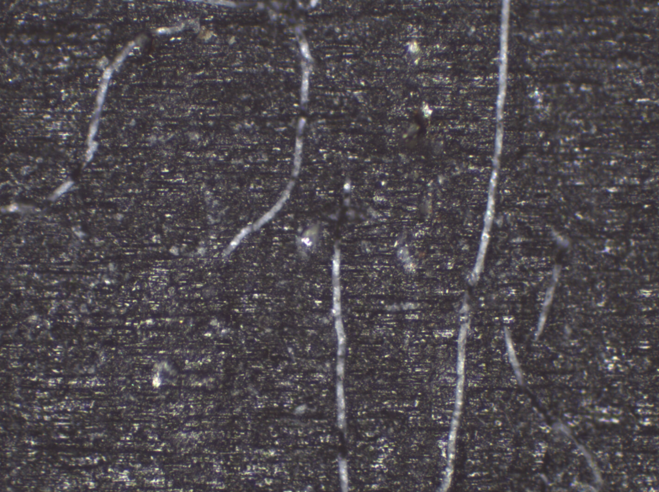
Raman Parameters
System | WITec alpha300
Laser wavelength | 532nm
Laser power | 10mW
Objective magnification | 10x
Method | Single spectrum
Accumulations | 20
Spot location | Determined visually
100.00 μm
Background & Motivation
Testing Methods & Experiment
Results and Analysis
Summary & Future Work
8
Notes:
In order to ensure the accuracy and relevance of the material selected for analysis, a visual search was first conducted to identify particles with the desired characteristics. This method involved scanning the surface and identifying particles that matched the characteristics we were looking for.
Once the particles were located, we proceeded to measure the Raman peaks of all the identified particles. This step was critical because these peaks provide essential data about the molecular bonds within the particles, helping us understand the material's response to stress.
Another important factor in particle selection was the location of the particle on the sample. Ideally, we aimed for a centric position within the sample, avoiding edge locations where the material properties could be influenced by external environmental factors. This approach ensured that the data we collected would be as consistent and representative as possible.
To confirm the mineralogical composition of the particles, we used the Raman peaks to verify that the identified particles were indeed Plagioclase. This mineral is a primary component of lunar regolith, making it an essential target for our experiments. The distinct Raman peaks corresponding to Plagioclase allowed us to confidently identify the material and ensure its suitability for the tests we conducted

Slide 10
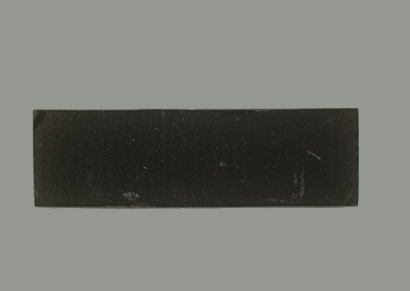


Compression Test
Before test
Experimental matrix for loading rectangular specimens of LHS-DLP specimens in a uniaxial loading cell, stress in MPa vs. the load in Newton.
The slope corresponds with the loaded cross-sectional area A0 (14.44 mm²)
3.8 mm
16.0 mm
After test
$$A_{0}$$
Background & Motivation
Testing Methods & Experiment
Results and Analysis
Summary & Future Work
9
Notes:
Our experimental matrix shows the relationship between the applied load (measured in Newtons) and the resulting stress (in megapascals). By varying the load on the samples, we could assess how the material responds at different stress levels. We calculated the stress by considering the cross-sectional area of the sample and applying the load. This matrix provided us with valuable data on how the simulant behaves when subjected to compressive forces.

Slide 11
Obtained Raman Peaks
Plagioclase
508.0
52 MPa
510.4
508.8
507.9
507.5
The Raman spectra collected shows the standard peaks for the sample and the plagioclase peaks are identified
The collected spectra for each applied load demonstrate a shift in the peak positions that are highlighted here
Background & Motivation
Testing Methods & Experiment
Results and Analysis
Summary & Future Work
10
Notes:
As the stress increased, we recorded shifts in the Raman peaks. These peaks correspond to specific molecular bonds within the plagioclase minerals. We observed that the peaks shifted rightward as the stress increased, indicating that the material was being compressed, causing a reduction in the interatomic distance. These shifts are directly related to the mechanical changes within the material, allowing us to detect stress levels and identify how the material reacts under different loading conditions.

Slide 12
Peak Right Shift
Parameters affecting peak shifts
  Mechanical parameters
  Charge transfer parameters
Compression makes the interatomic distance smaller
Change in mechanical properties, explains the rightward shift
At 52 MPa the peak can be observed back at 508 cm⁻¹ when buckling occurred, causing the interatomic distance to increase
Background & Motivation
Testing Methods & Experiment
Results and Analysis
Summary & Future Work
11
Notes:
Several parameters influence the shifts in the Raman peaks observed during our experiments. These include both mechanical and charge transfer parameters, which together explain the changes we see in the spectra.
One significant factor is compression. As the material is compressed, the interatomic distance becomes smaller. This compression leads to a change in the material’s mechanical properties, causing the Raman peaks to shift rightward. This shift is an indicator of the material's response to applied stress.
However, a key observation occurs at 52 MPa, where we notice the peak shift reversing. At this point, the peak returns to its original position at 508 cm⁻¹, signaling a change in the material’s structural behavior. This reversal happens when buckling occurs, which causes the interatomic distance to increase, and this change in the interatomic spacing is detected through the Raman spectrum.
In summary, the rightward shift of the Raman peaks under compression reflects the material's elastic response. However, when the stress exceeds a certain threshold, the material undergoes buckling, which marks the point where the material's mechanical properties transition from elastic to plastic behavior, causing the Raman peak to shift back
This change in distance explains the leftward shift
The buckling and the left shift of the Raman peak would indicate the failure point of the sample
Mention that’s it is raw data
Inverce cm up on the superscript
Remove sample picture
COMBINE WITH PREVIOUS SLIDE

Slide 13
Relation Between Right Shift and Stress
Sensitivity of the sample to mechanical loading
Piezo spectroscopic (PS) coefficient
Positive linear correlation, this confirms elastic behavior in the selected range
The material can detect moderate stress changes
Effectiveness decrease with higher loads
LHS 10%
PS coefficient
55.7 𝑐𝑚⁻¹/𝐺𝑃A
Background & Motivation
Testing Methods & Experiment
Results and Analysis
Summary & Future Work
12
Notes:
To quantify the material’s sensitivity to stress, we calculated the piezo-spectroscopic coefficient (PS coefficient). This coefficient measures how much the Raman peaks shift per unit of stress. We observed a positive linear correlation between the peak shift and applied stress, which confirms that the material is elastic and can detect moderate changes in stress. However, as the stress increased beyond a certain point, the material’s sensitivity decreased, which indicates a limit to its effectiveness at high stress levels.
The leftward shift at 52 MPa was not considered for the slope
At this point, the sample was no longer under uniaxial compression and deviated from elastic behavior
The deviation can be explained by the mechanical failure (buckling)

Slide 14
Summary of Results
Demonstrated the potential of using LHS-1D to manufacture functional sensors in extreme environments
Raman spectroscopy of this sample provided measurable shifts in the characteristic spectra of Plagioclase under applied compressive stress
Rightward shift of Raman peaks reveals a stress-dependent response
Leftward shift and buckling of the sample suggest a limit to the allowable stress
Background & Motivation
Testing Methods & Experiment
Results and Analysis
Summary & Future Work
13
Notes:
Our results demonstrate that lunar regolith simulants, such as LHS-1D, can be used to create functional sensors capable of detecting mechanical stress in extreme environments. The Raman spectroscopy data showed measurable shifts in the plagioclase peaks under stress, revealing a stress-dependent response. However, we also found that the material has a limit to its stress tolerance, which is marked by buckling and a leftward shift of the peaks. This suggests that while the material can serve as a sensor, its ability to withstand high stress is limited

Slide 15
Further Work
Test LMS-1D 10 wt% DLP samples to compare results and verify if the simulant composition influences mechanical stress sensitivity
Deconvolute data for more precise results
  Separation of overlapping signals
Manufacture samples with a higher regolith wt% to improve signal strength
Optimize the material composition and processing techniques to obtain more sensitive material to mechanical loads
Background & Motivation
Testing Methods & Experiment
Results and Analysis
Summary & Future Work
14
Notes:
As we look toward future research, we plan to test additional simulants, such as LMS-1D, to verify if the simulant composition affects its mechanical stress sensitivity. We also aim to deconvolute the overlapping Raman peaks to improve our measurements and obtain more precise data. Additionally, we will explore manufacturing samples with a higher regolith percentage to improve signal strength. Our ultimate goal is to optimize the material composition and processing techniques to create more sensitive sensors capable of detecting higher stress levels

Slide 16

This material is based upon work supported by National Science Foundation grant CMMI 2349931.
Professor Michael Kinzel and Postdoctoral Fellow Jan Erik Förster are acknowledged for their support in guidance and experimentation respectively.
Notes:
I would like to extend my gratitude to the National Science Foundation, which provided support for this research through grant CMMI 2349931. I would also like to thank Professor Michael Kinzel and Postdoctoral Fellow Jan Erik Förster for their invaluable guidance and support during the course of this work.

Slide 17
EXTRA SLIDES

Slide 18
Sample Manufacturing
Digital light processing (DLP), is a type of 3D printing that uses UV light to cure a sample layer by layer
LHS-1D 10 wt% , simulant from Exolith Lab, in epoxy resin
Dimensions of the sample, 16 mm x 3.8 mm x 3.8 mm
DLP Printing Parameters
Cure wavelength (nm) | 405
Exposure time (s) | 6
Lift Distance (mm) | 5
Lift speed (mm/min) | 100
Bottom exposure time (s) | 45
Retract speed (mm/min) | 150
Layer Height (mm) | 0.05
Background & Motivation
Testing Methods & Experiment
Results and Analysis
Summary & Future Work

Slide 19
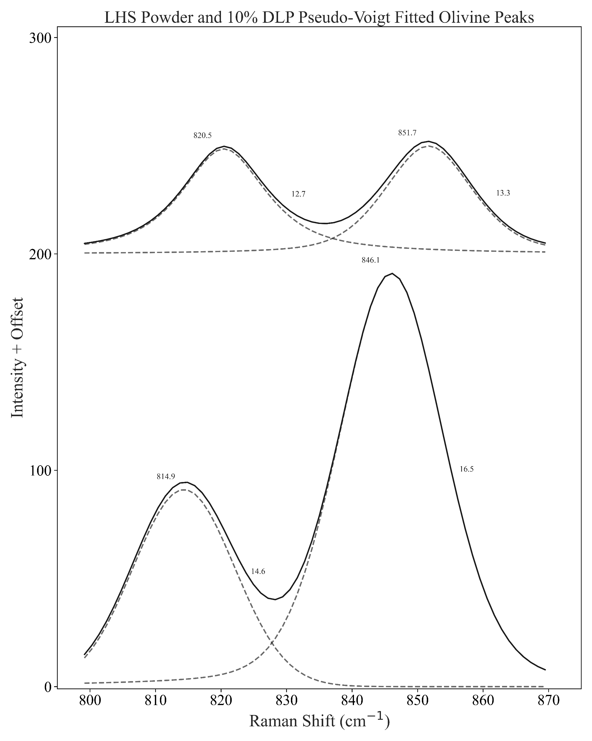
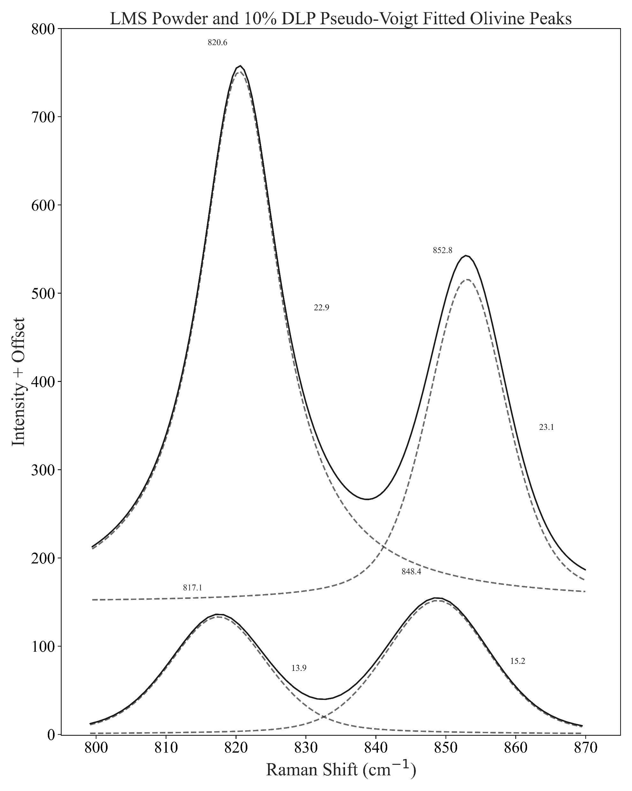
Deconvoluted Peaks
LHS Powder and 10% DLP
Pseudo-Voigt Fitted Olivine Peaks
LMS Powder and 10% DLP
Pseudo-Voigt Fitted Olivine Peaks
300
800
821
OL1
DLP
OL1
OL2
DLP
821
852
700
14.1
OL2
13.0
600
853
200
846
OL2
500
11.8
Powder
Intensity (CCD cts) + Offset
400
11.5
OL1
100
815
16.9
300
OL1
OL2
200
Powder
849
15.5
818
100
15.0
16.2
0
0
810
830
850
870
810
830
850
870
Raman Shift (cm⁻¹)
Raman Shift (cm⁻¹)

