Slide 1
Review of Quantum Computing Implications for Space Exploration and Mars Colonization
Philip Andriola
University of Florida
AIAA Region II Student Conference, April 3rd – April 4th, 2025
Copyright © by Philip J. Andriola
Published by the American Institute of Aeronautics and Astronautics, Inc., with permission.

Slide 2
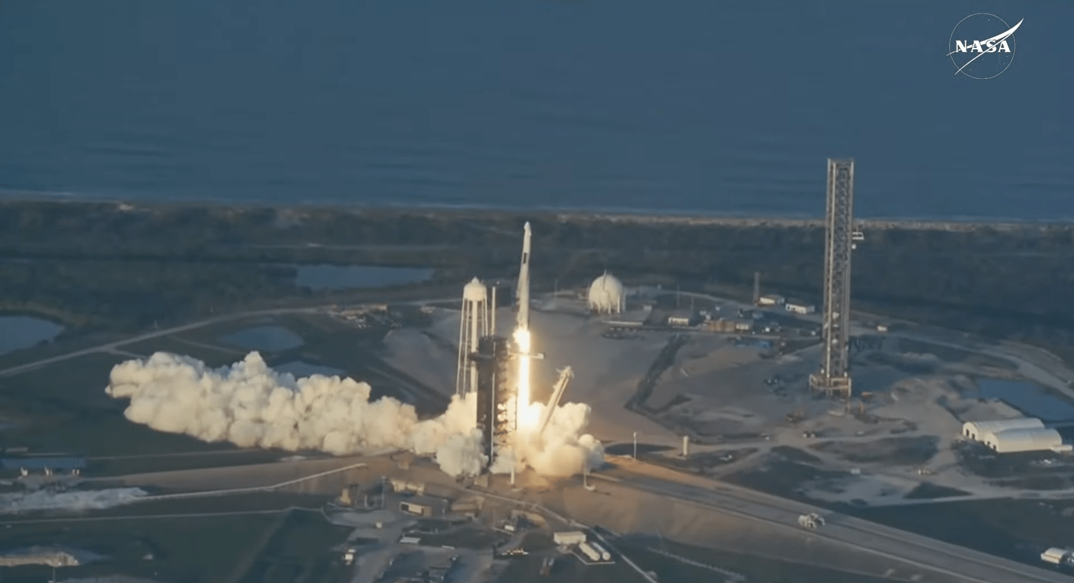
Introduction
The current space race IS a quantum race.
Various applications in space exploration.
Will help achieve large, long-term goals like Mars colonization.
[1]
https://www.nasa.gov/news-release/nasas-spacex-crew-10-launches-to-international-space-station/
Notes:
In the modern spae age, countries are competing to create unhackable quantum networks and satellite cosntellations for secure communication and national security opportunities. Because of this, we have seen a drastic leap in space technologies but also a massive investmetn in quantum computing research. With this research, mo
When it comes to the space industry, the name of the game is efficiency and sustainablitiy. Wuantum computing promises various abiltiies that will transform the modern day space industry and push our limits far beyond anything we have ever done.
My research investigated various applications of quantum computing. I analyzed how these applications could be used in psace exploration and long term goals of Mars colonization. I compiled this research to present the technology’s promise and also anlyze its feasability
re and more unique applications seem to become available, revealing quantum computing could be a major tool in various industries.

Slide 3
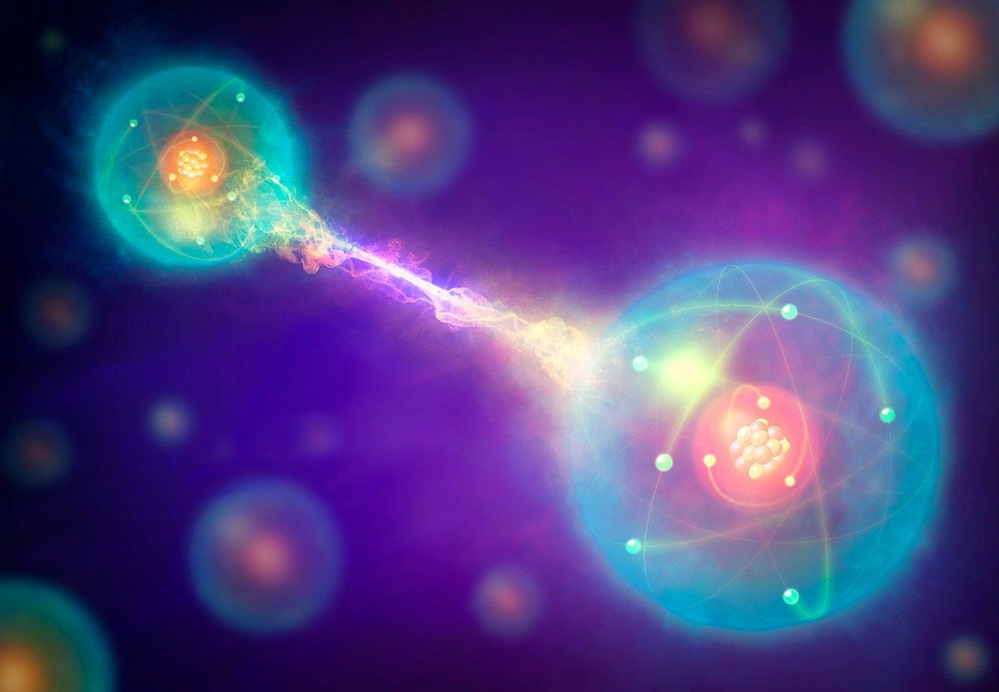
Key Quantum Principles
  Superposition
  Entanglement
  Interference
[2]
What Is Quantum Entanglement? NASA Science. Nasa.gov. https://science.nasa.gov/what-is-the-spooky-science-of-quantum-entanglement/.

Slide 4
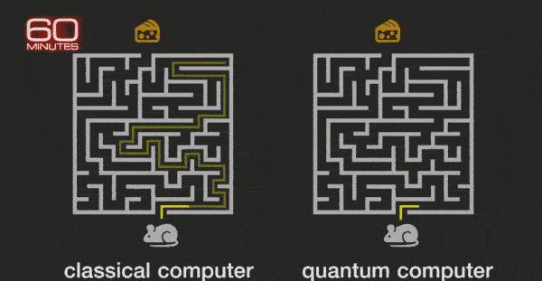
Basics of Quantum Computation
  Qubits vs. Classical Bits
    Classical bits: 0 or 1
    Qubits: 0 and 1 simultaneously (superposition)
[3]
https://www.youtube.com/watch?v=K4ssT6Dzmnw

Slide 5
Quantum Algorithms: Shor’s and Grover’s Algorithms
Two Early Quantum Algorithms:
  Shor’s Algorithm
  Grover’s Algorithm
Algorithm | Task | Classical Time | Quantum Time | Impact
Shor’s | Factoring Large Integers | Exponential | Polynomial | Breaks RSA Encryptions
Grover’s | Searching Unsorted Data | Linear (O(N)) | Quadratic (O(√N)) | Speeds Up Searches

Slide 6
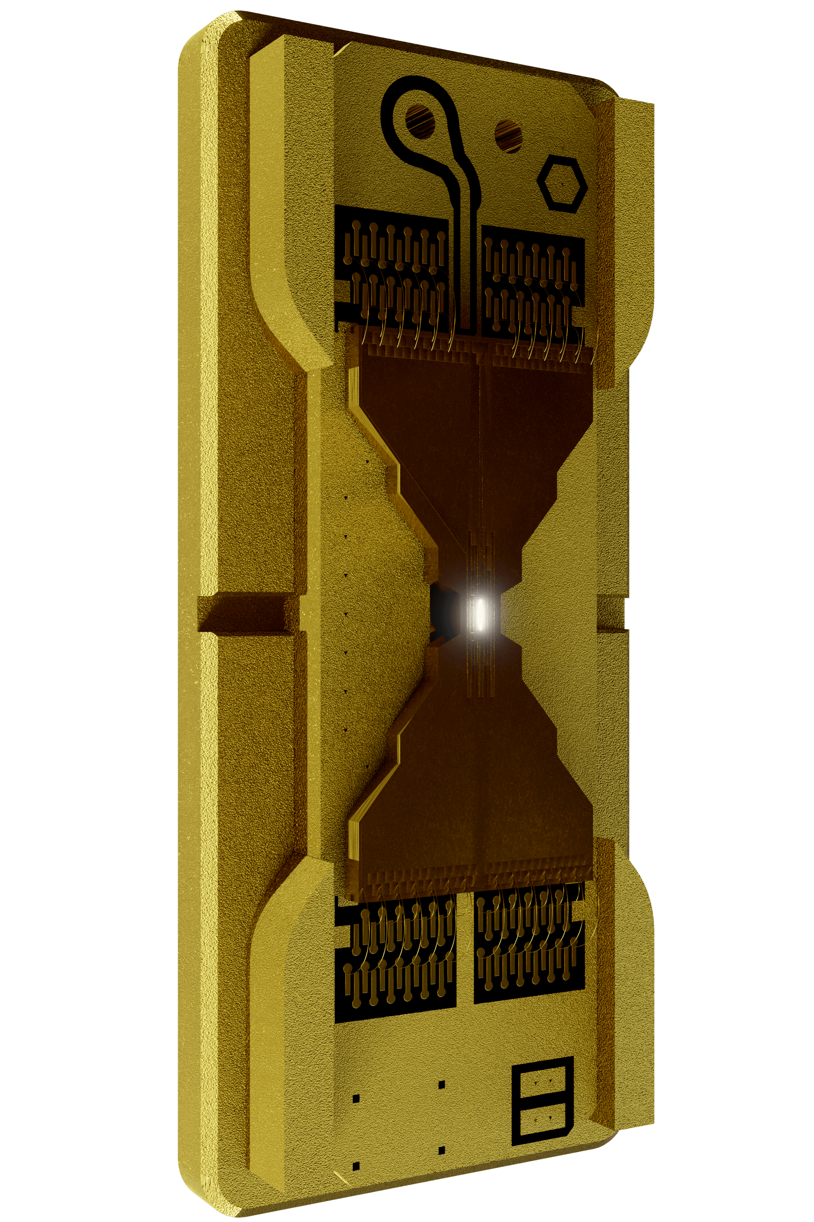
What Can Quantum Computing Do?
Optimization Problems
Resource Allocation
Advanced Simulation
Solve complex problems FAST
[4]
IonQ | Trapped Ion Quantum Computing. IonQ. IonQ. https://ionq.com/.
[13]

Slide 7
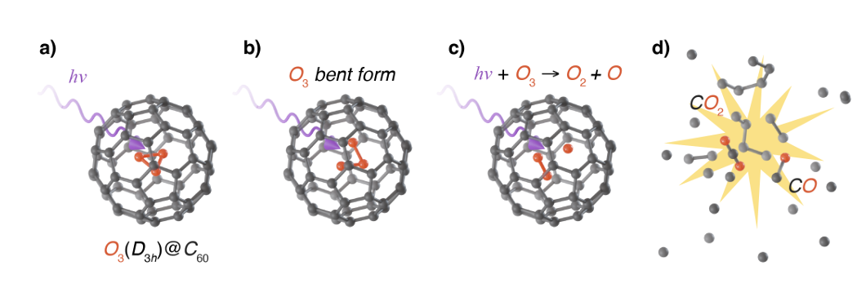
Quantum Computing in Space Mission Design
Engine and Fuel Efficiency
  Increase rocket efficiency through thermodynamic and quantum principles
  Fuel Alternatives: Cyclic Ozone
    Quantum models to explore new fuel sources for rockets (enhanced performance)
[5]
[5] Watts, T. W., Otten, M., Necaise, J. T., Nguyen, N., Link, B., Williams, K. S., Sanders, Y. R., Elman, S. J., Kieferova, M., Bremner, M. J., Morrell, K. J., Elenewski, J. E., Johnson, S. D., Mathieson, L., Obenland, K. M., Sundareswara, R., & Holmes, A., “Fullerene-encapsulated Cyclic Ozone for the Next Generation of Nano-sized Propellants via Quantum Computation,” arXiv, HRL Laboratories, LLC, Malibu, CA, 2024 (unpublished).
Notes:
Quantum computing could enhance several aspects of current state of rocket engines and efficiency. Research into various expiermntal engine cycles utilized quantum sensors and thermodynamic principles to maximize heat conservation and thrust production. This research specially was able to utilize random forces acting on an engine and transfer it to directed force for additional thrust. Additionally, quantum computers could model complex molecular interactions that could help find fuel alternatives. One promising alternative is fullerene encapsuled cyclic ozone. Cyclic ozone is sought after as a fuel source because of its reactivity and potential thrust production. However, it is highly unstable. Thus, quantum simulations could simulate a stabilize technique called fuellerene encapsulation. In which, essentially, a hydrocarbon cage acts as a stabilizing box for the cyclic ozone. This makes it easy to utilize ycclic ozones reactivity in a controlled manner.

Slide 8
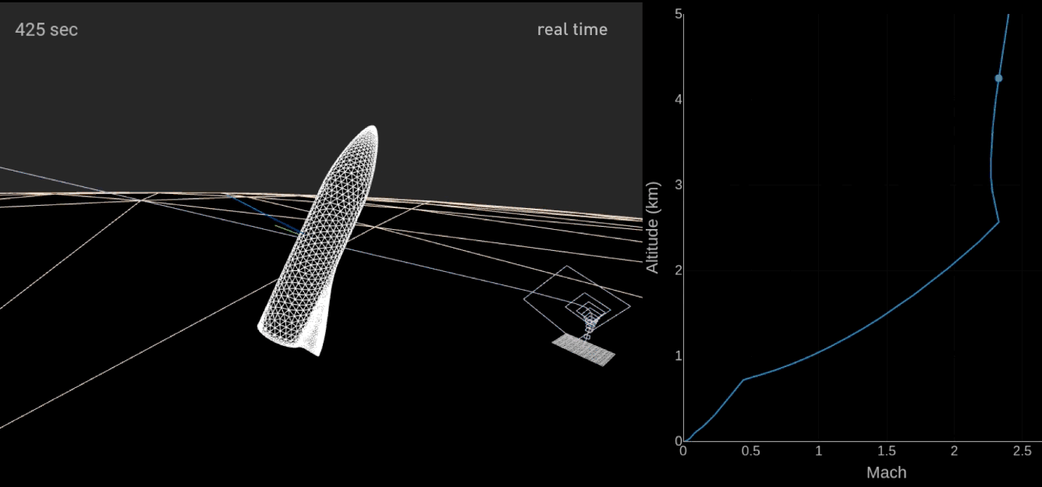
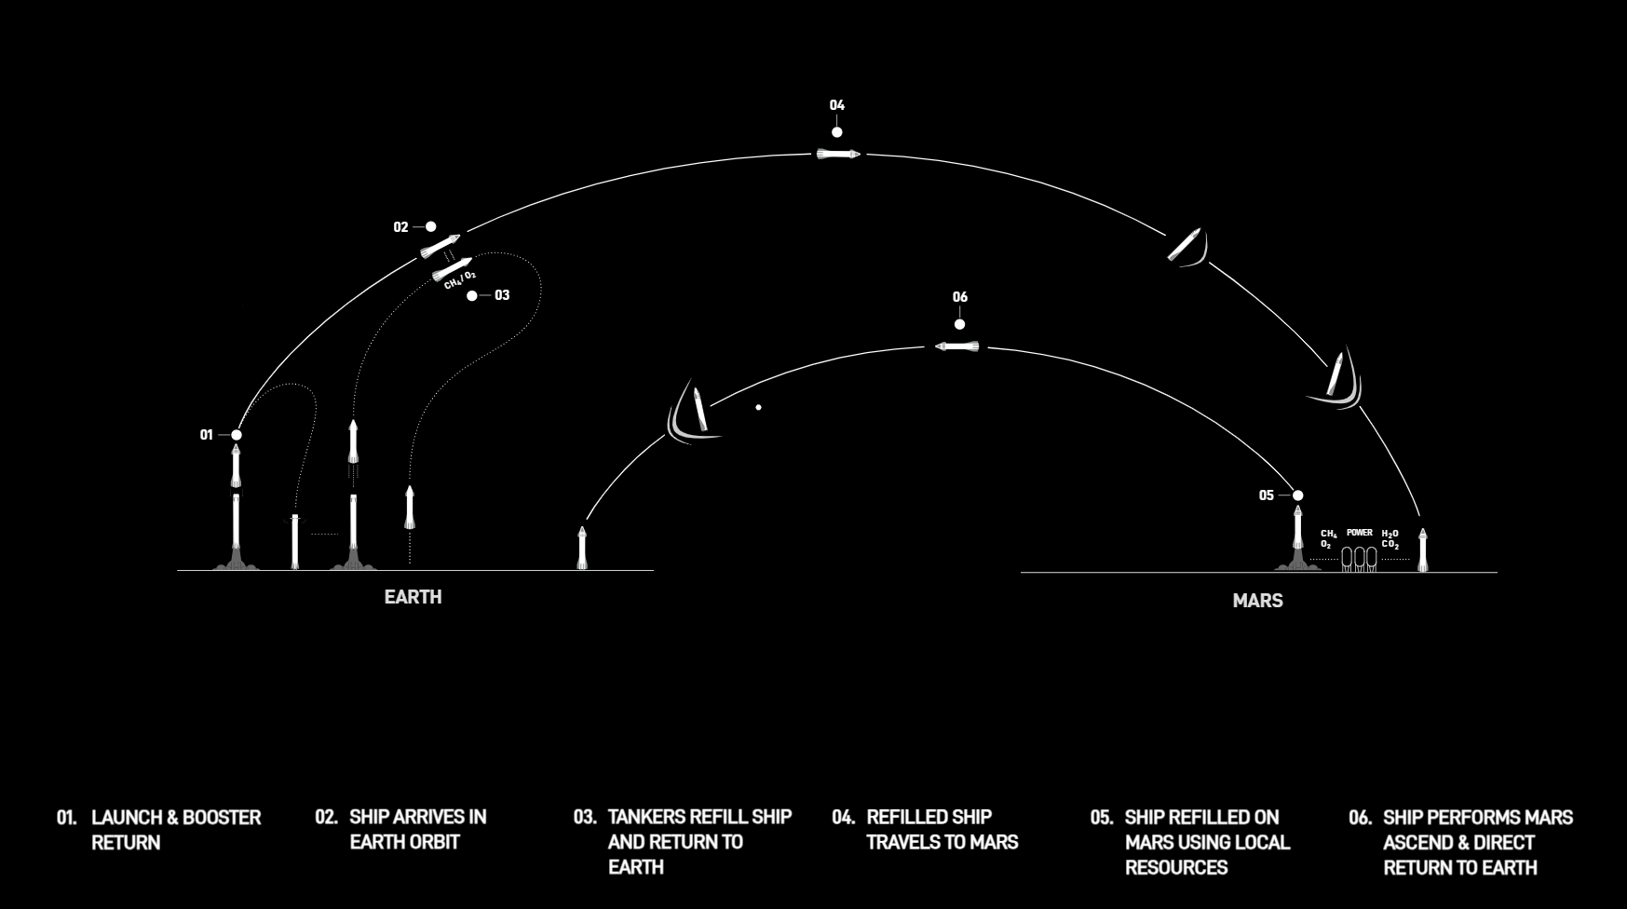
Quantum-Enhanced Takeoff and Landing
Reusable Rockets and Trajectory Optimization
  Quantum-enhanced flight path algorithms (e.g., Dijkstra’s algorithm) for fuel-efficient and ecologically optimized paths
Quantum-Reinforced Landing (QRL)
  Adapt to dynamic landing conditions (e.g., wind, Mars’ terrain) for precision landings
[6]
SpaceX. Missions: Mars. SpaceX. https://www.spacex.com/humanspaceflight/mars/.

Slide 9
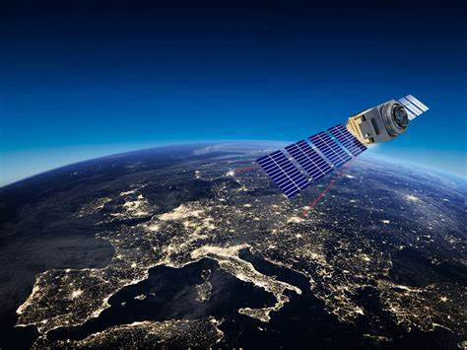
Quantum Communication Systems
Quantum Key Distribution (QKD)
  Secure communication using quantum states (cannot be intercepted without detection)
Quantum Communication for Deep Space
  Quantum teleportation, superdense coding, and entangled photons for improved space communication
[7]
https://www.qtlabs.at/technologies/space-qkd/

Slide 10
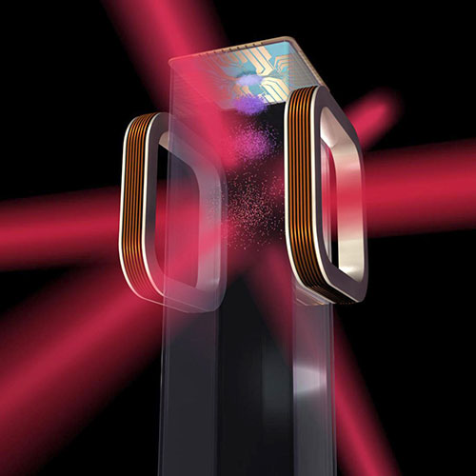
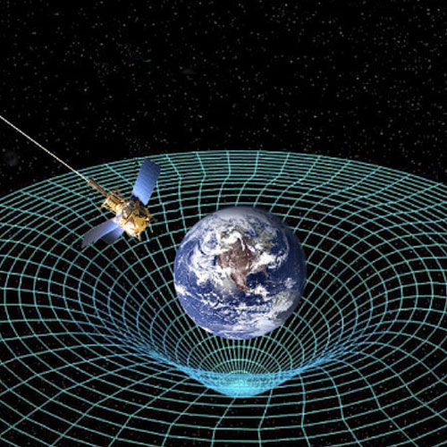
Quantum in Space Exploration Data Analytics
Simulating Complex Astrophysical Systems
  Simulate gravitational interactions, black holes, celestial bodies
  Quantum entanglement to represent complex internal interactions
Quantum Sensors
  High-precision measurements for planetary dynamics
[8]
JPL SIP - Capabilities. Nasa.gov. https://www.jpl.nasa.gov/about/strategic-implementation-plan/capabilities/10/. Accessed Apr. 3, 2025.
[6]

Slide 11
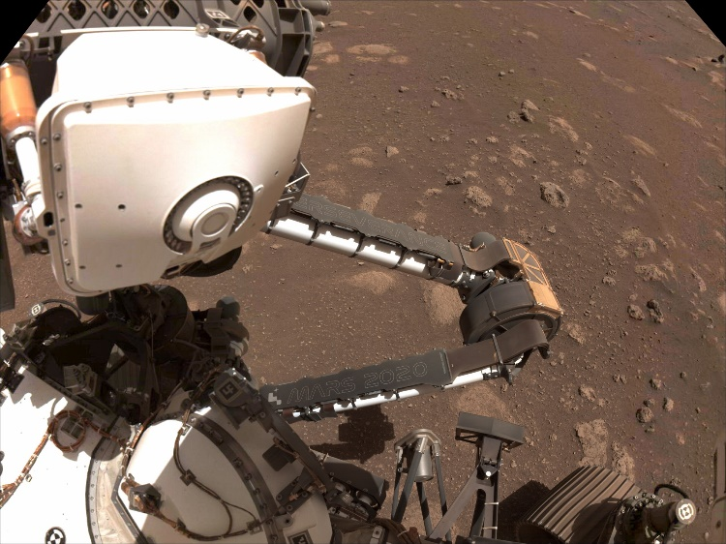
Quantum-Enhanced AI and Machine Learning
Quantum Reservoir Computing (QRC)
  AI and autonomous systems powered by quantum computation
  More efficient and less energy-intensive than classical systems
Real-time Decision Making
  Quantum’s ability to handle complex datasets quickly—key for autonomous systems in space
Reduced Memory = Greater longevity
[9]
Jet Propulsion Laboratory. Here’s How AI Is Changing NASA’s Mars Rover Science - NASA. NASA. https://www.nasa.gov/missions/mars-2020-perseverance/perseverance-rover/heres-how-ai-is-changing-nasas-mars-rover-science/.

Slide 12
The Promise of Quantum Computing for Mars Colonization
Mars Colonization Challenges
  Costly missions, limited resources, health concerns, atmospheric conditions, communication delays
  Quantum computing’s role:
    Optimize spacecraft navigation
    Improve life support systems
    Efficient resource management (water, energy, food)

Slide 13
Quantum-Enhanced Water, Food, and Health
Water Extraction on Mars
  Simulate and optimize autonomous vehicles for extracting water from Martian ice sheets
  Quantum sensors to detect hidden water sources
Food Production on Mars
  Simulate Martian agriculture, including regolith-based farming
  Tailor nutritional needs based on quantum simulations

Slide 14
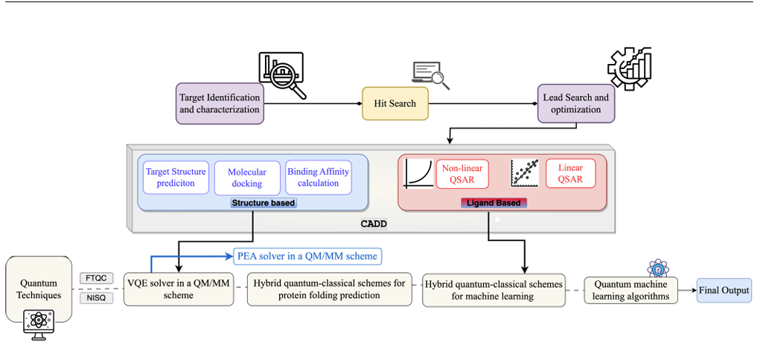
Quantum Computing for Health and Pharmaceuticals
Drug Discovery
  Quantum simulations for understanding drug behavior and interactions in space environments
  Potential to revolutionize space health by optimizing drug design and treatment methods
[10]
Kumar, G., Yadav, S., Mukherjee, A., Vikas Hassija, and Mohsen Guizani. “Recent Advances in Quantum Computing for Drug Discovery and Development.” IEEE Access, 2024, pp. 1–1. https://doi.org/10.1109/access.2024.3376408.

Slide 15
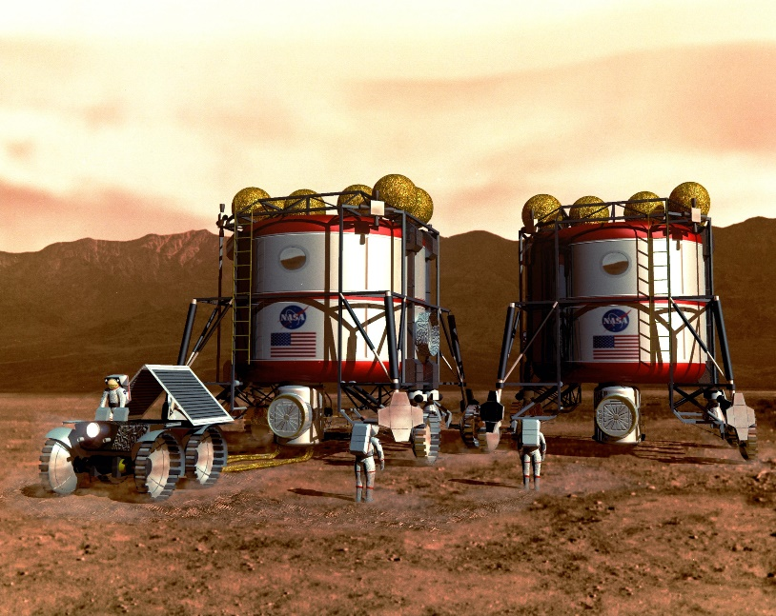
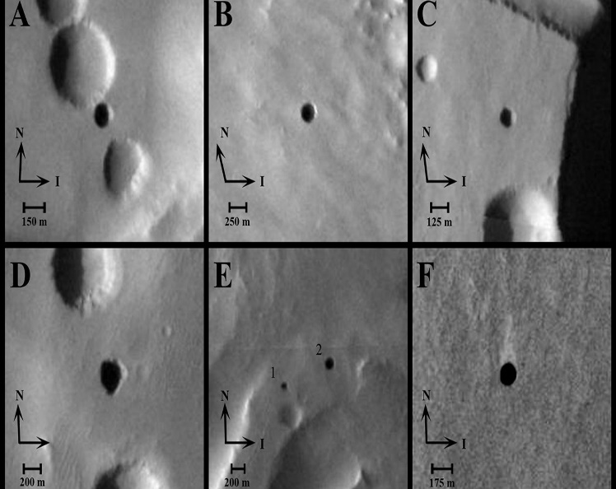
Habitat Construction
Underground and Above Ground Structures
[11]
NASA. NASA Orbiter Finds Possible Cave Skylights on Mars. NASA Science. https://science.nasa.gov/solar-system/planets/mars/nasa-orbiter-finds-possible-cave-skylights-on-mars/.
[12]
Two Habitats on Mars - NASA Science. Nasa.gov. https://science.nasa.gov/resource/two-habitats-on-mars/.

Slide 16
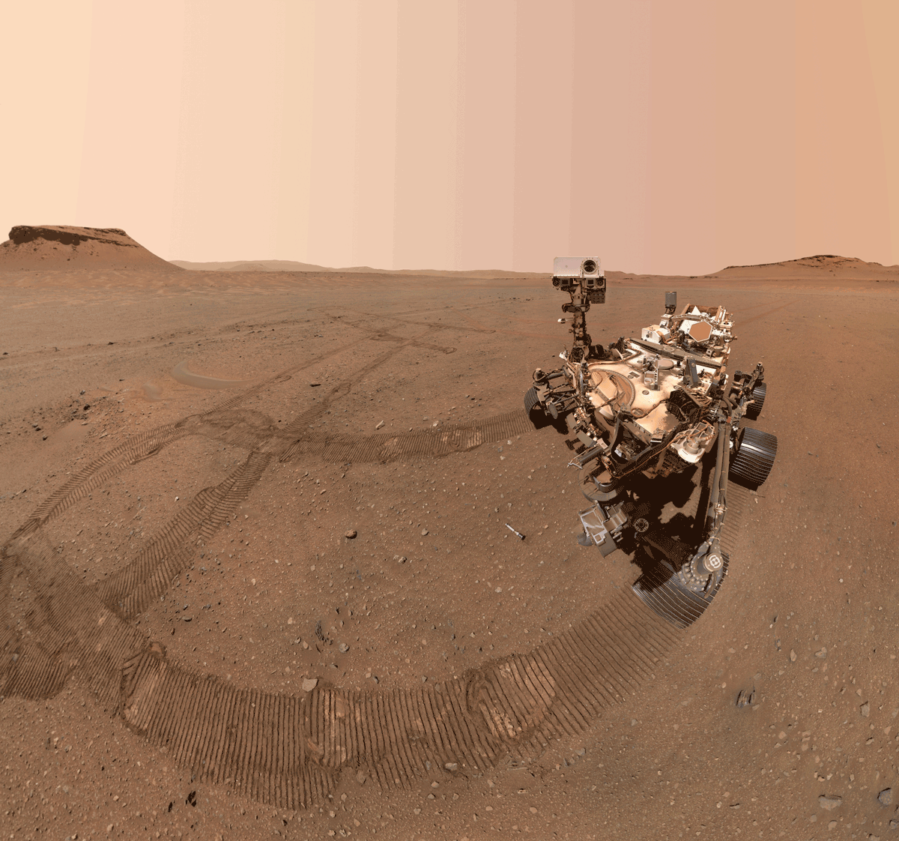
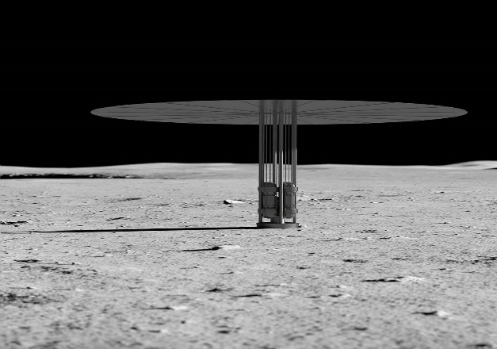
Resource Allocation on Mars
Oxygen Production
Energy Systems
[14]
Mohon, L. Kilopower - NASA. NASA. https://www.nasa.gov/directorates/stmd/tech-demo-missions-program/kilopower-hmqzw/.
[13]
Perseverance’s Three Forks Sample Depot Selfie - NASA Science. Nasa.gov. https://science.nasa.gov/resource/perseverances-three-forks-sample-depot-selfie/.

Slide 17
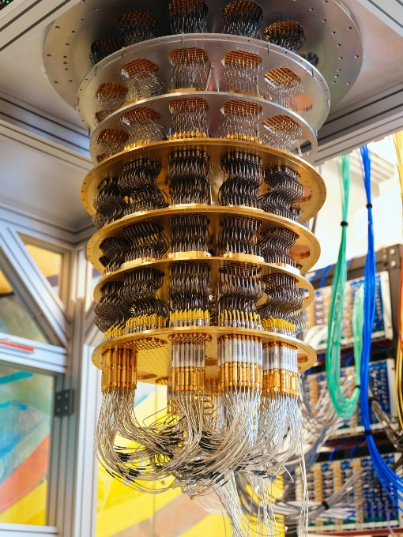
What Quantum Computing Do We Have?
Technology | Key Strengths | Key Challenges | Stage
Superconducting | Fast, chip-based, scalable | Higher error rates | Most mature
Laser Trapped Ions | High fidelity, long coherence | Slower, harder to scale | Mature
Photonic Qubits | Room-temp, good for networking | Difficult gates, scaling is tricky | Active R&D
Neutral Atom Qubits | Scalable arrays, good connectivity | Needs precise control; still new | Emerging
Spin Qubits in Silicon | CMOS-compatible, long coherence | Very early stage, cryogenic cooling | Experimental
Topological Qubits | Inherent error protection | Not yet realized in practice | Highly Experimental
[15]
https://quantumai.google/quantumcomputer

Slide 18
Challenges
Future Prospects of Quantum Computing in Space Exploration
  Still facing challenges with scalability and error correction.
  WHY DO WE NEED IT??
    Potential to revolutionize space exploration, especially with long-term goals like Mars colonization.
    Ongoing research and development will shape the future of quantum technologies in space.

