Slide 1
Optimization of Disc Baffle Perforation in Sloshing Nitrous Oxide Tanks
Yoyi L. Xie, Jack R. Rumpf, Alexis Alfonseca, Aneesh T. Kumar, Nathan Rupprecht, Matthew Lai, Emory Hill, and Szu Heng Chen
Georgia Institute of Technology
2025 Region II Student Conference, 3-4th April
Copyright © by Georgia Institute of Technology, Propulsive Landers at Georgia Tech (GTPL).
Published by the American Institute of Aeronautics and Astronautics, Inc., with permission.
1799546

Slide 2
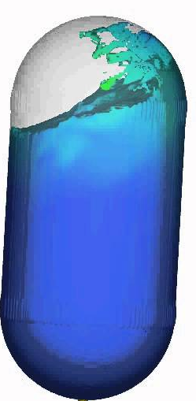
Introduction to Sloshing Dynamics
Upon excitation, liquids inside a fuel tank may oscillate and generate unwanted forces upon the tank.
This can disrupt the center of mass of the rocket in unpredictable manners, disrupting rocket navigation.
Baffles are commonly used to mitigate the effects of liquid sloshing.
Notes:
Reference: https://arc.aiaa.org/doi/10.2514/6.2013-4075

Slide 3
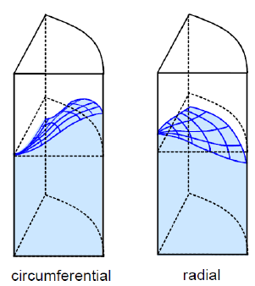
Significance and Challenges
Destabilizing forces from sloshing can have a significant effect on the rocket, as fuel comprises a large portion of the rockets total mass.
Extreme sloshing behavior can cause the rocket to exceed the critical angle of attack.
Sloshing can occur due to different forms of excitation (linear, rolling, etc.), therefore a variety of designs must be considered.
Notes:
Reference: https://link.springer.com/article/10.1007/s12567-021-00421-0

Slide 4
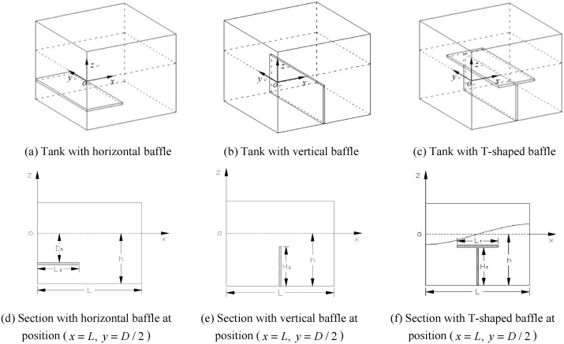
Roles of Baffles in Slosh Mitigation
Baffles dampen fluid sloshing by reducing free movement of the liquid, preventing oscillations from building and dissipating energy into turbulent flow.
There are various types of baffles, such as horizontal, vertical, T-shaped, and floating.
Disc baffles are simple to manufacture, relatively inexpensive, and effective against most sloshing

Slide 5
Research Objectives
The study was conducted as part of the development of a 1000 N HRE for Georgia Tech Propulsive Landers
Our paper focuses on comparing the performance of disc baffles with various perforations.
Identify an optimal perforation count while constraining total area to maximize damping.

Slide 6
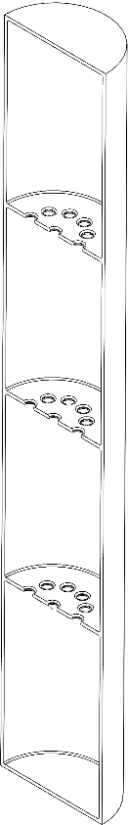
Tank Geometry and Experimental Setup
Tank dimensions:
  Height: 1.372m
  Diameter: 0.203m
The model contains 3 identical equally spaced baffles.

Slide 7
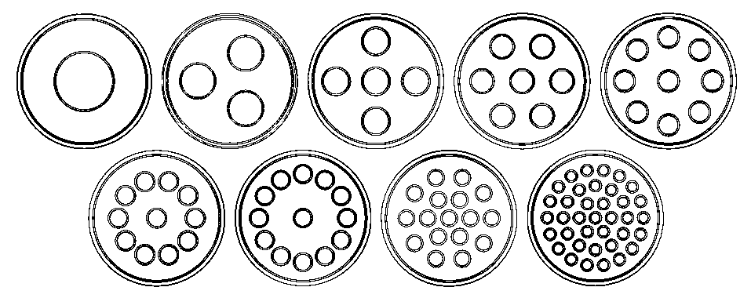
Disc Baffle Perforation Configurations
Perforation counts tested
  1, 3, 5, 7, 9, 11, 13, 17, 37 holes
Total perforated area remains constant
  6.59e-3 m squared

Slide 8
Computation Fluid Dynamics (CFD) Approach
The simulation was conducted in CFD software Ansys Fluent.
The tank was filled with a hybrid mixture of liquid N2O and gaseous N2O
N2O chemical properties (viscosity, density, surface tension) were used appropriately.

Slide 9
Simulation Model Details
The simulation was ran with surface gravity conditions (g = 9.807 m/s^2)
Initial nitrous oxide velocity set to 1 m/s
Tank assumed to be perfectly rigid, with small fillets in corners to increase accuracy and make more realistic for manufacturing (make this wording different)

Slide 10
Governing Equations and Flow Models
Inhomogeneous Eulerian model for fluid calculations.
SST k-omega model for turbulence interactions.
Ansys PRESTO (Pressure Staggering Option) to estimate face pressures .
First Order Upwind for flow stream calculations.

Slide 11
Inhomogenous Eulerian Multiphase Flow Model
The inhomogeneous Eulerian Model was selected to account for particle behavior between the nitrous liquid and gaseous phases, considering both phases’ dynamics and their interactions.
Solves separate momentum and continuity equations for each phase

Slide 12
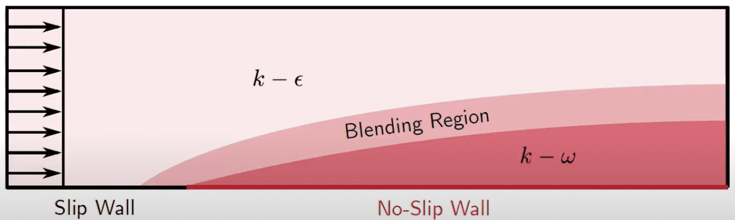
SST k-omega Turbulence Model
k-epsilon model performs best in free-stream and far-field flows due to its empirical calibration and wall functions that work well in regions with mild pressure gradients.
k-omega performs best in boundary layers and near-wall regions, directly resolving the viscous sublayer without wall functions.
The SST model adapts advantages of both for a more comprehensive turbulent flow model.

Slide 13
PRESTO Pressure Interpolation Scheme
PRESTO (Pressure Staggering Option) discretizes pressure equations
PRESTO is particularly beneficial for simulating flows with significant pressure gradients, which can occur in sloshing.

Slide 14
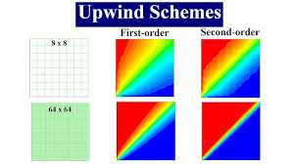
First-Order Upwind Numerical Discretization Scheme
First-Order Upwind is a numerical discretization scheme designed to solve convection in fluid flow.
First-Order Upwind is more robust and stable than higher orders.
Momentum, volume fraction, turbulent kinetic energy, and specific dissipation rate all were calculated through First-Order Upwind.

Slide 15
Simulation Data Collection
Horizontal and vertical force upon the tank by the nitrous oxide was collected.
Linear regression was used to fit the data to a model in order to calculate the damping ratios.

Slide 16
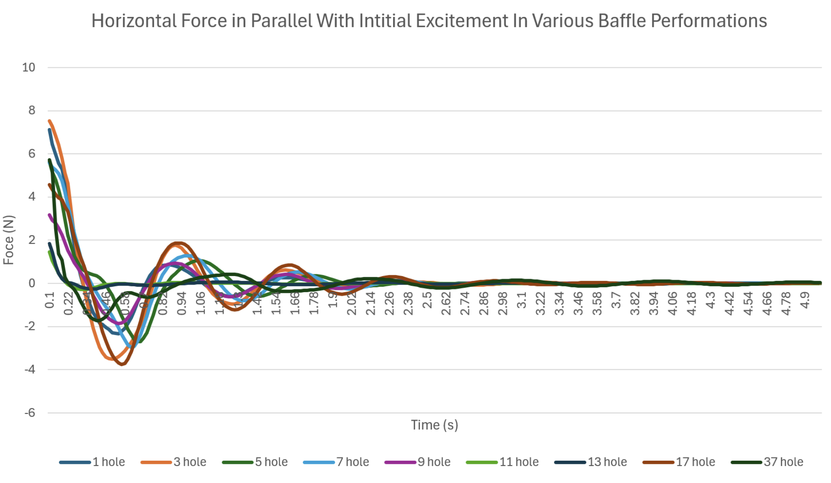
Results – Horizontal Force Analysis
The graph to the right shows the horizontal forces on the tank after 0.1s.
The amplitude of the oscillations seem to decrease fairly linearly, with a constant frequency of oscillations.
There seem to be some optimal designs for reducing force, but this can also be attributed to the conversion of the initial impact to more vertical compared to horizontal forces in certain designs.

Slide 17
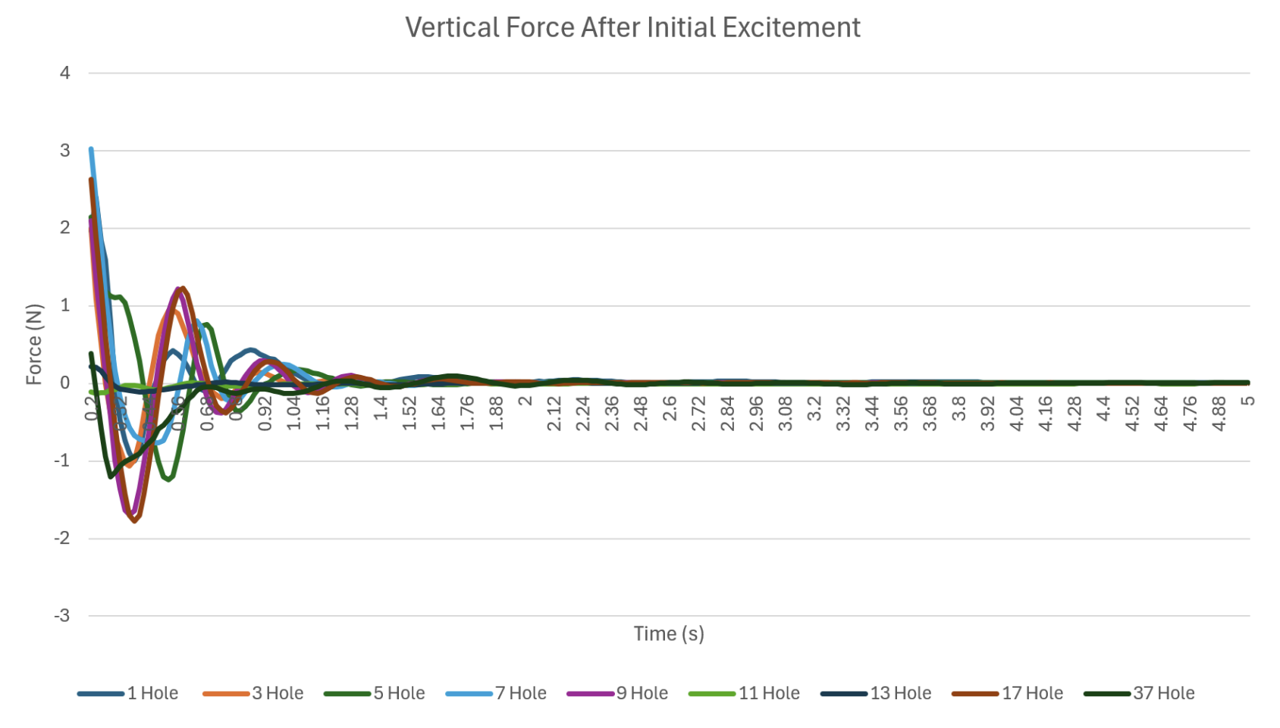
Results – Vertical Force Analysis
The vertical force pattern follows the horizontal forces, with damped oscillations and constant frequency oscillations.
Vertical force decreases at a much faster rate, as expected.

Slide 18
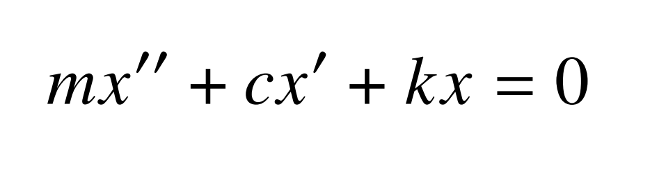
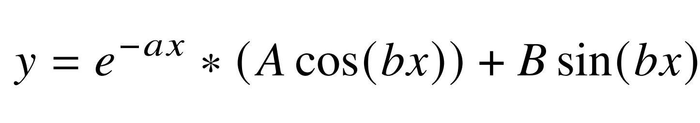
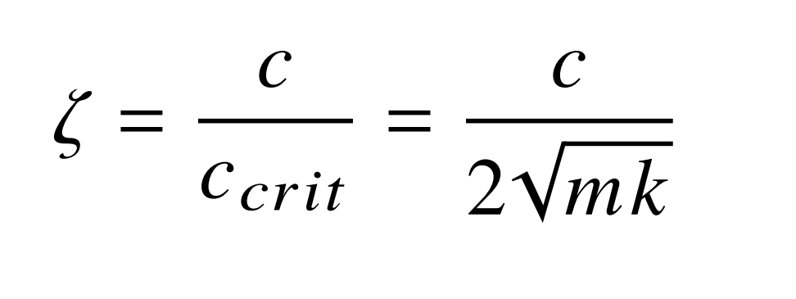
Spring-Mass-Damper Model Analogy
Linear sloshing can be described with a spring-mass-damper model, using the equation to the side.
The data is fit to the solution to the difference equation, shown to the side.
Damping ratio is calculated from the coefficients shown to the side.

Slide 19
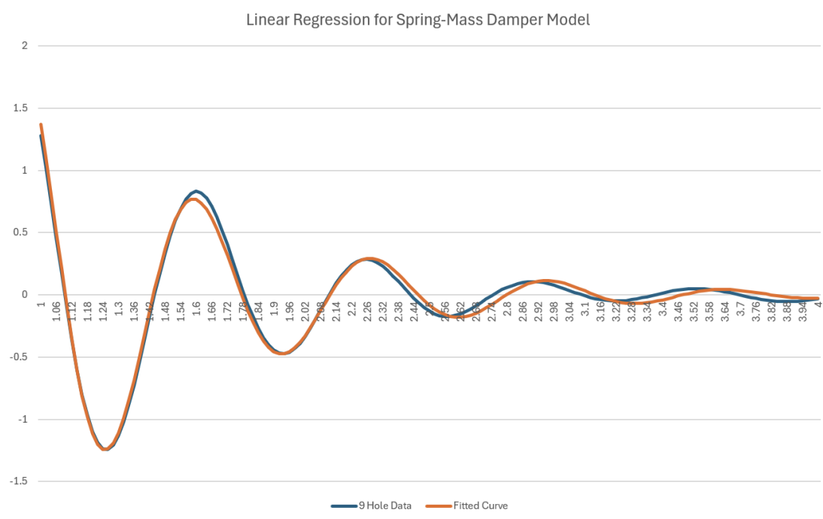
Spring-Mass-Damper Model Analogy
The linear regression fitting of the data to the solution had successful results, with all but 1 coefficient of determination value greater than 0.95.
The linear regression for the 9 hole baffle sloshing is shown to the right.

Slide 20
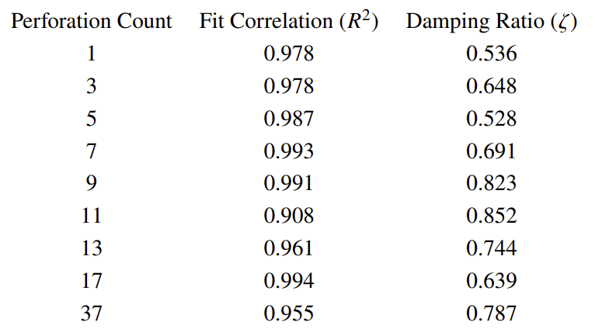
Damping Ratio Calculations
With the equation on the right, damping ratio is calculated from the coefficients of the spring-mass-damper differential equation.
Damping ratio is calculated for each baffle design force data.

Slide 21
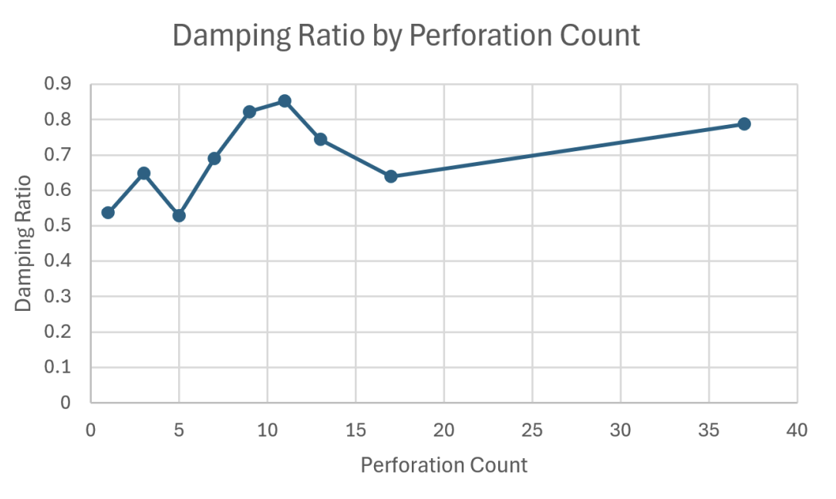
Damping Ratio Trends
The optimal perforation count seems to be within the selected the range of 7 to 13 holes, with an increasing damping ratio as the perforation approaches an extremely high count.
However, this trend is still unclear due to the lack of data and could benefit from further study. These results are heavily dependent on many factors that could be changed to further minimize force oscillations, such as the distribution of perforation within the baffle itself.

Slide 22
Discussion of Results/Limitations
An intermediate result may be optimal due to creating multiple, smaller movements in the liquid rather than a larger one, creating more regions to dissipate energy.
Especially with a higher count of perforation, there may be some limitations with the quality of the simulation especially regarding smaller particle behavior and surface tension, creating less precise behavior in baffles with extremely small holes.

Slide 23
Conclusions
Overall, we investigated the effect of varying baffle perforation in the damping of liquid sloshing within a hybrid nitrous tank.
We found an optimal damping count for our initial conditions (~10 perforations)

Slide 24
Future Work
Exploring different excitation methods within the tank could lead to different sloshing patterns, resulting in a different optimal baffle design
More violent sloshing behavior could change the effects the baffles have upon the sloshing behavior.

Slide 25

Acknowledgements
The research presented here is supported by Propulsive Landers at Georgia Tech, which provided the environment and resources that made this paper possible. The authors also express their gratitude to Anyi Lin, who assisted in providing guidance and navigation control knowledge, as well as computational assistance.

Slide 26
References
[1] Mane, S., “Hybrid Rocket Motor Published Paper,” International Journal of Enhanced Research in Science, Technology & Engineering, Vol. 12, No. 7, 2023, pp. 49–54. URL https://www.researchgate.net/publication/372481738_Hybrid_ Rocket_Motor_Published_Paper.
[2] Kumar, N., and Choudhary, N., “Sloshing Reduction in Three-Dimensional Rectangular Container Using Rigid Baffles,” Vibroengineering PROCEDIA, Vol. 42, 2022, pp. 39–44.
[3] Tang, L.-Z. H. Z. K., J. C., and Zheng, P., “Design and Simulation of Anti-Sloshing Baffles Applied to Detumbling Payload Propellant Tanks,” Journal of Physics: Conference Series, Vol. 2633, 2023, pp. 012014–012014.
[4] Zhu, X. M.-A. Y. X. Z. F., A., and Zhang, W., “Effect of Double-Side Curved Baffle on Reducing Sloshing in Tanks under Surge and Pitch Excitations,” Shock and Vibration, Vol. 2021, 2021, p. e6647604.
[5] Deshmukh, S. S.-P. A. P. K. P. R., Y., and Perumal, D. E., “Optimization and Reduction of Sloshing in the Fuel Tank,” International Journal for Research in Applied Science and Engineering Technology, Vol. 10, No. 4, 2022, pp. 2793–2800.
[6] Pan, L. X.-F. Y., K., and Cui, N., “The Design of the Floating Baffle for Cassini Tank and the Analysis of Restraining Sloshing,” Proceedings of the Institution of Mechanical Engineers Part G Journal of Aerospace Engineering, Vol. 232, No. 3, 2016, pp. 448–458.
[7] Abramson, H. N., “The Dynamic Behavior of Liquids in Moving Containers,” Tech. Rep. SP-106, NASA, Washington, D.C., 1966.

