Slide 1
Novel Coaxial and Differential Thrust Vector Control Systems for Small-Scale Rockets
Jack R. Rumpf, Aneesh T. Kumar, Alexis Alfonseca, Sanchir Erdenebat, and Szu Heng Chen
Georgia Institute of Technology
2025 Region II Student Conference, 3-4th April
Copyright © by Georgia Institute of Technology, Propulsive Landers at Georgia Tech (GTPL).
Published by the American Institute of Aeronautics and Astronautics, Inc., with permission.
1799546

Slide 2
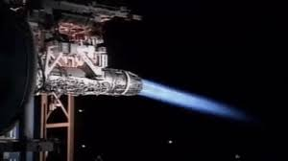
Introduction to Thrust Vector Control (TVC)
What is a Thrust Vector Control (TVC) and how can it be used?
Notes:
Reference: https://arc.aiaa.org/doi/10.2514/6.2013-4075
Aneesh

Slide 3
Introduction to Thrust Vector Control (TVC)
Finite Element Analysis (FEA)
Commercial Off the Shelf
Response Time
  Time it takes for thrust to be vectored 15 degrees
Notes:
Reference: https://arc.aiaa.org/doi/10.2514/6.2013-4075
Aneesh

Slide 4
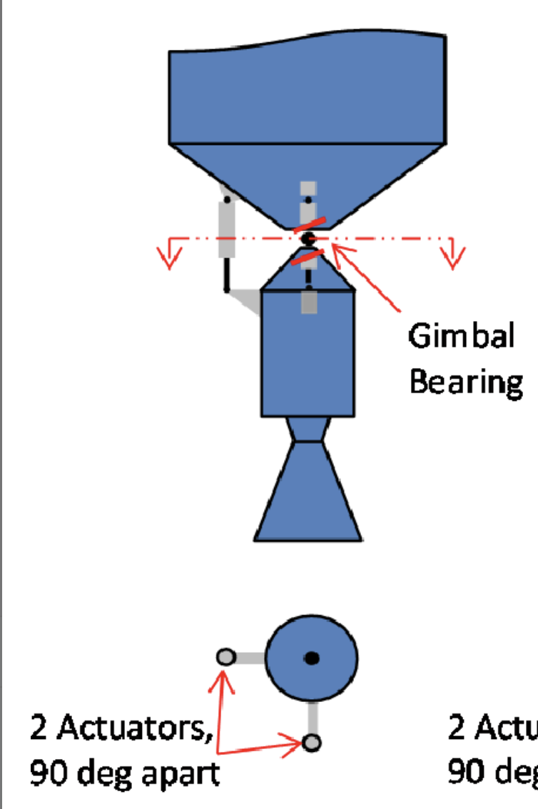
Introduction to Thrust Vector Control (TVC)
2 Linear Actuators
Gimbal
Alternatives
  Exhaust Vanes
  Auxiliary Thrusters
Notes:
Reference: https://arc.aiaa.org/doi/10.2514/6.2013-4075
Jack

Slide 5
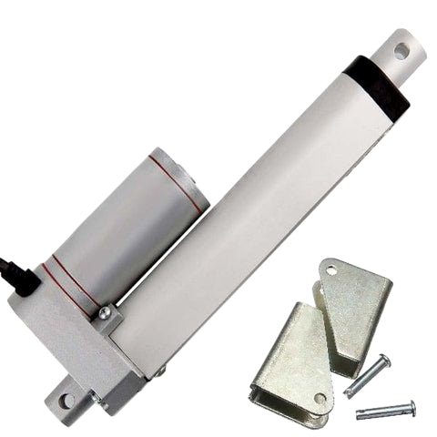
Limitations of Conventional (Gimbal) TVC
Cost
Weight
Response Time
Weight: 5.4lbs
Notes:
Reference: https://link.springer.com/article/10.1007/s12567-021-00421-0
Jack

Slide 6
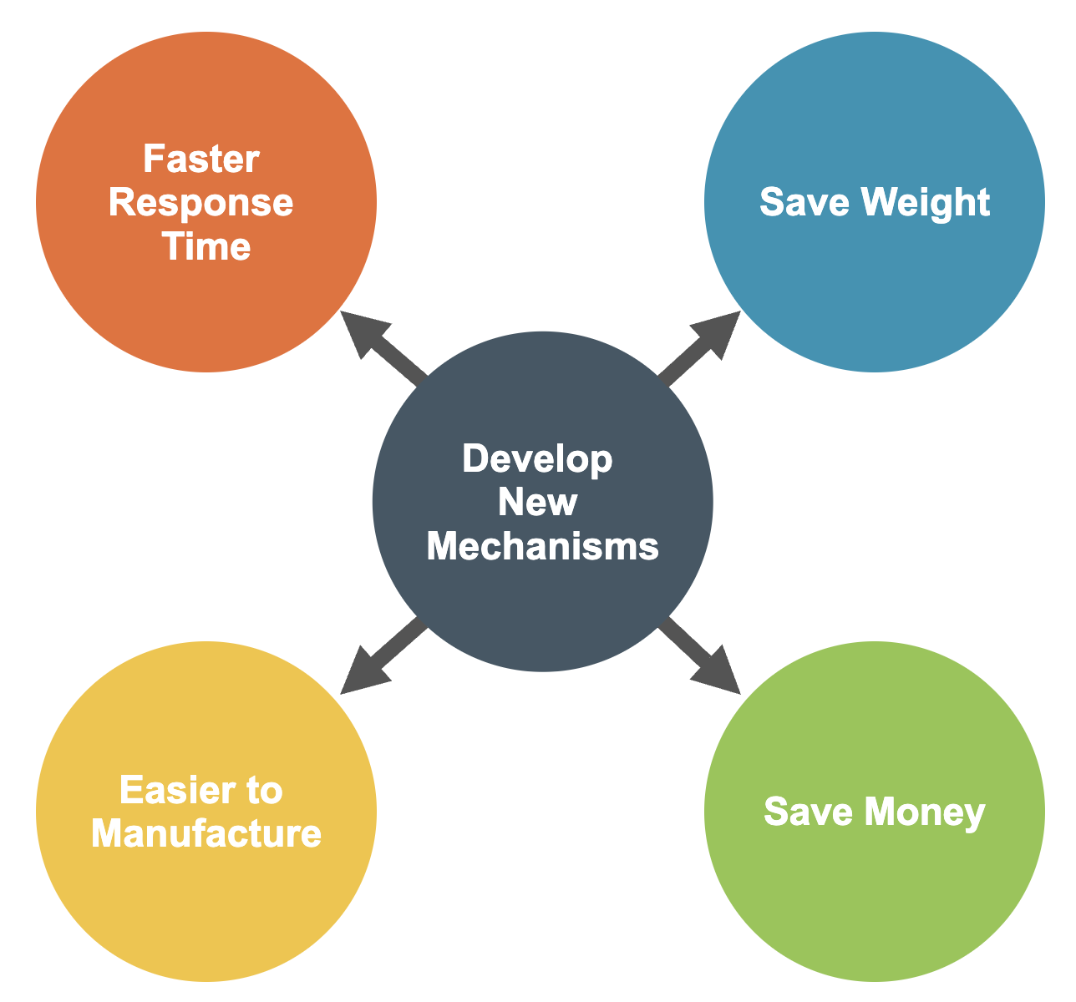
Motivation for Alternative TVC Approaches
Develop new mechanisms
Want faster alternative
More cost-effective solutions
Save weight
Notes:
Jack

Slide 7
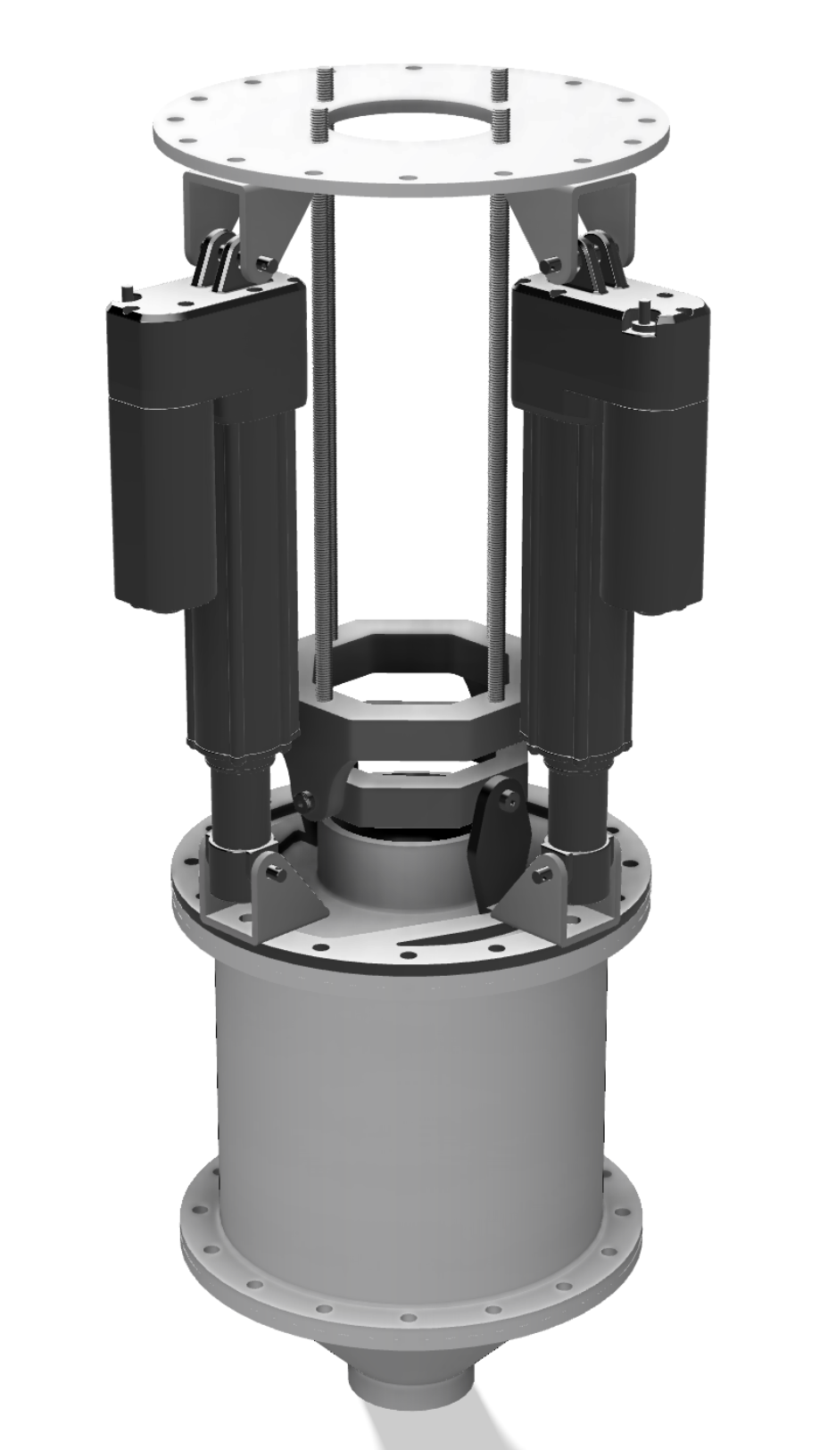
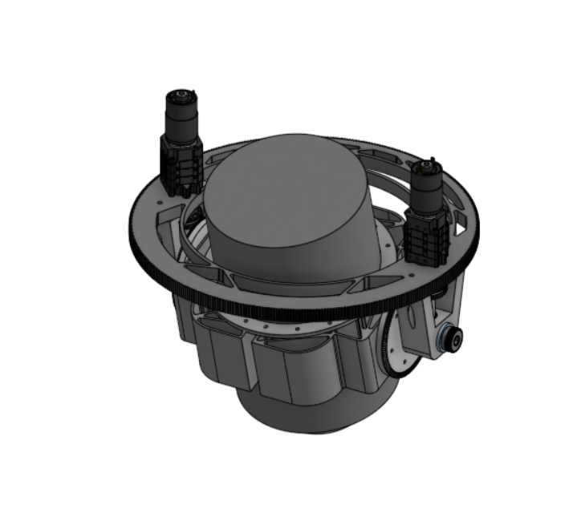
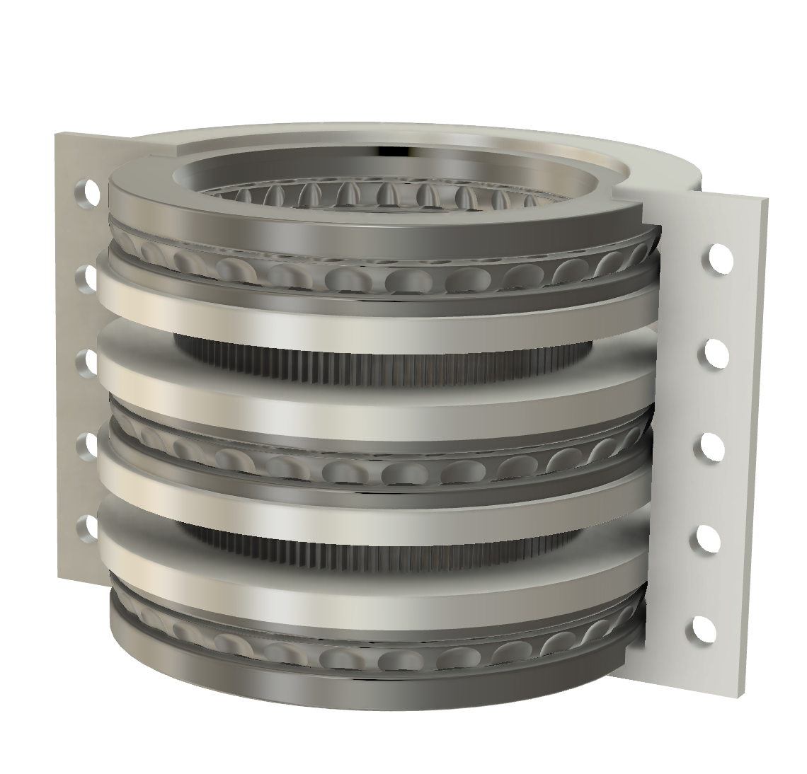
TVC Designs
TVC Designs:
  Gimbal
  Coaxial
  Differential
Notes:
Aneesh

Slide 8
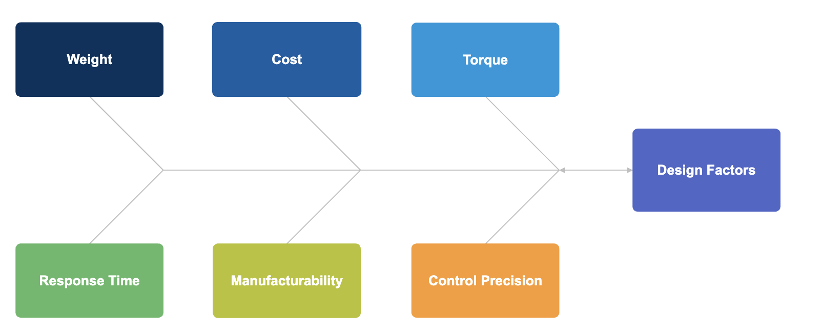
Factors to be Considered
Factors considered:
  Weight
  Cost
  Torque
  Response Time
  Manufacturability
  Control Precision
Notes:
Aneesh

Slide 9
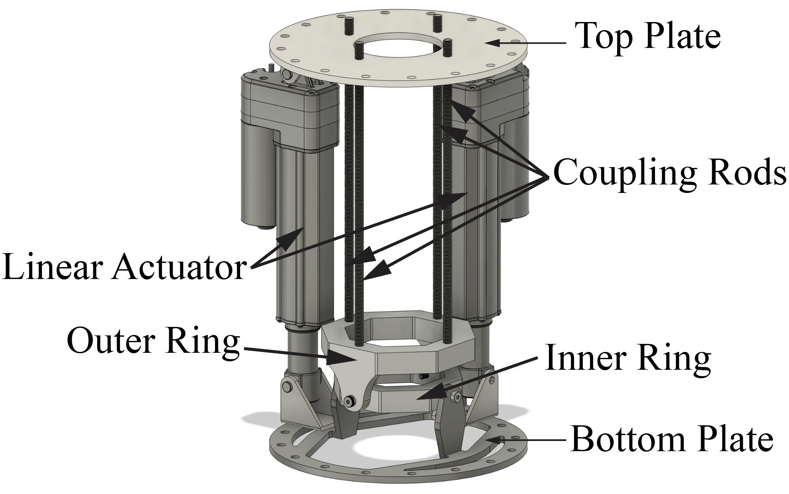
Conventional (Gimbal) TVC – Design Details
Inspired by traditional Gimbal TVC Designs
  Two rings for gimbal
  2 linear actuators for actuation
  Mounted to rocket via top plate
  Engine attached to bottom plate
  Coupling rods as structure
Notes:
Jack

Slide 10


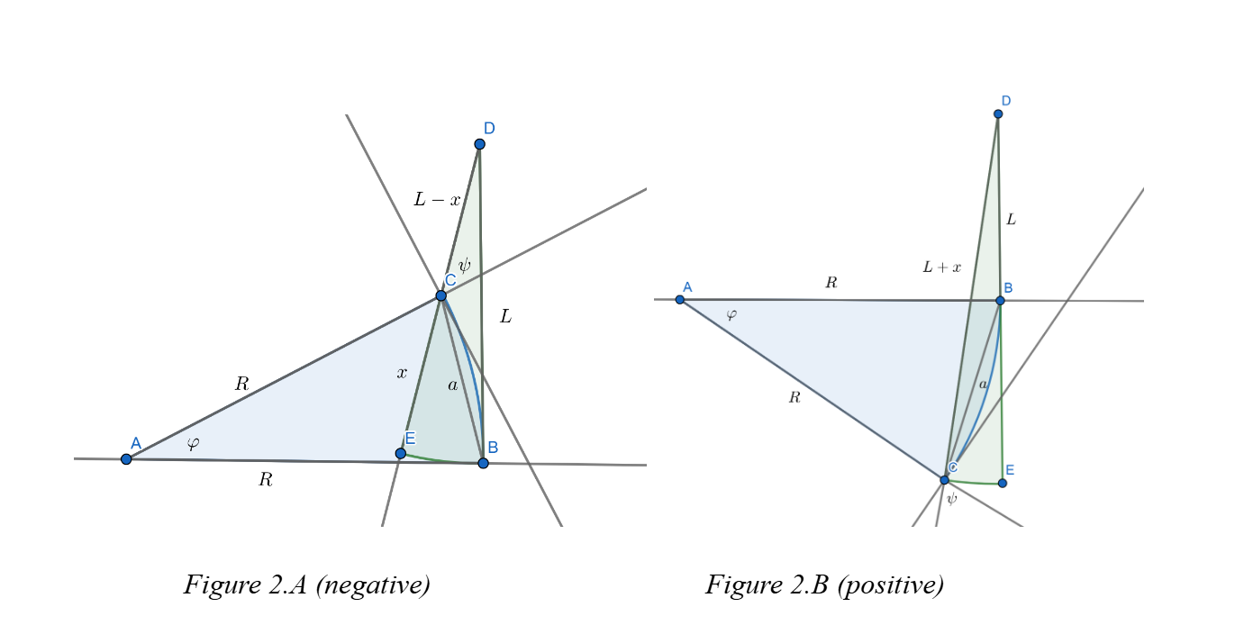
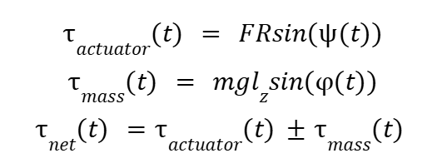
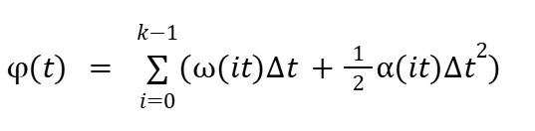
Conventional (Gimbal TVC) - Kinematic Analysis

Slide 11
Conventional (Gimbal) TVC – Kinematic Analysis
Uses 2 methods, one based on basic rotational kinematics applied to the system and the other based on the speed of the linear shaft.
Method 1:
  Find current angular acceleration based on torque applied by linear actuators
  Find current angular velocity based on past angular accelerations
  Calculate the angle traversed during the current timestep
  Add the angle traversed to the total angle traversed, check if we have reached the desired angle
  If not, increment the timestep. If yes, stop the solver.
  Output time taken. This will be the time taken based off force.
Notes:
Assumptions:
- The linear actuator applies the required force instantly – there is no delay in response.
-The system's time taken to return to rest after reaching the desired angle is negligible – the system has minimal rotational or kinematic inertia.
-Drag and friction are negligible.
-The system remains in a force limited or speed limited state for the entire duration of its motion.

Slide 12
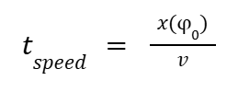
Conventional (Gimbal) TVC – Kinematic Analysis
Uses 2 methods, one based on basic rotational kinematics applied to the system and the other based on the speed of the linear shaft.
Method 2:
  Find the total length of shaft needed to traverse desired angle.
  Find the speed of the shaft at the given force.
  Divide this total length of the shaft by the speed.
  This will give the time taken by speed.
  The actual response time will be the higher of the two time values.
Notes:
Assumptions
- The system remains in a force limited or speed limited state for the entire duration of its motion.

Slide 13
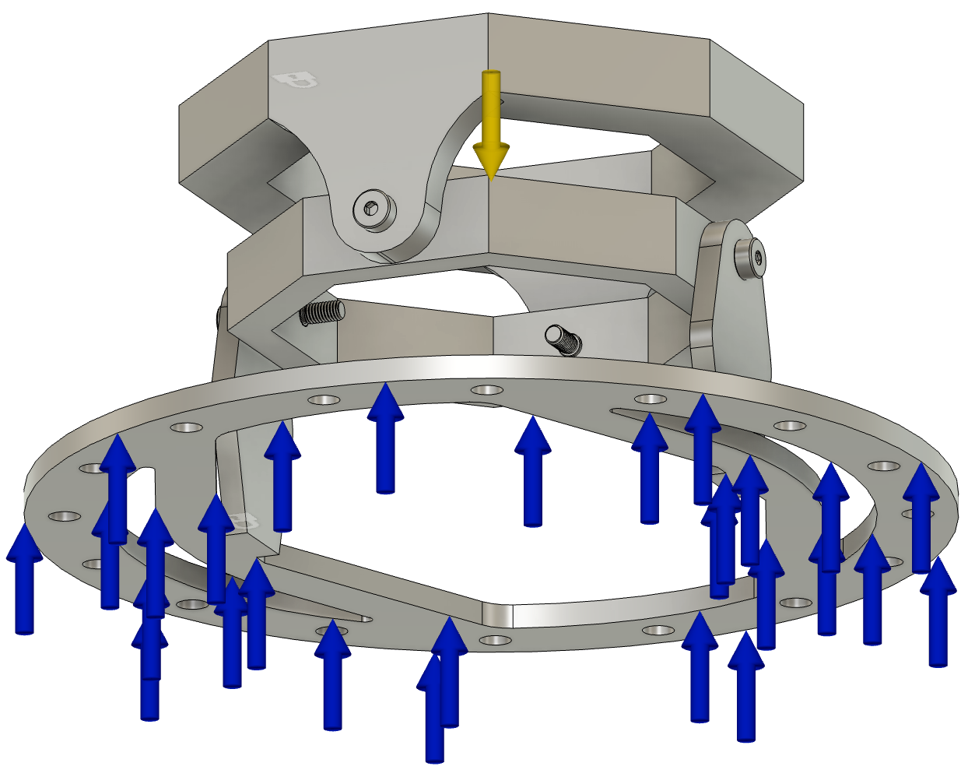
Conventional TVC – Structural Analysis
Used Fusion 360 to simulate loads faced on the engine
Used Fusion Automatic Meshing.
Static conditions places on the rings and TVC mount.
Applied a 2500 Newton thrust onto bottom plate.
Notes:
Aneesh

Slide 14
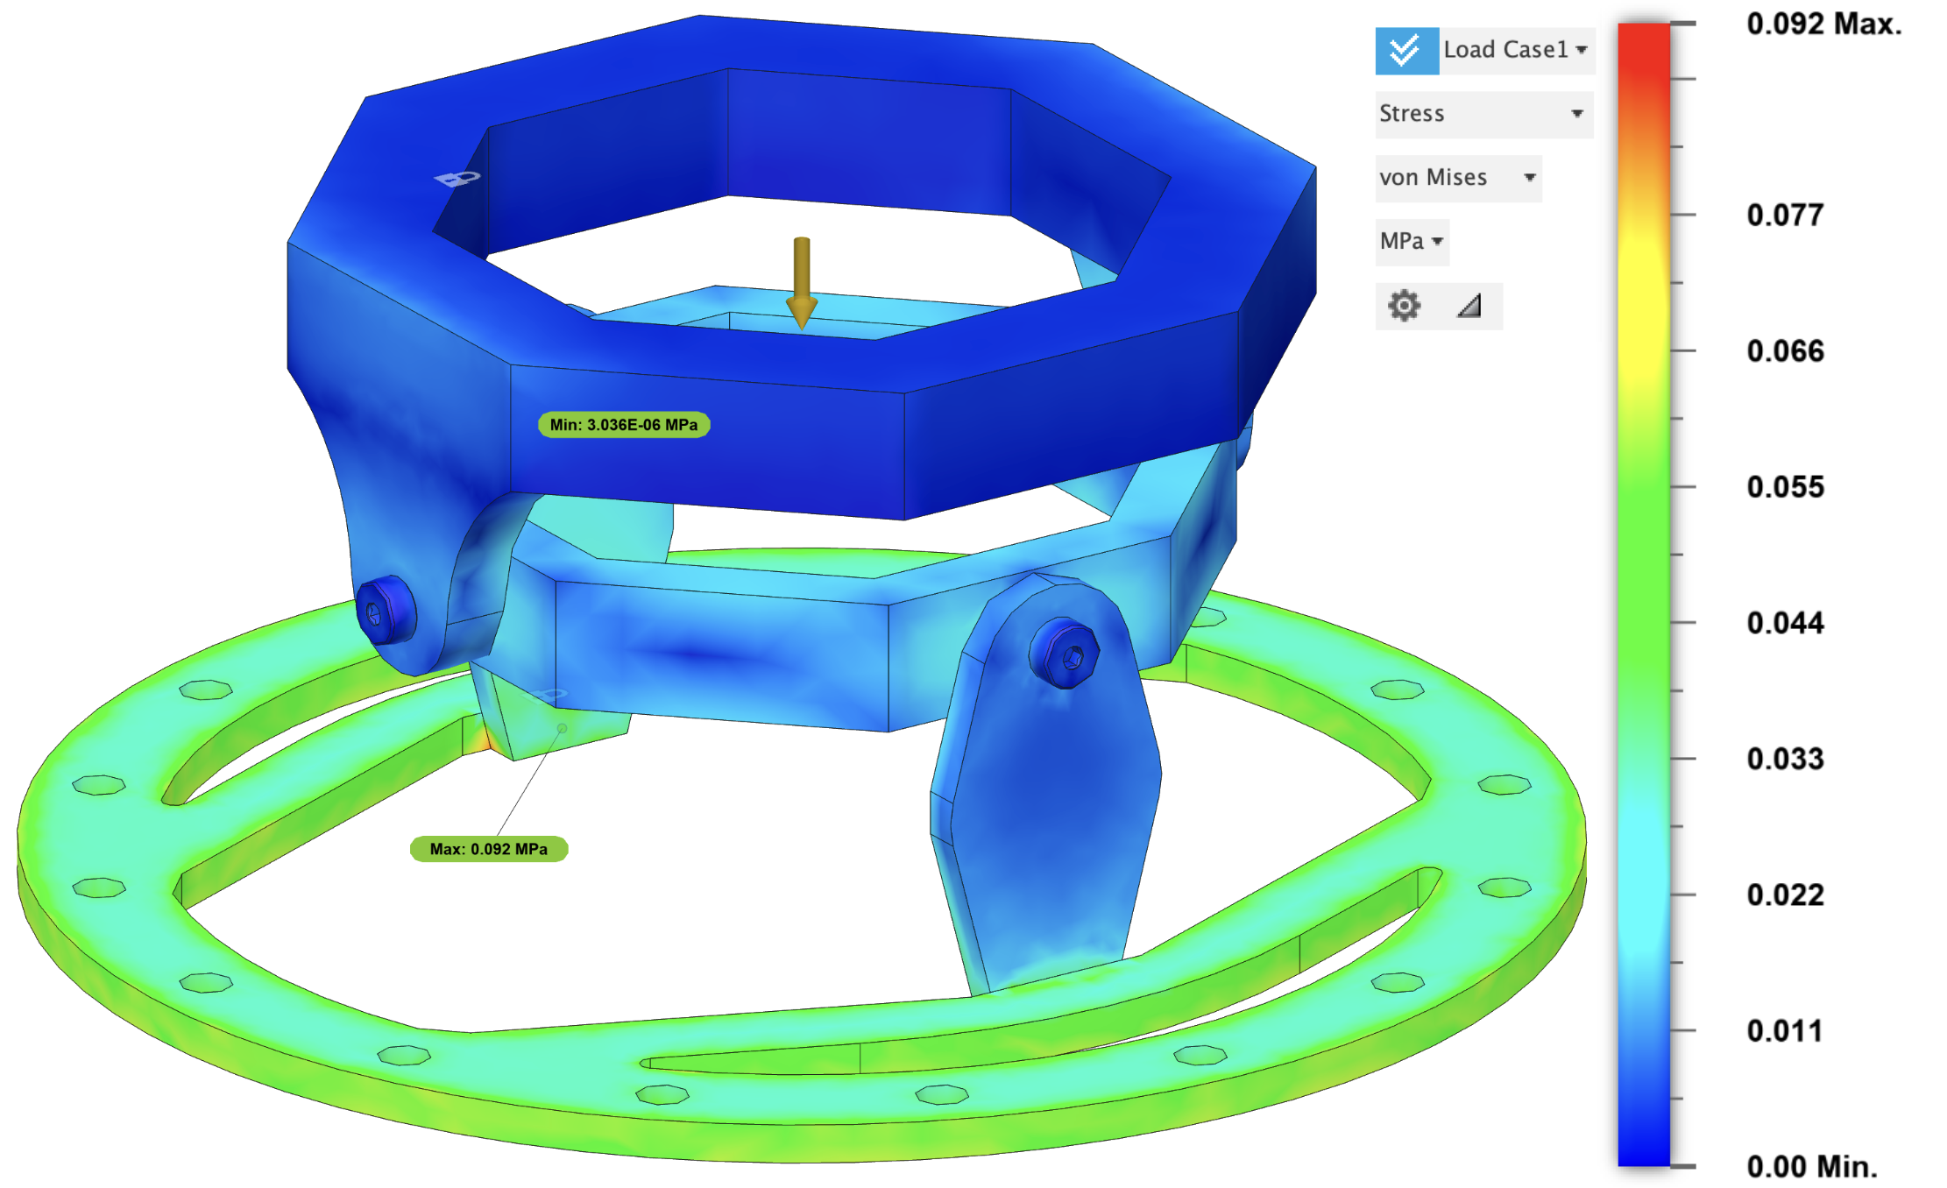
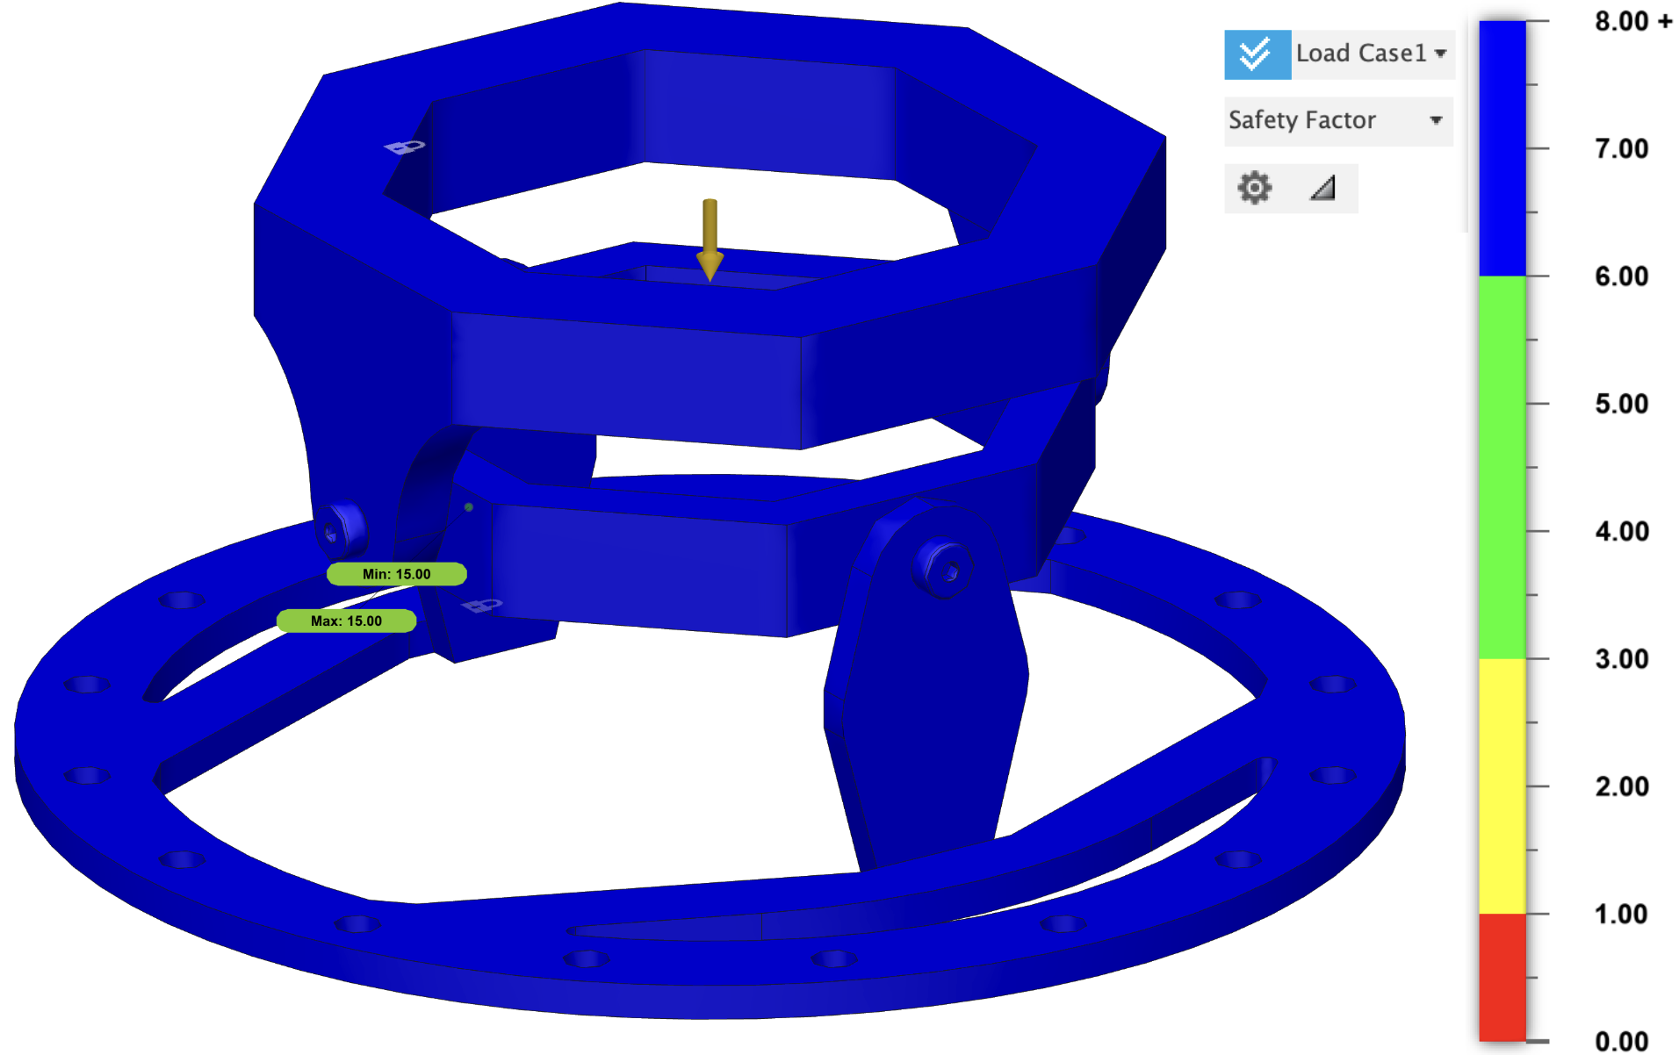
Conventional TVC – Structural Analysis
Results show stress under yield point stress of Aluminum 6061 (0.092 MPa)
Safety factor of 15 nearly uniformly throughout the parts
Notes:
Aneesh

Slide 15
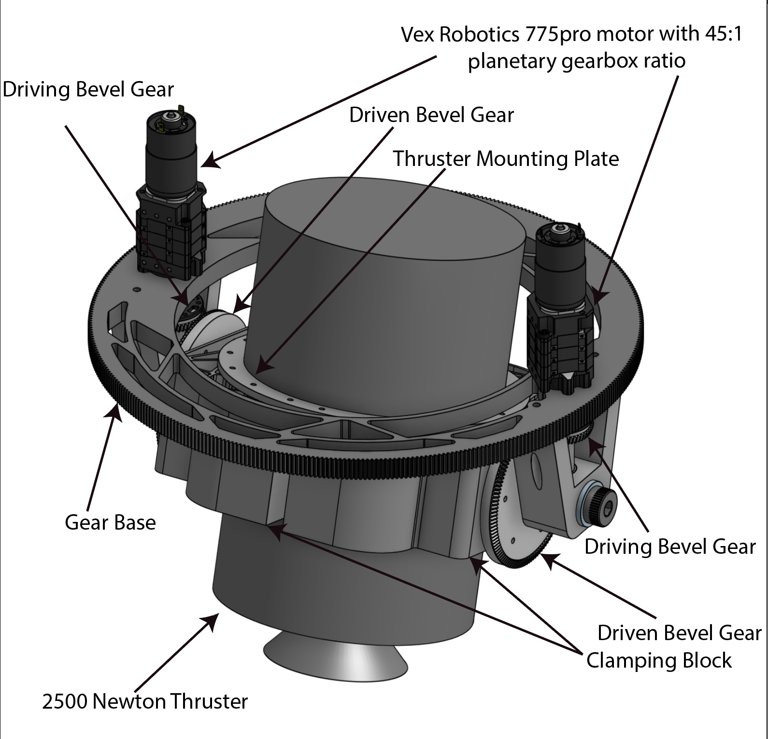
Coaxial TVC – Concept and Schematic
Based off swerve drivetrain systems from the FIRST Robotics Competition
  Has 1 motor to rotate entire mechanism using large gear about its center axes
  Has 2 motors to power the rotation of the thruster about its center radial axes, limited to ±15 degrees of rotation
Notes:
Aneesh

Slide 16




Coaxial TVC – Theoretical Modeling & Calculations
Uses basic rotational kinematics applied to the system.
  Find max angular acceleration given the angle and time constraints
  Use value to find angular velocity in equation 2
  Use equation 3 to find moment of inertia of a cylinder
  Use moment of inertia and angular acceleration max to calculate the torque required in equation 4
  Taking into account the safety factor of 4 find the resulting torque required
  Calculate the ratio required from the motor chosen using equation 5
  Ensure that the reduction maintains the speed calculated in angular velocity step
Notes:
Talk about the assumptions made for the calculations
There is no friction between any connections or pin joints
The Torque is assumed to be instantly applied at nominal output for motor
Simplification of Moment of Inertia of thruster to a cylinder
Aneesh

Slide 17
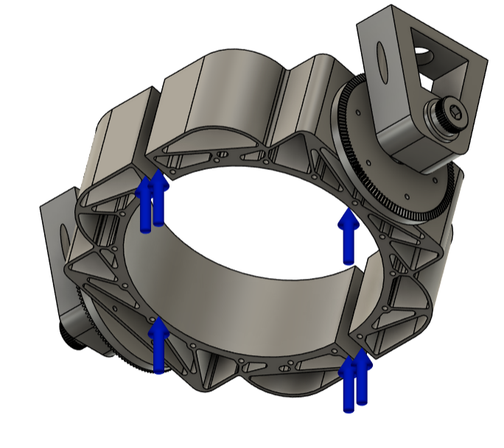
Coaxial TVC – Structural Analysis
Used Fusion 360 to simulate loads faced on the engine
Used Fusion Built-In Meshing
Static conditions places on bolt holes on the clamp as well as mounting onto large rotation gear.
Applied a 2500 Newton thrust onto plate
Notes:
Aneesh

Slide 18
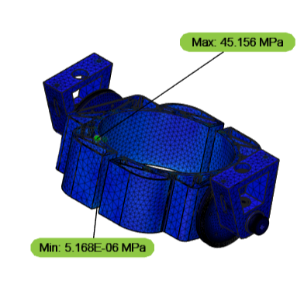
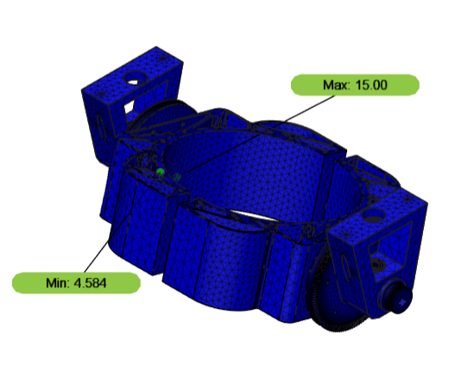
Coaxial TVC – Structural Analysis
Results show stress under yield point stress of Aluminum 6061 (276 MPa)
Safety factor of 15 nearly uniformly throughout the parts
  Bolt holes saw a decrease in safety factor to around 4.5; could be a place to increase support.
Notes:
Aneesh

Slide 19
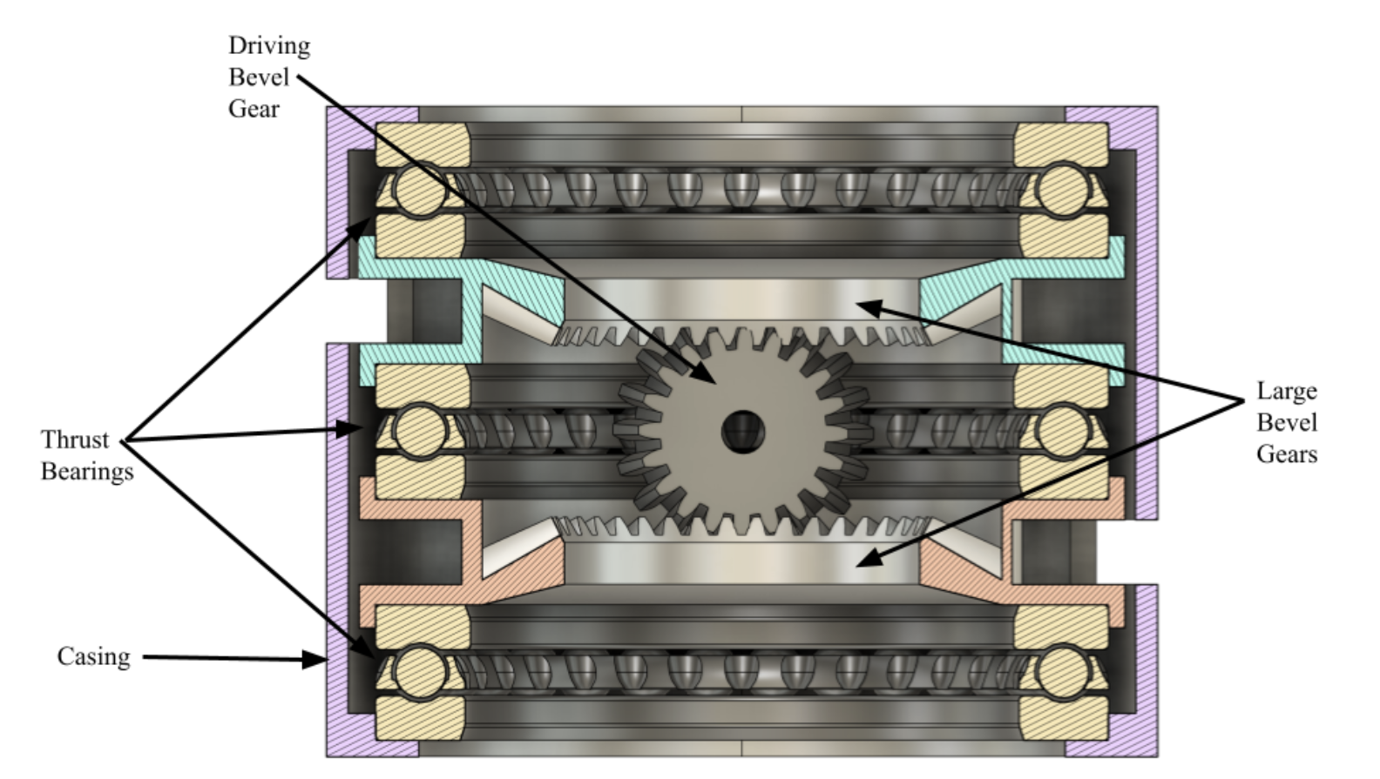
Differential TVC – Concept and Schematic
Based off differential swerve drivetrain systems from the FIRST Tech Challenge
  Has 2 motors which can be employed to both rotate the engine about the axis of the large bevel gear, or to both rotate the engine around the small bevel gear center axis.
  There is a limit of ±15 degrees of freedom about the axis of the small bevel gear
Notes:
Jack

Slide 20
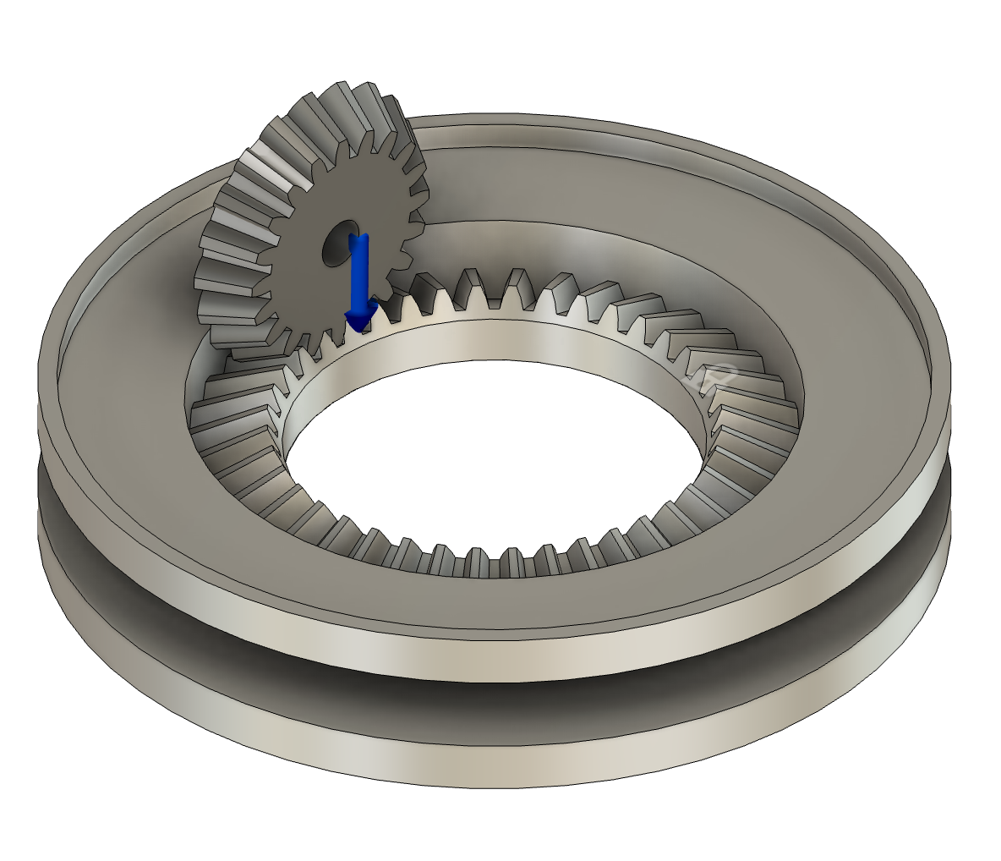
Differential TVC – Structural Analysis
Used Fusion 360 to simulate loads faced on the engine
Used Automatic Meshing
Static conditions placed onto large rotation gear.
Applied a 2500 Newton force directly in the gear.
Notes:
Jack

Slide 21
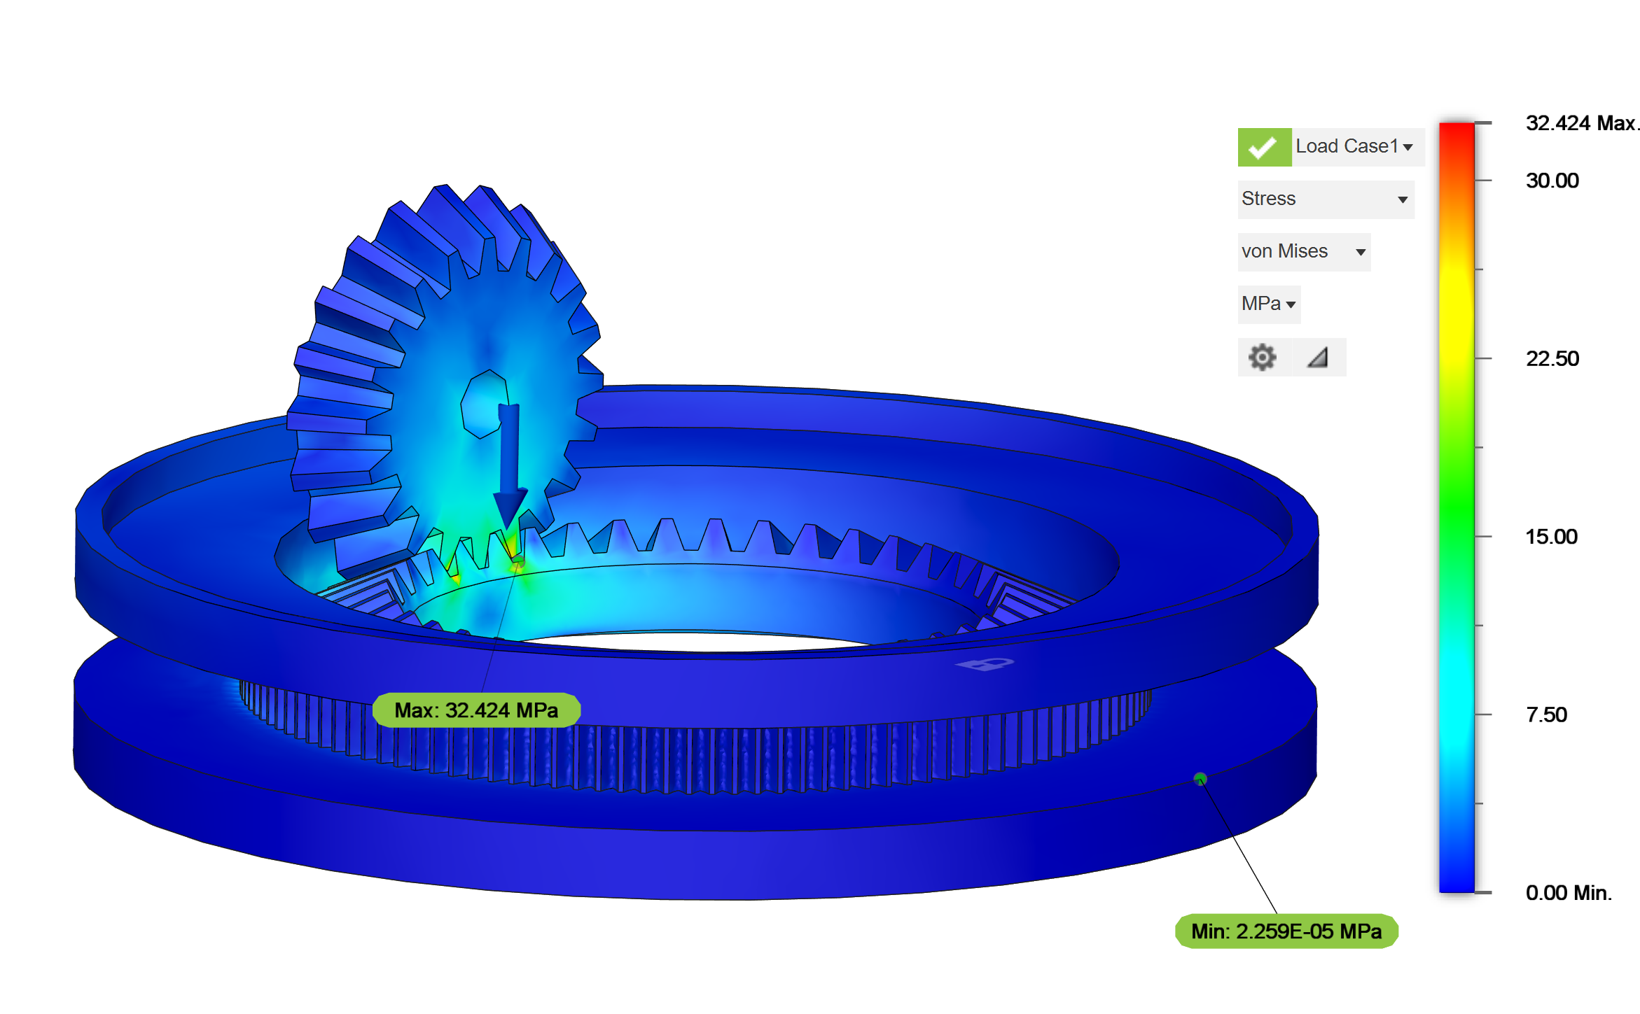
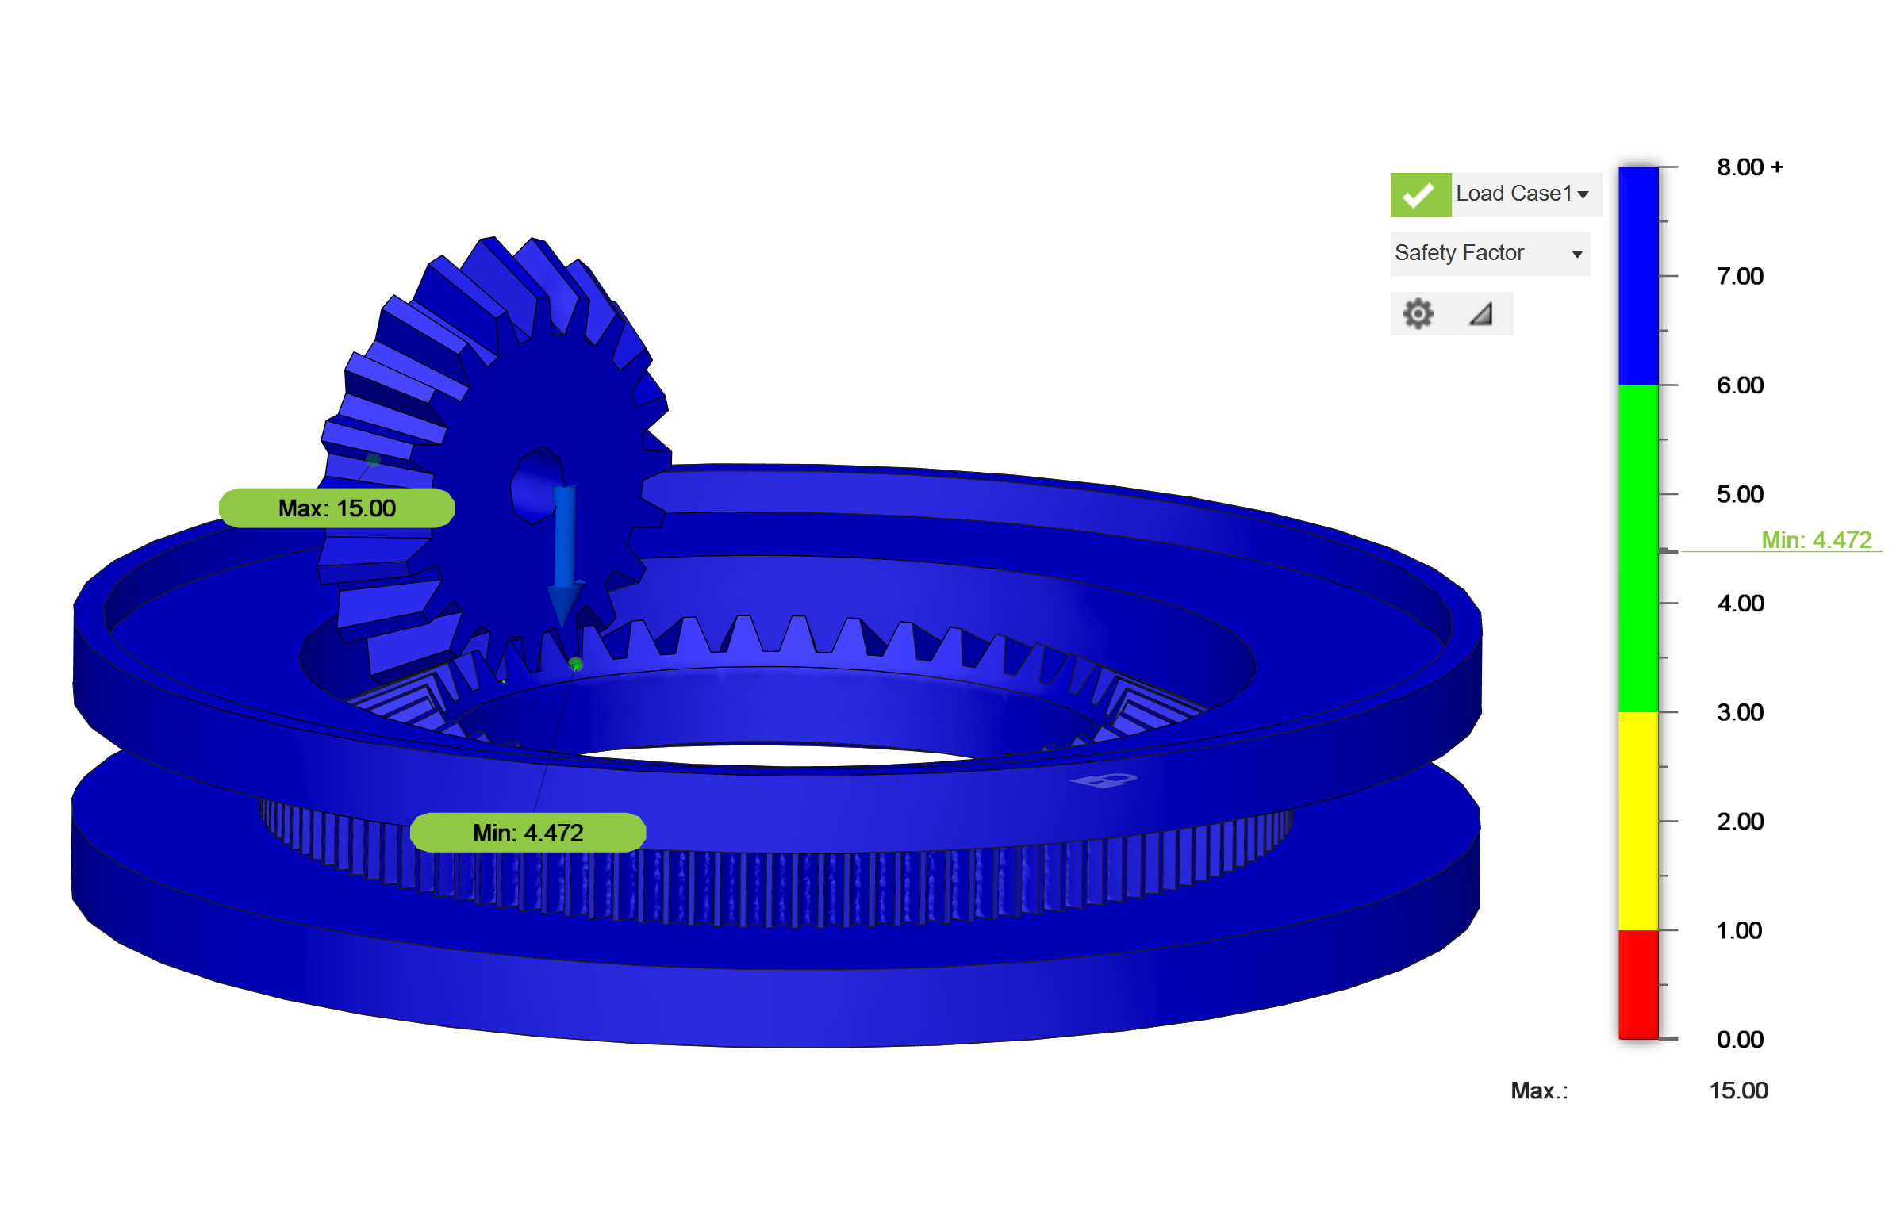
Differential TVC – Structural Analysis
Results show stress under yield point stress of Aluminum 6061 (276 MPa)
Safety factor of 15 nearly uniformly throughout the parts
  On the small gear as well as the point of interaction between the large gear and small gear the safety factor dips to 4.472
Notes:
Jack

Slide 22
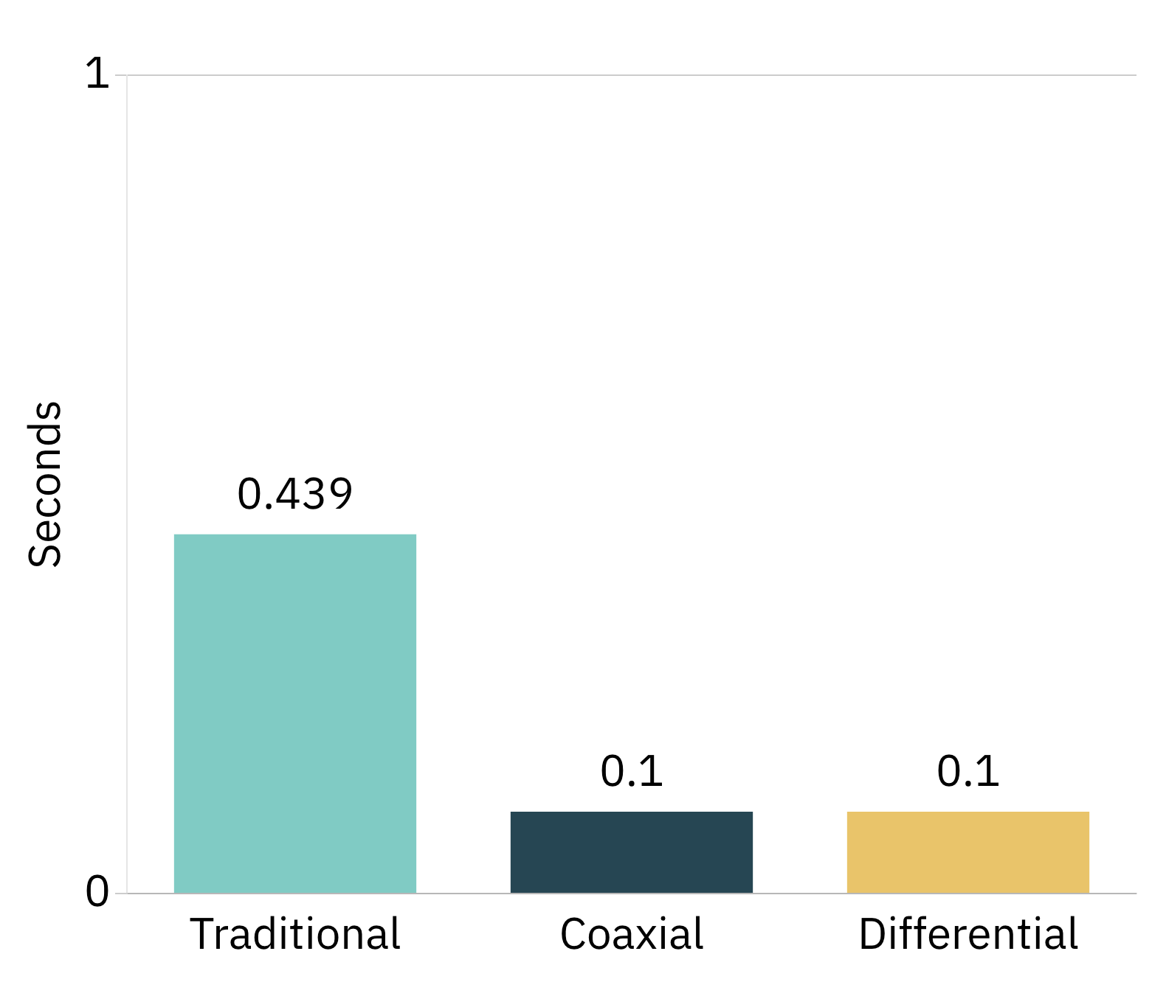
Comparative Analysis – Response Time and Torque
Enhanced Speed:
  Differential/coaxial systems: ~0.10 s response
  Conventional designs: ~0.439 s response.
Modular Adaptability:
  Easy adjustments via gearbox swaps for varied performance.
Improved Control Performance:
  Faster responses enhance stability, maneuverability, and recovery.
Notes:
Aneesh

Slide 23
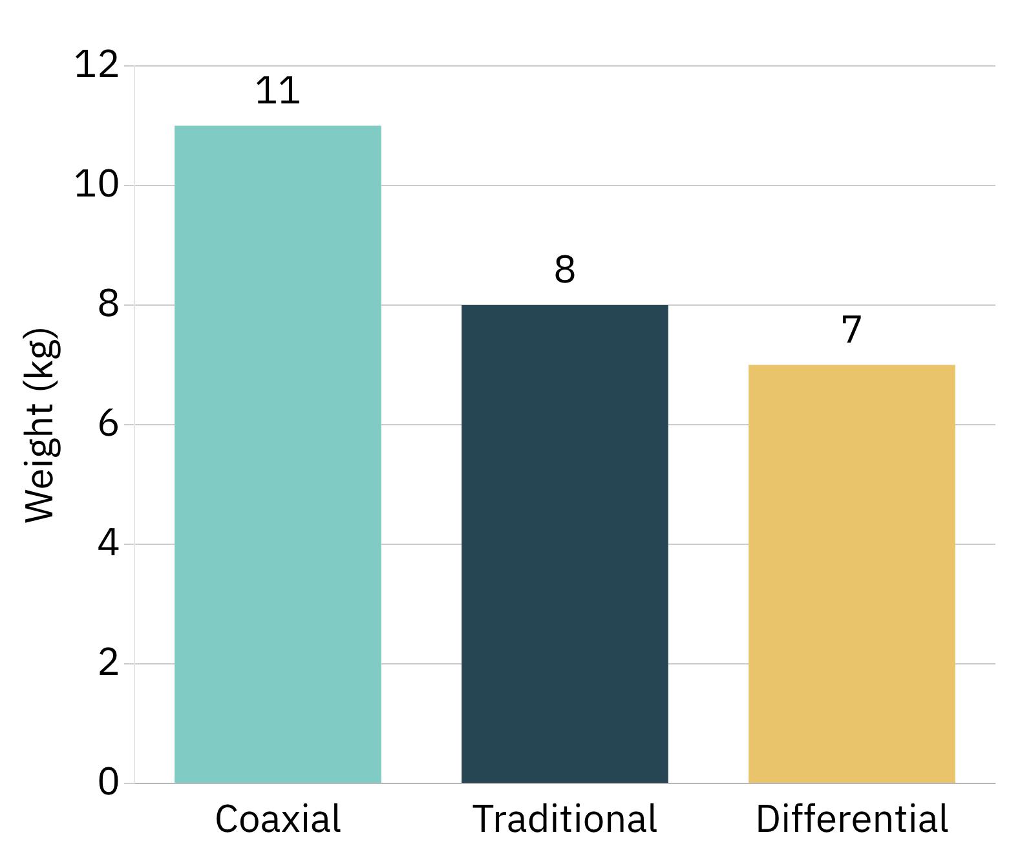
Comparative Analysis – Weight
Performance Impact:
  Weight is key for optimizing thrust-to-weight ratios and fuel efficiency.
System Weights:
  Conventional: ~8,000 g
  Differential: ~7,000 g
  Coaxial: ~11,000 g
Notes:
Aneesh

Slide 24
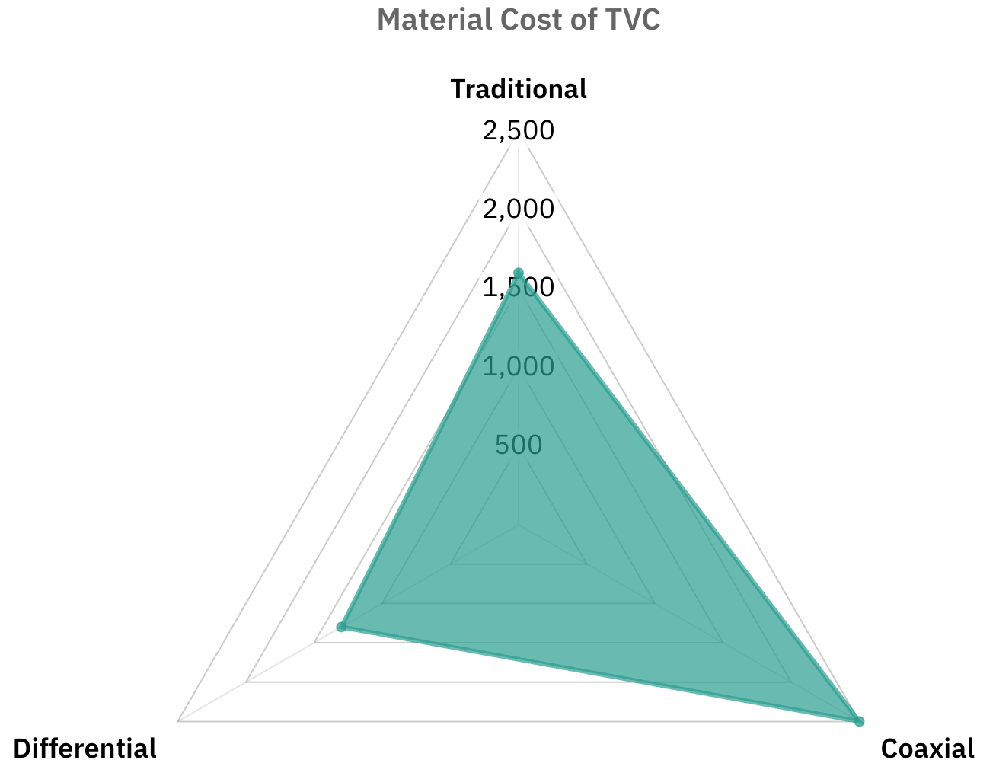
Comparative Analysis – Manufacturability and Cost
Manufacturability:
  Conventional: Simple machining and off-the-shelf linear actuators
  Differential/Coaxial: Requires higher precision
Cost:
  Conventional: ~$1,600
  Differential: ~$1,300
  Coaxial: ~$2,500.
Notes:
Jack

Slide 25
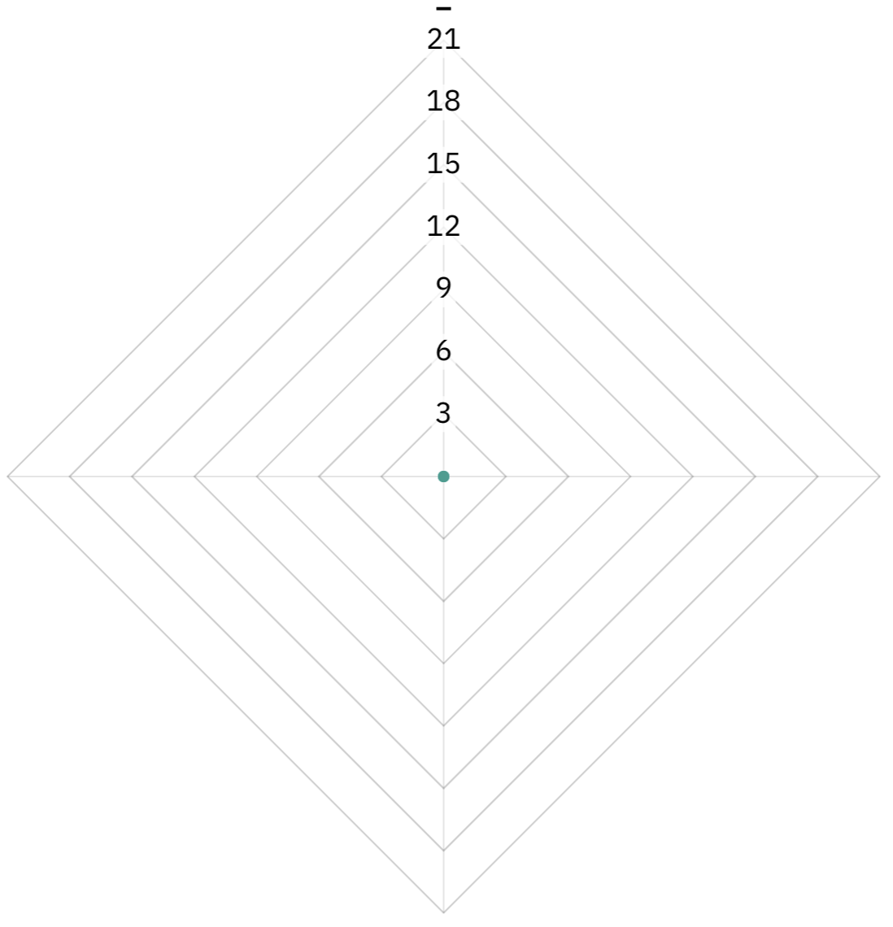
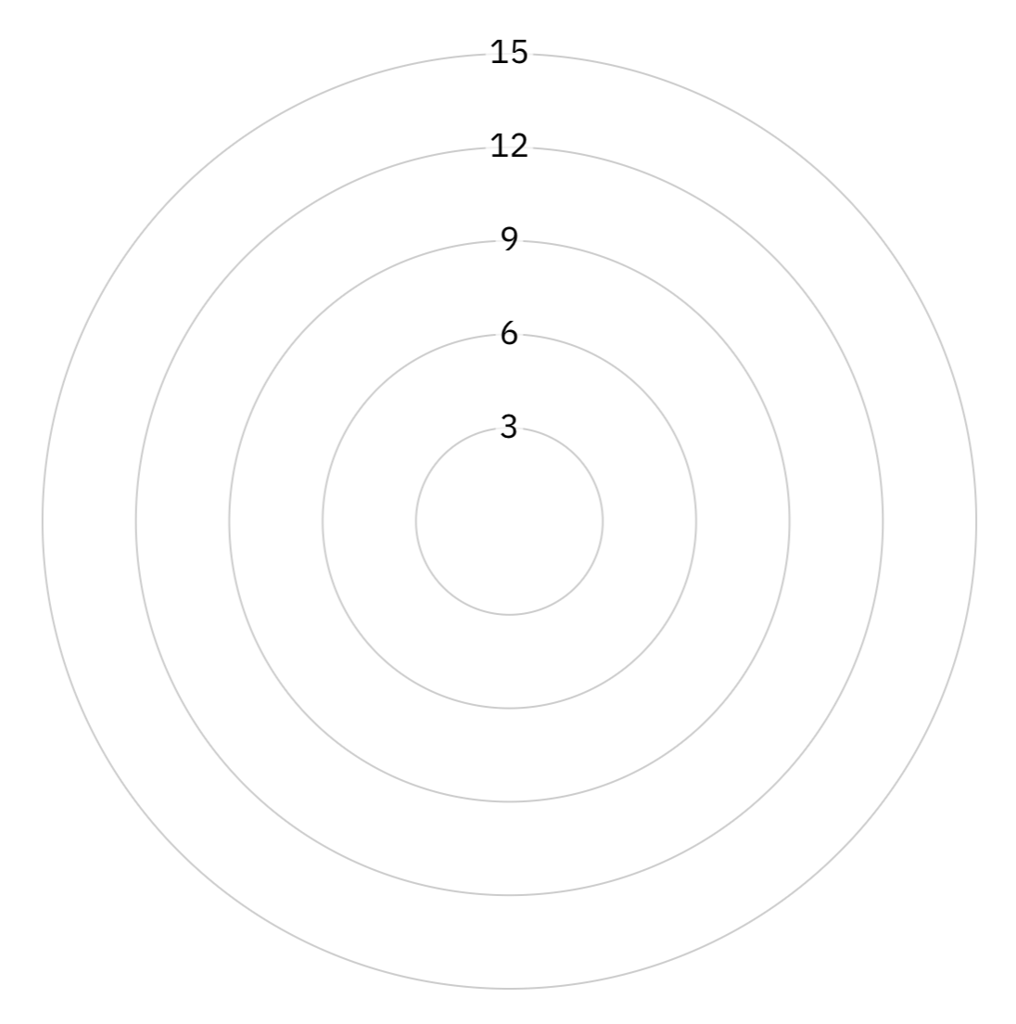
Comparative Analysis – Control Precision & Stability
TVC Comparison:
  Conventional:
    Independent actuators for high accuracy.
    Simpler control with absolute encoders.
    May exhibit uneven diagonal speeds.
  Differential/Coaxial:
    Rotational actuators for uniform, fast responses and rapid recovery.
    More complex control with incremental encoders offering superior torque allocation.
Notes:
Jack

Slide 26
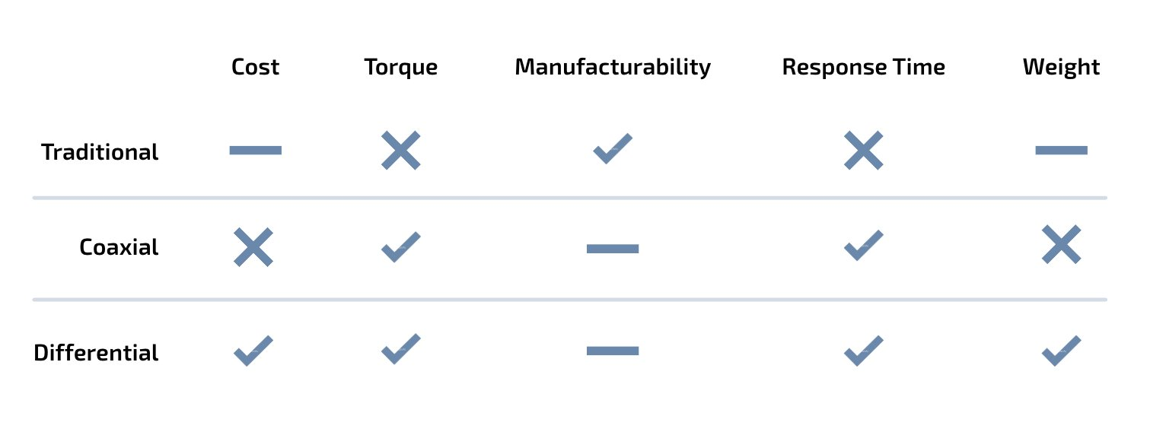
Conclusion
Notes:
Aneesh

Slide 27
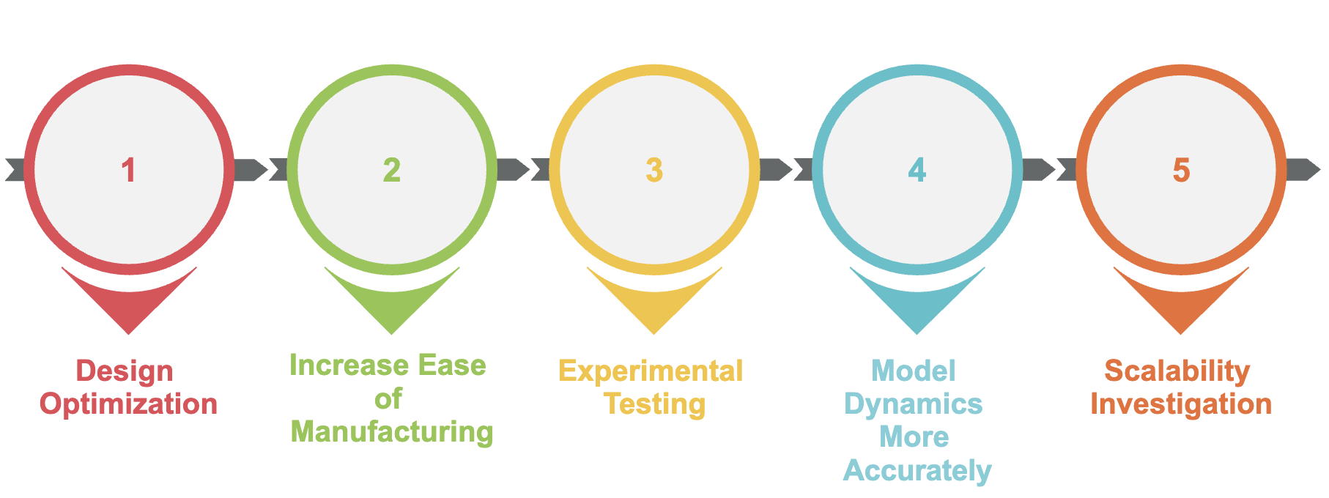
Future Directions
A roadmap or timeline graphic showing next steps and future research milestones.
Notes:
Aneesh

Slide 28
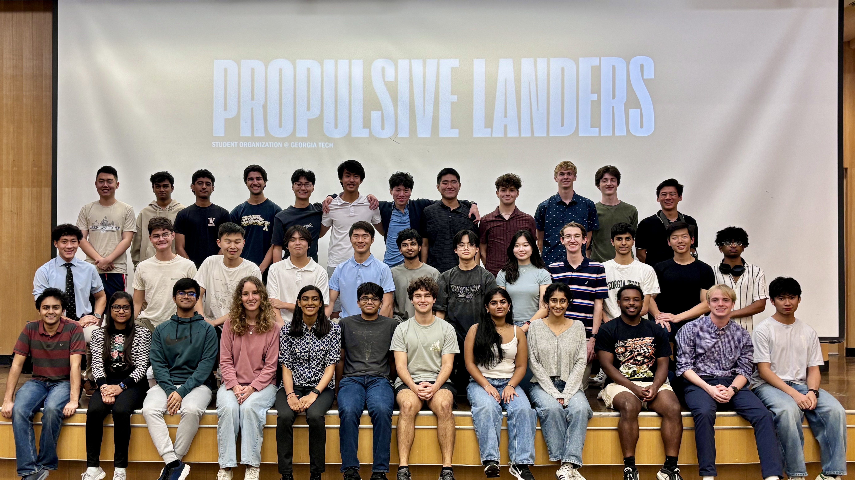
Acknowledgements
Anyi Lin
Carlos Barrow
Propulsive Landers at Georgia Tech
Notes:
Jack

Slide 29
References
[1] TiMOTIONUSA, “TA19 LongStroke Linear Actuator,” 2023. URL: https://www.timotion.com/en/products/linearactuators/ta19-series (accessed 2024-02-20)
[2] Lally, D., “Roller Chains and Planetary Gearboxes Yield Accurate, Efficient Motion Control,” November 7, 2018. URL: https://www.machinedesign.com/mechanical-motion-systems/article/21837300/roller-chains-and-planetary-gearboxes-yield-accurate-efficient-motion-control (accessed 2024-02-20)
[3] VEX Robotics, “775pro- VEXpro Motors- VEX Robotics,” 2023. URL: https://motors.vex.com/vexpro-motors/775pro (accessed 2024-02-20)
[4] Gabor, T., and Lombaerts, T., “Flight Dynamics and Control Assessment for Differential Thrust Aircraft,” CEAS Aeronautical Journal, Vol. 13, 2022, pp. 591–605. URL: https://link.springer.com/article/10.1007/s13272-022-00591-5 (accessed 2024-02-20)
[5] Biesbroek, R., and Verberne, J., “Thrust Vector Control and State Estimation Architecture for Low-Cost Small-Scale Launchers,” arXiv preprint, Vol. 2303.16983, 2023. URL: https://arxiv.org/pdf/2303.16983 (accessed 2024-02-20)
[6] Frazier, W., “Metal Additive Manufacturing in Aerospace: A Review,” Journal of Materials Engineering and Performance, Vol. 23, No. 6, 2014, pp. 1917–1928. URL: https://www.researchgate.net/publication/353439471_Metal_additive_manufacturing_in_aerospace_A_review (accessed 2024-02-20)

