Slide 1
Comparative Study of Nonlinear Attitude Estimation in GNC Testbeds for Collegiate Self-Landing Rockets
Favour Adekola, Anyi Lin
Georgia Tech Propulsive Landers
AIAA Region II Student Conference, 3-4 April 2025
Copyright © by Georgia Tech Propulsive Landers.
Published by the American Institute of Aeronautics and Astronautics, Inc., with permission.

Slide 2
What are Filtering Algorithms
Used in navigation, aerospace, automotive, and robotics industries to counteract noise present in positional sensors
IMUs are one sensor capable of predicting an object's attitude
Which of the many nonlinear filters perform the best when calculating attitude?

Slide 3
Methodology
Filters analyzed:
  Complementary, Extended Kalman Filter (EKF), Fourati, Madgwick, Mahony
A sample nine-axis IMU reading for a spiral trajectory with simulated noise was generated
Each filter's performance is determined by the magnitude of their roll, pitch, and yaw RMSE
  root mean square error

Slide 4
Complementary Filter
"Simple" filtering algorithm
Estimates attitude with the weighted sum of a gyroscope prediction and the combination of magnetometer and accelerometer prediction.
𝜃 = 𝛼𝜃_{𝑤} + (1−𝛼)𝜃_{𝑎𝑚}

Slide 5
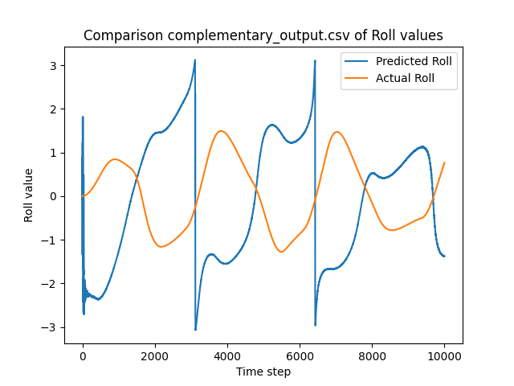
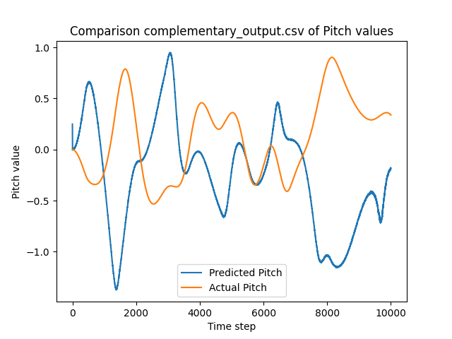
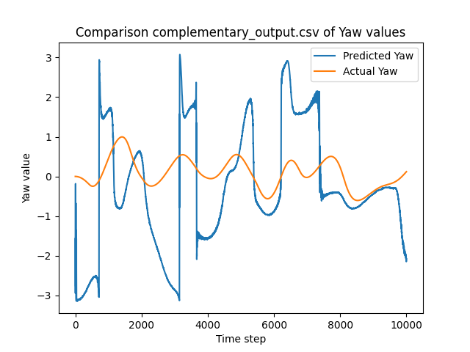
Complementary Filter
Computationally inexpensive
Backing structure for some of the more accurate filters

Slide 6
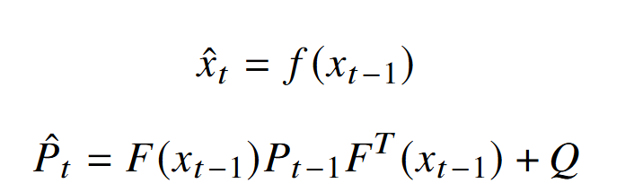
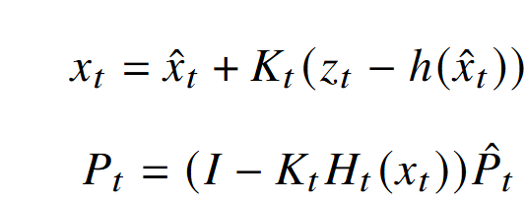

Extended Kalman Filter
EKF uses a math model of the system's states and their possible transitions.
Predicts and then updates the prediction to estimate
Prediction Step:
Update Step:
Kalman gain:

Slide 7
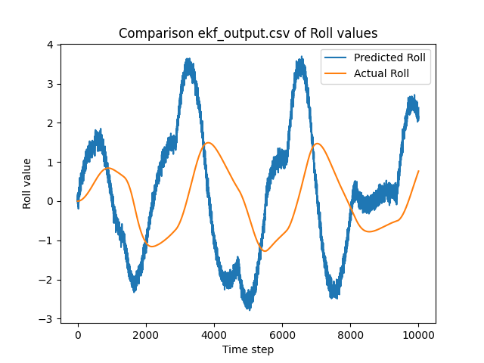
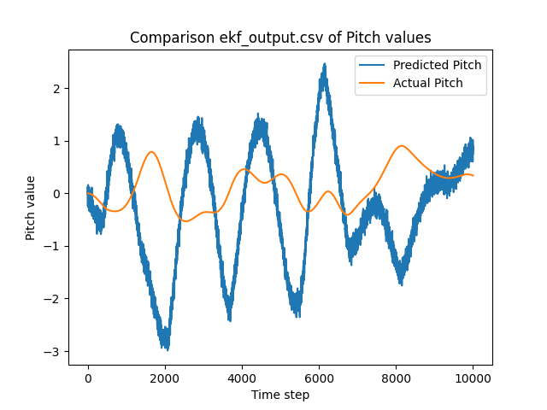
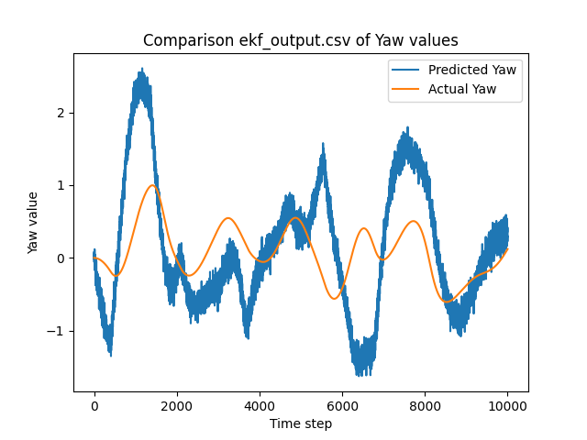
Extended Kalman Filter
Heavy computations
  Jacobians and Matrix operations

Slide 8
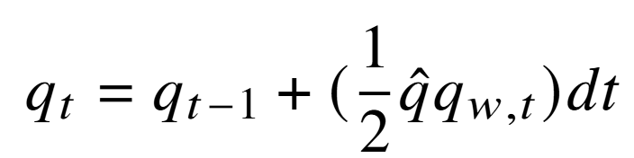
Fourati Filter
Utilizes a complementary structure with the Levenberg–Marquardt algorithm
Calculations done with quaternions

Slide 9
Fourati Filter
Levenberg–Marquardt algorithm
  Damped least squares (DLS) method
Useful in solving non-linear curve fitting and optimization problems
DLS modifies the normal least squares solution by adding a damping factor to its calculation

Slide 10
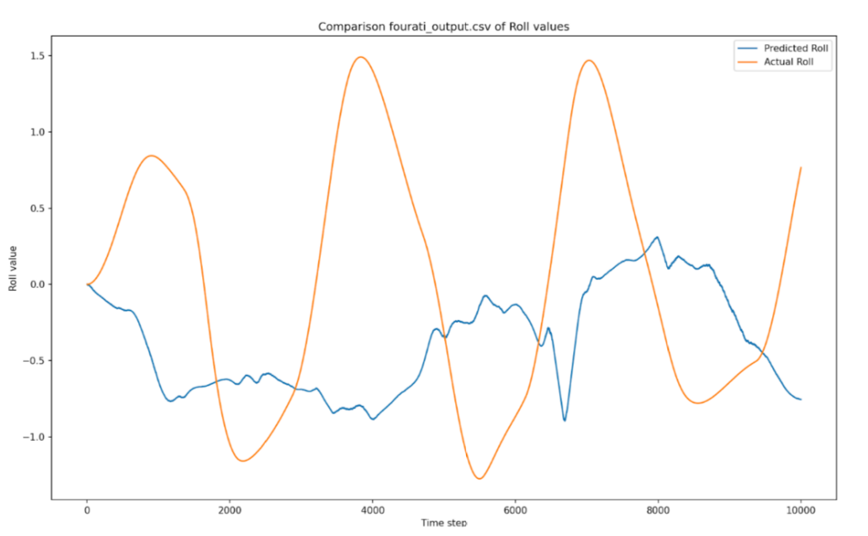
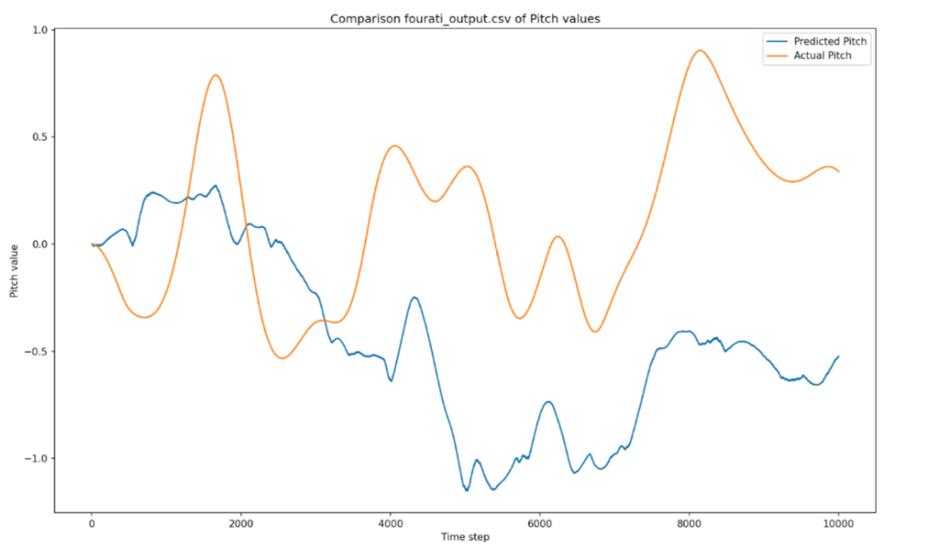
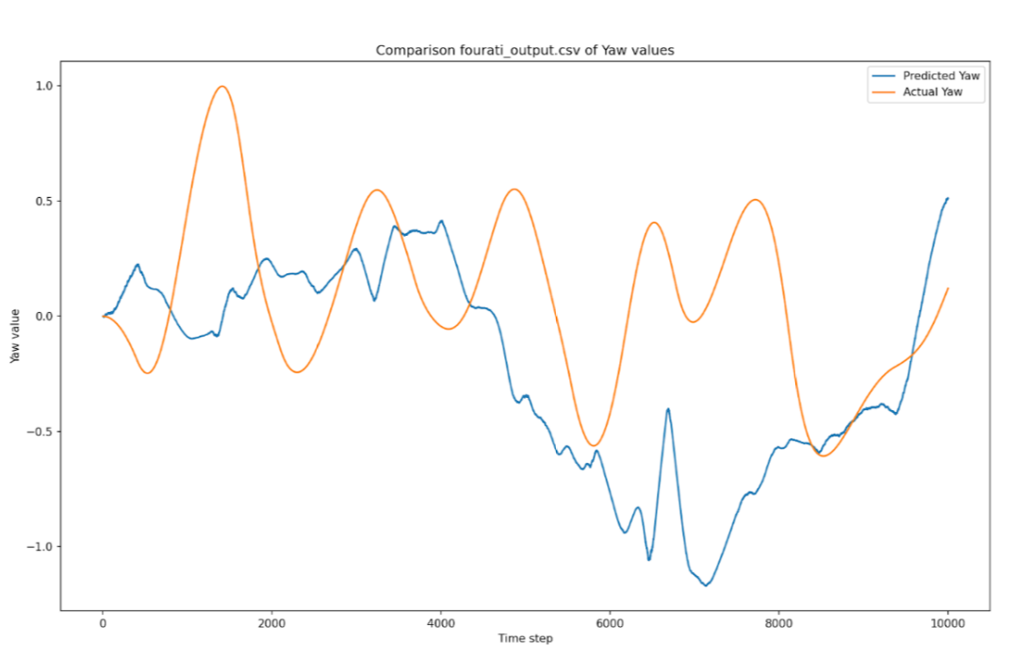
Fourati Filter
Falls between EKF and Complementary in computation
Few resources for implementation

Slide 11

Madgwick Filter
Utilizes a complementary structure with the gradient-descent algorithm
The objective function varies in formatting depending on what parts of the nine-axis IMU are being used.

Slide 12

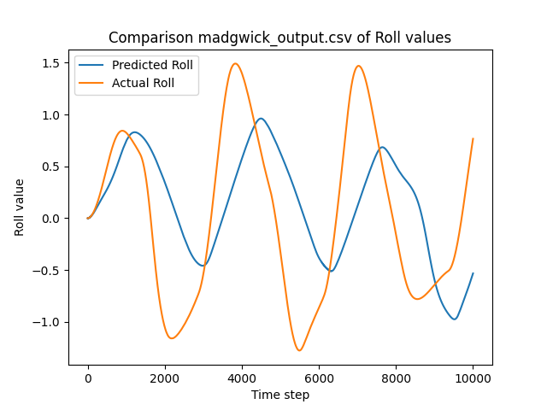
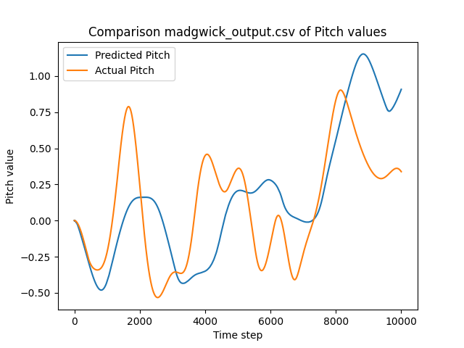
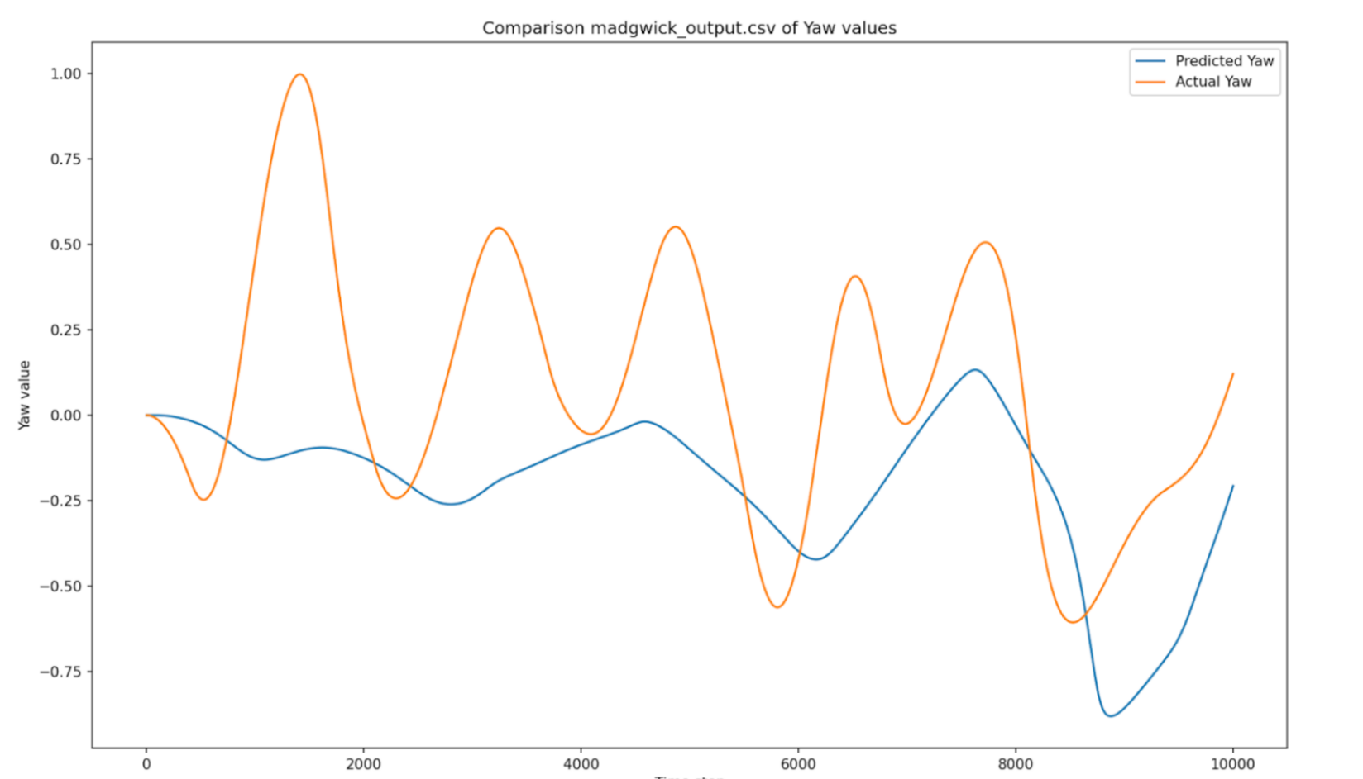
Madgwick Filter
Has a physically represented tuning parameter found by
  W Represents the mean zero gyroscope measurement error

Slide 13
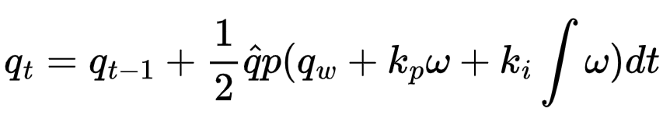
Mahony Filter
Utilizes complementary structure with proportional-integral (PI) feedback control.
PI control parameters enable more flexibility for noise correction

Slide 14
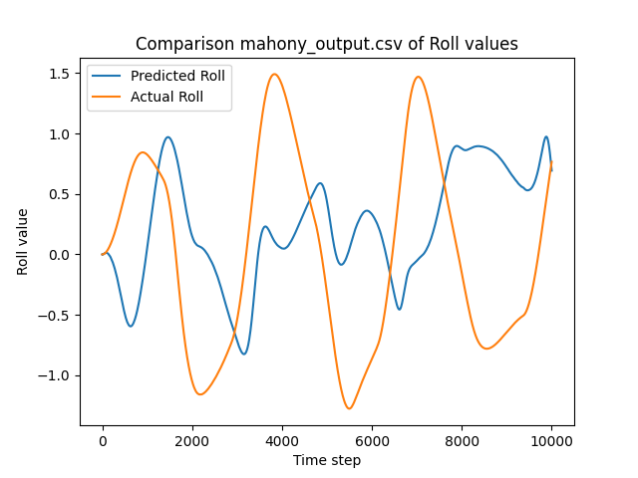
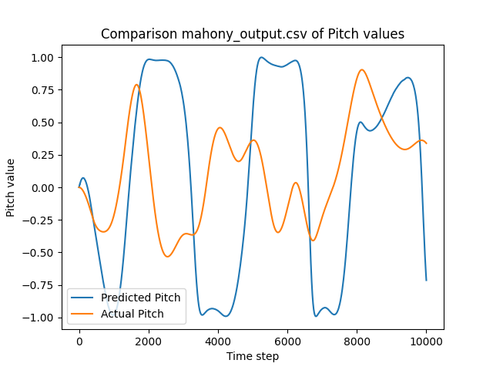
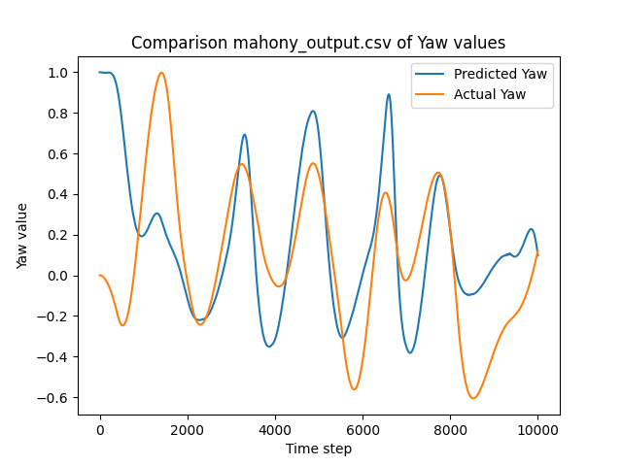
Mahony Filter
Suffers performance at high magnitudes of acceleration

Slide 15
Results
Filters | Complementary | EKF | Fourati | Madgwick | Mahony
RMSE | 2.7800 | 2.4498 | 1.4366 | 1.0431 | 1.3625
Madgwick filter was 267% more accurate than the Complementary filter (worst performing)
  131% more accurate than Mahony (second-best performing)

Slide 16
Results
Filters | Complementary | EKF | Fourati | Madgwick | Mahony
R-RMSE | 2.1716 | 1.8977 | 1.0314 | 0.8097 | 1.0104
P-RMSE | 0.9224 | 0.9026 | 0.7901 | 0.4971 | 0.8230
Y-RMSE | 1.4701 | 1.2592 | 0.6129 | 0.4306 | 0.3976
The Mahony filter outperformed the Madgwick in yaw estimation
The Fourati filter performed second-best in pitch estimation

Slide 17
Conclusion
Madgwick was the best performing filter
Choosing a filter is more than minimizing errors
  Needs to optimize for performance on limited hardware as well
More time tuning could provide better performance for any filter
Roll error was the highest

Slide 18
Conclusion
A secondary study would help address limitations in our analysis:
  Update state transition models
  Test for multiple trajectories
  Additionally tuning for all filters
  Utilizing actual instead of simulated sensor data

Slide 19
Future Direction
Development and launch of testbeds will affect final choices
Test on actual sensor data after testing launches
System dynamics will need to be updated prior to the rocket launch

Slide 20
Future Direction
The rocket will also have increased IMU capabilites compared to the Monoprop UAV
Possible integration of low-pass filter in rocket avionics

Slide 21
Acknowledgements
As part of this project, we would like to express our gratitude to Propulsive Landers at Georgia Tech for providing us with the opportunity to conduct research as part of the organization’s work.

Slide 22
References
[1] Cavallo, A., “Experimental Comparison of Sensor Fusion Algorithms for Attitude Estimation,” 2014, pp. 7585–7591.
https://doi.org/10.3182/20140824-6-ZA-1003.01173.
[2] Sabatini, A., “Quaternion-based extended Kalman filter for determining orientation by inertial and magnetic sensing,” IEEE
Transactions on Biomedical Engineering, Vol. 53, No. 7, 2006, pp. 1346–1356. https://doi.org/10.1109/TBME.2006.875664.
[3] Fourati, H., Manamanni, N., Afilal, L., and Handrich, Y., “A Nonlinear Filtering Approach for the Attitude and Dynamic Body
Acceleration Estimation Based on Inertial and Magnetic Sensors: Bio-Logging Application,” IEEE Sensors Journal, Vol. 11,
No. 1, 2011, pp. 233–244. https://doi.org/10.1109/JSEN.2010.2053353.
[4] Madgwick, S., Harrison, A., and Vaidyanathan, R., “Estimation of IMU and MARG orientation using a gradient descent
algorithm,” IEEE ... International Conference on Rehabilitation Robotics : [proceedings], Vol. 2011, 2011, p. 5975346.
https://doi.org/10.1109/ICORR.2011.5975346.
[5] Çoçoli, K., and Badia, L., “A Comparative Analysis of Sensor Fusion Algorithms for Miniature IMU Measurements,” 2023
International Seminar on Intelligent Technology and Its Applications (ISITIA), 2023, pp. 239–244. https://doi.org/10.1109/
ISITIA59021.2023.10220994.

Slide 23
References
[6] Mahony, R., Hamel, T., and Pflimlin, J.-M., “Nonlinear Complementary Filters on the Special Orthogonal Group,” Automatic
Control, IEEE Transactions on, Vol. 53, 2008, pp. 1203 – 1218. https://doi.org/10.1109/TAC.2008.923738.
[7] Zhang, A., and Atia, M. M., “An efficient tuning framework for Kalman filter parameter optimization using design of
experiments and genetic algorithms,” NAVIGATION: Journal of the Institute of Navigation, Vol. 67, No. 4, 2020, pp. 775–793.
https://doi.org/10.1002/navi.399
[8] Parikh, D., Vohra, S., and Kaveshgar, M., “Comparison of Attitude Estimation Algorithms With IMU Under External Acceleration,”
2022. https://doi.org/10.1109/iSES52644.2021.00037.
[9] Capriglione, D., Carratù, M., Catelani, M., Ciani, L., Patrizi, G., Pietrosanto, A., and Sommella, P., “Experimental Analysis of
Filtering Algorithms for IMU-Based Applications Under Vibrations,” IEEE Transactions on Instrumentation and Measurement,
Vol. 70, 2021, pp. 1–10. https://doi.org/10.1109/TIM.2020.3044339.

