Slide 1
Variable Length, Drag-Reducing Aerospike
Matthew Rickman
Jake Peterson
Alder Louviere
Mississippi State University
2025 Region II Student Conference, 3 April 2025 – 4 April 2025
Copyright © by Matthew R., Jake P., Alder L.
Published by the American Institute of Aeronautics and Astronautics, Inc., with permission.

Slide 2
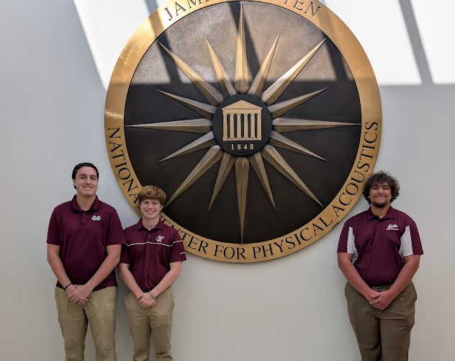
Team
From Left to Right: Matthew Rickman, Alder Louviere, Jake Peterson

Slide 3
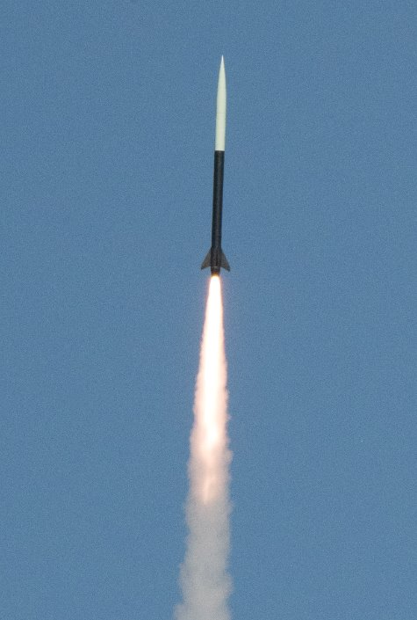
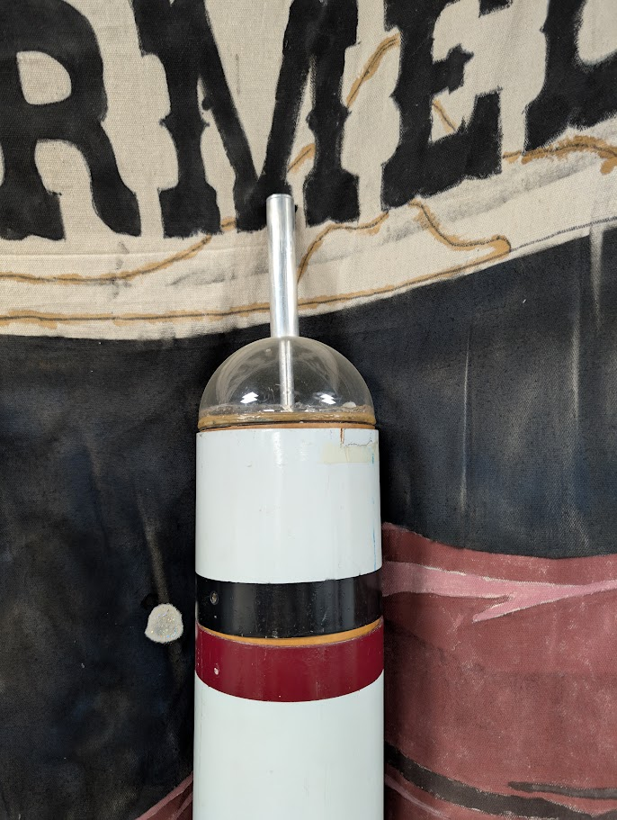
Background
Space Cowboys
Mach 2+ Flight Profile
30,000 Feet

Slide 4
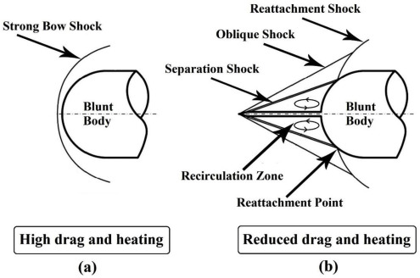
What is an Aerospike?
Thin structure that creates a detached shock
Used in lieu of a nose cone
Reduces drag at supersonic speeds

Slide 5
Problem Statement
Drag-reducing, variable-length aerospike
Optimized performance throughout flight profile
Transonic to low-supersonic

Slide 6
Objectives
Create baseline geometry for ANSYS Fluent testing
Evaluate spike configurations
Determine optimal spike geometry for each Mach

Slide 7
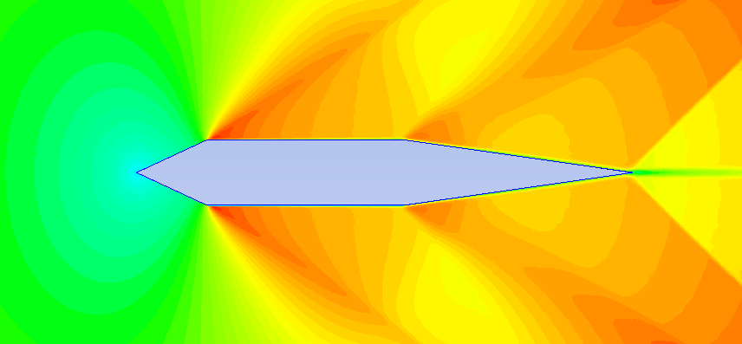
Initial ANSYS Progress
Started out with basic 2D airfoils to learn the software
Mach 0.8 flow
Coarse Grid (~50,000 elements)

Slide 8
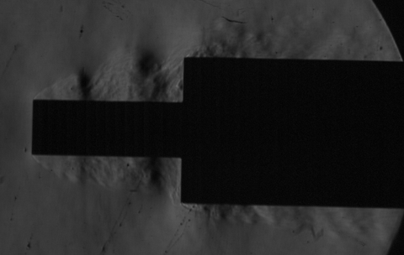
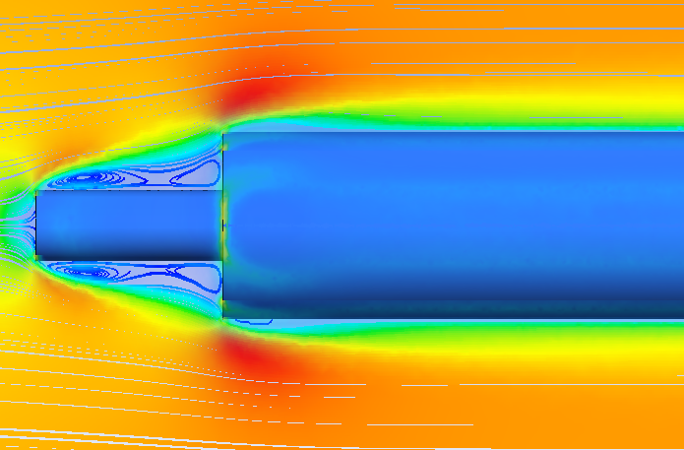
NCPA Test and Calibration
Had aerospike geometry tested at NCPA
Used the data to validate 3D CFD setup
NCPA Schlieren
ANSYS Simulation

Slide 9
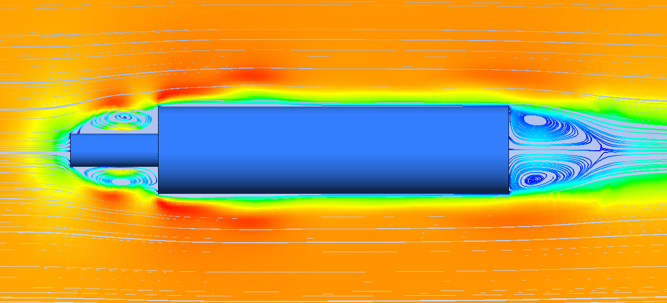
Full-Scale 3D CFD
Scaled models up to 6-inch diameter
Mesh grew from ~100,000 elements to ~5 million
Computation time ballooned to 10 hours per run

Slide 10
Limitations
Computational power
  Shift to axisymmetric design
  Simplified geometry
Small selection of prior research for this geometry and flight profile

Slide 11
Updated Methodology
2D, Axisymmetric model
  Constant diameter aerospike, only varying length
  One reference model without an aerospike
  Divide computation between multiple computers
  Goal: Determine the optimal spike length for each Mach

Slide 12
Optimizing Steps
Start with a length estimate:
    6-in for Mach 0.8 and 1, 9-in for Mach 1.25 and 1.5, and 12-in for Mach 2.0
Calculate Cd for the starting length and ± 1-in:
    Pursue the direction with the lowest Cd
If both directions are worse:
    Change to ± 0.2-in and continue until the lowest value is found

Slide 13
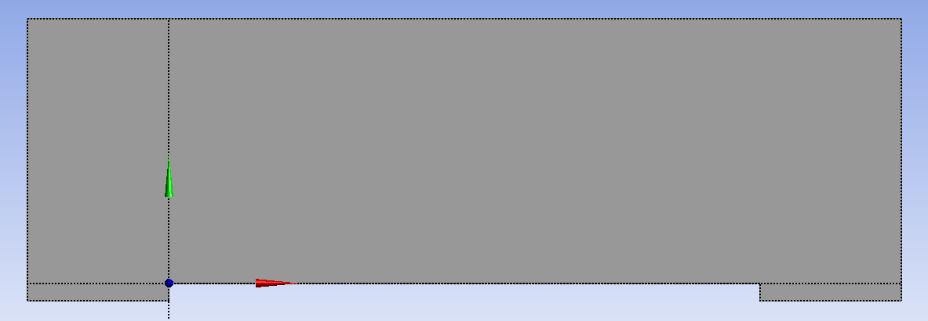
ANSYS – Reference Geometry
100-in. main body, 6-in. diameter, sub-divided
Axisymmetric

Slide 14
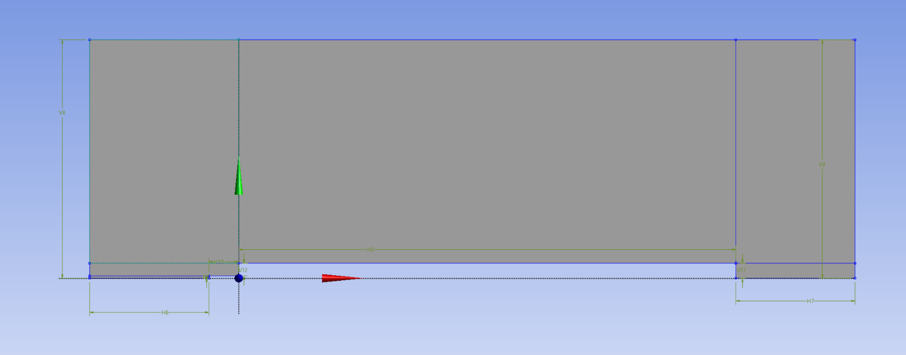
ANSYS - Geometry
100-in. main body, 6-in. diameter, sub-divided
1-in. diameter aerospike, various length
Axisymmetric

Slide 15

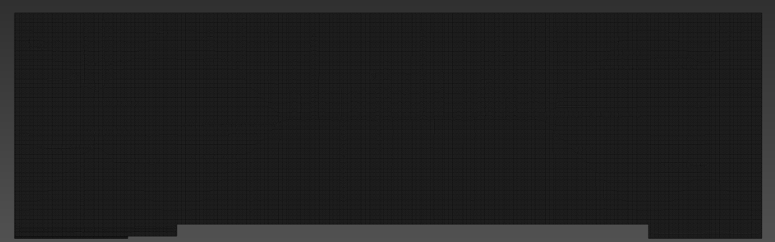
ANSYS – Mesh
0.2-in element size
~250,000 total elements, varied based on the aerospike length

Slide 16
ANSYS – Simulation
K-omega SST turbulence model
All simulations were performed at sea-level conditions for simplicity
Utilized pressure far fields to modify the freestream Mach number for each run

Slide 17

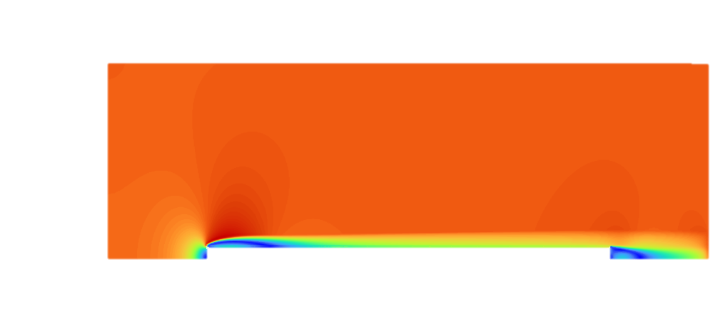
Mach 0.8 Contours
Almost identical contours due to freestream Mach being subsonic, so no large shockwaves are formed
Reference
Aerospike

Slide 18
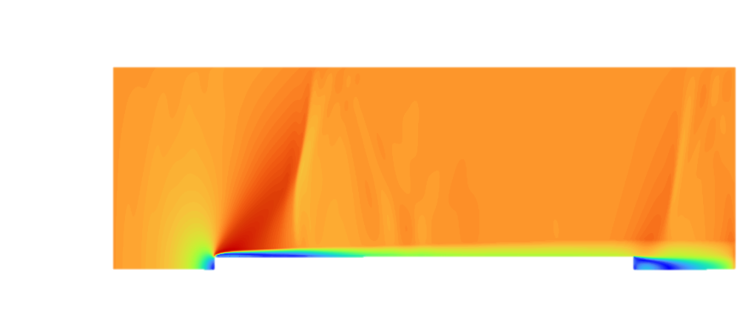
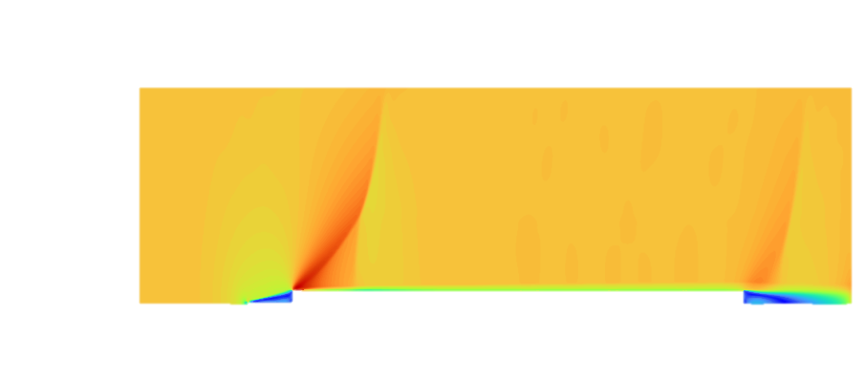
Mach 1 Contours
High drag shock
Lower drag shock
Reference
Aerospike

Slide 19


Mach 1.25 Contours
Strong bow shock
Slightly weaker bow shock
Reference
Aerospike

Slide 20
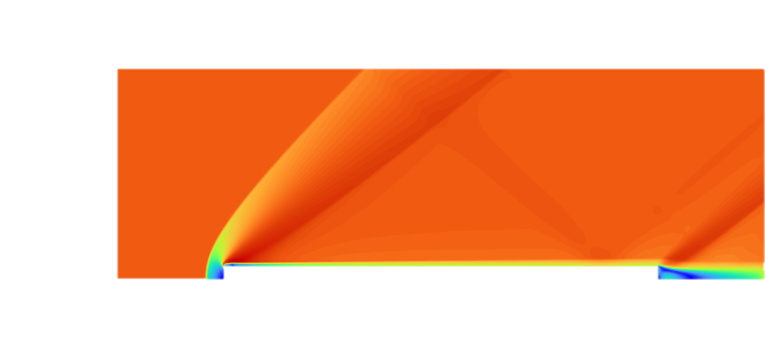

Mach 1.5 Contours
Strong bow Shock
Weak bow shock
Reference
Aerospike

Slide 21


Mach 2 Contours
Strong bow Shock
Weak bow Shock
Reference
Aerospike

Slide 22
Cd Comparisons
Almost a 50% reduction across all Mach numbers
Mach | Refence Cd | Optimum Length | Cd | % Reduction | Average Cd % Reduction
0.800 | 2.270 | 9.200 | 1.175 | 48.245 | 48.758
1.000 | 2.551 | 10.000 | 1.555 | 39.030
1.250 | 2.933 | 10.400 | 1.459 | 50.241
1.500 | 3.149 | 9.400 | 1.510 | 52.044
2.000 | 3.358 | 9.600 | 1.537 | 54.230

Slide 23
Conclusions/Practical Uses
Aerospike usage not recommended for a Space Cowboys rocket
  Higher velocity flight
  Flight with a longer time at supersonic speeds
  Aerodynamic stability is unknown

Slide 24
Future Work
Mesh-independent study
Test more parameters
Similar testing for a more appropriate flight profile
Construct and test a physical model

Slide 25
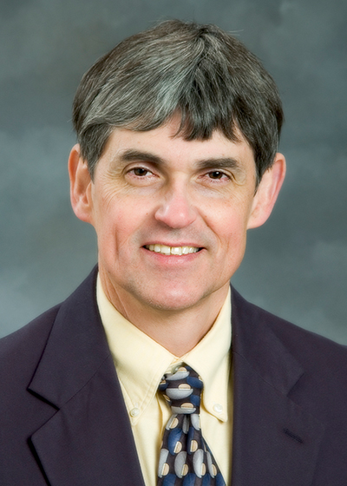

Acknowledgements
Dr. Keith Koenig
Dr. Shreyas Narsipur

