Slide 1
Experimental Analysis of a Student-Built Kerosene and Liquid Oxygen Rocket Engine Test Stand
Maximo A. Deiros, Francis V. Frazier, Jonatan A. Gonzalez, Jackson C. Stahl
Yellow Jacket Space Program - Georgia Institute of Technology
Region II Student Conference 2025

Slide 2
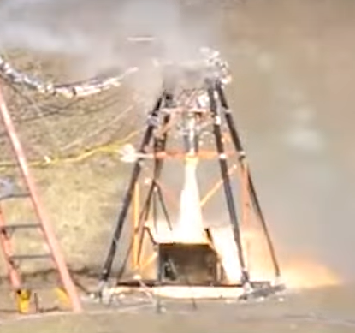

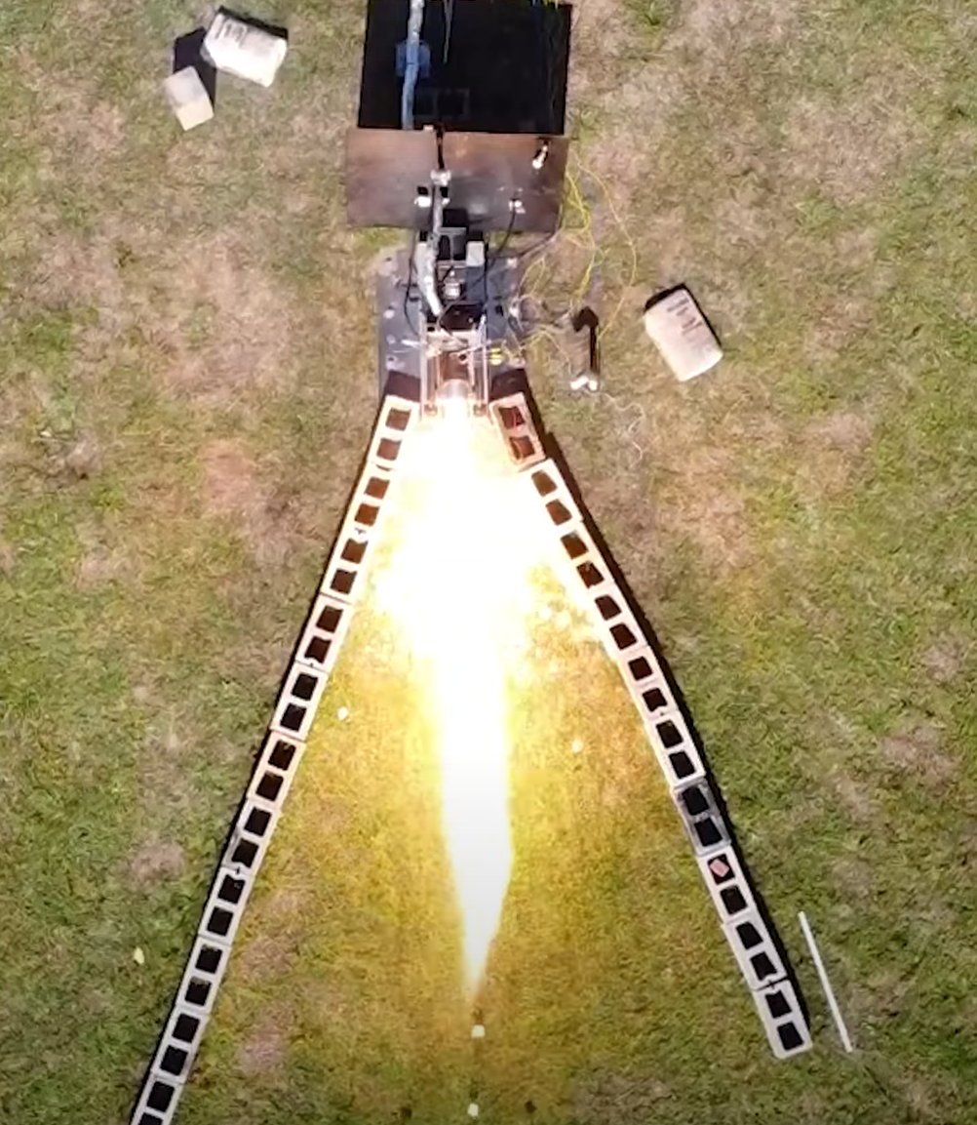
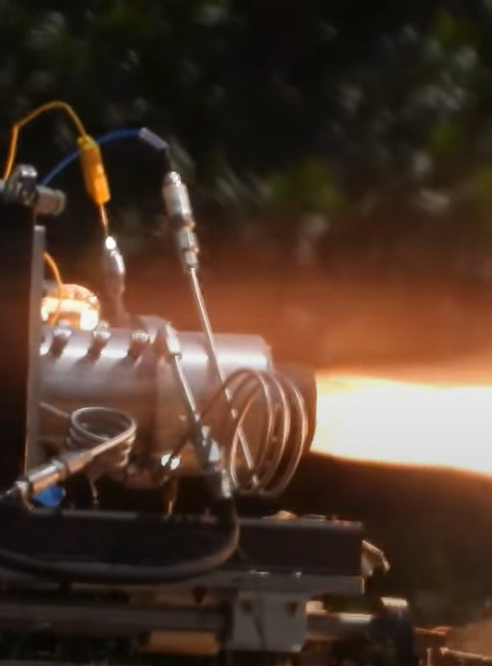
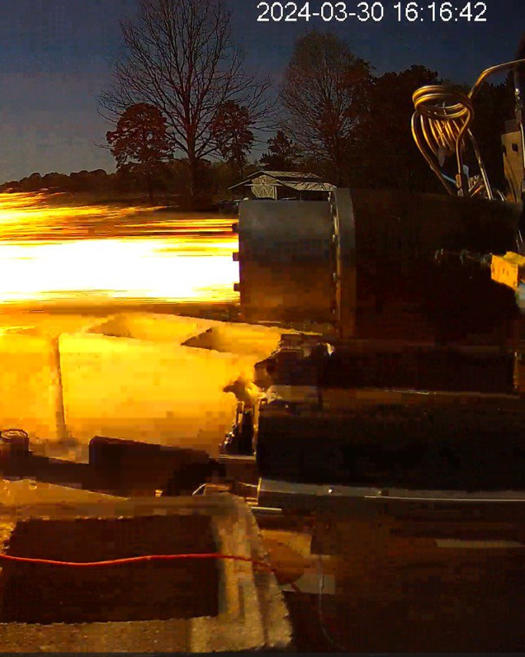
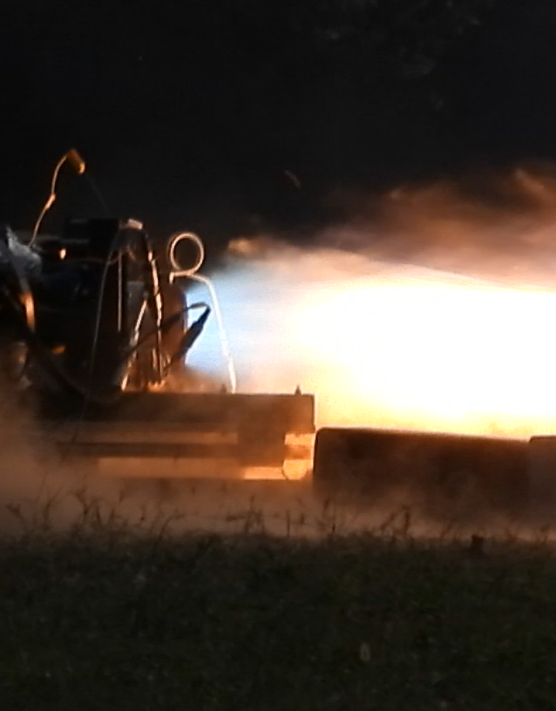

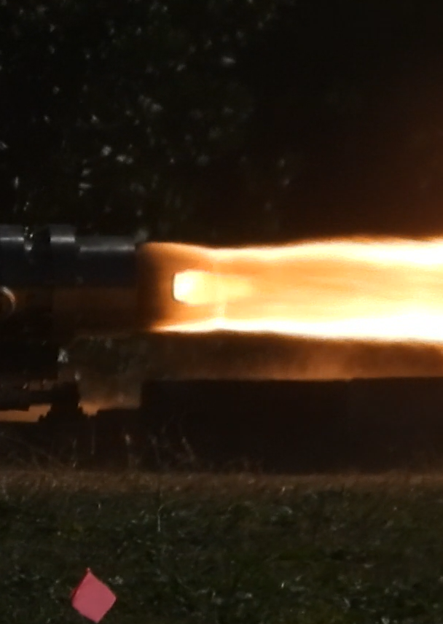
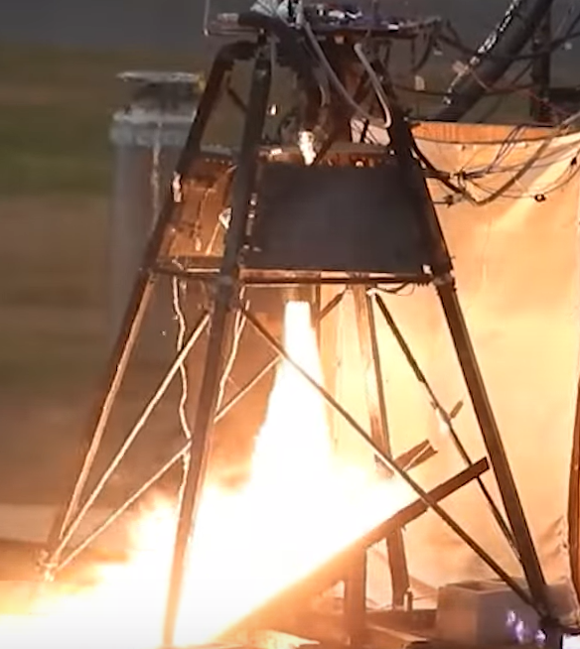


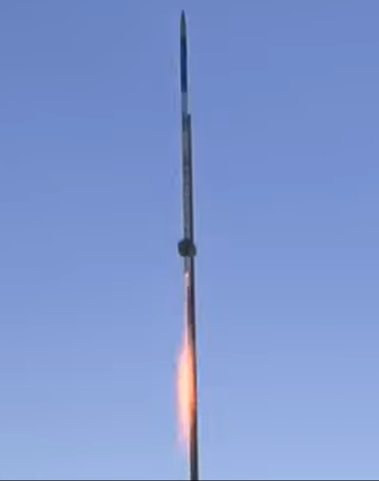
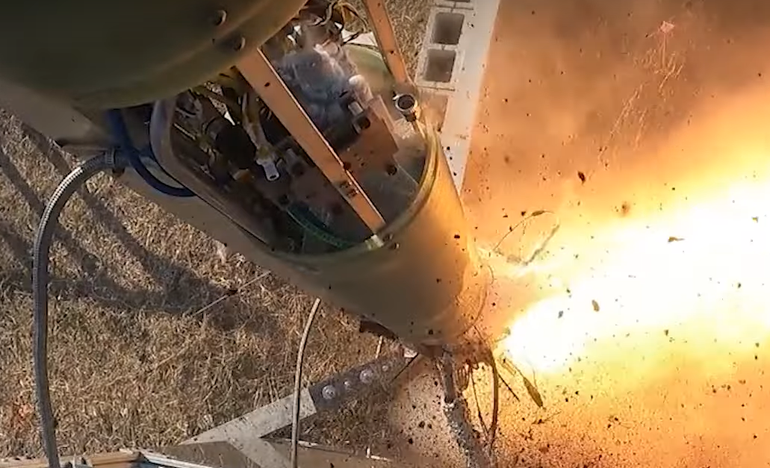
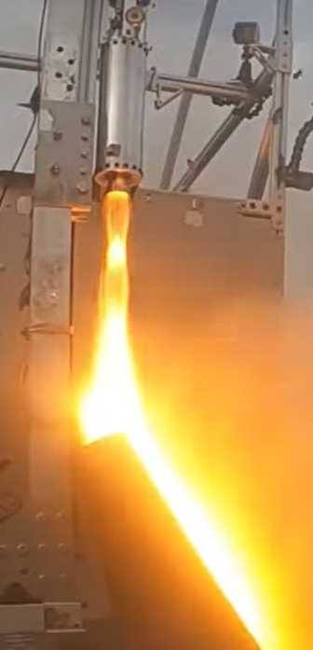
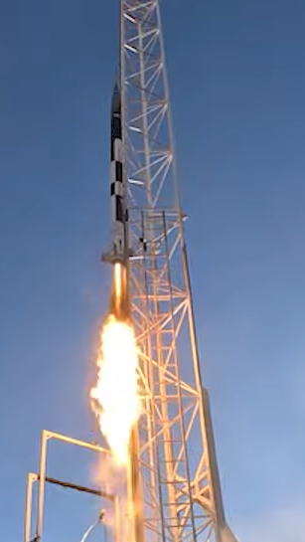

YJSP was founded in 2015 with the goal of becoming the first collegiate team to send a liquid-fueled rocket to space.
Since then, we have hot-fired 25+ times and launched 3 successful vehicles.
Notes:
Mention holding record for highest launched and recovered. Max presents.

Slide 3
The Yellow Jacket Space Program
Who we are
Student-run liquid propellant rocketry club at Georgia Tech
Goal to be the first collegiate to launch a liquid propellant rocket to the boundary of space
Holds record for highest launched and recovered collegiate liquid propellant rocket
  Darcy II achieved 30k feet in 2023

Slide 4
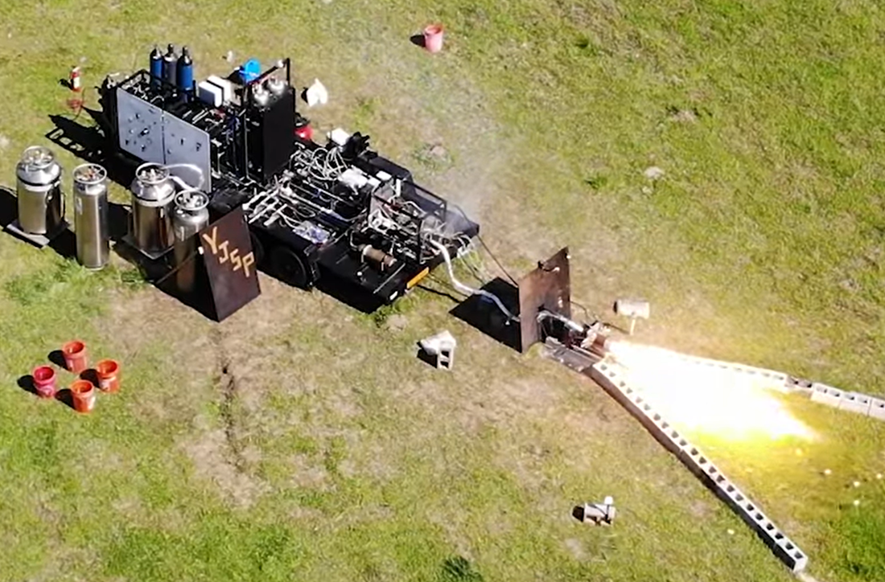
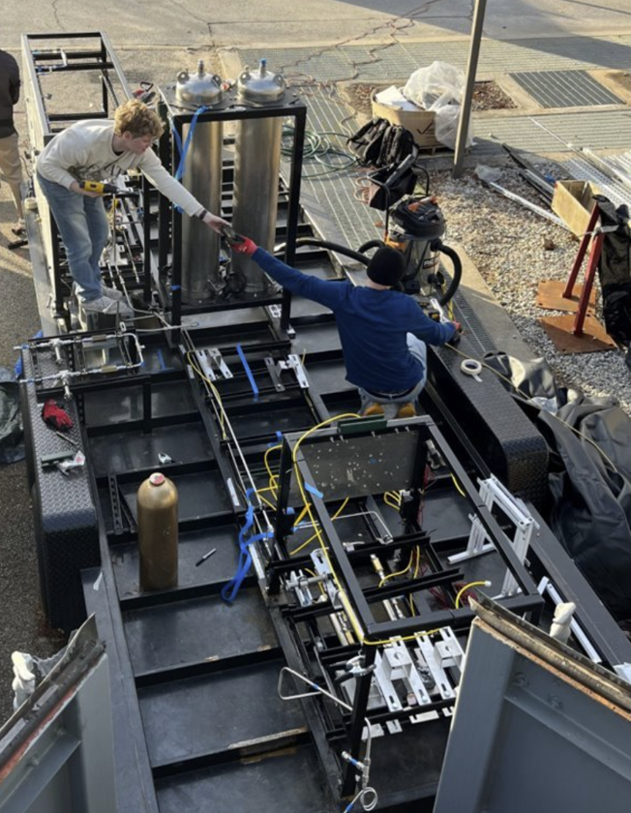

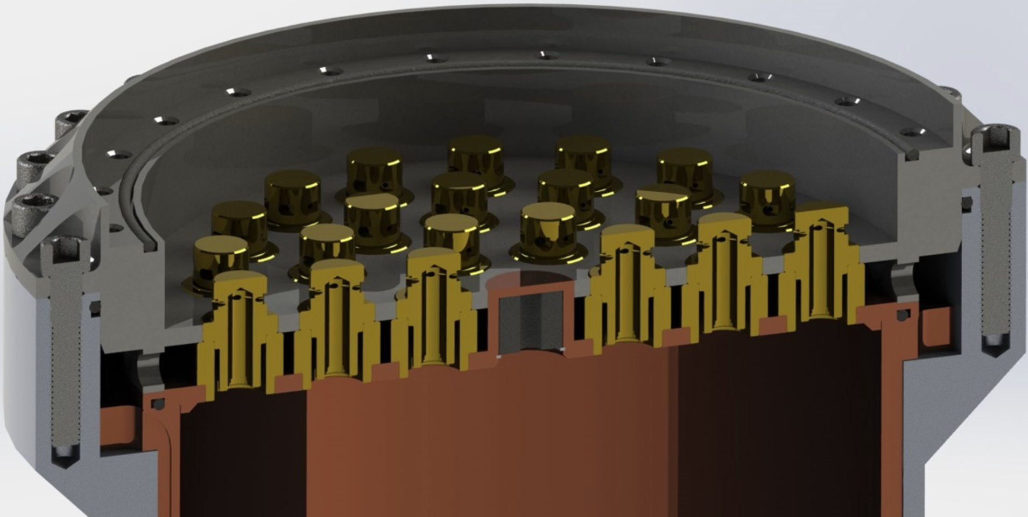
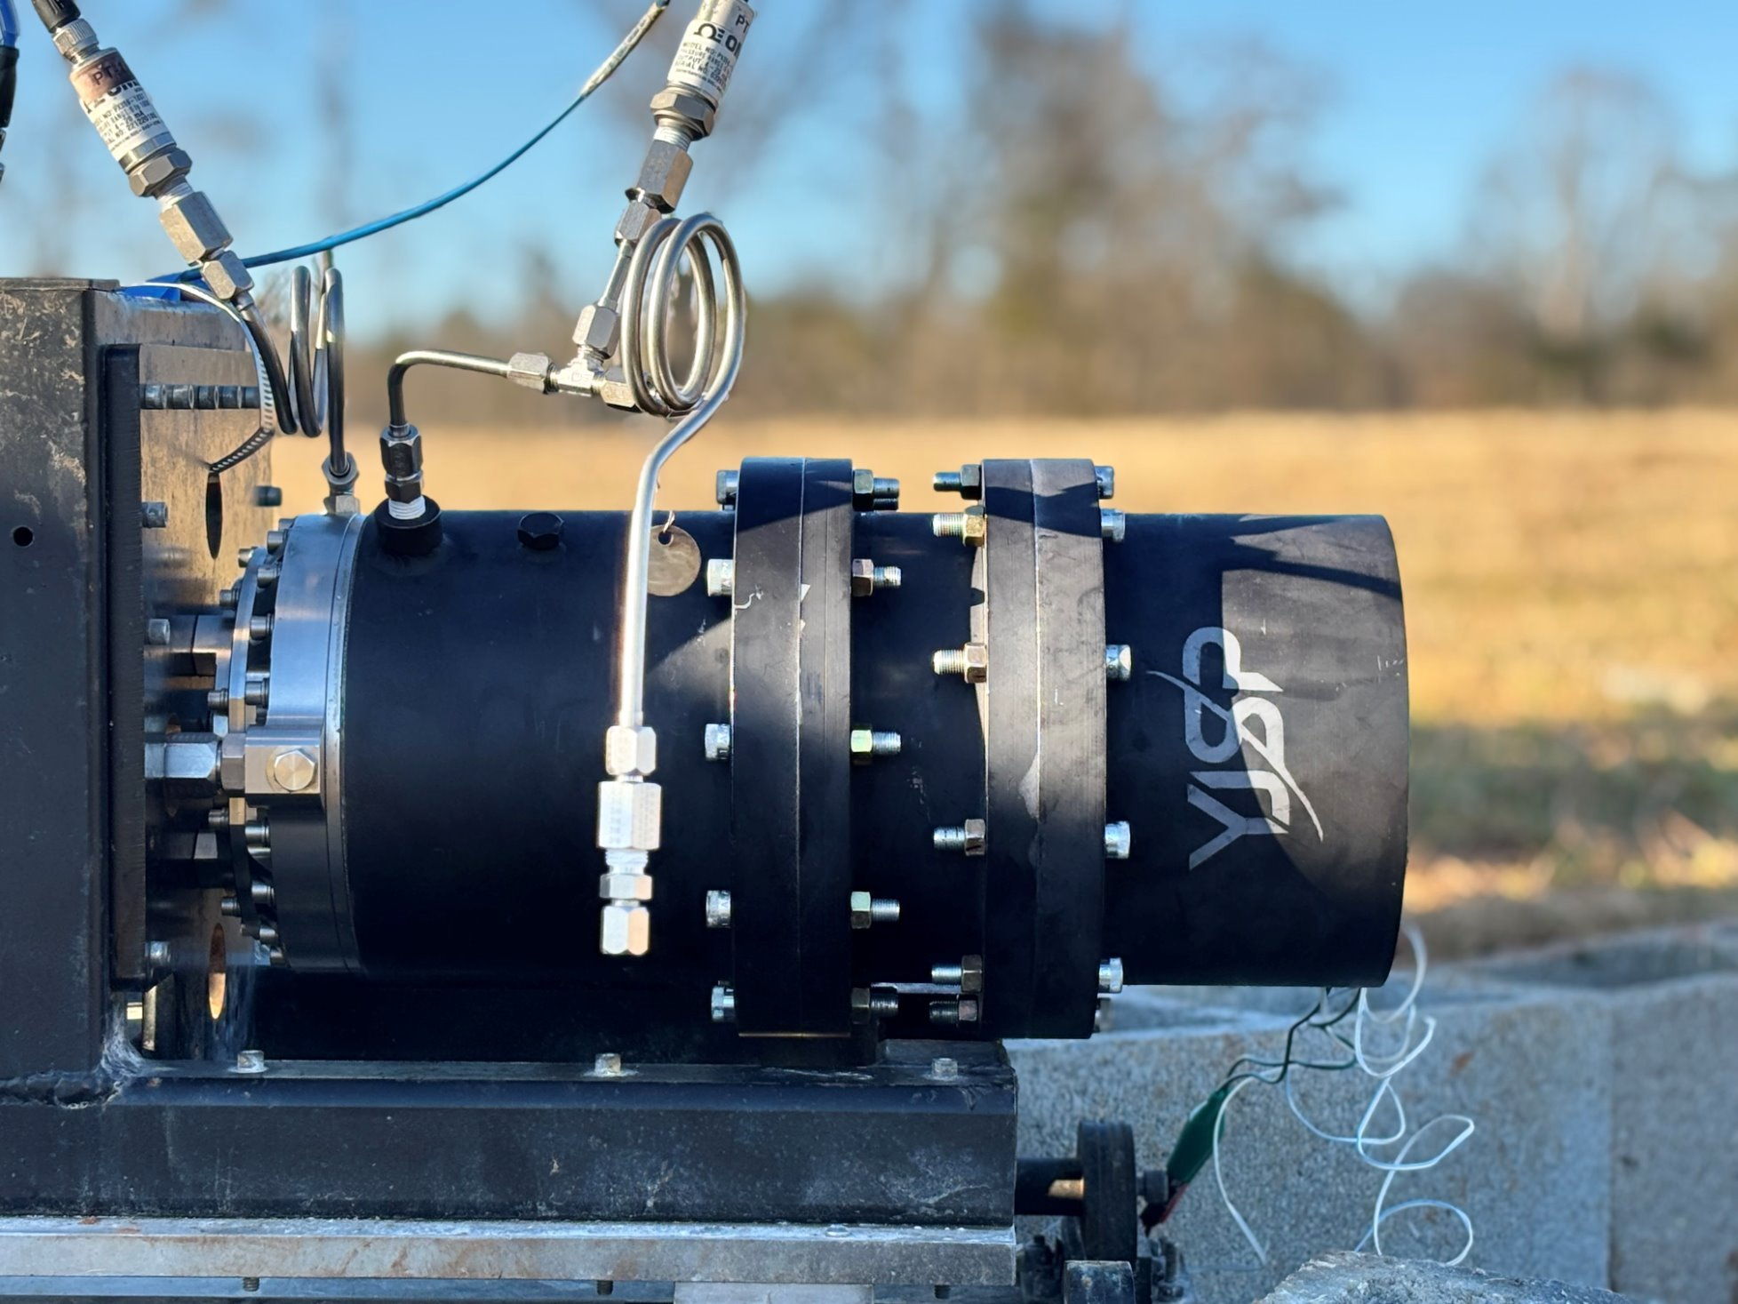
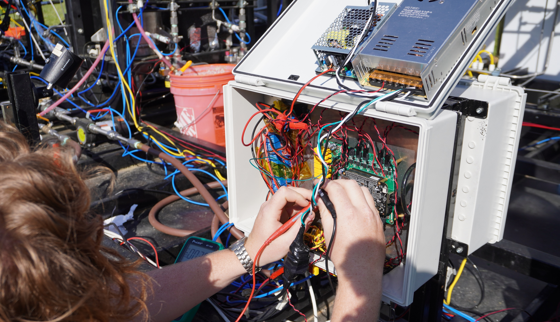
Engine Development Team
Design, Build, Test, and Fly reliable engines
Design and manufacture Kerosene-LOX engines and engine-related hardware to test on our Helluva Engine Test Stand (HETS)
Example projects:
  Heatsink, ablative, and regeneratively-cooled engines
  Coaxial swirl, pintle, and impinging-type injectors
  Electric pumps
  Torch igniter
  Thrust vector control system
  Custom engine design and optimization software
  Custom test stand avionics hardware and software systems
Notes:
Max presents

Slide 5

Helluva Engine Test Stand (HETS)
System Overview
Notes:
Max

Slide 6
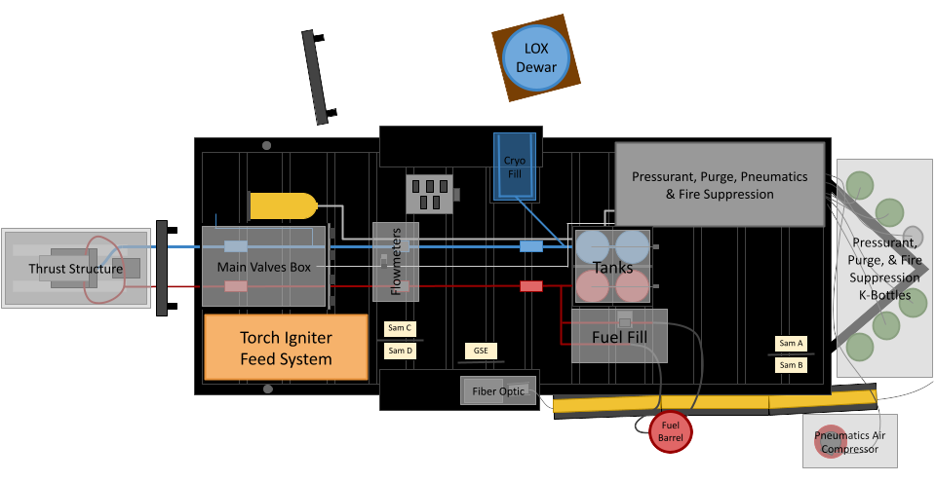
HETS System-Level Design
Specification | Value
Oxidizer | Liquid Oxygen (LOX)
Fuel | Kerosene
Max. Burn duration | 38s
Max. Thrust | 2750lbf
Notes:
Frank

Slide 7
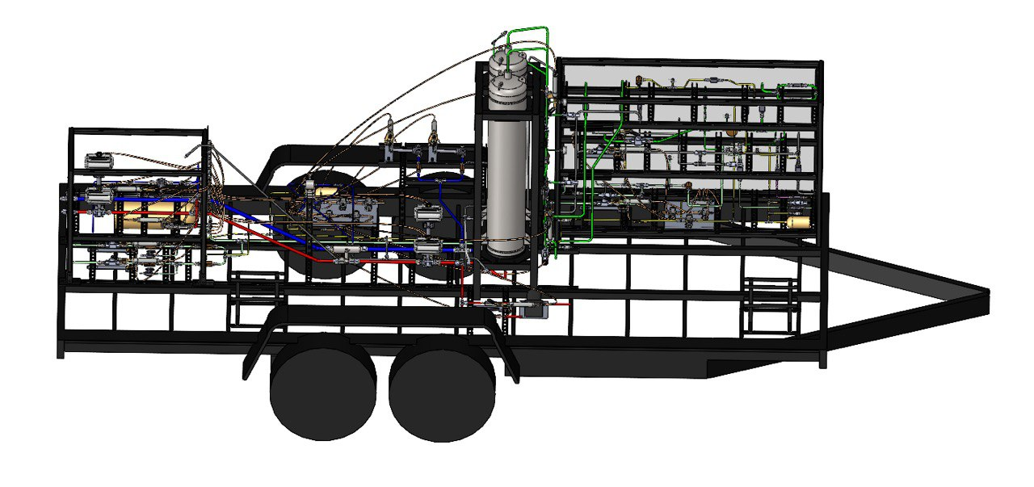
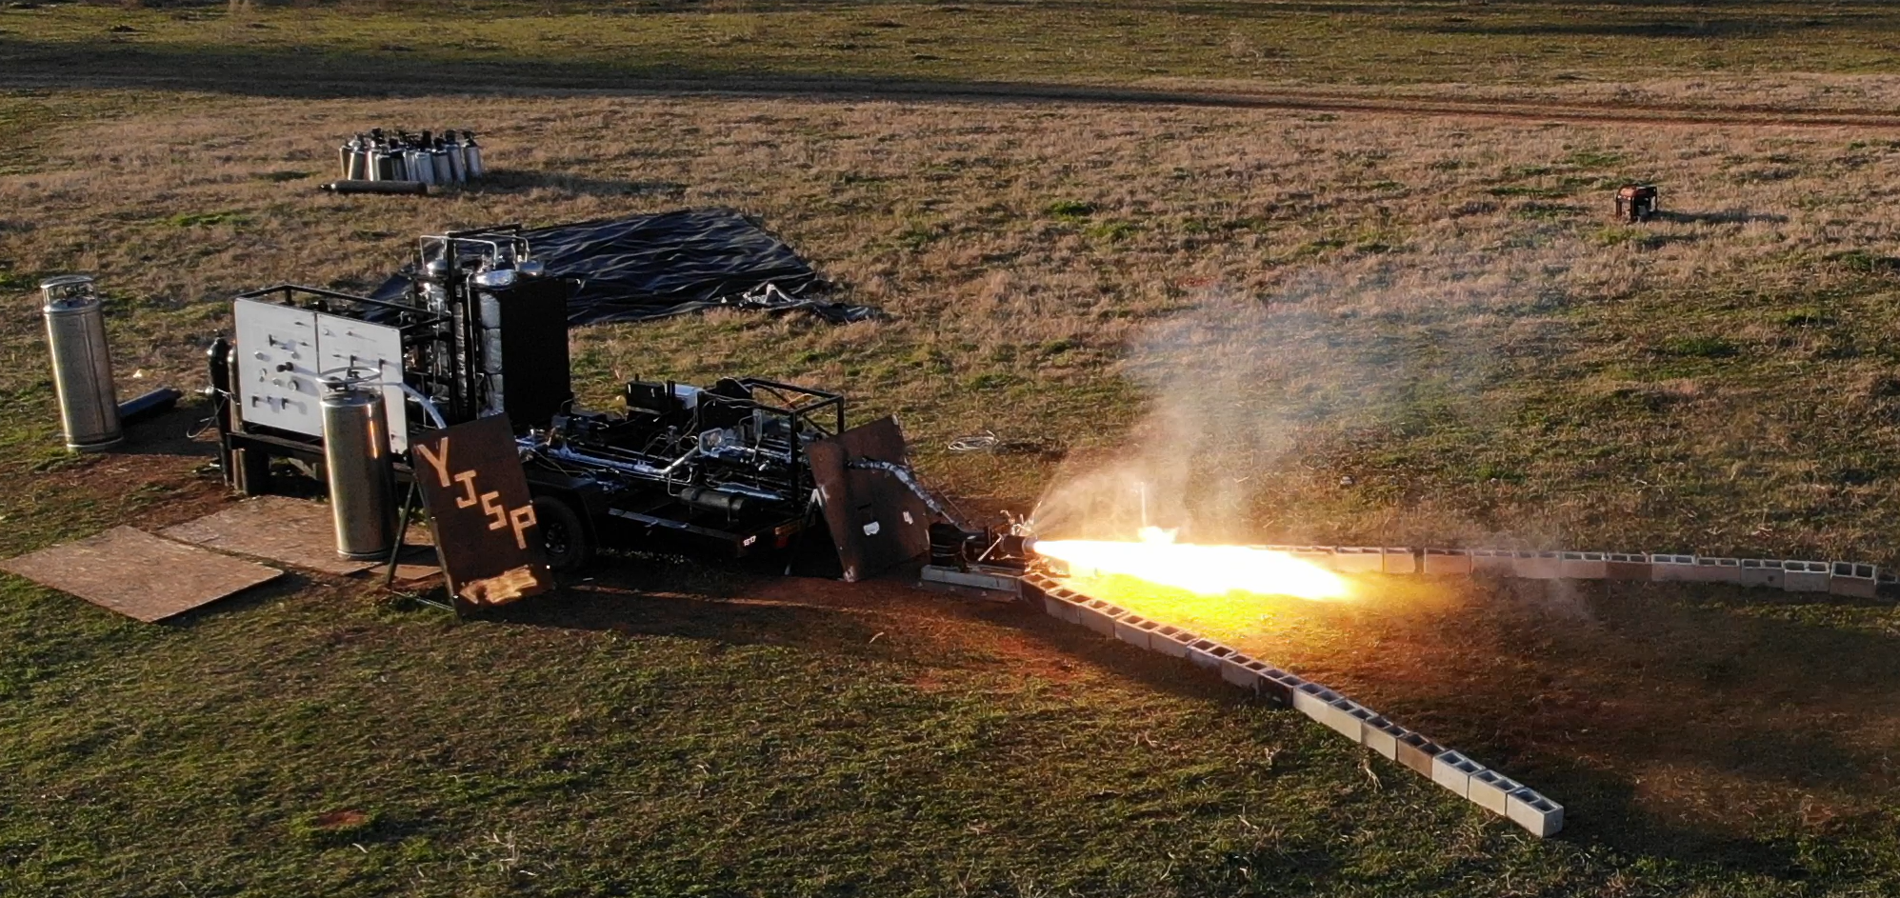
HETS System-Level Design
Key Design Choices
Thrust Structure
Engine Integration
Transportability
Size
Pressurant System Architecture
Overcome issues of pressure regulators
Active control
System Mounting
Transportability
Easy to work on
Future-proof
Notes:
Frank

Slide 8
Experimental Analysis and Insights
Propellant System
Pressurant System
Engine Start-Up Behavior
Notes:
Max

Slide 9
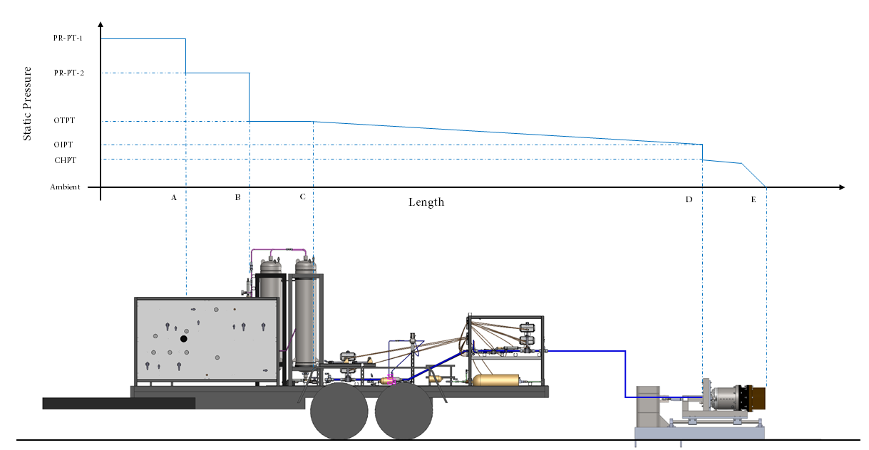

Propellant Feed-System Analysis
How consistently and precisely can HETS provide propellants to the engine?
GN2
Jet-A
LOX

Slide 10

Propellant Feed-System Analysis – Cont'd
How consistently and precisely can HETS provide propellants to the engine?
Need to ensure delivery of propellants at the correct pressures and mass flows to engine
Pressure data is collected with pressure transducers (PTs)
Mass flow rate data is collected in three ways
  Flow meters (COTS turbine flow meter for fuel and custom venturimeter for LOX)
  Calculated using previously obtained CdA of injector and pressure data
  Calculated using previously obtained CdA of system and pressure data
$$C_{d}A=\frac{\dot{m}}{\sqrt{2ρ∆P}}$$

Slide 11
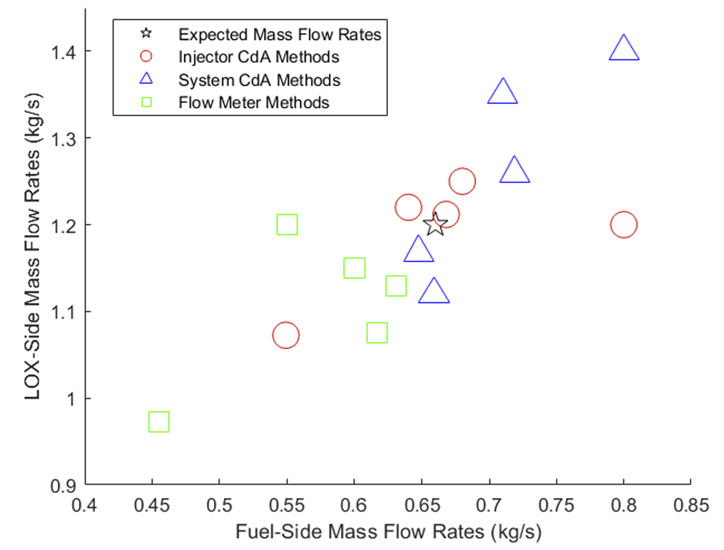
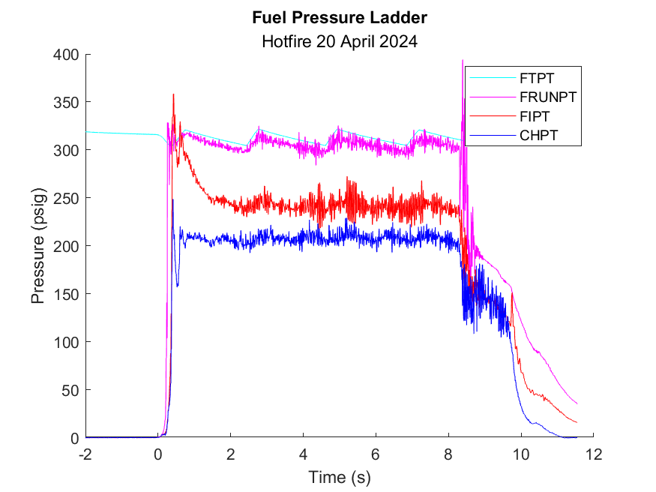
Propellant Feed-System Analysis – Cont'd
How consistently and precisely can HETS provide propellants to the engine?

Slide 12
Propellant Feed-System Analysis – Cont'd
How consistently and precisely can HETS provide propellants to the engine?
Potential sources of error:
Off-nominal pressure readings (spikes, hardstarts, etc.)
  Affects accuracy of ṁ calculated through CdA
Inconsistent system setup
  Leads to incorrect system CdA being used to calculate ṁ
Inconsistent fluid properties
  If calibration flows are done with different fluid than propellant (e.g. water), viscosity differences can lead to different calculated CdA
  Variations in density due to fluid temperature (can be affected by weather) will impact data

Slide 13

Propellant Feed-System Analysis – Cont'd
Improvements and Key Lessons
Accurate flow-metering methods
  Commercial-off-the-shelf (COTS) flow meters
Reynolds Number matching during characterization flows
Cold-flowing with injector
$$Re=\frac{ρVL}{μ}$$

Slide 14
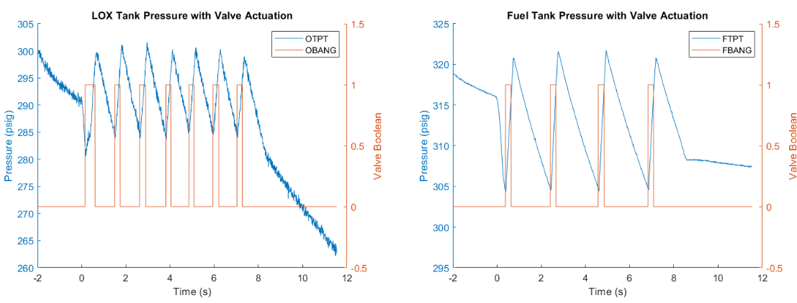
Pressurant System Analysis
How can pressurant gas be used effectively and efficiently?
Pressurant gas is limited and increases cost of operation
  Active tank pressurization control system with pressure-piloted “bang-bang” solenoid valves
Notes:
Possible intro to pressurant system. In our pressurant system, the primary goal is to minimize the amount of pressurant gas that we use. Gas supply is limited and overuse is going to increase the cost of operation. GFS passive regulation? To best maintain tank pressure, fast-acting pressure-piloted solenoid valves – “bang-bangs” – are used for an active tank pressurization control system. These bang-bang valves are either Boolean 1 or Boolean 0 – on or off, completely open or completely closed – and can be autonomously controlled via a programmable sequence. During a fire, when the tank pressure drops below 10 psi of the target value, the sequence will command the bang-bang valves open until tank pressure is 10 psi above the target value, at which point they close. This is what’s visualized in the plots. This active system has allowed us to control tank pressurization without issue over the course of the past year.

Slide 15
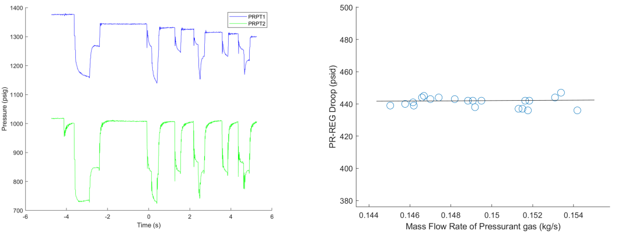
Pressurant System Analysis – Cont’d
Overcoming issues of pressure regulators
Large regulator (PR-REG) maintains bang-bang inlet pressure
  Influenced by droop when bang-bangs open
Notes:
The first obstacle to be encountered in the pressurant system was regulator droop. Our large pressure regulator, PR-REG, steps down the system pressure from that of our nitrogen k-bottles – which start their life at ~2300 psig – to around 1000 psig, maintaining the bang-bang inlet pressures to that pressure as well. This is shown in the plot to the left, where the blue line, PRPT1, is placed just before PR-REG, and the green line, PRPT2, is placed just after it. Now, these pressures aren’t as constant as we’d like them to be – these dips are what’s called droop. Droop is a drop in a regulator’s outlet pressure due to an increase in flow rate. In the case of this pressurant system, droop occurs when the bang-bangs open and suddenly flow pressurant into the tank. This drop in upstream pressure will decrease pressurant mass flow rate. The plot on the right shows a fairly constant droop across a small range of mass flow rates; for a larger range, this will begin to scale nonlinearly. For this larger range of mass flow rates, the bang-bang valves will be able to vary their duty cycle to appropriately pressurize the tanks, but if the nitrogen supply pressure drops too low, the minimum pressurant flow rate may not be achievable.
* Note that droop scales non-linearly with flow rate, but is relatively constant for small ranges of flow rate

Slide 16
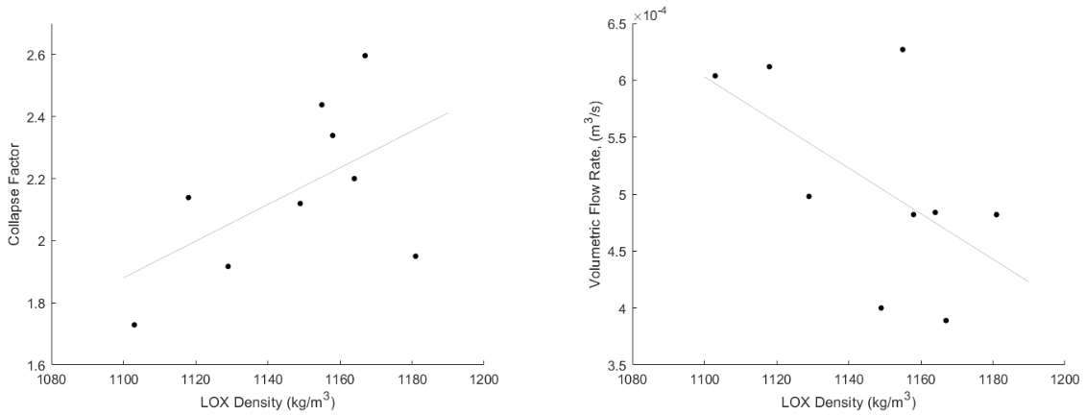

Pressurant System Analysis – Cont’d
Overcoming issues of cryogenic ullage collapse
Cryogenic propellant tanks experience collapse
  Colder, denser LOX increases collapse factor (CF) but decreases propellant volumetric flow rate, reducing pressurant gas needed
$$CF=\frac{\text{actual} \text{gas} \text{needed}}{\text{theoretical} \text{gas} \text{needed} }$$
Notes:
The other major obstacle encountered in the pressurant system was LOX tank ullage collapse. To maintain tank pressure, the incoming pressurant gas must replace the volume of the outgoing propellant – the volumetric flow rates must be equal. In cryogenic tanks, the significant difference in temperature between the incoming pressurant gas and the stored cryogenic propellant will incur significant heat transfer from the pressurant to the propellant. The pressurant will get colder and therefore denser – lowering volumetric flow rate, so more pressurant gas mass is needed to pressurize the cryogenic tank. To calculate the following collapse factor, we take the actual pressurant mass flow rate and divide it by the theoretical pressurant mass flow rate – that is, if we don’t account for the change in density.
It should be noted that colder LOX is more dense, so its own volumetric flow rate decreases. While it will cool the propellant more, increasing collapse factor, the theoretical gas needed to replace the outgoing volume decreases more substantially, reducing the pressurant gas needed. Therefore, colder LOX makes for a more efficient pressurant system.
Now, HETS fills LOX from cryogenic dewars in a variety of pressures, which we can use to condition the propellant. Low pressure LOX is colder and denser, so, because of the aforementioned, low pressure dewars are desirable. If only high-pressure dewars are available, there are two solutions: the dewar can be vented down to a lower pressure; or we can wait, the warm LOX will boil off and the remaining liquid will cool down.
*explain how we calculated it

Slide 17
Engine Start-Up Analysis
What are the causes and mitigations of engine hard-starts?
Ignition of accumulated propellants can cause a damaging overpressure – effectively a detonation
Typical causes
  Long lead time of one propellant
  Insufficient igniter energy
  Poor mixing of propellants before ignition
Difficult-to-model phenomenon that requires experimentation and research
Currently revamping pneumatics system on HETS for more consistent valve actuation, and experimenting with chilling in injector extensively before ignition
Notes:
Jonatan Presents

Slide 18
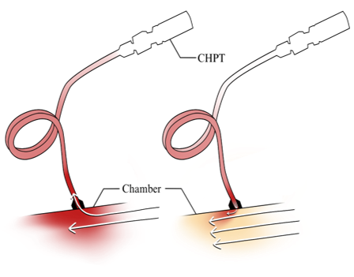
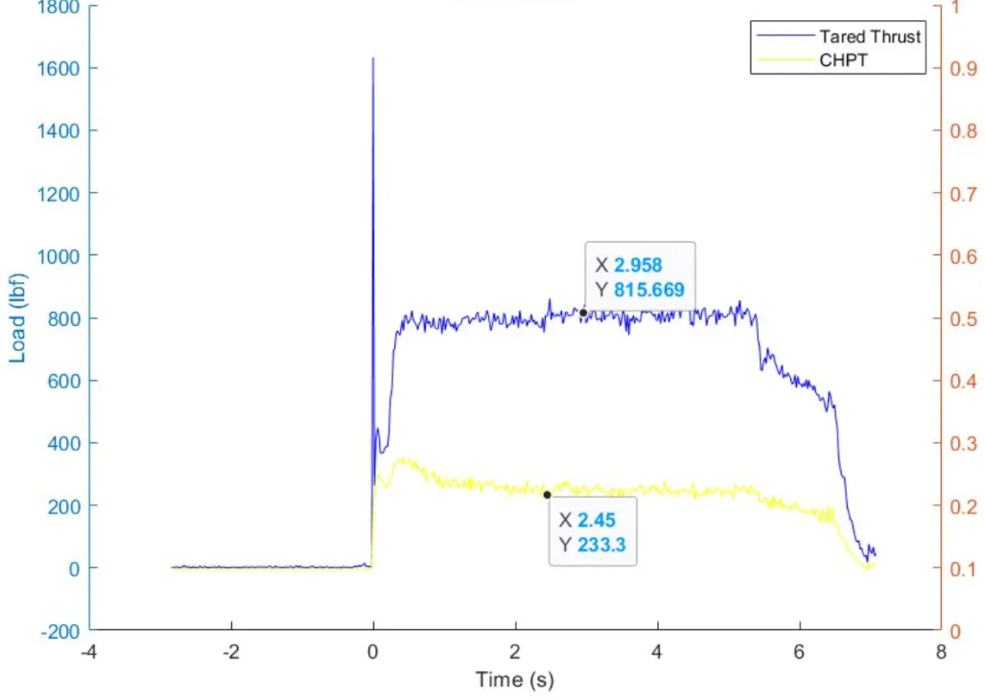
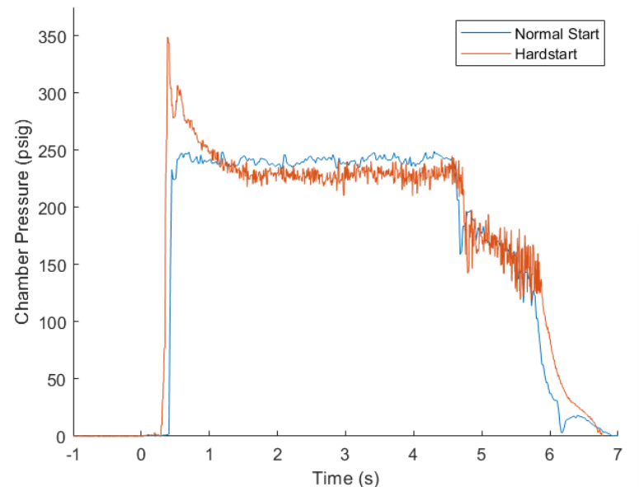
Engine Start-Up Analysis
Typical engine hard-start behavior
Hard-start thrust spike
Notes:
Jonatan Presents

Slide 19
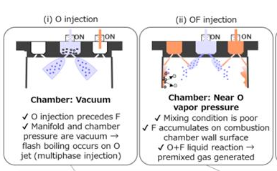
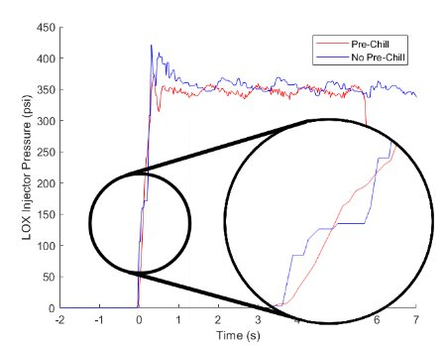
Engine Start-Up Analysis
Theoretical causes for engine hard-starts on HETS
Source: https://www.eucass.eu/doi/EUCASS2023-712.pdf
Notes:
Jonatan Presents

Slide 20
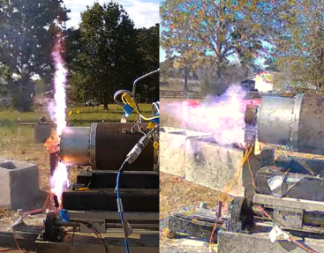
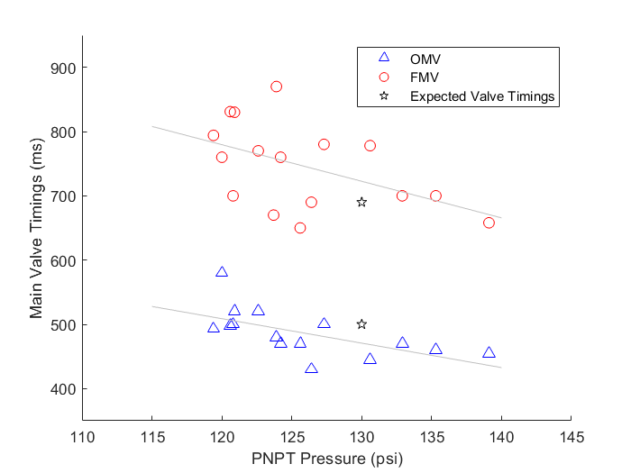
Engine Start-Up Analysis
Theoretical causes for engine hard-starts on HETS
Anomalous
Nominal
Notes:
Jonatan Presents

Slide 21
Engine Start-Up Analysis
Planned improvements to mitigate hard-starts
Re-examining main valve actuators to get more consistent opening times
Injector flow campaign to find consistent LOX trickle chill timing & pre-fire injector temperature
  Trickle-chill needed to ensure steady LOX stream forms quickly
Future injectors will include SRM igniter in faceplate to ensure closer flame & better vaporization of propellants upon injection
  Torch igniter also in development
Notes:
Jonatan Presents

Slide 22
Final Takeaways
Prioritize upgradeability
Easy operation and robust design enables high test cadence, more learning, and faster development
Future projects:
  Electric pumps for mass efficiency on rockets and throttle control
  Hard-start mitigations
  Calorimetry Chamber for combustion data
  “Test Like You Fly” propellant valve configuration
Notes:
Max presents

Slide 23


Thank You!

