Slide 1
Advancing Laser Communications for Mars Orbital Missions
Om Acharya
Embry-Riddle Aeronautical University
2025 Region II Student Conference, 3 April 2025 – 4 April 2025

Slide 2
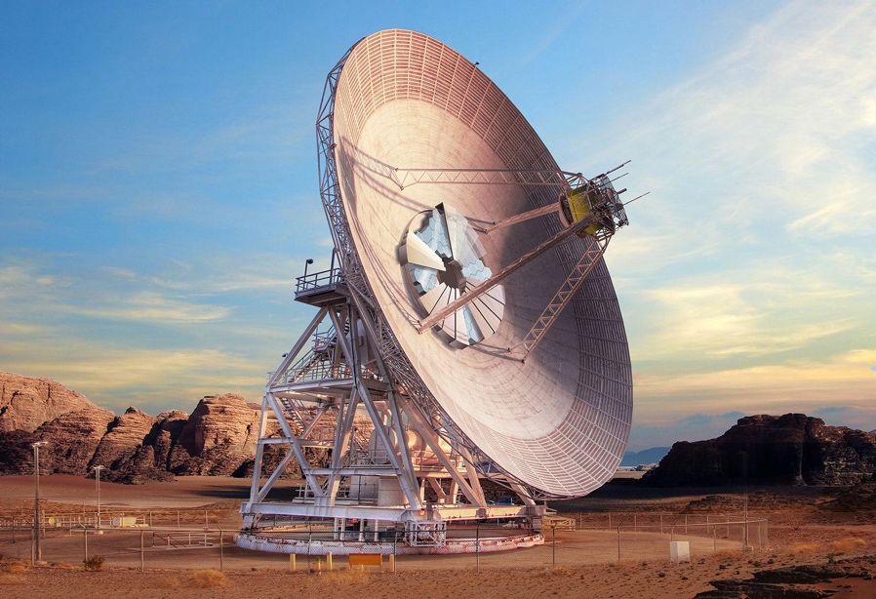
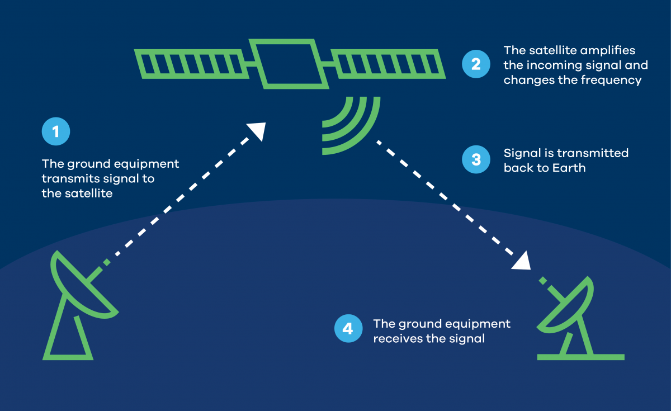
Introduction: Why Communication Matters!
Communication in ancient times of space:
RF systems: Transmission systems for Space Communications.
S-band Operation: 2 to 4 GHz.
Apollo missions: telemetry and transmissions.
The Communication Bottleneck in Deep Space Missions:
Growing data demands in Mars missions
Need for faster, secure, and energy-efficient alternatives
Beyond RF: The Future of Mars Data Transmission:
Optical/Laser communication systems
L-band Frequencies: 1 to 2 GHz
Seemless, efficient and secure communication system

Slide 3
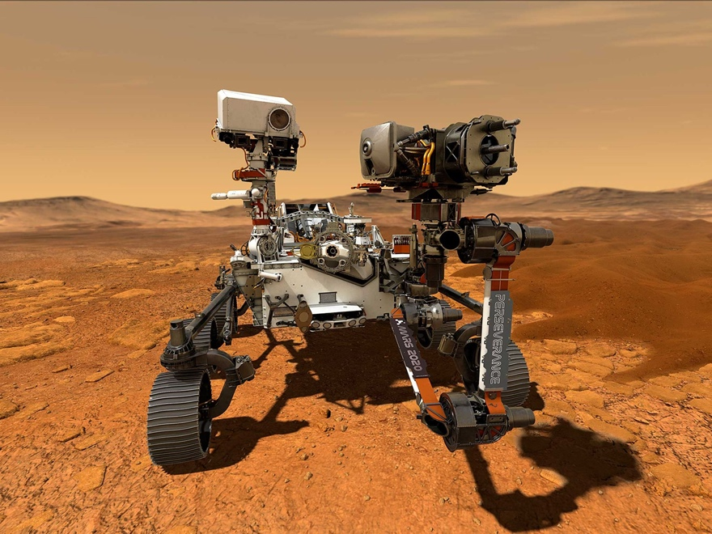
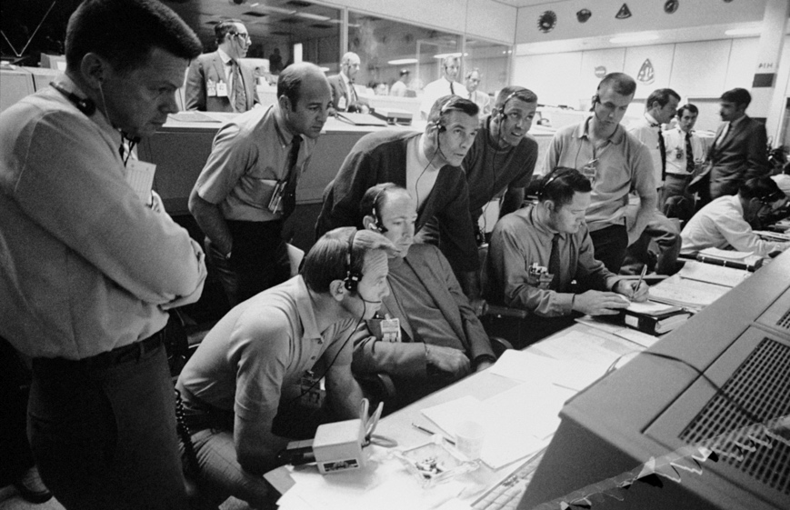
RF Use Cases & Problems in the Past
Long-term mission sustainability issues
High energy requirements for deep space trips
Prone to Interference & Interception
RF Usage in Mars Missions

Slide 4
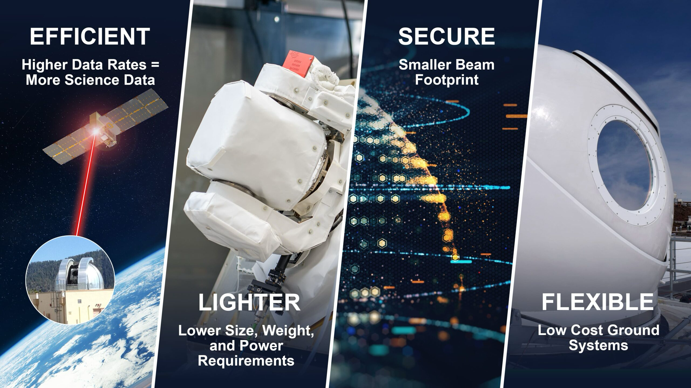
But, Why Lasers ?
Increased Data Transmission Rates
Reduced Spectrum Congestion
Lower Power Consumption
Enhanced Security
Cost effective
It’s Safe!
Why Not Lasers ?
Less ground infrastructure

Slide 5
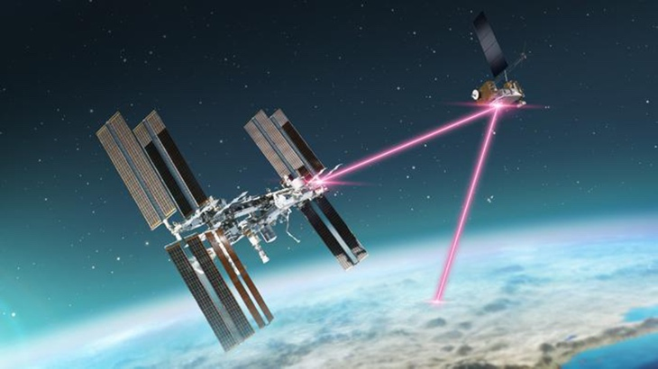
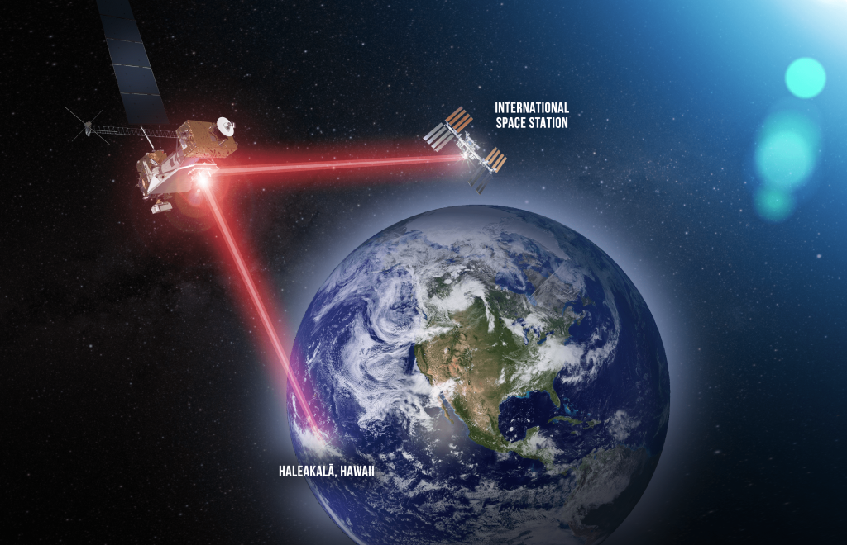
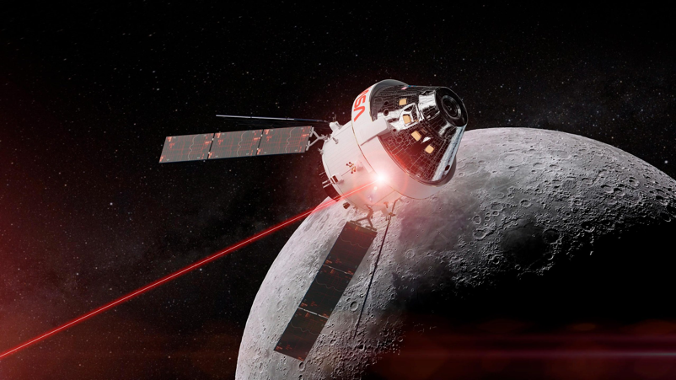
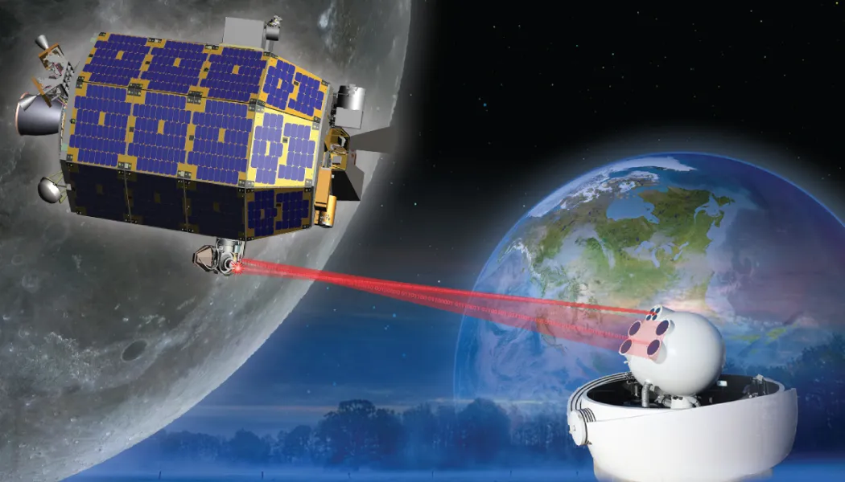
Evolution and Key Missions
ILLUMA-T
LCRD
LLCD
O2O

Slide 6
PAT Systems – The Backbone
PAT = Point, Acquisition and Tracking:
Main Components:
1
PAT Controller
2
Transmitter Module
3
Pre-Aiming Mechanism
4
Coarse Tracking Operation
5
Fine Tracking Operation
6
Optical Antenna
7
Detector
Why do we need it ?
Gyroscopic stabilization
Precision Beam Alignment

Slide 7
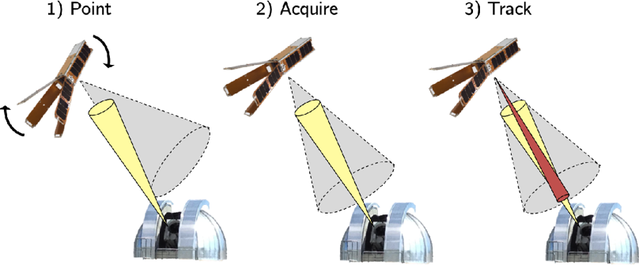
PAT Operation Phases
Initial Pointing
Scanning and Acquisition
Communication Tracking

Slide 8
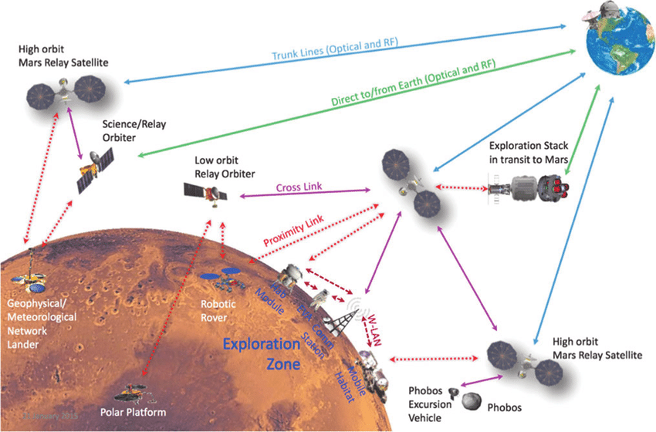
NASA: SCaN Mars Communication Architecture

Slide 9
NASA: ILLUMA - T
1
ILLUMA-T is a laser payload on the ISS that transmits high-speed data to Earth via NASA’s LCRD.
Its success will support future deep-space missions with scalable, energy-efficient data links.
2
It enables low-latency, high-bandwidth optical communication, reducing reliance on RF systems.
3
Optical Modem
Amplifier Terminal
Precision Beam Steering
Ground Stations

Slide 10
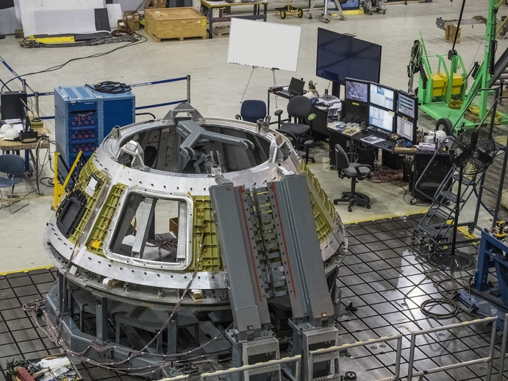
NASA: Orion EM-2 Optical Communications Terminal
1
O2O enables high-speed laser communication between the Orion spacecraft and Earth, supporting NASA’s Artemis missions.
2
It provides real-time video, telemetry, and scientific data with greater reliability and resistance to interference.
3
High-Speed Optical Downlink
Compact and Lightweight Design
Adaptive Beam Steering
Integration with NASA’s Optical Relay Network
O2O is key to building a long-term interplanetary optical network for future lunar and Mars missions.

Slide 11
NASA: Laser Communications Relay Demonstration
1
LCRD is NASA’s first optical relay system, enabling 1.2 Gbps laser communication from geosynchronous orbit.
2
It offers faster data rates, lower power use, and better security than traditional RF systems.
3
LCRD supports future missions like Artemis and Mars relays, advancing deep-space communication.

Slide 12
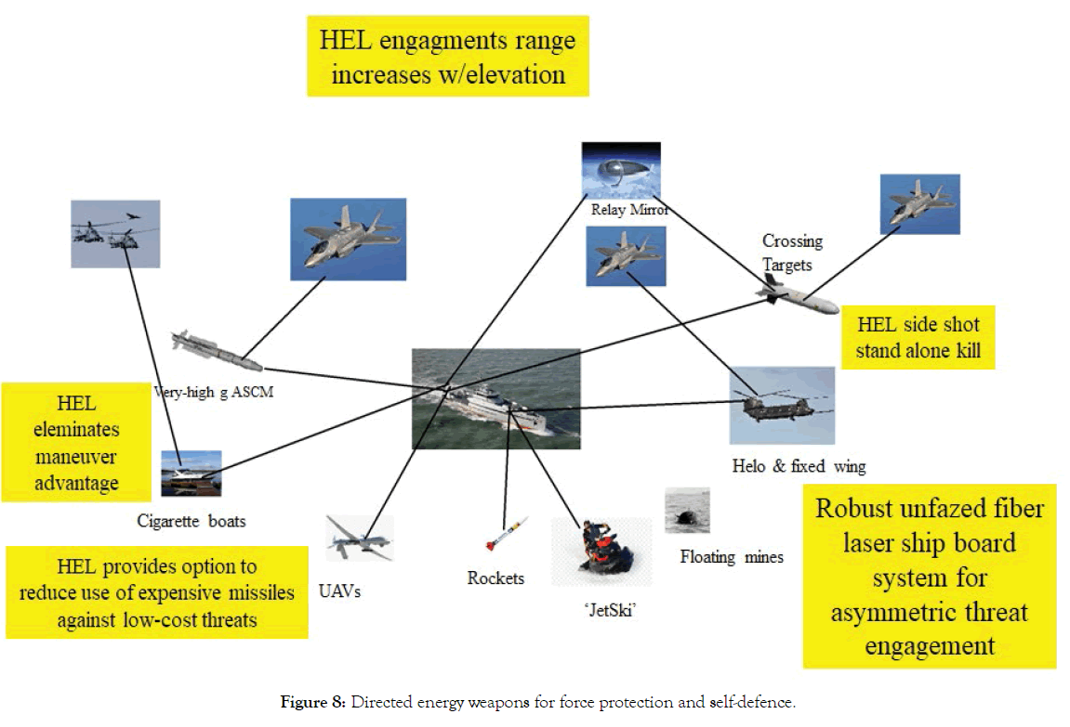
Lasers for Defense & Security
1
military applications and deep-space operations
2
3
military drone operation
4
classified deep-space missions
interception significantly more difficult

Slide 13
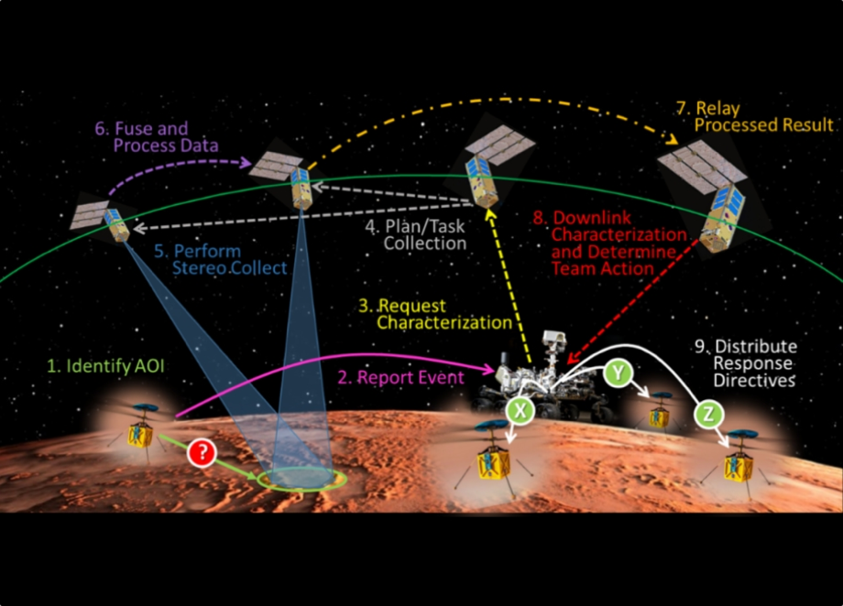
Lasers for Power Efficiency
1
Laser communication uses less power than RF by focusing energy in a tight beam with minimal loss.
2
It reduces heat generation and allows for smaller, lighter hardware—saving space and energy onboard.
3
3. Adaptive power control helps conserve energy while maintaining high-speed, long-distance data transmission.

Slide 14
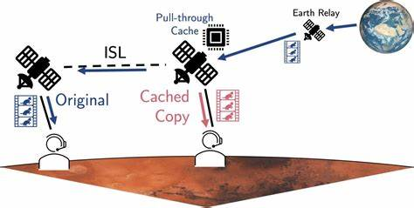
Relay Satellites
ADVANTAGES:
1
2
3
4
5
6
7
Communication Reliability:
Store and Forward Data:
Extended Operational Range:
The Mars Relay Network:
Autonomous Operations:
Integration of Optical and RF Communications:
Next-Generation Relay Constellations:

Slide 15
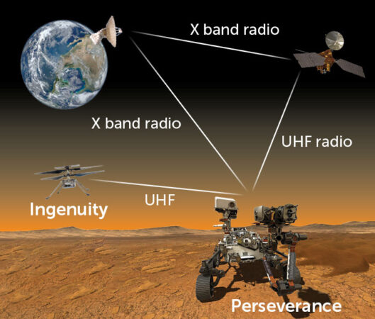
Conclusion
Laser Communications is the FUTURE
Pioneer for Security and robust communication
Efficient, seamless and continuous connection

Slide 16
Questions?

