Slide 1


Integrated State Estimation Development for Actively Controlled Rockets
Hridai Ambati, Patrick Barry, Kandarp Vadia, Albert Zheng
AIAA 2025 Region II Student Conference
4/3/2025 – 4/4/2025
Copyright © by Guidance, Navigation, and Control Project
Published by the American Institute of Aeronautics and Astronautics, Inc., with permission.

Slide 2
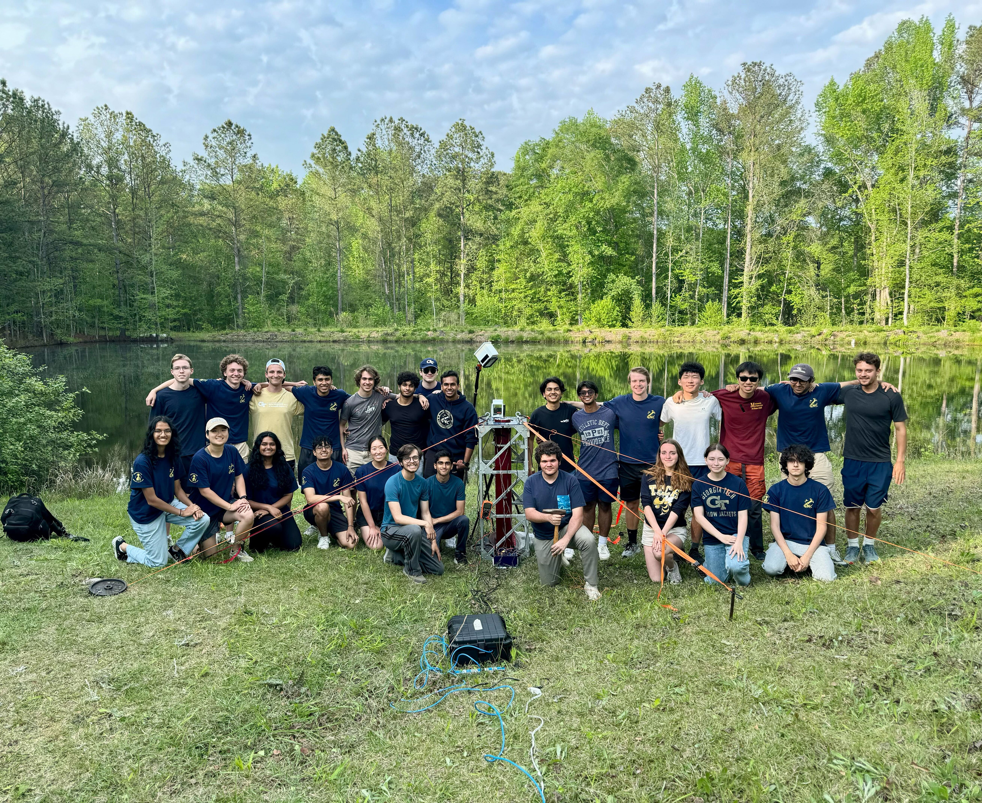

GEORGIA TECH GUIDANCE, NAVIGATION, AND CONTROL
WHO WE ARE
Mission for 2024-25
To become the first collegiate team to utilize jet vanes in a rocket launch.
We are the first collegiate team to demonstrate jet vanes thrust vectoring in a physical test.

Slide 3
Initial Attitude Estimation
Sensor Modeling
Bias Estimation
Overview
In-Flight Translational Estimation
In-Flight Attitude Estimation
Concluding Remarks
Flight Software Implementation

Slide 4
Motivation and Overview for State Estimation
In-House Simulations
Bias Estimation
In-Flight Attitude Estimation
6-DOF Simulations
Sensor Models
Flight Software Implementation
Initial Attitude Estimation
In-Flight Translational
Estimation
Infrastructure
In-Flight Phase
Ground Phase

Slide 5
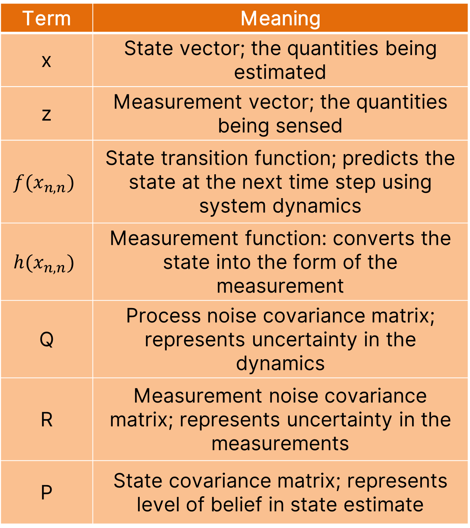
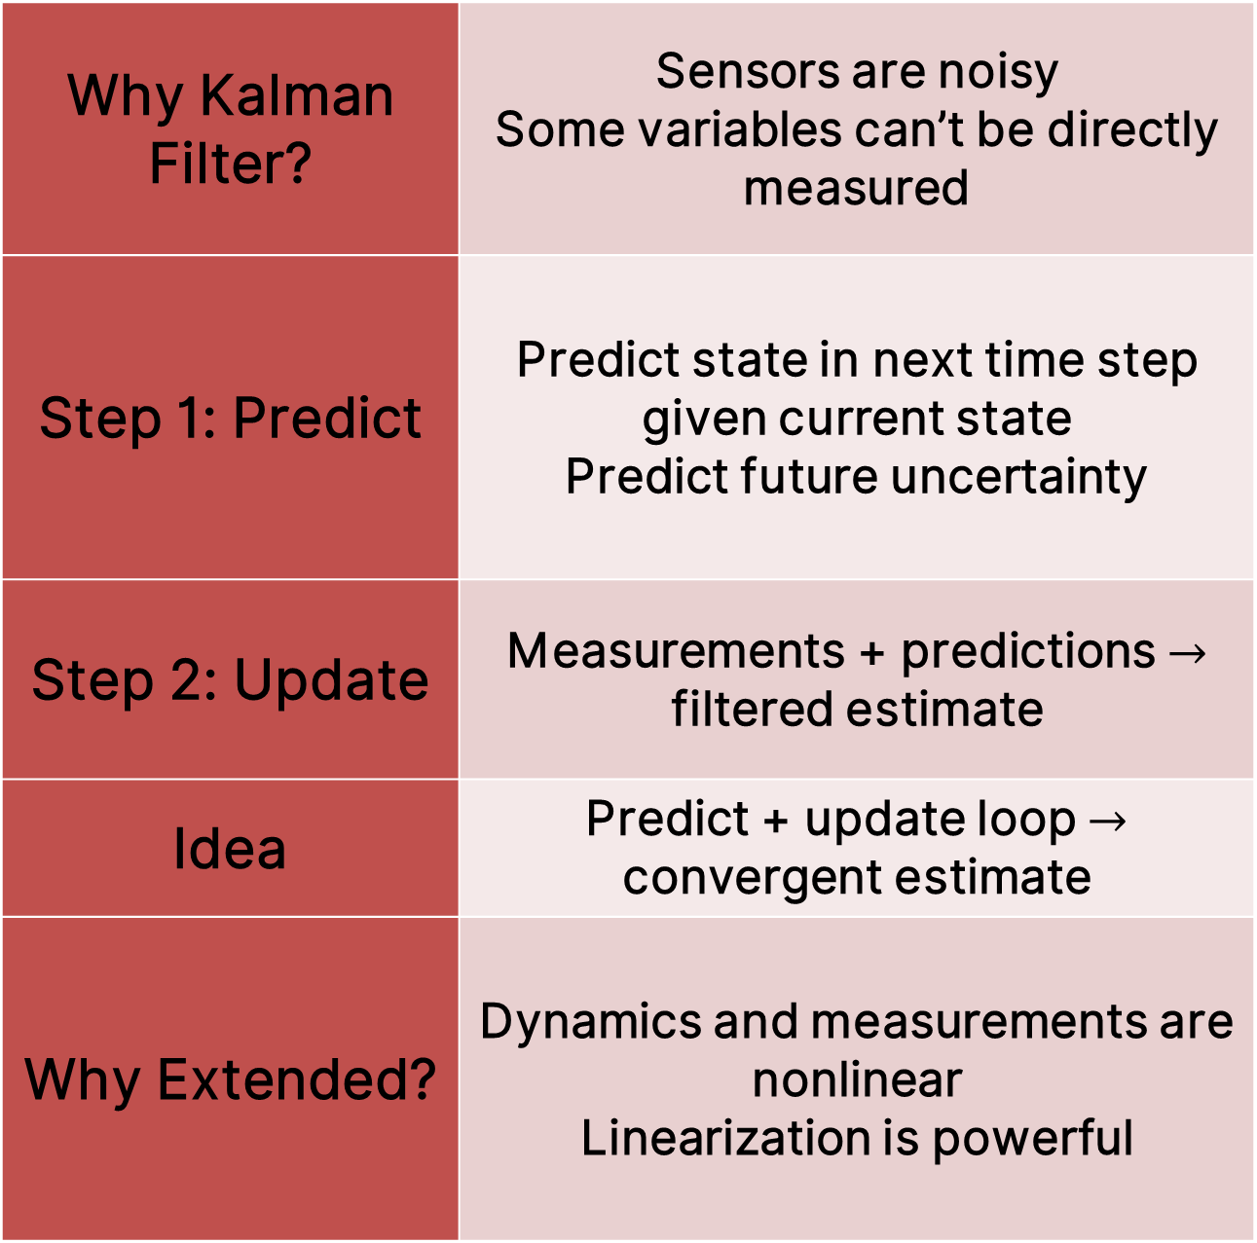
Overview of Extended Kalman Filter
Why Kalman Filter? | Sensors are noisy Some variables can’t be directly measured
Step 1: Predict | Predict state in next time step given current state Predict future uncertainty
Step 2: Update | Measurements + predictions $→$ filtered estimate
Idea | Predict + update loop $→$ convergent estimate
Why Extended? | Dynamics and measurements are nonlinear Linearization is powerful
Term | Meaning
x | State vector; the quantities being estimated
z | Measurement vector; the quantities being sensed
$$f(x_{n,n})$$ | State transition function; predicts the state at the next time step using system dynamics
$$h(x_{n,n})$$ | Measurement function: converts the state into the form of the measurement
Q | Process noise covariance matrix; represents uncertainty in the dynamics
R | Measurement noise covariance matrix; represents uncertainty in the measurements
P | State covariance matrix; represents level of belief in state estimate

Slide 6










Extended Kalman Filter
Initialize
Measurement
State Estimate Output
$${\hat{x}}_{0},{ \hat{P}}_{0}$$
$$z_{n,n}$$
$$R_{n}$$
Update
Predict
Refine state
$$x_{n,n}=x_{n,n−1}+K_{n}Δx$$
Predict next state
Predict next uncertainty
${\hat{x}}_{n,n}$, ${\hat{P}}_{n,n}$
$${\hat{x}}_{n,n−1}$$
$${\hat{x}}_{n+1,n}$$
$${\hat{P}}_{n,n−1}$$
$${\hat{P}}_{n+1,n}$$
$$t←t+1$$
$$z=h\left(x_{n,n}\right)$$
$$x_{n+1}=f\left(x_{n,n}\right)$$
(State to Sensor Mapping)
(Dynamic Model)

Slide 7
Initial Attitude Estimation
Sensor Modeling
Bias Estimation
Overview
In-Flight Translational Estimation
In-Flight Attitude Estimation
Concluding Remarks
Flight Software Implementation

Slide 8
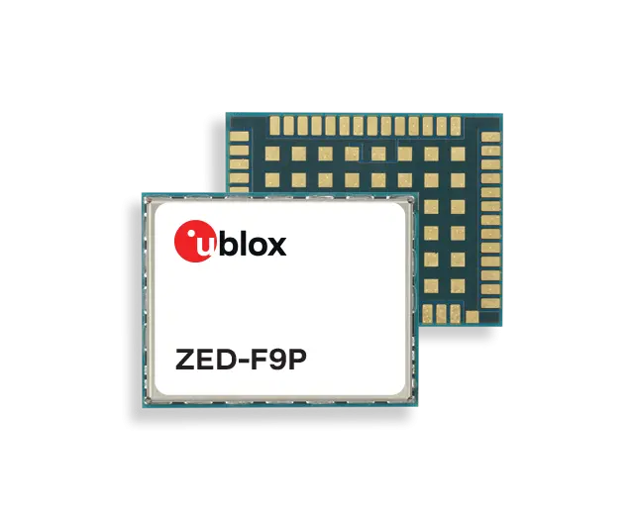
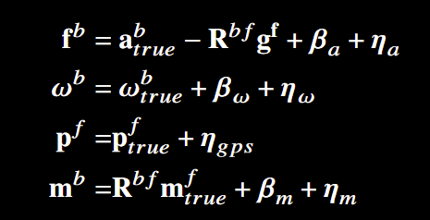
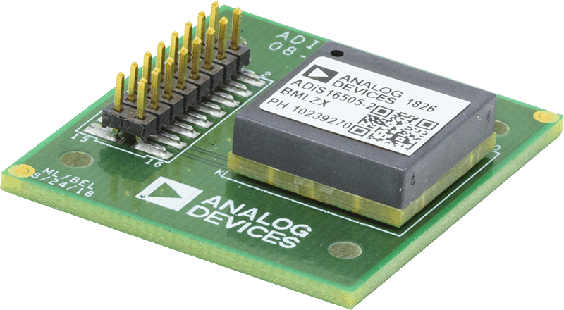
Sensor Modeling
  Navigation requires reference trajectory
    Team developed 6-DOF closed-loop dynamical simulation (position, velocity, attitude)
    Used custom Flat Earth frame, ignoring Earth’s curvature and rotation
  Key usage of reference trajectory in sensor model generation
    Models add fake noise and error, emulating real sensor data (replace measurement vectors in algorithm)
    Custom accelerometer, gyroscope, magnetometer, GPS
Notes:
1) First step to State Estimation is sensor modelling
2) Testing important considering limited launch cadence of collegiate rocketry
3) Testing requires ref trajectory as truth data and a set of sensor models
4) As a result, the team developed a closed-loop dynamical sim generating a trajectory (including p, v, attitude of the rocket)
5) Sim is plugged into diff eq solver, and uses standard 6-DOF EOM and integrated controls (CFD-derived Aerodynamics, and thrust allocation curves from static fire data)
6) Key usage of ref traj in generating sensor models, which serve to emulate real sensor data by adding fake noise and error and aim to replace z vectors in nav algs
7) Team developed custom acc, gyro, magnetometer, GPS
- High-level eqs (B = turn on bias, eta = gaussian noise, Rbf = rotation matrices from body to Flat Earth frame)
- Custom Flat Earth frame, which ignores Earth's curvature & rotation (origin at launchpad, x-axis upward, y-axis downrange, and z-axis completing RHR)

Slide 9
Initial Attitude Estimation
Sensor Modeling
Bias Estimation
Overview
In-Flight Translational Estimation
In-Flight Attitude Estimation
Concluding Remarks
Flight Software Implementation

Slide 10










Bias Estimation
$$t←t+1$$
$${\hat{x}}_{n,n−1}$$
$${\hat{P}}_{n,n−1}$$
4
2
Update
Predict
Estimate biases
$$x_{n,n}=x_{n,n−1}+K_{n}Δx$$
${\hat{x}}_{n,n}$, ${\hat{P}}_{n,n}$
Static dynamics
$$x_{n+1}=x_{n}$$
$$P_{n+1}=P_{n}$$
$${\hat{x}}_{n+1,n}$$
$$z_{n,n}$$
$$R_{n}$$
$${\hat{P}}_{n+1,n}$$
5
3
State Estimate Output
Measurement
$${\hat{x}}_{0},{ \hat{P}}_{0}$$
1
Initialize
$$z=h\left(x_{n,n}\right)={\hat{x}}_{n,n}+{\left[0 0 g 0 0 0\right]}^{T}$$
$$x_{bias}={\left[β_{a,x} β_{a,y} β_{a,z} β_{ω,x} β_{ω,y} β_{ω,z}\right]}^{T}$$
(Sensor to Bias Mapping)
(Accelerometer/Gyroscope Biases)

Slide 11
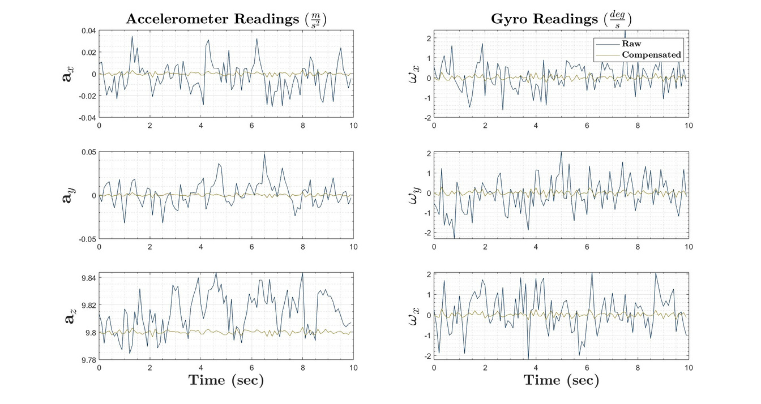
Bias Estimation

Slide 12
Initial Attitude Estimation
Sensor Modeling
Bias Estimation
Overview
In-Flight Translational Estimation
In-Flight Attitude Estimation
Concluding Remarks
Flight Software Implementation

Slide 13









Initial Attitude Estimation
1
Initialize
3
6
Measurement
Initialize
State Estimate Output
$${\hat{q}}_{0},{ \hat{P}}_{0}$$
$$z_{n,n}$$
$$R_{n}$$
4
$$e_{z}^{b}=−\frac{a^{b}}{\left|a^{b}\right|}$$
$$e_{y}^{b}=\frac{e_{z}^{b}×m^{b}}{|e_{z}^{b}×m^{b}|}$$
$$e_{z}^{b}=\frac{e_{y}^{b}×e_{z}^{b}}{|e_{y}^{b}×e_{z}^{b}|}$$
$$R^{bv}={\left[e_{x}^{b} e_{y}^{b} e_{z}^{b}\right]}^{T}$$
$$R^{bv}→q^{bv}$$
2
Update
Predict
$${\hat{q}}_{n+1,n}$$
Estimate quaternion
$$q_{n,n}=q_{n,n−1}+K_{n}Δq$$
5
$${\hat{P}}_{n+1,n}$$
Normalize
Static dynamics
$$x_{n+1}=x_{n}$$
$$P_{n+1}=P_{n}$$
${\hat{q}}_{n,n}$, ${\hat{P}}_{n,n}$
$${\hat{q}}_{n,n−1}$$
$${\hat{P}}_{n,n−1}$$
$$t←t+1$$
$$z=h\left(x_{n,n}\right)=\left[\begin{aligned}R^{bv}{\hat{a}}^{v} \\ R^{bv}m^{v}\end{aligned}\right]$$
$$q_{bf}={\left[q_{0} q_{1} q_{2} q_{3}\right]}^{T}$$
(Sensor to Quaternion Mapping)
(Refined Initial Quaternion)

Slide 14
Initial Attitude Estimation
Initialize
Measurement
State Estimate Output
$${\hat{q}}_{0},{ \hat{P}}_{0}$$
$$z_{n,n}$$
$$R_{n}$$
Update
Predict
$${\hat{q}}_{n+1,n}$$
Estimate quaternion
$$q_{n,n}=q_{n,n−1}+K_{n}Δq$$
$${\hat{P}}_{n+1,n}$$
Normalize
Static dynamics
$$x_{n+1}=x_{n}$$
$$P_{n+1}=P_{n}$$
${\hat{q}}_{n,n}$, ${\hat{P}}_{n,n}$
$${\hat{q}}_{n,n−1}$$
$${\hat{P}}_{n,n−1}$$
$$t←t+1$$
$$z=h\left(x_{n,n}\right)=\left[\begin{aligned}R^{bv}{\hat{a}}^{v} \\ R^{bv}m^{v}\end{aligned}\right]$$
$$q_{bf}={\left[q_{0} q_{1} q_{2} q_{3}\right]}^{T}$$
(Sensor to Quaternion Mapping)
(Refined Initial Quaternion)

Slide 15











Initial Attitude Estimation
$$q_{bf}={\left[q_{0} q_{1} q_{2} q_{3}\right]}^{T}$$
(Refined Initial Quaternion)
(Sensor to Quaternion Mapping)
$$z=h\left(x_{n,n}\right)=\left[\begin{aligned}R^{bv}{\hat{a}}^{v} \\ R^{bv}m^{v}\end{aligned}\right]$$
Initialize
$${\hat{q}}_{0},{ \hat{P}}_{0}$$
Predict
$${\hat{q}}_{n+1,n}$$
Measurement
State Estimate Output
Static dynamics
$$x_{n+1}=x_{n}$$
$$P_{n+1}=P_{n}$$
$${\hat{P}}_{n+1,n}$$
$$z_{n,n}$$
$$R_{n}$$
Update
Estimate quaternion
$$q_{n,n}=q_{n,n−1}+K_{n}Δq$$
Normalize
${\hat{q}}_{n,n}$, ${\hat{P}}_{n,n}$
$${\hat{q}}_{n,n−1}$$
$${\hat{P}}_{n,n−1}$$
$$t←t+1$$

Slide 16












Initial Attitude Estimation
Initialize
$$t←t+1$$
4
2
$${\hat{q}}_{n,n−1}$$
Update
$$e_{z}^{b}=−\frac{a^{b}}{\left|a^{b}\right|}$$
$$e_{y}^{b}=\frac{e_{z}^{b}×m^{b}}{|e_{z}^{b}×m^{b}|}$$
$$e_{z}^{b}=\frac{e_{y}^{b}×e_{z}^{b}}{|e_{y}^{b}×e_{z}^{b}|}$$
$$R^{bv}={\left[e_{x}^{b} e_{y}^{b} e_{z}^{b}\right]}^{T}$$
$$R^{bv}→q^{bv}$$
Predict
$${\hat{P}}_{n,n−1}$$
Estimate quaternion
$$q_{n,n}=q_{n,n−1}+K_{n}Δq$$
Static dynamics
$$x_{n+1}=x_{n}$$
$$P_{n+1}=P_{n}$$
5
${\hat{q}}_{n,n}$, ${\hat{P}}_{n,n}$
$${\hat{q}}_{n+1,n}$$
$$z_{n,n}$$
$$R_{n}$$
Normalize
$${\hat{P}}_{n+1,n}$$
3
Measurement
$${\hat{q}}_{0},{ \hat{P}}_{0}$$
6
1
State Estimate Output
Initialize
(Sensor to Quaternion Mapping)
$$z=h\left(x_{n,n}\right)=\left[\begin{aligned}R^{bv}{\hat{a}}^{v} \\ R^{bv}m^{v}\end{aligned}\right]$$
(Refined Initial Quaternion)
$$q_{bf}={\left[q_{0} q_{1} q_{2} q_{3}\right]}^{T}$$

Slide 17
Initial Attitude Estimation
$$t←t+1$$
4
2
$${\hat{q}}_{n,n−1}$$
Update
Predict
$${\hat{P}}_{n,n−1}$$
Estimate quaternion
$$q_{n,n}=q_{n,n−1}+K_{n}Δq$$
Static dynamics
$$x_{n+1}=x_{n}$$
$$P_{n+1}=P_{n}$$
5
${\hat{q}}_{n,n}$, ${\hat{P}}_{n,n}$
$${\hat{q}}_{n+1,n}$$
$$z_{n,n}$$
$$R_{n}$$
Normalize
$${\hat{P}}_{n+1,n}$$
3
Measurement
$${\hat{q}}_{0},{ \hat{P}}_{0}$$
6
1
State Estimate Output
Initialize
(Sensor to Quaternion Mapping)
$$z=h\left(x_{n,n}\right)=\left[\begin{aligned}R^{bv}{\hat{a}}^{v} \\ R^{bv}m^{v}\end{aligned}\right]$$
(Refined Initial Quaternion)
$$q_{bf}={\left[q_{0} q_{1} q_{2} q_{3}\right]}^{T}$$

Slide 18

Initialize
$$e_{z}^{b}=−\frac{a^{b}}{\left|a^{b}\right|}$$
$$e_{y}^{b}=\frac{e_{z}^{b}×m^{b}}{|e_{z}^{b}×m^{b}|}$$
$$e_{z}^{b}=\frac{e_{y}^{b}×e_{z}^{b}}{|e_{y}^{b}×e_{z}^{b}|}$$
$$R^{bv}={\left[e_{x}^{b} e_{y}^{b} e_{z}^{b}\right]}^{T}$$
$$R^{bv}→q^{bv}$$

Slide 19
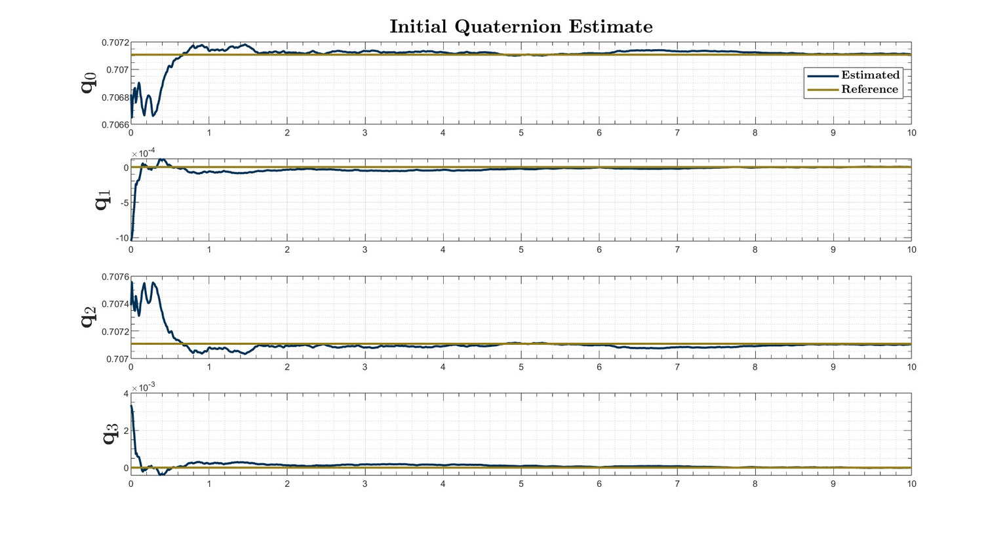

Slide 20
Initial Attitude Estimation
Sensor Modeling
Bias Estimation
Overview
In-Flight Translational Estimation
In-Flight Attitude Estimation
Concluding Remarks
Flight Software Implementation

Slide 21
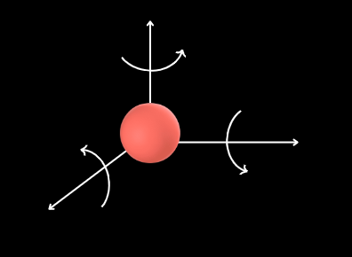



In-Flight Attitude Estimation
  Need to have knowledge of rocket’s attitude in flight
    Caveats:
      Sensors used in ground estimation carry more uncertainty in flight
      Attitude dynamics untrustworthy
  Solution: propagate gyroscope measurements directly
    Major downside is integration drift, but...
      Short flight
      High-quality sensor
$$ω_{x}$$
$$ω_{z}$$
$$ω_{y}$$

Slide 22



In-Flight Attitude Estimation: The Algorithm
Take gyroscope measurements:
$$ω_{x}, ω_{y}, ω_{z}$$
Initial “launchpad attitude” from ground estimation
Form instantaneous rotation quaternion, $q_{∆}=f(\overset{⃑}{ω}, ∆t)$
Update quaternion estimate,
$q_{t}=f(q_{t−1}, q_{∆})$

Slide 23
In-Flight Attitude Estimation: The Algorithm
Take gyroscope measurements:
$$ω_{x}, ω_{y}, ω_{z}$$
Form instantaneous rotation quaternion, $q_{∆}=f(\overset{⃑}{ω}, ∆t)$
Initial “launchpad attitude” from ground estimation
Update quaternion estimate,
$q_{t}=f(q_{t−1}, q_{∆})$

Slide 24
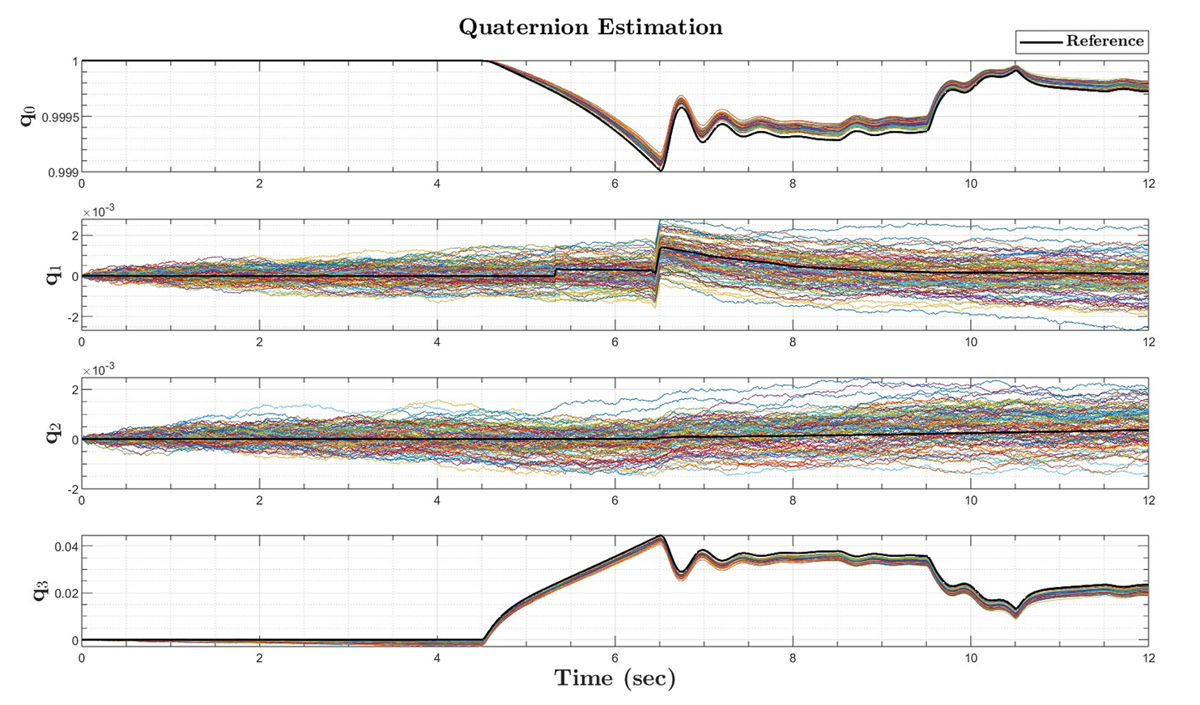
In-Flight Attitude Estimation: Results

Slide 25
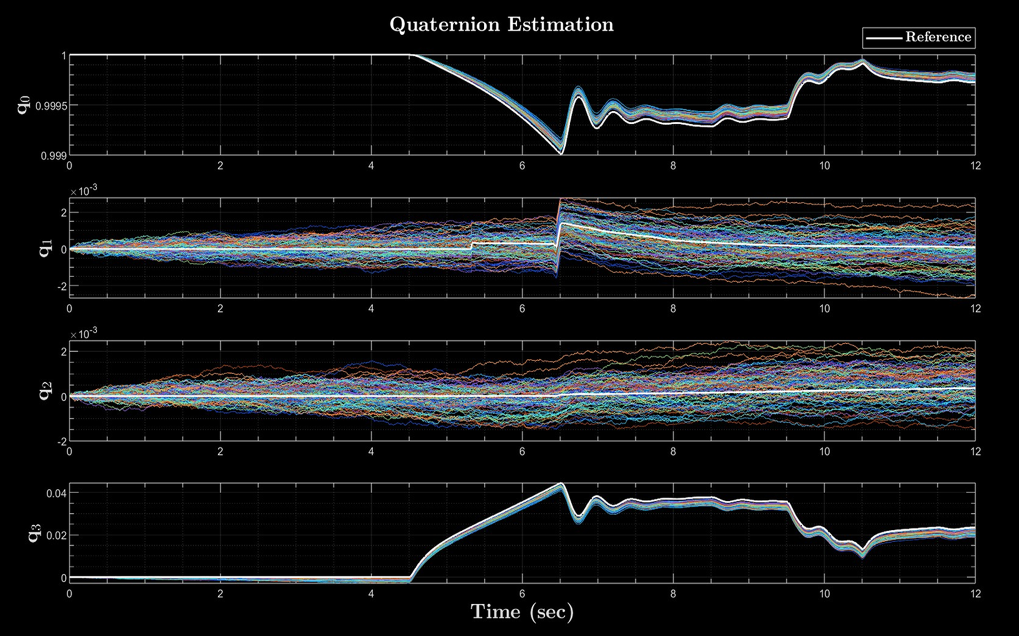
In-Flight Attitude Estimation: Results

Slide 26
Initial Attitude Estimation
Sensor Modeling
Bias Estimation
Overview
In-Flight Translational Estimation
In-Flight Attitude Estimation
Concluding Remarks
Flight Software Implementation

Slide 27
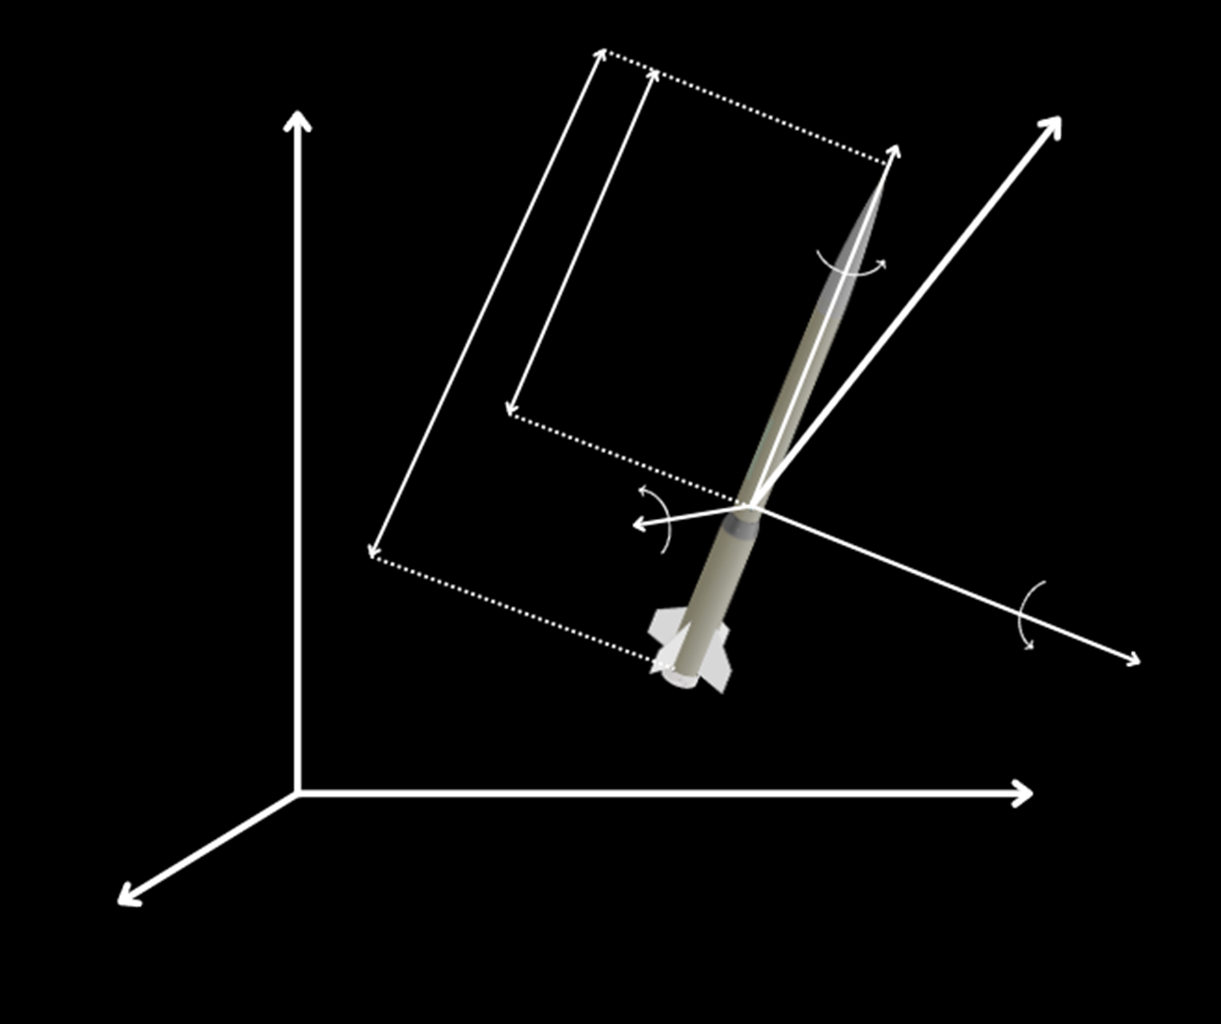
















Accelerometer Lever Arm
  Acceleration of CG $≠$ Acceleration of IMU
$$x^{i}$$
$$x^{b}$$
$$v^{b}$$
$$p$$
$$l$$
$$r_{CG}$$
$$IMU$$
Assumptions
$$q$$
CG position changes at a fixed rate
$$CG$$
IMU is fixed on the body
$$y^{b}$$
$$r$$
Negligible angular accelerations
$$z^{b}$$
$$y^{i}$$
$$z^{i}$$

Slide 28


GPS Coordinate Transformation
LLA
Earth-Center, Earth-Fixed
Latitude (𝜙)
x (ECEF)
WGS84 ellipsoidal equations
Global Positioning System
Local Rotation
North-East-Down Frame
Longitude (𝜆)
y (ECEF)
Altitude (h)
y (ECEF)
Flat Earth Frame
x
z
y

Slide 29
















In-Flight Estimation
$$x_{n,n}={\left[p_{x}^{f} p_{y}^{f} p_{z}^{f} v_{x}^{b} v_{y}^{b} v_{z}^{b}\right]}^{T}$$
(Refined State Estimate)
4
1
Measurement
$$LLA$$
$$LLA → p^{f}$$
GPS
6
Initialize
State Estimate Output
Predict
$${\hat{x}}_{0},{ \hat{P}}_{0}$$
$$z_{n,n}$$
$$R_{n}$$
5
3
$$v_{n}^{f}=q_{bf}⊗v_{n}^{b}⊗q_{bf}^{∗}$$
$$p_{n+1}^{f}=p_{n}^{f}+Δtv_{n}^{f}$$
$$v_{n+1}^{f}=v_{n}^{f}+Δta_{n}^{f}$$
Update
Predict
Estimate state
$$x_{n,n}=x_{n,n−1}+K_{n}Δx$$
${\hat{x}}_{n,n}$, ${\hat{P}}_{n,n}$
$$x_{n+1,n}$$
$$x_{n,n−1}$$
2
Translational kinematics
$${\hat{P}}_{n+1,n}$$
$${\hat{P}}_{n,n−1}$$
Attitude Estimator
$$ω^{b}$$
$$q_{bf}$$
IMU
$$a^{b}$$
$$t←t+1$$
Notes:
Remarks
- now you can see how the past 3 algorithms are just key infrastructure to support the success of this algorithm

Slide 30

In-Flight Estimation
$$x_{n,n}={\left[p_{x}^{f} p_{y}^{f} p_{z}^{f} v_{x}^{b} v_{y}^{b} v_{z}^{b}\right]}^{T}$$
(Refined State Estimate)
4
1
Measurement
$$LLA$$
$$LLA → p^{f}$$
GPS
6
Initialize
State Estimate Output
$${\hat{x}}_{0},{ \hat{P}}_{0}$$
$$z_{n,n}$$
$$R_{n}$$
5
3
Update
Predict
Estimate state
$$x_{n,n}=x_{n,n−1}+K_{n}Δx$$
${\hat{x}}_{n,n}$, ${\hat{P}}_{n,n}$
$$x_{n+1,n}$$
$$x_{n,n−1}$$
2
Translational kinematics
$${\hat{P}}_{n+1,n}$$
$${\hat{P}}_{n,n−1}$$
Attitude Estimator
$$ω^{b}$$
$$q_{bf}$$
IMU
$$a^{b}$$
$$t←t+1$$
Notes:
Remarks
- now you can see how the past 3 algorithms are just key infrastructure to support the success of this algorithm

Slide 31

Predict
$$v_{n}^{f}=q_{bf}⊗v_{n}^{b}⊗q_{bf}^{∗}$$
$$p_{n+1}^{f}=p_{n}^{f}+Δtv_{n}^{f}$$
$$v_{n+1}^{f}=v_{n}^{f}+Δta_{n}^{f}$$

Slide 32
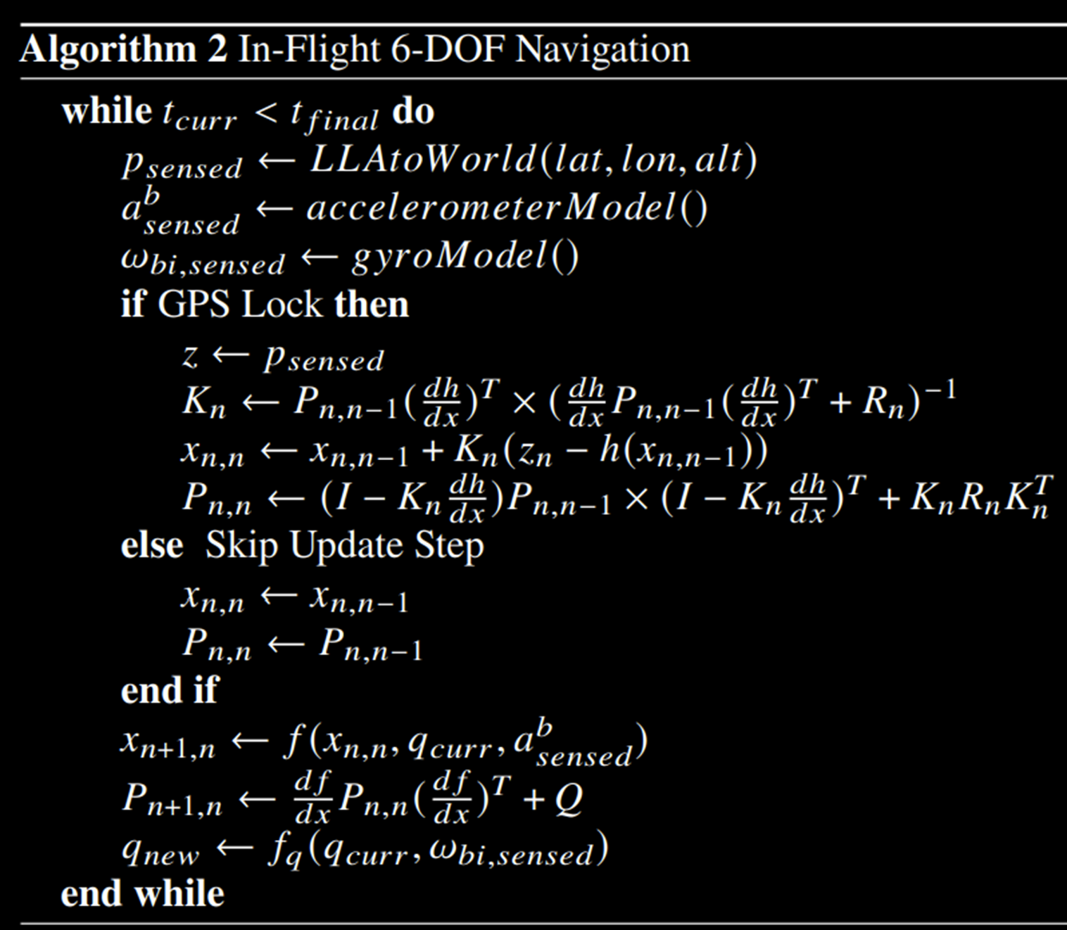
Notes:
This is what we just described but in algorithm form. Note the update step and uncertainty propagation are explicitly mathematically expressed here rather than being treated as a black box, which we have done all presentation.

Slide 33
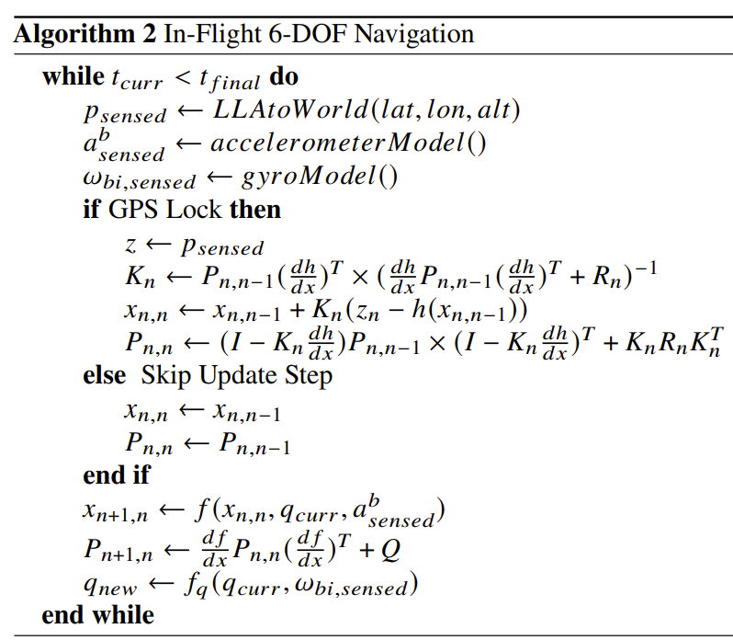
In Flight Translational Navigation

Slide 34
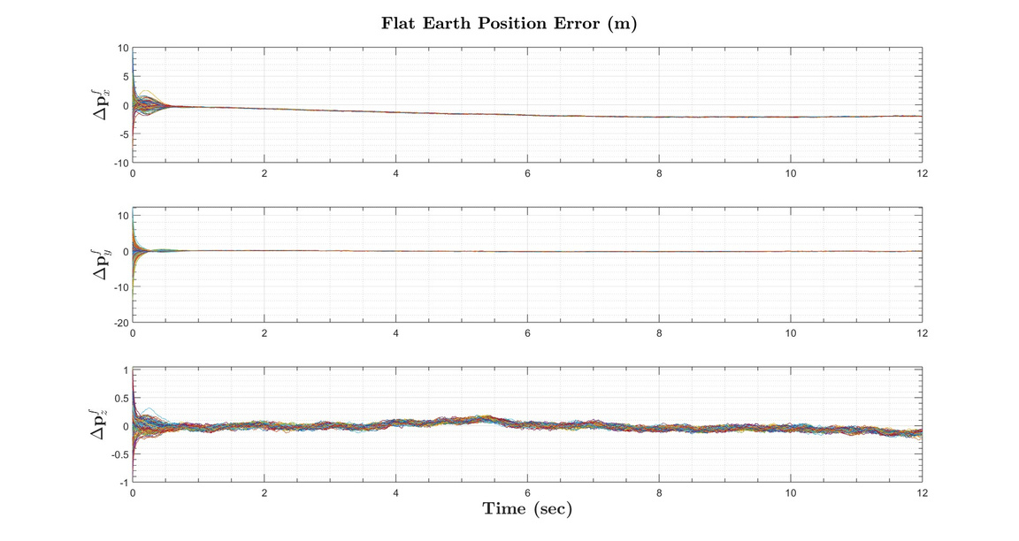

Slide 35
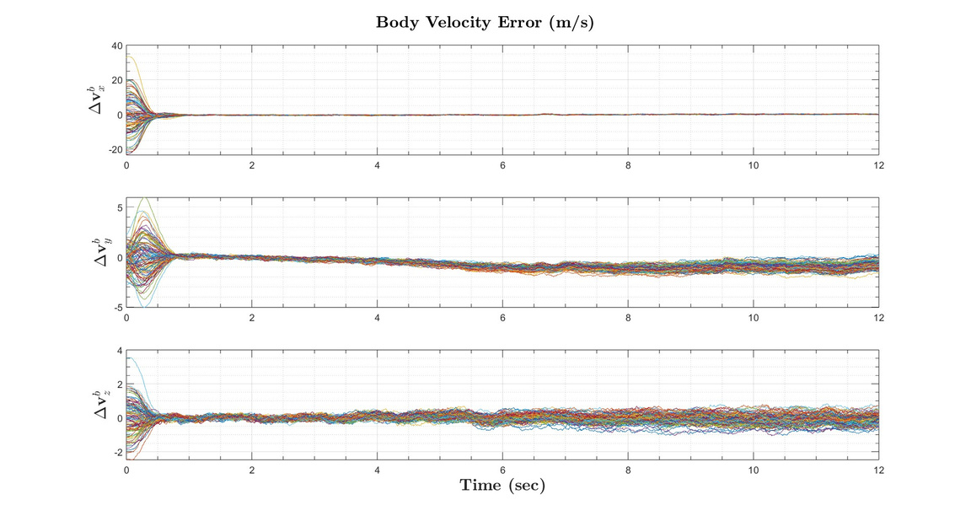

Slide 36
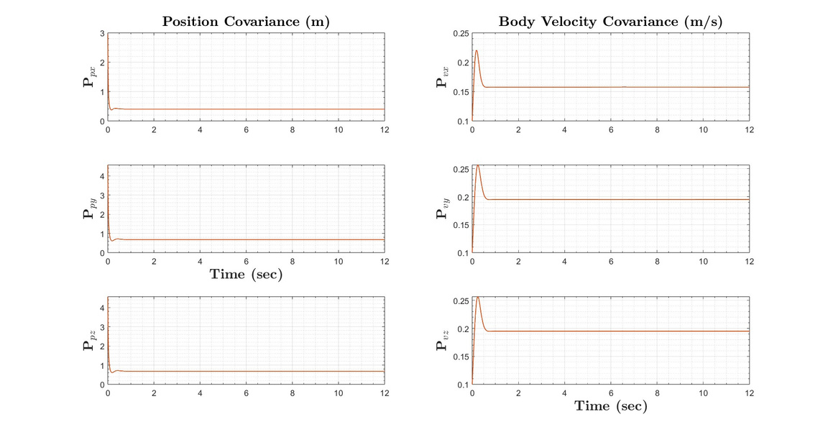

Slide 37
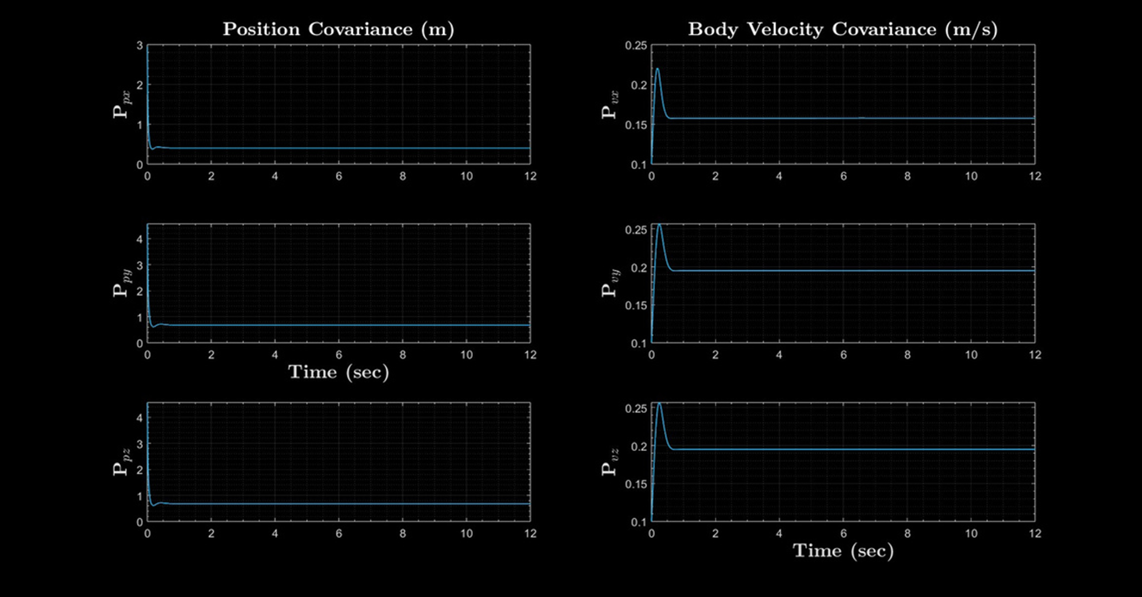

Slide 38
Initial Attitude Estimation
Sensor Modeling
Bias Estimation
Overview
In-Flight Translational Estimation
In-Flight Attitude Estimation
Concluding Remarks
Flight Software Implementation

Slide 39
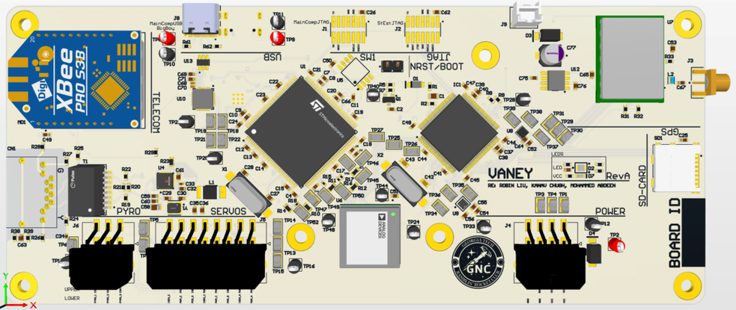
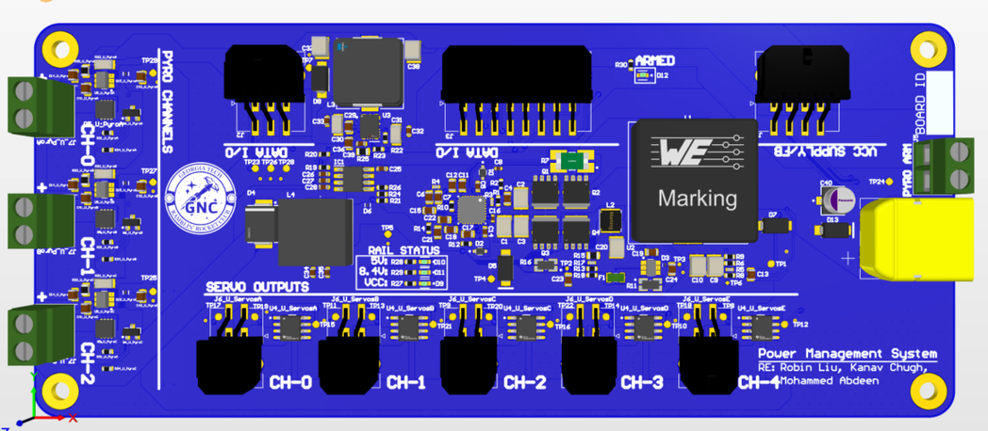
Flight Software Implementation
  Jet Vanes Rocket avionics: two custom PCBs
  STM32 microcontrollers run code written in C
    State estimation tasks on one MCU only
  In-flight algorithms running at 30 Hz
  State machine updates rocket’s phase of flight

Slide 40
Flight Software Implementation
Jet Vanes Rocket Avionics
PCB 1
Power Management
Vaney
STM32 Microcontrollers
Software written in C
1st MCU
2nd MCU
PCB 2
State Estimation
In-Flight Algorithms
State Machine
Updates Rocket’s Phase of Flight

Slide 41
Initial Attitude Estimation
Sensor Modeling
Bias Estimation
Overview
In-Flight Translational Estimation
In-Flight Attitude Estimation
Concluding Remarks
Flight Software Implementation
Concluding Remarks
  End-to-end development process of state estimation from scratch
  Four key state estimation algorithms
  Future work: Improve on the nuts and bolts

Slide 42



Slide 43


THANK YOU

