Slide 1


Glider Design for the 2024-2025 AIAA Design Build Fly Competition
By Amanda Matzek and Nolan LaRue

Slide 2
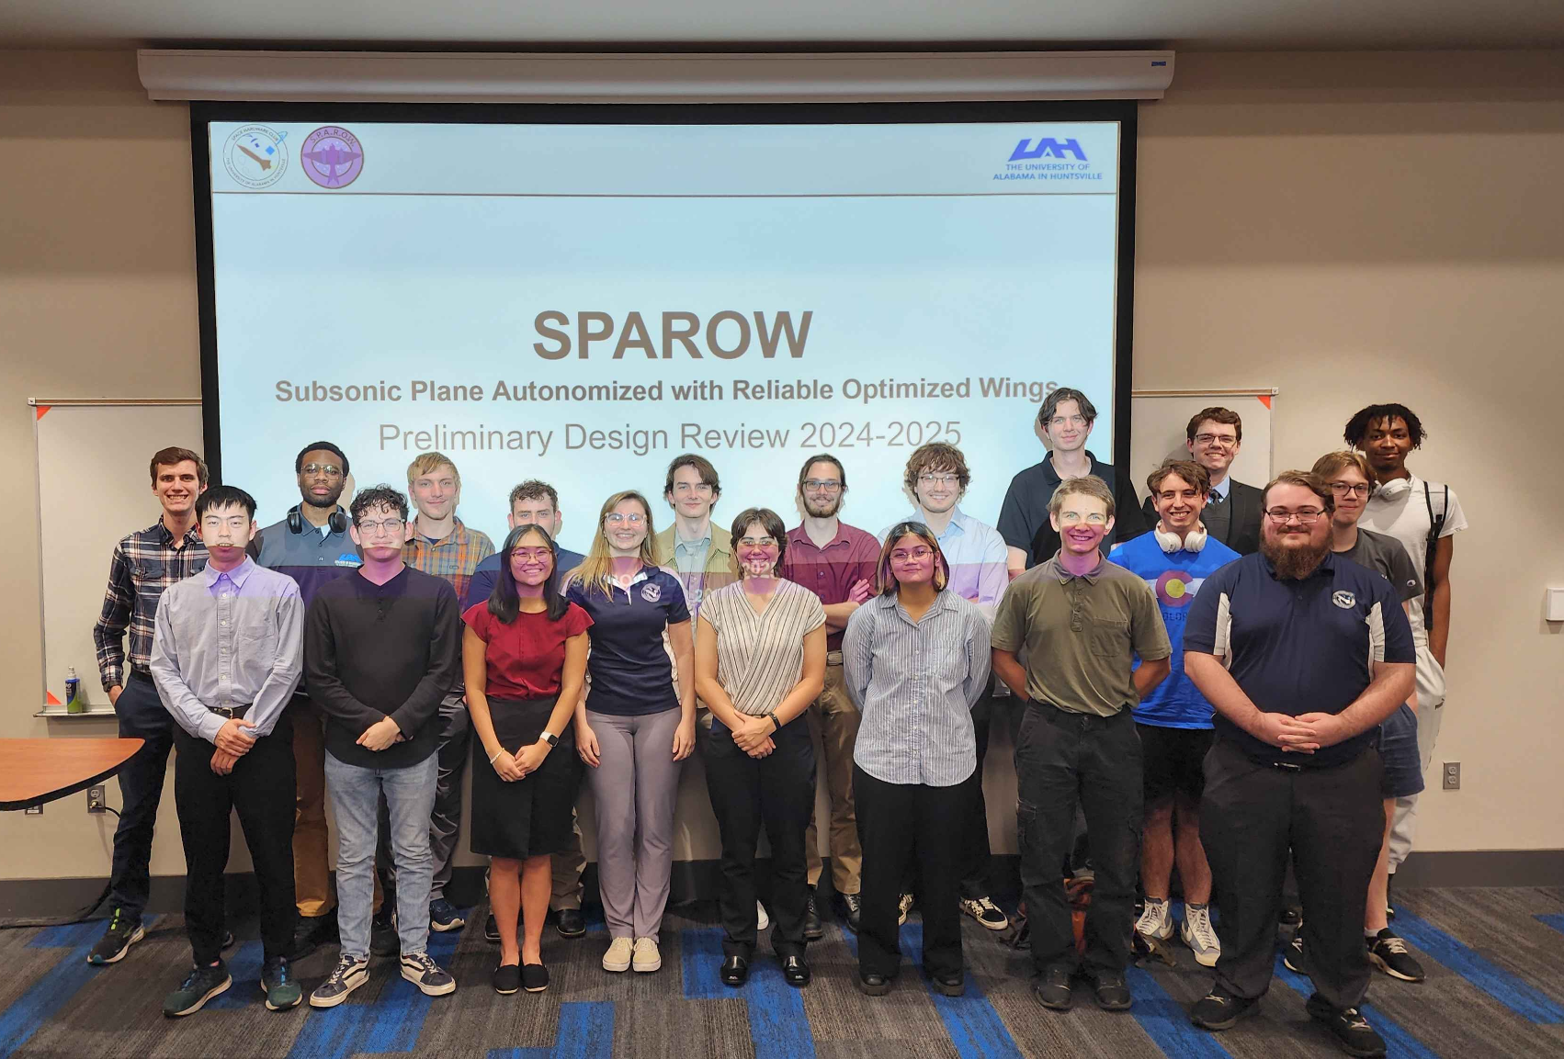
Introduction
SPAROW is a student team within the University of Alabama in Huntsville’s Space Hardware Club
SPAROW’s goal is to compete in the American Institute of Aeronautics and Astronautics (AIAA) Design Build Fly (DBF) competition in 2025
The 2025 challenge requires a carrier aircraft to release a glider mid-flight
The gilder must autonomously land itself in a specific region designated by the competition

Slide 3
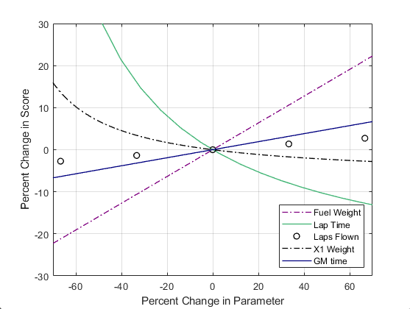
Design Parameters and Analysis
Internal requirements were generated for each aspect of the competition, including the glider design.
Requirements were based on competition parameters, performance parameters, and SPAROW’s limitations.
SPAROW created a sensitivity analysis script in MATLAB to visualize the effects a change in a specific parameter would have on the overall score.
SPAROW found that the glider would score best if it was extremely lightweight, though still durable and stable enough to fly and land itself

Slide 4
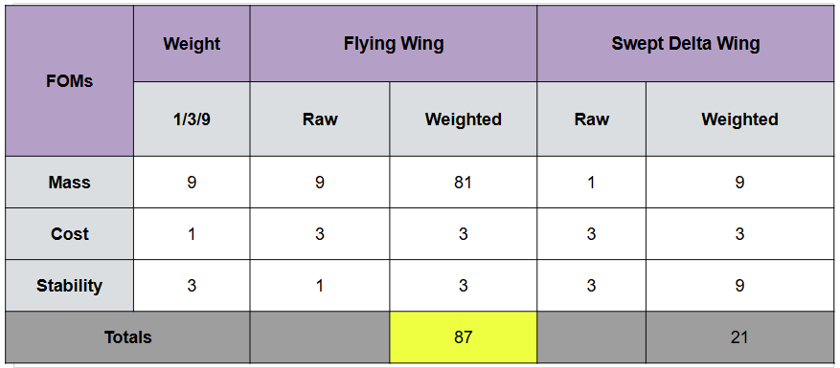
Trade Studies
Trade studies were performed on each aspect of the glider design to create the optimal aircraft
The wing configuration was traded and a flying wing design was chosen due to its low mass
Different weights were applied to each design aspect based on their potential effect on competition scoring

Slide 5
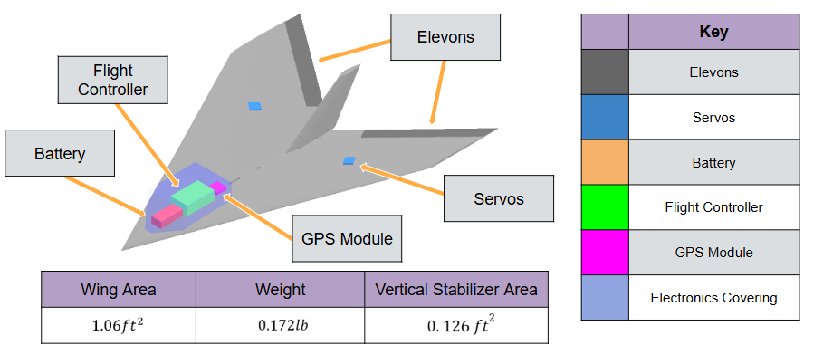
Modeling

Slide 6
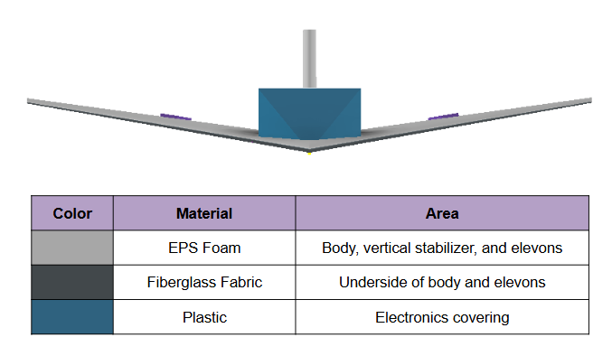
Material Selection
Multiple materials were traded for the body of the glider
EPS foam was ultimately chosen due to its low weight, high durability, and relatively low cost.
The bottom will be reinforced with fiberglass fabric due to both its landing conditions and integration with the drop mechanism

Slide 7
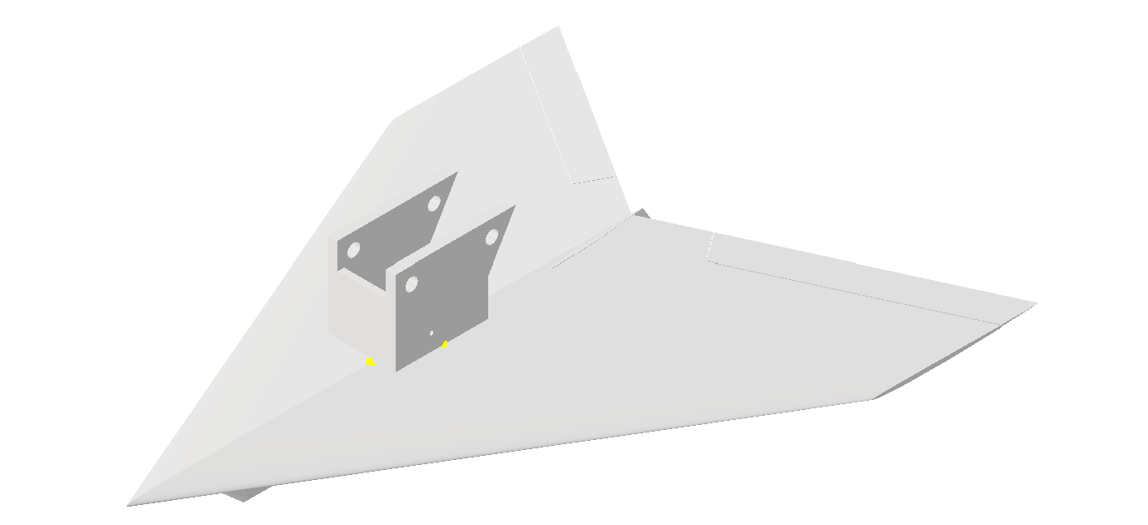
Prototyping and Testing
An initial basic model was made to test basic functionality. It held a similar size and lighter weight to the projected final model.
It was able to successfully connect with and deploy from the drop mechanism several times, with little error, fixable via light shake.
It also managed to glide a short distance with relatively good stability.

Slide 8
Conclusion
SPAROW intends to compete in the 2025 AIAA Design Build Fly Competition.
The team’s goal is to obtain an average score at competition and to build the knowledge and skills of the team for use in future competitions
The glider design has been improved through many cycles of the engineering design process and the finalized design.
Prototyping and testing of the glider has confirmed the design choices the SPAROW team has made.
SPAROW looks forward to competing in this year’s DBF competition and hopes to compete again next year.

Slide 9
Acknowledgements
We would like to thank the Alabama Space Grant Consortium for their financial support for the entirety of the Space Hardware Club. We also thank our Faculty Advisor, Dr. Gang Wang for supporting and assisting us in our work. Finally we would also like to thank Will Lehmer as our Chief Engineer, whose expertise and experience in the field has helped guide us greatly.

