Slide 1
Advancing CFD Approaches for Jet-Stirred Reactors
Omar Hamwy, Dr. Brandon Rotavera, Dr. Eliza Banu
University of Georgia, College of Engineering
AIAA 2025 Region II Student Conference

Slide 2
Outline
Background
Conditions & Assumptions
Geometry & Meshing
Post-Processing
  Validation
Results
Conclusion

Slide 3
Background

Slide 4
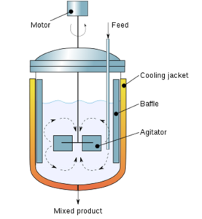
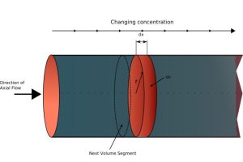
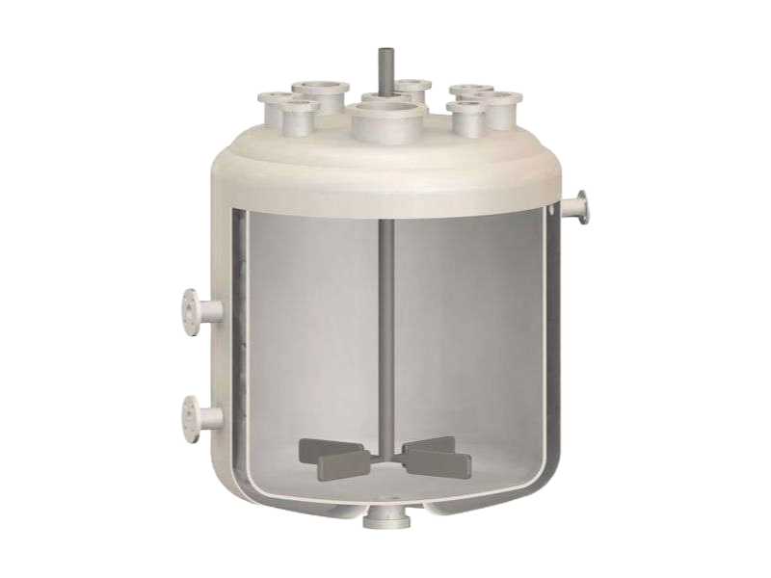
Chemical Reactors
CSTR
Chemical reactors are process equipment
Chemicals fed to make them react
Used usually for the purpose of making a desired product or studying a chemical process
Comprised of different types
  Plug Flow Reactor
  Batch Reactor
  Semi-Batch Reactor
  Catalytic Reactor
  Continuous Flow Stirred-Tank Reactor
All come with varying advantages and disadvantages.
PFR
Batch

Slide 5
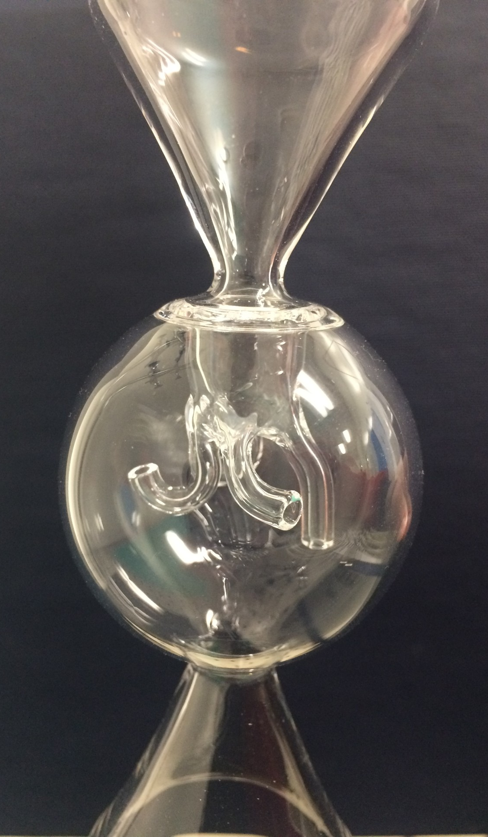
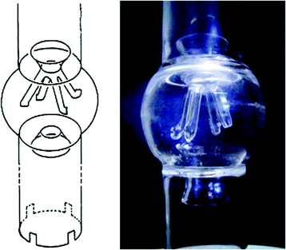
Jet-Stirred Reactors
A type of CSTR
Principally used to study:
  Flow patterns
  Mixing capabilities
  Chemical reactions
  Reaction rates
  Industrial processes
Applications in combustion system testing
  Testing biofuels
  Propulsions systems for propellant mixing
  Studying turbulence
JSR developed in Orleans, France
Rotavera group JSR

Slide 6
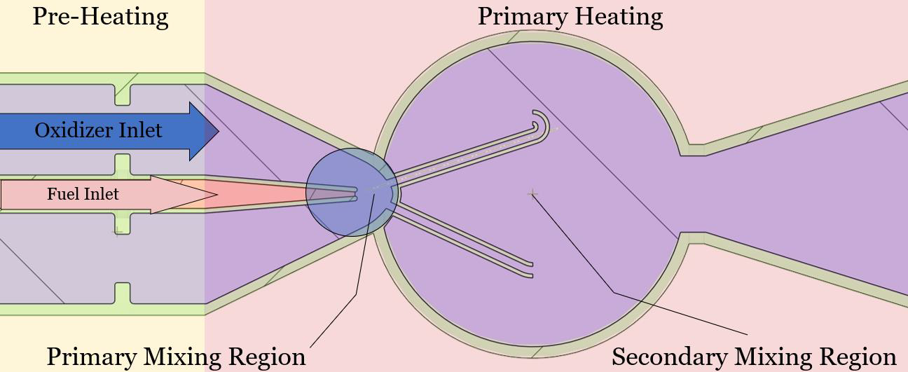
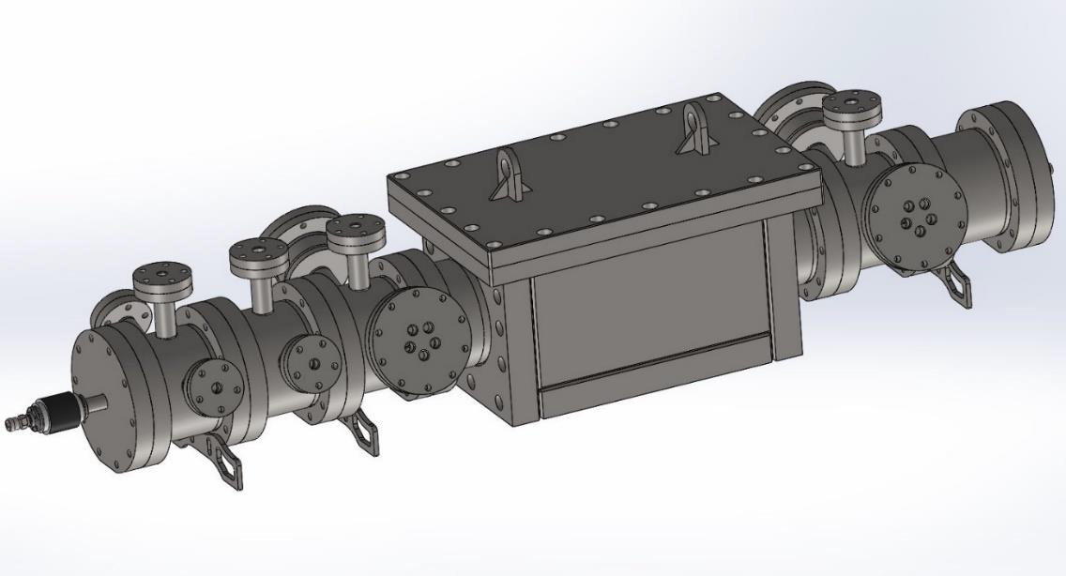
Process
Generally an oxidizer flows into a reactor mainly composed of 70-98% Nitrogen with Oxygen as the remainder.
A fuel (~0.5%) is also injected simultaneously.
Fuel and Oxidizer initially mixed in primary mixing region whilst being Primary Heated.
Reactants then enter the jets and are mixed further where they combust and are ejected.
xy plane process diagram
Rotavera group JSR analysis chamber

Slide 7
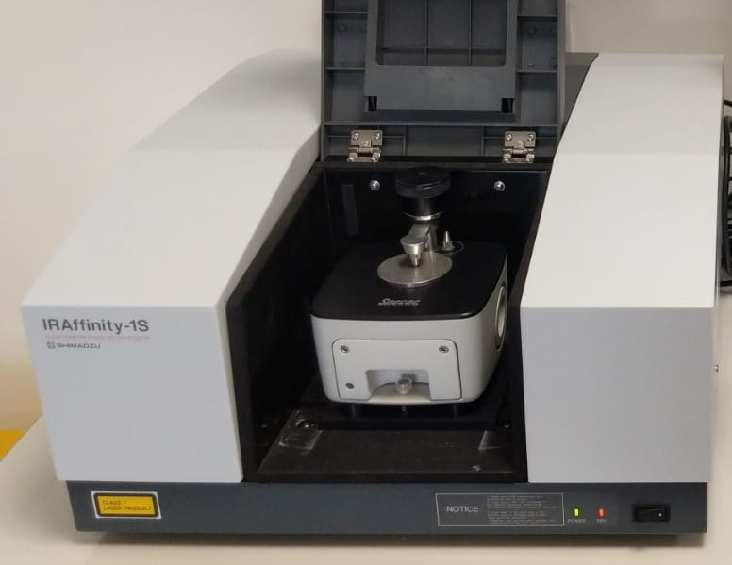
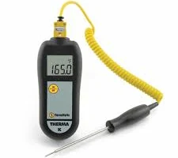
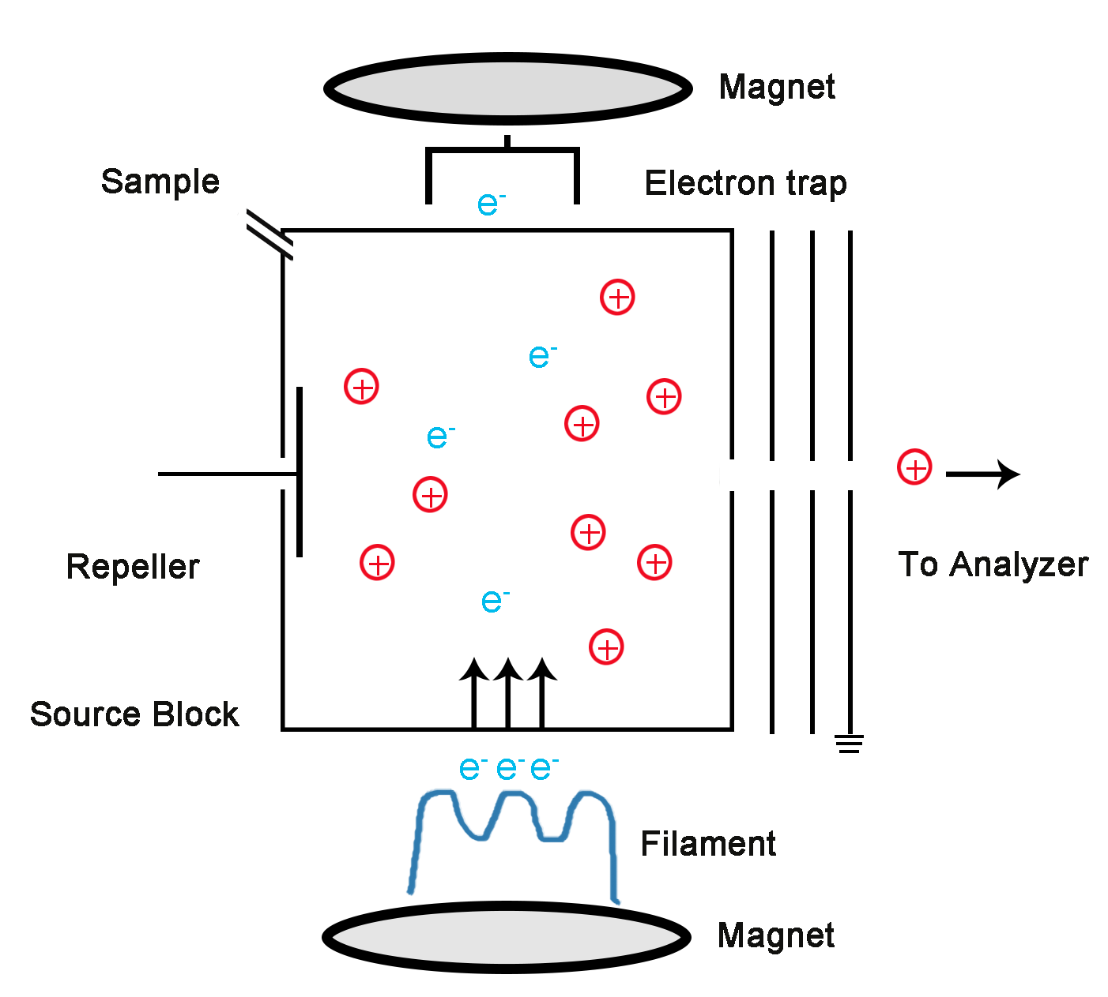
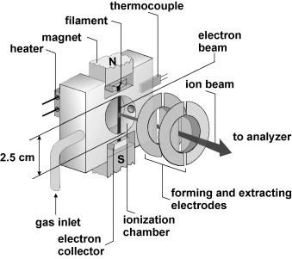
K-type thermocouple
Analysis
On-line Fourier Transform Infrared Spectroscopy
  Used to monitor steady-state
Electron Ionization-Mass Spectrometer/Vacuum-Ultraviolet Photon Detector
  A method of sonic sampling used to isolate samples for analysis down to 1 ppm (uses mass to charge ratio)
K-type thermocouple
  Used to measure temperature at different points in the outlet of the reactor
On-line Fourier Transform Infrared Spectroscopy
a) Electron Ionization-Mass Spectrometer; b)Vacuum-Ultraviolet Photon Detector

Slide 8
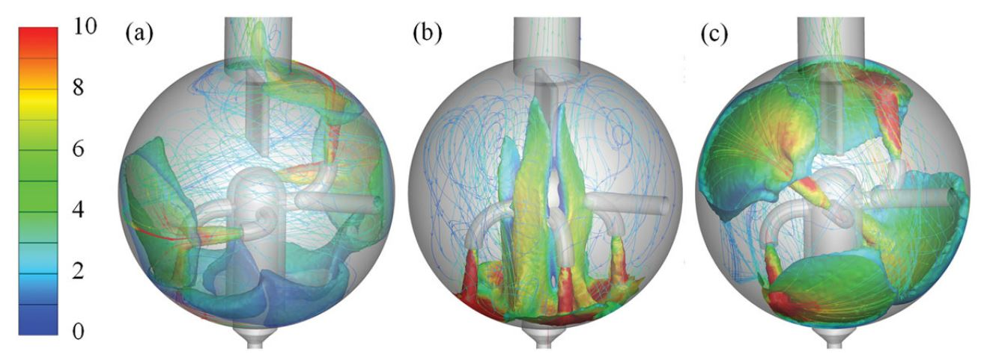
Research Focus
Using CFD to examine thermal uniformity in JSRs
Validate and refine previous simulational models
Primarily to test effects of temperature, pressure, and residence time on reactor thermal homogeneity
Will help determine optimal preset parameters for future combustion studies
  While others have prioritized studying this for JSR designs, this will not be the approach of the study
Rather, will treat JSRs as sound devices to purely study thermal gradients effects
(a)90° jet position; (b)down jet position; (c) 45° jet position
-Reyniers et al.
Notes:
(want to know how properties change between the points we actually measure)

Slide 9
Geometry

Slide 10
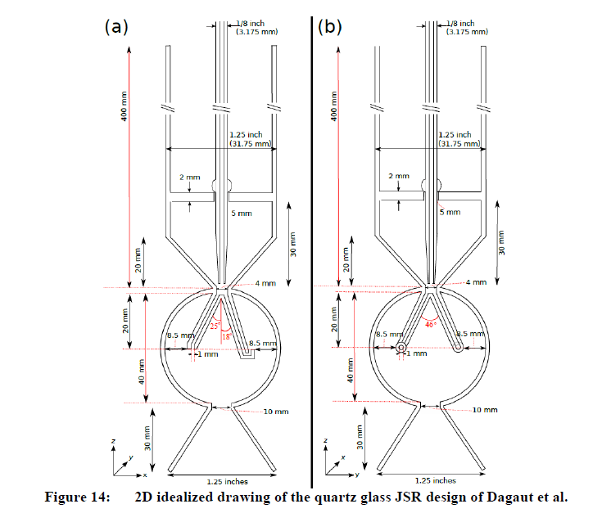
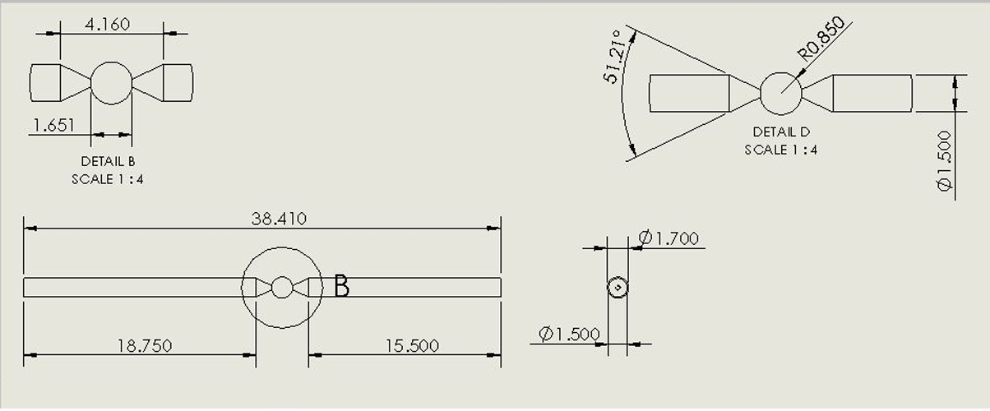
Dimensions
Drawings of Quartz Glass JSR Design of Rotavera Group
2D Drawings of Quartz Glass JSR Design of Dagaut et al

Slide 11
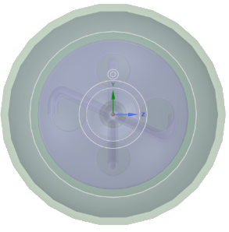
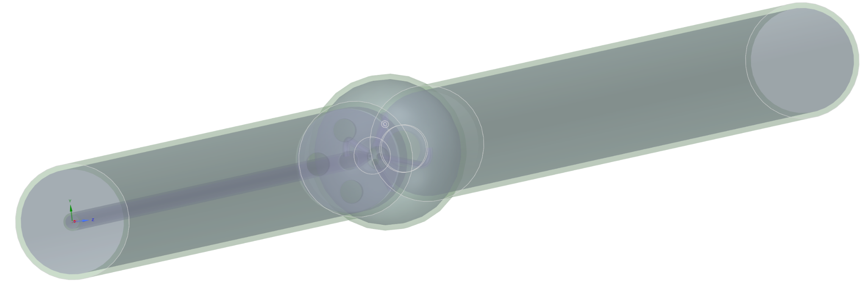
Obtained Computer-Aided Designs (CAD)
JSR axial view from inlet
JSR longitudinal view
JSR Isometric view

Slide 12
Conditions and Assumptions

Slide 13

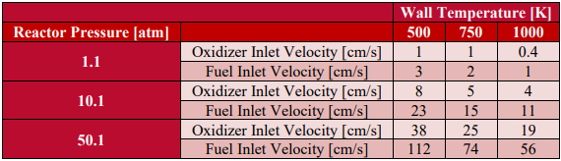
Conditions
Initial Conditions
Boundary Conditions
- Inlet temps of 300 K
- Wall temps of 500 K, 750 K, and 1000 K
- Initial conditions remain constant including velocity, temp, and pressure.

Slide 14

Assumptions Models
Steady-State Flow
Incompressible Flow
  Constant density; low-speed flow (1-112cm/s)
Negligible gravitational forces
  Valid for small-scale reactors
Material is quartz glass
Gas treated as Nitrogen due to predominance
Spalart-Allmaras Turbulence Model
  One-equation turbulence model
  Simulates effects of turbulence with fewer computational resources compared to more complex models such as k-omega or k-epsilon
  Ideal for high Reynolds number flows

Slide 15
Meshing

Slide 16
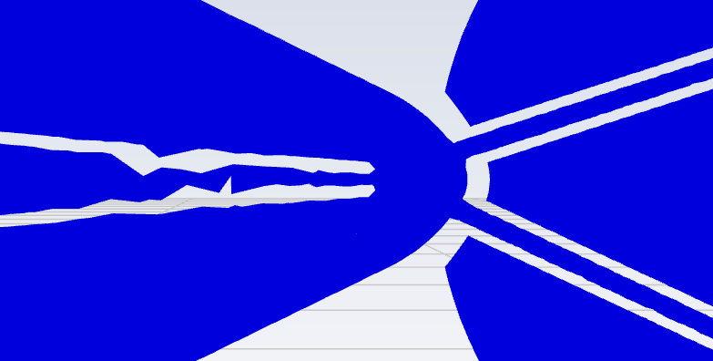
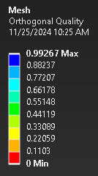
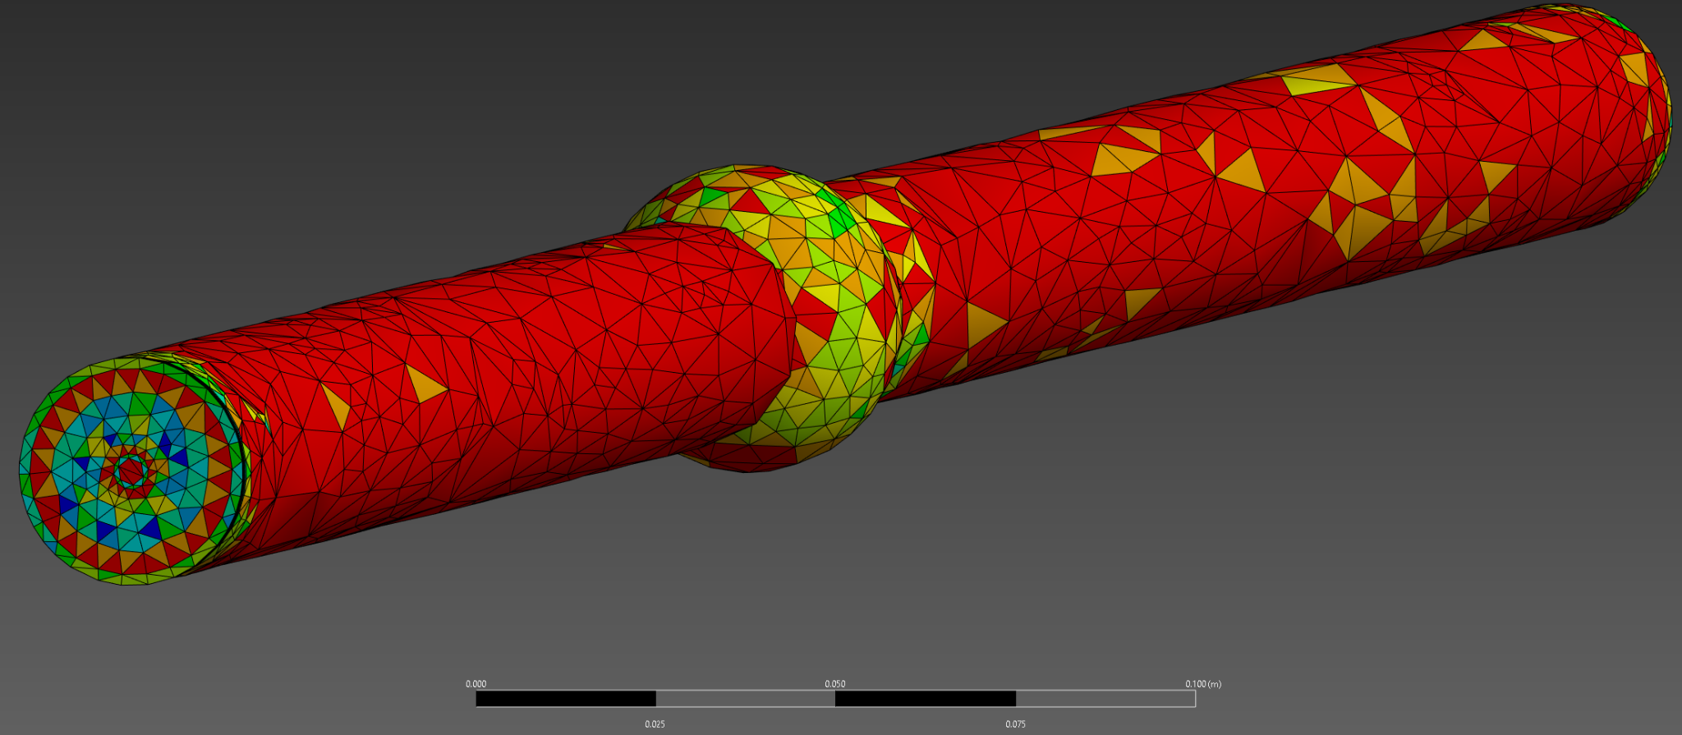
Challenges
Fuel capillary mesh was uneven at first
  Some repairs were made in geometry and mesh to correct this
Cell quality was low
  This was addressed by significantly reducing cell size and angle of curvature

Slide 17
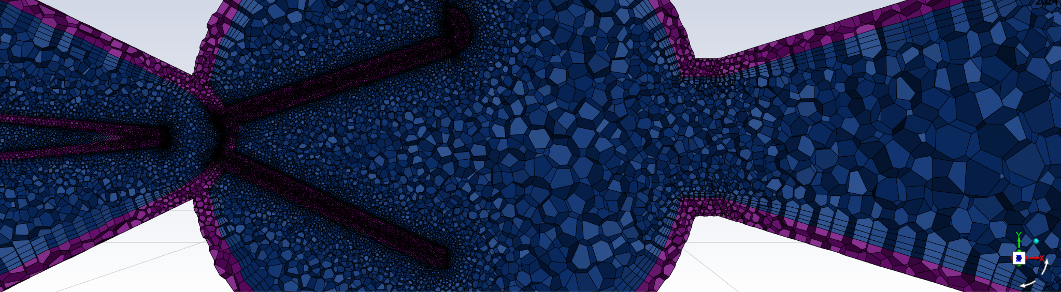
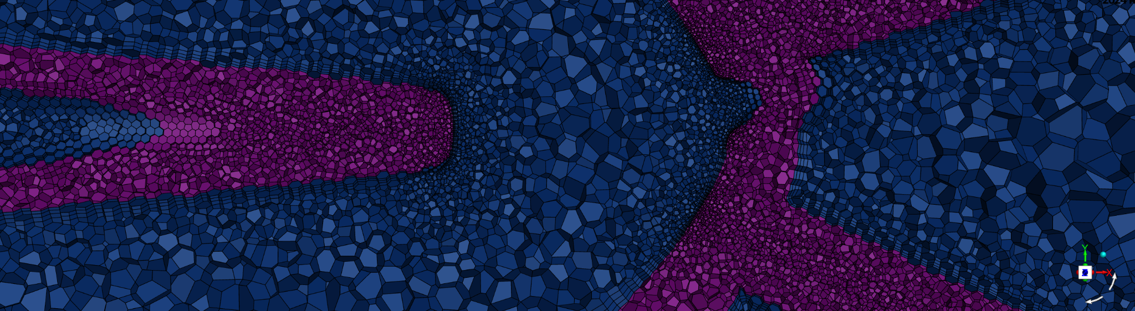
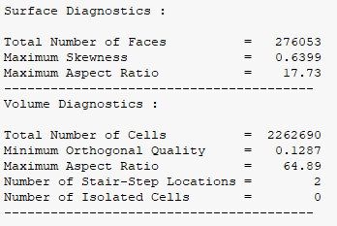
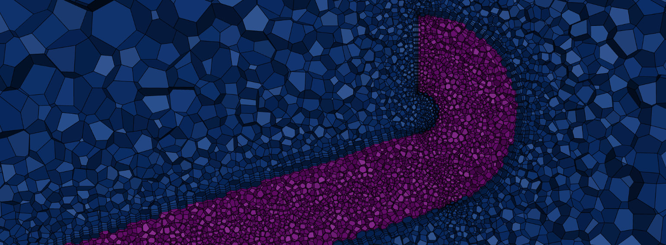
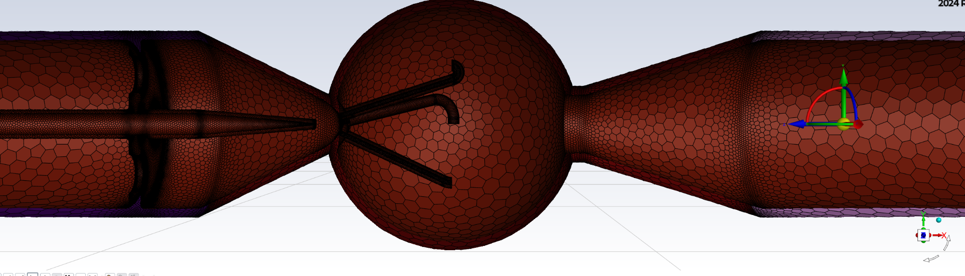
Meshing Results
Reduced the max and min sizes and curvature normal angle

Slide 18
Post-Processing

Slide 19
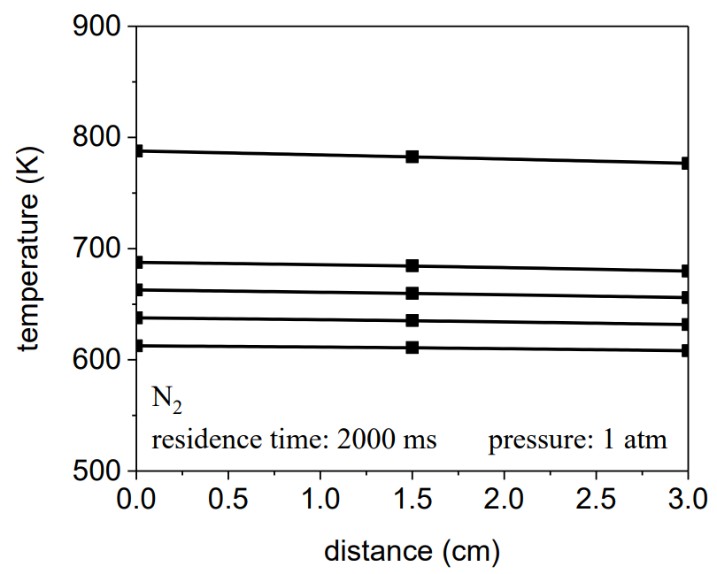
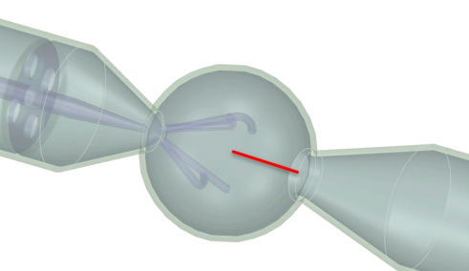
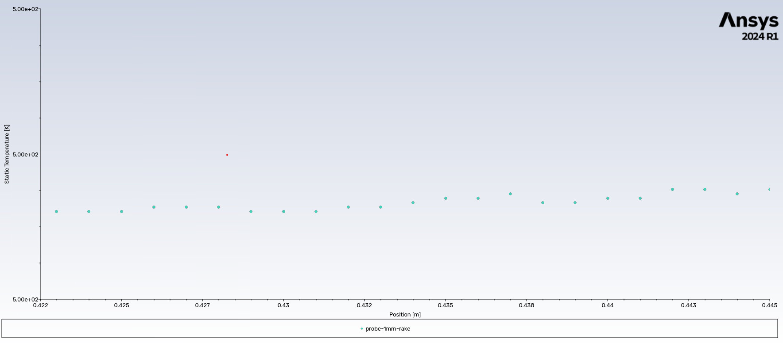

Validation
  Temperature profile was taken from experiments done in secondary mixing region of Rotavera Lab’s JSR
  Compared to temperature profile
Probe and rake position
Temperature probe experimental data
Temperature on y-axis
Probe Position in mm
Simulated temperature profile

Slide 20
Results
Notes:
Make sure to mention that the results will include 3 different pressures addressing pressure and velocity

Slide 21
1 ATM Condition

Slide 22
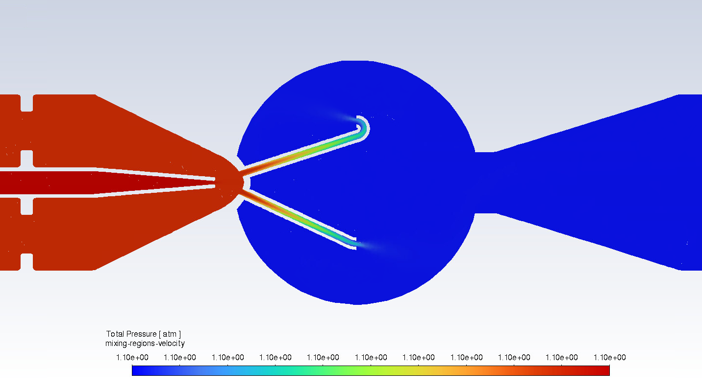
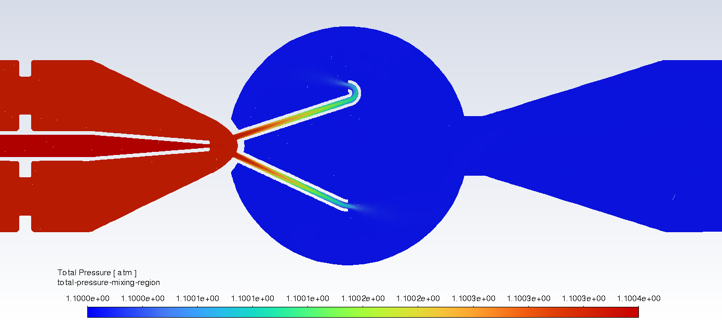
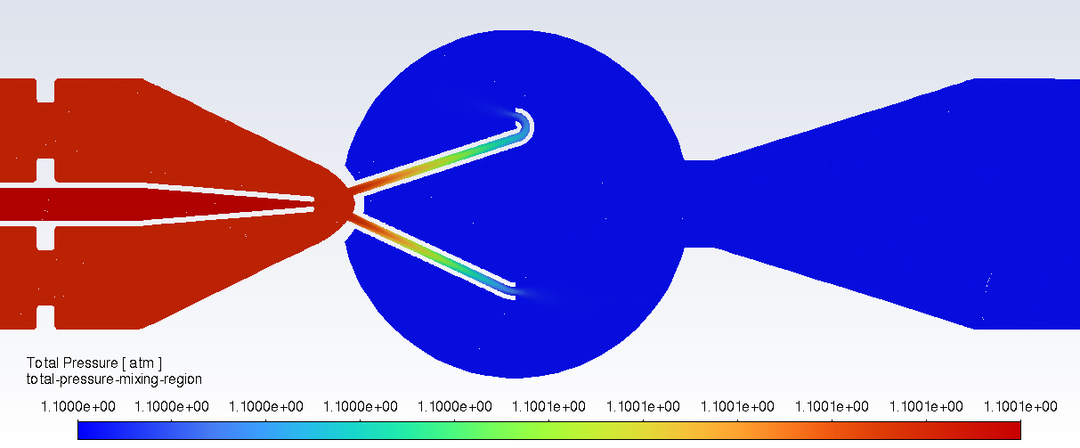
Pressure Contours
500 K
Consistent pressure profiles at 1 ATM
750 K
1000 K

Slide 23
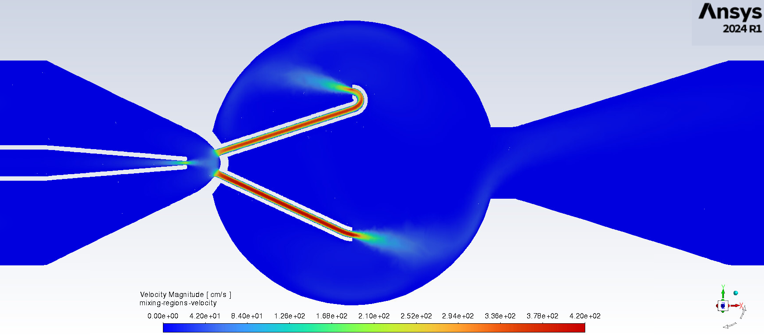
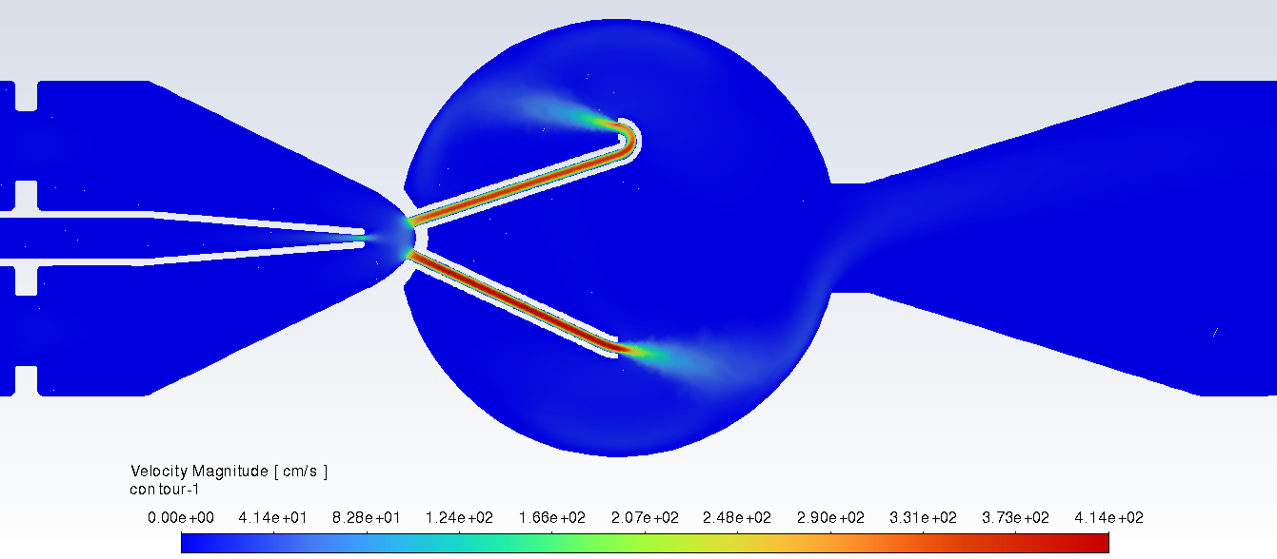
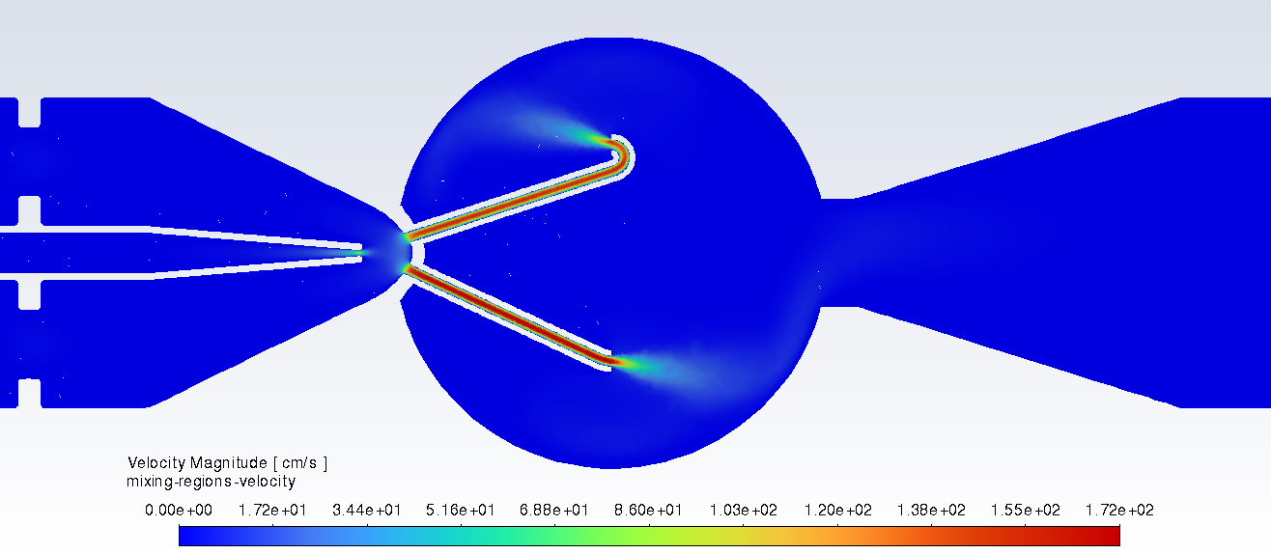
Velocity Contours
500 K
750 K
1000 K
Velocity values reduced with increasing wall temperature conditions as expected

Slide 24
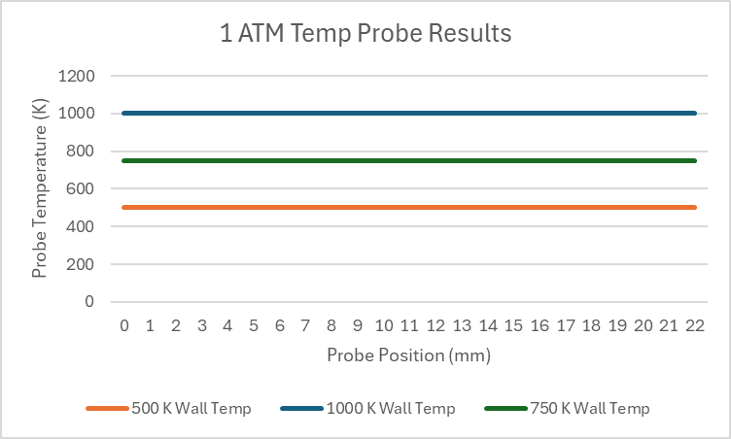
Simulated Temperature Probe Results
Results were consistent with experimental results
Residence time of 4 seconds

Slide 25
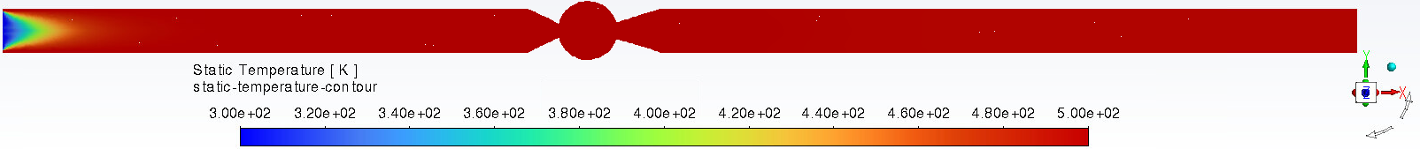
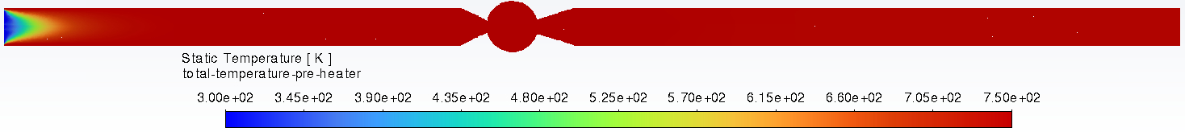
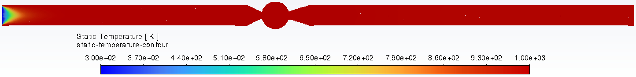
Static Temperature Contours
Static Temp Contour at 1 ATM and 500 K
Static Temp Contour at 1 ATM and 750 K
Static Temp Contour at 1 ATM and 1000 K
Notes:
Keep in mind that each contour has a different maximum temperature value even though they are dictated by the same color

Slide 26
10 ATM Condition

Slide 27
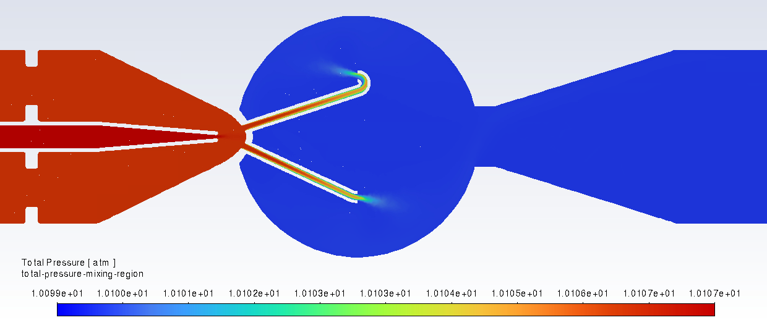
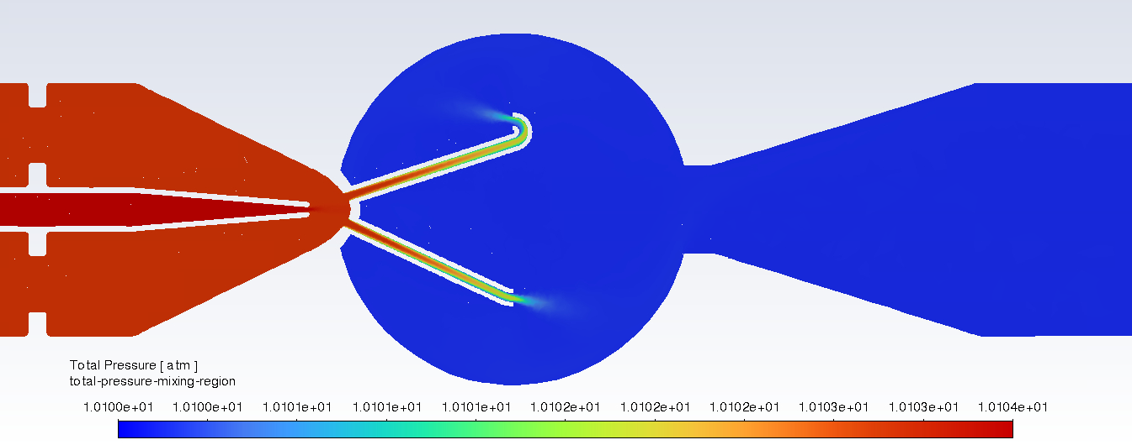
Pressure Contours
500 K
750 K
Again, consistent pressure profiles
1000 K contour convergence issues

Slide 28
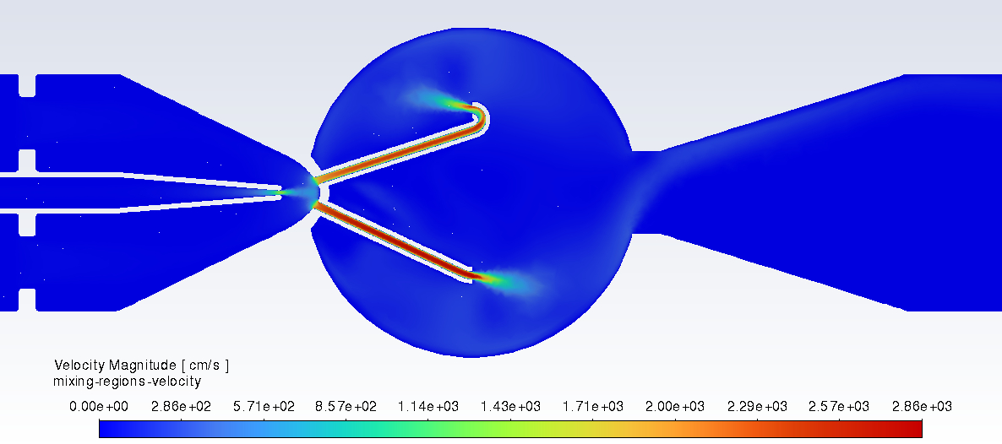
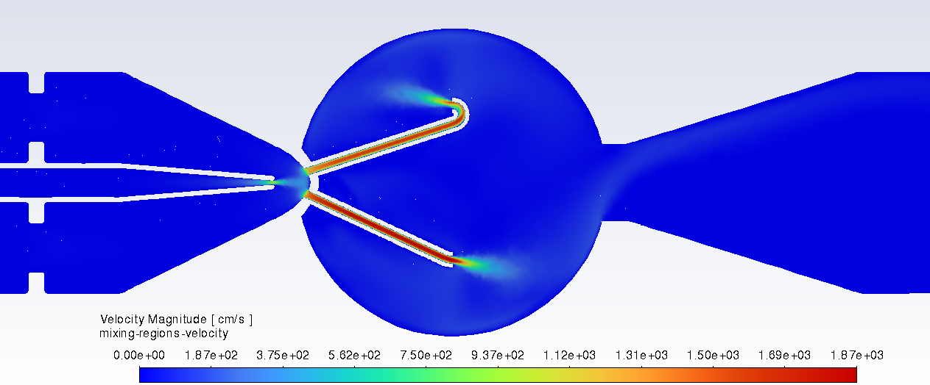
Velocity Contours
500 K
750 K
Higher velocities at higher pressure
1000 K contour convergence issues

Slide 29
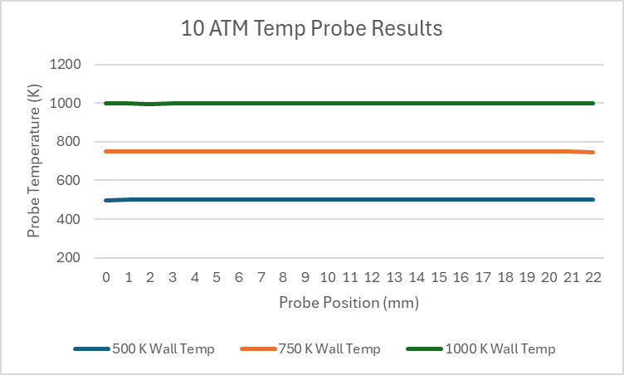
Simulated Temperature Probe Results
Results again indicate a linear profile
Very insignificant changes in data points (in the tenth decimal place)

Slide 30
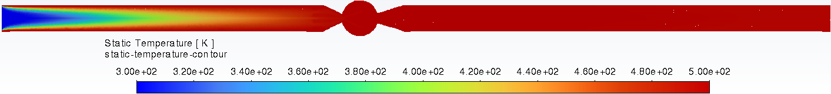
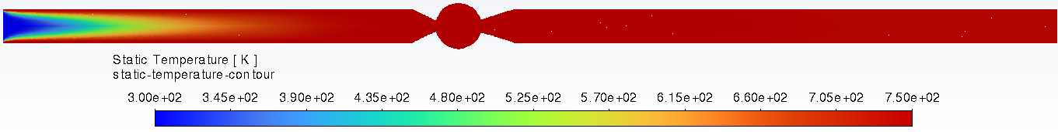
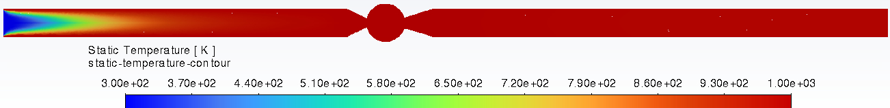
Static Temperature Contours
Static Temp Contour at 10 ATM and 500 K
Static Temp Contour at 10 ATM and 750 K
Static Temp Contour at 10 ATM and 1000 K

Slide 31
50 ATM Condition

Slide 32
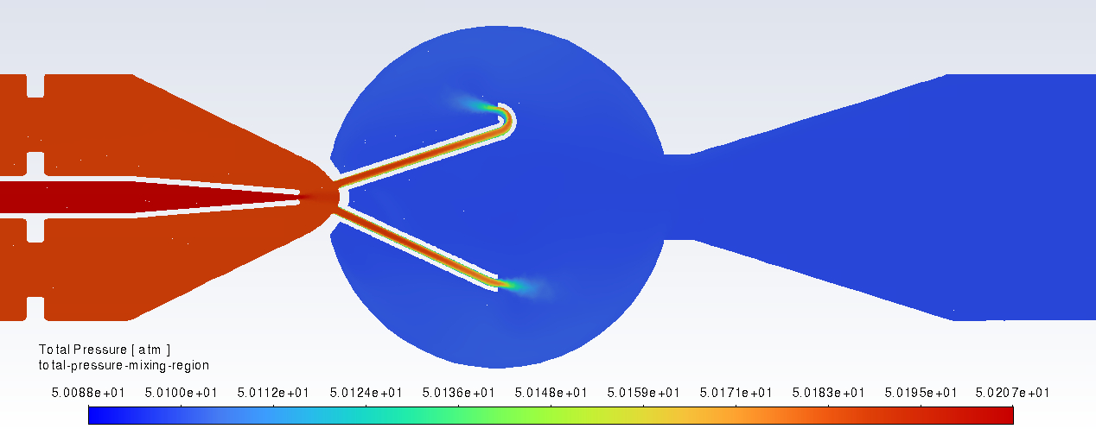
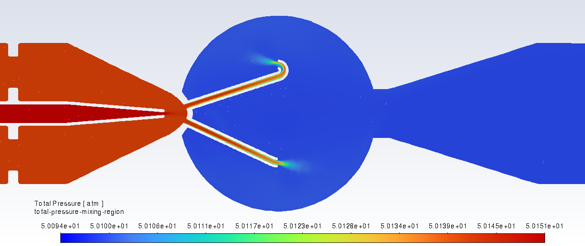
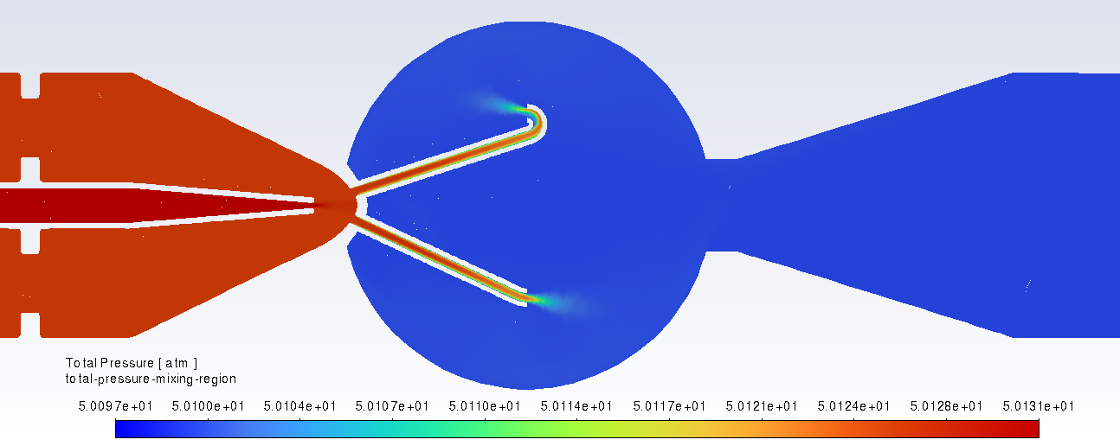
Pressure Contours
500 K
750 K
1000 K

Slide 33
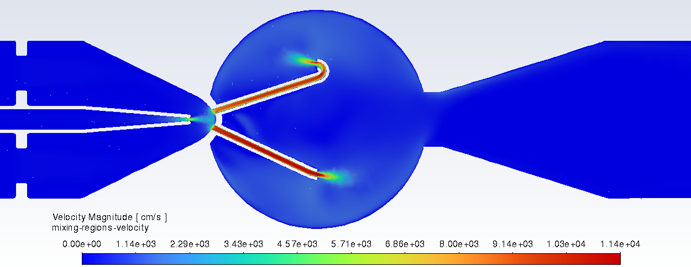


Velocity Contours
500 K
750 K
1000 K
Significant increase in velocity
Consistent profiles

Slide 34

Simulated Temperature Probe Results
Diffusion rates slow with increasing pressure

Slide 35



Static Temperature Contours
Static Temp Contour at 50 ATM and 500 K
Static Temp Contour at 50 ATM and 750 K
Static Temp Contour at 50 ATM and 1000 K

Slide 36
Conclusion

Slide 37
Next Steps
10 and 50 ATM experimental data
Influence of the SA model compared to other models
  Determine impact of other models
Add chemical reactions to the CFD model
  Determine degree of exothermicity impact using Chemkin simulations
  Changes in thermal gradient will inform us what would be a good starting point for initial conditions

Slide 38


Acknowledgements
Center for Undergraduate Research Opportunities
Georgia Advanced Computing Resource Center

Slide 39
References
Dagaut, P., Cathonnet, M., Rouan, J. P., Foulatier, R., Quilgars, A., Boettner, J. C., Gaillard, F., and James, H. "A jet-stirred reactor for kinetic studies of homogeneous gas-phase reactions at pressures up to ten atmospheres (≈1 MPa)," Journal of Physics E: Scientific Instruments Vol. 19, No. 3, 1986, p. 207. doi: 10.1088/0022-3735/19/3/009
Dejongh, J. (2024). “Computational Fluid Dynamics Modeling of Jet-Stirred Reactors”. University of Georgia
Herbinet, O., & Dayma, G. (2013). “Jet-stirred reactors”. Green Energy and Technology, 183–210. https://doi.org/10.1007/978-1-4471-5307-8_8
Reyniers, Pieter A., et al. “Computational Fluid Dynamic Design of Jet Stirred Reactors for Measuring Intrinsic Kinetics of Gas-Phase and Gas-Solid Reactions.” International Journal of Chemical Kinetics, vol. 48, no. 9, 11 July 2016, pp. 556–569, https://doi.org/10.1002/kin.21016. Accessed 15 June 2021.
Zhang, Tianhan, et al. “Numerical Studies of Novel Inwardly Off-Center Shearing Jet-Stirred Reactor.” AIAA Journal, vol. 56, no. 9, 1 Aug. 2018, pp. 3388–3392, https://doi.org/10.2514/1.j057293. Accessed 5 Nov. 2024.

Slide 40
THANK YOU!

