Slide 1
The Orbiter: Pushing the Boundaries of Conventional Amateur Rocketry
Yash Malik
Florida Institute of Technology
AIAA Region II Student Conference, April 4-5, 2025
Copyright © by Yash Malik, Florida Institute of Technology
Published by the American Institute of Aeronautics and Astronautics, Inc., with permission.

Slide 2
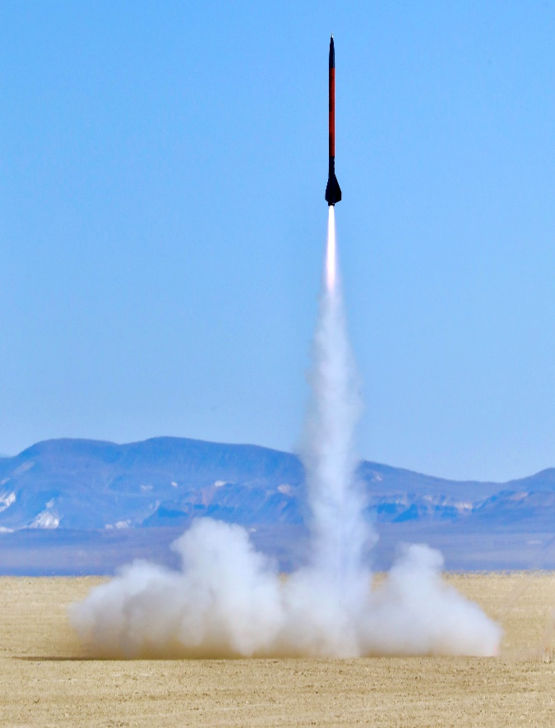
Amatuer Rocketry – What is it?
A hobby where the user designs, builds, and launches a rocket
Of those rockets one may fly it for either proof of concept, certification, or a test flight
2 main certification Organizations in the U.S.A
[1]

Slide 3


Certification Organizations
National Association of Rocketry (NAR)
  Holds Certification Program
  Largest and oldest program in the world
[2]
Tripoli Rocketry Association (TRA)
Holds Certification Program
Allows for experimental motors to be flown
[3]

Slide 4
Certification Levels
Level 1 (L1)
Must use a H or I motor
More than 80 N average thrust
Single motor of 160.01 [N*s]
Level 3 (L3)
Must have an L2
Must use a M, N, or O motor
Must have experience in L2 capable launches
Submit a design to L3 certification committee
Level 2 (L2)
Must have an L1
Must use a J, K, or L motor
No more than 5120.00 [N*s]
4

Slide 5
FAA Regulations – Class 2 Amateur Rocketry
[4]
14 CFR 101.22
Weighs more than 1.5 [kg] including propellant
Not launch with 5/10ths coverage prevailing
Not into any cloud
Not within 9.62 [km] of an airport
No prior authorization from FAA in controlled airspace (COA)
Must be 18 years or older
5

Slide 6
[5]
NAR High Power Safety Code – Relevant Rules
Shall only fly rockets within the scope of certification level
Shall only use paper, wood, rubber, breakable plastic, fiberglass, or when necessary ductile metal
Shall only use Certified Commercially made rocket motors with exceptions given by the manufacturer
Shall not exceed more than 40,960 [N*s] or weigh more than 1/3rd of the certified average thrust.
Shall use an active recovery system that shall be able to be reused
6
Notes:
NAR high power safety code rules that had applied to this project were:

Slide 7
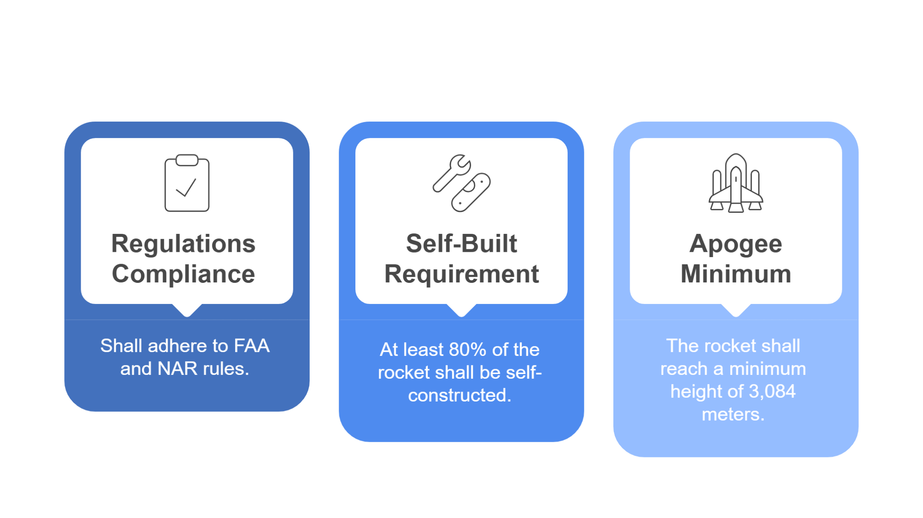
Requirements
7

Slide 8
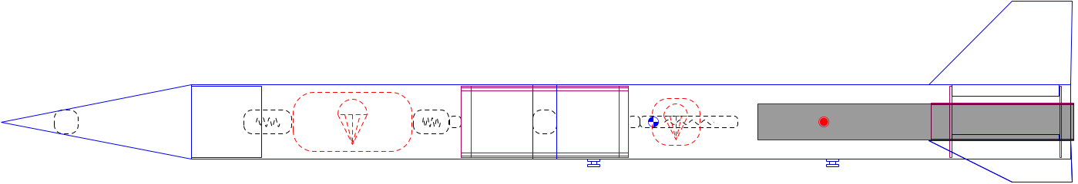
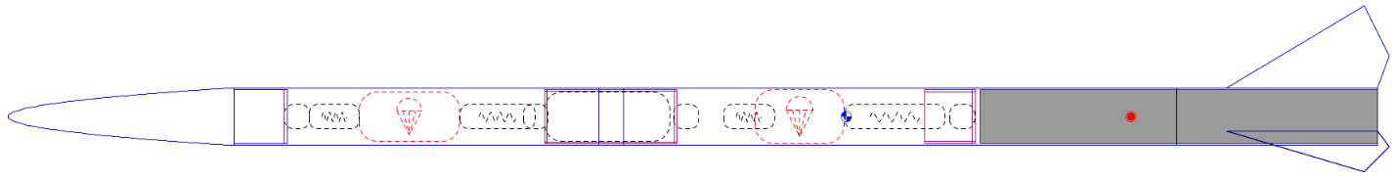
Conventional vs. Unconventional
8

Slide 9
System Overview
4.93 caliber
58.4mm
1.63m
9

Slide 10
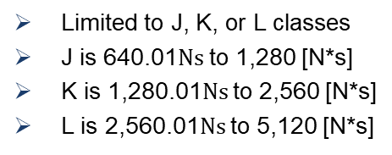
Motor
Motor Class |  | J |  | K |  | L
Criteria | Importance | Rating | Weighted Rating | Rating | Weighted Rating | Rating | Weighted Rating
Diameter Range | 30% | 1 | 0.3 | 3 | 0.9 | 4 | 1.2
Cost | 35% | 4 | 1.4 | 3 | 1.05 | 1 | 0.35
Total Impulse | 20% | 4 | 0.8 | 3 | 0.6 | 2 | 0.4
Length | 15% | 2 | 0.3 | 3 | 0.45 | 5 | 0.75
Total | 100% |  | 2.8 |  | 3 |  | 2.7
Limited to J, K, or L classes
J is 640.01$Ns$ to 1,280 [N*s]
K is 1,280.01$Ns$ to 2,560 [N*s]
L is 2,560.01$Ns$ to 5,120 [N*s]
10
Notes:
Note: There is a grey area when it comes to the impulse ranges of J, K, or L

Slide 11
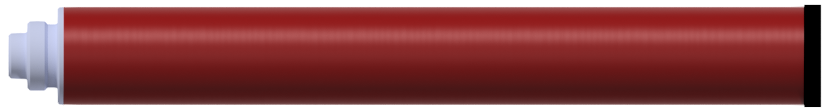
Motor
Decided on AeroTech K805-P
Used RMS 54/1706
Had needed separate ejection charges
Height was unachievable using the conventional method
44.5cm
5.66cm
11

Slide 12
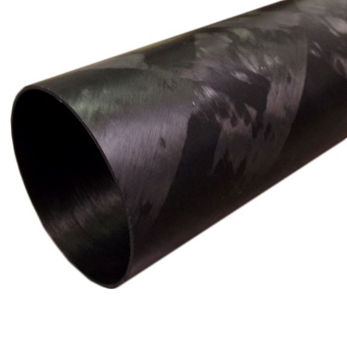
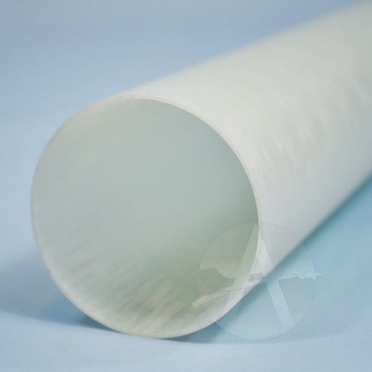
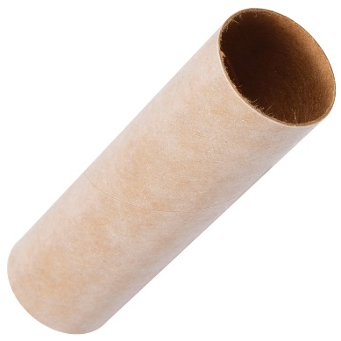
Airframe
Materials
Cardboard
Fiberglass
Carbon Fiber
Manufacture or Buy?
[6]
[7]
Manufacturing was chosen
Body Tubes made up a large amount of the 80% requirement
Fiberglass was chosen
[8]
12

Slide 13
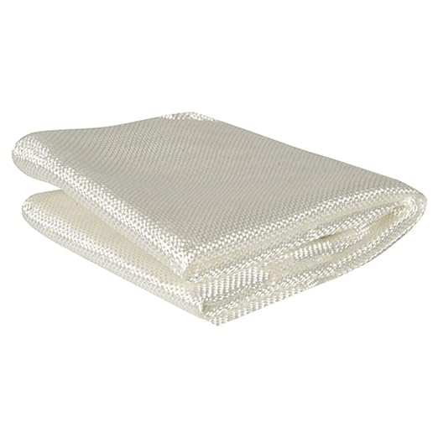
Airframe
Fiberglass
Desired weight
Minimum diameter rocket
Space constraints
Different method for attaching fins
Avionics Bay
[9]
The avionics bay was much smaller
Was made of 3D printed materials only
The strength was needed to be tested
13

Slide 14
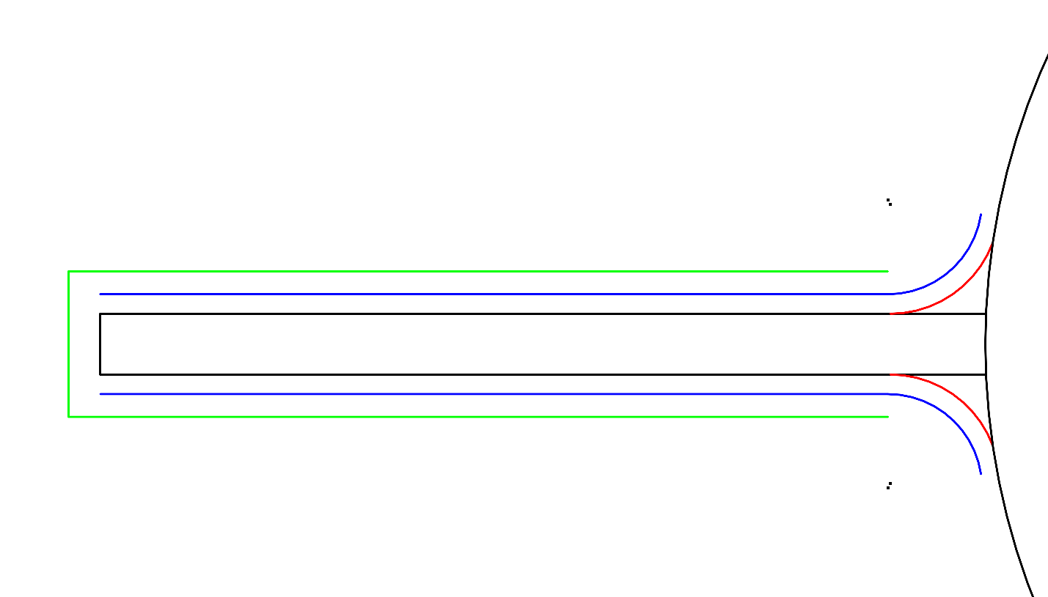

Airframe - Fins
Composite sandwich
PETG base
Fiberglass overlay
Fillets
Fiberglass Layer 1
Fiberglass Layer 2
8.25cm
15.3cm
14

Slide 15
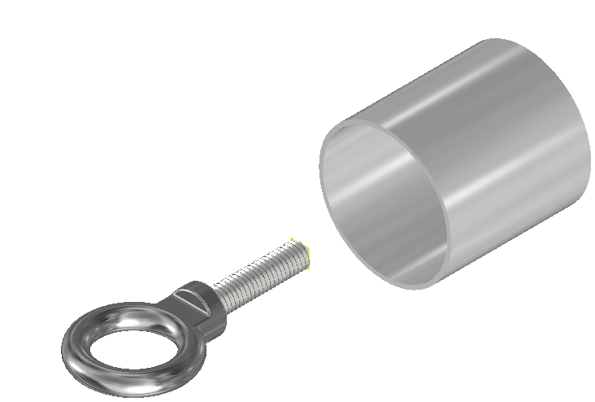
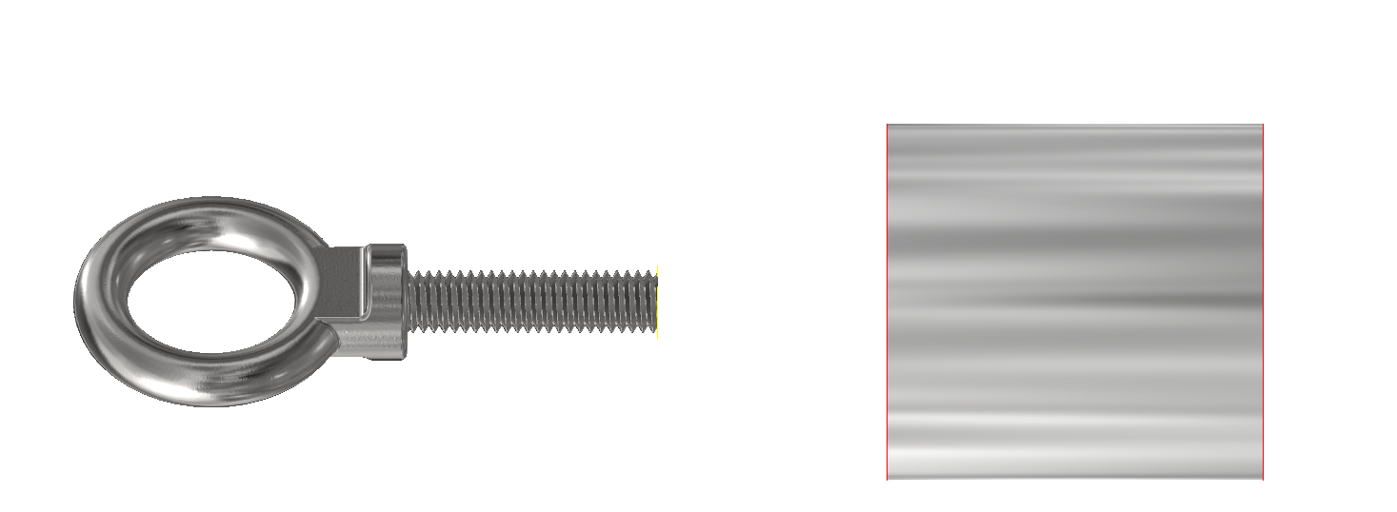
Motor Retention System
Minimum diameter meant that no retaining ring was used
Created a position of failure
Custom options were explored
Aluminum 6061 was chosen
58.4mm
11.4cm
58.4mm
9.53mm
15

Slide 16
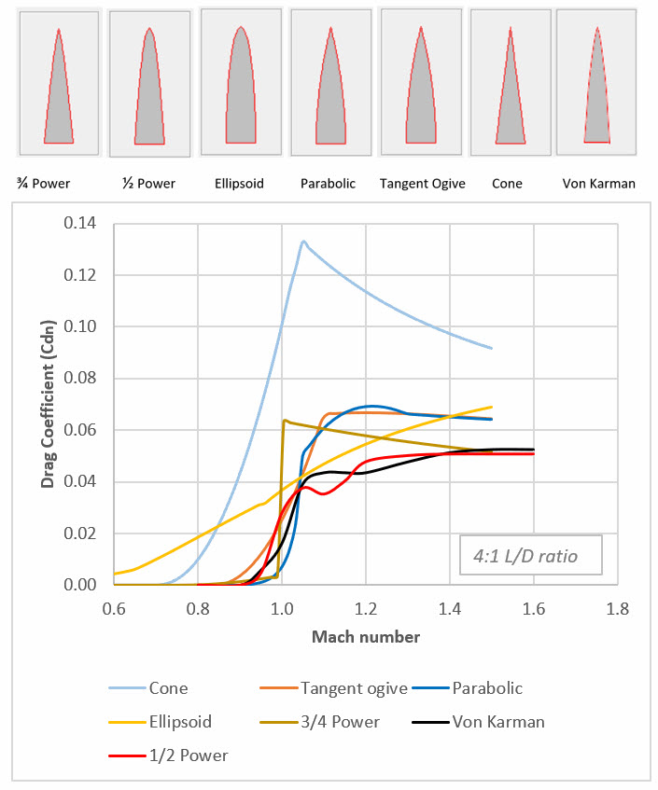
Nose Cone - Geometry
Many shapes
Drag coefficient vs. Mach number was looked at
Three types were evaluated
½ Power series was chosen
[4]
16

Slide 17

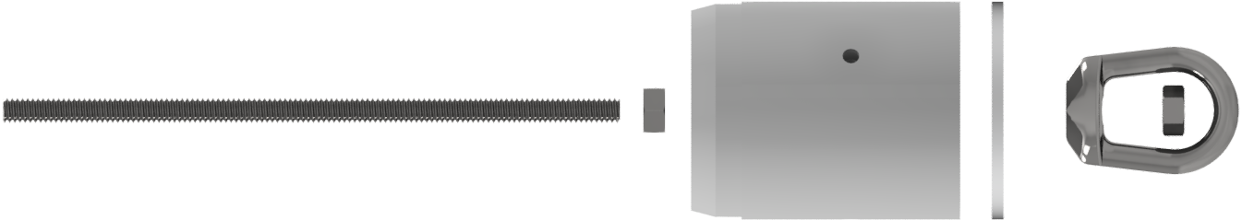
Nose Cone – Shoulder
Contained print in place nuts
Allowed for a strong connection to the airframe
Served as a mounting point for the recovery system
6.66cm
38.1mm
15.2cm
6.35mm
3.04mm
17

Slide 18
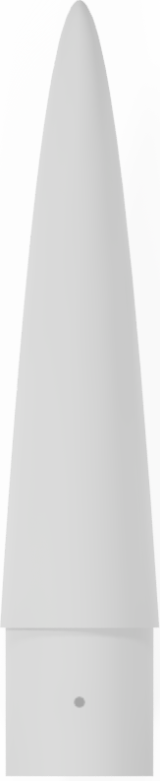
Nose Cone – Materials
3D printed materials were utilized to achieve the complex geometry
Since the nose cone was made from 3D printed materials, simulations were done to ensure it could withstand aerothermal heating
28.3cm
5.41cm
18

Slide 19

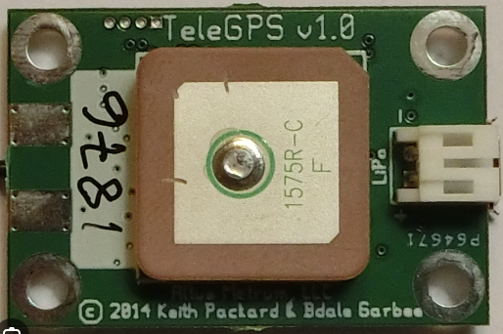
Electronics
Altimeter
  Handle Mach speeds
  Dual Deploy for fast recovery
GPS
  Functional at high speeds and altitude
  Transmit far to account for drift
Battery
  9V with 1,000 mAh
  2 batteries for power redundancy
  Separation prevented shorting of electronics
PerfectFlite Stratologger SL100
[11]
Altus Metrum TeleGPS
[12]
19

Slide 20
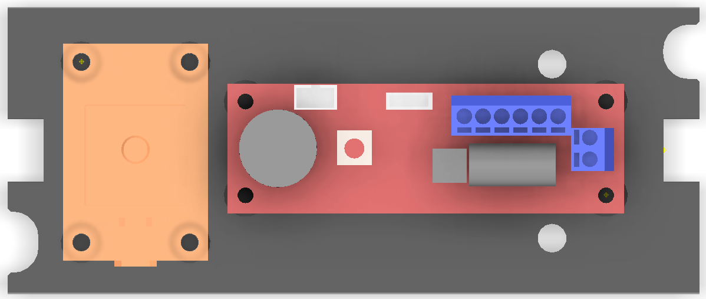
Avionics Sled – Mounting Positions
Mounted on a plate, which slid into the avionics bay
Electronics mounted with battery terminals facing away from each other
12.2cm
3.81cm
2.29cm
5cm
2.54cm
6.98cm
20

Slide 21

Recovery System
Main
Booster
Main concern was Ejection charge
All Kevlar was chosen
Mounted to the Avionics and Nose Cone bulkheads
Made use of Quick Links at all connection points
Swivels for parachutes
Determined strength from deployment at terminal velocity
A Sheet chute and Tarc chute were chosen for the recovery system
21

Slide 22
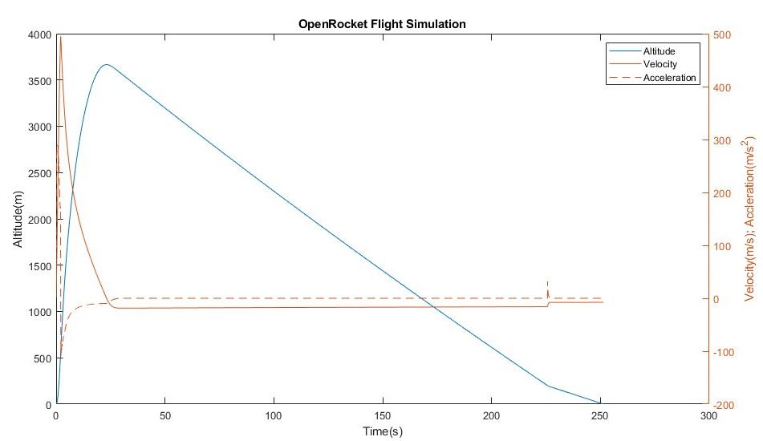
OpenRocket Flight Simulation
Looked at:
  Flight Simulation
  Drag coefficient vs. Mach Number
Calculated using derivations of Barrowman’s Method
22

Slide 23
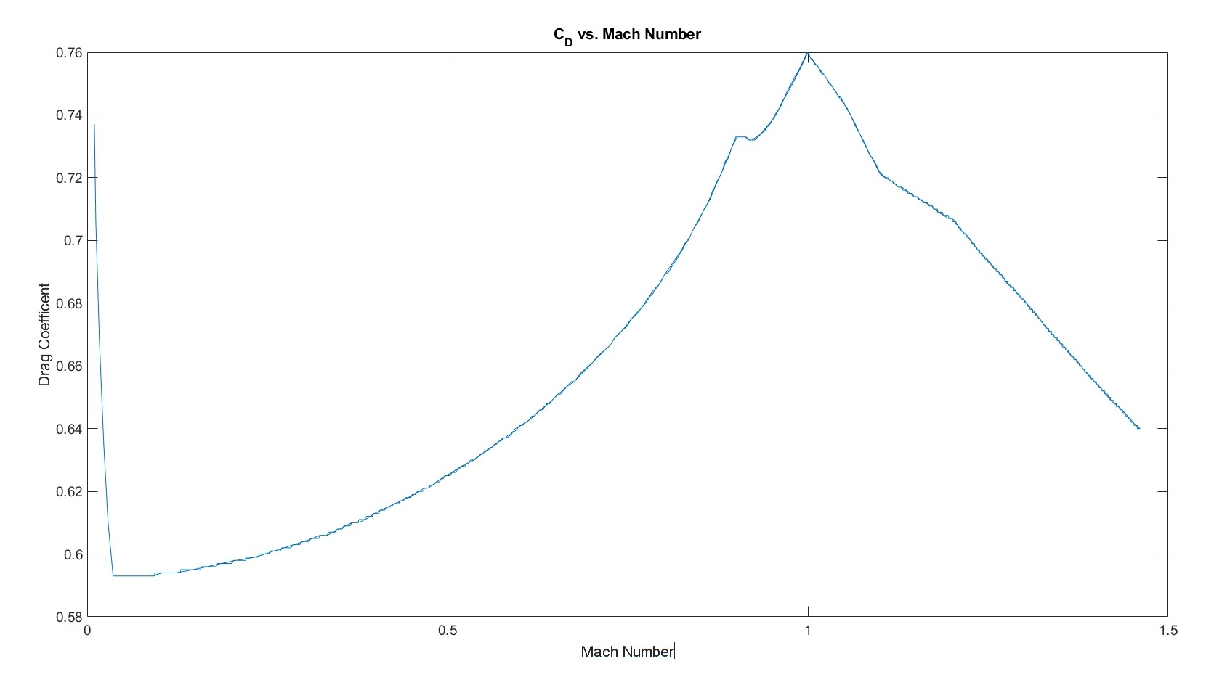
Drag coefficient vs. Mach number
23

Slide 24
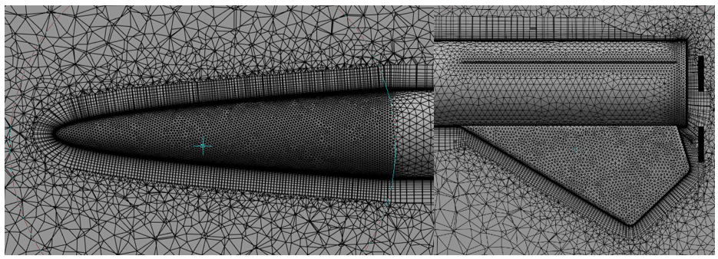
Ansys Fluent
~1.81 million elements
Face meshing for nose cone and fins 2 [mm]
Face meshing for body 4 [mm]
Inflation over the rocket: First layer thickness 1 [μm] and 20 layers
Body sizing for control volume 60 [cm]
24

Slide 25
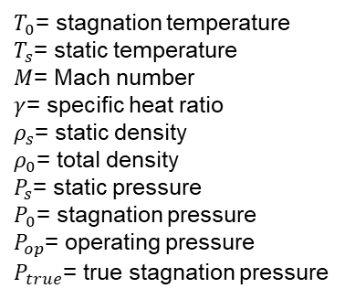
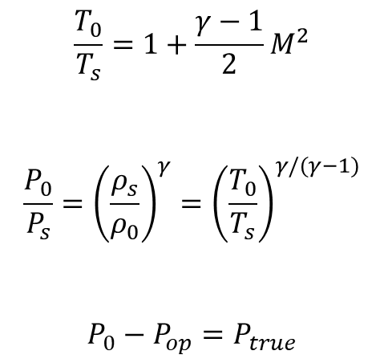
Ansys Fluent Simulation Settings
K-Epsilon Realizable
Wall roughness constant of 60 [μm]
Pressure Inlet calculated using Isentropic Equations
Assumed 101,325 [Pa] for static pressure
Calculated ~271,000 [Pa] for stagnation pressure
$$\frac{T_{0}}{T_{s}}=1+\frac{γ−1}{2}M^{2}$$
$$\frac{P_{0}}{P_{s}}={\left(\frac{ρ_{s}}{ρ_{0}}\right)}^{γ}={\left(\frac{T_{0}}{T_{s}}\right)}^{γ/(γ−1)}$$
$$P_{0}−P_{op}=P_{true}$$
$T_{0}$= stagnation temperature
$T_{s}$= static temperature
$M$= Mach number
$γ$= specific heat ratio
$ρ_{s}$= static density
$ρ_{0}$= total density
$P_{s}$= static pressure
$P_{0}$= stagnation pressure
$P_{op}$= operating pressure
$P_{true}$= true stagnation pressure
25

Slide 26
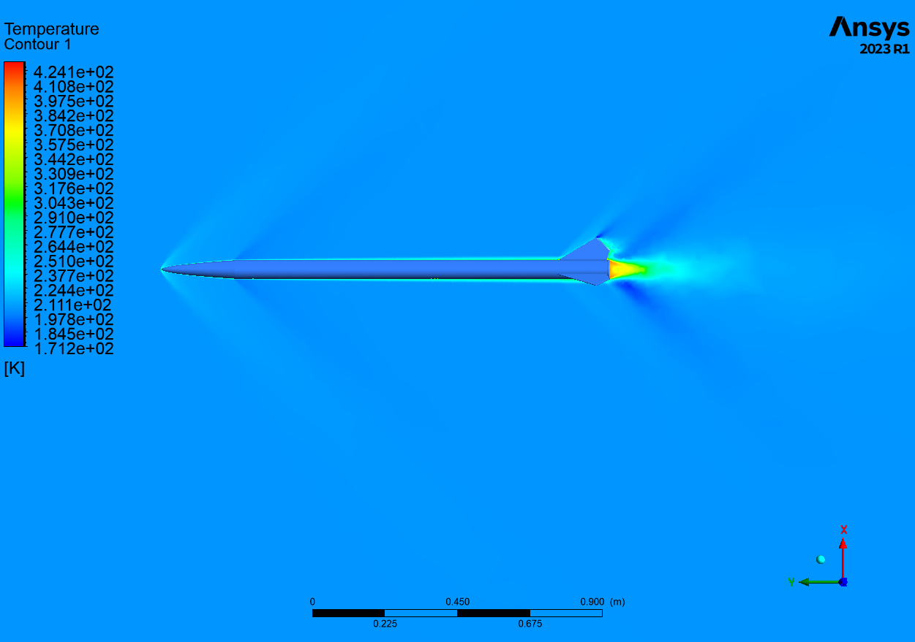
Ansys Fluent Results – Temperature
Temperature at the tip of 158ºC
PA-6 CF (Nylon Reinforced Carbon Fiber) was chosen
Maximum Deflection Temperature of 182ºC [10]
26

Slide 27
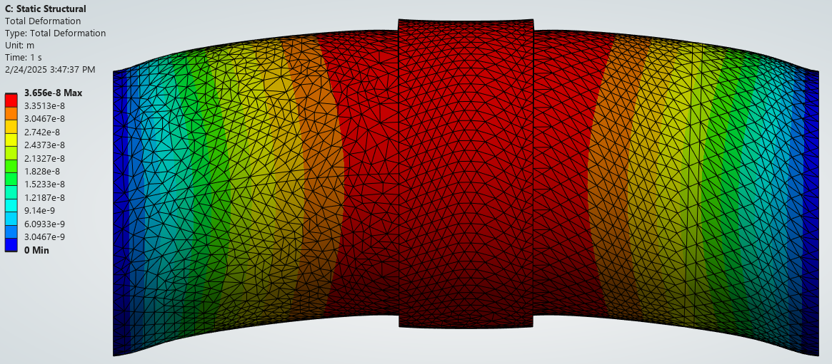
Ansys Static Structural – Auto scale
Fixed supports were used on the ends
Simulated 3 materials: Onyx, PA-6 CF, PLA
Best material shown
0.365 [nm] of total deformation
300 [N] applied load
27

Slide 28
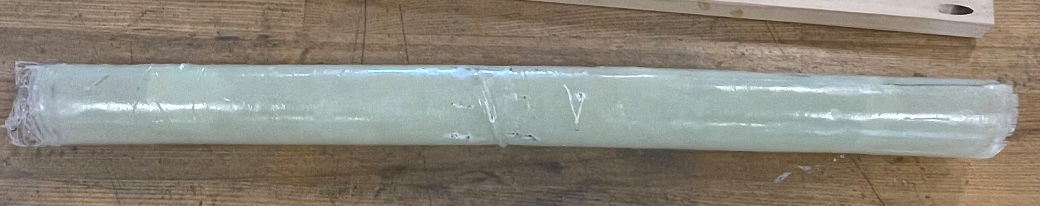
Manufacturing – Body tubes
A 3D printed mandril was used
Fiberglass cloth was wrapped around it, which created the body tube
West System’s 105 Epoxy and 206 Hardener was utilized
Adhesion to the mandril was prevented with Car Wax
28

Slide 29
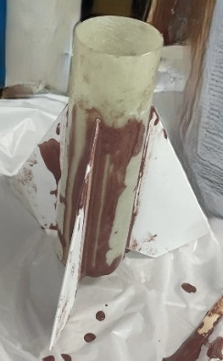
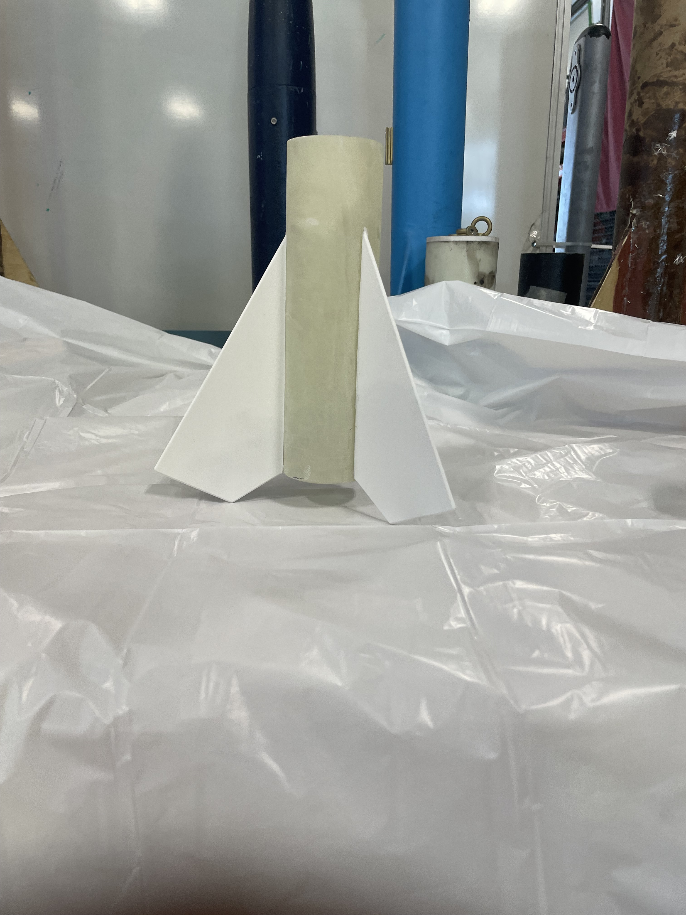
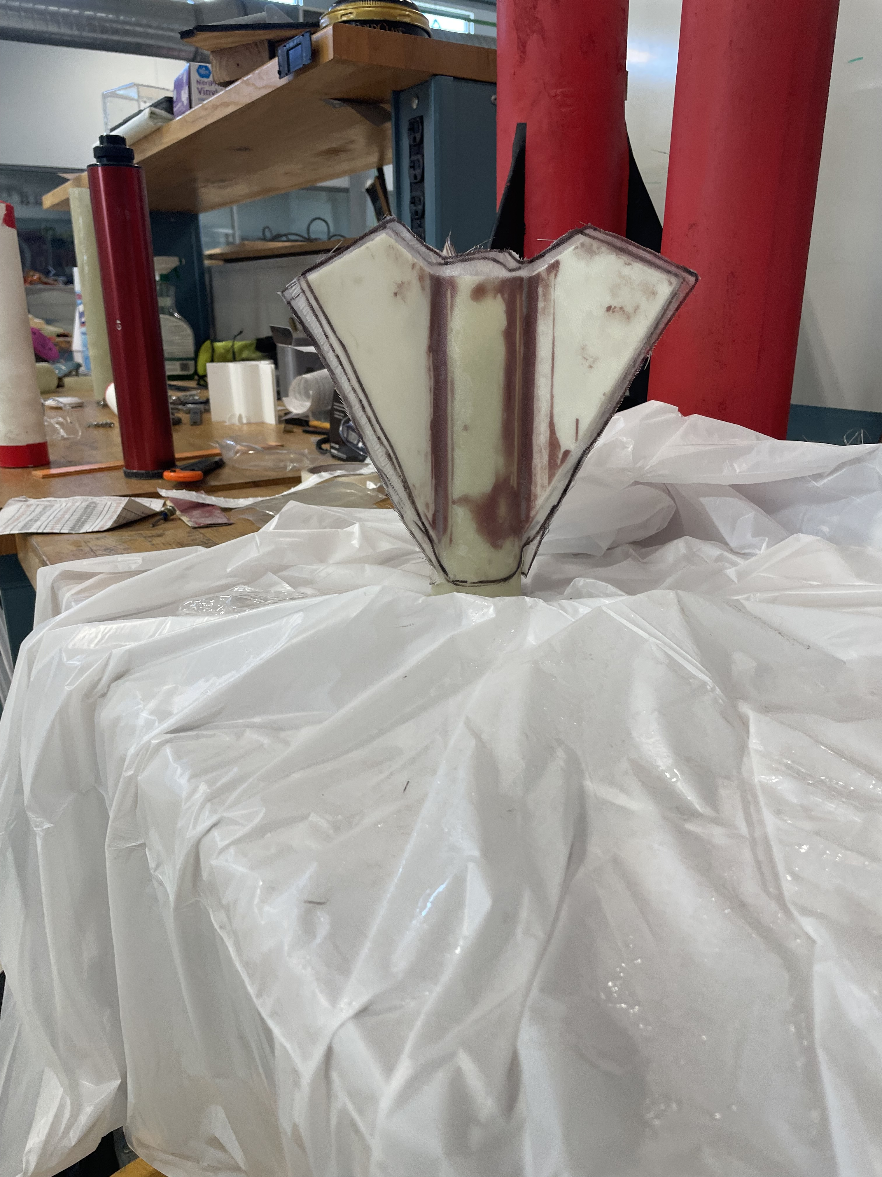
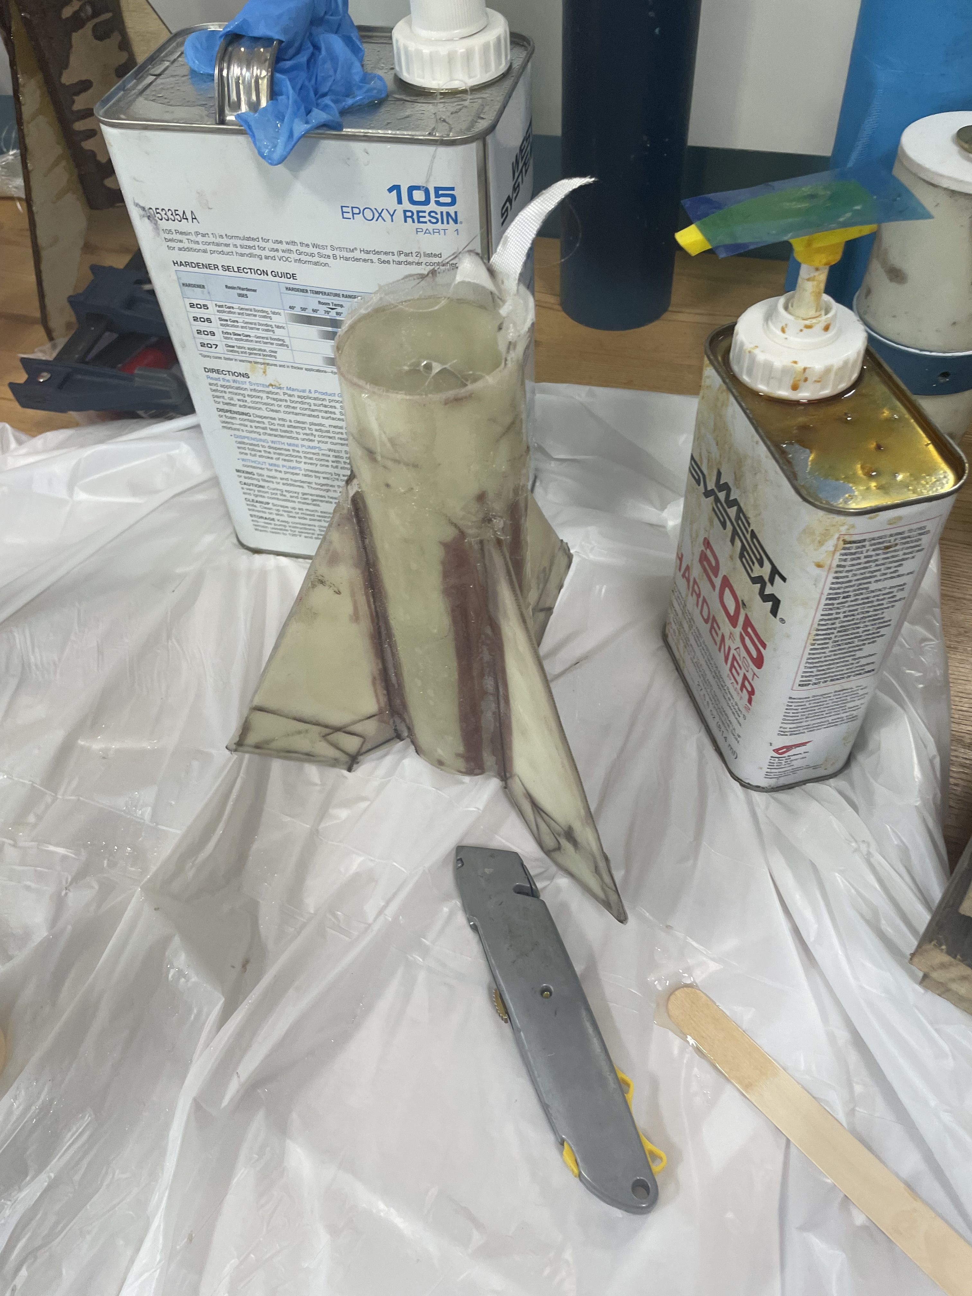
Manufacturing – Fins
Process
29

Slide 30
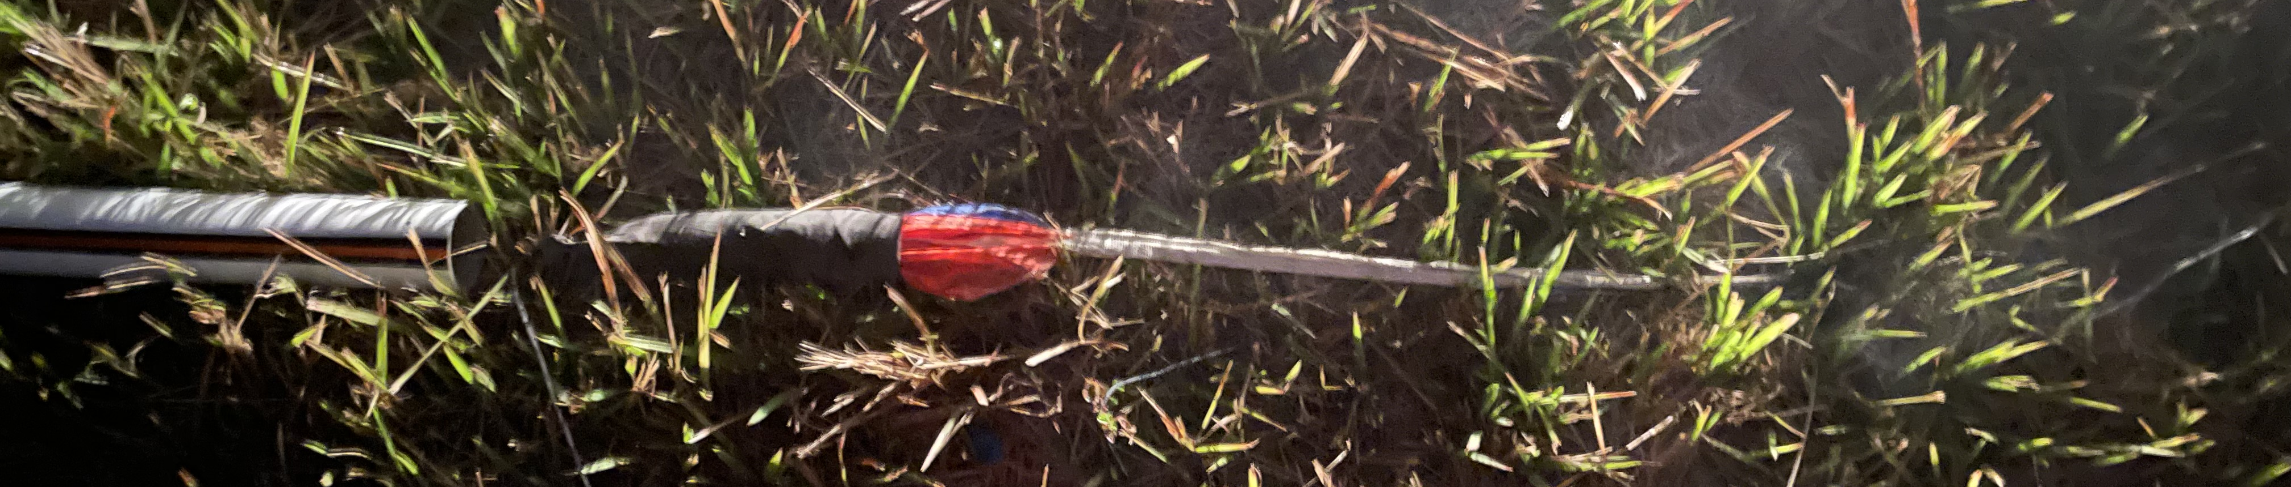
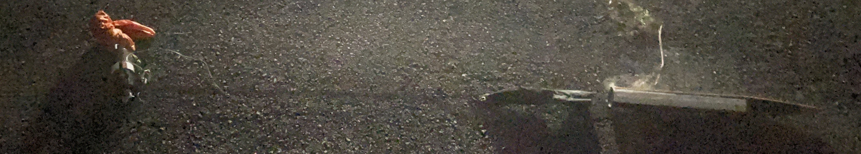
Testing – Ejection tests
Pressurized Triple Seven was used
Ejection charges were assembled using a pressurized tube
Used 20 Grains of Triple Seven on both sides
Drogue Parachute
Main Parachute
30

Slide 31
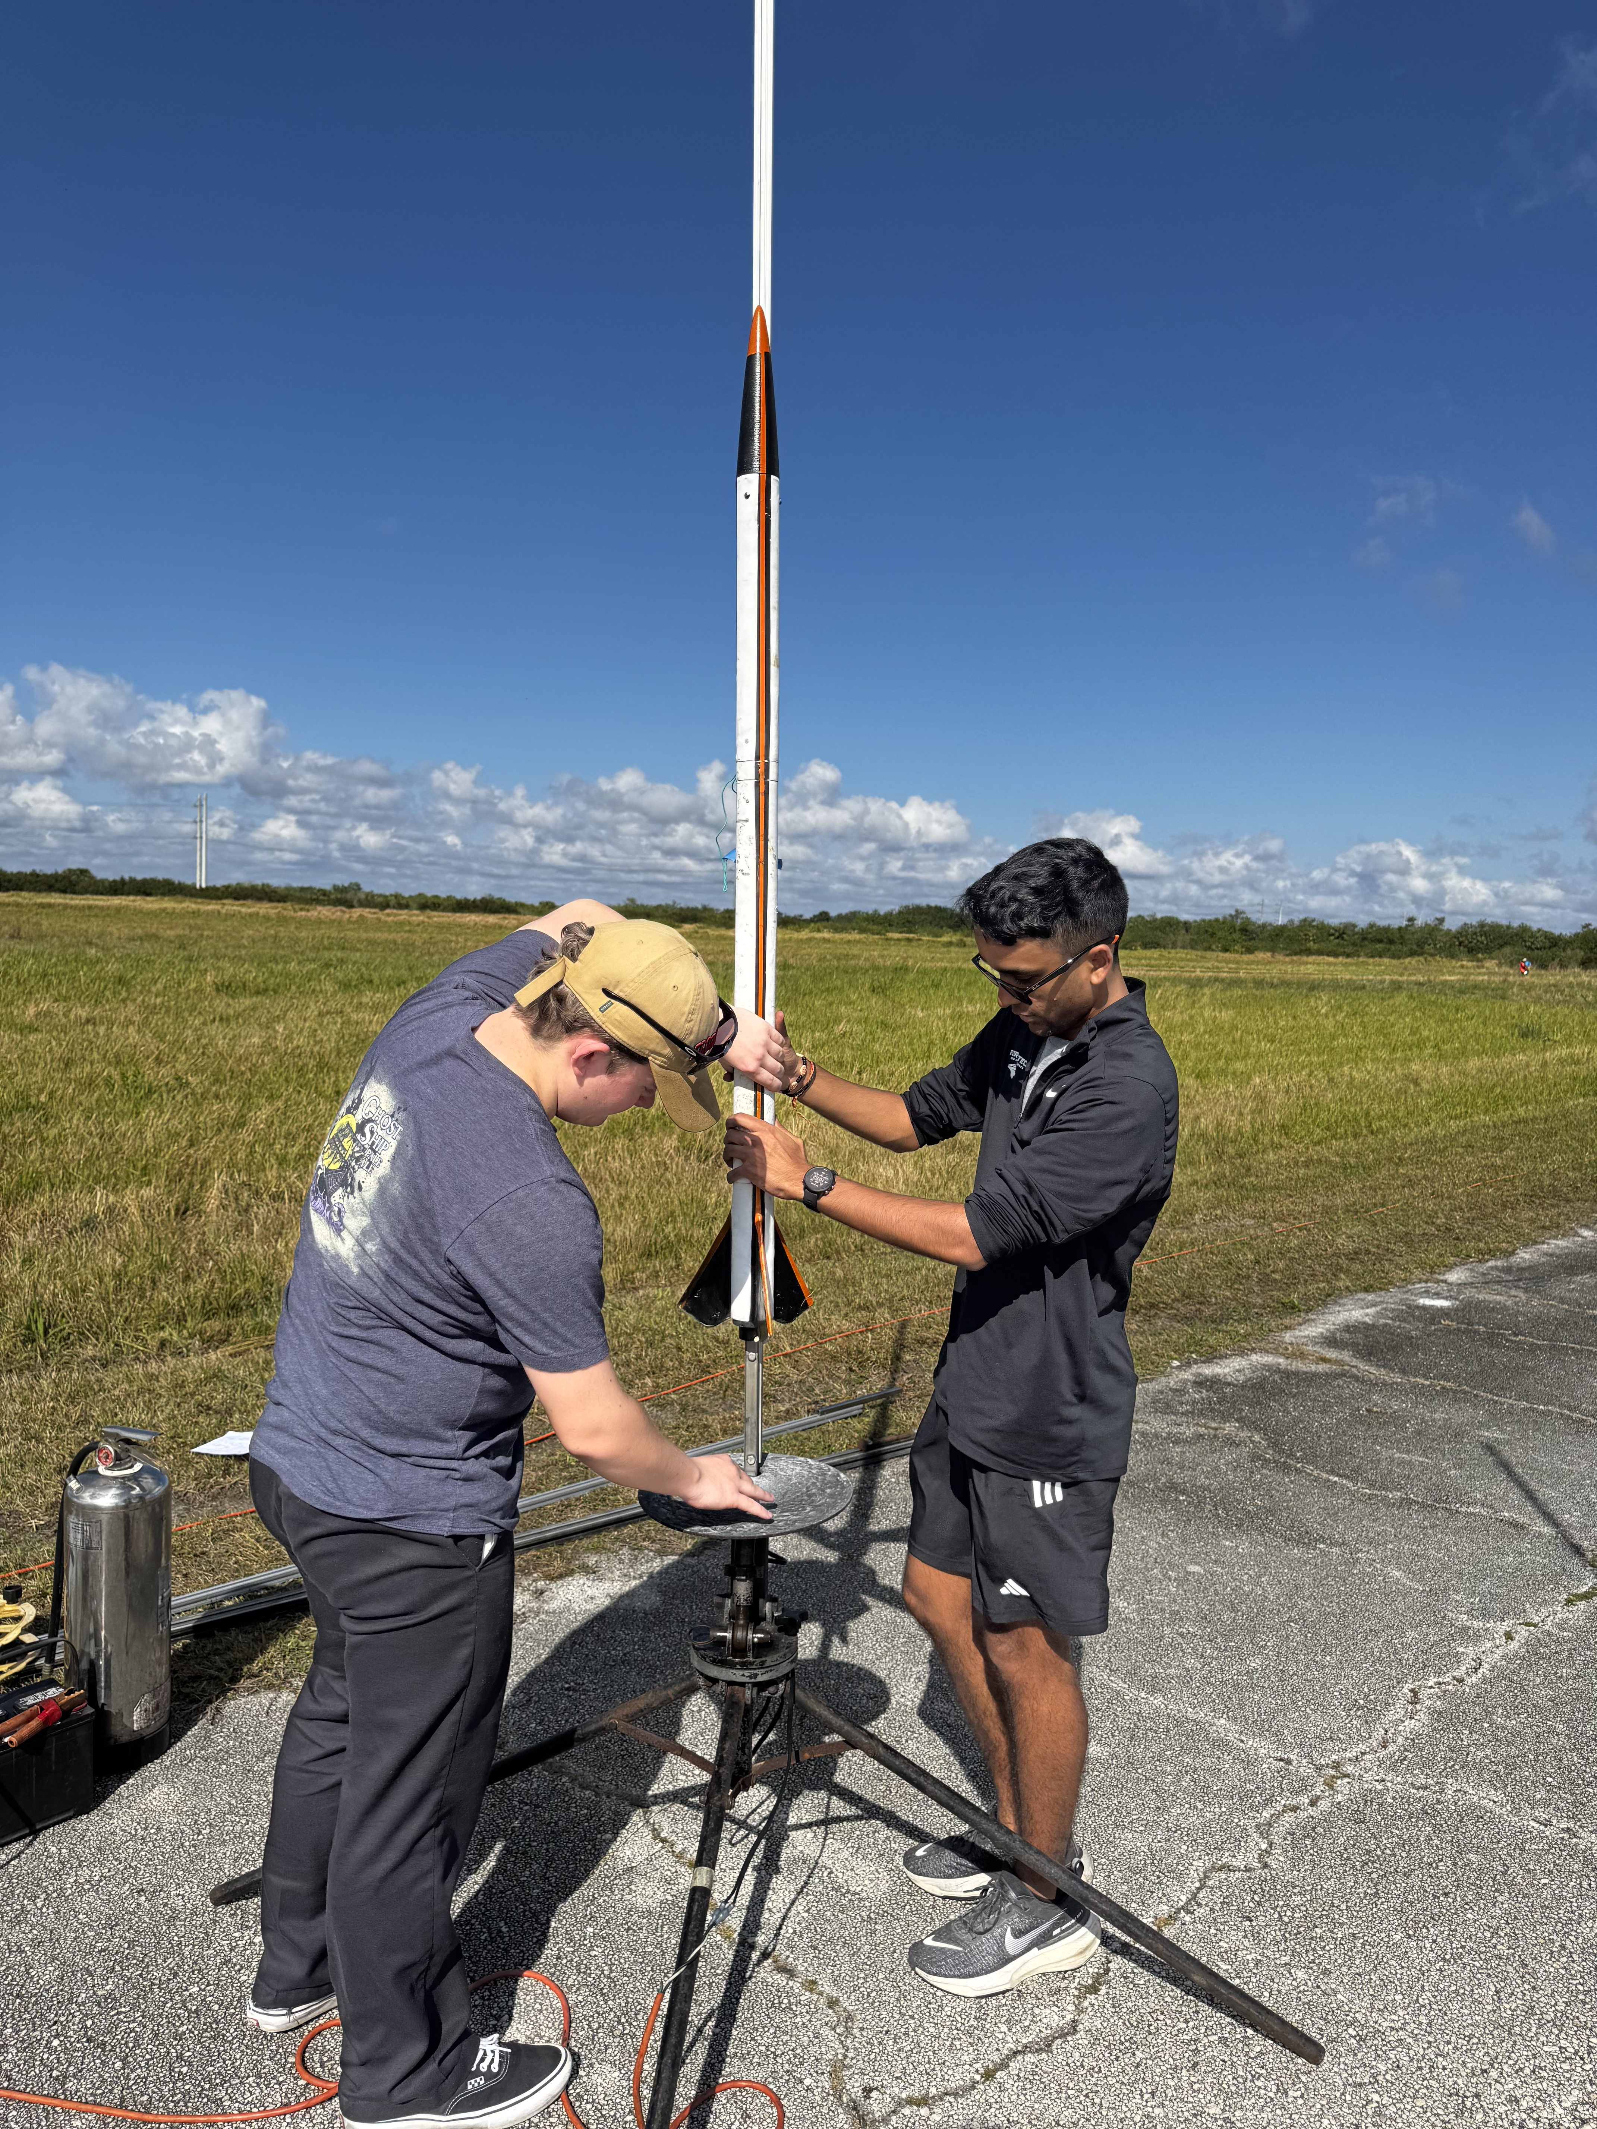
Preflight
The motor was assembled
  Included greasing the forward and aft closures and the smoke charge insulation
  Screwing the threaded forward closure to the case
  Attaching the forward seal disk to the phenolic liner
  Sliding in the liner with the grains inside into the case
  Screwing aft closure to the case
Ejection charges were assembled
The Orbiter was placed on the pad
31

Slide 32
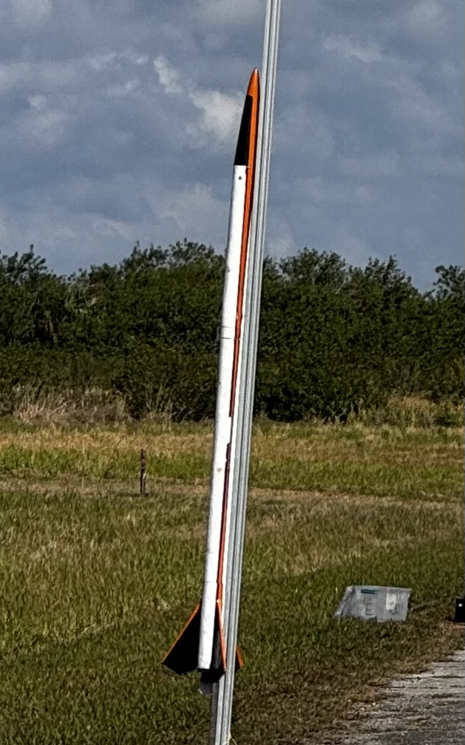
Flight
A max altitude of 2876 [m] was achieved
A maximum speed of 142 [m/s] was reached
Signal was lost from the GPS during boost and during descent at 349 [m]
32

Slide 33
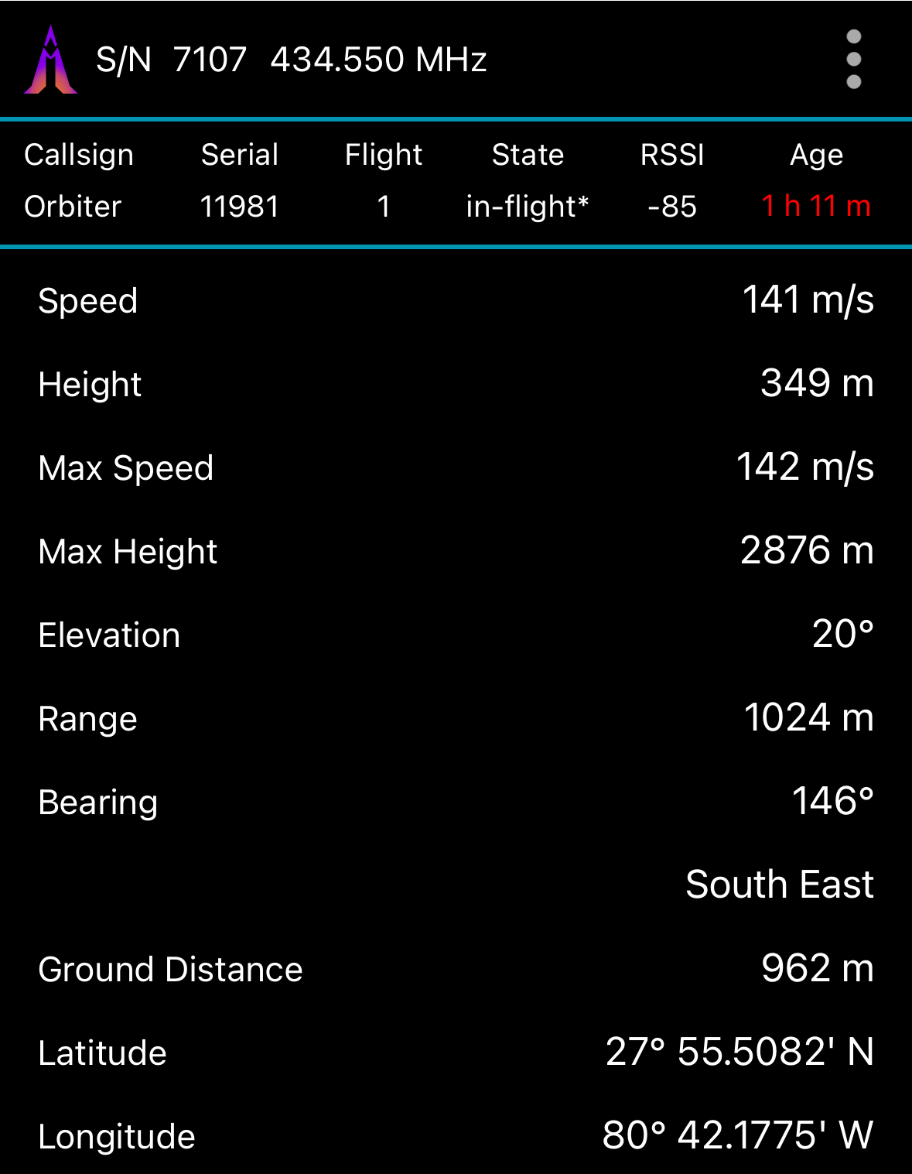
Post Flight Analysis
Failure was contributed to recovery system failure and GPS tracking
An event had occurred visually and from the data
No part of the rocket was ever recovered due to the errors
33

Slide 34
Conclusion
While the rocket itself was not a success the project is a success
It pushed the bounds of conventional amateur rocketry
Explored new and alternative methods
Future steps towards improvement include:
  Refined Manufacturing of body tubes
  Improved testing methods for preflight on GPS
  Improved design on the parachute bags
Create an efficient and better design
34

Slide 35
References
[1] https://www.nar.org/content.aspx?page_id=0&club_id=114127
[2] https://freebiesupply.com/logos/nar-logo/
[3] https://en.wikipedia.org/wiki/Tripoli_Rocketry_Association
[4] https://www.ecfr.gov/current/title-14/chapter-I/subchapter-F/part-101#sp14.2.101.c
[5] https://www.nar.org/content.aspx?page_id=22&club_id=114127&module_id=669238
[6] https://www.madcowrocketry.com/4-5-carbon-fiber-airframe/
[7]https://www.apogeerockets.com/Building_Supplies/Body_Tubes/Fiberglass_Tubes/4in_G12_Fiberglass_Filament_Wound_Tube_48in_Long
[8] https://www.istockphoto.com/photos/cardboard-tube
[9] https://www.homedepot.com/p/Wellco-6-oz-39-3-in-x-12-ft-Woven-Fiberglass-Cloth-for-Boat-RC-Plane-Auto-Surfboard-Tub-Pool-Repair-FC12393200/326891078
[10] https://www.nakka-rocketry.net/RD_nosecone.html
[11] http://www.perfectflite.com/Downloads/StratoLogger%20manual.pdf
[12] https://altusmetrum.org/TeleGPS/
[13] ANSYS Fluent

Slide 37
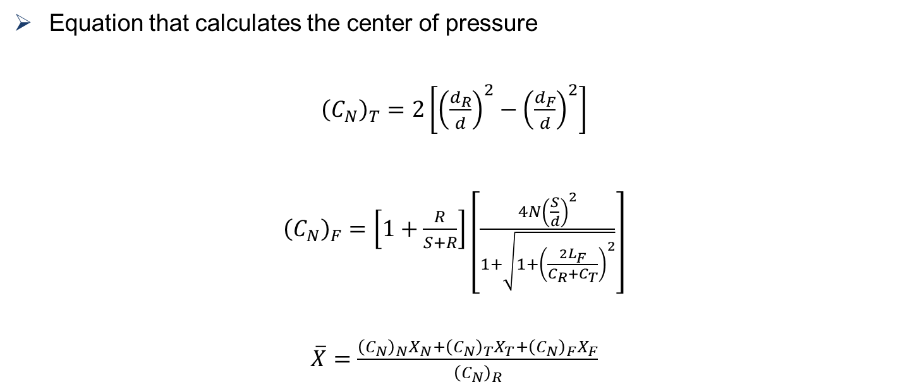
Barrowman’s Method
Equation that calculates the center of pressure
${\left(C_{N}\right)}_{T}=2\left[{\left(\frac{d_{R}}{d}\right)}^{2}−{\left(\frac{d_{F}}{d}\right)}^{2}\right]$
${\left(C_{N}\right)}_{F}=\left[1+\frac{R}{S+R}\right]\left[\frac{4N{\left(\frac{S}{d}\right)}^{2}}{1+\sqrt{1+{\left(\frac{2L_{F}}{C_{R}+C_{T}}\right)}^{2}}}\right]$
$\overline{X}=\frac{{\left(C_{N}\right)}_{N}X_{N}+{\left(C_{N}\right)}_{T}X_{T}+{\left(C_{N}\right)}_{F}X_{F}}{{\left(C_{N}\right)}_{R}}$

Slide 38
Ejection Charge Assembly
Hot Glue plug
Hot Glue plug
Pressurized Tube
Ematch

Slide 39
Ansys Supplemental Information
Control Volume size
  4[m] x 4[m] x 10.5[m]
Static Structural Materials
  PLA – Polylactic acid
  Onyx – Carbon fiber filled nylon

