Slide 1
Design of a General-Purpose Optimal Controller via the hp-Legendre-Gauss-Radau Collocation Method
Nicholas Hirsch
University of Florida
AIAA Region II Student Conference, 4/3/2025 – 4/4/2025
Copyright © by Nicholas Hirsch at the University of Florida Department of Mechanical and Aerospace Engineering
Published by the American Institute of Aeronautics and Astronautics, Inc., with permission.

Slide 2

Motivation
Designing a controller for a dynamic system takes a significant amount of time, money, and effort.
  New systems often need new controllers.
A general-purpose controller which is reusable would be a step towards solving this problem.
Arbitrary dynamics
&
constraints
General-
purpose
controller
Desired
user
response

Slide 3
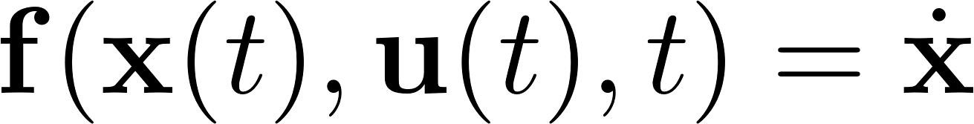
The Optimal Control Problem
Optimal control is ideal for this setup.
  A vast array of systems (ex. nonlinear, coupled, path-constrained) can be formulated as an optimal control problem (OCP).
The optimal control law minimizes a cost:
Subject to the constraints:

Slide 4
Direct v. Indirect Methods
Two methods to solve an OCP.
  Indirect: Use calculus of variations to derive optimal control law analytically.
  Direct: Approximate control law using basis of functions.
Which is better?
  Indirect: Need to derive control law for each system.
  Direct: If right approximation chosen, can fit it to the optimal control law of any system.

Slide 5
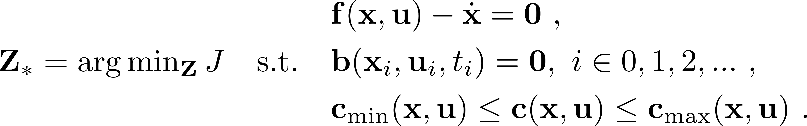
Direct Reformulation of the OCP
To find optimal control law directly:
  Pick a set of basis functions.
  Fit coefficients attached to each function via optimization.
Direct OCP is then:
Decision vector can include other free variables.

Slide 6
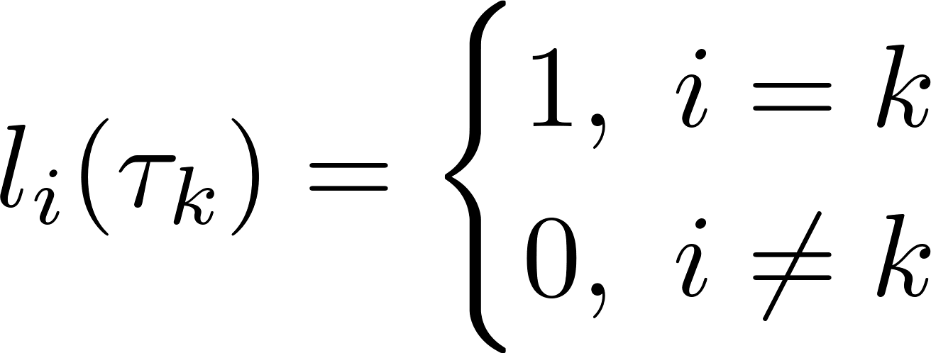
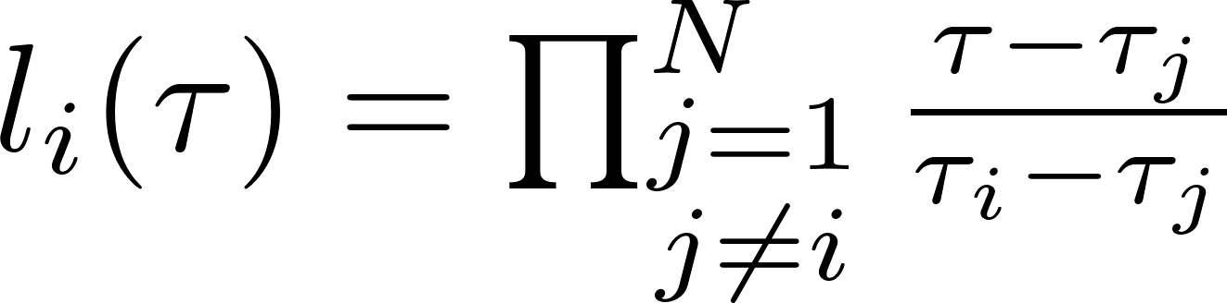
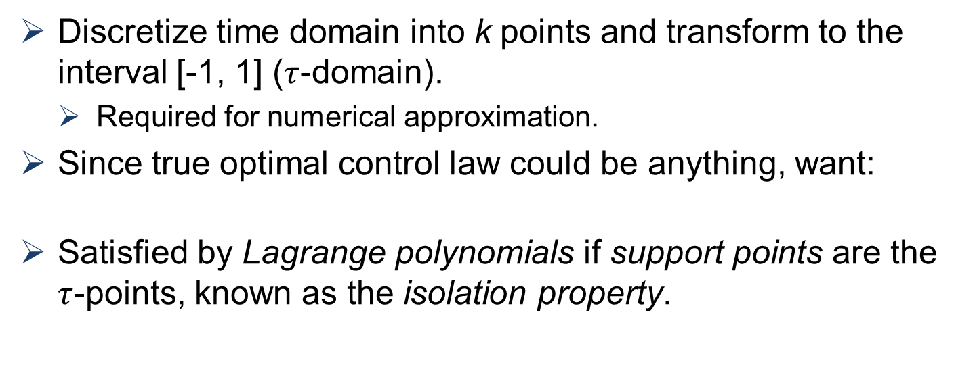
Lagrange Polynomials
Discretize time domain into k points and transform to the interval [-1, 1] ($τ$-domain).
  Required for numerical approximation.
Since true optimal control law could be anything, want:
Satisfied by Lagrange polynomials if support points are the $τ$-points, known as the isolation property.

Slide 7
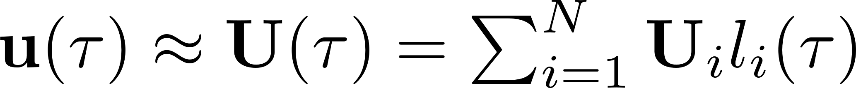

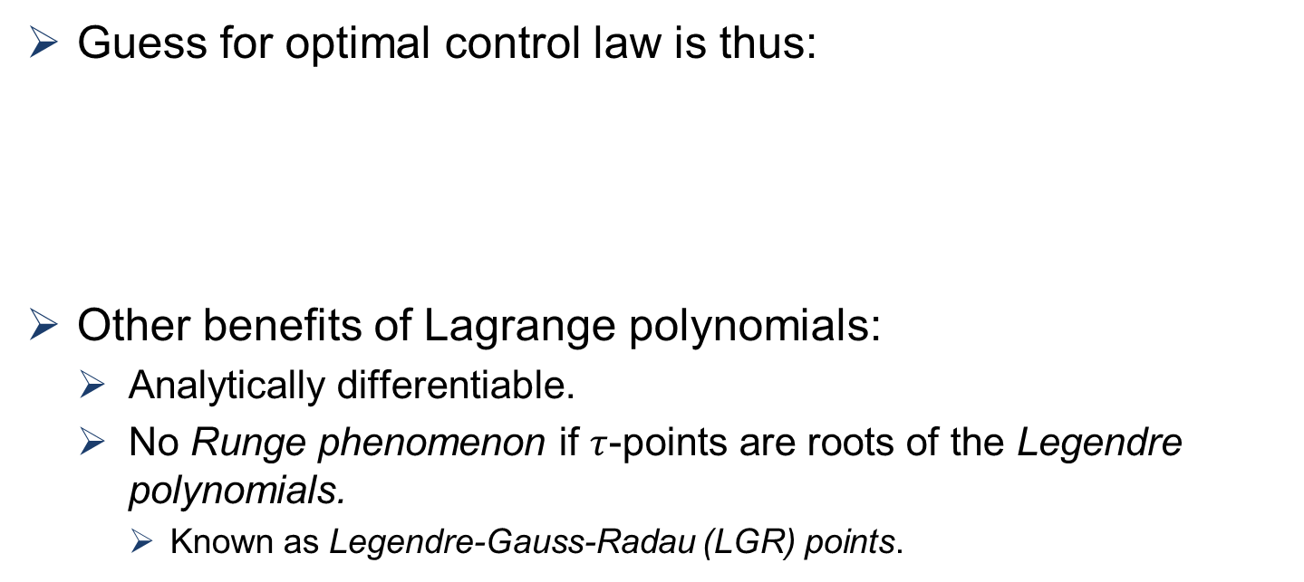
Lagrange Polynomials
Guess for optimal control law is thus:
Other benefits of Lagrange polynomials:
  Analytically differentiable.
  No Runge phenomenon if $τ$-points are roots of the Legendre polynomials.
    Known as Legendre-Gauss-Radau (LGR) points.

Slide 8
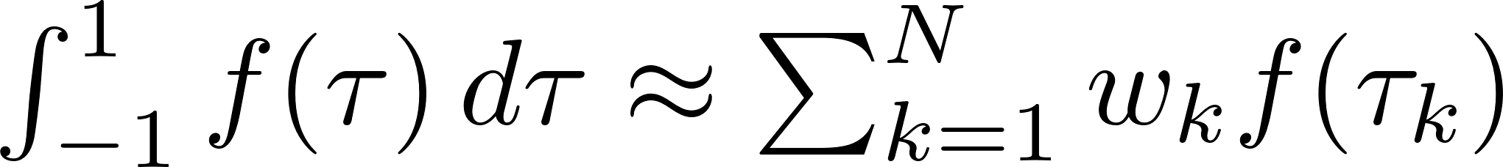
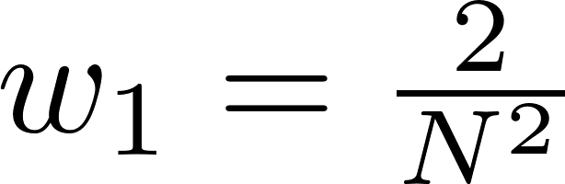
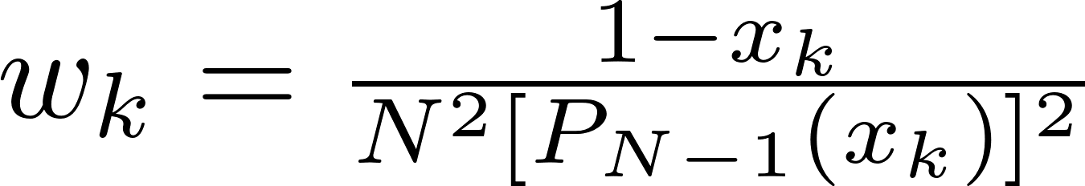
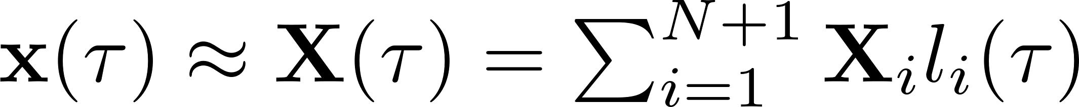
Lengendre-Gauss-Radau Quadrature
To calculate cost during optimization, need integration scheme.
  Already using LGR points so natural to use LGR quadrature.
Cost can be function of the state and its derivative, so approximate both using Lagrange polynomials as:

Slide 9
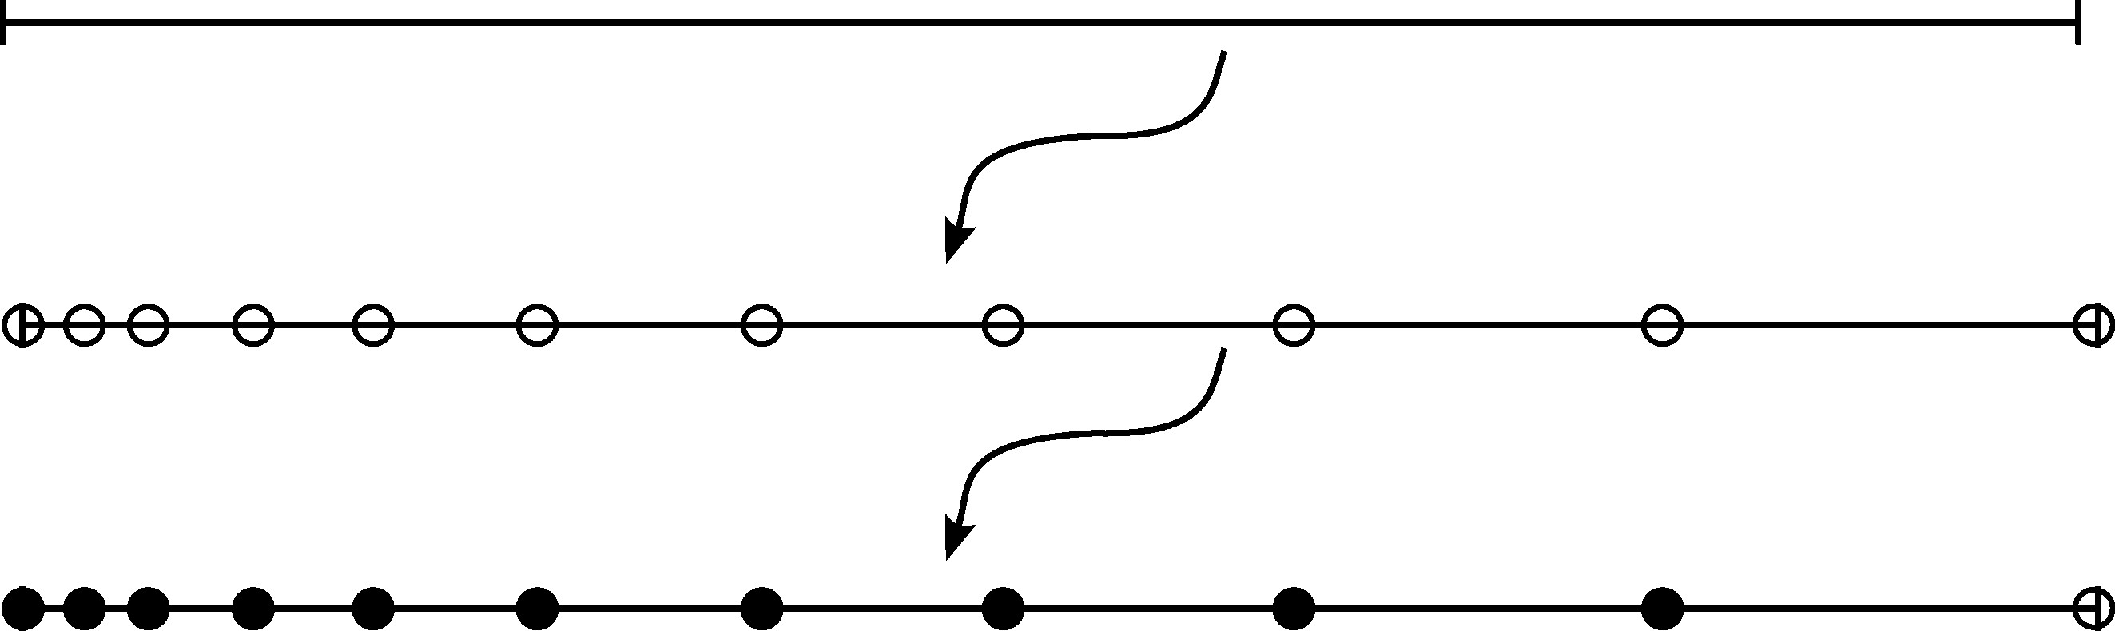
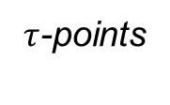
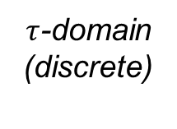

Legendre-Gauss-Radau Quadrature
To calculate LGR points on [-1, 1].
  Final time ($τ$=1) not an LGR point, so no control at final time!
  Still need final state as dynamics must be enforced.
    Unfortunately causes Runge phenomenon.
t-domain (continuous)
$τ$-points
$τ$-domain
(discrete)
LGR points
non-LGR point

Slide 10
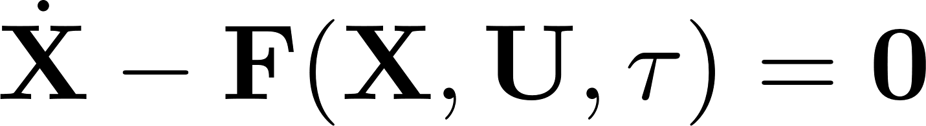
Collocation
Also need a method of solving differential equations (dynamics) numerically, LGR collocation used.
  Reformulate dynamics as constraint, collocation ensures at each LGR point this constraint is satisfied.
    These are known as defect constraints.

Slide 11
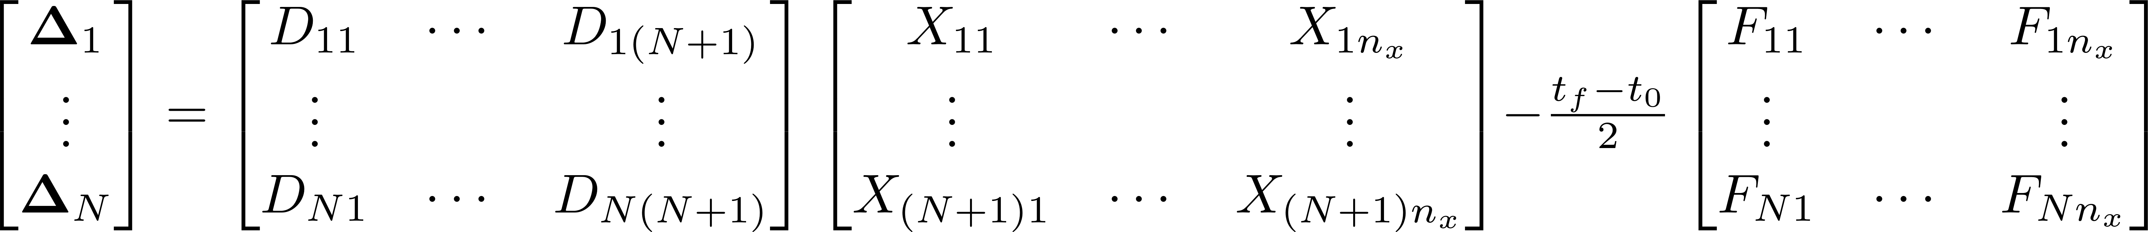

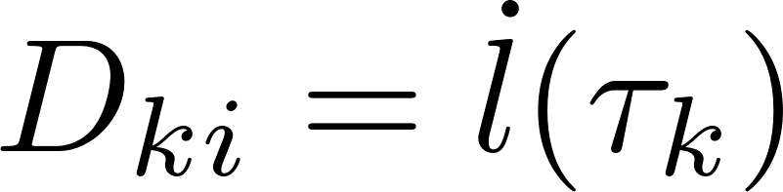
Collocation
Defect constraints may be collocated as:
Control is missing at final point (time), so no defect constraint enforced there.
Differentiation matrix is static.
  Compute once and done, same for LGR weights.
  Computationally efficient.

Slide 12
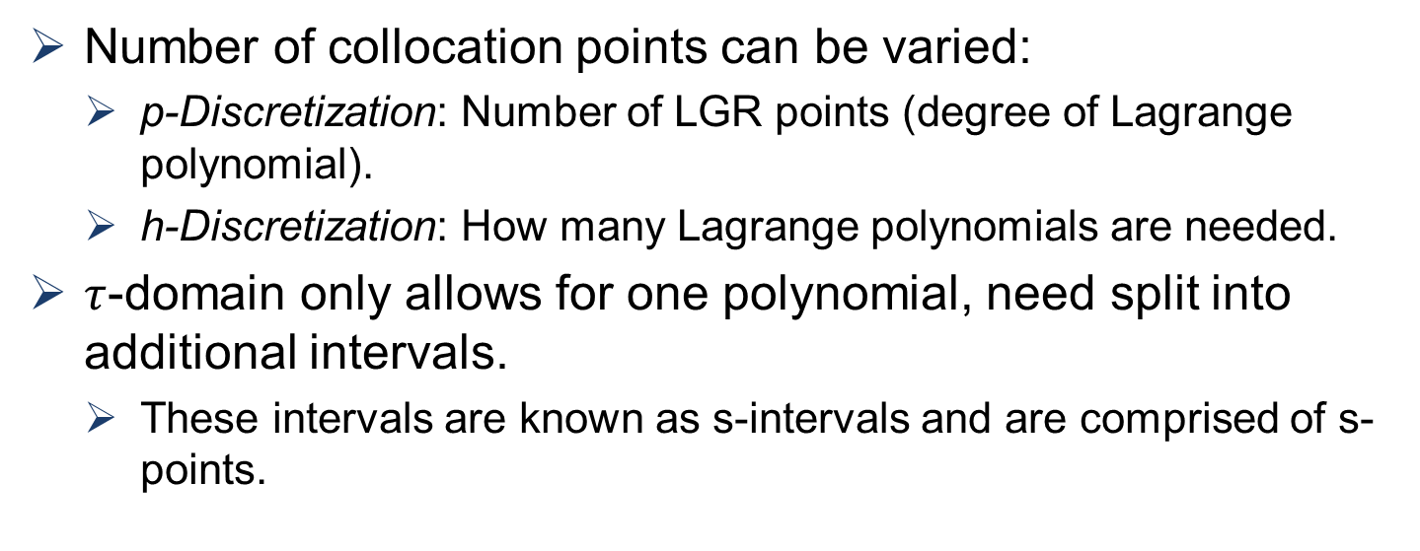
hp-Discretization
Number of collocation points can be varied:
  p-Discretization: Number of LGR points (degree of Lagrange polynomial).
  h-Discretization: How many Lagrange polynomials are needed.
$τ$-domain only allows for one polynomial, need split into additional intervals.
  These intervals are known as s-intervals and are comprised of s-points.

Slide 13
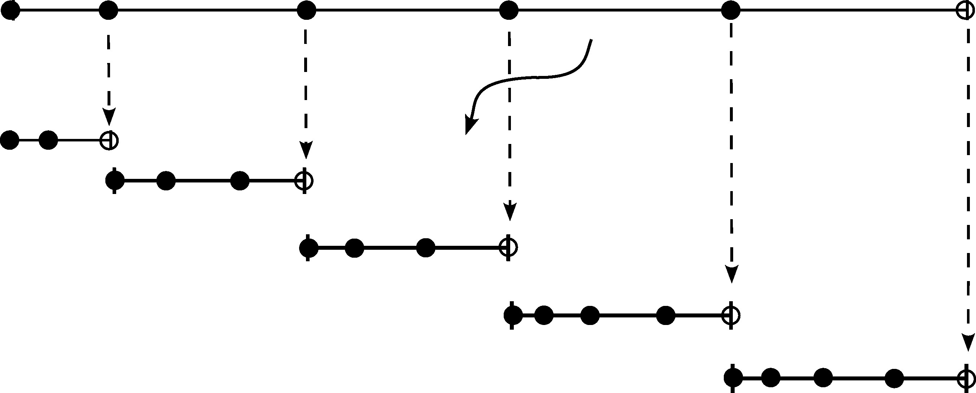
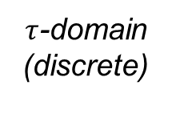
hp-Discretization
$τ$-domain
(discrete)
consistency
constraint
s-domain
interval
(discrete)

Slide 14
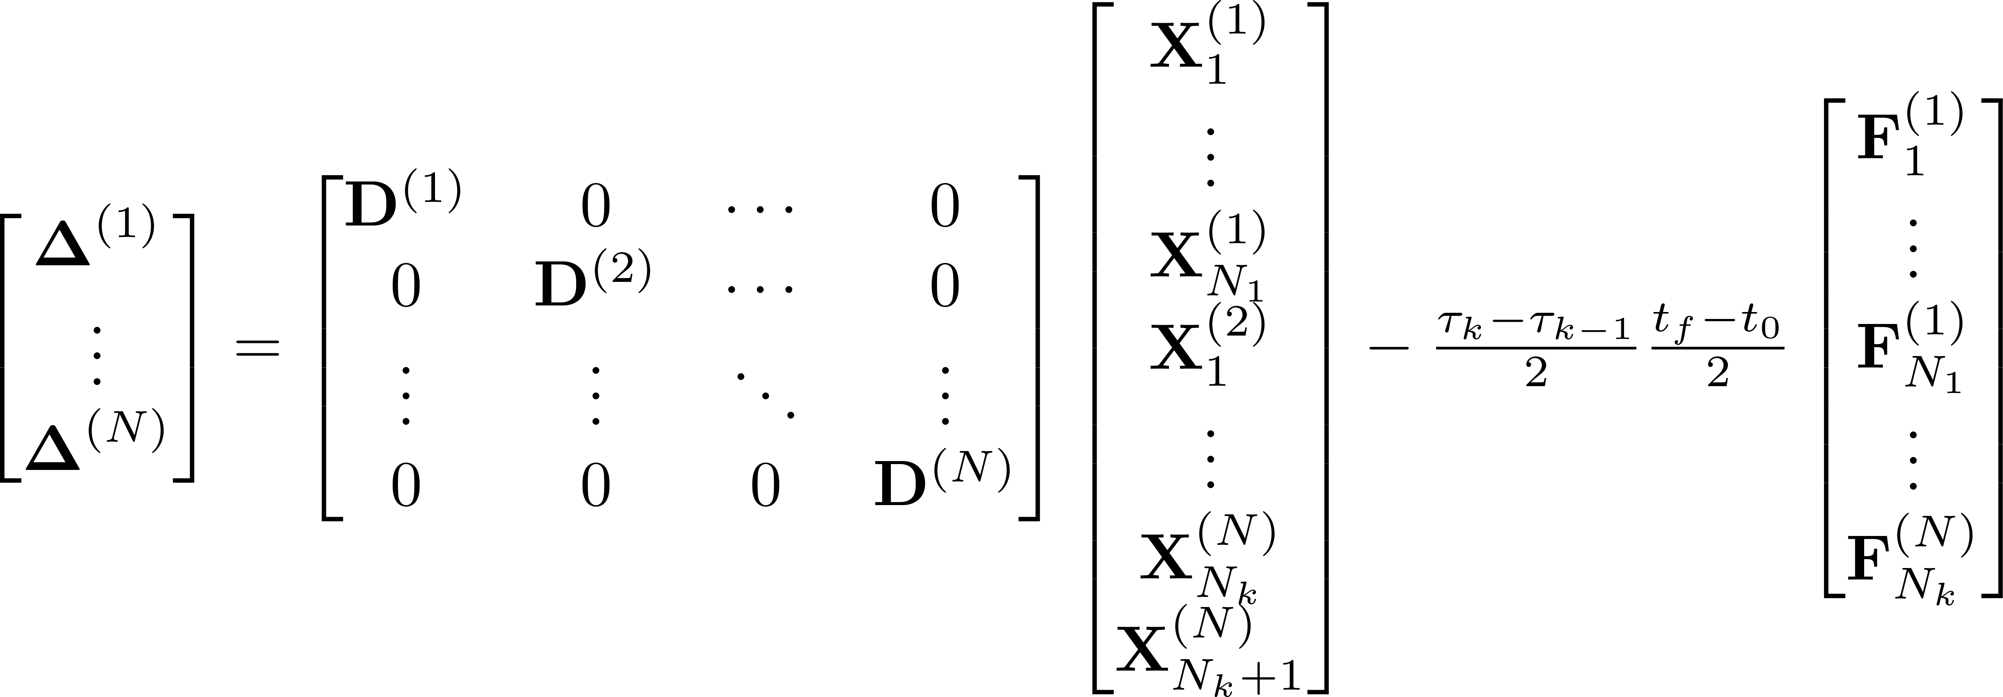
hp-Discretization
The expanded defect constraints are now:
The s-intervals overlap, so last point of one interval is same as first of next.
  Acts as an additional consistency constraint/coupling.

Slide 15
MATLAB Implementation
Using LGR collocation, the general-purpose controller takes in the following:
  Number of s-intervals (h-discretization).
  Degree of Lagrange polynomials (p-discretization).
  Initial guess for decision variables.
  Dynamics.
  Boundary and constant path constraints.
  Non constant path constraints.
  Tolerances.
fmincon() is used to perform the optimization.

Slide 16
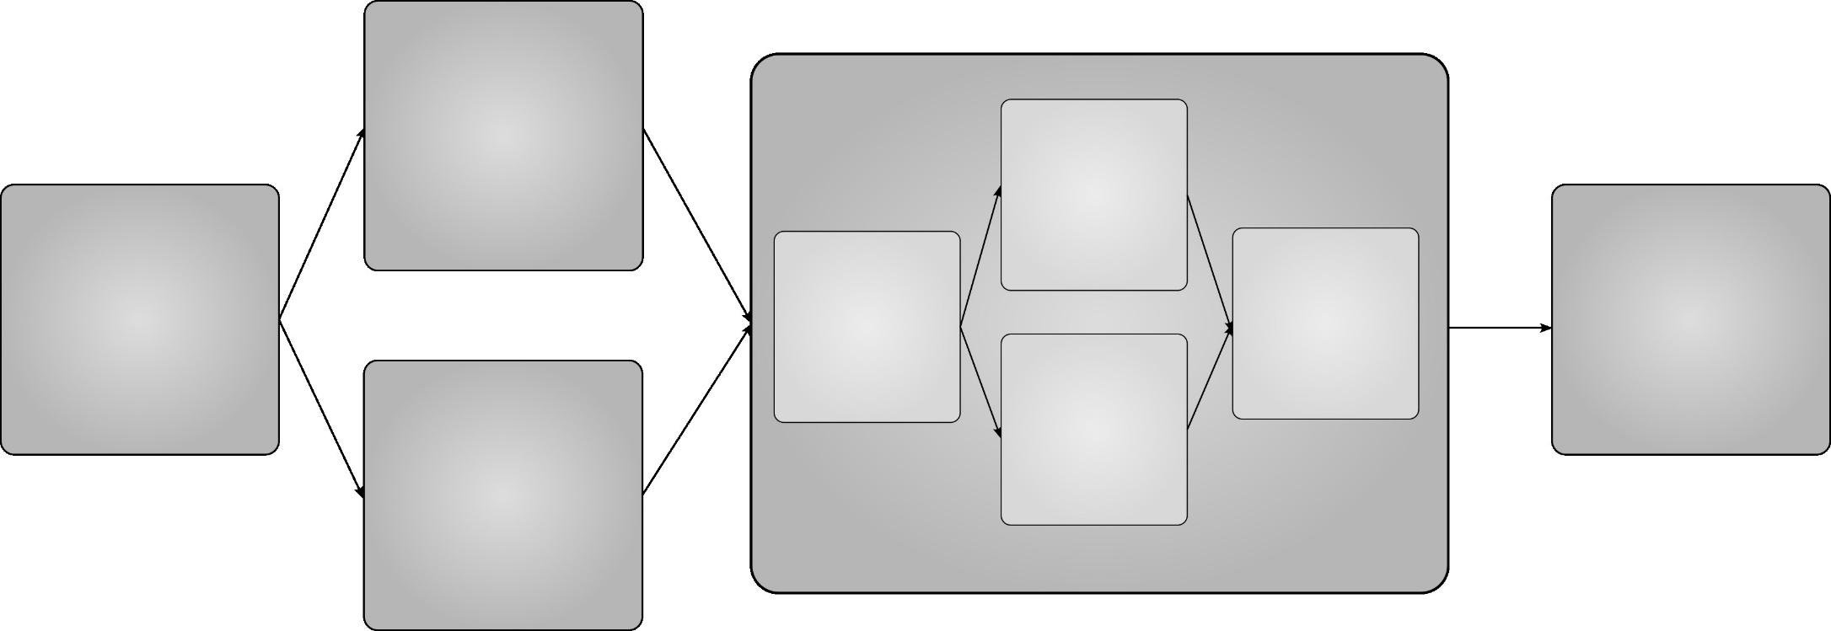
MATLAB Implementation
Form
D-Matrix
Compute
Cost
System
&
Optimization
Parameters
Optimal
Control
Law &
Trajectory
Update
Decision
Variables
Check If
Tolerances
Met
Compute
Weights
&
Discretize
Compute
Defect
Constraints

Slide 17
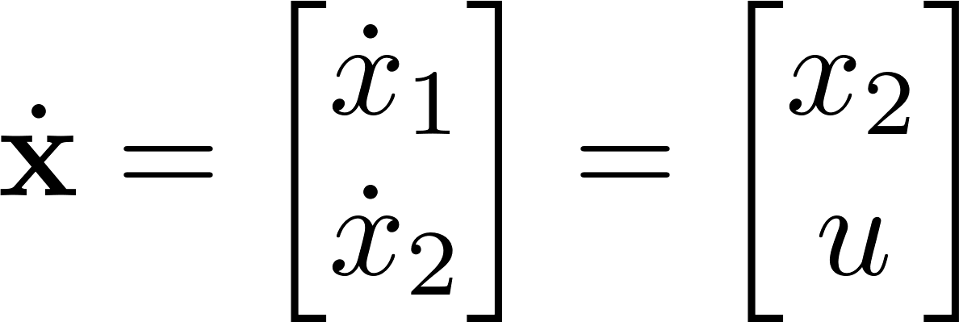
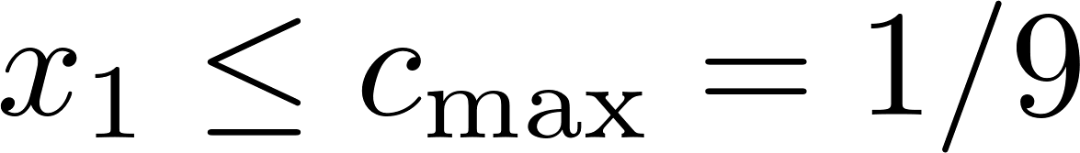
Example: The Bryson-Denham Problem
Consider a path-constrained double-integrator system:

Slide 18
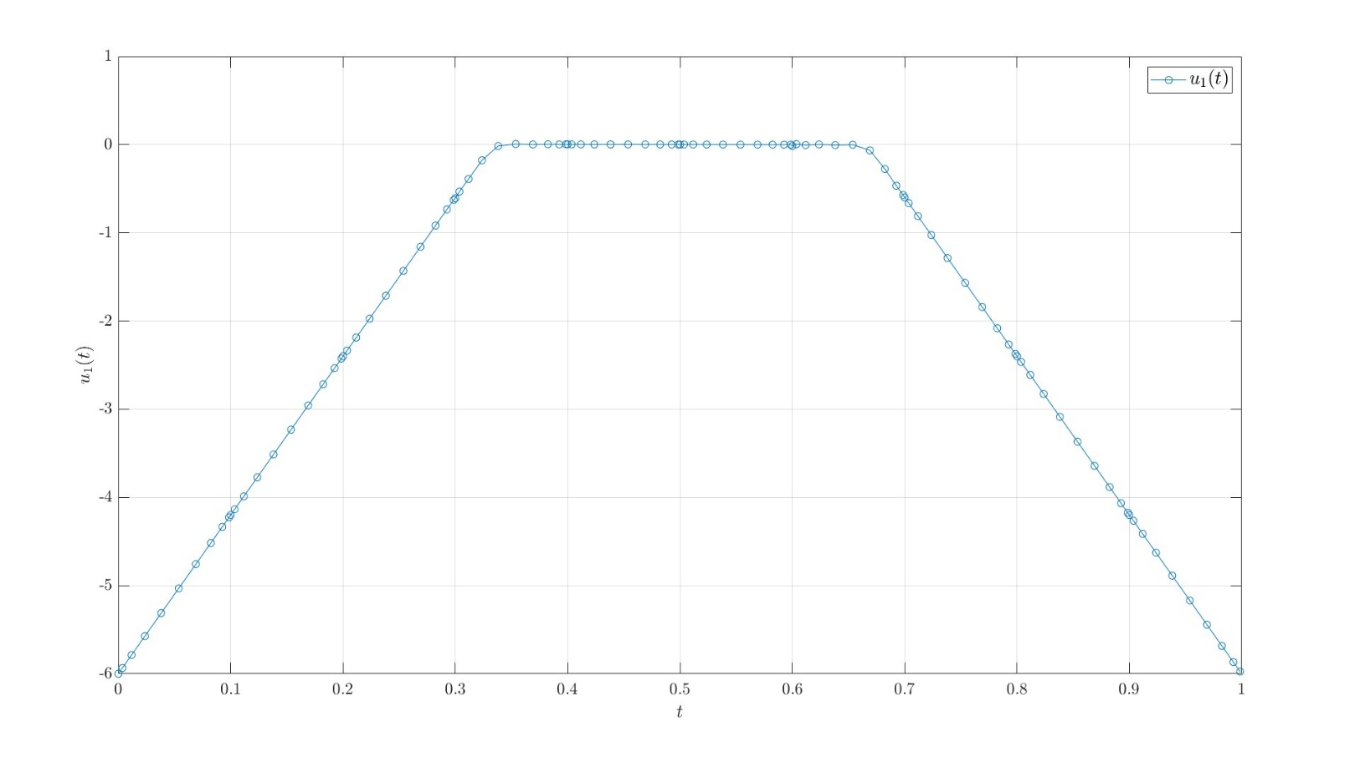
Example: The Bryson-Denham Problem

Slide 19
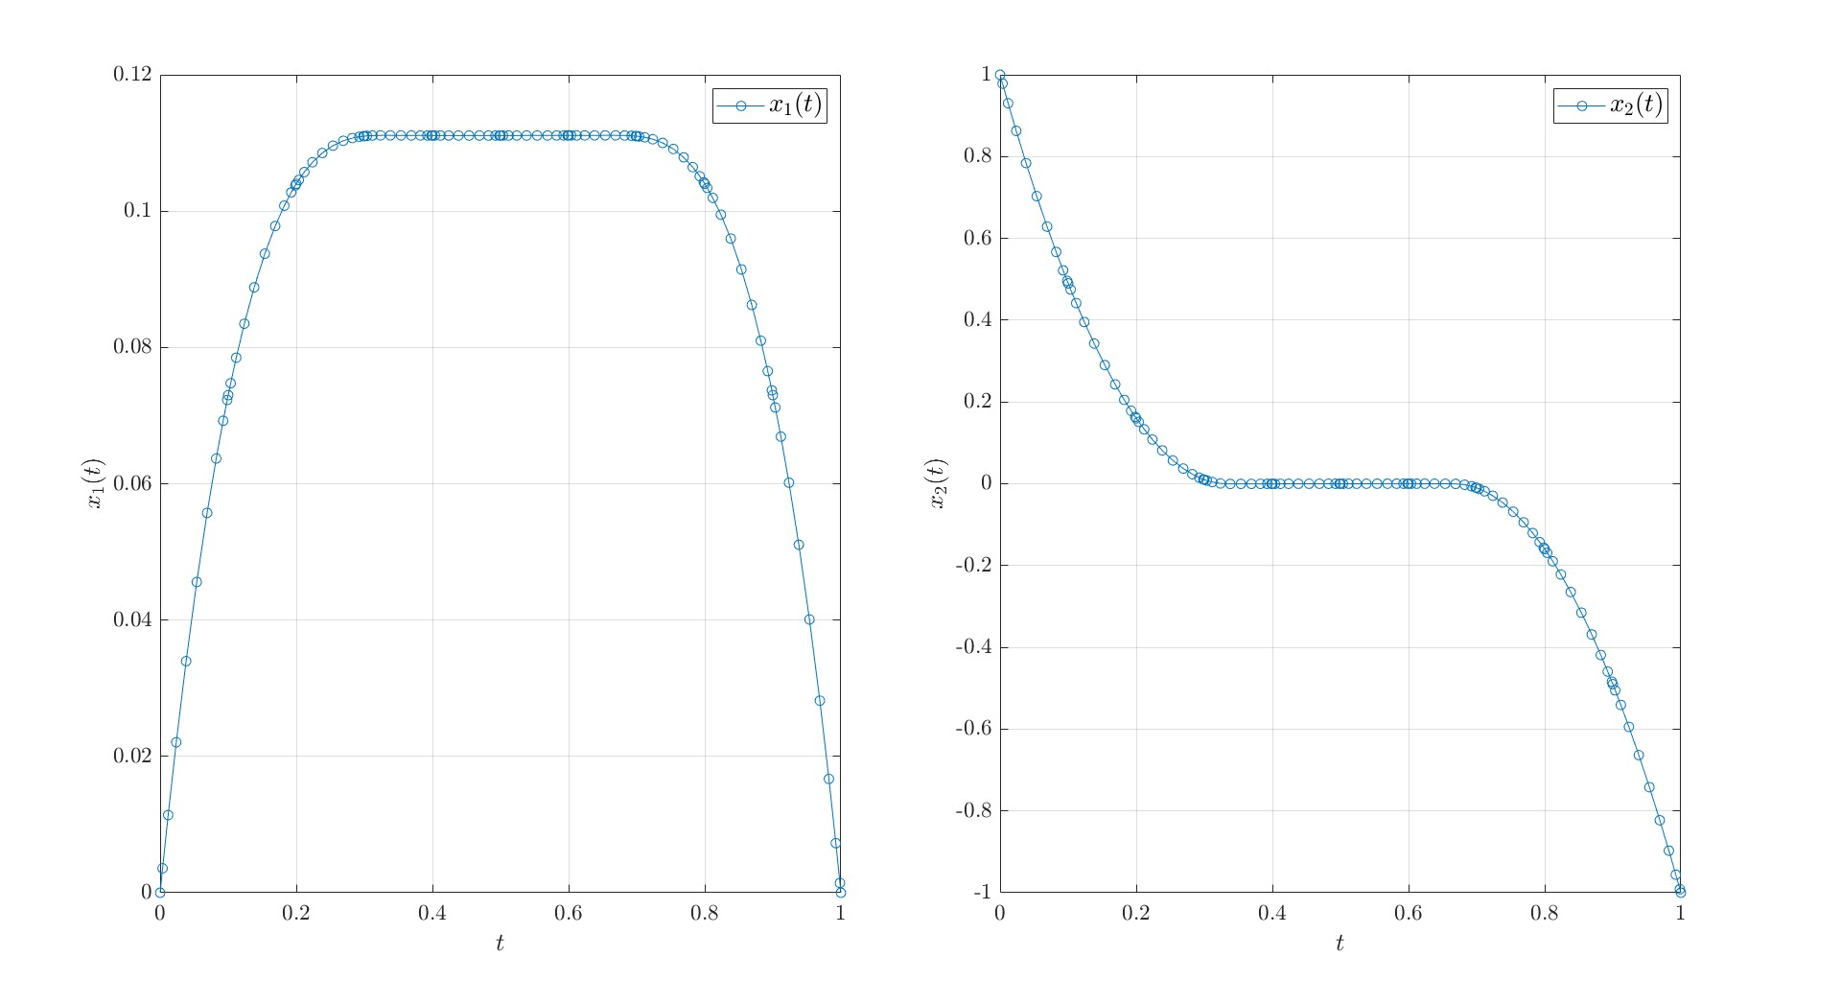
Example: The Bryson-Denham Problem

Slide 20
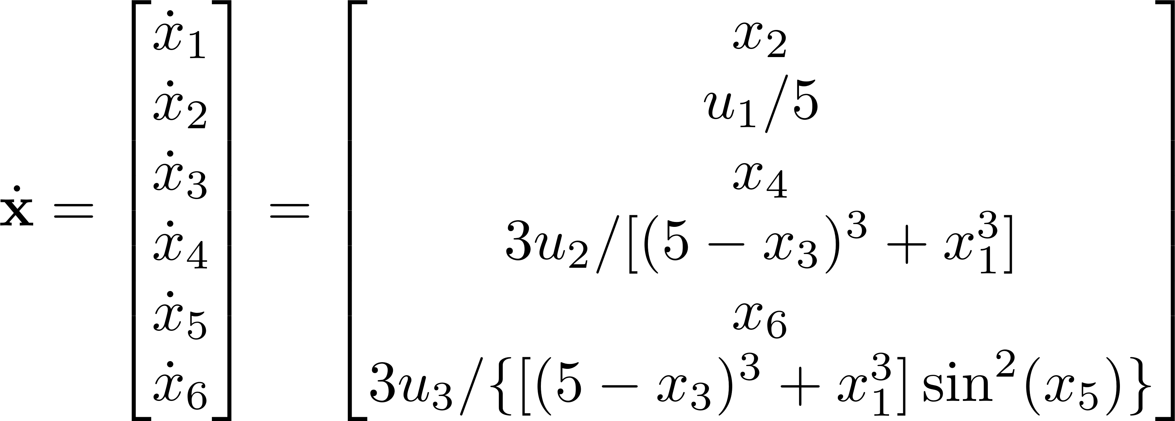
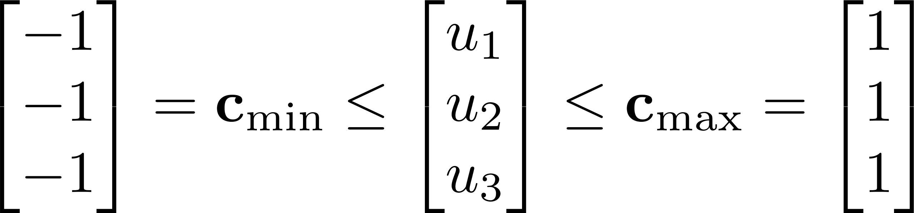
Example: The Robotic Arm Problem
Consider a robotic arm attempting to move between two orientations:

Slide 21
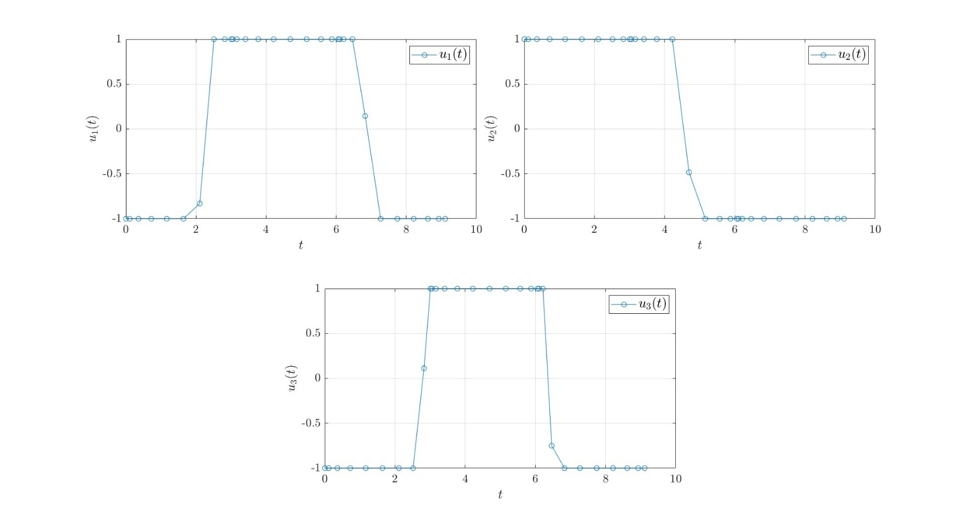
Example: The Robotic Arm Problem

Slide 22
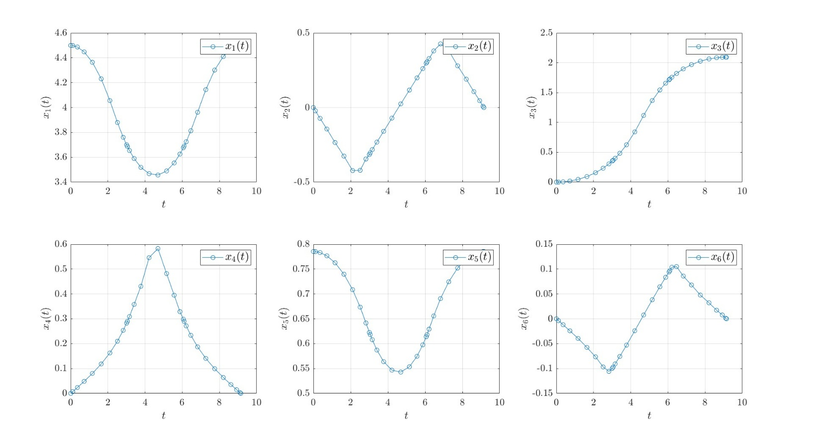
Example: The Robotic Arm Problem

Slide 23
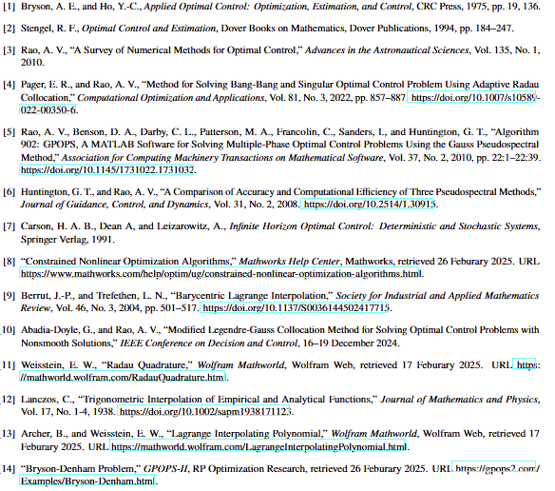
References

