Slide 1
Development of a Student-Built LOX/Jet-A Coaxial Swirl Injector
Dario Zaccagnino
Georgia Institute of Technology
AIAA Region II Student Conference

Slide 2
Yellow Jacket Space Program
Liquid rocketry club at Georgia Tech founded by students in 2015
Our goal is to send a liquid fueled vehicle to space
Club is comprised of over 200 members from different backgrounds and majors
  Aerospace, Mechanical, Electrical, Business, Computer Science, etc
Through the club, students learn valuable skills that directly apply to the Aerospace industry

Slide 3
Background
A liquid rocket engine is one of the most important part of a launch vehicle. It provides the necessary thrust to reach space and/or orbit
This engine must be high performing, efficient, and reliable for success
  This is mostly accomplished through a device known as an injector
YJSP has previously designed, built, and tested a Pintle injector with poor performance and reliability
A coaxial swirl injector was chosen to try to solve these problems

Slide 4
Design process
Two important parameters are needed to design a coaxial-swirl injector
  The coefficient of discharge and the spray angle
Many academic papers were found that outlined different experimental or theoretical discharge equations for a coax swirl injector [1][2][3][4]
Calculating the spray angle is critical in knowing what the injector Recess Number (RN) is.
  Ratio between the swirler recess length and the impact location of the two swirler liquid sheets
  Reference [5] is used to calculate the spray angle

Slide 5
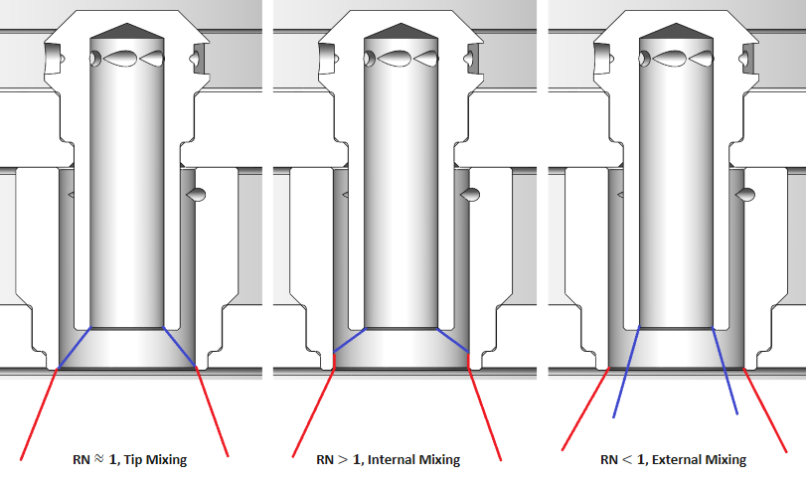
Recess Number
An externally mixing injector (RN < 1) is more stable, but with lower performance
  Fuel and oxidizer only interact far away from the injector face plate decreasing L*
For an internally mixing injector, the fuel and oxidizer directly impinge thus improving mixing
  More unstable as there are distinct mixing locations
  Element-to-element variations and non-uniform flow distribution can cause different combustion behavior in the chamber

Slide 6
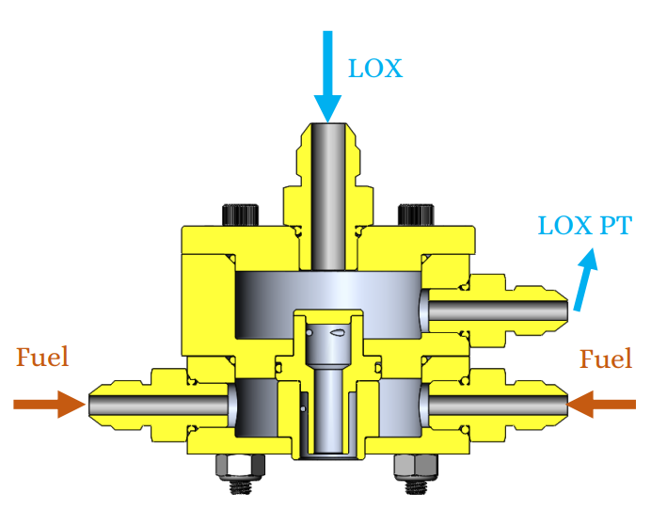

Single Element Testing Campaign
A single element swirler and manifold assembly was designed and tested to determine the coefficient of discharge
  Flowed with water with a set inlet pressure equal to the predicted pressure drop
  Calculate via the CdA equation
8 waterflow tests were performed to dial in the coefficient of discharge
$$\begin{aligned}&Cd= \frac{\dot{m}}{A\sqrt{2ρΔp }}\end{aligned}$$

Slide 7
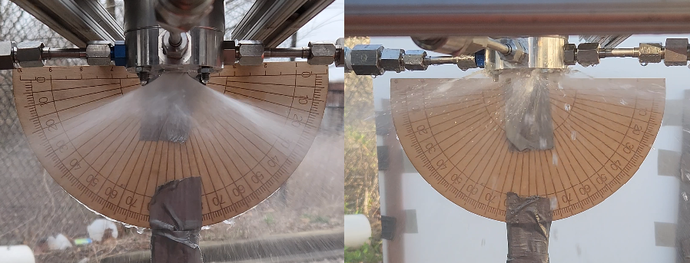
Spray Angles
Good (left) vs poor (right) spray behavior
  Poor spray behavior was observed with tangential entry holes of 0.046” in diameter or smaller
  Good spray was within 5 degrees of predicted

Slide 8
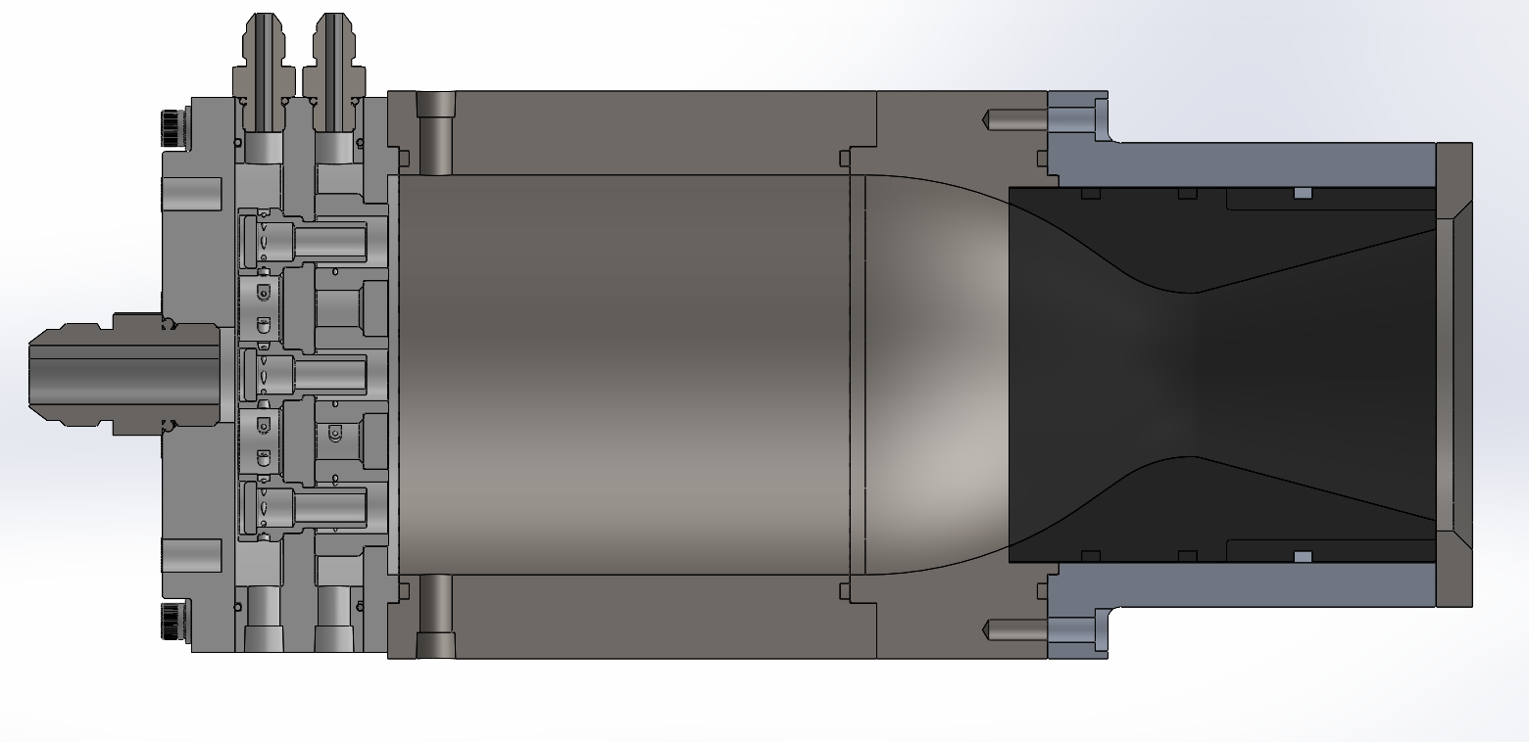
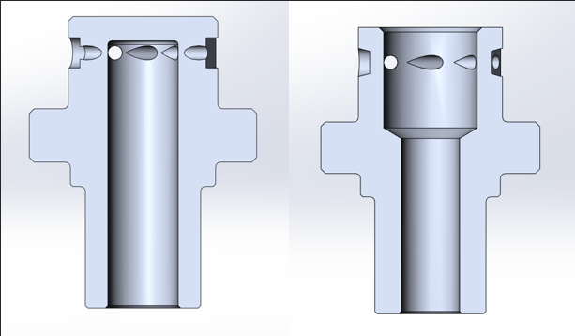
Subscale Combustor
Using the data learned in the single element campaign (swirler sizing), a subscale coaxial swirl injector was designed
Key features
  7 element combustor (2 versions: open and closed LOX swirlers)
    Open: constant diameter swirler
    Closed: swirler chamber with a larger diameter than the nozzle
  Swirler elements brazed to manifolds
  CNC machined 303 stainless steel (easier to machine)
  800lbf, 1.8 MR, 261 psia PC
Open
Closed

Slide 9
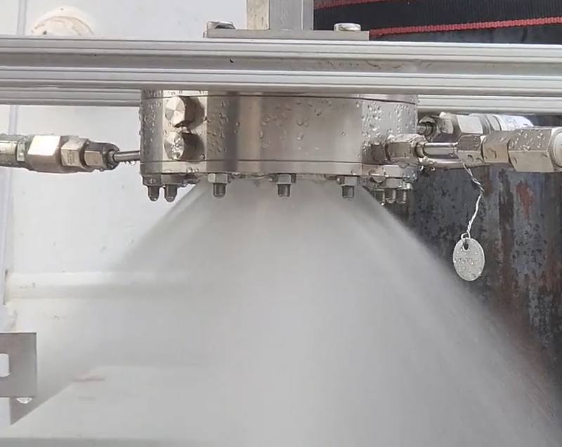

Subscale Combustor
Waterflowed to gather coefficient of discharge and spray behavior
  Fuel side Cd was exactly as predicted
  Both LOX manifolds had a large ~20% error in Cd
10 hotfire tests were conducted
  C*-efficiency is calculated as the measured c* over the theoretical c*
    The measured c* is found using the chamber pressure, the total mass flow rate, and the throat area [6]
    The theoretical c* is calculated using NASA’s CEA program [7]
$$\begin{aligned}&c^{∗}=\frac{p_{c}A_{t}}{\dot{m}}\#\end{aligned}$$

Slide 10
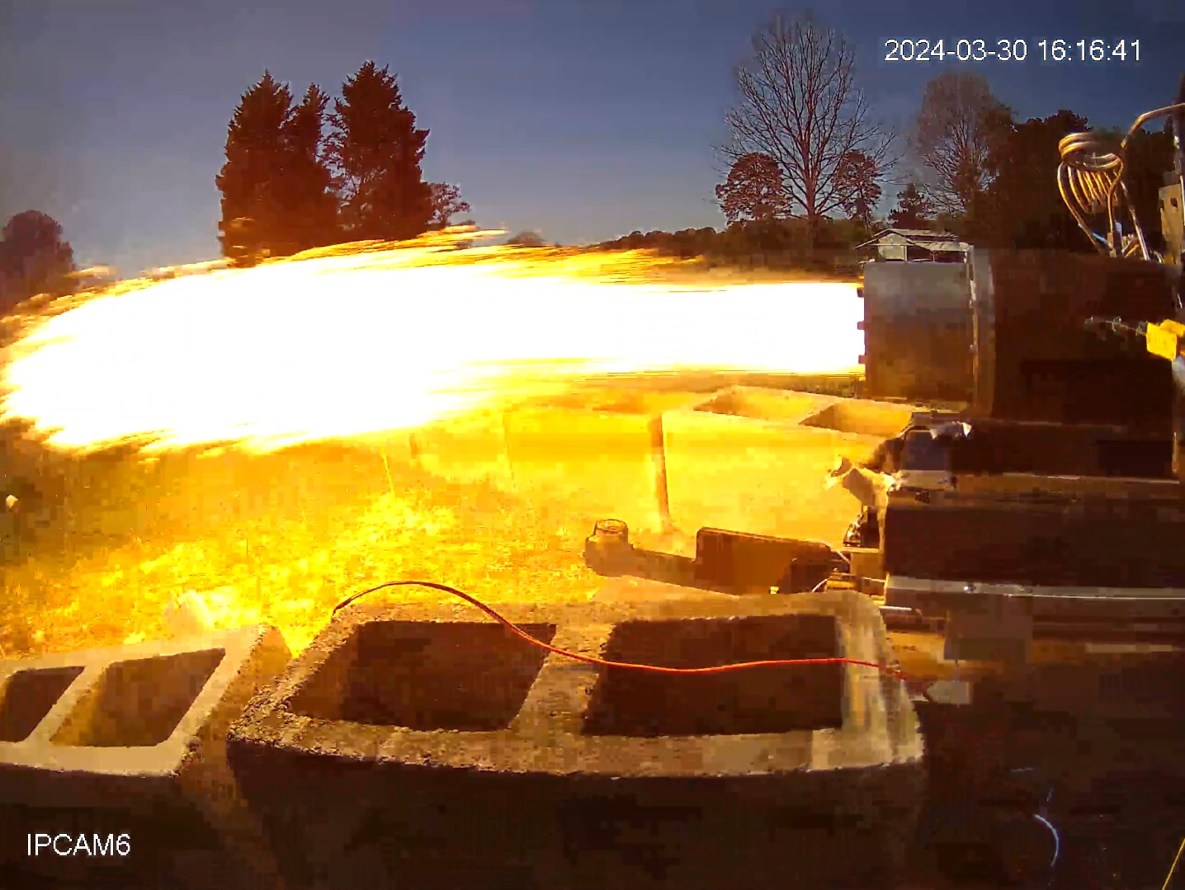
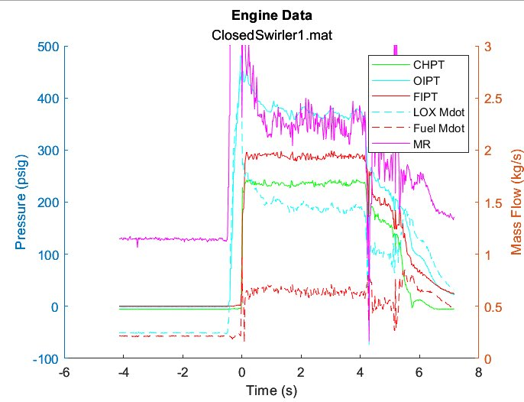
Subscale Combustor

Slide 11
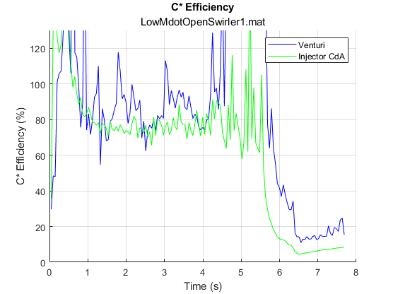
C*-efficiency
Between 75%-80% for hotfires 1-7
Hotfires 8-10 used an internally mixed injector showing a ~5% increased in efficiency
Hotfire Number | Calculated c*-efficiency (%)
1 (Open LOX) | 75%
2 (Open LOX) | 75%
3 (Closed LOX) | 70%
4 (Open LOX) | 78%
5 (Open LOX) | 79%
6 (Open LOX) | 79%
7 (Open LOX) | 79%
8 (Open LOX, internal mixing) | 84%
9 (Closed LOX, internal mixing) | 77%
10 (Open LOX, internal mixing) | 83%

Slide 12
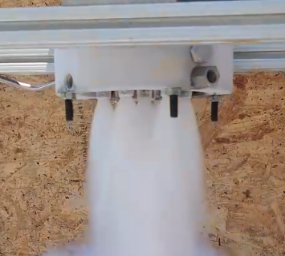
Cryogenic Spray Angle
The injector was initially designed to be internally mixing (RN >1), but poor performance suggested it might not be
  This was confirmed by conducting a LN2 cryo flow of the injector (as opposed to a waterflow)
  As shown, the cryogenic spray angles are significantly smaller compared to the water spray angle
  The LOX posts on the injector were machined down to convert the injector to internal mixing (increasing the recess length)

Slide 13
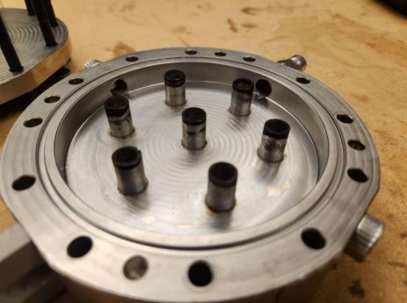
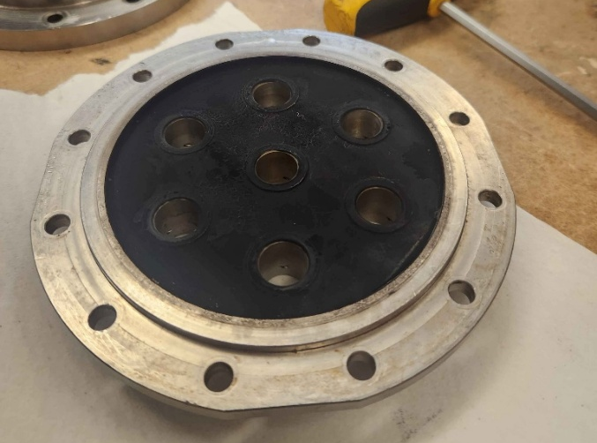
Subscale Combustor
Slight increase in efficiency compared to the pintle injector
  Not a concern as the future flight version injector would have more elements which typically increases efficiency
No melting problems were ever observed even after an 8s long duration hotfire
  The pintle injector typically exhibited melting problems [8]

Slide 14
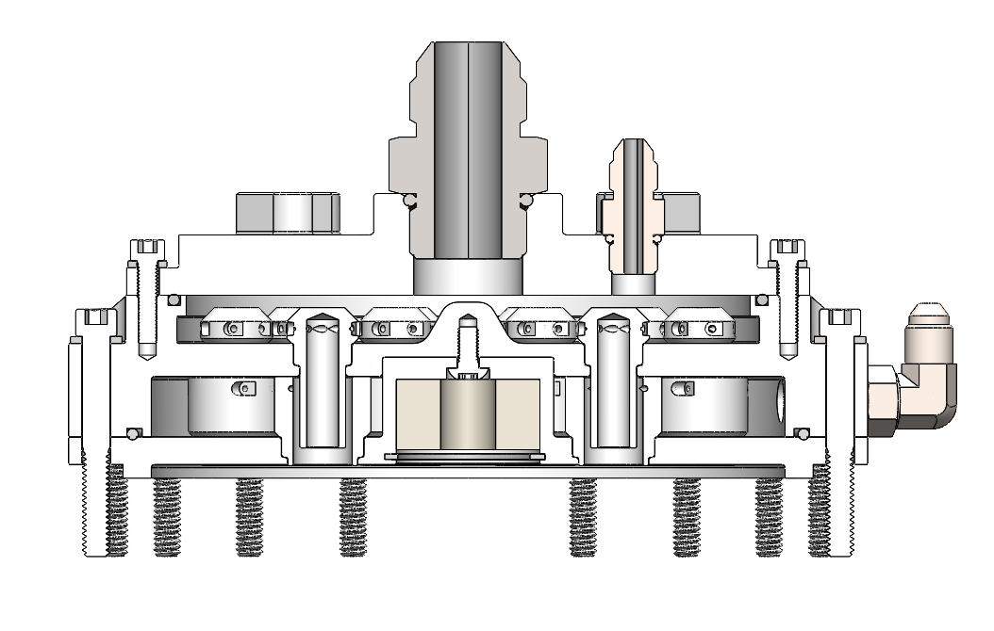
Vespula Flight Injector
Injector flying on Vespula to 100,000ft
Key features
  18 elements
  2500lbf, 2 MR, 300 psia PC
  303 Stainless Steel
  Centrally mounted igniter (SRM)
Coefficient of discharge model was adjusted based on the waterflow test on the subscale injector

Slide 15


1D Thermal Resistance Model
Hot gas side properties (hg and Tg) from Reference 10
Find total resistance
  hc is found using a turbulent flat plate correlation [9]
Find total heatflux
Re-arange equations to find surface temperatures
Very similar results to the ANSYS Steady State Thermal FEA
$$\begin{aligned}&R_{total}=\frac{1}{h_{g}}+\frac{t}{k}+\frac{1}{h_{c}}\#\end{aligned}$$
$$\begin{aligned}&q=\frac{T_{g}−T_{c}}{R_{total}}\#\end{aligned}$$
 | 1D Thermal Resistance Model | Steady State Thermal FEA
Hot Gas Side Surface Temperature (K) | 1194 | 1365
Coolant Side Surface Temperature (K) | 575 | 587

Slide 16
Waterflow Results
Injector Side | Measured Cd | Predicted Cd | % Error
Fuel | 0.05 | 0.0244 | 105%
Open LOX | 0.150 | 0.1355 | 10.8%
Large error on fuel side
  Caused by a machining tolerance error leaving small (0.005”) gaps on the top of each fuel swirler
  Solved by adding gasket and machining down the outer ring of swirlers
  Subscale combustor was inspected and found similar issue
    This was not noticed in the waterflows as the error was simply 0%
    Going from a single element manifold to a multi-element manifold decreases the Cd (increases pressure drop) as observed on the LOX side
      However, the gaps on the fuel side increased the Cd (decreased pressure drop) and just happened to cancel out the manifold Cd decrease
Final discharge coefficient for fuel side corresponded to a 30% stiffness value (predicted was 20%)

Slide 17
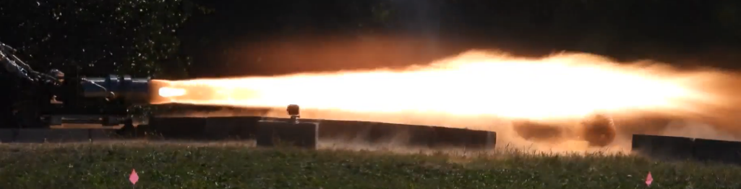
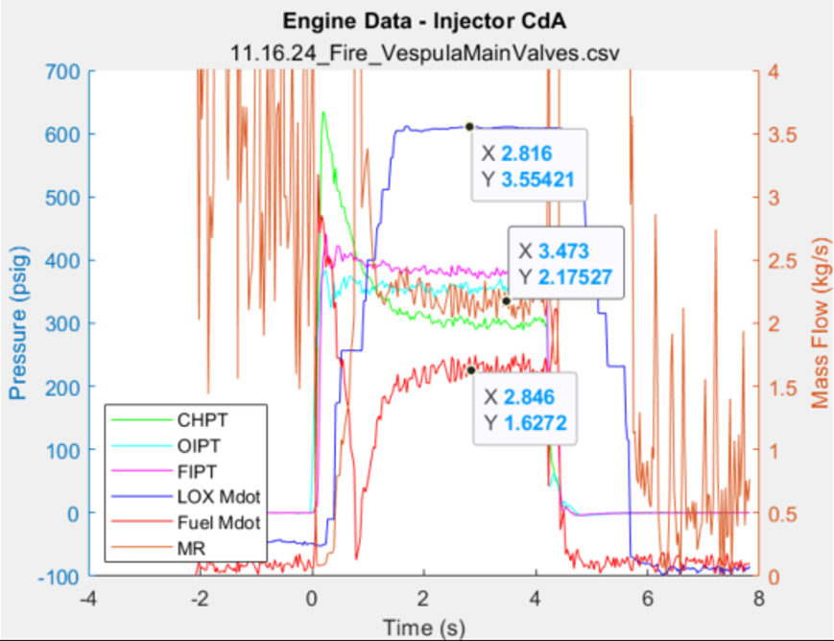
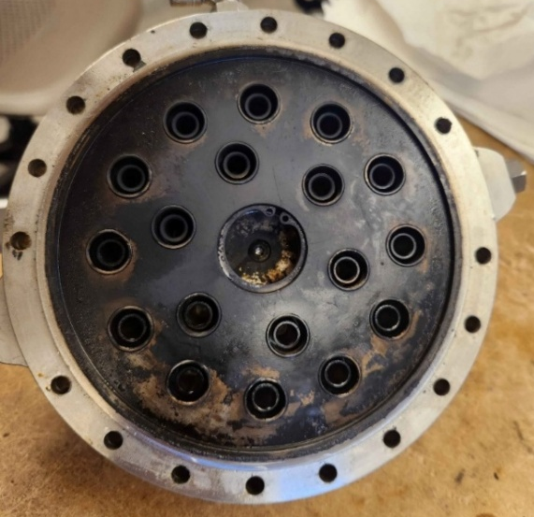
Vespula Flight Injector Hotfire
Hotfired and achieved a 92% c*-efficiency
  Highest YJSP has ever hit
  Overshot the design target of 85% for Vespula

Slide 18
Conclusions
2 years (4 school semesters) from a clean sheet design to a fully developed flight injector
  Met all original targets
  All completely done in-house (design, machining, testing, etc.)
Lessons learned will be valuable for future injector designs, especially for YJSP’s space-shot vehicle

