Slide 1

A Review of Hypersonic Vehicle Engine Optimization
Nicholas Pisani, Peter Waszkowski
Florida Institute of Technology
AIAA Student Conference Region II, April 3 & 4, 2025
Copyright © by Nicholas Pisani & Peter Waszkowski, Florida Institute of Technology
Published by the American Institute of Aeronautics and Astronautics, Inc., with permission.

Slide 2
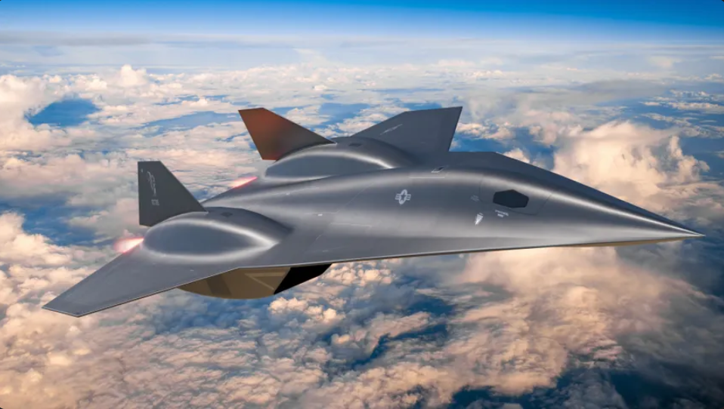
Background on Hypersonics
Future of government and civilian aircraft
Utilize supersonic combustion to provide sufficient thrust
In the past, have not been independently operated: Rockets or supersonic aircraft
[16]

Slide 3
Introduction
Hypersonic vehicles have the potential to improve both government and civilian aerospace capabilities:
Stealth, response time and survivability
Thrill seeking and high-speed travel
Reusable launch vehicles

Slide 4
Introduction
Inlets
Combustion Stabilization
Nozzles
Combined Cycle

Slide 5
Following the Flow Path
Inlets
Combustion Stabilization
Nozzles
Combined Cycle
Notes:
Inlets = streamline shock inducing geometry through variable geometry and integration within combined cycle engines
Nozzle = Rao’s method/proper design analysis to increase efficiency and limit trailing edge flow interaction

Slide 6
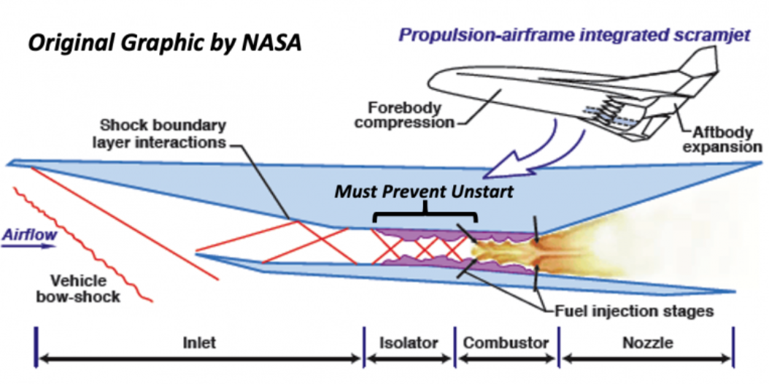
Background on Inlets
Primary purpose of inlets in hypersonic vehicle engines is to decelerate and pressurize flow
Main scramjet inlet inefficiencies: Spillage drag and shock losses
[17]

Slide 7
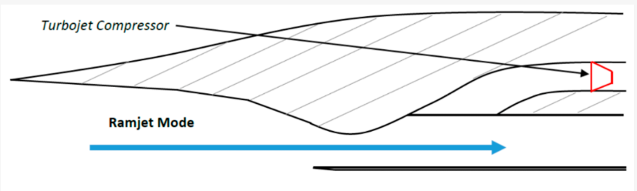
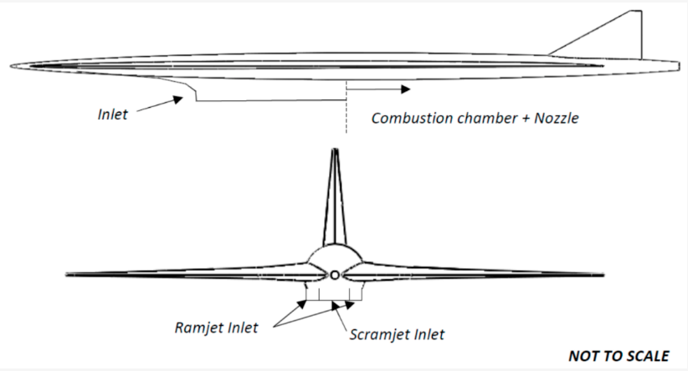
Inlets: Ramjet compression system
Straight cowl lip inlet used for a ramjet and scramjet combined inlet section
[5]
[5]

Slide 8
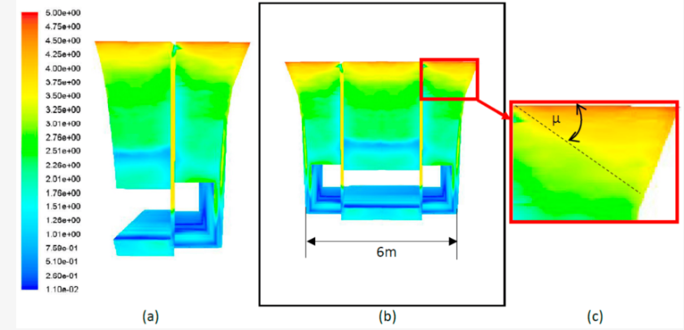
Inlets: Ramjet compression system
Drawbacks of Configuration 1:
Shock angle interference
Less aerodynamic profile
Insufficient thrust values
Mach #
Configuration 1:
[5]

Slide 9
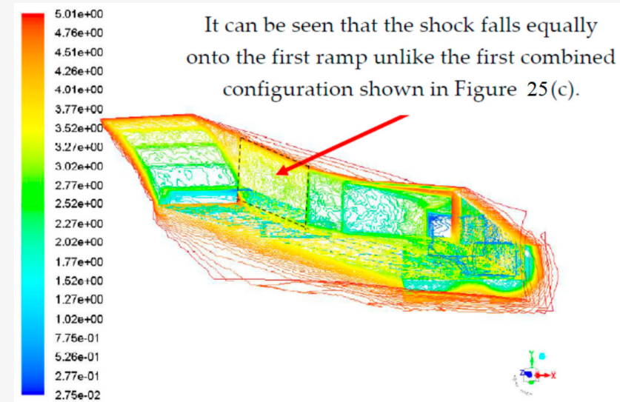
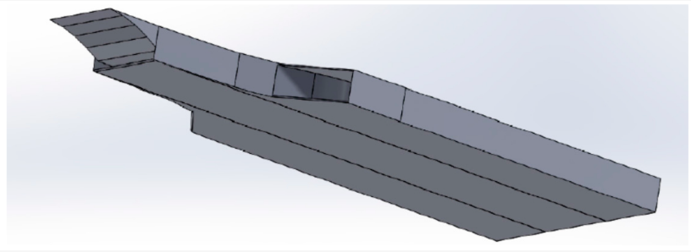
Inlets: Ramjet compression system
Solution: Configuration 2
Benefit:
Eliminate shock angle interference
More aerodynamic profile
Mach #
Configuration 2:
Configuration 1
[5]
[5]

Slide 10
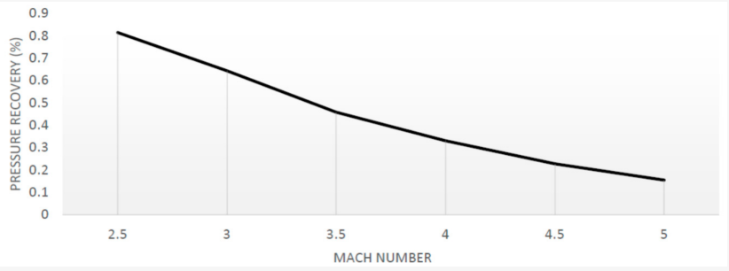
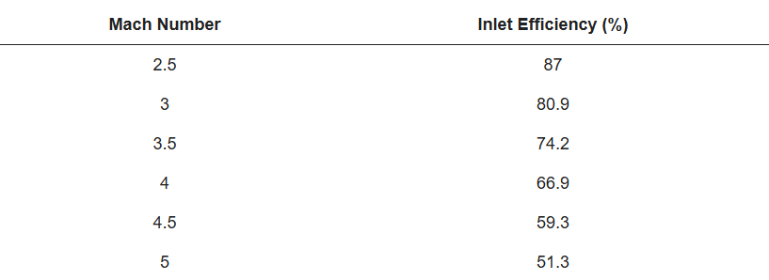
Inlets: Ramjet compression system
Inlet design proved successful for the ramjet, but not the scramjet at hypersonic flight regimes
[5]
[5]
Pressure Recovery Factor (PRF): Quantity used to characterize an inlet’s ability to recover pressure levels after shock interactions
Inlet Efficiency: Direct relationship with PRF

Slide 11
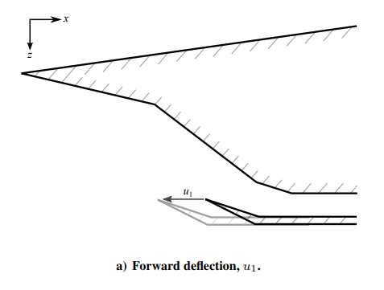
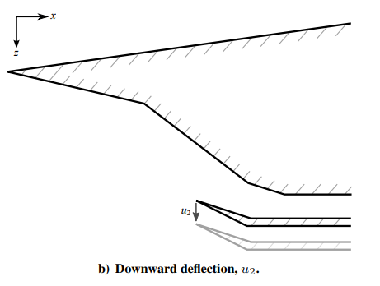
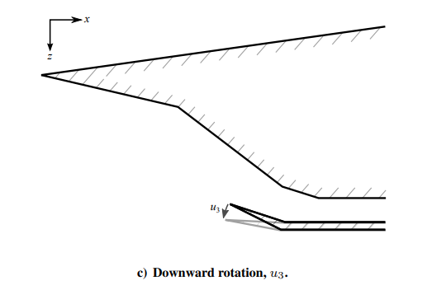
Inlets: Benefits of variable geometry
Performance analysis of cowl motions using a low-order model designed for control-oriented applications that simulate wave interactions [6].
Three Cowl Lip Motions:
Forward/backward
2) Up/Down
3) Rotation
[6]
[6]
[6]

Slide 12
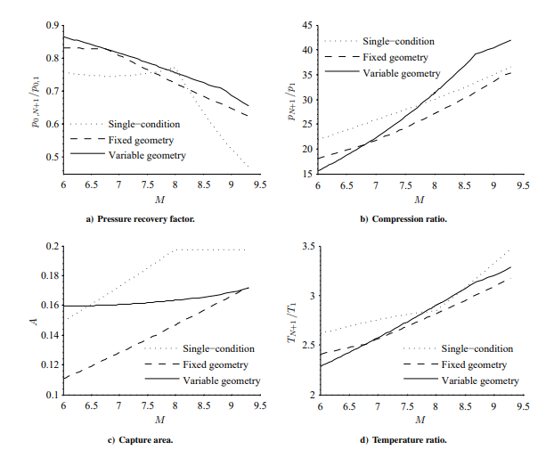
Benefits of variable inlet geometry:
Two main categories of results analysis indicate benefit of vertical displacement (up and down motion):
      PRF
  Capture Area
[6]
[6]

Slide 13
Following the Flow Path
Inlets
Combustion Stabilization
Nozzles
Combined Cycle

Slide 14
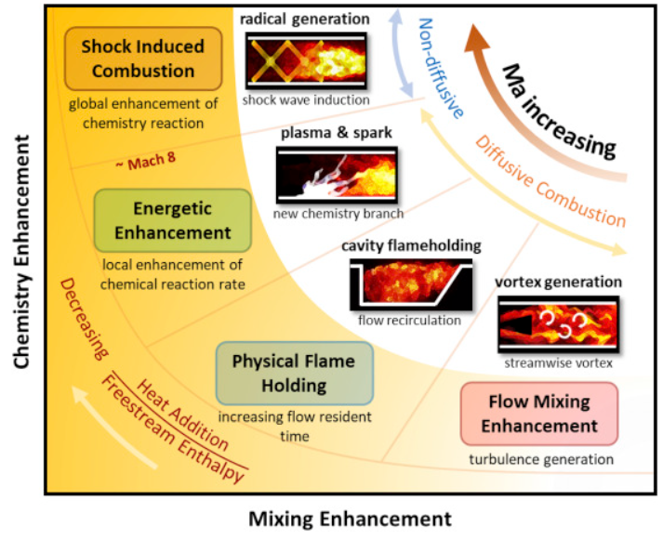
Combustion Stabilization: Background
Constant, predictable thrust
Mixing, residence, reaction
Cavity flame holding
Plasma enhancement
Shock induced combustion
[3]
Notes:
Flow mixing time increases the combustion ability
elongating flow residence time allows the stabilization
improves the ability to stay within the combustion chamber

Slide 15
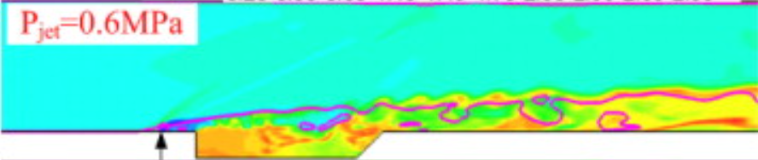
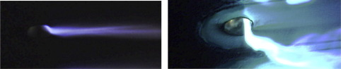
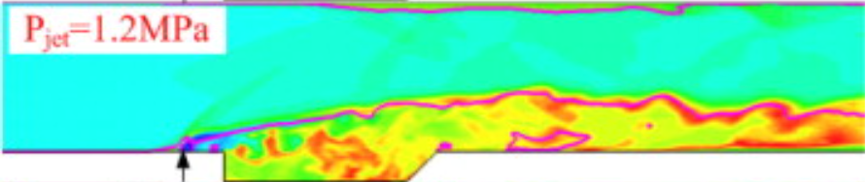
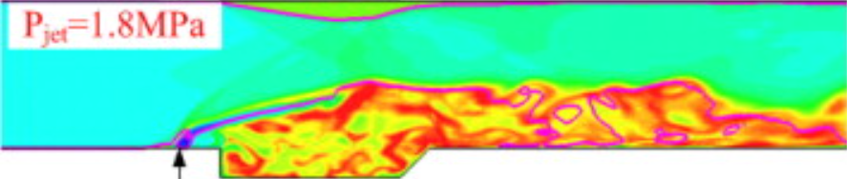
Combustion Stabilization: Flameholding
Fuel jet and cavity → Mixing enhancement
Plasma Injection Module → Reaction enhancement
[8]
[7]
Notes:
Fuel jet and cavity - location and shape of shear layer interaction will influence shape of flame -> affecting the distribution and propagation; High-pressure injector = further upstream combustion; low-pressure injector = potential to fully ignite downstream of cavity
Fuel jet/cavity -> flame spreading angle increases cause increase in combustion process, mixing, propagation, and chem rxn time; too much causes aggressive disruption in boundary layer and choking effect
PIM -> higher normalized pressures at high fuel mass flow rates can be used (rich) & viscous cycle of discharge/ignition/no discharge/no ignition (varying pressures)

Slide 16
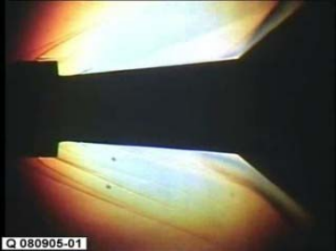
Combustion Stabilization: Ignition
Oblique shock ignition
2 modes:
  Inviscid flow combustion
  Separation zone combustion
[10]
Notes:
inviscid flow field -> peak heat load occurring downstream of separation zone created; lower local heat loads
separation zone -> amplifies boundary layer separation zone and increases local heat loads; thermal failure
Must be high stagnation temp (not low/sub sonic) and uniform distribution of flow

Slide 17
Following the Flow Path
Inlets
Combustion Stabilization
Nozzles
Combined Cycle
Notes:
Inlets = streamline shock inducing geometry through variable geometry and integration within combined cycle engines
Nozzle = Rao’s method/proper design analysis to increase efficiency and limit trailing edge flow interaction

Slide 18
Background on Nozzles
Goal of nozzles: depressurize and accelerate flow
Influence interactions between exhaust flow and bypass flow - cannot cause drag
Flow cannot be underexpanded nor overexpanded
[17]

Slide 19
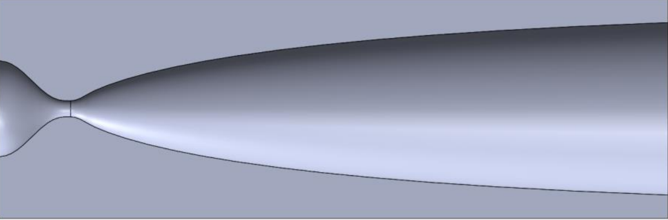
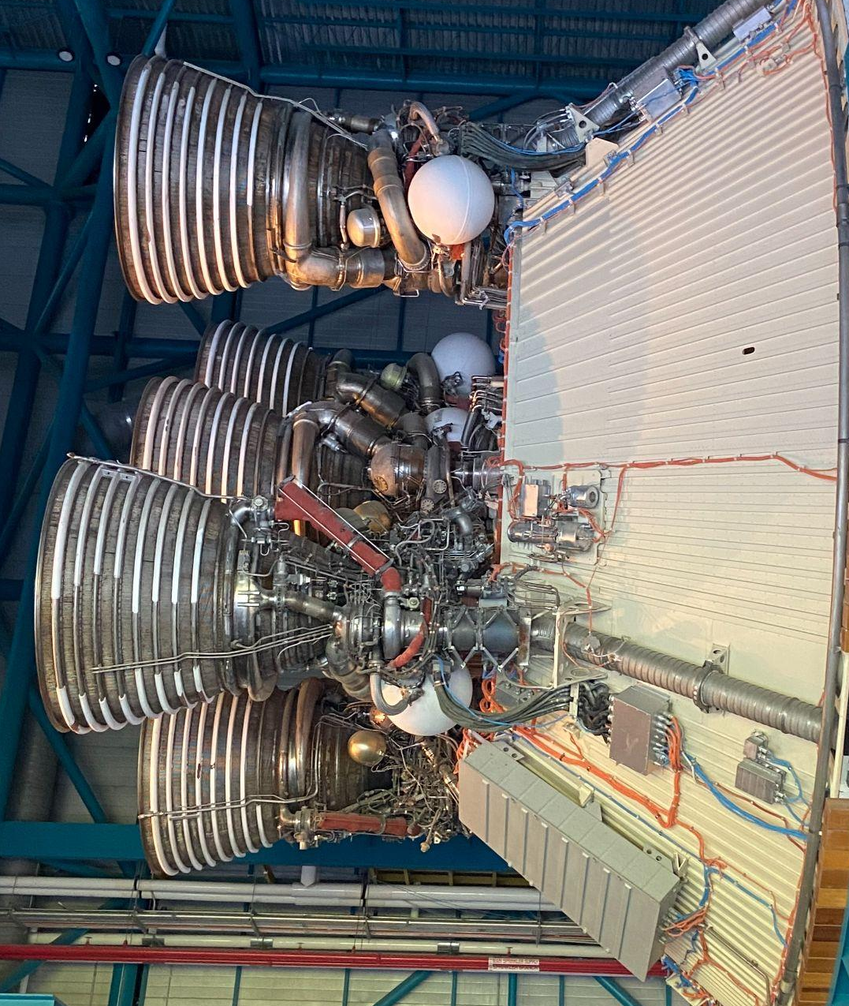
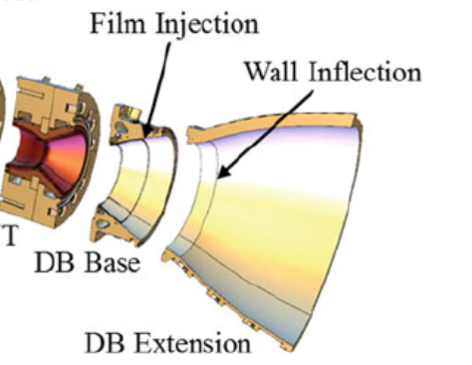
Nozzles: Effective hypersonic designs
Testing the effectiveness of three existing hypersonic nozzles based on surface area and nozzle geometry:
de Laval Nozzle
Bell Nozzle
Dual-Bell Nozzle
DB Base
DB Extension
[11]
SOLIDWORKS Model of de Laval Nozzle
[16]
**de Laval and Bell shortened using Rao’s Method
*Note: not the design from this study

Slide 20
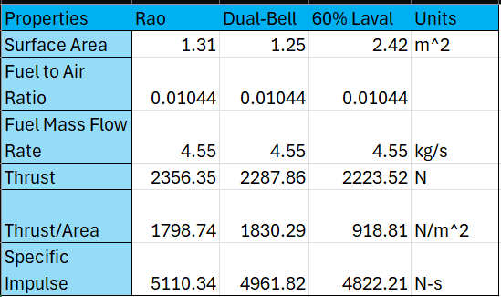
Nozzles: Effective hypersonic designs
Quantitative results of simulation and analysis:
Rao’s Method: Maximize thrust while minimizing surface area
[11]
*Fuel chosen was Hydrogen gas: real scramjet nozzle experience

Slide 21
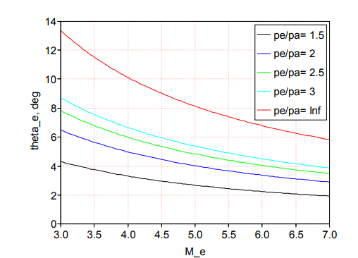
Nozzles: Hypersonic design process
Development of hypersonic nozzles is extensive and should focus mainly on four steps:
Control Volume Analysis
Force and force vector analysis
Rao’s Method
Method of Characteristics
Exhaust pressure
Ambient pressure
Streamline Angle, deg
[2]
Mach #

Slide 22
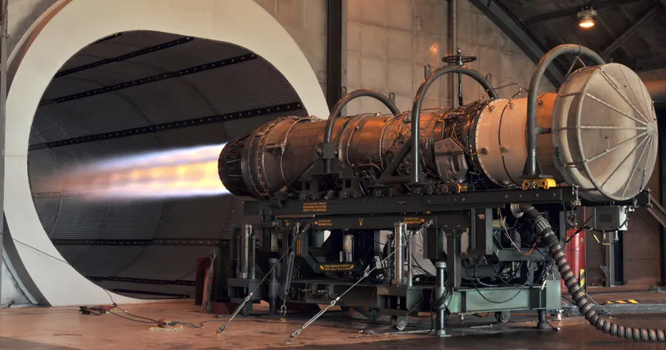
Nozzles: Main Takeaways
Produce effective performance models
  Minimize surface area
  Determine effective nozzle contour
Efficient Nozzles Efficient Engines Efficient Vehicles
[18]

Slide 23
Following the Flow Path
Inlets
Combustion Stabilization
Nozzles
Combined Cycle
Notes:
Inlets = streamline shock inducing geometry through variable geometry and integration within combined cycle engines
Nozzle = Rao’s method/proper design analysis to increase efficiency and limit trailing edge flow interaction

Slide 24
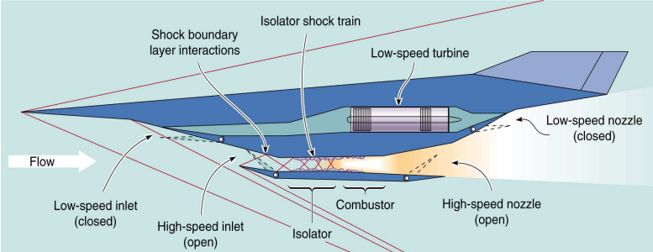
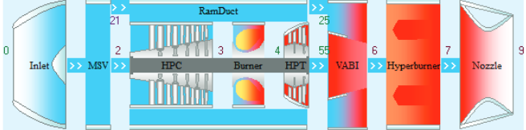
Background on Combined Cycle Engines
Full flight operation
Turbine-based (TBCC) vs. Rocket-based (RBCC)
The mode transition is a key point of interest
[4]
[4]

Slide 25
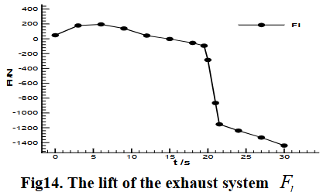
Parallel TBCC
Two flow paths
More complex - requires additional mechanical systems
Aerodynamic forces during transition must be considered
[12]
Notes:
Thrust coefficient of exhaust system over 0.9; sharp decrease in lift will cause strong aerodynamic moments to be corrected by flaps in transition.

Slide 26
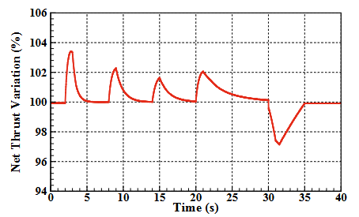
Tandem TBCC
Single flow path
Technology level
Transition between turbine and ramjet operation is difficult
[13]
Notes:
net thrust variance of 4% and mass flow rate less than 8% variance; turbojet blown out -> decrease in mach number of inlet to the ramjet combustion area potentially causes ramjet unstart

Slide 27
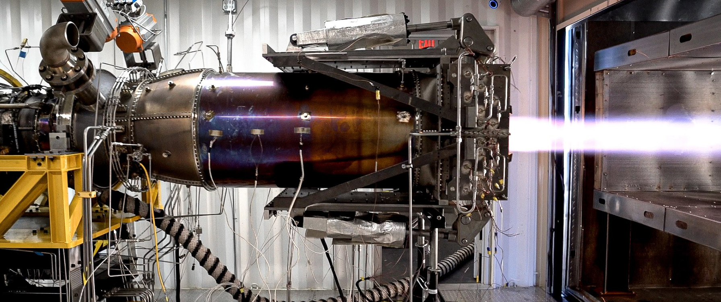
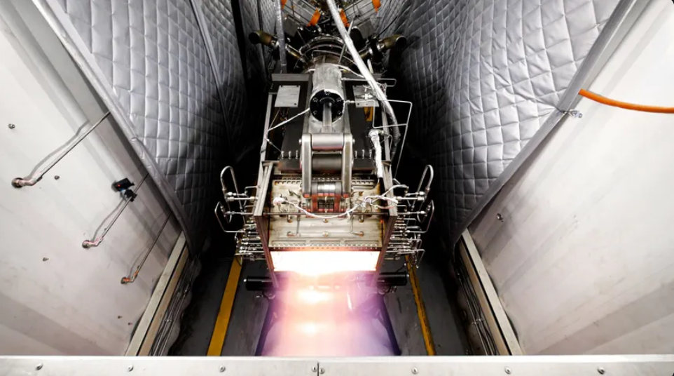
Conclusion
Prioritize overall engine efficiency by combining aspects
More research necessary
  Combination cycle engines
  Physical experimentation crucial
[19]
[19]

Slide 28
References
[1] Ma, Y., Guo, M., Tian, Y., & Le, J. (2024). Recent advances and prospects in hypersonic inlet design and intelligent optimization. Aerospace Science and Technology, 146, 108953. https://doi.org/10.1016/j.ast.2024.108953
[2] Cain, T. (2010, September). Scramjet nozzles - DTIC. NATO Research and Technology Organization. https://apps.dtic.mil/sti/pdfs/ADA592961.pdf
[3] Qili Liu, Damiano Baccarella, Tonghun Lee, Review of combustion stabilization for hypersonic airbreathing propulsion, Progress in Aerospace Sciences, Volume 119, 2020, 100636, ISSN 0376-0421, https://doi.org/10.1016/j.paerosci.2020.100636. (https://www.sciencedirect.com/science/article/pii/S0376042120300488)
[4] McDaniel, J., Goyne, C., Edwards, J., Chelliah, H., Cutler, A., & Givi, P. (2009). US National Center for Hypersonic Combined Cycle Propulsion: An overview. 16th AIAA/DLR/DGLR International Space Planes and Hypersonic Systems and Technologies Conference. https://doi.org/10.2514/6.2009-7280
[5] Veeran, S., Pesyridis, A., & Ganippa, L. (2018). Ramjet compression system for a hypersonic air transportation vehicle combined cycle engine. Energies, 11(10), 2558. https://doi.org/10.3390/en11102558
[6] Dalle, D. J., Torrez, S. M., & Driscoll, J. F. (2011). Performance analysis of variable-geometry scramjet inlets using a low-order model. 47th AIAA/ASME/SAE/ASEE Joint Propulsion Conference & Exhibit. https://doi.org/10.2514/6.2011-5756
[7] A. Ben-Yakar, M.G. Mungal, R.K. Hanson, Time evolution and mixing characteristics of hydrogen and ethylene transverse jets in supersonic crossflows, Phys. Fluids. 18 (2006) 026101. https://doi.org/10.1063/1.2139684
[8] Wang, H., Wang, Z., Sun, M., & Qin, N. (2013). Combustion characteristics in a supersonic combustor with hydrogen injection upstream of Cavity Flameholder. Proceedings of the Combustion Institute, 34(2), 2073–2082. https://doi.org/10.1016/j.proci.2012.06.049
[9] Savelkin, K. V., Yarantsev, D. A., Adamovich, I. V., & Leonov, S. B. (2015). Ignition and Flameholding in a supersonic combustor by an electrical discharge combined with a fuel injector. Combustion and Flame, 162(3), 825–835. https://doi.org/10.1016/j.combustflame.2014.08.012
[10] Veraar, R., Mayer, A., Verreault, J., Stowe, R., Farinaccio, R., & Harris, P. (2009). Proof-of-principle experiment of a shock-induced combustion ramjet. 16th AIAA/DLR/DGLR International Space Planes and Hypersonic Systems and Technologies Conference. https://doi.org/10.2514/6.2009-7432
[11] Vianna Moizes, D. A., Kotler, A. R., Thornton, M. R., & Ahmed, K. A. (2023). Comparison and analysis of hypersonic scramjet nozzles. AIAA SCITECH 2023 Forum. https://doi.org/10.2514/6.2023-0716
[12] Li, C., Xu, J., Mo, J., & Zhang, K. (2009). Numerical simulation of the unsteady mode transition process of an over-under TBCC exhaust system. 45th AIAA/ASME/SAE/ASEE Joint Propulsion Conference &amp;Amp; Exhibit. https://doi.org/10.2514/6.2009-5301
[13] Zhang, M., Wang, Z., Liu, Z., & Zhang, X. (2016). Analysis of mode transition performance for a tandem TBCC engine. 52nd AIAA/SAE/ASEE Joint Propulsion Conference. https://doi.org/10.2514/6.2016-4573
[14] Russel, J. (2009). Turbine-based combined cycle propulsion. Turbine-Based Combined Cycle Propulsion. https://www.colorado.edu/faculty/kantha/sites/default/files/attached-files/russell.pdf

Slide 29
Further Image References
[15] Kylie, N. (2024, December 16). SR-72: 5 advances expected in the hypersonic UAV “son of blackbird.” Simple Flying. https://simpleflying.com/5-advances-hypersonic-uav-son-of-blackbird/
[16] Génin, C., Schneider, D., & Stark, R. (2020). Dual-Bell nozzle design. Notes on Numerical Fluid Mechanics and Multidisciplinary Design, 395–406. https://doi.org/10.1007/978-3-030-53847-7_25
[17] University, T. (n.d.). Horizon Inlet Unstart Dynamics. Space Institute. https://www.utsi.edu/horizon/research/inlet-unstart-dynamics/
[18] Wikimedia Foundation. (2025, March 13). Jet engine. Wikipedia. https://en.wikipedia.org/wiki/Jet_engine#Nozzles
[19] Chimera. Hermeus. (n.d.). https://www.hermeus.com/chimera

