Slide 1
Methods of Space Debris Removal in Low Earth Orbit
Alexander Berthelot

Slide 2
Outline
  Introduction
  Debris Clouds and Associated Risks
  Cost-Benefit Overview
  Methods
    Orbital Laser Systems
    Space Sweeper with Sling-Sat
    Retrieval Mission with Solar Sail
  Conclusion
  Questions

Slide 3
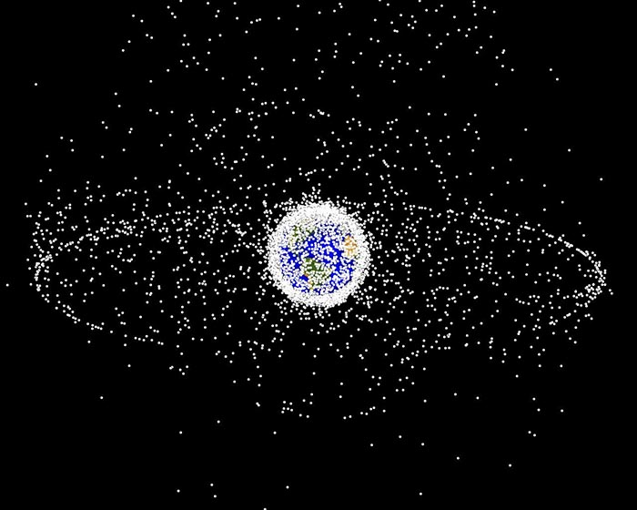
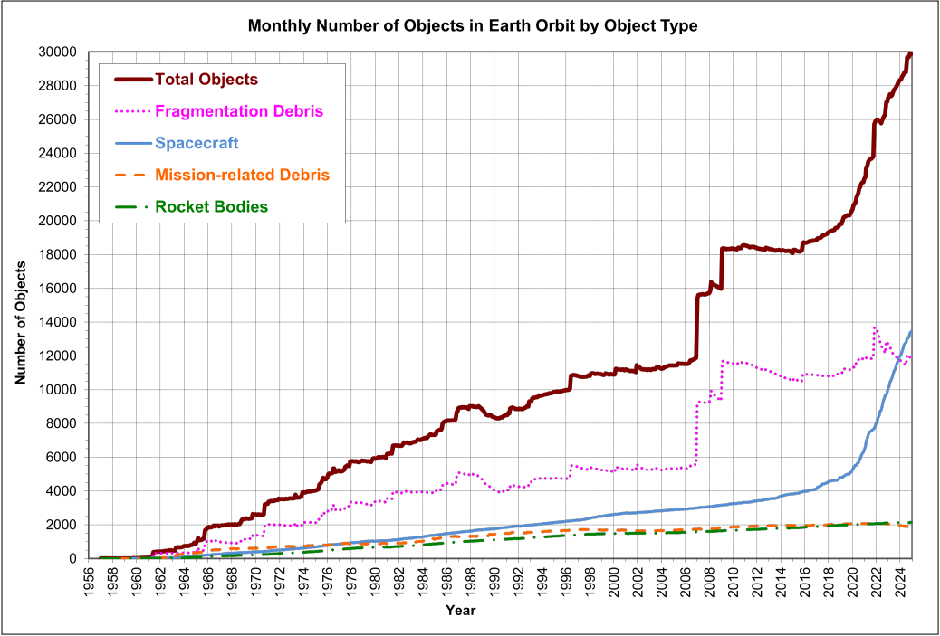
Introduction
Figure 1 NASA generated image of orbital debris from GEO perspective [1].
Chinese anti-satellite test in 2007 produced ~3,000 debris pieces
Kessler Syndrome threatens our orbits
Commercial satellite operations are rapidly expanding
Debris removal is essential for the safety of future space operations
Figure 2 trackable debris data collected by NASA [2].

Slide 4
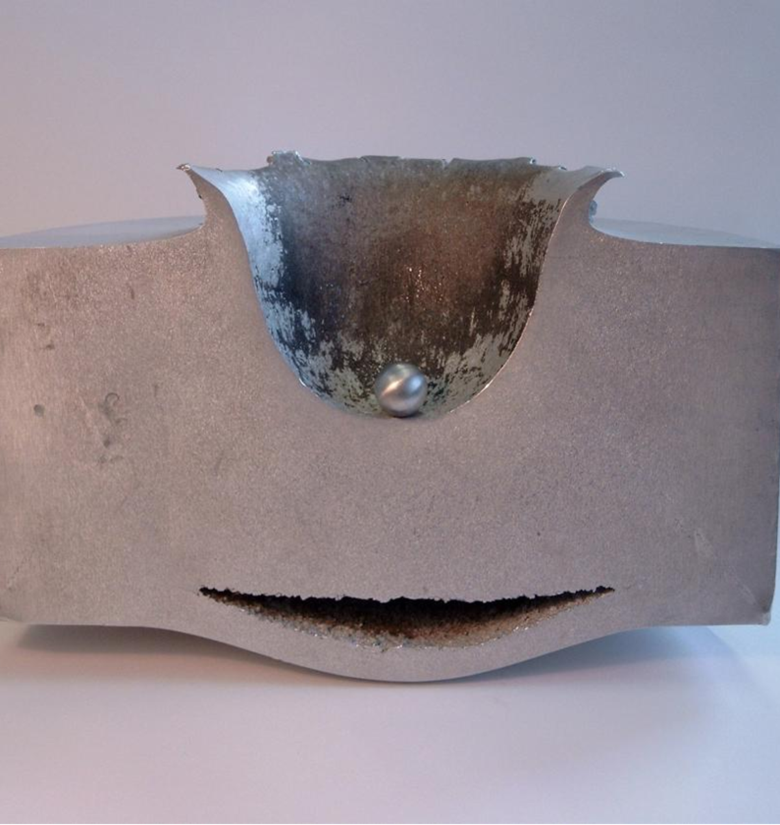
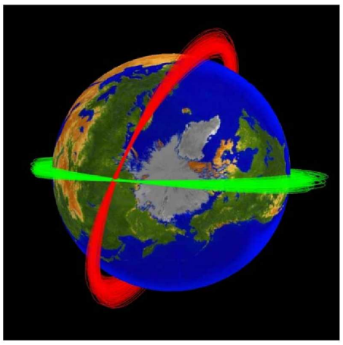
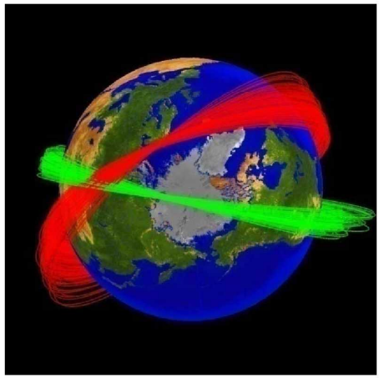
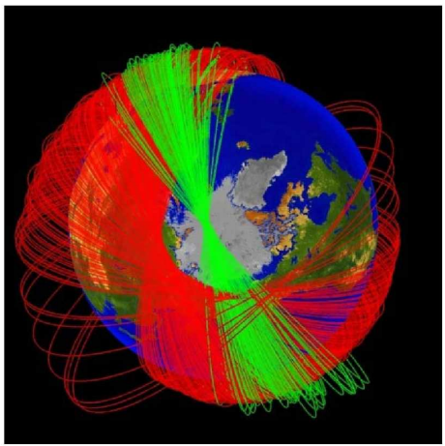
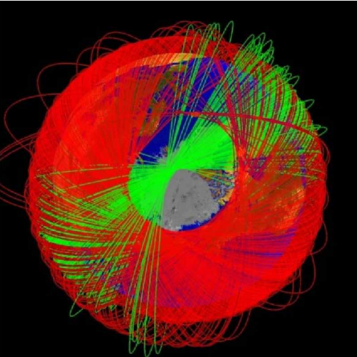
Debris Clouds and their Risk Factors
Figure 3 Impact on an 18 cm plate from a 1.2 cm ball traveling at 6.8 km/s [3].
Iridium 33 and Cosmos 2251 collided in 2009
Collision produced ~1800 pieces of trackable debris (>10 cm)
~200,000 pieces between 1 and 10 cm
Hyper-velocities average ~7 km/s
7 Days
30 Days
6 Months
1 Year
Figures 4-7 Iridium 33 and Cosmos 2251 debris orbits over time [4].

Slide 5
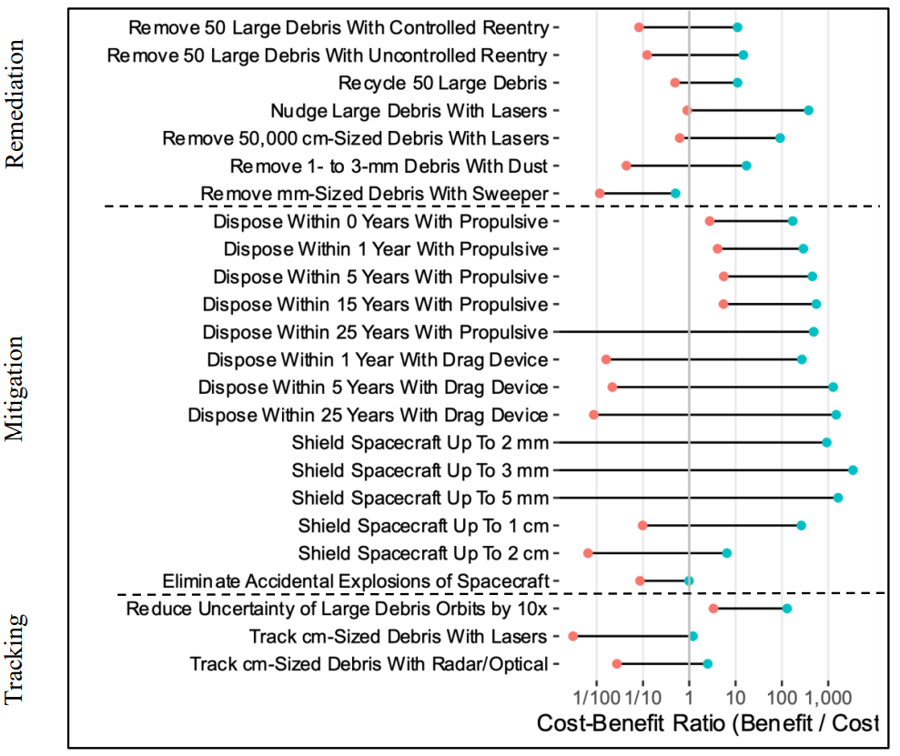
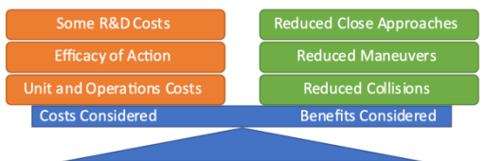
Cost-Benefit Definition
Current space operations mostly rely on avoidance maneuvers and spacecraft shielding
Self deorbiting spacecraft provides the most risk reduction
Figure 8 Balance between measured costs and benefits [5].
Figure 9 Benefit/Cost ratios of tracking, mitigation, and remediation methods [5].

Slide 6
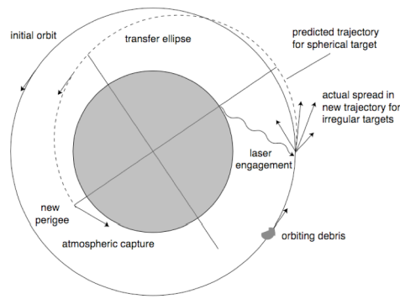
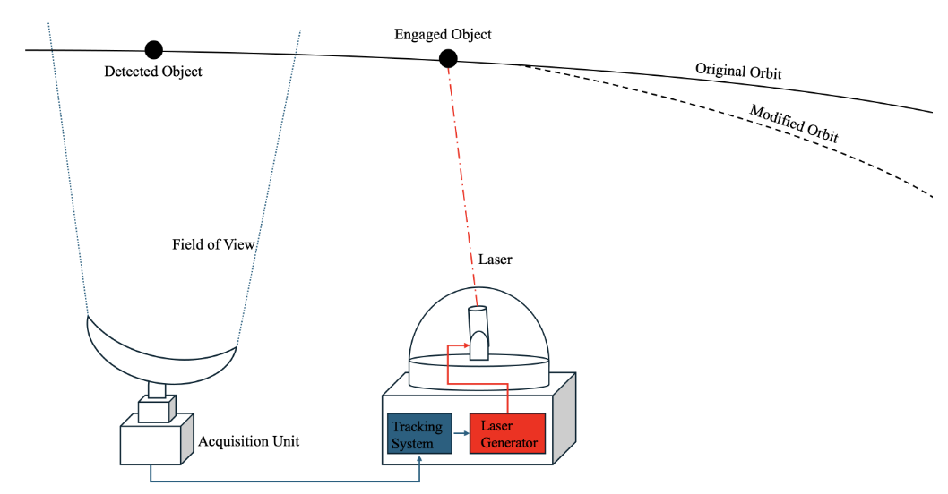
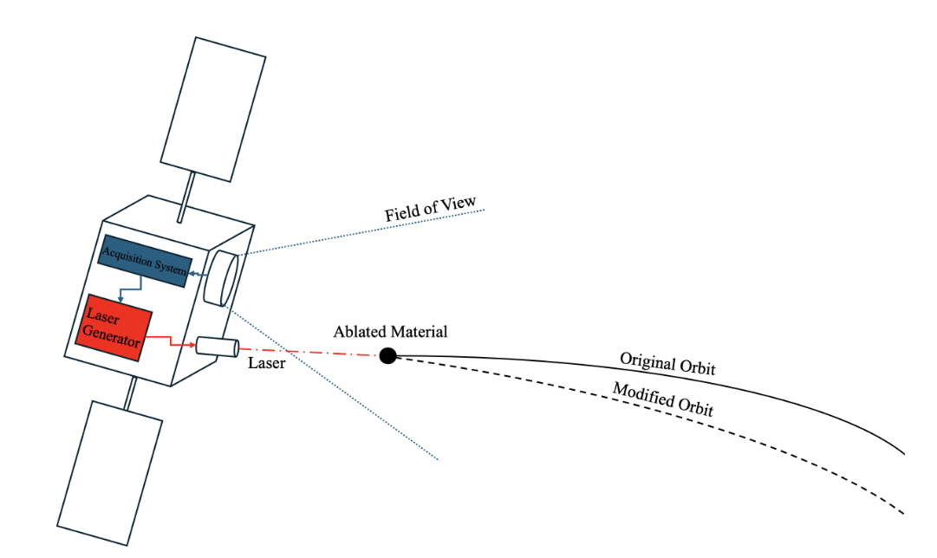
Laser Orbital Debris
Removal (LODR)
Figure 10 Orbital view of deorbiting debris with ground-based LODR [6].
Targets debris between 1-10 cm
300-500 kW solid state laser
Pulsed beams at 10-20 Hz
5-year operations
Figure 11 Illustration of a ground-based LODR system [6]
Figure 12 Illustration of a space-based LODR system [6]

Slide 7
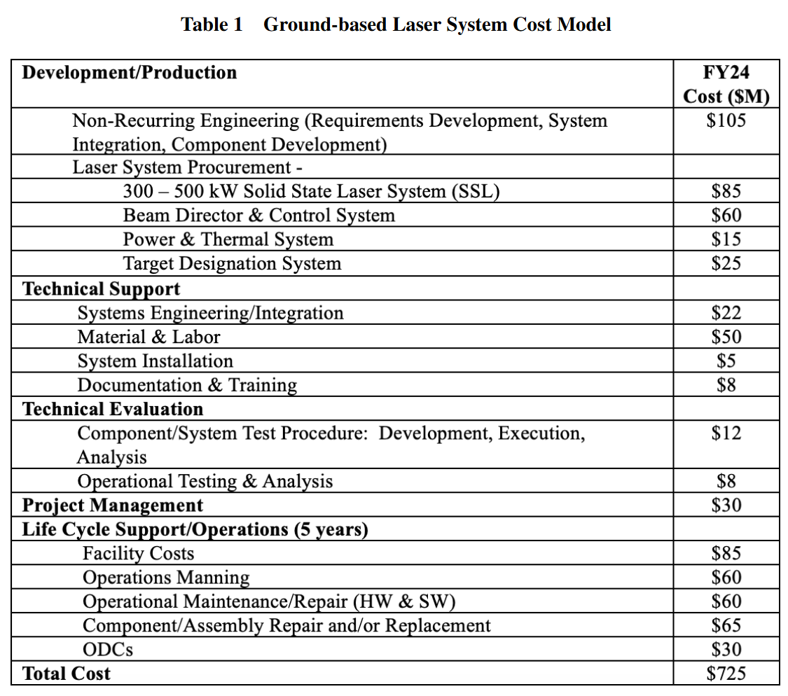
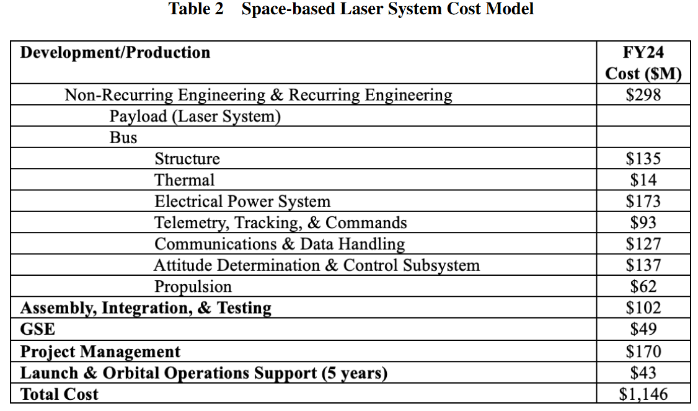
Ground vs. Space Laser Systems
[6].
[6].

Slide 8
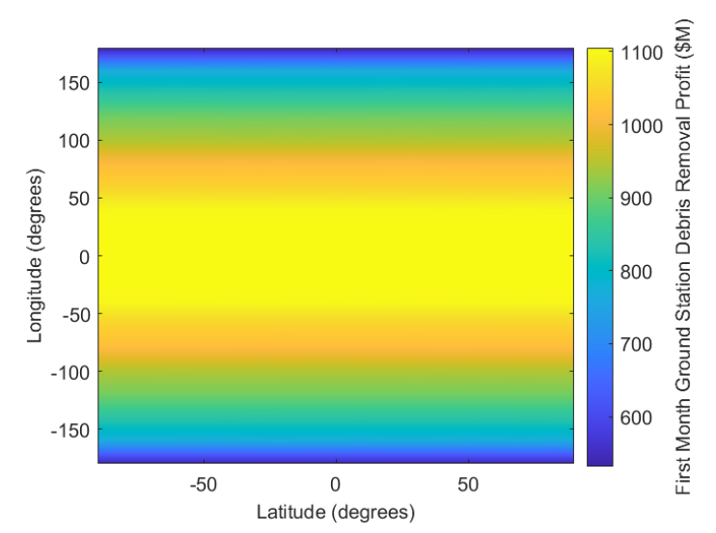
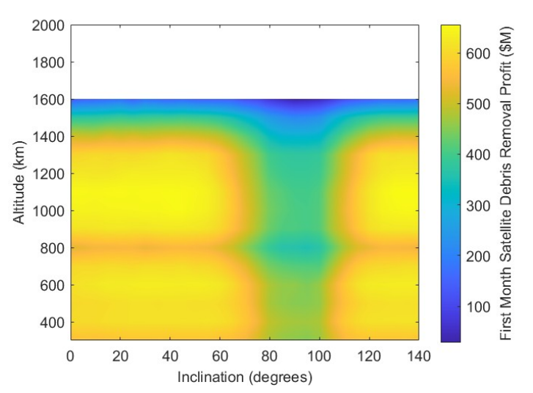
LODR Net Benefit
The profit gradient represents the amount in $M saved due to risk reduction
Simulation of one month of operations based on cost models
Ground Based
Space Based
Figure 13 Results for profit based on ground position [6].
Figure 14 Results for profit based on satellite position [6].

Slide 9
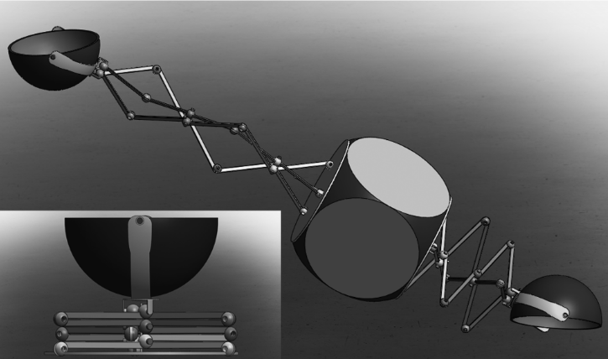
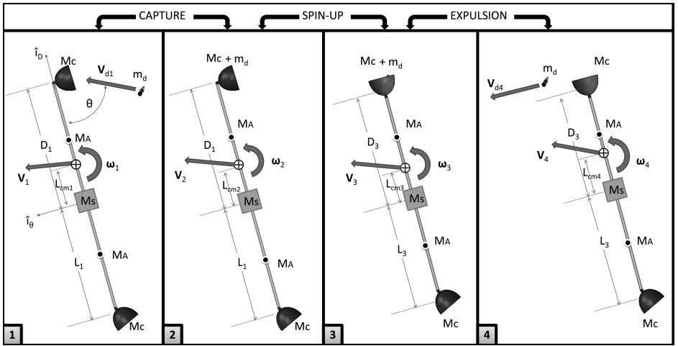
Space Sweeper with Sling-Sat (4S)
Performs timed captures and ejections to achieve fuel efficient ΔVs
Adjustable arms allow changes in angular velocity and thus ejection speed
Consumes ~60% of the fuel it would require for the same results of a standard mission
Figure 16 Sling-Sat adjustable arm concept [8].
Figure 15 Sling-Sat Dimension variables [7].

Slide 10
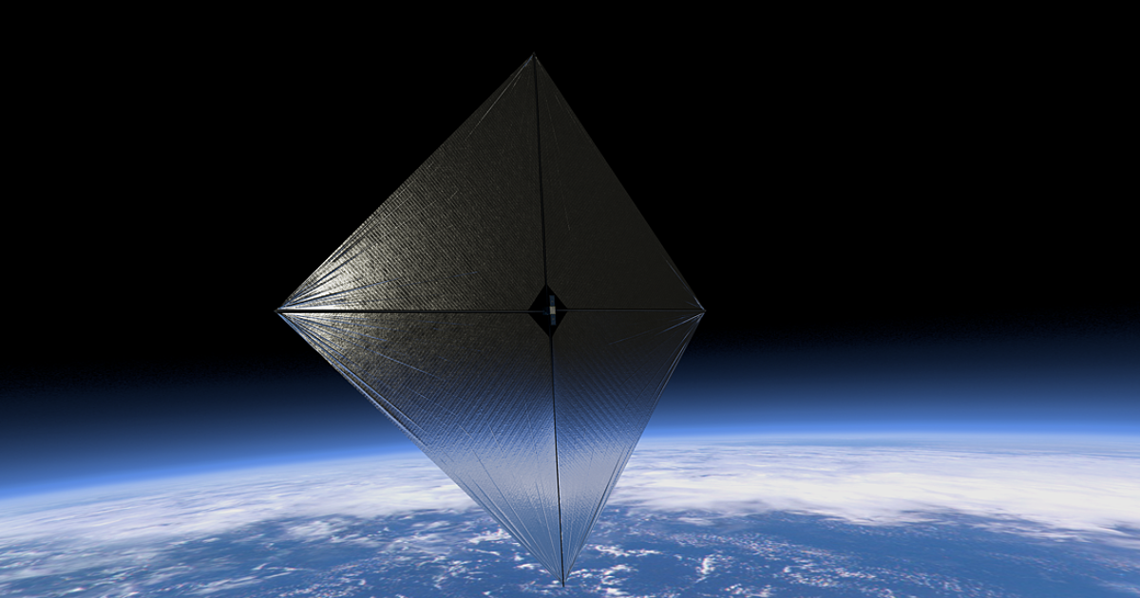
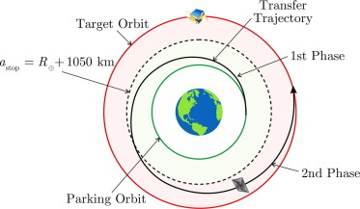
Debris Removal with Solar Sail
Solar radiation pressure provides propulsion in place of on-board fuel
Small debris is targeted due to mass constraints
Mission length is ~500 days during low solar activity
Figure 18 NASA Advanced Composite Solar Sail System (ACS3) [10].
Figure 17 Illustration of orbital transition [9].

Slide 11
Conclusion
LODR Systems
  Effective in deorbiting small debris >1 cm
  High energy requirement
  International cooperation may be required for the fear of a weapon system
4S Mission Structure
  Targets small-medium sized debris pieces
  High fuel efficiency without sacrificing performance
  Can capture and deorbit multiple objects in a single mission
Solar Sail Mission Structure
  Targets small debris pieces
  Eliminates the need for on-board fuel
  Long mission times and only deorbits one object at a time

Slide 12
Thank you for Listening
Questions?

Slide 13
References
[1] NASA Orbital Debris Program Office. [Online]. Available: https://orbitaldebris.jsc.nasa.gov/photo-gallery/
[2] NASA Orbital Debris Quarterly News. [Online]. Available: https://www.orbitaldebris.jsc.nasa.gov/quarterly-news/pdfs/ODQNv29i1.pdf
[3] The European Space Agency [Online]. Available: https://www.esa.int/ESA_Multimedia/Images/2009/02/Hypervelocity_impact_sample
[4] Johnson, N. “The Collision of Iridium 33 and Cosmos 2251: The Shape of Things to Come,” 60th International Astronautical Congress, JSC-CN-18971, 2009, Available: https://ntrs.nasa.gov/citations/20100002023
[5] Locke, J., Colvin, J. T., Ratliff, L., Abdul-Hamid, A., and Samples, Colin., “Cost and Benefit Analysis of Mitigating, Tracking, and Remediating Orbital Debris,” NASA Office of Technology, Policy, and Strategy, May. 2024, Available: https://ntrs.nasa.gov/citations/20240003484
[6] Cottrill, L., Tiscareno, A., Park, L., Bardaji, J., and Abdul-Hamid, A., “Cost and Benefit Analysis of Removing Small Debris Using Space-Based and Ground-Based Laser Systems,” AIAA SCITECH 2025 Forum, AIAA 2025-1161, Jan. 2025, Available: https://doi.org/10.2514/6.2025-1161
[7] Missel, J., and Mortari, D., “Optimization of Debris Removal Path for TAMU Sweeper,” Advances in the Astronautical Sciences, Vol. 143, No. 1, 2012, pp. 935–945; also AAS Paper 12-167, Available: https://citeseerx.ist.psu.edu/document?repid=rep1&type=pdf&doi=8b36307bb05ee36f555620a2cccb8279fe6db935

Slide 14
References …
[8] Missel, J., and Mortari, D., “Removing Space Debris Through Sequential Captures and Ejections,” Journal of Guidance, Control, and Dynamics, Vol. 36, No. 3, pp. 637-903, May. 2013, Available: https://doi.org/10.2514/1.58768
[9] Bianchi, C., Niccolai, L., Mengali, G., and Ceriotti, M., “Preliminary design of a space debris removal mission in LEO using a solar sail,” Advances in Space Research, Vol. 73, No. 8, pp. 4254-4268, April. 2024, Available: https://doi.org/10.1016/j.asr.2024.01.024
[10] Wilkie, K., and Fernandez, J., “Advanced Composite Solar Sail System (ACS3) Mission Update,” The 6 th International Symposium on Space Sailing, NASA Langley Research Center, June. 2023, Available: https://ntrs.nasa.gov/citations/20230008378
[11] Morimoto, D., Takahashi, H., Sugiyama, Y., Otsuka, K. Ohtani, K., Hasegawa, S., and Makihara, K., “Support Vector Machine Framework for Detecting Ambiguous Contours of Space Debris Cloud,” Journal of Spacecraft and Rockets, published online 22 Oct. 2024, Available: https://doi.org/10.2514/1.A35927
[12] Wilhelm, C., and Kannan, H., “Fundamentals of Mega-Constellation Resilience,” AIAA SCITECH 2022 Forum, AIAA 2022 1468, Jan. 2022, Available: https://doi.org/10.2514/6.2022-1468
[13] Phipps, C. R., Baker, K. L., Libby, S. B., Liedahl, D. A., Olivier, S. S., Pleasance, L. D., Rubenchik, A., Trebes, J. E., George, E. V., Marcovici, B., Reilly, J. P., and Valley, M. T. “Removing orbital debris with pulsed lasers,” AIP Conference Proceedings, Vol 1464, 2012, pp. 450–462, Available: https://photonicassociates.com/documents/LODR.pdf
[14] Bonnal, C., Ruault, J., and Desjean, M., “Active debris removal: Recent progress and current trends,” Acta Astronautica, Vol. 85, pp. 51-60, April-May. 2013, Available: https://doi.org/10.1016/j.actaastro.2012.11.009

