Slide 1
Design and Fabrication of an EDS-Enabled Brush Prototype for
Lunar Dust Mitigation
Nishant Sood
IDREEM Lab, George W. Woodruff School of Mechanical Engineering
AIAA Region II Student Conference, 3rd–4th April 2025
Copyright © by Nishant Sood
Published by the American Institute of Aeronautics and Astronautics, Inc., with permission.
1111

Slide 2
Introduction
Evidence of a Lunar dust layer
  Apollo Missions
  Lunar Ejecta and Meteorites Experiment (LEAM)
Challenges posed by lunar dust include:
  Health, mechanical wear, thermal control, etc.

Slide 3
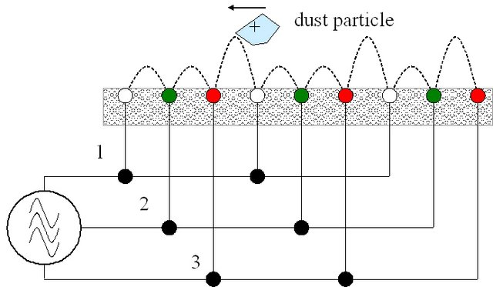
Introduction
Proposed Solutions
  Simple Brushes
  Electrodynamic Dust Shield (EDS) Systems
Source: Calle et al., Integration of the Electrodynamic Dust Shield on a Lunar Habitat Demonstration Unit, Fig 2

Slide 4
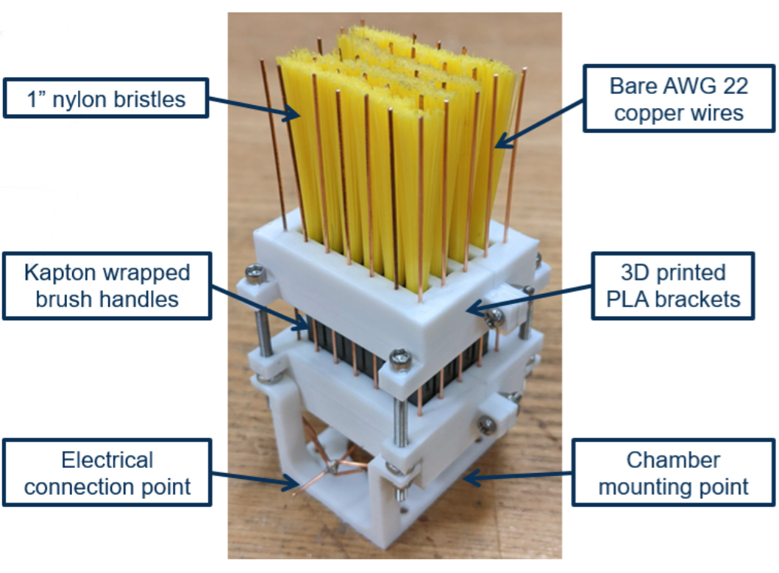
Past Work
Georgia Tech Team - “Shoot for the Moon”
Integrating EDS capabilities into a mechanical brush
  Initial prototype:

Slide 5
Past Work
Shorting in metal components
Inflexible electrodes
Demonstrated EDS feasibility
Limitations arose from the manufacturing/design of the brush

Slide 6
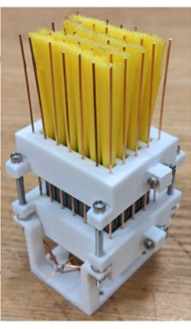
Defining Design Parameters
Prototype Component | Previous Implementation | Considerations
Electrodes | 3D Soldered wire grid | • ±0.5mm Tolerance on electrode spacing • Ease of electrode array assembly • Physical shorting/arcing prevention, flexible electrodes
Bristles | Whole brushes between electrodes | • Ensure any conductive metal components are insulated • Electrodes enmeshed in bristles
Structure | 3D Printed and fastened | Ease of assembly and sufficient insulation to electrodes • Support for bristles/electrodes • Sufficient tolerances for the electrode array

Slide 7
Proposed Solution
Addressing improvements on the previous system
  Operational brushing
  Manufacturing tolerances
  Electrode efficacy
  Economical for rapid prototyping and design validation

Slide 8
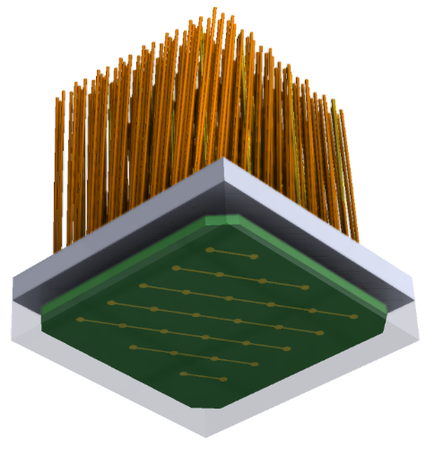
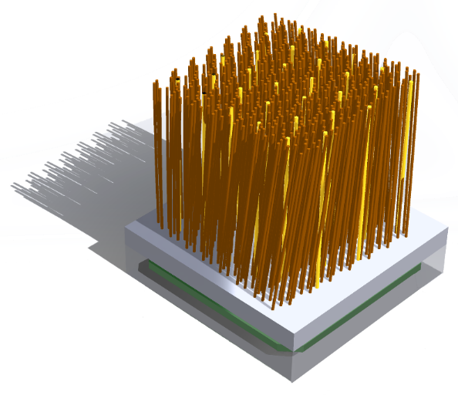
Prototype Design
PCB for electrode array
  Allows for tight tolerances between electrodes
  More economical/rapid prototyping
Epoxy Resin Structure
  Retains bristles through resin-set techniques
  Acts as a dielectric to insulate electrode bases.

Slide 9
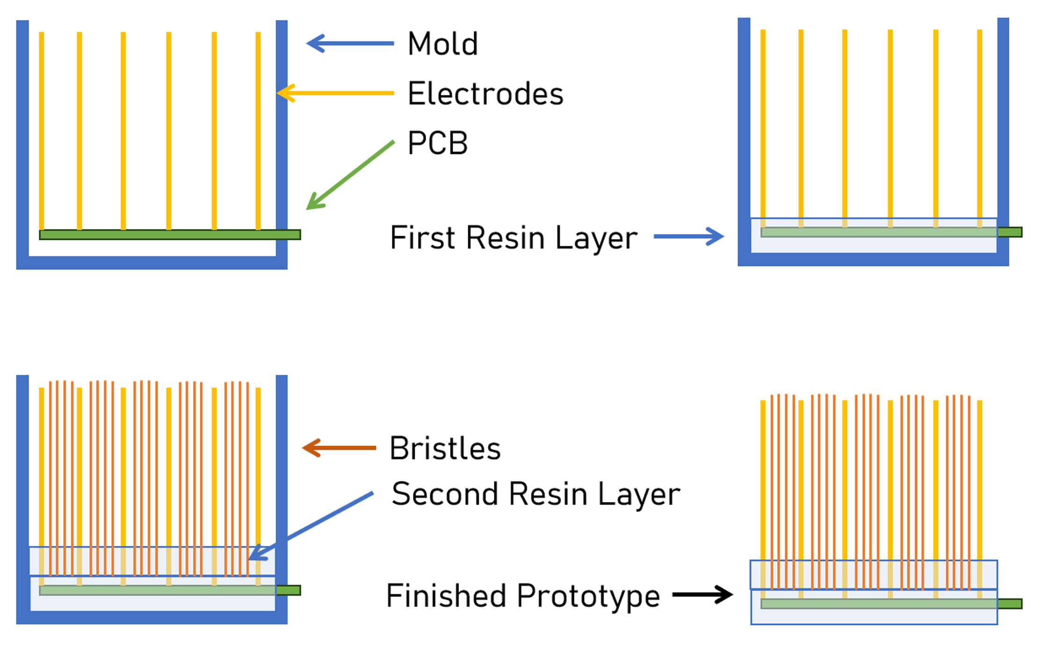
Prototype Design - Manufacturing

Slide 10
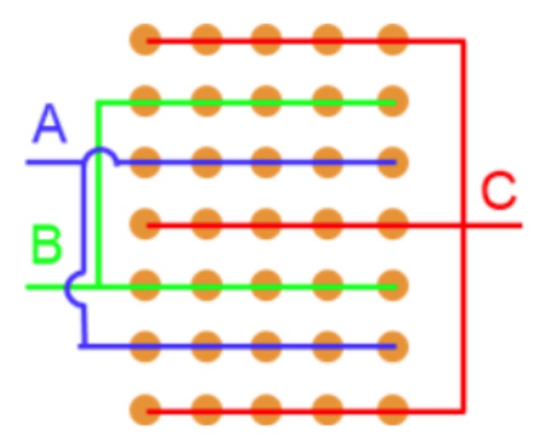
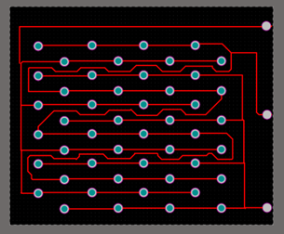
Prototype Design – PCB Details
Wiring configuration for a 3 phase EDS operation
2D layout of 3 phase EDS operation

Slide 11
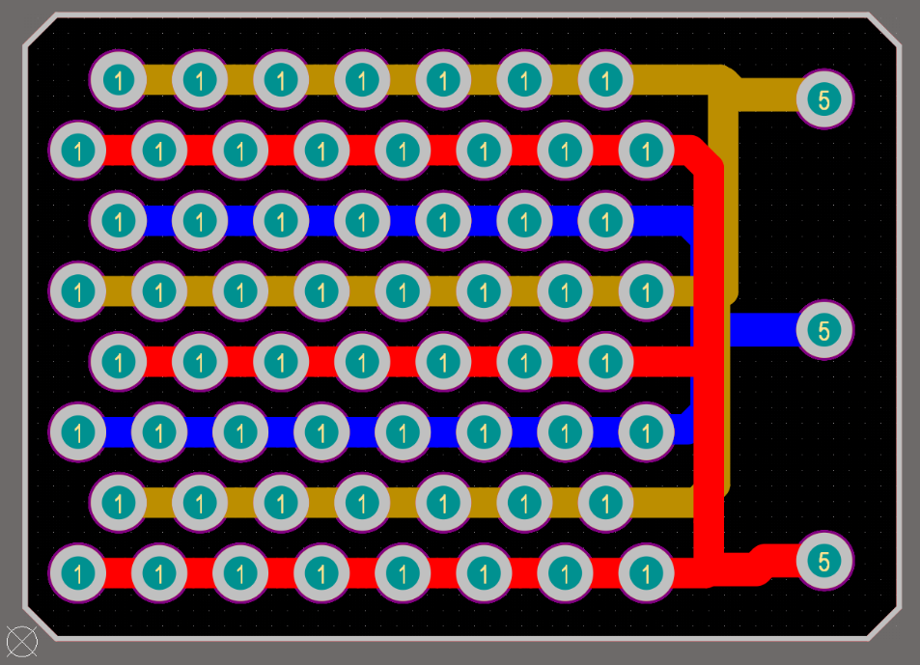
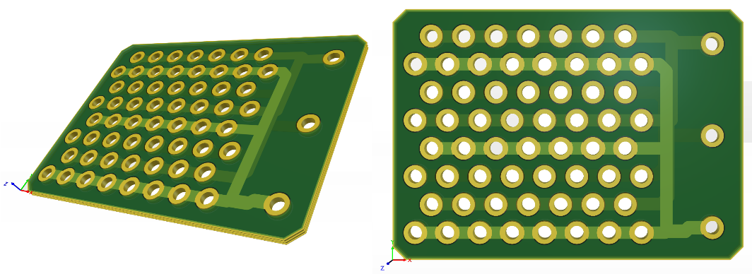
Prototype Design
Multilayer 3 phase EDS operation

Slide 12
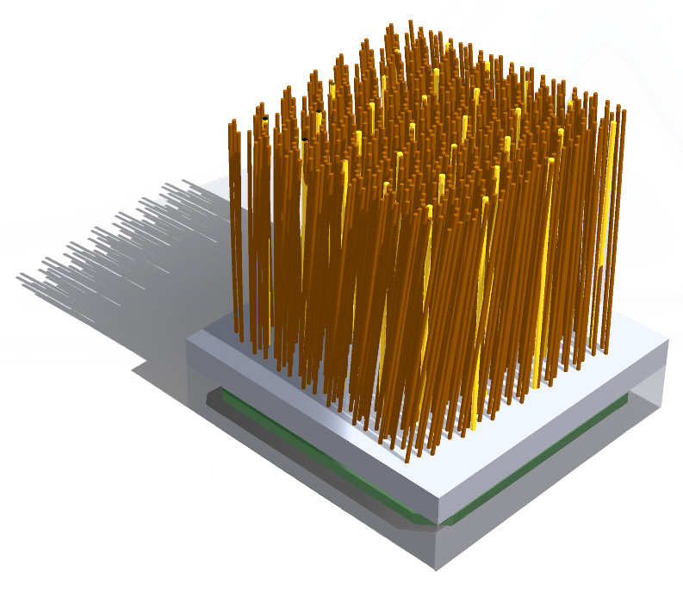

Final Prototype Design
Electrode material
  Insulation
  Flexibility
  Brushing
Bristle material
  Nylon

Slide 13
Conclusion and Future Work
Manufacturing test articles
Evaluating performance using lunar simulant in vacuum chambers
Validate design and inform future iterations

Slide 14


Acknowledgements
This work was directly supported by the NASA Solar System Exploration Research Virtual Institute (SSERVI) under Cooperative Agreement #NNH22ZDA020C, Center for Lunar Environment and Volatile Exploration Research (CLEVER).

