Slide 1
Performance of Ammonia Fuel for a Commercial Grade Turbofan
Ethan Nall
Auburn University
2025 Region II Student Conference, 3 April 2025 – 4 April 2025

Slide 2


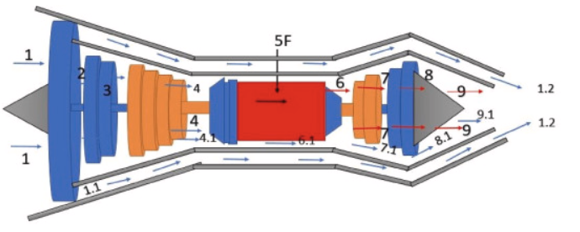
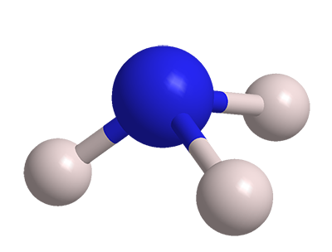
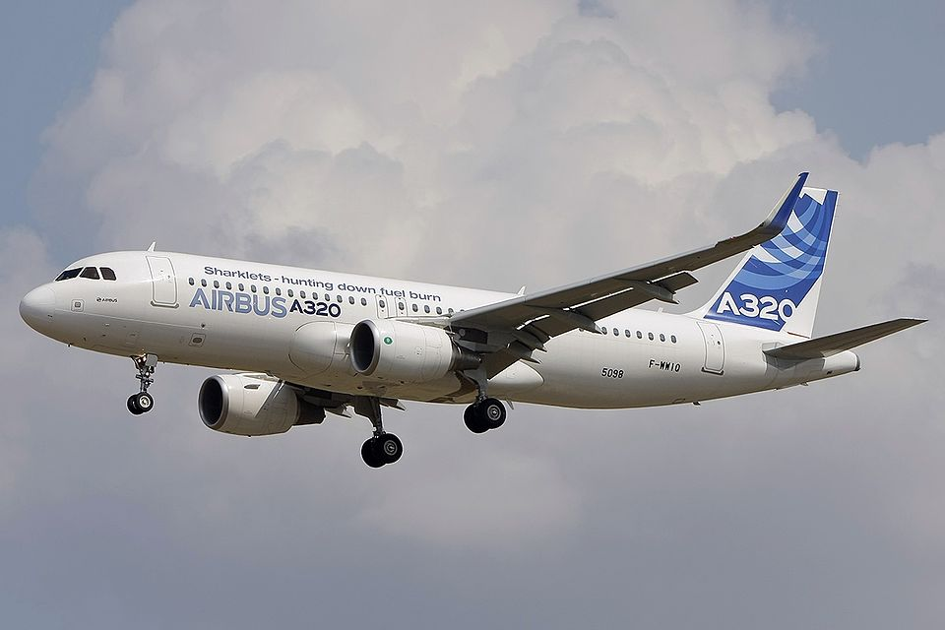
Presentation Map
Commercial Application
Ammonia
CFM 56 Specs
NPSS Model & Results
Solutions and Future
Notes:
In this presentation I will cover the specific engine used, a CFM 56 variant and what specific operating ranges I will cover with this engine. I have chosen an engine that is industry standard.

Slide 3
NPSS High-Bypass Turbofan Model
CFM 56-5B (Standard for A320)^{[1]}
Separate CEA references using Jet-A(L) and Ammonia as fuel type
Analysis combustor temp range: 1600-2500 °R
Considered for both scenarios
  Thrust – Power Output
  TSFC – Fuel Conversion to Thrust
  W_{fuel} – Ability to Digest Fuel
Notes:
I will be using HBR Turbo CFM 56-5B as it is standard in the industry standard A320 jet. Separate CEA models will be made using fuels Jet-A and ammonia. Jet-A is the industry standard hydrocarbon fuel that will be used in this study. Study will be run over a wide range of combustor temps but the applicable data will cover 1600-2500 rankine as that is the standard running temp. The relevant variable I will look at are the TSFC or thrust spec… this variable shows the efficiency at which the engine can convert the fuel into thrust and is extremely important in ammonia’s fuel viability.

Slide 4
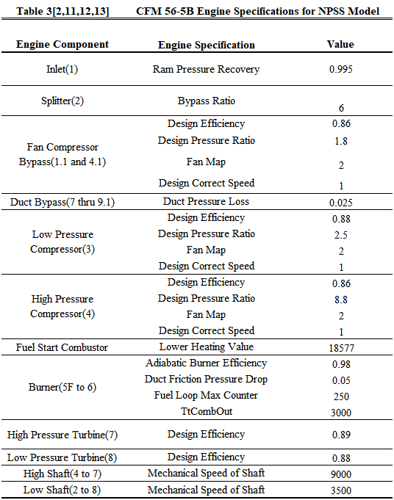
NPSS High-Bypass Turbofan Model
CFM 56-5B Design Specs^{[1]}

Slide 5
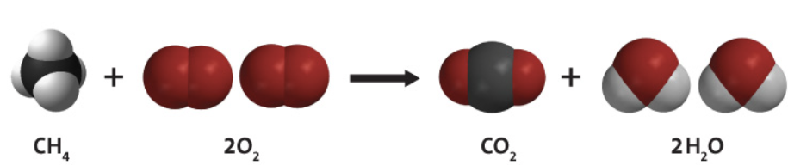
Background-Alternate to Hydrocarbon
Hydrocarbon fuel emissions
2.5% of CO₂ of global total^{[2]}

Slide 6

Alternatives
Ammonia^{[3]}
  Infrastructure available
  Easily transportable
  Clean
Hydrogen infrastructure is not viable
Methane has low energy density
$$4NH_{3}+O_{2}→4NO+H_{2}O$$

Slide 7

Ammonia Considerations
Combustion Efficiency
  Raw Ammonia inefficient in combustion in jet engine system
Ammonia Cracking^{[4]}
  Ammonia compound reduced to components
$$2NH_{3}+Heat→N_{2}+3H_{2}$$

Slide 8
Ammonia Considerations
Haber-Bosch^{[5]}
  Cracked ammonia mixes with Nitrogen and Hydrogen in atmosphere to reform Ammonia
  Takes energy from system
Larger combustor volumes
  Reduced rate of Haber-Bosch

Slide 9

NPSS and CEA Software
Numerical Propulsion System Simulation (NPSS)
  Thermodynamic modeling
  Internal thermodynamic processes
  Design condition modification
Chemical Equilibrium Analysis
  Analysis used in NPSS models
  Include all present reactants for analysis

Slide 10
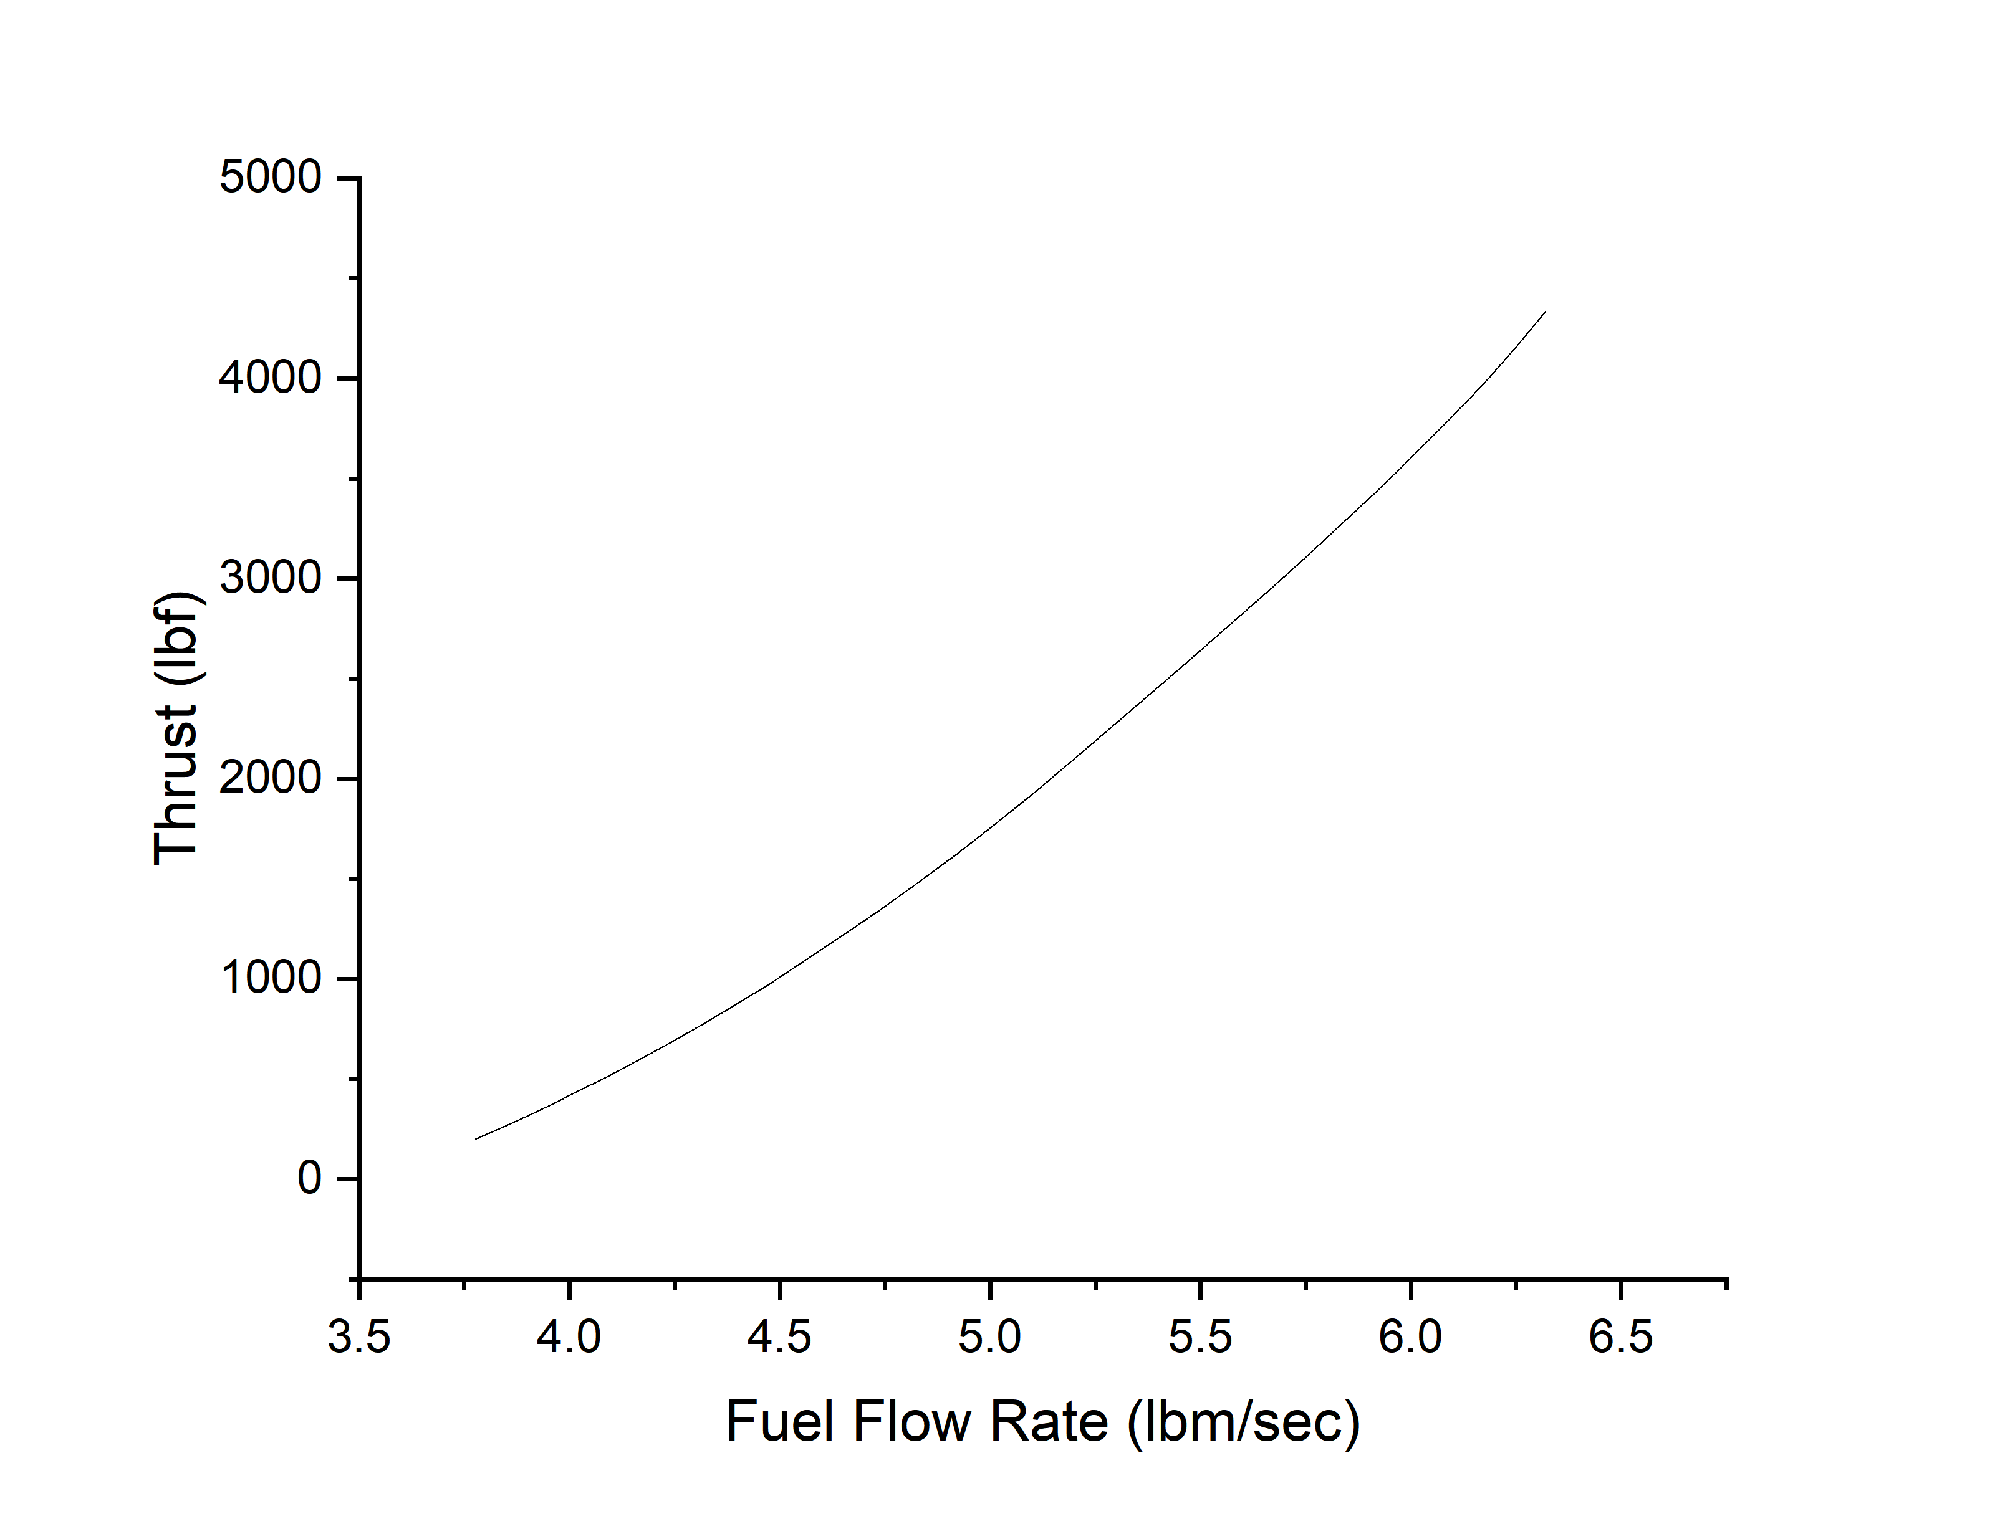
Ammonia NPSS Results
Thrust vs Fuel Flow Rate
  Rate of exponential growth significant of efficiency fuel is being converted to thrust
  Similar to normal curves
  Shows Ammonia’s viability in this metric

Slide 11
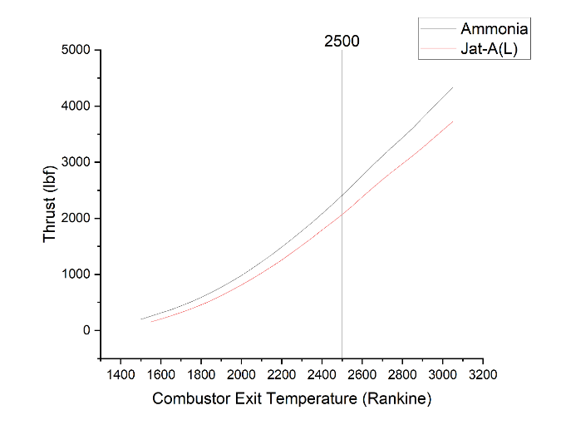
Ammonia NPSS Results
Thrust vs Combustor Exit Temperature
  Show the effects of Haber-Bosch and cracking
  Does not show TSFC effects
  Average percent difference is 10.16% in favor of Ammonia

Slide 12
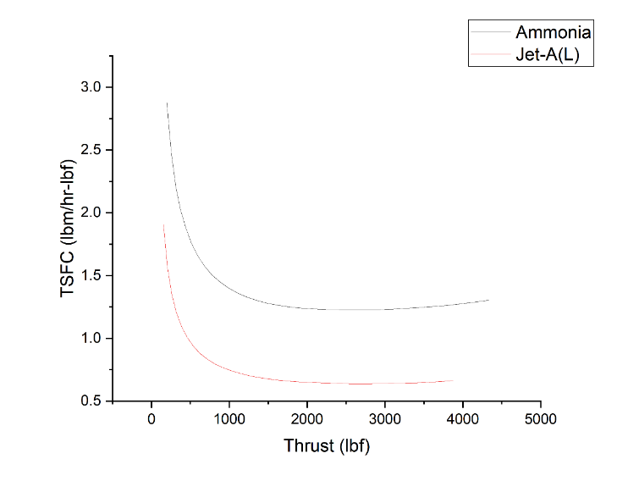
Ammonia NPSS Results
TSFC vs Thrust
  Significant of the thrust production efficiency on a fuel flow basis
  Higher than hydrocarbon a significant amount due to low energy density

Slide 13
NPSS Conclusions
Ammonia fuel is similar if not slightly better in thrust production per minute and does not suffer a drop in thrust production due to unintentional thermodynamic phenomena
Ammonia fuel is significantly worse in engine fuel efficiency than Jet-A(L)
Ammonia less energy dense than hydrocarbon jet fuel

Slide 14
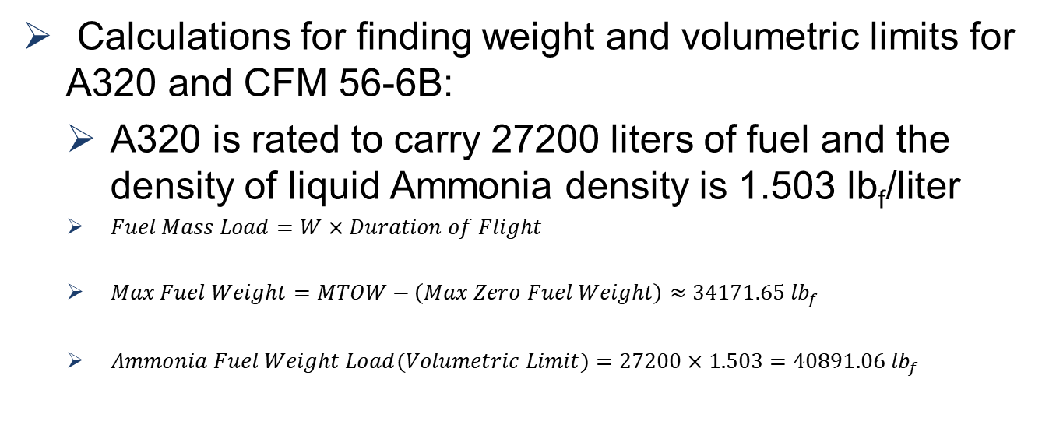
Ammonia-HBR Turbofan System Application^{[6]}
Calculations for finding weight and volumetric limits for A320 and CFM 56-6B:
  A320 is rated to carry 27200 liters of fuel and the density of liquid Ammonia density is 1.503 lb_{f}/liter
  $Fuel Mass Load=W×Duration of Flight$
  $Max Fuel Weight=MTOW−\left(Max Zero Fuel Weight\right)≈34171.65 {lb}_{f}$
  $Ammonia Fuel Weight Load(Volumetric Limit)=27200×1.503=40891.06 {lb}_{f}$

Slide 15
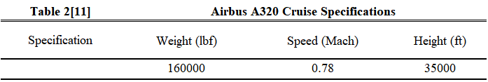
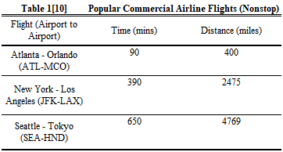
Ammonia-HBR Turbofan System Application
Applicability is determined by ability to serve for the following common flights non-stop with cruise specifications^{[7]}

Slide 16
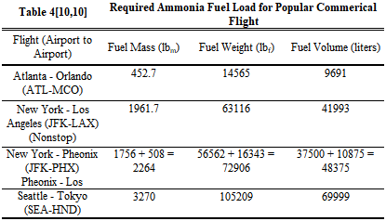
Ammonia-HBR Turbofan System Application
Calculations made to find required weight and volume for the Ammonia fuel to complete flights

Slide 17
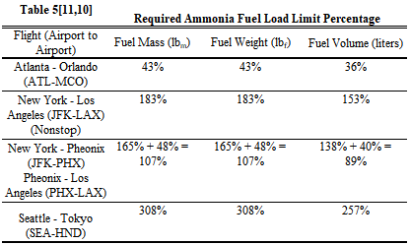
Ammonia-HBR Turbofan System Application
Percentage of A320 fuel capacity limits are compared to fuel requirements for the flights^{[6]}

Slide 18
Ammonia-HBR Turbofan System Application
Ammonia fuel greatly exceeds the requirements for the A320 fuel capacity limits and in pure form with the current system, Ammonia is not a viable fuel for commercial aviation
  Ammonia viable for small flights and is close to being feasible for a cross-country flight
  Not feasible for crossing ocean

Slide 19
Recommendations
Ensuring that the Ammonia is cracked and combusted as efficiently as possible
Manipulation of Ammonia fuel state could increase energy density
If engine performance is still subpar then mixing the Ammonia fuel with another fuel solution could help

Slide 20
Future Possibilities
Assuming a commercial aircraft crosses the ocean without emitting carbon:
  Fossil fuel market would drop which could encourage more research into alternatives
  Super/Hyper-sonic commercial transportation would have to redesign for new fuel source
  Concerns for the Nitrogen cycle possibly over saturating ecosystems, combustion cycle needs to be as efficient as possible to reduce N₂O emissions

Slide 21
Conclusion
Commercial Application
Ammonia
CFM 56 Specs
NPSS Model & Results
Solutions and Future
Notes:
In this presentation I will cover the specific engine used, a CFM 56 variant and what specific operating ranges I will cover with this engine. I have chosen an engine that is industry standard.

Slide 22
References
[1] Oğur, E., Koç, A., Köse, Ö., Koç, Y., & Yağlı, H. (2024). Performance assessment of ammonia as a turbofan engine fuel during various altitude levels. Energy, 308, 132714. https://doi.org/10.1016/j.energy.2024.132714
[2] Hannah Ritchie (2024) - “What share of global CO₂ emissions come from aviation?” Published online at OurWorldinData.org. Retrieved from: 'https://ourworldindata.org/global-aviation-emissions' [Online Resource]
[3] Poore, Colton. “Ammonia Fuel Offers Great Benefits but Demands Careful Action - Princeton Engineering.” Princeton University, The Trustees of Princeton University, 7 Nov. 2023, engineering.princeton.edu/news/2023/11/07/ammonia-fuel-offers-great-benefits-demands-careful-action.
[4] “High Efficiency Ammonia Cracking-a Carbon-Free Foundation for Clean Hydrogen Fuel.” Amogy, Amogy, 14 Jan. 2025, amogy.co/news/high-efficiency-ammonia-cracking-a-carbon-free-foundation-for-clean- hydrogenfuel#:~:text=Traditional%20ammonia%20cracking%20takes%20place,effective%20catalysts%20use%20 ruthenium%20metal.
[5] Jimenez, Luis. “Haber-Bosch Process.” Haber-Bosch Process, 14 Dec. 2022, large.stanford.edu/courses/2022/ph240/jimenez2/.
[6] “A320CEO.” Airbus Aircraft, 17 July 2024, aircraft.airbus.com/en/aircraft/a320-family/a320ceo.
[7] “Distance from Beijing to Shenzhen (Pek – SZX).” Air Miles Calculator, www.airmilescalculator.com/distance/pek-to- szx/#:~:text=The%20distance%20between%20Beijing%20(Beijing,1951%20kilometers%20%2F%201054%20naut ical%20miles. Accessed 31 Mar. 2025.

